Slide 2
Required to rate post-FIRM and some pre-FIRM buildings
Determine compliance with floodplain management ordinance
Support LOMA/LOMR-F
Prerequisite for the CRS

Slide 3
Current Version: FEMA Form 086-0-33 (7/15)
Mandatory for use after ___________
Good until the 11/30/2018 expiration date
Download from FEMA.gov
PDF and PDF fillable versions

Slide 5
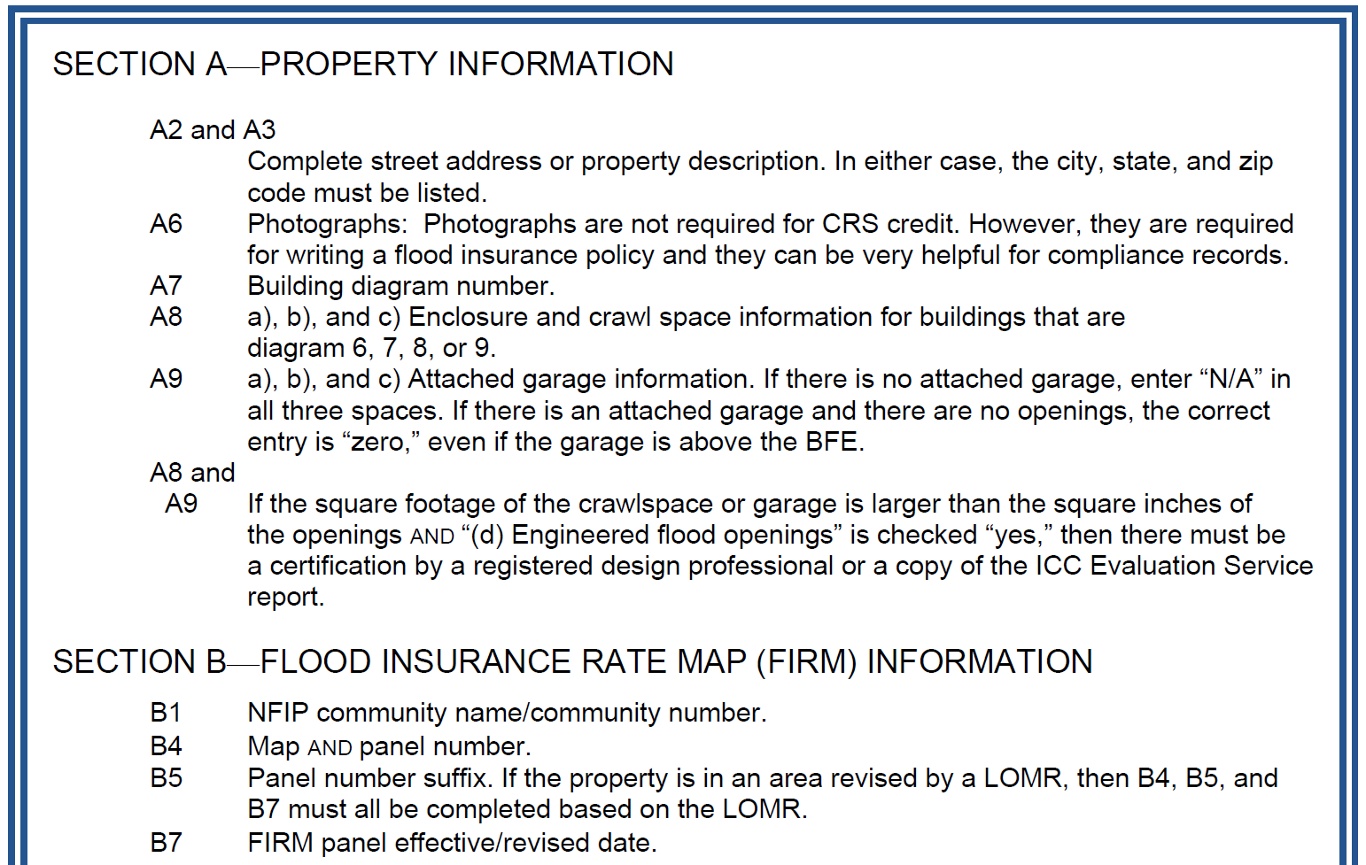
Manual Pages 310-7 – 8
Checklist in the 2013 Manual still good

Slide 7
Not needed for local permits or CRS
(But still a good idea)

Slide 8
Manual Page 310-7

Slide 9
Elevation Certificate Instructions Page 13
Diagram 1A = slab-on-grade

Slide 10
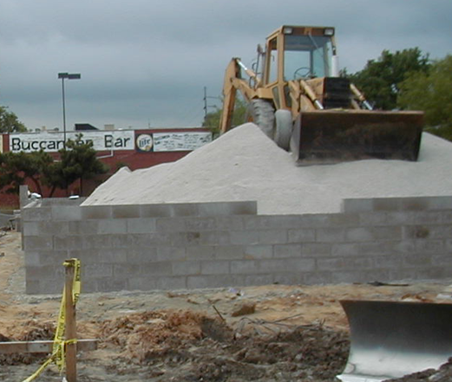
Elevation Certificate Instructions Page 13
Diagram 1B = raised slab or foundation wall with fill

Slide 11
Elevation Certificate Instructions Page 13
Diagram 2A = full basement

Slide 12
Elevation Certificate Instructions Page 13
Diagram 2B = full basement, door below ground level

Slide 13
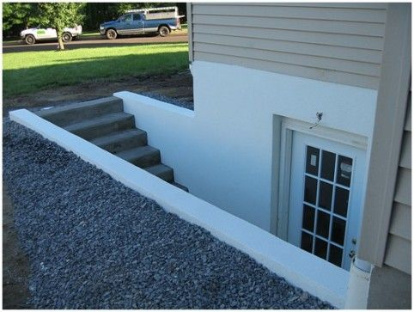
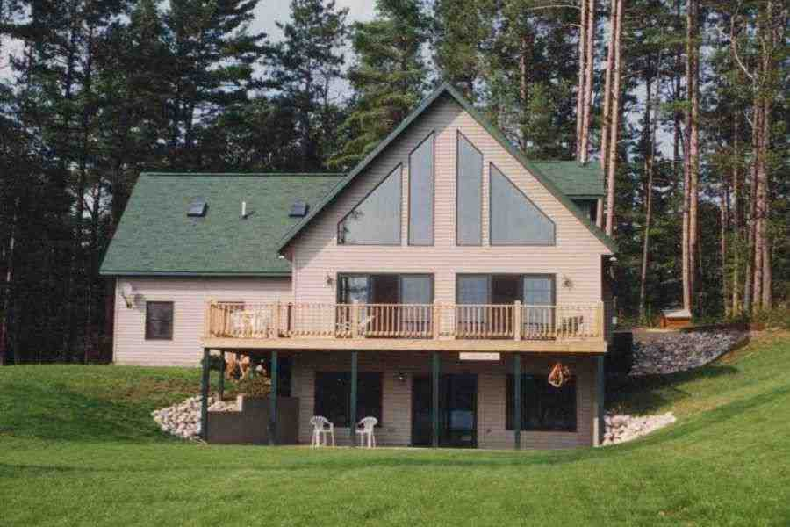
Elevation Certificate Instructions Page 13
Diagram 2B = full basement, door below ground level

Slide 14
Elevation Certificate Instructions Page 14
Diagrams 3 & 4 = Split levels

Slide 15
Elevation Certificate Instructions Page 14
Diagrams 5 & 6 = Elevated on piers, posts, piles, etc.

Slide 16
Elevation Certificate Instructions Page 15
Diagram 7 =
Elevated on
full story
foundation
walls

Slide 17
Elevation Certificate Instructions Page 15
Diagrams 8 & 9 = Elevated on crawlspaces

Slide 18
Elevation Certificate Instructions Page 15
Diagrams 8 & 9 = Elevated on crawlspaces
Diagram 9 = Compliant, below grade crawlspace
< 5’ high,
< 2’ below grade
If below grade crawlspace
> 5’ high or
> 2’ below grade
→ basement

Slide 19
Diagram Number Assignment

Slide 20
Diagram Number Assignment
We’ll show a photo of a building
Each building is compliant
You see the whole building – don’t invent things on the other side of the building
Determine the diagram number for each building
Raise the appropriate Diagram number card
If a table raises >1 card, it is disqualified

Slide 21
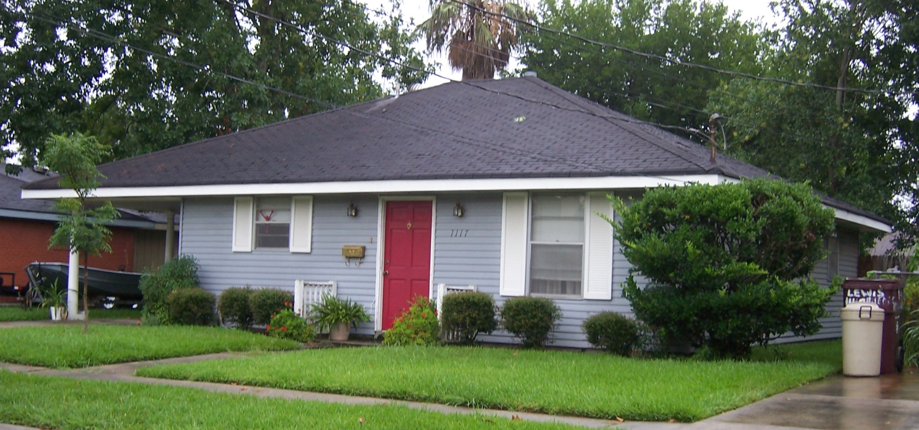
What diagram?

Slide 22
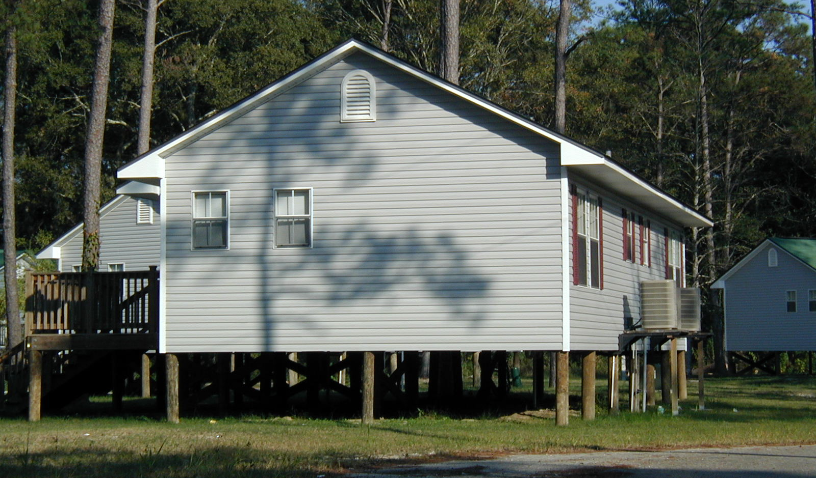
What diagram?

Slide 23
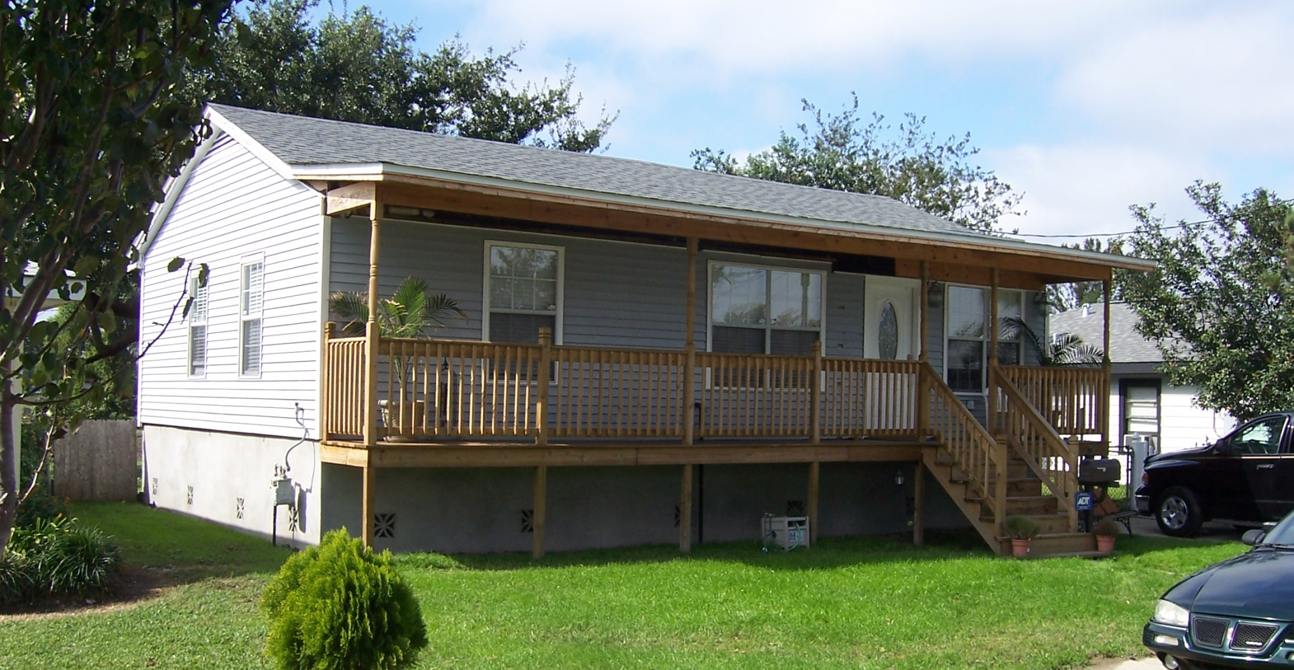
What diagram?

Slide 24
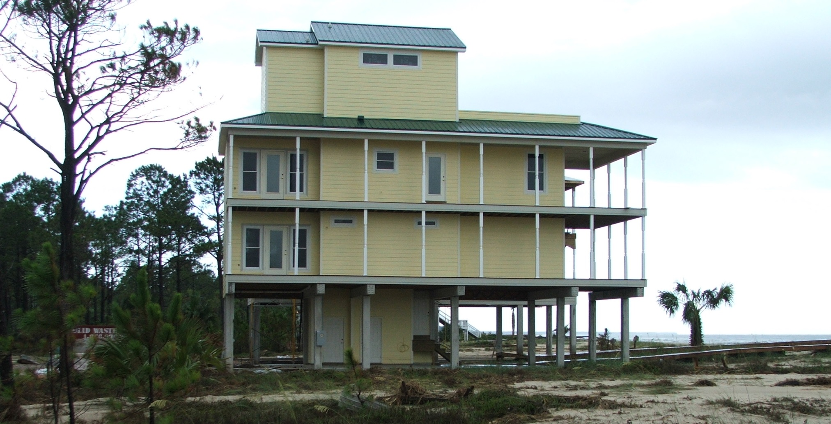
What diagram?

Slide 25
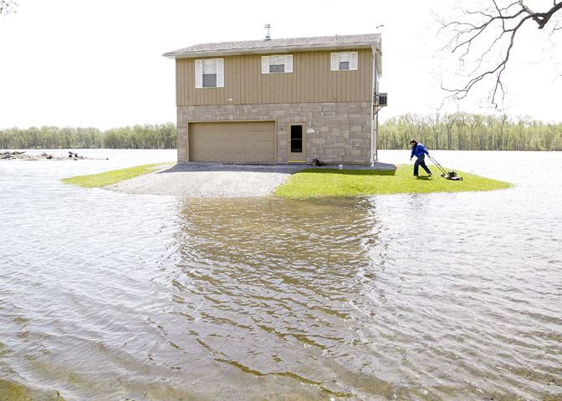
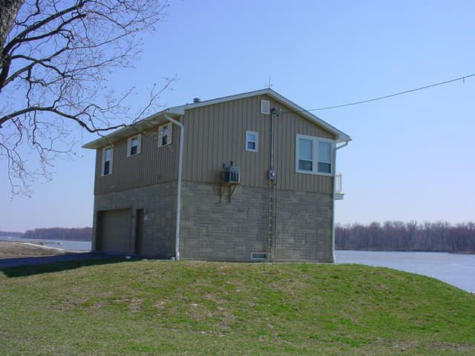
What diagram?

Slide 27
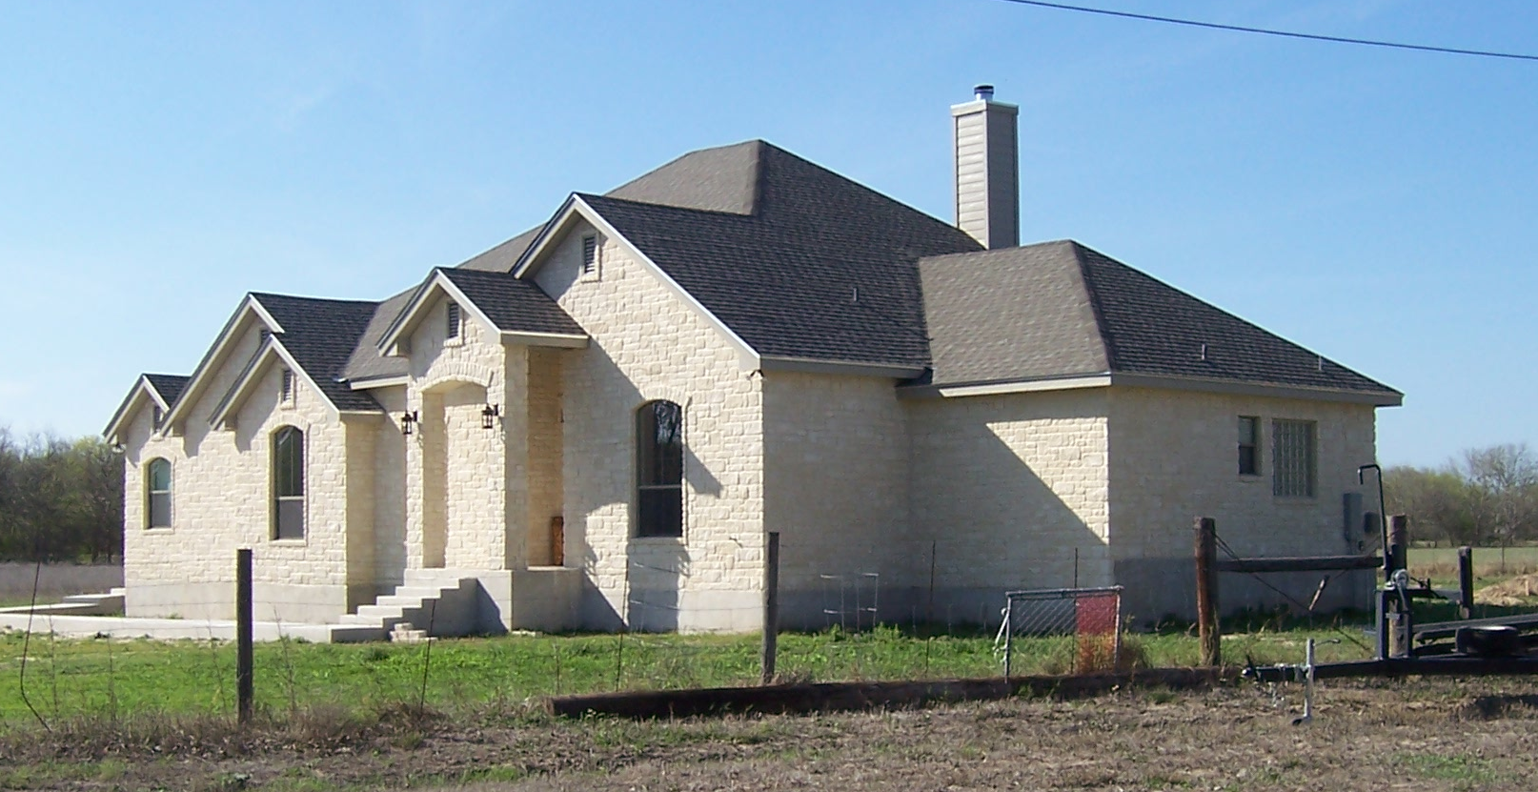
What diagram?

Slide 28
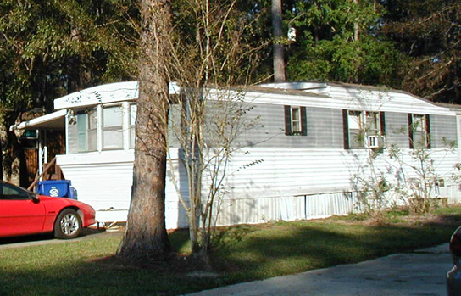
What diagram?

Slide 29
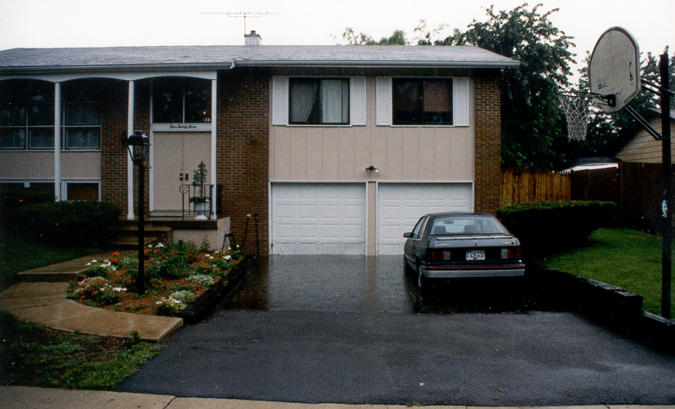
What diagram?

Slide 30
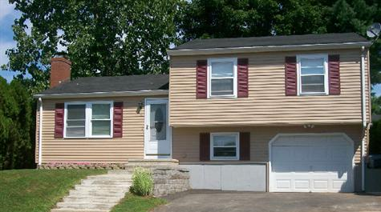
What diagram?

Slide 31
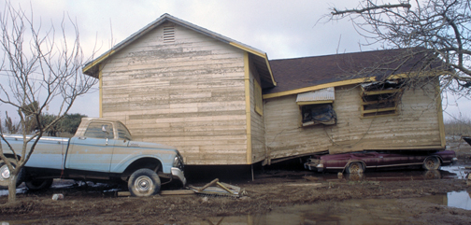
What diagram?

Slide 32
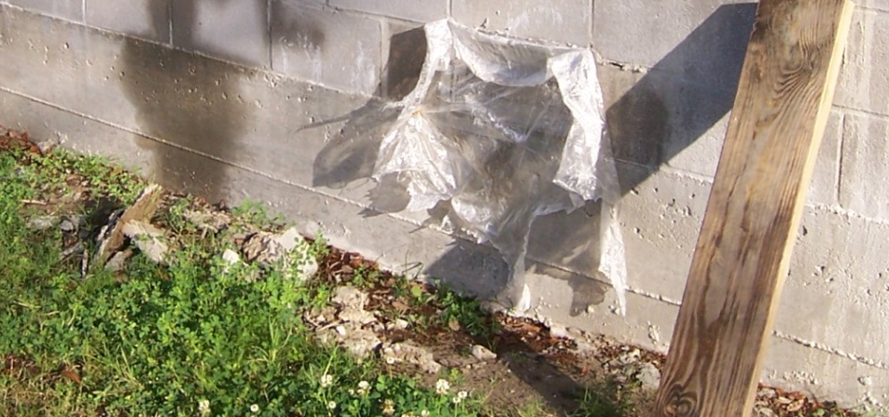
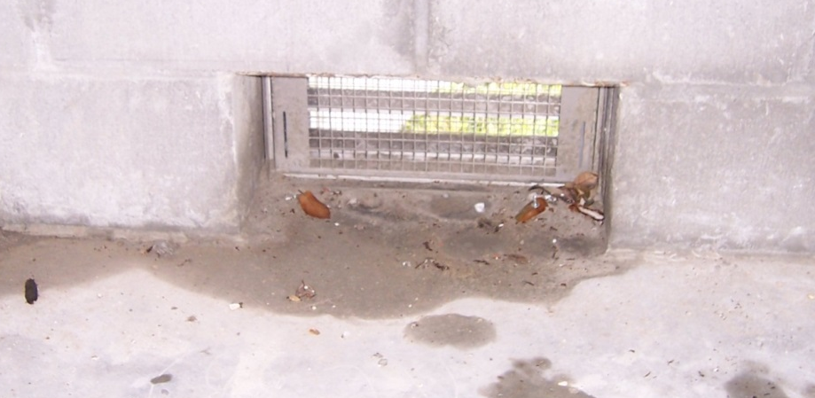
Elevation Certificate Instructions Page 8
1,405
10
1,680
Measure from exterior or interior grade, whichever is higher

Slide 33
Elevation Certificate Instructions Page 8
1,405
10
1,680
A9 Attached garage:
Separate from the rest of the building
No floors above it

Slide 34
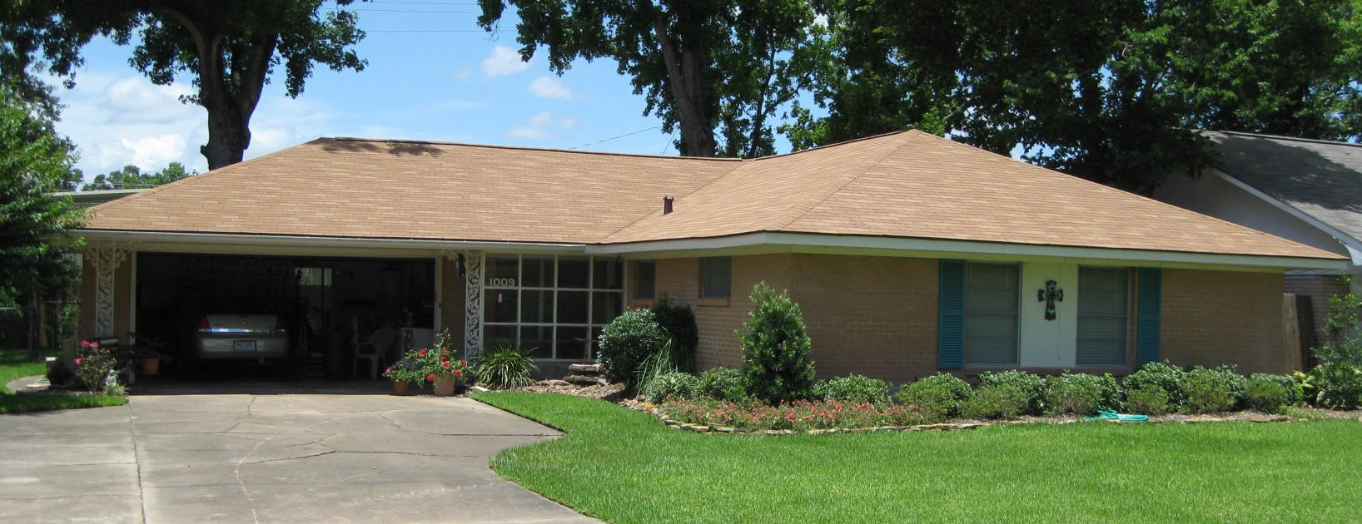
Is this an attached garage?

Slide 35
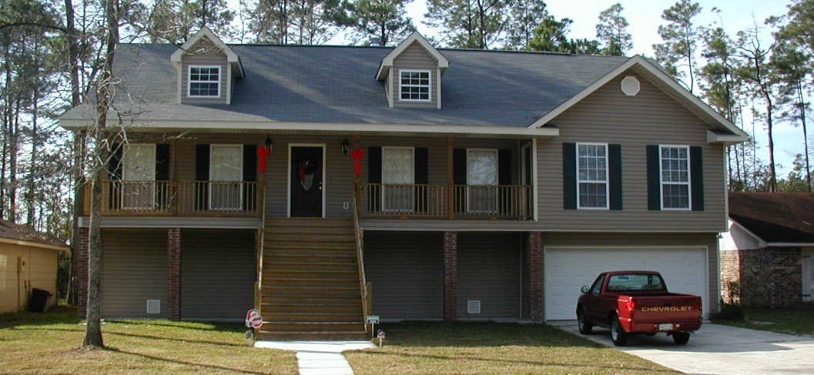
Is this an attached garage?

Slide 36
Is this an attached garage?

Slide 37
Elevation Certificate Instructions Page 8
1,405
10
1,680
N/A
N/A
N/A

Slide 38
Elevation Certificate Instructions Page 8
1,405
10
1,680
N/A
N/A
N/A
X
X
If “yes,” record the actual area of the openings
and attach the engineer’s certificate
or the ICC Evaluation Service report

Slide 39
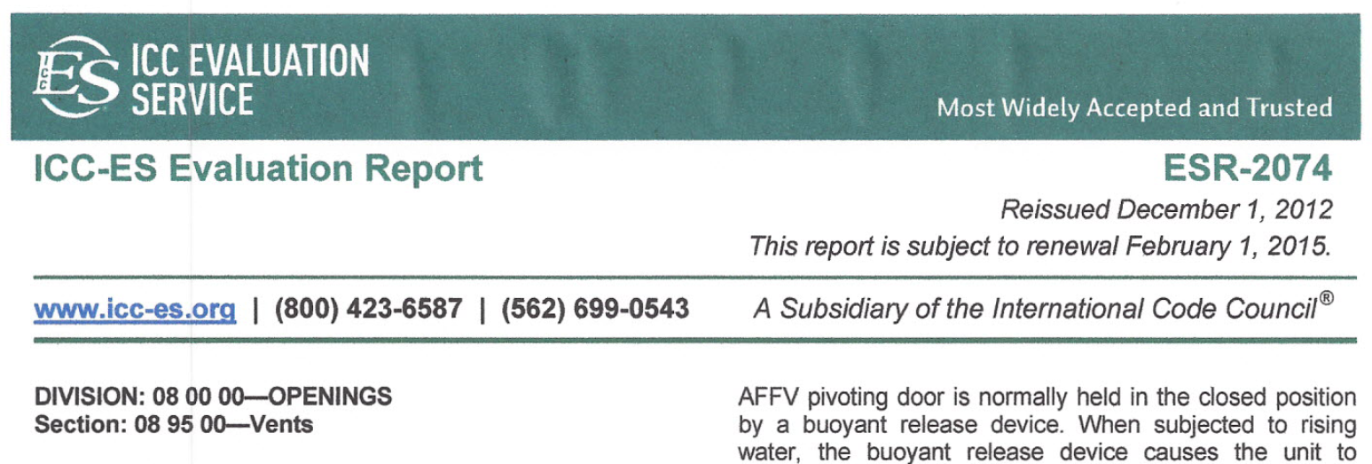
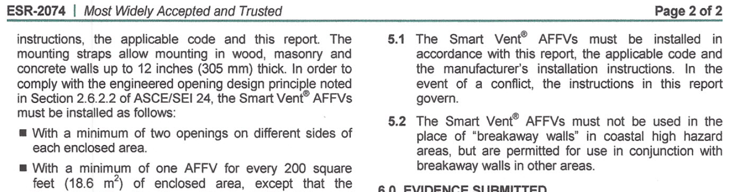

Slide 40
Elevation Certificate Instructions Page 9
Complete the Elevation Certificate on the basis of the FIRM in effect at the time of the certification.
B4. For maps in a county-wide format, the sixth character of the “Map Number” is the letter “C” followed by a four-digit map number.
For maps not in a county-wide format, enter the “Community Panel Number” shown on the FIRM.

Slide 41
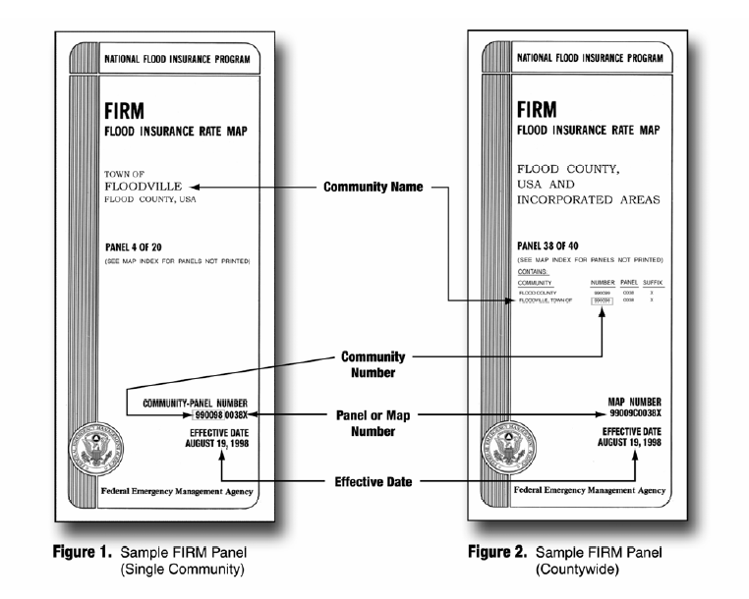
FEMA Elevation Certificate

Slide 42
Elevation Certificate Instructions Page 9
Complete the Elevation Certificate on the basis of the FIRM in effect at the time of the certification.
B5. Suffix comes after the panel number
Indicates how many times the panel has been revised
B8. Use the zone for the building
If building is in > 1 zone, list all the zones
B9. Except in Zones AO and A, use the BFE on the FIRM, not a higher local regulatory flood elevation

Slide 43
Elevation Certificate Instructions Page 9
Complete the Elevation Certificate on the basis of the FIRM in effect at the time of the certification.

Slide 44
Elevation Certificate Instructions Pages 10 – 11

Slide 45
Elevation Certificate Instructions Pages 10 – 11
Section C2.a) – h)
Every time
If >1 floor
V Zones
If garage
Every time
Every time
Every time
e) Describe the machinery or equipment in Section D’s comments

Slide 46
Elevation Certificate Instructions Pages 10 – 11
Section C2.a) – h)
Every time
If >1 floor
V Zones
If garage
Every time
Every time
Every time
Not on checklist
Only needed for LOMAs and LOMR-Fs
Not on the CRS EC checklist

Slide 47
Elevation Certificate Instructions Pages 10 – 11
Section C2 Assignment
Every time
If >1 floor
V Zones
If garage
Every time
Every time
Every time
Not on checklist

Slide 48
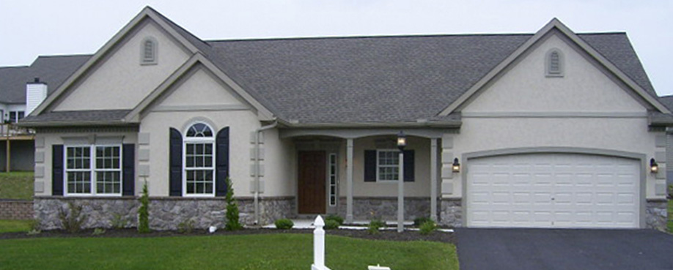
House #1 – in the AE Zone
477.6 476.2 478.6 478.1 478.0
(grade) (A/C in back yard) (first floor) (garage floor) (grade)

Slide 49
House #1 – in the AE Zone
Diagram No.?
1A
478.6 x
N/A
N/A
478.1 x
476.2 x
477.6 x
478.0 x
N/A
477.6 476.2 478.6 478.1 478.0
(grade) (A/C in back yard) (first floor) (garage floor) (grade)

Slide 50
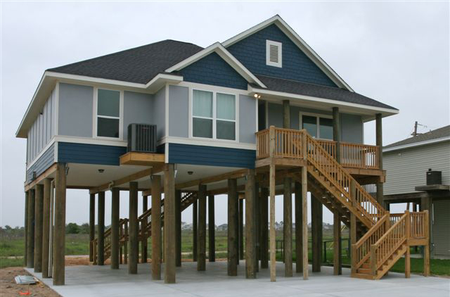
House #2 – in the VE Zone
18.7
17.5
18.7
17.5
7.9
(bottom
of stairs)
8.1
(grade)
7.8
(grade)
8.1 (slab)

Slide 51
House #2 – in the VE Zone
Diagram No.?
5
18.7
17.5
18.7
17.5
18.7 x
N/A
17.5 x
N/A
18.7 x
7.8 x
8.1 x
7.9 x
7.9
(bottom
of stairs)
8.1
(grade)
7.8
(grade)
8.1 (slab)

Slide 52
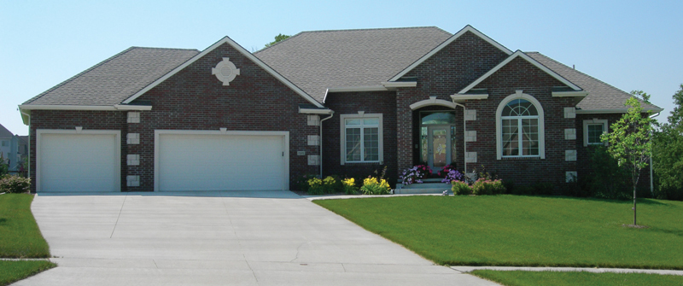
House #3 – in the AE Zone
Garage floor: 317.0
Driveway: 316.9
Vent
Vents
Front door threshold: 318.6
Furnace and water heater are on a platform 2.0 feet above the garage floor
Crawlspace floor: 315.6
Grade:
316.1

Slide 53
House #3 – in the AE Zone
Diagram No.?
9
315.6 x
318.6 x
N/A
317.0 x
319.0 x
316.1 x
316.9 x
N/A
Garage floor: 317.0
Driveway: 316.9
Vent
Vents
Front door threshold: 318.6
Furnace and water heater are on a platform 2.0 feet above the garage floor
Crawlspace floor: 315.6
Grade:
316.1

Slide 54
Elevation Certificate Instructions Page 11

Slide 55
Elevation Certificate Instructions Page 11
Can be completed by property owner or permit official

Slide 56
Elevation Certificate Instructions Page 11

Slide 57
Elevation Certificate Instructions Pages 11 ‒ 12

Slide 58
Helpful Hints
Never assume the EC was filled out correctly because it has the professional surveyor's seal on it
Establish a review process that determines if the EC is complete and correct, preferably done as part of the final site inspection
Make a complete and correct EC a condition for the certificate of occupancy
Fill out as much of the EC as you can at the time of the permit application (i.e., Sections A and B)
FEMA Regions conduct workshops on the EC

Slide 59
Questions?

