Slide 1
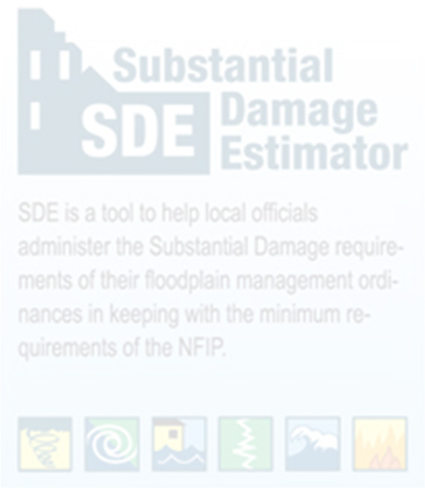

Working with GISTC Database in Substantial Damage Estimator (SDE) Software, Version 3.0
Substantial Damage Estimator (SDE 3.0)
Prepared by: West Virginia GIS Tech Center
07/20/2023

Slide 2
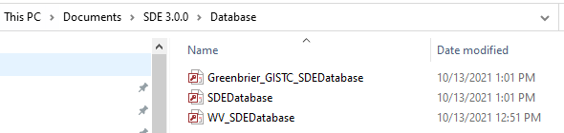
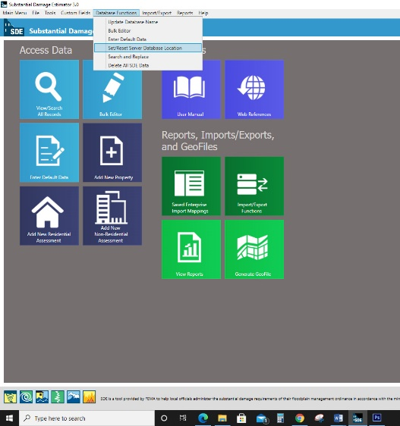
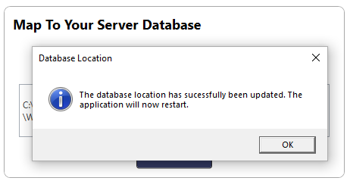
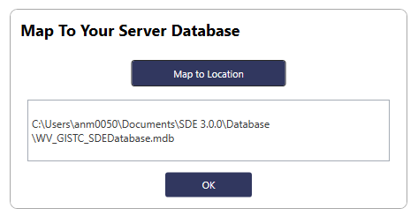
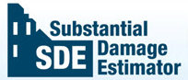
Copy the Greenbrier GISTC SDEDataBase Access file
How to Import the Database
1
10/10/2021
Locate the SDE folder on the host computer, open the Database folder and paste this file there.
2
Open the SDE Software. Go to the Database Function Menu on the Main toolbar and Set/Reset Server Database Location function.
3
Navigate it to the Database folder, where you pasted the Greenbrier_GISTC_Database and wait until it has been saved.
5
4

Slide 3
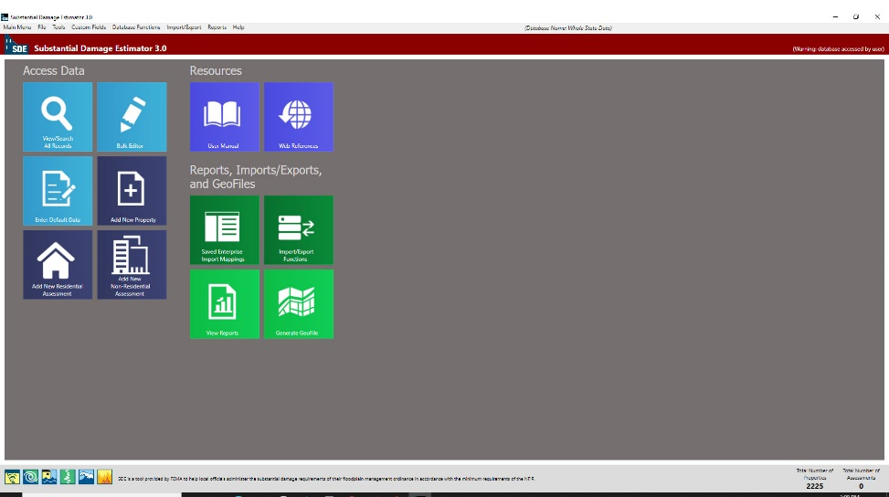
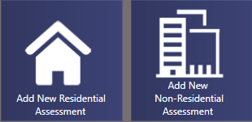
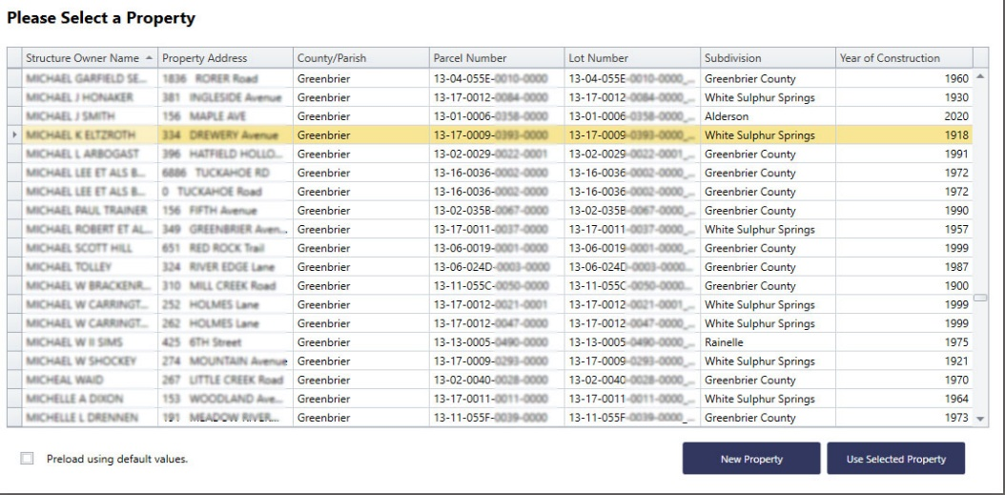
In the main menu, based on the building’s function, click on one of these dark blue icons: “Add New Residential Assessment” or “Add New Non-Residential Assessment”.
How to Import the Database
The Software will restart and get back to the main menu. The total number of properties (2225 Structures) should be shown up at the right bottom of the page.
10/10/2021
Wait until this table shows up. Using filter, you can look for a specific building. Then select the structure.

Slide 4
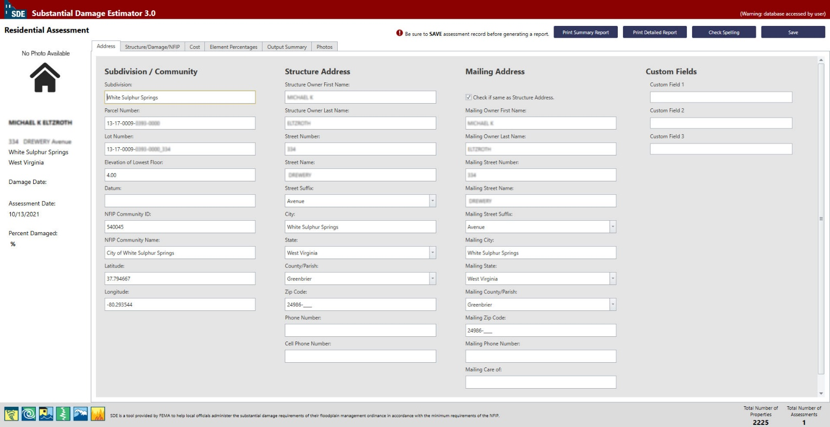
Damage Estimation Process
1
10/10/2021
The data loaded from WV_GISTC_Database. To add further information or ensure about information, you can check WV Flood Tool Website
Owner’s Name and Address
Check it if the Mailing Address and Structure’s Address are the same
Parcel’s Geographic Data
Further information can be imported here
Total Number of Assessment should be changed to “1”

Slide 5
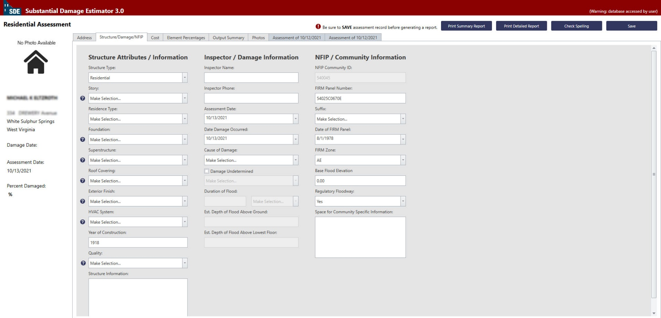
Damage Estimation Process
2
10/10/2021
Some fields have been loaded automatically from Database, but there are some other that should be manually filled.
Required fields
Optional fields

Slide 6
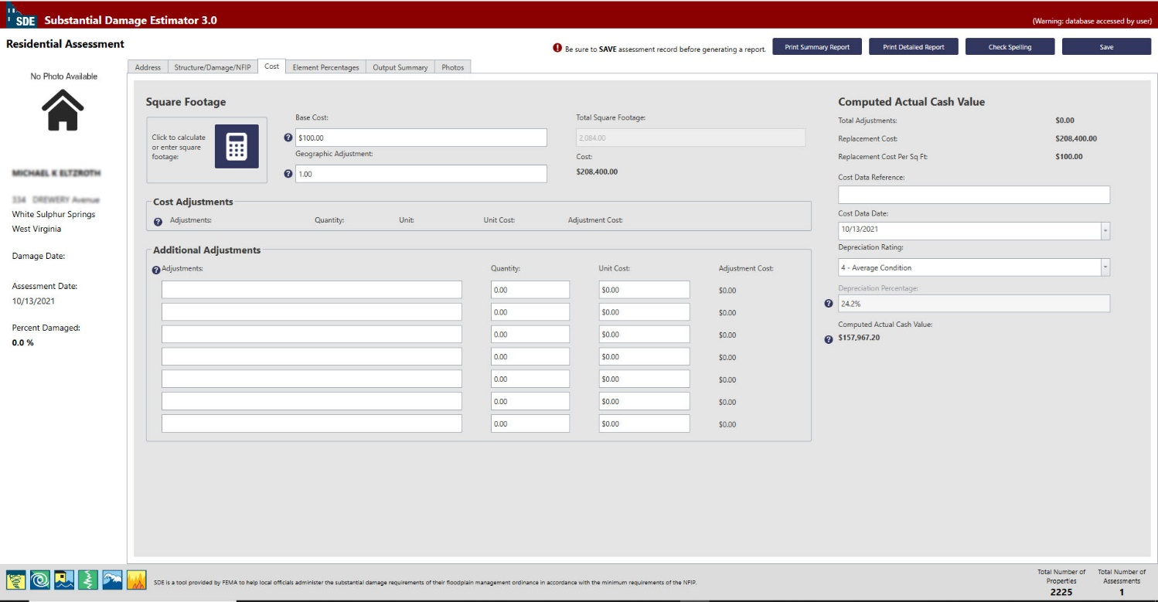
Damage Estimation Process
3
10/10/2021
Residential:100
Should be “1”
Non-Residential:200

Slide 7
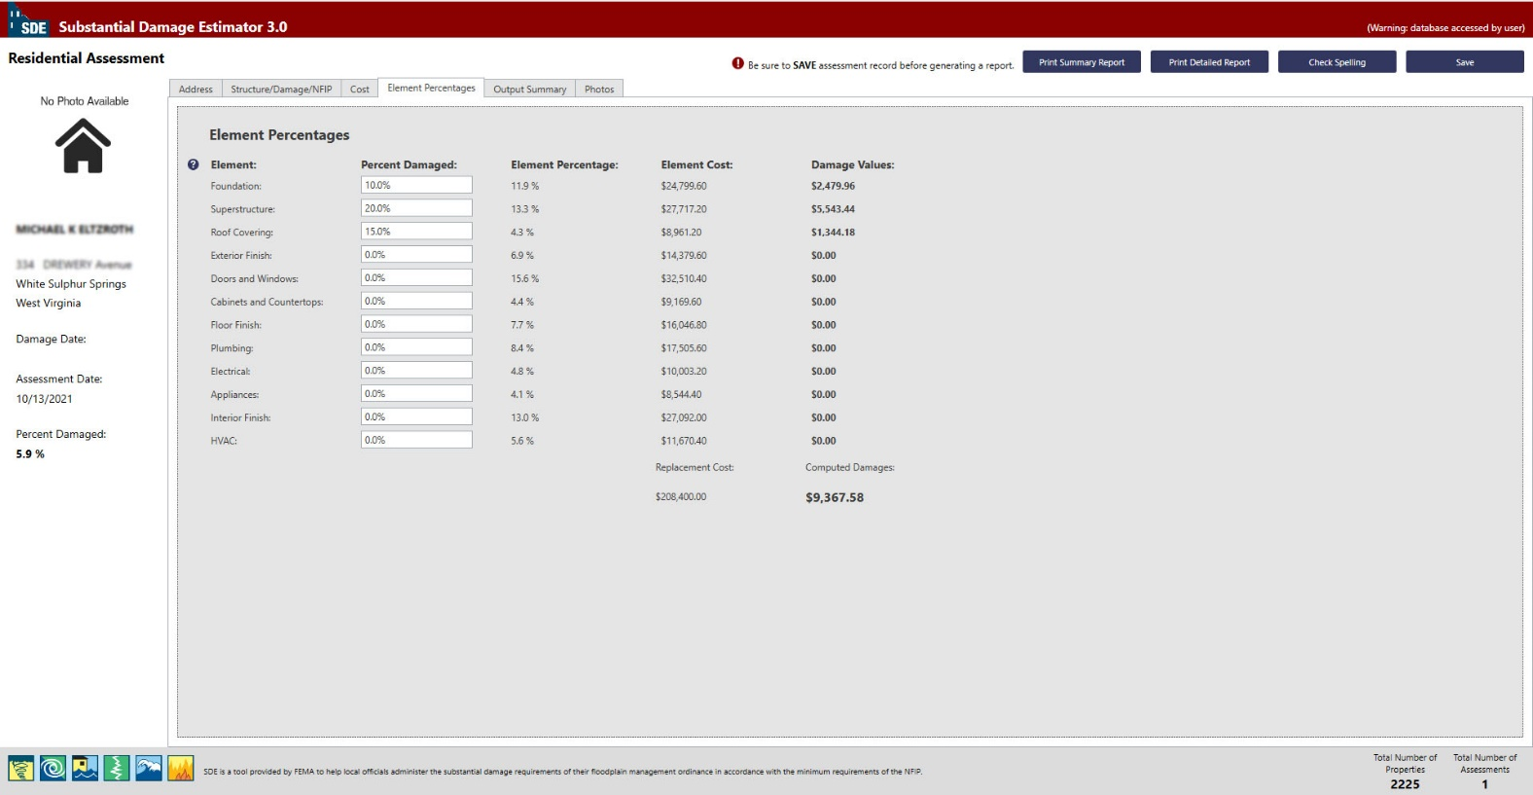
Damage Estimation Process
4
10/10/2021
If you know the amount of percentage damage on the elements of the buildings, fill the related fields. Remember that it may not be necessary for all the threshold makers to be met to achieve the indicated level of damage.

Slide 8
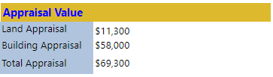
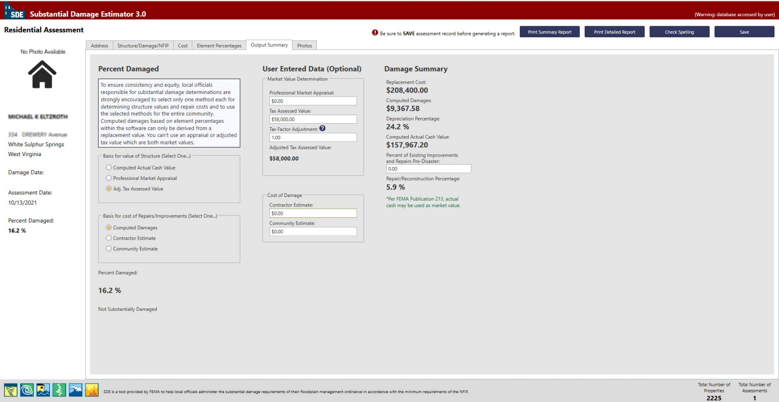
Damage Estimation Process
5
10/10/2021
Basis for value of structure should be set on: Adj. Tax Assessed Value
Tax Assessment Value is found in WV Assessment
Tax Factor Adjustment should be: 1
Damage Summary will be calculated and shown up here.

Slide 9
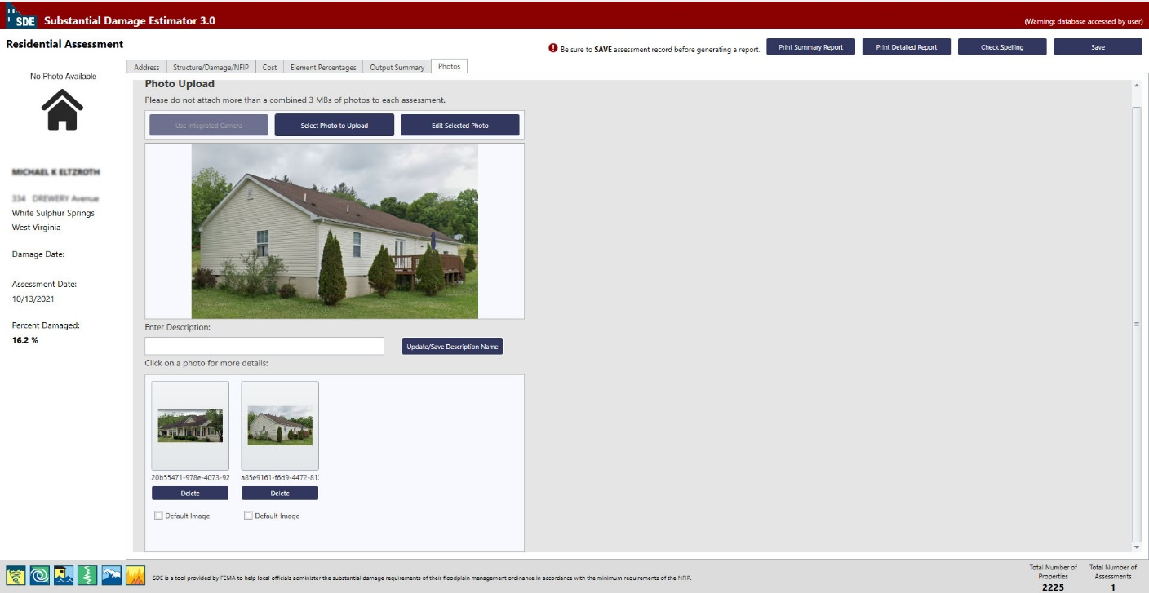
Damage Estimation Process
6
10/10/2021

Slide 10

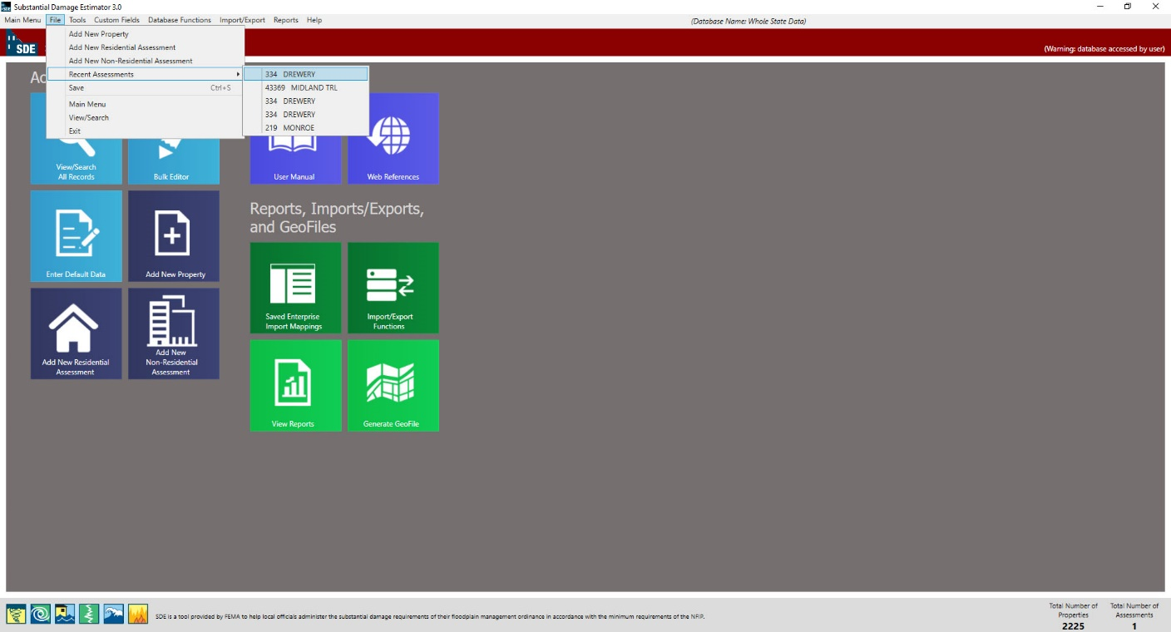
Damage Estimation Process
Make Sure to Save Data before closing.
10/10/2021
You can Print Summary Report or Print detailed Report at the end.
During working, you can save and exit the software if needed. When come back, to find the recent assessment you were working, go to: file/Recent Assessment and find it among five recent assessments.

