Slide 1
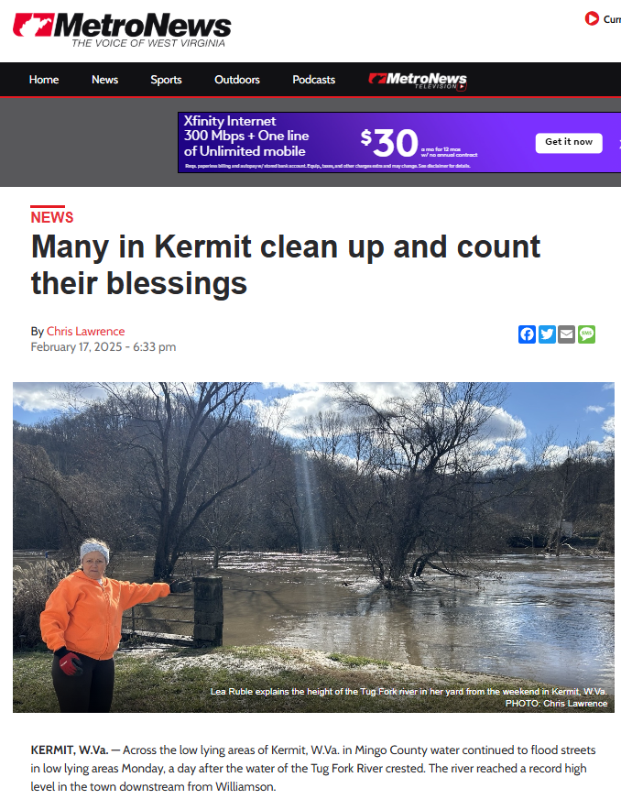
USACE TRACT 3316FP (Parcels 30-12-0001-0275-0000 & 1-276)
85 BLANKENSHIP ST, KERMIT, WV, 25674
USACE Floodproofed structures referenced in WV Metro News article “Many in Kermit clean up and count their blessings” dated February 17, 2025.
The town of Kermit has one of the highest percentages in the state of mitigated structures in high-risk flood areas

Slide 2
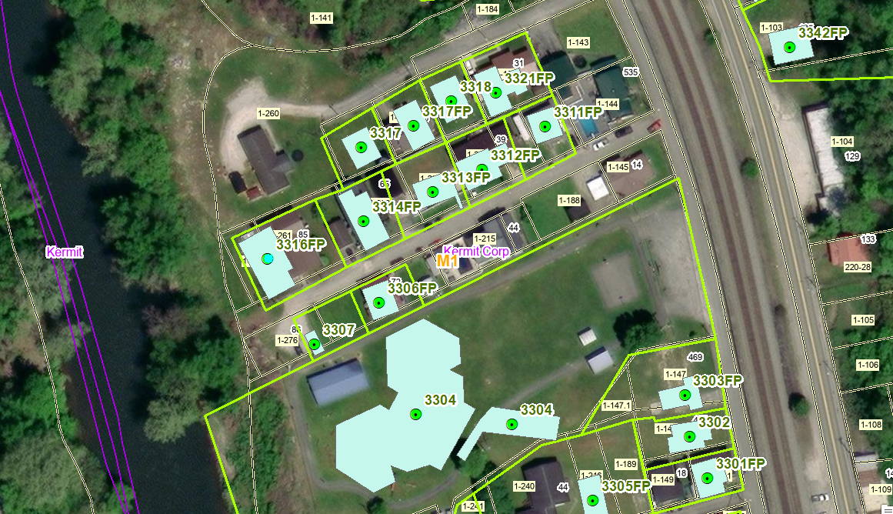
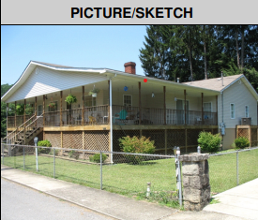
USACE TRACT 3316FP (Parcels 30-12-0001-0275-0000 & 1-276)
85 BLANKENSHIP ST, KERMIT, WV, 25674
USACE Structure 3316FP relocated on site and elevated at a cost of $65,160 in 1996 by Orville Ruble, father of Lea Ruble. Furnace moved to lower enclosure according to Lea Ruble in news article, a violation of Floodproofing Agreement.
Structure 3316FP

Slide 3
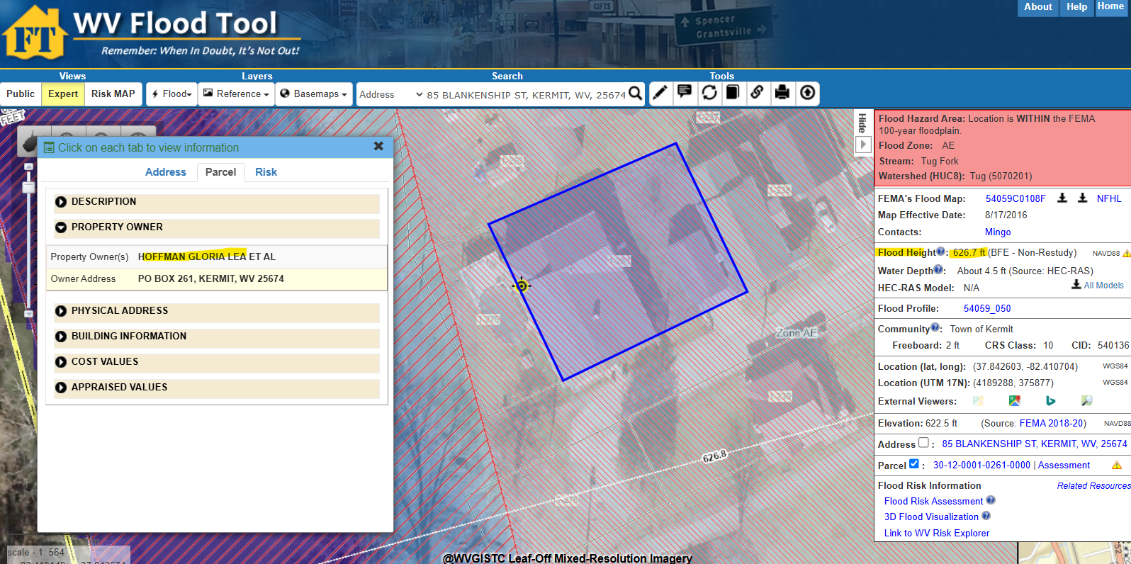
USACE TRACT 3316FP (Parcels 30-12-0001-0275-0000 & 1-276)
85 BLANKENSHIP ST, KERMIT, WV, 25674
WV Flood Tool Link
According to Lea Ruble in news article, the floodwaters during the February 2025 flood event for USACE Structure 3316FP floodwaters for February 2025 event rose 21 inches. For this location, the FEMA 100-yr flood elevation is 626.7 ft. (NAVD88), while the April 1977 (HWM) flood elevation (Appendix C) is 628.5 ft. (NGVD29), or after a NGVD29 to NAVD88 vertical datum conversion, the 1977 high-water mark is 627.8 ft. (NAVD88).

Slide 4
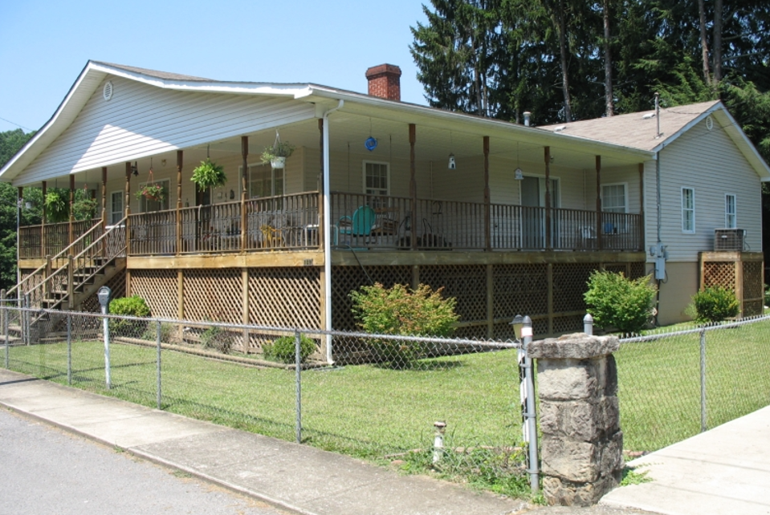
USACE TRACT 3316FP (Parcels 30-12-0001-0275-0000 & 1-276)
85 BLANKENSHIP ST, KERMIT, WV, 25674
USACE Section 202 picture of Floodproofed Structure 3316FP taken July 2006
According to Lea Ruble in news article, furnace moved from living quarters to lowest enclosure or basement.

Slide 5
USACE TRACT 3316FP (Parcels 30-12-0001-0275-0000 & 1-276)
85 BLANKENSHIP ST, KERMIT, WV, 25674
Question: Should the County Commission be inspecting floodproofed structures to ensure the floodproofing agreements for lower enclosures are not violated? In this example, the homeowner moved the furnace from the living space to the basement.
Owner Lea Ruble of Kermit, WV, talks about the Tug Fork flooding of her home (USACE Structure 3316FP) in MetroNews article “Many in Kermit clean up and count their blessings” dated February 17, 2025.
Structure 3316FP
Owner Lea Ruble of Kermit, WV, talks about the Tug Fork flooding of her home (USACE Structure 3316FP) in Metro News article “Many in Kermit clean up and count their blessings” dated February 17, 2025.

Slide 6
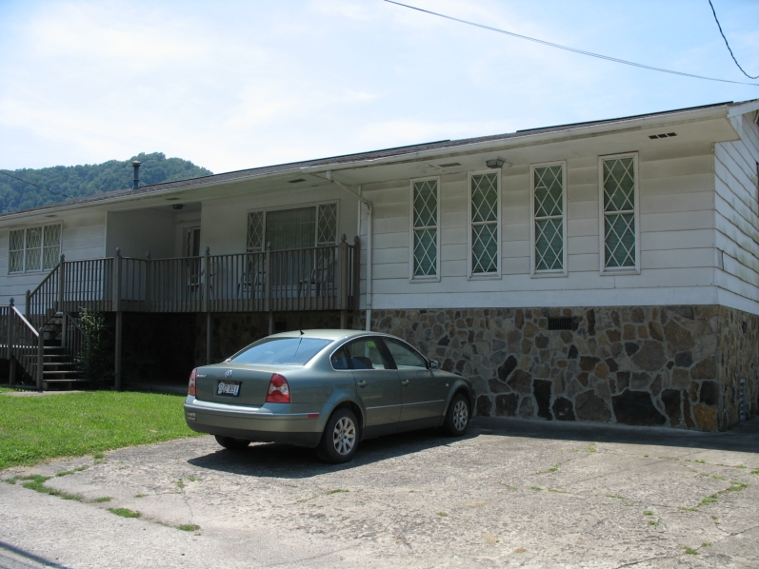
USACE TRACT 3242FP (Parcel 30-12-0001-0151-0000)
415 MINGO AVE, KERMIT, WV, 25674

Slide 7
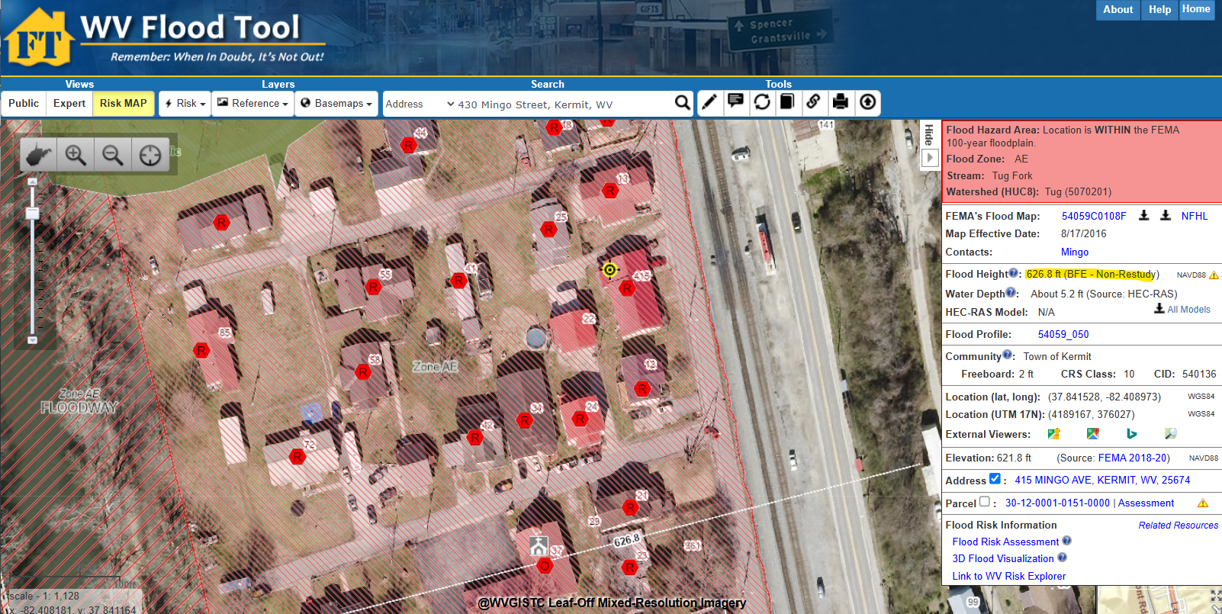
USACE TRACT 3242FP (Parcel 30-12-0001-0151-0000)
415 MINGO AVE, KERMIT, WV, 25674
WV Flood Tool Link
For Structure 3242FP on 415 Mingo Street in news article, the FEMA 100-yr flood elevation is 626.8 ft. (NAVD88), while the April 1977 (HWM) flood elevation (Appendix C) is 628.5 ft. (NGVD29), or after a NGVD29 to NAVD88 vertical datum conversion, the 1977 high-water mark is 627.8 ft. (NAVD88).
415 Mingo St., Kermit, WV

Slide 8
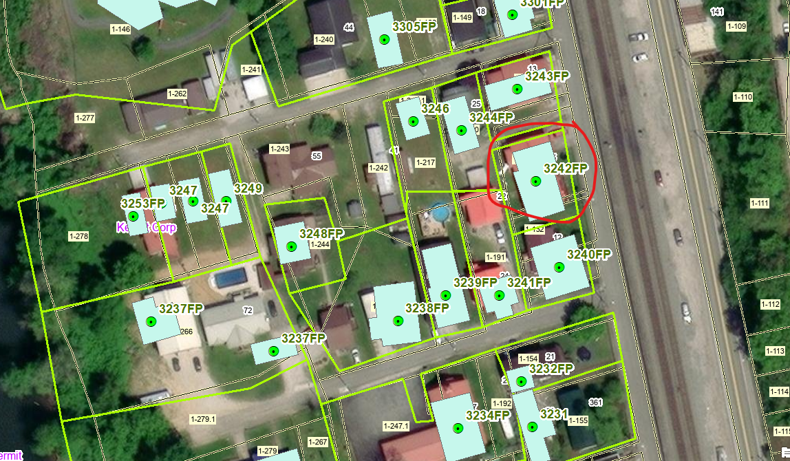
USACE TRACT 3242FP (Parcel 30-12-0001-0151-0000)
415 MINGO AVE, KERMIT, WV, 25674

Slide 9
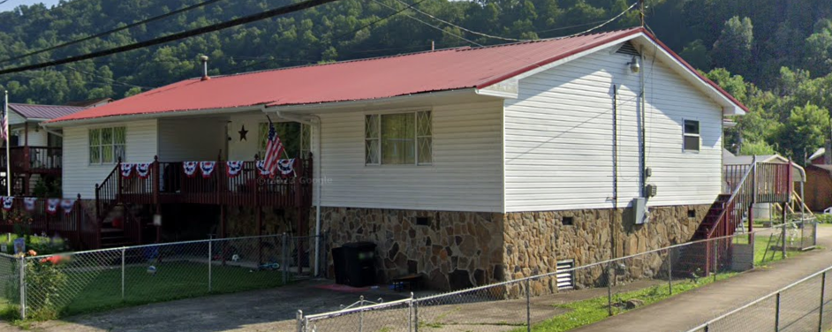
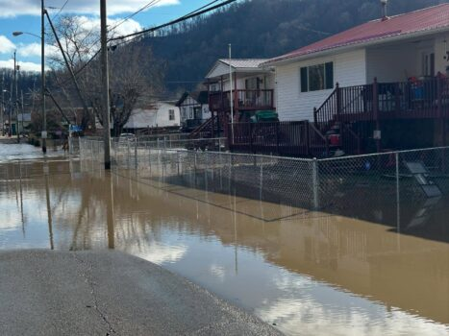
USACE TRACT 3242FP (Parcel 30-12-0001-0151-0000)
415 MINGO AVE, KERMIT, WV, 25674
Google Street View July 2023
USACE Section 202 picture of Floodproofed Structure 3242FP taken July 2006
2025 Flooding of Structure 3242FP
News article picture of February 2025 flooding

