Slide 1
Mapping of Wayne County USACE Section 202 Projects
to WV Tax Parcels and WV Flood Tool
USACE Huntington Section 202 Nonstructural Flood Reduction Projects
Section 202 of the Energy and Water Development Appropriations Act of 1981 primarily refers to a provision that allows for the funding of USACE "non-structural flood damage reduction projects," meaning projects that focus on mitigation strategies like property buyouts, relocations, and floodproofing, rather than building physical structures like levees, to reduce flood damage in specific areas, often in response to significant flooding events like the major 1977 flood of the Tug Fork Basin.
Section 202 projects require significant community participation, including “voluntary” buyouts or floodproofing measures, to be implemented effectively.
Wayne County Section 202 Projects (occurred primarily between 1999-2006 period).
Wayne County Section 202 Projects in the process of being mapped to the WV Flood Tool.
36 Floodproofed Structures. Funding for floodproofed structures totaled more than $5 million in 2025 dollars.
18 Floodplain Acquisition Parcels.
DATA SOURCES for Mapping Section 202 Projects to WV Flood Tool
USACE Land Record Information. 2006 Nonstructural O&M Manual with detailed planimetrics, building footprints, elevation data, building photos, flood elevations, mitigation closing date, owner associated with mitigation project, etc.; recorded floodproofing agreements and elevation certificates.
GIS files showing locations USACE tracts and projects
Other Verification Sources. 2024 Integrated Assessment System (IAS) tax parcels (deed and calculated acreages, legal description, owner name, parcel history, building year, building sketch diagram), 1999 USGS CIR and 2003 SAMS aerial imagery, Google Street View of multiple dates, and voting records.

Slide 2
USACE Section 202 Mitigated Floodproofed Buildings for Wayne County
(2025 Audit to Tax Parcels)
Legend
Acquired Property
Structure Floodproofed
Structure Removed or Modified
Relocated out of SFHA
36 Floodproofed Structures
(28 compliant, 1 new replacement structure, 1 relocated out of SFHA, 1 non-compliant, 5 removed)

Slide 3
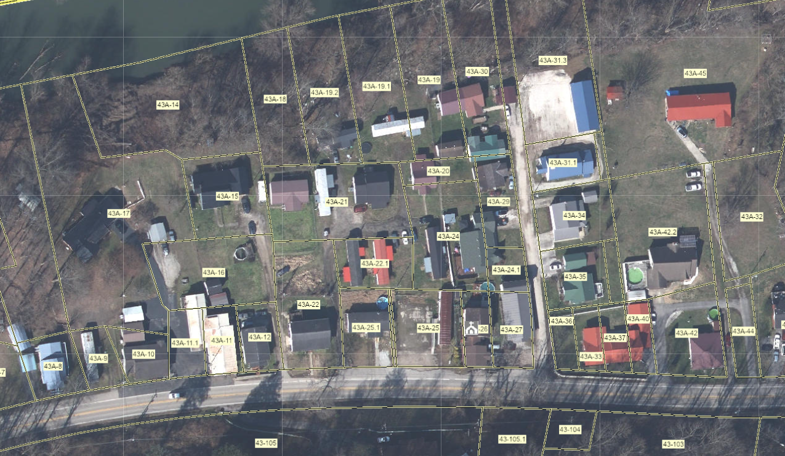
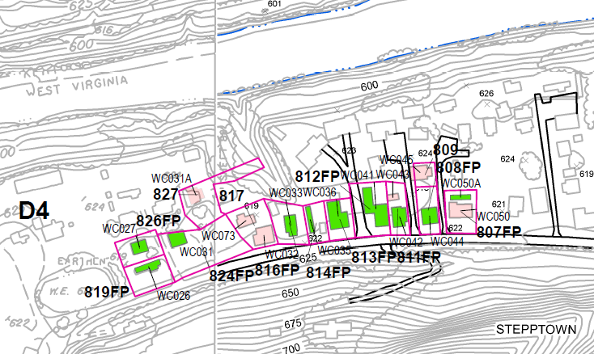

USACE TRACTS: 809, 808FP, 811FP, 812FP
USACE Tract 812FP: Switch IAS Records of Parcels 43A-17 and 43A-11
USACE Tract 811FP: Copy IAS Record IAS 43A-11.1 to IAS Record 43A-12
USACE Tract 808FP: Replace IAS Record 43A-22 with IAS Record 43A-27
USACE Tract 809: Copy IAS Record/Geometry of 43A-24.1 to north end of 43A-22
Replace IAS Record 43A-25.2 with IAS Record 43A-22
USACE Floodproofing Map
USACE 2006 Nonstructural O&M Manual (Page 96)
809
808FP
807FP
812FP
811FP
816FP
814FP
Harry’s Market

Slide 4
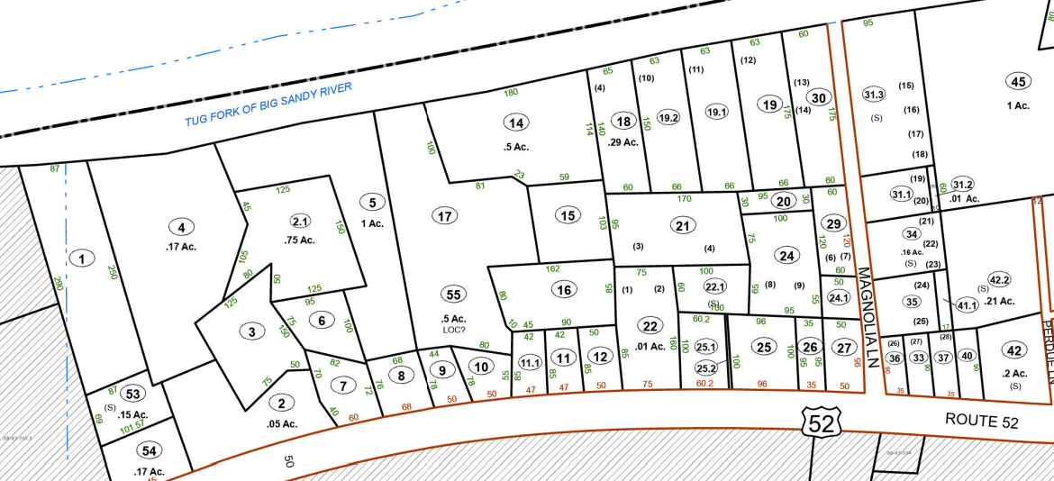

USACE TRACTS: 809, 808FP, 811FP, 812FP
Stepptown community
USACE Tract 812FP: Switch IAS Records of Parcels 43A-17 and 43A-11
USACE Tract 811FP: Copy IAS Record IAS 43A-11.1 to IAS Record 43A-12
USACE Tract 808FP: Replace IAS Record 43A-22 with IAS Record 43A-27
USACE Tract 809: Copy IAS Record/Geometry of 43A-24.1 to north end of 43A-22
Replace IAS Record 43A-25.2 with IAS Record 43A-22
USACE 2006 Nonstructural O&M Manual (Page 96)
809
807FP
811FP
808FP
813FP
812FP
817
816FP
814FP
826FP
824FP
Harry’s Market
819FP

Slide 5
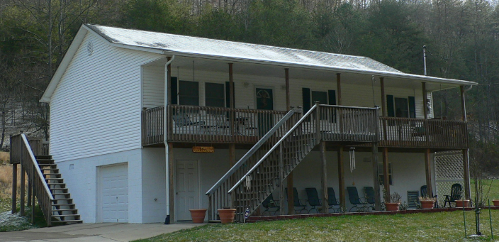
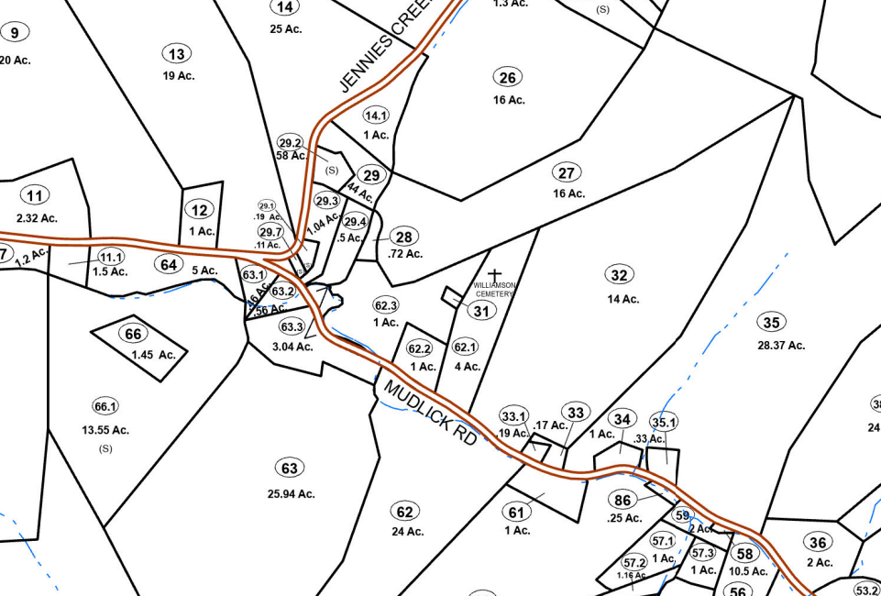
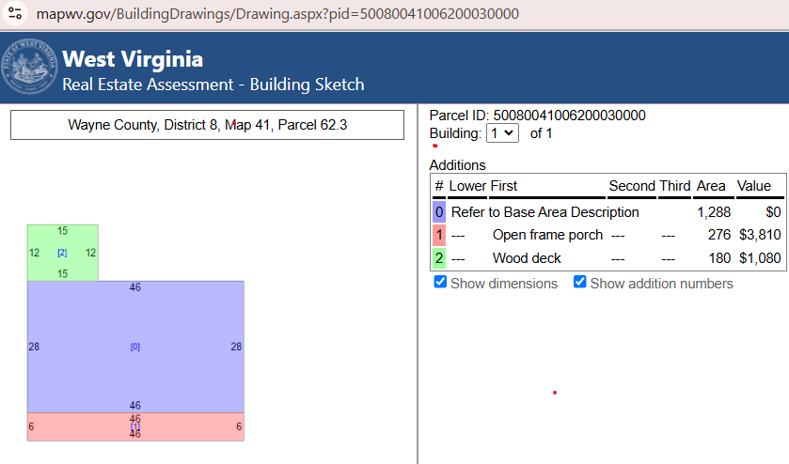
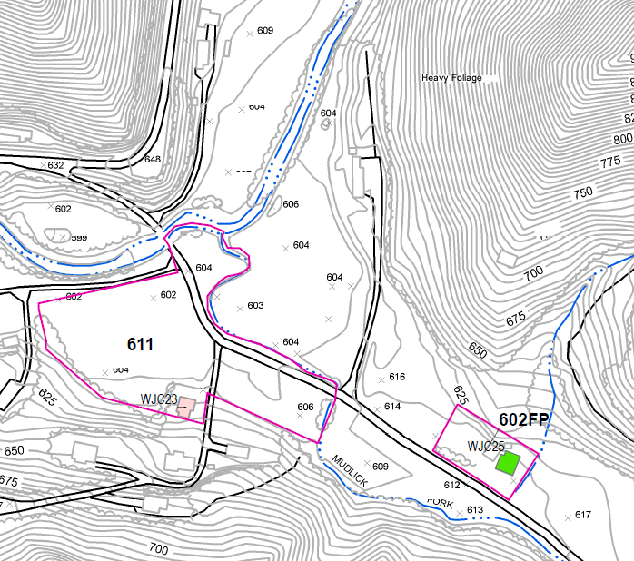
USACE TRACT 602 FP
Switch IAS Records of Parcels 41-62.3 with 41-62.1
Building Photo link
Correct Building Sketch Diagram for Parcel 8-41-62.1
USACE Floodproofing Map
602FP
602FP

Slide 6
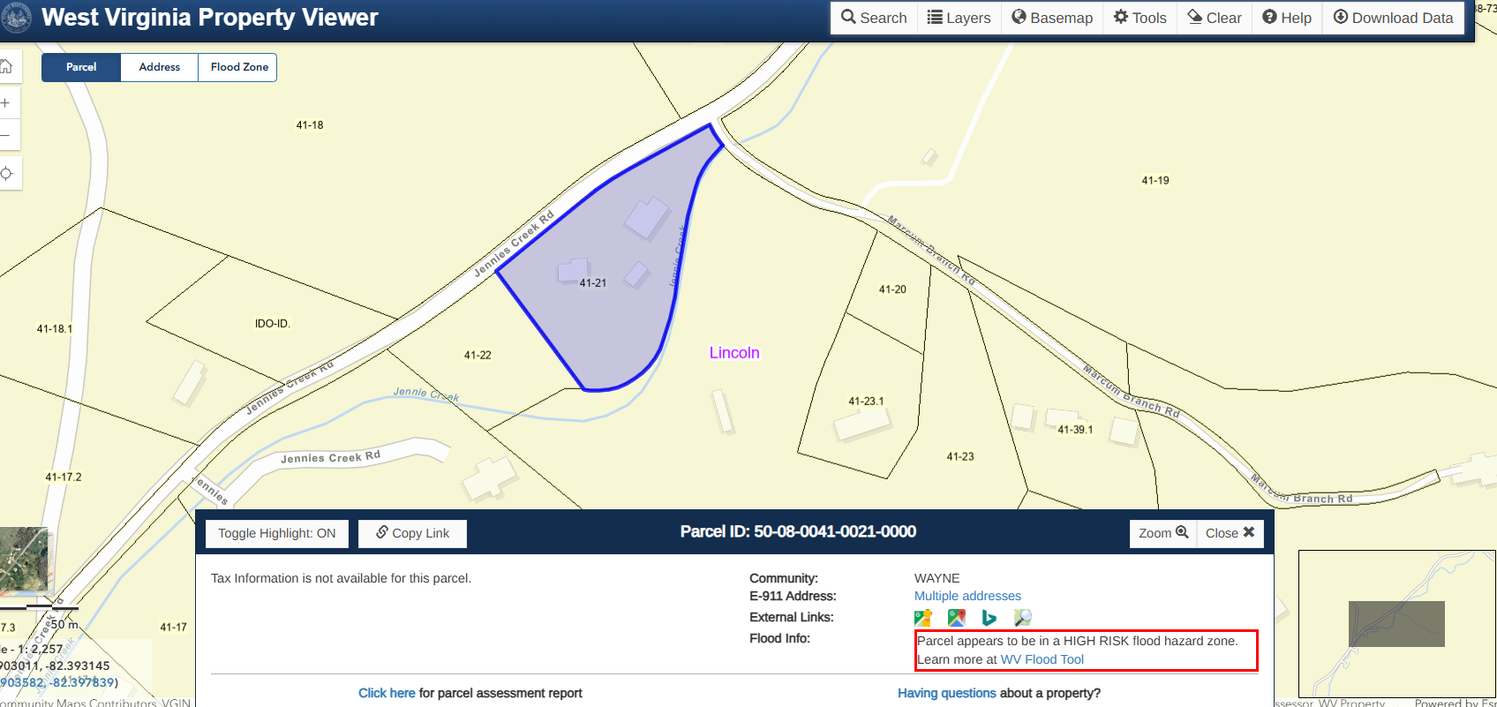
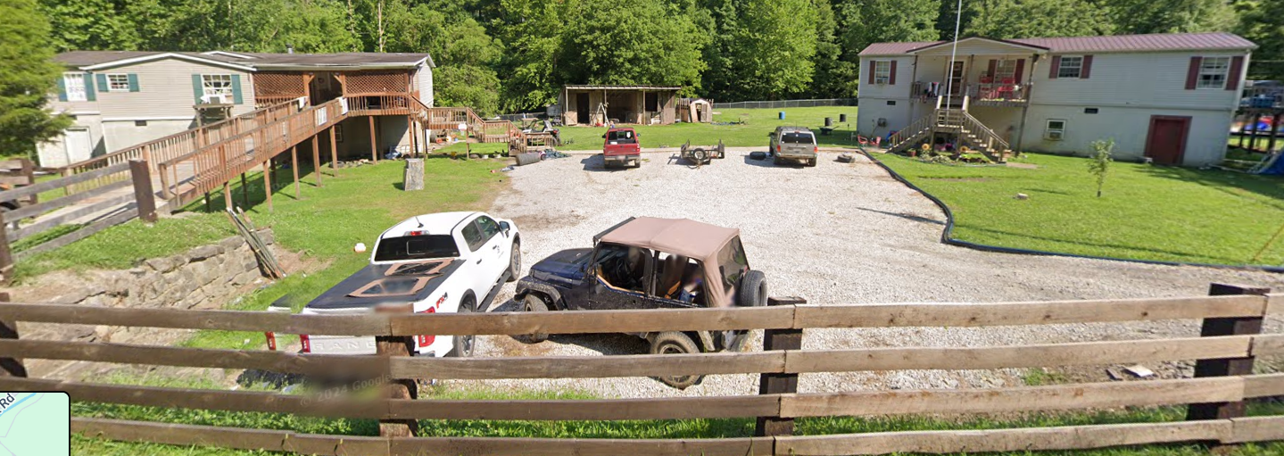
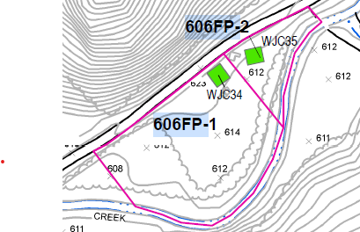
USACE TRACTS 606FP-1 & 606FP-2
Copy IAS Record 8-38-23 to 8-41-21
Two elevated structures built in 2002 with USACE Section 202 grant funds on parcel.
USACE Tract 606FP-1: 2450 JENNIES CREEK RD, Kermit, WV, 25674. USACE Building Picture.
USACE Tract 606FP-2: 2480 JENNIES CREEK RD, Kermit, WV, 25674. USACE Building Picture.
USACE 2006 Nonstructural O&M Manual (Page 85)
2480 Jennies Creek Rd
2450 Jennies Creek Rd
606FP-2
606FP-1
USACE Floodproofing Map
No IAS record/parcel attributes for Parcel 8-4-21?

Slide 7
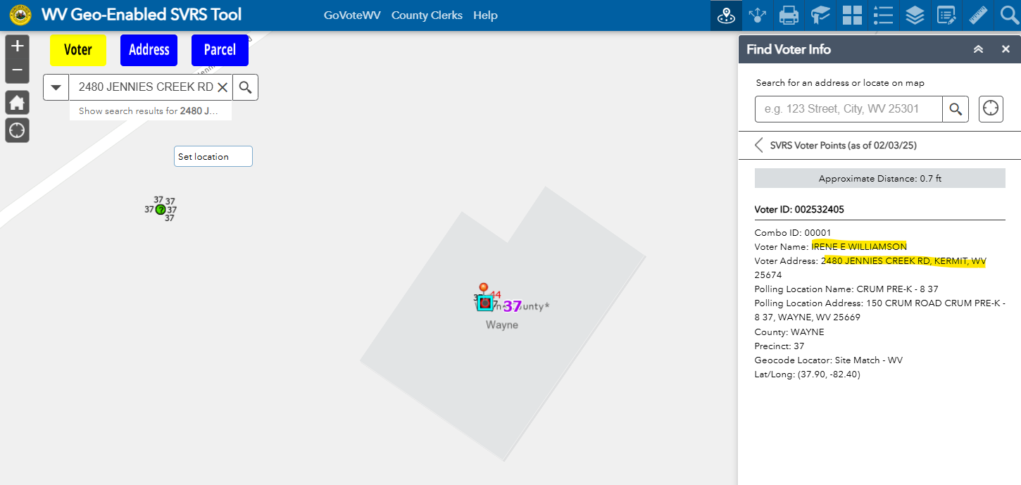
USACE TRACTS 606FP-1 & 606FP-2
2025 voting registration record links floodproofing agreement owner IRENE WILLIAMSON to
USACE Tract 606FP-1 & 606FP-2
606FP-2
Copy IAS Record 8-38-23 to 8-41-21
Two elevated structures built in 2002 with USACE Section 202 grant funds on parcel.
USACE Tract 606FP-1: 2450 JENNIES CREEK RD, Kermit, WV, 25674. USACE Building Picture.
USACE Tract 606FP-2: 2480 JENNIES CREEK RD, Kermit, WV, 25674. USACE Building Picture.

Slide 8
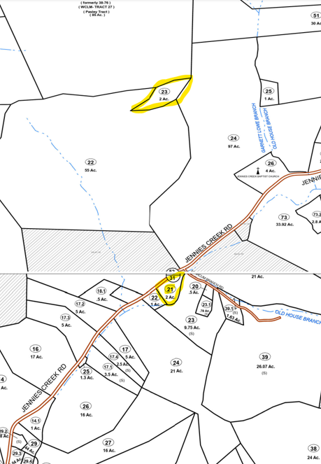
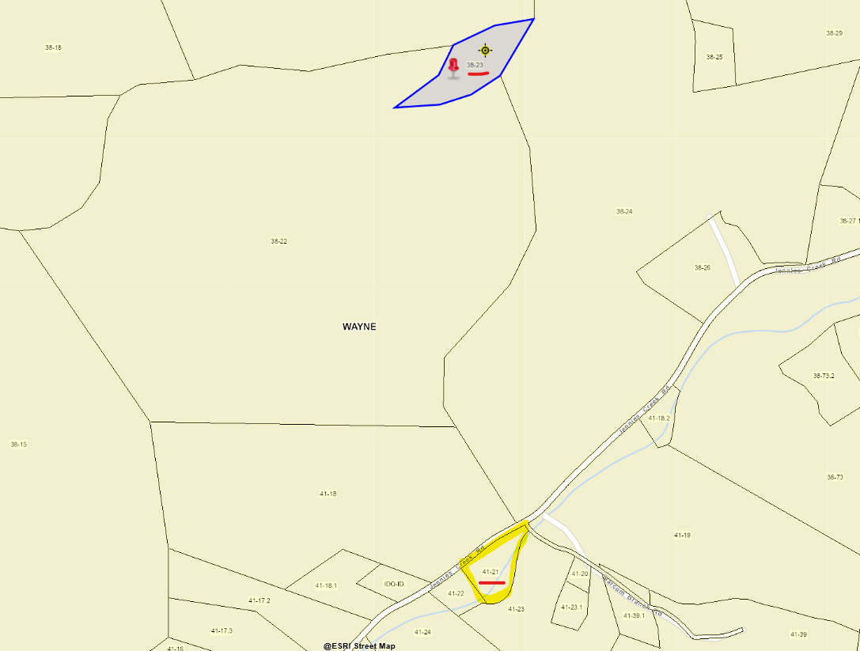
USACE TRACTS 606FP-1 & 606FP-2
Copy IAS Record 8-38-23 to 8-41-21
Two elevated structures built in 2002 with USACE Section 202 grant funds on parcel.
USACE Tract 606FP-1: 2450 JENNIES CREEK RD, Kermit, WV, 25674. USACE Building Picture.
USACE Tract 606FP-2: 2480 JENNIES CREEK RD, Kermit, WV, 25674. USACE Building Picture.
Tax District 8, Map 38
IAS Record 50-08-0038-0023-0000
Parcel 8-38-23
USACE 2006 Nonstructural O&M Manual (Page 85)
Parcel 8-41-21
Tax District 8, Map 41

Slide 9
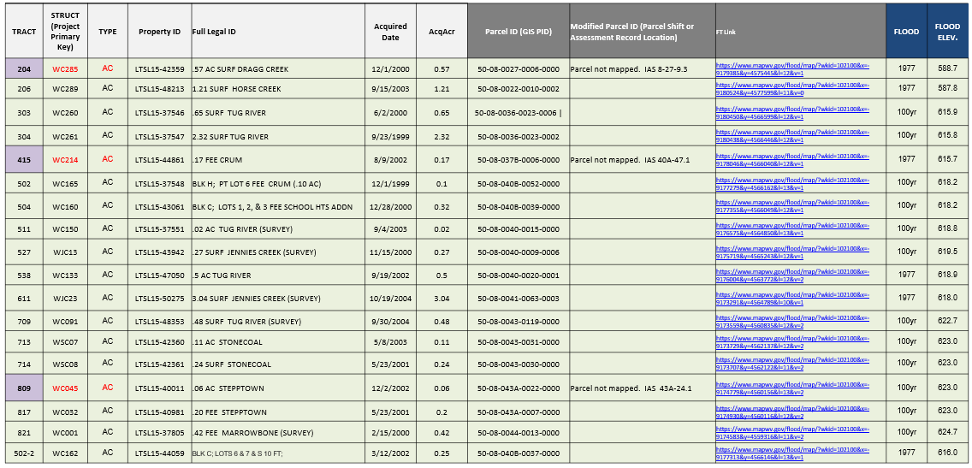
USACE Section 202 Voluntary Floodplain Acquisition Parcels for Wayne County
(2025 Audit to 2024 Tax Parcels)
18 Acquisition Parcels Owned by the Wayne County Commission

Slide 10
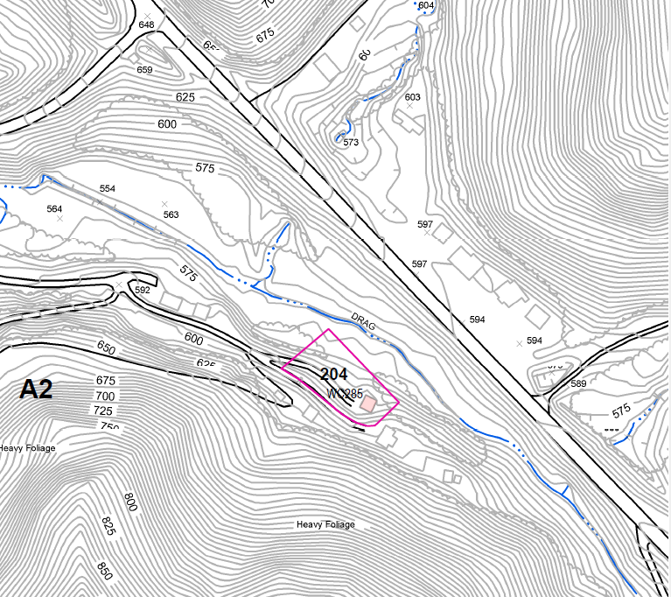
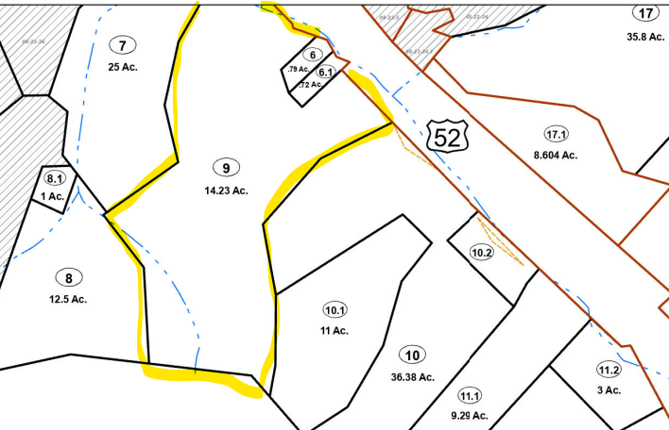
USACE TRACT 204
Parcel 8-27-9.3 (50-08-0027-0009-0003), owner County Commission, is in IAS but no geometry mapped.
USACE O&M Map for acquired parcel Tract 204 on 12/1/2000 intersects Parcel 27-9 and Parcels 27-6 which according to IAS have a private owner CANTRELL TONY E & CHARLENE.
Recommend obtaining map plat and other land documents for Tract 204 from USACE.
USACE 2006 Nonstructural O&M Manual (Page 50)
Tract 204 Floodplain Acquisition Parcel

Slide 11
USACE TRACT 204
USACE Tract 204 Floodplain Acquisition Parcel
USACE Huntington District may have map plat of Tract 204.
PDF Tax Map for Lincoln District 8, Map 27

Slide 12
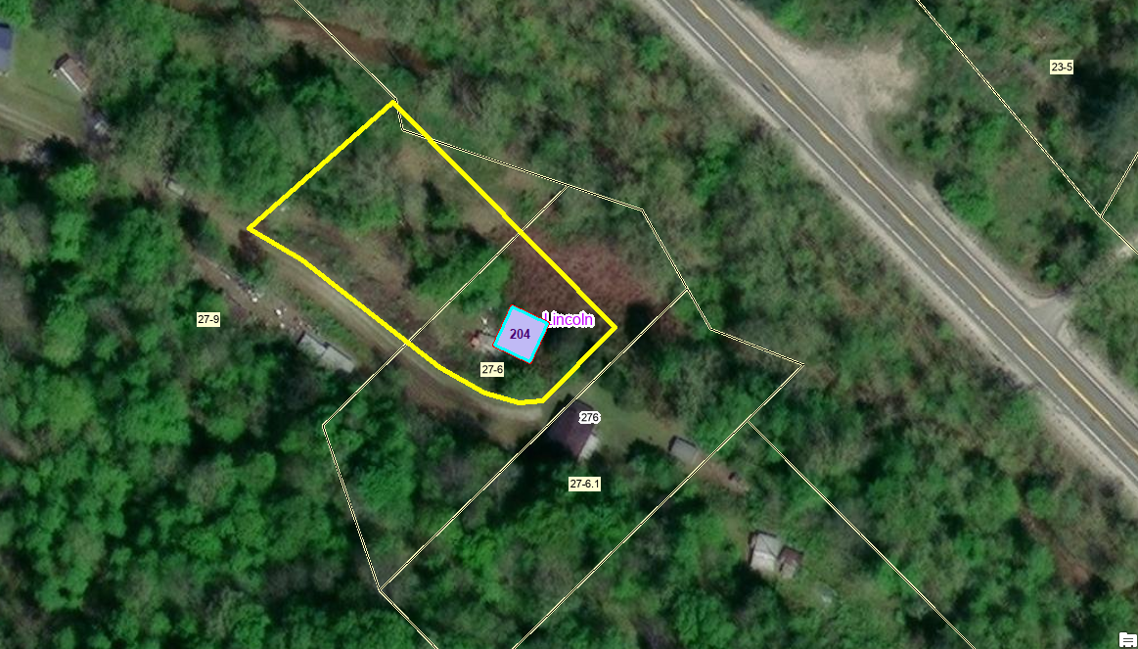
USACE TRACT 204
USACE 2006 Nonstructural O&M Manual (Page 124)
WV Flood Tool Link
Tract 204 Unmapped Floodplain Acquisition Parcel
located at Wilkie Chaffin Drive along Drag Creek. Tract 204 mapped by USACE intersects Parcels 27-6 and 27-9
Parcel 27-9.3 of .57 acre along Drag Creek formerly owned by Windel & Mary Chaffin

Slide 13
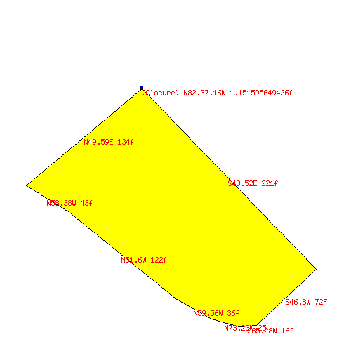
USACE TRACT 204
WV Flood Tool Link
USACE 2006 Nonstructural O&M Manual (Page 124)
Tract generated using TractPlotter.com
Tract Calls from Legal Description
S43.52E 221f
S46.8W 72F
S85.28W 16f
N73.23W 25
N59.56W 36f
N51.6W 122f
N58.38W 43f
N49.59E 134f
Tract Coordinate Origin from Legal Description:
(37.9722675819, -82.4601151574)
Plot of Tract 204 generated from legal description calls. Tract outline matches USACE shapefile.
24820 square feet 0.5699 acres (+/- 0.000981 acres) Perimeter: 669 feet Closure: N82.37.16W 1.151596f (0.1721% or 1:581 perimeter error)

Slide 14
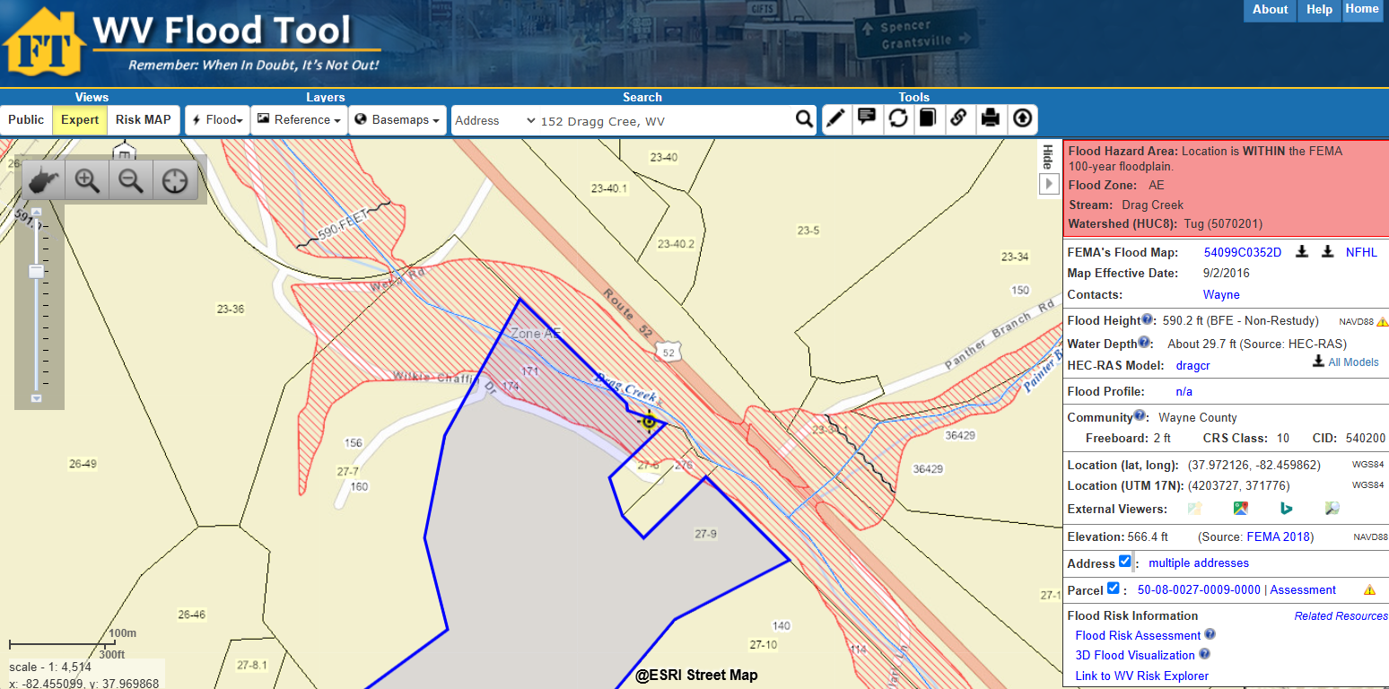
USACE TRACT 204
Tract 204 Unmapped Floodplain Acquisition Parcel
located at Wilkie Chaffin Drive along Drag Creek.

Slide 15
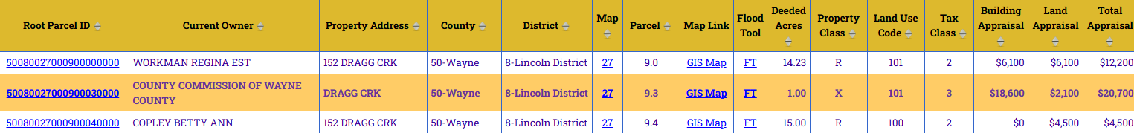
USACE TRACT 204
USACE 2006 Nonstructural O&M Manual (Page 124)
WV Flood Tool Link
Tax Map Issues:
Parcel 27-9 (14.23 deeded acres versus 30.29 calculated acres) may need to be split as:
Parcel 9.0: 14.23 d. acres; owner Workman Regina Est. (171 and 174 Wilkie Chaffin Drive Trailers)
Parcel 9.3: 0.57 d. acres; Owner Wayne County Commission – Floodplain Parcel (no parcel geometry mapped)
Parcel 9.4: 15.0 d. acres; Owner Betty Ann Copley (no parcel geometry mapped)
Total Deeded Acreage: 29.8 acres for Parcels 9.0, 9.3, and 9.4
USACE O&M Map of floodplain acquisition parcel Tract 204 (27-9.3) recorded on12/1/2000, owner WAYNE COUNTY COMMISSION, intersects Parcel 27-9 (owner WORKMAN REGINA) and Parcel 27-6 (owner CANTRELL TONY E & CHARLENE). Adjoining Parcel 27-7 (owner BETTY ANN COPLEY) consists of 25 d. acres/15.1 c. acres.
Parcel 27-9 IAS Records

Slide 16
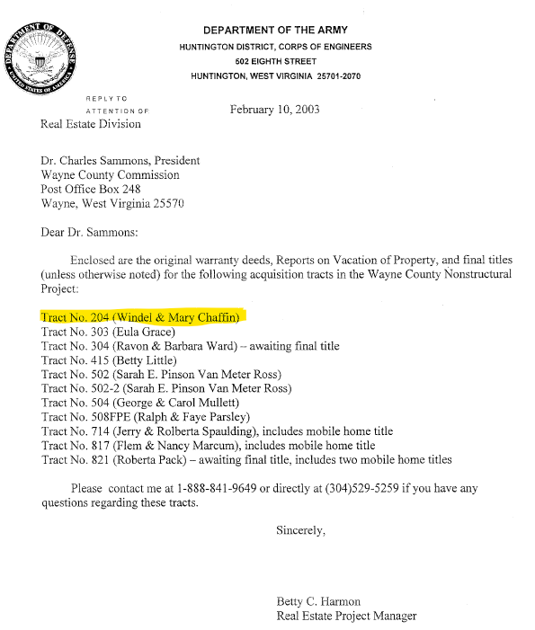
USACE TRACT 204
USACE 2006 Nonstructural O&M Manual (Page 124)
USACE Tract 204
Previous owners according to Section 202 Sponsor Transfer Letter dated 20 Feb. 2003 were Windel & Mary Chaffin
USACE Tract 204 Previous Owners according to Sponsor Transfer Letter dated 20 Feb. 2003 were Windel & Mary Chaffin
County Commission deeded parcel on 12/12/2000 for (Deed Book 611 Page 292). Coordinate geometry listed in the legal description of deed. Check with USACE for map plat from Section 204 Case File.

Slide 17
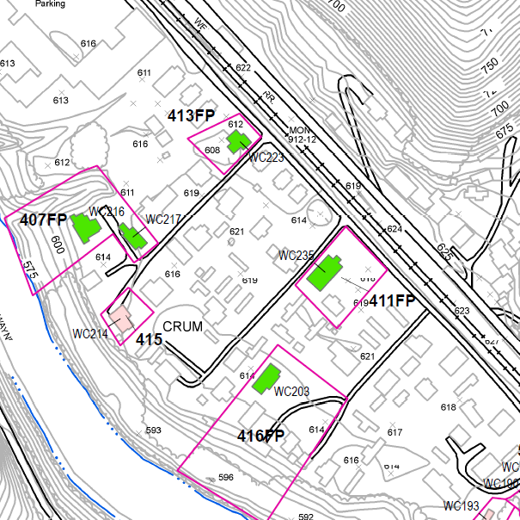
USACE TRACT 415
USACE 2006 Nonstructural O&M Manual (Page 60)
WV Flood Tool Link – parcel geometry location
USACE Tract 415 Floodplain Parcel of 0.17 acres acquired 8/9/2002, Owned by County Commission
50-08-040A-0047-0001
Parcel 40A-47.1 in IAS but no geometry mapped. Recommend obtaining USACE plat and land records for Tract 415 to map floodplain acquisition parcel 40A-41.1 of 0.17 acres.

Slide 18
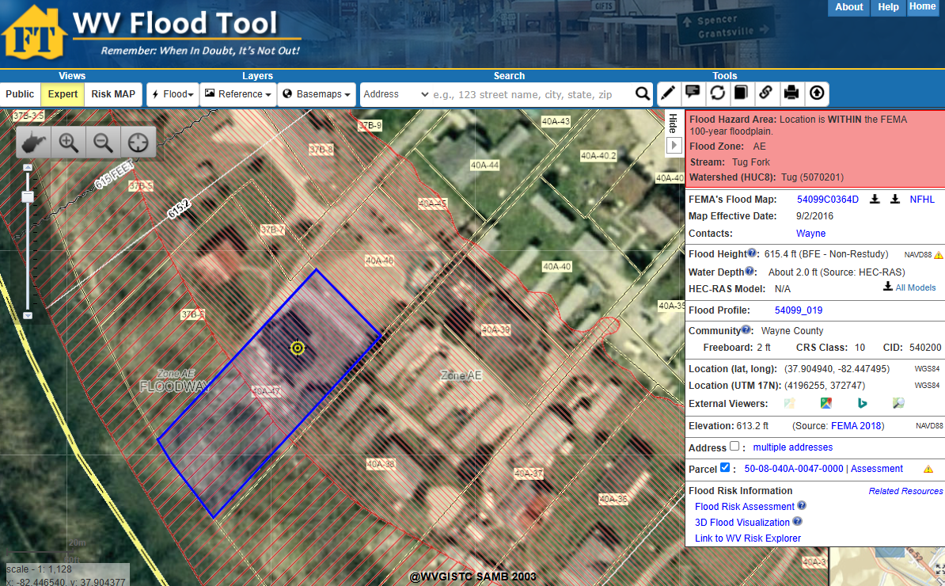
USACE TRACT 415
USACE Tract 415 Floodplain Parcel of 0.17 acres acquired 8/9/2002, Owned by County Commission
2023 SAMS Imagery Basemap
WV Flood Tool Link
USACE Tract 415
Structure WC214 of Tract 415 removed. Use 1999 CIR and 2003 SAMS imagery to match building footprints with USACE Land Records
USACE 2006 Nonstructural O&M Manual (Page 60)

Slide 19
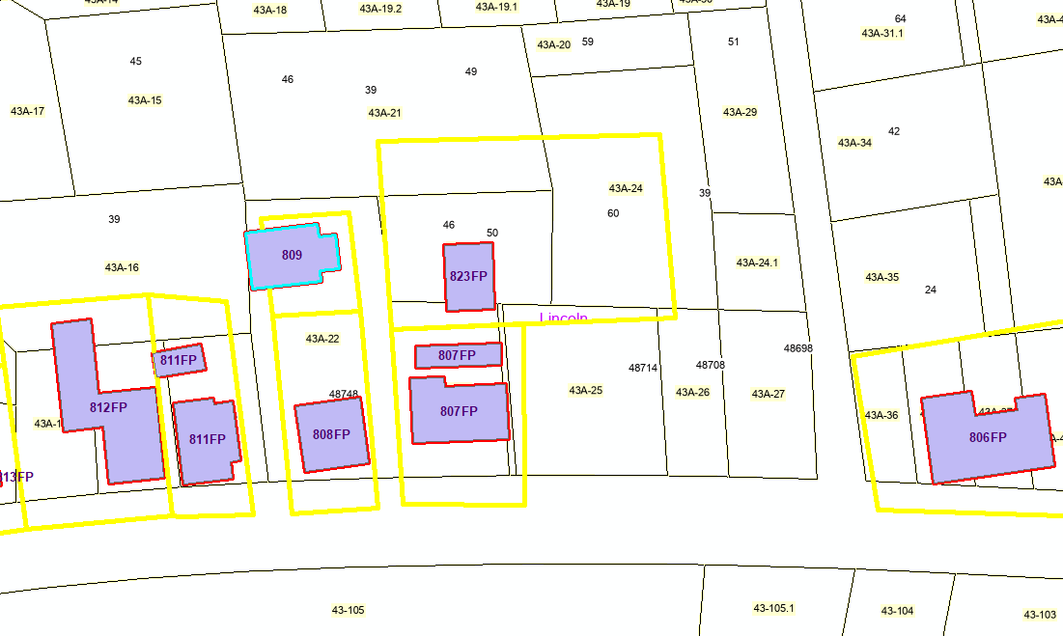
USACE TRACT 809
USACE Tract 809: Copy IAS Record/Geometry of 43A-24.1 to north end of 43A-22
USACE Tract 809
IAS Record
USACE 2006 Nonstructural O&M Manual (Page 96)
WV Flood Tool Link geometry location

Slide 20
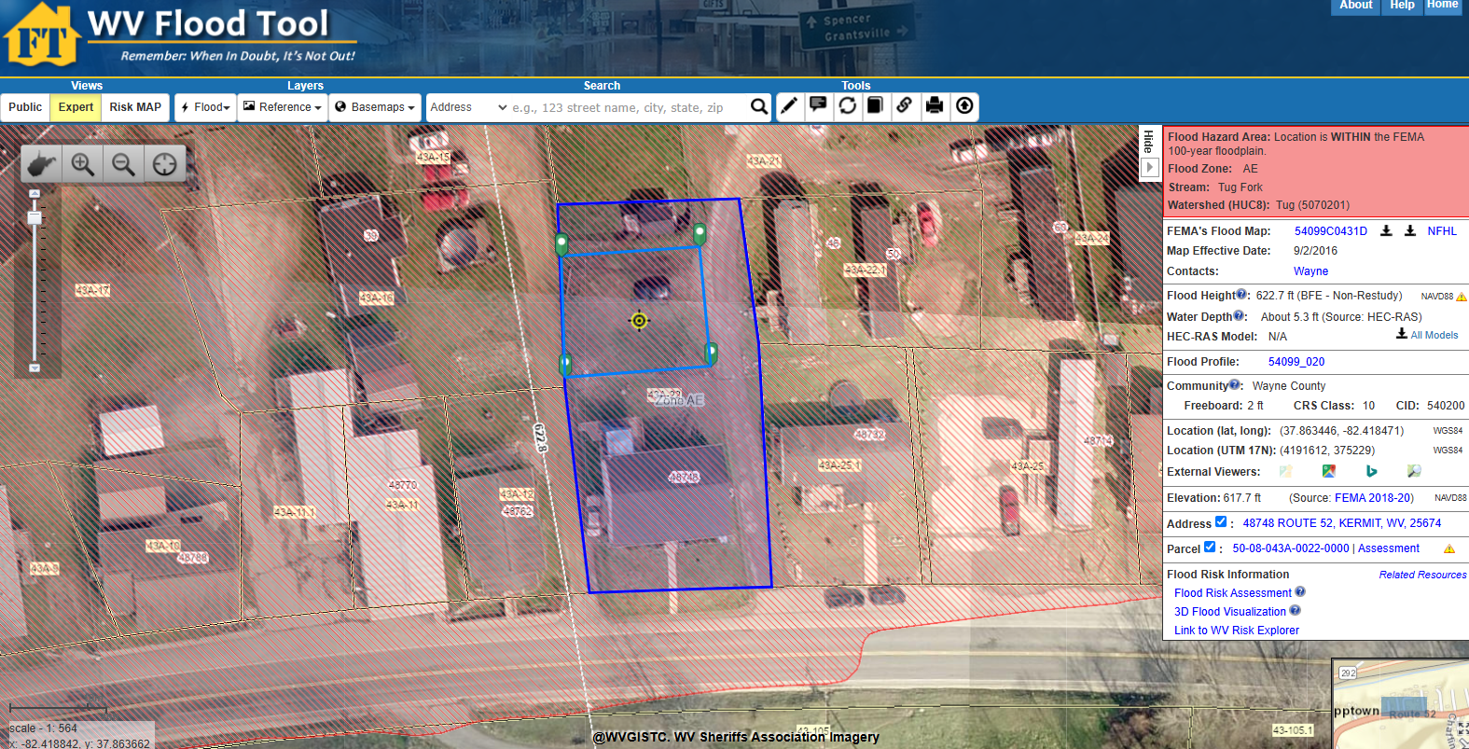
USACE TRACT 809
IAS Record
USACE Tract 809 Floodplain Parcel of 0.06 acres acquired 8/9/2002, Owned by County Commission
Tract 809
USACE 2006 Nonstructural O&M Manual (Page 96)
WV Flood Tool Link geometry location

