Slide 1
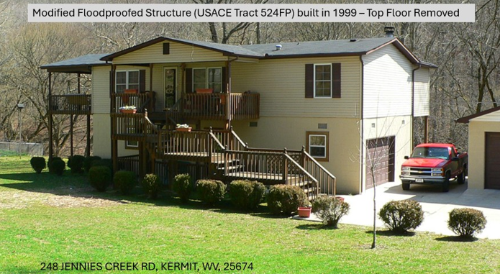
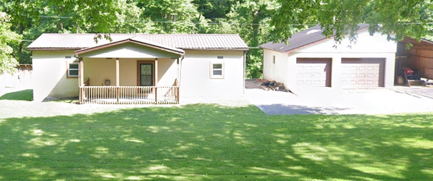
Wayne County Section 202 Non-Structural Project
USACE TRACTS 524FP (Parcel 50-08-0040-0039-0000)
248 JENNIES CREEK RD, KERMIT, WV, 25674
The original structure 524FP was floodproofed in 1991 and elevated 10.2 feet for the owners Curtis and Christin Marcum in 1999. The structure was then sold in 2015 to James and Maxine Dingess who modified the floodproofed structure from two stories to one story.
QUESTIONS:
Is the modified Section 202 structure Tract 524FP at 248 Jennies Creek Road a habitable structure?
Should the Floodproofing Agreement have been recorded again in 2015 when the original floodproofing owner MARCUM sold the property to the new owner DINGESS?
1999 USACE Floodproofed Bldg. (Tract 524FP)
Structure Modified (2023 Google Street View)
Structure 524FP Modified to One Story

Slide 2
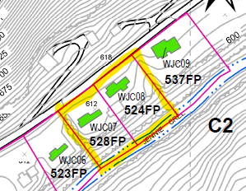
USACE TRACT 524FP (Parcel 50-08-0040-0039-0000)
248 JENNIES CREEK RD, KERMIT, WV, 25674
WV Flood Tool
Page 4 of Floodproofing Agreement dated 28 September 1999…
“The Owners, for themselves and their heirs and assigns, hereby covenant and warrant to The County Commission of Wayne County, and to its assigns forever, and agree, that no construction, alteration, or placement of structures of any kind or nature whatsoever on said land shall take place thereof to be used for human habitation, commercial or business purposes is elevated above 619.0 feet mean sea level, the 100-year flood elevation, and that this restriction shall be specifically included in every instrument subsequent hereto conveying title to any interest in said land or structures thereon.”
Recorded
Floodproofing Agreement for Tract No. 524FP Wyant County Nonstructural Project in 1999
USACE 2006 Nonstructural O&M Manual (Page 69)
Property was transferred to James and Maxine Dingess in 2005 (Deed Book 709, Page 307) but floodproofing agreement was not attached.
Building Pictures in O&M Manual (Pg. 71)

Slide 3
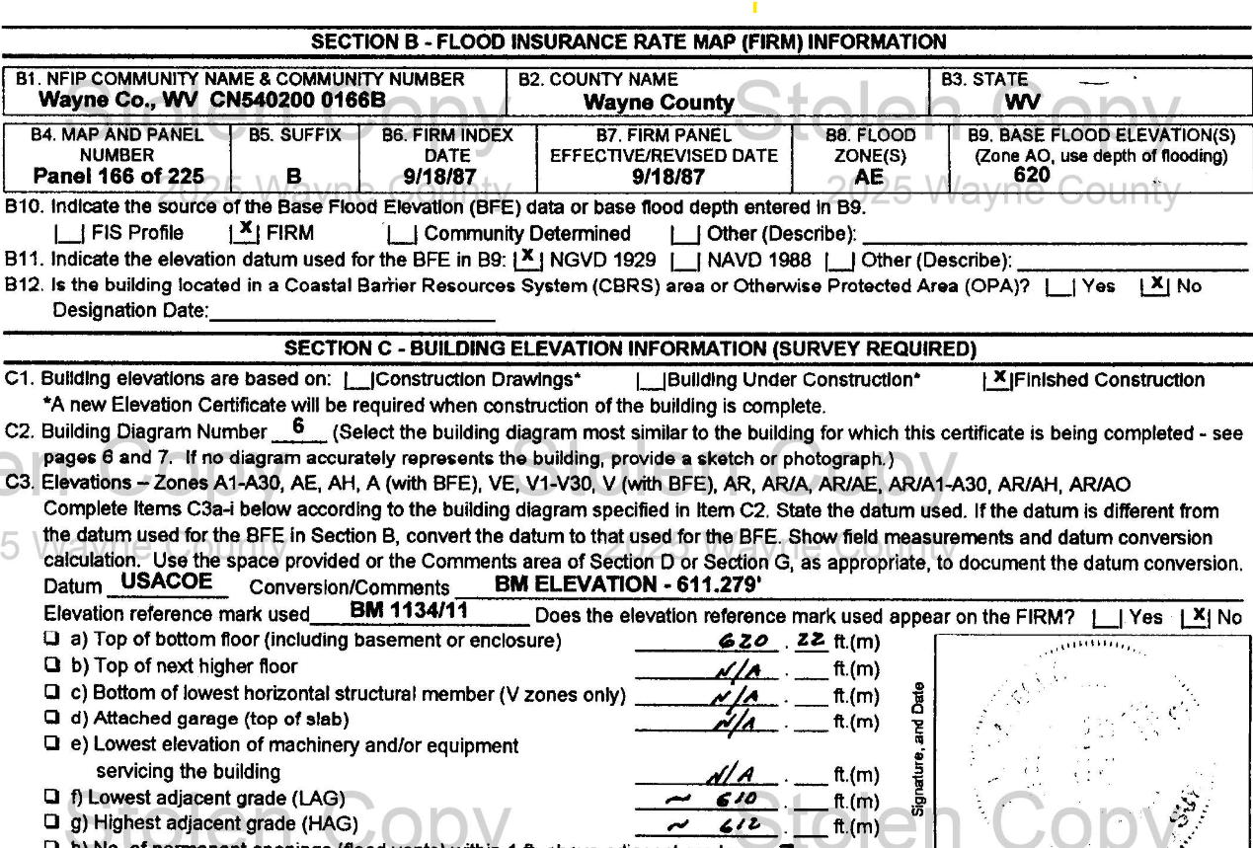
WV Flood Tool
USACE Tract 524FP Building Structure elevated 10.2 ft. or 620.2 ft., above the 100-year flood elevation of 619 feet
Elevation Certificate attached to Floodproofing Agreement (page 8)

Slide 4
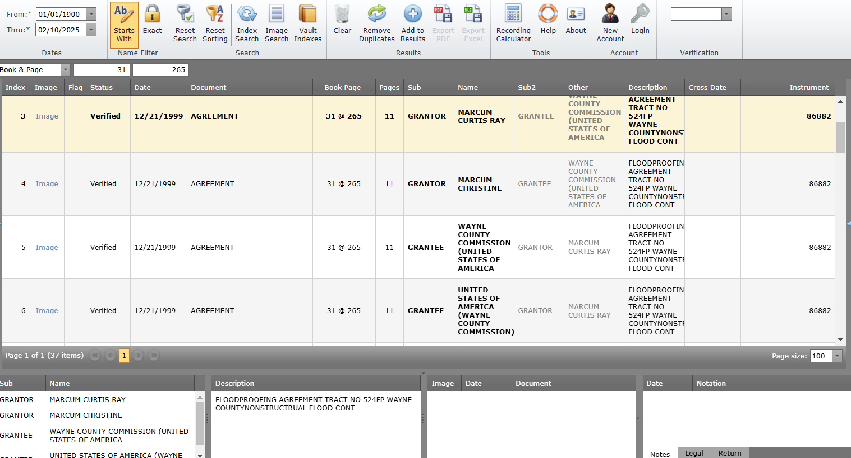
All Section 202 Nonstructural Floodproofing Agreements for Mitigated Structures are located on Waye County’s Online Deed System
USACE Tract 524FP Building Floodproofing Agreement dated 12/21/1999 for structure mitigated for Owners Curtis and Christine Marcum

Slide 5
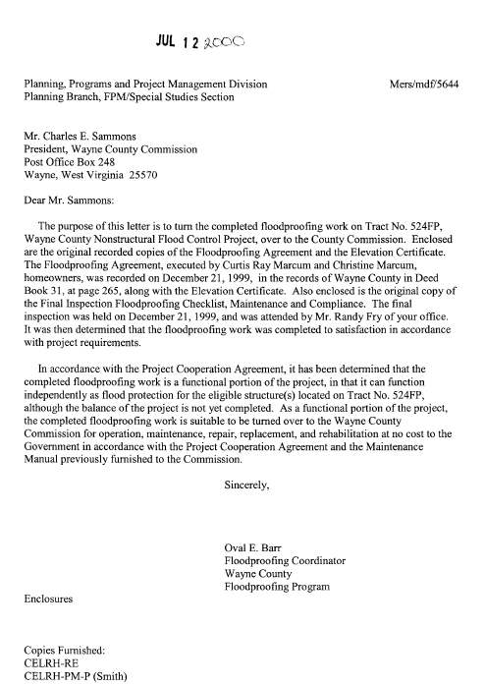
USACE TRACTS 524FP (Parcel 50-08-0040-0039-0000)
USACE 2006 Nonstructural O&M Manual (Page 141)
524FP Building Transfer Letter to County Commission
Letter dated July 12, 2000, from Wayne County Floodproofing Coordinator to President of Wayne County Commission regarding Tract No. 524FP (248 JENNIES CREEK RD, KERMIT, WV, 25674).
Enclosed with the letter were recorded copies of the Floodproofing Agreement (executed by Curtis Ray Marcum and Christin Marcum on December 21, 1999, in the records of Wayne County in Deed Book 31, Page 265, along with the Elevation Certificate.
Letter stated that the completed floodproofing of this tract was handed to the Wayne County Commission for operation, maintenance, repair, replacement at not cost to the Government in accordance with the Project Cooperation Agreement and the Maintenance Manual.

Slide 6
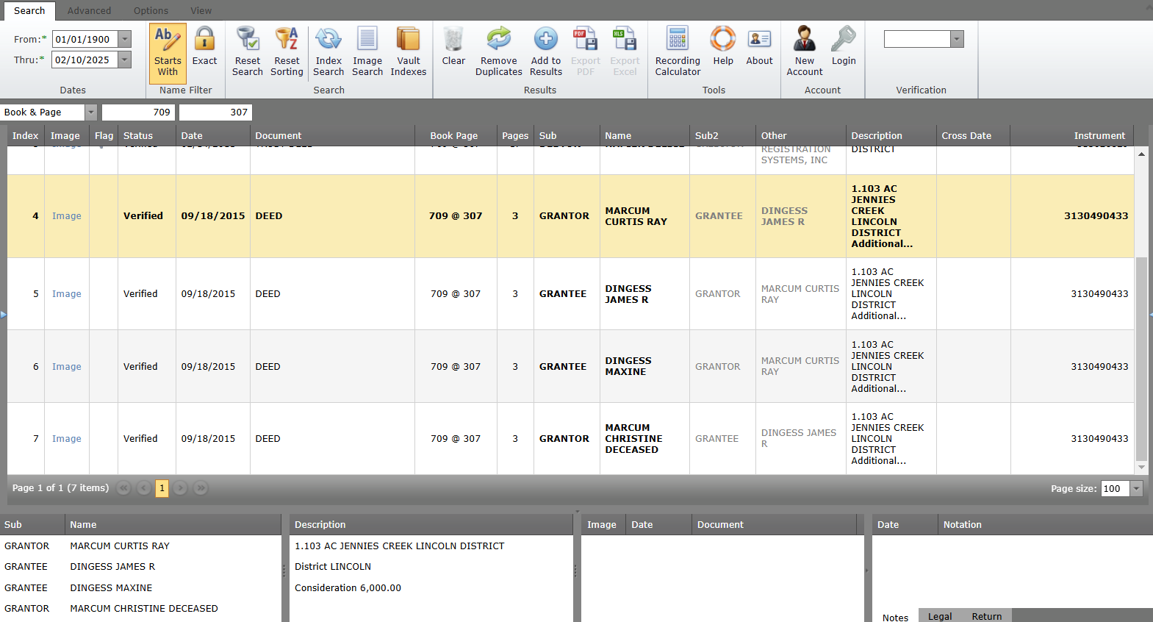
http://www.waynecountywv.us/IDXSearch/Image.aspx?control=317868
USACE Tract 524FP sold by Curtis Marcum to James & Maxine Dingess in 2015 with no floodproofing agreement attached to the deed

Slide 7
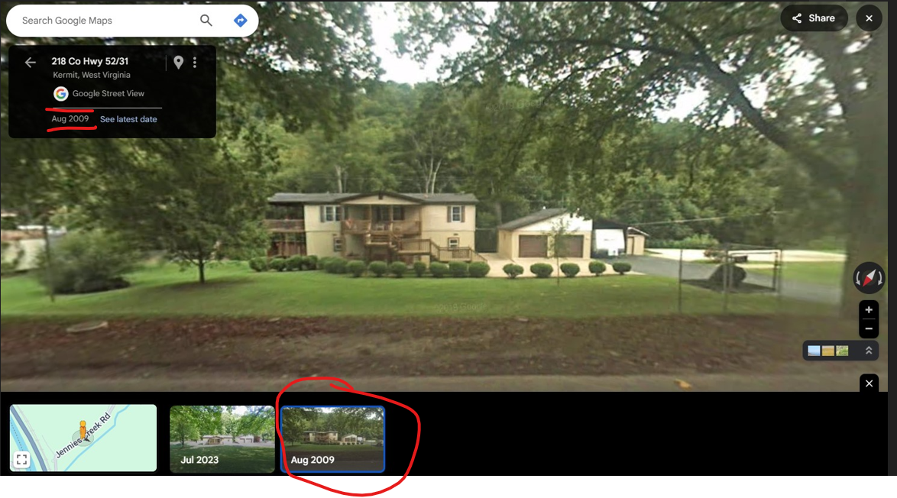
USACE TRACTS 524FP & 528FP (Parcel 50-08-0040-0039-0000)
248 JENNIES CREEK RD, KERMIT, WV, 25674
2009 Google Street View
2009 Picture of Building 524FP (2 Stories)
2009 Picture of Building 528FP Slab
(Structure Removed)
2023 Picture of Bldg. 524FP (1 Story)

Slide 8
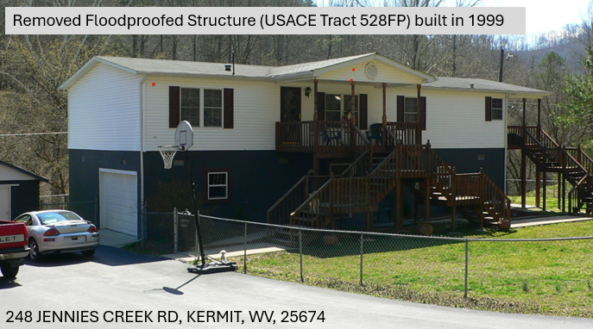
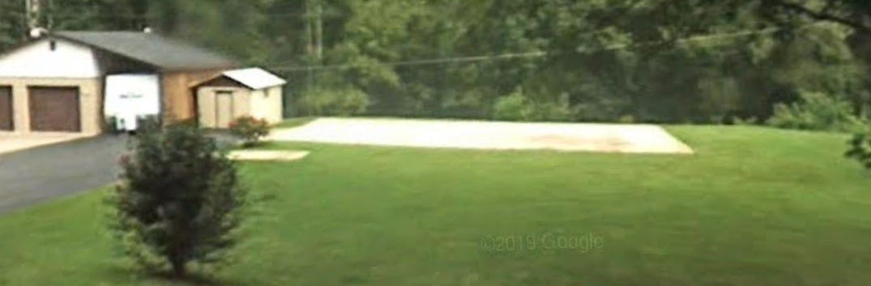
USACE TRACTS 524FP & 528FP (Parcel 50-08-0040-0039-0000)
248 JENNIES CREEK RD, KERMIT, WV, 25674
1999 USACE Floodproofed Bldg. (Tract 524FP)
1999 USACE Floodproofed Bldg. (Tract 528FP)
USACE 2006 Nonstructural O&M Manual (Page 69)
Structure Modified (2023 Google Street View)
Structure Removed (2009 Google Street View)
Building Pictures in O&M Manual (Pg. 71)
Structure 524FP Modified to One Story
Structure 528FP Removed

Slide 9
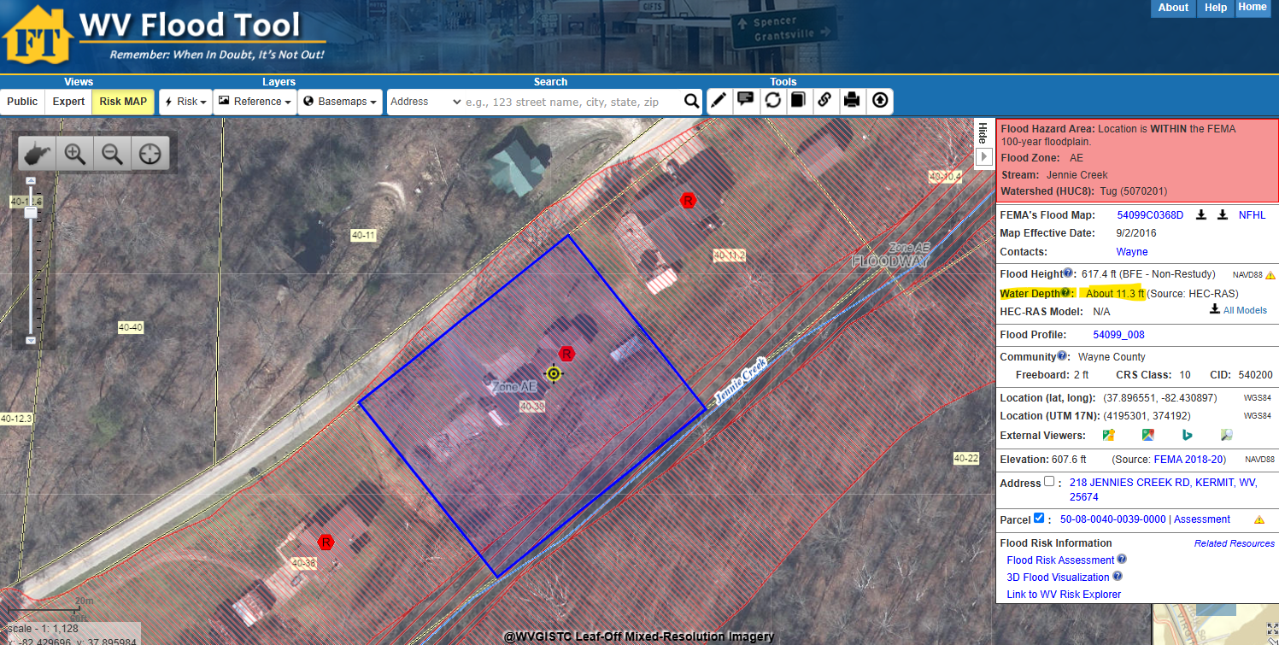
USACE TRACTS 524FP & 528FP (Parcel 50-08-0040-0039-0000)
248 JENNIES CREEK RD, KERMIT, WV, 25674
WV Flood Tool
USACE Tract 528FP Remaining slab of 1999 mitigated structure
2016 FEMA Effective Map reveals a 100-Yr Flood depth of 11.3 ft. for Structure 524FP
524FP
528FP
USACE Tract 524FP 1999 mitigated structure modified from two stories to one story

Slide 10
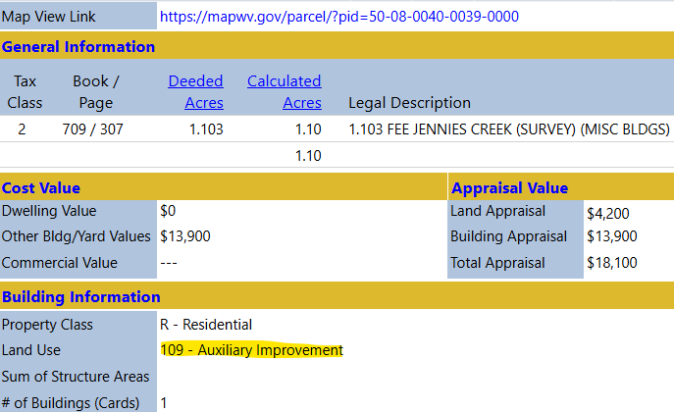
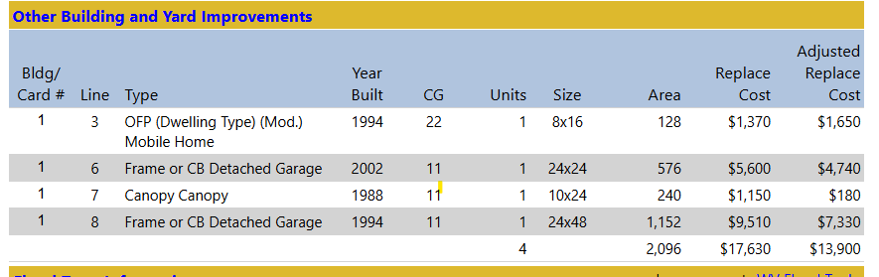
USACE TRACTS 524FP & 528FP (Parcel 50-08-0040-0039-0000)
Building 524FP
Assessment record lists land use as an Auxiliary Structure. Is this land use designation correct?

Slide 11
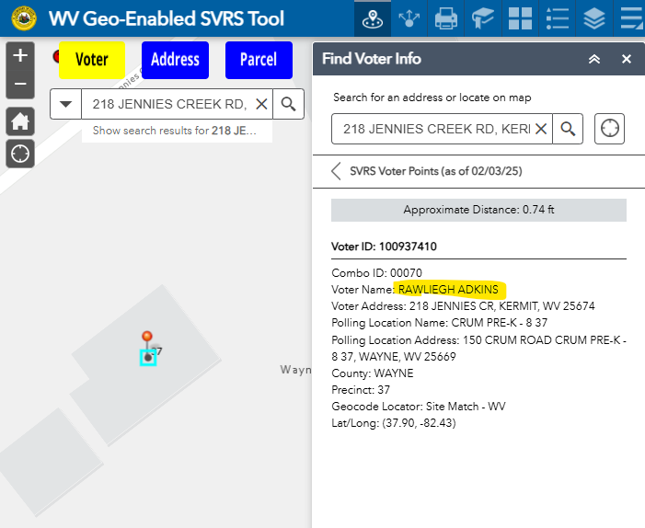
USACE TRACTS 524FP & 528FP (Parcel 50-08-0040-0039-0000)
Building 524FP
County Clerk voting records show a Rawleigh Adkins registered to vote at this address, indicating this is a habitable building.

Slide 12
Wayne County Section 202 Non-Structural Project
USACE TRACTS 524FP & 528FP are both located on Parcel 50-08-0040-0039-0000
248 JENNIES CREEK RD, KERMIT, WV, 25674
<< Property Parcel Timeline >>
USACE Guidelines for inspections of Section 202 Non-Structural Project were set forth in the Project Cooperation Agreement (PCA) signed April 1998 and the O&M manual dated March 2006 established for annual reporting.
USACE 2006 Nonstructural O&M Manual dated March 2006
Project Cooperation Agreement (PCA) dated April 13, 1998
Recorded Floodproofing Agreement dated December 21,1999, Deed Book 31, Page 265. Elevation certificate attached to agreement.
Floodproofing work turned over to County Commission. Letter dated July 12, 2000.
Property transferred on September 18, 2015, between Curtis Marcum and James/Maxine Dingess but no Floodproofing Agreement attached to the deed.

