Slide 1
Statewide Hazard Assessment
Landslide Risk Assessment
Maneesh Sharma and Kurt Donaldson
West Virginia GIS Technical Center
West Virginia University
Morgantown, WV 26505
Maneesh.Sharma@mail.wvu.edu
Kurt.Donaldson@mail.wvu.edu

Slide 2
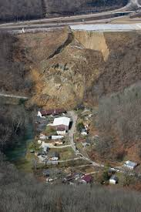
Landslide Risk Assessment
Goals
Develop landslide inventory
Create valid landslide models for specific WV regions
Generate county-level resolution landslide maps
Create an interactive web map application for displaying landslide models and variables
Use the new landslide models and information to update the State Hazard Mitigation Plan
Did you know?
Landslides are the #2 Hazard in West Virginia
2015 Yeager Airport Slide

Slide 3
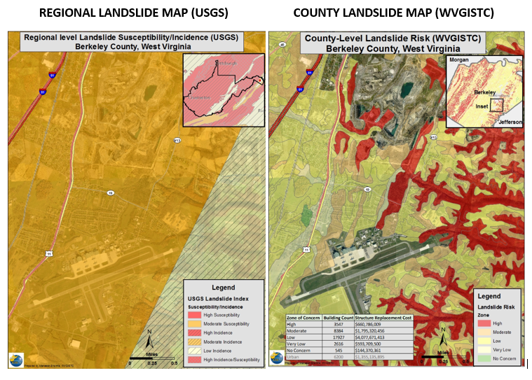
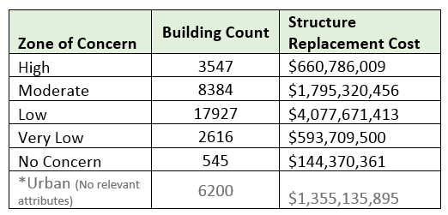
Landslide Maps – Old versus New
Old Way - Very Generalized
New Way – More Detailed
Landslide
Risks
Buildings Exposed to Landslide Risks
Risk Assessment table showing building counts along with estimated replacement costs in landslide zones of concern
Landslide susceptibility map showing generalized USGS map and more detailed prototype map

Slide 4
Landslide Study Limitations
Limitations
This study is suitable for overview planning-level and general emergency services planning
The risk analysis for roads should be used in conjunction with site-specific risk analysis performed by WV Department of Transportation
This study has NOT been done for, and may not be suitable for legal, design, engineering, or site-preparation purposes.
This study can NOT substitute for site-specific investigations by qualified practitioners. Landslide risk is complex and continually changing. Although other existing studies may provide more precise and comprehensive information, detailed original site investigations are normally an essential best practice for public safety, sustainability, and financial viability.

Slide 5
Landslide Incident Inventory
Key Takeaways
159,247 landslide features inventoried
66,151 landslide initiation points mapped using high resolution (1- or 2-m) LiDAR.
46,330 landslide polygons digitized based on WV Geological and Economic Survey 1976 study.
41,307 landslide polygons digitized based on a USGS 1975-1985 study.
Most common landslide - Slides and slumps
Future work - Landslide mapping in areas where LiDAR coverage was incomplete; LiDAR for these areas delivered by FEMA in December 2021.

Slide 6
Landslide Incident Inventory
# | Agency | Year | Author or Source Agency | Title/Description | General Location | Purpose | Total Incidence Data
1 | WVGES | 1973 | Landers and Smosna | Final Report on Landslides of July 9, 1973 in Kanawha City Area of Charleston, West Virginia | Charleston, West Virginia | Landslide mapping | 10
2 | WVGES | 1976-80 | Lessing et al. | WV Landslides and Slide-Prone Areas; funded by Appalachian Regional Commission | Statewide (39 topo quads) | Landslide mapping | 46,330
3 | USGS | 1978-85 | USGS (various) | Landslide Quad Maps: Open File Maps | Statewide (382 topo quads) | Landslide mapping | 41,307
4 | USGS | 1993 | Jacobson et al | U.S. Geological Survey Bulletin 1981: Geomorphic studies of the storm and flood of November 3-5, 1985, in the upper Potomac and Cheat River basins in West Virginia and Virginia | Cheat and Potomac River basins; Wills Mountain Anticline; Eastern WV | Research study (1985) | 3,571
5 | WVU | 1983-97 | WVU | Landslide incidences with Images | Statewide | Instruction & landslide inventory | 46
6 | WVU | 1996 | Kite and Grubb | Update of 1976 Landslide Maps, Morgantown North and South Quadrangles | Morgantown, West Virginia | Landslide inventory | 41
7 | WVU | 2008 | Konsoer et al | LiDAR, GIS, and multivariate statistical analysis to assess landslide risk, Horseshoe Run watershed, West Virginia | Horseshoe Run Watershed, Tucker County | Surficial Geology Mapping | 149
8 | NPS/WVGES | 2014 | Yates and Kite | Unpublished Digital Surficial Geologic Map of Bluestone National Scenic River and Vicinity, West Virginia (NPS, GRD, GRI, BLUE, BLUS digital map) adapted from a West Virginia University and West Virginia Geological and Economic Survey Open File Map by Yates and Kite (2014) | Bluestone National Scenic River and Vicinity | Surficial Geology Mapping | 12
9 | NPS/WVGES | 2015 | Yates and Kite | Digital Surficial Geologic Map of New River Gorge National River, West Virginia (NPS, GRD, GRI, NERI, NERS digital map) adapted from a West Virginia University and West Virginia Geological and Economic Survey Open File Report map by Yates and Kite (and Gooding) (2015) | New River Gorge National River | Surficial Geology Mapping | 212
10 | WVDOT | 2016 | Geospatial Transportation Information (GTI) Section | Road landslide inventory | Statewide | Landslide inventory | 1,406
11 | WVDHSEM | 2017 | State Hazard Mitigation Office | FEMA Buyout Properties for Landslides | Southern West Virginia | Landslide mitigation | 12
12 | WVU | 2022 | WVGISTC | Statewide Landslide Risk Assessment; Funded by FEMA and WV Division of Homeland Security and Emergency Management | Statewide | Landslide risk assessment | 66,151
159,247 landslide features

Slide 7
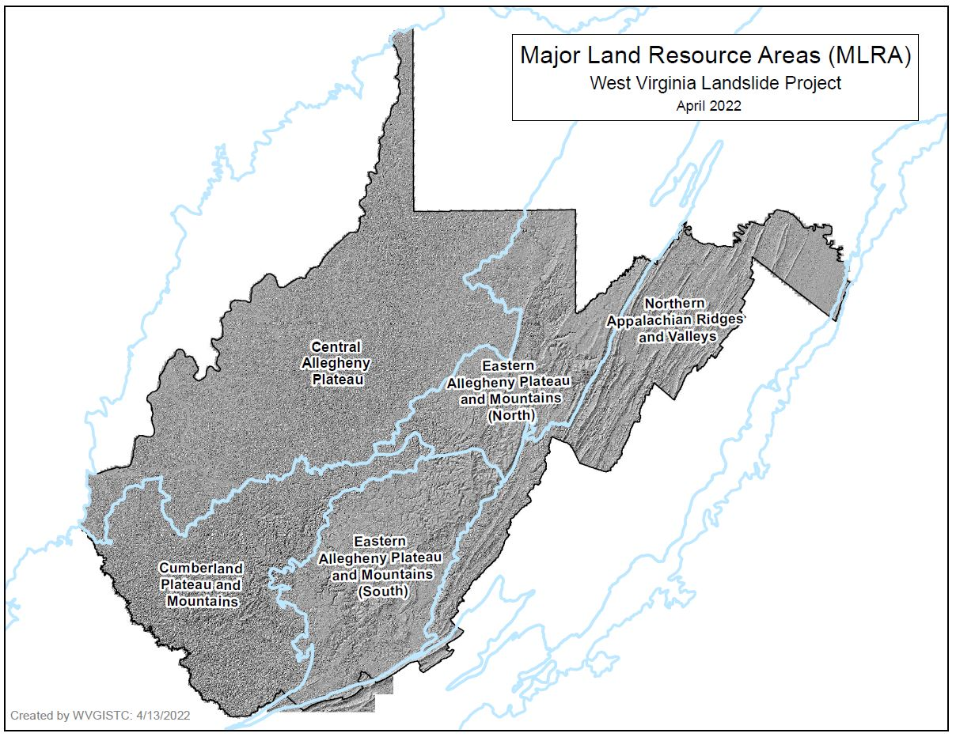
Landslide Incident Inventory
Landslide mapping from new LiDAR-derived DEM
Identifying following types of landslides
Slide
Fall
Flow
Lateral Spread
Multiple Failures
Unknown
Statewide DEM and
MLRA Boundary

Slide 8
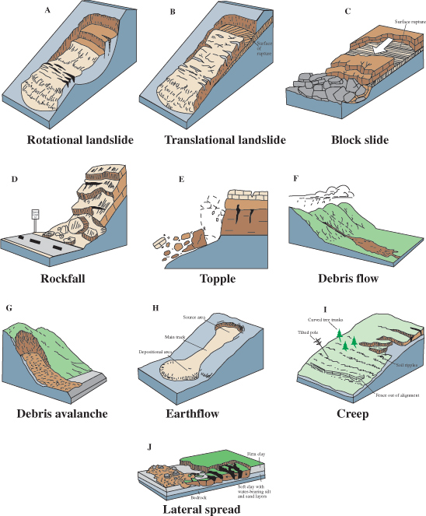
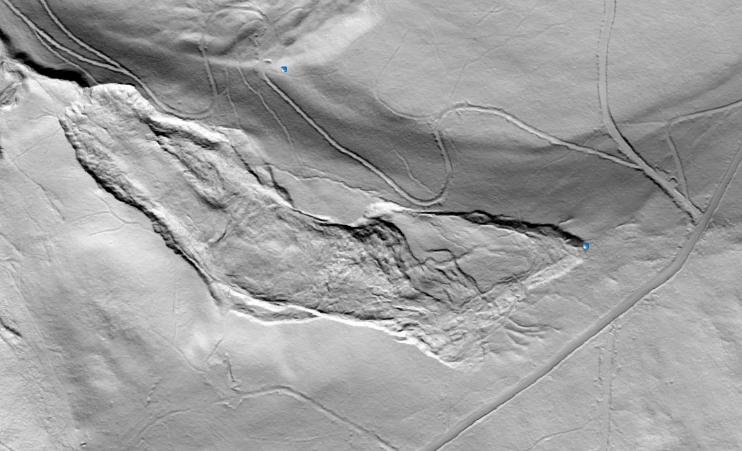
Landslide Incident Inventory
Slide (includes rotational and translational movement)*: mass movements, where there is a distinct zone of weakness that separates the slide material from more stable underlying material
Mineral County, WV
*Description from https://pubs.usgs.gov/fs/2004/3072/fs-2004-3072.html
Images from https://pubs.usgs.gov/fs/2004/3072/fs-2004-3072.html

Slide 9
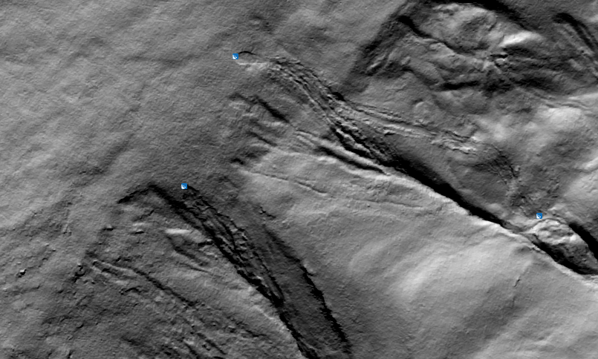
Landslide Incident Inventory
Debris Flow*: A form of rapid mass movement in which a combination of loose soil, rock, organic matter, air, and water mobilize as a slurry that flows downslope; they are often associated with steep gullies, and debris-flow deposits are usually indicated by the presence of debris fans at the mouths of gullies
Pendleton County, WV
*Description from https://pubs.usgs.gov/fs/2004/3072/fs-2004-3072.html
Images from https://pubs.usgs.gov/fs/2004/3072/fs-2004-3072.html

Slide 10
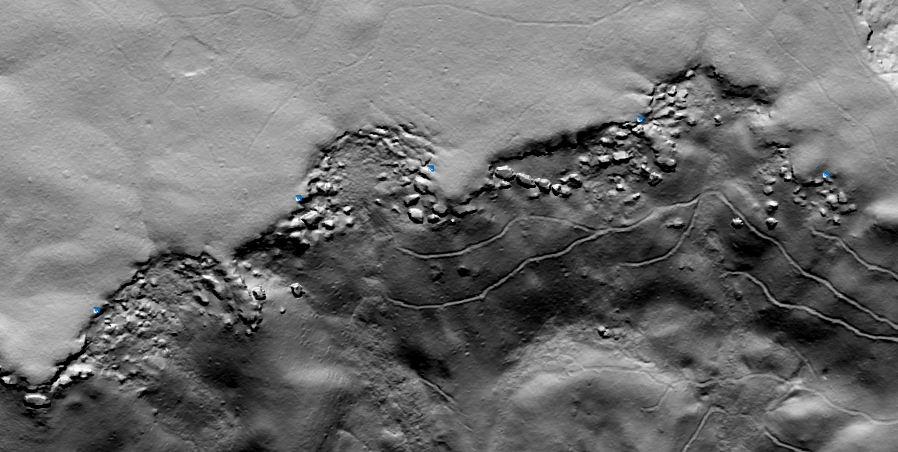
Landslide Incident Inventory
Lateral Spread*: When coherent material, either bedrock or soil, rests on materials that liquefy, the upper units may undergo fracturing and extension and may then subside, translate, rotate, disintegrate, or liquefy and flow; usually occur on very gentle slopes or flat terrain
Greenbrier County, WV
*Description from https://pubs.usgs.gov/fs/2004/3072/fs-2004-3072.html
Images from https://pubs.usgs.gov/fs/2004/3072/fs-2004-3072.html

Slide 11
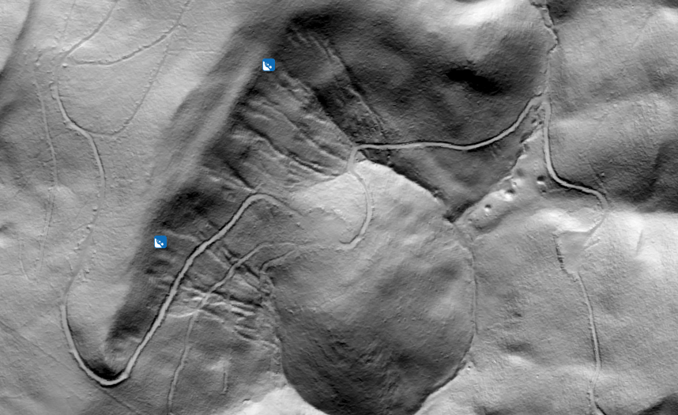
Landslide Incident Inventory
Multiple Failures: This classification is used when multiple (>4) failures, usually small debris flows, occur in a restricted area
Pendleton County, WV
*Description from https://pubs.usgs.gov/fs/2004/3072/fs-2004-3072.html
Images from https://pubs.usgs.gov/fs/2004/3072/fs-2004-3072.html

Slide 12
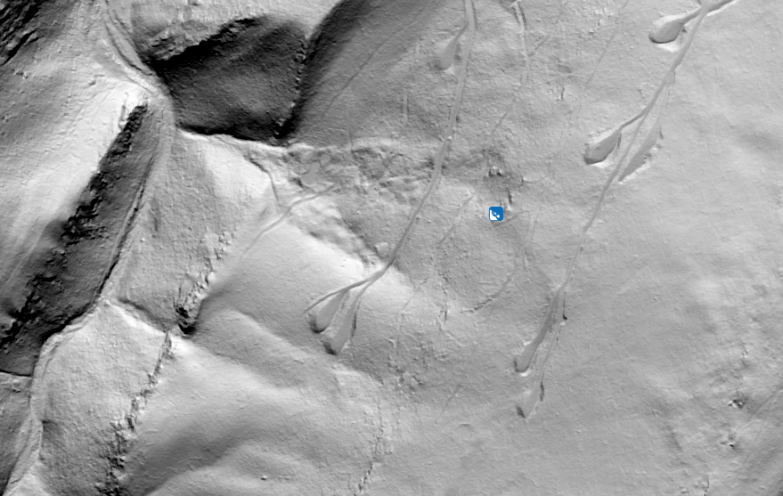
Landslide Incident Inventory
Fall*: Abrupt movements of masses of geologic materials, such as rocks and boulders, that become detached from steep slopes or cliffs
Undetermined: Some failure is present, but it is not possible to determine the type of movement
Pendleton County, WV
*Description from https://pubs.usgs.gov/fs/2004/3072/fs-2004-3072.html
Images from https://pubs.usgs.gov/fs/2004/3072/fs-2004-3072.html

Slide 13
Landslide Incident Inventory
Type of Movement | Number of user identified points | Percentage of user identified points | Description
Slide | 64,800 | 97.9 | A zone of weakness separates the slide from the underlying material; can be translational or rotational
Fall | 12 | .02 | Rocks or other geologic materials dislocate from steep slopes
Debris Flow | 882 | 1.3 | Fluid mobilizes material into a slurry that flows downslope; often associated with gullies or steep channels
Lateral Spread | 313 | 0.5 | Extension along very shallow or horizontal slopes which causes material to break into block-like shapes
Multiple Failures | 125 | 0.2 | Usually a combination of multiple small debris flows in a restricted location
Undetermined | 19 | 0.03 | Some failure is clearly present, but it is difficult to determine the type of movement

Slide 14
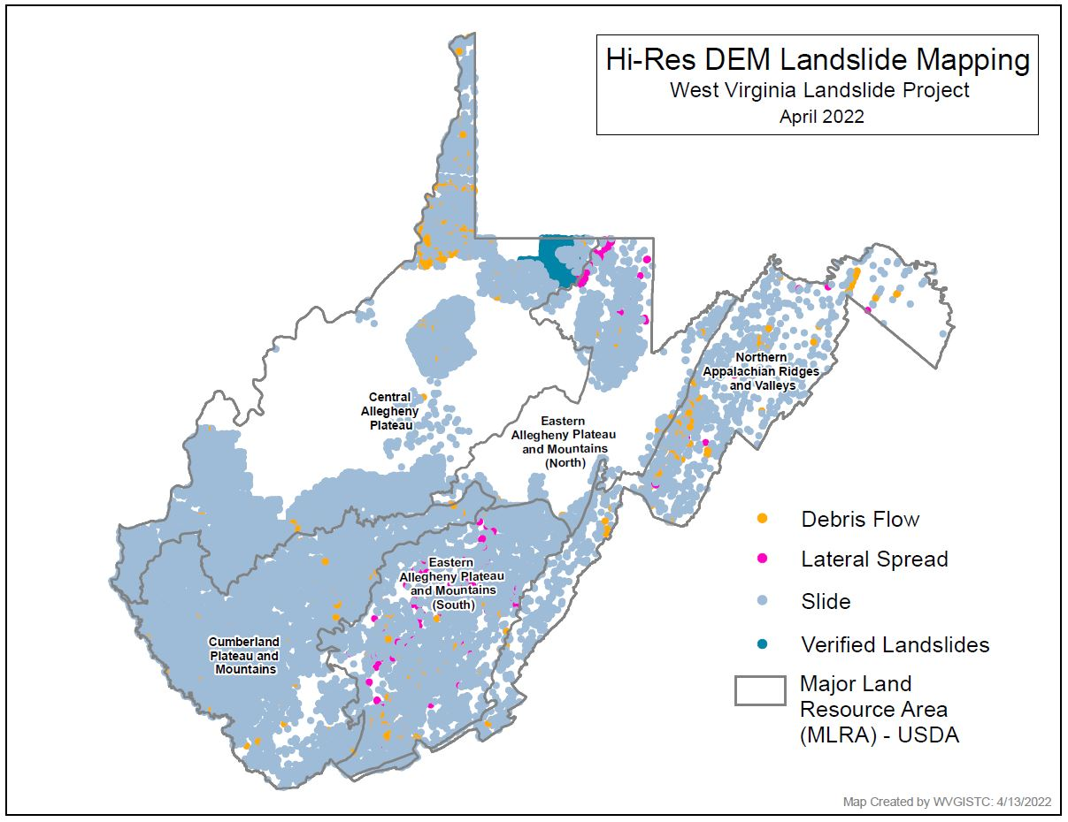
Landslide Incident Inventory
WV GIS TC
Landslide Mapping
2018-April 2022
WV GIS TC Mapping on LiDAR-Based DEMs
66,151 Failures (>10 m wide) Most from 1 m DEMs
882 Debris Flows
313 Lateral Spreads
64,800 Other Failures
>97 % “Slides” (or Slumps)
Few Rock Falls Identified
Mapped Landslides Verified on best available DEMs
1,082 WVGES (1976-80) Monongalia Co. Slides

Slide 15
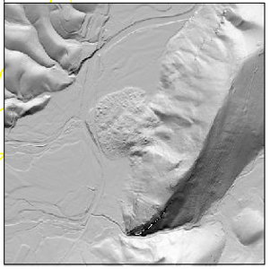
Mapping Landslides from new DEM
FEMA purchased statewide Quality Level 2 lidar for the entire State that will improve the mapping of existing landslides. Lidar-derived products include 1-meter DEM and 1-foot Contours
Great Valley
Kanawha Section
Blue Ridge
Ridge & Valley
Allegheny Mountains
Logan Plateau

Slide 16
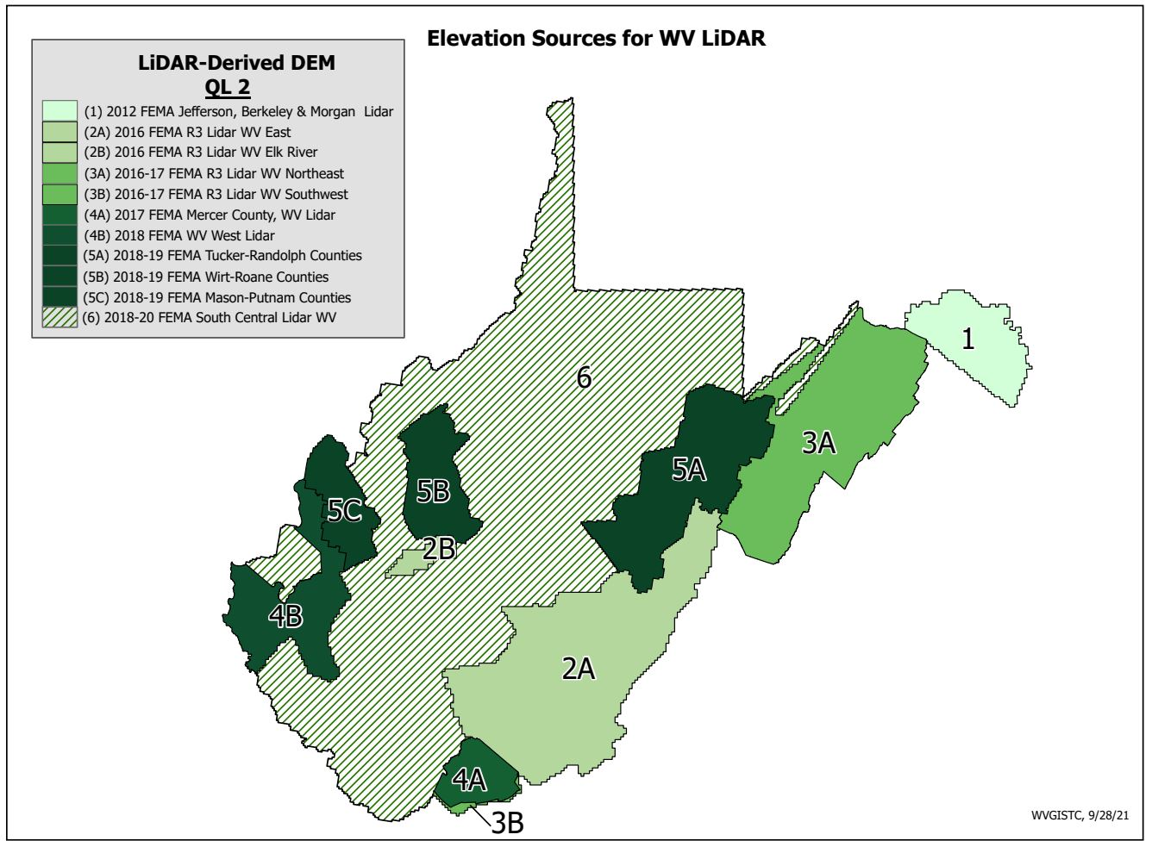
Mapping Landslides from new DEM
Best-Available Elevation Sources for West Virginia: https://www.mapwv.gov/flood/map/docs/WV_FloodTool_ElevationSource_Metadata.pdf

Slide 17
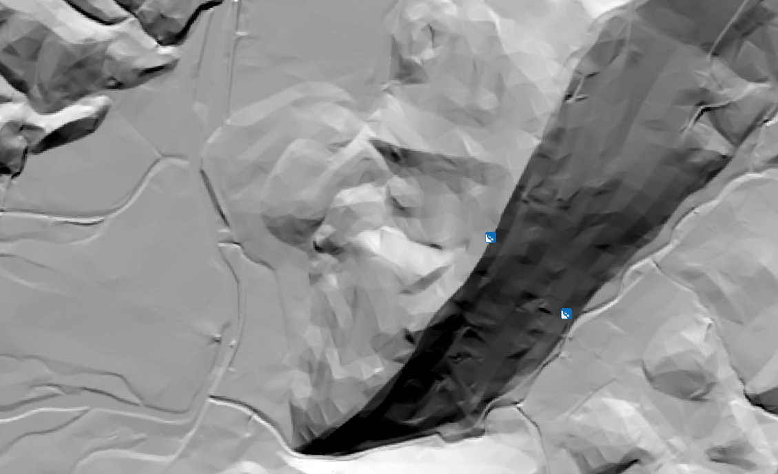
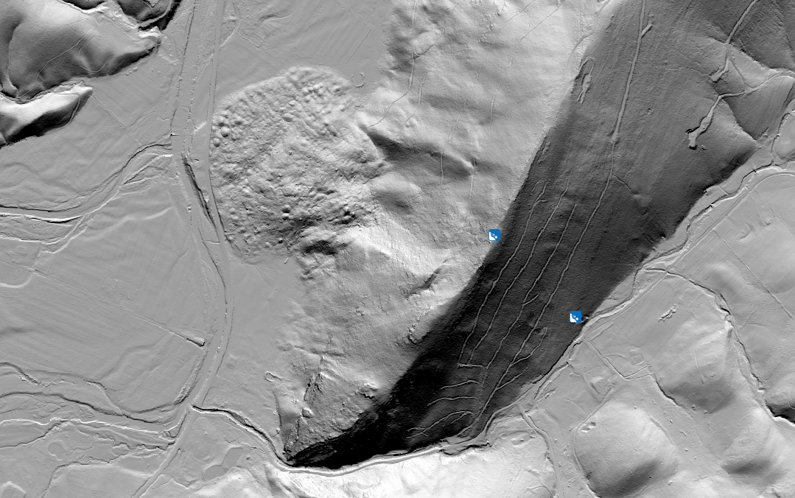
Old DEM
Mapping Landslides from new DEM
New DEM
Comparison of Old and New 1 meter DEM

Slide 18
Landslide Method Development
Key Takeaways
Landslide susceptibility modeling
Performed using machine learning
Random forest method most efficient
Performed for various MLRA’s to minimize heterogeneity in physiographic conditions that may influence landslide susceptibility
Main Landslide contributing factor- Slope, soil type, and geology
Steeper slopes, unconsolidated soils, and less resistant rock units like shale and siltstone will increase landslide susceptibility.
Anthropogenic disturbance contributes heavily to landslide risk
Future work - Rerun models after new LiDAR-based landslide mapping is complete.

Slide 19
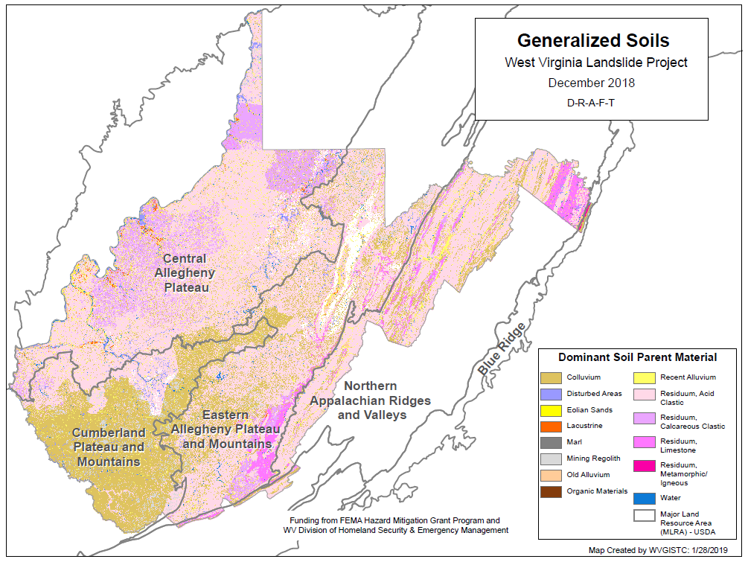
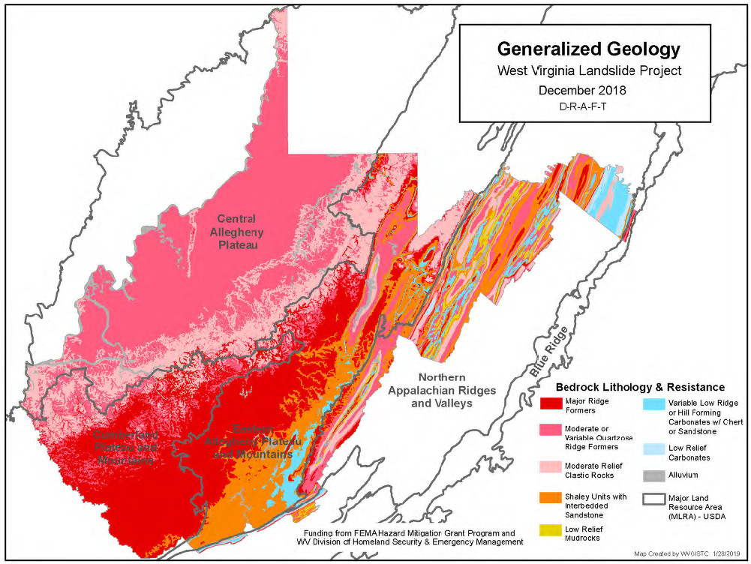
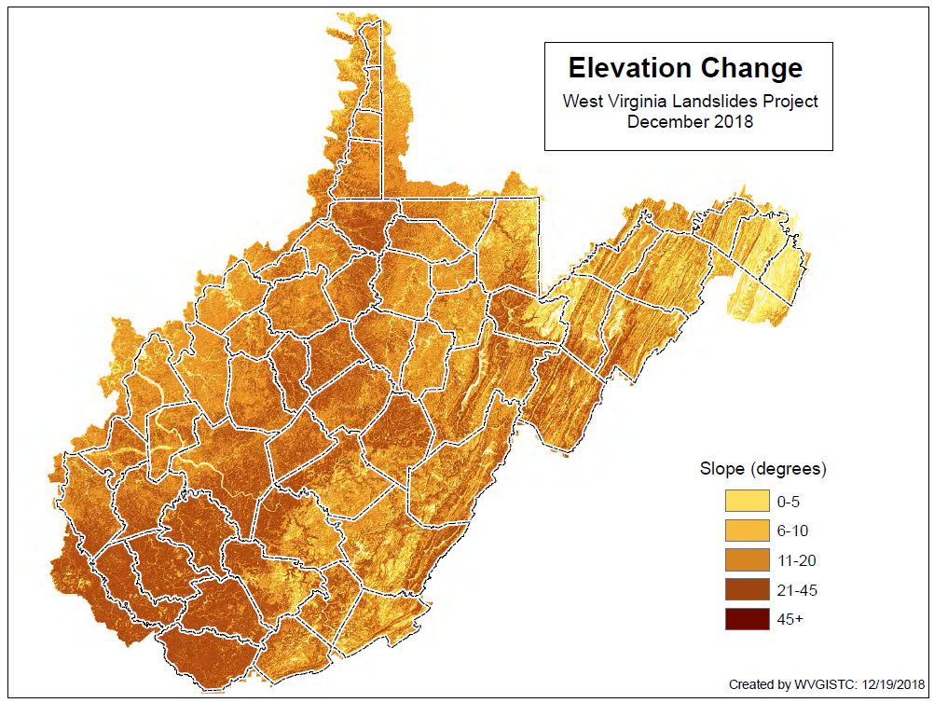
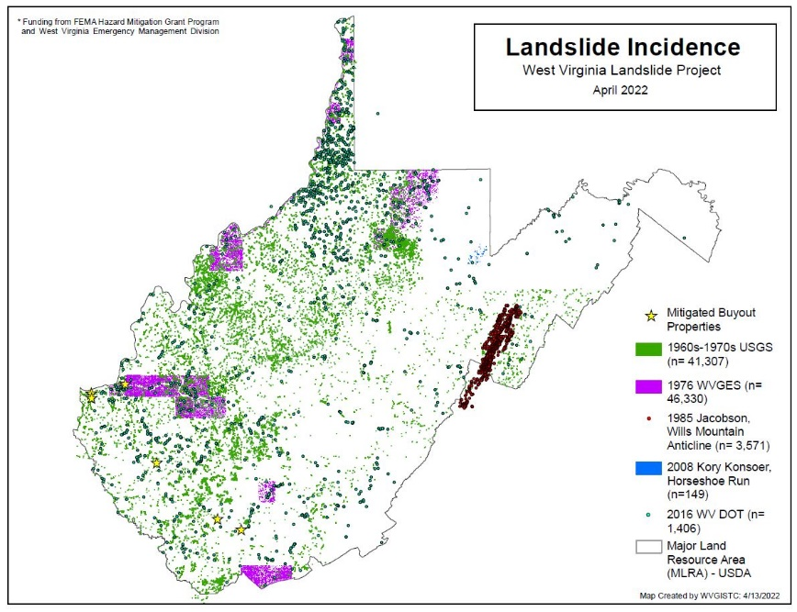
Landslide Method Development
The West Virginia University Study Team includes Dr. Steve Kite (Geomorphologist), Dr. James Thompson (Soil Scientist), Dr. Aaron Maxwell (Geologist/Modeler), and Dr. Maneesh Sharma (Geologist/GIS)

Slide 20
Landslide Method Development
West Virginia
Physiography
& NRCS MLRAs
Existing Physiographic Maps Inadequate for WV Landslide Project
MLRA Boundaries Better
Provinces & Subdivisions Appalachian Plateaus
Kanawha Section
Logan Plateau
Allegheny Mountains
Valley & Ridge
Ridge & Valley
Great Valley
Blue Ridge
Red = Landslide-Prone
Great Valley
Kanawha Section
Blue Ridge
Ridge & Valley
Allegheny Mountains
Logan Plateau

Slide 21
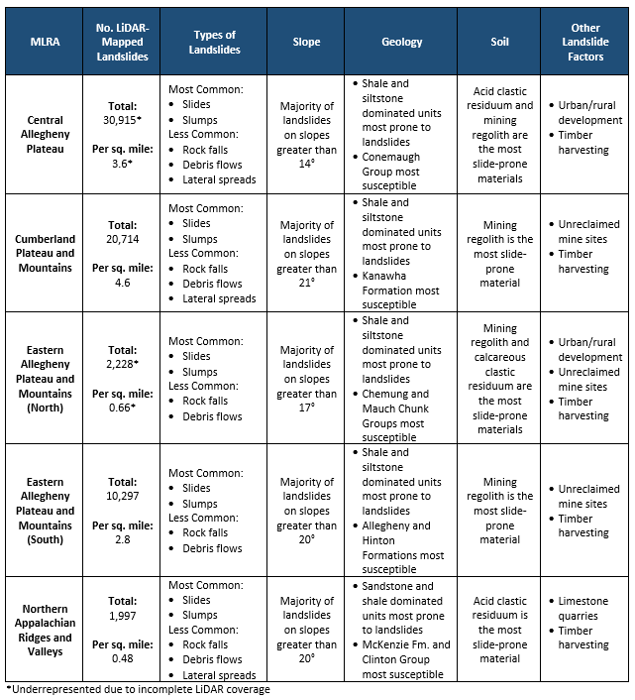
Landslide Method Development
Summary of MLRA Landslide Characteristics

Slide 22
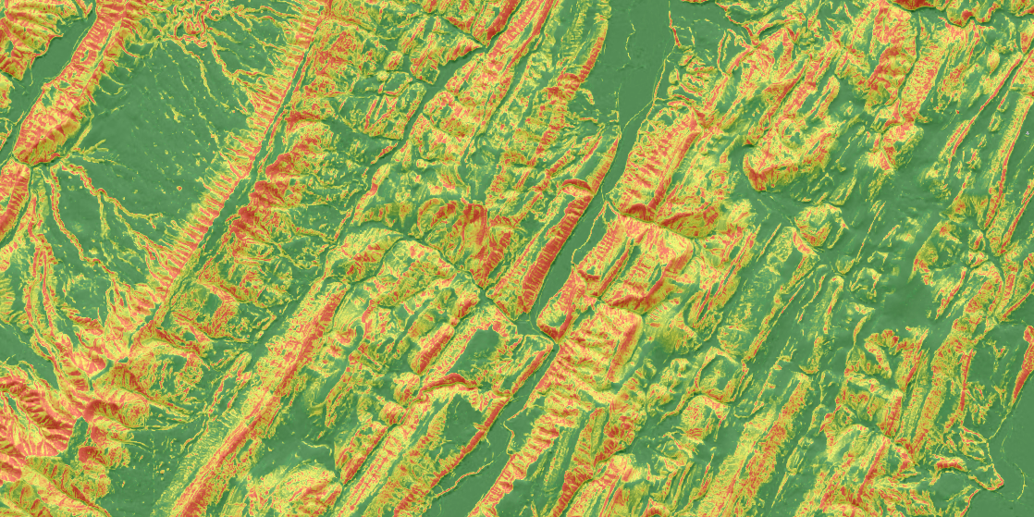
Landslide Method Development
Goal: Generate predictive models of slope failure probability/occurrence

Slide 23
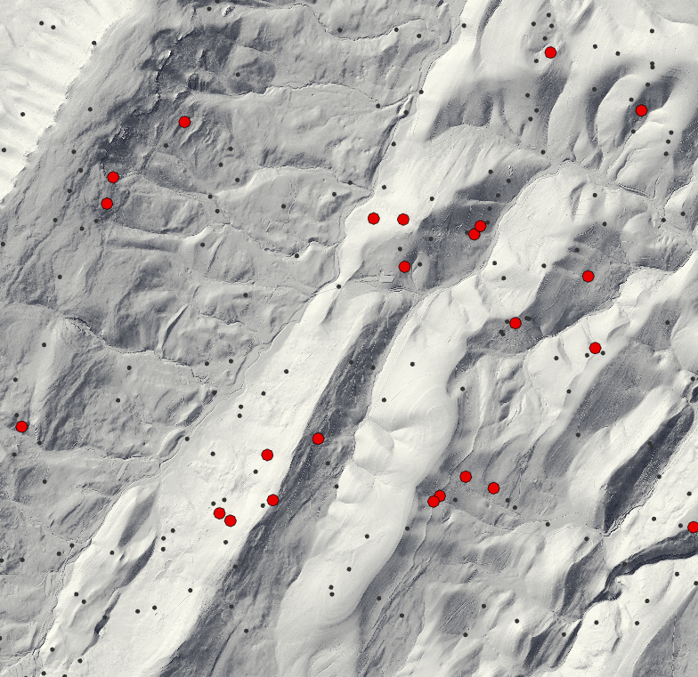

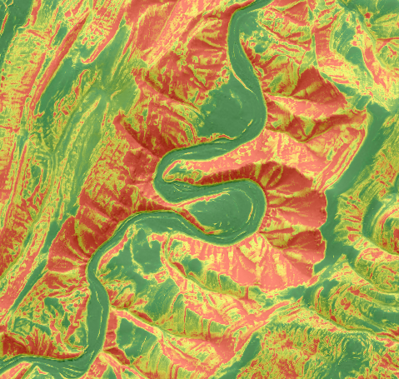
Machine Learning = Learning from Examples
Landslide Method Development
Thing you want to predict
Machine learning algorithm
Trained Model
Things you know that might help you predict the new thing
New things to predict
Predictions

Slide 24
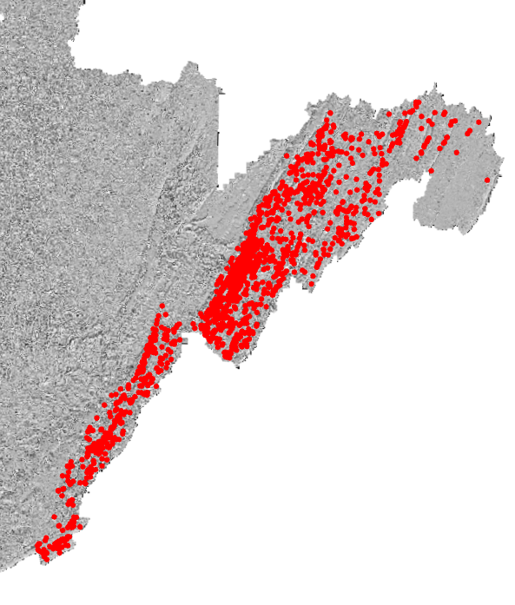
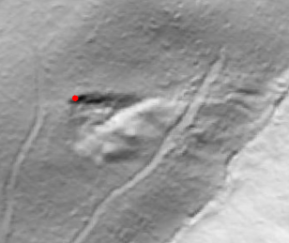
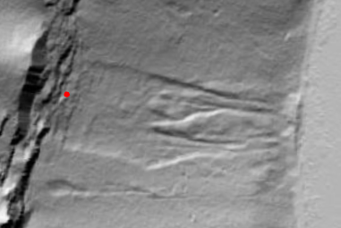
Training the Model
Landslide Method Development
Based on visual interpretation of terrain data

Slide 25
Modeling Methods: Predictor Variables
Landslide Method Development
Terrain Derivatives:
Topographic Slope
Mean Slope
Topographic Roughness
Slope Position
Topographic Dissection
Heat Load Index
Aspect Linear Transformation
Surface Area Ratio
Surface Relief Ratio
Site Exposure Index
Longitudinal Curvature
Cross Sectional Curvature
Profile Curvature
Plan Curvature

Slide 26
Modeling Methods: Predictor Variables
Landslide Method Development
Non-Terrain:
Roads
Distance from US Roads
Distance from State Roads
Distance from Local Roads
Cost Distance from US Roads
Cost Distance from State Roads
Cost Distance from Local Roads
Hydrology
Distance from Streams
Cost Distance from Streams
Geology
Geologic Rock Type (Categorical)
Modified Geologic Rock Type (Categorical)
Soils
DPSM (Categorical)
Drainage Class (Categorical)

Slide 27
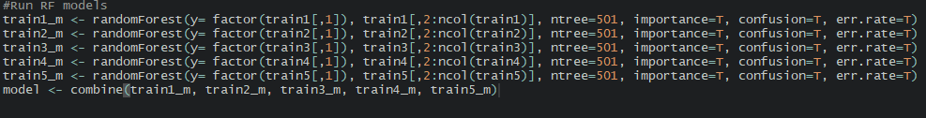
Modeling Method
Landslide Method Development
Random Forest
Provide predictor variables
Provide presence and absence data

Slide 28
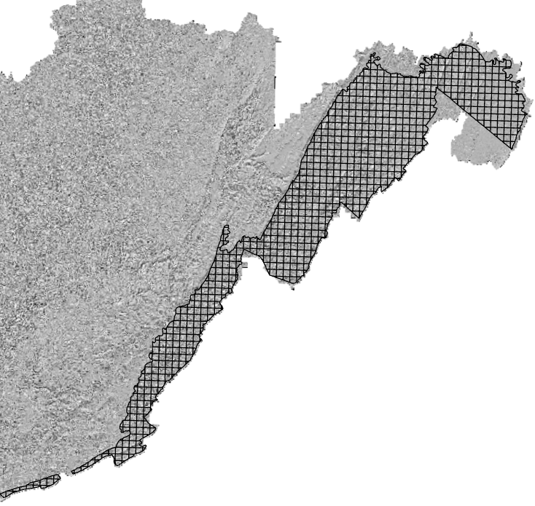
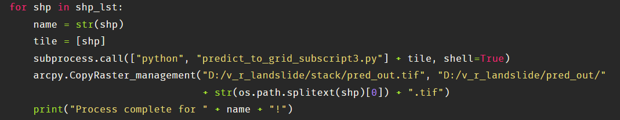
Predict to Entire Extent
Landslide Method Development
Tile-by-tile
Python scripts
~1 week to process

Slide 29
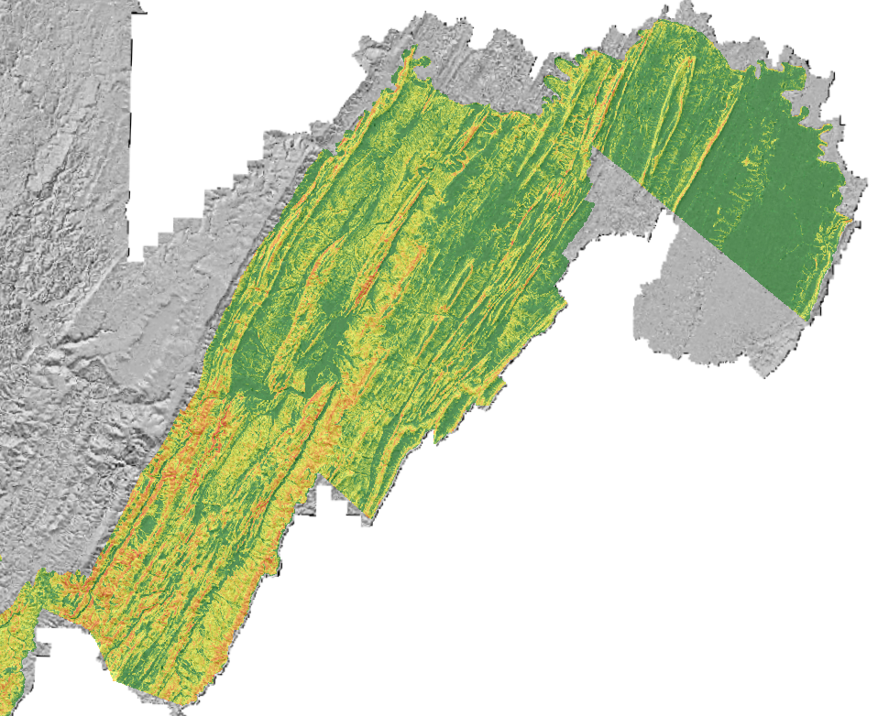
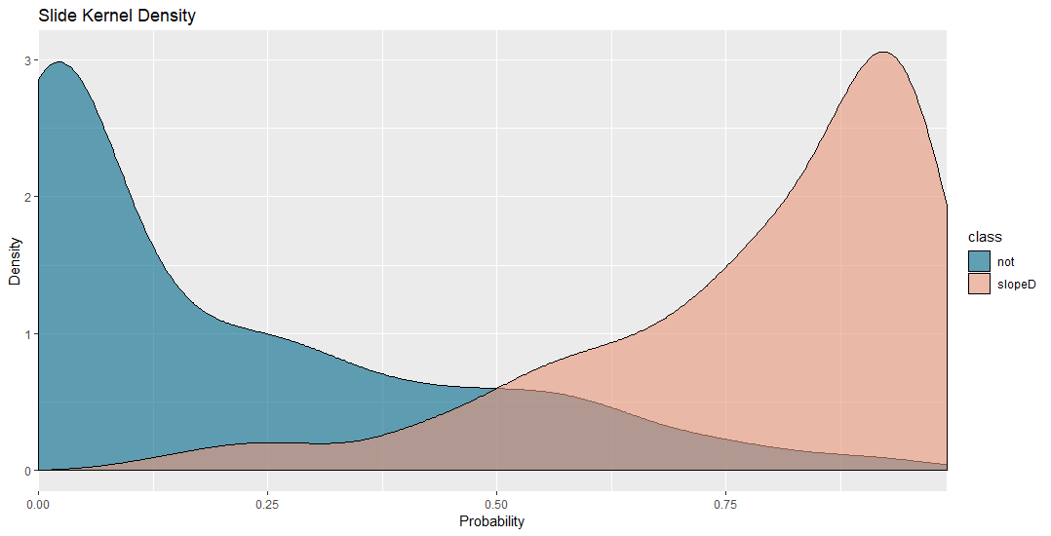
Results
Landslide Method Development
AUC – 0.94
Notes:
The area under the curve (AUC) that relates the hit rate to the false alarm rate has become a standard measure in tests of predictive modeling accuracy. The AUC is an estimate of the probability that a classifier will rank a randomly chosen positive instance higher than a randomly chosen negative instance.

Slide 30
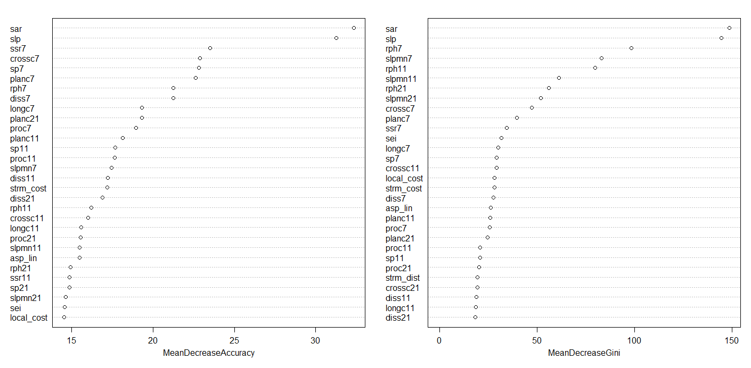
Important Variables
Landslide Method Development
Surface Area Ratio
Slope
Surface Relief Ratio
Slope Position
Curvature
Topographic Roughness
Topographic Dissection

Slide 31
Landslide Method Development
Semi-automated with scripting
Developed models for different physiographic regions
Predicted entire state

Slide 32
Landslide Risk Assessment Results
Key Takeaways
Risk assessment performed at sub-county scale
53% area in high/medium susceptibility
11% roads in high/medium risk*
Structures- majority located in high medium landslide susceptibility area are Residential
Kanawha and Monongalia counties rank 1st or 2nd
Harrison and Ohio counties rank 1st and 2nd for Commercial asset values
Essential Facilities – 14 located in high/medium susceptibility area
Relative risk to humans and related infrastructure is highest in Region 6, which ranks either 1st or 2nd in all five road and structure risk analysis categories

Slide 33
Landslide Risk Assessment Results
Key Takeaways
State Summary
At-Risk State Total
Total Road Miles in High/Medium risk Areas | Number of Structure/Parcel in High/Medium Risk Areas | Total Replacement Costs for Structures in High/Medium Risk Areas* | Number of Essential Facilities in High/Medium Risk Areas | Total Replacement cost for Critical Infrastructure in High/Medium Risk Areas | Total Land Area in High/Medium Risk (Acres)
4,346 | 29,618 | $1,979,392,672 | 14 | $241,432,300 | 8,261,236
State Total
Total Road Miles in State | Total Number of Structure/Parcel in State | Total Cost of Strucutre in State | Total Number of Essential Facilities in the State | Total Replacement Cost for Critical Infrastructure* | Total area in the State (Acres)
39,287 | 800,758 | $85,823,642,303 | 1930 | $6,694,090,205 | 15,499,505
Percentage at Risk
Percent Road Miles in High/Medium risk Areas | Percent Structure/Parcel in High/Medium Risk Areas | Percent Replacement Cost for Structures in High/Medium Risk Areas* | Percent Essential Facilities in High/Medium Risk Areas | Percent Replacement cost for Critical Infrastructure in High/Medium Risk Areas* | Percent of Land Area in High/Medium Risk
11% | 4% | 2% | 1% | 4% | 53%

Slide 34
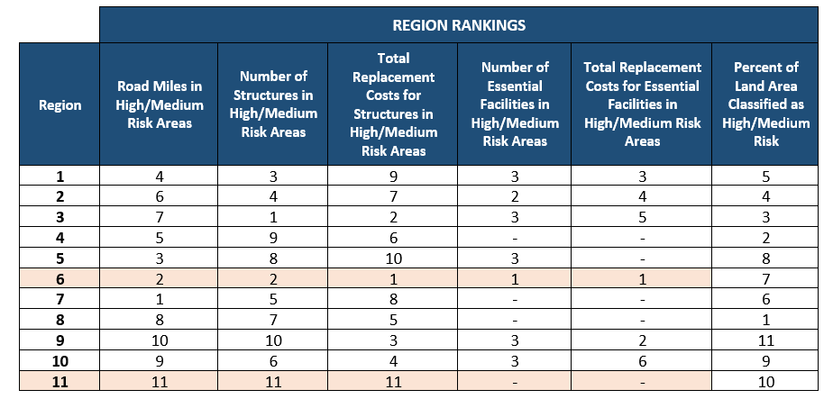
Landslide Risk Assessment Results
Key Takeaways

Slide 35
Landslide Risk Assessment Results
Road risk analysis
Risk assessment performed using DOT data
For Interstates, US Roads, State, and Other roads (county roads, N/A, state parks, and forests road, FANS, HARP, and Others)
Municipal non-state roads, railroads, and trail features not included
Roads were analyzed at two scales
An overview level on all roads without any distinction between road types to get the total risk to roads
Result used to rank Regions based on the total length of susceptible road segments.
The second set of analyses contains susceptibility details relating to different types of roads

Slide 36
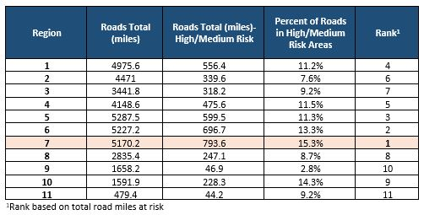
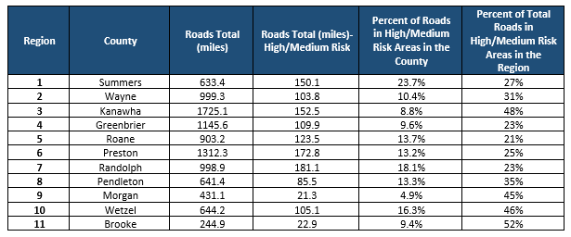
Landslide Risk Assessment Results
Road length susceptible to High/Medium Landslide Risk
Road length susceptible to High/Medium Landslide Risk

Slide 37
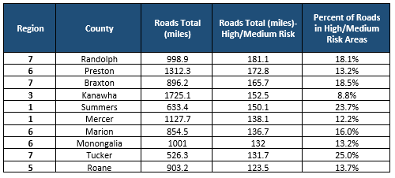
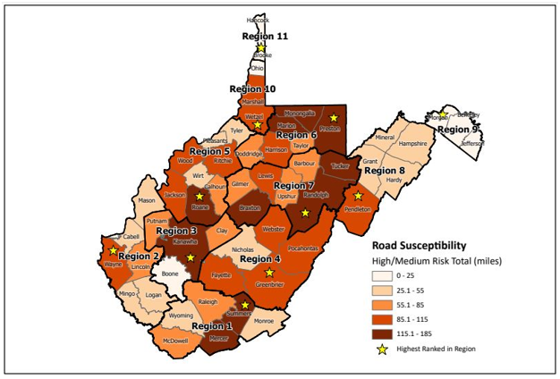
Landslide Risk Assessment Results
Top 10 counties statewide by road miles in High/Medium Susceptibility Areas
Total road miles in High/Medium Susceptibility Areas

Slide 38
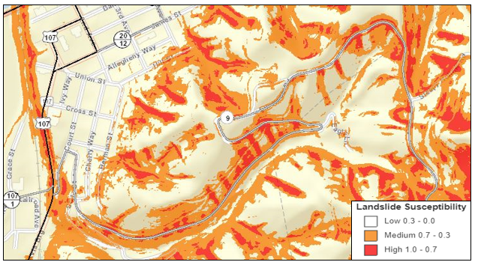
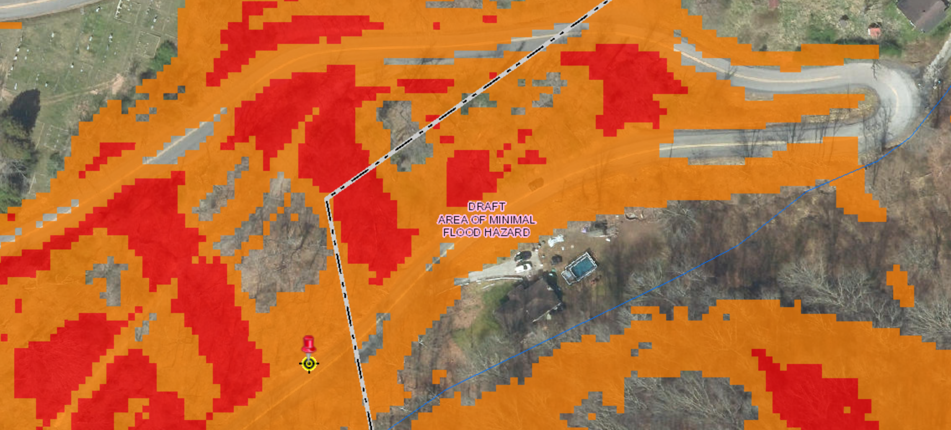
Landslide Risk Assessment Results
Landslide risk near Hinton, WV in Summers County
WV Flood Tool
WV Landslide Tool

Slide 39
Landslide Risk Assessment Results
Structure/Parcel Risk Analysis
Risk assessment performed on parcel level data
Primary structure point used within 1% annual chance floodplain
Parcel with site address points used outside floodplain
Limitations
Parcels containing no addressing points assigned a building value of zero ($0).
Building values for some structures are less than the values recorded
Appraisal values may be in neighboring parcels instead of the parcel where the structure is located. This results in building values not being assigned to site address points.
Some government and other property values do not get pulled in from the statewide assessment database, resulting in a lower value of at-risk structures.
This study is NOT intended for regulatory use and is NOT the final authoritative source of all landslide risk data in the community

Slide 40
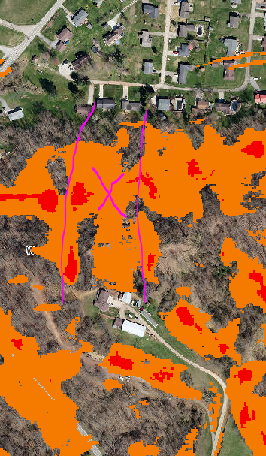
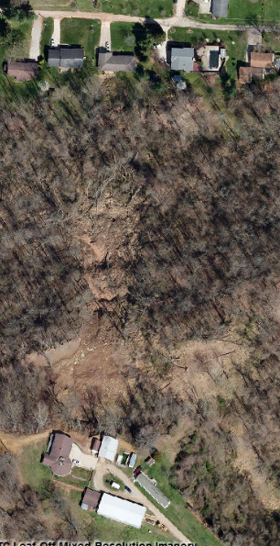
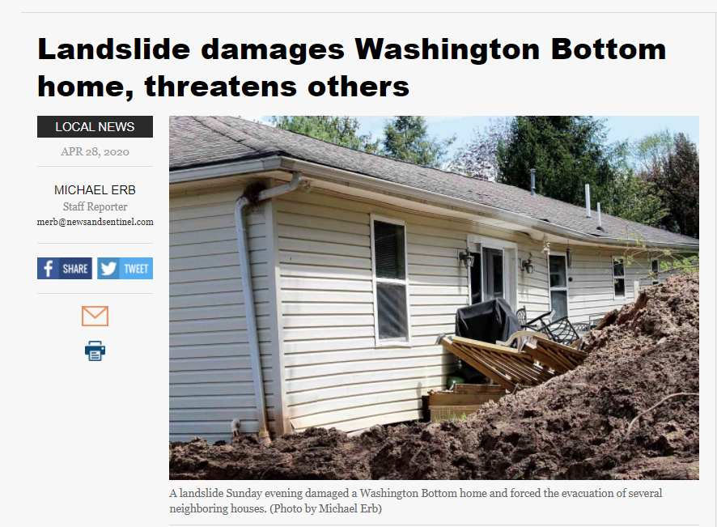
Landslide Risk Assessment Results
WV Flood Tool
WV Landslide Tool
Impacted Home
Higher Risk
Landslide Susceptibility Zone
April 2020 Landslide
Wood County Impacted home moved from foundation
Landslide Susceptibility
Spring 2020 Aerial Imagery

Slide 41
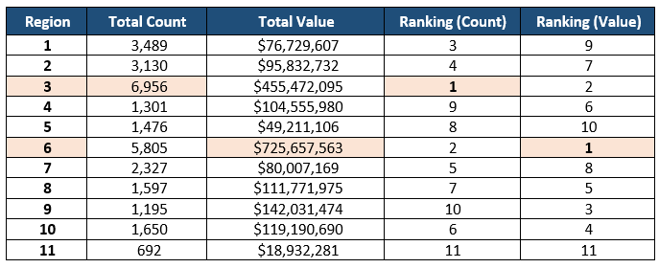
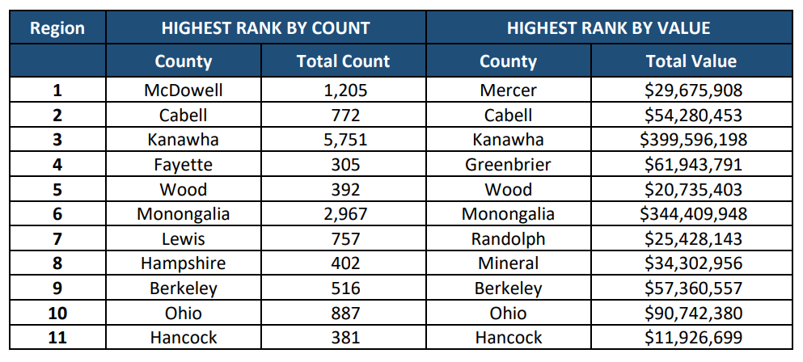
Landslide Risk Assessment Results
Structures with High/Medium Risk Landslide Susceptibility
Highest ranked county in each Region by structure count & by value

Slide 42
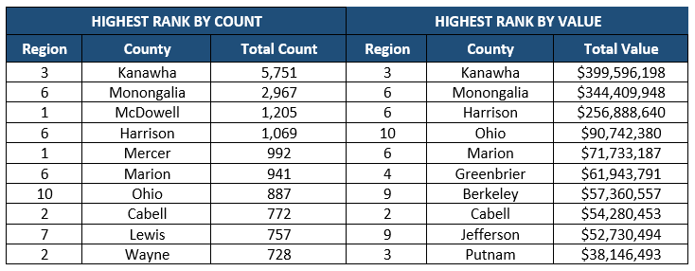
Landslide Risk Assessment Results
Top 10 counties statewide by structure count & by value

Slide 43
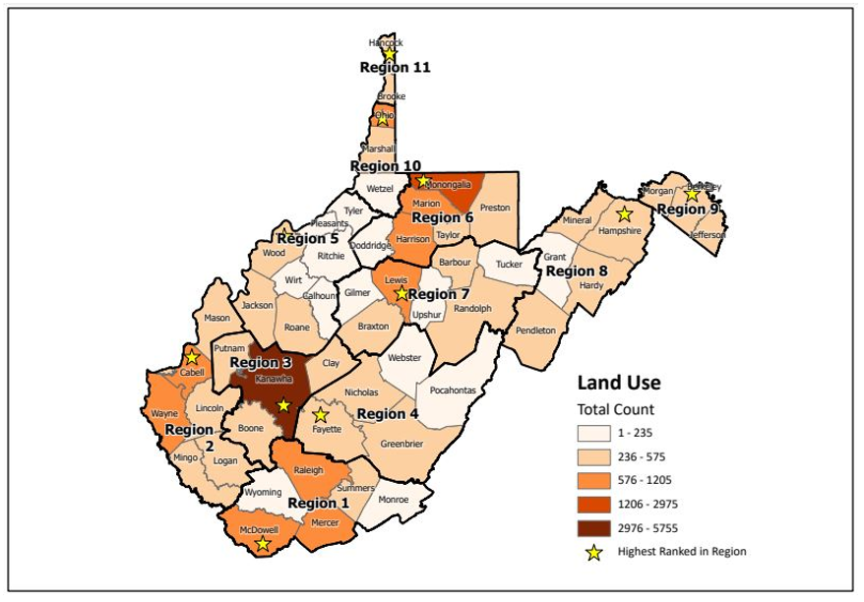
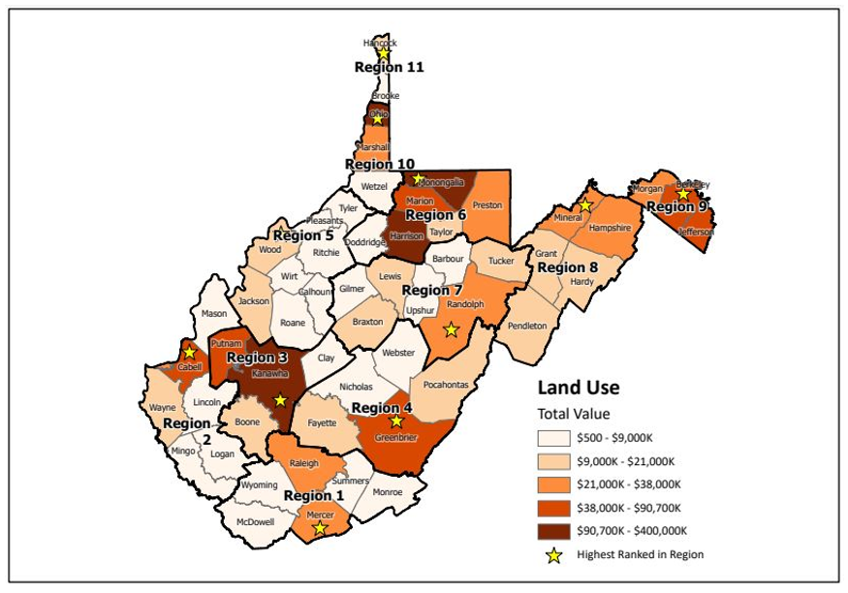
Landslide Risk Assessment Results
Number of structures in High/Medium Susceptibility Areas
Total Value of structures in High/Medium Susceptibility Areas

Slide 44
Landslide Risk Assessment Results
Essential Facility Risk Analysis
Risk assessment performed on parcel level data
Facilities included in this analysis include: police departments, fire departments, 911 centers, nursing homes, hospitals, and K-12 schools
Limitations
This study is not intended for site-specific analysis or remediation measures and is only suitable for planning-level analysis
Some government and other property values do not get pulled in from the statewide assessment database, resulting in a lower value of at-risk structures.
This study is NOT intended for regulatory use and is NOT the final authoritative source of all landslide risk data in the community

Slide 45
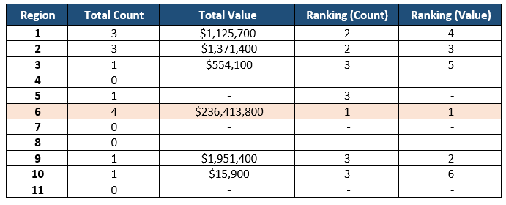
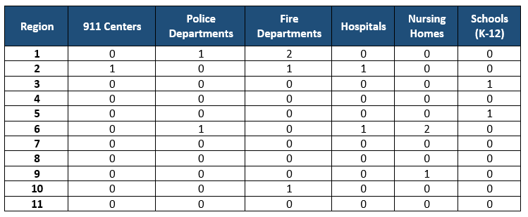
Landslide Risk Assessment Results
Essential facilities with High/Medium Risk Landslide Susceptibility
Types of essential facilities in High/Medium Risk Areas

Slide 46
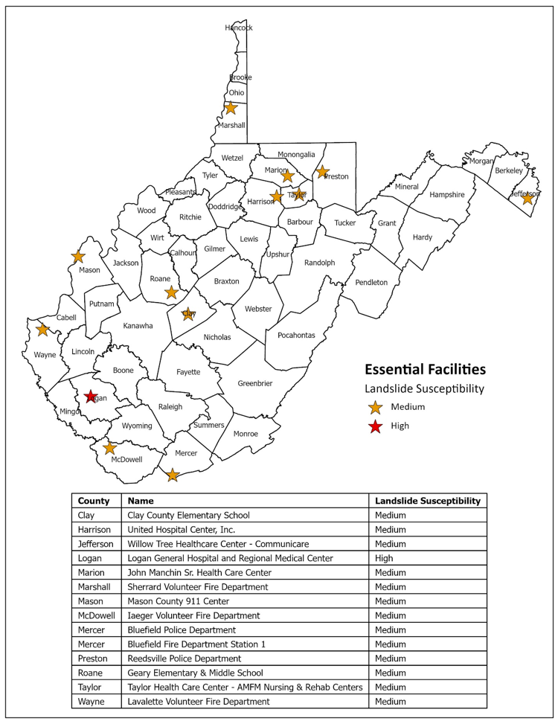
Landslide Risk Assessment Results
Essential facilities located in High/Medium Landslide Susceptibility Areas

Slide 47

Landslide Risk Assessment Results
Iaeger Volunteer Fire Department. McDowell County
WV Flood Tool
WV Landslide Tool

Slide 48

Landslide Risk Assessment Results
AMFM Nursing & Rehab Centers, Taylor County
WV Flood Tool
WV Landslide Tool

Slide 49
Landslide Risk Assessment Results
Total Area Risk Analysis
Total area risk analysis assesses the total area of land classified as high/medium risk of landslide susceptibility in West Virginia
Limitations
This study is not intended for site-specific analysis or remediation measures and is only suitable for planning-level analysis
This study is NOT intended for regulatory use and is NOT the final authoritative source of all landslide risk data in the community

Slide 50


Landslide Risk Assessment Results
Total area of land classified as High/Medium Landslide Susceptibility
Highest ranked county in each Region by percent of area classified as High/Medium Susceptibility

Slide 51


Landslide Risk Assessment Results
Top 10 counties statewide by percent of area in High/Medium Susceptibility Areas
Percent of total land area in High/Medium Susceptibility Areas

Slide 52

Susceptibility and Hazard Assessment
Landslide Susceptibility Prediction
Produced landslide susceptibility map by county
Calculate at risk properties for each county/region

Slide 53

Landslide Incident Inventory
www.mapWV.gov/Landslide
Over 100,000 landslide incident point and polygon features have been inventoried into a digital geodatabase

Slide 54


Landslide Incident Inventory
www.mapWV.gov/Landslide
Over 100,000 landslide incident point and polygon features have been inventories into a digital geodatabase

Slide 55


Landslide Incident Inventory
www.mapWV.gov/Landslide
According to Dr. Kite “Looks to be in the 5000-8000 square meter range in total. One of the biggest observed slides I know about in the state”. Feb 25, 2019

Slide 56


Landslide Outreach Material
StoryMaps
West Virginia Landslides and Slide-Prone Areas, WVGES 1976
https://arcg.is/1KDnvq
Causes of Landslides in Mountain State, West Virginia
https://arcg.is/1SW0Sn

Slide 57




Landslide Outreach Material
Brochures
About identifying signs of slope instability and mitigation measures that may help reduce landslide risk at the community level
About identifying signs of slope instability and mitigation measures that may help reduce landslide risk at the individual property level

Slide 58


Landslide Outreach Material
Regional Reports
Statewide Report

Slide 59
Landslide Risk Assessment
Goals
Develop a landslide inventory
Create valid landslide models for specific WV regions
Generate county-level resolution landslide maps
Create an interactive web map application for displaying landslide models and variables
Use the new landslide models and information to update the State Hazard Mitigation Plan
QUESTIONS?
2015 Yeager Airport Slide

