Slide 1


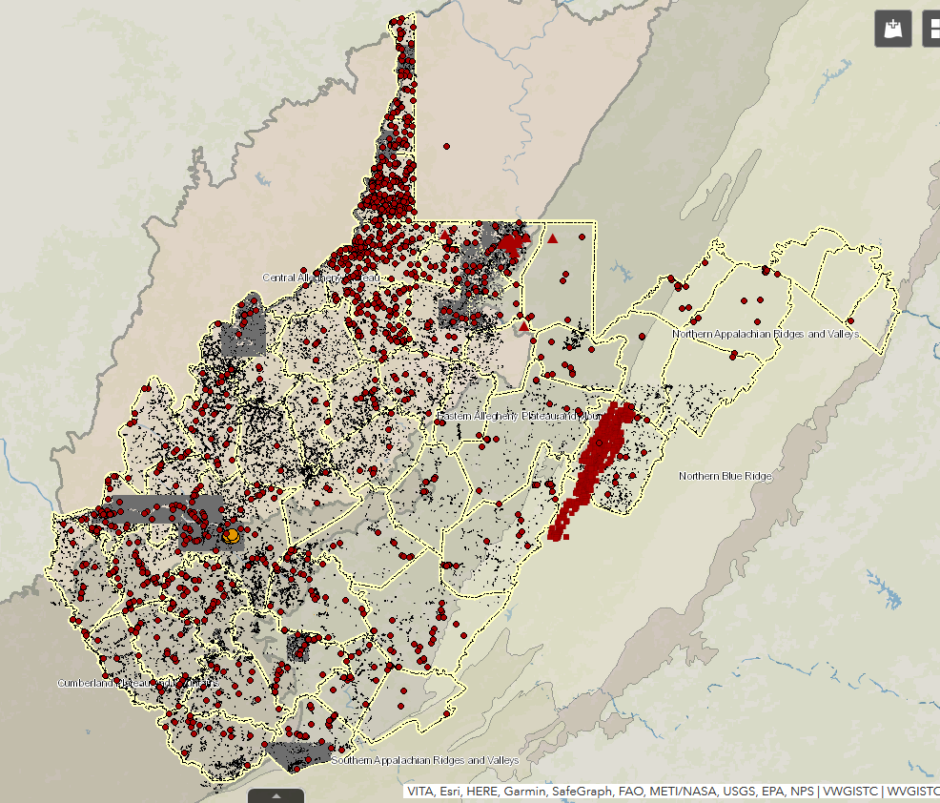
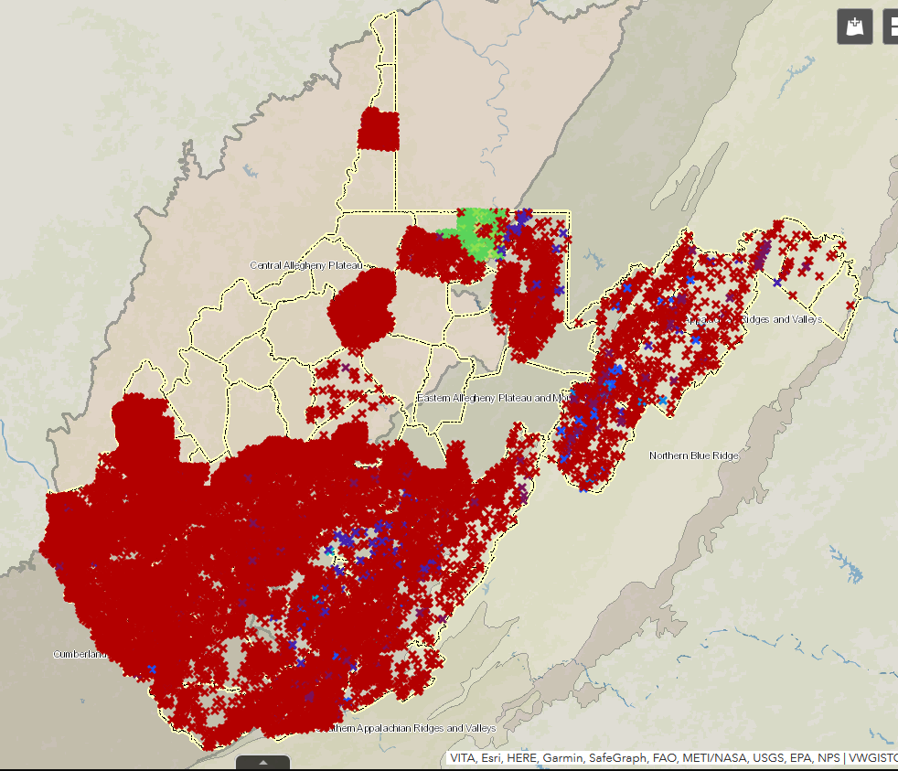
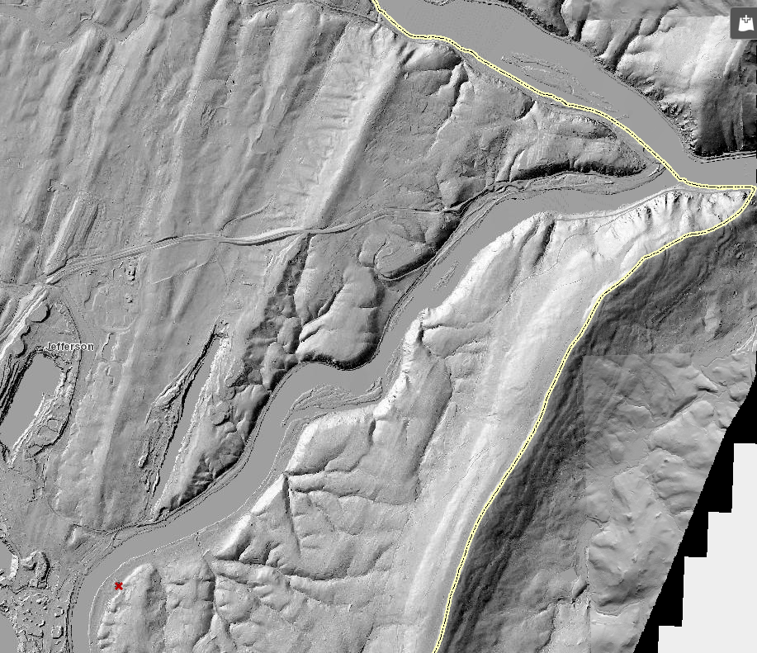
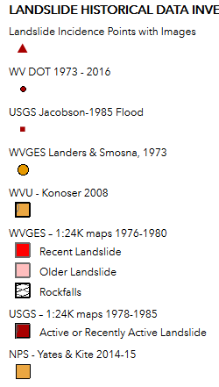
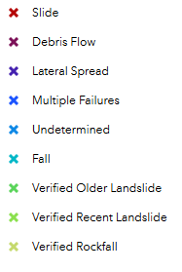
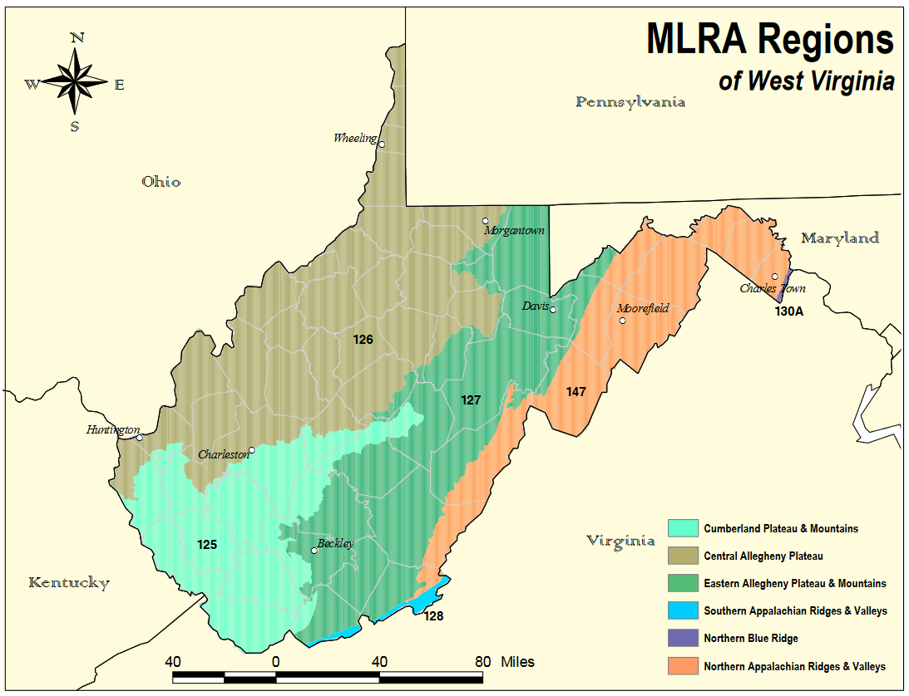
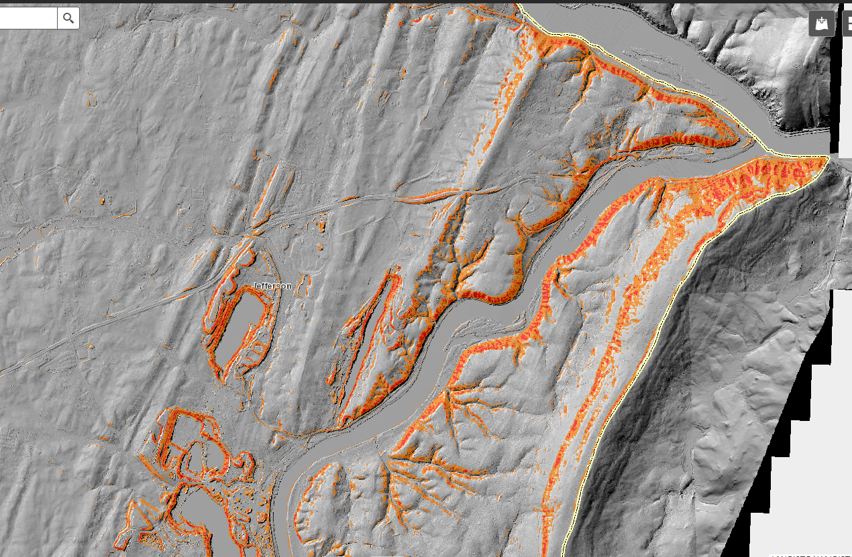
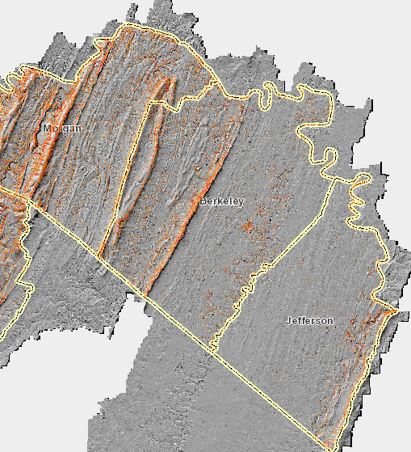

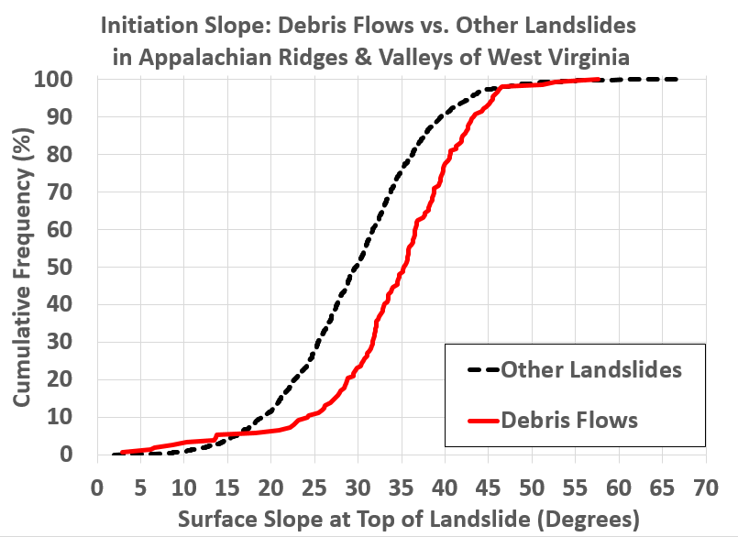
Landslide Risk Assessment in the Mountain State: Random Forest Modelling in Major Land Resource Areas Helps Surmount Gaps
in the West Virginia Landslide Inventory and Better Align LiDAR-Based Mapping with Local Geologic Knowledge
KITE, J. Steven, MAXWELL, Aaron Edward, SHARMA, Maneesh, DONALDSON, Kurt,
MAYNARD, Shannon Marie, BELL, Matthew, HANWELL, Elizabeth, & YESENCHAK, Rachel
WV GIS Technical Center, Department of Geology & Geography, West Virginia University
Session 194: Landslide Hazard Assessments & Risk Reduction: Data Collection & Modelling Challenges
Geological Society of America Annual Meeting Virtual Poster Presentation, Thursday, 29 October 2020: 10:00 AM - 12:00 PM
Leave Empty
This space will be automatically filled with a QR code and number for easy sharing
West Virginia Landslide Risk Assessment 2018-2021
Funded by FEMA Hazard Mitigation Grant Program &
WV Division of Homeland Security & Emergency Preparedness
Step 1: Statewide digital landslide inventory
> 93,000 previously mapped landslides (WVGES, USGS, etc.)
> 65,000 more landslides mapped on LiDAR-based DEMs
Step 2: Susceptibility models built from LiDAR-based mapping
Separate model for each major NRCS Major Land Resource
Area (MLRA) (≈ physiographic units) in West Virginia
* MLRA 147 Northern Appalachian Ridges & Valleys Focus
Random Forest Machine Learning: best predictive power
(Maxwell et al. 2020, Remote Sensing v. 12 no. 486)
Strongest Correlations: Topographic Attributes
Geology has weaker correlations than Topography
Step 3: Landslide Risk Model - in progress, not in this poster
West Virginia Landslide Tool Inventory Images (October 2020)
https://wvu.maps.arcgis.com/apps/webappviewer/index.html?id=cb01c47cfa884309b4f38dcd7542f805/
Known Landslide Issues exist near Harpers Ferry, but mapping shows only one landslide
Previously Mapped Landslides
Landslides Mapped on LiDAR- Based DEMs by WV GIS Tech Center
LiDAR DEM Landslide Map
MD
WV
VA
Model Predicted Medium to High Susceptibility based on correlations elsewhere in MLRA
Northern Appalachian Ridges & Valleys + bits of Blue Ridge & Southern Appalachian Ridges & Valleys
Topographic Attributes (e.g. Slope & Slope Area Ratio) show very strong correlation to landslide initiation points
Geology is Significant WVGES Geological Map Unit | Slide Count | Debris Flow % | Slides /100 Mi²
Alluvium | 10 | 0 | 11
Price = Pocono Group | 67 | 4 | 35
Hampshire Fm. | 107 | 3 | 22
Chemung Group | 210 | 2 | 34
Brallier Fm. & Harrell Shale | 228 | 0 | 56
Middle Devonian shale | 140 | 1 | 34
Oriskany SS & Huntersville Chert | 210 | 11 | 75
Oriskany & Helderberg, undivided | 23 | 4 | 68
Helderberg Group | 79 | 23 | 79
Tonoloway, Wills Crk. & W’msport | 130 | 11 | 73
McKenzie Fm. & Clinton Group | 301 | 5 | 191
Tuscarora Sandstone | 96 | 34 | 134
Juniata & Oswego Fm. | 27 | 48 | 59
Martinsburg & Reedsville | 139 | 14 | 102
Cambro-Ordovician carbonates | 20 | 0 | 6
Overall Ridges & Valleys | 1799 | 8 | 50
Random Forest Susceptibility Model, WV Eastern Panhandle
Landslide Susceptibility Model
MD
Maryland
WV
VA
MLRA 147 Northern Appalachian Ridges & Valleys
Virginia
MLRA Map by Jim Thompson, WVU
https://jamesthompson.plantandsoil.wvu.edu/files/d/edafb843-93e2-4cc7-9287-b0e95519585f/mlraregionsmap.pdf
80 % of Landslides Initiate on 20-40°slopes
80 % of Debris Flows Initiate on 25-45°slopes
Will be covered by controls
if you define slides
West Virginia Landslide Tool
Image (October 2020)

