Slide 1
Statewide Hazard Assessment
Landslide Risk Assessment

Slide 2
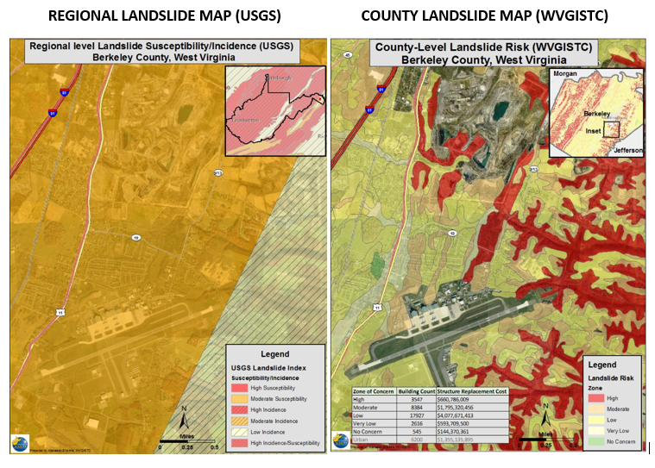
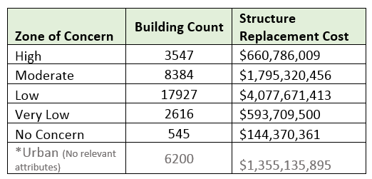
Landslide Maps – Old versus New
Old Way - Very Generalized
New Way – More Detailed
Landslide
Risks
Buildings Exposed to Landslide Risks
Risk Assessment table showing building counts along with estimated replacement costs in landslide zones of concern
Landslide susceptibility map showing generalized USGS map and more detailed prototype map

Slide 3
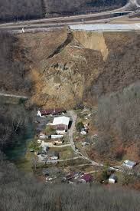
Landslide Risk Assessment
Goals
Develop landslide inventory
Create valid landslide models for specific WV regions
Generate county-level resolution landslide maps
Create an interactive web map application for displaying landslide models and variables
Use the new landslide models and information to update the State Hazard Mitigation Plan
Did you know?
Landslides are the #2 Hazard in West Virginia
2015 Yeager Airport Slide

Slide 4
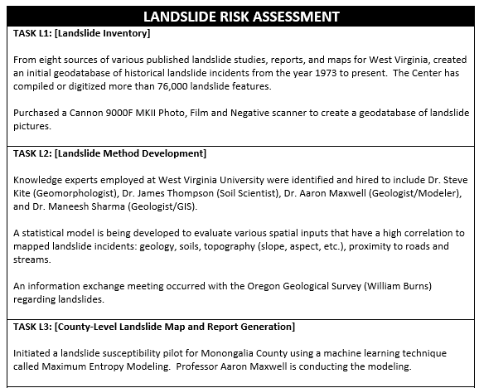
HMGP Landslide Tasks
Five Major Landslide Goals and Deliverables

Slide 5
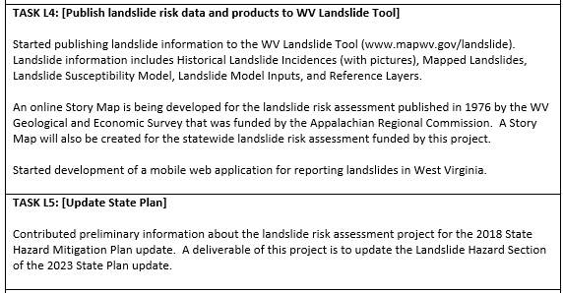
HMGP Landslide Tasks (Cont.)
Five Major Landslide Goals and Deliverables

Slide 6
Landslide Incident Inventory
Collected data from various sources
  WVGES
    Landers and Smosna, 1973
    Lessing et al, 1976
    Kite, 1985
  NPS/WVGES
    Yates and Kite, 2014-15
  USGS
    Ohlmacher et al, 1978-85
    Jacobson et al, 1993
  WVDHSEM
    State Hazard Mitigation office
  WVDOT
    Geospatial Transportation Information (GTI) Section, 1973-2016
  WVU
    Kite, 1983-97
    Konsoer et al, 2008
    WVGISTC, 2018-ongoing

Slide 7
Landslide Incident Inventory
# | Agency | Year | Author or Source Agency | Title/Description | General Location | Purpose | Total Incidence Data
1 | WVGES | 1973 | Landers and Smosna | Final Report on Landslides of July 9, 1973 in Kanawha City Area of Charleston, West Virginia | Charleston, West Virginia | Landslide mapping | 10
2 | WVGES | 1976-80 | Lessing et al. | WV Landslides and Slide-Prone Areas; funded by Appalachian Regional Commission | Statewide (39 topo quads) | Landslide mapping | 46,330
3 | USGS | 1978-85 | USGS (various) | Landslide Quad Maps: Open File Maps | Statewide (382 topo quads) | Landslide mapping | 41,307
4 | USGS | 1993 | Jacobson et al | U.S. Geological Survey Bulletin 1981: Geomorphic studies of the storm and flood of November 3-5, 1985, in the upper Potomac and Cheat River basins in West Virginia and Virginia | Cheat and Potomac River basins; Wills Mountain Anticline; Eastern WV | Research study (1985) | 3,571
5 | WVU | 1983-97 | WVU | Landslide incidences with Images | Statewide | Instruction & landslide inventory | 46
6 | WVU | 1996 | Kite and Grubb | Update of 1976 Landslide Maps, Morgantown North and South Quadrangles | Morgantown, West Virginia | Landslide inventory | 41
7 | WVU | 2008 | Konsoer et al | LiDAR, GIS, and multivariate statistical analysis to assess landslide risk, Horseshoe Run watershed, West Virginia | Horseshoe Run Watershed, Tucker County | Surficial Geology Mapping | 149
8 | NPS/WVGES | 2014 | Yates and Kite | Unpublished Digital Surficial Geologic Map of Bluestone National Scenic River and Vicinity, West Virginia (NPS, GRD, GRI, BLUE, BLUS digital map) adapted from a West Virginia University and West Virginia Geological and Economic Survey Open File Map by Yates and Kite (2014) | Bluestone National Scenic River and Vicinity | Surficial Geology Mapping | 12
9 | NPS/WVGES | 2015 | Yates and Kite | Digital Surficial Geologic Map of New River Gorge National River, West Virginia (NPS, GRD, GRI, NERI, NERS digital map) adapted from a West Virginia University and West Virginia Geological and Economic Survey Open File Report map by Yates and Kite (and Gooding) (2015) | New River Gorge National River | Surficial Geology Mapping | 212
10 | WVDOT | 2016 | Geospatial Transportation Information (GTI) Section | Road landslide inventory | Statewide | Landslide inventory | 1,406
11 | WVDHSEM | 2017 | State Hazard Mitigation Office | FEMA Buyout Properties for Landslides | Southern West Virginia | Landslide mitigation | 7
12 | WVU | 2019 | WVGISTC | Statewide Landslide Risk Assessment; Funded by FEMA and WV Division of Homeland Security and Emergency Management | Statewide | Landslide risk assessment | 17,970
111,061 landslide features

Slide 8
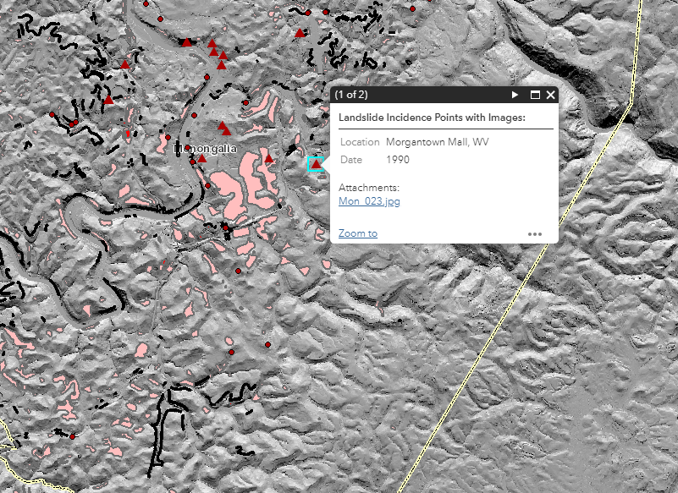
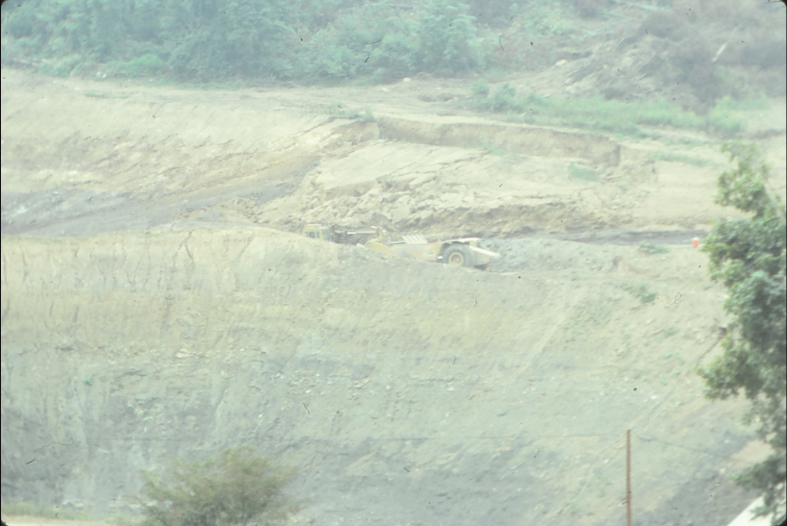
Landslide Incident Inventory
Landslide Incidence Points with Images
  From Dr. Kite
    Slides were scanned and tagged with geographical information, dates taken, and descriptions
    Added to the landslide incidence database

Slide 9
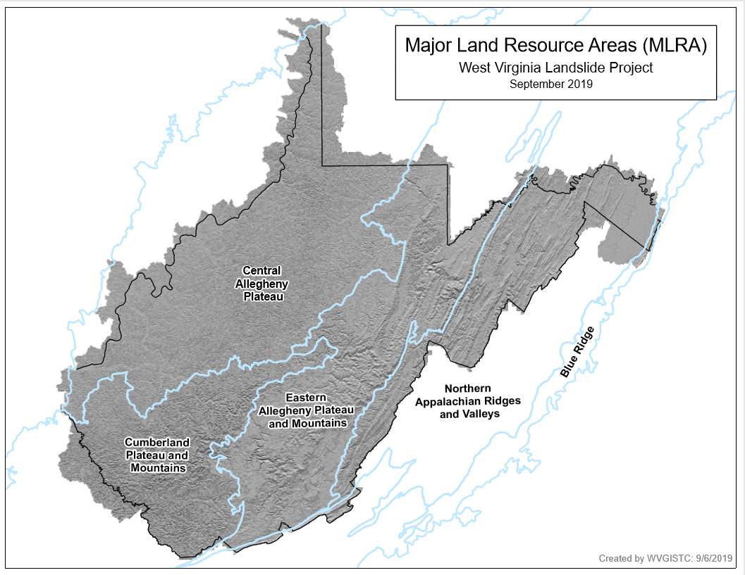
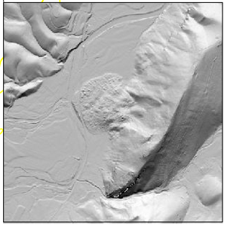
Mapping Landslides from new DEM
FEMA is purchasing statewide Quality Level 2 lidar for the entire State that will improve the mapping of existing landslides. Lidar-derived products include 1-meter DEM and 1-foot Contours
Great Valley
Kanawha Section
Blue Ridge
Ridge & Valley
Allegheny Mountains
Logan Plateau

Slide 10
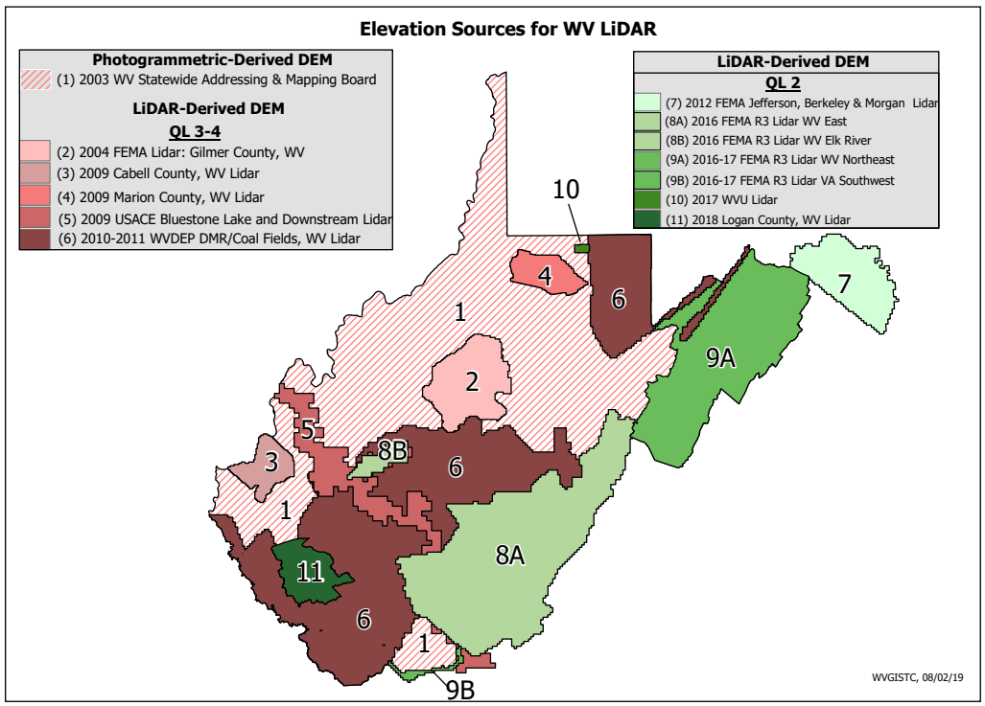
Mapping Landslides from new DEM
Best-Available Elevation Sources for West Virginia: https://www.mapwv.gov/floodtest/docs/WV_FloodTool_ElevationSource_Metadata.pdf

Slide 11

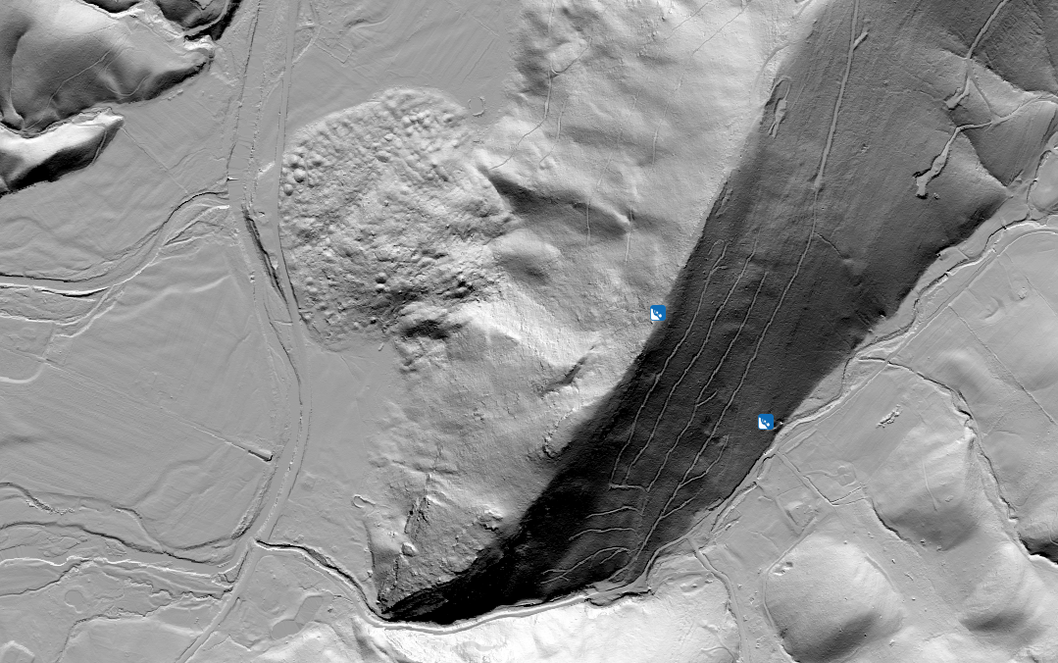
Old DEM
Mapping Landslides from new DEM
New DEM
Comparison of Old and New 1 meter DEM

Slide 12
Landslide Incident Inventory
Landslide mapping from new LiDAR-derived DEM
  Identifying following types of landslides
    Slide
    Fall
    Flow
    Lateral Spread
    Multiple Failures
    Unknown

Slide 13
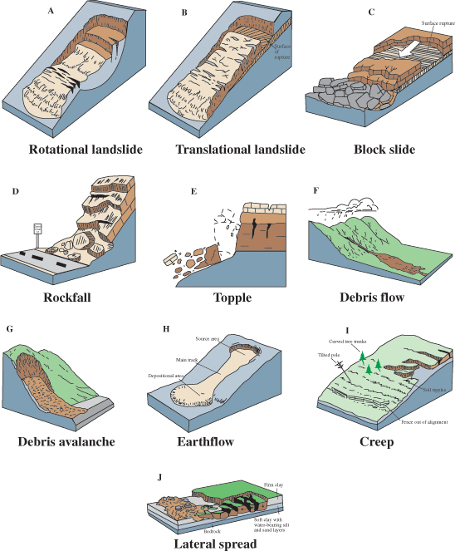
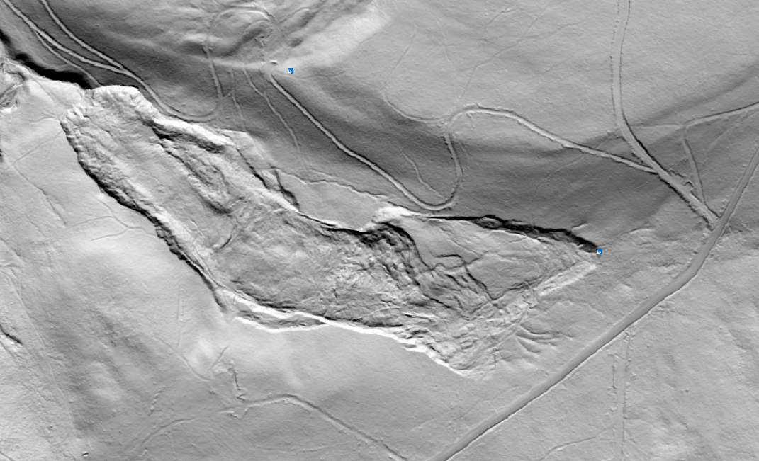
Landslide Incident Inventory
Slide (includes rotational and translational movement)*: mass movements, where there is a distinct zone of weakness that separates the slide material from more stable underlying material
Mineral County, WV
*Description from https://pubs.usgs.gov/fs/2004/3072/fs-2004-3072.html
Images from https://pubs.usgs.gov/fs/2004/3072/fs-2004-3072.html

Slide 14
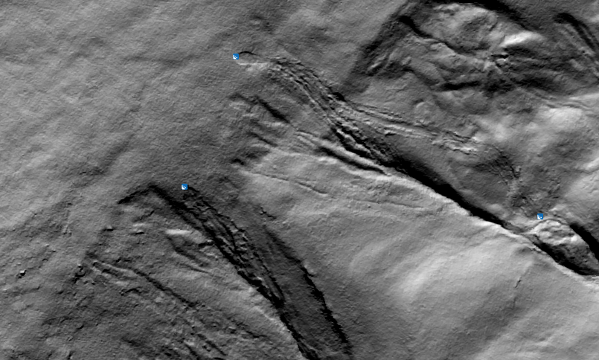
Landslide Incident Inventory
Debris Flow*: A form of rapid mass movement in which a combination of loose soil, rock, organic matter, air, and water mobilize as a slurry that flows downslope; they are often associated with steep gullies, and debris-flow deposits are usually indicated by the presence of debris fans at the mouths of gullies
Pendleton County, WV
*Description from https://pubs.usgs.gov/fs/2004/3072/fs-2004-3072.html
Images from https://pubs.usgs.gov/fs/2004/3072/fs-2004-3072.html

Slide 15
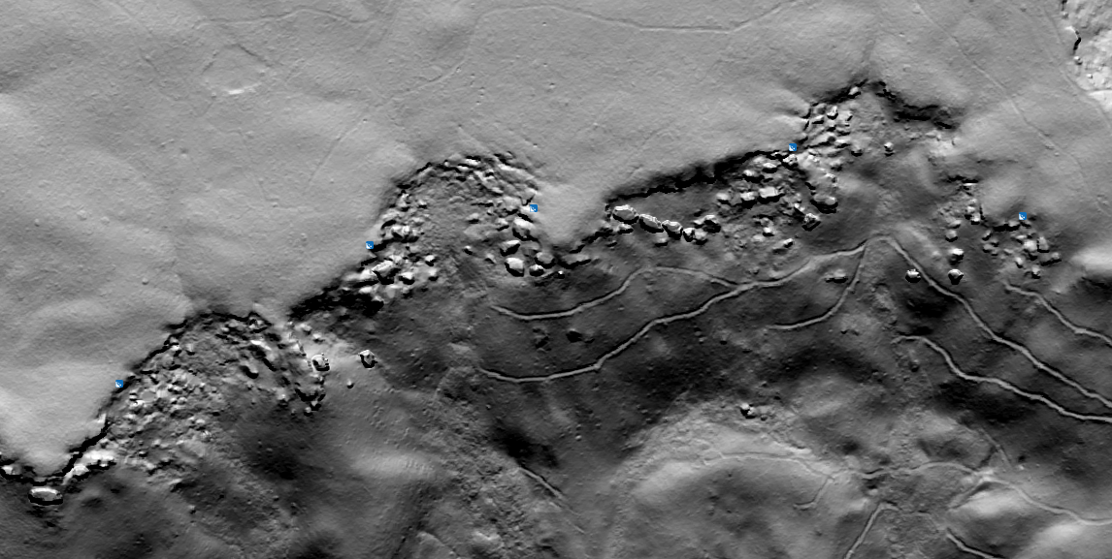
Landslide Incident Inventory
Lateral Spread*: When coherent material, either bedrock or soil, rests on materials that liquefy, the upper units may undergo fracturing and extension and may then subside, translate, rotate, disintegrate, or liquefy and flow; usually occur on very gentle slopes or flat terrain
Greenbrier County, WV
*Description from https://pubs.usgs.gov/fs/2004/3072/fs-2004-3072.html
Images from https://pubs.usgs.gov/fs/2004/3072/fs-2004-3072.html

Slide 16
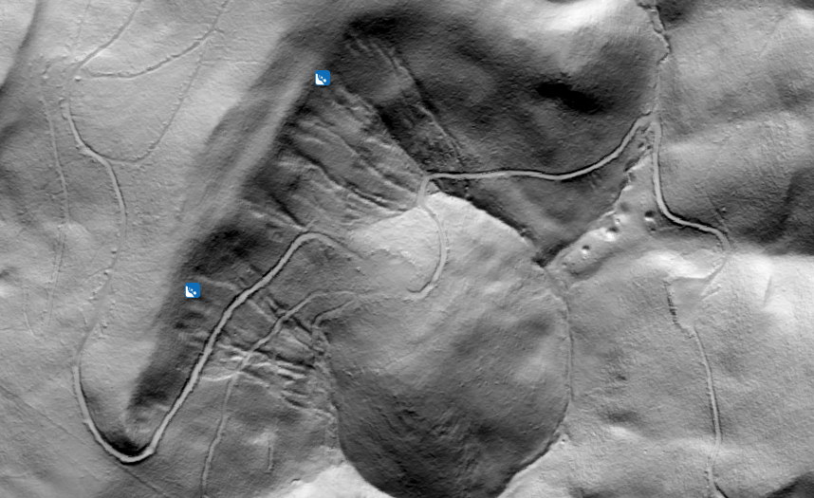
Landslide Incident Inventory
Multiple Failures: This classification is used when multiple (>4) failures, usually small debris flows, occur in a restricted area
Pendleton County, WV
*Description from https://pubs.usgs.gov/fs/2004/3072/fs-2004-3072.html
Images from https://pubs.usgs.gov/fs/2004/3072/fs-2004-3072.html

Slide 17
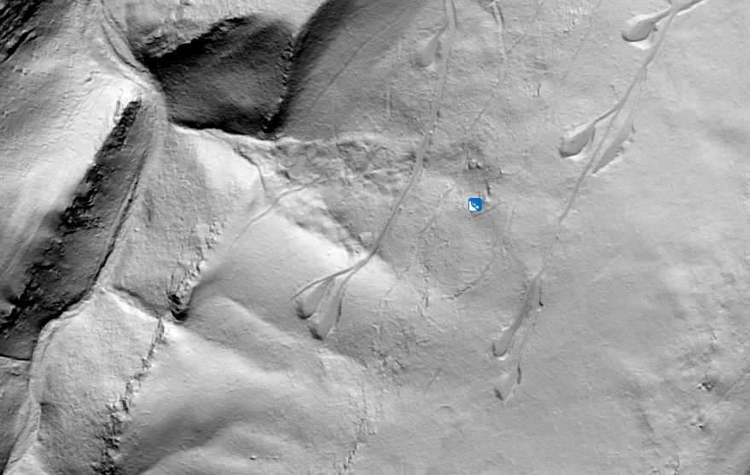
Landslide Incident Inventory
Fall*: Abrupt movements of masses of geologic materials, such as rocks and boulders, that become detached from steep slopes or cliffs
Undetermined: Some failure is present, but it is not possible to determine the type of movement
Pendleton County, WV
*Description from https://pubs.usgs.gov/fs/2004/3072/fs-2004-3072.html
Images from https://pubs.usgs.gov/fs/2004/3072/fs-2004-3072.html

Slide 18
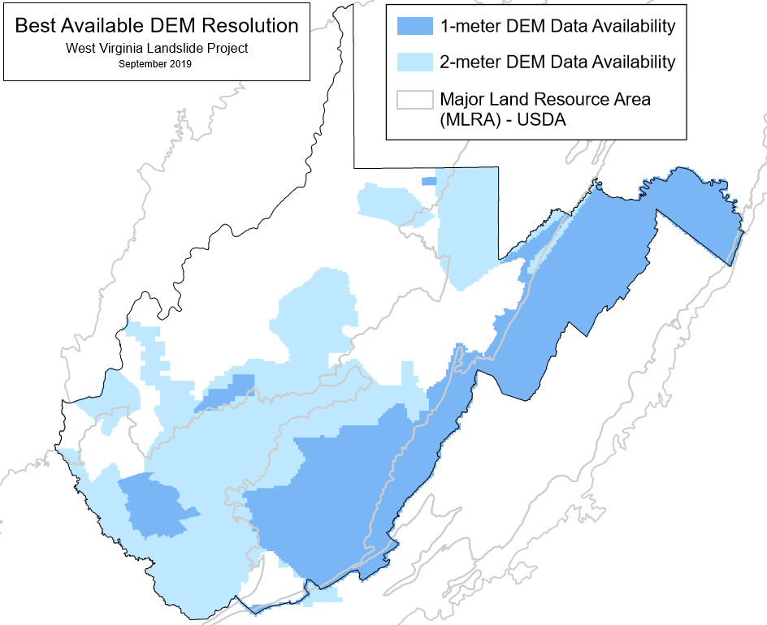
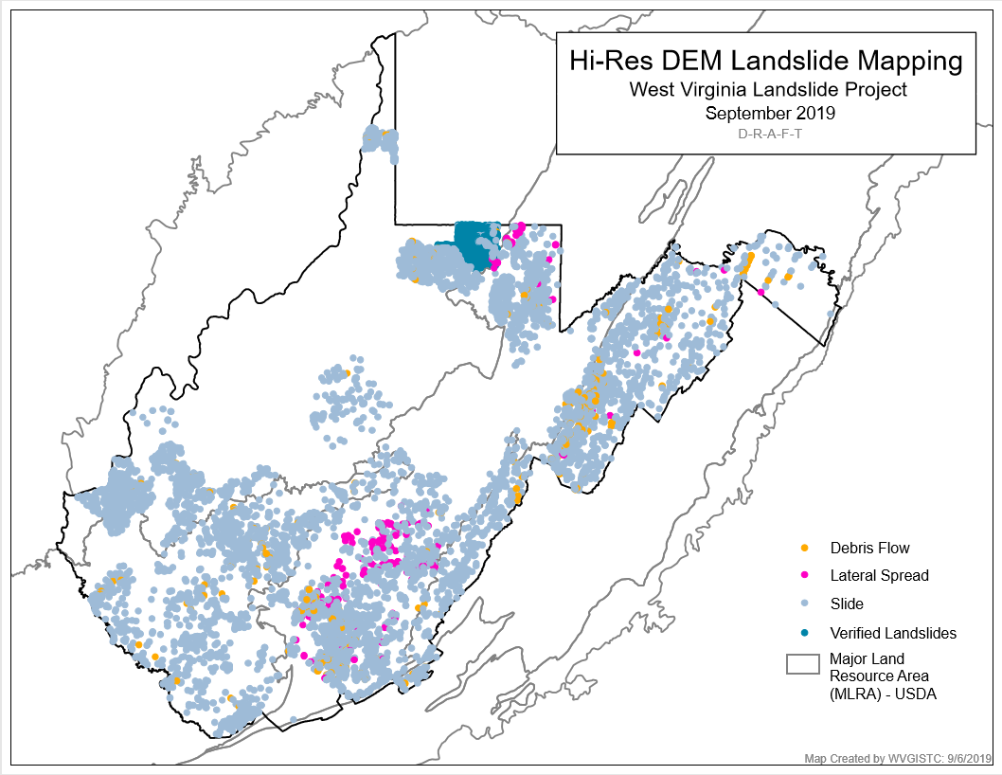
Landslide Incident Inventory
WV GIS TC
Landslide Mapping
March-September 2019
Best Available DEMs
1 m
2 m
>3 m
WV GIS TC Mapping on LiDAR-Based DEMs
8,991 Failures (>10 m wide) Most from 1 m DEMs
334 Debris Flows
241 Lateral Spreads
8,416 Other Failures
  >97 % “Slides” (or Slumps)
Few Rock Falls Identified
Mapped Landslides Verified on best available DEMs
1,082 WVGES (1976-80) Monongalia Co. Slides

Slide 19
Landslide Incident Inventory
Type of Movement | Number of user identified points | Percentage of user identified points | Description
Slide | 8232 | 92.2 | A zone of weakness separates the slide from the underlying material; can be translational or rotational
Fall | 5 | 0 | Rocks or other geologic materials dislocate from steep slopes
Debris Flow | 334 | 3.7 | Fluid mobilizes material into a slurry that flows downslope; often associated with gullies or steep channels
Lateral Spread | 241 | 2.7 | Extension along very shallow or horizontal slopes which causes material to break into block-like shapes
Multiple Failures | 97 | 1.2 | Usually a combination of multiple small debris flows in a restricted location
Undetermined | 16 | 0.2 | Some failure is clearly present, but it is difficult to determine the type of movement

Slide 20
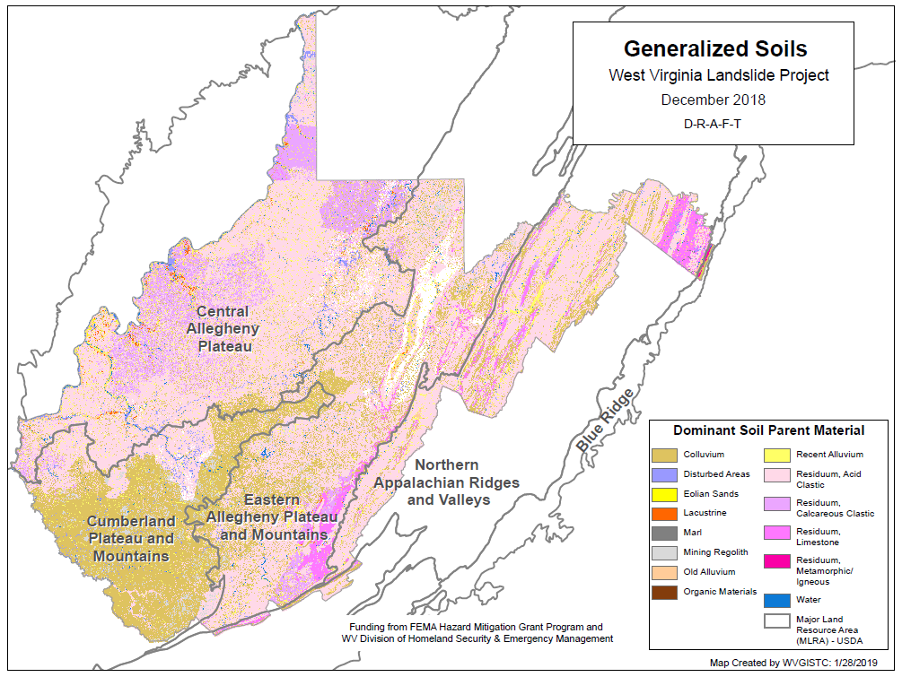
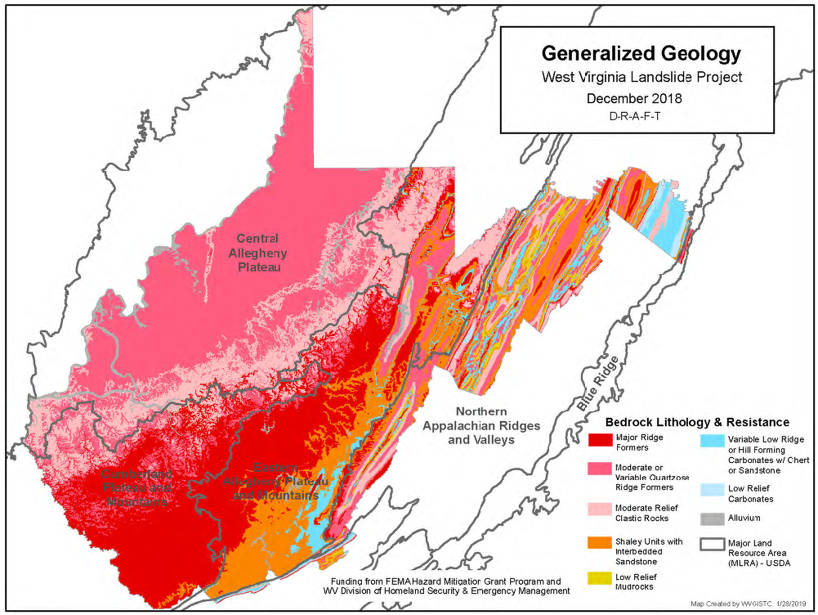
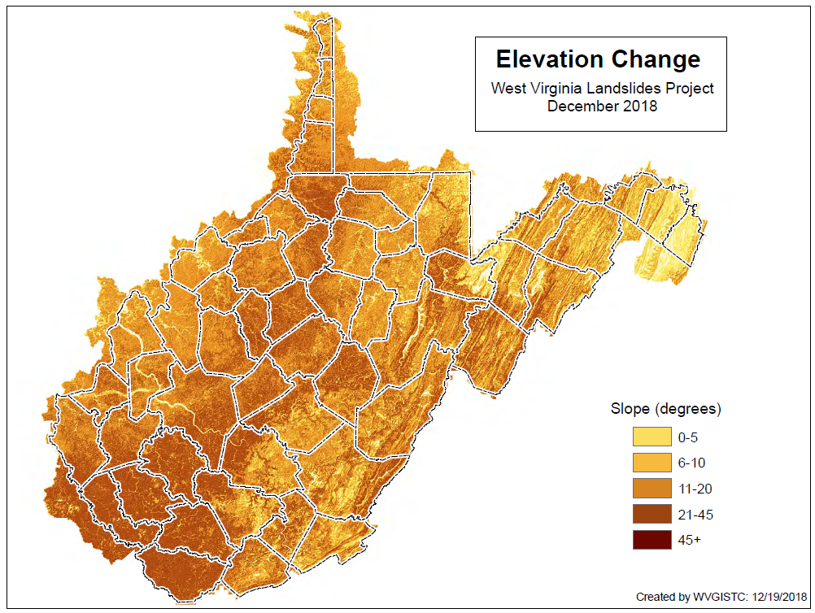
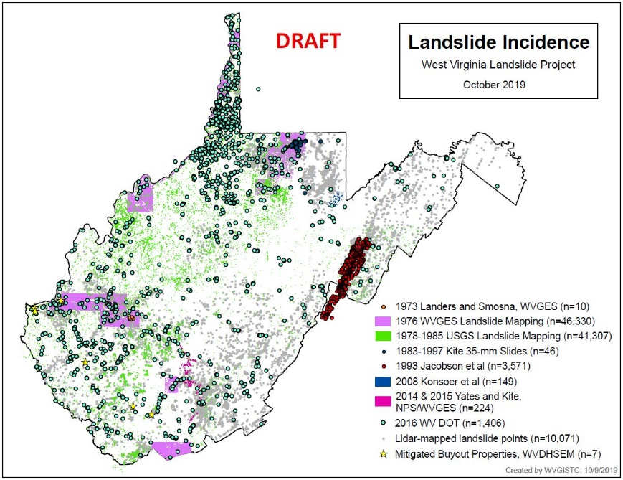
Landslide Method Development
The West Virginia University Study Team includes Dr. Steve Kite (Geomorphologist), Dr. James Thompson (Soil Scientist), Dr. Aaron Maxwell (Geologist/Modeler), and Dr. Maneesh Sharma (Geologist/GIS)

Slide 21
Landslide Method Development
West Virginia
Physiography
& NRCS MLRAs
Existing Physiographic Maps Inadequate for WV Landslide Project
MLRA Boundaries Better
Provinces & Subdivisions Appalachian Plateaus
Kanawha Section
Logan Plateau
Allegheny Mountains
Valley & Ridge
Ridge & Valley
Great Valley
Blue Ridge
Red = Landslide-Prone
Great Valley
Kanawha Section
Blue Ridge
Ridge & Valley
Allegheny Mountains
Logan Plateau

Slide 22
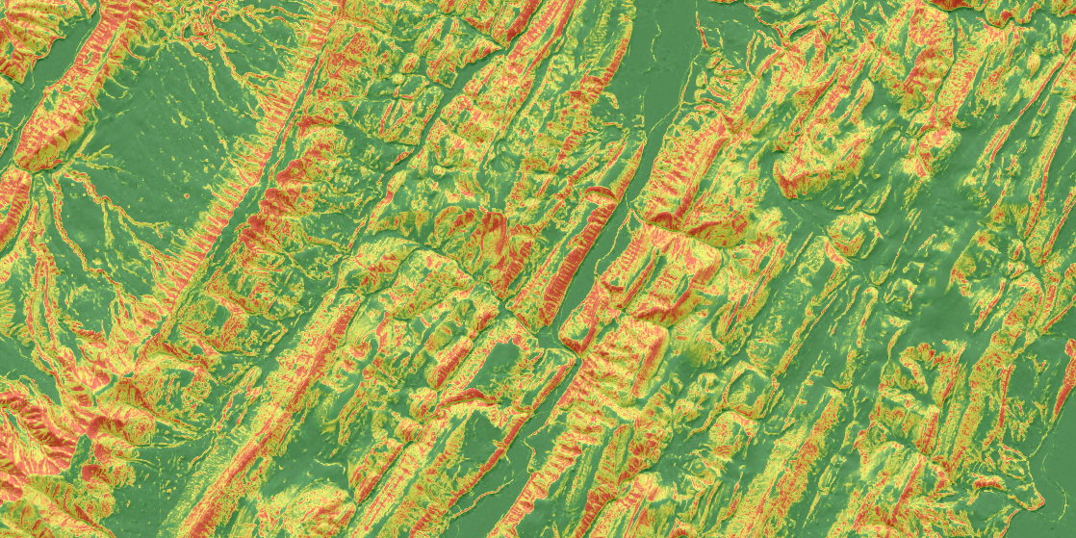
Landslide Method Development
Goal: Generate predictive models of slope failure probability/occurrence

Slide 23
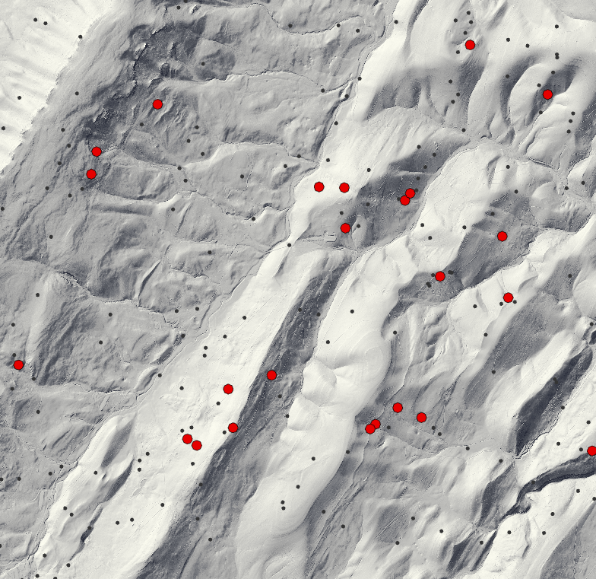

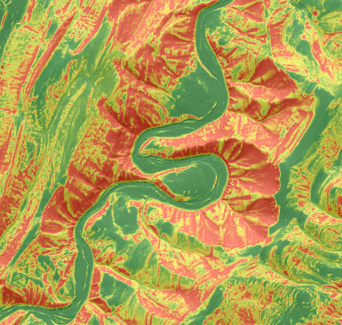
Machine Learning = Learning from Examples
Landslide Method Development
Thing you want to predict
Machine learning algorithm
Trained Model
Things you know that might help you predict the new thing
New things to predict
Predictions

Slide 24
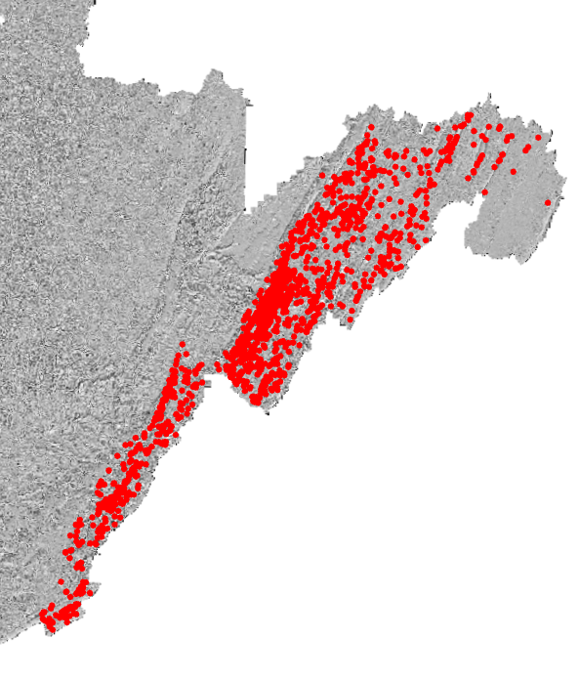
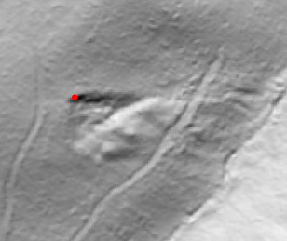
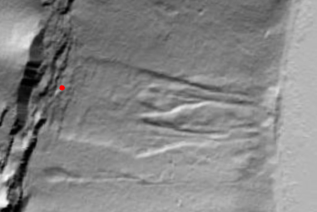
Training the Model
Landslide Method Development
Based on visual interpretation of terrain data
1,799 examples

Slide 25
Modeling Methods: Predictor Variables
Landslide Method Development
Terrain Derivatives:
  Topographic Slope
  Mean Slope
  Topographic Roughness
  Slope Position
  Topographic Dissection
  Heat Load Index
  Aspect Linear Transformation
  Surface Area Ratio
  Surface Relief Ratio
  Site Exposure Index
  Longitudinal Curvature
  Cross Sectional Curvature
  Profile Curvature
  Plan Curvature

Slide 26
Modeling Methods: Predictor Variables
Landslide Method Development
Non-Terrain:
  Roads
    Distance from US Roads
    Distance from State Roads
    Distance from Local Roads
    Cost Distance from US Roads
    Cost Distance from State Roads
    Cost Distance from Local Roads
  Hydrology
    Distance from Streams
    Cost Distance from Streams
  Geology
    Geologic Rock Type (Categorical)
    Modified Geologic Rock Type (Categorical)
  Soils
    DPSM (Categorical)
    Drainage Class (Categorical)

Slide 27
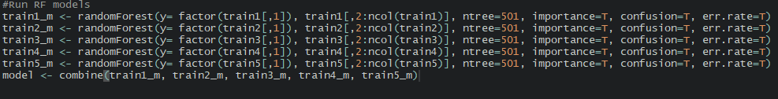
Modeling Method
Landslide Method Development
Random Forest
Provide predictor variables
Provide presence and absence data

Slide 28
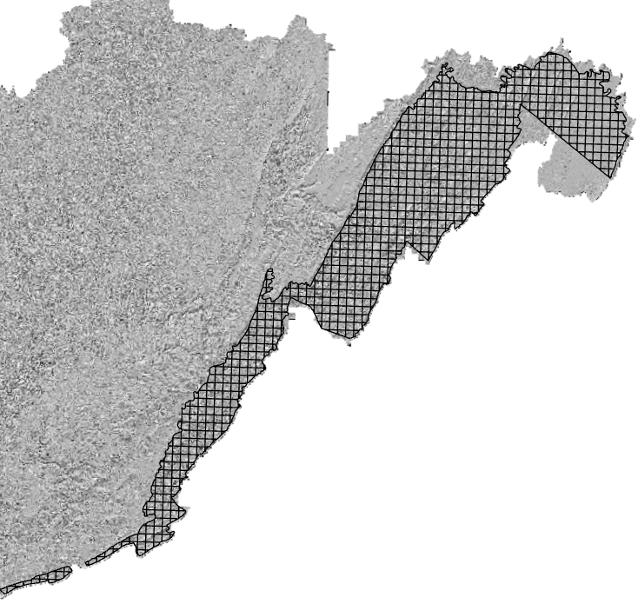
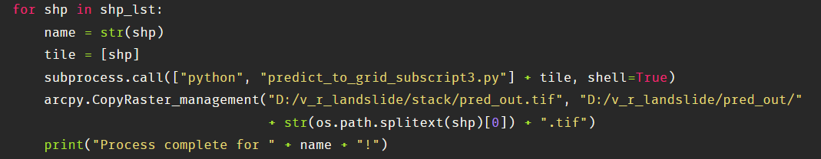
Predict to Entire Extent
Landslide Method Development
Tile-by-tile
Python scripts
~1 week to process

Slide 29
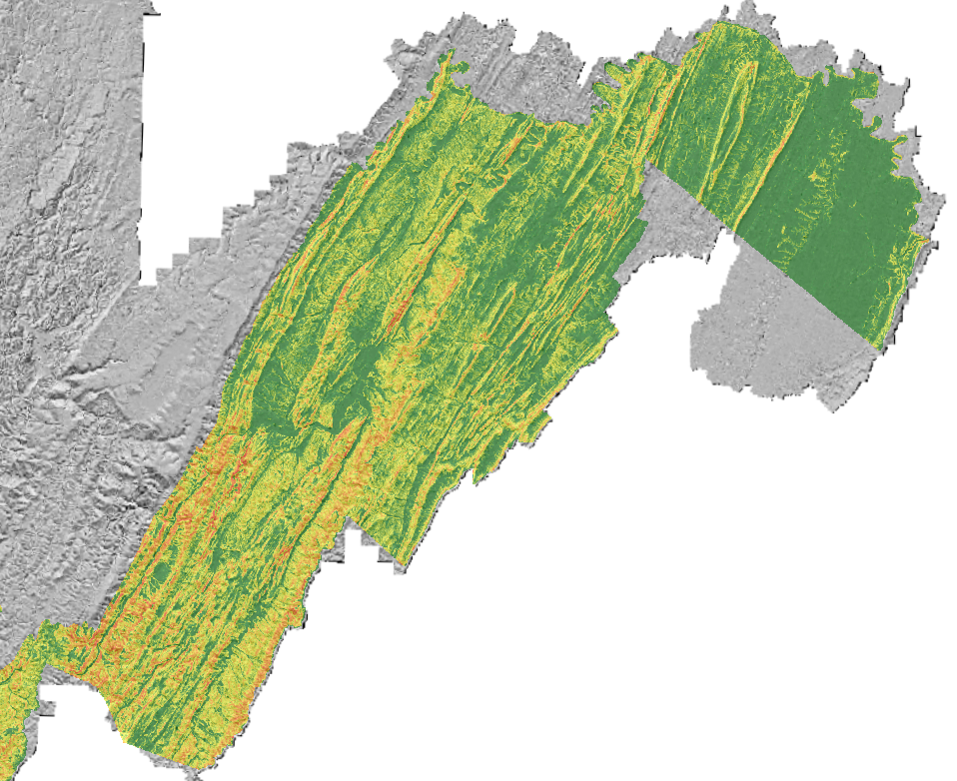
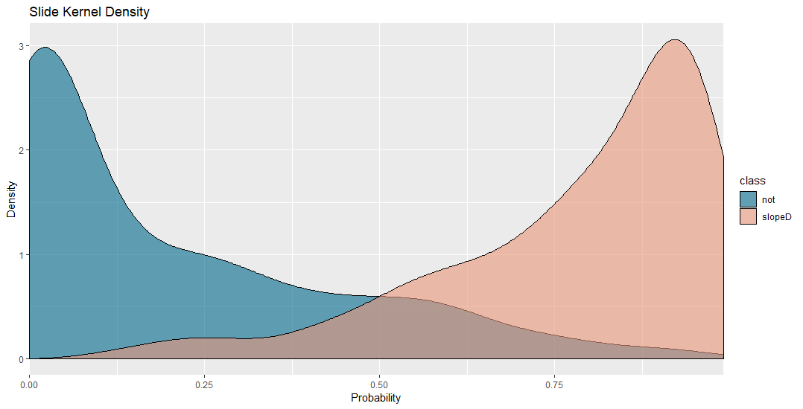
Results
Landslide Method Development
AUC – 0.94
Notes:
The area under the curve (AUC) that relates the hit rate to the false alarm rate has become a standard measure in tests of predictive modeling accuracy. The AUC is an estimate of the probability that a classifier will rank a randomly chosen positive instance higher than a randomly chosen negative instance.

Slide 30
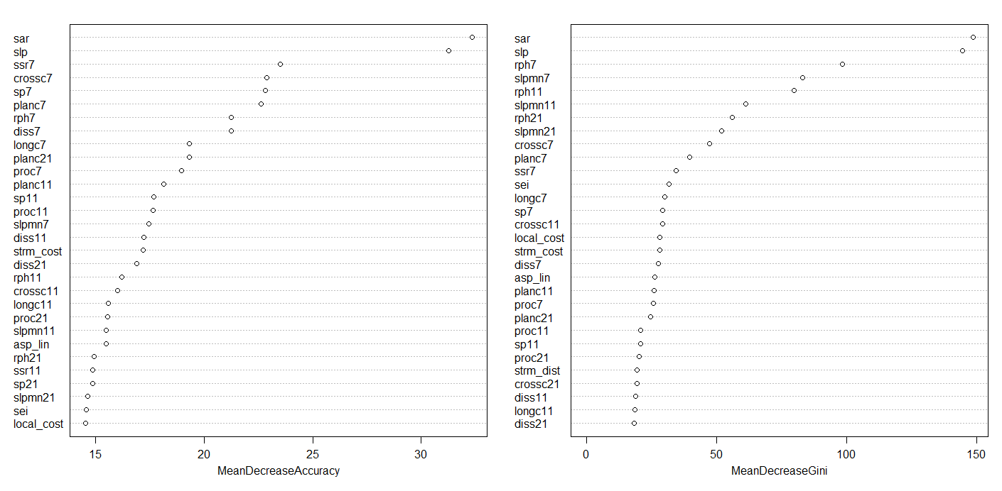
Important Variables
Landslide Method Development
Surface Area Ratio
Slope
Surface Relief Ratio
Slope Position
Curvature
Topographic Roughness
Topographic Dissection

Slide 31
Moving Forward
Landslide Method Development
Semi-automate with scripting
Develop models for different physiographic regions
Predict entire state
Further validate results

Slide 32
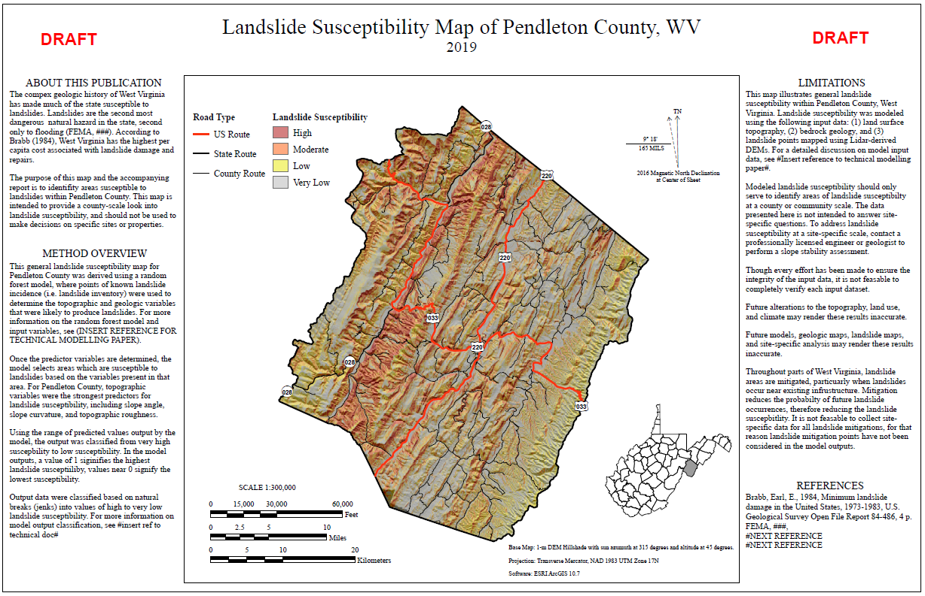
Susceptibility and Hazard Assessment
Landslide Susceptibility Prediction
Produce landslide susceptibility map by county
Calculate at risk properties for each county

Slide 33
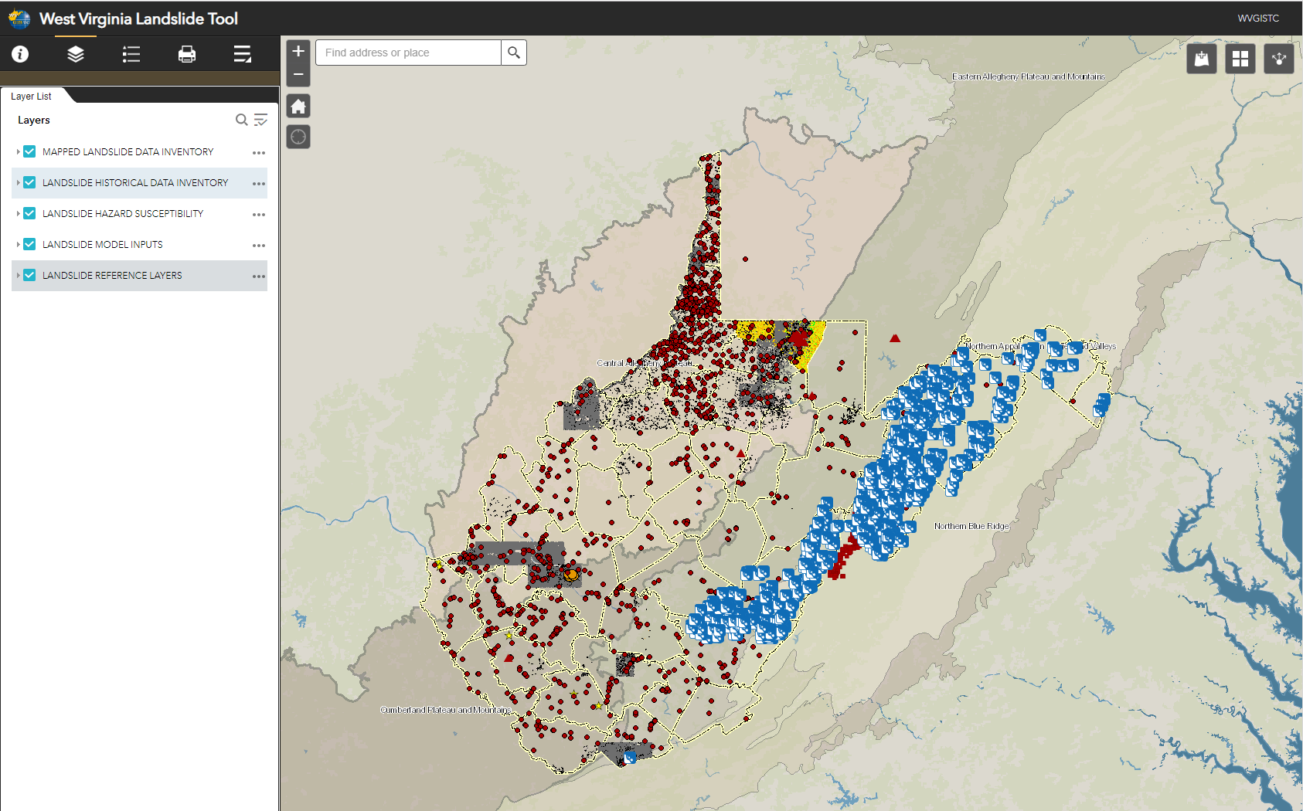
Landslide Incident Inventory
www.mapWV.gov/Landslide (in development)
Over 100,000 landslide incident point and polygon features have been inventoried into a digital geodatabase

Slide 34
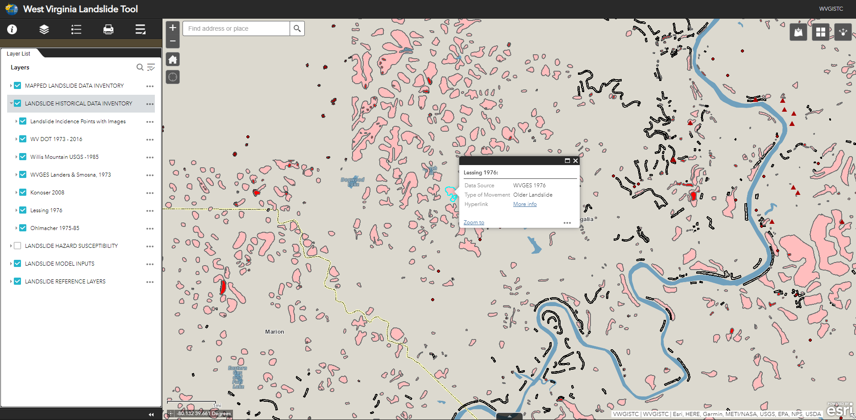

Landslide Incident Inventory
www.mapWV.gov/Landslide (in development)
Over 100,000 landslide incident point and polygon features have been inventories into a digital geodatabase

Slide 35
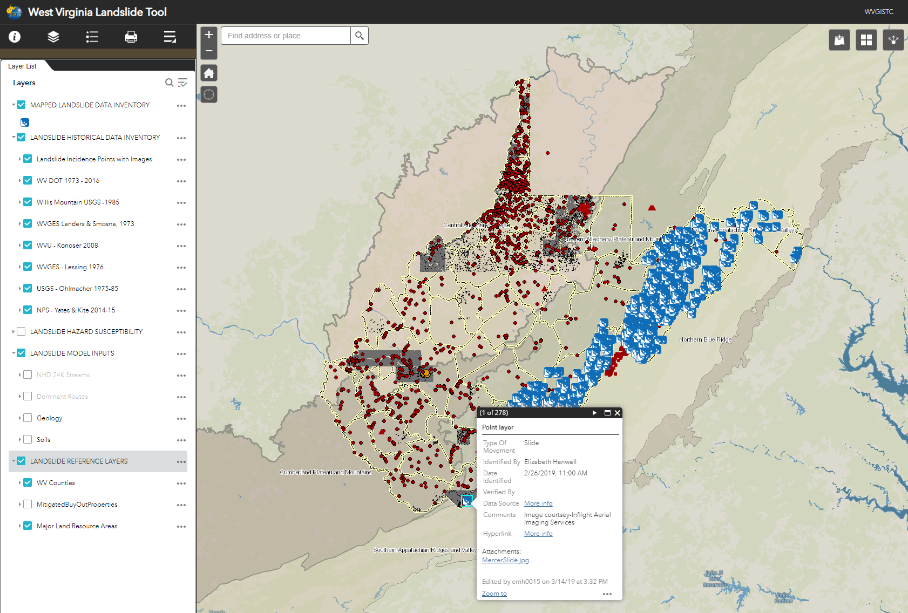
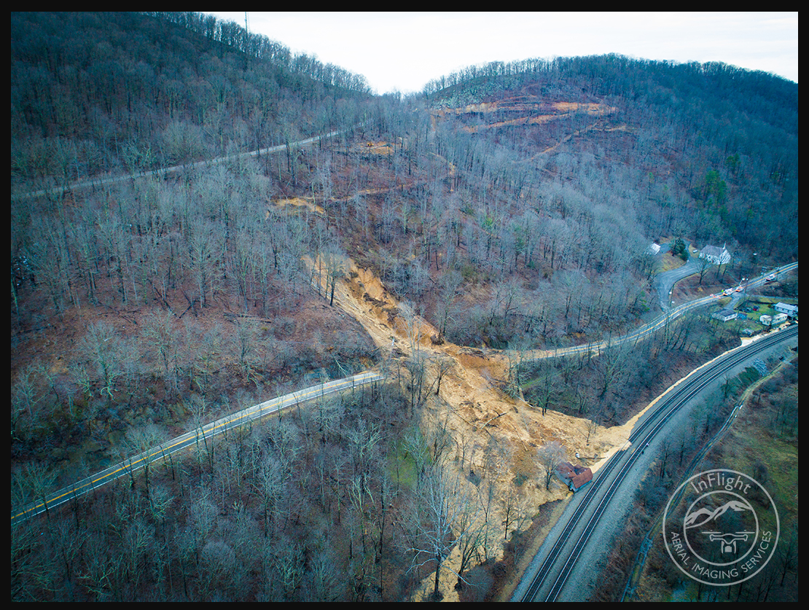
Landslide Incident Inventory
www.mapWV.gov/Landslide (in development)
5000-8000 square meter range in total. One of the biggest observed in the state. Feb 25, 2019

Slide 36
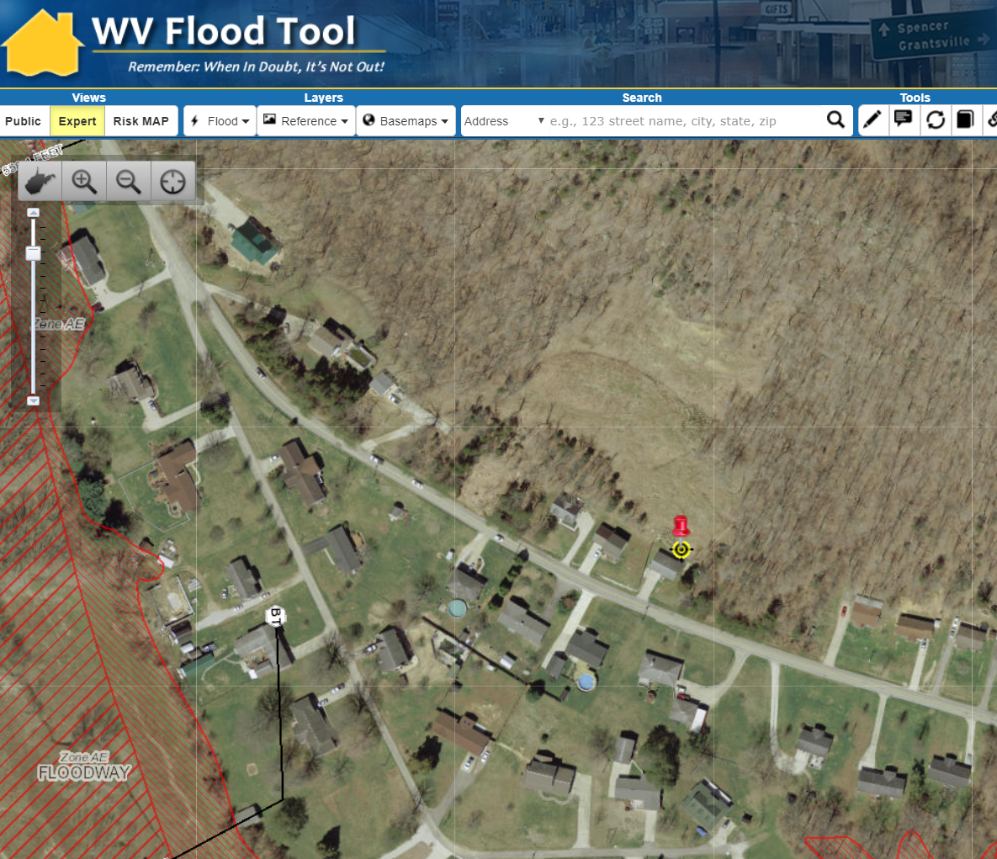
Landslide Buyout properties
Cabell County buyout properties
06-08-004A-0049-0004 - https://www.mapwv.gov/flood/map/?wkid=102100&x=-9159293&y=4632966&l=11&v=1
06-08-004A-0049-0007 - https://www.mapwv.gov/flood/map/?wkid=102100&x=-9159328&y=4632979&l=11&v=1
06-08-004A-0049-0005 - https://www.mapwv.gov/flood/map/?wkid=102100&x=-9159374&y=4633002&l=11&v=1
https://arcg.is/1SW0Sn

Slide 37
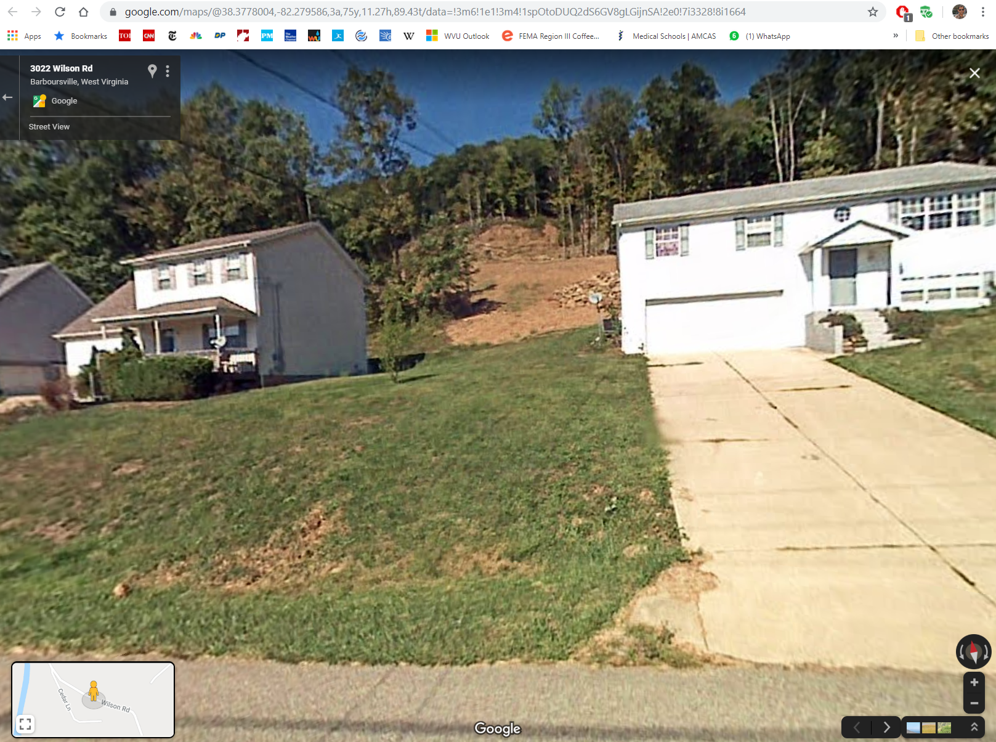
Landslide Buyout properties
Cabell County buyout properties
06-08-004A-0049-0004 - https://www.mapwv.gov/flood/map/?wkid=102100&x=-9159293&y=4632966&l=11&v=1
06-08-004A-0049-0007 - https://www.mapwv.gov/flood/map/?wkid=102100&x=-9159328&y=4632979&l=11&v=1
06-08-004A-0049-0005 - https://www.mapwv.gov/flood/map/?wkid=102100&x=-9159374&y=4633002&l=11&v=1
https://www.google.com/maps/@38.3778004,-82.279586,3a,75y,11.27h,89.43t/data=!3m6!1e1!3m4!1spOtoDUQ2dS6GV8gLGijnSA!2e0!7i3328!8i1664

Slide 38
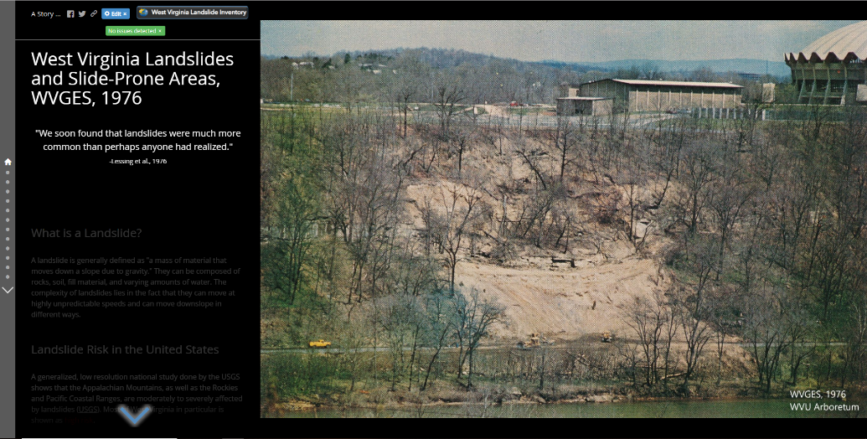
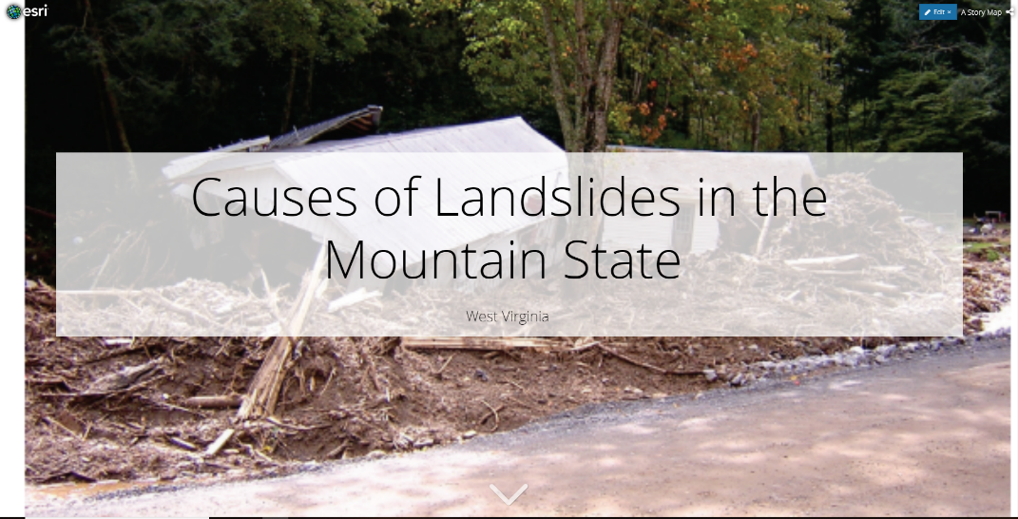
Landslide Outreach Material
Two StoryMaps In Development
  West Virginia Landslides and Slide-Prone Areas, WVGES 1976
https://arcg.is/1KDnvq
Causes of Landslides in Mountain State, West Virginia
https://arcg.is/1SW0Sn

Slide 39
Mitigation Approaches
Landslide is classed as sever hazard
Two mitigation approaches
  Emergency Management and Response
    Emergency Management
      Anticipation
      Prediction
      Issuance of warnings of impending occurrence of life- and property-threatening landslides
    Response
      Identification of landslide-prone areas
      Planning, training and other preparatory measures to ensure effective warning and response
  Long Term Hazard Reduction
    Focus on reducing frequency of landslides
    Reducing the likelihood of slide causing damage
    Minimizing damage when slides do occur
https://www.fema.gov/media-library/assets/documents/7251

Slide 40
Mitigation Approaches
Landslide losses can be reduced in two ways
  Reduce the occurrence by requiring
    Excavation, grading, landscaping and construction do NOT contribute to slope instability
  Minimize damage when landslide do occur by
    Restricting development in landslide prone terrain
    By protecting building and other structure from landslide damage

Slide 41
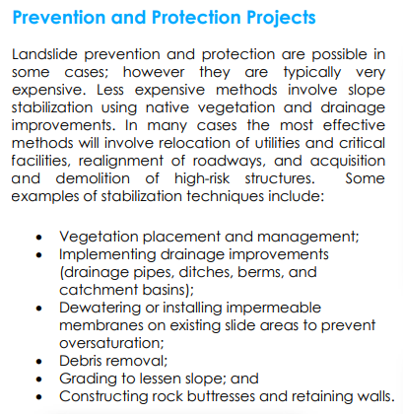
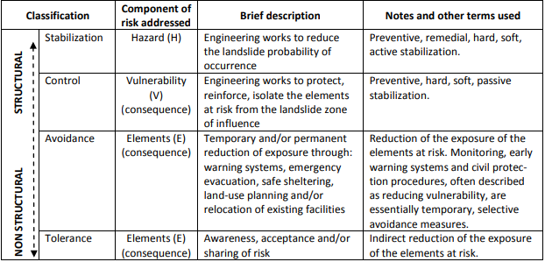
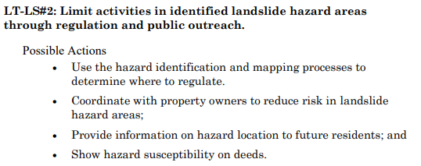
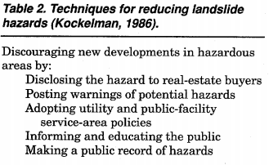
Outreach: Landslide Remediation
(1)
(2)
(4)
(3)
(1) https://files.dnr.state.mn.us/waters/watermgmt_section/shoreland/landslide-mitigation.pdf
(2) SafeLand Grant Agreement No.: 226479 (2011); Toolbox of landslide mitigation measures
(3) https://www.fema.gov/media-library-data/20130726-1440-20490-1637/fema_182.pdf
(4) https://www.beavertonoregon.gov/DocumentCenter/View/4662/NHMP-Chapter-9-Landslide
Notes:
https://files.dnr.state.mn.us/waters/watermgmt_section/shoreland/landslide-mitigation.pdf
SafeLand Grant Agreement No.: 226479 (2011); Toolbox of landslide mitigation measures
https://www.fema.gov/media-library-data/20130726-1440-20490-1637/fema_182.pdf
https://www.beavertonoregon.gov/DocumentCenter/View/4662/NHMP-Chapter-9-Landslide

Slide 42
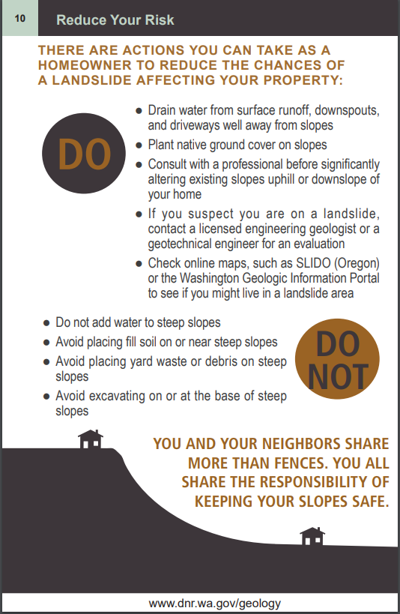
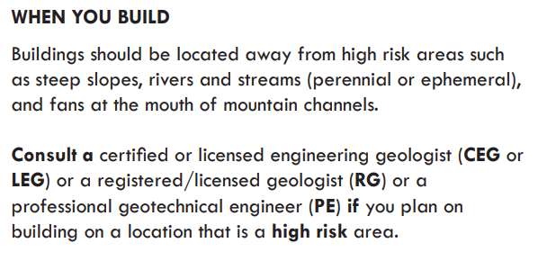

Outreach: For Homeowners
(1)
(2)
(3)
https://www.oregongeology.org/Landslide/ger_homeowners_guide_landslides.pdf
https://www.oregongeology.org/Landslide/homeowners-landslide-guide.pdf
https://www2.gov.bc.ca/assets/gov/public-safety-and-emergency-services/emergency-preparedness-response-recovery/embc/preparedbc/preparedbc-guides/preparedbc_landslide_info_for_homeowners_and_home_buyers_2018.pdf
Notes:
https://www.oregongeology.org/Landslide/ger_homeowners_guide_landslides.pdf
https://www.oregongeology.org/Landslide/homeowners-landslide-guide.pdf
https://www2.gov.bc.ca/assets/gov/public-safety-and-emergency-services/emergency-preparedness-response-recovery/embc/preparedbc/preparedbc-guides/preparedbc_landslide_info_for_homeowners_and_home_buyers_2018.pdf

Slide 43
Landslide Risk Assessment
Goals
Develop a landslide inventory
Create valid landslide models for specific WV regions
Generate county-level resolution landslide maps
Create an interactive web map application for displaying landslide models and variables
Use the new landslide models and information to update the State Hazard Mitigation Plan
QUESTIONS?
2015 Yeager Airport Slide

