Slide 1
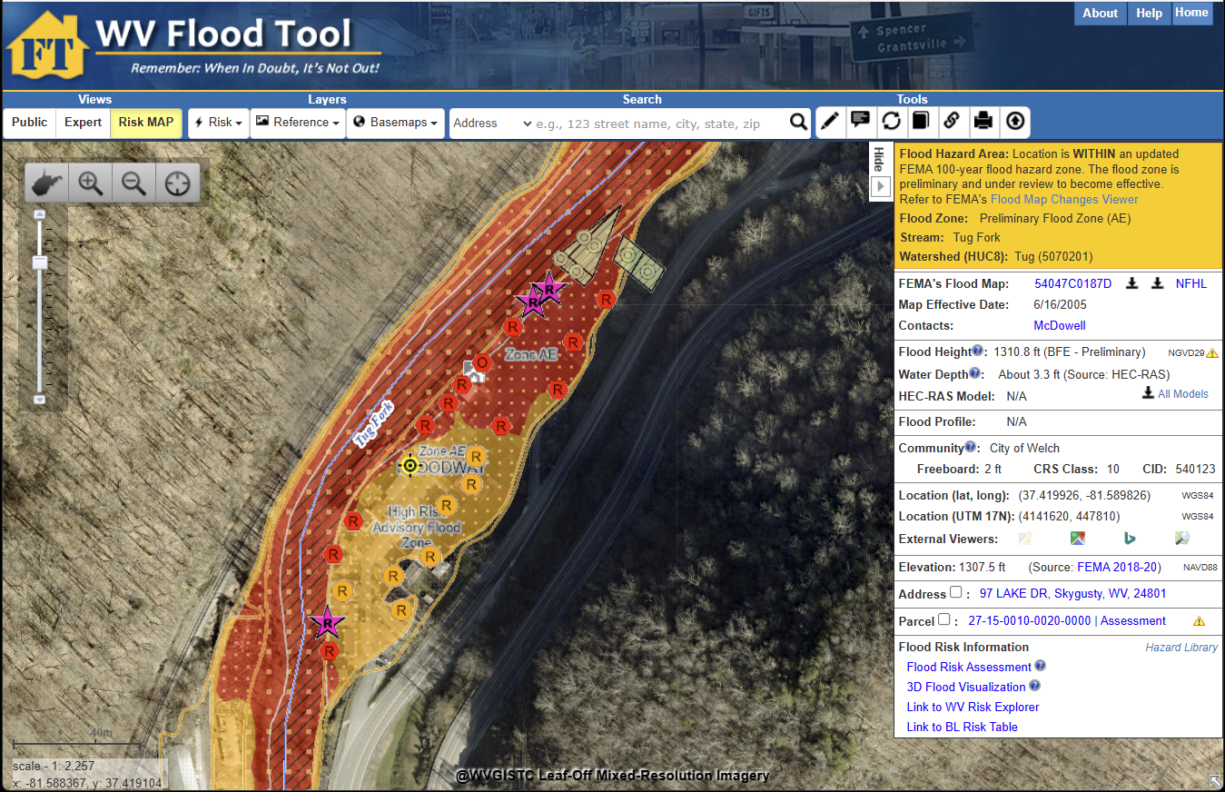
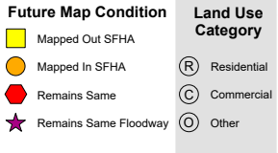
Map Changes on WV Flood Tool (McDowell County)
Preliminary Flood Zone (increased SFHA)
Buildings Mapped in increased SFHA
Orange-colored floodplains and buildings on the
WV Flood Tool denote newly mapped Special Flood Hazard Area (SFHA)
Floodway
WV Flood Tool

Slide 2
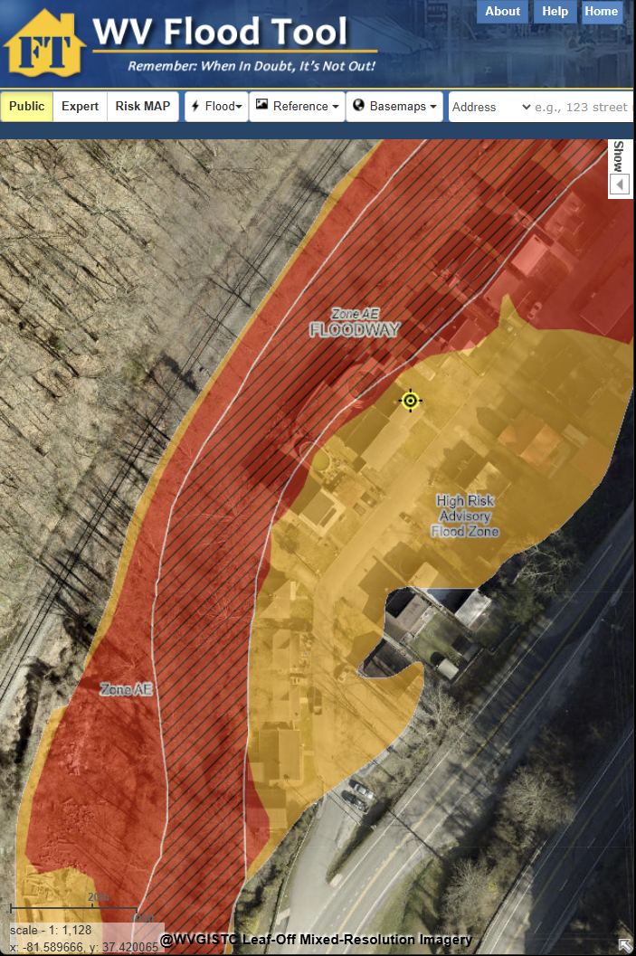
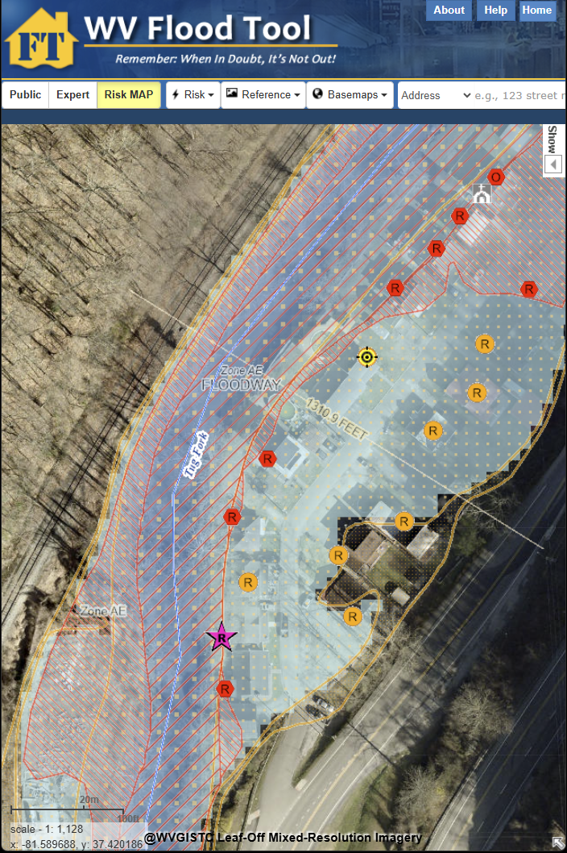
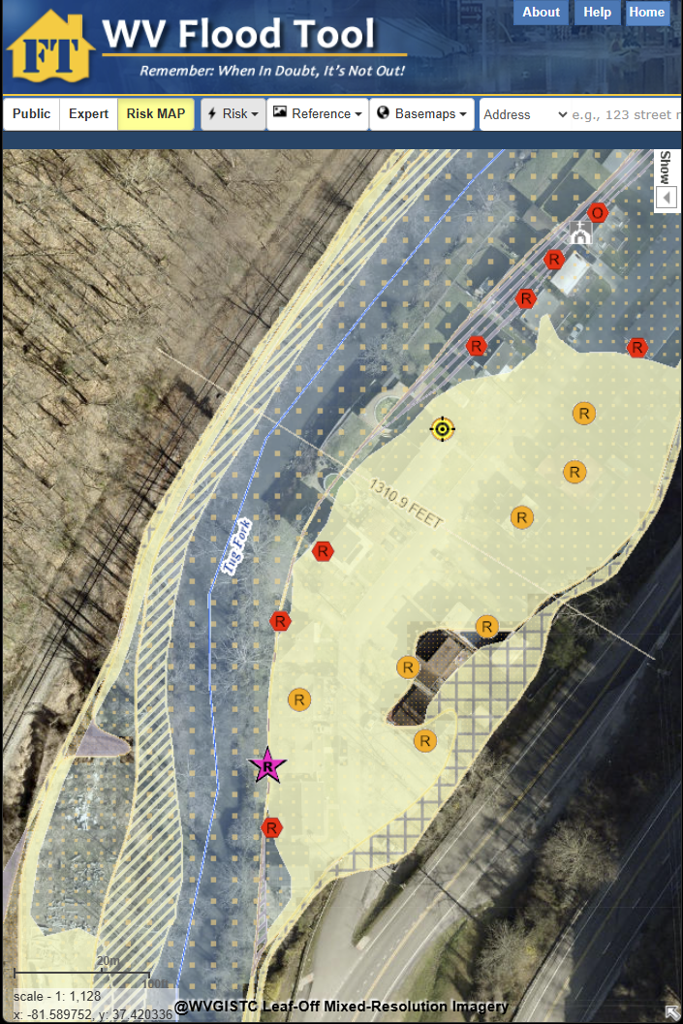

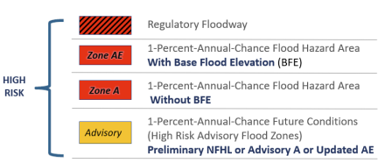
Map Changes on WV Flood Tool
Floodway
SFHA Increase
SFHA Increase
SFHA Increase
Public View – Floodplains
SFHA Increase (orange)
Risk MAP View – Primary Structures
Buildings Mapped in SFHA (orange)
Risk MAP View – CSLF Layer
SFHA Increase (yellow)

Slide 3
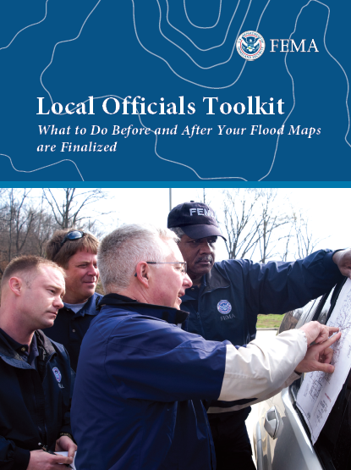
Property-Level Risk: 3,429 Primary Structures
SFHA: More buildings expected to be mapped in (+1,280) the SFHA than mapped out (-418)
Floodway: 121 buildings are newly mapped in the expanded Regulatory Floodway
Flood Depths: Buildings with highest flood depths (> 10 ft.) are along the Tug Fork & Elkhorn Creek
PRELIMINARY FLOODPLAIN BUILDING COUNTS | Special Flood Hazard Area (SFHA) 1% Annual Chance (100-Yr) Floodplain |  |  |  |  |  | Floodway
Community | Remaining in SFHA | Newly Mapped in SFHA* | Newly Mapped Out SFHA* | Total Structures in New SFHA | SFHA Net Change |  | Total Floodway | Floodway Net Change*
Anawalt, Town of | 46 | 6 | 1 | 52 | +5 |  | 21 | +1
Bradshaw, Town of | 20 | 31 | 0 | 51 | +31 |  | 3 | +1
Davy, Town of | 49 | 3 | 4 | 52 | -1 |  | 5 | 0
Gary, City of | 230 | 12 | 40 | 242 | -28 |  | 23 | +3
Iaeger, Town of | 44 | 15 | 3 | 59 | +12 |  | 1 | 0
Keystone, Town of | 68 | 3 | 16 | 71 | -13 |  | 16 | +3
Kimball, Town of | 61 | 2 | 13 | 63 | -11 |  | 28 | +3
Northfork, Town of | 124 | 15 | 3 | 139 | +12 |  | 23 | +18
War, Town of | 74 | 31 | 7 | 105 | +24 |  | 19 | +12
Welch, City of | 285 | 67 | 39 | 352 | +28 |  | 113 | +25
McDowell County* (Unincorporated) | 1,148 | 1,095 | 292 | 2,243 | +803 |  | 158 | +55
Total | 2,149 | 1,280 | 418 | 3,429 | +862 |  | 410 | +121
 |  | BLRA Link | BLRA Link | BLRA Link |  |  | BLRA Link | BLRA Link
*Local Officials can mail SFHA Map Change Letters of which the State NFIP Office can assist

Slide 4
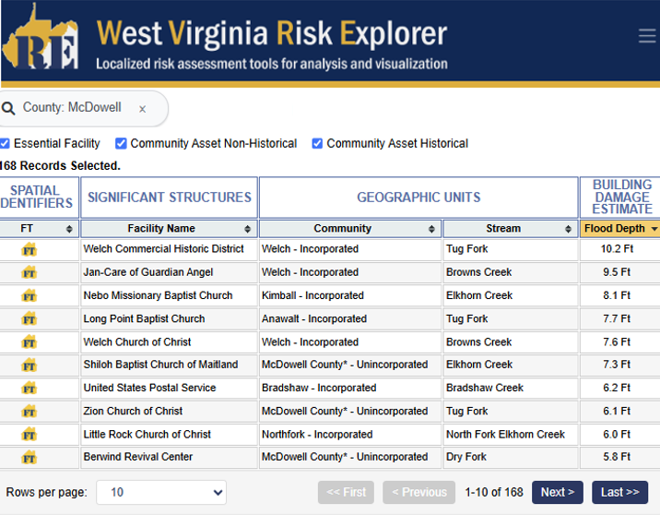
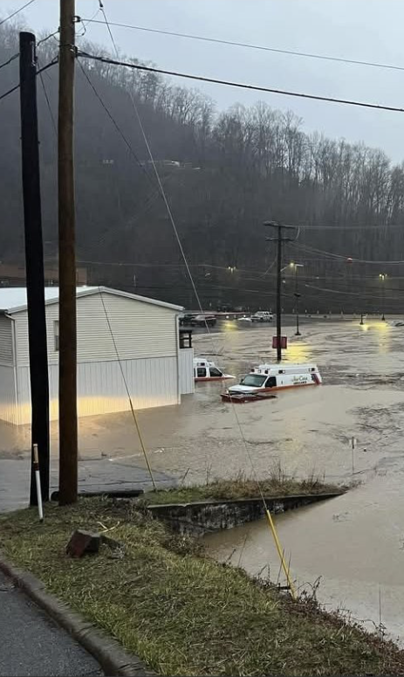
Property-Level Risk: 169 Significant Structures
169 Records Selected.
Web link to online report
Building Risk Tool: 31 Essential Facilities & 138 Community Assets
2025 Flooding of Jan-Care EMS
Essential facilities: Defined as K-12 schools, hospitals, nursing homes, fire/police stations, and E-911 offices. McDowell Co. #2 in State.
4 essential facilities have been Mapped In the high-risk floodplain
11 essential facilities have been Mapped Out of the high-risk floodplain
Note: Essential facilities are mapped to the 0.2% Annual Chance (500-yr) floodplain
Notes:
The mitigated Kimball Town Hall / Fire Station completed in 2006 has been mapped out of the moderate- and high-risk FEMA floodplains.

Slide 5
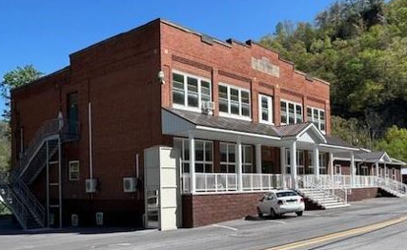
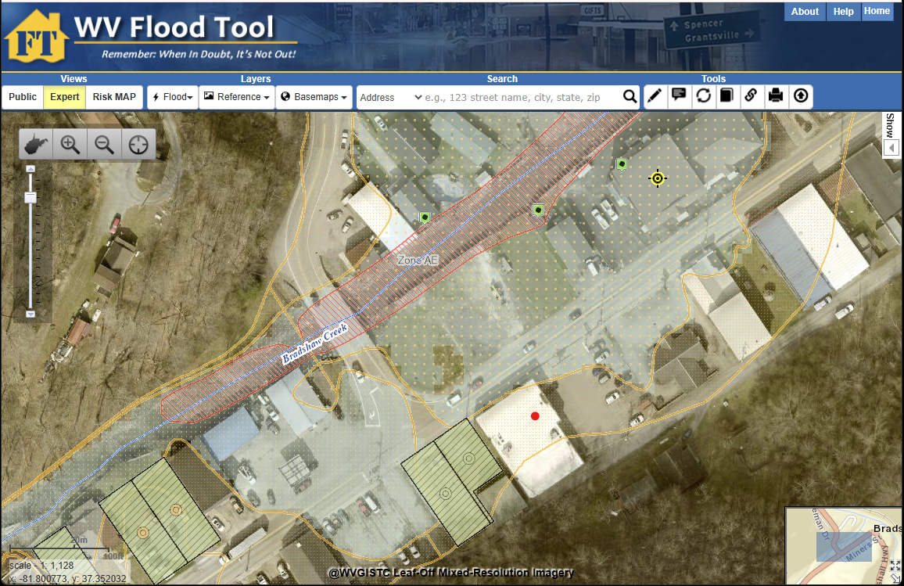
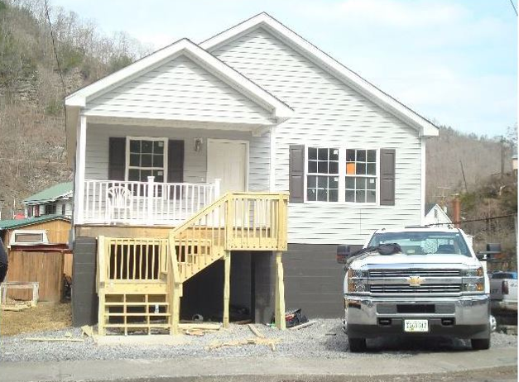
Property-Level Mitigation: Estimated Loss Avoidance = $125 Million
Open Space Preservation: McDowell County has the highest density of open space parcels in the state. Federal sponsors of voluntary buyout programs include the FEMA, USACE, and NRCS.
Mitigated Structures: Floodproofed buildings via USACE Section 202 projects
Mitigated Tools: WV Flood Tool | Mitigated Structures & Open Space Dashboards
Elevated Town Hall / Police Station (Bradshaw)
Mitigated Structures (green tag)
Bradshaw, WV
Mitigated Parcels
(green shaded parcels)
Elevated Residential Structure (Bradshaw)

Slide 6
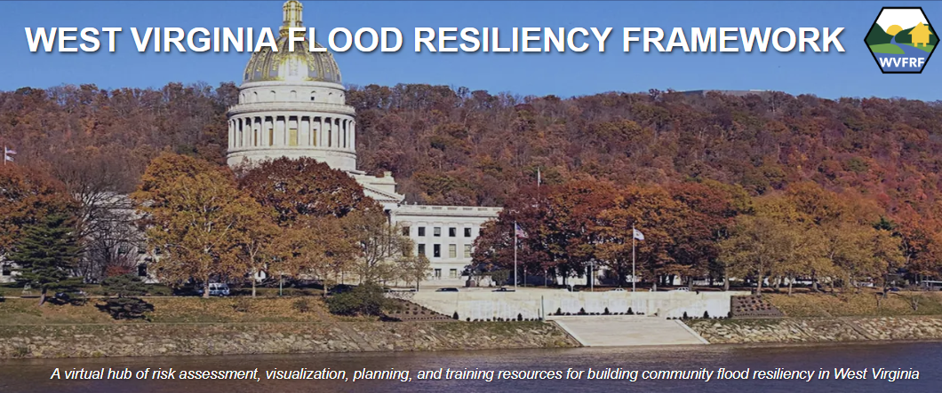




WV Flood Resiliency Tools (www.WVFRF.org)
WV Risk Explorer
WV Flood Tool
WV Property Viewer
WV Hazard Library

Slide 7
Cumulative Flood Risk Rankings – Multiple Scales
Geographic Scale | Geographic Entity | Rank | Total Entities in State | Indicator Rating | Risk Score | Top 20%
Region | PDC Region 1 | 3 | 11 | VERY HIGH | 80.0% | Yes
County | McDowell County | 3 | 55 | VERY HIGH | 96.2% | Yes
Unincorporated Area | McDowell - Unincorporated | 4 | 55 | VERY HIGH | 94.4% | Yes
Incorporated Place | Kimball - Incorporated | 5 | 229 | VERY HIGH | 98.2% | Yes
 | Northfork - Incorporated | 8 | 229 | VERY HIGH | 96.9% | Yes
 | Keystone - Incorporated | 13 | 229 | VERY HIGH | 94.7% | Yes
 | Gary - Incorporated | 15 | 229 | VERY HIGH | 93.8% | Yes
 | Welch - Incorporated | 22 | 229 | VERY HIGH | 90.7% | Yes
 | War - Incorporated | 30 | 229 | VERY HIGH | 87.2% | Yes
 | Davy - Incorporated | 47 | 229 | Relatively High | 79.8%
 | Iaeger - Incorporated | 49 | 229 | Relatively High | 78.9%
 | Anawalt - Incorporated | 51 | 229 | Relatively High | 78.0%
 | Bradshaw - Incorporated | 62 | 229 | Relatively High | 73.2%
Watershed | Tug Fork Watershed | 3 | 33 | VERY HIGH | 93.7% | Yes
Rivers/Streams | Tug Fork | 22 | 156 | VERY HIGH | 86.4% | Yes
 | Elkhorn Creek | 26 | 156 | VERY HIGH | 83.8% | Yes
 | Dry Fork | 35 | 156 | Relatively High | 78.0%
Riverine flood risk rankings from August 2024 analysis.
Risk data supports hazard and emergency operations plans, mitigation grants, etc.
County-Community Report | Risk Comparison Report

Slide 8

Top 10% Flood Risk Factors and Scores for McDowell County
category | Flood Risk Indicator | Value for McDowell | Indicator Score (0 - 100%) | Indicator Rating | State ranking
Building Exposure | Building Floodplain Count | 3,479 | 96.2% | VERY HIGH | 3
 | Building Floodway Count | 526 | 94.4% | VERY HIGH | 3
 | Building Floodplain Ratio | 17.6% | 92.5% | VERY HIGH | 5
 | Building Density | 0.80 /Acre | 96.2% | VERY HIGH | 3
Building Characteristics | Bldg. Year Pre-FIRM Ratio | 92.9% | 100.0% | VERY HIGH | 1
Critical Infrastructure | Essential Facilities | 32 | 98.1% | VERY HIGH | 2
 | Roads Inundated Ratio | 12.3% | 92.5% | VERY HIGH | 5
Community Assets | Community Assets Non-Historical | 116 | 98.1% | VERY HIGH | 2
Building Damage Loss | Bldg. Substantial Damage Count | 226 | 88.8% | Very High | 7
 | Bldg. Previous Damage Claims | 1,049 | 90.7% | VERY HIGH | 6
People / Social Vulnerabilities | Population in Floodplain Ratio | 45.0% | 100.0% | VERY HIGH | 1
 | Population Displaced Ratio | 30.4% | 100.0% | VERY HIGH | 1
 | WV Social Vulnerability Index | - | 100.0% | VERY HIGH | 1
12 of 25 riverine flood risk indicators among the top 10% counties
45% of population resides in the floodplain
93% of structures built before initial flood maps
High building exposure including essential facilities and community assets
Top 20% Report

Slide 9
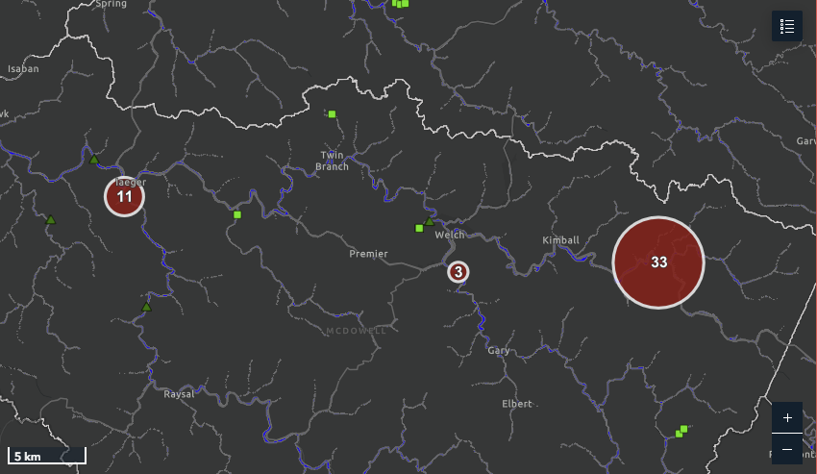


Flood Fatalities mapped for McDowell County(n=47)
Flood Fatality Dashboard
1901 Story Map & Graphic
2025 Fatality Map
1901 Flood
Dry Fork
2025 Flood
Tug Fork
1901 Flood
Elkhorn Creek

