Slide 1
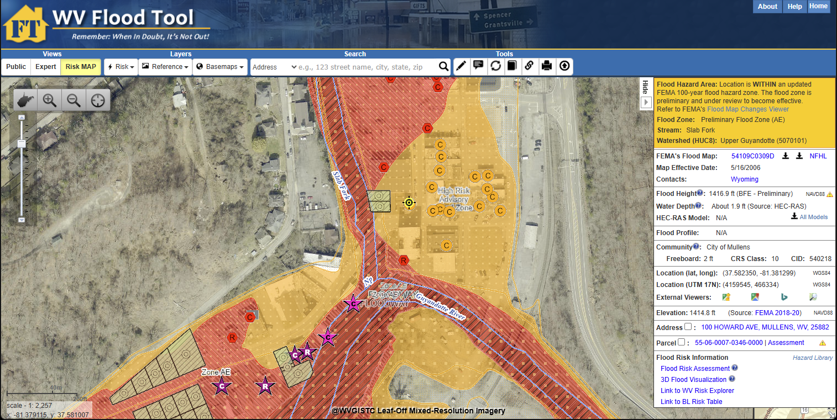
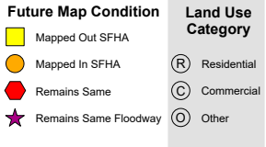
Map Changes on WV Flood Tool (Wyoming County)
Preliminary Flood Zone (increased SFHA)
Floodway
Slab Fork Profile
Backwater flooding of Slab Fork tributary happens when high water on major Guyandotte River blocks the smaller stream from draining. The main river's high water level acts like a dam. Water backs up the tributary channel, overflows the banks, and floods nearby land.
Buildings Mapped in increased SFHA
Orange-colored floodplains and buildings on the
WV Flood Tool denote newly mapped Special Flood Hazard Area (SFHA)
WV Flood Tool

Slide 2
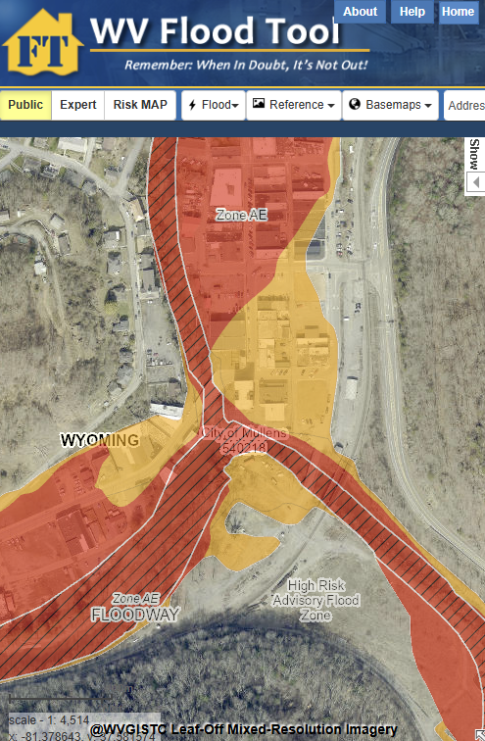
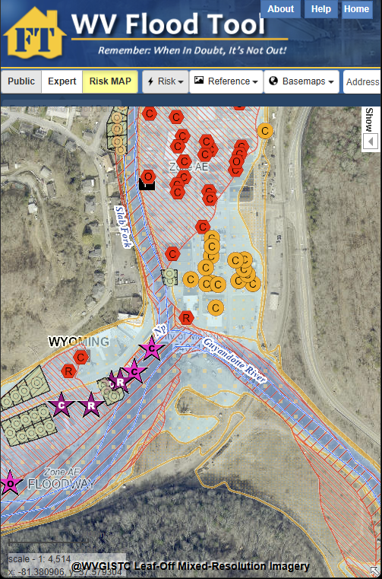
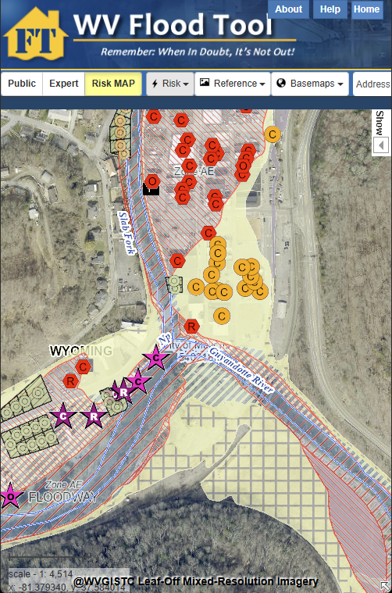
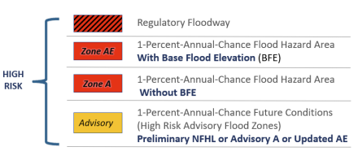

Map Changes on WV Flood Tool
SFHA Increase
SFHA Increase
SFHA Increase
Floodway
Public View – Floodplains
SFHA Increase (orange)
Risk MAP View – Primary Structures
Buildings Mapped in SFHA (orange)
Risk MAP View – CSLF Layer
SFHA Increase (yellow)

Slide 3
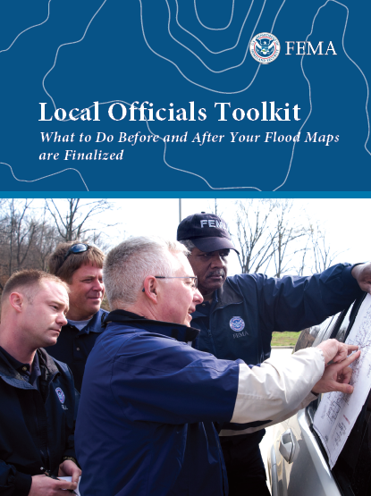
Property-Level Risk: 2,628 Primary Structures
SFHA: More buildings expected to be mapped in (+1,110) the SFHA than mapped out (-306)
Impact: Mandatory flood insurance requirement for federally-backed loans
Floodway: 135 buildings are newly mapped in the expanded Regulatory Floodway
Impact: Engineering study requirement for new development
Flood Depths: 11 buildings with high flood depths (> 10 ft.) are along the Guyandotte River & Beech Branch
Impact: Deeper flood waters make building elevation more expensive
PRELIMINARY FLOODPLAIN BUILDING COUNTS | Special Flood Hazard Area (SFHA) 1% Annual Chance (100-Yr) Floodplain |  |  |  |  |  | Floodway
Community | Remaining in SFHA | Newly Mapped in SFHA* | Newly Mapped Out SFHA* | Total Structures in New SFHA | SFHA Net Change |  | Total Floodway | Floodway Net Change*
Mullens, City of | 90 | 136 | 14 | 226 | +122 |  | 26 | +14
Oceana, Town of | 144 | 92 | 43 | 236 | +49 |  | 44 | +34
Pineville, Town of | 97 | 23 | 5 | 120 | +18 |  | 5 | 0
Wyoming County* (Unincorporated) | 1,187 | 859 | 244 | 2,046 | +615 |  | 150 | +87
Total | 1,518 | 1,110 | 306 | 2,628 | +804 |  | 225 | +135
 |  | BLRA Link | BLRA Link | BLRA Link |  |  | BLRA Link | BLRA Link
*Local Officials can mail SFHA Map Change Letters of which the State NFIP Office can assist
A significant number of buildings for the communities of Mullens and Oceana are mapped into the SFHA and Floodway

Slide 4
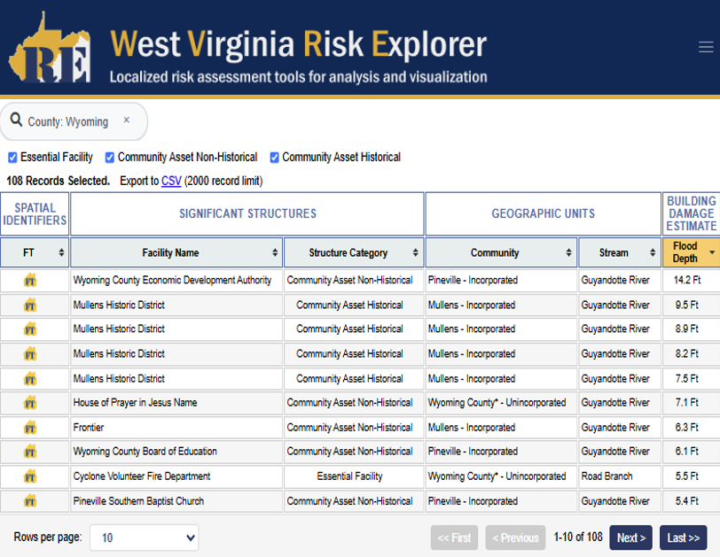
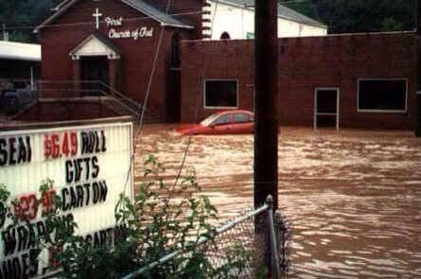
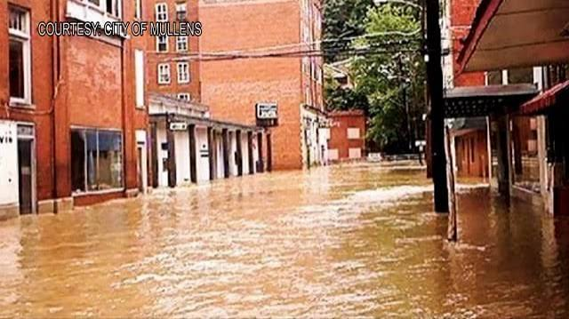
Property-Level Risk: 108 Significant Structures
Web link to online report
Oceana Church of God (2001 Flood)
Community Asset (Non-Historical)
Mullens Historic District (2001 Flood)
Community Asset (Historical)
Building Risk Tool: 10 Essential Facilities & 98 Community Assets
Three essential facilities have been Mapped In the high-risk floodplain: Cyclone FD, Road Branch School, & Berlin McKinney School
Note: Essential facilities are mapped to the 0.2% Annual Chance (500-yr) floodplain

Slide 5
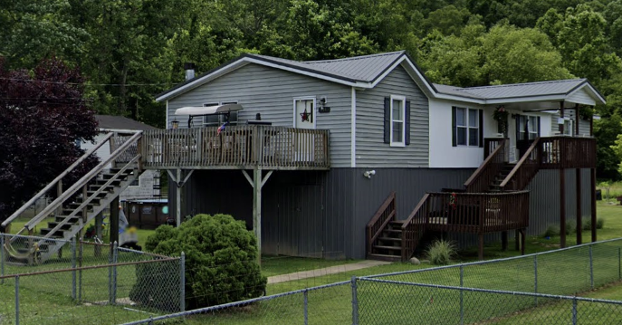
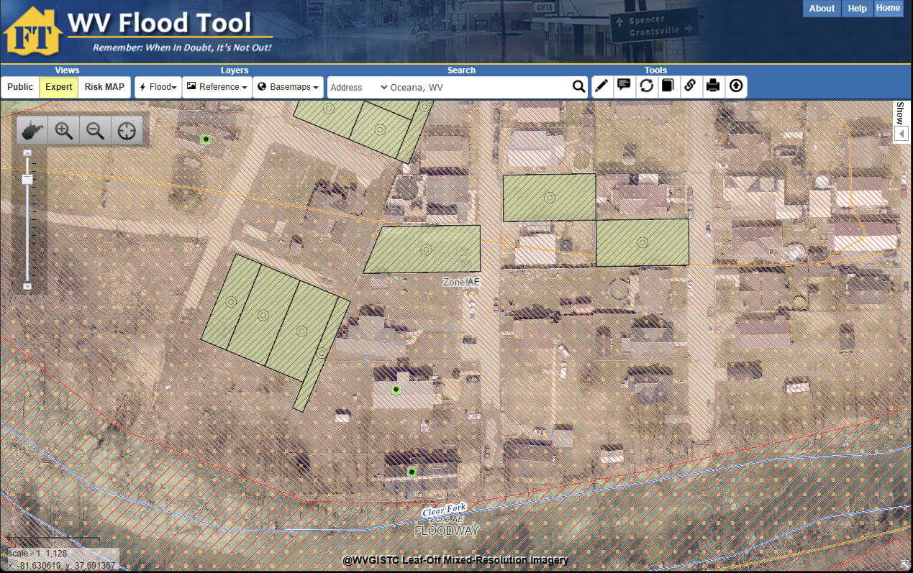
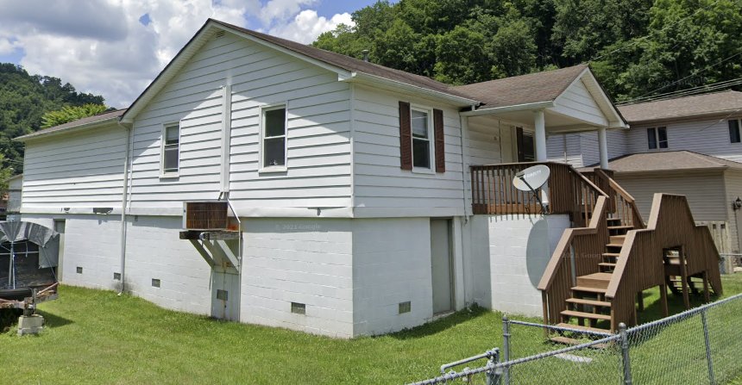
Property-Level Mitigation: Estimated Loss Avoidance = $45 Million
Open Space Preservation: Wyoming County has a high density of deed-restricted open space parcels, ranked 4th in the State. Federal sponsors of the voluntary parcel acquisitions are FEMA, HUD, and NRCS.
Mitigated Structures: Multiple floodproofed elevated structures exist in County
Mitigated Tools: WV Flood Tool | Mitigated Structures & Open Space Dashboards
Oceana, WV
Residential Elevated Structures (Oceana, WV)
Mitigated Parcels
(green shaded parcels)
Mitigated Structures (green tag)

Slide 6
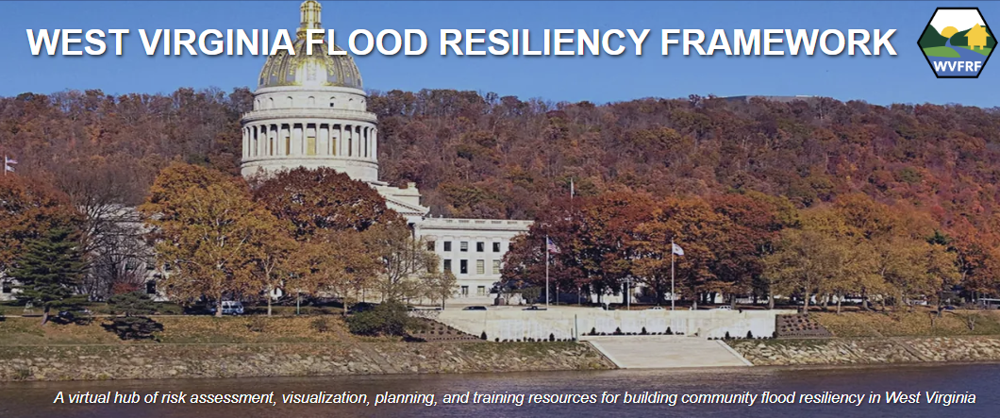




WV Flood Resiliency Tools (www.WVFRF.org)
WV Risk Explorer
WV Flood Tool
WV Property Viewer
WV Hazard Library

Slide 7
Cumulative Flood Risk Rankings – Multiple Scales
Geographic Scale | Geographic Entity | Rank | Total Entities in State | Indicator Rating | Risk Score | Top 20%
Region | PDC Region 1 | 3 | 11 | Relatively High | 80.0% | Yes
County | Wyoming County | 6 | 55 | VERY HIGH | 90.7% | Yes
Unincorporated Area | Wyoming - Unincorporated | 8 | 55 | Relatively High | 87.0% | Yes
Incorporated Place | Oceana - Incorporated | 12 | 229 | VERY HIGH | 95.1% | Yes
 | Pineville – Incorporated | 33 | 229 | Relatively High | 85.9% | Yes
 | Mullens - Incorporated | 41 | 229 | Relatively High | 82.4% | Yes
Watershed | Upper Guyandotte Watershed | 5 | 33 | Relatively High | 87.5% | Yes
Rivers/Streams | Guyandotte River | 22 | 156 | Relatively High | 86.4% | Yes
 | Clear Fork | 26 | 156 | Relatively High | 83.8% | Yes
Riverine flood risk rankings from August 2024 analysis.
Risk data supports hazard and emergency operations plans, mitigation grants, etc.
County-Community Report | Risk Comparison Report

Slide 8


Top 20% Flood Risk Factors and Scores for Wyoming County
category | Flood Risk Indicator | Value for WYOMING | Indicator Score (0 - 100%) | Indicator Rating | State ranking
Floodplain Characteristics | Flood Declared Disasters | 21 | 88.8% | Very High | 7
Building Exposure | Building Floodplain Count | 2,592 | 87.0% | Very High | 8
 | Building Floodway Count | 268 | 83.3% | Very High | 10
 | Building Floodplain Ratio | 18.6% | 96.2% | VERY HIGH | 3
 | Building Density | 0.48 /Acre | 90.7% | VERY HIGH | 6
Building Characteristics | Bldg. Mobile Homes Ratio | 35.2% | 85.1% | Very High | 9
 | Building 1-Story Ratio | 93.3% | 90.7% | VERY HIGH | 6
Critical Infrastructure | Roads Inundated Ratio | 12.9% | 94.4% | VERY HIGH | 4
Community Assets | Community Assets Non-Historical | 80 | 90.7% | VERY HIGH | 5
Building Damage Loss | Bldg. Previous Damage Claims | 902 | 87.0% | Very High | 8
 | Bldg. Repetitive Loss Structures | 283 | 90.7% | VERY HIGH | 6
People / Social Vulnerabilities | Population in Floodplain Ratio | 30.0% | 90.7% | VERY HIGH | 6
 | Population Displaced Ratio | 17.6% | 90.7% | VERY HIGH | 6
 | WV Social Vulnerability Index |  | 98.1% | VERY HIGH | 2
9 of 25 riverine flood risk indicators among the top 10% counties
High percentage of buildings in floodplain and floodway
30% of population resides in the floodplain
Top 20% Report

Slide 9
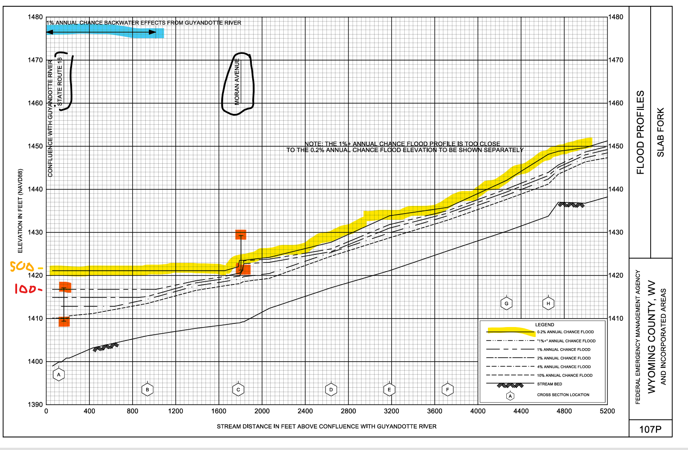
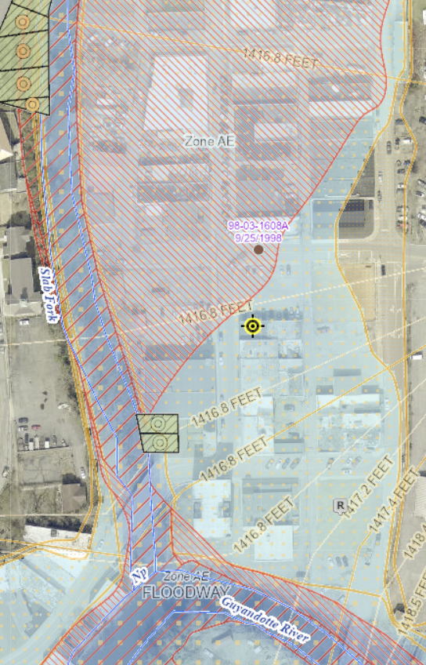
New Flood Profiles: Backwater Flooding of Slab Fork, Mullens WV
Preliminary Flood Maps
1% BFE = 1416.8 feet
0.2% FE = 1421.1 feet
FIS Flood Profile
WV Flood Tool Map
Backwater flooding of Slab Fork tributary happens when high water on major Guyandotte River blocks the smaller stream from draining. The main river's high water level acts like a dam. Water backs up the tributary channel, overflows the banks, and floods nearby land.
Backwater
Mullens flood elevation (FE) = 1421.1 feet for 0.2% Annual Chance (500-yr) flood, like the severe July 2001 flood event.
Mullens base flood elevation (BFE) = 1416.8 feet for a 1% Annual Chance (100-yr) flood event

