Slide 1


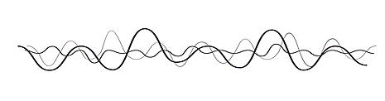
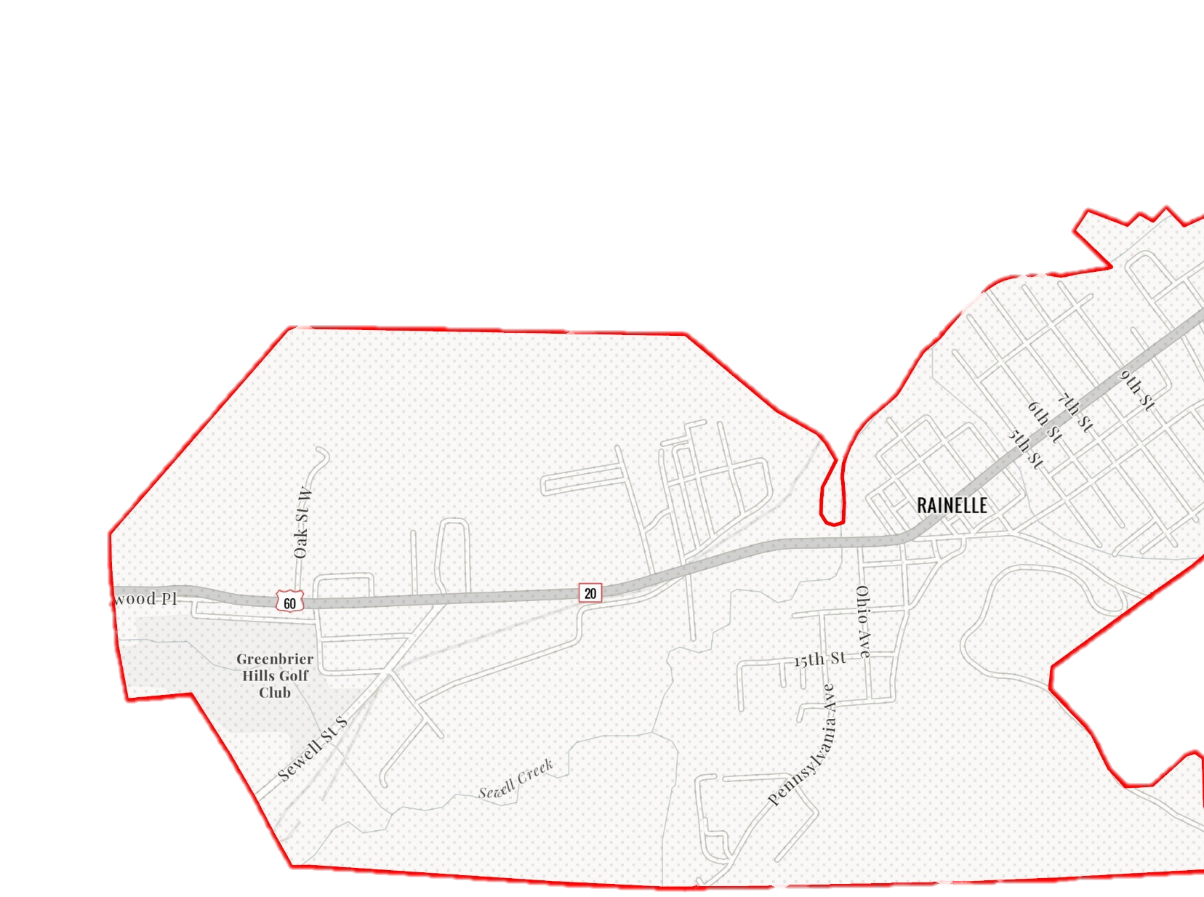
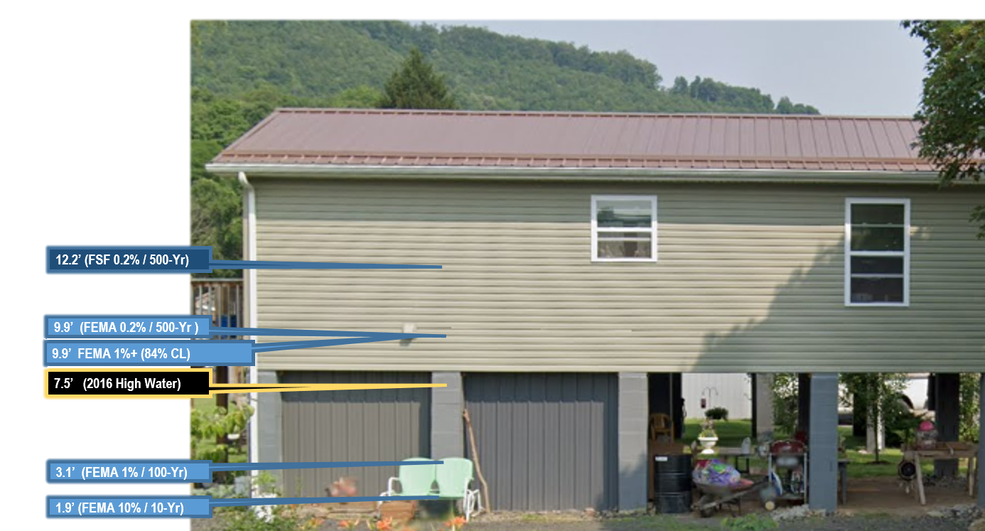
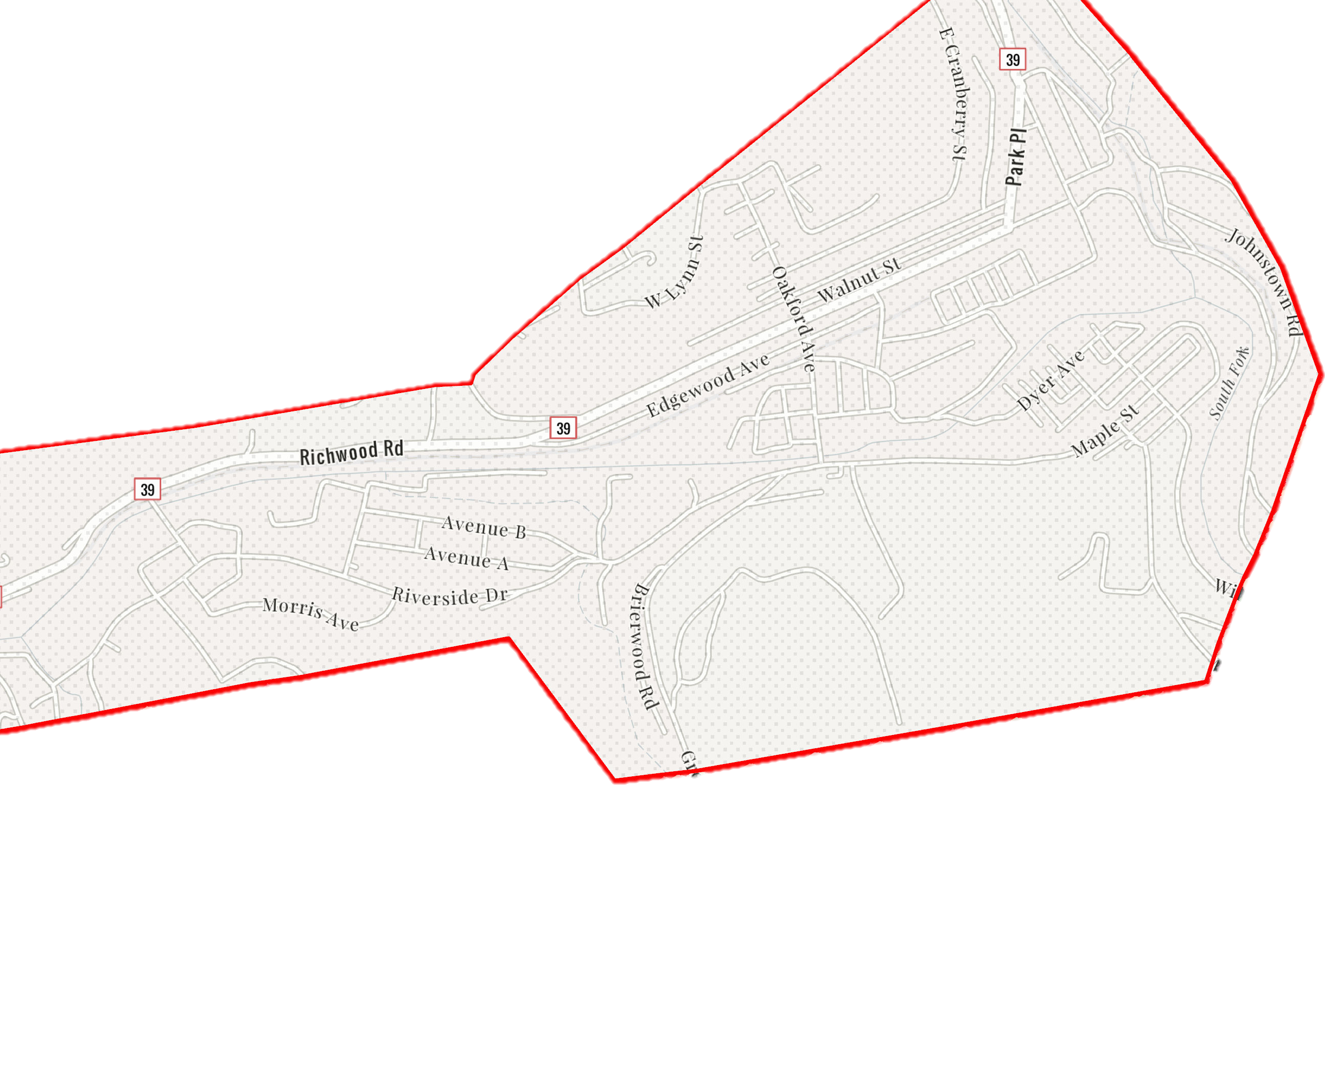
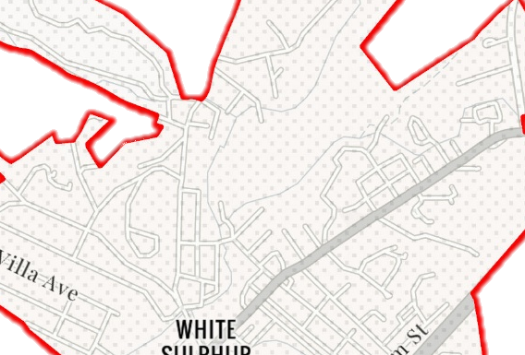
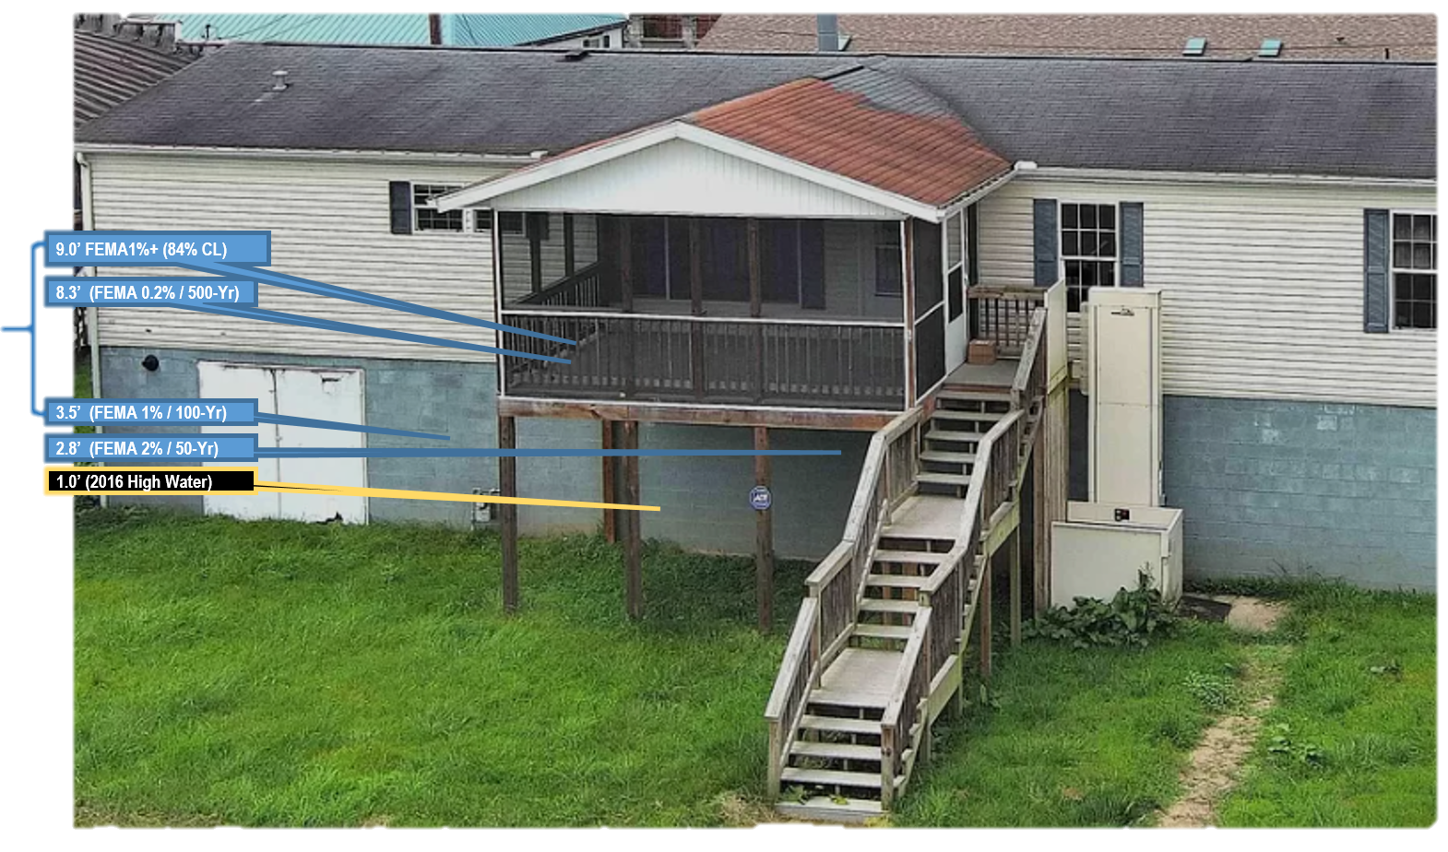
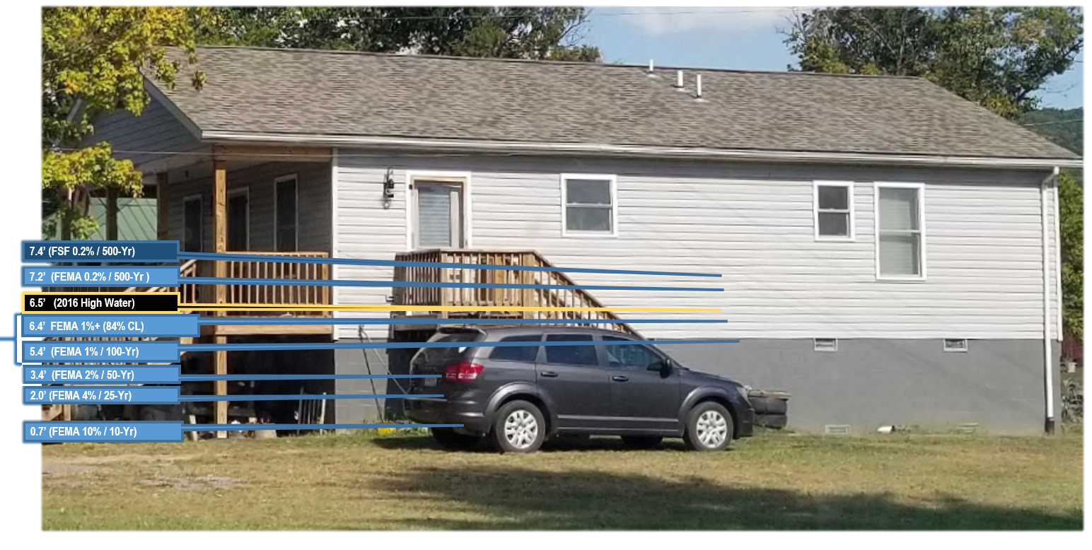
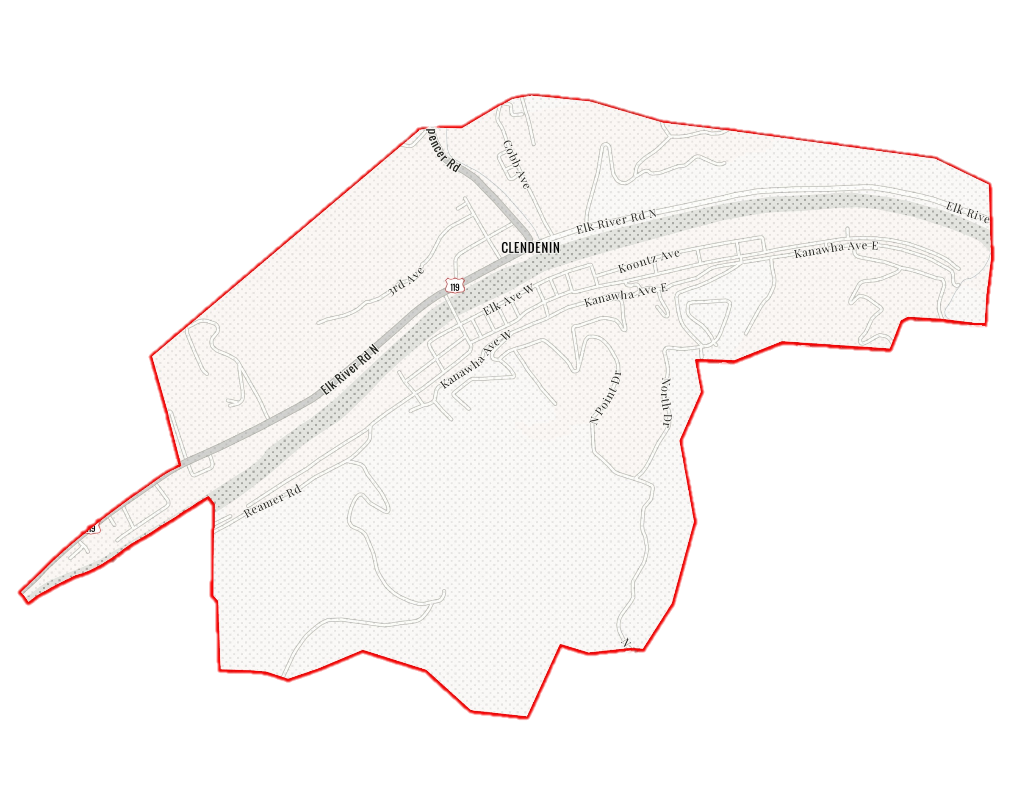
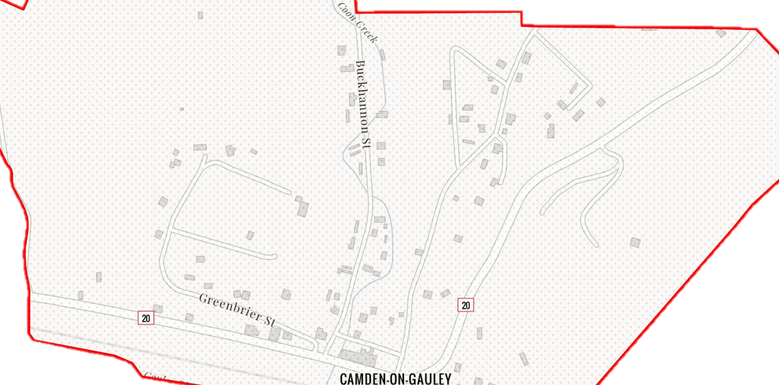
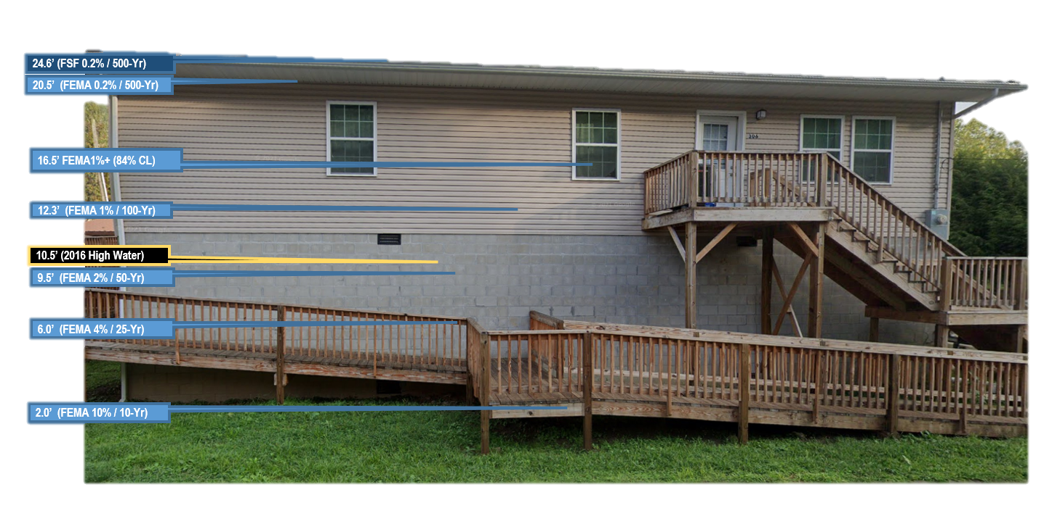
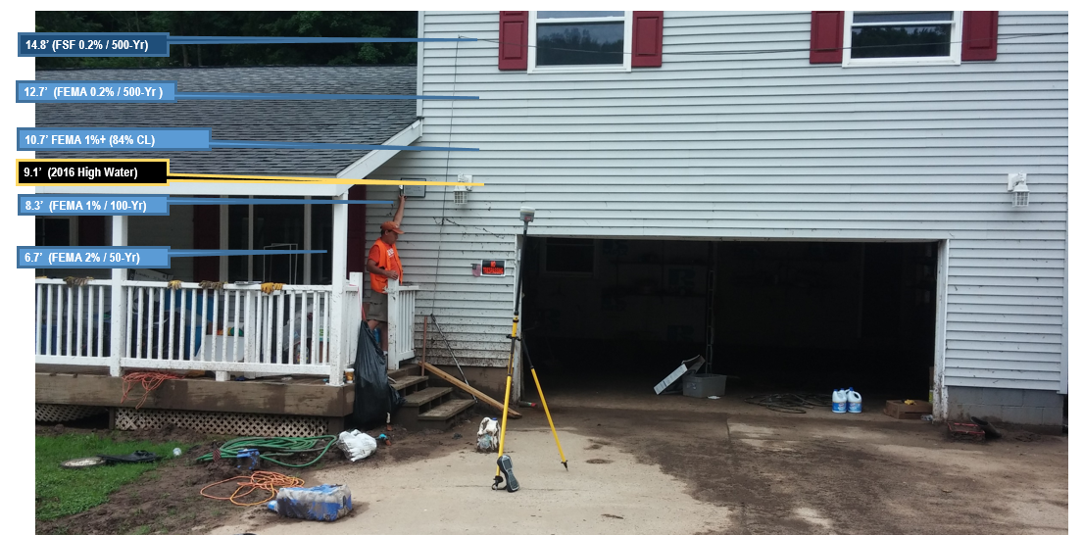
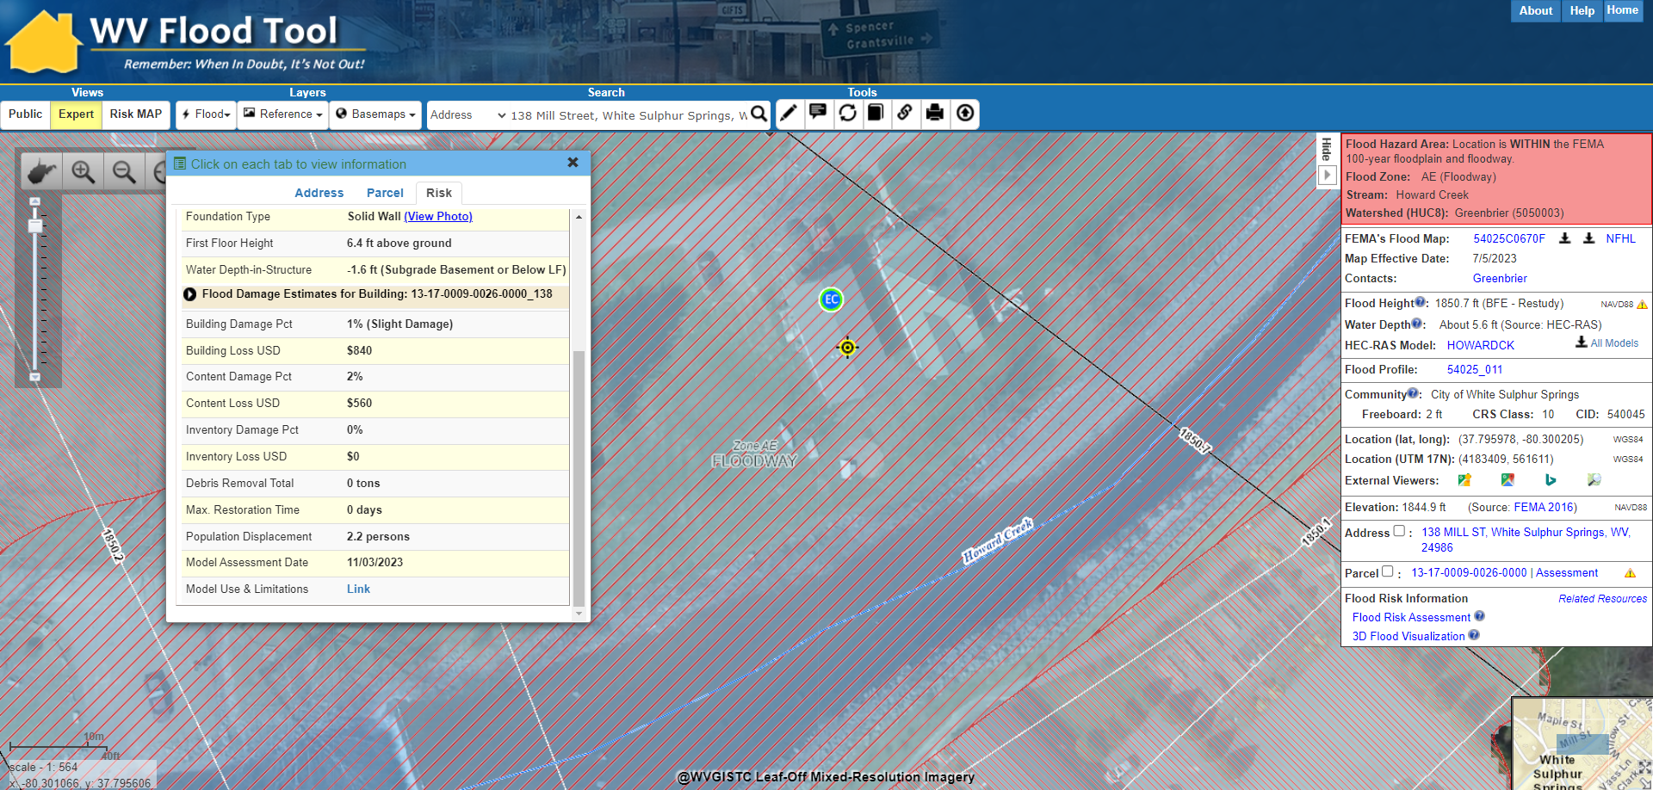
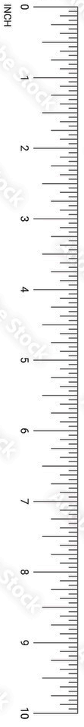
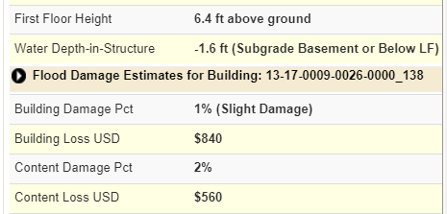

Flood Risk Visualization, Building Level WVFRF, Feb. 2024
FLOOD RISK VISUALIZATION TOOLS
Visualization Products (select products include narrations). A map index provides a spatial gateway to flood visualizations and videos.
i) Building-Level Visualizations
(1)Building Flood Profiles for different sized storms
(2) Building Flood Depth and Damage Assessment (WV Flood Tool)
ii) Community-Level Visualizations (graphic or narrated movies at community or viewshed levels)
iii) Story Maps
iv) Other video or visualization products
Frequency: Probability that a flood of a specific size will be equaled or exceeded in any given year.
A collection of movies, animations, story maps, and other flood visualization tools available at the building and community levels for communicating and understanding flood risk in West Virginia.
a) Visualization Content
Flood Frequency Probability & Magnitude
ii) Damage Assessments
iii) Mitigated and unmitigated properties
FEMA
Flood Recurrence Interval and Flood Size | Annual Probability | Cumulative Probability - Flooding at least once over 30 years | FEMA Risk Description
500 yr (1 in 500) | 0.2% | 6% | Moderate Risk
100 yr (1 in 100) Plus confidence error | 1%+
100 yr (1 in 100) | 1% | 26% | High Risk
50 yr (1 in 50) | 2% | 45% | High Risk
25 yr (1 in 25) | 4% | 71% | High Risk
10 yr (1 in 10) | 10% | 96% | High Risk
Rainelle
182 Seventh Street, Rainelle, WV, 25962
 | HEIGHT (ft.)
BUILDING
First Floor Height | 9
Freeboard (FBD) | 2
FLOOD DEPTH
FEMA 10% (10-Yr) | NA
FEMA 4% (25-Yr) | NA
FEMA 2% (50-Yr) | 1.9
2016 Flood HWM | 7.5
FEMA 1% (100-Yr) | 3.1
FEMA 100-Yr + FBD | 5.1
FEMA 1%+ (84% CL) | 9.9
FEMA 0.2% (500-Yr) | 9.9
FSF 0.2% (500-Yr) Climate | 12.2
Relationship between flood recurrence intervals and the probability of an event occurring within a given period.
Richwood
113 Valley Ave, Richwood, WV
 | HEIGHT (ft.)
BUILDING
First Floor Height | 8
Freeboard (FBD) | 2
FLOOD DEPTH
FEMA 10% (10-Yr) | 0
FEMA 4% (25-Yr) | 0
FEMA 2% (50-Yr) | 2.8
2016 Flood HWM | 1.0
FEMA 1% (100-Yr) | 3.5
FEMA 100-Yr + FBD | 5.5
FEMA 1%+ (84% CL) | 9.0
FEMA 0.2% (500-Yr) | 8.3
FSF 0.2% (500-Yr) | 6.7
White Sulphur Springs
138 Mill Street, White Sulphur Springs, WV, 24986
 | HEIGHT (ft.)
BUILDING
First Floor Height | 6.4
Freeboard (FBD) | 2.0
FLOOD DEPTH
FEMA 10% (10-Yr) | 0.7
FEMA 4% (25-Yr) | 2.0
FEMA 2% (50-Yr) | 3.4
2016 Flood HWM | 6.5
FEMA 1% (100-Yr) | 5.4
FEMA 100-Yr + FBD | 7.4
FEMA 1%+ (84% CL) | 6.4
FEMA 0.2% (500-Yr) | 7.2
FSF 0.2% (500-Yr) | 7.4
Clendenin
306 Maywood Ave., Clendenin, WV, 25045
 | HEIGHT (ft.)
BUILDING
First Floor Height | 12.0
Freeboard (FBD) | 2.0
FLOOD DEPTH
FEMA 10% (10-Yr) | 2.0
FEMA 4% (25-Yr) | 6.0
FEMA 2% (50-Yr) | 9.5
2016 Flood HWM | 10.5
FEMA 1% (100-Yr) | 12.3
FEMA 100-Yr + FBD | 14.3
FEMA 1%+ (84% CL) | 16.5
FEMA 0.2% (500-Yr) | 20.5
FSF 0.2% (500-Yr) | 24.6
91 RIVERSIDE DR, Camden On Gauley, WV, 26208
Camden on Gauley
 | HEIGHT (ft.)
BUILDING
First Floor Height | 4
Freeboard (FBD) | 2
FLOOD DEPTH
FEMA 10% (10-Yr) | 1.9
FEMA 4% (25-Yr) | 4.4
FEMA 2% (50-Yr) | 6.7
2016 Flood HWM | 9.1
FEMA 1% (100-Yr) | 8.3
FEMA 100-Yr + FBD | 10.3
FEMA 1%+ (84% CL) | 10.7
FEMA 0.2% (500-Yr) | 12.7
FSF 0.2% (500-Yr) Climate | 14.8
Flood Profile
Comparing Flood Depths in Five Pilot Communities
Building Flood Depth and Damage Assessment (WV Flood Tool)
Community | Physical Address | Flood Depth in Ft (Current Study)
 |  | Effective Date | 10 year (10%) | 25 year (4%) | 50 year (2%) | 100 year (1%) | 100 year Plus(1%+) | 500 year (0.2%)
White Sulphur Springs | 138 Mill Street, White Sulphur Springs, WV, 24986 | Effective: 2023 | 0.2 | 2.0 | 3.4 | 5.4 | 6.4 | 7.2
Rainelle | 182 SEVENTH ST, Rainelle, WV, 25962 | Effective: 2023 | NA | 0.1 | 1.9 | 3.9 | 9.9 | 9.9
Richwood | 3 Short St, Richwood, WV, 26261 | Effective: 2021 | NA | NA | 2.8 | 3.5 | 9.0 | 8.3
Clendenin | 306 Maywood Ave., Clendenin, WV, 25045 | Effective: 2023 | 2.0 | 6.0 | 9.5 | 12.3 | 16.5 | 20.5
Camden | 81 RIVERSIDE DR, Camden On Gauley, WV, 26208 | Effective: 2022 | 1.9 | 4.4 | 6.7 | 8.3 | 10.7 | 12.7

