Slide 1


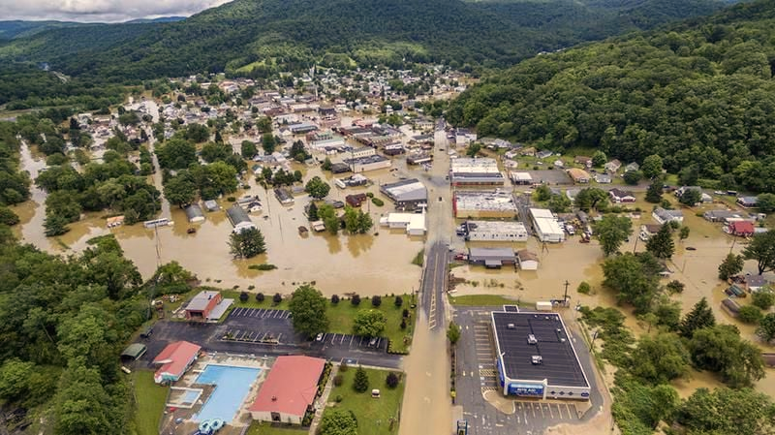
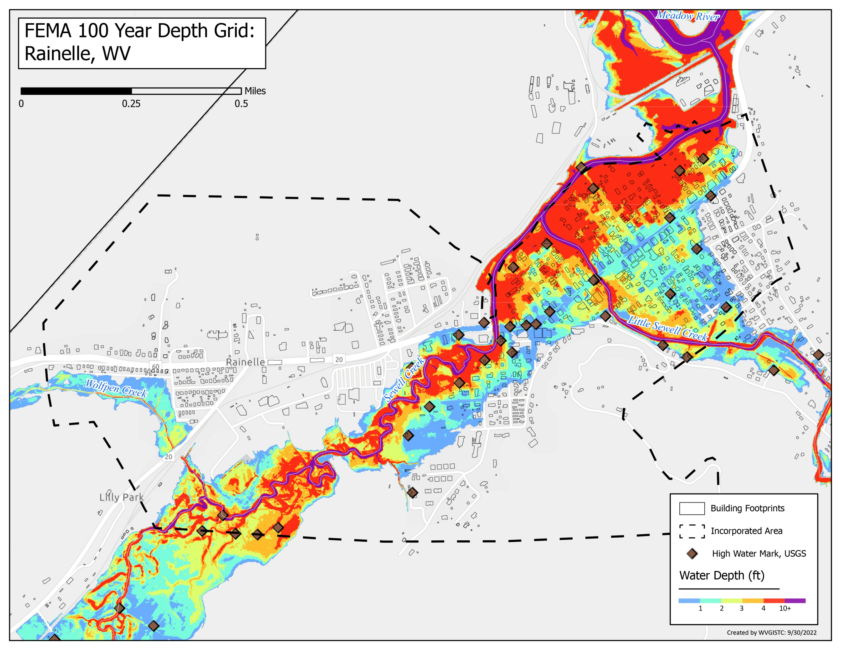
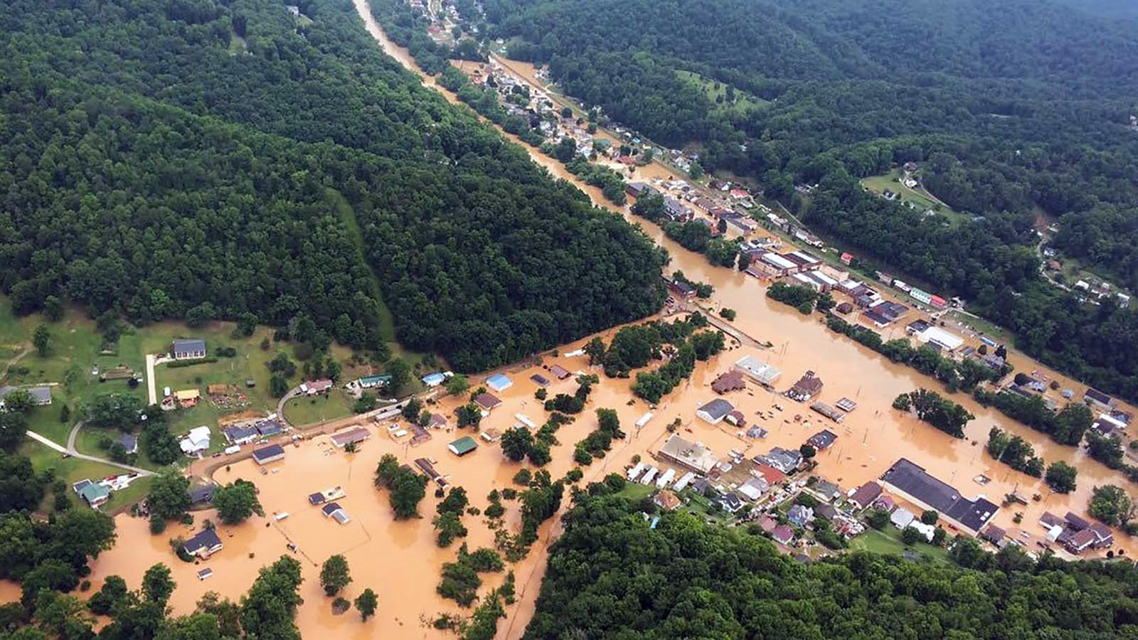
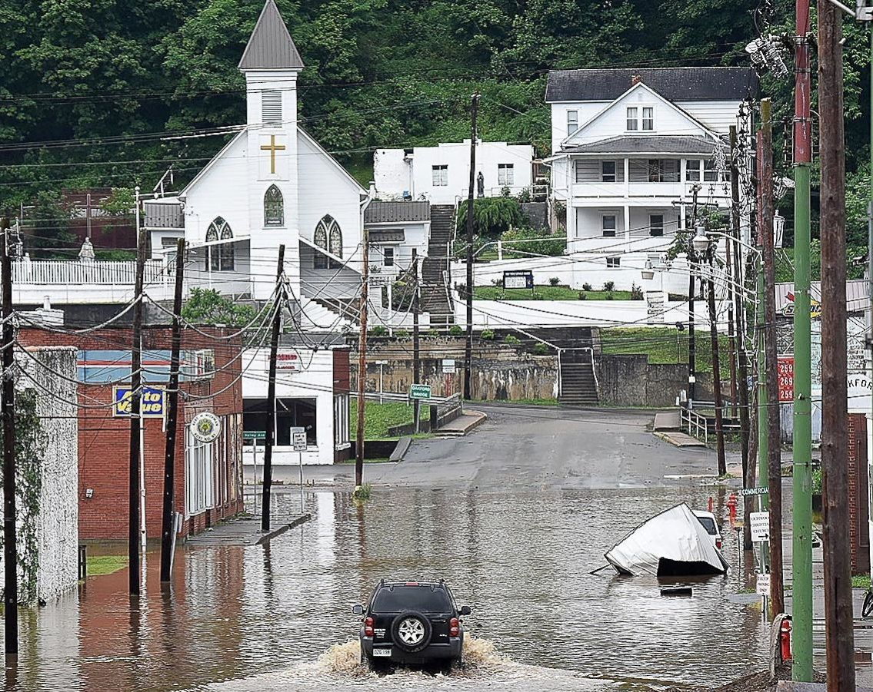
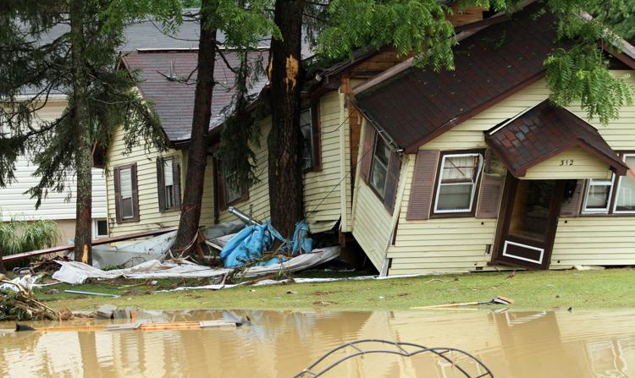
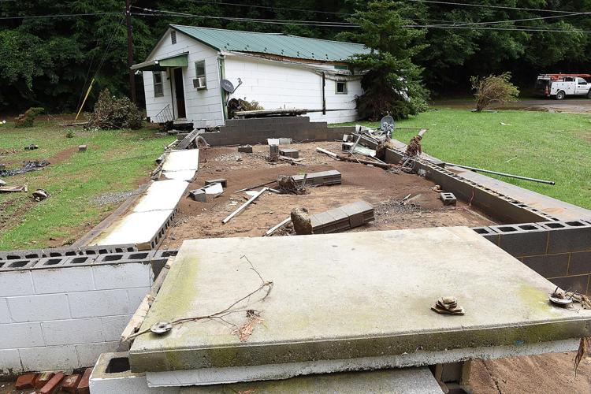
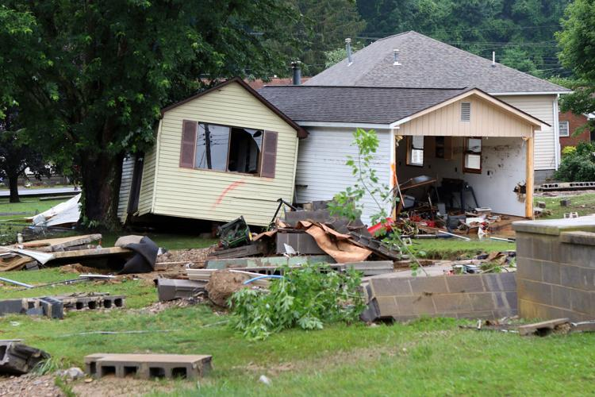
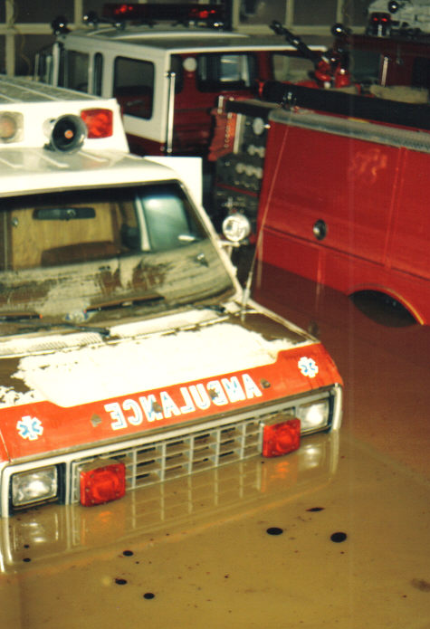
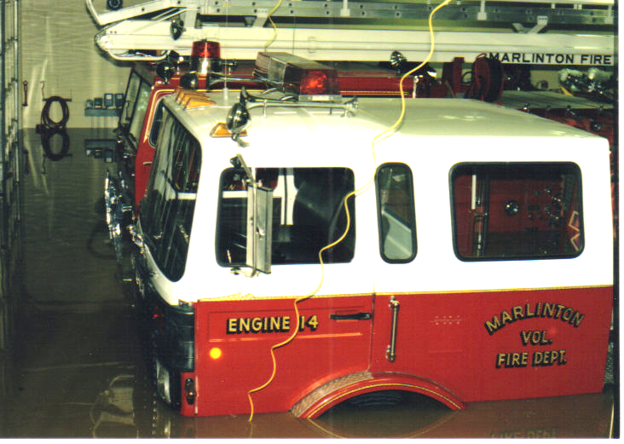
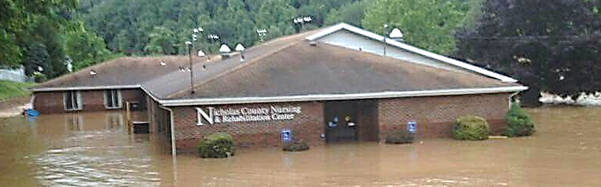
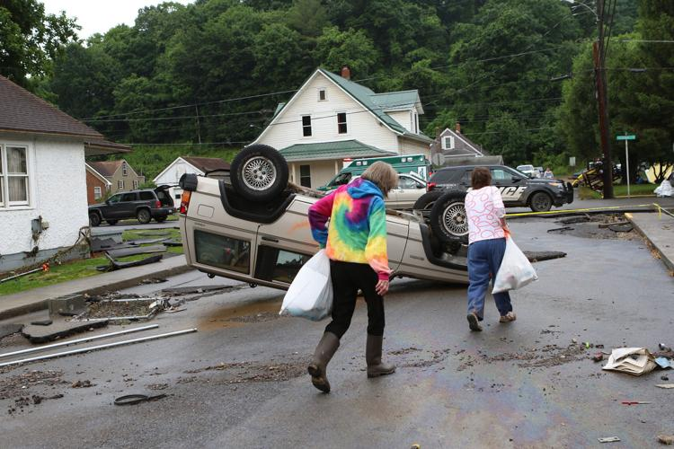
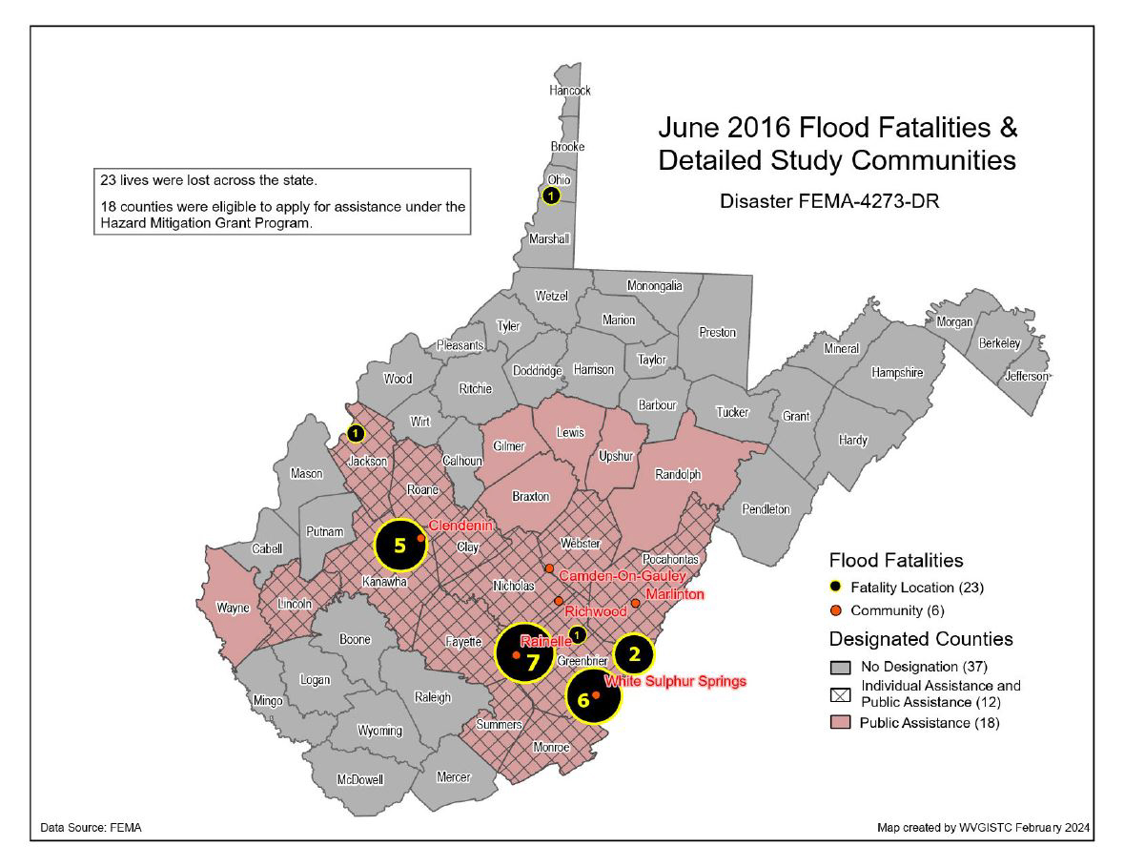
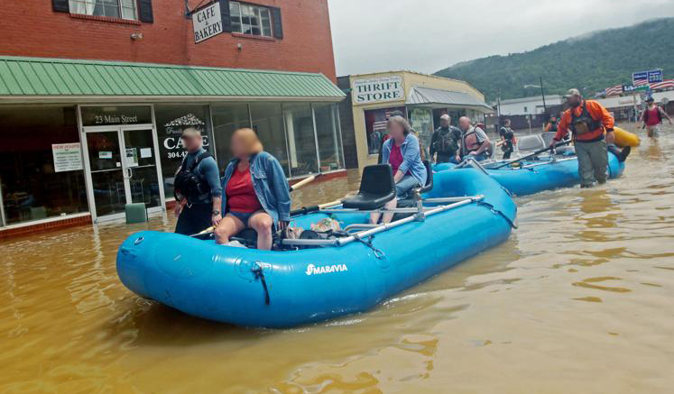
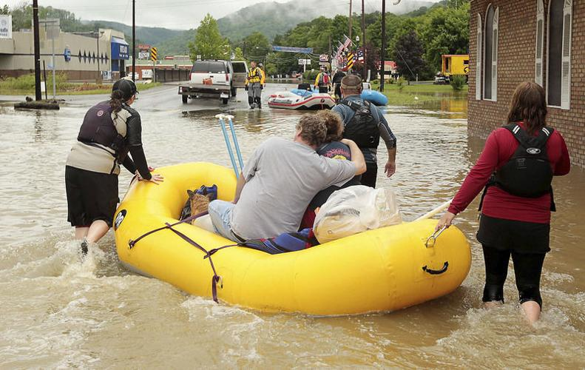
Community Flood Risk Assessment, WVFRF, Feb. 2024
Flood Hazard Risk
Flood Hazard Indicators | White Sulphur Springs | Rainelle | Clendenin | Richwood | Marlinton | Camden-on-Gauley | Statewide Median/Ratio
Regulatory Floodplain Area (Modified aSFHA) | 267 | 223 | 235 | 247 | 494 | 35 | 74
Regulatory Floodplain Area Ratio | 22.0% | 31.2% | 24.1% | 23.1% | 31.5% | 16.4% | 13.8%
Federally-Declared Flood Disasters (in County) since 1953 | 9 | 9 | 8 | 5 | 6 | 4 | 5
Maximum Estimated Flood Depth | 5 | 6 | 28 | 8 | 9 | 13 | 2
Rainelle, June 2016
Among the Top 20% Incorporated Communities
Clendenin, June 2016
Richwood, June 2016
Structure Risk
Building Counts / Ratios | White Sulphur Springs | Rainelle | Clendenin | Richwood | Marlinton | Camden-on-Gauley | Statewide Ratio
Structures in Regulatory Floodplain (SFHA) Ratio in All Bldgs. in community | 303 18.6% | 336 33.7% | 302 47.0% | 261 20.8% | 357 54.8% | 21 30.0% | 8.2%
Structures in All High-Risk Floodplains Ratio in All Bldgs. in community | 303 18.7% | 336 33.7% | 302 47.0% | 288 22.9% | 400 61.4% | 21 30.0% | 9.6%
Buildings in High-Risk Floodway Ratio in SFHA Bldgs. | 83 27.4% | 43 12.8% | 1 0.3% | 124 47.5% | 14 3.9% | 0 0.0% | 9.9%
Structures in Estimated Depths of Greater than 10 ft | 0 | 0 | 34 | 0 | 0 | 2 | -
White Sulphur Springs, June 2016
Building Types / Values | White Sulphur Springs | Rainelle | Clendenin | Richwood | Marlinton | Camden-on-Gauley | Statewide Ratio
Building Value in Floodplain | $24,475K | $17,261K | $19,351K | $11,754K | $44,762K | $574K | -
Exposed Residential Count Ratio | 84.7% | 73.6% | 74.2% | 79.9% | 57.8% | 61.9% | 80.9%
Residential Value in Floodplain Ratio of Total Floodplain Value | $15,489K 63.8% | $9,488K 55.0% | $12,851K 66.4% | $6,447K 54.8% | $10,840K 24.2% | $263K 45.8% | 28.3%
Non-Residential Value in Floodplain | $8,986K | $7,773K | $6,500K | $5,307K | $33,922K | $311K | -
White Sulphur Springs, June 2016
Building Year / New Construction | White Sulphur Springs | Rainelle | Clendenin | Richwood | Marlinton | Camden-on-Gauley | Statewide Ratio
Pre-FIRM in Floodplain Ratio | 86.7% | 77.2% | 83.8% | 92.0% | 88.0% | 90.5% | 84.7%
Post-FIRM in Floodplain Ratio | 13.3% | 22.8% | 16.2% | 8.0% | 12.0% | 9.5% | 15.3%
Vulnerable Structures | White Sulphur Springs | Rainelle | Clendenin | Richwood | Marlinton | Camden-on-Gauley | Statewide Ratio
Manufactured Homes in Floodplain Ratio in High-Risk Floodplain Bldgs. | 2 0.6% | 14 4.2% | 14 4.6% | 39 13.5% | 23 5.8% | 4 19.0% | 8.9%
Floodplain Buildings with Basements Ratio | 21.1% | 7.1% | 40.4% | 13.5% | 24.3% | 30.7% | 41.6%
One-Story Floodplain Residential Buildings Ratio | 82.0% | 93.5% | 79.5% | 77.9% | 68.4% | 61.5% | 69.3%
Renter-Occupied Housing in Floodplain Ratio | 39.8% | 40.3% | 27.7% | 24.7% | 55.8% | 23.1% | 35.8%
Low-Value (< $10K) Floodplain Buildings Ratio | 6.2% | 15.7% | 8.6% | 23.2% | 7.3% | 33.3% | 5.4%
Significant Structures | White Sulphur Springs | Rainelle | Clendenin | Richwood | Marlinton | Camden-on-Gauley
Floodplain Essential Facilities | 1 | 2 | 2 | 3 | 6 | 1
Floodplain Non-Hist. Community Assets | 7 | 6 | 15 | 8 | 13 | 1
Floodplain Historical Community Assets | 0 | 0 | 121 | 10 | 5 | 0
Among the Top 20% Incorporated Communities
Marlinton, November 1985
Richwood, June 2016
Marlinton, November 1985
People / Social Risk
White Sulphur Springs, June 2016
Rainelle, June 2016
Human Exposure & Impacts Indicators | White Sulphur Springs | Rainelle | Clendenin | Richwood | Marlinton | Camden-on-Gauley | Statewide Ratio
Population Residing in High-Risk Floodplains Ratio in Community Population | 685 25.8% | 564 45.6% | 876 67.5% | 621 23.8% | 1,138 85.6% | 41 23.3% | 8.8%
Population Displaced Ratio in Community Population | 466 17.5% | 473 38.3% | 820 63.2% | 440 16.9% | 1,010 76.0% | 28 15.9% | 5.9%
Short-Term Shelter Population Companion Pets | 91 26 | 107 33 | 134 25 | 101 25 | 201 35 | 6 1 | -

