Slide 1


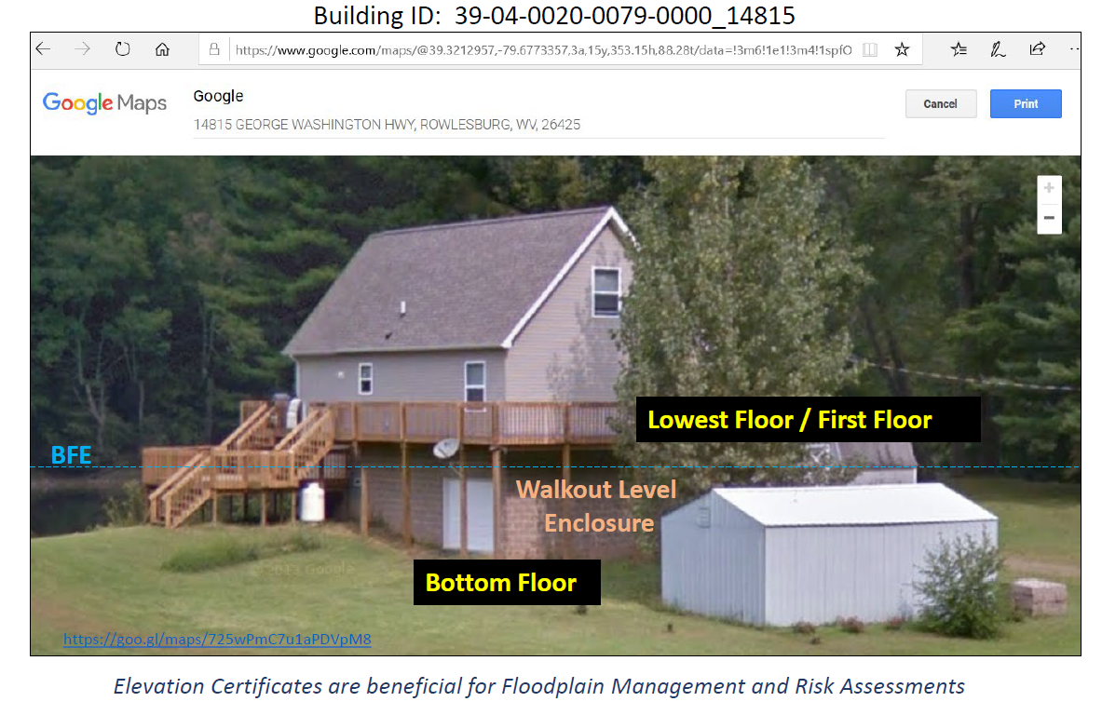
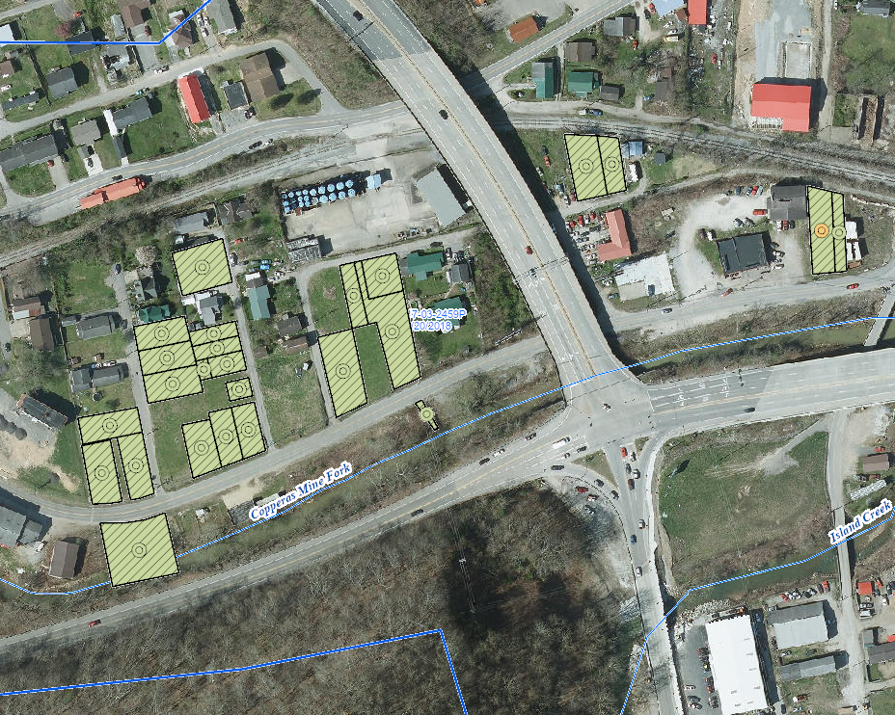
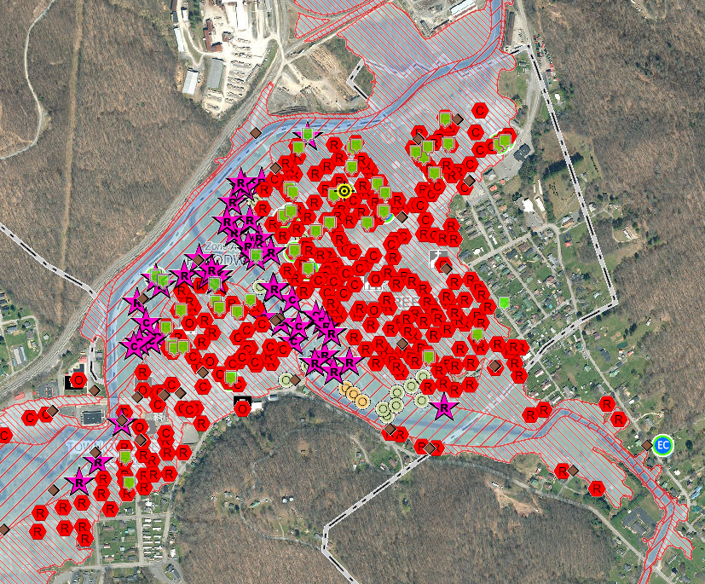
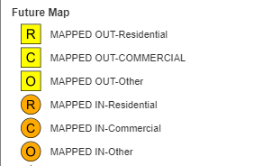
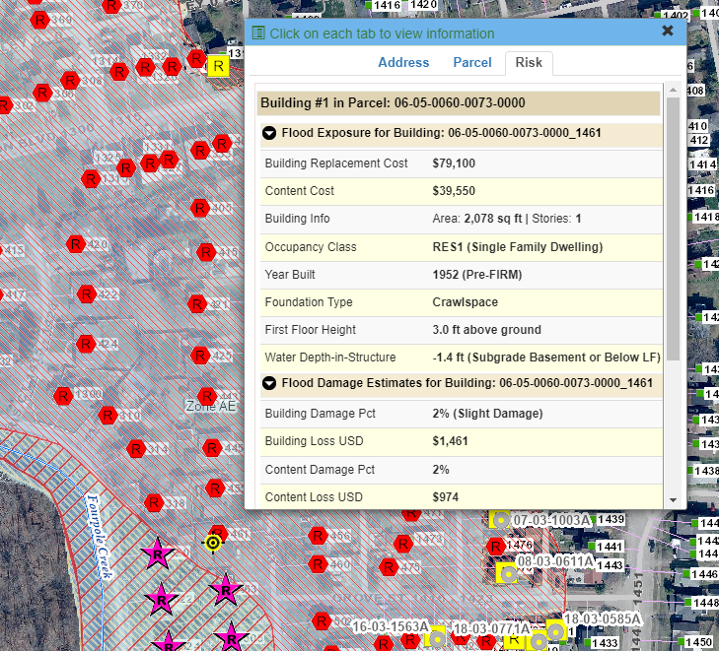
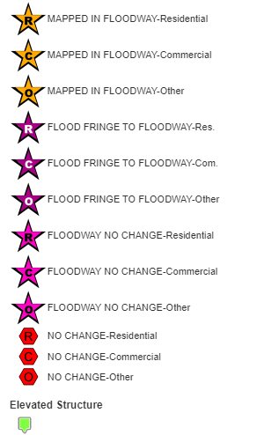
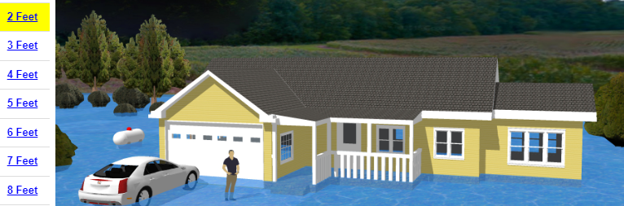
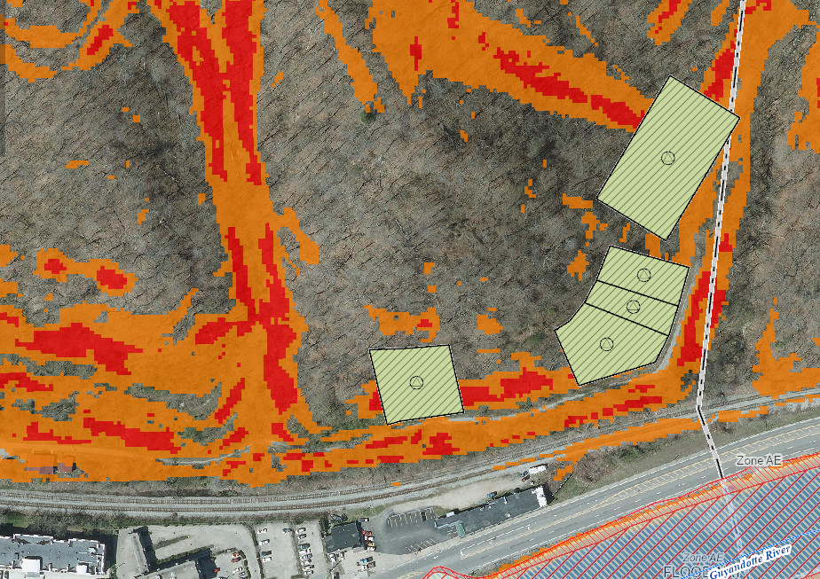
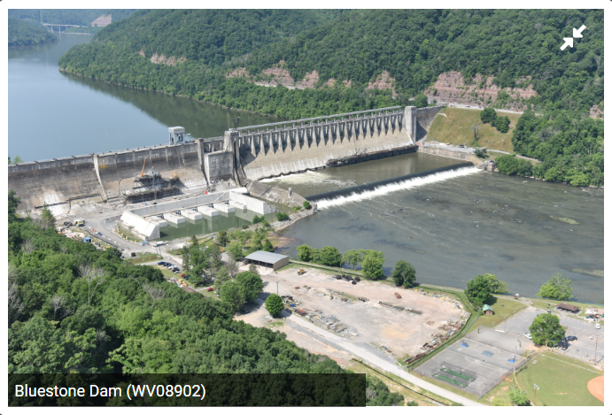
WV Flood Tool RiskMAP View, WVFRF, Feb. 2024
Hazard Mitigation
Communities may elect to participate in hazard mitigation buyout programs sponsored by FEMA and other agencies aimed at repetitive loss properties. Parcels are typically deed-restricted to maintain open space and prevent future losses.
Structure built with First Floor Height (FFH) above Design Flood Elevation (DFE = BFE + Freeboard)
Structure Level Risk Assessment
At-risk buildings are depicted with symbols and colors representing severity of risk and changes in status, e.g. “Mapped In” or “Mapped Out.”
Buildings in the Floodway are at greatest risk of loss.
Logan, WV: Hazard Mitigation Buyout parcels along Copperas Mine Fork, Island Creek
Building Types / Value information
Based on flood depth
Physical Damage Estimates
Based on flood depth
Utilize FEMA loss formulas
Multi-Hazard Analysis
Building information and loss estimates for building in Huntington, Cabell County
3D flood hazard visualization for areas with flood depth data available
Landslide susceptibility along the Guyandotte River in Logan County
Damaged homes along Pine Street correlate with areas of strong susceptibility as determined by landslide modeling
The failure of a High Hazard dam, such as Bluestone, near Hinton, WV, will affect communities for miles downstream.

Slide 2
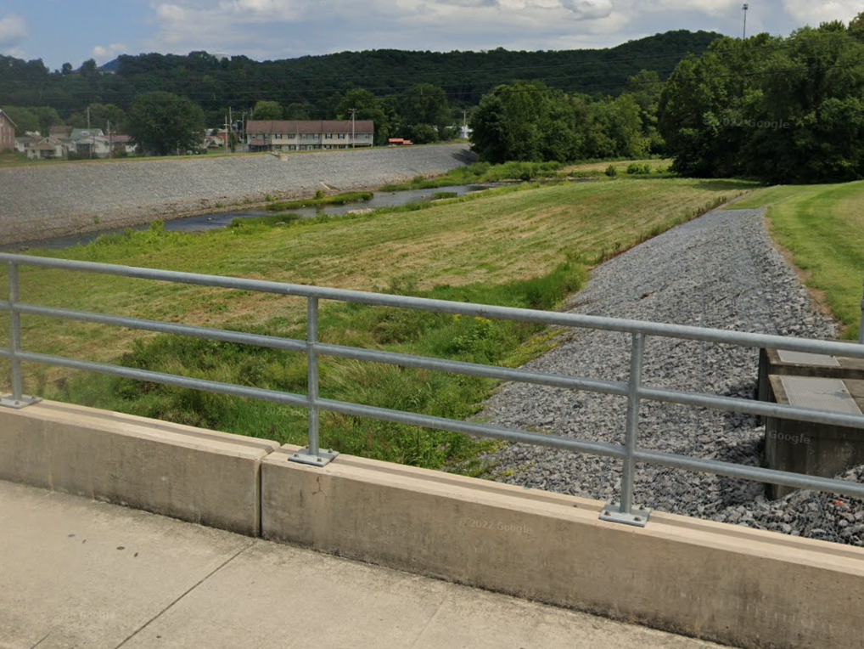
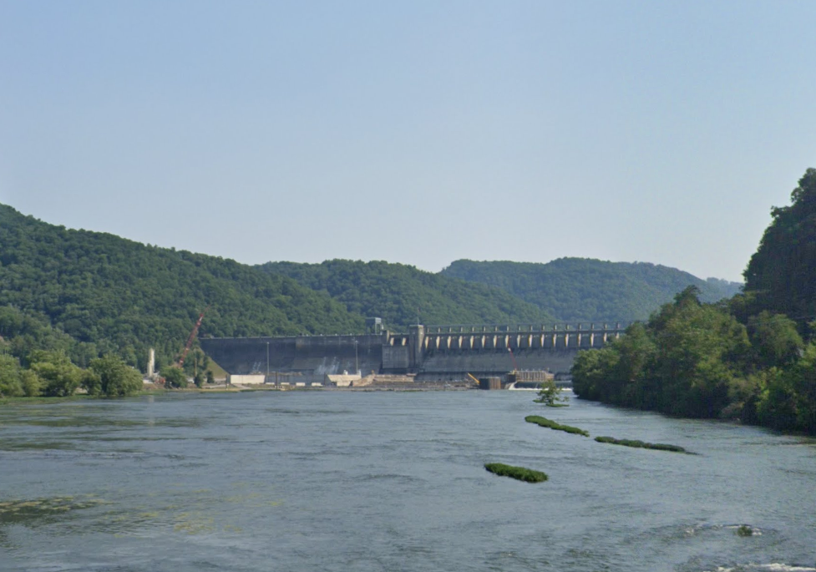

Slide 3
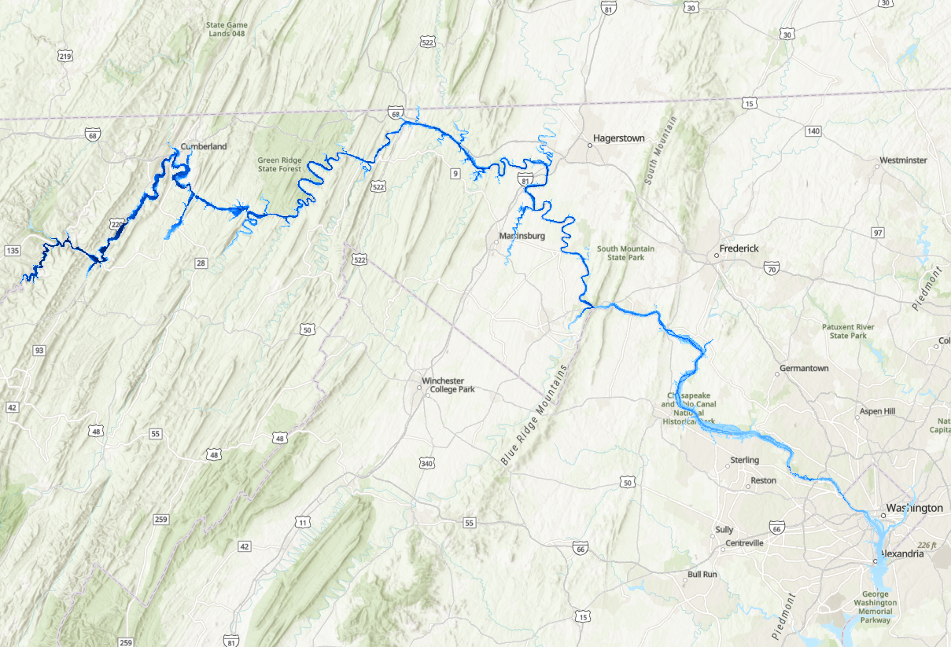
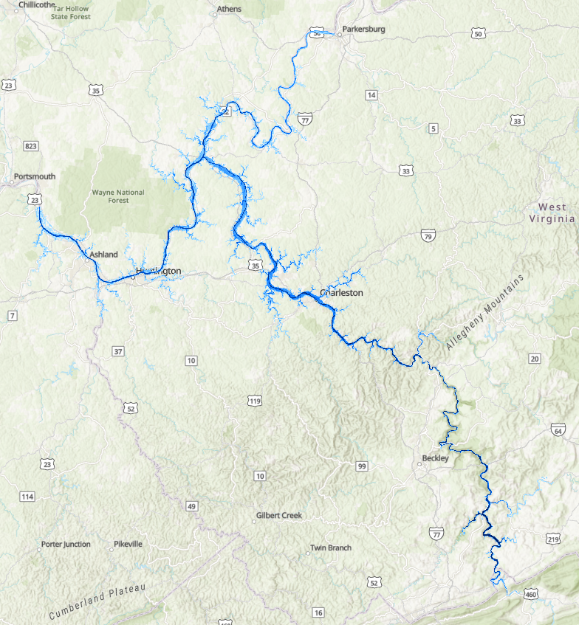

Slide 4
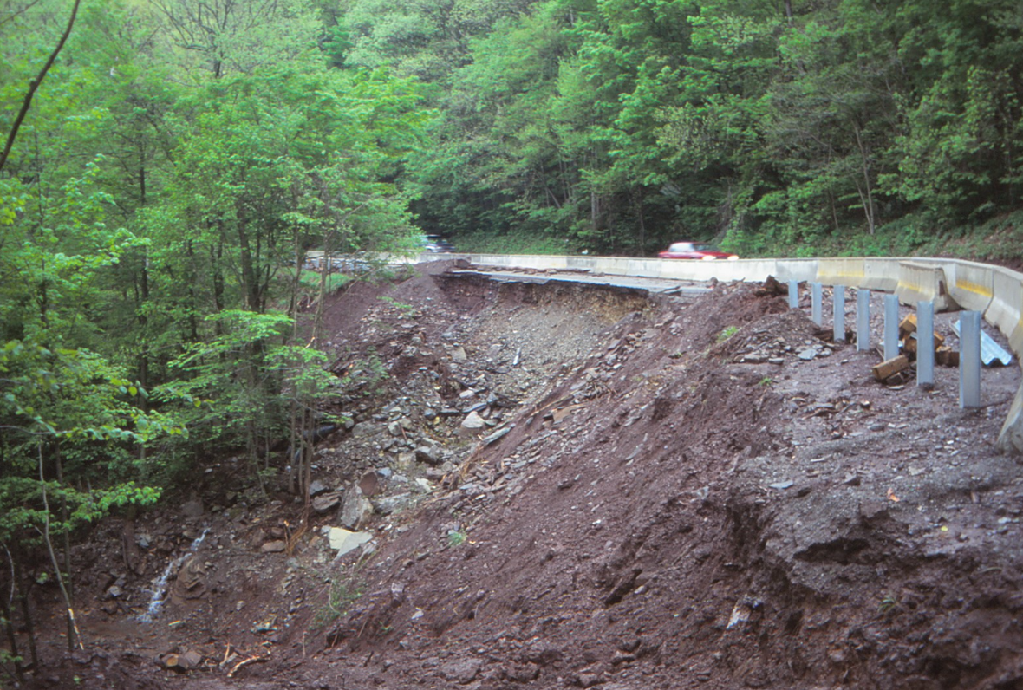
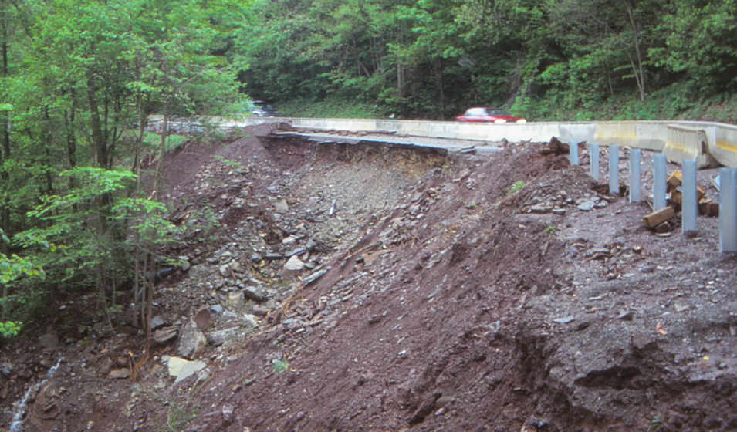

Slide 5
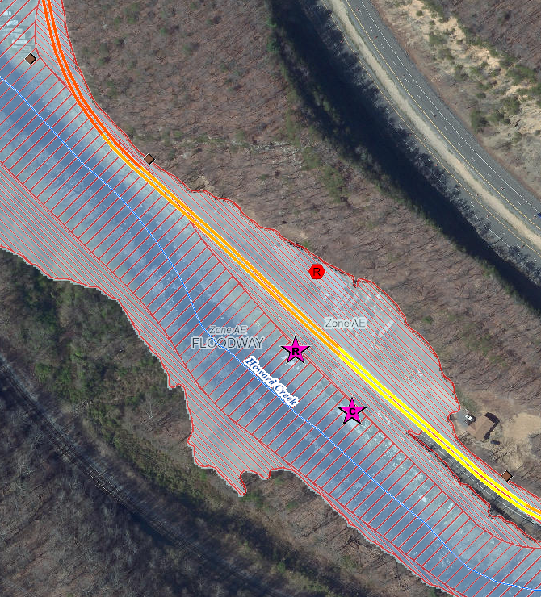

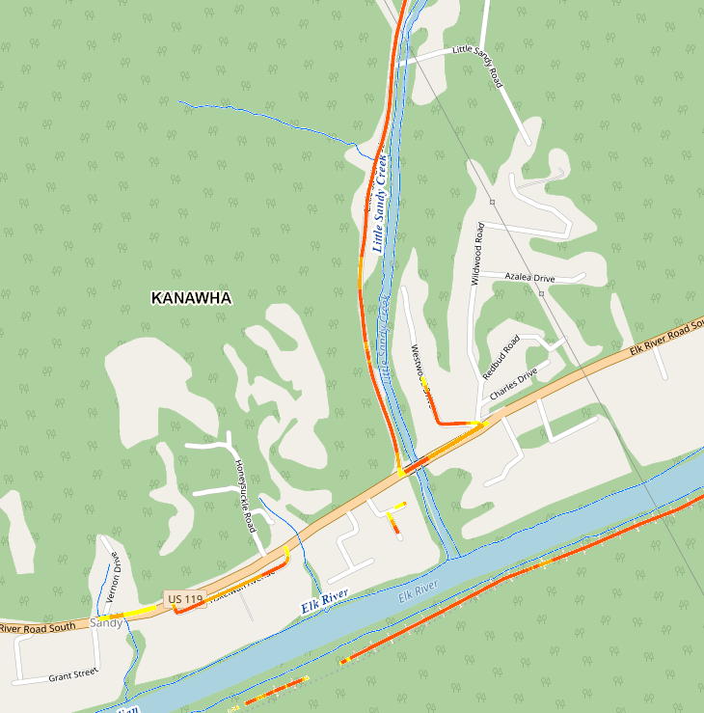

Slide 6
