Slide 1



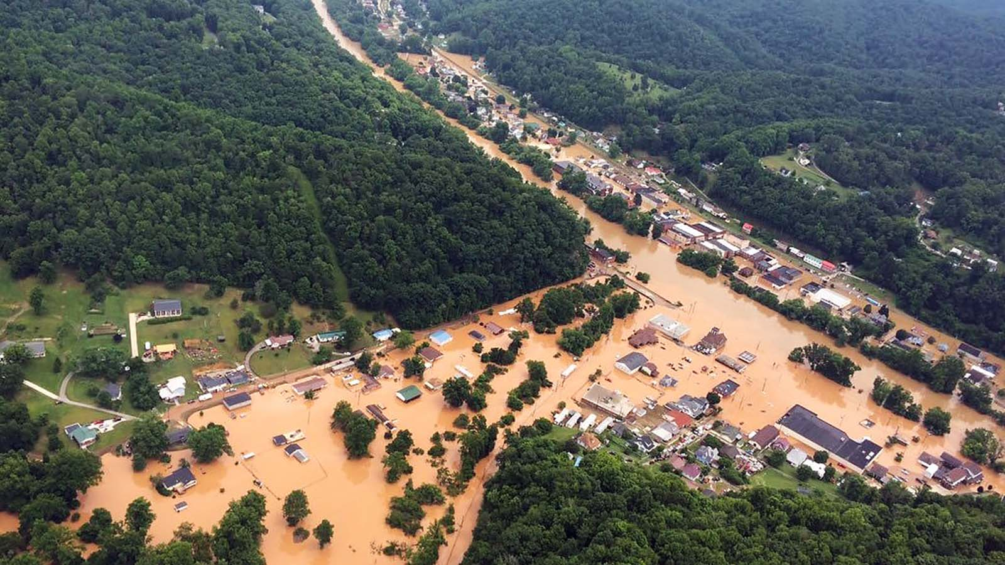
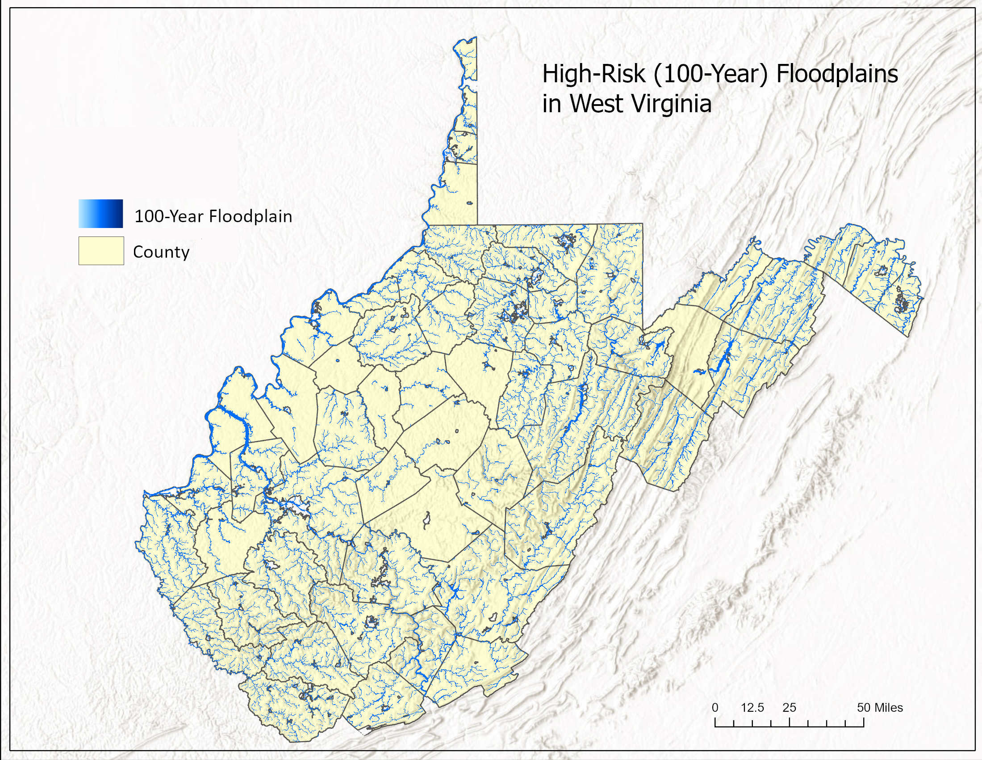
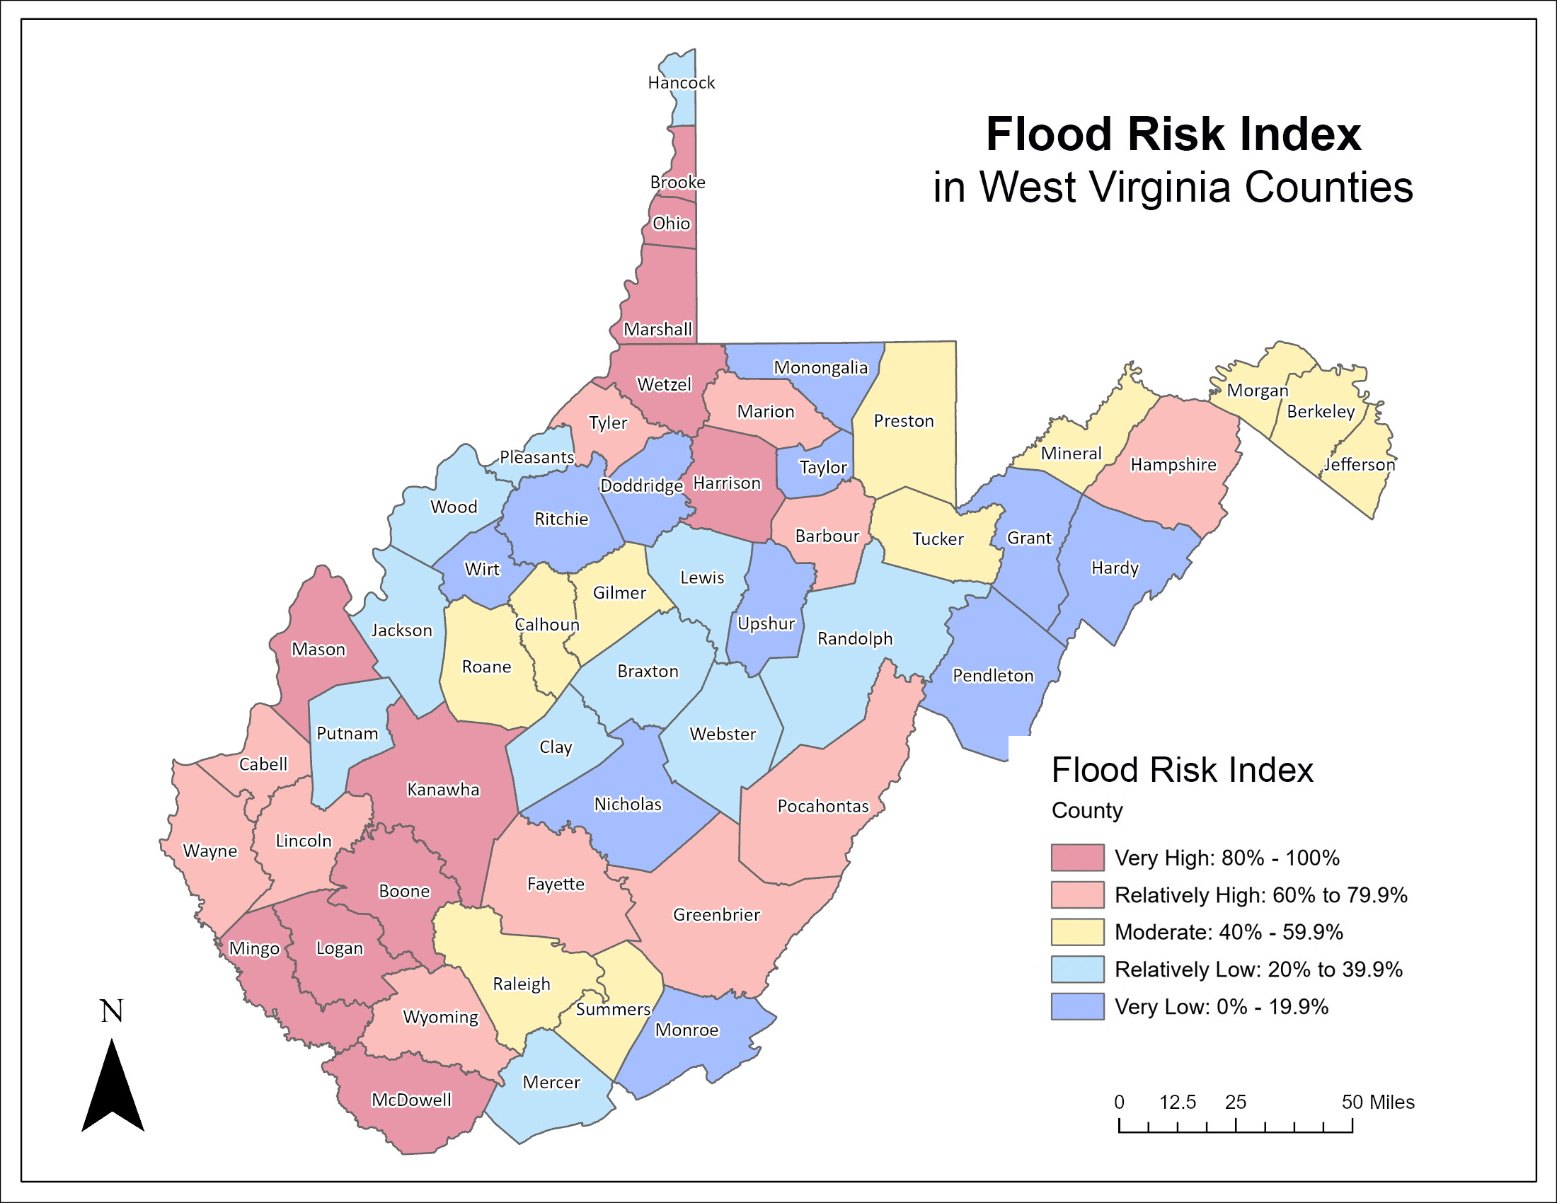
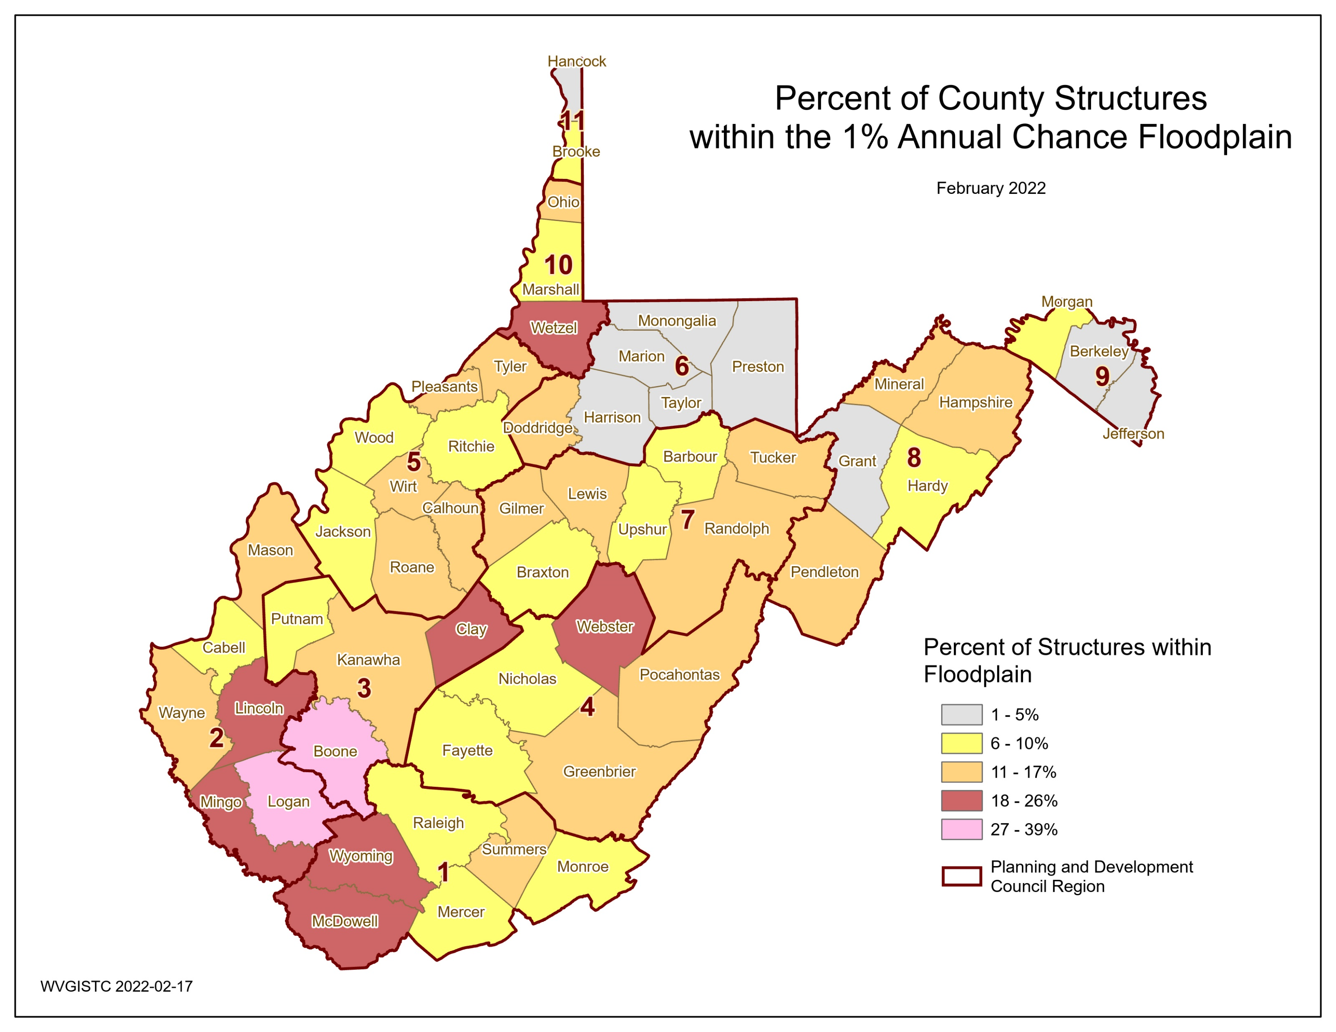

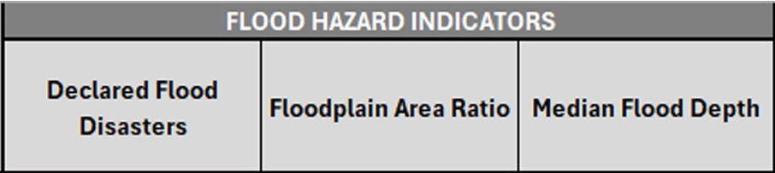
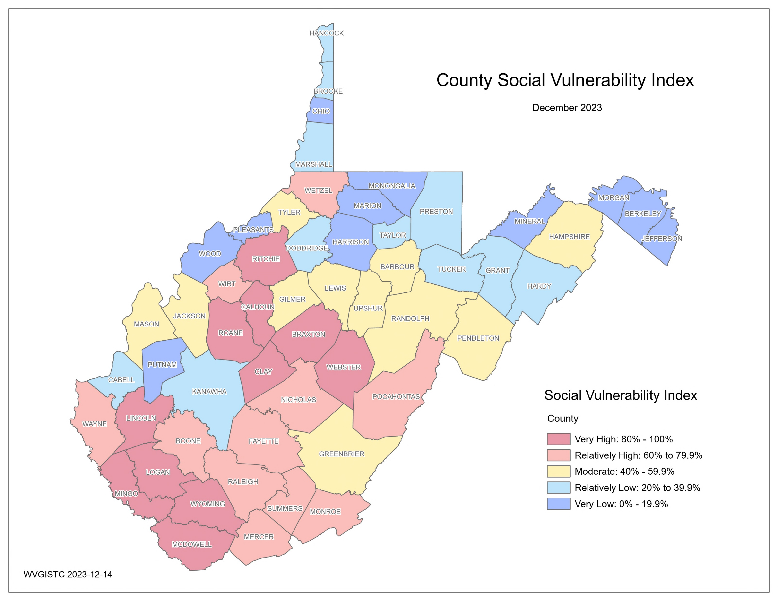
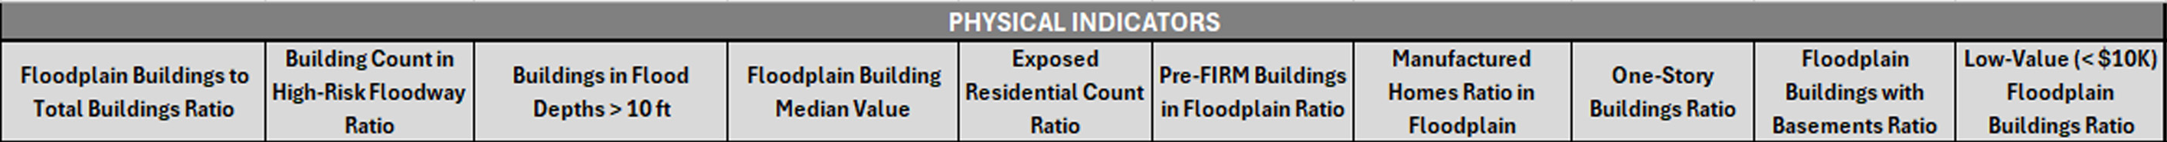
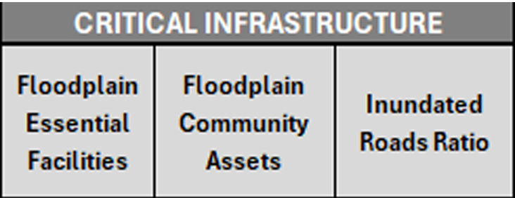
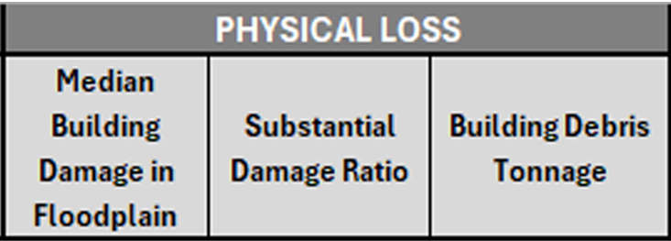
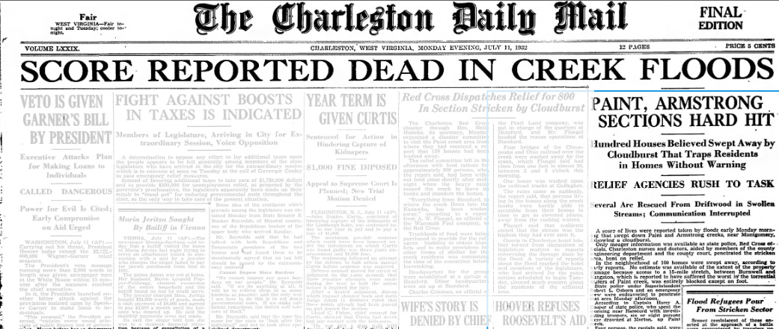
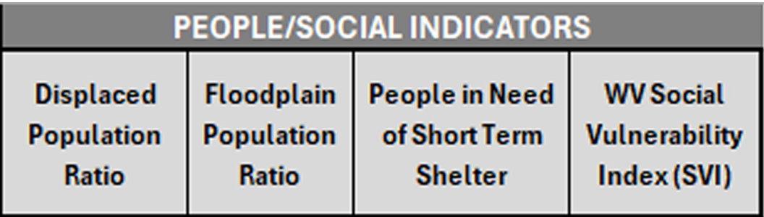
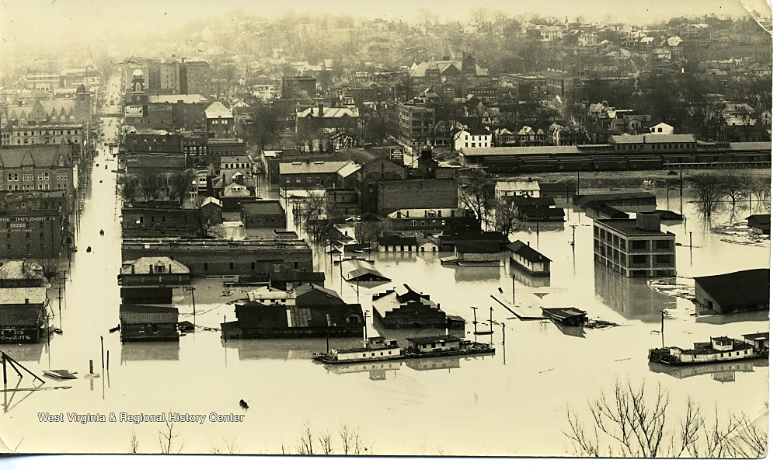
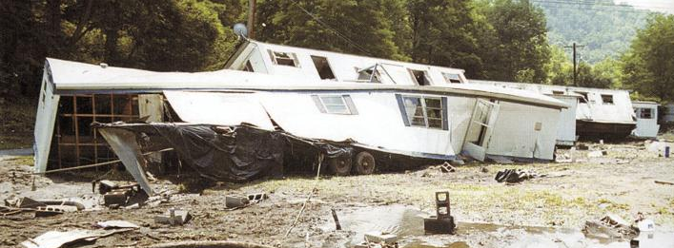
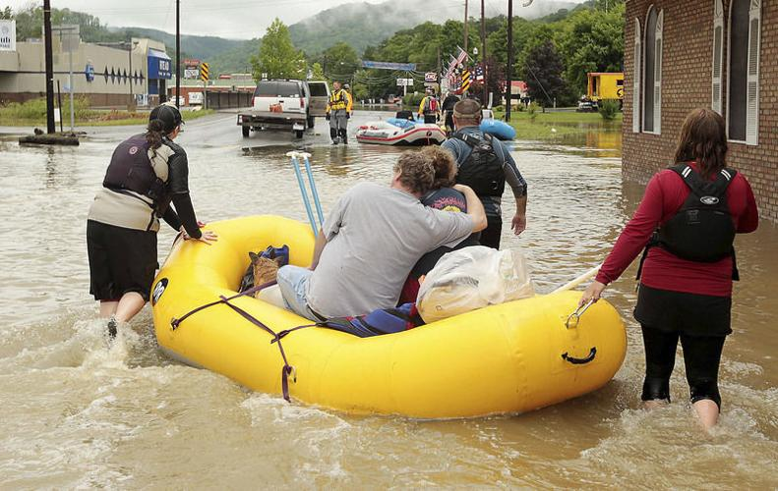
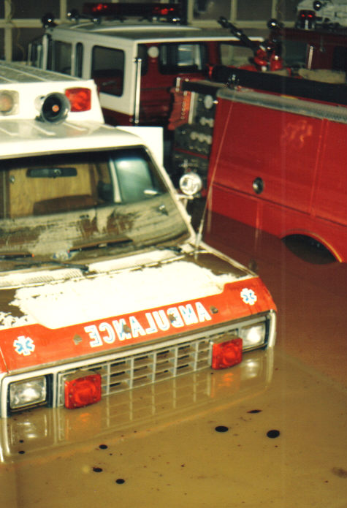
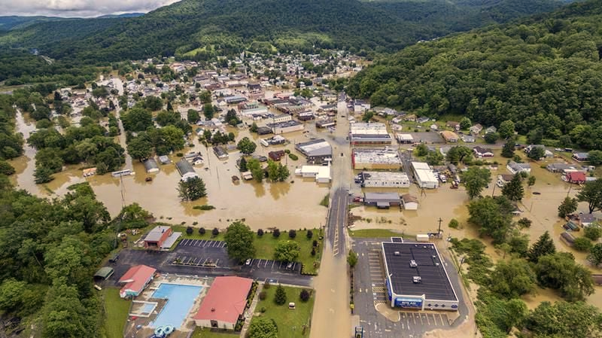

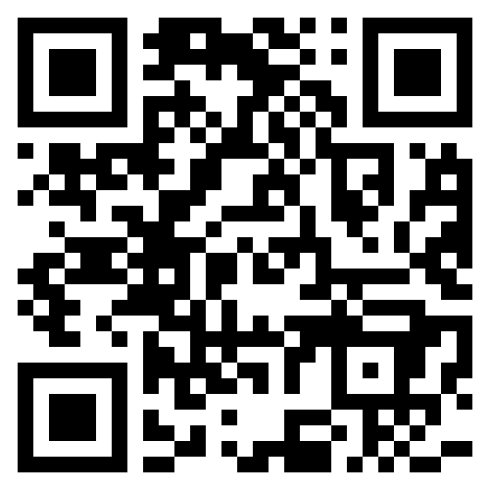
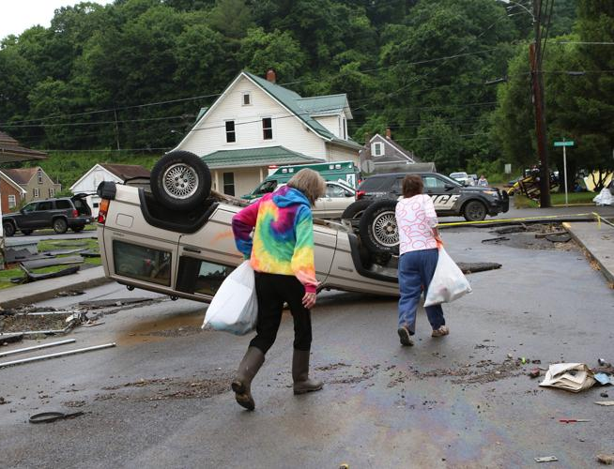
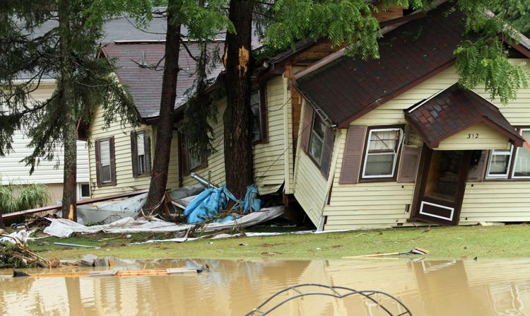
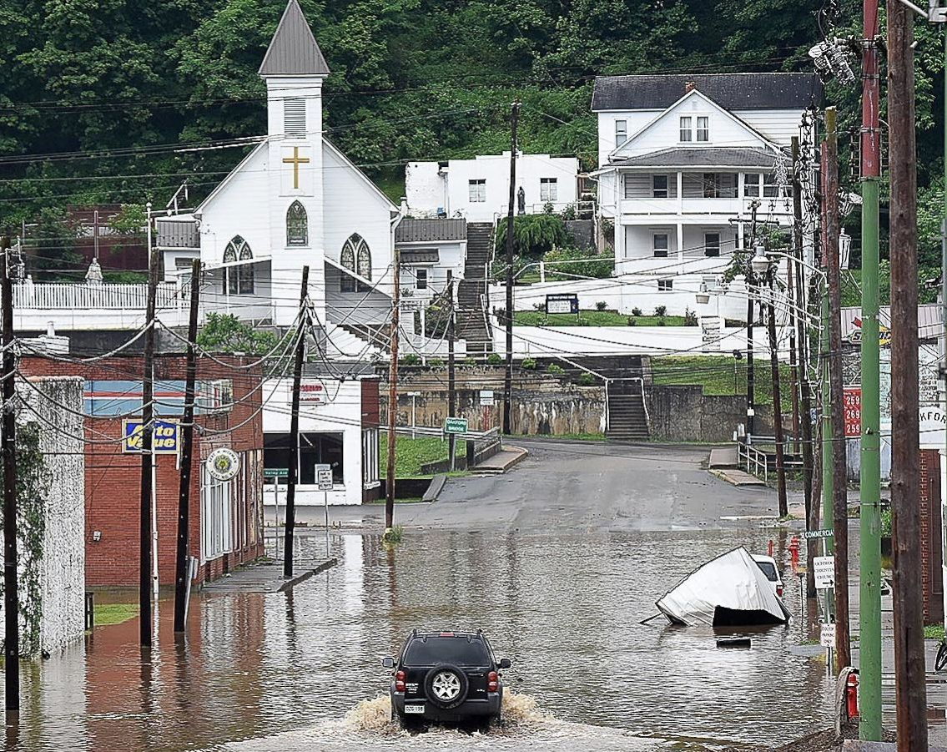
Flood Risk Analysis in West Virginia: Statewide Index Development
Behrang Bidadian, Annie Mahmoudi, Aaron E. Maxwell, & Jamie Shinn
WV GIS Technical Center, West Virginia University
Introduction
Results
Flood risk comprises three components:
Hazard, encompassing flood frequency, magnitude, depth, duration, and timing
Exposure, indicating the population and assets prone to the hazard
Vulnerability or susceptibility of exposed elements to inundation
(Crichton, 2002; Fedeski & Gwilliam, 2007; Koks et al., 2015)
As part of the West Virginia Flood Resilience Framework (WVFRF) funded by the National Science Foundation (NSF), this project takes a comprehensive approach to flood risk assessment by analyzing various indicators within the above groups. It addresses diverse aspects of these components at both county and community scales to develop a statewide risk index.
COUNTY | RISK INDEX
McDowell County | 100.0%
Boone County | 98.1%
Kanawha County | 96.2%
Ohio County | 94.4%
Wetzel County | 92.5%
Logan County | 90.7%
Mason County | 88.8%
Mingo County | 87.0%
Harrison County | 85.1%
Marshall County | 83.3%
Brooke County | 81.4%
Study Area
West Virginia, with a population of about 1.8 million in its 55 counties, spans over 24,000 square miles, with approximately 3.4% of this area covered by high-risk (100-year) floodplains.
32 flood disasters were federally declared between 1953 and 2023 in West Virginia (FEMA, 2023). The frequency of floods in the state, with each county experiencing numerous flood events, underscores the need for effective flood management and mitigation strategies.
Methodology
Discussion
Selecting 23 flood risk indicators
Collecting and processing data for the selected indicators at the county level
Mapping the indicators
Calculating percentile ranks for each indicator
Adding percentile ranks for each county to obtain a sum value
Calculating percentile ranks for the sum values from the previous step to obtain the index scores
Mapping the index scores at the county level
A cross-section of an ongoing project
Structure data based on the building-level risk assessment (BLRA) of Feb. 2024 at the WV GIS Tech. Center
Demographic data based on the Census Bureau’s American Community Surveys, 5-year estimates of 2021
The final product to include more risk indicators in addition to mitigation.
The West Virginia Social Vulnerability Index (WV SVI), developed as a stage of this project, can be a valuable tool for identifying the most disadvantaged counties with higher vulnerability to flood disasters in the state.
Conclusion
Mapping and spatially analyzing the West Virginia flood risk index will offer a more comprehensive understanding of the risk landscape, highlighting significant areas of concern in the state. This information will be crucial for developing strategies to reduce flood risk and implementing effective mitigation measures.
The final product will be accessible through an interactive online tool, providing insights at both county and community scales. For more information, please scan the QR code.
July 1932
Background image by National Weather Service, image courtesy of National Oceanic and Atmospheric Administration (NOAA) at https://www.weather.gov/rlx/2016-historic-june-flooding
Parkersburg, WV, 1937
Clendenin, WV, June 2016
References
McDowell County, July 2001
Rainelle, WV, June 2016
Crichton, D. (2002). UK and global insurance responses to flood hazard. Water International, 27(1), 119-131. https://doi.org/10.1080/02508060208686984
Federal Emergency Management Agency (FEMA). 2023. Disaster Declarations for States and Counties. https://www.fema.gov/data-visualization/disaster-declarations-states-and-counties
Fedeski, M., & Gwilliam, J. (2007). Urban sustainability in the presence of flood and geological hazards: The development of a GIS-based vulnerability and risk assessment methodology. Landscape and urban planning, 83(1), 50-61. https://doi.org/10.1016/j.landurbplan.2007.05.012
Koks, E. E., Jongman, B., Husby, T. G., & Botzen, W. J. W. (2015). Combining hazard, exposure and social vulnerability to provide lessons for flood risk management. Environmental science & policy, 47, 42-52. https://doi.org/10.1016/j.envsci.2014.10.013
Marlinton, WV, November 1985
White Sulphur Springs, WV, June 2016
Richwood, WV, June 2016
Rainelle, WV, June 2016

