Slide 1

Welcome to the Building Flood Resiliency in West Virginia Communities Symposium
March 12 & 13, 2024

Slide 2
Plan for this morning
01
02
03
Introductions
Special Guests
A few formalities
04
05
06
Research Project
Symposium Overview
State Resiliency Office (SRO)
Meet the research team
Introductions & Remarks
Research project guidelines
Background & Goals of WVFRF
Visions & Goals
Remarks from SRO

Slide 3
The research team
  Dr. Jamie Shinn, Project Leader, Assistant Professor of Environmental Studies at the SUNY College of Environmental Science and Forestry (SUNY ESF)
  Dr. Aaron Maxwell, Project Co-leader, Assistant Professor of Geography at WVU
  Julian Levine, Project Co-leader, Director of Population Health & Community Engagement at the West Virginia School of Osteopathic Medicine Center for Rural and Community Health
  Kurt Donaldson, Director, West Virginia GIS Technical Center
  Eric Hopkins, Behrang Bidadian, & Annie Mahmoudi, West Virginia GIS Technical Center
  Katherine Garvey & Jared Anderson, WVU Land Use and Sustainable Development Law Clinic
  Robert Martin & Edwin Martin, West Virginia State Resiliency Office (SRO)
  David Lumsden, Episcopal Diocese of WV
  Paula Brown, Greenbrier County Homeland Security & Emergency Management
  Jenny Gannaway, West Virginia Voluntary Organizations Active in Disasters (WV VOAD)
  Debbie Sizemore, Williamsburg Area Response Team (WART)
  Cathy Rennard, Former Disaster Case Manager Supervisor for WV VOAD
  Andrea Cass, PhD student, SUNY ESF
  Dara Vance, West Virginia School of Osteopathic Medicine

Slide 4
Special Guests
  Brian Aluise, Senator Joe Manchin’s office
  Thomas Smith, Senator Shelley Moore Capito’s office
  Darian David, Congresswoman Carol Miller’s office
  State Senator Mike Caputo, member of joint legislative committee on flooding
  Dr. Jacob Kravetz, National Science Foundation
  Aaron Titus, Executive Director of Crisis Cleanup
  Governor Jim Justice (not present)

Slide 5
Research Project Formalities
Participation: Your participation is completely voluntary and you may take a break or leave at any time
Risks: Potential for psychological or emotional discomfort as a result of discussing flood events
Benefits: No compensation for your participation, but we hope for beneficial outcomes
Confidentiality: No identifiable written data will ever be made public and any direct quotes used will be anonymous; our team will be taking photographs and videos. If you would not like your photo used, please inform any member of our team
Questions: Jamie at jeshinn@esf.edu or (315) 565-3022; Institutional Review Board at (315) 443-3013
We assume everyone present:
  Agrees to participate in the research project
  Is 18 years of age or older
  Understands that part of the symposium will be video recorded and photographed
  You have been given a copy of this information in your welcome packets

Slide 6




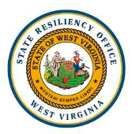



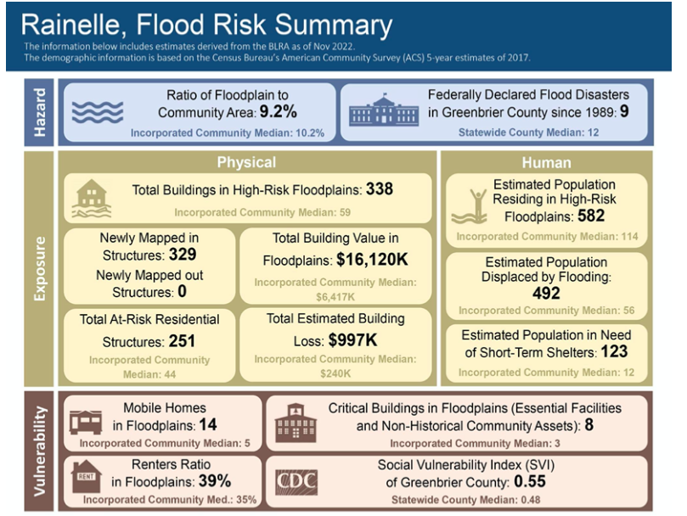
The West Virginia Flood Resiliency Framework (WVFRF)
Project Website: https://mapwv.gov/civic/
While designed for WV, project outcomes and processes will be transferable to communities across Appalachia and the US as a model for using social science and PGIS methods to create community-driven disaster response systems
Flood risk indicator report for Rainelle, WV

Slide 7
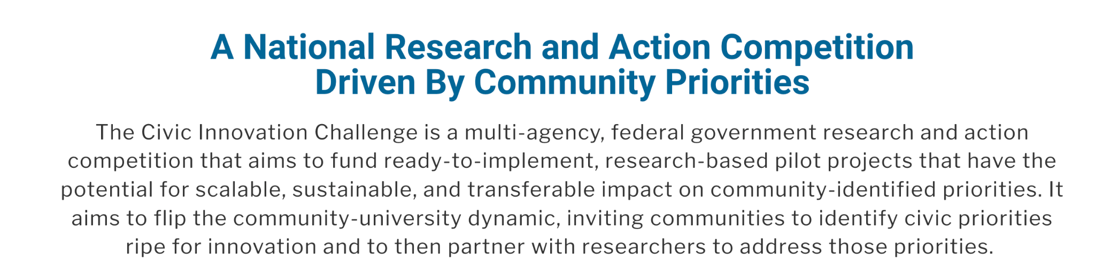

More information available at: https://nsfcivicinnovation.org/

Slide 8
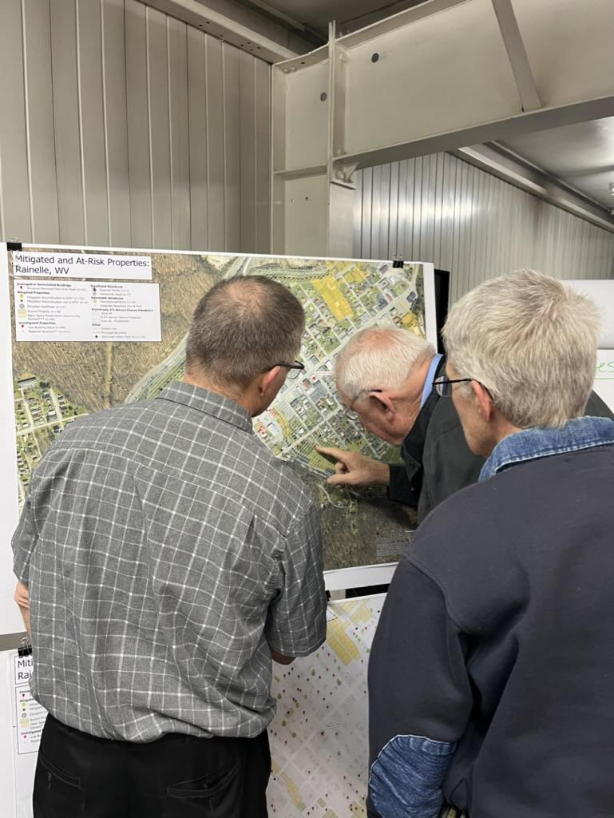
Stage 1 Award: Lessons Learned from 2016 Flood in Greenbrier County (2022-2023)
Survey of residents on flooding (2,215 responses)
Community and virtual focus groups to identify lessons learned
Creation of flood risk vulnerability maps and visualizations
Confirmed hypotheses:
  Organizations in the response and recovery network require increased capacity
  There is a need for improved cross network coordination
  Additional flood risk knowledge is essential to better prepare communities for future floods
Presenting flood maps at community focus group in Rainelle, WV
Read report at: https://www.greenbriercountyhealthalliance.org/civic-report

Slide 9
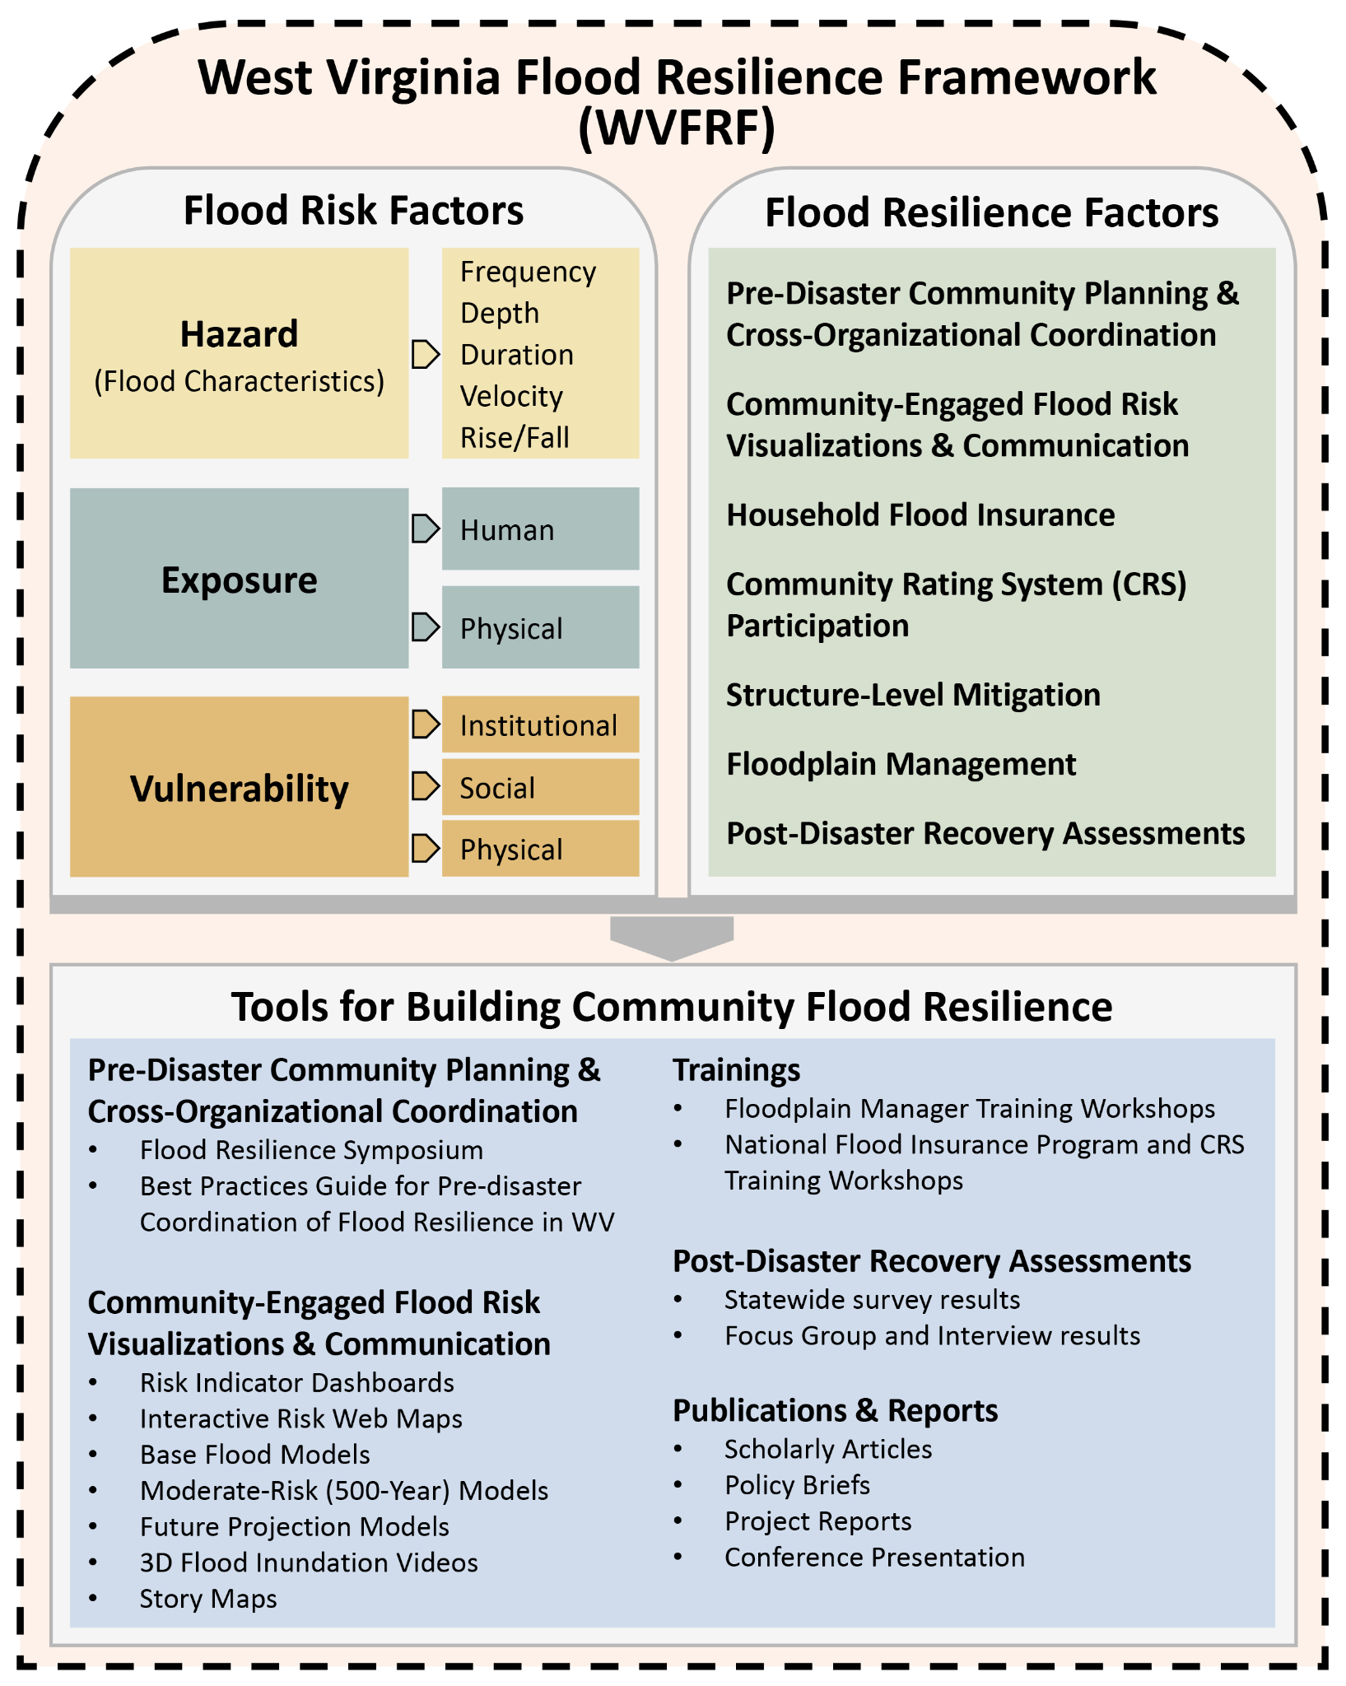
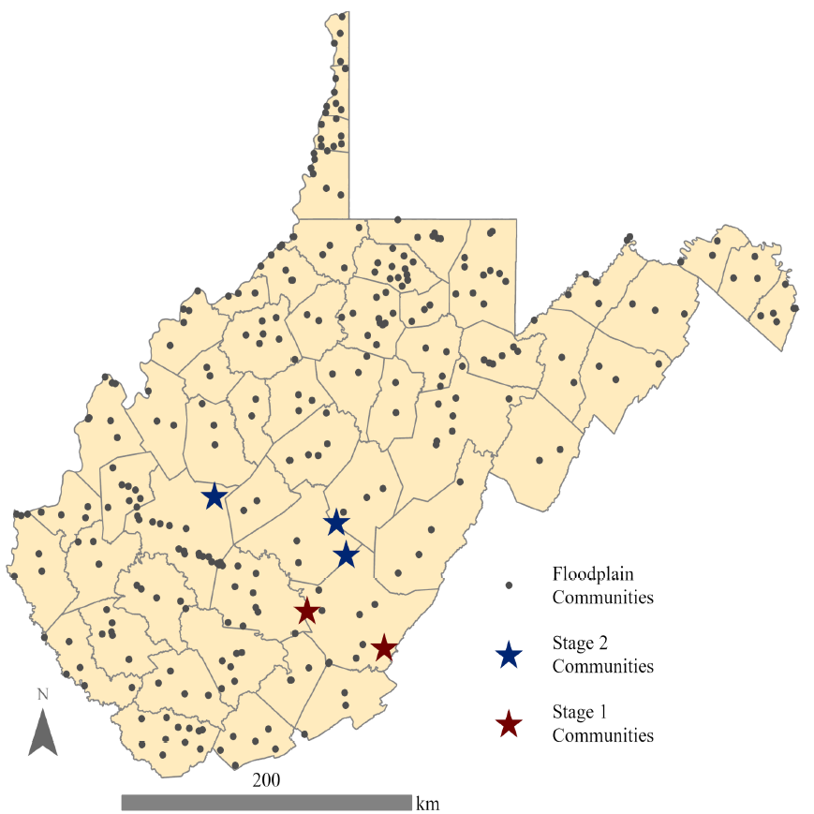
Stage 2 Award: Creating the WVFRF
$800,000, 12-month award, began Oct 1, 2023
Statewide survey on flood recovery and preparation - just launched!
Flood risk indicator reports for all 286 floodplain communities
Flood risk visualization tools for high-risk communities
Floodplain management trainings
Symposium on Building Flood Resiliency in WV Communities
Creation of WVFRF: A freely available online resource for residents, local leaders, non-profit organizations, state and regional officials, and others to catalyze flood resilience for WV communities through improved flood risk knowledge, floodplain management, comprehensive disaster preparation, and long-term resilience planning
WVFRF conceptualization
WV floodplain communities

Slide 10
Symposium Goals
Create common understanding of who the main players are their capabilities before, during, and after a flood
Increase understanding of how each organizations can better coordinate efforts in each phase of a disaster
Deepen understanding of barriers to coordination between organizations
Identify considerations that contribute to or detract from community resiliency

Slide 11
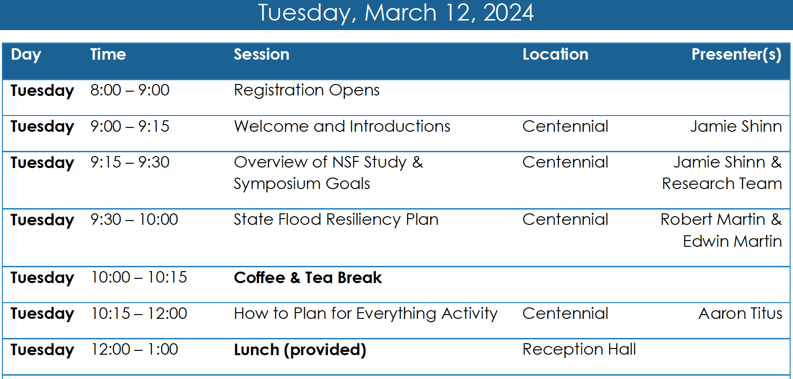

Thank you!
Please be sure to take our end-of-symposium survey before you leave on Wednesday!

Slide 12
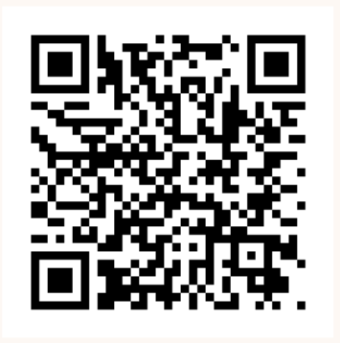
Please participate in our surveys!
West Virginia Flood Resiliency Framework (WVFRF) Survey
End-of-Symposium survey
Please be sure to take our end-of-symposium survey before you leave the event (5-10 min).
Please take and share with your networks! By completing this survey, you can enter our raffle to possibly win a $250 gift card!

Slide 13
Breakout 1 Questions
Who are the main players and what are their capabilities before, during, and after a flood?
What are the barriers to coordination between agencies and organizations in each phase of a disaster ?
How can we overcome these barriers?

Slide 14
Breakout 2 Questions
What are key attributes of individual and/or community flood resiliency?
How can we build these attributes?
What do you want to see included in the West Virginia Flood Resiliency Framework?

