Slide 1
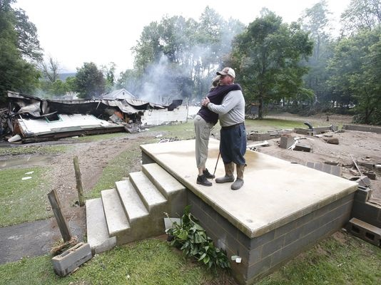
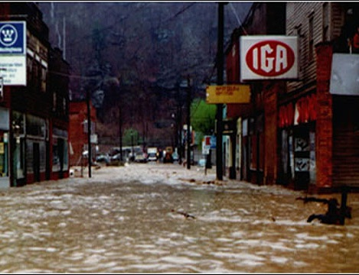
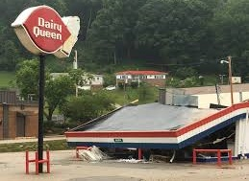
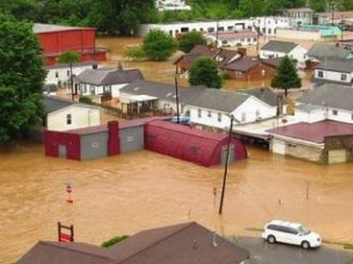

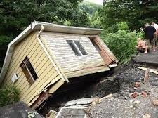
WV Flood Risk Assessment &
Visualization Tools
WVU GIS Technical Center
Kurt Donaldson
Aaron Maxwell
Behrang Bidadian
Annie Mahmoudi
2024 Symposium: Building Flood Resiliency in West Virginia Communities
← Devastating June 2016 Flood

Slide 2






















Partnerships and Interagency Coordination
No single agency has all the answers but leveraging multiple programs and perspectives can provide a cohesive solution

Slide 3
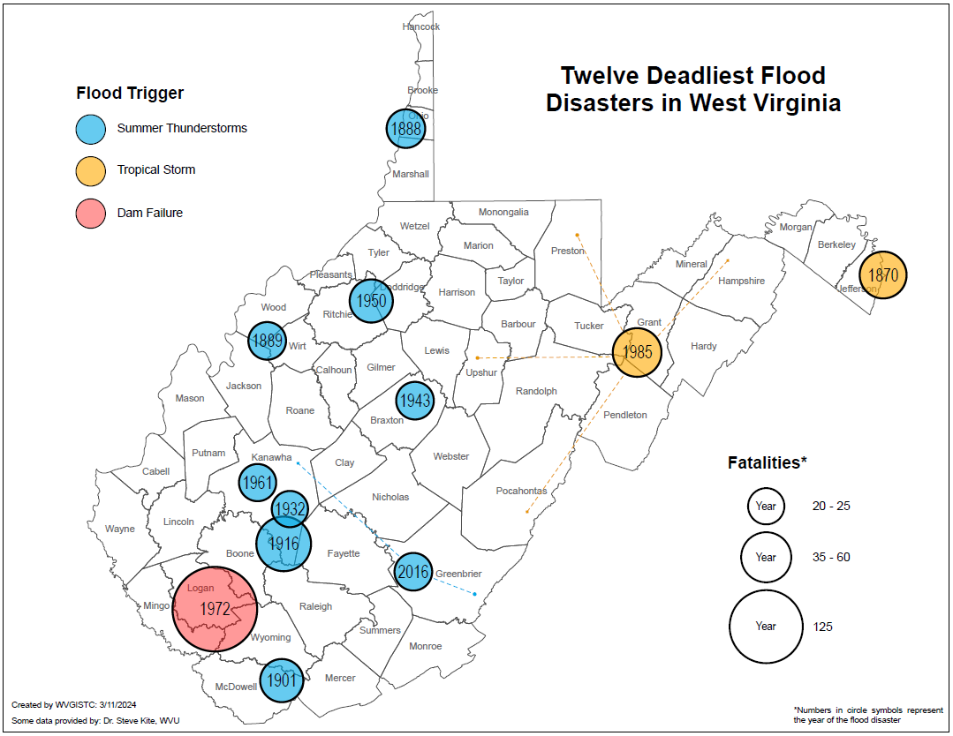
12 Deadliest Disasters
According to the analysis of flood fatalities in the 48 contiguous United States between 1959 and 2019, West Virginia has the third highest ranking in the nation when flood fatalities are standardized as the average annual number of fatalities per million inhabitants (Han and Hatim, 2021).

Slide 4
12 Deadliest Disasters
Summer Thunderstorms
Tropical Storms
Four of the Deadliest Floods have occurred in Kanawha County from cloudbursts during the summer months

Slide 5
Major Disasters (Property Damage)
Tug Basin Flood
1 BILLION

Slide 6
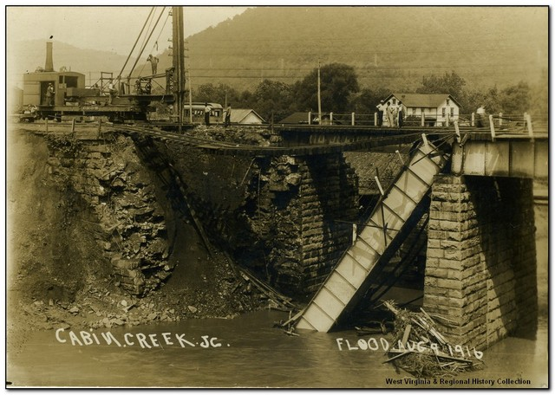
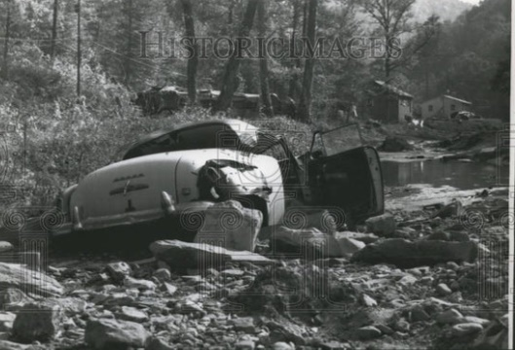
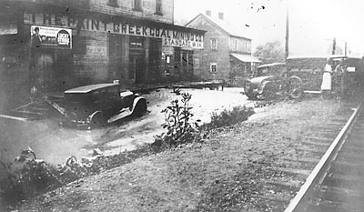
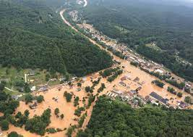
Kanawha County Deadly Flood Disasters
1916 CABIN CREEK (60 DEAD)
1961 CHARLESTON (20 DEAD)
1932 PAINT CREEK (20 DEAD)
2016 FLOOD (23 DEAD; 5 KANAWHA)

Slide 7
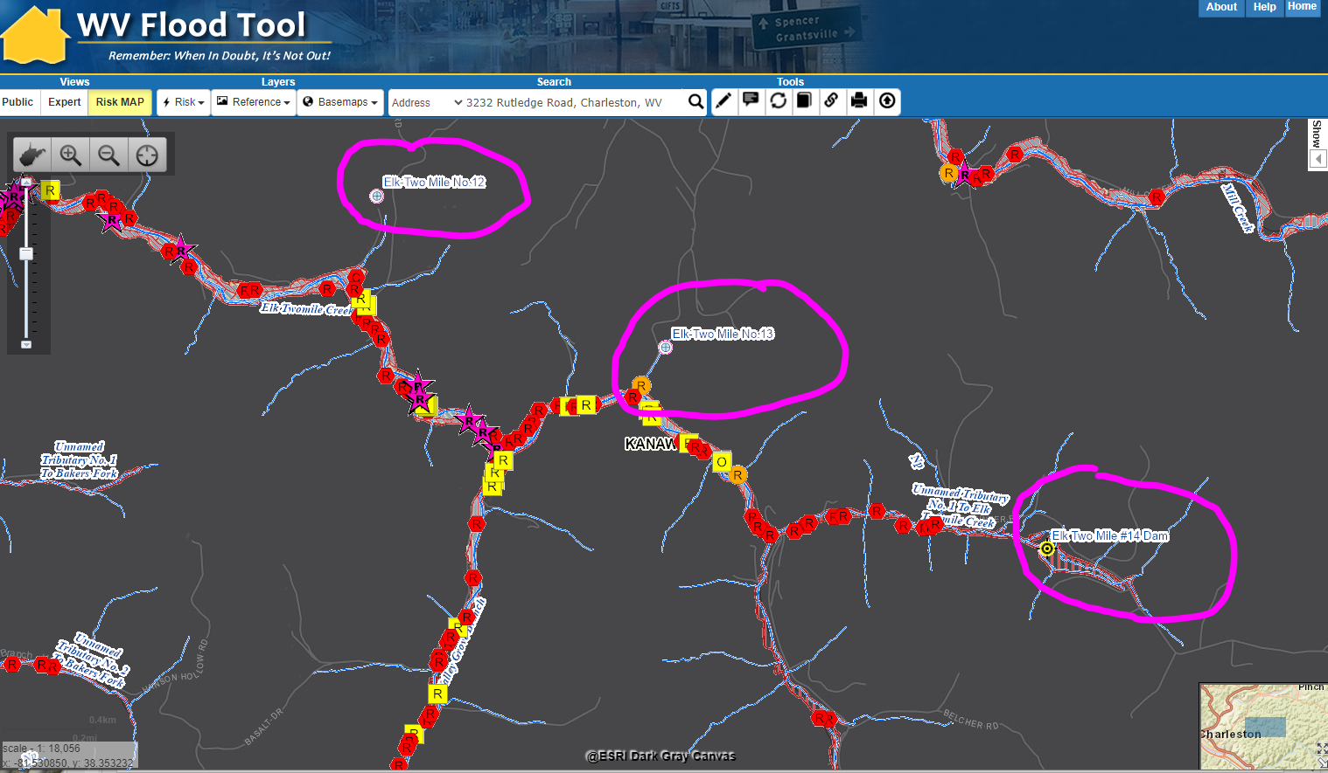
WV Flood Tool RiskMap View: Rutledge Avenue
Dams
Rutledge Road

Slide 8
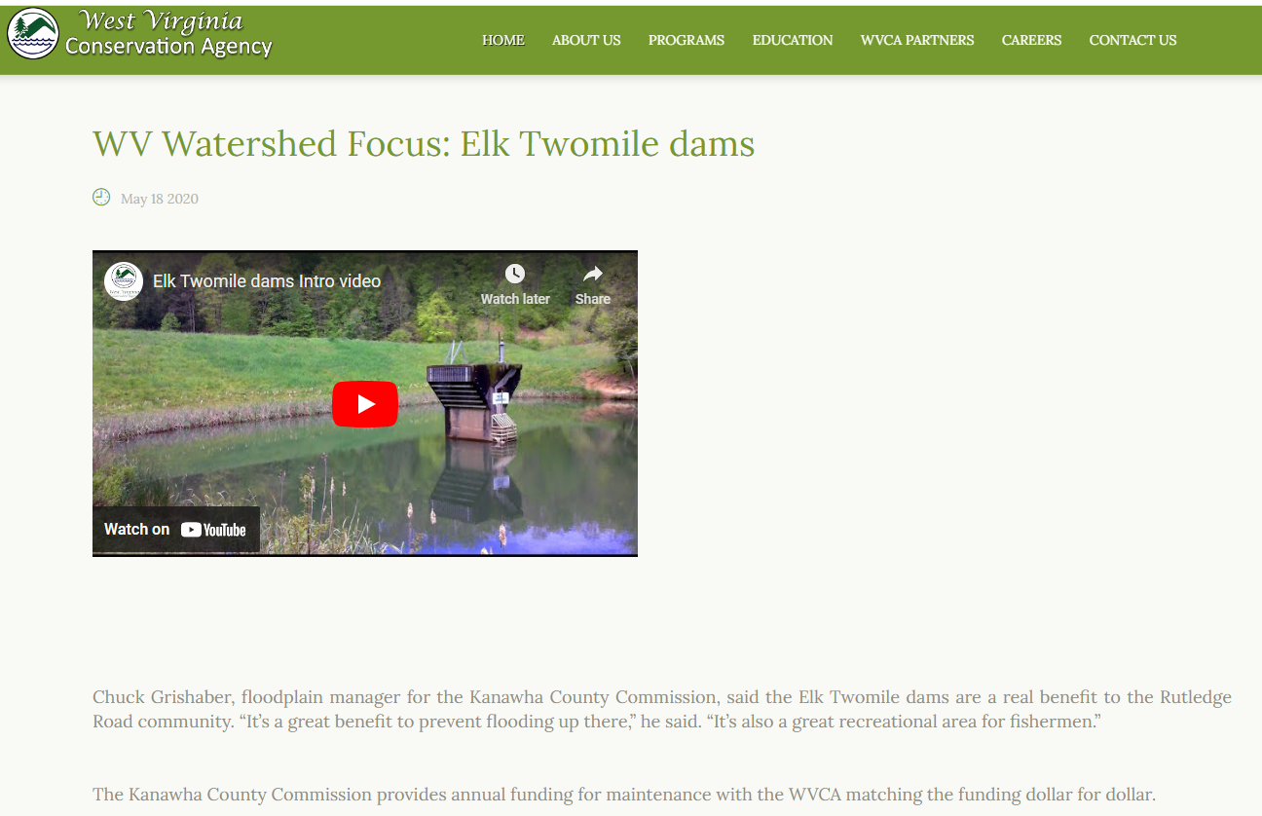
Elk Twomile Dams (flood mitigation)

Slide 9
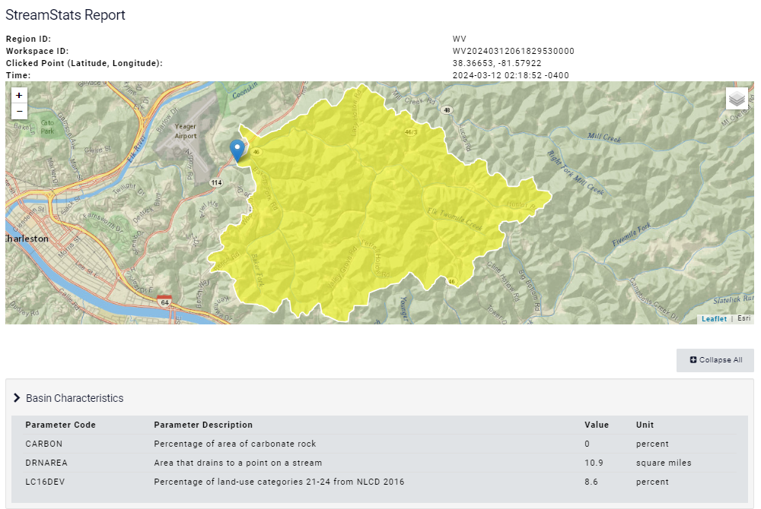
StreamStats Report for Rutledge Road (Airport)
No Flood Mitigated Structures in headwaters above Rutledge Road
Yaeger Airport

Slide 10
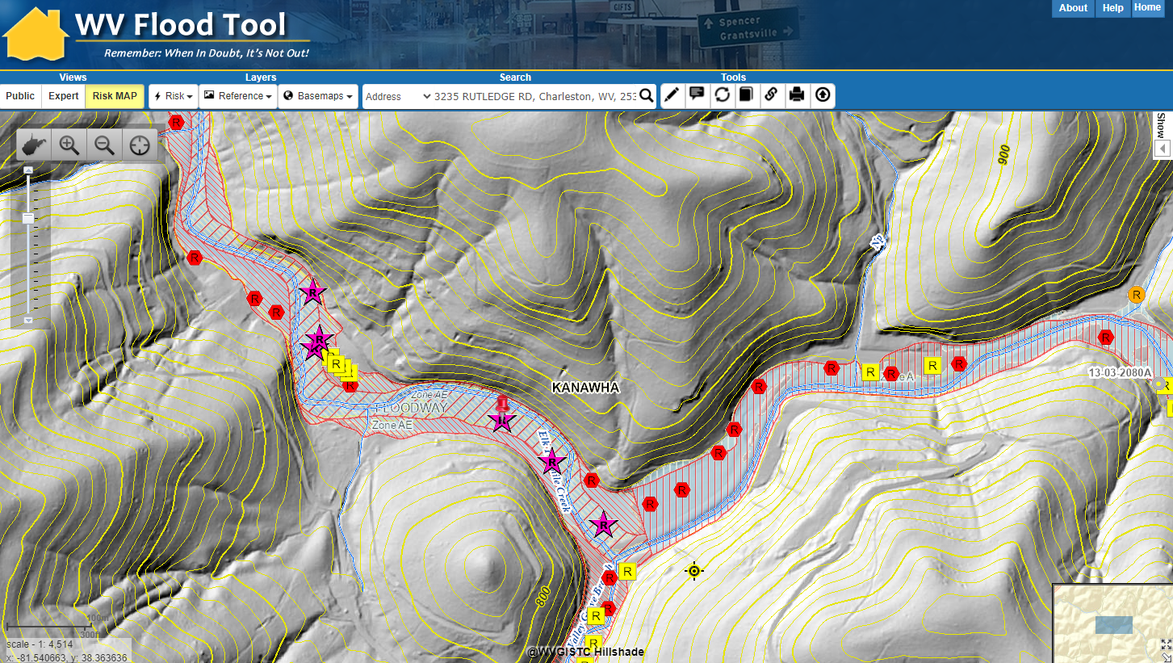
Risk Assessment: 3235 RUTLEDGE RD, Charleston
BUILDING LEVEL ANALYSIS
Elk Twomile Creek

Slide 11
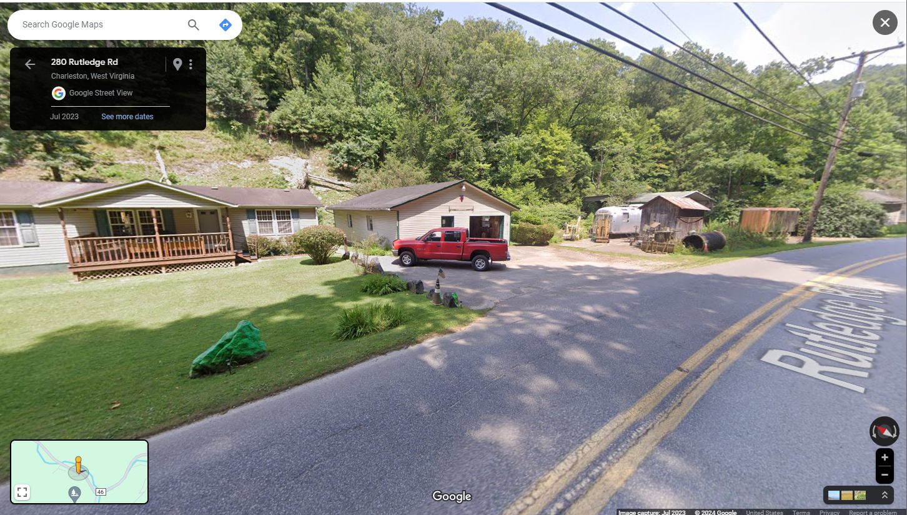
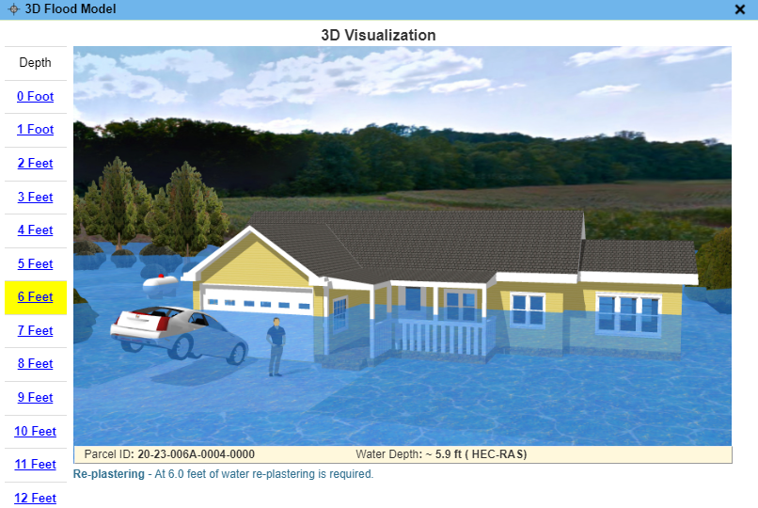
Risk Assessment: 3235 RUTLEDGE RD, Charleston
WV Flood Tool link to Street View and 3D Visualization
FLOOD VISUALIZATIONS
Google Street View

Slide 12
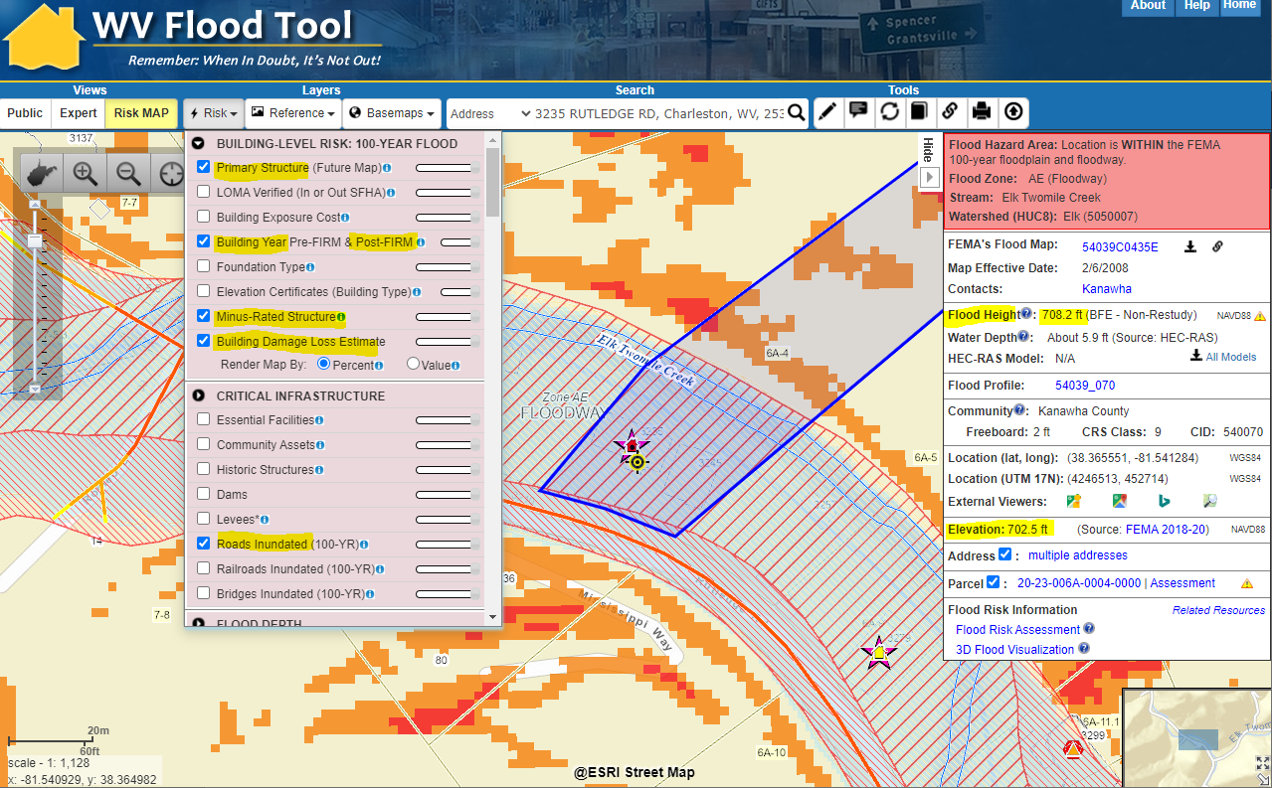
3232 Rutledge Road Structure (1997)
100-YR Risk Assessment
STRUCTURE
Floodway
Minus-Rated
Moderate Structure Damage Estimated
Debris Damage Risk
OTHER RISKS
Road Inundated
Landslide Susceptibility
Risk Assessment for 3232 Rutledge Road one-story residential home built in 1997
BUILDING LEVEL ANALYSIS
What is at risk? Degree of risk?
Source: WV Flood Tool
RiskMAP View
Panel 5400700153C 1985 FIRM with BFE

Slide 13
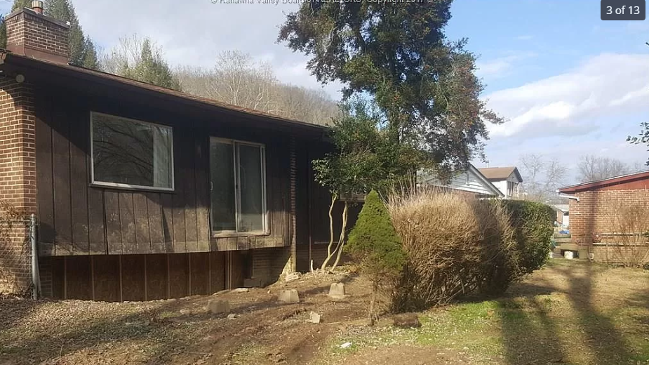
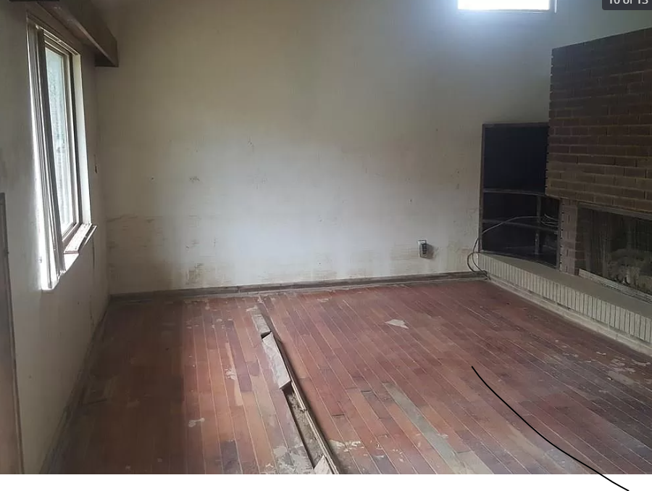
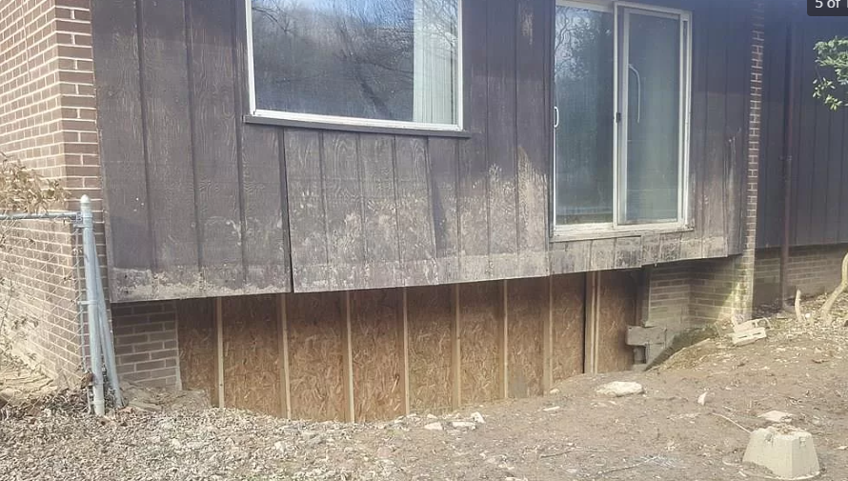
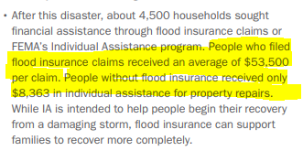
Risk Assessment: 200 Riverview Drive (2 fatalities)
Flood Insurance Claim Avg: $53,500
IA for People w/o Insurance: $8,863
Source: FEMA Flood Report

Slide 14
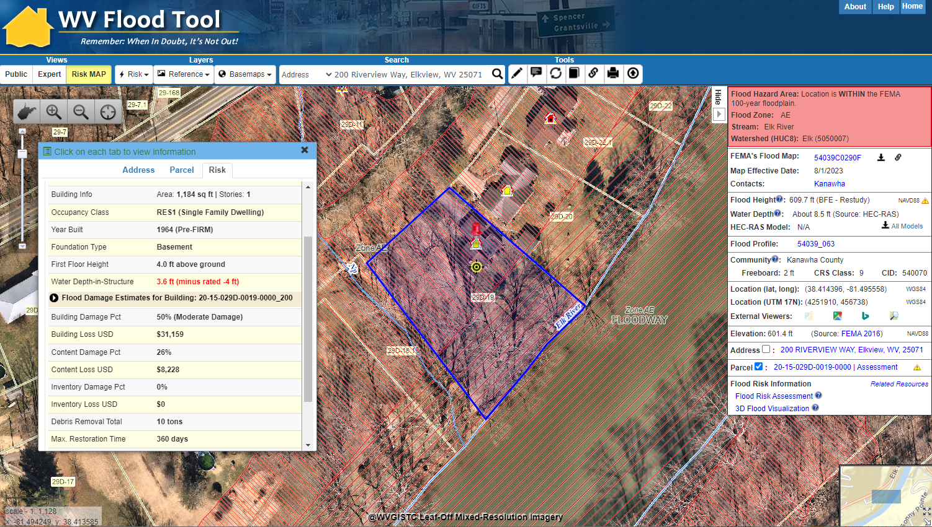
Riverview Drive: Pre-FIRM Minus-Rated Structure
100-YR Risk Assessment
STRUCTURE
Subgrade Basement
Minus-Rated
High Flood Depth
Nearly Substantial Damage Estimated
Hydrodynamic Flood Forces (Foundation Collapse)
Risk Assessment for 200 Riverview Drive for one-story residential home with basement built in 1964
BUILDING LEVEL ANALYSIS
50% Substantial Damage
Hazus
Building-Level
Damage Loss Estimate
RiskMAP View
Source: WV Flood Tool

Slide 15
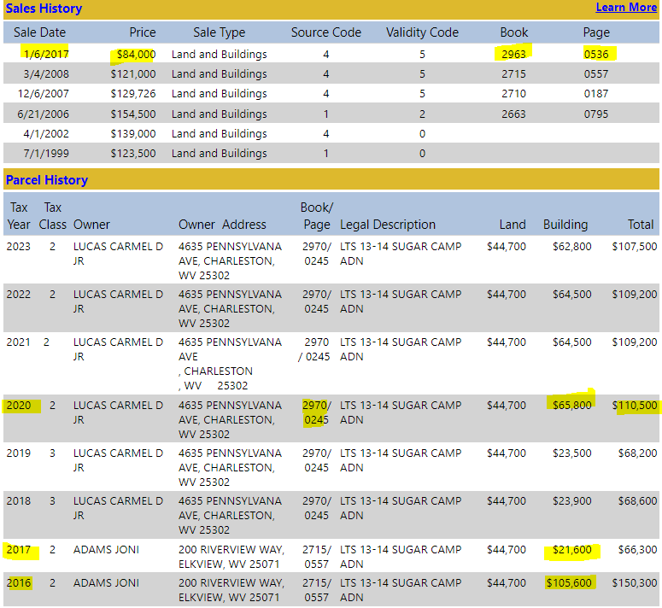
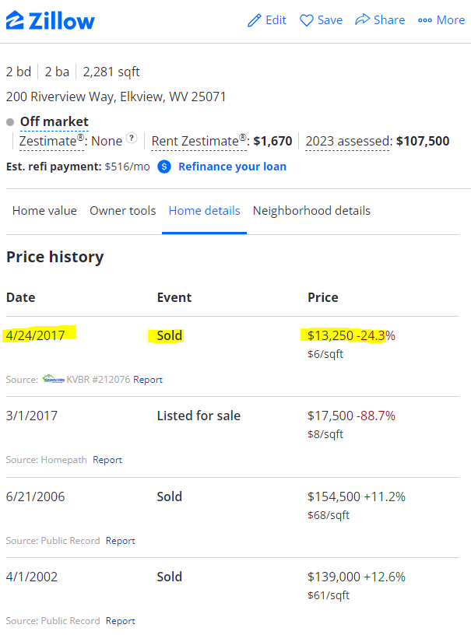
200 Riverview Drive: FEMA 50% Rule
WV Flood Tool Parcel Report
FEMA 50% Rule
80% Decrease

Slide 16
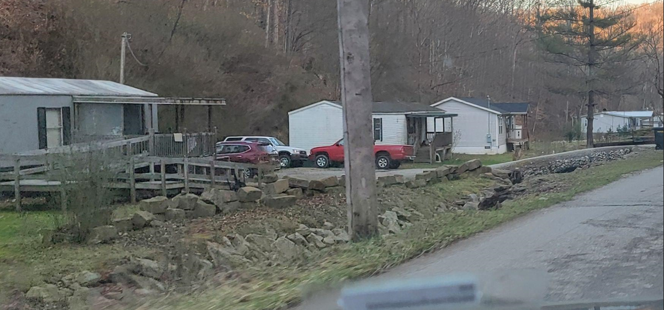
Risk Assessment: 2466 JORDAN CREEK RD
All these homes along Jordan Creek Road near Clendenin were swept away during the flood
BUILDING LEVEL ANALYSIS

Slide 17
WV Flood Tool
Flood Tool Views
(www.mapwv.gov/flood)
Public View for general public
Expert View for floodplain managers
RiskMAP View for flood risk planners

Slide 18
WV Flood Tool Layers
FLOOD RISK LAYERS | REFERENCE LAYERS | FLOOD LAYERS
BUILDING-LEVEL RISK (100-YR) | TAX PARCELS | FLOOD HAZARD
Primary Structure (Future Map Conditions) | Parcels (1.4 million) POPUP TABLE | NFHL Flood Areas (Effective, Draft, Preliminary)
Building Exposure Cost POPUP TABLE | Detailed Parcel Reports and History | High-Risk Advisory Flood Zones (Zone A and AE)
Building Year Pre-FIRM / Post-FIRM | Sketch Diagrams | Base Flood Elevations
Foundation type |  | Cross-Sections
Minus-Rated Structure | E-911 ADDRESSES / ROADS | LOMAs / LOMRs
Building Damage Estimates POPUP TABLE | E-911 Addresses (1 million) | LOMAs Location Verified
 | E-911 Road Centerlines | Panel Index (link to FEMA issued map)
CRITICAL INFRASTRUCTURE | DOT Primary Routes | Structures, Levees, Mile Markers*
Essential Facilities |  | Flood Elevation Certificates
Community Assets - Non-Historical | BUILDING FOOTPRINTS | FEMA Stream Names
Community Assets - Historical | Building Footprints (Microsoft - 1 million)
Dams and Levees | Building Footprints (WVGISTC - 2 million) | FLOOD DEPTH
Roads / RR / Bridges Inundated |  | HEC-RAS Model Backed (1% Flood)
 | BOUNDARIES | Hazus Flood Depth (1% Flood)
OTHER HAZARDS | Community Boundaries | USGS High Water Marks
Landslide Incident | Watershed Boundaries
Landslide Susceptibility |  | FLOOD PREDICTION
 | ELEVATION CONTOURS | USGS Real-Time Gages
MITIGATED PROPERTIES & OPEN SPACE | 1-foot contours (zoomed-in scales)
Mitigated Structure | 10-foot contours (zoomed-out scales) | BASEMAPS
Buyout Parcel |  | Aerial Imagery (11 unique sets)
Public Land | GEOGRAPHIC NAMES / STREAMS | Road/Street Basemaps
Private Land | Existing and historical towns | Hillshade lidar-derived (1 meter)
 | Streams lines and names | Topographic Maps

Slide 19
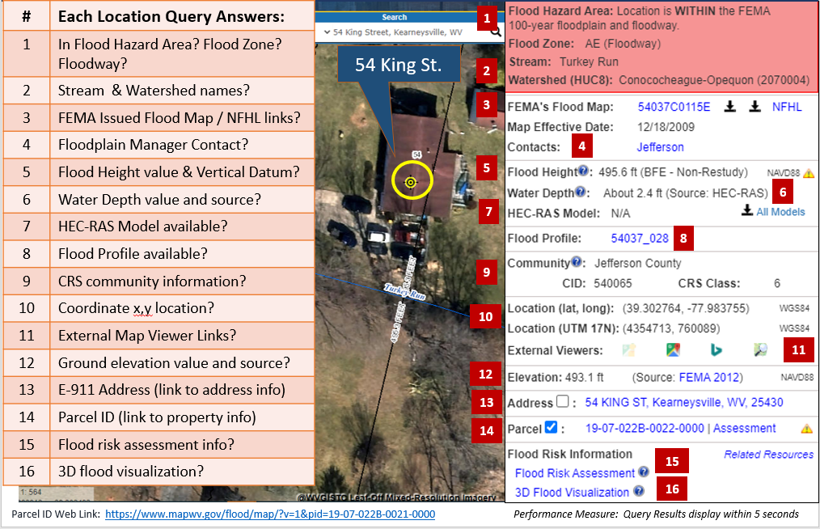
FLOOD QUERY RESULTS PANEL

Slide 20
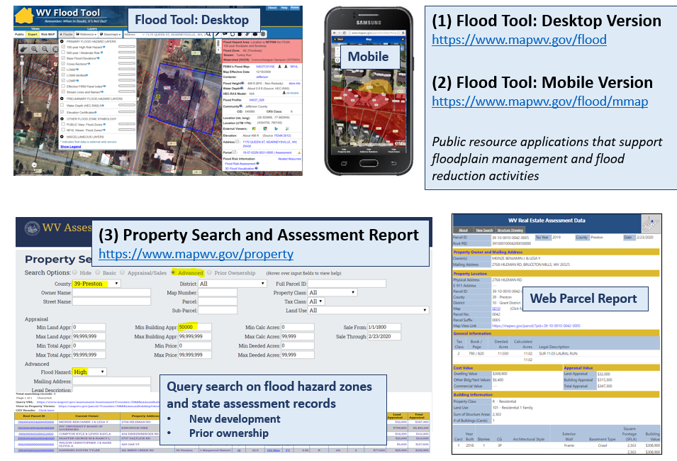
WV Flood Tool (& property tool)

Slide 21

WV Flood Resiliency Framework
An online toolkit that includes a suite of risk assessment and visualization tools for empowering communities across the state with the knowledge they need for coordination and capacity building to better prepare for future floods.
FLOOD RISK INDICATOR TOOLS:
  The WV Flood Tool shows flood characteristics, exposure, vulnerability, loss estimates, and mitigation measures at the property level, while the WV Flood Risk Index aggregates hazard data to indicate the communities most at risk of riverine flooding.
FLOOD RISK VISUALIZATION TOOLS:
  A collection of movies, animations, story maps, and other flood visualization tools presented at the building and community levels for communicating and understanding flood risk.
OTHER HAZARDS TOOLS:
  Interactive tools that provide risk assessment information about other hazards in the state, such as the WV Landslide Tool.
WEBSITE HUB:
  A website hub organizes the data and tools to maximize engagement, communication, collaboration, and data. It includes a section for published reports, plans, guides, and other useful risk assessment resources.

Slide 22
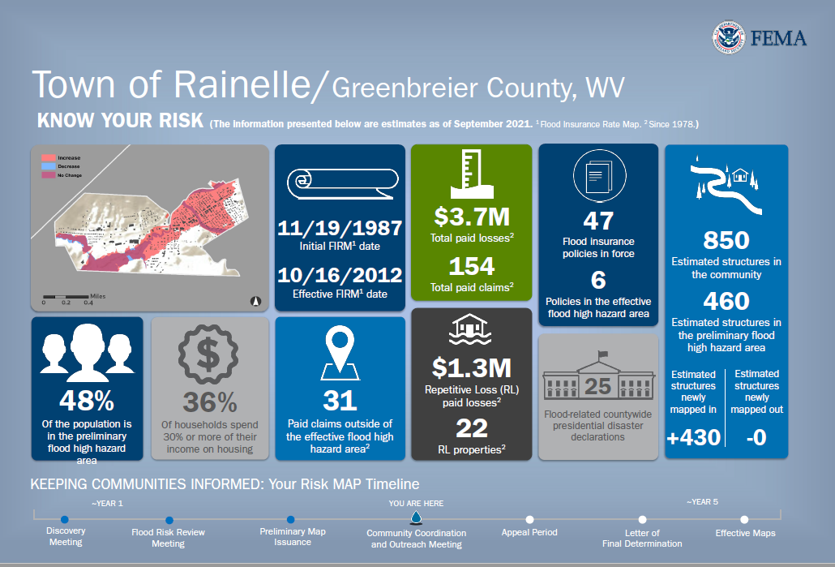

Community Risk Profile
ADDING RANKINGS TO SHOW COMMUNITIES OF HIGH RISK
with
WV Flood Risk Index

Slide 23
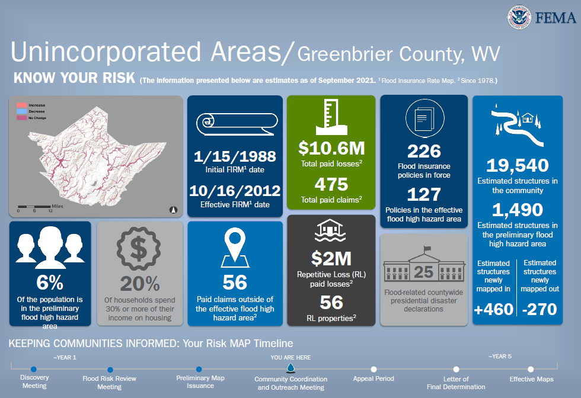
Community Risk Profile
with
WV Flood Risk Index

Slide 24
Risk Assessments at Multiple Scales
GEOGRAPHIC SCALES |  | APPLICATIONS |  |  |  | WVFRF TOOLS
Geographic Unit | # Units | Floodplain Management & Mitigation | FEMA Mapping | Risk Planning | Disaster Management | Risk Tools | Flood Visualization Tools | Document Center Tools
PROPERTY LEVEL
Structures¹ | 98,000 | X | X | X | X | WV Flood Tool (Individual Data) | Yes | Yes
Parcels | 275,000 | X | X | X | X |  |  | Yes
Other Features² |  | X | X | X | X
COMMUNITY LEVEL
Incorporated Places | 211 | X | X | X | X | WV Flood Risk Index (Aggregate Level) | Yes | Yes
Unincorporated Areas | 55 | X | X | X | X |  |  | Yes
Communities (NFIP)³ | 266 | X | X | X | X |  | Yes | Yes
COUNTY-REGION-STATE LEVEL
Counties | 55 | X | X | X | X | WV Flood Risk Index (Aggregate Level) | Yes | Yes
Regions (RPDCs) | 11 | X | X | X | X |  |  | Yes
State | 1 | X | X | X | X |  |  | Yes
DRAINAGE LEVEL
Watersheds | 32 | X | X | X | X | WV Flood Risk Index (Aggregate Level) |  | Yes
Streams (named) | 6,748 | X | X | X | X |  |  | Yes
NOTES:
¹ Primary structures located in high-risk effective and advisory floodplains (1%-annual-chance flood)
² Other Features include roads, bridges, National Register Areas, flood mitigation structures (dams, levees, floodwalls)
³ Total 284 communities in state: 266 NFIP; 18 incorporated places not in NFIP

Slide 25
FLOOD RISK INDEX TOOL

Slide 26
Flood Risk Index Tool Overview
This tool offers a range of flood risk indicators of various categories and integrates them at different aggregate levels. It generates dynamic (e.g., interactive maps) and static (e.g., downloadable reports) results to enhance understanding of the risk. Additionally, the tool provides functions for comparing risk among communities or other units of different scales.
Key Concepts:
Incorporating best available quantitative and qualitative risk data
Considering both risk and mitigation factors
Ranking and calculating indicator/index scores to identify communities/counties/regions of highest risk
Analyzing risk at multiple scales
Political Scales:
Communities
Incorporated
Unincorporated
Counties
Planning & Development Council Regions
State
Drainage Areas Scales:
Watersheds
Streams

Slide 27
Principal Functions of Flood Risk Index Tool
Risk Factor Scores and Cumulative Index
Web Reports (include additional flood data besides indicators)
Visualizations and Charts
Rationale and Recommendations (integrates quantitative data with qualitative information from risk behavior/knowledge studies)
Data Export
Notes:
Going to describe Risk Factor Scores and Cumulative Index in more detail

Slide 28
Risk Factor Scores and Cumulative Index
Major Categories (5) | Detailed Categories (22) | Tool Indicators (64)
1) Flood Hazard Risk | Floodplain Area | 6 indicators
 | Floodplain Length
 | Declared Disasters
 | Flood Depth
2) Structure Risk | Building Counts / Ratios | 41 indicators
 | Building Types & Values
 | Vulnerable Structures
 | FIRM Status
 | Building Year / New Construction
 | Significant Structures
 | Physical Damage Estimates
 | Recorded Building Damages
 | Transportation Infrastructure
3) People/Social Risk | Social Vulnerability | 4 indicators
 | Population Exposure
 | Population Displacement & Shelter Needs
4) Other Hazards | Dams/Levees | 4 indicators
 | Landslide
5) Mitigation Measures | Structural Measures | 9 indicators
 | Physical Non-Structural Measures
 | Non-Physical Non-structural Measures

Slide 29
Risk Factor Scores and Cumulative Index …
1) Flood Hazard Risk Indicators
Major Category | Detailed Category | Code | Indicator | Short Description | Unit
Flood Hazard Risk | Floodplain Area | SFHA | Floodplain Area | Acreage of modified Special Flood Hazard Area (SFHA), or 1%-annual-chance (100-yr) floodplain Areas excluded from Total aSFHA: Open water lakes > 10 acres; Large river bank-to-bank > 500 ft.; Federal lands > 10 acres. | Acres
Rationale | Recommendations | Data Source
For unincorporated areas and at the county level, it can be more challenging for communities larger in geographic size to enforce their floodplain management ordinance. Often larger jurisdictions have more acres and miles of floodplain extent than compared to smaller communities. In smaller communities, the floodplain area is compacted and thus new development in the floodplain should be easier to monitor than larger rural areas or countywide. The acreage of the SFHA (aSFHA) is a programming variable required for those communities participating in FEMA’s Community Rating System (CRS) program. | Larger jurisdictions must be vigilant in monitoring and permitting new development for an expansive geographic area that includes a large amount floodplain area/miles. | FEMA FIRM Streams and Waterbodies (USGS NHD 24K), National Public Lands (USGS PAD-US)

Slide 30

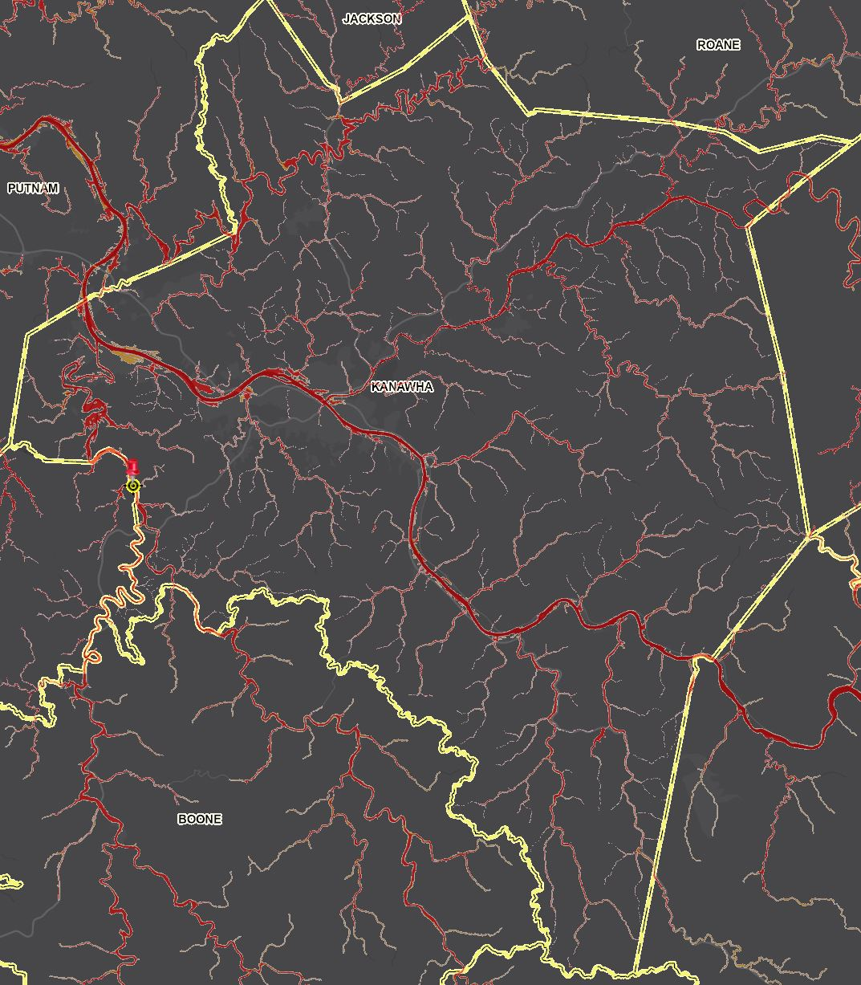
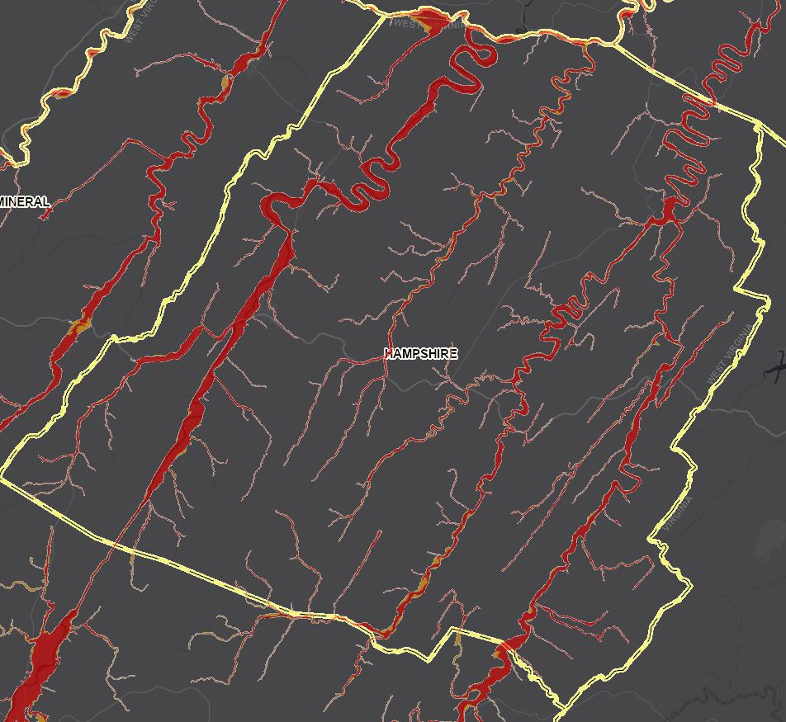
Risk Factor Scores and Cumulative Index …
Top 20% Rankings for Floodplain Area
RANK | All Communities | Percent Rank | Unincorporated Areas | Percent Rank | Counties | Percent Rank | Regions | Percent Rank
1 | Hampshire County* | 100.0% | Hampshire County* | 100.0% | HAMPSHIRE | 100.0% | 5 | 100%
2 | Mason County* | 99.6% | Mason County* | 98.1% | KANAWHA | 98.1% | 8 | 90%
3 | Kanawha County* | 99.2% | Kanawha County* | 96.2% | MASON | 96.2% | 2 | 80%
4 | Greenbrier County* | 98.9% | Greenbrier County* | 94.4% | GREENBRIER | 94.4%
5 | Randolph County* | 98.5% | Randolph County* | 92.5% | RANDOLPH | 92.5%
6 | Webster County* | 98.2% | Webster County* | 90.7% | WOOD | 90.7%
7 | Wood County* | 97.8% | Wood County* | 88.8% | WEBSTER | 88.8%
8 | Hardy County* | 97.5% | Hardy County* | 87.0% | HARDY | 87.0%
9 | Jackson County* | 97.1% | Jackson County* | 85.1% | JACKSON | 85.1%
10 | Pendleton County* | 96.8% | Pendleton County* | 83.3% | WAYNE | 83.3%
11 | Wayne County* | 96.4% | Wayne County* | 81.4% | PENDLETON | 81.4%
12 | Lincoln County* | 96.1%
13 | Berkeley County* | 95.7%
14 | Cabell County* | 95.4%
15 | Pocahontas County* | 95.0%
16 | Preston County* | 94.6%
17 | Putnam County* | 94.3%
18 | Nicholas County* | 93.9%
19 | Mineral County* | 93.6%
20 | Raleigh County* | 93.2%
21 | Jefferson County* | 92.9%
22 | Morgan County* | 92.5%
23 | Harrison County* | 92.2%
24 | Wirt County* | 91.8%
25 | Tyler County* | 91.5%
26 | Ritchie County* | 91.1%
27 | Braxton County* | 90.8%
28 | Boone County* | 90.4%
29 | Monroe County* | 90.1%
30 | Tucker County* | 89.7%
31 | Mercer County* | 89.3%
32 | Grant County* | 89.0%
33 | Lewis County* | 88.6%
34 | Roane County* | 88.3%
35 | Gilmer County* | 87.9%
36 | Wetzel County* | 87.6%
37 | Calhoun County* | 87.2%
38 | Barbour County* | 86.9%
39 | Upshur County* | 86.5%
40 | Clay County* | 86.2%
41 | Doddridge County* | 85.8%
42 | Mingo County* | 85.5%
43 | Marshall County* | 85.1%
44 | Logan County* | 84.8%
45 | Marion County* | 84.4%
46 | Wyoming County* | 84.0%
47 | Monongalia County* | 83.7%
48 | Fayette County* | 83.3%
49 | Summers County* | 83.0%
50 | Pleasants County* | 82.6%
51 | McDowell County* | 82.3%
52 | Taylor County* | 81.9%
53 | Brooke County* | 81.6%
54 | Wheeling** | 81.2%
55 | Parkersburg | 80.9%
56 | Ohio County* | 80.5%
57 | Huntington** | 80.2%
A WV Flood Tool Screenshot of the floodplains in Hampshire County (link)
Colors:
Black --> Incorporated areas Brown --> Unincorporated areas Green --> Counties (Total) Red --> Split communities
A WV Flood Tool Screenshot of the floodplains in Kanawha County (link)

Slide 31
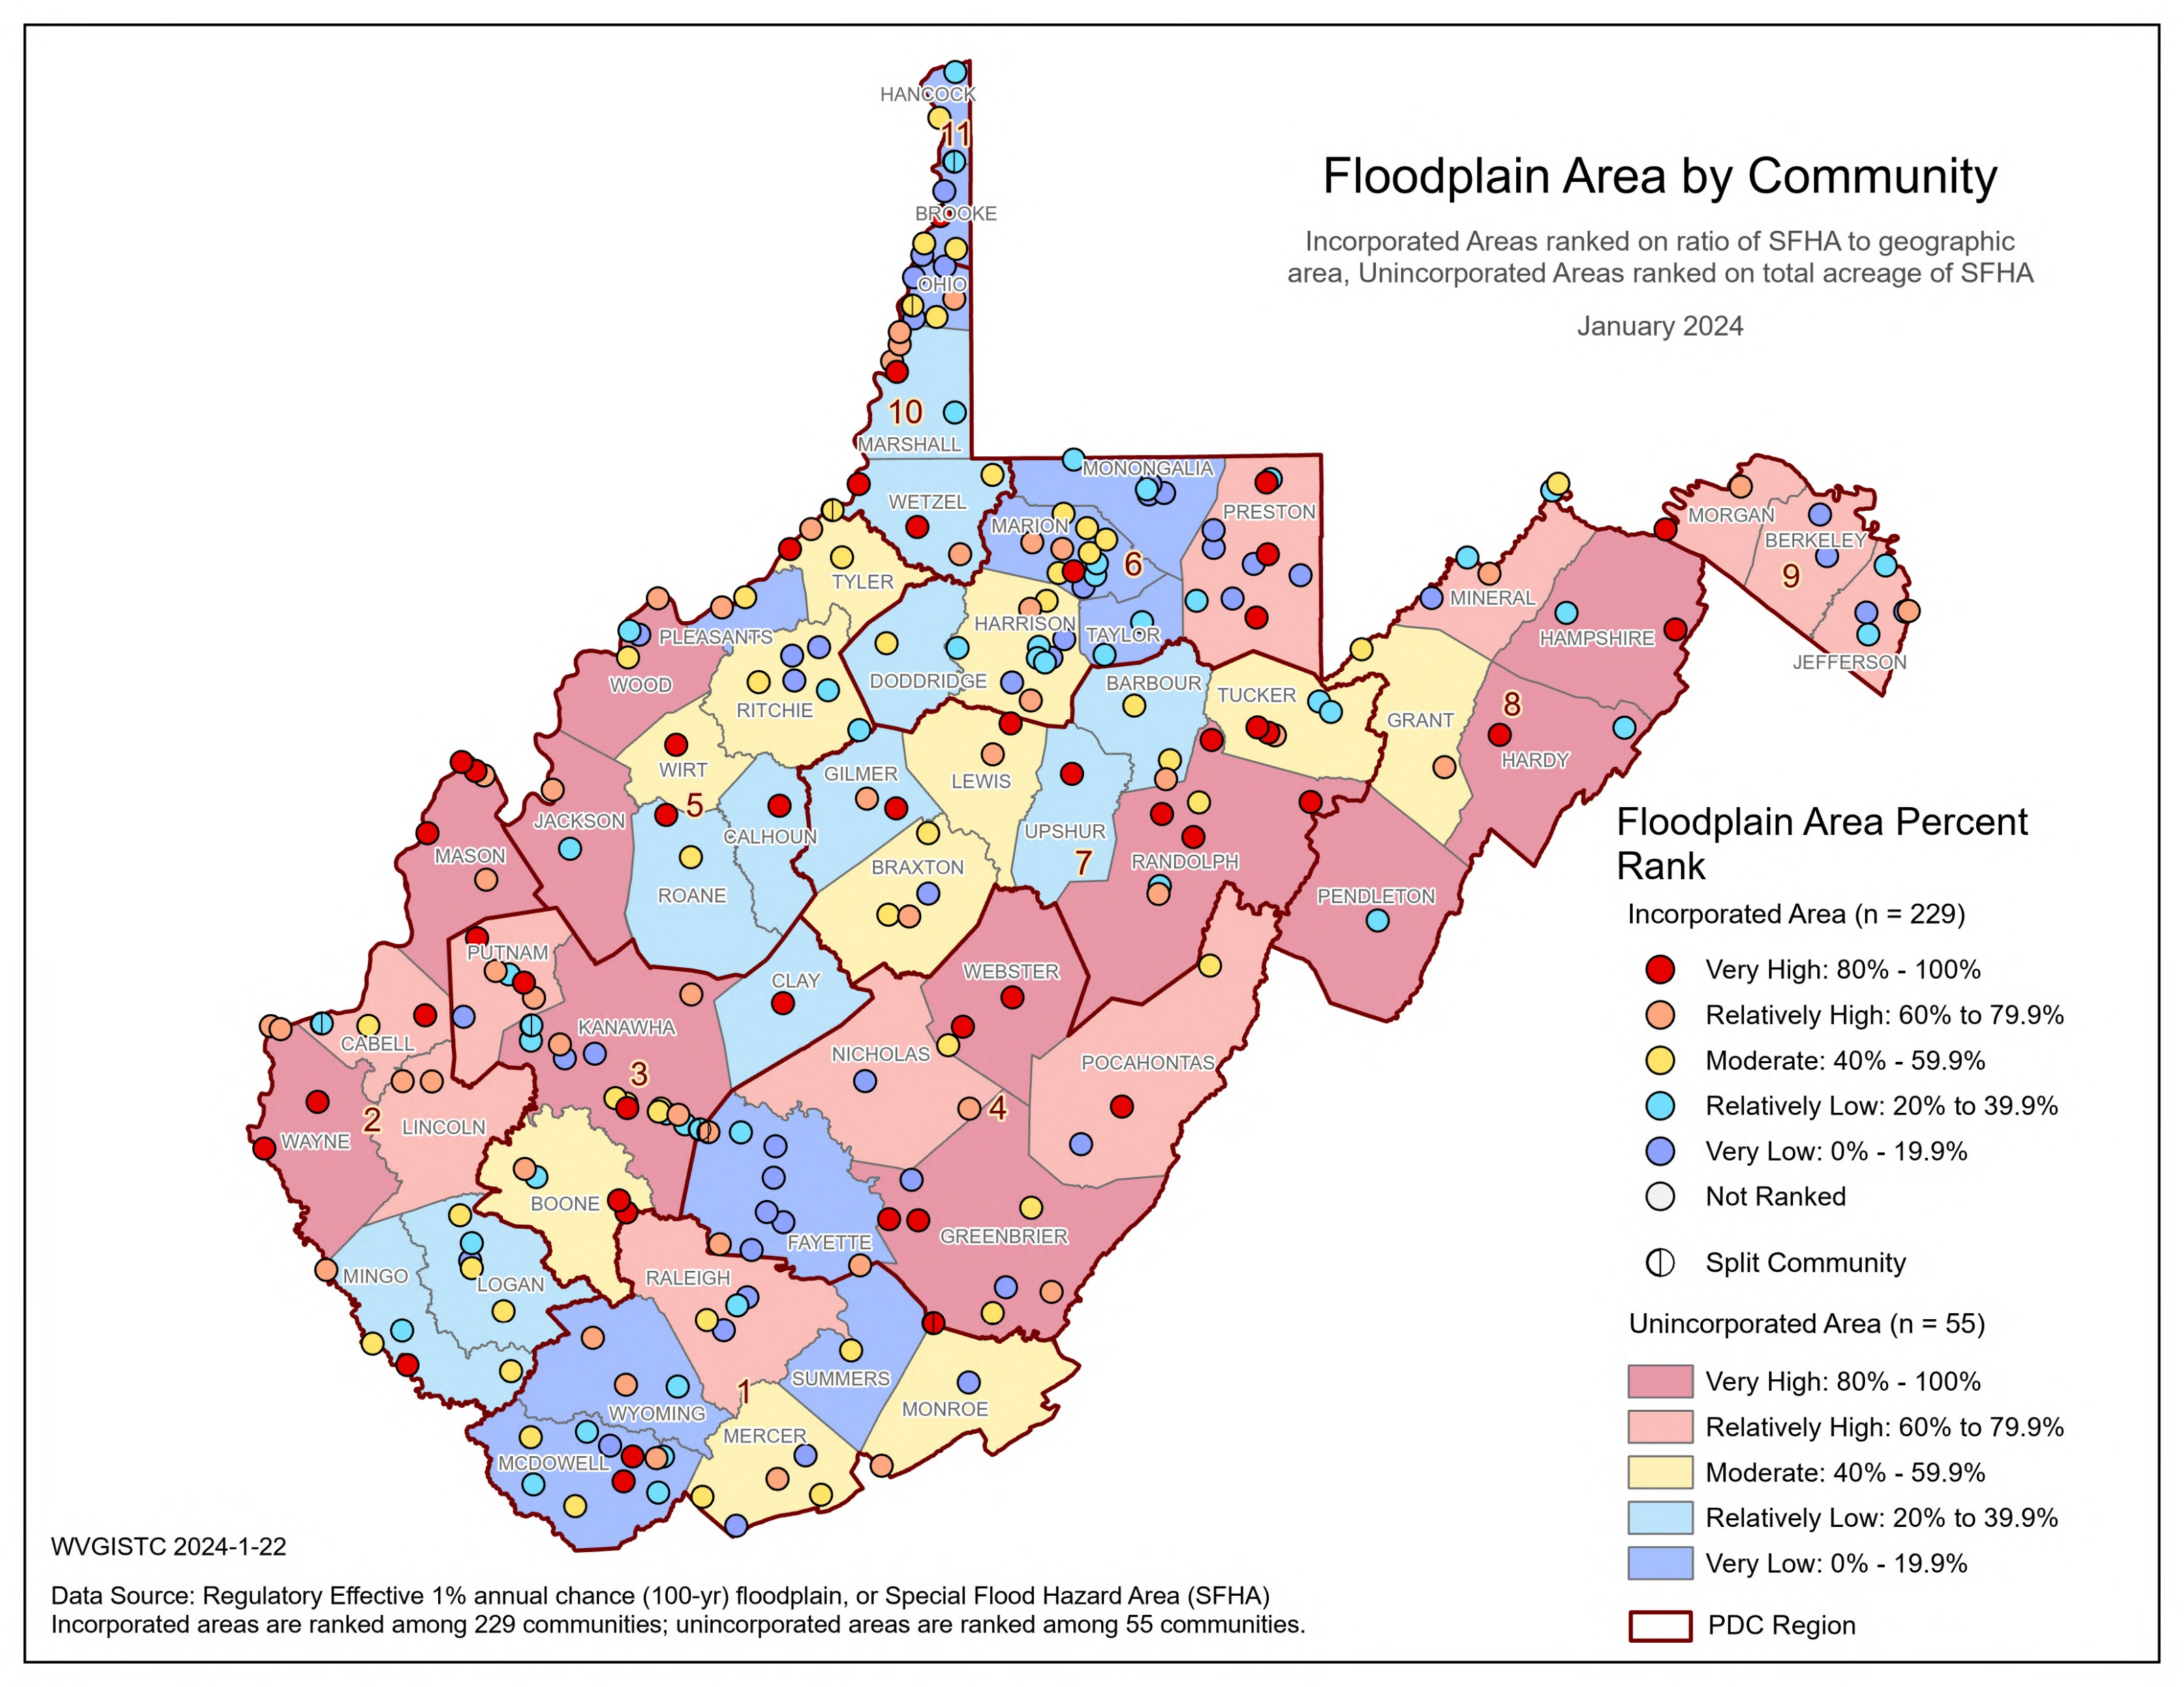
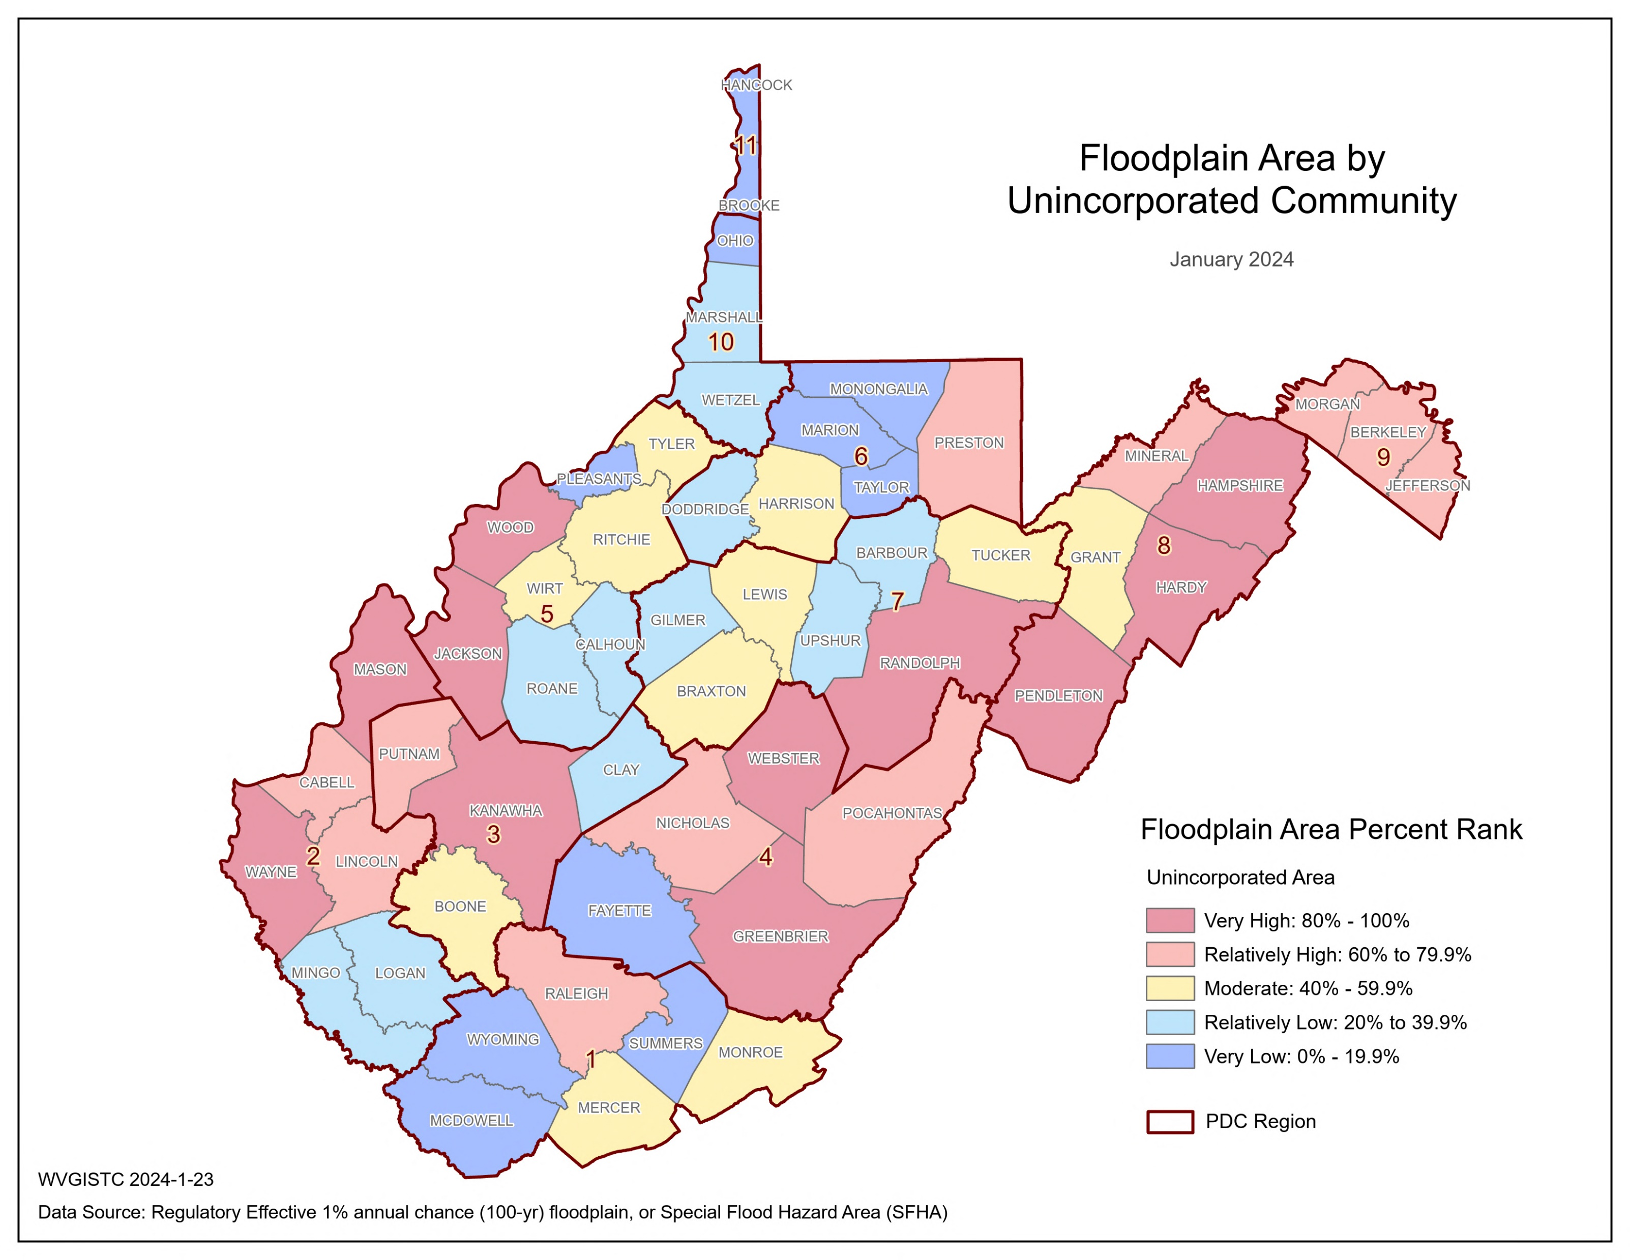
Risk Factor Scores and Cumulative Index …
Top 5 Unincorporated Communities | Modified Total SFHA Area (acres)
Hampshire County* | 26,373
Mason County* | 21,862
Kanawha County* | 20,983
Greenbrier County* | 20,700
Randolph County* | 19,838
* Unincorporated area

Slide 32
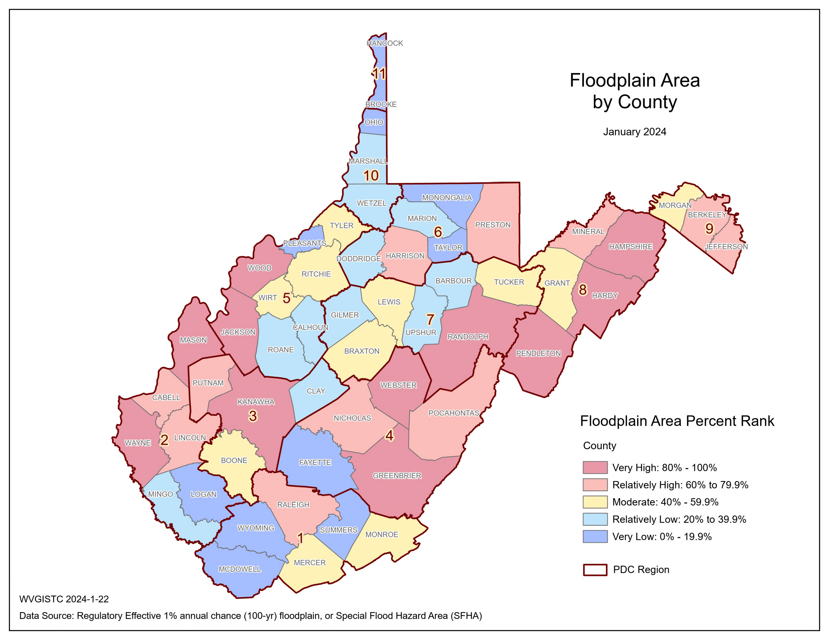
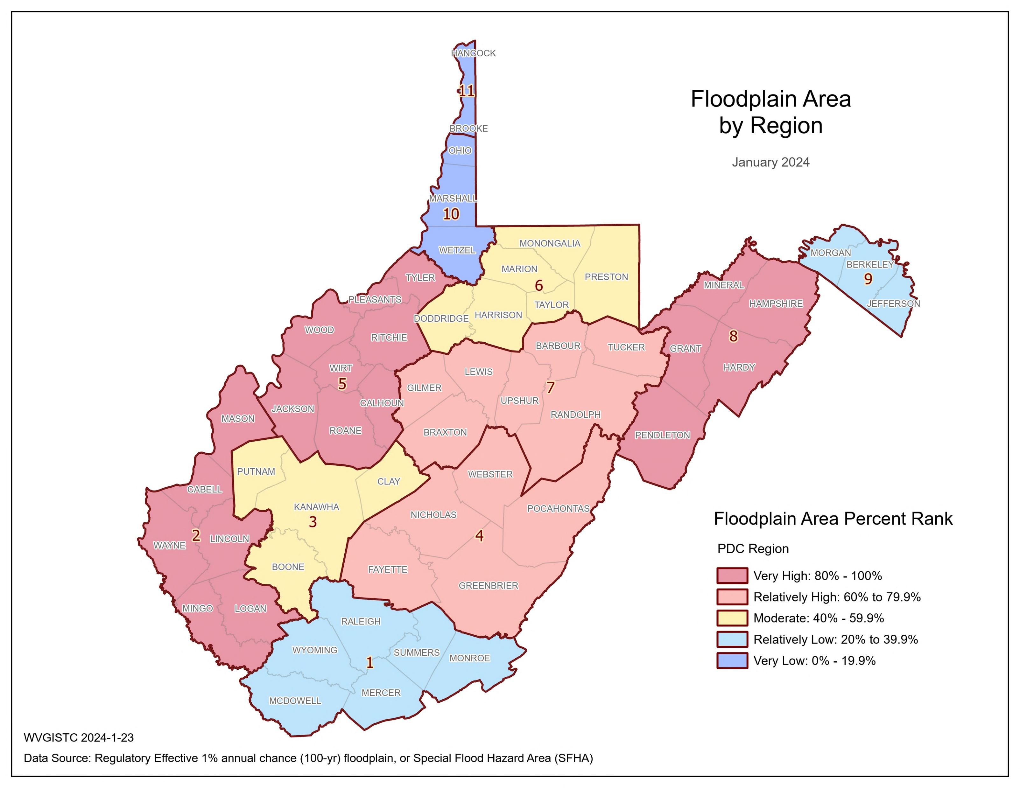
Risk Factor Scores and Cumulative Index …
Top 5 Counties | Modified Total SFHA Area (acres)
Hampshire | 26,607
Kanawha | 23,929
Mason | 23,117
Greenbrier | 21,615
Randolph | 20,523
Top 3 Regions | Modified Total SFHA Area (acres)
5 | 76,780
8 | 74,648
2 | 72,366

Slide 33
Risk Factor Scores and Cumulative Index …
Indicator | White Sulphur Springs | Rainelle | Clendenin | Richwood | Marlinton | Camden-on-Gauley | Statewide Median
Total SFHA Area (acres) | 267 | 223 | 235 | 247 | 494 | 35 | 77
Water Bodies > 10 acres & Wide Streams > 500 ft. | 0 | 0 | 0 | 0 | 0 | 0 | 0
Federal Lands (> 10 acres) | 0 | 0 | 0 | 0 | 0 | 0 | 0
Modified Total SFHA Area (acres) (Minus large water bodies and federal lands) | 267 | 223 | 235 | 247 | 494 | 35 | 74
Total Community Area (acres) | 1,214 | 714 | 974 | 1,068 | 1,566 | 214 | 559
Ratio of aSFHA to Community Area | 22.0% | 31.2% | 24.1% | 23.1% | 31.5% | 16.4% | 13.8%
Floodplain Area Ratio Percent Rank | 74.2% (Relatively High) | 87.7% (Very High) | 78.6% (Relatively High) | 77.7% (Relatively High) | 89.0% (Very High) | 58.5% (Moderate) | -
Percent Rank Legend:
Very High: 80% to 100%
Relatively High: 60% to 79.9%
Moderate: 40% to 59.9%
Relatively Low: 20% to 39.9%
Very Low: 0% to 19.9%
Red: 90% to 100%

Slide 34
Risk Factor Scores and Cumulative Index …
Major Category | Detailed Category | Code | Indicator | Short Description | Unit
Flood Hazard Risk | Declared Disasters | DCL_DSTR | Declared Flood Disasters | Number of federally-declared flood disasters in the county since 1953 | #
Rationale | Recommendations | Data Source
Previous disasters indicate potential for future risk. In addition, the recentness of a flood disaster has proven to increase communities' willingness to seek/accept change/mitigation. In West Virginia, many flood control structures (e.g., dams, levees, flood walls) built in the 20th Century have decreased the number of major flood disasters. | A major disaster declaration provides a wide range of federal assistance programs for individuals and public infrastructure, including funds for both emergency and permanent work. Historical flooding including high water marks should be incorporated into communities’ flood reduction efforts to include areas of mitigation interest. | Open FEMA

Slide 35
Risk Factor Scores and Cumulative Index …
Top 20% Ranking:
Name | RPDC Region | Federally-Declared Flood Disasters | Last Disaster Date | Percent Rank | Class
Mingo County | 2 | 11 | 3/4/2021 | 100.0% | Very High
Lincoln County | 2 | 10 | 3/4/2021 | 96.3% | Very High
Logan County | 2 | 10 | 3/4/2021 | 96.3% | Very High
Wayne County | 2 | 9 | 3/4/2021 | 92.6% | Very High
Greenbrier County | 4 | 9 | 6/29/2016 | 92.6% | Very High
Kanawha County | 3 | 8 | 3/4/2021 | 88.9% | Very High
Jackson County | 5 | 8 | 6/29/2016 | 88.9% | Very High
Raleigh County | 1 | 7 | 6/10/1996 | 81.5% | Very High
Wyoming County | 1 | 7 | 6/29/2010 | 81.5% | Very High
Cabell County | 2 | 7 | 3/4/2021 | 81.5% | Very High
Randolph County | 7 | 7 | 6/30/2019 | 81.5% | Very High
Total federally-declared flood disasters in West Virginia: | 32
Total in USA: | 880
Scores Legend:
80 to 100 | Very High | Red text: 90 to 100 Very High
60 to 79.9 | Relatively High
40 to 59.9 | Moderate
20 to 39.9 | Relatively Low
0 to 19.9 | Very Low
Bottom 20% Ranking:
Clay County | 3 | 3 | 6/29/2016 | 1.9% | Very Low
Pleasants County | 5 | 3 | 4/15/2015 | 1.9% | Very Low
Wood County | 5 | 3 | 3/15/1997 | 1.9% | Very Low
Taylor County | 6 | 3 | 2/22/2000 | 1.9% | Very Low
Grant County | 8 | 3 | 6/30/2019 | 1.9% | Very Low
Mineral County | 8 | 3 | 2/2/1996 | 1.9% | Very Low
Berkeley County | 9 | 3 | 2/2/1996 | 1.9% | Very Low
Jefferson County | 9 | 3 | 2/2/1996 | 1.9% | Very Low
Morgan County | 9 | 3 | 2/2/1996 | 1.9% | Very Low
Brooke County | 11 | 3 | 4/11/2015 | 1.9% | Very Low
Hancock County | 11 | 3 | 2/2/1996 | 1.9% | Very Low
Ritchie County | 5 | 2 | 4/11/2015 | 0.0% | Very Low

Slide 36
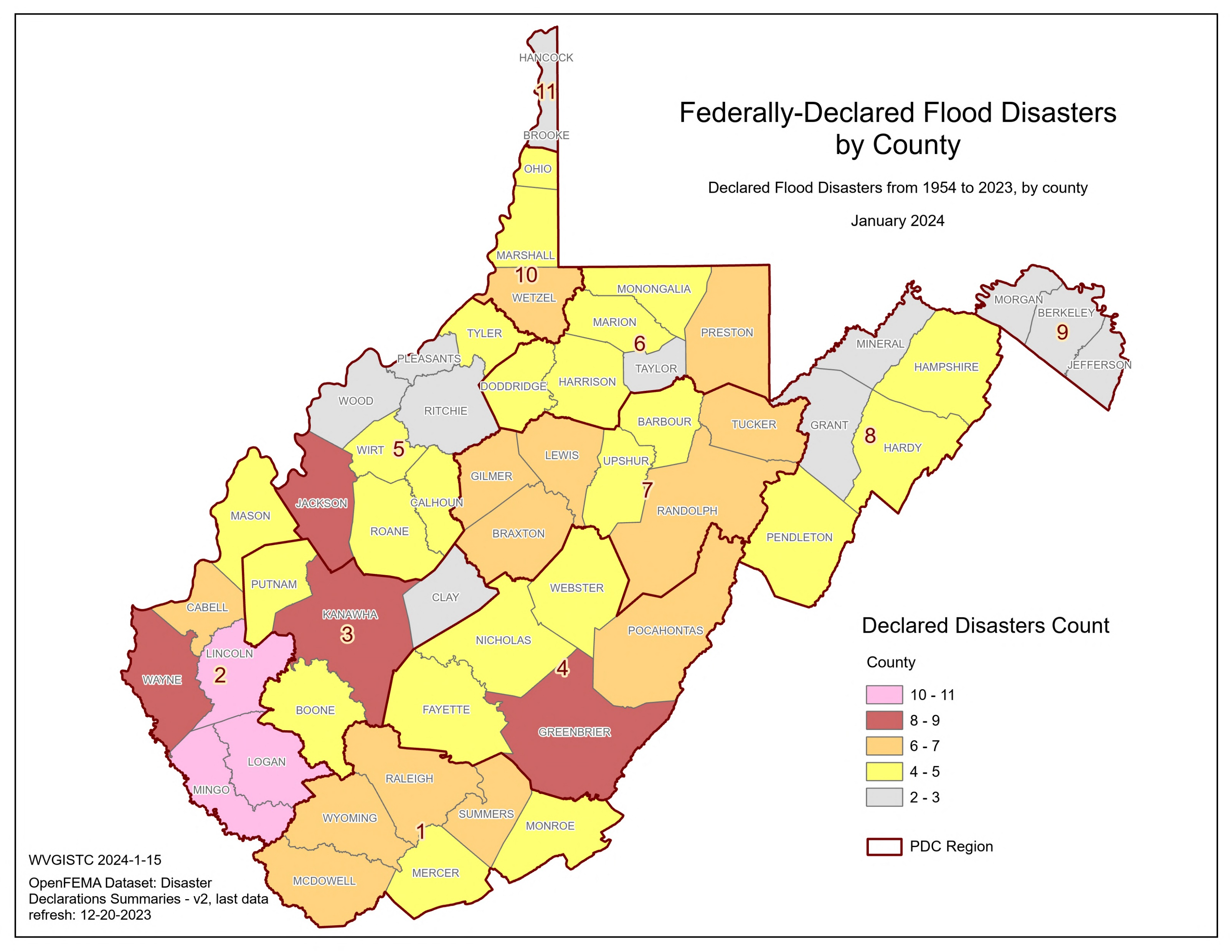
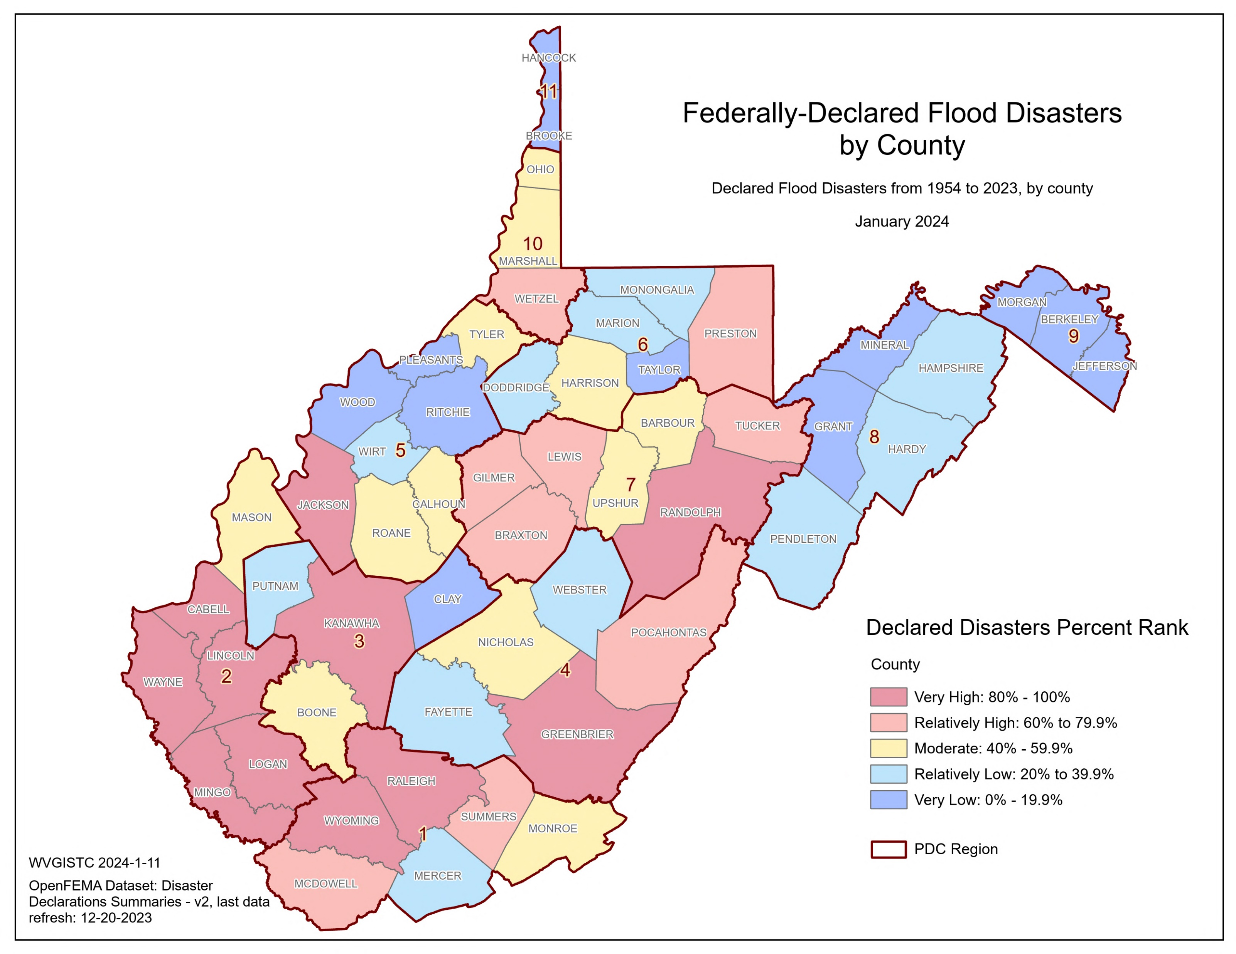
Risk Factor Scores and Cumulative Index …
Top 5 Counties | Federally-Declared Flood Disasters | Last Disaster Date
Mingo County | 11 | 3/4/2021
Lincoln County | 10 | 3/4/2021
Logan County | 10 | 3/4/2021
Wayne County | 9 | 3/4/2021
Greenbrier County | 9 | 6/29/2016

Slide 37
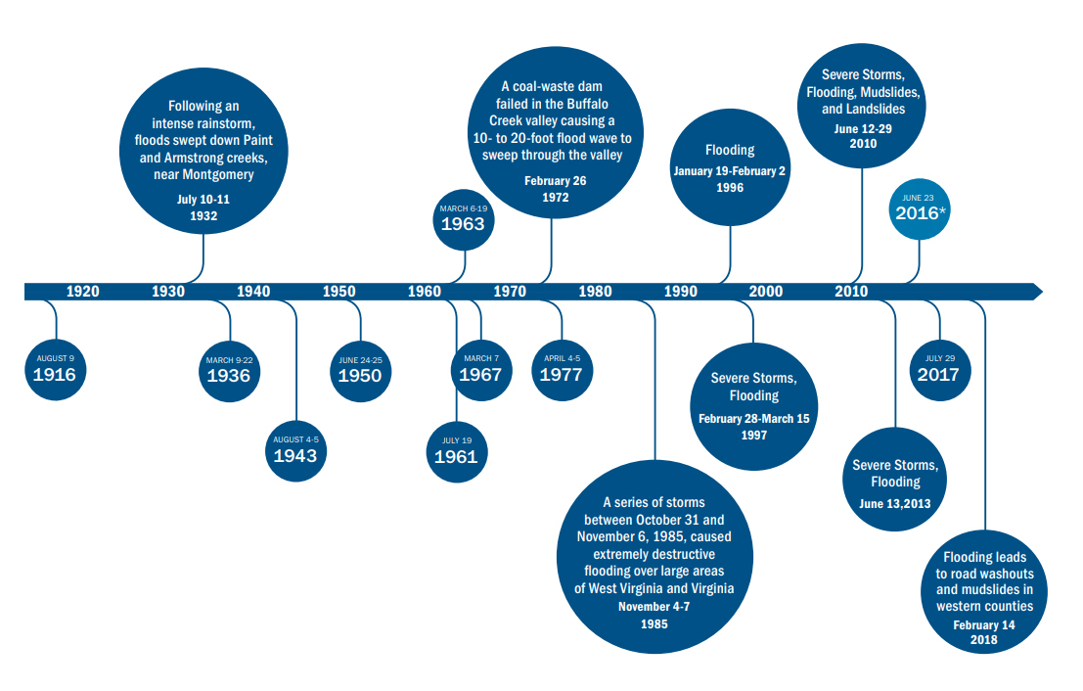
Risk Factor Scores and Cumulative Index …
Timeline of notable flood events in WV (1916 – 2018)
Qualitative
Component
Source:
Federal Emergency Management Agency (FEMA). Understanding flood dangers in central West Virginia: Lessons learned from the June 2016 flood. https://www.fema.gov/sites/default/files/documents/Region_III_WV_FloodReport.pdf

Slide 38
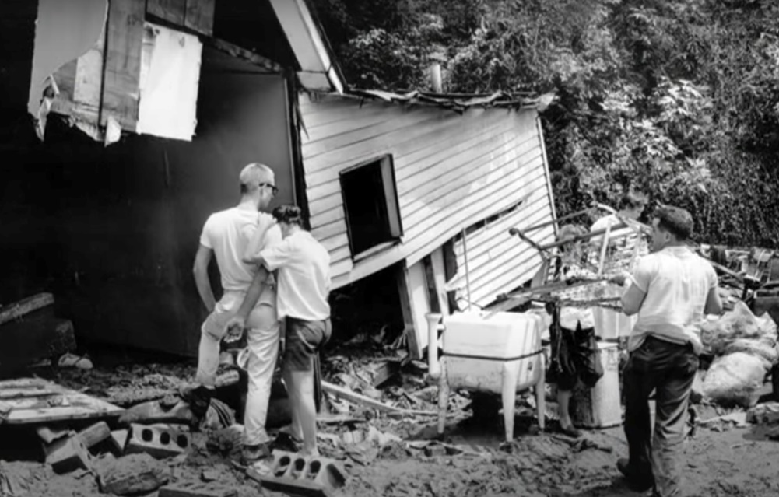
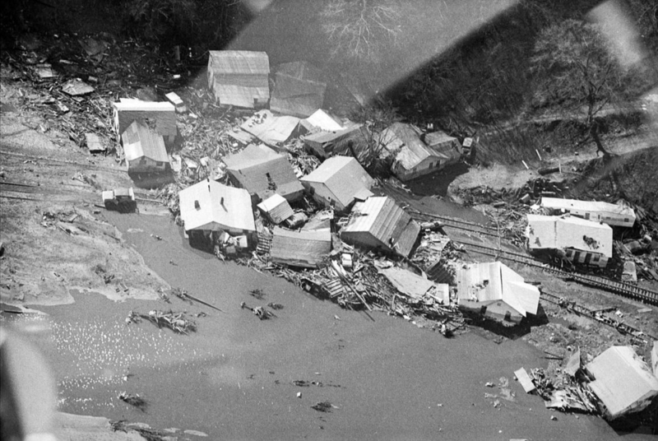
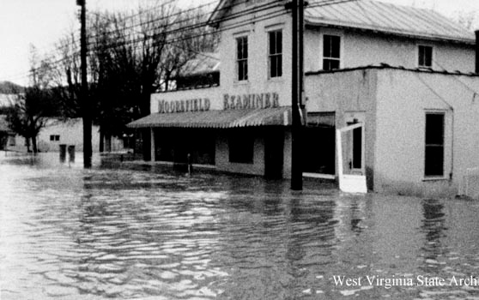
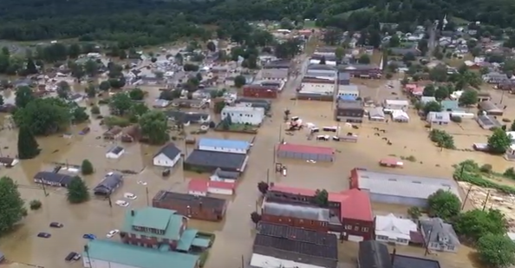
Risk Factor Scores and Cumulative Index …
July 1961 (22 + 2 landslide fatalities)
Image: Kanawha County (Image link)
February 1972 (125 fatalities including 4 missing)
Image: Huntington (Image link)
November 1985 (47 fatalities in WV)
Image: Moorefield (Image link)
June 2016 (23 fatalities)
Image: Rainelle (Image link)
Fatalities data source: https://www.wvencyclopedia.org/assets/0003/4074/Deadliest_Floods_in_WestVirginia_History.pdf

Slide 39
Risk Factor Scores and Cumulative Index …
2) Structure Risk
Major Category | Detailed Category | Code | Indicator | Short Description | Unit
Structure Risk | Building Counts / Ratios | BLDG_SFHA | Building Count in SFHA | All primary insurable structures in the effective 100-year Floodplain or Special Flood Hazard Area (SFHA) | #
Rationale | Recommendations | Data Source
The higher number of buildings in the floodplain indicates higher physical and human exposure to riverine flooding. If a building owner has a mortgage from a federally regulated lender and the property is in the Special Flood Hazard Area, then the building owner is required by Federal law to carry flood insurance. The building count in the SFHA is a programming variable required for those communities participating in FEMA’s Community Rating System (CRS) program. | Communities with a high floodplain building count should actively engage property owners about flood insurance and minimizing flood losses of property owners. See Floodsmart.gov for more information. Communities can become more resilient to flooding by exceeding the minimum NFIP requirements. Higher building standards adopted by local communities may include increasing the freeboard of the base flood elevation; or encourage property owners to build to the higher 500-year flood elevation or historical high-water mark. Floodplain managers and emergency planners should pre-load at-risk structures into substantial damage estimator software. Local officials should review early warning systems as well as short-term shelters located outside the floodplain and away from inundated roads. State and county leaders should prioritize pre-disaster planning for communities with many flood-prone buildings. | All political scales: FEMA Special Flood Hazard Area (SFHA) for effective 1%-Annual-Chance Floodplains; Watershed and Stream scales: Effective and Advisory Floodplains for 1% Annual-Chance event; BLRA

Slide 40
Risk Factor Scores and Cumulative Index …
Top 20% Rankings for Building Count in SFHA
RANK | All Communities | Percent_Rank | Incorporated Communities | Percent_Rank | Unincorporated Areas | Percent_Rank | Counties | Percent_Rank | Regions | Percent_Rank
1 | Kanawha County* | 100.0% | Wheeling** | 100.0% | Kanawha County* | 100.0% | KANAWHA | 100.0% | 3 | 100%
2 | Logan County* | 99.6% | Charleston | 99.5% | Logan County* | 98.1% | LOGAN | 98.1% | 2 | 90%
3 | Wheeling** | 99.2% | Dunbar | 99.0% | Mingo County* | 96.2% | OHIO | 96.2% | 1 | 80%
4 | Mingo County* | 98.8% | Wellsburg | 98.5% | Boone County* | 94.4% | BOONE | 94.4%
5 | Boone County* | 98.4% | New Martinsville | 98.0% | Lincoln County* | 92.5% | MINGO | 92.5%
6 | Lincoln County* | 98.1% | Huntington** | 97.6% | Mercer County* | 90.7% | CABELL | 90.7%
7 | Mercer County* | 97.7% | Buckhannon | 97.1% | Raleigh County* | 88.8% | MCDOWELL | 88.8%
8 | Raleigh County* | 97.3% | Milton | 96.6% | Wayne County* | 87.0% | WAYNE | 87.0%
9 | Wayne County* | 96.9% | Clarksburg | 96.1% | Cabell County* | 85.1% | LINCOLN | 85.1%
10 | Cabell County* | 96.6% | Marlinton | 95.7% | Putnam County* | 83.3% | MERCER | 83.3%
11 | Charleston | 96.2% | South Charleston | 95.2% | Wood County* | 81.4% | WOOD | 81.4%
12 | Putnam County* | 95.8% | Rainelle | 94.7%
13 | Wood County* | 95.4% | Weston | 94.2%
14 | McDowell County* | 95.1% | Moundsville | 93.8%
15 | Wyoming County* | 94.7% | Welch | 93.3%
16 | Randolph County* | 94.3% | Benwood | 92.8%
17 | Hampshire County* | 93.9% | Vienna | 92.3%
18 | Dunbar | 93.6% | White Sulphur Springs | 91.4%
19 | Mason County* | 93.2% | Clendenin | 91.4%
20 | Marion County* | 92.8% | Buffalo | 90.9%
21 | Greenbrier County* | 92.4% | Parkersburg | 90.4%
22 | Fayette County* | 92.1% | Madison | 90.0%
23 | Clay County* | 91.7% | Gary | 89.5%
24 | Wetzel County* | 91.3% | Keyser | 89.0%
25 | Jackson County* | 90.9% | Richwood | 88.5%
26 | Webster County* | 90.6% | Philippi | 88.0%
27 | Harrison County* | 90.2% | Parsons | 87.6%
28 | Wellsburg | 89.8% | Princeton | 87.1%
29 | New Martinsville | 89.4% | Elkins | 86.6%
30 | Summers County* | 89.0% | Wayne | 86.1%
31 | Huntington** | 88.7% | Spencer | 85.7%
32 | Monongalia County* | 88.3% | Hartford | 85.2%
33 | Braxton County* | 87.9% | Mannington | 84.7%
34 | Doddridge County* | 87.5% | Chesapeake | 84.2%
35 | Lewis County* | 87.2% | St. Albans | 83.8%
36 | Nicholas County* | 86.8% | Oceana | 83.3%
37 | Upshur County* | 86.4% | Alderson** | 82.8%
38 | Marshall County* | 86.0% | New Cumberland | 82.3%
39 | Roane County* | 85.7% | Morgantown | 81.9%
40 | Mineral County* | 85.3% | Weirton** | 81.4%
41 | Buckhannon | 84.9% | Man | 80.9%
42 | Tyler County* | 84.5% | Ravenswood | 80.4%
43 | Berkeley County* | 84.2% | Bridgeport | 80.0%
44 | Jefferson County* | 83.8%
45 | Calhoun County* | 83.4%
46 | Wirt County* | 83.0%
47 | Morgan County* | 82.7%
48 | Milton | 82.3%
49 | Pocahontas County* | 81.9%
50 | Clarksburg | 81.5%
51 | Preston County* | 81.2%
52 | Hardy County* | 80.8%
53 | Marlinton | 80.0%
54 | Monroe County* | 80.0%
Colors:
Black --> Incorporated areas Brown --> Unincorporated areas Green --> Counties (Total) Red --> Split communities
Black on blue: Six incorporated communities included in the detailed risk study (Camden-on-Gauley, Clendenin, Rainelle, Richwood, White Sulphur Springs, and Marlinton)

Slide 41
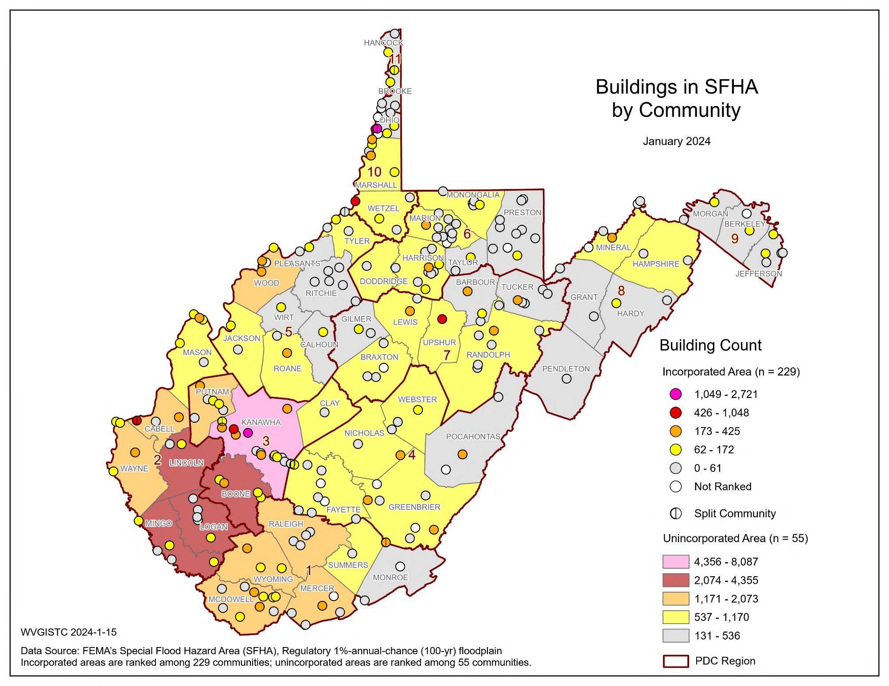
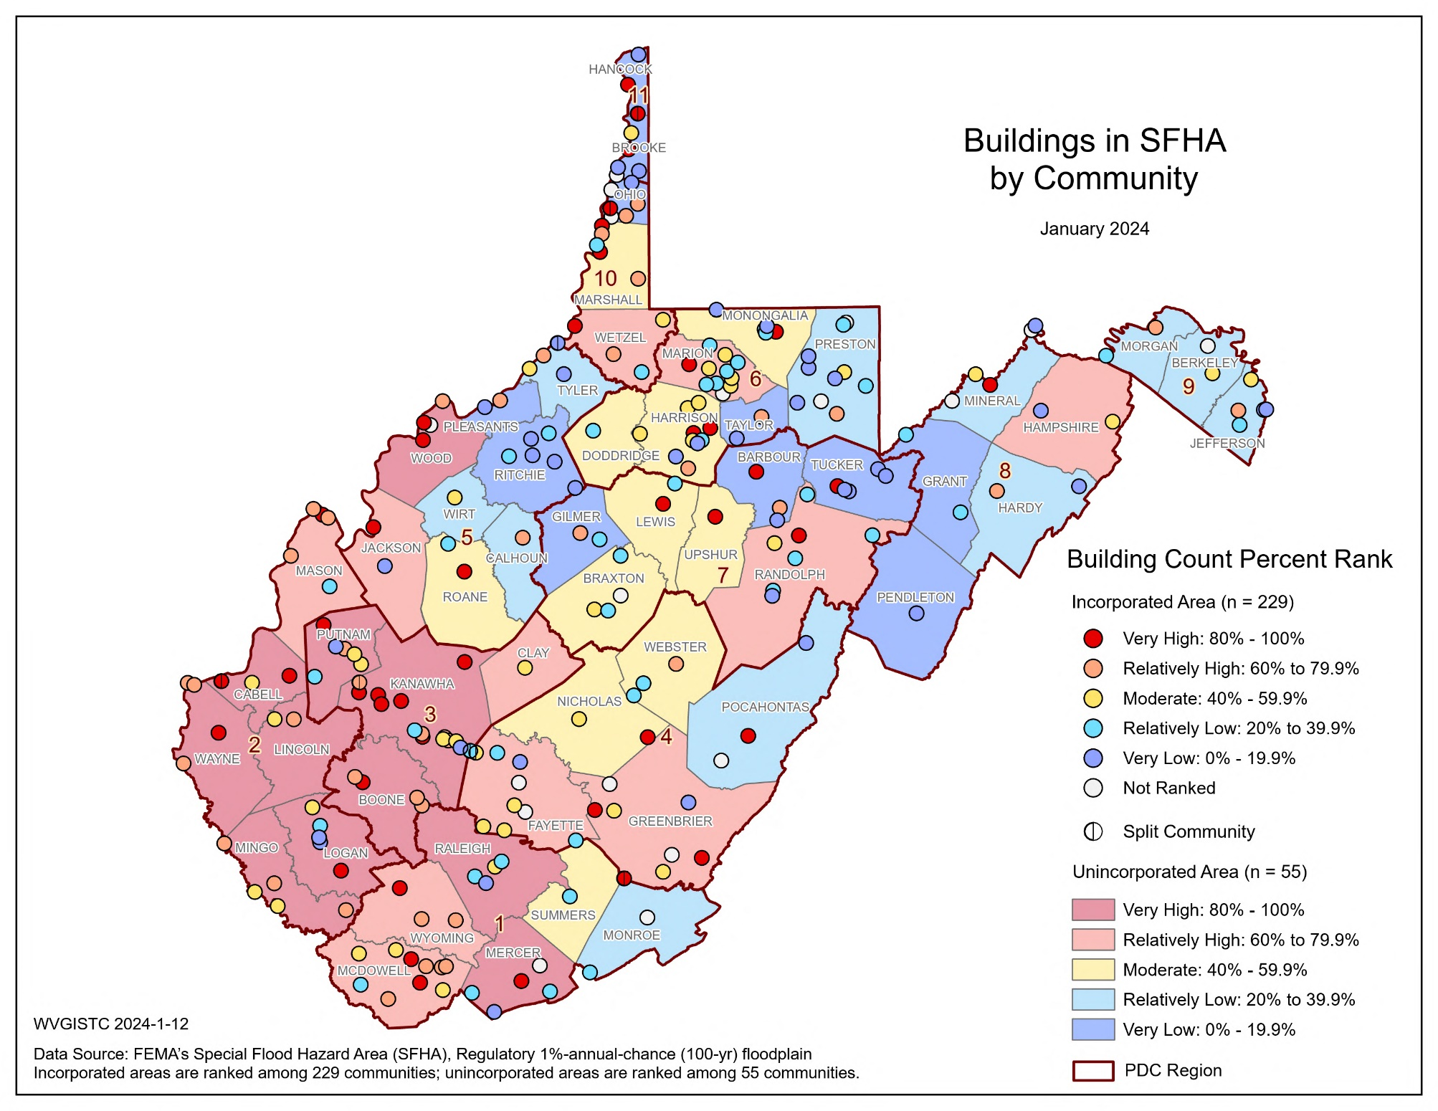
Risk Factor Scores and Cumulative Index …
Top 5 Communities | County | BLDG SFHA
Kanawha County* | Kanawha | 8,087
Logan County* | Logan | 4,355
Wheeling** | Ohio/Marshall | 2,721
Mingo County* | Mingo | 2,672
Boone County* | Boone | 2,615
* Unincorporated area
** Split community

Slide 42
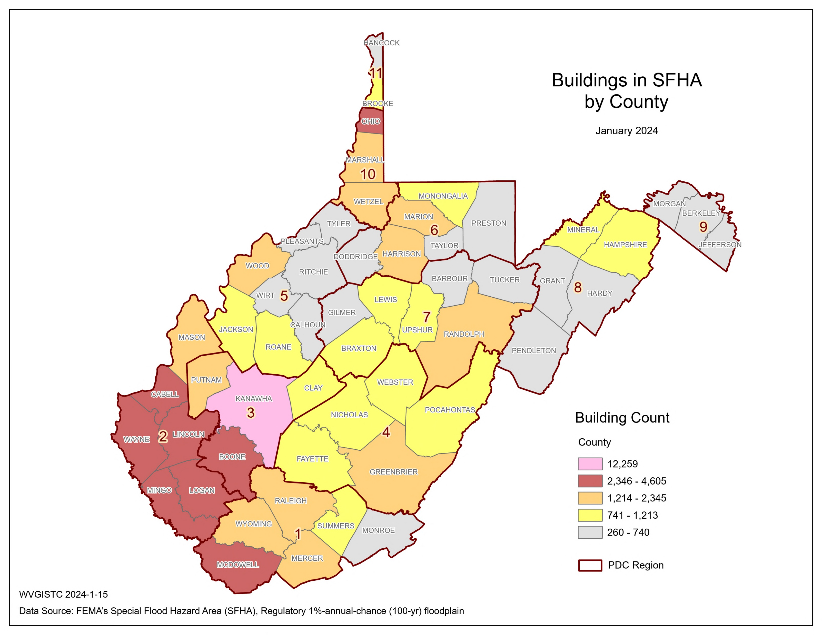
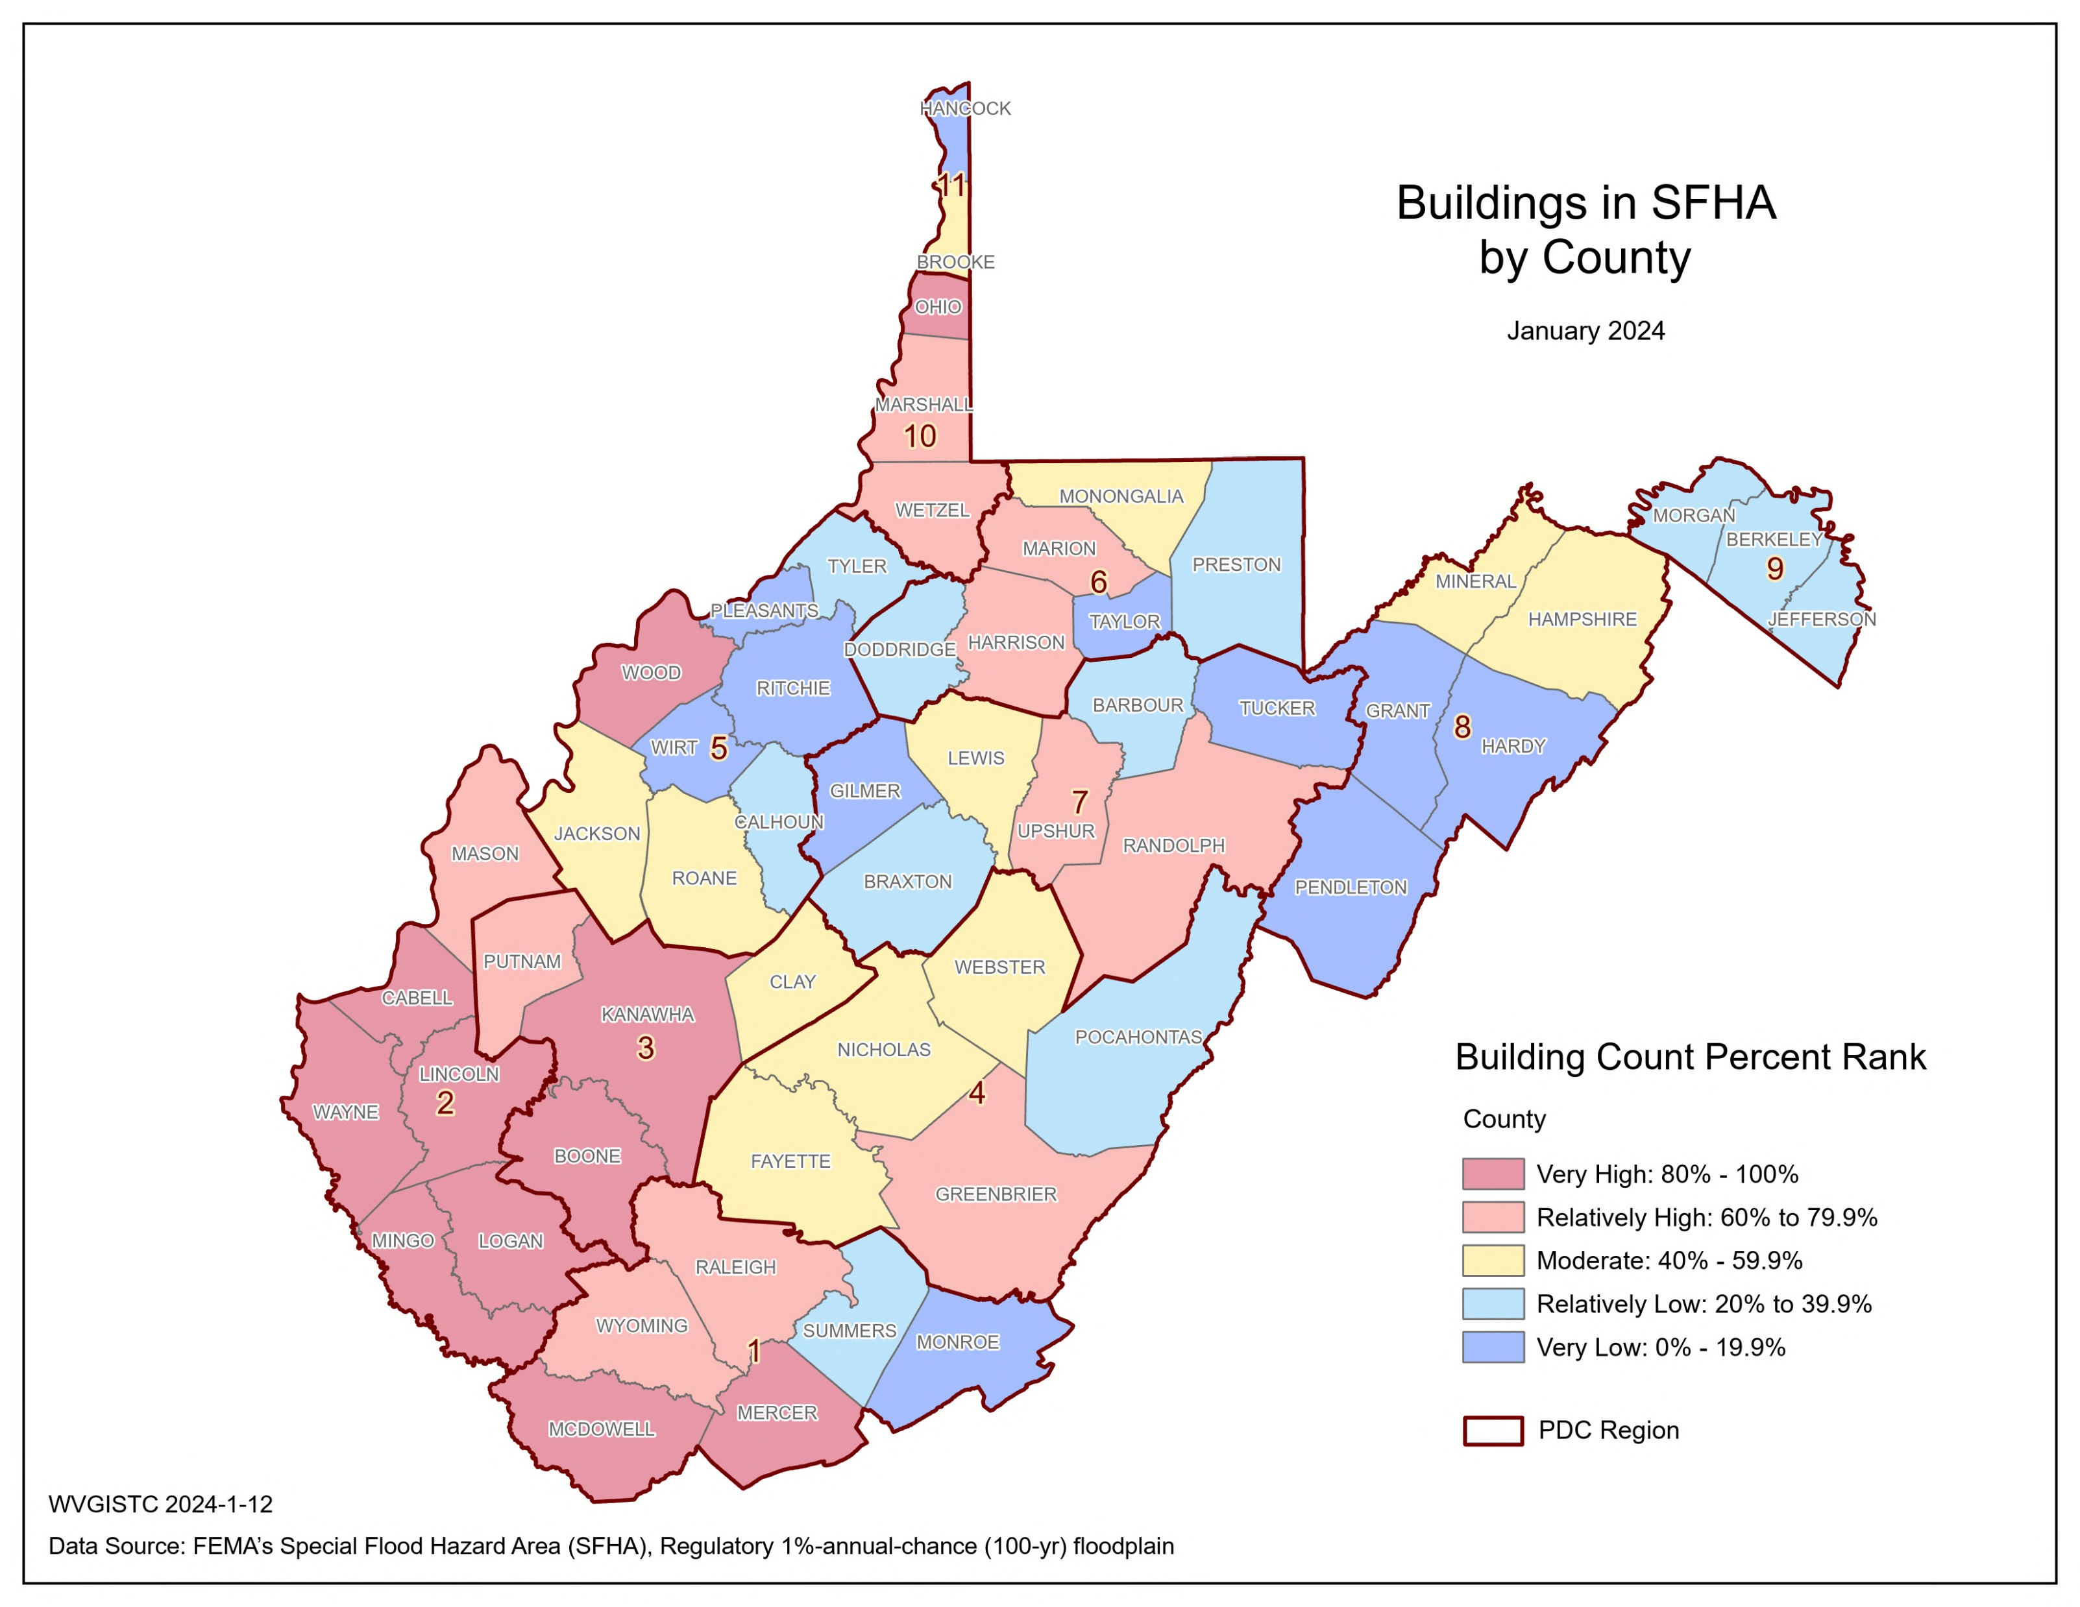
Risk Factor Scores and Cumulative Index …
Top 5 Counties | BLDG SFHA
Kanawha | 12,259
Logan | 4,605
Ohio | 3,260
Boone | 3,201
Mingo | 3,032

Slide 43
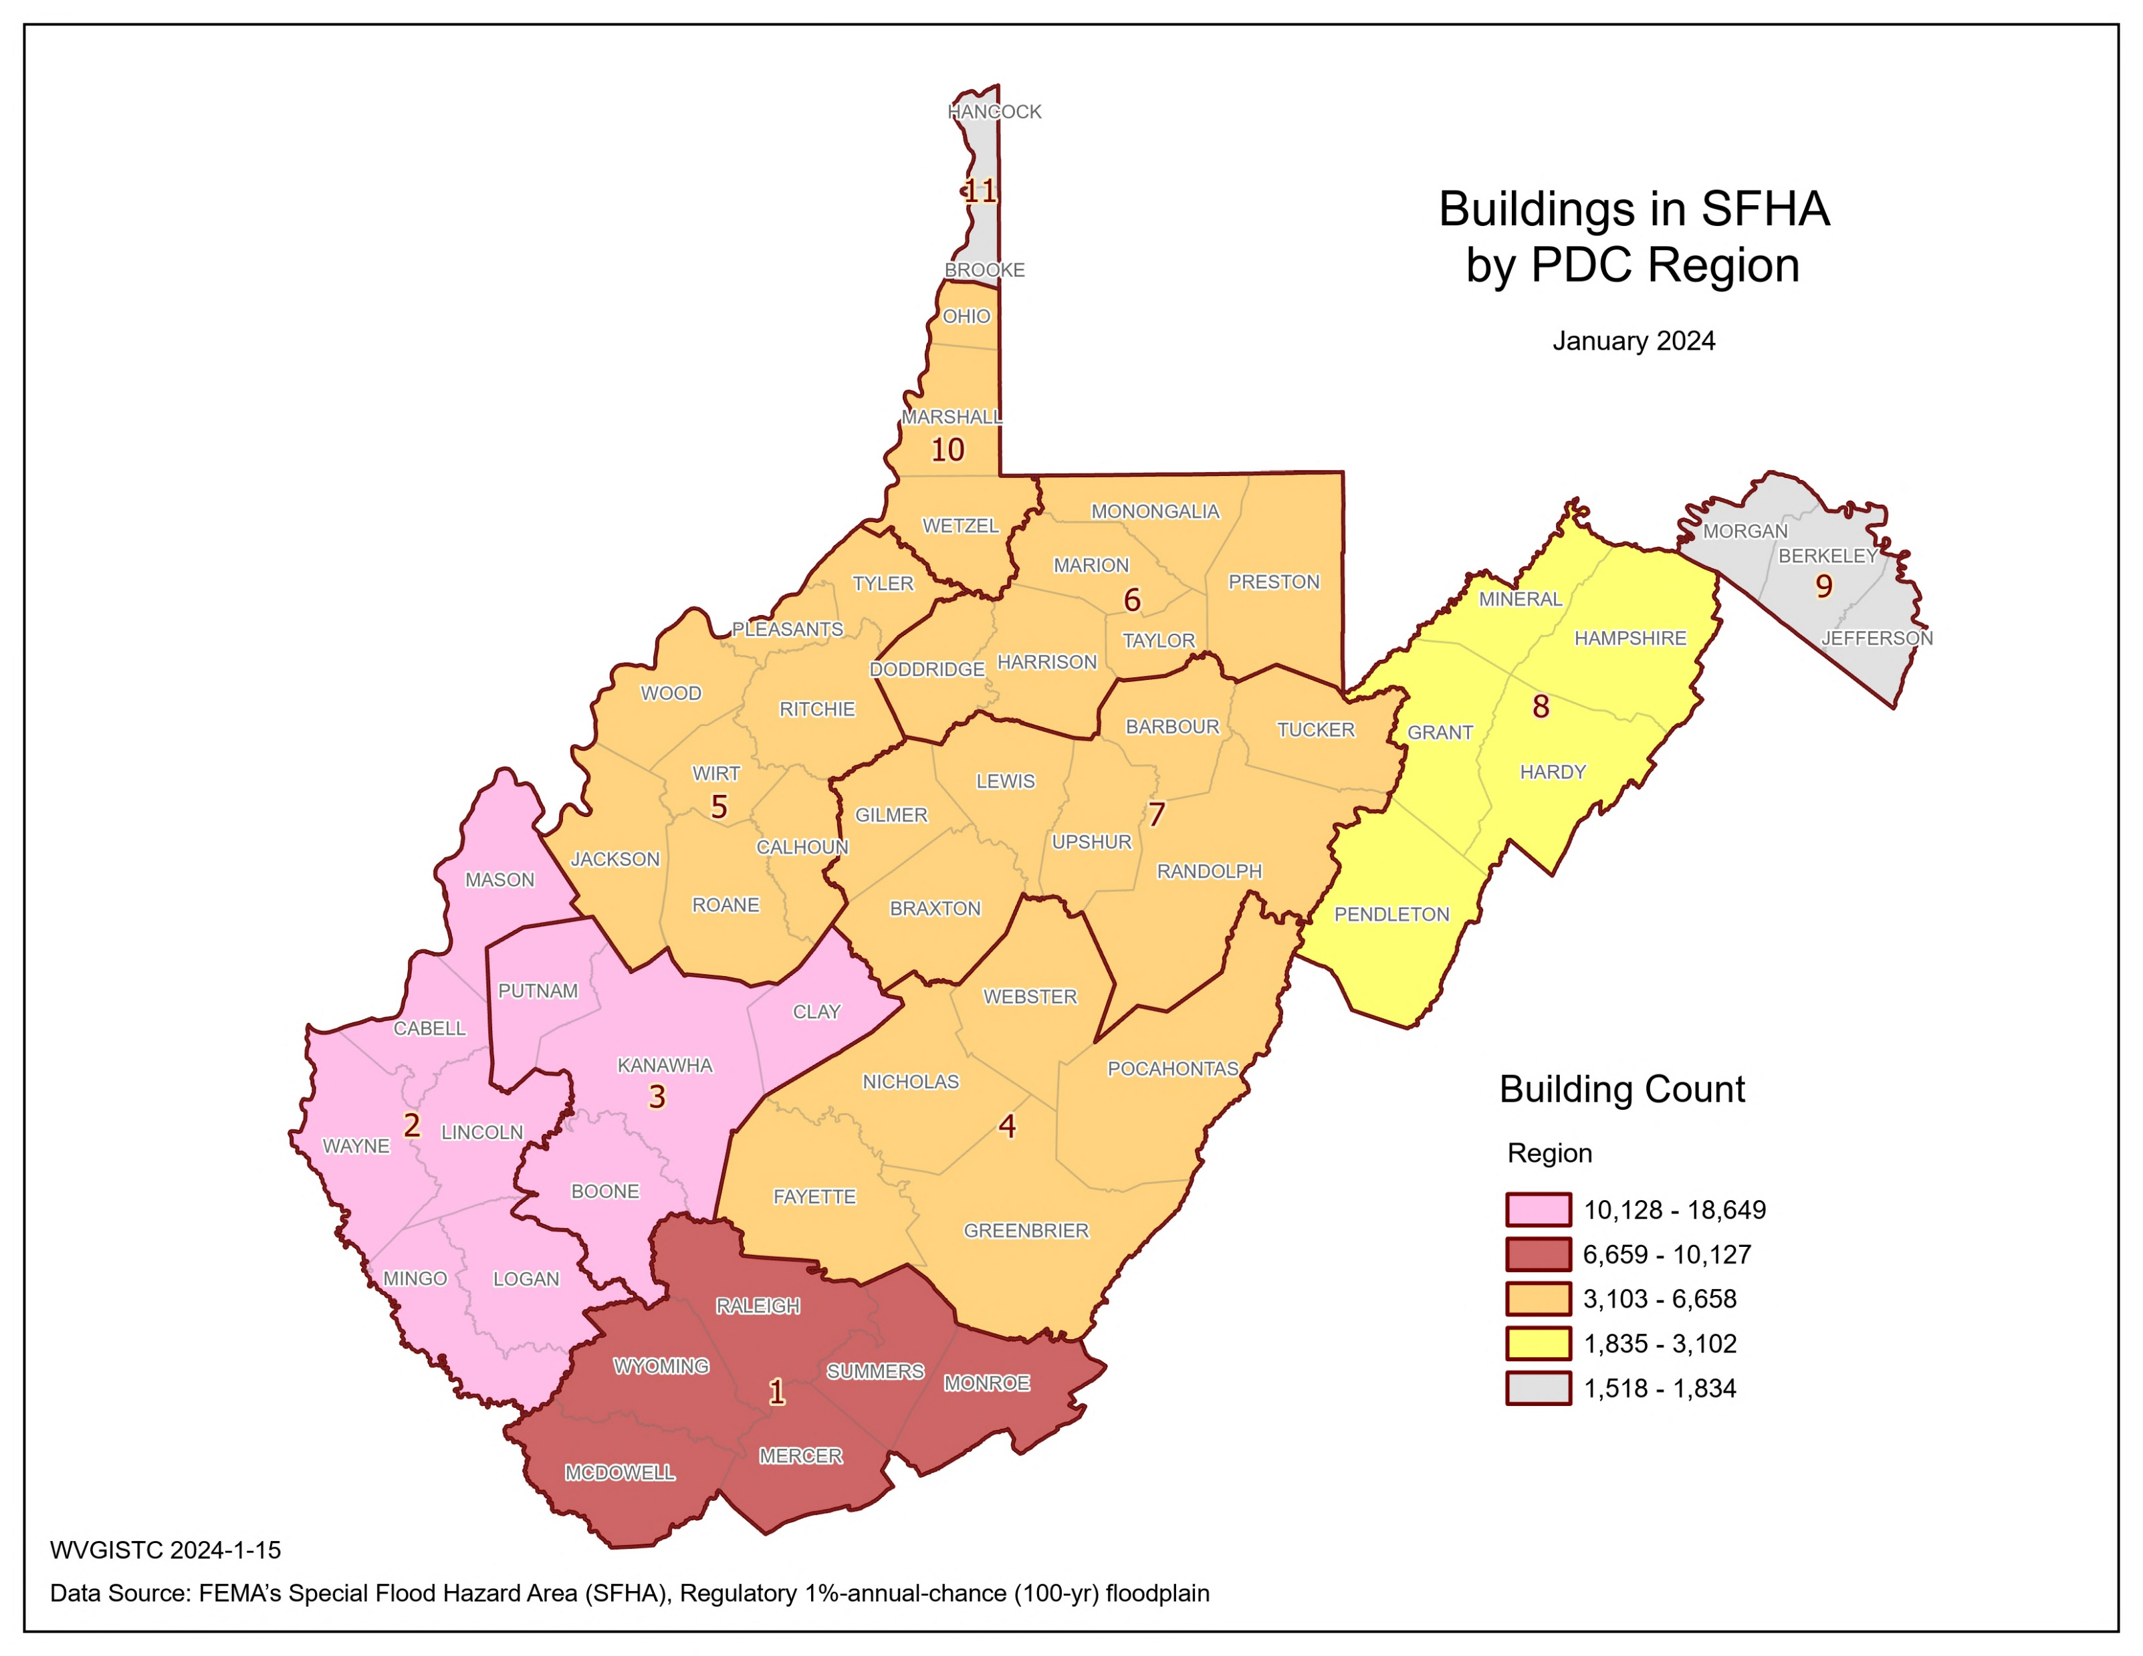
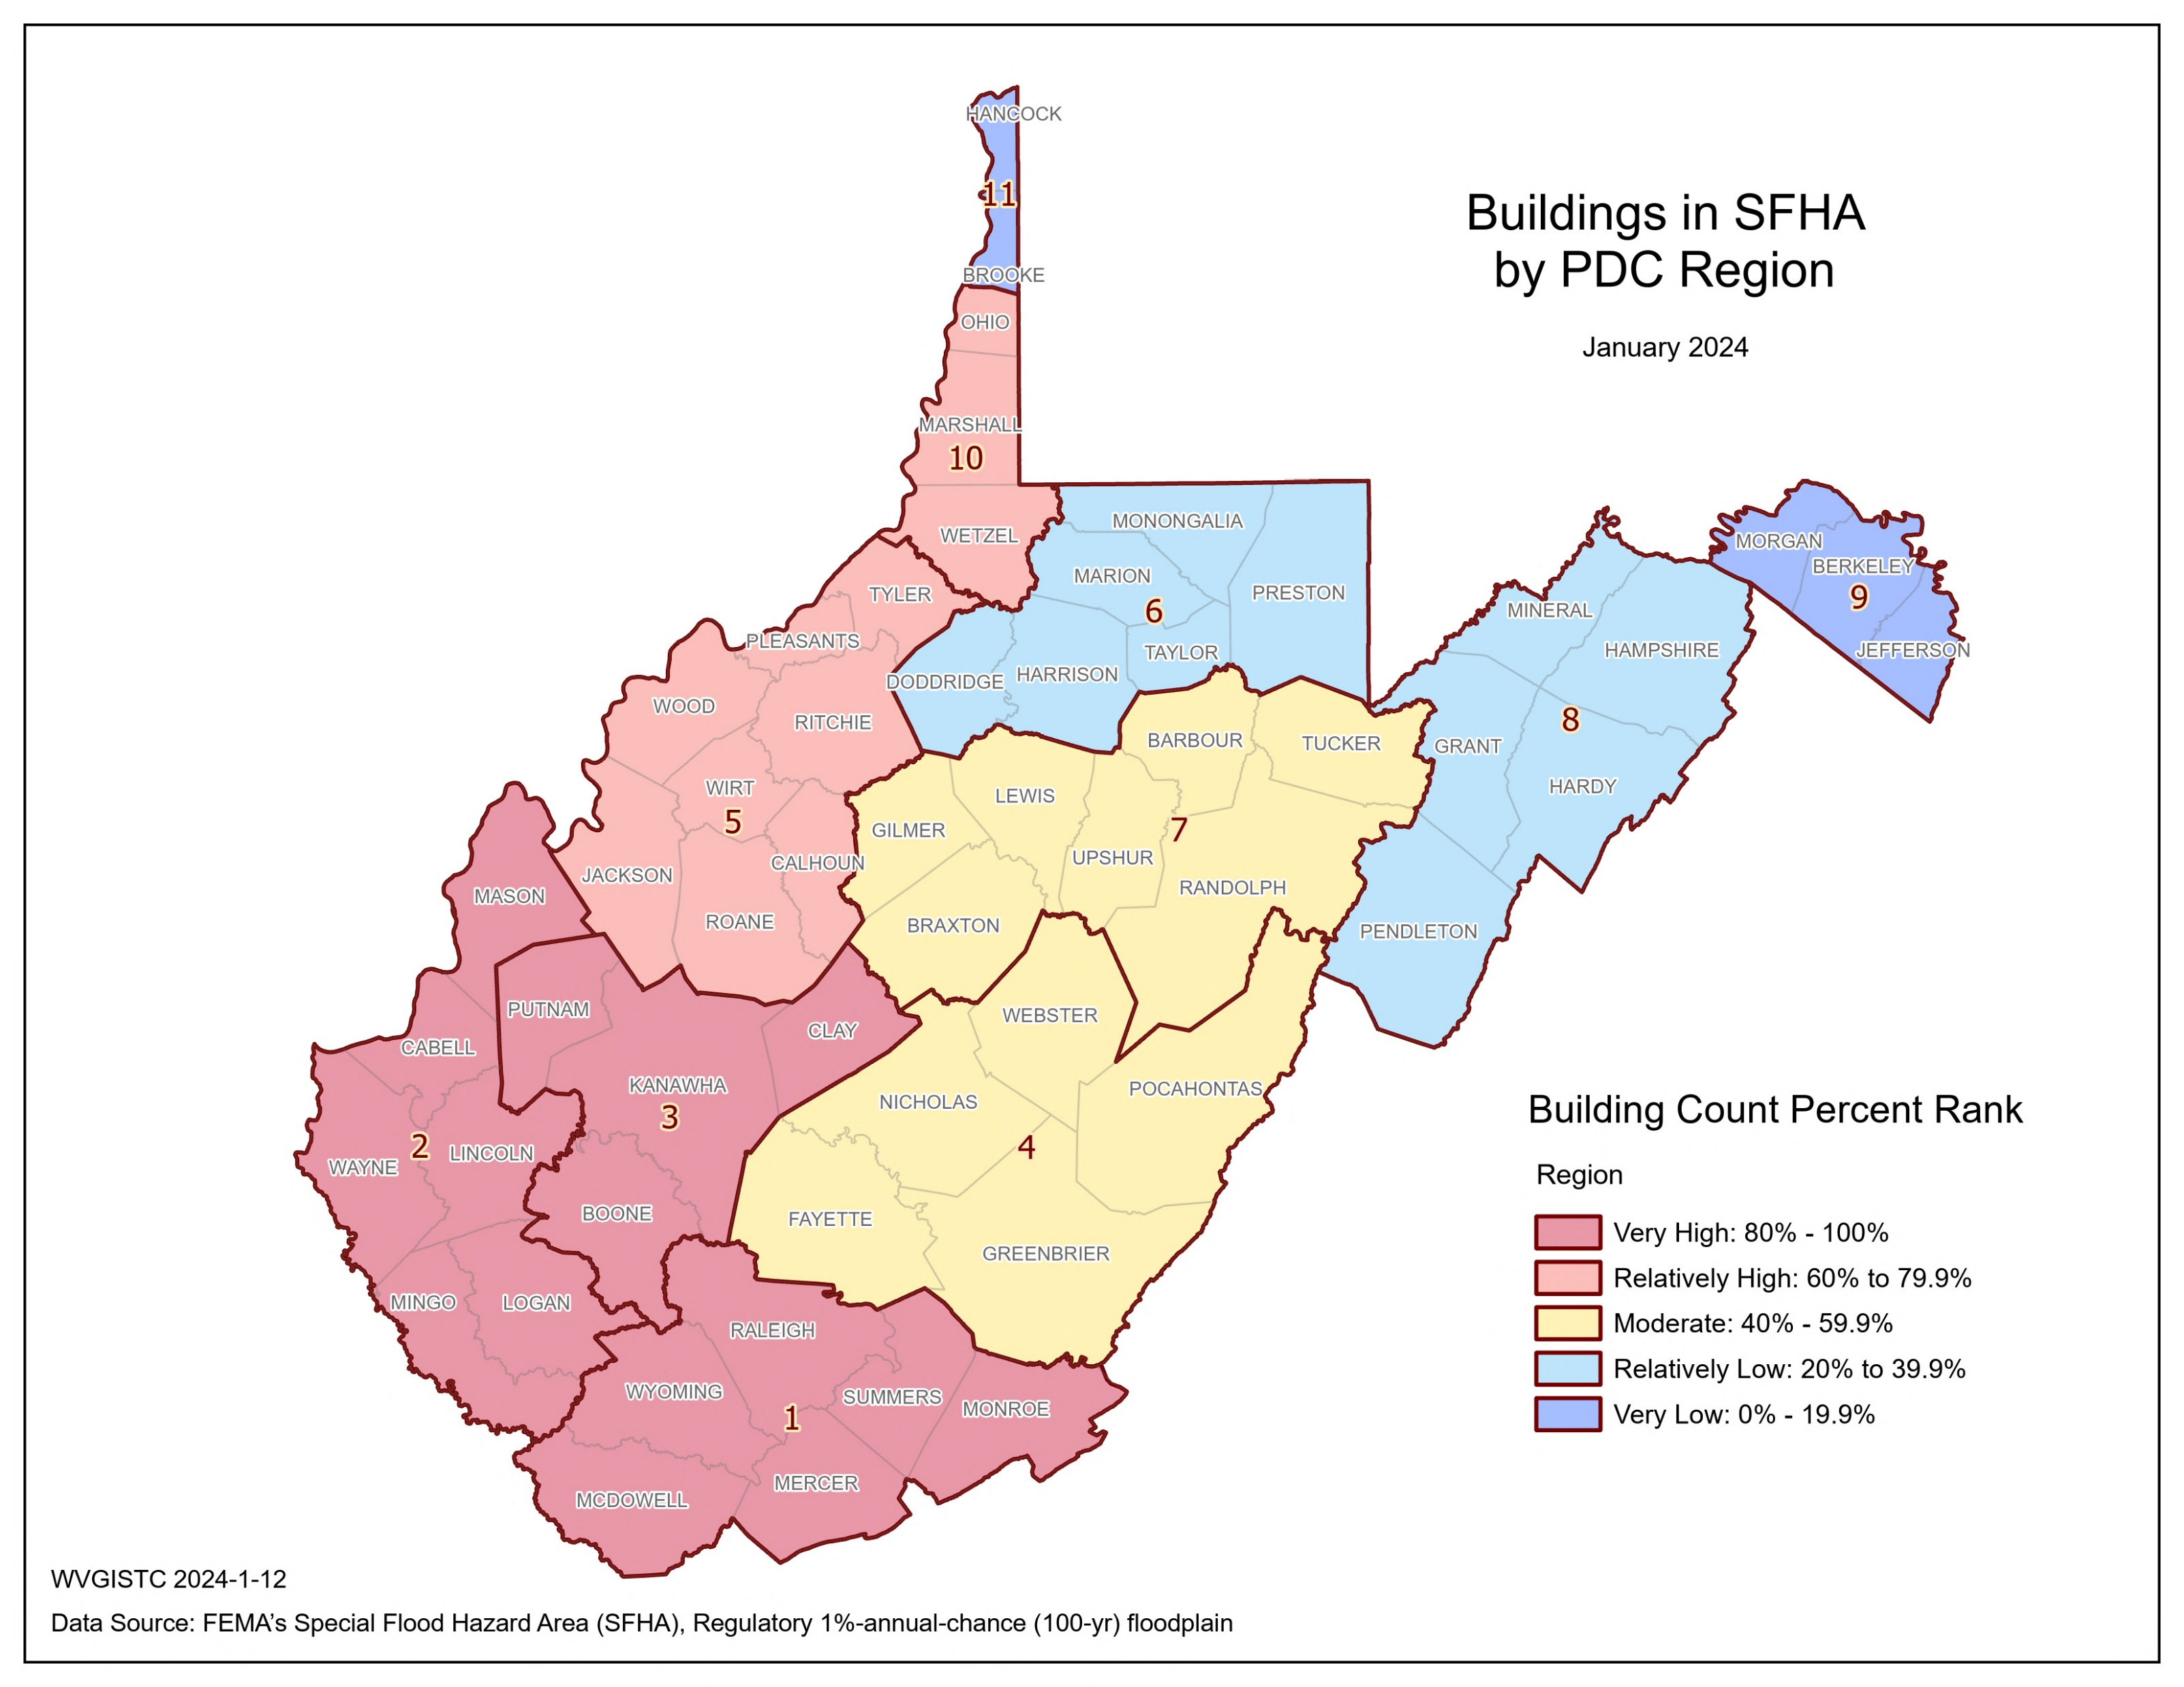
Risk Factor Scores and Cumulative Index …
Top 3 Regions | BLDG SFHA
3 | 18,649
2 | 17,047
1 | 10,127

Slide 44
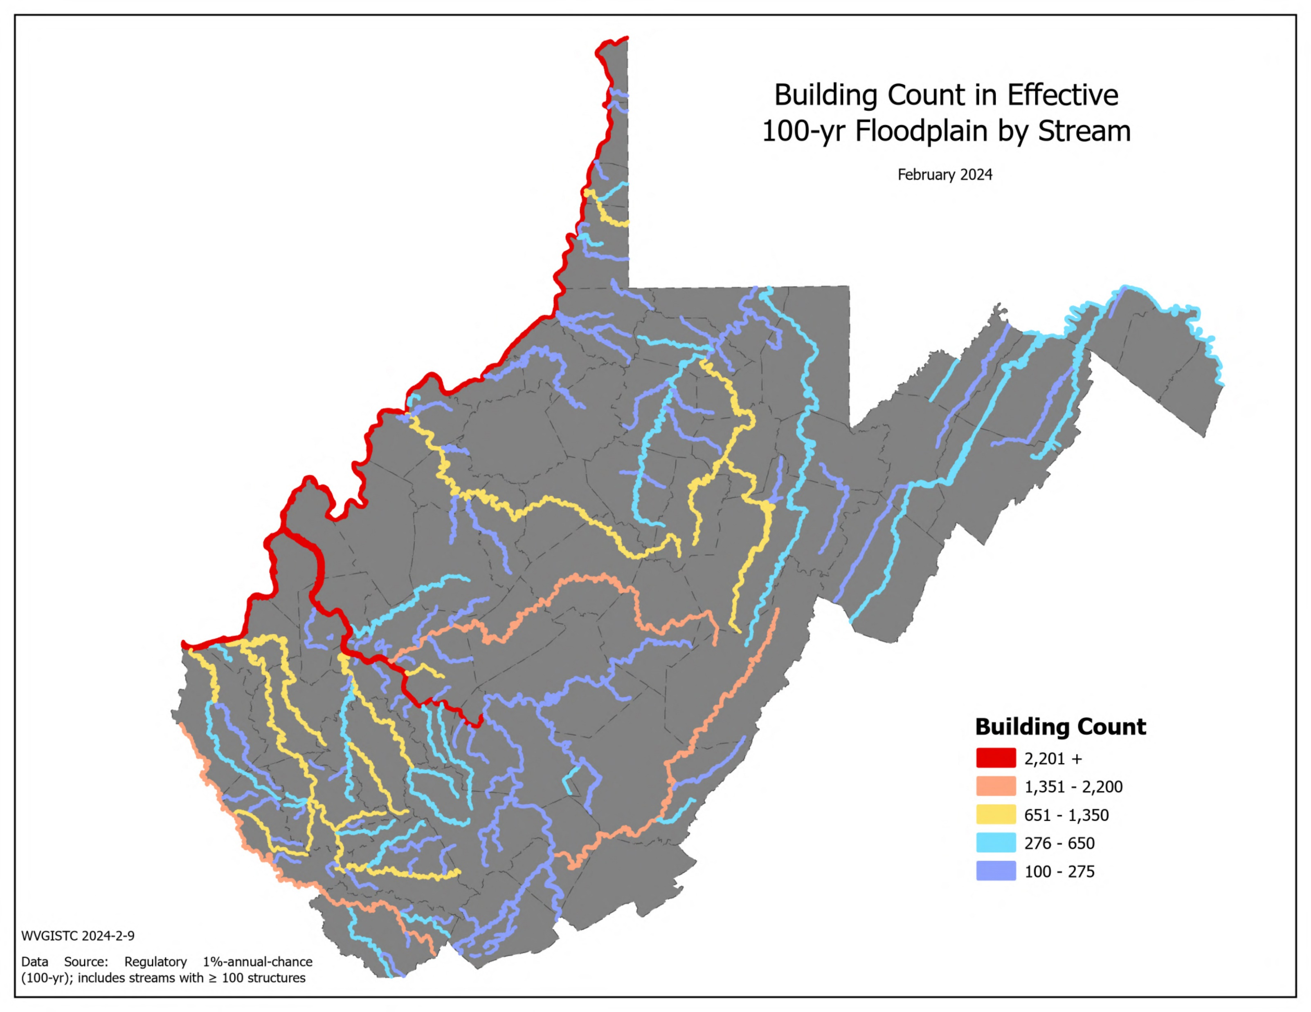
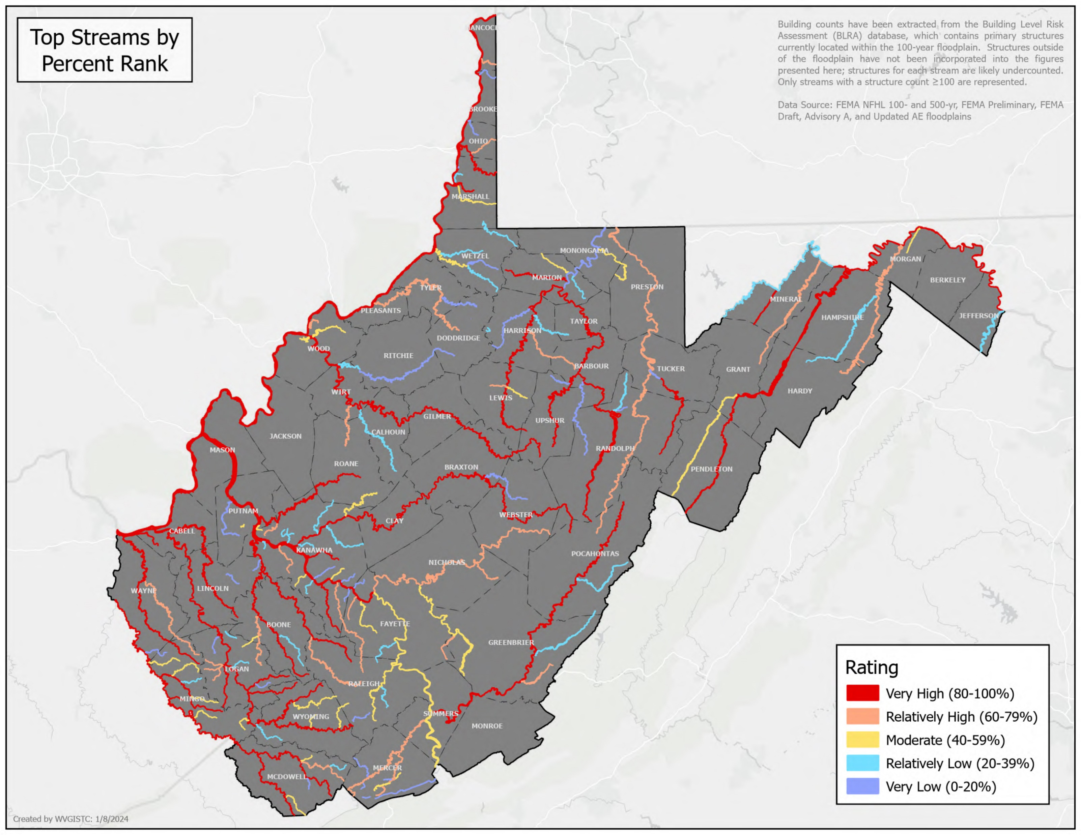
Risk Factor Scores and Cumulative Index …
Top 5 Streams | BLDG SFHA
Ohio River | 6,922
Kanawha River | 5,279
Elk River | 2,181
Greenbrier River | 1,620
Guyandotte River | 1,230

Slide 45


Risk Factor Scores and Cumulative Index …
Top 5 Watersheds | BLDG SFHA
Lower Kanawha | 7,503
Coal | 6,257
Upper Guyandotte | 6,223
Upper Ohio-Wheeling | 5,849
Tug | 5,536

Slide 46

Risk Factor Scores and Cumulative Index …
Building Counts in SFHA and Physiographic Provinces
NRCS Major Land Resource Areas (MLRAs)
Complementary Analyses
Source: https://www.nrcs.usda.gov/sites/default/files/2022-10/AgHandbook296_text_low-res.pdf

Slide 47


Risk Factor Scores and Cumulative Index …
Indicator | White Sulphur Springs | Rainelle | Clendenin | Richwood | Marlinton | Camden-on-Gauley | Statewide Median
Count in Approx. A | 0 | 0 | 0 | 0 | 68 | 4 | 0
Count in AE | 219 | 293 | 301 | 137 | 275 | 17 | 32
Count in AE Floodway | 83 | 43 | 1 | 124 | 14 | 0 | 0
Count in AO | 0 | 0 | 0 | 0 | 0 | 0 | 0
Count in AH | 0 | 0 | 0 | 0 | 0 | 0 | 0
Count in Detailed Sum | 302 | 336 | 302 | 261 | 289 | 17 | 39
Building Count in SFHA | 302 | 336 | 302 | 261 | 357 | 21 | 49
Building Count in SFHA Percent Ranks | 91.4% (Very High) | 94.7% (Very High) | 91.4% (Very High) | 88.5% (Very High) | 95.7% (Very High) | 23.8% (Relatively Low) | -
Clendenin, June 2016 (Image link)
Rainelle, June 2016 (Image link)
Percent Rank Legend:
Very High: 80% to 100%
Relatively High: 60% to 79.9%
Moderate: 40% to 59.9%
Relatively Low: 20% to 39.9%
Very Low: 0% to 19.9%
Red: 90% to 100%

Slide 48
Risk Factor Scores and Cumulative Index …
3) People/Social Risk
Major Category | Detailed Category | Code | Indicator | Short Description | Unit
People/ Social Risk | Social Vulnerability | WV_SVI | WV Social Vulnerability Index | Social vulnerability index developed for West Virginia based on eight socioeconomic and demographic indicators | %
Rationale | Recommendations | Data Source
A community with a higher social vulnerability is less likely to be able to recover from a flood disaster quickly and fully. The WV Socioeconomic Index is a combination of eight social and economic indicators to measure a population's vulnerability to flood hazards. The select indicators are economic factors (Poverty Rate Unemployment Rate), population characteristics (Vulnerable Ages Rate, Disability Rate, Population without a High School Diploma, Population Change), and housing (Median Housing Unit Value, Mobile Homes as Percentage of Housing). | Flood disaster planning and preparedness should evaluate socioeconomic and individual factors such as age, disability, education, employment, and housing can influence the risk of flood deaths and damage loss. Source: NIH. A wide range of federal assistance programs for individuals and public infrastructure, including funds for both emergency and permanent work, are available for disadvantaged populations and communities. | Census Bureau’s American Community Survey (ACS) 5-year estimate of 2021; Census Bureau’s Decennial Census (DEC) of 2010 & 2020 (For population change)

Slide 49
Risk Factor Scores and Cumulative Index …
Vulnerability Indicator | Description | Rationale | Data Source
Poverty Rate | Percentage of households with incomes below poverty level | The poor are less likely to have the income or assets needed to prepare for a possible disaster or to recover after it occurs (Cutter et al., 2003; Flanagan et al., 2011; Morrow, 1999; Thomas, 2017). | Census 2021 ACS 5-Year Estimates
Unemployment Rate | Percentage of families (two or more people residing together and related by birth, marriage, or adoption) with no workers in the past 12 months (from 2021) | In addition to income problems, unemployed persons lack benefit plans providing health cost assistance when injuries or deaths occur due to disasters (Brodie et al., 2006; Flanagan et al., 2011). | Census 2021 ACS 5-Year Estimates
Vulnerable Ages Ratio | Percentage of population in two groups of “younger than 15” or “65 and older” | Children and the elderly are generally more vulnerable to disasters such as flooding due to the lack of experience or physical and cognitive limitations to protect themselves (Cutter et al., 2003; Flanagan et al., 2011; Morrow, 1999). | Census 2021 ACS 5-Year Estimates
Disability Ratio | Percentage of civilian noninstitutionalized population with disabilities of independent living, self-care, ambulatory, cognitive, vision, or hearing difficulties | Disabled people are more vulnerable to natural hazards such as flooding and may require special assistance to evacuate (Cutter et al., 2003; Flanagan et al., 2011; Morrow, 1999). | Census 2021 ACS 5-Year Estimates
No High School Diploma Ratio | Percentage of population 25 years and older with no high school diploma | Highly educated individuals and societies are reported to have better preparedness and response to disasters, suffered lower negative impacts, and can recover faster (Muttarak & Lutz, 2014). | Census 2021 ACS 5-Year Estimates
Population Growth Ratio | Percentage of population change from 2010 to 2020 | Although rapid population growth in dense urban areas can contribute to the risk (Cutter et al., 2003) we believe population decrease can be a factor of social vulnerability in WV communities. | Decennial Census (DEC) of 2010 & 2020
Housing Median Value | Median dollar values of owner-occupied residential units | The value can be an indicator of building quality. Buildings of low quality cannot withstand flooding adequately and are more vulnerable. Residents in communities with higher median housing values may be more likely to carry flood insurance policies, as their properties represent substantial investments. This can enhance financial preparedness and resilience (Flanagan et al., 2011; Morrow, 1999; Thieken et al., 2008). | Census 2021 ACS 5-Year Estimates
Mobile Homes Ratio | Percentage of manufactured homes in the whole community | Light-weight manufactured homes are not designed for withstanding floods and are more vulnerable to flood damage. Communities with a higher prevalence of manufactured homes often encounter more obstacles in achieving resilience, as these structures typically do not offer the same level of security as traditionally constructed homes. Moreover, these homes are often situated in regions beyond the urban core, where access to major roadways and public transit systems may be less available. | Census 2021 ACS 5-Year Estimates

Slide 50
Risk Factor Scores and Cumulative Index …
Top 20% Rankings for
WV Social Vulnerability index
RANK | All Communities | INDEX_SC | Incorporated Communities | INDEX_SC | Unincorporated Areas | INDEX_SC | Counties | INDEX_SC | Regions | INDEX_SC
1 | Anawalt | 100.0% | Anawalt | 100.0% | McDowell County* | 100.0% | McDowell County, West Virginia | 100.0% | 1 | 100%
2 | War | 99.6% | War | 99.6% | Wyoming County* | 98.1% | Wyoming County, West Virginia | 98.1% | 4 | 90%
3 | McDowell County* | 99.3% | Smithfield | 99.1% | Mingo County* | 96.3% | Mingo County, West Virginia | 96.3% | 2 | 80%
4 | Smithfield | 98.9% | Auburn | 98.7% | Webster County* | 94.4% | Clay County, West Virginia | 94.4%
5 | Lester | 98.6% | Lester | 98.2% | Clay County* | 92.6% | Webster County, West Virginia | 92.6%
6 | Auburn | 98.2% | Reedy | 97.8% | Braxton County* | 90.7% | Calhoun County, West Virginia | 90.7%
7 | Reedy | 97.9% | Matewan | 97.4% | Logan County* | 88.9% | Logan County, West Virginia | 88.9%
8 | Matewan | 97.5% | Clay | 96.9% | Calhoun County* | 87.0% | Braxton County, West Virginia | 87.0%
9 | Wyoming County* | 97.2% | Pax | 96.5% | Boone County* | 85.2% | Ritchie County, West Virginia | 85.2%
10 | Mingo County* | 96.8% | Delbarton | 96.0% | Lincoln County* | 83.3% | Lincoln County, West Virginia | 83.3%
11 | Delbarton | 96.5% | Keystone | 95.6% | Roane County* | 81.5% | Roane County, West Virginia | 81.5%
12 | Clay | 96.1% | Fort Gay | 95.2%
13 | Fort Gay | 95.7% | Northfork | 94.7%
14 | Pax | 95.4% | Quinwood | 94.3%
15 | Keystone | 95.0% | Iaeger | 93.8%
16 | Northfork | 94.7% | Harman | 93.4%
17 | Quinwood | 94.3% | Cowen | 93.0%
18 | Iaeger | 94.0% | Richwood | 92.5%
19 | Webster County* | 93.6% | Elizabeth | 92.1%
20 | Harman | 93.3% | Cameron | 91.6%
21 | Richwood | 92.9% | Grantsville | 91.2%
22 | Logan County* | 92.6% | Gary | 90.7%
23 | Cowen | 92.2% | Junior | 90.3%
24 | Cameron | 91.8% | Oceana | 89.9%
25 | Clay County* | 91.5% | West Hamlin | 89.4%
26 | Grantsville | 91.1% | Bradshaw | 89.0%
27 | Elizabeth | 90.8% | Anmoore | 88.5%
28 | Oceana | 90.4% | Kermit | 88.1%
29 | Sophia | 90.1% | Sophia | 87.7%
30 | West Hamlin | 89.7% | Gilbert | 87.2%
31 | Gary | 89.4% | Chesapeake | 86.8%
32 | Braxton County* | 89.0% | Hillsboro | 86.3%
33 | Kermit | 88.7% | Harrisville | 85.9%
34 | Junior | 88.3% | Danville | 85.5%
35 | Calhoun County* | 87.9% | Spencer | 85.0%
36 | Hillsboro | 87.6% | Rainelle | 84.6%
37 | Gilbert | 87.2% | Bramwell | 84.1%
38 | Bradshaw | 86.9% | Pennsboro | 83.7%
39 | Anmoore | 86.5% | Cairo | 83.3%
40 | Spencer | 86.2% | Womelsdorf (Coalton) | 82.8%
41 | Chesapeake | 85.8% | Pineville | 82.4%
42 | Harrisville | 85.5% | Hartford | 81.9%
43 | Boone County* | 85.1% | Hinton | 81.5%
44 | Danville | 84.8% | Rowlesburg | 81.1%
45 | Pennsboro | 84.4% | Ansted | 80.6%
46 | Womelsdorf (Coalton) | 84.0% | Alderson** | 80.2%
47 | Pineville | 83.7%
48 | Hartford | 83.3%
49 | Rowlesburg | 83.0%
50 | Hinton | 82.6%
51 | Bramwell | 82.3%
52 | Alderson** | 81.9%
53 | Lincoln County* | 81.6%
54 | Rainelle | 81.2%
55 | Sutton | 80.9%
56 | Davy | 80.5%
57 | Beverly | 80.1%
Colors:
Black --> Incorporated areas Brown --> Unincorporated areas Green --> Counties (Total) Red --> Split communities Blue --> Incorporated communities participating in the National Flood Insurance Program (NFIP) with no regulatory Special Flood Hazard Area (SFHA) Purple --> Incorporated communities with no regulatory Special Flood Hazard Area (SFHA) not participating in the National Flood Insurance Program (NFIP) (not mentioned in the FEMA's Community Status Book Report)
Black on blue: Six incorporated communities included in the detailed risk study (Camden-on-Gauley, Clendenin, Rainelle, Richwood, White Sulphur Springs, and Marlinton)
Notes:
All communities, even not in NFIP

Slide 51


Risk Factor Scores and Cumulative Index …
Top 5 Incorporated Communities | County | WV SVI
Anawalt | McDowell | 100.0%
War | McDowell | 99.6%
Smithfield | Wetzel | 99.1%
Auburn | Ritchie | 98.7%
Lester | Raleigh | 98.2%
Top 5 Unincorporated Communities | WV SVI
McDowell | 100.0%
Wyoming | 98.1%
Mingo | 96.3%
Webster | 94.4%
Clay | 92.6%

Slide 52


Risk Factor Scores and Cumulative Index …
Top 5 Counties | WV SVI
McDowell | 100.0%
Wyoming | 98.1%
Mingo | 96.3%
Clay | 94.4%
Webster | 92.6%
Top 3 Regions | WV SVI
1 | 100%
4 | 90%
2 | 80%

Slide 53








Risk Factor Scores and Cumulative Index …
Vulnerability Indicators | Vulnerability Indicators | White Sulphur Springs | Rainelle | Clendenin | Richwood | Marlinton | Camden-on-Gauley | State Ratio/Value | National Ratio/Value
 | Poverty Rate | 21.9% | 27.7% | 9.2% | 26.1% | 25.7% | 14.3% | 17.0% | 12.4%
 | Unemployment Rate | 13.0% | 22.1% | 7.3% | 39.8% | 16.3% | 8.3% | 23.7% | 14.6%
 | Vulnerable Ages Ratio | 37.5% | 36.0% | 45.4% | 43.1% | 37.6% | 33.0% | 36.7% | 34.6%
 | Disability Ratio | 20.5% | 31.9% | 11.2% | 29.9% | 27.6% | 9.7% | 19.3% | 12.6%
 | No High School Diploma Ratio | 8.3% | 15.4% | 10.1% | 13.2% | 16.1% | 4.8% | 11.9% | 11.1%
 | Population Change Ratio | -9.1% | -20.9% | -30.4% | -19.1% | -5.3% | -25.4% | -3.2% | 7.4%
 | Median Housing Value | $121,000 | $59,100 | $70,300 | $68,300 | $79,700 | $73,800 | $128,800 | $244,900
 | Mobile Homes Ratio | 0.0% | 9.3% | 3.9% | 7.5% | 4.9% | 11.1% | 14.0% | 5.9%
WV Social Vulnerability Index Score (Among incorporated communities) |  | 21.1% (Relatively Low) | 84.6% (Very High) | 36.6% (Relatively Low) | 92.5% (Very High) | 60.4% (Relatively High) | 27.3% (Relatively Low) | - | -
Index Legend:
Very High: 80% to 100%
Relatively High: 60% to 79.9%
Moderate: 40% to 59.9%
Relatively Low: 20% to 39.9%
Very Low: 0% to 19.9%
Red: 90% to 100%

Slide 54


Risk Factor Scores and Cumulative Index …
Complementary Analysis
Spatial Analysis of Fatalities by Previous Floods

Slide 55


Risk Factor Scores and Cumulative Index …
Demographic Analysis of Fatalities by Previous Floods
Complementary Analyses
Qualitative
Component
Analysis of Risky Behavior and Evacuation Response Time

Slide 56

Risk Factor Scores and Cumulative Index …
4) Other Hazards
Dam Failure Risk (Incorporated Places) (Y/N)
Number of High-Risk Dams (Unincorporated Areas and larger scales)
Levee Failure Risk (Y/N)
High-Susceptibility Landslide Area Ratio
Example of a high-risk dam,
Bluestone Dam, Hinton
(link)

Slide 57

Risk Factor Scores and Cumulative Index …
Bluestone Dam
Source: National Inventory of Dams
A Maximum High (MH) breach scenario modeling for Bluestone Dam

Slide 58


Risk Factor Scores and Cumulative Index …
Bluestone Dam
Source: National Inventory of Dams
A Maximum High (MH) breach scenario modeling for Bluestone Dam
Notes:
Maximum High (MH) is the pool level near the top of dam resulting from water flowing into the reservoir from heavy rainfall, snowmelt, or other significant high-water events.

Slide 59




Risk Factor Scores and Cumulative Index …
(Image link)
Landslide susceptibility in Barboursville, WV (link)

Slide 60
Risk Factor Scores and Cumulative Index …
5) Mitigation Measures
Structural Measures: Such as Dams, Levees, Floodwalls, and Chanel Widening focus on reducing the probability of flood hazard
Related indicator:
Dam Protection (Y/N)
Physical Non-Structural Measures: Such as Building Elevation, Floodproofing, Acquisition and Relocation focus on mitigating the consequences of flooding instead of reducing the probability of flooding
Related indicators:
Mitigated Structures to Design Flood Elevation (DFE) (BFE + Freeboard)
Buyout Parcels (#)
Open Space Preservation (Area/Ratio)
Wet/Dry Floodproofing Structures based on Building Adaptability Models (#)
Non-Physical Non-structural Measures
Flood Insurance Policies in Force
Higher Standards (CRS, Ordinances, Flood Disclosure Laws)
Community Rating System (CRS) Participation
Floodplain Management Ordinances
- Higher Freeboard
- Building Above Code
- Land Use
Higher Regulatory Mapping Standards
- Increased Regulatory Floodplain
- Increased BFE
Flood Emergency and Evacuation Plans
Risk Communications
Flood Disclosure Laws
Related indicators:
Community Rating System (CRS) Class
Freeboard (ft)
Flood Disclosure Laws (Y/N)
Flood Insurance Ratio
Source: USACE
Notes:
Wet Floodproofing Criteria: Building Residential (Occupancy Class RES1, RES3A, RES3B), Foundation = Crawl Space (Perimeter Wall), Not in Floodway, Flood Depth < 12 feet
Dry Floodproofing Criteria: Building (Occupancy Class Residential Res3C to RES6, Commercial, and Other Non-Residential), Not in floodway, Flood Depth < 3 feet)

Slide 61
Risk Factor Scores and Cumulative Index …
Floodplain Building Value Recovery
Complementary Analyses
Source: Tax assessment database. May not include values for tax exempt properties.
Community | 2015 | 2016 | 2017 | 2018 | 2019 | 2020 | 2021 | 2022
Camden-on-Gauley | 0.3 Million | 0.5 Million | 0.5 Million | 0.5 Million | 0.5 Million | 0.5 Million | 0.5 Million | 0.5 Million
Clendenin | 23.6 Million | 24.0 Million | 10.1 Million | 15.2 Million | 15.3 Million | 17.4 Million | 17.1 Million | 17.7 Million
Rainelle | 13.1 Million | 13.2 Million | 5.0 Million | 9.4 Million | 11.1 Million | 11.1 Million | 11.4 Million | 12.4 Million
Richwood | 10.0 Million | 10.1 Million | 9.1 Million | 9.3 Million | 9.9 Million | 9.7 Million | 9.8 Million | 9.8 Million
White Sulphur Springs | 22.7 Million | 23.2 Million | 13.5 Million | 21.5 Million | 22.4 Million | 23.0 Million | 26.4 Million | 29.2 Million

Slide 62
Risk Factor Scores and Cumulative Index …
Example of risk index development methodology among the detailed study (6) communities with 31 risk indicators
Flood Hazard Indicators
Regulatory Floodplain Area Ratio
Federally-Declared Flood Disasters (in County) since 1953
Maximum Estimated Flood Depth
Vulnerable Structures
Ratio of Manufactured Homes in High-Risk Floodplain Bldgs.
Floodplain Buildings with Basements Ratio
One-Story Floodplain Residential Buildings Ratio
Renter-Occupied Housing in Floodplain Ratio
Low-Value (< $10K) Floodplain Buildings Ratio
Physical Damage
Building Flood Loss Ratio
Substantial Damage Ratio
Previous Flood Claims (since 1978)
Previous Paid Losses (since 1978)
Repetitive Loss Structures
Building Counts / Ratios
Structures in All High-Risk Floodplains Ratio in All Bldgs.
Buildings in High-Risk Floodway Ratio in SFHA Bldgs.
Structures in Estimated Depths of Greater than 10 ft
Significant Structures
Floodplain Essential Facilities
Most Vulnerable Essential Facilities
Floodplain Non-Hist. Community Assets
Most Vulnerable Non-Historical Community Assets
Floodplain Historical Community Assets
Most Vulnerable Historical Community Assets
Transportation Infrastructure
Inundated Roads Ratio
Building Types / Values
Total Building Value in Floodplain
Median Building Value in Floodplain
Residential Value in Floodplain
Non-Residential Value in Floodplain
People/Social
WV Social Vulnerability Index
Floodplain Population Ratio
Displaced Population Ratio
Most Vulnerable Essential Facilities: [School, Hospital, Nursing Home] OR [In Floodway] OR [Flood Depth >= 3 ft. Flood]
Most Vulnerable Community Assets: [In Floodway] OR [Flood Depth >= 3 ft. Flood]
Building Year / New Construction
Pre-FIRM in Floodplain Ratio

Slide 63
Risk Factor Scores and Cumulative Index …
 | Floodplain Area (Modified aSFHA) Ratio | Percent Rank Floodplain Area (Modified aSFHA) Ratio | Declared Flood Disasters in County since 1953 | Percent Rank Declared Flood Disasters in County since 1953 | Maximum Estimated Flood Depth | Percent Rank Maximum Estimated Flood Depth | High-Risk Floodplain Buildings to Total Buildings Ratio | Percent Rank High-Risk Floodplain Buildings to Total Buildings Ratio | Floodway Buildings to SFHA Buildings Ratio | Percent Rank Floodway Buildings to SFHA Buildings Ratio
White Sulphur Springs | 22.0% | 20.0% | 9 | 80.0% | 5 | 0.0% | 18.7% | 0.0% | 27.4% | 80.0%
Rainelle | 31.2% | 80.0% | 9 | 80.0% | 6 | 20.0% | 33.7% | 60.0% | 12.8% | 60.0%
Clendenin | 24.1% | 60.0% | 8 | 60.0% | 28 | 100.0% | 47.0% | 80.0% | 0.3% | 20.0%
Richwood | 23.1% | 40.0% | 5 | 20.0% | 8 | 40.0% | 22.9% | 20.0% | 47.5% | 100.0%
Marlinton | 31.5% | 100.0% | 6 | 40.0% | 9 | 60.0% | 61.4% | 100.0% | 3.9% | 40.0%
Camden-on-Gauley | 16.4% | 0.0% | 4 | 0.0% | 13 | 80.0% | 30.0% | 40.0% | 0.0% | 0.0%
 | Buildings in FEMA Depth > 10 ft | Percent Rank Buildings in FEMA Depth > 10 ft | Total Building Value in Floodplain | Percent Rank Total Building Value in Floodplain | Median Floodplain Building Value | Percent Rank Median Floodplain Building Value | Residential Value in Floodplain | Percent Rank Residential Value in Floodplain | Non-Residential Value in Floodplain | Percent Rank Non-Residential Value in Floodplain | Pre-FIRM in Floodplain Ratio | Percent Rank Pre-FIRM in Floodplain Ratio
White Sulphur Springs | 0 | 0.0% | $24,475,000 | 80.0% | $54,100 | 100.0% | $15,489,000 | 100.0% | $8,986,000 | 80.0% | 86.7% | 40.0%
Rainelle | 0 | 0.0% | $17,261,000 | 40.0% | $38,500 | 60.0% | $9,488,000 | 40.0% | $7,773,000 | 60.0% | 77.2% | 0.0%
Clendenin | 34 | 100.0% | $19,351,000 | 60.0% | $48,600 | 80.0% | $12,851,000 | 80.0% | $6,500,000 | 40.0% | 83.8% | 20.0%
Richwood | 0 | 0.0% | $11,754,000 | 20.0% | $19,100 | 20.0% | $6,447,000 | 20.0% | 5,307,000 | 20.0% | 92.0% | 100.0%
Marlinton | 0 | 0.0% | $44,762,000 | 100.0% | $19,100 | 20.0% | $10,840,000 | 60.0% | 33,922,000 | 100.0% | 88.0% | 60.0%
Camden-on-Gauley | 2 | 80.0% | $574,000 | 0.0% | $16,700 | 0.0% | $263,000 | 0.0% | $311,000 | 0.0% | 90.5% | 80.0%

Slide 64
Risk Factor Scores and Cumulative Index …
 | Floodplain Manufactured Homes Ratio | Percent Rank Floodplain Manufactured Homes Ratio | Floodplain Buildings with Basements Ratio | Percent Rank Floodplain Buildings with Basements Ratio | One-Story Residential Buildings Ratio | Percent Rank One-Story Residential Buildings Ratio | Renter-Occupied Housing in Floodplain Ratio | Percent Rank Renter-Occupied Housing in Floodplain Ratio | Low-Value (< $10K) Floodplain Buildings Ratio | Percent Rank Low-Value (< $10K) Floodplain Buildings Ratio
White Sulphur Springs | 0.6% | 0.0% | 21.1% | 40.0% | 82.0% | 80.0% | 39.8% | 60.0% | 6.2% | 0.0%
Rainelle | 4.2% | 20.0% | 7.1% | 0.0% | 93.5% | 100.0% | 40.3% | 80.0% | 15.7% | 60.0%
Clendenin | 4.6% | 40.0% | 40.4% | 100.0% | 79.5% | 60.0% | 27.7% | 40.0% | 8.6% | 40.0%
Richwood | 13.5% | 80.0% | 13.5% | 20.0% | 77.9% | 40.0% | 24.7% | 20.0% | 23.2% | 80.0%
Marlinton | 5.8% | 60.0% | 24.3% | 60.0% | 68.4% | 20.0% | 55.8% | 100.0% | 7.3% | 20.0%
Camden-on-Gauley | 19.0% | 100.0% | 30.7% | 80.0% | 61.5% | 0.0% | 23.1% | 0.0% | 33.3% | 100.0%
 | Floodplain Essential Facilities | Percent Rank Floodplain Essential Facilities | Most Vulnerable Essential Facilities | Percent Rank Most Vulnerable Essential Facilities | Floodplain Non-Hist. Community Assets | Percent Rank Floodplain Non-Hist. Community Assets | Most Vulnerable Non-Historical Community Assets | Percent Rank Most Vulnerable Non-Historical Community Assets | Floodplain Historical Community Assets | Percent Rank Floodplain Historical Community Assets | Most Vulnerable Historical Community Assets | Percent Rank Most Vulnerable Historical Community Assets
White Sulphur Springs | 1 | 0.0% | 0 | 0.0% | 7 | 40.0% | 2 | 20.0% | 0 | 0.0% | 0 | 0.0%
Rainelle | 2 | 40.0% | 0 | 0.0% | 6 | 20.0% | 2 | 20.0% | 0 | 0.0% | 0 | 0.0%
Clendenin | 2 | 40.0% | 2 | 80.0% | 15 | 100.0% | 15 | 100.0% | 121 | 100.0% | 52 | 100.0%
Richwood | 3 | 80.0% | 0 | 0.0% | 8 | 60.0% | 3 | 60.0% | 10 | 80.0% | 4 | 60.0%
Marlinton | 6 | 100.0% | 4 | 100.0% | 13 | 80.0% | 6 | 80.0% | 5 | 60.0% | 4 | 60.0%
Camden-on-Gauley | 1 | 0.0% | 1 | 60.0% | 1 | 0.0% | 0 | 0.0% | 0 | 0.0% | 0 | 0.0%

Slide 65
Risk Factor Scores and Cumulative Index …
 | Building Flood Loss Ratio | Percent Rank Building Flood Loss Ratio | Substantial Damage Ratio | Percent Rank Substantial Damage Ratio | Previous Flood Claims (since 1978) | Percent Rank Previous Flood Claims (since 1978) | Previous Paid Losses (since 1978) | Percent Rank Previous Paid Losses (since 1978) | Repetitive Loss Structures | Percent Rank Repetitive Loss Structures | Inundated Roads Ratio | Percent Rank Inundated Roads Ratio
White Sulphur Springs | 5.5% | 20.0% | 0.0% | 0.0% | 89 | 20.0% | $3,005,000 | 20.0% | 2 | 0.0% | 17.2% | 0.0%
Rainelle | 5.9% | 40.0% | 0.3% | 20.0% | 154 | 80.0% | $3,721,000 | 40.0% | 35 | 60.0% | 36.1% | 80.0%
Clendenin | 25.7% | 100.0% | 15.2% | 80.0% | 122 | 40.0% | $6,582,000 | 60.0% | 24 | 40.0% | 57.1% | 100.0%
Richwood | 4.8% | 0.0% | 0.3% | 20.0% | 144 | 60.0% | $6,750,000 | 80.0% | 66 | 80.0% | 21.4% | 40.0%
Marlinton | 7.6% | 60.0% | 4.0% | 60.0% | 585 | 100.0% | $13,448,000 | 100.0% | 252 | 100.0% | 20.4% | 20.0%
Camden-on-Gauley | 19.5% | 80.0% | 19.1% | 100.0% | 21 | 0.0% | $358,000 | 0.0% | 11 | 20.0% | 35.0% | 60.0%
 | WV Social Vulnerability Index | Percent Rank WV Social Vulnerability Index | Floodplain Population Ratio | Percent Rank Floodplain Population Ratio | Displaced Population Ratio | Percent Rank Displaced Population Ratio
White Sulphur Springs | 21.1% | 0.0% | 25.8% | 40.0% | 17.5% | 40.0%
Rainelle | 84.6% | 80.0% | 45.6% | 60.0% | 38.3% | 60.0%
Clendenin | 36.6% | 40.0% | 67.5% | 80.0% | 63.2% | 80.0%
Richwood | 92.5% | 100.0% | 23.8% | 20.0% | 16.9% | 20.0%
Marlinton | 60.4% | 60.0% | 85.6% | 100.0% | 76.0% | 100.0%
Camden-on-Gauley | 27.3% | 20.0% | 23.3% | 0.0% | 15.9% | 0.0%
SUM of all Percent Rank Values | Percent Rank on the SUM: Risk Index Score for 6 Communities
960.0% | 20.0%
1360.0% | 40.0%
2120.0% | 100.0%
1400.0% | 60.0%
2120.0% | 80.0%
900.0% | 0.0%

Slide 66
Risk Factor Scores and Cumulative Index …
Risk Index (Selected Indicators for only 6 Communities)
Rank | Community | Index Score
1 | Clendenin | 100%
2 | Marlinton | 80%
3 | Richwood | 60%
4 | Rainelle | 40%
5 | White Sulphur Springs | 20%
6 | Camden-on-Gauley | 0%
Notes:
The same process for all 219 incorporated communities, Unincorporated Area, Counties, & Regions
Dr. Maxwell is going to show a quick demo of the tool.

Slide 67




Flood Risk Indicator Dashboard
Interactively explore indicators
Floodplain area
Floodplain length
Declared disasters
Flood depth
Structures
Building counts/ratios
Building types & values
Vulnerable structures
FIRM status
Building year/new construction
Significant structures
Physical damage estimates
Recorded building damage losses
Transportation infrastructure
Flood hazards
Floodplain management
Flood insurance
Mitigated structures
Green infrastructure
People/Social
Social vulnerability
Population exposure
Population displacement & shelter needs
Mitigation

Slide 68

Flood Risk Indicator Dashboard
Interactively explore indicators

Slide 69





Flood Risk Indicator Dashboard
Visualize and explore data at different scales
Unincorporated
Watersheds
Regions
Incorporated
Counties

Slide 70




Flood Risk Indicator Dashboard
Make comparisons

Slide 71












Flood Risk Index Tool Demo: Within WRF
Link to documentation and resources
Documentation

Slide 72









Flood Risk Indicator Dashboard: Status
  Completed
    Basic UI design
    People/social indicators
  In-Progress
    Additional indicators
    Documentation
  To do
    App refinement
    Integration with WRF
Beta version by July 2024/Version 1.0 by Oct. 2024
Notes:
Annie is going to show some related visualization products.

Slide 73
FLOOD RISK VISUALIZATIONS

Slide 74


Flood Risk Visualization Overview
A collection of movies, animations, story maps, and other flood visualization tools available at the building and community levels for communicating and understanding flood risk in West Virginia.
Animation (3D Movies)
3D movies have been created using two distinct approaches:
The first approach illustrates the percentage of damage during a 100-year flood event for Bolivar, Shepherdstown, Charlestown, and Harpers Ferry in Jefferson County.
The second approach showcases mitigated buildings, as well as community assets and essential facilities situated within the 100-year flood zone for White Sulphur Springs and Rainelle in Greenbrier County, as well as Clendenin in Kanawha County.
Story Maps
Story Maps can serve as educational tools by providing detailed information about floods, their causes, impacts, and mitigation strategies. They can include multimedia elements such as videos, images, and infographics to explain complex concepts in an accessible manner.

Slide 75


Key Concepts of Flood Risk Visualization
Visualization Content
5-, 10-, 20-, 25-, 50-, 100-, and 500-year flood elevations (above sea level) refer to expected water levels of the 20%, 10%, 5%, 4%, 2%, 1%, and 0.2% annual chance flood events.
- Flood Frequency Probability and Magnitude
- Damage Loss Estimates
- Mitigated and unmitigated properties
Levels of Visualization
Building-Level Visualizations
- Building Flood Profiles for different sized storms (includes High Water Marks)
- Building Flood Depth and Damage Assessment (WV Flood Tool)
Community-Level Visualizations
- Movies
- Viewsheds
- Story Maps
Visualization Products
A map index provides a spatial gateway to flood visualizations and videos.

Slide 76

Map Index

Slide 77
Map Index
Clendenin
Camden
Richwood
Rainelle
White Sulphur Springs

Slide 78




Map Index
Clendenin
Camden
Flood Profile
Richwood
Perspective
Story Map
Movie
Rainelle
White Sulphur Springs

Slide 79
Map Index
Clendenin
Camden
Flood Profile
Richwood
Perspective
Story Map
Movie
Rainelle
White Sulphur Springs

Slide 80
Map Index
Clendenin
Camden
Richwood
Rainelle
White Sulphur Springs

Slide 81
Map Index
Clendenin
Camden
Richwood
Rainelle
Flood Profile
White Sulphur Springs
Perspective
Story Map
Movie

Slide 82
Map Index
Clendenin
Camden
Richwood
Rainelle
White Sulphur Springs

Slide 83
QUESTIONS? COMMENTS?

Slide 84
LINKED SLIDES

Slide 85




Clendenin
20-02-0006-0044-0000_306
306 Maywood Ave., Clendenin, WV, 25045
Building Flood Profile

Slide 86


10% Probability of Flood in a year (10-year flood)
2.0’ (FEMA 10% / 10-Yr)
Building’s Ground Elevation

Slide 87

4% Probability of Flood in a year (25-year flood)
6.0’ (FEMA 4% / 25-Yr)

Slide 88

2% Probability of Flood in a year (50-year flood)
9.5’ (FEMA 2% / 50-Yr)

Slide 89

1% Probability of Flood in a year (100-year flood)
12.3’ (FEMA 2% / 50-Yr)

Slide 90

0.2% Probability of Flood in a year (500-year flood)
20.5’ (FEMA 0.2% / 500-Yr)

Slide 91


2016 High Watermark
High Watermark
9.5’ (FEMA 2% / 50-Yr)
10.5’ (2016 High Water)

Slide 92
The Design Flood Elevation (DFE) should be the BFE plus 2 feet of freeboard. The DFE should also be above the high-water marks of the 2016 flood plus freeboard.
 | HEIGHT (ft.)
BUILDING
First Floor Height | 12.0
Freeboard (FBD) | 2.0
FLOOD DEPTH
FEMA 10% (10-Yr) | 2.0
FEMA 4% (25-Yr)
FEMA 2% (50-Yr)
2016 Flood HWM
FEMA 1% (100-Yr)
FEMA 100-Yr + FBD
FEMA 1%+
FEMA 0.2% (500-Yr)
FSF 0.2% (500-Yr)
306 Maywood Ave., Clendenin, WV, 25045
2.0’ (FEMA 10% / 10-Yr)
Building 20-02-0006-0044-0000_306
FLOOD DEPTHS:
FEMA
First Street Foundation (FSF)
USGS 2016 Flood High Water Mark

Slide 93
The Design Flood Elevation (DFE) should be the BFE plus 2 feet of freeboard. The DFE should also be above the high-water marks of the 2016 flood plus freeboard.
 | HEIGHT (ft.)
BUILDING
First Floor Height | 12.0
Freeboard (FBD) | 2.0
FLOOD DEPTH
FEMA 10% (10-Yr) | 2.0
FEMA 4% (25-Yr) | 6.0
FEMA 2% (50-Yr)
2016 Flood HWM
FEMA 1% (100-Yr)
FEMA 100-Yr + FBD
FEMA 1%+
FEMA 0.2% (500-Yr)
FSF 0.2% (500-Yr)
306 Maywood Ave., Clendenin, WV, 25045
6.0’ (FEMA 4% / 25-Yr)
2.0’ (FEMA 10% / 10-Yr)
Building 20-02-0006-0044-0000_306
FLOOD DEPTHS:
FEMA
First Street Foundation (FSF)
USGS 2016 Flood High Water Mark

Slide 94
The Design Flood Elevation (DFE) should be the BFE plus 2 feet of freeboard. The DFE should also be above the high-water marks of the 2016 flood plus freeboard.
 | HEIGHT (ft.)
BUILDING
First Floor Height | 12.0
Freeboard (FBD) | 2.0
FLOOD DEPTH
FEMA 10% (10-Yr) | 2.0
FEMA 4% (25-Yr) | 6.0
FEMA 2% (50-Yr) | 9.5
2016 Flood HWM
FEMA 1% (100-Yr)
FEMA 100-Yr + FBD
FEMA 1%+
FEMA 0.2% (500-Yr)
FSF 0.2% (500-Yr)
306 Maywood Ave., Clendenin, WV, 25045
9.5’ (FEMA 2% / 50-Yr)
6.0’ (FEMA 4% / 25-Yr)
2.0’ (FEMA 10% / 10-Yr)
Building 20-02-0006-0044-0000_306
FLOOD DEPTHS:
FEMA
First Street Foundation (FSF)
USGS 2016 Flood High Water Mark

Slide 95
The Design Flood Elevation (DFE) should be the BFE plus 2 feet of freeboard. The DFE should also be above the high-water marks of the 2016 flood plus freeboard.
 | HEIGHT (ft.)
BUILDING
First Floor Height | 12.0
Freeboard (FBD) | 2.0
FLOOD DEPTH
FEMA 10% (10-Yr) | 2.0
FEMA 4% (25-Yr) | 6.0
FEMA 2% (50-Yr) | 9.5
2016 Flood HWM | 10.5
FEMA 1% (100-Yr)
FEMA 100-Yr + FBD
FEMA 1%+
FEMA 0.2% (500-Yr)
FSF 0.2% (500-Yr)
306 Maywood Ave., Clendenin, WV, 25045
10.5’ (2016 High Water)
9.5’ (FEMA 2% / 50-Yr)
6.0’ (FEMA 4% / 25-Yr)
2.0’ (FEMA 10% / 10-Yr)
Building 20-02-0006-0044-0000_306
FLOOD DEPTHS:
FEMA
First Street Foundation (FSF)
USGS 2016 Flood High Water Mark

Slide 96
The Design Flood Elevation (DFE) should be the BFE plus 2 feet of freeboard. The DFE should also be above the high-water marks of the 2016 flood plus freeboard.
 | HEIGHT (ft.)
BUILDING
First Floor Height | 12.0
Freeboard (FBD) | 2.0
FLOOD DEPTH
FEMA 10% (10-Yr) | 2.0
FEMA 4% (25-Yr) | 6.0
FEMA 2% (50-Yr) | 9.5
2016 Flood HWM | 10.5
FEMA 1% (100-Yr) | 12.3
FEMA 100-Yr + FBD | 14.3
FEMA 1%+ | 16.5
FEMA 0.2% (500-Yr)
FSF 0.2% (500-Yr)
306 Maywood Ave., Clendenin, WV, 25045
16.5’ FEMA1%+
12.3’ (FEMA 1% / 100-Yr)
10.5’ (2016 High Water)
9.5’ (FEMA 2% / 50-Yr)
6.0’ (FEMA 4% / 25-Yr)
2.0’ (FEMA 10% / 10-Yr)
Building 20-02-0006-0044-0000_306
FLOOD DEPTHS:
FEMA
First Street Foundation (FSF)
USGS 2016 Flood High Water Mark

Slide 97
The Design Flood Elevation (DFE) should be the BFE plus 2 feet of freeboard. The DFE should also be above the high-water marks of the 2016 flood plus freeboard.
 | HEIGHT (ft.)
BUILDING
First Floor Height | 12.0
Freeboard (FBD) | 2.0
FLOOD DEPTH
FEMA 10% (10-Yr) | 2.0
FEMA 4% (25-Yr) | 6.0
FEMA 2% (50-Yr) | 9.5
2016 Flood HWM | 10.5
FEMA 1% (100-Yr) | 12.3
FEMA 100-Yr + FBD | 14.3
FEMA 1%+ | 16.5
FEMA 0.2% (500-Yr) | 20.5
FSF 0.2% (500-Yr)
306 Maywood Ave., Clendenin, WV, 25045
20.5’ (FEMA 0.2% / 500-Yr)
16.5’ FEMA1%+
12.3’ (FEMA 1% / 100-Yr)
10.5’ (2016 High Water)
9.5’ (FEMA 2% / 50-Yr)
6.0’ (FEMA 4% / 25-Yr)
2.0’ (FEMA 10% / 10-Yr)
Building 20-02-0006-0044-0000_306
FLOOD DEPTHS:
FEMA
First Street Foundation (FSF)
USGS 2016 Flood High Water Mark

Slide 98
The Design Flood Elevation (DFE) should be the BFE plus 2 feet of freeboard. The DFE should also be above the high-water marks of the 2016 flood plus freeboard.
 | HEIGHT (ft.)
BUILDING
First Floor Height | 12.0
Freeboard (FBD) | 2.0
FLOOD DEPTH
FEMA 10% (10-Yr) | 2.0
FEMA 4% (25-Yr) | 6.0
FEMA 2% (50-Yr) | 9.5
2016 Flood HWM | 10.5
FEMA 1% (100-Yr) | 12.3
FEMA 100-Yr + FBD | 14.3
FEMA 1%+ | 16.5
FEMA 0.2% (500-Yr) | 20.5
FSF 0.2% (500-Yr) | 24.6
306 Maywood Ave., Clendenin, WV, 25045
24.6’ (FSF 0.2% / 500-Yr)
20.5’ (FEMA 0.2% / 500-Yr)
16.5’ FEMA1%+
12.3’ (FEMA 1% / 100-Yr)
10.5’ (2016 High Water)
9.5’ (FEMA 2% / 50-Yr)
6.0’ (FEMA 4% / 25-Yr)
2.0’ (FEMA 10% / 10-Yr)
Building 20-02-0006-0044-0000_306
FLOOD DEPTHS:
FEMA
First Street Foundation (FSF)
USGS 2016 Flood High Water Mark

Slide 99




Rainelle
182 SEVENTH ST, Rainelle, WV, 25962
Building Flood Profile
13-13-0001-0054-0000_182

Slide 100


10% Probability of Flood in a year (10-year flood)
Building’s Ground Elevation
No Inundation

Slide 101

4% Probability of Flood in a year (25-year flood)
0’ (FEMA 4% / 25-Yr)

Slide 102

2% Probability of Flood in a year (50-year flood)
1.9’ (FEMA 2% / 50-Yr)

Slide 103

1% Probability of Flood in a year (100-year flood)
3.1’ (FEMA 1% /100-Yr)

Slide 104

0.2% Probability of Flood in a year (500-year flood)
9.9’ (FEMA 1% +/ 84% CL)
9.9’ (FEMA 0.2% /500-Yr)

Slide 105

2016 High Watermark
High Watermark
7.5’ (2016 High Water)

Slide 106

 | HEIGHT (ft.)
BUILDING
First Floor Height | 9
Freeboard (FBD) | 2
FLOOD DEPTH
FEMA 10% (10-Yr) | NA
FEMA 4% (25-Yr) | NA
FEMA 2% (50-Yr) | 1.9
2016 Flood HWM
FEMA 1% (100-Yr)
FEMA 100-Yr + FBD
FEMA 1%+
FEMA 0.2% (500-Yr)
FSF 0.2% (500-Yr)
1.9’ (FEMA 10% / 10-Yr)
Building: 13-13-0001-0054-0000_182
182 Seventh Street, Rainelle, WV, 25962
FLOOD DEPTHS:
FEMA
First Street Foundation (FSF)
USGS 2016 Flood High Water Mark

Slide 107
 | HEIGHT (ft.)
BUILDING
First Floor Height | 9
Freeboard (FBD) | 2
FLOOD DEPTH
FEMA 10% (10-Yr) | NA
FEMA 4% (25-Yr) | NA
FEMA 2% (50-Yr) | 1.9
2016 Flood HWM
FEMA 1% (100-Yr) | 3.1
FEMA 100-Yr + FBD
FEMA 1%+
FEMA 0.2% (500-Yr)
FSF 0.2% (500-Yr) Climate
3.1’ (FEMA 1% / 100-Yr)
1.9’ (FEMA 10% / 10-Yr)
Building: 13-13-0001-0054-0000_182
182 Seventh Street, Rainelle, WV, 25962
FLOOD DEPTHS:
FEMA
First Street Foundation (FSF)
USGS 2016 Flood High Water Mark

Slide 108
 | HEIGHT (ft.)
BUILDING
First Floor Height | 9
Freeboard (FBD) | 2
FLOOD DEPTH
FEMA 10% (10-Yr) | NA
FEMA 4% (25-Yr) | NA
FEMA 2% (50-Yr) | 1.9
2016 Flood HWM
FEMA 1% (100-Yr) | 3.1
FEMA 100-Yr + FBD | 5.1
FEMA 1%+ | 9.9
FEMA 0.2% (500-Yr)
FSF 0.2% (500-Yr)
9.9’ FEMA 1%+
3.1’ (FEMA 1% / 100-Yr)
1.9’ (FEMA 10% / 10-Yr)
Building: 13-13-0001-0054-0000_182
182 Seventh Street, Rainelle, WV, 25962
FLOOD DEPTHS:
FEMA
First Street Foundation (FSF)
USGS 2016 Flood High Water Mark

Slide 109
 | HEIGHT (ft.)
BUILDING
First Floor Height | 9
Freeboard (FBD) | 2
FLOOD DEPTH
FEMA 10% (10-Yr) | NA
FEMA 4% (25-Yr) | NA
FEMA 2% (50-Yr) | 1.9
2016 Flood HWM | 7.5
FEMA 1% (100-Yr) | 3.1
FEMA 100-Yr + FBD | 5.1
FEMA 1%+ | 9.9
FEMA 0.2% (500-Yr)
FSF 0.2% (500-Yr)
9.9’ FEMA 1%+
7.5’ (2016 High Water)
3.1’ (FEMA 1% / 100-Yr)
1.9’ (FEMA 10% / 10-Yr)
Building: 13-13-0001-0054-0000_182
182 Seventh Street, Rainelle, WV, 25962
FLOOD DEPTHS:
FEMA
First Street Foundation (FSF)
USGS 2016 Flood High Water Mark

Slide 110
 | HEIGHT (ft.)
BUILDING
First Floor Height | 9
Freeboard (FBD) | 2
FLOOD DEPTH
FEMA 10% (10-Yr) | NA
FEMA 4% (25-Yr) | NA
FEMA 2% (50-Yr) | 1.9
2016 Flood HWM | 7.5
FEMA 1% (100-Yr) | 3.1
FEMA 100-Yr + FBD | 5.1
FEMA 1%+ | 9.9
FEMA 0.2% (500-Yr) | 9.9
FSF 0.2% (500-Yr)
9.9’ (FEMA 0.2% / 500-Yr )
9.9’ FEMA 1%+
7.5’ (2016 High Water)
3.1’ (FEMA 1% / 100-Yr)
1.9’ (FEMA 10% / 10-Yr)
Building: 13-13-0001-0054-0000_182
182 Seventh Street, Rainelle, WV, 25962
FLOOD DEPTHS:
FEMA
First Street Foundation (FSF)
USGS 2016 Flood High Water Mark

Slide 111
 | HEIGHT (ft.)
BUILDING
First Floor Height | 9
Freeboard (FBD) | 2
FLOOD DEPTH
FEMA 10% (10-Yr) | NA
FEMA 4% (25-Yr) | NA
FEMA 2% (50-Yr) | 1.9
2016 Flood HWM | 7.5
FEMA 1% (100-Yr) | 3.1
FEMA 100-Yr + FBD | 5.1
FEMA 1%+ | 9.9
FEMA 0.2% (500-Yr) | 9.9
FSF 0.2% (500-Yr) | 12.2
12.2’ (FSF 0.2% / 500-Yr)
9.9’ (FEMA 0.2% / 500-Yr )
9.9’ FEMA 1%+
7.5’ (2016 High Water)
3.1’ (FEMA 1% / 100-Yr)
1.9’ (FEMA 10% / 10-Yr)
Building: 13-13-0001-0054-0000_182
182 Seventh Street, Rainelle, WV, 25962
FLOOD DEPTHS:
FEMA
First Street Foundation (FSF)
USGS 2016 Flood High Water Mark

Slide 112

Clendenin

Slide 113

FEMA 10% Annual Chance (10-year)
Clendenin, WV
0.1 ft.
FLOOD DEPTH
27.8 ft.
Residential
Non-Residential
13.4% of Clendenin is in the 10% Annual Flood Chance
96% probability of flooding at least once over 30 years

Slide 114

FEMA 4% Annual Chance (25-year)
Clendenin, WV
0.1 ft.
FLOOD DEPTH
27.8 ft.
Residential
Non-Residential
19% of Clendenin is in the 4% Annual Flood Chance
71% probability of flooding at least once over 30 years

Slide 115

FEMA 2% Annual Chance (50-year)
Clendenin, WV
0.1 ft.
FLOOD DEPTH
35.2 ft.
Residential
Non-Residential
22.5% of Clendenin is in the 2% Annual Flood Chance
45% probability of flooding at least once over 30 years

Slide 116

FEMA 1% Annual Chance (100-year)
Clendenin, WV
0.1 ft.
FLOOD DEPTH
38.1 ft.
Residential
Non-Residential
23.5% of Clendenin is in the 1% Annual Flood Chance
26% probability of flooding at least once over 30 years

Slide 117

FEMA 1%+ Annual Chance (100-year)
Clendenin, WV
0.1 ft.
FLOOD DEPTH
42.4 ft.
Residential
Non-Residential
23.5% of Clendenin is in the 1%+ Annual Flood Chance
26% probability of flooding at least once over 30 years

Slide 118

FEMA 0.2% Annual Chance (500-year)
Clendenin, WV
0.1 ft.
FLOOD DEPTH
43.6 ft.
Residential
Non-Residential
25% of Clendenin is in the 0.2% Annual Flood Chance
6% probability of flooding at least once over 30 years

Slide 119

Rainelle

Slide 120

FEMA 10% Annual Chance (10-year)
Rainelle, WV
0.1 ft.
FLOOD DEPTH
30 ft.
Residential
Non-Residential
96% probability of flooding at least once over 30 years
13% Rainelle is in the 10% Annual Flood Chance
Notes:
FEMA 10year Aerial

Slide 121

FEMA 4% Annual Chance (25-year)
Rainelle, WV
0.1 ft.
FLOOD DEPTH
30 ft.
Residential
Non-Residential
71% probability of flooding at least once over 30 years
20% Rainelle is in the 4% Annual Flood Chance
Notes:
FEMA 25year Aerial

Slide 122

FEMA 2% Annual Chance (50-year)
FEMA 2% Annual Chance (50-year)
Rainelle, WV
Rainelle, WV
0.1 ft.
FLOOD DEPTH
30 ft.
Residential
Non-Residential
45% probability of flooding at least once over 30 years
26% Rainelle is in the 2% Annual Flood Chance
Notes:
FEMA 50year Aerial

Slide 123

FEMA 2% Annual Chance (50-year)
FEMA 1% Annual Chance (100-year)
Rainelle, WV
Rainelle, WV
0.1 ft.
FLOOD DEPTH
30 ft.
Residential
Non-Residential
26% probability of flooding at least once over 30 years
31% Rainelle is in the 1% Annual Flood Chance
Notes:
FEMA 100year Aerial

Slide 124

FEMA 2% Annual Chance (50-year)
FEMA 1%+ Annual Chance (100-year)
Rainelle, WV
Rainelle, WV
0.1 ft.
FLOOD DEPTH
30 ft.
Residential
Non-Residential
26% probability of flooding at least once over 30 years
31% Rainelle is in the 1% + Annual Flood Chance
Notes:
FEMA 100year PLUS Aerial

Slide 125

FEMA 2% Annual Chance (50-year)
FEMA 0.2% Annual Chance (100-year)
Rainelle, WV
Rainelle, WV
0.1 ft.
FLOOD DEPTH
30 ft.
Residential
Non-Residential
6% probability of flooding at least once over 30 years
37% Rainelle is in the 0.2% Annual Flood Chance
Notes:
FEMA 500year Aerial

