Slide 1
Notes:
This lecture will provide a brief introduction to geographic information systems (GIS), geographic information science (GISc), this course, and geospatial science at West Virginia University.

Slide 2







About Us
Donaldson
  Director/Project Manager
Maxwell
  Faculty Director
  Assistant Professor (WVU Geology and Geography)
WVGISTC
  Two GIS Programmers/ Developers
  Three GIS Analysts
  Contractors/Consultants
  Graduate Research Assistants
  Student Workers
WV GIS Technical Center
WVU Department of Geology & Geography
330 Brooks Hall
P.O. Box 6300
Morgantown, WV 26506
Phone: (304) 293-0557
Fax: (304) 293-6522
Notes:
My name is Aaron Maxwell. I am an Assistant Professor in the Department of Geology and Geography. I grew up in Preston County, West Virginia, went to college in Philippi, West Virginia at Alderson Broaddus College, then attended graduate schools at West Virginia University in the department in which I now work.
My primary interest is working with digital map data. The fields of Geographic Information Systems (GIS) and Geographic Information Science (GISc) are focused on developing methods to create, store, visualize, and analyze map data using computers. Remote sensing relates to the process of collecting data from a distance, or without coming into physical contact with the feature of interest. A common example is collecting images of the Earth’s surface using sensors attached to satellites.
So, I am an Earth Scientists who analyzes digital map data to extract useful and actionable information. This is just one application of data science.

Slide 3


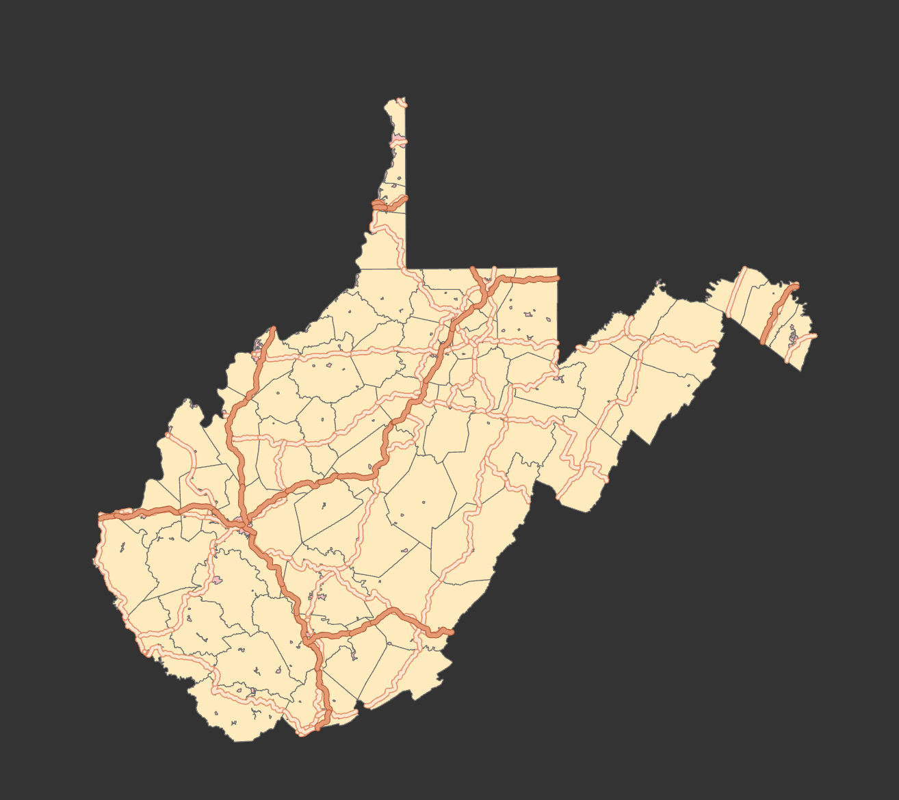
Establishment
Executive Order 4-93 (November 1993)
Through West Virginia Geologic and Economic Survey and Department of Commerce
On April 23 1998, Governor Cecil Underwood dedicated the center in new laboratory facilities in the Department of Geology and Geography at West Virginia University
Provide coordination and technical support in the development and operation of geographic information systems (GIS) for the state’s spatial data infrastructure
Statewide geospatial activities are coordinated through the WV Office of GIS Coordination, WV Geological and Economic Survey

Slide 4








Mission
Reduce duplication of data development efforts among organizations
Catalog and distribute GIS spatial data and information free-of-charge through the internet
Coordinate acquisition of new data additions to the West Virginia Spatial Data Infrastructure
Assist with strategic planning, development, and implementation of statewide mapping guidelines
Provide advisory services and training programs in the field of geographic information science
Conduct research and provide education towards improvement of geographic information technologies

Slide 5
Services to the State

Slide 6
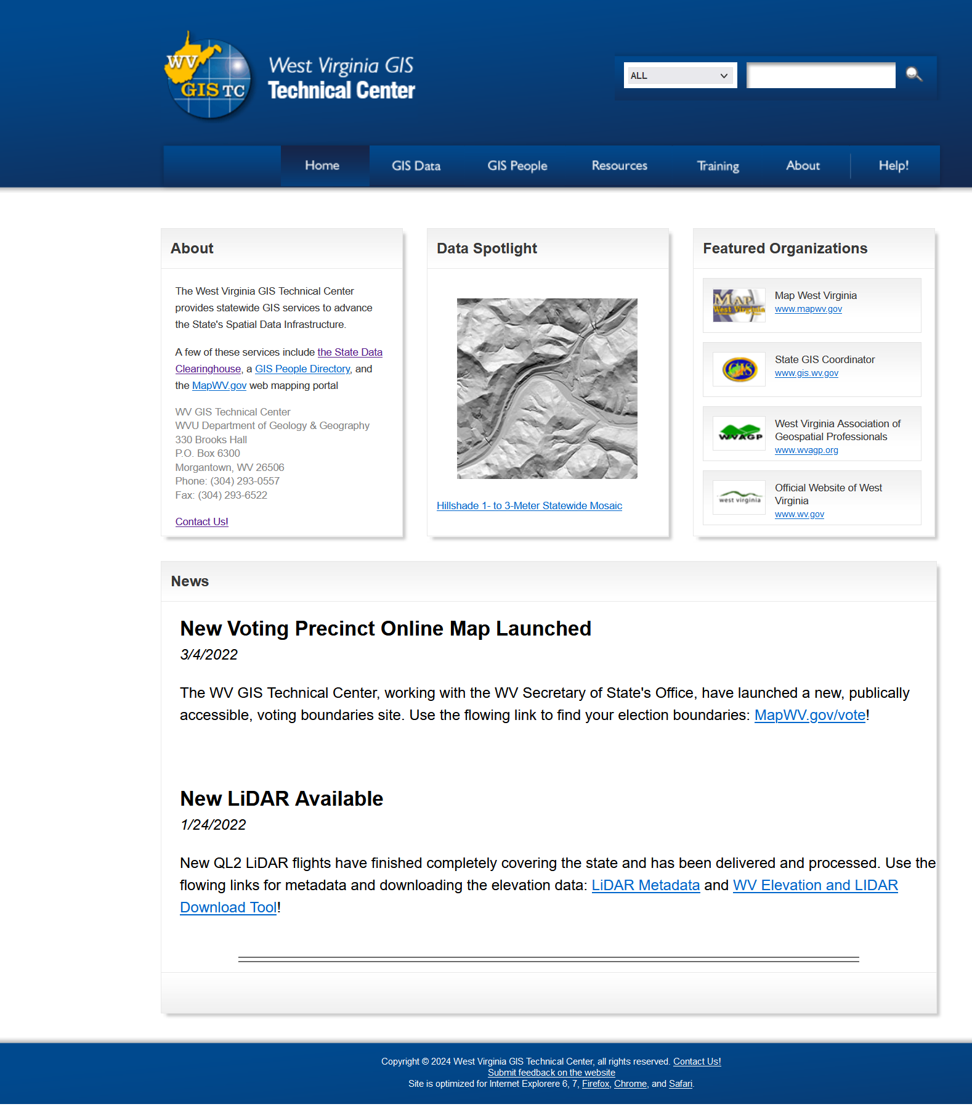
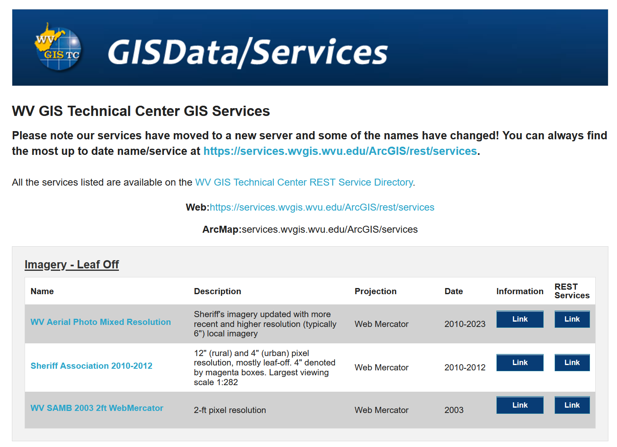
Spatial Data Clearinghouse
https://wvgis.wvu.edu/data/data.php
https://www.mapwv.gov/gis_services.html
Over 300 unique datasets and 120 web services
Valued at more than $70 million dollars
In 2023 the wvgis.wvu.edu webpage averaged over 53,000 views (i.e., page loads or reloads either from internal or external links) and 581 visits (i.e., landing on page from an external page) per day with over 19 million page views and 212,000 page visits for the entire year
In need of updating and modernization.
This web-based clearinghouse is central to the state’s geospatial data infrastructure.

Slide 7
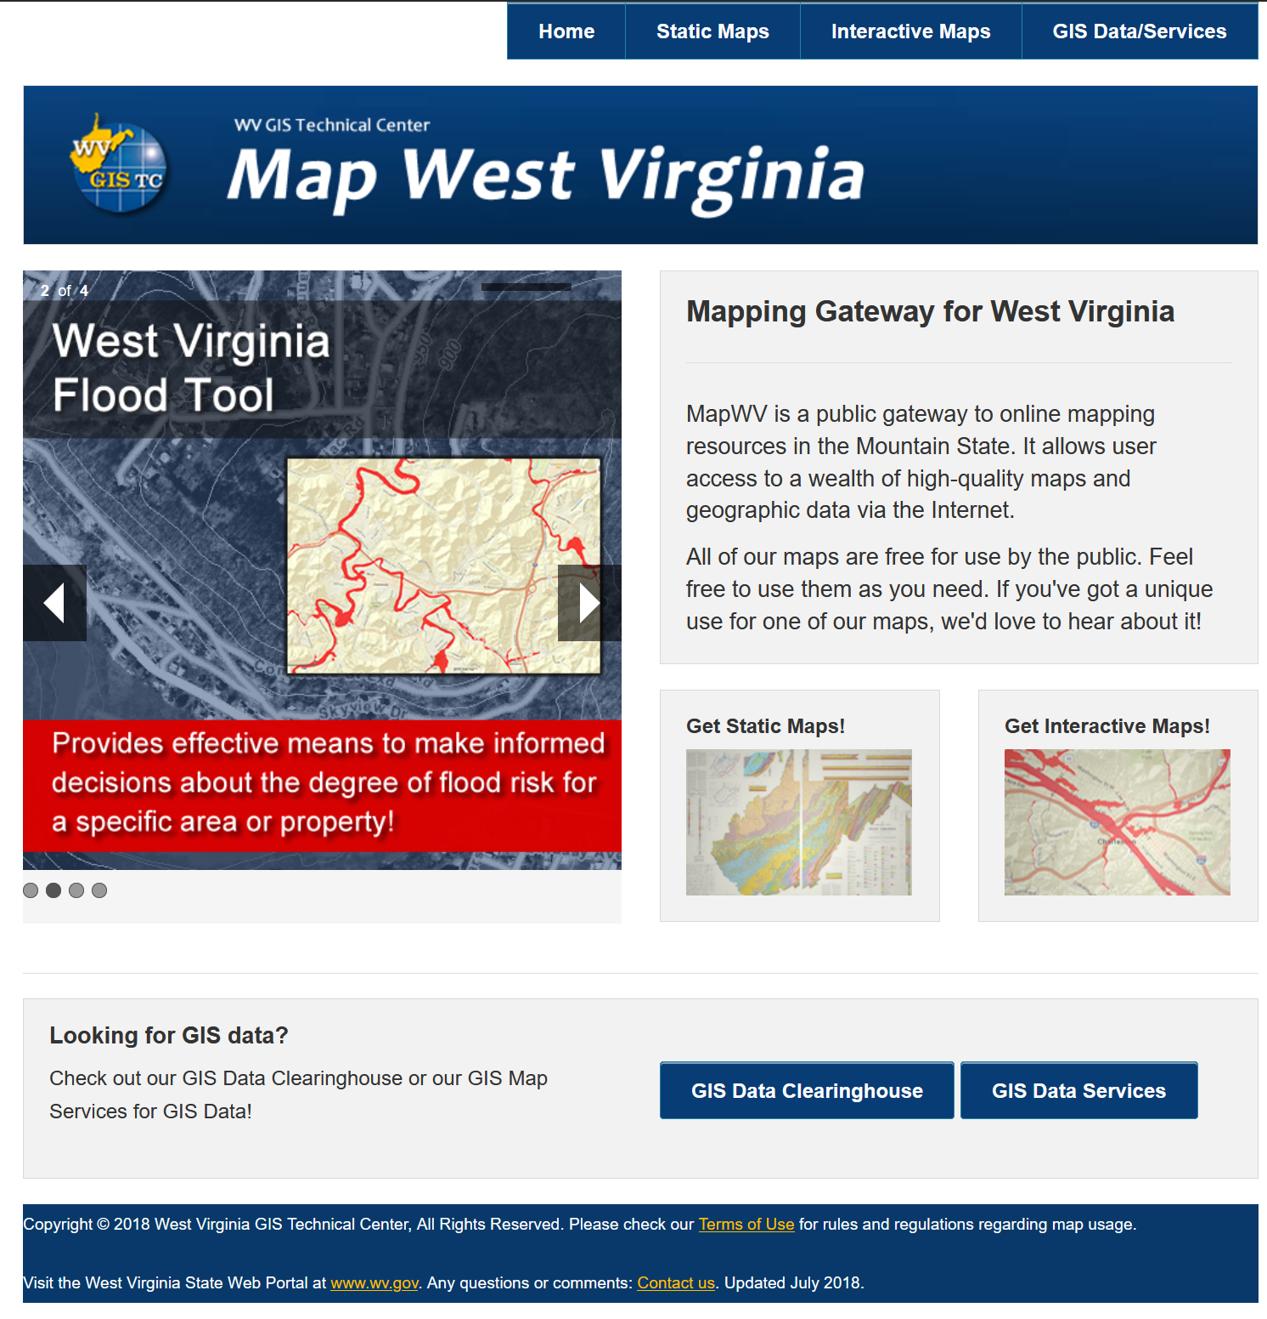
Web Maps and Services
www.mapwv.gov
Publicly accessible gateway to essential base map layers and geoprocessing services
In 2023 mapwv.gov had on average over 106,000 page views and 8,000 page visits per day with a total of over 38 million views and 2.9 million visits.
The most visited app is the WV Property Viewer (https://www.mapwv.gov/parcel/) followed by the WV Property Assessment app (https://www.mapwv.gov/assessment/).
Other key services/apps include the WV Flood Tool (https://www.mapwv.gov/flood/), WV Trail Inventory (https://www.mapwv.gov/trails/), and Hunting, Trapping, Fishing Map (https://mapwv.gov/huntfish/).
Requires continuing support/maintenance

Slide 8
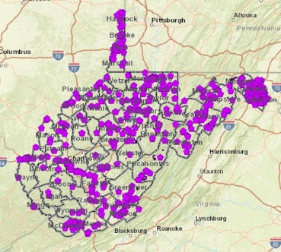
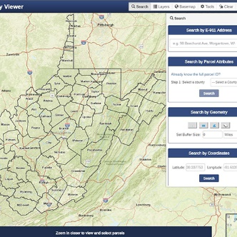
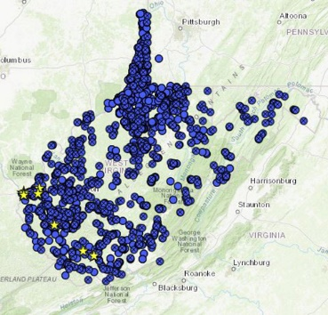
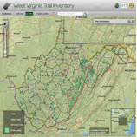
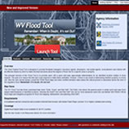
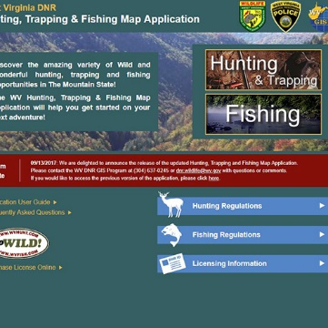
Interactive Maps
WV Cultural Resources
Property Viewer
https://www.mapwv.gov/parcel/
https://mapwv.gov/shpo/
Landslide
Tool
Trail Inventory
https://www.mapwv.gov/trails/
Flood Tool
Hunting and Fishing
https://www.mapwv.gov/flood/
https://mapwv.gov/huntfish/

Slide 9

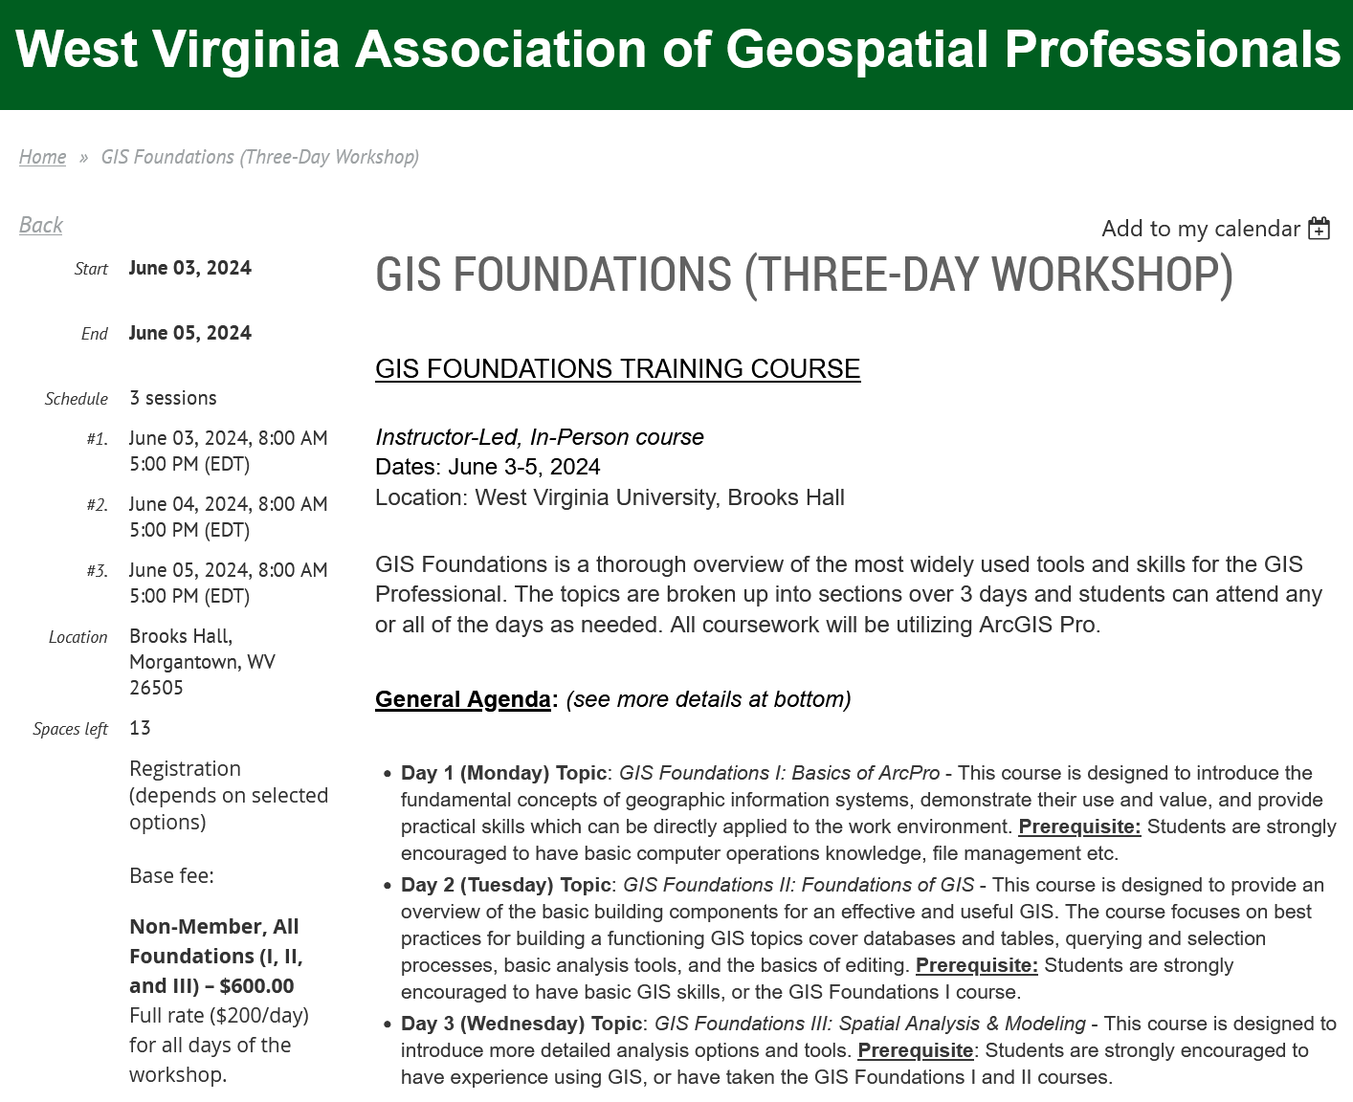

Teaching/Workforce Development
West Virginia Association of Geospatial Professionals (WVAGP)
West Virginia View
https://www.wvagp.org/
https://wvview.org/
https://www.wvagp.org/event-4829791

Slide 10
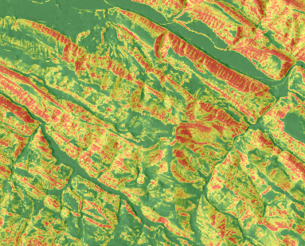
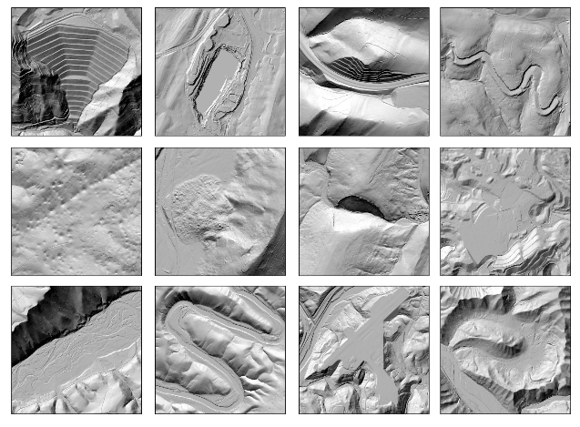
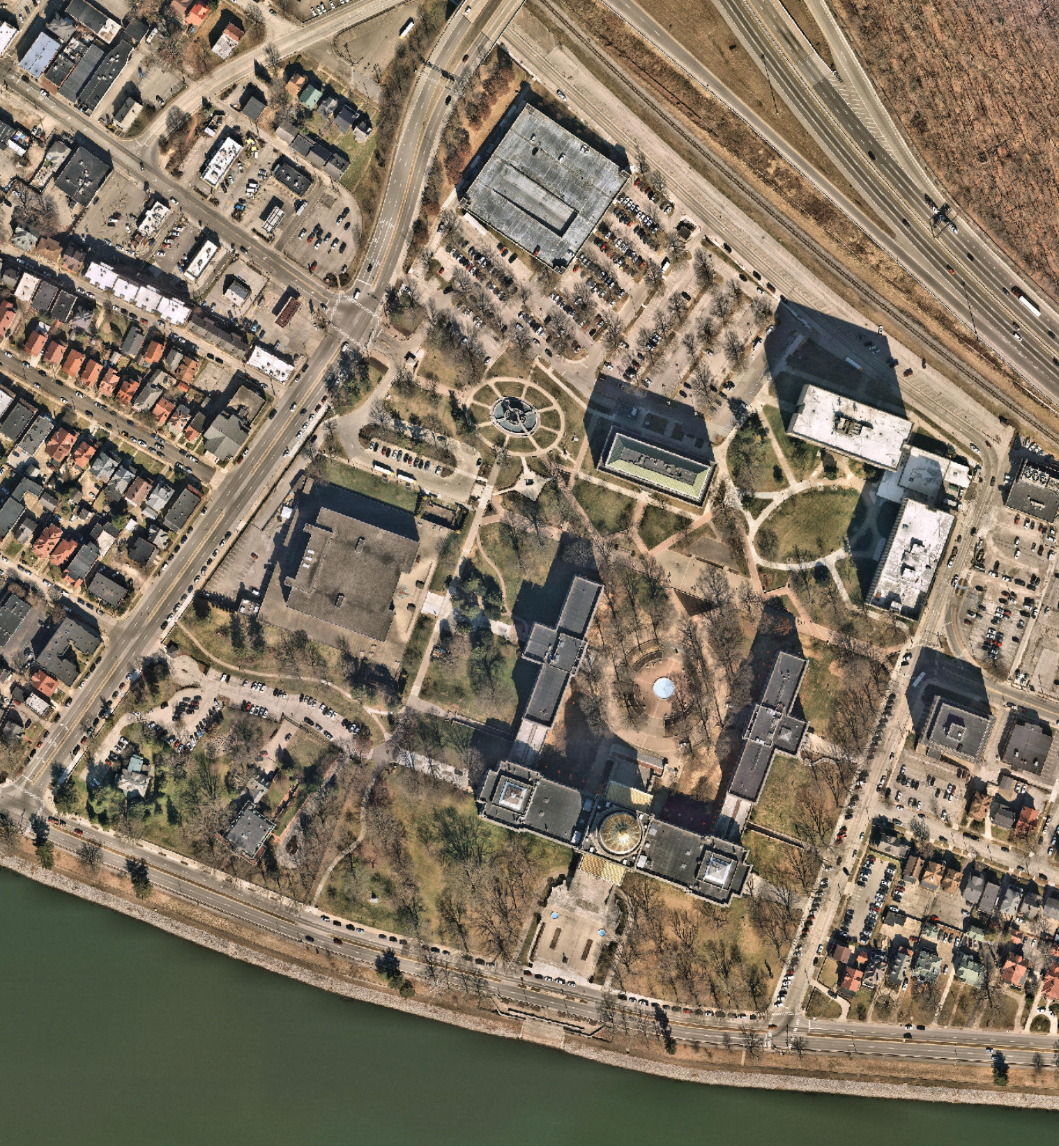
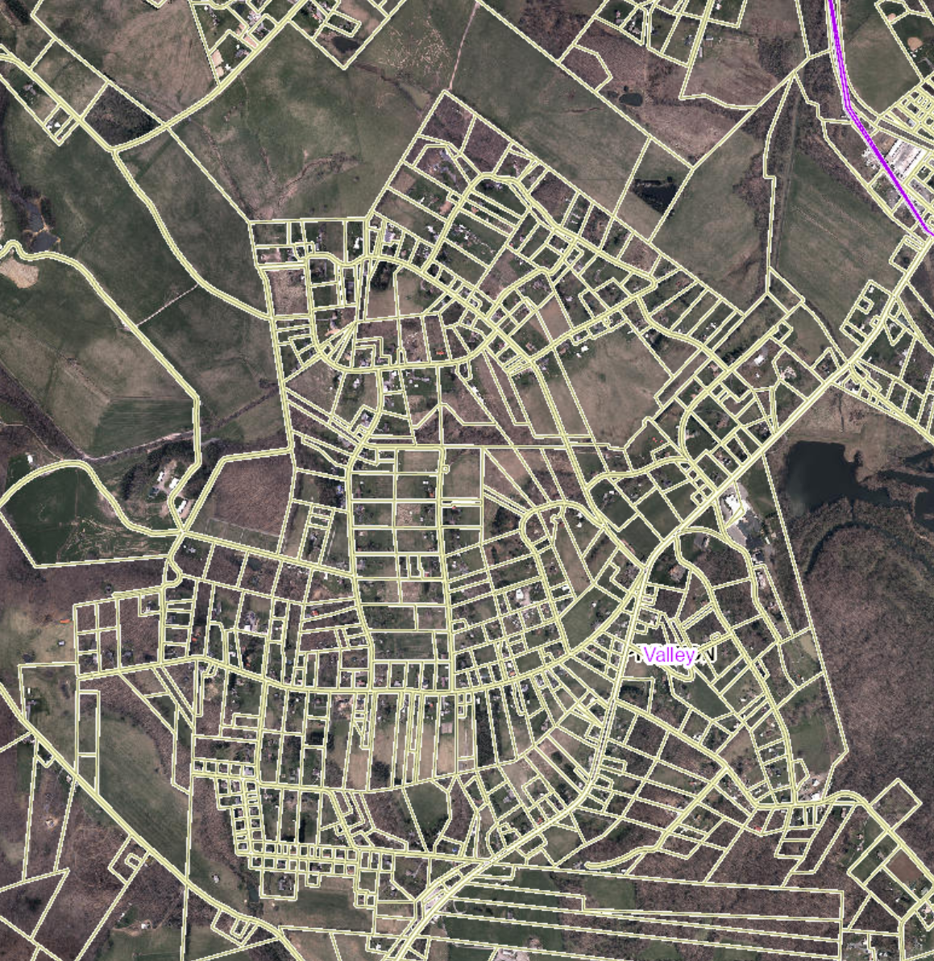
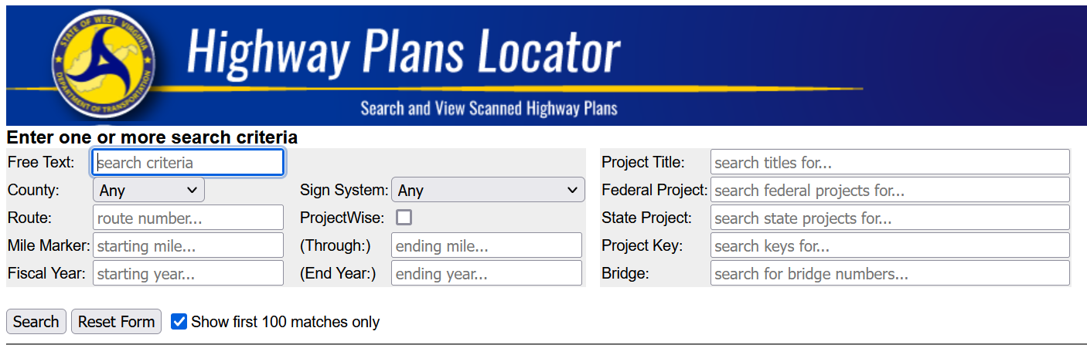

Project/Data Highlight
Statewide LiDAR Elevation Data
Landslide Hazards
http://data.wvgis.wvu.edu/elevation/
https://www.arcgis.com/apps/webappviewer/index.html?id=cb01c47cfa884309b4f38dcd7542f805
Statewide High-Res Aerial Imagery
Tax Parcels
https://www.mapwv.gov/parcel/
https://services.wvgis.wvu.edu/ArcGIS/rest/services
Highway plan scanning
Addressing
http://www.mapwv.gov/DOTplans/
http://wvsams.mapwv.org/samsii/

Slide 11
WV Flood Tool

Slide 12
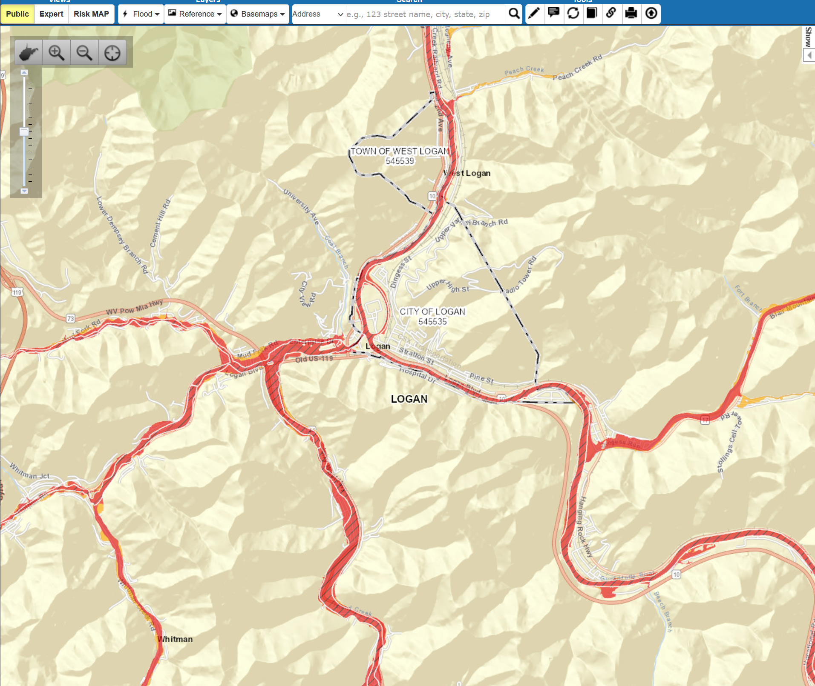

West Virginia Flood Tool
Support the public and floodplain managers of 268 flood-prone communities with regulatory and flood risk products including maintaining an inventory of 98,000 structures located in high-risk floodplains.
www.mapwv.gov/flood

Slide 13
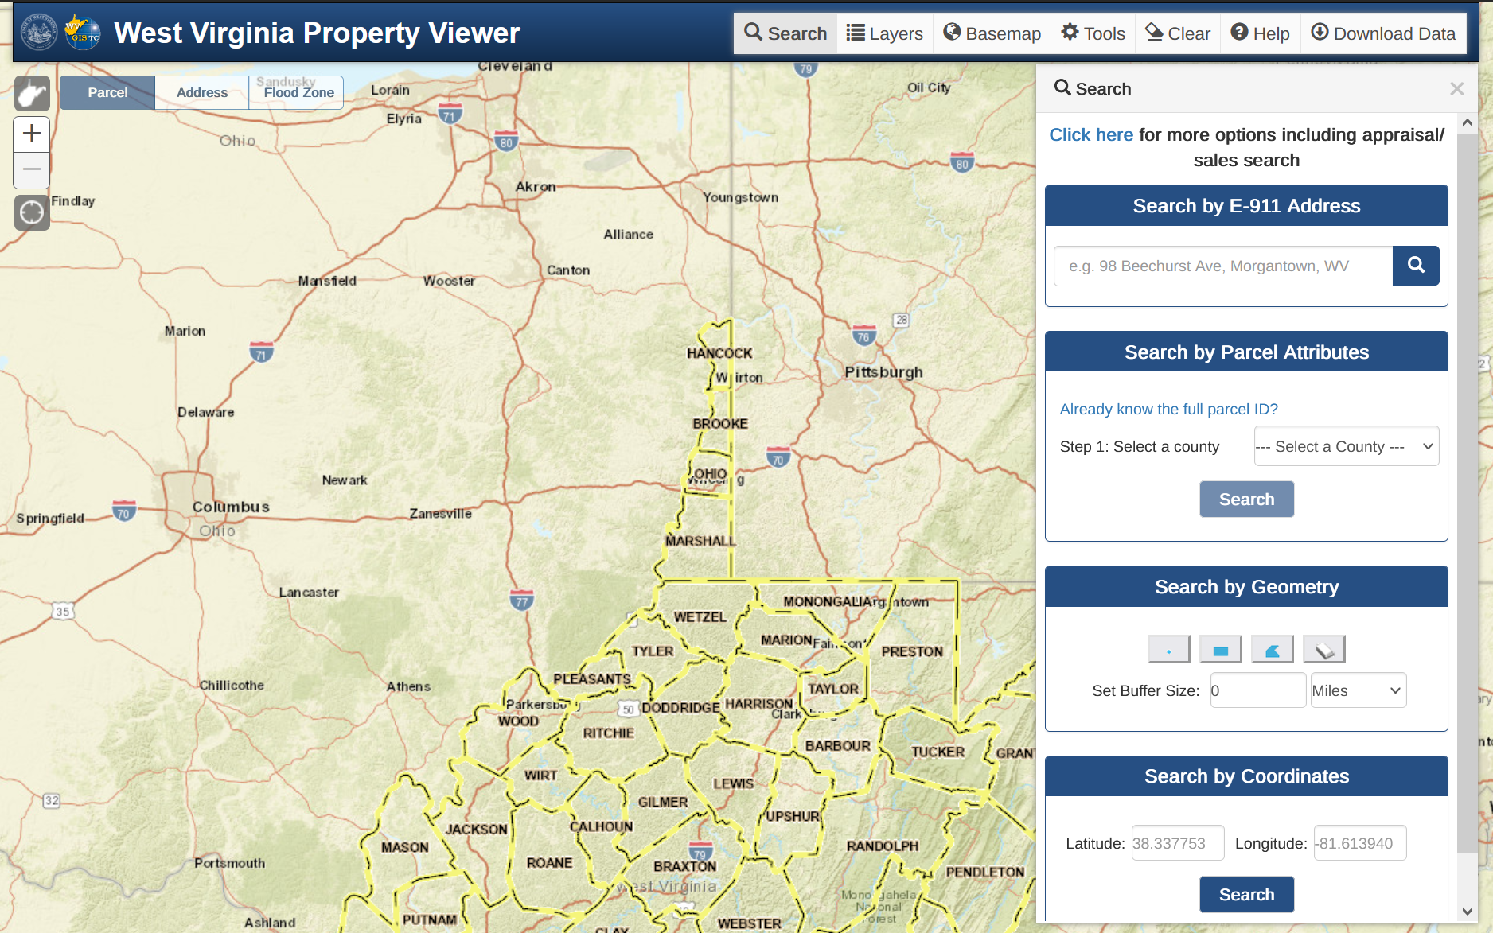
West Virginia Property Viewer
Coordinate with county assessors and WV State Tax Department to maintain 1.4 million parcels on the WV Property Viewer
www.mapwv.gov/property
Most popular website hosted by the Center
Weekly updates of delinquent properties from the WV State Auditor’s Office

Slide 14
WVFRF

Slide 15



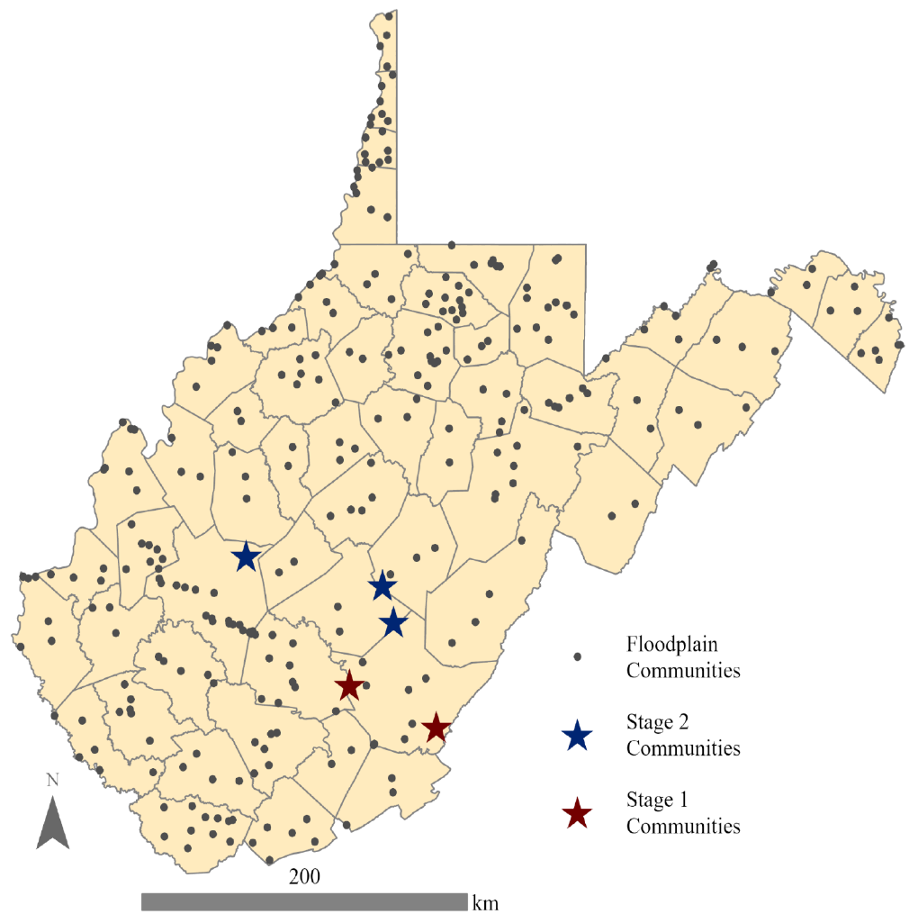









WV Flood Resiliency Framework
National Science Foundation
Award Number 2321985: "CIVIC-FA Track B: Creating the West Virginia Flood Resilience Framework for comprehensive disaster response and long-term community recovery"
State-wide survey to assess how well WV residents have recovered from past floods and how prepared they are for future floods
Flood risk indicator reports for all 286 floodplain communities in WV
Develop in-depth flood risk visualization tools for select communities
In-person and virtual trainings about floodplain management and flood insurance
Host the Statewide Flood Resilience Symposium
Build and launch the WVFR

Slide 16

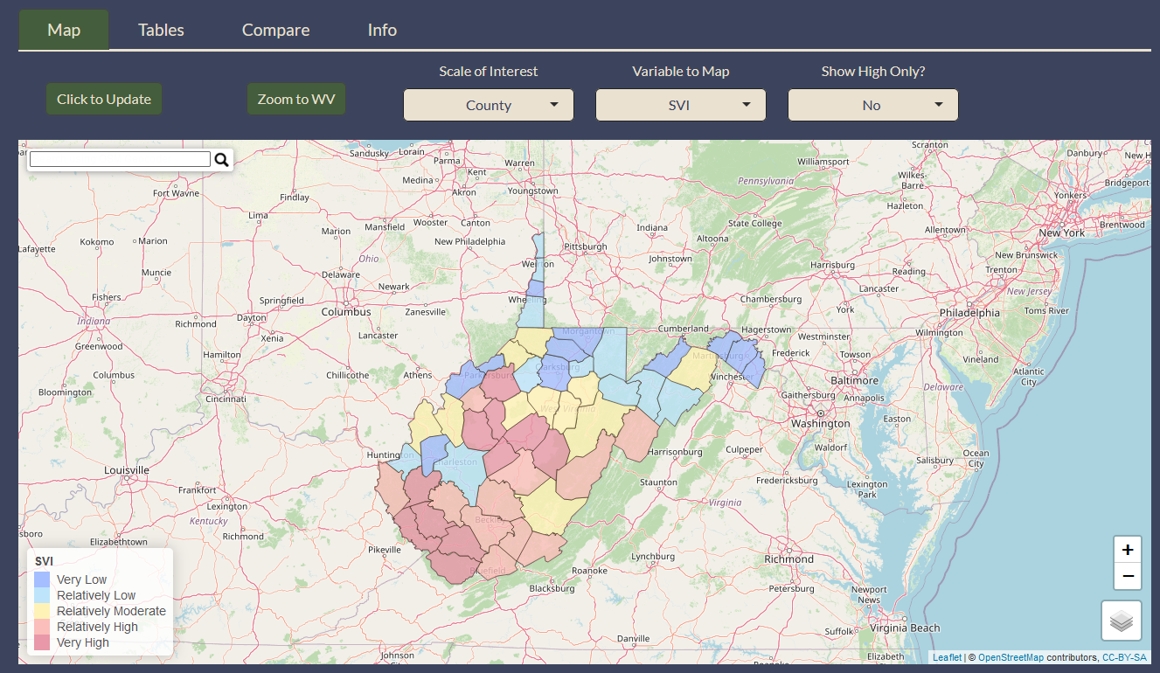
Goals
Support data-driven decision making at multiple scales
Aggregate best available data
Support State Resiliency Plan
Understand risks and resiliencies
Prioritize mitigation efforts
Link to resources from other agencies
Interfaces for different users: property owners, business owners, community leaders, and mitigation professionals

Slide 17
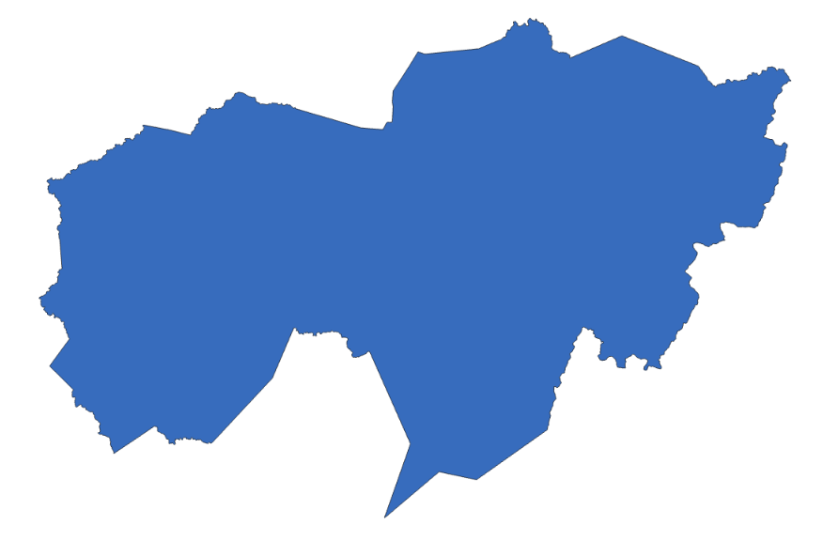
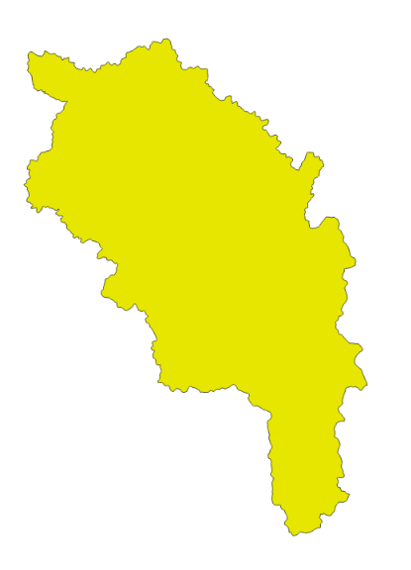
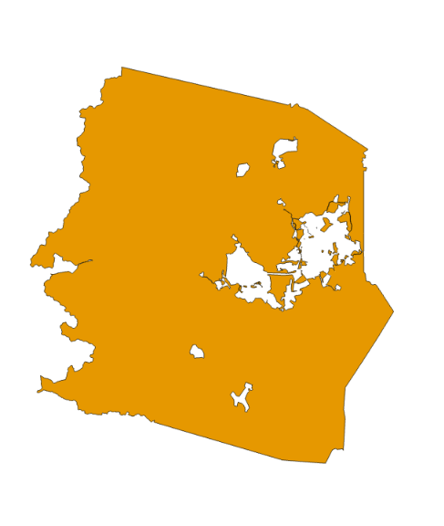

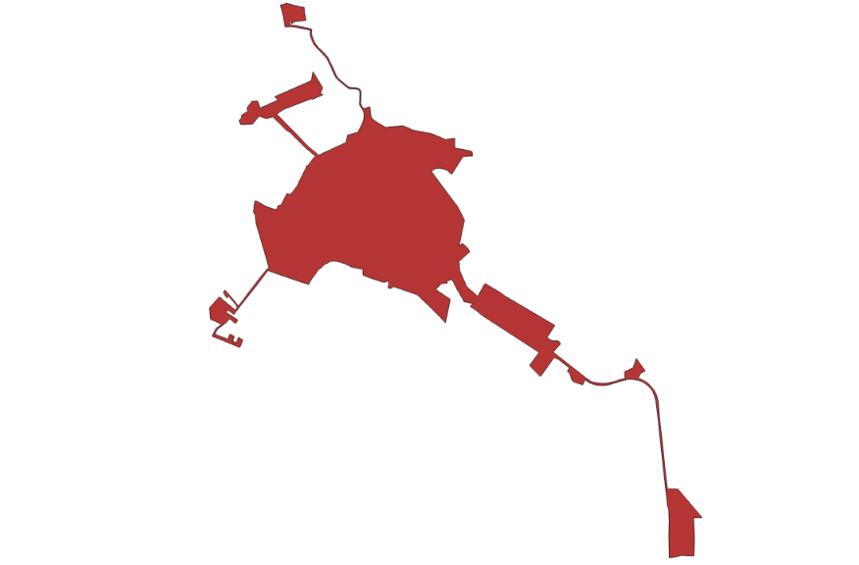
Indicators
Major Categories | Detailed Categories | Tool Indicators
Flood Hazard Risk | Floodplain Area | 6 indicators
 | Floodplain Length
 | Declared Disasters
 | Flood Depth
Structure Risk | Building Counts / Ratios | 41 indicators
 | Building Types & Values
 | Vulnerable Structures
 | FIRM Status
 | Building Year / New Construction
 | Significant Structures
 | Physical Damage Estimates
 | Recorded Building Damages
 | Transportation Infrastructure
People/Social Risk | Social Vulnerability | 4 indicators
 | Population Exposure
 | Population Displacement & Shelter Needs
Other Hazards | Dams/Levees | 4 indicators
 | Landslide
Mitigation Measures | Structural Measures | 9 indicators
 | Physical Non-Structural Measures
 | Non-Physical Non-structural Measures
Watersheds
Regions
Unincorporated
Provide a variety of indicators at different scales
Currently working on this phase of the project
Counties
Incorporated

Slide 18
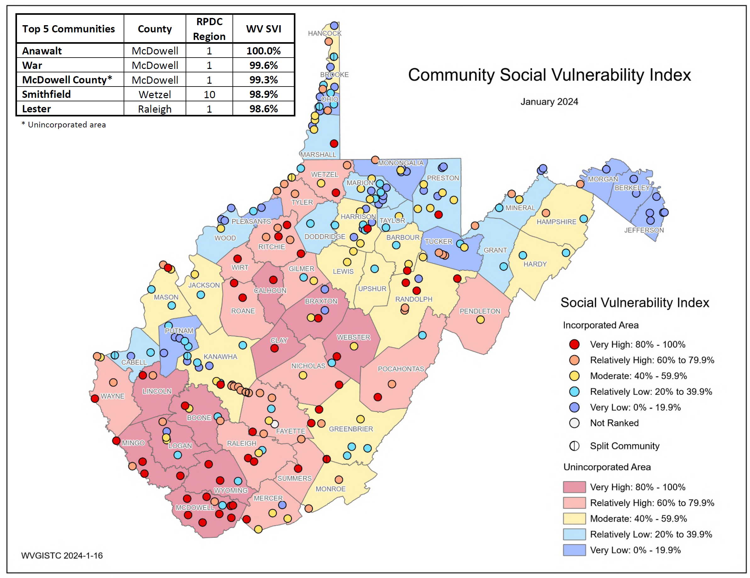
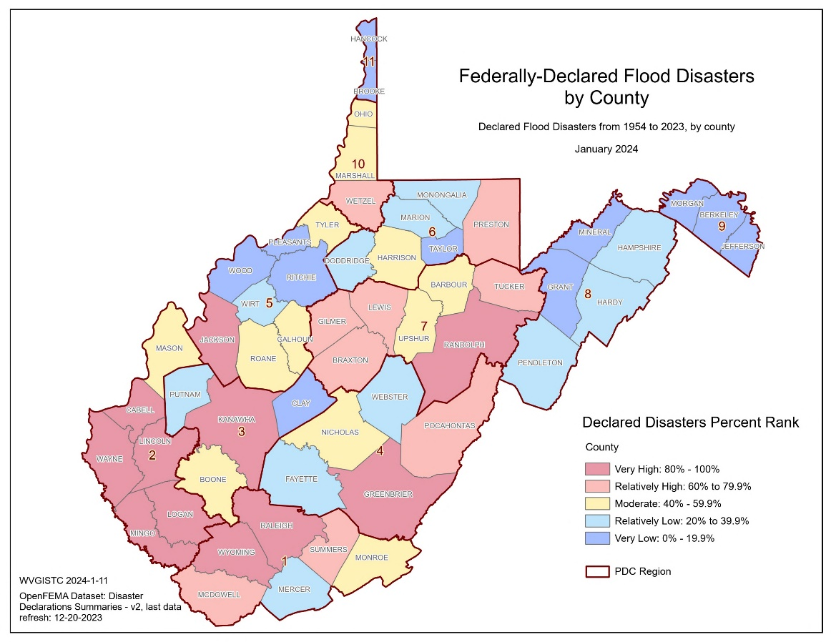
Indicators

Slide 19

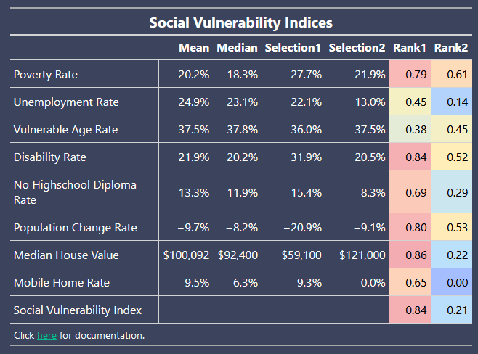


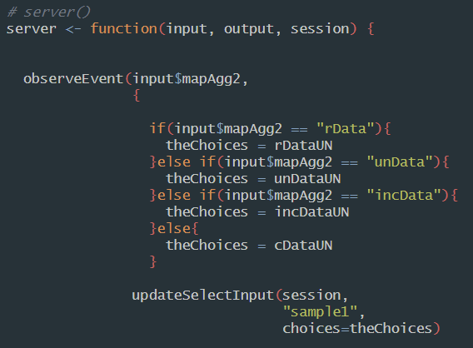
Timeline
  Completed
    Basic UI design
    People/social indicators
  In-Progress
    Additional indicators
    Documentation
  To do
    App refinement
    Integration with WRF
Beta version by July 2024/Version 1.0 by Oct. 2024

Slide 20
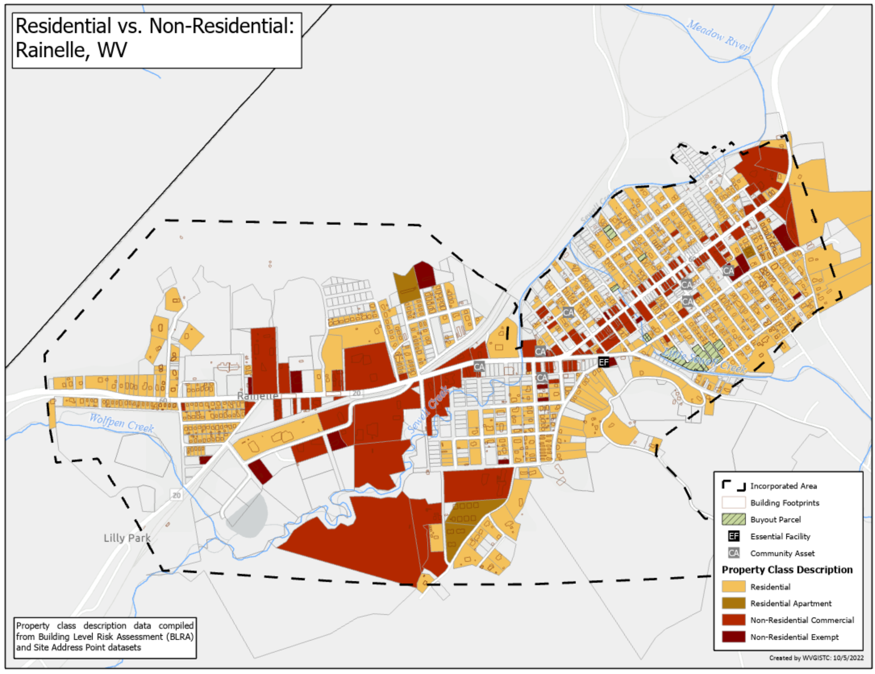
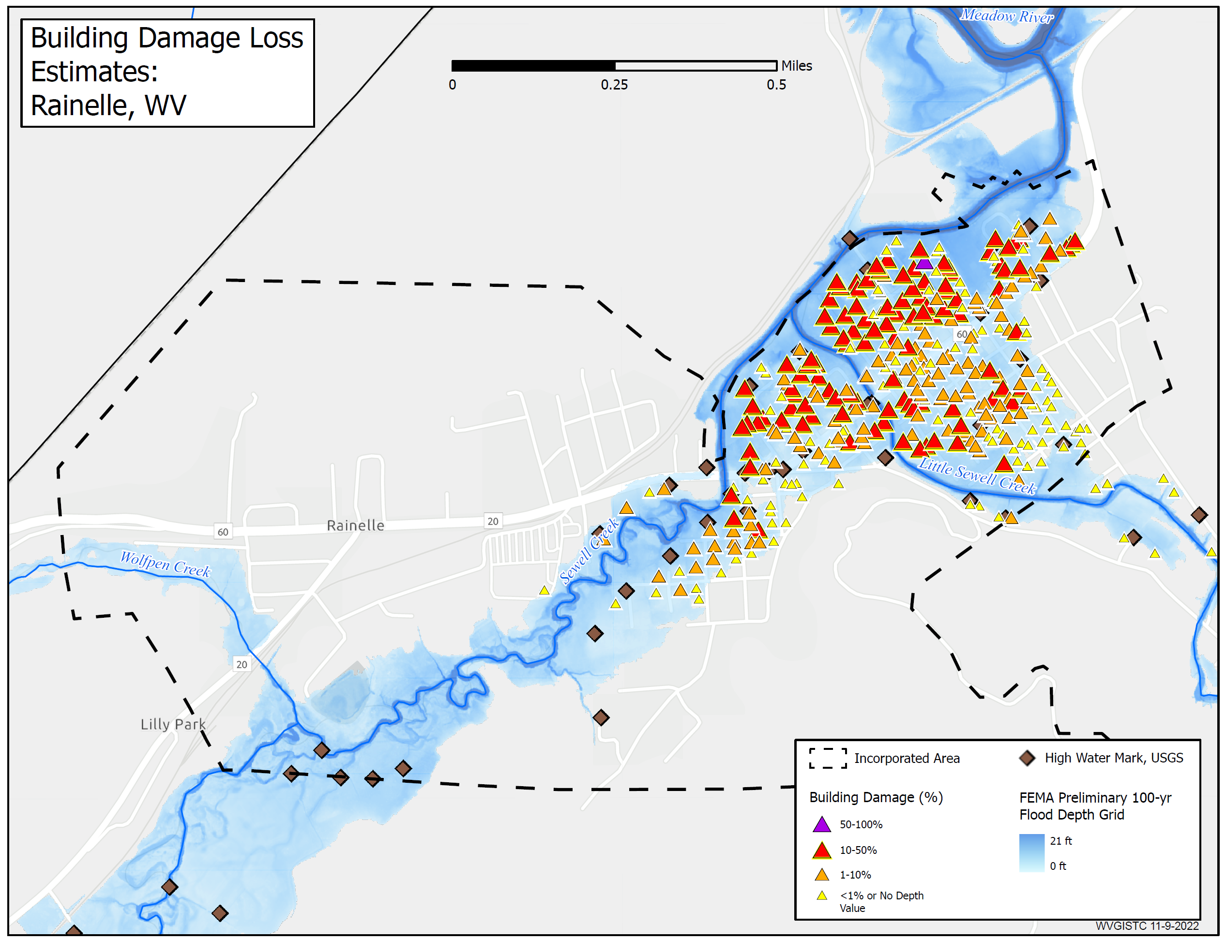
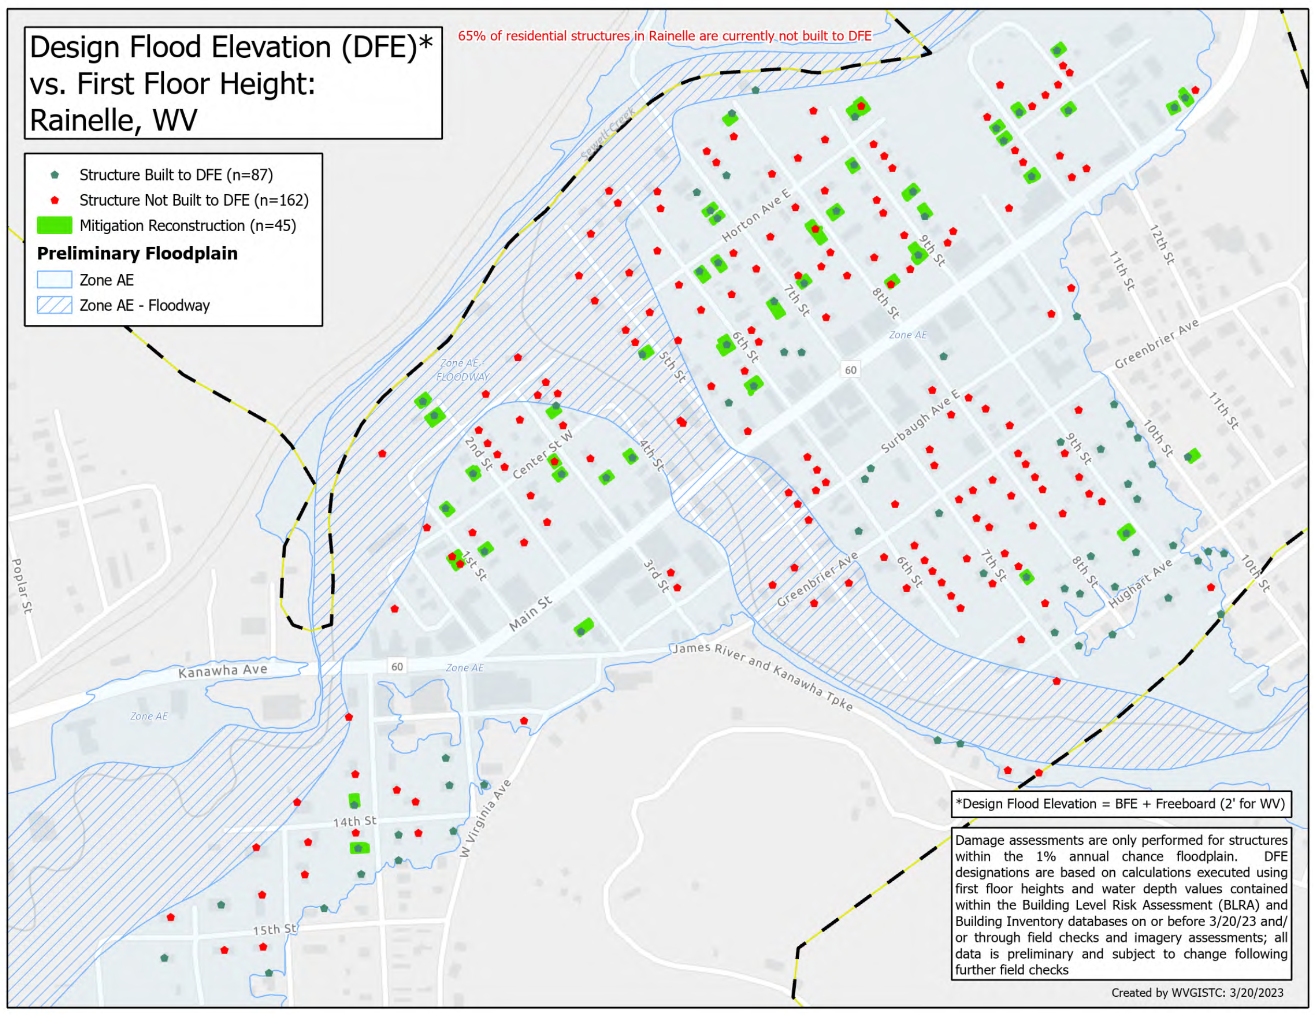
Longevity
Value of tool lies in accuracy/timeliness of data
National-scale tools have limited site-specific data
Developing such data is time consuming and labor intensive

Slide 21


Maintaining/Expanding the WVFRF
Initial funding from NSF ends in October 2025
Maintenance and updates are needed
Support SRO’s mission
Goal of finding a means to sustain the tool long-term
Support for two analysts, hardware/software, travel

