Slide 1
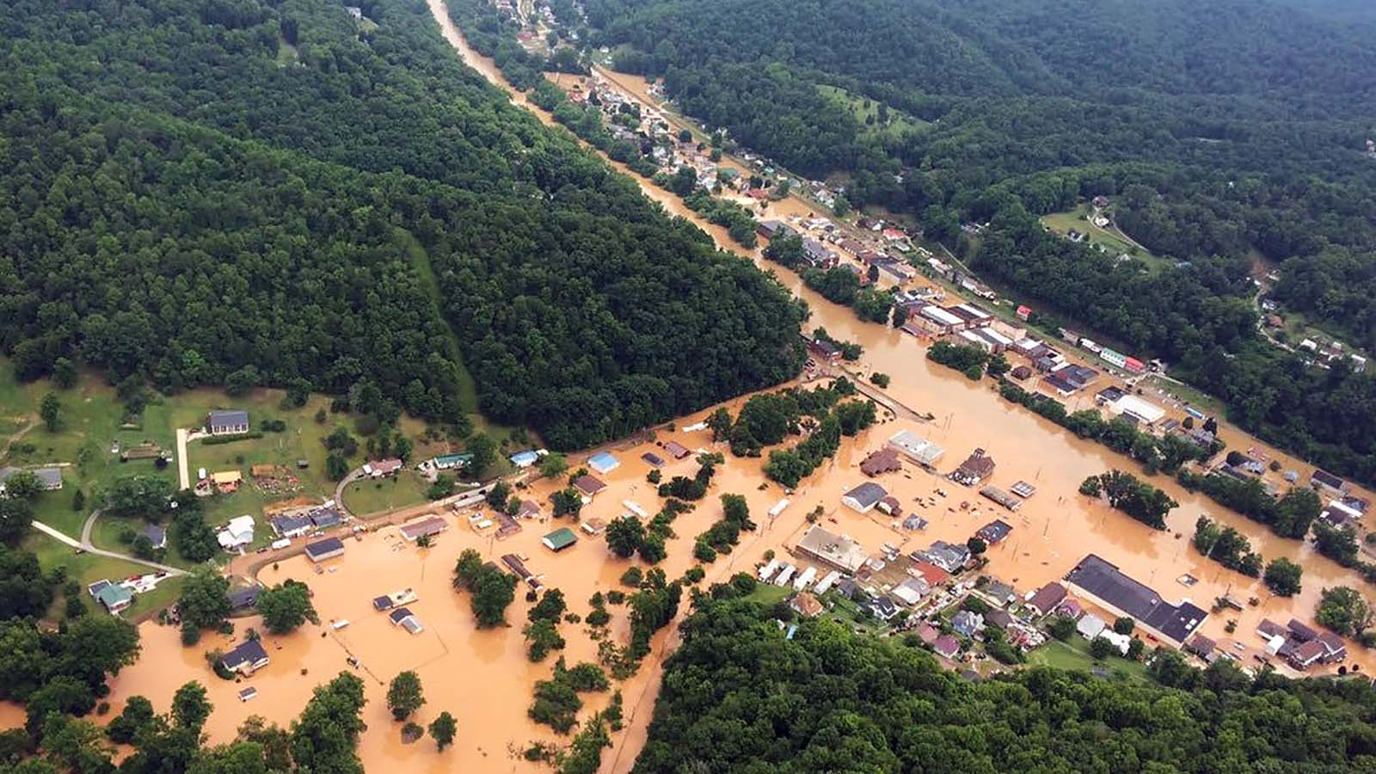



West Virginia Flood Resiliency Framework
(WVFRF)
Kurt Donaldson
Behrang Bidadian
Joint Legislative Committee on Flooding (JLCF)
September 2025

Slide 2



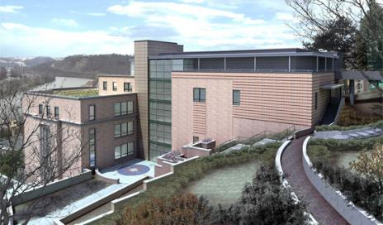





About Us
Director/Project Manager:
Kurt Donaldson
Faculty Director:
Aaron Maxwell
WVGISTC Team:
  Three Risk & GIS Analysts
  Two GIS Programmers/Developers
  Contractors/Consultants
  Graduate Research Assistants
  Student Workers
Mission:
Spatial data infrastructure enhancement
Advisory services and training programs in geographic information science
GIS research and education
Support disaster resilience in the state:
Flood & Landslide risk assessment
WV GIS Technical Center (WVGISTC)
WVU Department of Geology & Geography
330 Brooks Hall
P.O. Box 6300
Morgantown, WV 26506
Phone: (304) 293-0557
Email:
kurt.donaldson@mail.wvu.edu
behrang.bidadian@mail.wvu.edu

Slide 3

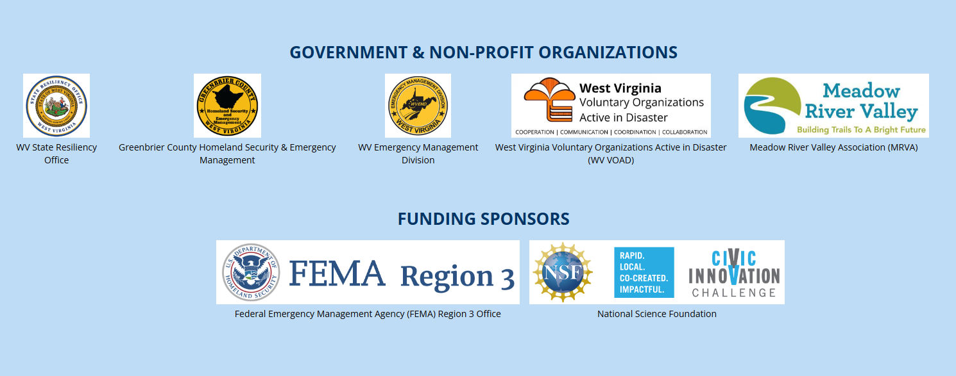
Sponsors

Slide 4

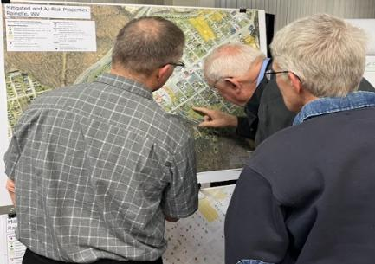
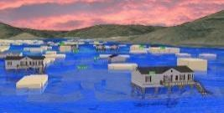
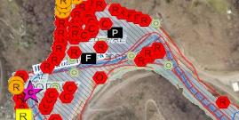
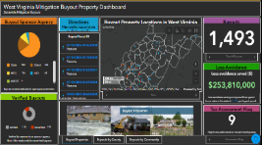
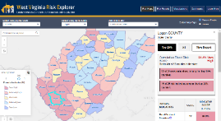
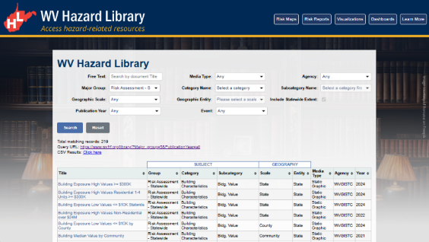
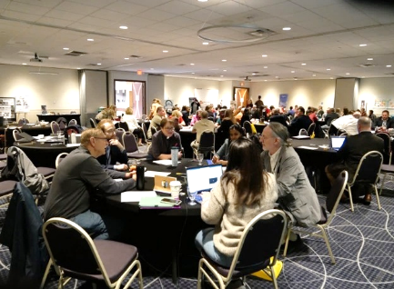
WV Flood Resiliency Framework (WVFRF)
A virtual hub of risk assessment, visualization, planning, and training resources for building community flood resiliency in WV
Flood Visualizations
WV Flood Tool
COMMUNITY
ENGAGEMENT
• Focused Outreach Meetings
• Flood Symposium
• Resiliency Tools & Products
• Learning Resources & Reports
RISK TOOLS
• WV Risk Explorer
• WV Flood Tool
• Visualizations
• Dashboards
9 Geographic Scales
Flood Dashboards
WV Risk Explorer
Community Engagement Meeting
Example Tools
HAZARD LIBRARY
Search online hazard resources by title, subject, media, event, geography, data, etc.
STAKEHOLDERS
• Risk Reduction Associates
• Emergency Responders
• Floodplain Managers
• Local Officials
• Volunteers
• Public
Hazard Library
Flood Symposium Stakeholders
Notes:
Collaboration of civic actors and academic researchers
The WV Flood Resiliency Framework employs risk assessment, visualization, and resource discovery tools to engage communities and stakeholders in building flood resiliency.

Slide 5
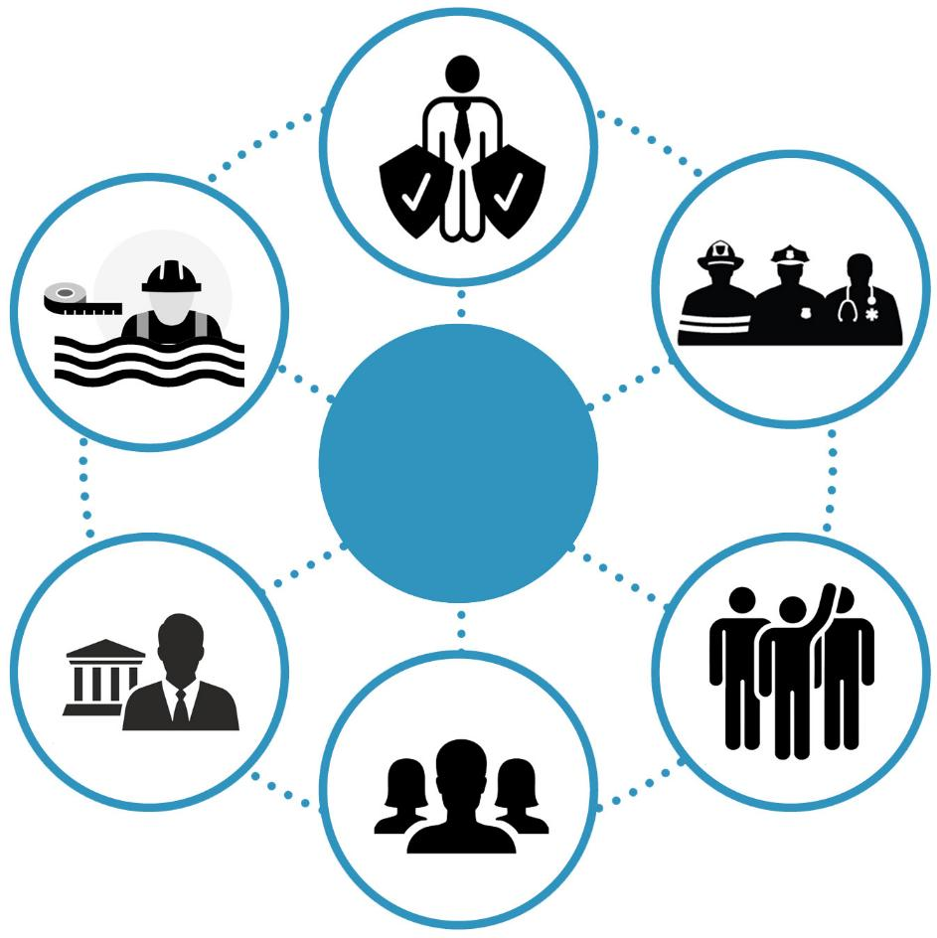
Stakeholders
Risk Reduction Associates
Floodplain
Managers
Emergency Responders
Stakeholders
Supporting policy updates, state resilience initiatives, and hazard mitigation planning
Local/State Officials
Volunteers
Public
Notes:
Six targeted stakeholder groups for WVFRF tools and hazard library resources.

Slide 6
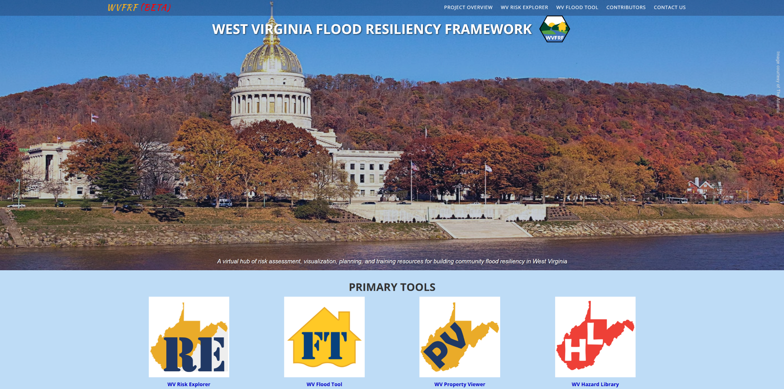
WVFRF Integrated Tools
COMMUNITY
ENGAGEMENT
• Focused Outreach Meetings
• Flood Symposium
• Resiliency Tools & Products
• Learning Resources & Reports
RISK TOOLS
• WV Risk Explorer
• WV Flood Tool
• Visualizations
• Dashboards
9 Geographic Scales
HAZARD LIBRARY
Search online hazard resources by title, subject, media, event, geography, data, etc.
STAKEHOLDERS
• Risk Reduction Associates
• Emergency Responders
• Floodplain Managers
• Local Officials
• Volunteers
• Public
Notes:
A virtual hub of risk assessment, visualization, planning, and training resources for building community flood resiliency in West Virginia
Integrated tools
Focusing on the WVRE
Link: https://wvfrf.org/

Slide 7


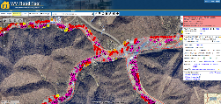
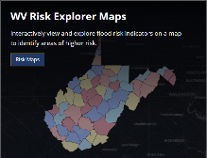
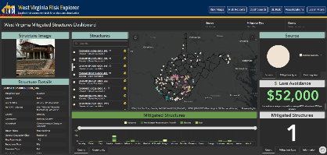
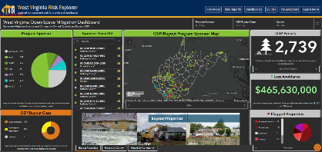
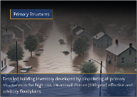
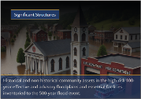


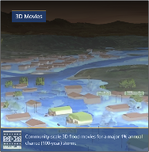
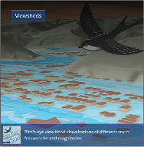


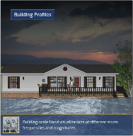
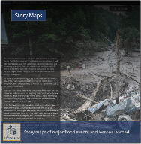
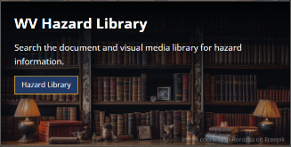

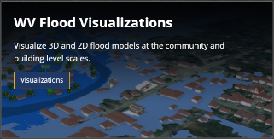
West Virginia Risk Explorer (WVRE)
Risk Assessment Tools
Localized riverine flood risk assessment including a broad range of risk categories by aggregating detailed building-level data at multiple scales
Help identify the communities most at risk of riverine flooding for efficient allocation of limited mitigation resources
Mitigation Assessment Tools
Quantifying of mitigation efforts such as elevation, relocation, and buyouts and calculation of loss estimates
Enable planners and decision-makers to evaluate past and ongoing efforts, identify gaps, and prioritize future investments
Building/Property-Level
Aggregated
Mitigated Structures Dashboard
Open-Space Mitigation Dashboard
Risk Communication Tools
Scenario-based 2D and 3D visualizations to translate complex data into accessible insights
Facilitate risk comprehension for different groups of stakeholders to support informed decision-making and encourage public engagement
Hazard Library and Data Access
Access to online hazard resources including data, documents, and media searchable by title, subject, event, geography, and more.
Allow users to access comprehensive datasets for use in analyses, maps, or applications to support planning, research, and decision-making related to hazard mitigation and response
Notes:
Click on the image to open the link
Link (WVRE): https://www.wvfrf.org/wvre/

Slide 8
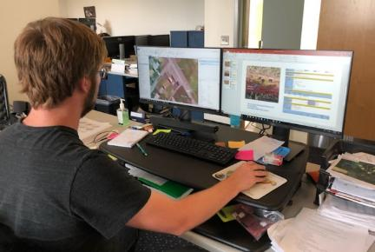

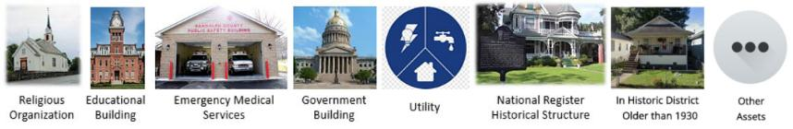
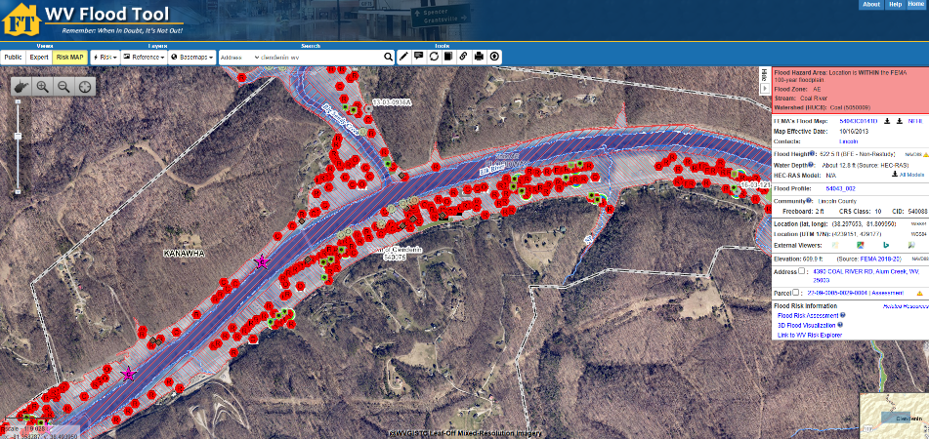

WV Floodplain Building Inventory (BI)
Riverine Flood Exposure Assessment (Building-Level)
Product: WV Flood Tool mapwv.gov/flood
All primary (insurable) structures in FEMA’s 1%-annual-chance (100-yr) floodplain
Community Assets (Historical & Non-Historical) in the 100-yr floodplain
Essential Facilities in the 100-yr and 500-yr floodplains
COMMUNITY
ENGAGEMENT
• Focused Outreach Meetings
• Flood Symposium
• Resiliency Tools & Products
• Learning Resources & Reports
RISK TOOLS
• WV Risk Explorer
• WV Flood Tool
• Visualizations
• Dashboards
9 Geographic Scales
Essential
Facilities
Community
Assets
HAZARD LIBRARY
Search online hazard resources by title, subject, media, event, geography, data, etc.
STAKEHOLDERS
• Risk Reduction Associates
• Emergency Responders
• Floodplain Managers
• Local Officials
• Volunteers
• Public
Notes:
Detailed building characteristics from tax assessment
Population exposure and displacement estimates (100-yr flood)
Manual process of identification using Arc GIS
Programmed scripts to extract and process data
Use of Hazus model for damage estimation by depth damage curves
Link 1 (FT): https://www.mapwv.gov/flood/
Link 2: https://www.mapwv.gov/flood/map/?wkid=102100&x=-9055385&y=4648559&l=9&v=2

Slide 9
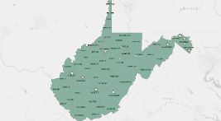
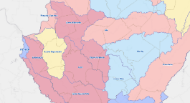
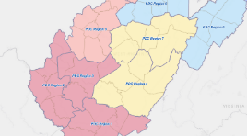
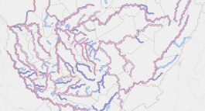
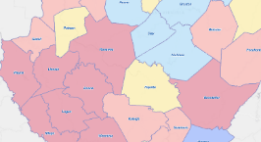
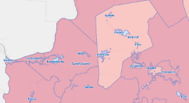
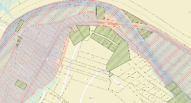
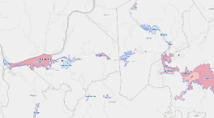
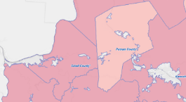
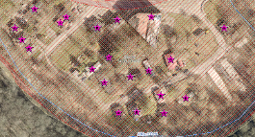
Analytical & Visualization Tools at Multiple Scales
Political Boundaries
Drainage Areas / Streams
State
Watersheds
(33)
PDC Regions (11)
Streams/Rivers
(156)
Counties (55)
Property Levels
Communities (284)
Parcels
Incorporated Places
(229)
Unincorporated Areas
(55)
Buildings
Notes:
The WV Flood Tool and WV Risk Explorer applications quantify riverine flood risk at the building and summary geographic levels, respectively. Cumulative risk rankings at different geographic scales and entities are computed from various risk indicators, including building, people, and social-economic factors.
Flood Tool: Building/Parcel-Level; New tools: Aggregation ability

Slide 10
WV Flood Risk Index
Overall Flood Risk
(1) FLOODPLAIN CHARACTERISTICS
(2) BUILDING EXPOSURE
(3) BUILDING CHARACTERISTICS
(4) CRITICAL INFRASTRUCTURE
(5) COMMUNITY ASSETS
(6) BUILDING DAMAGE LOSS
(7) PEOPLE / SOCIAL VULNERABILITIES
(8) OTHER HAZARDS
Floodplain Area
Building Floodplain Count¹ ²
Building Value¹ ²
Essential Facilities
Historical Assets
Substantial Damage Estimates*¹ ²
Population in Floodplain
Landslides
Floodplain Length¹ ²
Building Floodway Count¹ ²
Mobile Homes
Roads Inundated
Non-Historical Assets
Previous Claims
Population Displaced
Karst**
Floodplain Depth¹ ²
Building Floodplain Ratio²
Basement
Repetitive Losses
WV Social Vulnerability Index
Dam/Levee Failure**
Flood Disaster Frequency
Building Density¹ ²
One Story
Building Year*
Used for the Index
* Multiple Indicators
** In Progress
1
River/Stream Indicator
2
Watershed Indicator
Notes:
Categories 1 to 7 used to develop the risk index

Slide 11
Riverine Flood Risk Assessment

Slide 12


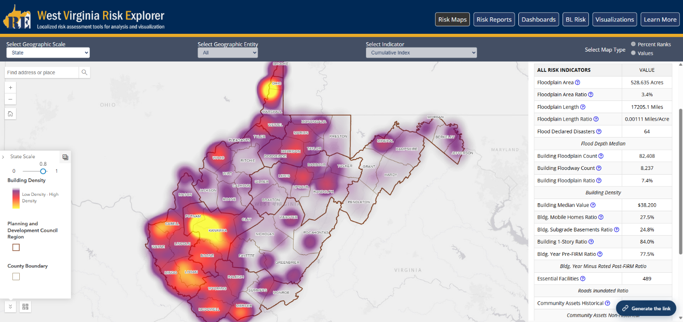

Statewide Flood Risk Assessment
Notes:
Click on the images to open the links
Link 1: https://www.wvfrf.org/wvre/map/?scaleid=3&gslid=&index=CUM_INDEX&type=pct
Link 2: https://wvfrf.org/wvre/map/?scaleid=1&gslid=&index=CUM_INDEX&type=pct

Slide 13
Geographic Entities at VERY HIGH Risk (Top 10%)
RANK | All Communities | Index Score
1 | New Martinsville - Incorporated | 100.0%
2 | Boone County* - Unincorporated | 99.6%
3 | Clendenin - Incorporated | 99.2%
4 | Marlinton - Incorporated | 98.9%
5 | Wheeling** - Incorporated | 98.5%
6 | McDowell County* - Unincorporated | 98.2%
7 | Alderson** - Incorporated | 97.8%
8 | Wayne County* - Unincorporated | 97.5%
9 | Parsons - Incorporated | 97.1%
10 | Kanawha County* - Unincorporated | 96.8%
11 | Madison - Incorporated | 96.4%
12 | Kimball - Incorporated | 96.1%
13 | Lincoln County* - Unincorporated | 95.7%
14 | Milton - Incorporated | 95.4%
15 | Mingo County* - Unincorporated | 95.0%
16 | Logan County* - Unincorporated | 94.6%
17 | Danville - Incorporated | 94.3%
18 | Wellsburg - Incorporated | 93.9%
19 | Oceana - Incorporated | 93.6%
20 | Rowlesburg - Incorporated | 93.2%
21 | Northfork - Incorporated | 92.9%
22 | Gary - Incorporated | 92.5%
23 | Wyoming County* - Unincorporated | 92.2%
24 | Welch - Incorporated | 91.8%
25 | Summers County* - Unincorporated | 91.5%
26 | Buckhannon - Incorporated | 91.1%
27 | Richwood - Incorporated | 90.8%
28 | Ceredo - Incorporated | 90.4%
29 | Mannington - Incorporated | 90.1%
Incorporated Places | Index Score
Clendenin - Incorporated | 100.0%
New Martinsville - Incorporated | 99.5%
Alderson** - Incorporated | 99.1%
Marlinton - Incorporated | 98.6%
Kimball - Incorporated | 98.2%
Parsons - Incorporated | 97.8%
Wheeling** - Incorporated | 97.3%
Northfork - Incorporated | 96.9%
Danville - Incorporated | 96.4%
Madison - Incorporated | 96.0%
Milton - Incorporated | 95.6%
Oceana - Incorporated | 95.1%
Keystone - Incorporated | 94.7%
Wellsburg - Incorporated | 94.2%
Gary - Incorporated | 93.8%
Rowlesburg - Incorporated | 93.4%
Grantsville - Incorporated | 92.9%
Richwood - Incorporated | 92.5%
Rainelle - Incorporated | 92.1%
Mannington - Incorporated | 91.6%
Spencer - Incorporated | 91.2%
Welch - Incorporated | 90.7%
Buckhannon - Incorporated | 90.3%
Unincorporated Areas | Index Score
Kanawha County* - Unincorporated | 100.0%
Boone County* - Unincorporated | 98.1%
Wayne County* - Unincorporated | 96.2%
McDowell County* - Unincorporated | 94.4%
Mingo County* - Unincorporated | 92.5%
Logan County* - Unincorporated | 90.7%
Counties | Index Score
Kanawha | 100.0%
Boone | 98.1%
McDowell | 96.2%
Logan | 94.4%
Mingo | 92.5%
Wyoming | 90.7%
Regions | Index Score
PDC Region 2 | 100%
PDC Region 3 | 90%
RANK | Streams (Top 20) | Index Score
1 | Coal River | 100.0%
2 | Ohio River | 99.7%
3 | Little Coal River | 99.5%
4 | Greenbrier River | 99.3%
5 | Davis Creek | 99.1%
6 | Island Creek | 98.9%
7 | Kanawha River | 98.7%
8 | Campbells Creek | 98.4%
9 | Wheeling Creek | 98.2%
10 | Pocatalico River | 98.0%
11 | Cacapon River | 97.8%
12 | Big Coal River | 97.6%
13 | Mud River | 97.4%
14 | Cabin Creek | 97.1%
15 | Pond Fork | 96.9%
16 | Elk River | 96.7%
17 | Twelvepole Creek | 96.5%
18 | Buckhannon River | 96.3%
19 | South Branch Potomac River | 96.1%
20 | Paint Creek | 95.8%
Watersheds | Index Score
Lower Kanawha | 100%
Coal | 96.7%
Upper Kanawha | 93.5%
Tug | 90.3%
Last update: Aug. 2024
Streams & Watersheds: Jul. 2025
Colors:
Black --> Incorporated places
Black on yellow** --> Split communities
Black on blue: Incorporated communities included in the detailed risk report (Camden-on-Gauley, Clendenin, Marlinton, Rainelle, Richwood, and White Sulphur Springs)
Brown on gray --> Unincorporated areas
Green --> Counties (Total)
Notes:
Next update in Fall 2025 may change the rankings

Slide 14
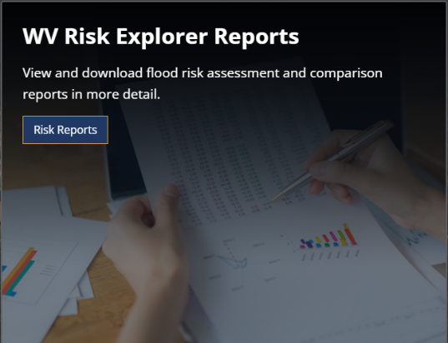
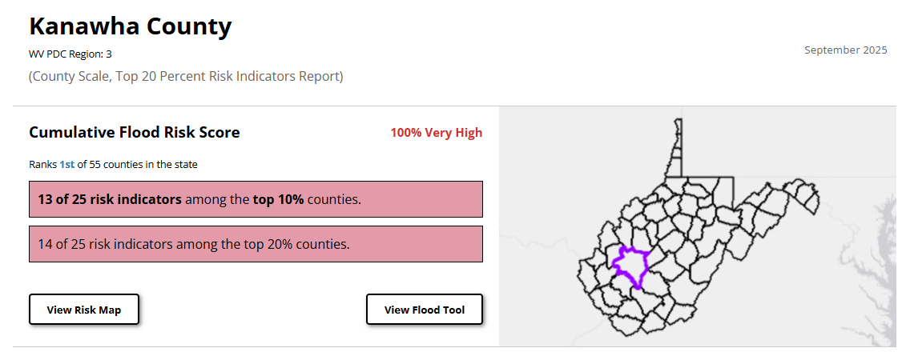
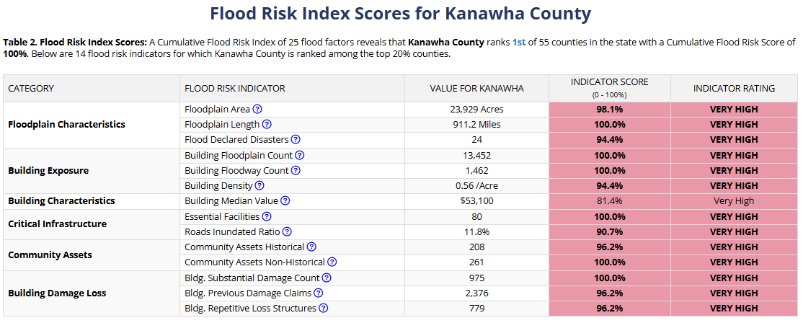
Kanawha County Risk Report
1
2
1
4
1
1
4
1
6
3
1
1
3
3
Notes:
Click on the images to open the links
Link 1: https://www.wvfrf.org/wvre/report/?entityid=68&scaleid=1&type=all
Link 2: https://wvfrf.org/wvre/report/?scaleid=3&entityid=20&type=all
Link3: https://wvfrf.org/wvre/report/?scaleid=3&entityid=all&type=comparison&highlight=20#Table1_20

Slide 15

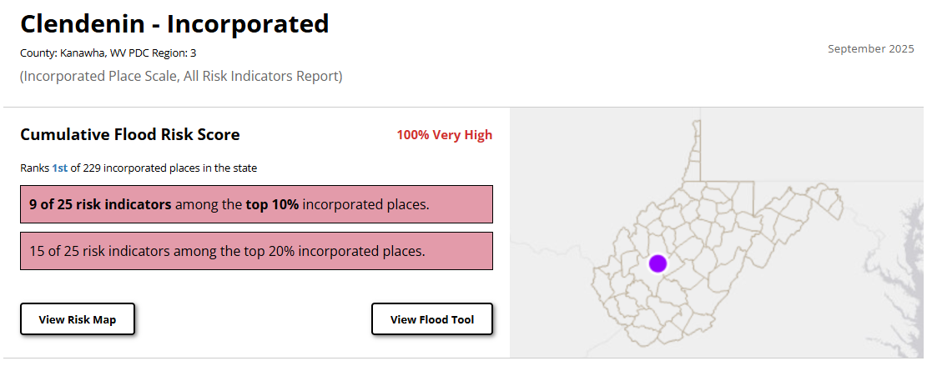
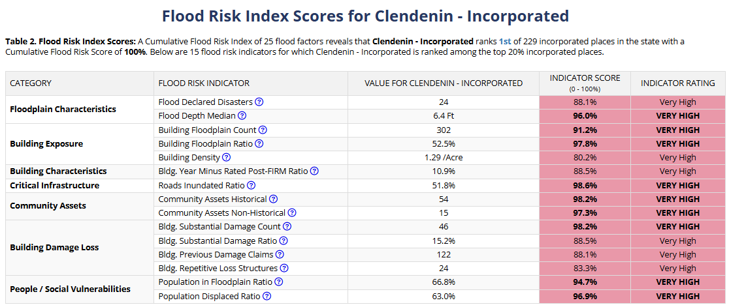
Clendenin Risk Report
1
4
5
6
5
8
Notes:
Click on the images to open the links
Link 1: https://www.wvfrf.org/wvre/report/?entityid=68&scaleid=1&type=all
Link 2: https://www.wvfrf.org/wvre/report/?scaleid=5&entityid=173&type=all
Link3:

Slide 16
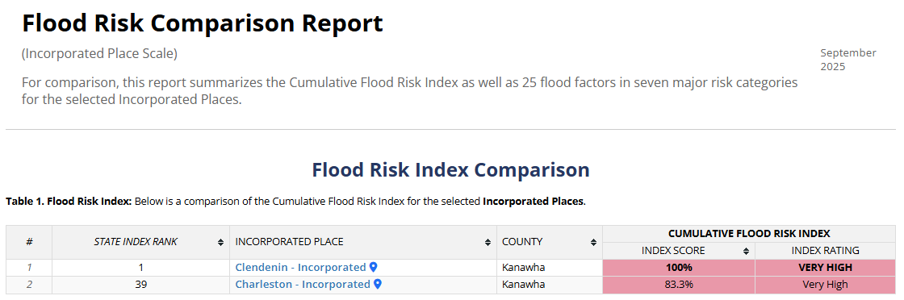
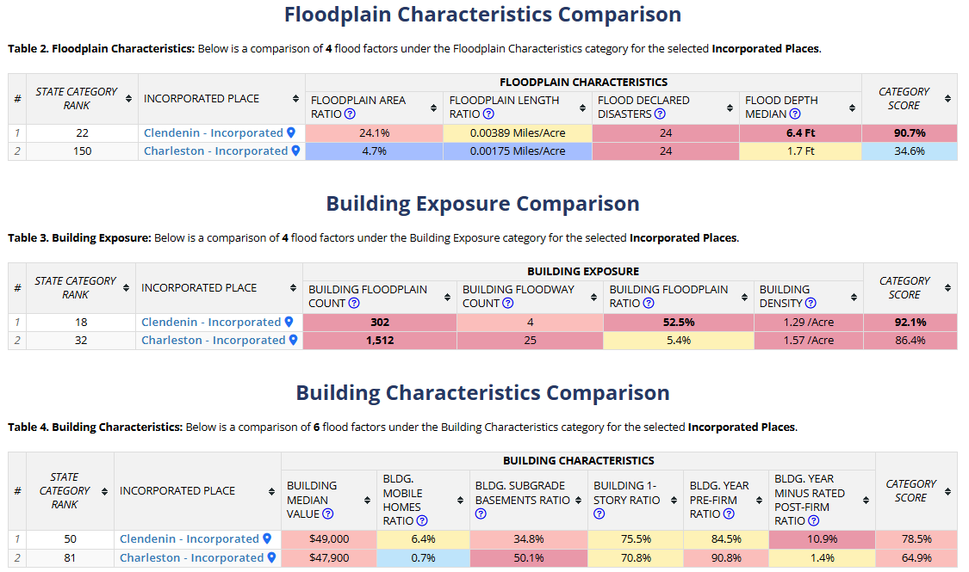
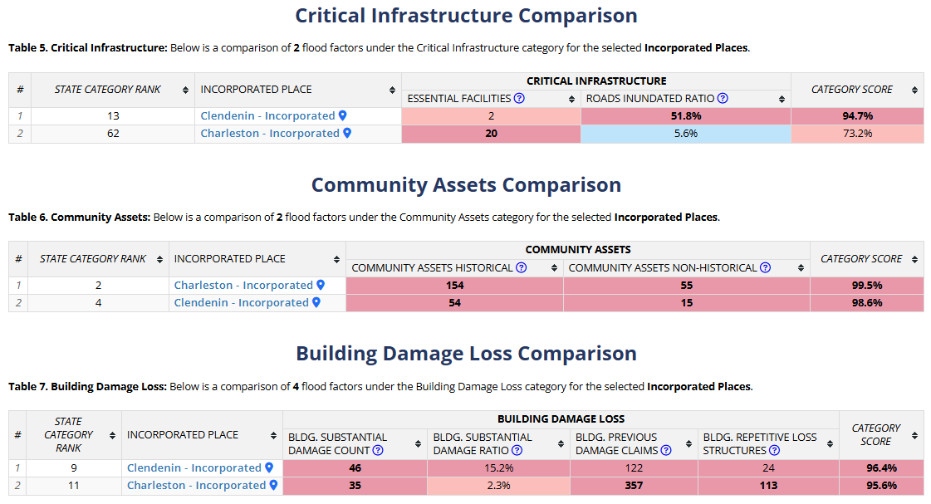
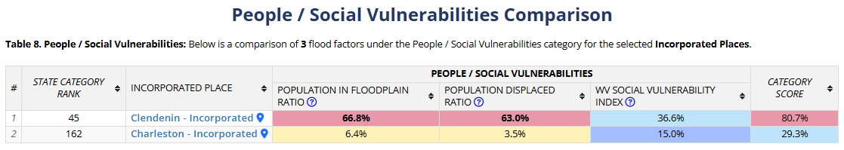
Clendenin – Charleston Risk Comparison
Notes:
Click on the images to open the links
Link 1: https://www.wvfrf.org/wvre/report/?entityid=68&scaleid=1&type=all
Link 2: https://www.wvfrf.org/wvre/report/?scaleid=5&entityid=167,173&type=comparison
Link3:

Slide 17
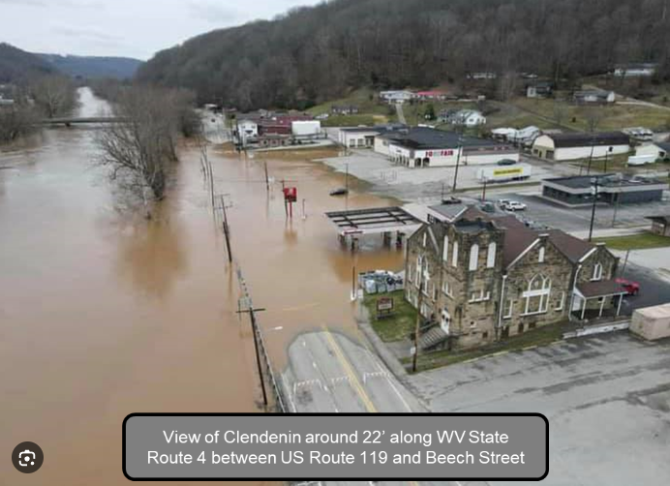
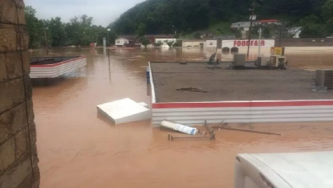
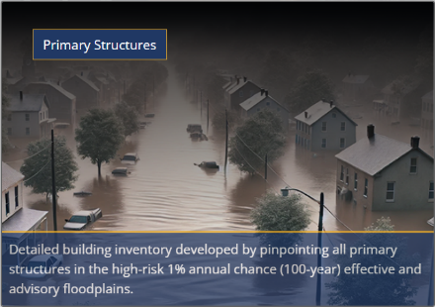



Building-Level Risk Reports, Clendenin
Clendenin, June 2016
Clendenin, June 2016
Notes:
Click on the images to open the links
Link 1 (Primary): https://www.wvfrf.org/wvre/blra/?sortfield=Depth_Grid&sorttype=desc&hiddenFields=default
Link 2 (Primary, Clendenin): https://www.wvfrf.org/wvre/blra/?sortfield=Depth_Grid&sorttype=desc&statement=COMMUNITY%2520%253D%2520Clendenin%2520-%2520Incorporated&from=1&perPage=25&hiddenFields=default
Link3: (Significant): https://www.wvfrf.org/wvre/blra/?type=sigstruct&sortfield=Depth_Grid&sorttype=desc&hiddenFields=default
Link4: Sig. Clendenin): https://www.wvfrf.org/wvre/blra/?type=sigstruct&sortfield=Depth_Grid&sorttype=desc&statement=COMMUNITY%2520%253D%2520Clendenin%2520-%2520Incorporated&from=1&perPage=25&hiddenFields=default

Slide 18
Flood Visualizations

Slide 19




Visualization Tools Examples
Viewshed for Clendenin
Building Profile in Clendenin
3D Movie for Clendenin
Building Profile in Charleston
Notes:
Click on the images to open the links
Link 1 (Viewshed for Clendenin): https://data.wvgis.wvu.edu/pub/RA/HL/RA-L/VIEWSHED/Clendenin/Viewshed_Clendenin_2024.pdf
Link 2: (Building Profile in Clendenin) : https://data.wvgis.wvu.edu/pub/RA/HL/RA-L/BLDG-PROFILE/BLDG-PROFILE_Clendenin_2025.pdf
Link 3: (3D Movie for Clendenin): https://data.wvgis.wvu.edu/pub/RA/HL/RA-L/MOVIE/3Dmovie_Clendenin_2024.mp4
Link 4: (Building Profile in Charleston): https://data.wvgis.wvu.edu/pub/RA/HL/RA-L/BLDG-PROFILE/BLDG-PROFILE_Charleston_Saint-Francis-Hospital_2025.pdf

Slide 20
Flood Mitigation

Slide 21






Mitigation Measures, Kanawha County & Clendenin
Kanawha County
Clendenin
Notes:
Click on the images to open the links
Link 1 (Mit. Str.): https://wvfrf.org/wvre/dashboard/?link=https://wvu.maps.arcgis.com/apps/dashboards/0a2182528f4e49ca827da8b9dcb65897
Link 2 (OSP Mit.): https://www.wvfrf.org/wvre/dashboard/?link=https://wvu.maps.arcgis.com/apps/dashboards/83e1bdae8f7d4780940d3d6bccd92719

Slide 22

Future Enhancements
Hazard Library Finalization (coming soon)
Expanded catalog of hazard layers and supporting data
Planned Updates
Regular feature data updates, additions, and indicator refinements
User Feedback Loop
Reporting and feedback for tool improvements
Mobile-Friendly Access
Responsive design for field use
Expanded Hazard Coverage
Landslide, Dam Failure, and Karst
Future Maintenance
Ongoing functioning and system performance improvements
Training & Support
User training sessions, documentation, and guidance
?

Slide 23











Links to Tools / Data
→ WV Flood Tool: https://www.mapwv.gov/flood/
→ West Virginia Flood Resiliency Framework (WVFRF): https://wvfrf.org/
→ West Virginia Risk Explorer (WVRE) (Landing Page): https://www.wvfrf.org/wvre/
→ WV Risk Explorer Maps: https://wvfrf.org/wvre/map/?scaleid=3&gslid=&index=CUM_INDEX&type=pct
→ WV Risk Explorer Reports: https://wvfrf.org/wvre/report/?entityid=68&scaleid=1&type=all
→ WV Flood Dashboards: https://wvfrf.org/wvre/dashboard/home/
→ WV Building-Level (BL) Risk: https://wvfrf.org/wvre/buildings/
→ WV Flood Visualizations: https://wvfrf.org/wvre/visualization/home/
→ Access Data: https://wvfrf.org/wvre/data/home/
WV Hazard Library: https://wvfrf.org/library/
→ Landslide Tools: https://wvfrf.org/wvre/landslides/

Slide 24


Thank you!
Questions?
Email:
kurt.donaldson@mail.wvu.edu
behrang.bidadian@mail.wvu.edu

Slide 25
Backup Slides

Slide 26



Benefits of the Tools
Planning
Enhancing state resiliency and hazard mitigation plans
Updating emergency operation plans
Prioritizing and allocating resources
Identifying the need for more refined risk assessments
Risk Communications
Encouraging community-level risk communication and engagement
Educating new homeowners and renters
Informing the insurance and mortgage industries
Mitigation
Identifying areas of mitigation interest
Supporting the development or enhancement of codes and standards
Informing long-term community recovery
COMMUNITY
ENGAGEMENT
• Focused Outreach Meetings
• Flood Symposium
• Resiliency Tools & Products
• Learning Resources & Reports
RISK TOOLS
• WV Risk Explorer
• WV Flood Tool
• Visualizations
• Dashboards
9 Geographic Scales
HAZARD LIBRARY
Search online hazard resources by title, subject, media, event, geography, data, etc.
STAKEHOLDERS
• Risk Reduction Associates
• Emergency Responders
• Floodplain Managers
• Local Officials
• Volunteers
• Public

Slide 27
Unique Features of WV Risk Explorer Tools
Risk indicators Rankings to Identify Communities at Higher Risk in Risk Maps & Reports
Interactively view and explore flood risk indicators on a map to identify areas of higher risk.
Interactive Downloadable Risk Reports by Multi-Scale Aggregation of Detailed Building-Level Inventory
View and download flood risk assessment and comparison reports in more detail.
Sharable Queries for Risk Reports, Maps, and Tables
Share your geographic selections along with data field queries for consistent use across teams.
Rationale and Recommendations for Risk Indicators
Use the Technical Documentation to understand the rationale for the risk indicators and the recommendations associated with them.
Statewide Consistent Methodology and Risk Indicators
In-depth flood risk indicators covering all of West Virginia uniformly, not just selected regions.
Flood Dashboards
Use the interactive dashboards to analyze risk factors and mitigation measures.
Flood Visualizations
Visualize 3D and 2D flood models at the community and building level scales.
Hazard Library Customized to West Virginia
Search the document and visual media library for hazard information.
Data Access
Download risk data for use in your own analyses, maps, or applications.
Scalable
Scalable for other hazards such as landslides or enhancements to risk indicators.
COMMUNITY
ENGAGEMENT
• Focused Outreach Meetings
• Flood Symposium
• Resiliency Tools & Products
• Learning Resources & Reports
RISK TOOLS
• WV Risk Explorer
• WV Flood Tool
• Visualizations
• Dashboards
9 Geographic Scales
HAZARD LIBRARY
Search online hazard resources by title, subject, media, event, geography, data, etc.
STAKEHOLDERS
• Risk Reduction Associates
• Emergency Responders
• Floodplain Managers
• Local Officials
• Volunteers
• Public

Slide 28








User Guides
WVRE One-Pager
WVRE Learn More Page
WVRE Technical Document
https://wvfrf.org/wvre/more/
Metadata Documents
https://data.wvgis.wvu.edu/pub/RA/HL/WVFRF/Flyer/WVRE_Info_OnePager.pdf
https://data.wvgis.wvu.edu/pub/RA/HL/Data/RA-AL/1a_AL-RISK-INDEX/2_Metadata/WV_RiskIndex_DataDictionary.pdf
https://data.wvgis.wvu.edu/pub/RA/HL/Data/RA-AL/1b_AL-MATRIX/2_Metadata/Full_Matrix_DataDictionary.pdf
WVRE Demo (Video)
https://data.wvgis.wvu.edu/pub/RA/HL/Data/RA-BL/2a_BL-BLRA/3_Metadata/Full_BLRA_Metadata.pdf
https://data.wvgis.wvu.edu/pub/RA/RI/WVRE/DOCS/WVRE_TechnicalDoc.pdf
https://data.wvgis.wvu.edu/pub/RA/HL/WVFRF/Video/WV_Risk_Explorer_Movie_20240826.mp4
https://data.wvgis.wvu.edu/pub/RA/HL/Data/RA-BL/2b_BL-SIG-STRC/1_All_Sig_Structures/2_Metadata/Significant_Structures_Metadata.pdf
Notes:
Click on the images to open the links

