Slide 1




West Virginia Flood Resiliency Framework
(WVFRF)
June 4, 2025

Slide 2

About me
Behrang Bidadian
Working at the WV GIS Tech Center since 2019
Resilient Development
Disaster Risk Assessment/Management
Certified Floodplain Manager (C.F.M.)
GIS & Spatial Analysis (Cert.)
Architectural Engineering (M.Arch.)
Geology (M.S.)
Human & Community Development (Ph.D.)

Slide 3
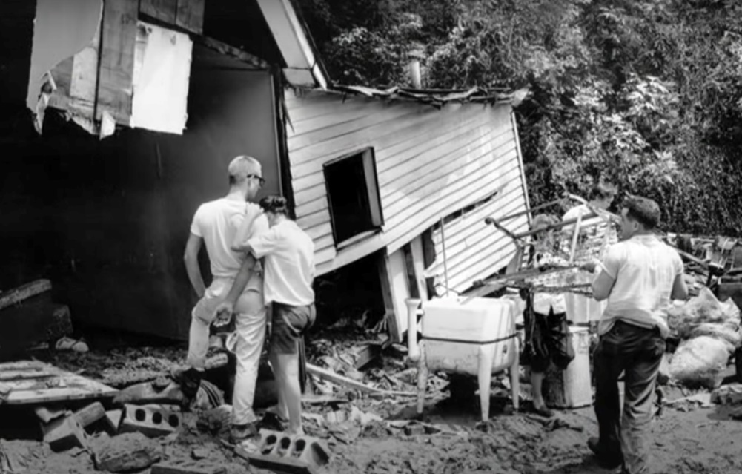
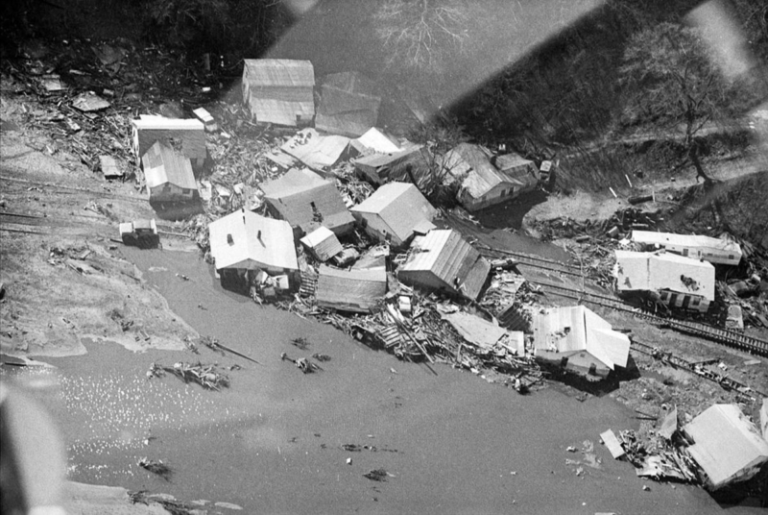
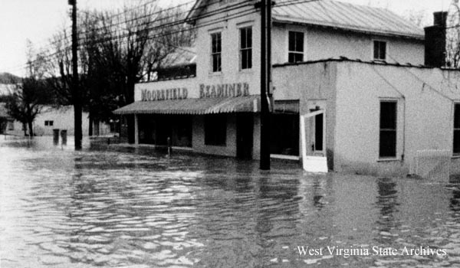
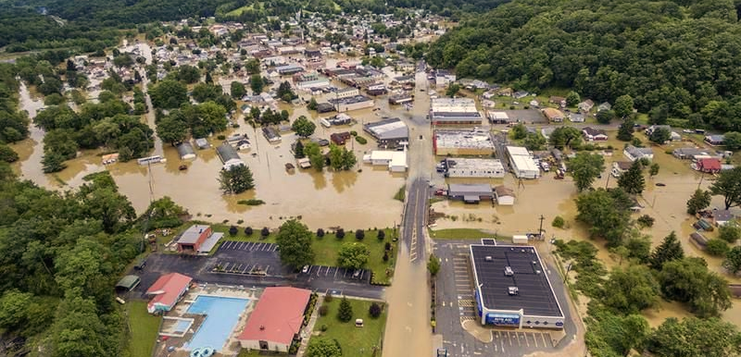
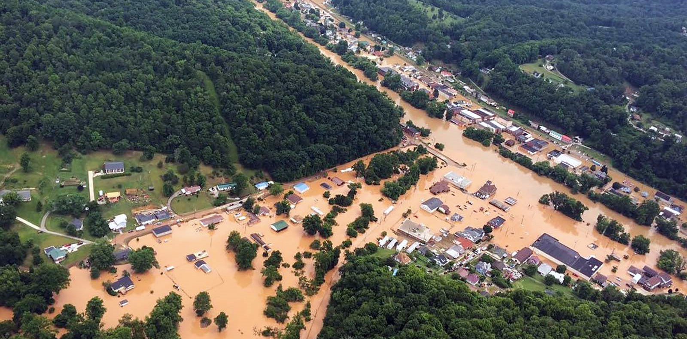
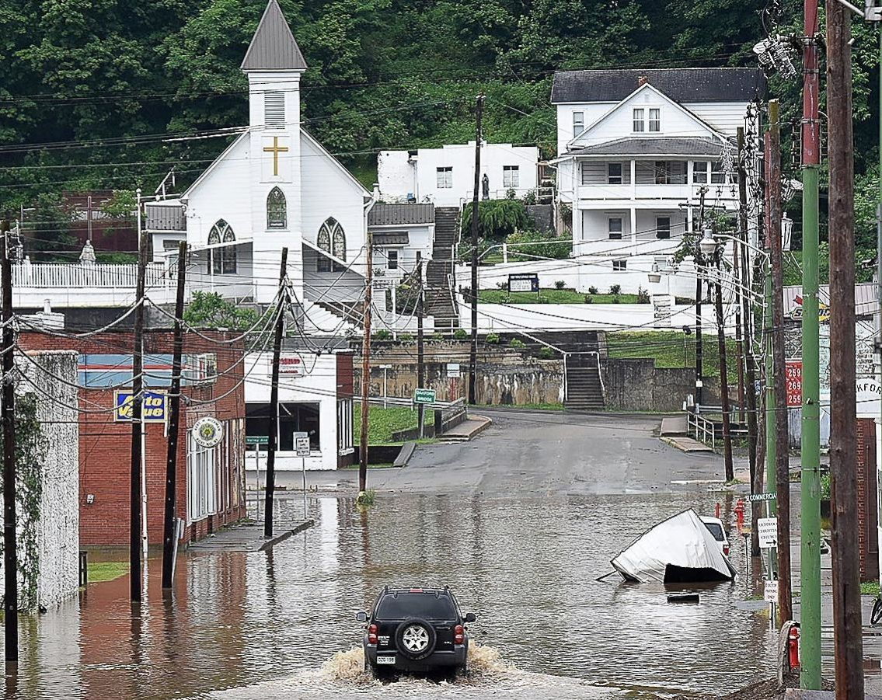
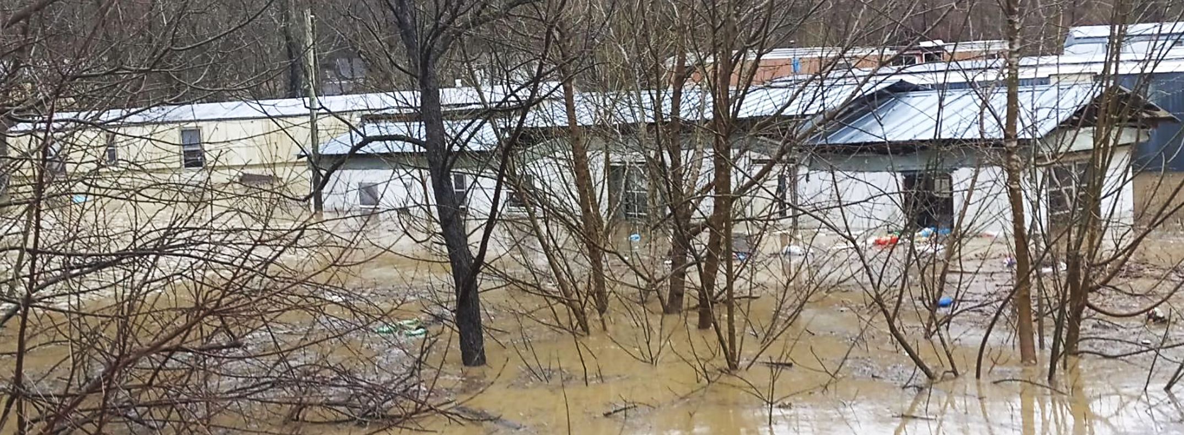
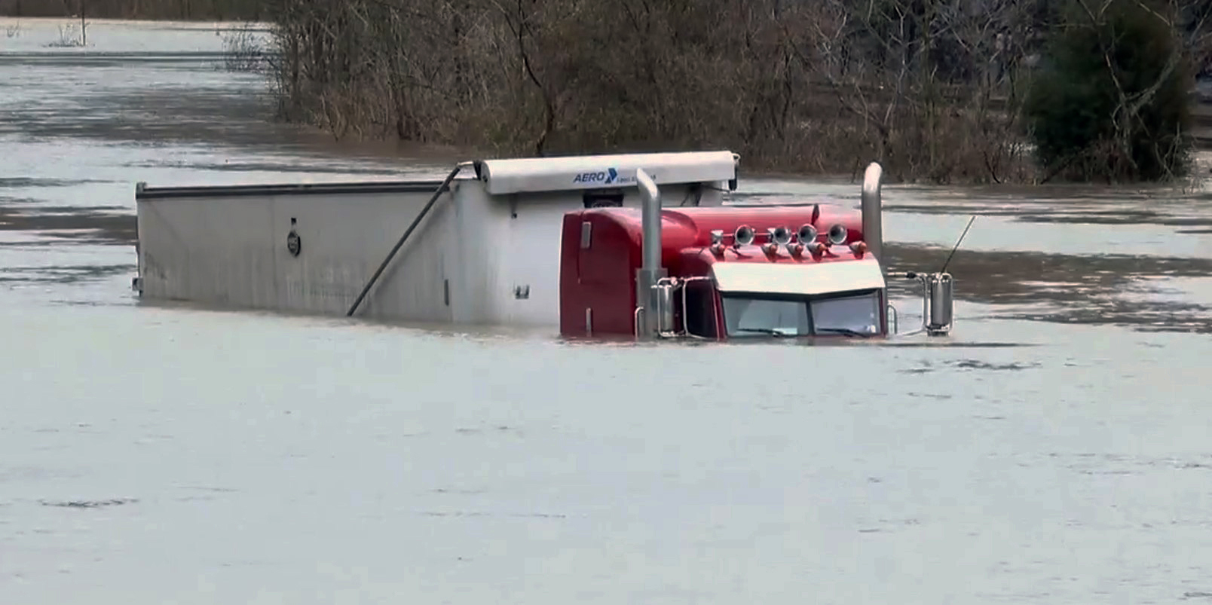
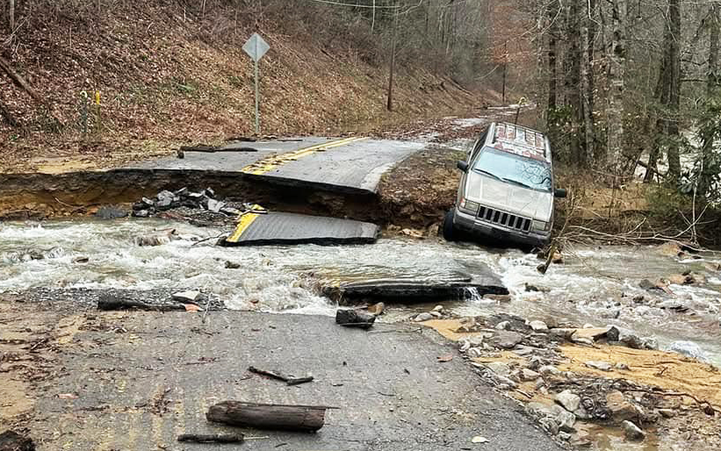
Flood Risk in WV
64 Federally-Declared Flood Disasters since 1953
220 Loss of Lives
About 98,000 Buildings (9%)
in 1%-annual-chance (100-yr) Floodplain
About 199,000 Persons (11%)
Reside in 100-yr Floodplain
Kanawha County
Buffalo Creek
Moorefield, Hardy County
July 1961
(22 + 2 landslide fatalities)
February 1972
(123 fatalities including 4 missing)
November 1985
(49 fatalities)
Clendenin, Kanawha County
Richwood, Nicholas County
June 2016
(23 fatalities)
Rainelle, Greenbrier County
February 2025
(3 fatalities)
Mingo County
Williamson, Mingo County
McDowell County
Notes:
Awareness rises after a disaster but fades away later: Need to assess and communicate the risk
Preparation on sunny days
Federally-Declared Flood Disasters: Incident subcategories of “flood,” “severe storms,” or “hurricanes”
Total Structures: 1,118,761 Total Population: 1,801,049

Slide 4
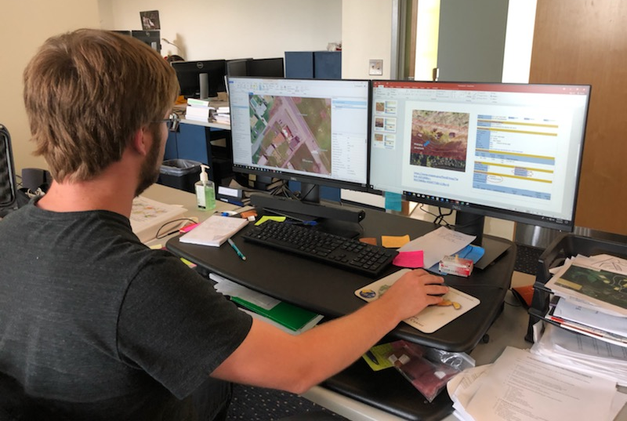

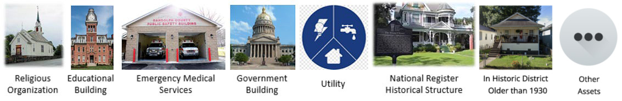
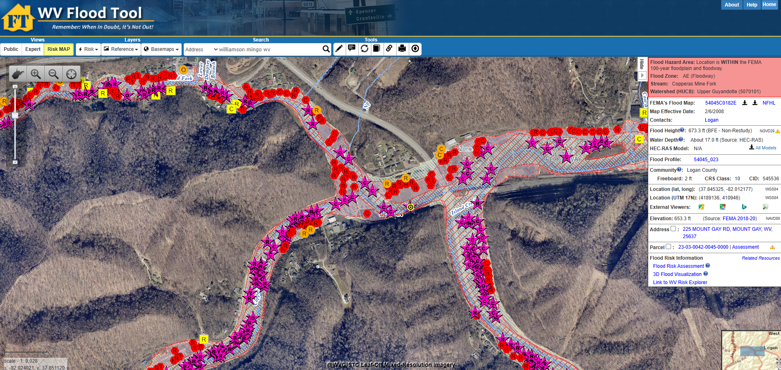

WV Floodplain Building Inventory (BI)
Flood Exposure Assessment (Building-Level)
Funded by: FEMA Hazard Mitigation Grant Program (HMGP) and State Hazard Mitigation Office
Detailed building characteristics from tax assessment
+
Population exposure and displacement estimates (100-yr flood)
Manual process of identification using Arc GIS
+
Programmed scripts to extract and process data
Product: WV Flood Tool mapwv.gov/flood
All primary (insurable) structures in the 1%-annual-chance (100-yr) floodplain
Community Assets (Historical & Non-Historical) in the 100-yr floodplain
Essential Facilities in the 100-yr and 500-yr floodplains
COMMUNITY
ENGAGEMENT
• Focused Outreach Meetings
• Flood Symposium
• Resiliency Tools & Products
• Learning Resources & Reports
RISK TOOLS
• WV Risk Explorer
• WV Flood Tool
• Visualizations
• Dashboards
9 Geographic Scales
Essential
Facilities
Community
Assets
HAZARD LIBRARY
Search online hazard resources by title, subject, media, event, geography, data, etc.
STAKEHOLDERS
• Risk Reduction Associates
• Emergency Responders
• Floodplain Managers
• Local Officials
• Volunteers
• Public
Notes:
Link 1 (FT): https://www.mapwv.gov/flood/
Link 2: https://www.mapwv.gov/flood/map/?wkid=102100&x=-9129668&y=4557559&l=9&v=2

Slide 5
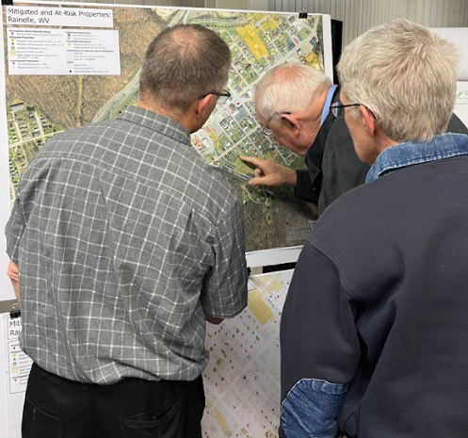
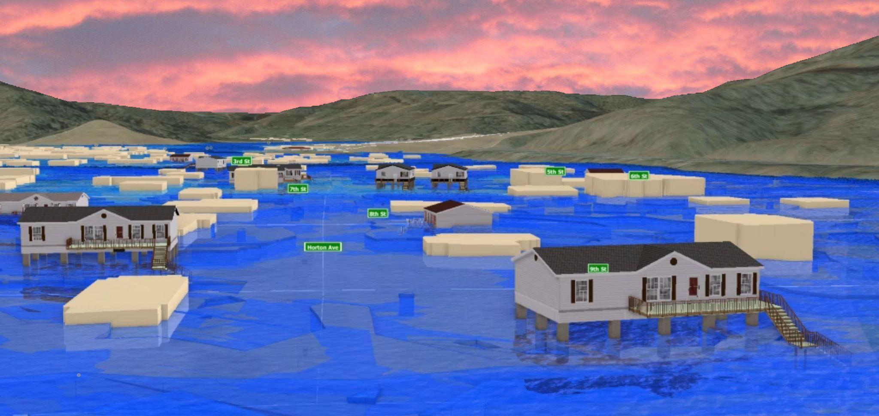
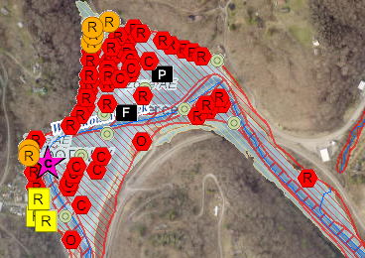
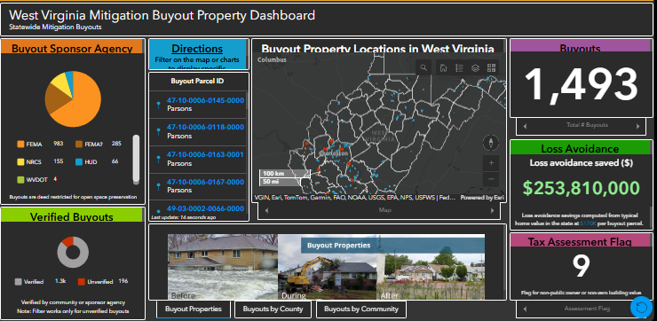
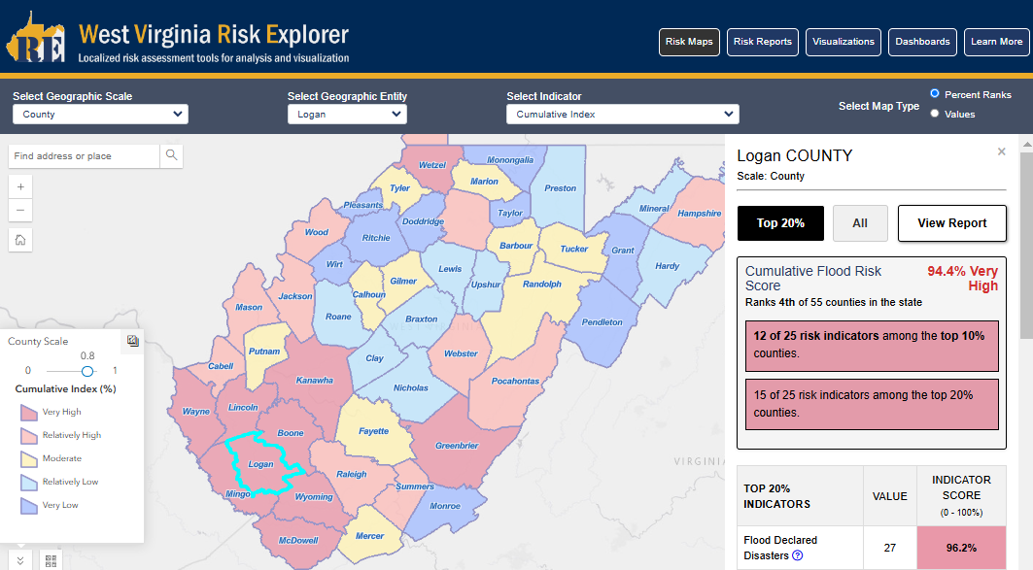
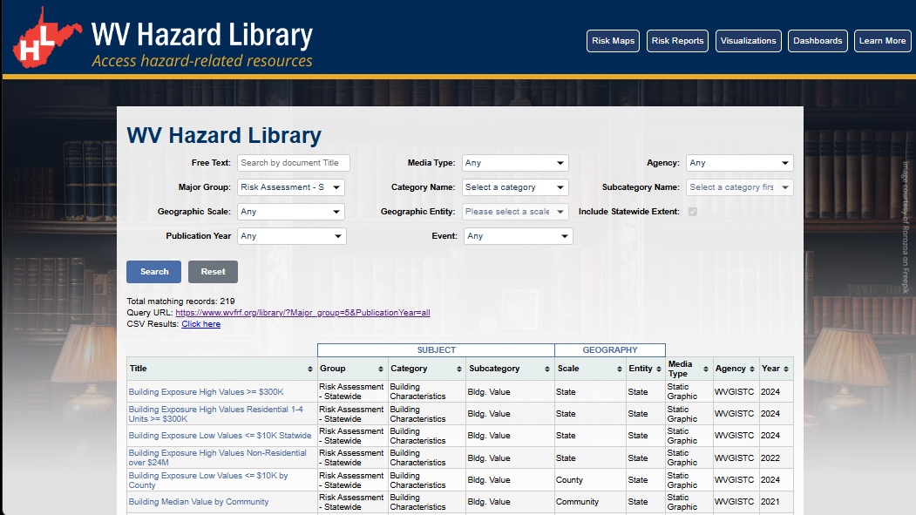
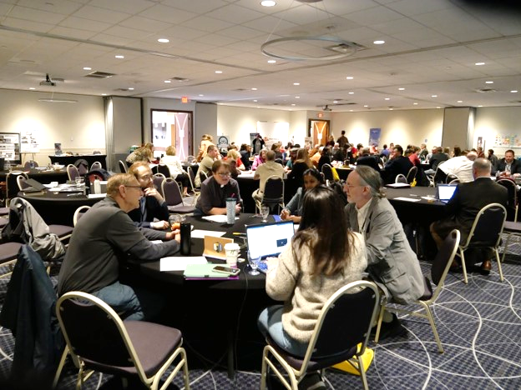
WV Flood Resiliency Framework (WVFRF)
A virtual hub of risk assessment, visualization, planning, and training resources for building community flood resiliency in WV
Flood Visualizations
WV Flood Tool
COMMUNITY
ENGAGEMENT
• Focused Outreach Meetings
• Flood Symposium
• Resiliency Tools & Products
• Learning Resources & Reports
RISK TOOLS
• WV Risk Explorer
• WV Flood Tool
• Visualizations
• Dashboards
9 Geographic Scales
Flood Dashboards
WV Risk Explorer
Community Engagement Meeting
Example Tools
HAZARD LIBRARY
Search online hazard resources by title, subject, media, event, geography, data, etc.
STAKEHOLDERS
• Risk Reduction Associates
• Emergency Responders
• Floodplain Managers
• Local Officials
• Volunteers
• Public
Hazard Library
Flood Symposium Stakeholders
Notes:
Collaboration of civic actors and academic researchers
The WV Flood Resiliency Framework employs risk assessment, visualization, and resource discovery tools to engage communities and stakeholders in building flood resiliency.

Slide 6
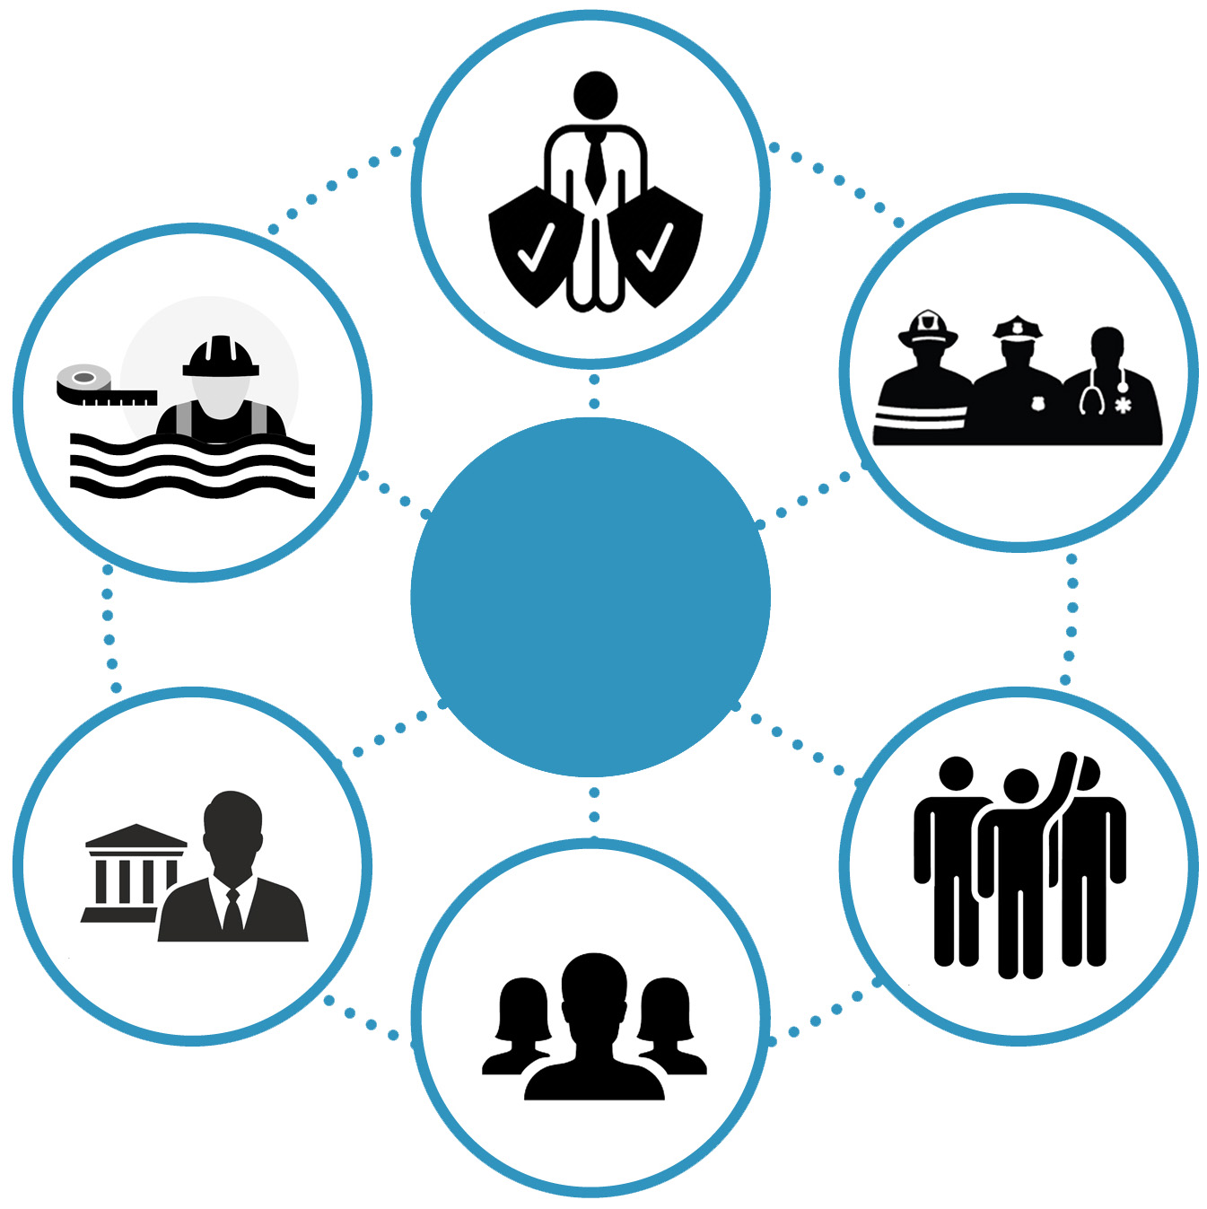
Stakeholders
Risk Reduction Associates
Floodplain Managers
Emergency Responders
Stakeholders
Local Officials
Volunteers
Public
Notes:
Six targeted stakeholder groups for WVFRF tools and hazard library resources.

Slide 7
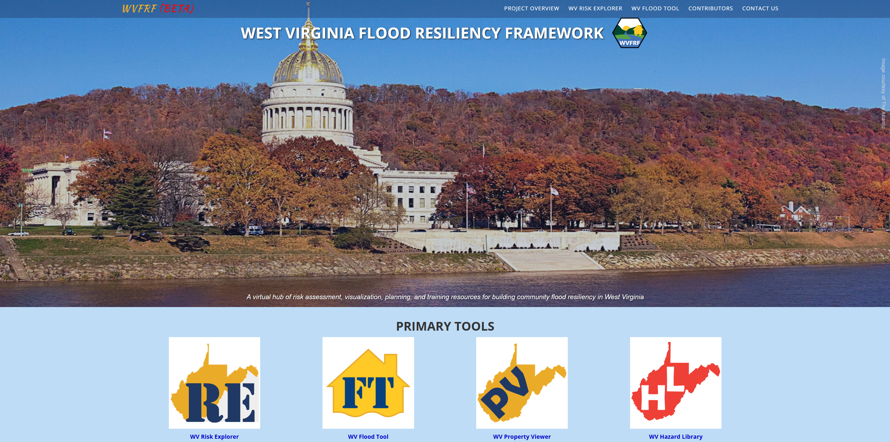
WVFRF Tools
COMMUNITY
ENGAGEMENT
• Focused Outreach Meetings
• Flood Symposium
• Resiliency Tools & Products
• Learning Resources & Reports
RISK TOOLS
• WV Risk Explorer
• WV Flood Tool
• Visualizations
• Dashboards
9 Geographic Scales
HAZARD LIBRARY
Search online hazard resources by title, subject, media, event, geography, data, etc.
STAKEHOLDERS
• Risk Reduction Associates
• Emergency Responders
• Floodplain Managers
• Local Officials
• Volunteers
• Public
Notes:
A virtual hub of risk assessment, visualization, planning, and training resources for building community flood resiliency in West Virginia
Integrated tools
Focusing on the WVRE
Link: https://wvfrf.org/

Slide 8

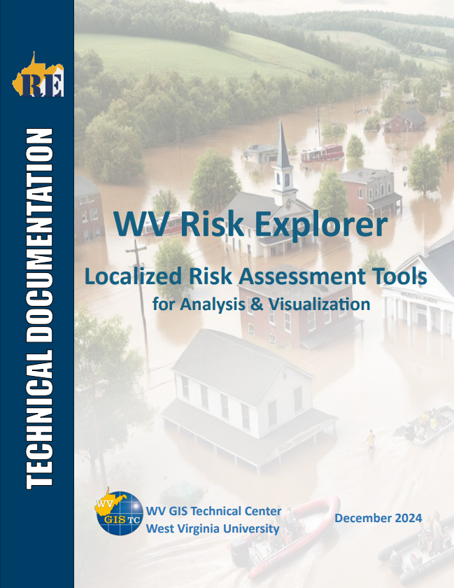

WV Flood Risk Index
Overall Flood Risk
(1) FLOODPLAIN CHARACTERISTICS
(2) BUILDING EXPOSURE
(3) BUILDING CHARACTERISTICS
(4) CRITICAL INFRASTRUCTURE
(5) COMMUNITY ASSETS
(6) BUILDING DAMAGE LOSS
(7) PEOPLE / SOCIAL VULNERABILITIES
(8) OTHER HAZARDS
Floodplain Area
Building Floodplain Count¹ ²
Building Value¹ ²
Essential Facilities
Historical Assets
Substantial Damage Estimates*¹ ²
Population in Floodplain
Landslides
Floodplain Length¹ ²
Building Floodway Count¹ ²
Mobile Homes
Roads Inundated
Non-Historical Assets
Previous Claims
Population Displaced
Karst**
Floodplain Depth¹ ²
Building Floodplain Ratio²
Basement
Repetitive Losses
WV Social Vulnerability Index
Dam/Levee Failure**
Flood Disaster Frequency
Building Density¹ ²
One Story
Building Year*
1
River/Stream Indicator
2
Watershed Indicator
* Multiple Indicators
** In Progress
Notes:
Categories 1 to 7 used to develop the risk index
Links to Technical Document or Learn More

Slide 9
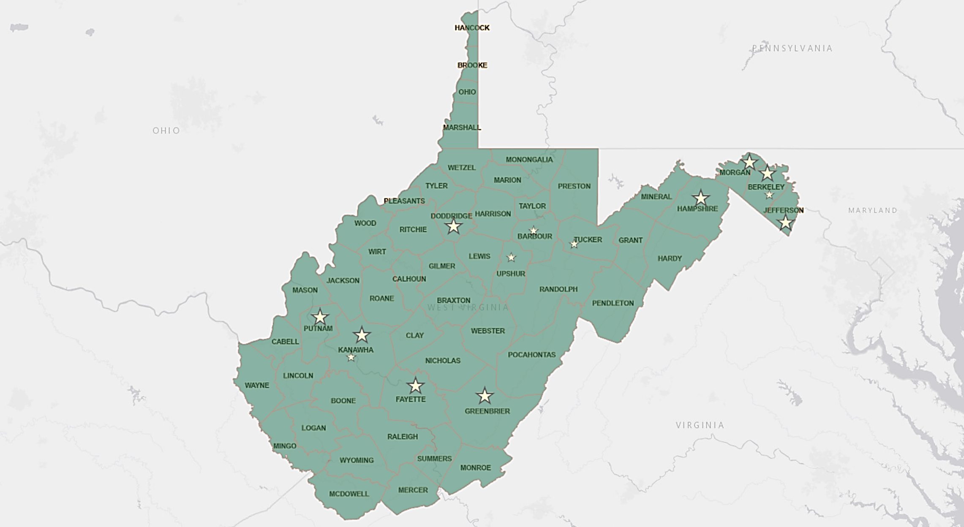
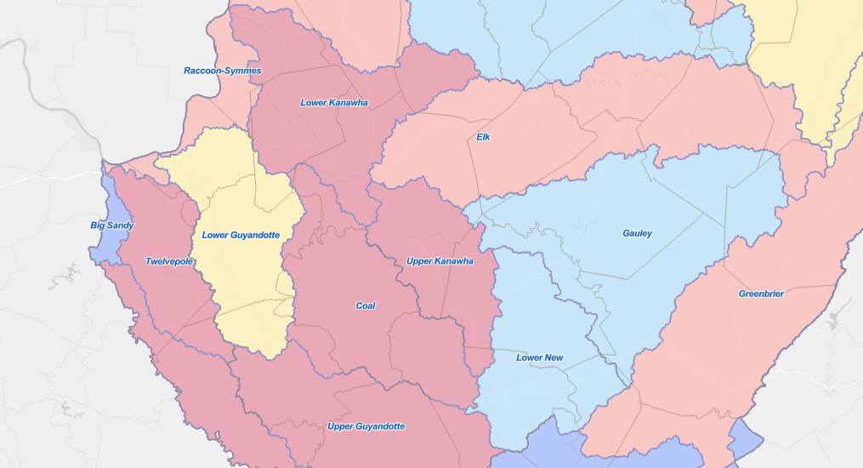
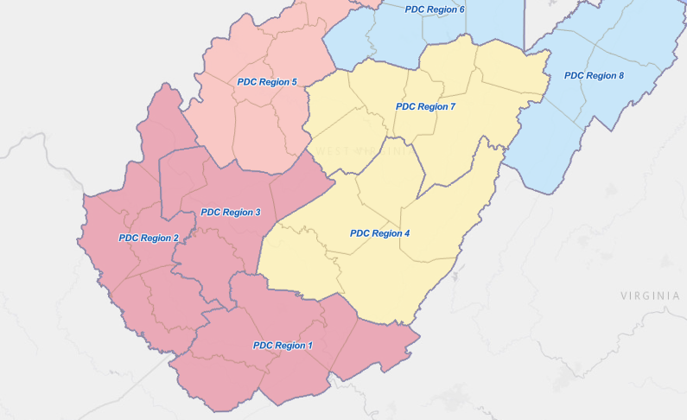
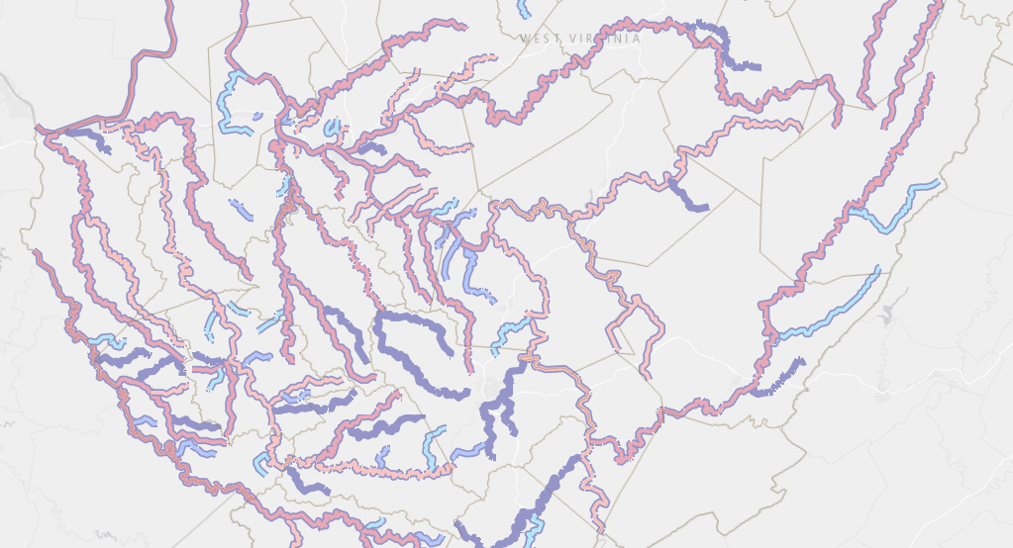
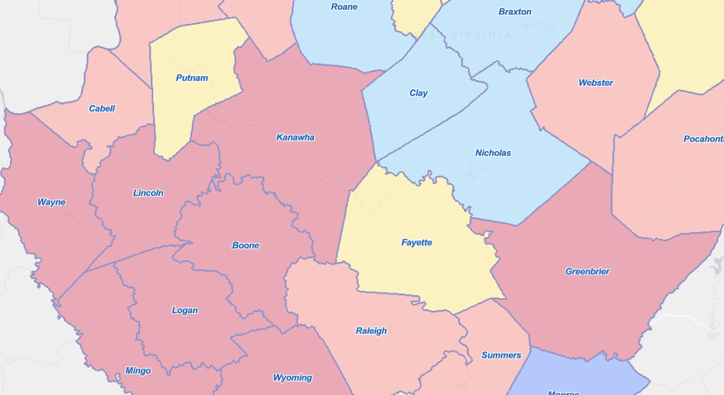
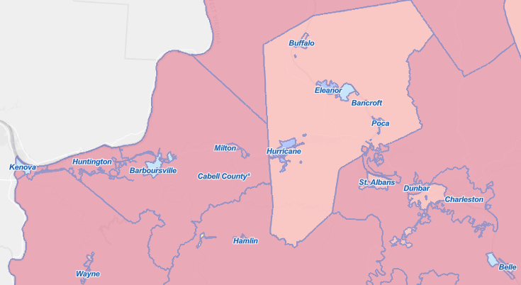
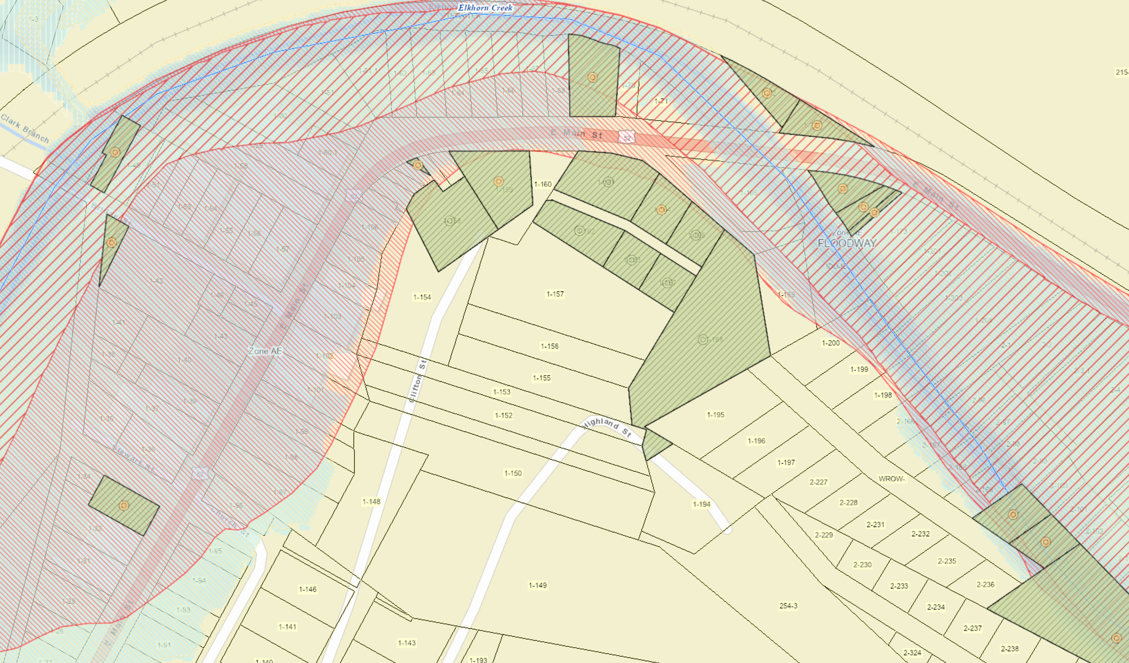
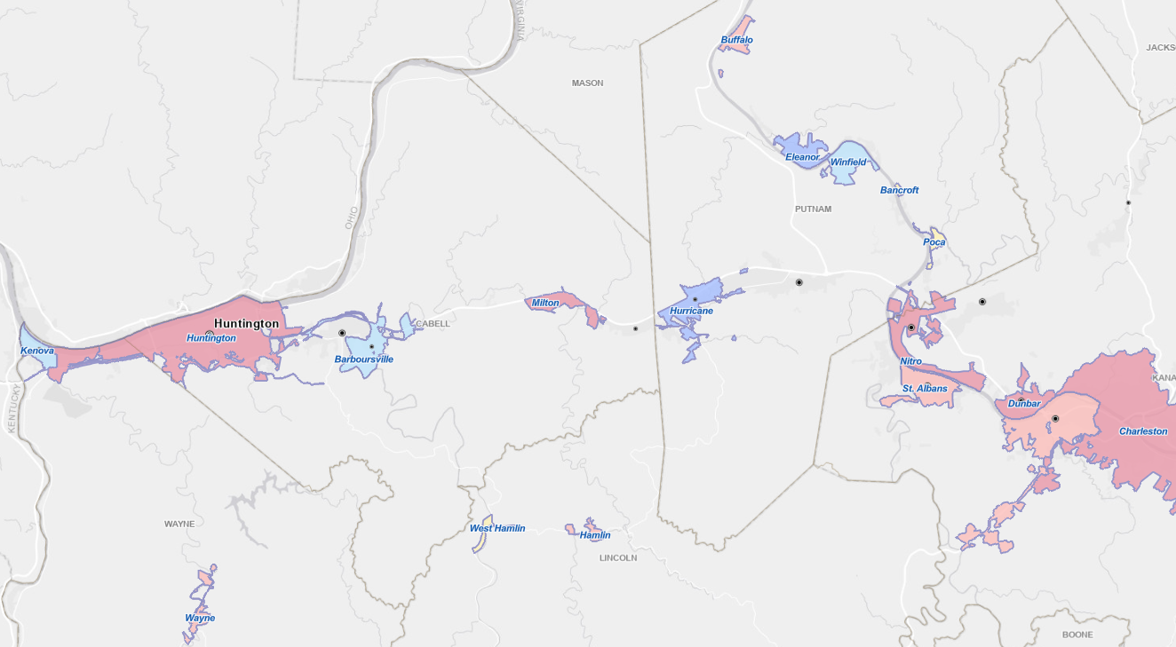
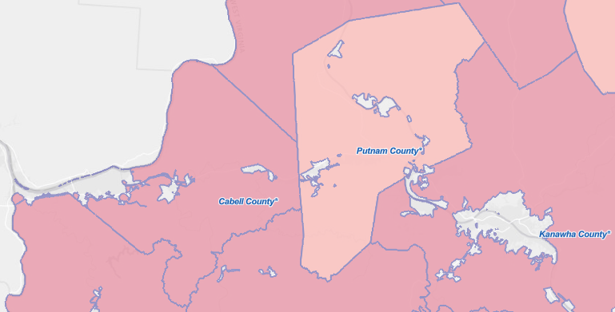
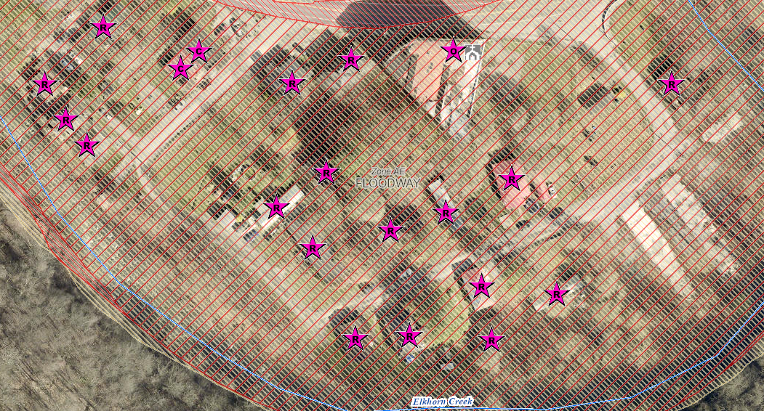
Analytical & Visualization Tools at Multiple Scales
Political Boundaries
Drainage Areas / Streams
State
Watersheds
(33)
PDC Regions (11)
Streams/Rivers
(156)
Counties (55)
Property Levels
Communities (284)
Parcels
Incorporated Places
(229)
Unincorporated Areas
(55)
Buildings
Notes:
The WV Flood Tool and WV Risk Explorer applications quantify riverine flood risk at the building and summary geographic levels, respectively. Cumulative risk rankings at different geographic scales and entities are computed from various risk indicators, including building, people, and social-economic factors.
Flood Tool: Building/Parcel-Level; New tools: Aggregation ability

Slide 10
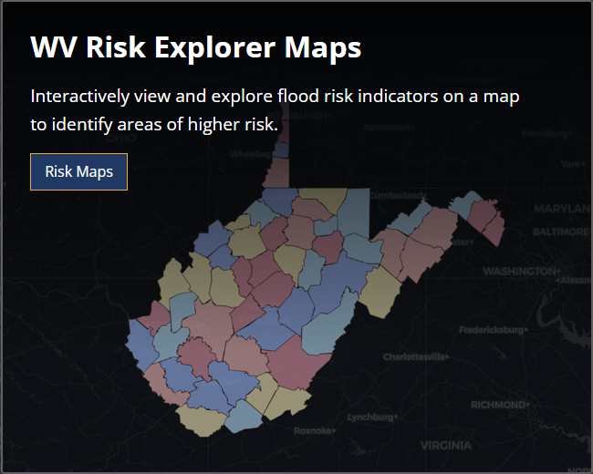
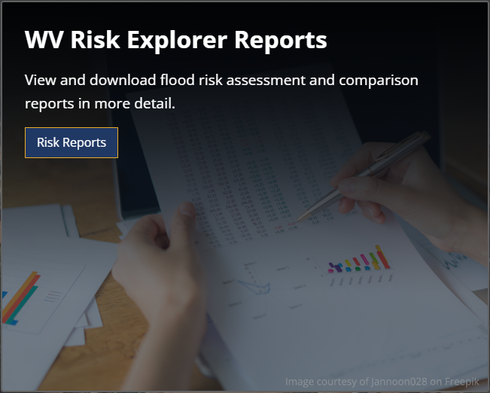
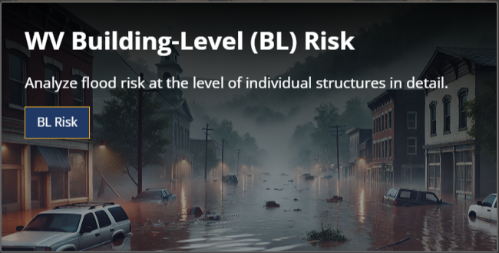
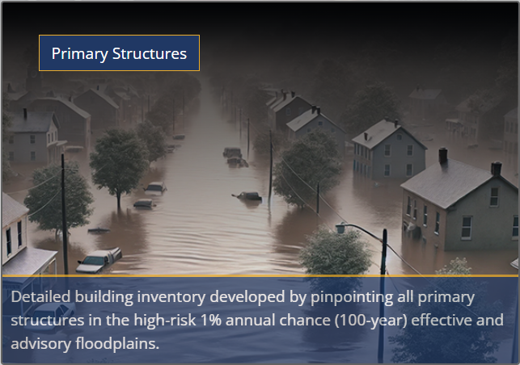
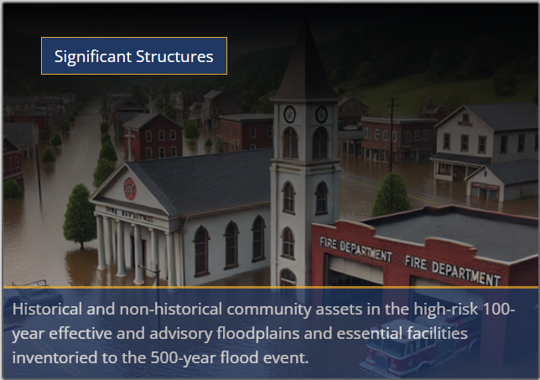
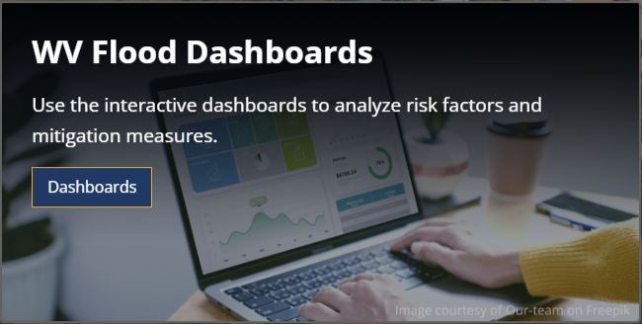
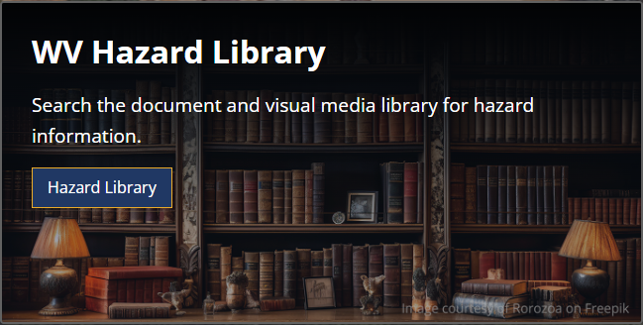
West Virginia Risk Explorer (WVRE)
Risk Assessment Tools: Localized risk assessment tools for analysis
WVRE Landing Page: wvfrf.org/wvre
Notes:
Link 1 (WVRE): https://www.wvfrf.org/wvre/
Link 2: Risk Maps: https://www.wvfrf.org/wvre/map/?scaleid=3&gslid=&index=CUM_INDEX&type=pct
Link 3: Risk Reports: https://www.wvfrf.org/wvre/report/?entityid=68&scaleid=1&type=all
Link 4: Risk Dashboards: https://www.wvfrf.org/wvre/dashboard/home/
Link 5: HL: https://www.wvfrf.org/library/
Link 6: BL: https://www.wvfrf.org/wvre/buildings/
Link 6a: Primary Strc: https://www.wvfrf.org/wvre/blra/?sortfield=Depth_Grid&sorttype=desc&hiddenFields=default
Link 6b: Sig. Stct: https://www.wvfrf.org/wvre/blra/?type=sigstruct&sortfield=Depth_Grid&sorttype=desc&hiddenFields=default

Slide 11
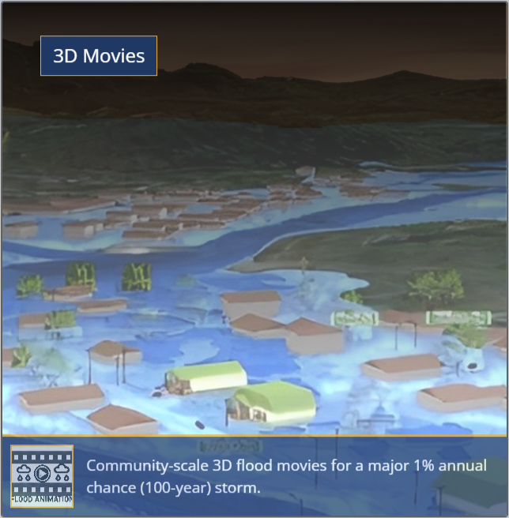
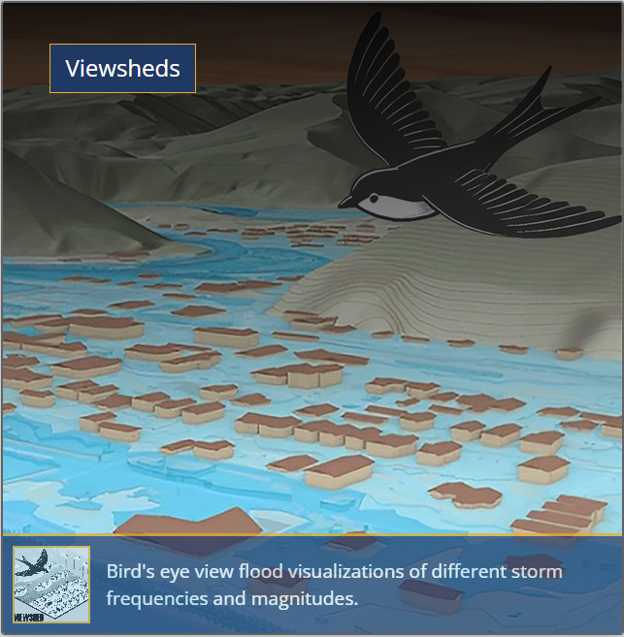
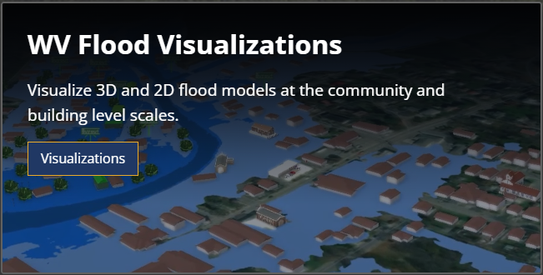
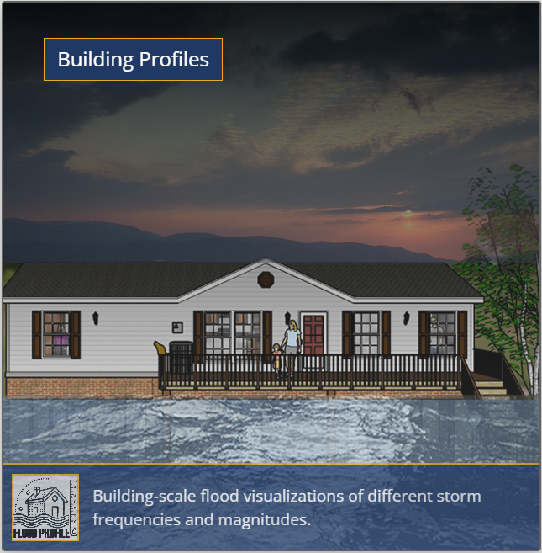
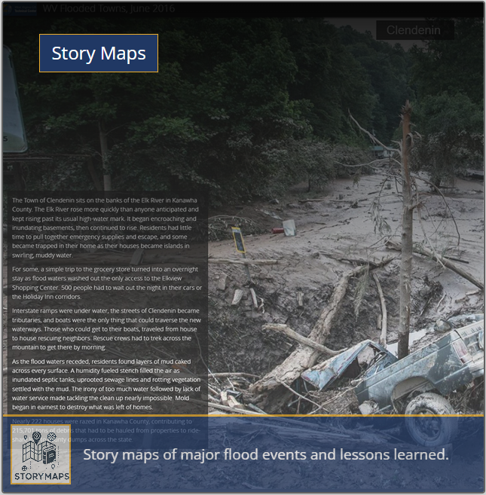
West Virginia Risk Explorer (WVRE)…
Risk Communication Tools:
Facilitating risk comprehension for different groups of stakeholders
Notes:
Link 1 (WVRE): https://www.wvfrf.org/wvre/
Link 2: Vis.: https://www.wvfrf.org/wvre/visualization/home/
Link 3: Movies: https://www.wvfrf.org/library/?TypeID=1&PublicationYear=all
Link 4: Viewsheds: https://www.wvfrf.org/library/?TypeID=14&PublicationYear=all
Link 5: B. Profiles: https://www.wvfrf.org/library/?TypeID=2&PublicationYear=all
Link 6: Story Maps: https://www.wvfrf.org/library/?TypeID=11&PublicationYear=all

Slide 12
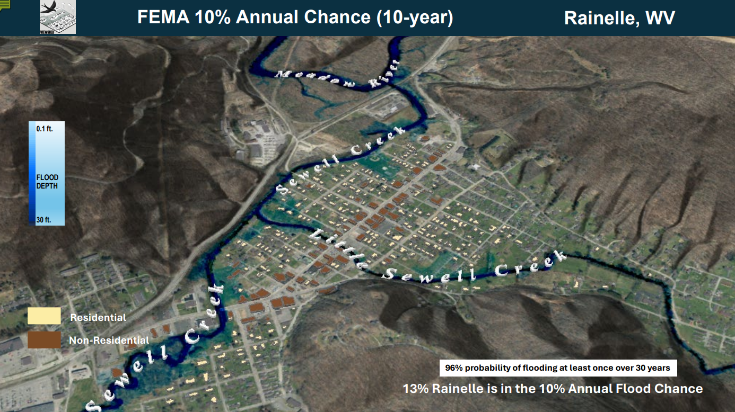
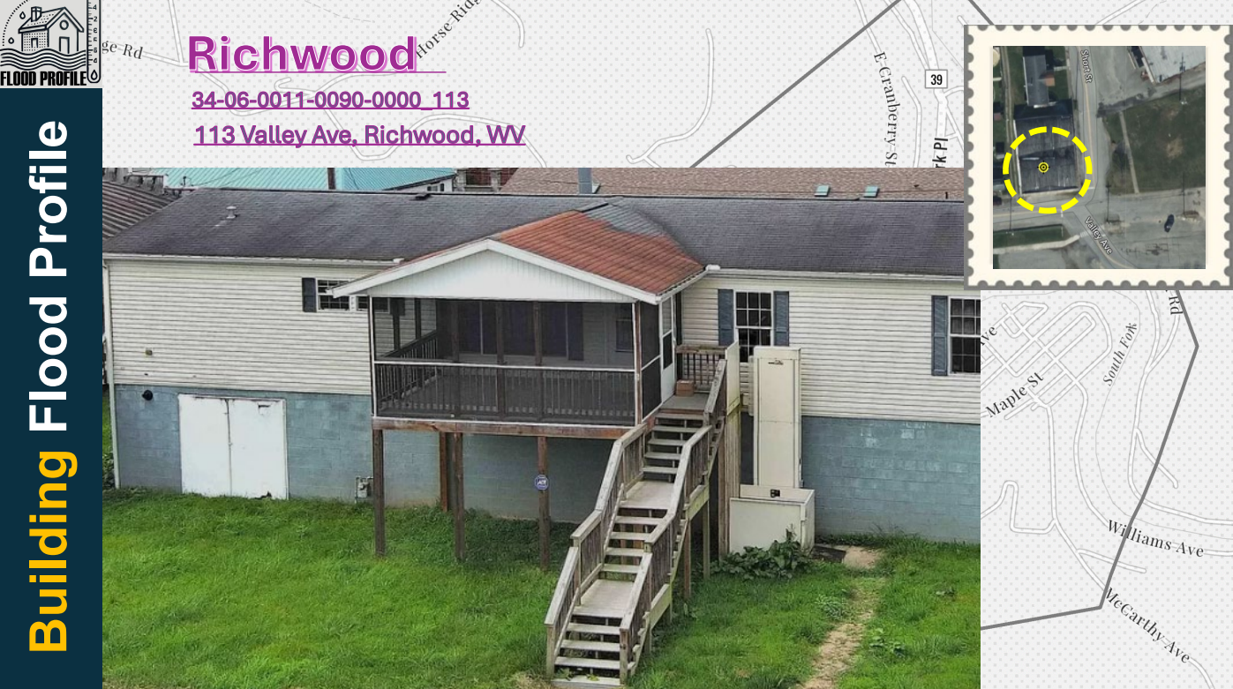
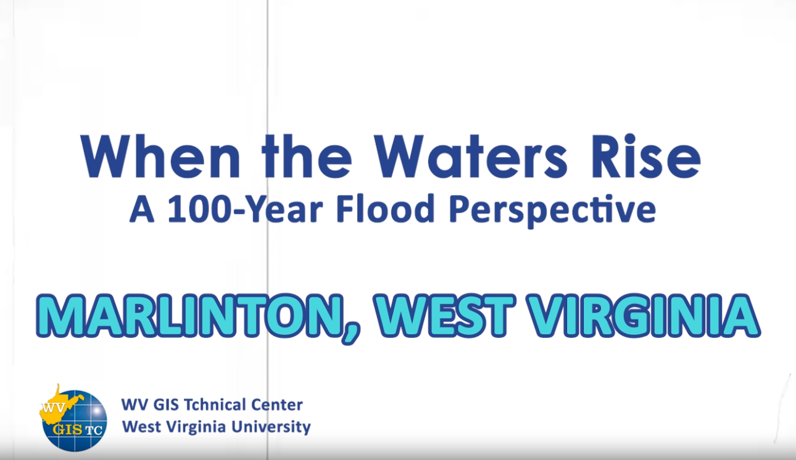
West Virginia Risk Explorer (WVRE)…
Visualization Examples:
Viewshed for Rainelle
Building Profile in Richwood
3D Movie for Marlinton
Notes:
Link 1 (Viewshed for Rainelle): https://data.wvgis.wvu.edu/pub/RA/HL/RA-L/VIEWSHED/Rainelle/VIEWSHED_Rainelle_2024.pdf
Link 2: (Building Profile in Richwood) : https://data.wvgis.wvu.edu/pub/RA/HL/RA-L/BLDG-PROFILE/BLDG-PROFILE_Richwood_2024.pdf
Link 3: (3D Movie for Marlinton): https://data.wvgis.wvu.edu/pub/RA/HL/RA-L/MOVIE/3DMovie_Marlinton_2024.mp4

Slide 13
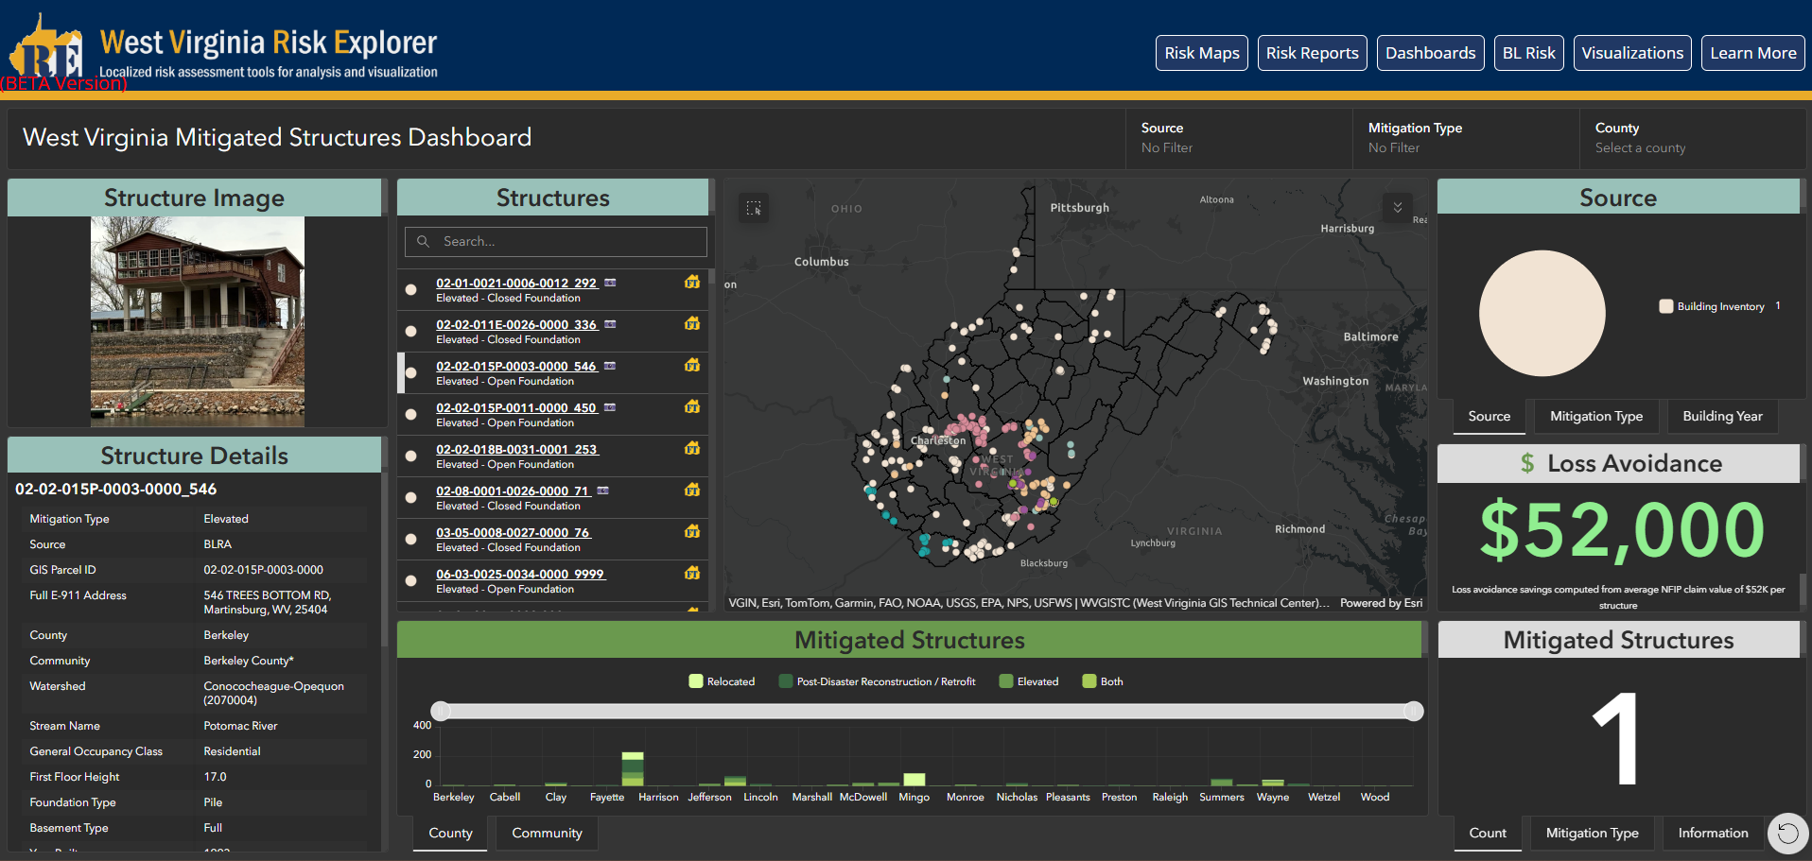
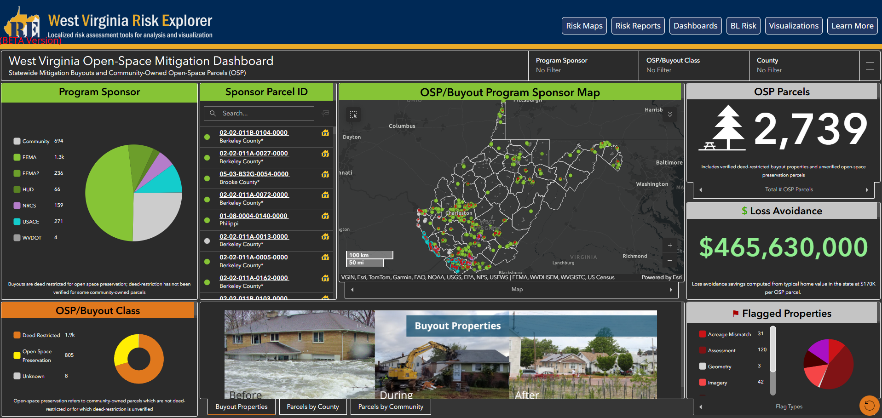
West Virginia Risk Explorer (WVRE)…
Mitigation Assessment Tools:
Mitigated Structures Dashboard
Open-Space Mitigation Dashboard
Notes:
Link 1 (WVRE): https://www.wvfrf.org/wvre/
Link 2: Dashboards: https://www.wvfrf.org/wvre/dashboard/home/
Link 3: Mitigated Strct: https://www.wvfrf.org/wvre/dashboard/?link=https://wvu.maps.arcgis.com/apps/dashboards/0a2182528f4e49ca827da8b9dcb65897
Link 4: Buyouts: https://www.wvfrf.org/wvre/dashboard/?link=https://wvu.maps.arcgis.com/apps/dashboards/83e1bdae8f7d4780940d3d6bccd92719

Slide 14

Future Direction
Finalizing the Hazard Library (soon)
Future Maintenance and data updates?
Training?
?

Slide 15
Thank you!
Questions?
Framework website: www.wvfrf.org
WV Risk Explorer web tools: www.wvfrf.org/wvre
Email:
behrang.bidadian@mail.wvu.edu
kurt.donaldson@mail.wvu.edu

