Slide 1
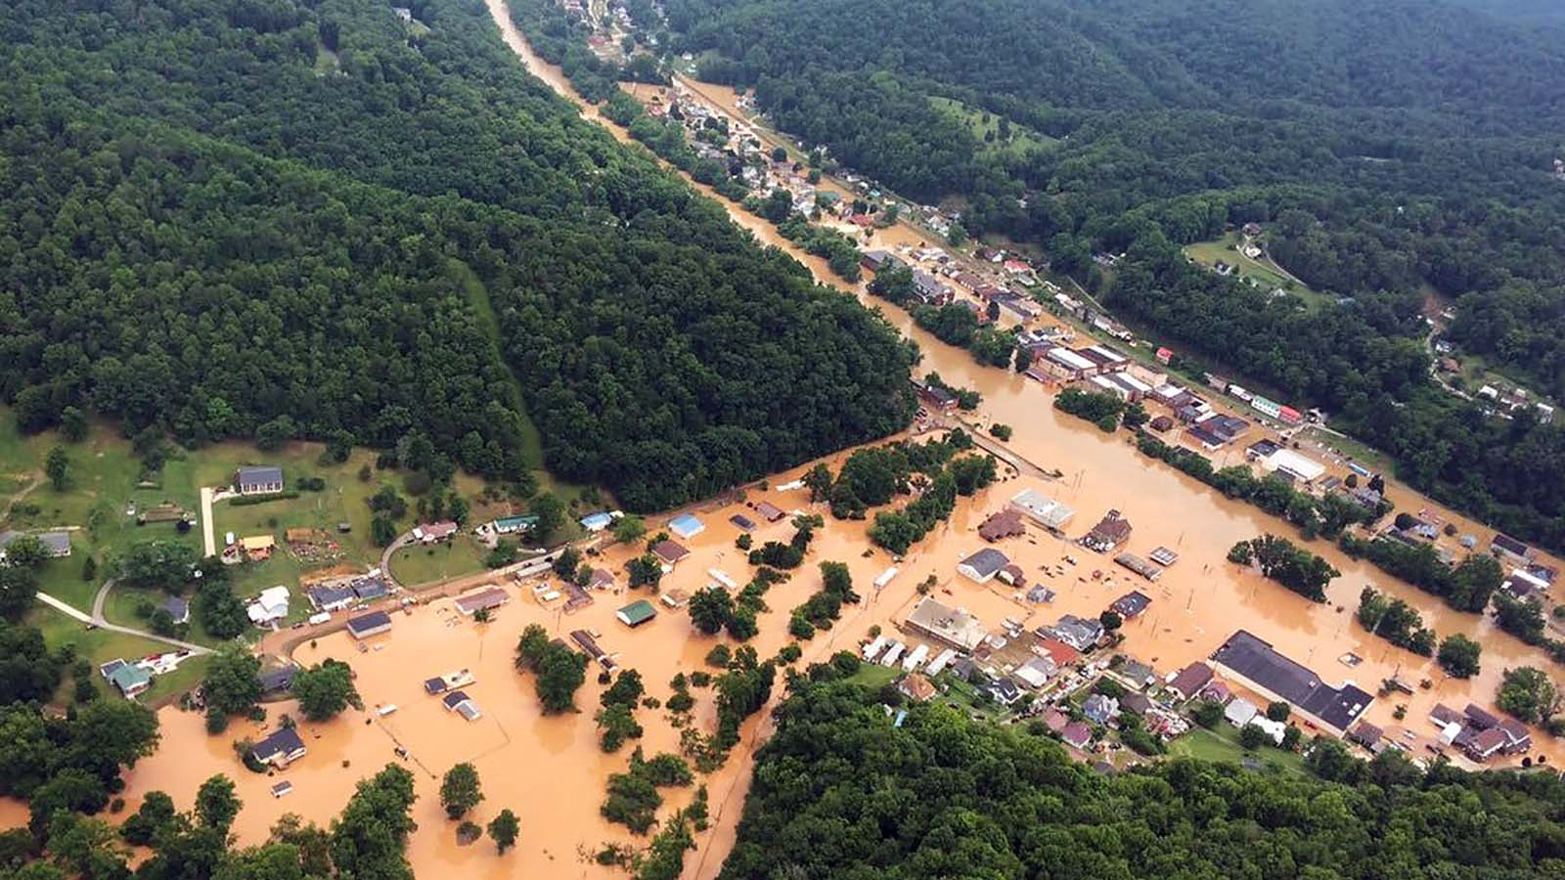




Highlights for Emergency Management Behrang Bidadian, Ph.D.
West Virginia Emergency Management Council Conference
October 2025

Slide 2

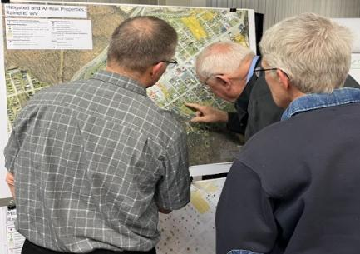

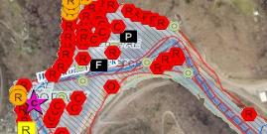
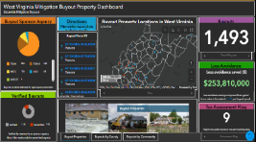
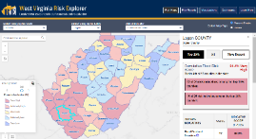
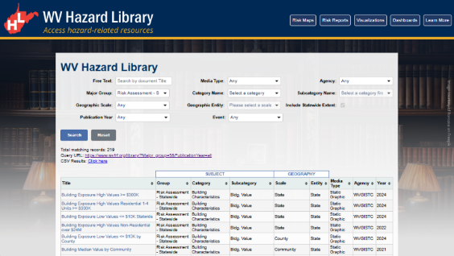
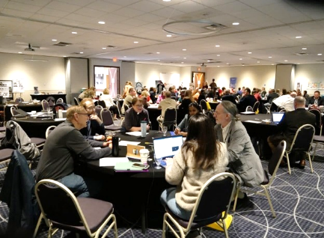
WV Flood Resiliency Framework (WVFRF)
A virtual hub of risk assessment, visualization, planning, and training resources for building community flood resiliency in WV
Flood Visualizations
WV Flood Tool
COMMUNITY
ENGAGEMENT
• Focused Outreach Meetings
• Flood Symposium
• Resiliency Tools & Products
• Learning Resources & Reports
RISK TOOLS
• WV Risk Explorer
• WV Flood Tool
• Visualizations
• Dashboards
9 Geographic Scales
Flood Dashboards
WV Risk Explorer
Community Engagement Meeting
Example Tools
HAZARD LIBRARY
Search online hazard resources by title, subject, media, event, geography, data, etc.
STAKEHOLDERS
• Risk Reduction Associates
• Emergency Responders
• Floodplain Managers
• Local Officials
• Volunteers
• Public
Hazard Library
Flood Symposium Stakeholders
Notes:
Collaboration of civic actors and academic researchers
The WV Flood Resiliency Framework employs risk assessment, visualization, and resource discovery tools to engage communities and stakeholders in building flood resiliency.

Slide 3

Stakeholders
Risk Reduction Associates
Enhancing understanding of risk extent and
hotspot locations to
improve preparedness for future events
Floodplain
Managers
Emergency Responders
Stakeholders
Local Officials
Volunteers
Public
Notes:
Six targeted stakeholder groups for WVFRF tools and hazard library resources.

Slide 4
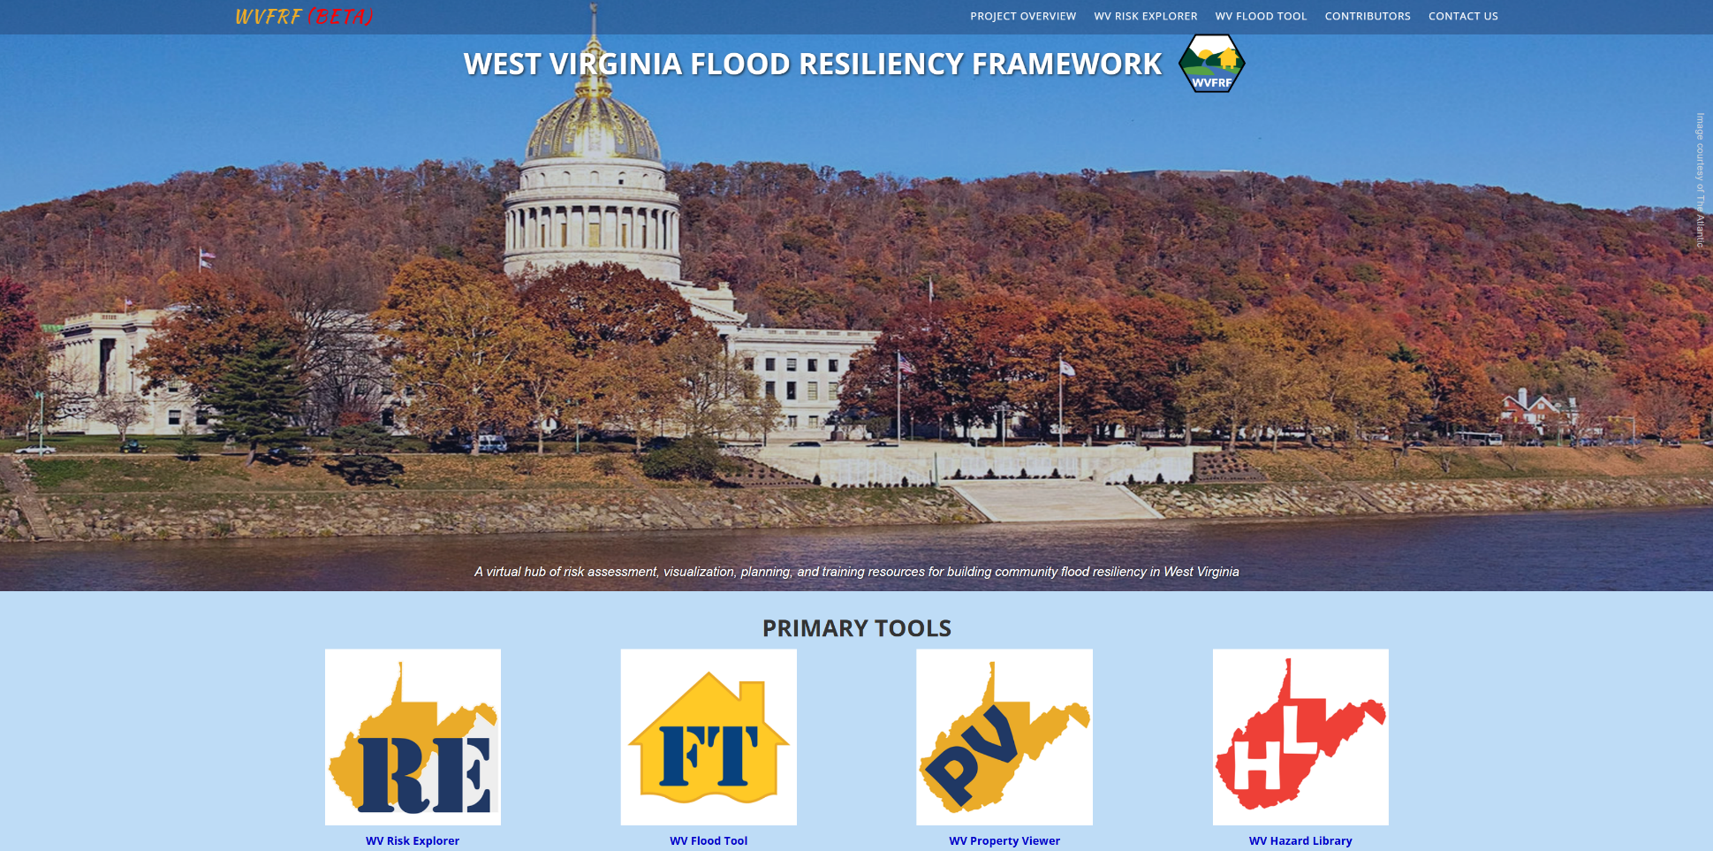
WVFRF Integrated Tools
COMMUNITY
ENGAGEMENT
• Focused Outreach Meetings
• Flood Symposium
• Resiliency Tools & Products
• Learning Resources & Reports
RISK TOOLS
• WV Risk Explorer
• WV Flood Tool
• Visualizations
• Dashboards
9 Geographic Scales
HAZARD LIBRARY
Search online hazard resources by title, subject, media, event, geography, data, etc.
STAKEHOLDERS
• Risk Reduction Associates
• Emergency Responders
• Floodplain Managers
• Local Officials
• Volunteers
• Public
Notes:
A virtual hub of risk assessment, visualization, planning, and training resources for building community flood resiliency in West Virginia
Integrated tools
Focusing on the WVRE
Click on the image to open the link
Link: https://wvfrf.org/

Slide 5
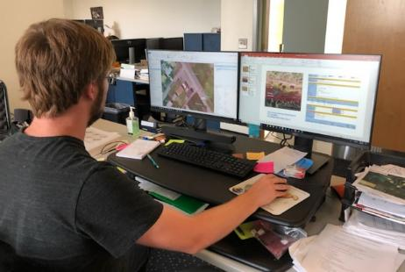

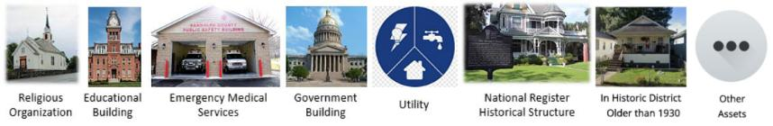
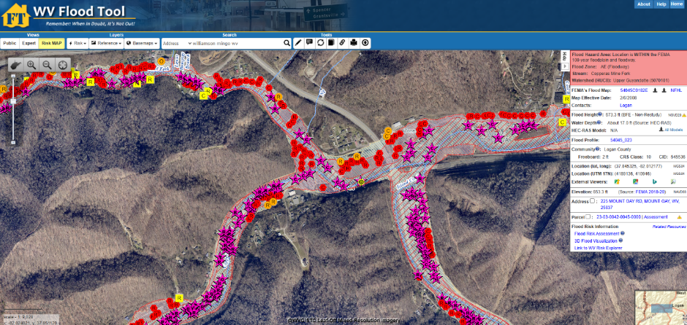

WV Floodplain Building Inventory (BI)
Riverine Flood Exposure Assessment (Building-Level)
Funded by: FEMA Hazard Mitigation Grant Program (HMGP) and State Hazard Mitigation Office
Detailed building characteristics from tax assessment
+
Population exposure and displacement estimates (100-yr flood)
Manual process of identification using Arc GIS
+
Programmed scripts to extract and process data
Product: WV Flood Tool mapwv.gov/flood
All primary (insurable) structures in FEMA’s 1%-annual-chance (100-yr) floodplain
Community Assets (Historical & Non-Historical) in the 100-yr floodplain
Essential Facilities in the 100-yr and 500-yr floodplains
COMMUNITY
ENGAGEMENT
• Focused Outreach Meetings
• Flood Symposium
• Resiliency Tools & Products
• Learning Resources & Reports
RISK TOOLS
• WV Risk Explorer
• WV Flood Tool
• Visualizations
• Dashboards
9 Geographic Scales
Essential
Facilities
Community
Assets
HAZARD LIBRARY
Search online hazard resources by title, subject, media, event, geography, data, etc.
STAKEHOLDERS
• Risk Reduction Associates
• Emergency Responders
• Floodplain Managers
• Local Officials
• Volunteers
• Public
Notes:
Link 1 (FT): https://www.mapwv.gov/flood/
Link 2: https://www.mapwv.gov/flood/map/?wkid=102100&x=-9129668&y=4557559&l=9&v=2
Use of Hazus model for damage estimation by depth damage curves

Slide 6

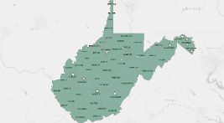
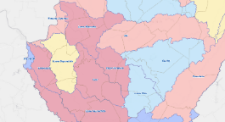
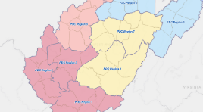
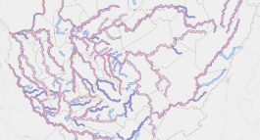
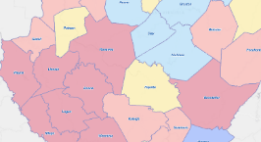
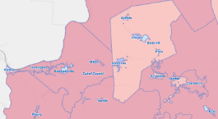
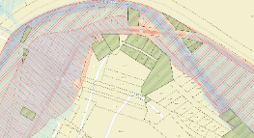
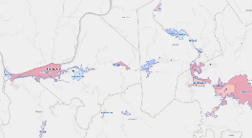
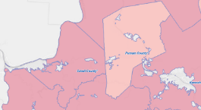
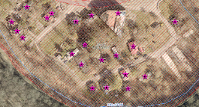
Analytical & Visualization Tools at Multiple Scales
Political Boundaries
Drainage Areas / Streams
State
Watersheds
(33)
PDC Regions (11)
Streams/Rivers
(156)
Counties (55)
Property Levels
Communities (284)
Parcels
Incorporated Places
(229)
Unincorporated Areas
(55)
Buildings
Notes:
The WV Flood Tool and WV Risk Explorer applications quantify riverine flood risk at the building and summary geographic levels, respectively. Cumulative risk rankings at different geographic scales and entities are computed from various risk indicators, including building, people, and social-economic factors.
Flood Tool: Building/Parcel-Level; New tools: Aggregation ability

Slide 7
WV Flood Risk Index
Overall Flood Risk
(1) FLOODPLAIN CHARACTERISTICS
(2) BUILDING EXPOSURE
(3) BUILDING CHARACTERISTICS
(4) CRITICAL INFRASTRUCTURE
(5) COMMUNITY ASSETS
(6) BUILDING DAMAGE LOSS
(7) PEOPLE / SOCIAL VULNERABILITIES
(8) OTHER HAZARDS
Floodplain Area
Building Floodplain Count¹ ²
Building Value¹ ²
Essential Facilities
Historical Assets
Substantial Damage Estimates*¹ ²
Population in Floodplain
Landslides
Floodplain Length¹ ²
Building Floodway Count¹ ²
Mobile Homes
Roads Inundated
Non-Historical Assets
Previous Claims
Population Displaced
Karst**
Floodplain Depth¹ ²
Building Floodplain Ratio²
Basement
Repetitive Losses
WV Social Vulnerability Index
Dam/Levee Failure**
Flood Disaster Frequency
Building Density¹ ²
One Story
Building Year*
Used for the Index
* Multiple Indicators
** In Progress
1
River/Stream Indicator
2
Watershed Indicator
Notes:
Categories 1 to 7 used to develop the risk index

Slide 8

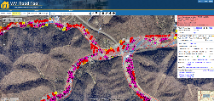
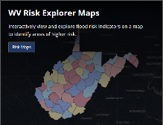
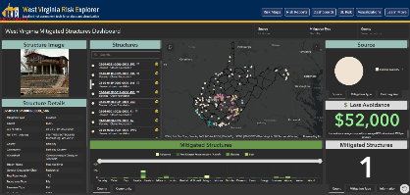
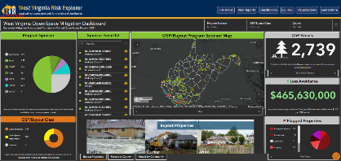
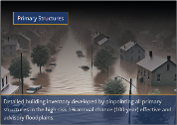



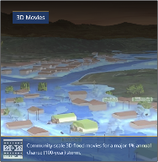
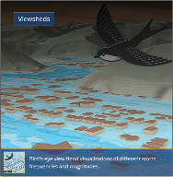


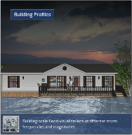
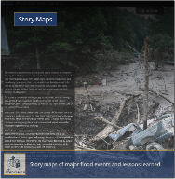
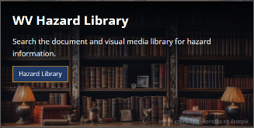

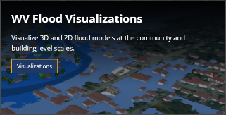
West Virginia Risk Explorer (WVRE)
Risk Assessment Tools
Localized riverine flood risk assessment by quantifying and aggregating detailed building-level data at multiple scales
Help identify the communities most at risk of riverine flooding for efficient allocation of limited mitigation resources
Mitigation Assessment Tools
Quantifies mitigation efforts such as elevation, relocation, and buyouts and calculation of loss estimates
Enable planners and decision-makers to evaluate past and ongoing efforts, identify gaps, and prioritize future investments
Building/Property-Level
Aggregated
Mitigated Structures Dashboard
Open-Space Mitigation Dashboard
Risk Communication Tools
Scenario-based 2D and 3D visualizations for effective risk communication
Facilitate risk comprehension for various stakeholders to support informed decision-making and encourage public engagement
Hazard Library and Data Access
Access to online hazard resources including data, documents, and media searchable by title, subject, event, geography, and more.
Allow users to access comprehensive datasets for use in analyses, maps, or applications to support planning, research, and decision-making related to hazard mitigation and response
Notes:
Click on the images to open the links
Link (WVRE landing page): https://www.wvfrf.org/wvre/

Slide 9


Risk Tools Comparison
https://www.mapwv.gov/flood
https://wvfrf.org/wvre/
WV Flood Tool |  | WV Risk Explorer
Determine the degree of flood risk for a specific area or property using the Public and Expert Views. View building risk assessments and mitigation measures using the Risk Map View. |  | View and analyze riverine flood risk at the aggregate level for community, county, region, watershed, and stream scales. Compare risk among different geographic entities, complete with risk scores and rankings, from the building level to state scales.
Primary Components: Public View Expert View (Floodplain Management) RiskMap View (Risk Reduction) Reference Layers & Basemaps Property Search Tools Links to External Viewers & Resources |  | Primary Components: Risk Maps Tool Risk Reports Tool Risk & Mitigation Dashboard Tools Building Level Risk Tools Flood Visualization Tools Data linkages WV Flood Tool & Hazard Library
Applications: Flood Risk Determinations at Property Level Floodplain Management Mitigation Measures Damage Assessments Property Identification Flood Visualizations & Risk Communications CRS Map Credits Other Hazards |  | Applications: Plans (Resiliency, Emergency Operations, Hazard Mitigation) Risk Studies (Risk MAP, Risk Reduction, Community Focused) Mitigation Measures, Tracking & Monitoring Flood Visualizations & Risk Communications CRS Programming Variables Other Hazards
Notes:
The WV Flood Tool and WV Risk Explorer applications allow for risk assessment at the building and summary geographic levels, respectively.
Click on the logos to open the links
Link 1: https://www.mapwv.gov/flood/
Link 2: https://wvfrf.org/wvre/

Slide 10
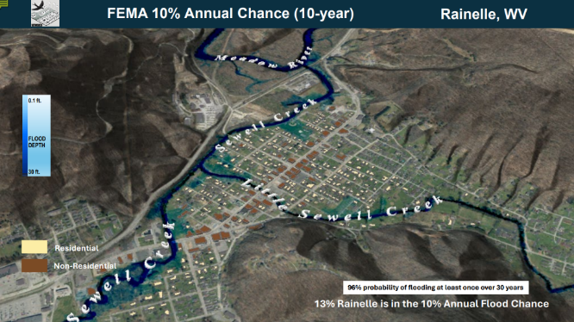
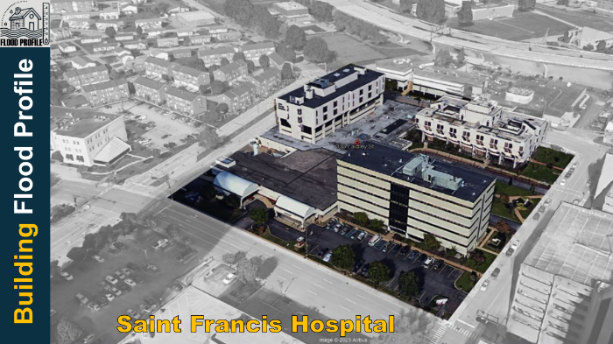
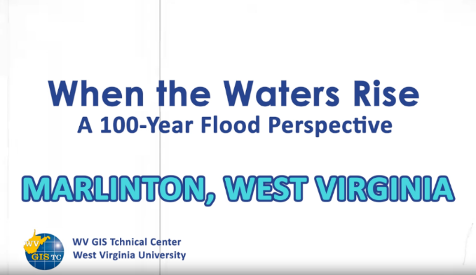
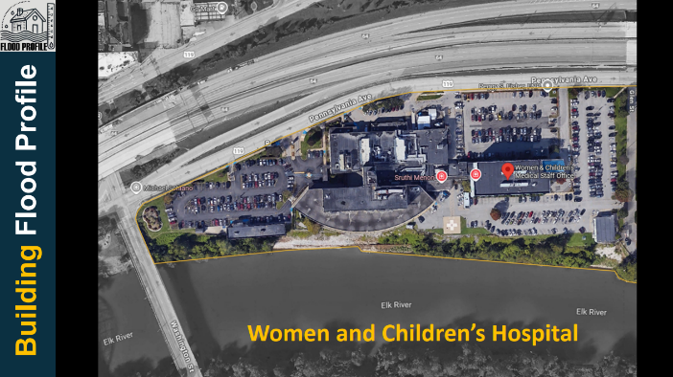
Visualization Examples
Viewshed for Rainelle
Building Profiles in Charleston
3D Movie for Marlinton
Notes:
Click on the images to open the links
Link 1 (Viewshed for Rainelle): https://data.wvgis.wvu.edu/pub/RA/HL/RA-L/VIEWSHED/Rainelle/VIEWSHED_Rainelle_2024.pdf
Link 2: (Building Profile St. Francis, Charleston): https://data.wvgis.wvu.edu/pub/RA/HL/RA-L/BLDG-PROFILE/BLDG-PROFILE_Charleston_Saint-Francis-Hospital_2025.pdf
Link 3: (Building Profile Women & Children’s, Charleston): https://data.wvgis.wvu.edu/pub/RA/HL/RA-L/BLDG-PROFILE/BLDG-PROFILE_Charleston_Women-and-Childrens-Hospital.pdf
Link 4: (3D Movie for Marlinton): https://data.wvgis.wvu.edu/pub/RA/HL/RA-L/MOVIE/3DMovie_Marlinton_2024.mp4

Slide 11



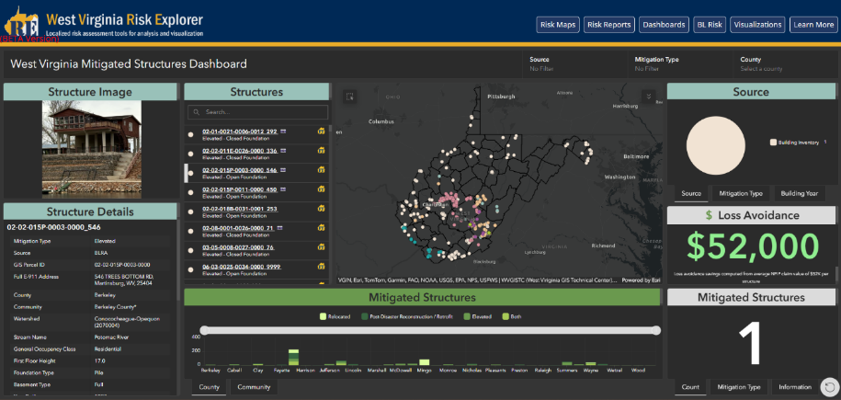
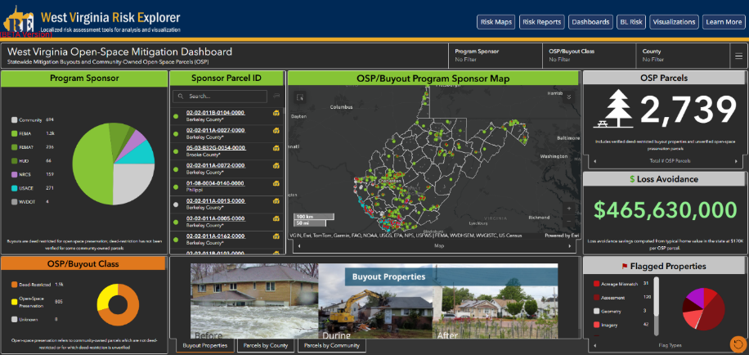
Mitigation Assessment Tools
Tracking mitigation efforts such as building elevation, relocation, acquisition, and buyouts
Mitigated Structures Dashboard
Open-Space Mitigation Dashboard
Notes:
Click on the images to open the links
Link 1 (WVRE): https://www.wvfrf.org/wvre/
Link 2: Dashboards: https://www.wvfrf.org/wvre/dashboard/home/
Link 3: Mitigated Strct: https://www.wvfrf.org/wvre/dashboard/?link=https://wvu.maps.arcgis.com/apps/dashboards/0a2182528f4e49ca827da8b9dcb65897
Link 4: Buyouts: https://www.wvfrf.org/wvre/dashboard/?link=https://wvu.maps.arcgis.com/apps/dashboards/83e1bdae8f7d4780940d3d6bccd92719

Slide 12

Future Enhancements
Hazard Library Finalization (coming soon)
Expanded catalog of hazard layers and supporting data
Planned Updates
Regular feature data updates, additions, and indicator refinements
User Feedback Loop
Reporting and feedback for tool improvements
Mobile-Friendly Access
Responsive design for field use
Expanded Hazard Coverage
Landslide, Dam Failure, and Karst
Future Maintenance
Ongoing functioning and system performance improvements
Training & Support
User training sessions, documentation, and guidance
?

Slide 13

Riverine Flood Risk Assessment Highlights for Emergency Management

Slide 14


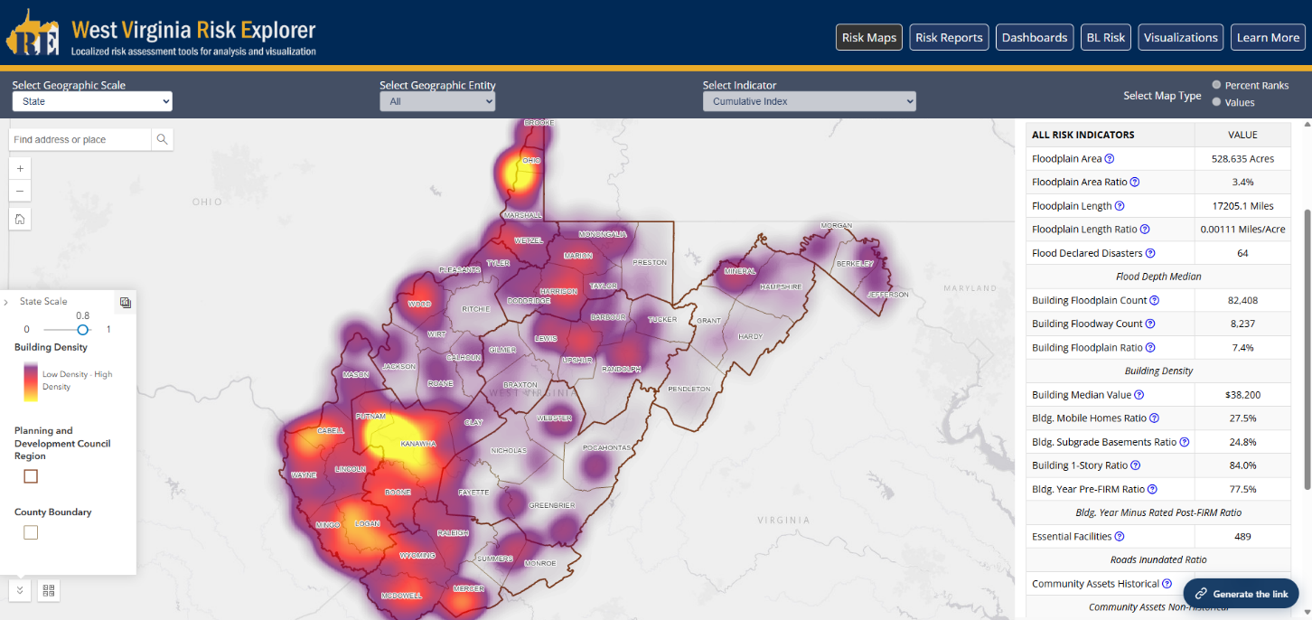

Statewide Flood Risk Assessment
Notes:
Click on the images to open the links
Link 1: https://www.wvfrf.org/wvre/map/?scaleid=3&gslid=&index=CUM_INDEX&type=pct
Link 2: https://wvfrf.org/wvre/map/?scaleid=1&gslid=&index=CUM_INDEX&type=pct

Slide 15
Geographic Entities at VERY HIGH Risk (Top 10%)
RANK | All Communities | Index Score
1 | New Martinsville - Incorporated | 100.0%
2 | Boone County* - Unincorporated | 99.6%
3 | Clendenin - Incorporated | 99.2%
4 | Marlinton - Incorporated | 98.9%
5 | Wheeling** - Incorporated | 98.5%
6 | McDowell County* - Unincorporated | 98.2%
7 | Alderson** - Incorporated | 97.8%
8 | Wayne County* - Unincorporated | 97.5%
9 | Parsons - Incorporated | 97.1%
10 | Kanawha County* - Unincorporated | 96.8%
11 | Madison - Incorporated | 96.4%
12 | Kimball - Incorporated | 96.1%
13 | Lincoln County* - Unincorporated | 95.7%
14 | Milton - Incorporated | 95.4%
15 | Mingo County* - Unincorporated | 95.0%
16 | Logan County* - Unincorporated | 94.6%
17 | Danville - Incorporated | 94.3%
18 | Wellsburg - Incorporated | 93.9%
19 | Oceana - Incorporated | 93.6%
20 | Rowlesburg - Incorporated | 93.2%
21 | Northfork - Incorporated | 92.9%
22 | Gary - Incorporated | 92.5%
23 | Wyoming County* - Unincorporated | 92.2%
24 | Welch - Incorporated | 91.8%
25 | Summers County* - Unincorporated | 91.5%
26 | Buckhannon - Incorporated | 91.1%
27 | Richwood - Incorporated | 90.8%
28 | Ceredo - Incorporated | 90.4%
29 | Mannington - Incorporated | 90.1%
Incorporated Places | Index Score
Clendenin - Incorporated | 100.0%
New Martinsville - Incorporated | 99.5%
Alderson** - Incorporated | 99.1%
Marlinton - Incorporated | 98.6%
Kimball - Incorporated | 98.2%
Parsons - Incorporated | 97.8%
Wheeling** - Incorporated | 97.3%
Northfork - Incorporated | 96.9%
Danville - Incorporated | 96.4%
Madison - Incorporated | 96.0%
Milton - Incorporated | 95.6%
Oceana - Incorporated | 95.1%
Keystone - Incorporated | 94.7%
Wellsburg - Incorporated | 94.2%
Gary - Incorporated | 93.8%
Rowlesburg - Incorporated | 93.4%
Grantsville - Incorporated | 92.9%
Richwood - Incorporated | 92.5%
Rainelle - Incorporated | 92.1%
Mannington - Incorporated | 91.6%
Spencer - Incorporated | 91.2%
Welch - Incorporated | 90.7%
Buckhannon - Incorporated | 90.3%
Unincorporated Areas | Index Score
Kanawha County* - Unincorporated | 100.0%
Boone County* - Unincorporated | 98.1%
Wayne County* - Unincorporated | 96.2%
McDowell County* - Unincorporated | 94.4%
Mingo County* - Unincorporated | 92.5%
Logan County* - Unincorporated | 90.7%
Counties | Index Score
Kanawha | 100.0%
Boone | 98.1%
McDowell | 96.2%
Logan | 94.4%
Mingo | 92.5%
Wyoming | 90.7%
Regions | Index Score
PDC Region 2 | 100%
PDC Region 3 | 90%
RANK | Streams (Top 20) | Index Score
1 | Coal River | 100.0%
2 | Ohio River | 99.7%
3 | Little Coal River | 99.5%
4 | Greenbrier River | 99.3%
5 | Davis Creek | 99.1%
6 | Island Creek | 98.9%
7 | Kanawha River | 98.7%
8 | Campbells Creek | 98.4%
9 | Wheeling Creek | 98.2%
10 | Pocatalico River | 98.0%
11 | Cacapon River | 97.8%
12 | Big Coal River | 97.6%
13 | Mud River | 97.4%
14 | Cabin Creek | 97.1%
15 | Pond Fork | 96.9%
16 | Elk River | 96.7%
17 | Twelvepole Creek | 96.5%
18 | Buckhannon River | 96.3%
19 | South Branch Potomac River | 96.1%
20 | Paint Creek | 95.8%
Watersheds | Index Score
Lower Kanawha | 100%
Coal | 96.7%
Upper Kanawha | 93.5%
Tug | 90.3%
Last update: Aug. 2024
Streams & Watersheds: Jul. 2025
Colors:
Black --> Incorporated places
Black on yellow** --> Split communities
Black on blue: Incorporated communities included in the detailed risk report (Camden-on-Gauley, Clendenin, Marlinton, Rainelle, Richwood, and White Sulphur Springs)
Brown on gray --> Unincorporated areas
Green --> Counties (Total)
Notes:
Next update in Fall 2025 may change the rankings

Slide 16
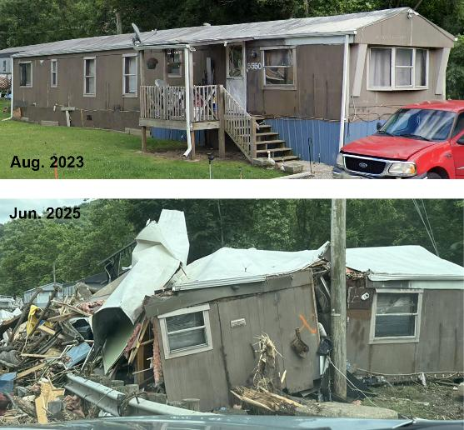
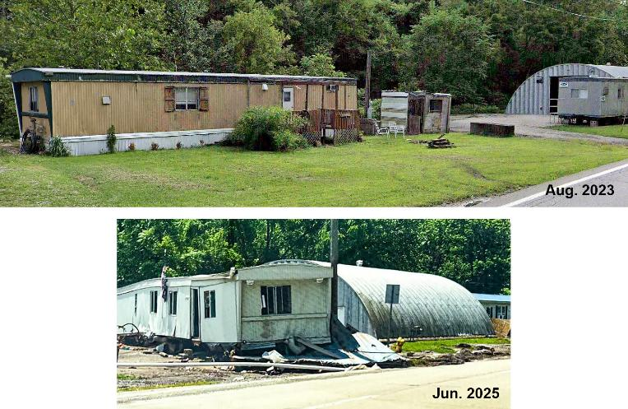
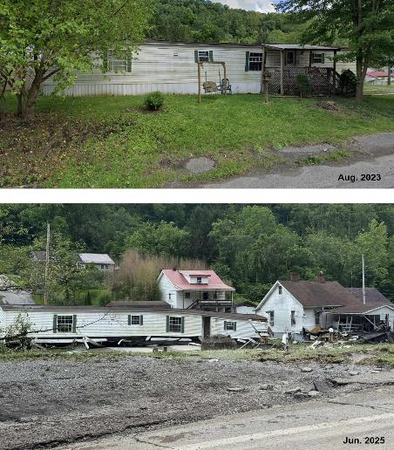
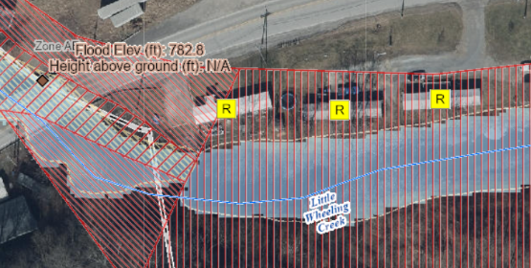
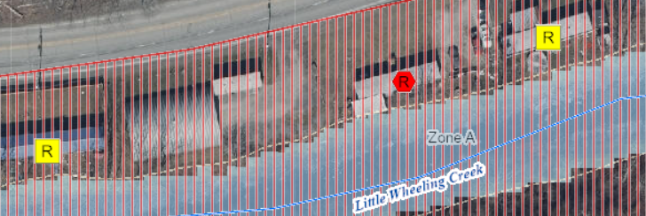
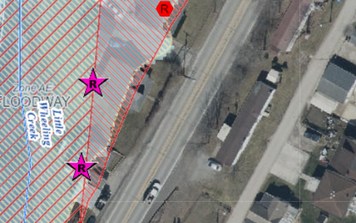
Building Characteristics: Mobile Homes
Lightweight manufactured homes are not designed to withstand flooding and are more vulnerable to flood damage.
5550 National Rd, Triadelphia, WV
Ohio County
Building ID: 35-07-0TW7-0012-0000_5550
5736 National Rd, Triadelphia, WV
Ohio County
Building ID: 35-07-0TW7-0012-0000_5736
5048 National Rd, Triadelphia, WV
Triadelphia, WV
Not in Floodplain
Notes:
Washed away be the lateral force and destroyed

Slide 17
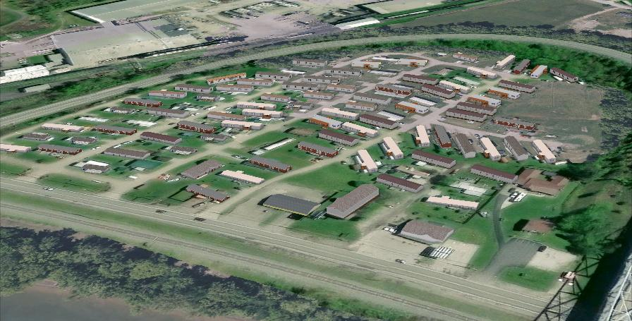
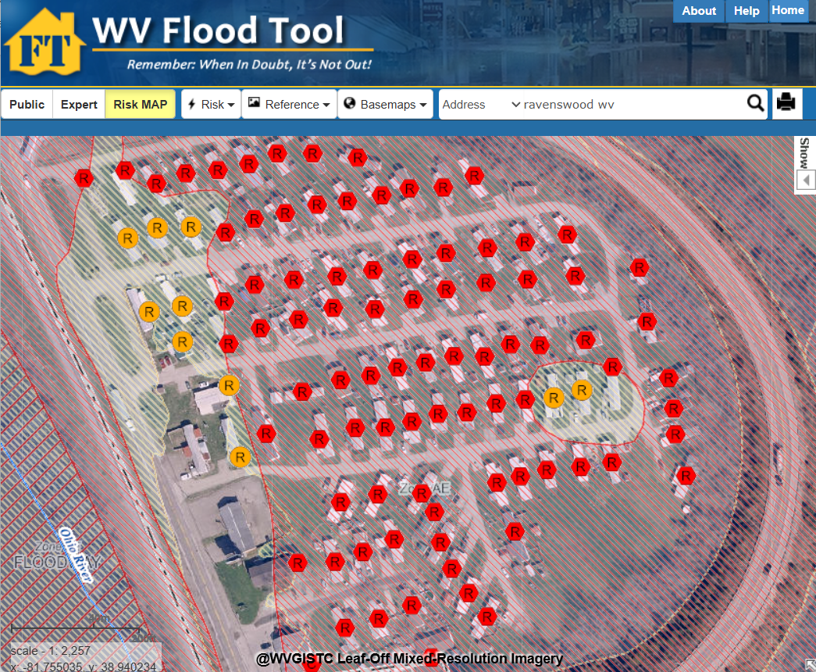
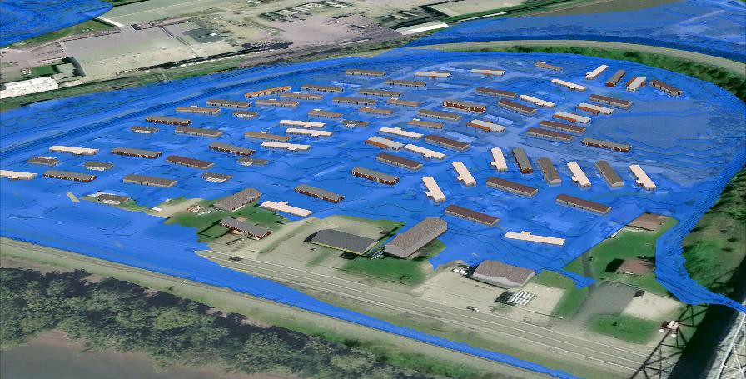
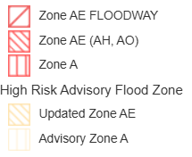
Mobile Home Park at Risk, Ravenswood, Jackson County
Higher Vulnerability
WV Flood Tool
FEMA 1% Annual Chance (100-year) Flood
Notes:
Click on the image to open the link
Link (FT): https://www.mapwv.gov/flood/map/?wkid=102100&x=-9100583&y=4712952&l=11&v=2

Slide 18
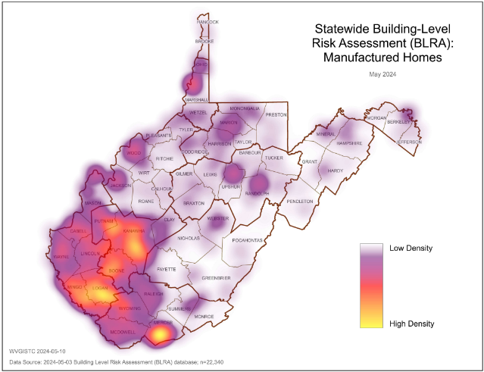


Mobile Homes in Floodplain (100-Yr)
WV / USA Comparison
 | West Virginia | Nationwide
Mobile Homes | 120,734 | 8,182,612
Occupied Residential Units | 859,437 | 139,647,020
% Mobile Home | 14% | 6%
Mobile Homes in Floodplain (Statewide)
Mobile Homes in WV Floodplain | 23,315
Total Mobile Homes in WV | 120,734
% in Floodplain | 19%
Total Single-Family Housing in WV Floodplain | 84,778
% Mobile Homes in Single-Family in WV Floodplain | 28%
Census Bureau 2021 ACS 5-year Estimates
Top 5
Counties
Notes:
Click on the images to open the links
Link1 (Risk Reports): https://www.wvfrf.org/wvre/report/?entityid=68&scaleid=1&type=all
Link 2 (County-Level): https://wvfrf.org/wvre/report/?scaleid=3&entityid=all&type=comparison

Slide 19


Building Characteristics: One-Story Buildings
During a flood event, residents in single-story buildings face limited options for seeking higher elevations.
Statewide Ratio: 84% of structures in 100-Yr floodplain are one-story
Top 5
Counties
Top 5
Incorporated Places
Notes:
Click on the images to open the links
Link1 (Risk Reports): https://www.wvfrf.org/wvre/report/?entityid=68&scaleid=1&type=all
Link 2 (County-Level): https://wvfrf.org/wvre/report/?scaleid=3&entityid=all&type=comparison

Slide 20







Critical Infrastructure: Essential Facilities
Essential Facilities provide emergency services during a flood.
Communities need to establish emergency protocols to maintain critical services amidst a flood.
Clendenin Volunteer Fire Department
Kanawha County
Inundated, Jun. 2016
Building ID: 20-02-0007-0040-0000_109
Marlinton Volunteer Fire Department
Pocahontas County
Inundated, Nov. 1985
Building ID: 38-08-0001-0095-0000_709B
Notes:
Mention Rainelle fire station in 2016

Slide 21






Flooded Essential Facilities
Schools with children in vulnerable age groups often also serve as shelters during floods.
Spanishburg Elementary School
Mercer County
Inundated, Feb. 2025
Building ID: 28-11-0026-0075-0000_8544
Clendenin Elementary School
Kanawha County
Inundated, Jun. 2016
(Demolished)
Bridge Elementary School
Kanawha County
Inundated, Jun. 2016
Building ID: 20-15-0023-0077-0000_5120
2014 imagery

Slide 22







Flooded Essential Facilities…
Nursing homes and hospitals with immobile patients are particularly more susceptible to flooding.
Pocahontas Center (Nursing Home)
Marlinton
Building ID: 38-08-0005-0065-0002_5
Water enters Nursing Home at 2131 ft. ground elevation or 14 ft. flood stage.
Nicholas County Nursing &
Rehabilitation Center
Richwood
Inundated, June. 2016
(Not active anymore)
Building ID: 34-06-0010-0072-0000_18
Notes:
Click on the image to play the video
Video Link: https://data.wvgis.wvu.edu/pub/RA/HL/FD/2016-06/Video/2016-06_Nicholas_Richwood_Nursing-Home_Video.mp4
Marlinton NH Link on FT: https://www.mapwv.gov/flood/map/?wkid=102100&x=-8915889&y=4610371&l=12&v=2

Slide 23


Essential Facilities in Floodplains (100-, 500-Yr)
Essential Facilities (Statewide)
Facility Type | Police Station | Fire Station | E-911 Center | School | Hospital | Nursing Home | Total
In Floodplains | 88 | 187 | 10 | 170 | 15 | 19 | 489
Total in WV | 312 | 548 | 54 | 828 | 67 | 111 | 1,920
% in Floodplains | 28% | 34% | 19% | 21% | 22% | 17% | 25%
Top 5
Counties
Top 5
Incorporated Places
Notes:
Click on the images to open the links
Link1 (Risk Reports): https://www.wvfrf.org/wvre/report/?entityid=68&scaleid=1&type=all
Link 2 (County-Level): https://wvfrf.org/wvre/report/?scaleid=3&entityid=all&type=comparison
Link 3 (Incorp. Places): https://wvfrf.org/wvre/report/?scaleid=5&entityid=all&type=comparison

Slide 24







Critical Infrastructure: Road Inundation
Pleasant Valley, Marion County, Jul. 2025
Welch, McDowell County, Feb. 2025
I-79, Kanawha County, Jun. 2016
Fairmont, Marion County, Jul. 2025
Williamson, Mingo County, Feb. 2025
White Sulphur Springs, Greenbrier County, Jun. 2016

Slide 25





Critical Infrastructure: Road Inundation (100-Yr)
Road Inundation (Statewide)
 | Roads | Public Bridges
At Risk of Inundation | 6,503 (Miles) | 2,603
Total | 109,052 (Miles) | 7,349
% At Risk | 6% | 35%
Town of Friendly
Orchard St. (2)
WV Flood Tool
Top 5
Counties
Top 5
Incorporated Places
Notes:
Click on the images to open the links
Link1 (Risk Reports): https://www.wvfrf.org/wvre/report/?entityid=68&scaleid=1&type=all
Link 2 (County-Level): https://wvfrf.org/wvre/report/?scaleid=3&entityid=all&type=comparison
Link 3 (Incorp. Places): https://wvfrf.org/wvre/report/?scaleid=5&entityid=all&type=comparison
Link 4 (FT, Friendly): https://www.mapwv.gov/flood/map/?wkid=102100&x=-9023376&y=4795525&l=9&v=2

Slide 26



Community Assets: Non-Historical
Non-Historical community assets such as churches often serve as emergency shelters during floods.
Flooding can disrupt critical community lifelines including safety, health, shelter, water, and energy.
Jan-Care of Guardian Angel (EMS)
Welch, McDowell County
Inundated, Feb. 2025
Building ID: 27-15-0002-0247-0000_58

Slide 27




Flooded Community Assets
Valley Grove Assembly of God
Valley Grove, Ohio County
Inundated, Jun. 2025
Building ID: 35-08-0VG9-0083-0000_8580
Williamson Water Plant (Veolia Water)
Williamson, Mingo County
Inundated, Feb. 2025
Building ID: 30-11-0007-0233-0000_317

Slide 28









Flooded Community Assets…
Borderland Baptist Church
Mingo County
Inundated, Feb. 2025
Building ID: 30-10-362K-0010-0000_46
Cornerstone Church
Matewan, Mingo County
Inundated, Feb. 2025
Building ID: 30-08-0009-0071-0000_1028
East Williamson Baptist Church
Williamson, Mingo County
Inundated, Feb. 2025
Building ID: 30-11-0010-0098-0000_9999
Church Of God Ennis & Maybeury
McDowell County
6 inches of water in basement, Feb. 2025
Building ID: 27-06-0011-0019-0000_40150

Slide 29


Non-Historical Community Assets in Floodplains (100-Yr)
Non-Historical Community Assets (Statewide)
Facility Type | Religious | Postsecondary Educational | EMS | Government | Utility | Other | Total
In Floodplain | 1,450 | 21 | 24 | 423 | 166 | 8 | 2,092
Top 5
Counties
Top 5
Incorporated Places
Notes:
Click on the images to open the links
Link1 (Risk Reports): https://www.wvfrf.org/wvre/report/?entityid=68&scaleid=1&type=all
Link 2 (County-Level): https://wvfrf.org/wvre/report/?scaleid=3&entityid=all&type=comparison
Link 3 (Incorp. Places): https://wvfrf.org/wvre/report/?scaleid=5&entityid=all&type=comparison

Slide 30




Estimated Displaced Population (100-Yr Flood)
Population (Statewide)
Total Population * | 1,801,049
In Floodplain | 198,888
% in Floodplain | 11.0%
Displaced Population | 119,350
% Displaced | 6.6%
Shelter Needs (Persons) | 23,003
% in Need of Shelter | 1.3%
Companion Pets in Shelters | 6,411
Rainelle, Greenbrier County, Jun. 2016
Top 5
Counties
* Census Bureau 2021 ACS 5-year Estimates
Notes:
Click on the images to open the links
Link1 (Risk Reports): https://www.wvfrf.org/wvre/report/?entityid=68&scaleid=1&type=all
Link 2 (County-Level): https://wvfrf.org/wvre/report/?scaleid=3&entityid=all&type=comparison

Slide 31










Social Vulnerability
Communities with higher social vulnerability are less able to prepare for, respond to, and recover from flood disasters quickly and fully.
Social Vulnerability Index (WV SVI) (0% to 100%)
Combines indicators of:
Poverty Rate
Unemployment Rate
Vulnerable Ages Rate
Disability Rate
Population without a High School Diploma
Population Change
Median Housing Unit Value
Percentage of Mobile Homes in Housing Units
Top 5
Counties
Notes:
Click on the images to open the links
Link1 (Risk Reports): https://www.wvfrf.org/wvre/report/?entityid=68&scaleid=1&type=all
Link 2 (County-Level): https://wvfrf.org/wvre/report/?scaleid=3&entityid=all&type=comparison
Link3 (SVI map): https://wvfrf.org/wvre/map/?scaleid=3&gslid=&index=PR_WV_SVI&type=pct

Slide 32


2016 Flood Fatality Analysis
23 Victims
Detailed Fatality Analysis

Slide 33

2016 Flood Fatality Analysis
23 Fatalities, Jun. 2016
Causes: | Deaths Count | % of Fatalities
Drowned due to High Flood Velocities and Flood Depths | 18 | 78%
Flood Injuries (Heart Failure, Electrocution, Severe burns) | 5 | 22%
23 Fatalities, Jun. 2016
Building Characteristics: | Deaths Count | % of Fatalities
One-Story Buildings (including Mobile Homes) | 17 | 74%
23 Fatalities, Jun. 2016
Behavior: | Deaths Count | % of Fatalities
Delayed Evacuation | 14 | 61%
Risky Behavior | 9 | 39%
Risky Behavior Examples:
Driving into floodwaters
Attempting to rescue pets
Retrieve memorabilia from basements
Playing near flooded creeks
Crossing or viewing from bridges

Slide 34

Recommendations for Emergency Management

Slide 35

Verify Risk Assessments
Use the Aggregated-Level Risk Reports and Maps to identify the hot spots of the risk and vulnerability.
WV Risk Explorer Reports
WV Risk Explorer Maps
Use Building-Level (BL) Tools & Tables to identify most vulnerable structures.
Give priority to such structures for emergency response.
Statewide Building-Level Tool for Primary Structures
Statewide Building-Level Tool for Significant Structures
WV Flood Tool
Statewide BLRA (Table & GIS)
Notes:
Links:
Risk Reports: https://wvfrf.org/wvre/report/?entityid=68&scaleid=1&type=all
Risk Maps: https://wvfrf.org/wvre/map/?scaleid=3&gslid=&index=CUM_INDEX&type=pct
BL Primary: https://wvfrf.org/wvre/blra/?sortfield=Depth_Grid&sorttype=desc&hiddenFields=default
BL Sig.: https://wvfrf.org/wvre/blra/?type=sigstruct&sortfield=Depth_Grid&sorttype=desc&hiddenFields=default
FT: https://www.mapwv.gov/flood/
Data: https://data.wvgis.wvu.edu/pub/RA/HL/Data/RA-BL/2a_BL-BLRA/

Slide 36



Plan with Stream Gauges
https://water.noaa.gov
Notes:
NOAA’s Tool for Greenbrier River, Marlinton:
https://water.noaa.gov/#@=-96.401081,38.1465724,4.070669&b=topographic&g=obsFcst,1!1!1!1!1!1!1!1!1!1!1!1!1!1!1!0!0!0!0!0,0.5,1!1!1!1!0,0,0,true&ab=0,0,#D94B4A,1,1,1,#cccccc,1,0,0,#B243B1,1,0,0,#98E09A,1,false&a=hydrologic,0.35,false&s=0,0,0.9,0.9,false&n=false,#72afe9,0.9,0,0.9,0,0.9,false&p=false,0.75,0,7,0,1,2025,9,23,0,false&d=0,0,1,1,1,1,1,1,#006EFF,1,#006EFF,1,#006EFF,false&q=

Slide 37


Plan with High Water Marks
https://www.mapwv.gov/flood
Notes:
FT link, example: https://www.mapwv.gov/flood/map/?wkid=102100&x=-9055897&y=4648626&l=9&v=1

Slide 38




Plan for Rapid High-Rising Floodwaters
All these homes along Jordan Creek Road near Clendenin were swept away during the flood of June 2016
Wheeling / Triadelphia, Ohio County, Jun. 2025

Slide 39


Identify At-Risk Significant Structures
Fire Stations, Police Stations, E-911 Centers, & EMS in Floodplain Emergency Response Disruption!
Nursing Homes, Hospitals, and Schools in Floodplain Vulnerable Groups at Risk!
Churches in Floodplain Sheltering Disruption!
Utilities in Floodplain Disruption of Critical Lifelines!
Welch, McDowell County, Feb. 2025
Clendenin, Greenbrier County, Jun. 2016
Notes:
FT link: https://www.mapwv.gov/flood/map/?wkid=102100&x=-9055897&y=4648626&l=9&v=1

Slide 40


Plan for Inundated Road Impacts
https://www.mapwv.gov/flood
Notes:
FT link, example: https://www.mapwv.gov/flood/map/?wkid=102100&x=-8990557&y=4575291&l=9&v=2

Slide 41

Plan with Population Estimates
Use the risk assessment tools and reports to have a better understanding of population exposure, social vulnerability, evacuation estimates, and shelter needs.
Plan for pet-friendly shelters.
Use the Flood Fatality Dashboard to better understand the cause of deaths of the past disasters.
Notes:
Dashboard Link: https://wvfrf.org/wvre/dashboard/?link=https://www.arcgis.com/apps/dashboards/817bb3791b0841898aa7edeec56a5788

Slide 42




Educate to Avoid Risky Behavior
Risky Behavior Examples:
Driving into floodwaters
Attempting to rescue pets
Retrieve memorabilia from basements
Playing near flooded creeks
Crossing or viewing from bridges
Vehicular Fatality Wood County
Apr. 2024
The driver entered the flooded area of Nicolette Road at a deep dip in the roadway. The water flipped the blue SUV vehicle over in approximately 15-20 feet of water off the roadway edge.
Vehicular Drowning
Valerie Swisher, 49, drowned on Nicolette Road (County Highway 47/3) on a small tributary of the Little Kanawha River.
Notes:
FT Link: https://www.mapwv.gov/flood/map/?wkid=102100&x=-9073513&y=4751600&l=10&v=2

Slide 43

Property-Level Mitigation by Owners
Purchase flood Insurance;
Elevate buildings;
Provide flood openings;
Seal foundations;
Elevate and anchor utilities;
Protect valuable possessions
https://www.floodsmart.gov
“What to do before a flood”

Slide 44











Links to Tools / Data
→ WV Flood Tool: https://www.mapwv.gov/flood/
→ West Virginia Flood Resiliency Framework (WVFRF): https://wvfrf.org/
→ West Virginia Risk Explorer (WVRE) (Landing Page): https://www.wvfrf.org/wvre/
→ WV Risk Explorer Maps: https://wvfrf.org/wvre/map/?scaleid=3&gslid=&index=CUM_INDEX&type=pct
→ WV Risk Explorer Reports: https://wvfrf.org/wvre/report/?entityid=68&scaleid=1&type=all
→ WV Flood Dashboards: https://wvfrf.org/wvre/dashboard/home/
→ WV Building-Level (BL) Risk: https://wvfrf.org/wvre/buildings/
→ WV Flood Visualizations: https://wvfrf.org/wvre/visualization/home/
→ Access Data: https://wvfrf.org/wvre/data/home/
WV Hazard Library: https://wvfrf.org/library/
→ Landslide Tools: https://wvfrf.org/wvre/landslides/

Slide 45


Thank you! Questions?
Email:
behrang.bidadian@mail.wvu.edu
kurt.donaldson@mail.wvu.edu

Slide 46
Backup Slides

Slide 47



Benefits of the Tools
Planning
Enhancing state resiliency and hazard mitigation plans
Updating emergency operation plans
Prioritizing and allocating resources
Identifying the need for more refined risk assessments
Risk Communications
Encouraging community-level risk communication and engagement
Educating new homeowners and renters
Informing the insurance and mortgage industries
Mitigation
Identifying areas of mitigation interest
Supporting the development or enhancement of codes and standards
Informing long-term community recovery
COMMUNITY
ENGAGEMENT
• Focused Outreach Meetings
• Flood Symposium
• Resiliency Tools & Products
• Learning Resources & Reports
RISK TOOLS
• WV Risk Explorer
• WV Flood Tool
• Visualizations
• Dashboards
9 Geographic Scales
HAZARD LIBRARY
Search online hazard resources by title, subject, media, event, geography, data, etc.
STAKEHOLDERS
• Risk Reduction Associates
• Emergency Responders
• Floodplain Managers
• Local Officials
• Volunteers
• Public

Slide 48
Unique Features of WV Risk Explorer Tools
Risk indicators Rankings to Identify Communities at Higher Risk in Risk Maps & Reports
Interactively view and explore flood risk indicators on a map to identify areas of higher risk.
Interactive Downloadable Risk Reports by Multi-Scale Aggregation of Detailed Building-Level Inventory
View and download flood risk assessment and comparison reports in more detail.
Sharable Queries for Risk Reports, Maps, and Tables
Share your geographic selections along with data field queries for consistent use across teams.
Rationale and Recommendations for Risk Indicators
Use the Technical Documentation to understand the rationale for the risk indicators and the recommendations associated with them.
Statewide Consistent Methodology and Risk Indicators
In-depth flood risk indicators covering all of West Virginia uniformly, not just selected regions.
Flood Dashboards
Use the interactive dashboards to analyze risk factors and mitigation measures.
Flood Visualizations
Visualize 3D and 2D flood models at the community and building level scales.
Hazard Library Customized to West Virginia
Search the document and visual media library for hazard information.
Data Access
Download risk data for use in your own analyses, maps, or applications.
Scalable
Scalable for other hazards such as landslides or enhancements to risk indicators.
COMMUNITY
ENGAGEMENT
• Focused Outreach Meetings
• Flood Symposium
• Resiliency Tools & Products
• Learning Resources & Reports
RISK TOOLS
• WV Risk Explorer
• WV Flood Tool
• Visualizations
• Dashboards
9 Geographic Scales
HAZARD LIBRARY
Search online hazard resources by title, subject, media, event, geography, data, etc.
STAKEHOLDERS
• Risk Reduction Associates
• Emergency Responders
• Floodplain Managers
• Local Officials
• Volunteers
• Public

Slide 49








User Guides
WVRE One-Pager
WVRE Learn More Page
WVRE Technical Document
https://wvfrf.org/wvre/more/
Metadata Documents
https://data.wvgis.wvu.edu/pub/RA/HL/WVFRF/Flyer/WVRE_Info_OnePager.pdf
https://data.wvgis.wvu.edu/pub/RA/HL/Data/RA-AL/1a_AL-RISK-INDEX/2_Metadata/WV_RiskIndex_DataDictionary.pdf
https://data.wvgis.wvu.edu/pub/RA/HL/Data/RA-AL/1b_AL-MATRIX/2_Metadata/Full_Matrix_DataDictionary.pdf
WVRE Demo (Video)
https://data.wvgis.wvu.edu/pub/RA/HL/Data/RA-BL/2a_BL-BLRA/3_Metadata/Full_BLRA_Metadata.pdf
https://data.wvgis.wvu.edu/pub/RA/RI/WVRE/DOCS/WVRE_TechnicalDoc.pdf
https://data.wvgis.wvu.edu/pub/RA/HL/WVFRF/Video/WV_Risk_Explorer_Movie_20240826.mp4
https://data.wvgis.wvu.edu/pub/RA/HL/Data/RA-BL/2b_BL-SIG-STRC/1_All_Sig_Structures/2_Metadata/Significant_Structures_Metadata.pdf
Notes:
Click on the images to open the links

Slide 50








Risk Assessment Tools
Localized risk assessment tools for analysis
Aggregated
Building/Property-Level
Notes:
Click on the images to open the links
Link1: Flood Tool: https://www.mapwv.gov/flood/
Link 2: BL: https://www.wvfrf.org/wvre/buildings/
Link 2a: Primary Strc: https://www.wvfrf.org/wvre/blra/?sortfield=Depth_Grid&sorttype=desc&hiddenFields=default
Link 2b: Sig. Stct: https://www.wvfrf.org/wvre/blra/?type=sigstruct&sortfield=Depth_Grid&sorttype=desc&hiddenFields=default
Link 3: Risk Maps: https://www.wvfrf.org/wvre/map/?scaleid=3&gslid=&index=CUM_INDEX&type=pct
Link 4: Risk Reports: https://www.wvfrf.org/wvre/report/?entityid=68&scaleid=1&type=all
Link 5: Risk Dashboards: https://www.wvfrf.org/wvre/dashboard/home/

Slide 51





Risk Communication Tools
Facilitating risk comprehension for different groups of stakeholders
(combined with other risk communication activities such as SFHA change letters, focus group meetings, presentations, etc.)
Notes:
Click on the images to open the links
Link 1 (WVRE): https://www.wvfrf.org/wvre/
Link 2: Vis.: https://www.wvfrf.org/wvre/visualization/home/
Link 3: Movies: https://www.wvfrf.org/library/?TypeID=1&PublicationYear=all
Link 4: Viewsheds: https://www.wvfrf.org/library/?TypeID=14&PublicationYear=all
Link 5: B. Profiles: https://www.wvfrf.org/library/?TypeID=2&PublicationYear=all
Link 6: Story Maps: https://www.wvfrf.org/library/?TypeID=11&PublicationYear=all

Slide 52






Hazard Library and Data Access
Online hazard resources including comprehensive datasets, documents, and media
Notes:
Click on the images to open the links
Link 1: HL: https://www.wvfrf.org/library/
Link 2: Access Data: https://wvfrf.org/wvre/data/home/

