Slide 1
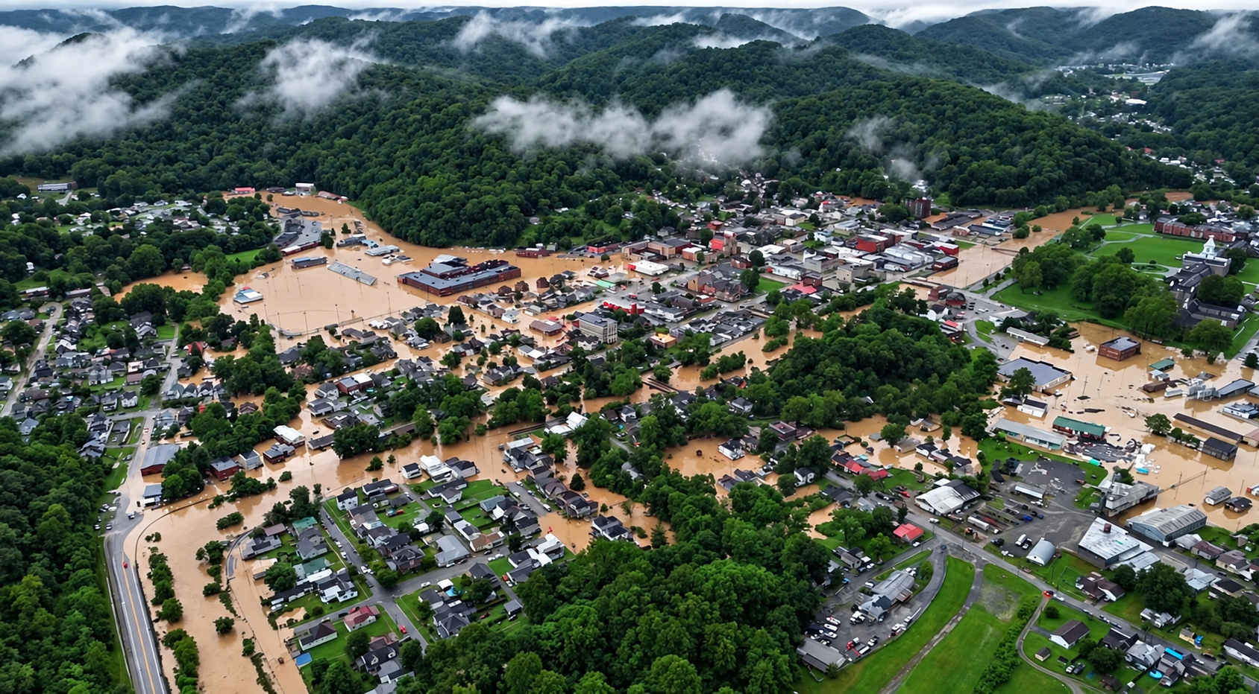



West Virginia Flood Resiliency Framework
(WVFRF)
Weston, WV, July 2026; Image courtesy of WV News
Behrang Bidadian, Ph.D.
September 28, 2026

Slide 2


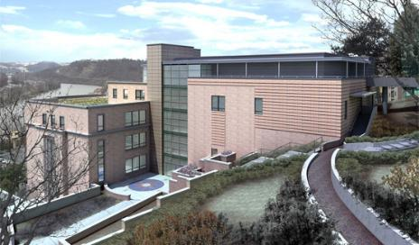


















About West Virginia GIS Tech Center (WVGISTC)
Director/Project Manager:
Kurt Donaldson
Faculty Director:
Aaron Maxwell, Ph.D.
Full-Time Team:
  Three Risk Analysts/GIS Specialists
  Two GIS Programmers/Developers
Mission:
Spatial data infrastructure enhancement
Advisory services and training programs in geographic information science
GIS research and education
Support disaster resilience in the state:
Flood & Landslide risk assessment
WV GIS Technical Center (WVGISTC)
WVU Department of Geology & Geography
330 Brooks Hall
P.O. Box 6300
Morgantown, WV 26506
Phone: (304) 293-0557
Email:
kurt.donaldson@mail.wvu.edu
behrang.bidadian@mail.wvu.edu
Part-Time / Temporary Team:
  Graduate Research Assistants (8 in Fall 2026)
  Undergraduate Student Workers (2 in Fall 2026)
  Mountaineer Temps (2 in Fall 2026)
  Contractors/Consultants

Slide 3


About me
Behrang Bidadian
Working at the WV GIS Tech Center since 2019
Resilient/Sustainable Development
Disaster Risk Management
Certified Floodplain Manager (C.F.M.)
GIS & Spatial Analysis (Cert.)
Architectural Engineering (M.Arch.)
Geology (M.S.)
Human & Community Development (Ph.D.)
behrangbidadian.org

Slide 4
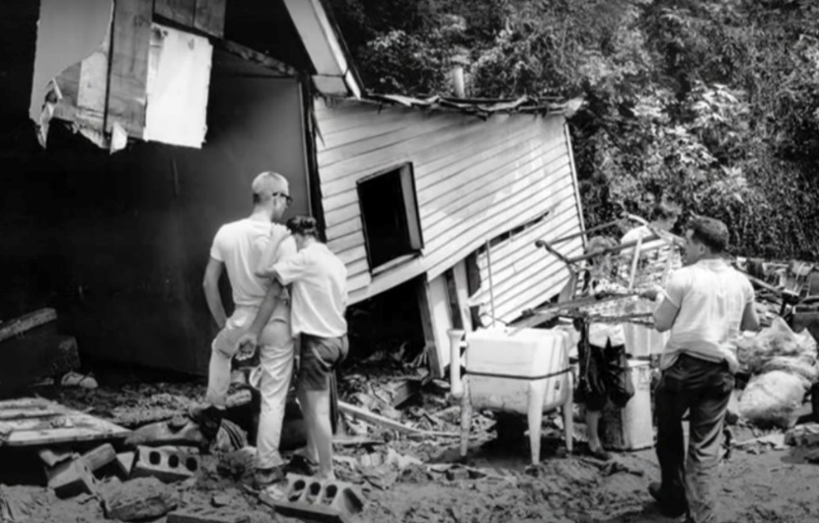
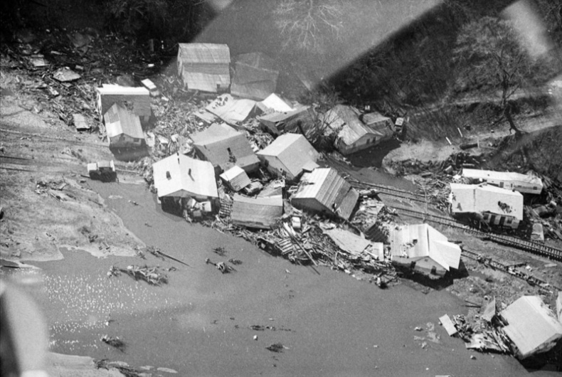
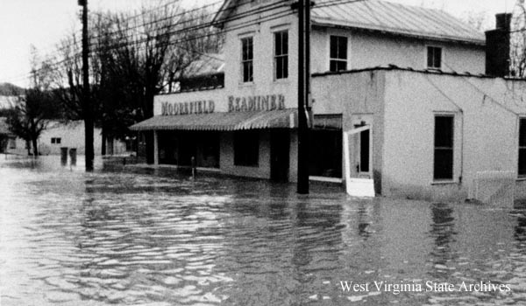
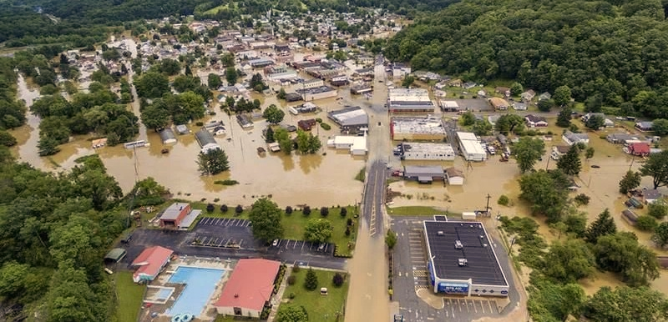
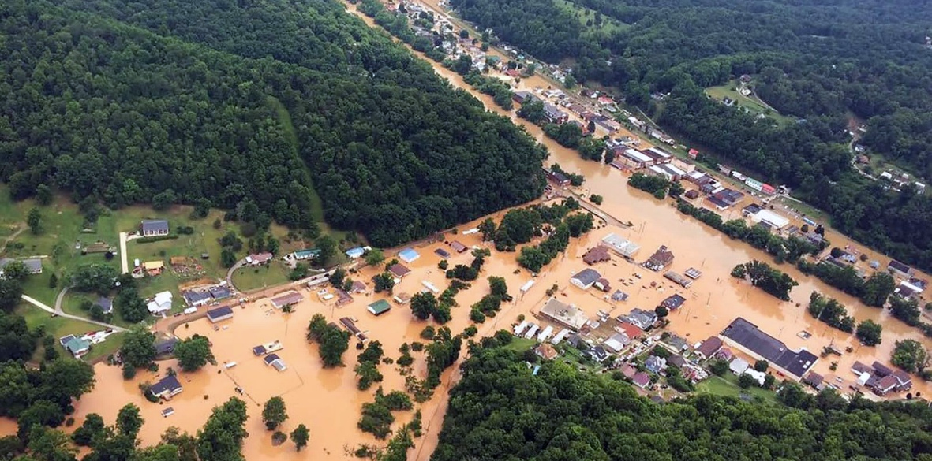
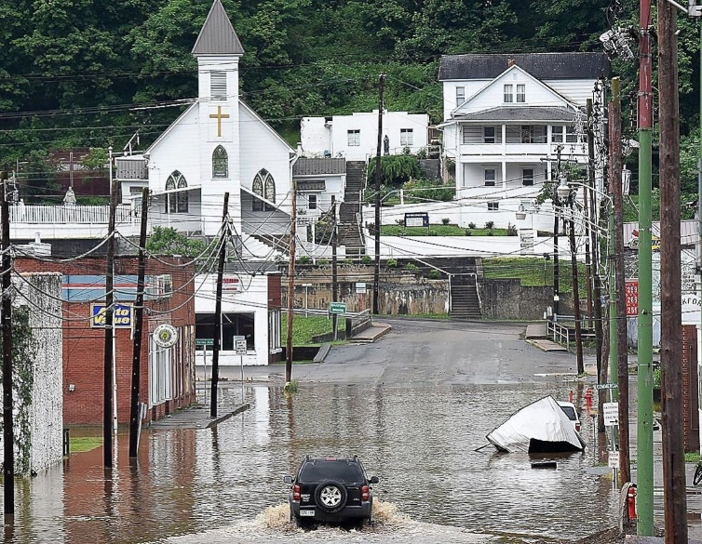
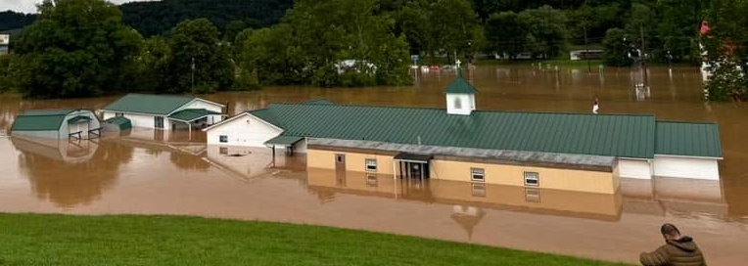
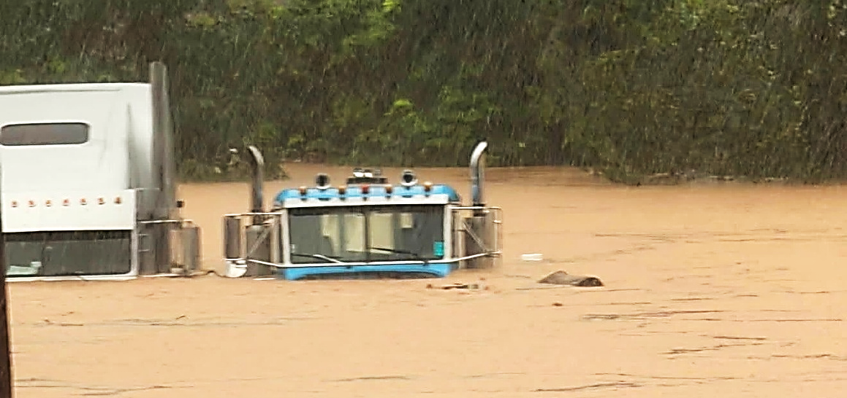
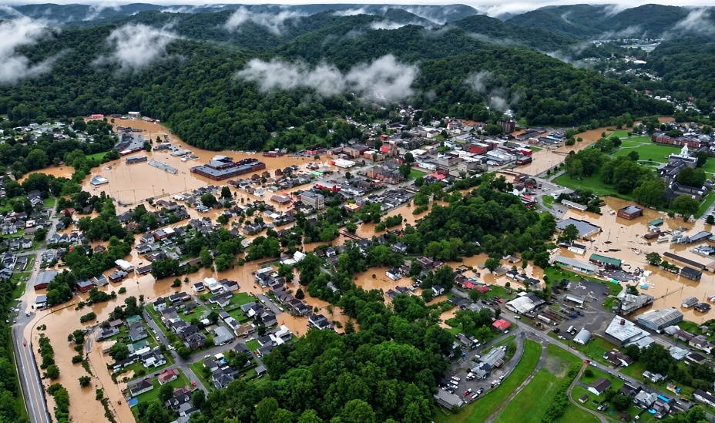
Flood Risk in WV
65 Federally Declared Flood Disasters Since 1953
233 Lives Lost to Flood Disasters
Kanawha County
About 98,000 Buildings (9%) in the
1%-Annual-Chance (100-Year) Floodplain
About 199,000 People (11%) Reside in
the 100-Year Floodplain
Buffalo Creek
Moorefield, Hardy County
July 1961
(22 + 2 landslide fatalities)
February 1972
(123 fatalities)
November 1985
(49 fatalities)
Clendenin, Kanawha County
Richwood, Nicholas County
June 2016
(23 fatalities)
Rainelle, Greenbrier County
Weston, Lewis County
July 2026
(2 fatalities)
Weston, Lewis County
Weston, Lewis County
Notes:
Awareness rises after a disaster but fades away later: Need to assess and communicate the risk
Preparation on sunny days
Federally-Declared Flood Disasters: Incident subcategories of “flood,” “severe storms,” or “hurricanes”
Total Structures: 1,118,761 Total Population: 1,801,049

Slide 5


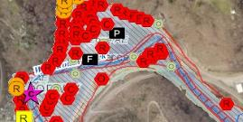
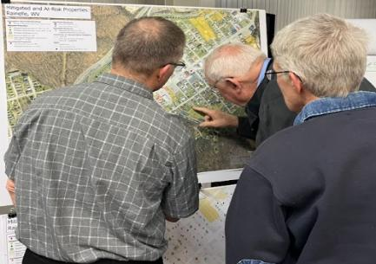
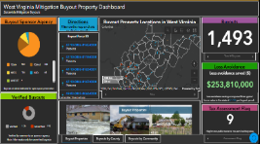
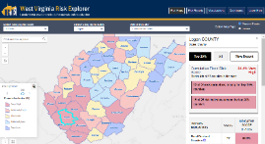
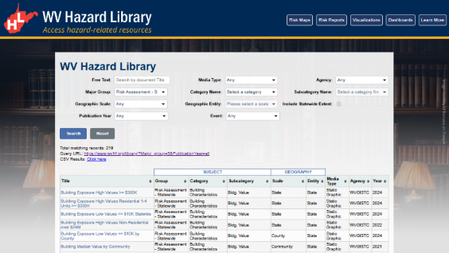
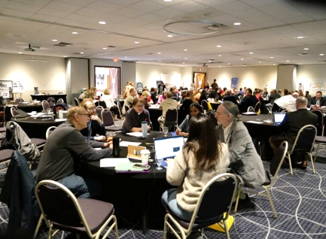

WV Flood Resiliency Framework (WVFRF)
A virtual hub of risk assessment, visualization, planning, and training resources for building community flood resiliency in WV
Flood Visualizations
WV Flood Tool
COMMUNITY
ENGAGEMENT
• Focused Outreach Meetings
• Flood Symposiums
• Resiliency Tools & Products
• Learning Resources & Reports
RISK TOOLS
• WV Risk Explorer
• WV Flood Tool
• Visualizations
• Dashboards
9 Geographic Scales
Flood Dashboards
WV Risk Explorer
Community Engagement Meeting
Example Tools
HAZARD LIBRARY
Search online hazard resources by title, subject, media, event, geography, data, etc.
STAKEHOLDERS
• Risk Reduction Associates
• Emergency Responders
• Floodplain Managers
• Local Officials
• Volunteers
• Public
Hazard Library
Flood Symposium Stakeholders
Notes:
Collaboration of civic actors and academic researchers
The WV Flood Resiliency Framework employs risk assessment, visualization, and resource discovery tools to engage communities and stakeholders in building flood resiliency.

Slide 6
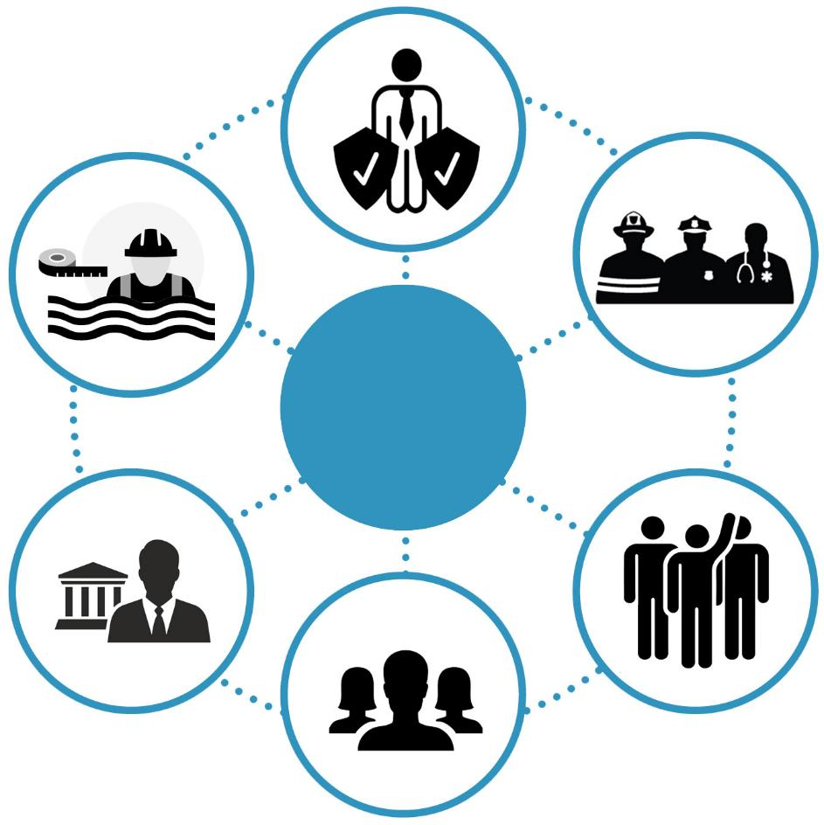
Stakeholders
Risk Reduction Associates
Floodplain
Managers
Emergency Responders
Stakeholders
Local Officials
Volunteers
Public
Notes:
Six targeted stakeholder groups for WVFRF tools and hazard library resources.

Slide 7
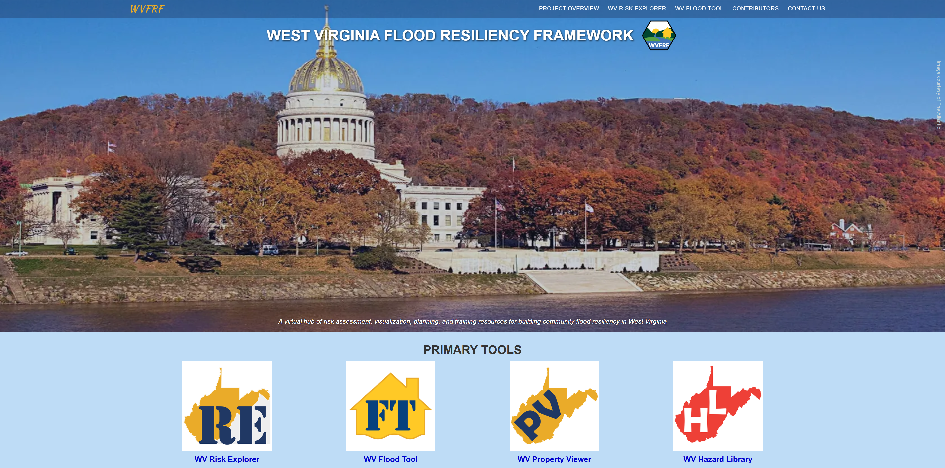
WVFRF Integrated Tools: wvfrf.org
Notes:
A virtual hub of risk assessment, visualization, planning, and training resources for building community flood resiliency in West Virginia
Integrated tools
Focusing on the WVRE
Link: https://wvfrf.org/

Slide 8



Benefits of the Tools
Planning
Enhancing state resiliency and hazard mitigation plans
Updating emergency operation plans
Prioritizing and allocating resources
Identifying the need for more refined risk assessments
Risk Communications
Encouraging community-level risk communication and engagement
Educating new homeowners and renters
Informing the insurance and mortgage industries
Mitigation
Identifying areas of mitigation interest
Supporting the development or enhancement of codes and standards
Informing long-term community recovery
COMMUNITY
ENGAGEMENT
• Focused Outreach Meetings
• Flood Symposium
• Resiliency Tools & Products
• Learning Resources & Reports
RISK TOOLS
• WV Risk Explorer
• WV Flood Tool
• Visualizations
• Dashboards
9 Geographic Scales
HAZARD LIBRARY
Search online hazard resources by title, subject, media, event, geography, data, etc.
STAKEHOLDERS
• Risk Reduction Associates
• Emergency Responders
• Floodplain Managers
• Local Officials
• Volunteers
• Public

Slide 9
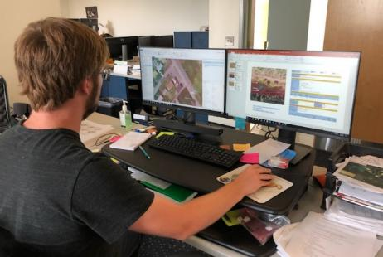

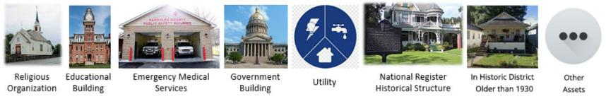
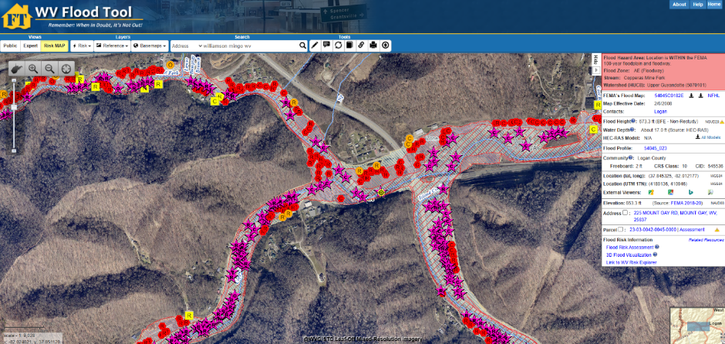

WV Floodplain Building Inventory (BI)
Riverine Flood Exposure Assessment (Building-Level)
Funded by: FEMA Hazard Mitigation Grant Program (HMGP), Cooperating Technical Partners (CTP) Program, and State Hazard Mitigation Office
Detailed building characteristics from tax assessment
+
Damage assessment based on flood loss models
+
Population exposure and displacement estimates (100-yr flood)
Manual process of identification using Arc GIS
+
Programmed scripts to extract and process data
Product: WV Flood Tool mapwv.gov/flood
All primary (insurable) structures in FEMA’s 1%-annual-chance (100-yr) floodplain
Community Assets (Historical & Non-Historical) in the 100-yr floodplain
Essential Facilities in the 100-yr and 500-yr floodplains
COMMUNITY
ENGAGEMENT
• Focused Outreach Meetings
• Flood Symposium
• Resiliency Tools & Products
• Learning Resources & Reports
RISK TOOLS
• WV Risk Explorer
• WV Flood Tool
• Visualizations
• Dashboards
9 Geographic Scales
Essential
Facilities
Community
Assets
HAZARD LIBRARY
Search online hazard resources by title, subject, media, event, geography, data, etc.
STAKEHOLDERS
• Risk Reduction Associates
• Emergency Responders
• Floodplain Managers
• Local Officials
• Volunteers
• Public
Notes:
Floodplains
HEC-RAS model
Link 1 (FT): https://www.mapwv.gov/flood/
Link 2: https://www.mapwv.gov/flood/map/?wkid=102100&x=-9129668&y=4557559&l=9&v=2
Use of Hazus model for damage estimation by depth damage curves

Slide 10

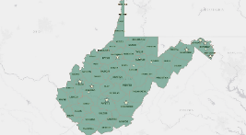
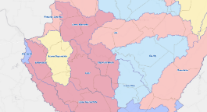
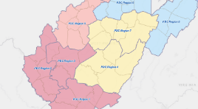
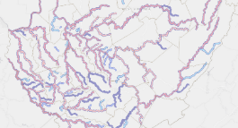
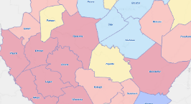
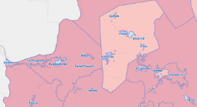
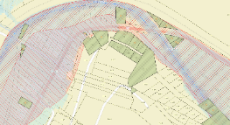
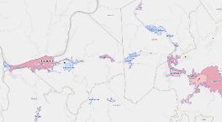
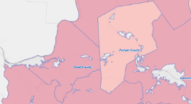
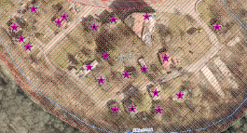
Analytical & Visualization Tools at Multiple Scales
Political Boundaries
Drainage Areas / Streams
State
Watersheds
(33)
PDC Regions (11)
Streams/Rivers
(156)
Counties (55)
Property Levels
Communities (284)
Parcels
Incorporated Places
(229)
Unincorporated Areas
(55)
Buildings
Notes:
The WV Flood Tool and WV Risk Explorer applications quantify riverine flood risk at the building and summary geographic levels, respectively. Cumulative risk rankings at different geographic scales and entities are computed from various risk indicators, including building, people, and social-economic factors.
Flood Tool: Building/Parcel-Level; New tools: Aggregation ability

Slide 11
WV Flood Risk Index
Overall Flood Risk
(1) FLOODPLAIN CHARACTERISTICS
(2) BUILDING EXPOSURE
(3) BUILDING CHARACTERISTICS
(4) CRITICAL INFRASTRUCTURE
(5) COMMUNITY ASSETS
(6) BUILDING DAMAGE LOSS
(7) PEOPLE / SOCIAL VULNERABILITIES
(8) OTHER HAZARDS
Floodplain Area
Building Floodplain Count¹ ²
Building Value¹ ²
Essential Facilities
Historical Assets
Substantial Damage Estimates*¹ ²
Population in Floodplain
Landslides
Floodplain Length¹ ²
Building Floodway Count¹ ²
Mobile Homes
Roads Inundated
Non-Historical Assets
Previous Claims
Population Displaced
Karst**
Floodplain Depth¹ ²
Building Floodplain Ratio²
Basement
Repetitive Losses
WV Social Vulnerability Index
Dam/Levee Failure**
Flood Disaster Frequency
Building Density¹ ²
One Story
Building Year*
Used for the Index
* Multiple Indicators
** In Progress
1
River/Stream Indicator
2
Watershed Indicator
Notes:
Categories 1 to 7 used to develop the risk index

Slide 12
Geographic Entities at VERY HIGH Risk (Top 10%)
RANK | All Communities | Index Score
1 | New Martinsville - Incorporated | 100.0%
2 | Boone County* - Unincorporated | 99.6%
3 | Clendenin - Incorporated | 99.2%
4 | Marlinton - Incorporated | 98.9%
5 | Wheeling** - Incorporated | 98.5%
6 | McDowell County* - Unincorporated | 98.2%
7 | Alderson** - Incorporated | 97.8%
8 | Wayne County* - Unincorporated | 97.5%
9 | Parsons - Incorporated | 97.1%
10 | Kanawha County* - Unincorporated | 96.8%
11 | Madison - Incorporated | 96.4%
12 | Kimball - Incorporated | 96.1%
13 | Lincoln County* - Unincorporated | 95.7%
14 | Milton - Incorporated | 95.4%
15 | Mingo County* - Unincorporated | 95.0%
16 | Logan County* - Unincorporated | 94.6%
17 | Danville - Incorporated | 94.3%
18 | Wellsburg - Incorporated | 93.9%
19 | Oceana - Incorporated | 93.6%
20 | Rowlesburg - Incorporated | 93.2%
21 | Northfork - Incorporated | 92.9%
22 | Gary - Incorporated | 92.5%
23 | Wyoming County* - Unincorporated | 92.2%
24 | Welch - Incorporated | 91.8%
25 | Summers County* - Unincorporated | 91.5%
26 | Buckhannon - Incorporated | 91.1%
27 | Richwood - Incorporated | 90.8%
28 | Ceredo - Incorporated | 90.4%
29 | Mannington - Incorporated | 90.1%
Incorporated Places | Index Score
Clendenin - Incorporated | 100.0%
New Martinsville - Incorporated | 99.5%
Alderson** - Incorporated | 99.1%
Marlinton - Incorporated | 98.6%
Kimball - Incorporated | 98.2%
Parsons - Incorporated | 97.8%
Wheeling** - Incorporated | 97.3%
Northfork - Incorporated | 96.9%
Danville - Incorporated | 96.4%
Madison - Incorporated | 96.0%
Milton - Incorporated | 95.6%
Oceana - Incorporated | 95.1%
Keystone - Incorporated | 94.7%
Wellsburg - Incorporated | 94.2%
Gary - Incorporated | 93.8%
Rowlesburg - Incorporated | 93.4%
Grantsville - Incorporated | 92.9%
Richwood - Incorporated | 92.5%
Rainelle - Incorporated | 92.1%
Mannington - Incorporated | 91.6%
Spencer - Incorporated | 91.2%
Welch - Incorporated | 90.7%
Buckhannon - Incorporated | 90.3%
Unincorporated Areas | Index Score
Kanawha County* - Unincorporated | 100.0%
Boone County* - Unincorporated | 98.1%
Wayne County* - Unincorporated | 96.2%
McDowell County* - Unincorporated | 94.4%
Mingo County* - Unincorporated | 92.5%
Logan County* - Unincorporated | 90.7%
Counties | Index Score
Kanawha | 100.0%
Boone | 98.1%
McDowell | 96.2%
Logan | 94.4%
Mingo | 92.5%
Wyoming | 90.7%
Regions | Index Score
PDC Region 2 | 100%
PDC Region 3 | 90%
RANK | Streams (Top 20) | Index Score
1 | Coal River | 100.0%
2 | Ohio River | 99.7%
3 | Little Coal River | 99.5%
4 | Greenbrier River | 99.3%
5 | Davis Creek | 99.1%
6 | Island Creek | 98.9%
7 | Kanawha River | 98.7%
8 | Campbells Creek | 98.4%
9 | Wheeling Creek | 98.2%
10 | Pocatalico River | 98.0%
11 | Cacapon River | 97.8%
12 | Big Coal River | 97.6%
13 | Mud River | 97.4%
14 | Cabin Creek | 97.1%
15 | Pond Fork | 96.9%
16 | Elk River | 96.7%
17 | Twelvepole Creek | 96.5%
18 | Buckhannon River | 96.3%
19 | South Branch Potomac River | 96.1%
20 | Paint Creek | 95.8%
Watersheds | Index Score
Lower Kanawha | 100%
Coal | 96.7%
Upper Kanawha | 93.5%
Tug | 90.3%
Last update: Aug. 2024
Streams & Watersheds: Jul. 2025
Colors:
Black --> Incorporated places
Black on yellow** --> Split communities
Black on blue: Incorporated communities included in the detailed risk report (Camden-on-Gauley, Clendenin, Marlinton, Rainelle, Richwood, and White Sulphur Springs)
Brown on gray --> Unincorporated areas
Green --> Counties (Total)
Notes:
Next update in 2027 may change the rankings

Slide 13
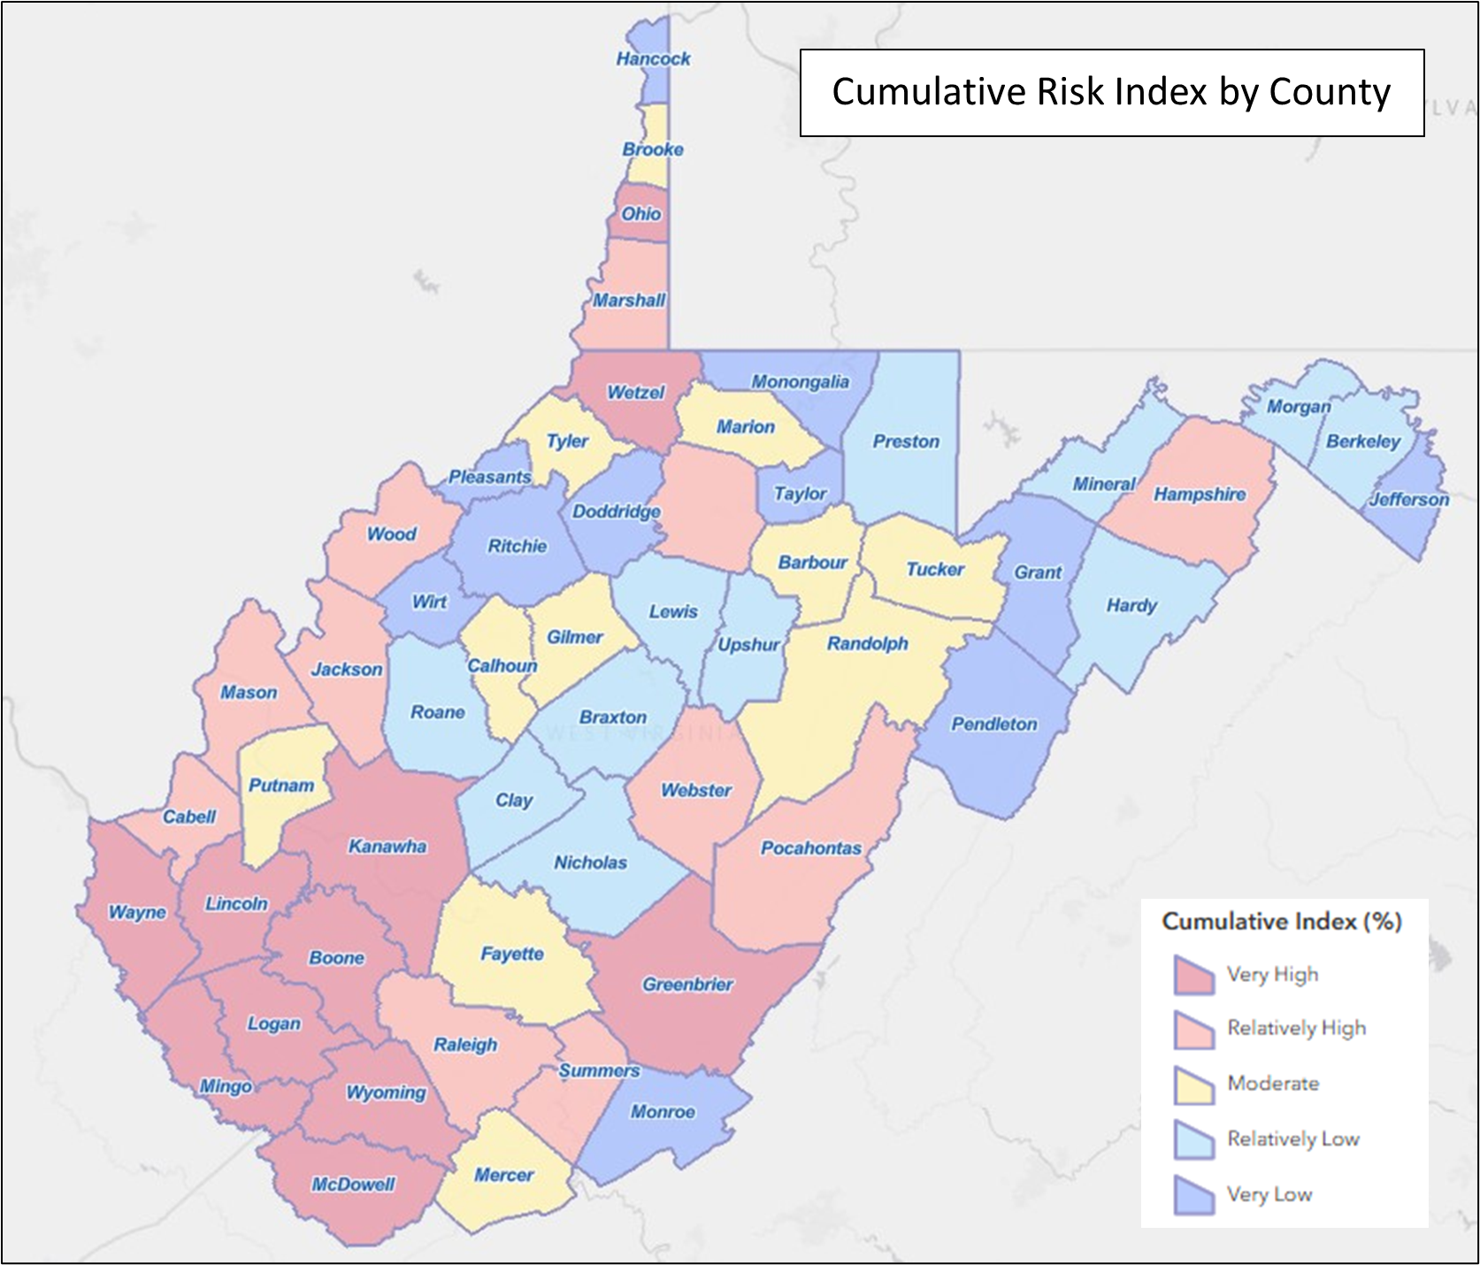
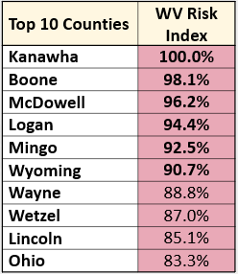
Cumulative Risk Index Map
Last update: Aug. 2024
Notes:
Next update in 2027 may change the rankings
High-risk areas mostly Southwest neighboring KY

Slide 14

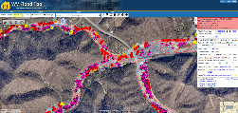
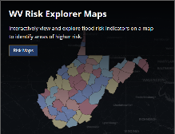
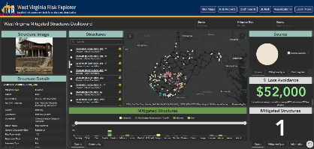
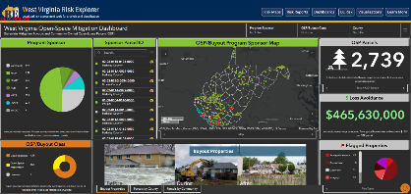
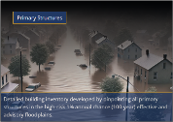
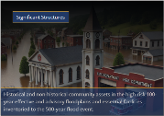


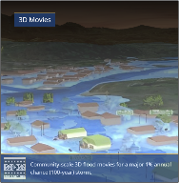
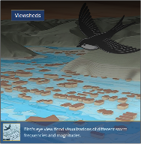


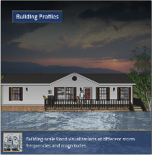
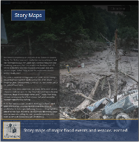
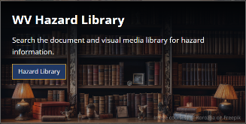

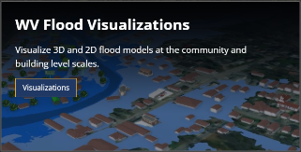
West Virginia Risk Explorer (WVRE): wvfrf.org/wvre
Risk Assessment Tools
Localized riverine flood risk assessment by quantifying and aggregating detailed building-level data at multiple scales
Help identify the communities most at risk of riverine flooding for efficient allocation of limited mitigation resources
Mitigation Assessment Tools
Quantifies mitigation efforts such as elevation, relocation, and buyouts and calculation of loss estimates
Enable planners and decision-makers to evaluate past and ongoing efforts, identify gaps, and prioritize future investments
Building/Property-Level
Aggregated
Mitigated Structures Dashboard
Open-Space Mitigation Dashboard
Risk Communication Tools
Scenario-based 2D and 3D visualizations for effective risk communication
Facilitate risk comprehension for various stakeholders to support informed decision-making and encourage public engagement
Hazard Library and Data Access
Access to online hazard resources including data, documents, and media searchable by title, subject, event, geography, and more.
Allow users to access comprehensive datasets for use in analyses, maps, or applications to support planning, research, and decision-making related to hazard mitigation and response
Notes:
Click on the images to open the tools for a short demo
Link (WVRE landing page): https://www.wvfrf.org/wvre/

Slide 15
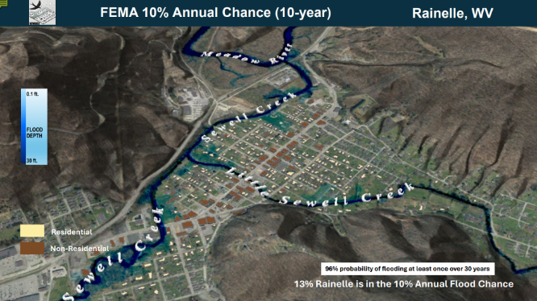
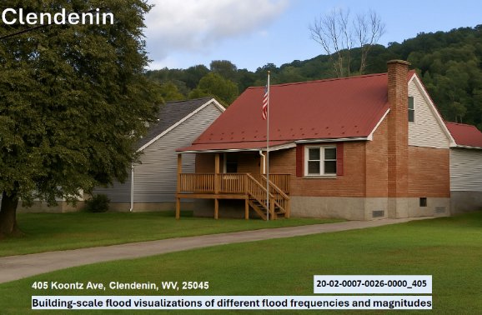
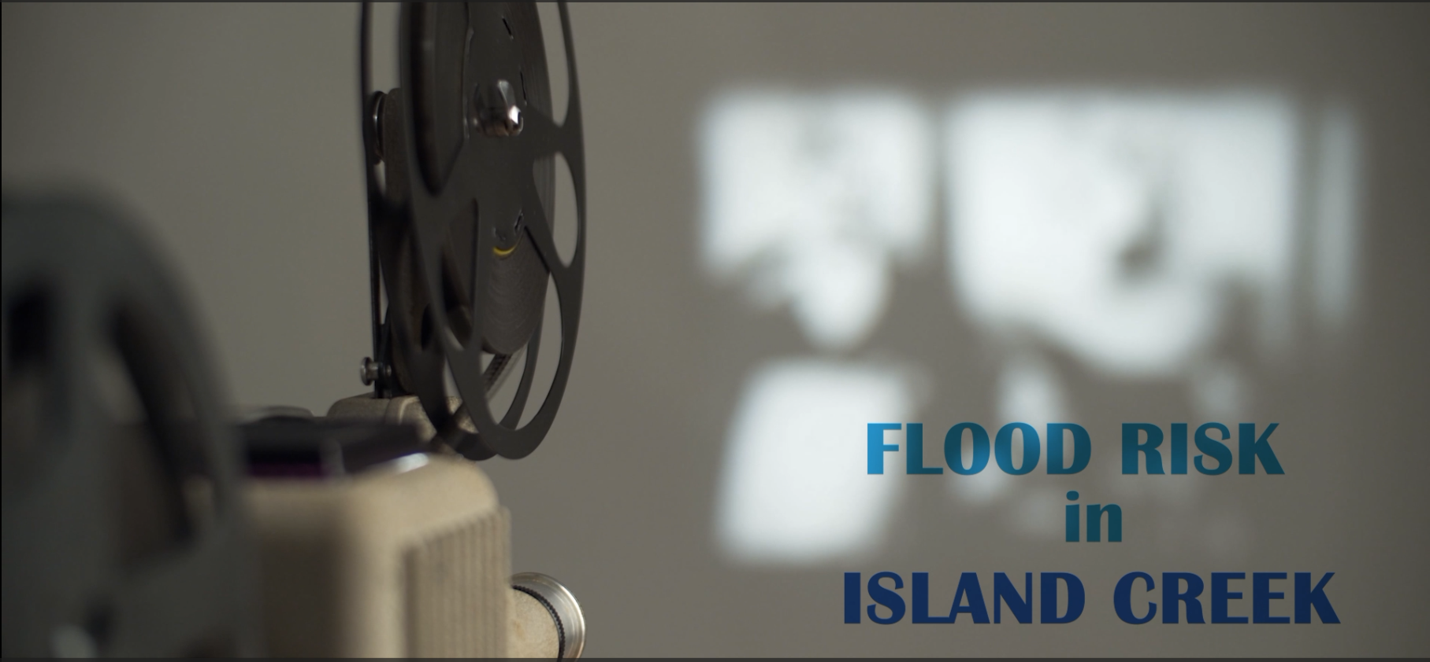
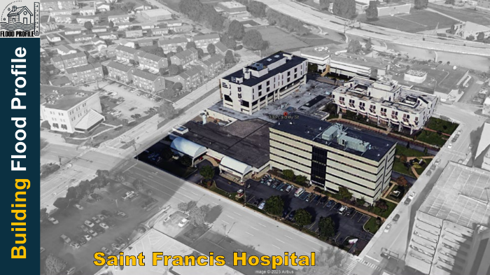
Risk Communication Tools: Visualization Examples
Viewshed for Rainelle
Building Profile in Clendenin
3D Movie for Logan County
Building Profile in Charleston
Notes:
Click on the images to open the links
Link 1 (Viewshed for Rainelle): https://data.wvgis.wvu.edu/pub/RA/HL/RA-L/VIEWSHED/Rainelle/VIEWSHED_Rainelle_2024.pdf
Link 2: (Building Profile in Clendenin) : https://data.wvgis.wvu.edu/pub/RA/HL/RA-L/BLDG-PROFILE/BLDG-PROFILE_Clendenin_2025.pdf
Link 3: (3D Movie for Marlinton): https://data.wvgis.wvu.edu/pub/RA/HL/RA-L/MOVIE/3DMovie_Marlinton_2024.mp4
Link 4: : (Building Profile in Charleston): https://data.wvgis.wvu.edu/pub/RA/HL/RA-L/BLDG-PROFILE/BLDG-PROFILE_Charleston_Saint-Francis-Hospital_2025.pdf

Slide 16


Future Direction
Maintenance and Data Updates
Training and Technical Support
Sustainable Funding for Ongoing Operations of the Tools
Framework Adaptation and Regional Expansion
Building a more resilient future, together!
Notes:
Begging slide ☺

Slide 17



Thank you!
Questions?
Email:
behrang.bidadian@mail.wvu.edu
kurt.donaldson@mail.wvu.edu

Slide 18
Backup Slides

Slide 19













Social Vulnerability
Communities with higher social vulnerability are less able to prepare for, respond to, and recover from flood disasters quickly and fully.
Social Vulnerability Index (WV SVI) (0% to 100%)
Combines indicators of:
Poverty Rate
Unemployment Rate
Vulnerable Ages Rate
Disability Rate
Population without a High School Diploma
Population Change
Median Housing Unit Value
Percentage of Mobile Homes in Housing Units
Top 5
Counties
Notes:
Click on the images to open the links
Link1 (Risk Reports): https://www.wvfrf.org/wvre/report/?entityid=68&scaleid=1&type=all
Link 2 (County-Level): https://wvfrf.org/wvre/report/?scaleid=3&entityid=all&type=comparison
Link3 (SVI map): https://wvfrf.org/wvre/map/?scaleid=3&gslid=&index=PR_WV_SVI&type=pct

Slide 20








User Guides
WVRE One-Pager
WVRE Learn More Page
WVRE Technical Document
https://wvfrf.org/wvre/more/
Metadata Documents
https://data.wvgis.wvu.edu/pub/RA/HL/WVFRF/Flyer/WVRE_Info_OnePager.pdf
https://data.wvgis.wvu.edu/pub/RA/HL/Data/RA-AL/1a_AL-RISK-INDEX/2_Metadata/WV_RiskIndex_DataDictionary.pdf
https://data.wvgis.wvu.edu/pub/RA/HL/Data/RA-AL/1b_AL-MATRIX/2_Metadata/Full_Matrix_DataDictionary.pdf
WVRE Demo (Video)
https://data.wvgis.wvu.edu/pub/RA/HL/Data/RA-BL/2a_BL-BLRA/3_Metadata/Full_BLRA_Metadata.pdf
https://data.wvgis.wvu.edu/pub/RA/RI/WVRE/DOCS/WVRE_TechnicalDoc.pdf
https://data.wvgis.wvu.edu/pub/RA/HL/WVFRF/Video/WV_Risk_Explorer_Movie_20240826.mp4
https://data.wvgis.wvu.edu/pub/RA/HL/Data/RA-BL/2b_BL-SIG-STRC/1_All_Sig_Structures/2_Metadata/Significant_Structures_Metadata.pdf
Notes:
Click on the images to open the links

Slide 21






Hazard Library and Data Access
Online hazard resources including comprehensive datasets, documents, and media
Notes:
Click on the images to open the links
Link 1: HL: https://www.wvfrf.org/library/
Link 2: Access Data: https://wvfrf.org/wvre/data/home/

