Slide 1
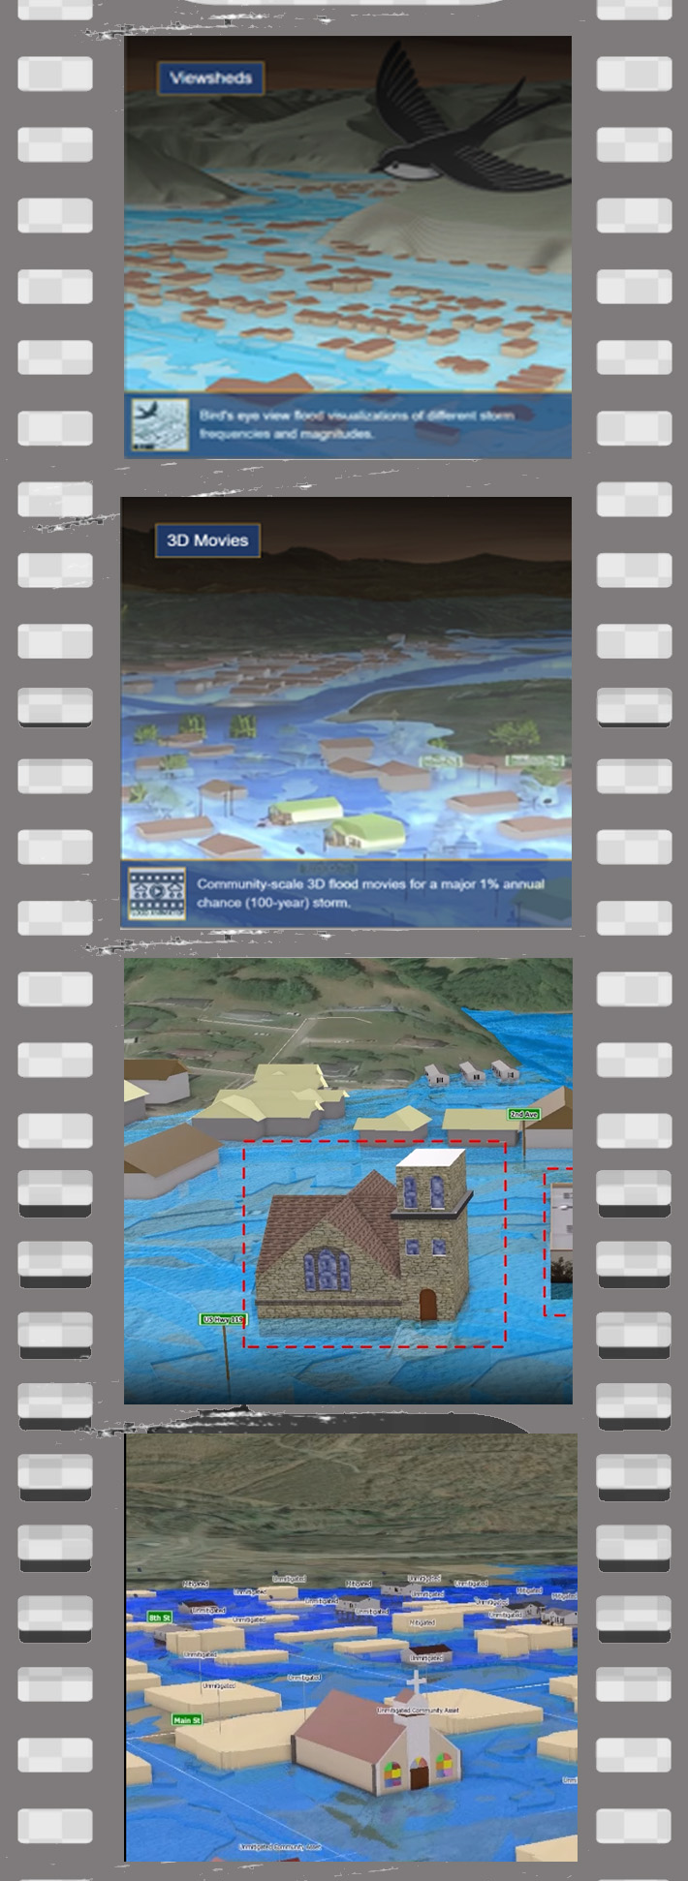


USING 3D GIS VISUALIZATION
for
Flood Risk Planning and Communication
Annie Mahmoudi
WV GIS TECHNICAL CENTER

Slide 2
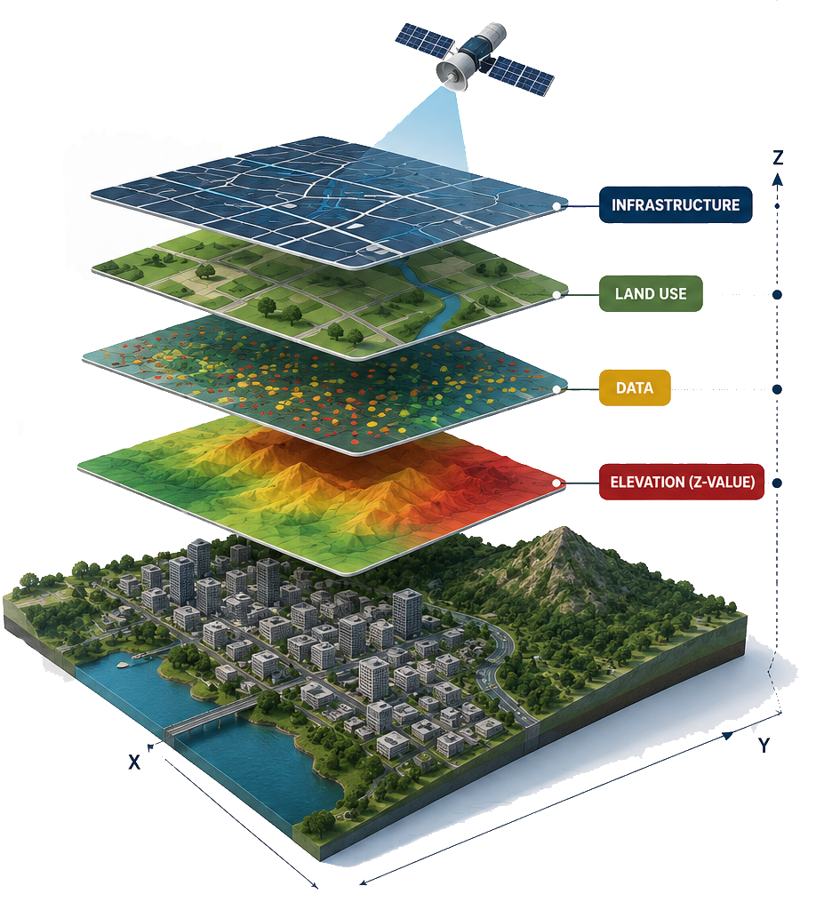
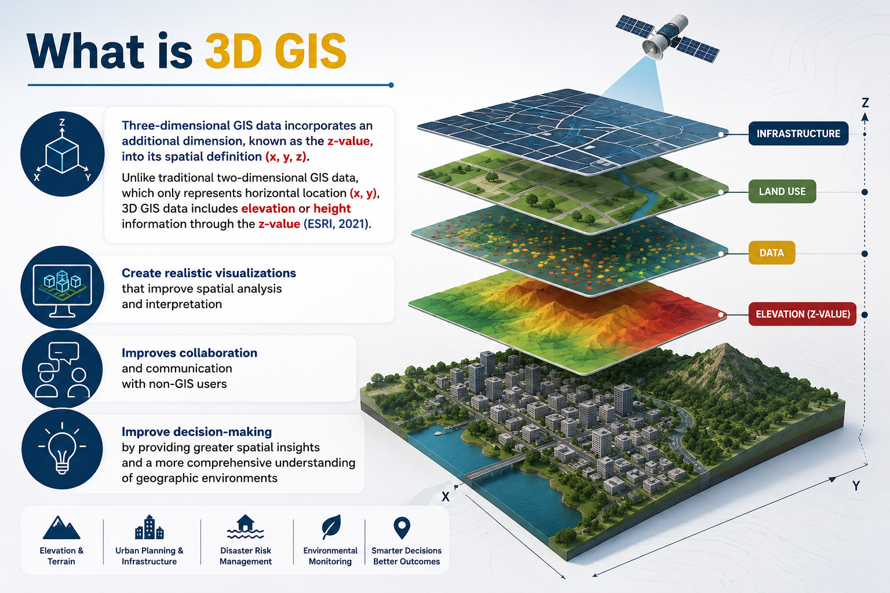
What Is 3D GIS
Three-dimensional GIS data incorporates an additional dimension, known as the z-value, into its spatial definition (x, y, z). Unlike traditional two-dimensional GIS data, which only represents horizontal location (x, y), 3D GIS data includes elevation or height information through the z-value (ESRI, 2021).
Create realistic visualizations that improve spatial analysis and interpretation
Improves collaboration and communication with non-GIS users
Improve decision-making by providing greater spatial insights and a more comprehensive understanding of geographic environments

Slide 3
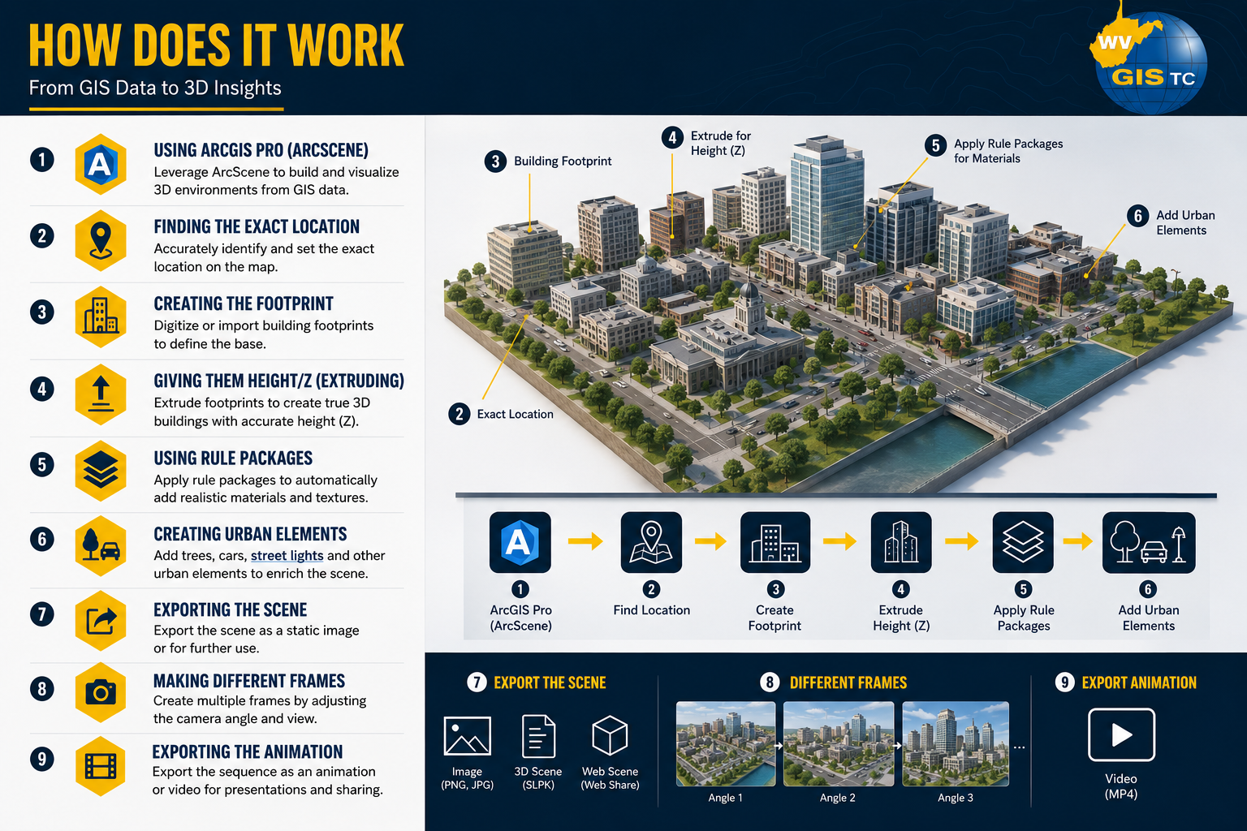
HOW DOES IT WORK
From GIS Data to 3D insights
Using ArcScene
Finding the Exact Location
Creating the Footprint
Giving them Height/Z (Extruding)
Using Rule Packages
Creating Different Urban Elements
Exporting the Scene
Making Different Frames
Exporting the Animation

Slide 4
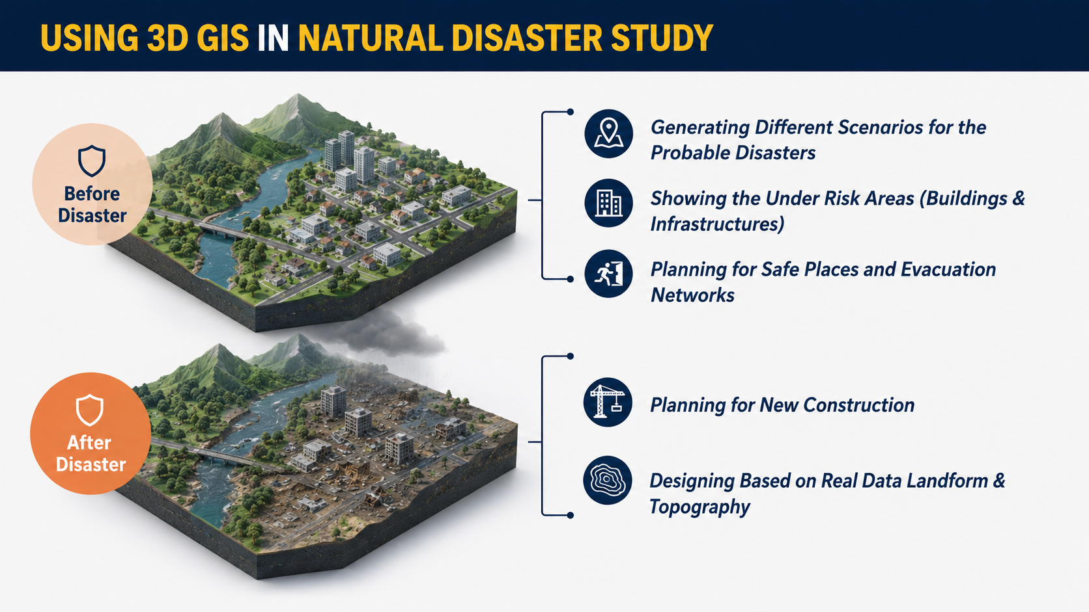
USING 3D GIS IN NATURAL DISASTER STUDY
Generating Different Scenarios for the Probable Disasters
Before Disaster
Showing the Under Risk Areas (Buildings & Infrastructures)
Planning for Safe Places and Evacuation Networks
After Disaster
Planning for New Construction
Designing Based on Real Data Landform & Topography

Slide 5
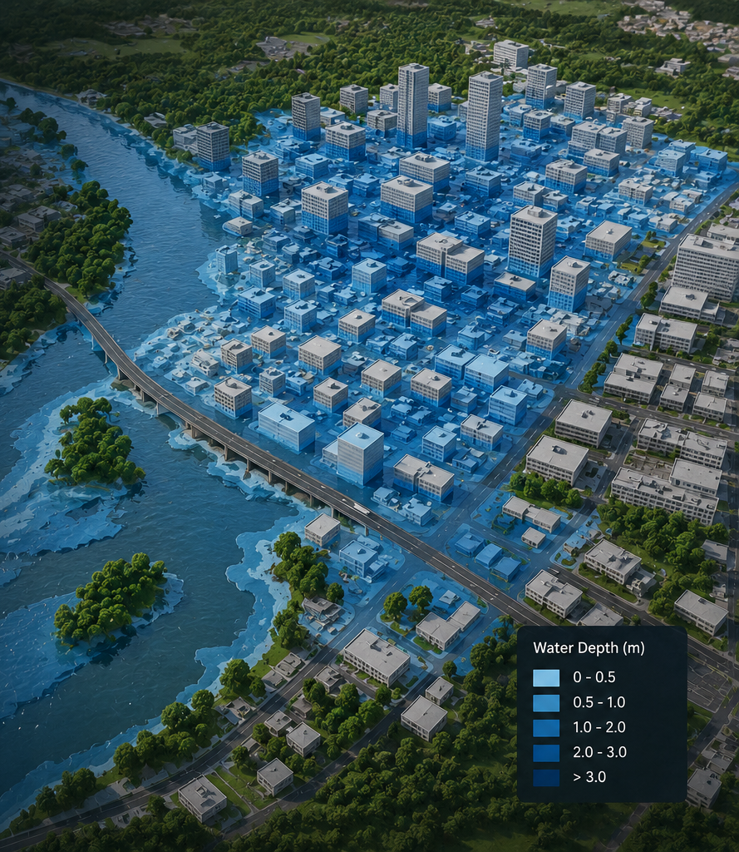
ROLE OF 3D GIS IN FLOOD SCENARIOS
Presenting the Areas Located in High-Risk Flood Zones
Making Water Depths by Extruding the Flood Data Polygons
Accurately Showing the Inundated Areas and the Depth of Inundation
Camera is Placed at Different Angles to Show the Extension of Flooding (Like a Video Captured by a Drone During Flooding)

Slide 6
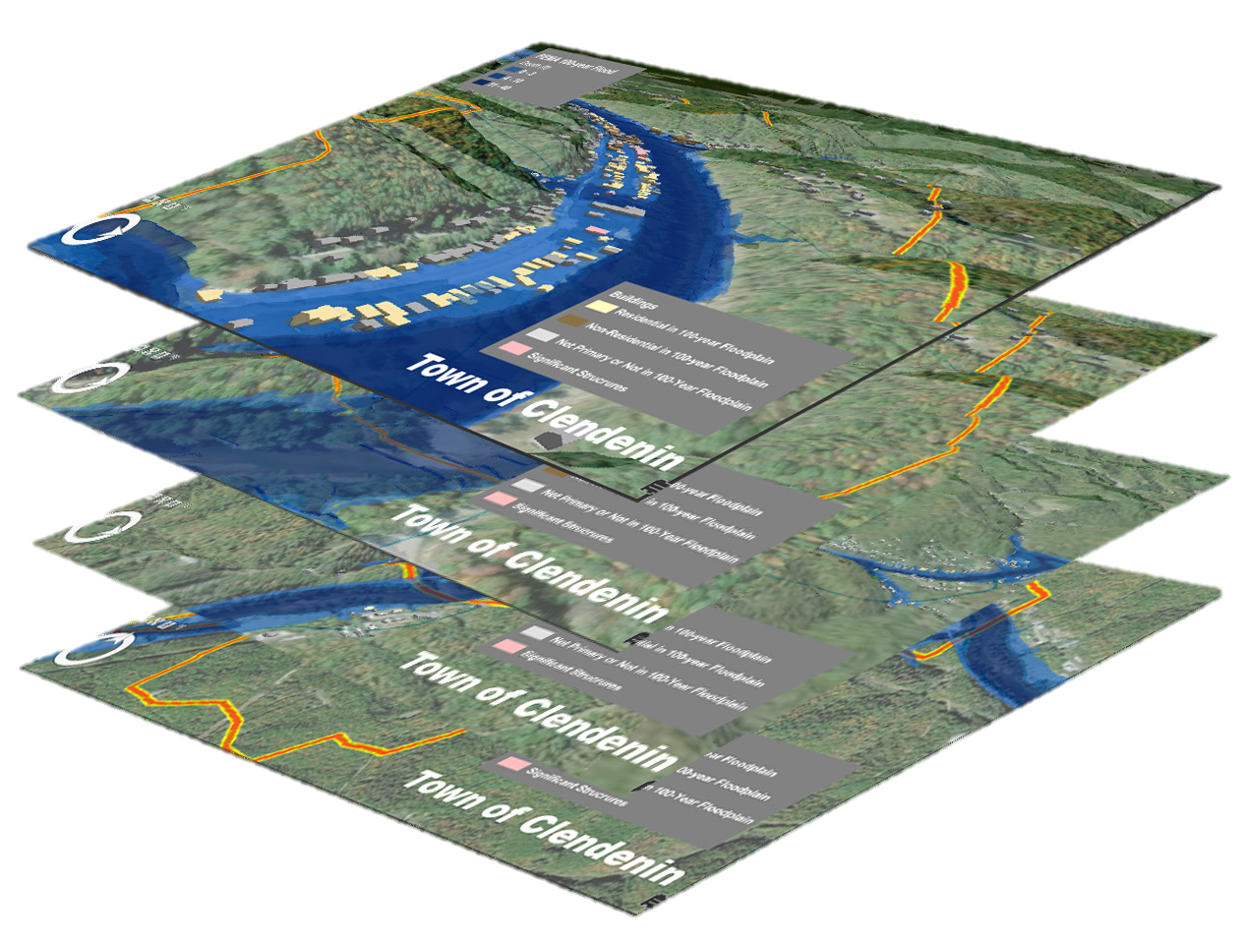
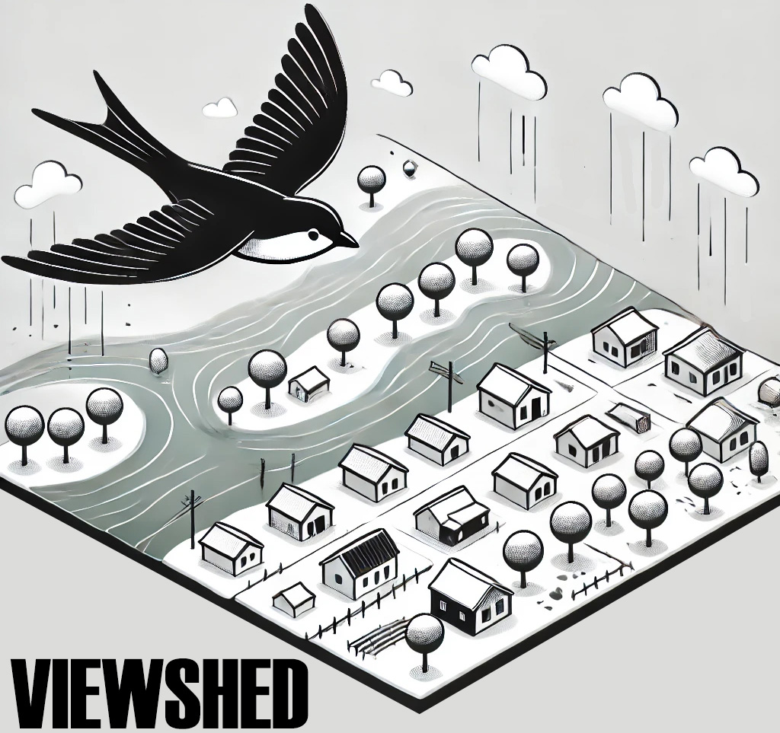

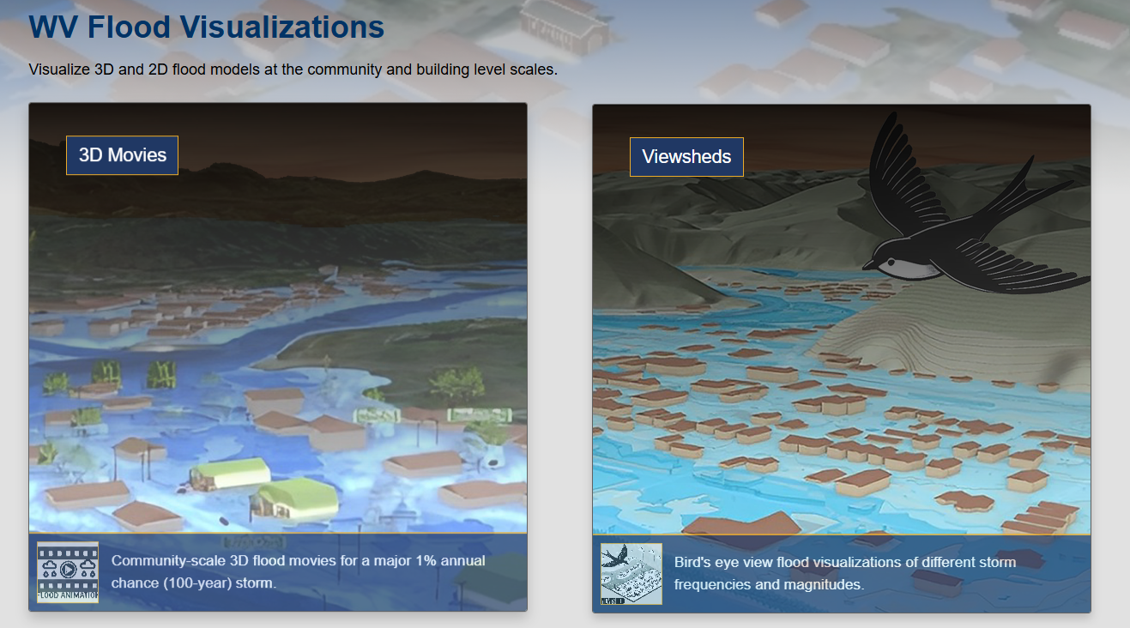
DEVELOPING FLOOD SCENARIOS by WV GISTC
VIEWSHEDS
Showing Different Flood Intervals (10-year, 25-year, 50-year, 100-year, and 500-year) in a Community.
The Inundated Areas are calculated, and the flooded areas are presented.
Accessible Through WV Hazard Library & WV Risk Explorer.

Slide 7
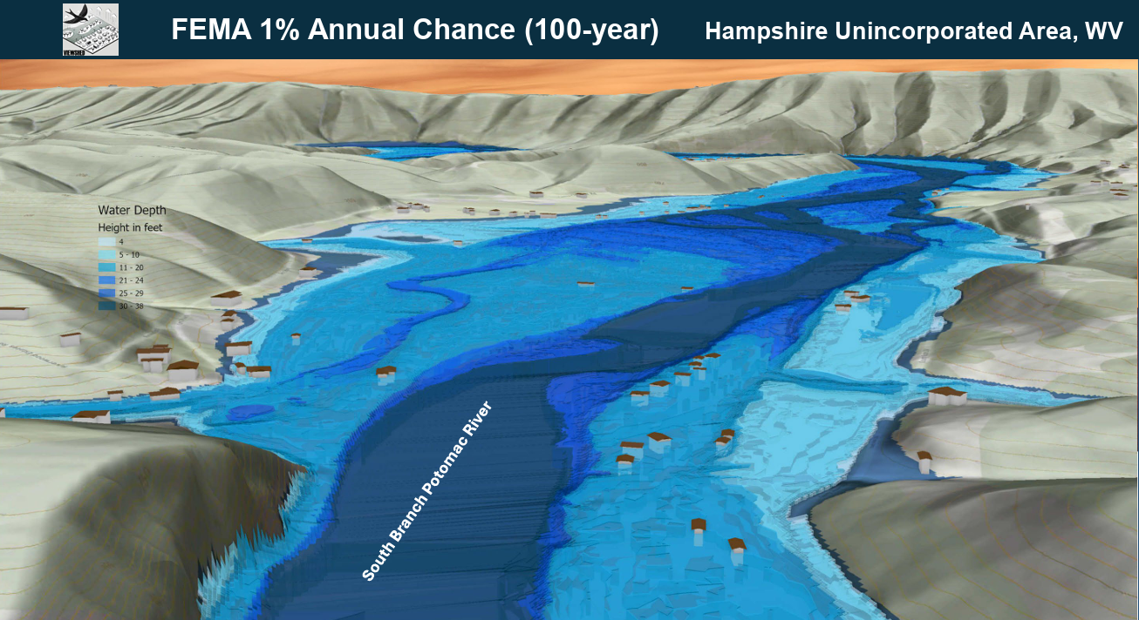
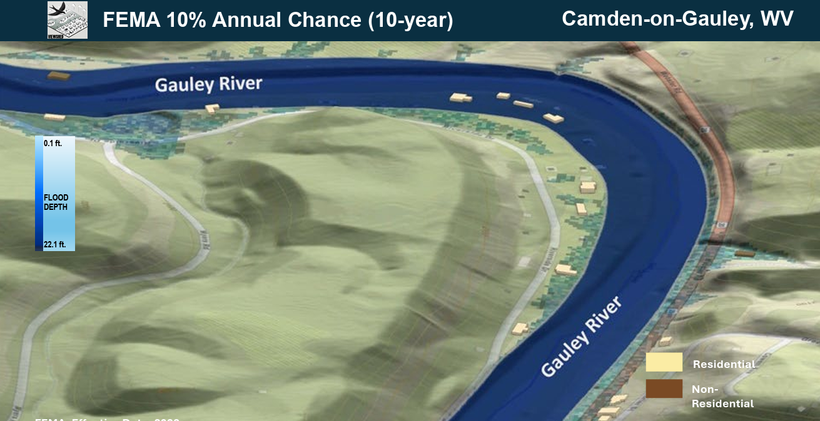
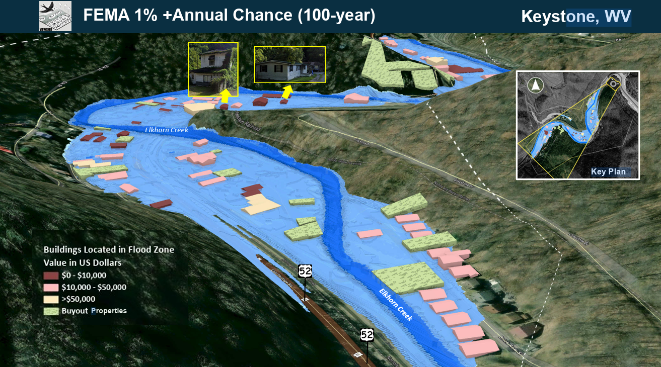
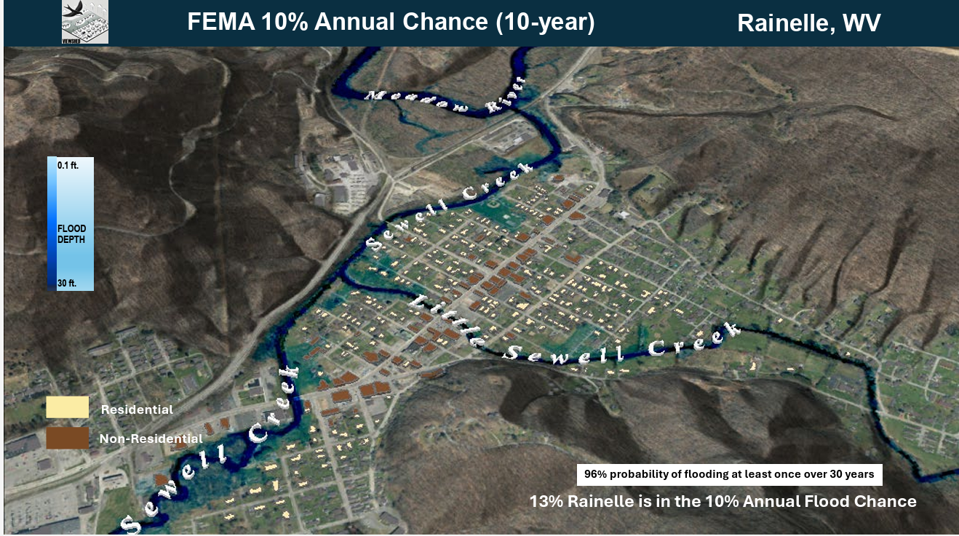
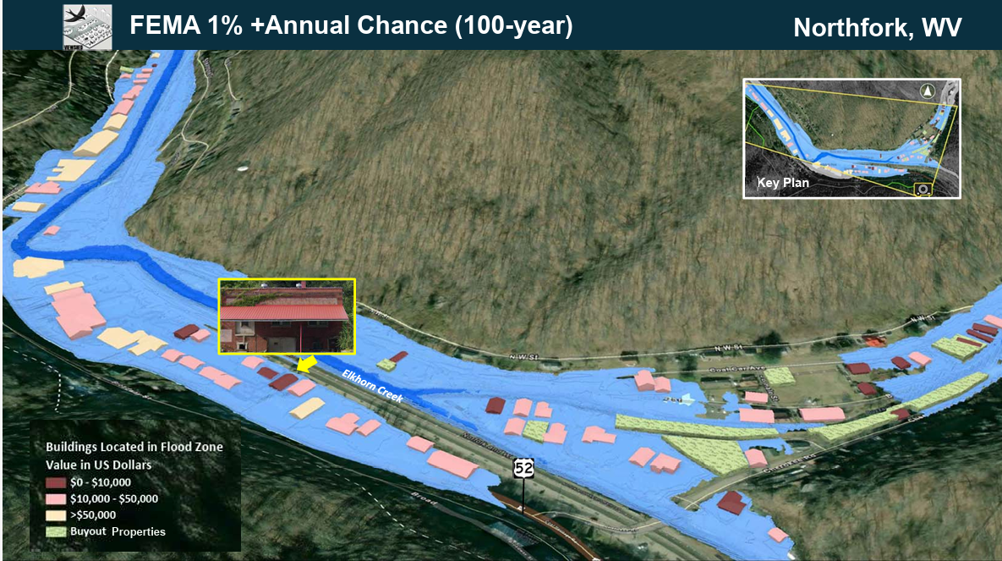
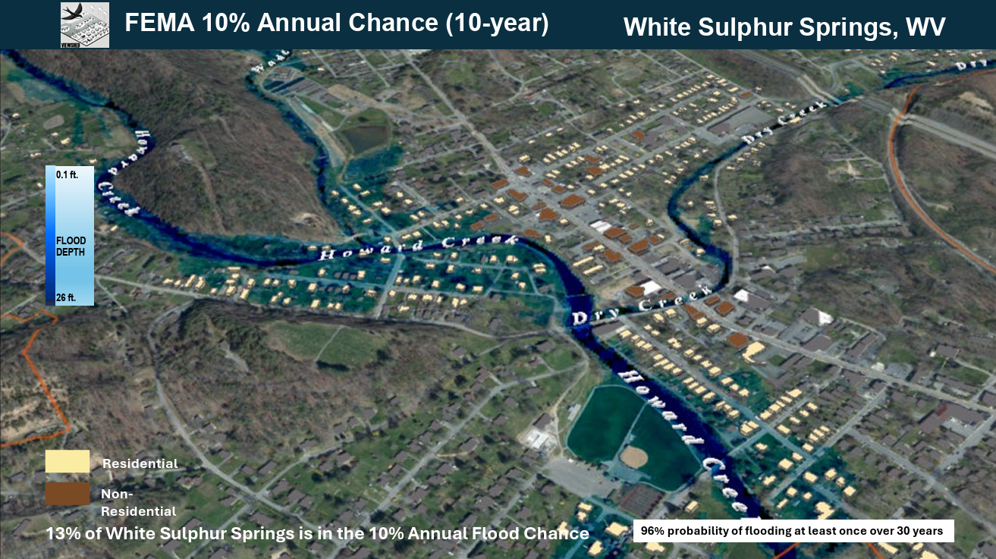
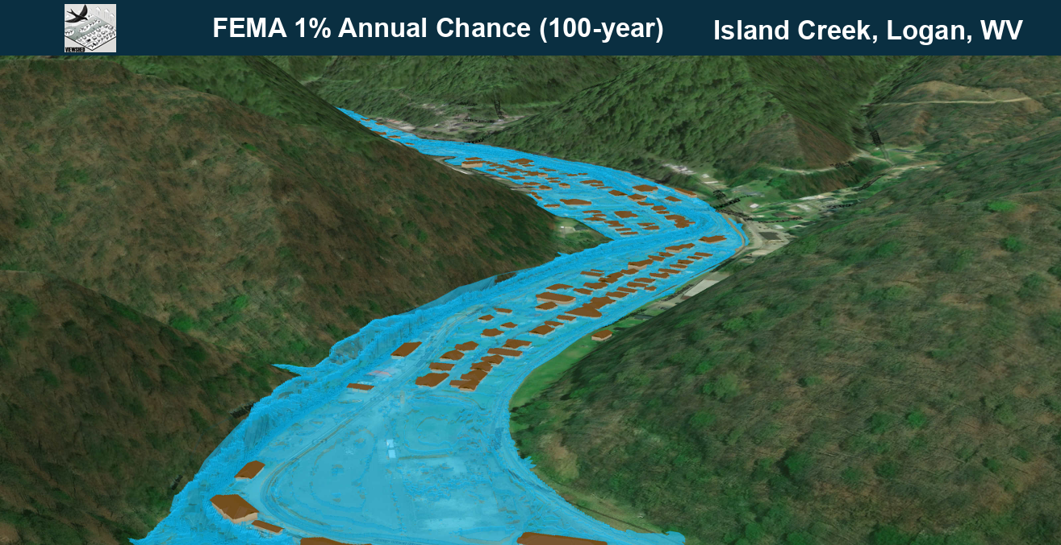
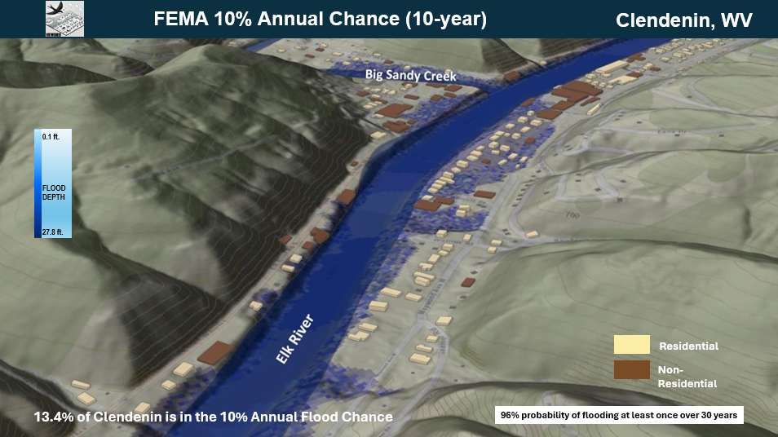
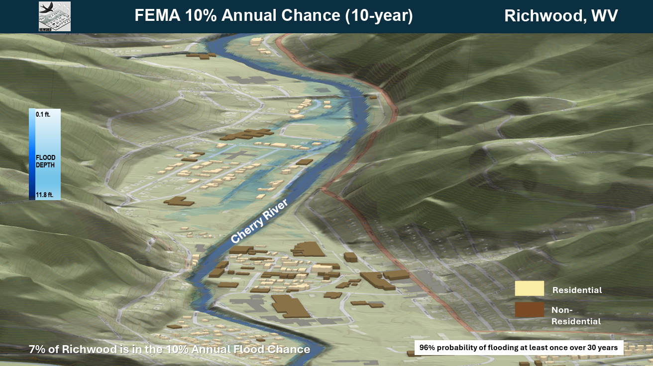
VIEWSHED
Hampshire Unincorporated Area
Camden on Gauley,
Webster County
Keystone, McDowell County
Rainelle, Greenbrier County
Northfork, McDowell County
White Sulphur Springs,
Greenbrier County
Clendenin, Kanawha County
Island Creek, Logan County
Richwood, Nicholas County

Slide 8
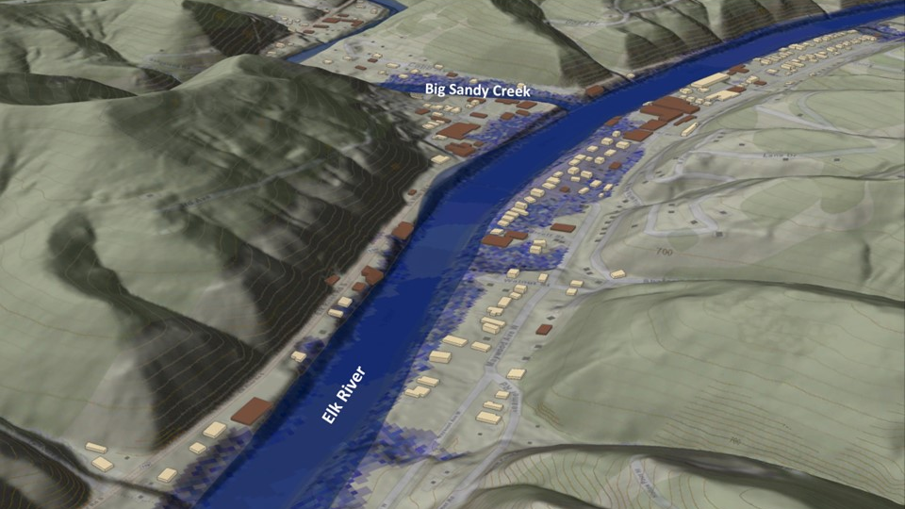
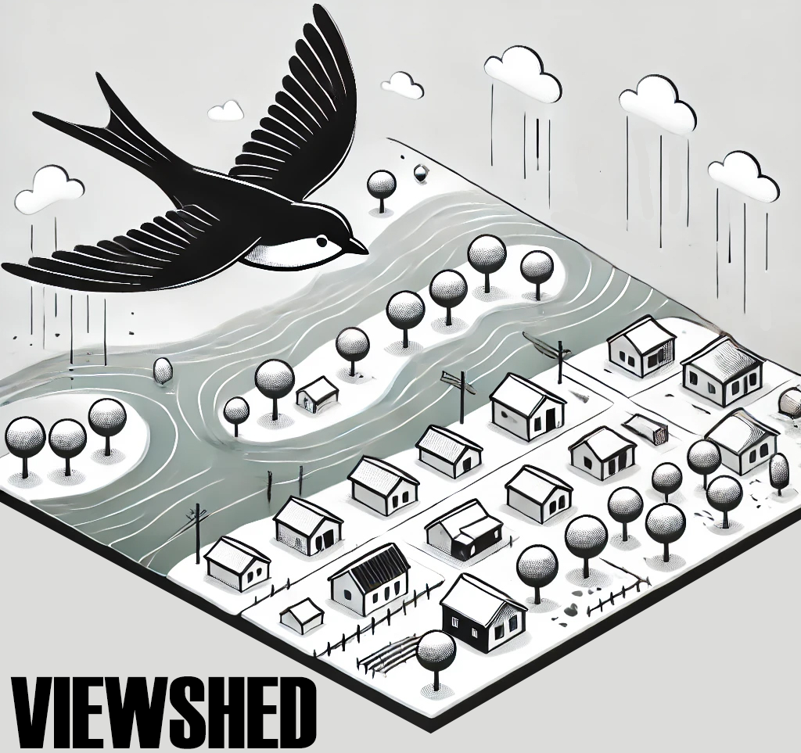
FEMA 10% Annual Chance (10-year)
Clendenin, WV
0.1 ft.
FLOOD DEPTH
27.8 ft.
Residential
Non-Residential
13.4% of Clendenin is in the 10% Annual Flood Chance
96% probability of flooding at least once over 30 years

Slide 9
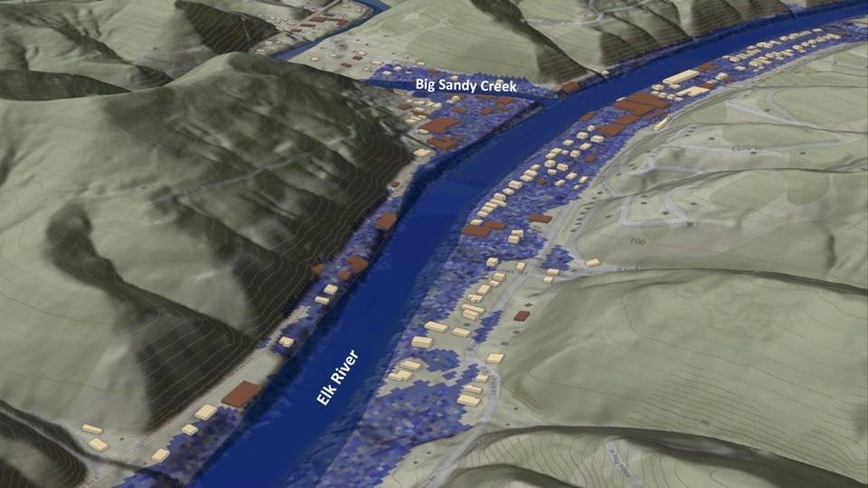
FEMA 4% Annual Chance (25-year)
Clendenin, WV
0.1 ft.
FLOOD DEPTH
27.8 ft.
Residential
Non-Residential
19% of Clendenin is in the 4% Annual Flood Chance
71% probability of flooding at least once over 30 years

Slide 10
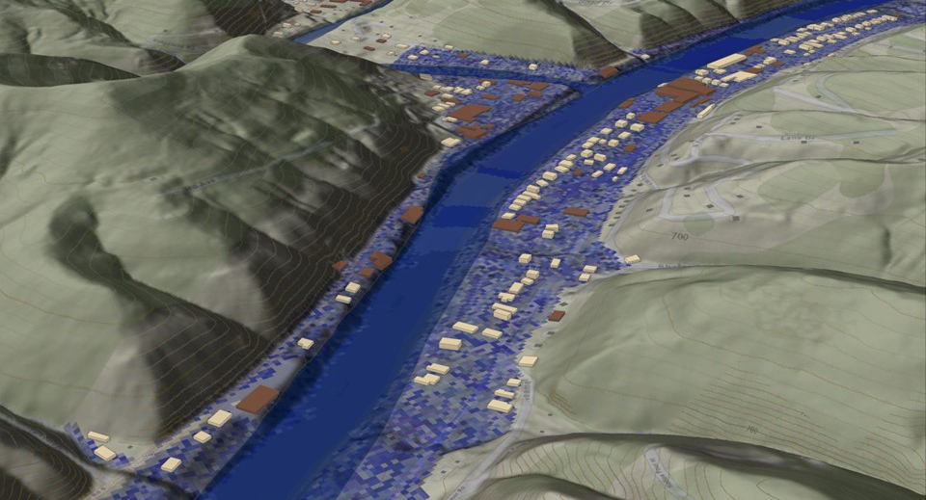
FEMA 2% Annual Chance (50-year)
Clendenin, WV
0.1 ft.
FLOOD DEPTH
35.2 ft.
Residential
Non-Residential
22.5% of Clendenin is in the 4% Annual Flood Chance
45% probability of flooding at least once over 30 years

Slide 11
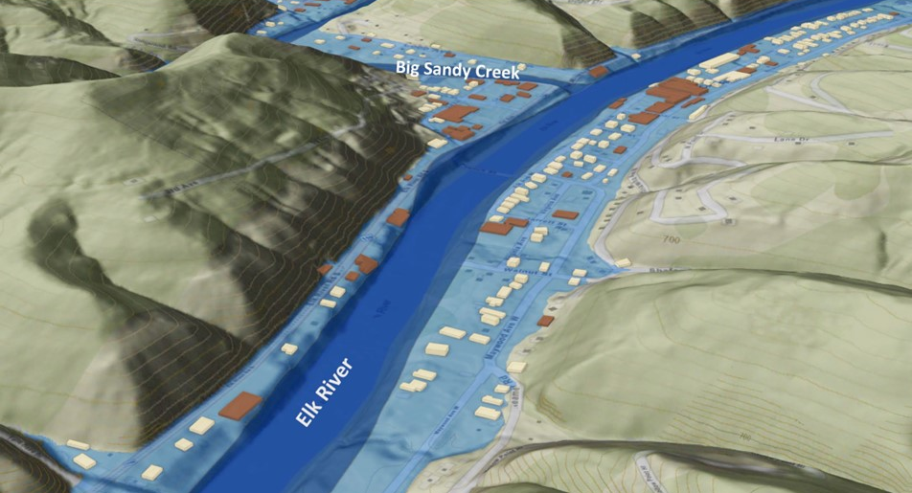
FEMA 1% Annual Chance (100-year)
Clendenin, WV
0.1 ft.
FLOOD DEPTH
38.1 ft.
Residential
Non-Residential
FEMA, Effective Date: 2023
23.5% of Clendenin is in the 1% Annual Flood Chance
26% probability of flooding at least once over 30 years

Slide 12
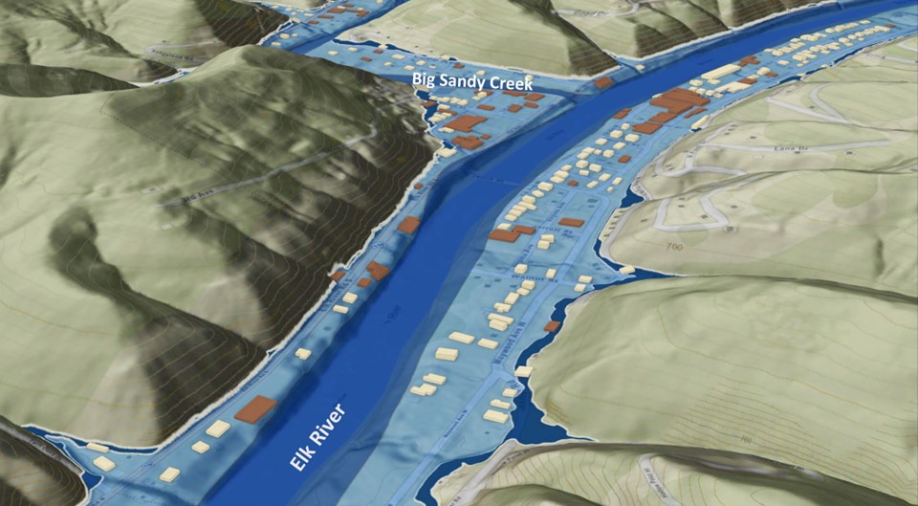
FEMA 0.2% Annual Chance (500-year)
Clendenin, WV
0.1 ft.
FLOOD DEPTH
43.6 ft.
Residential
Non-Residential
25% of Clendenin is in the 0.2% Annual Flood Chance
6% probability of flooding at least once over 30 years

Slide 13
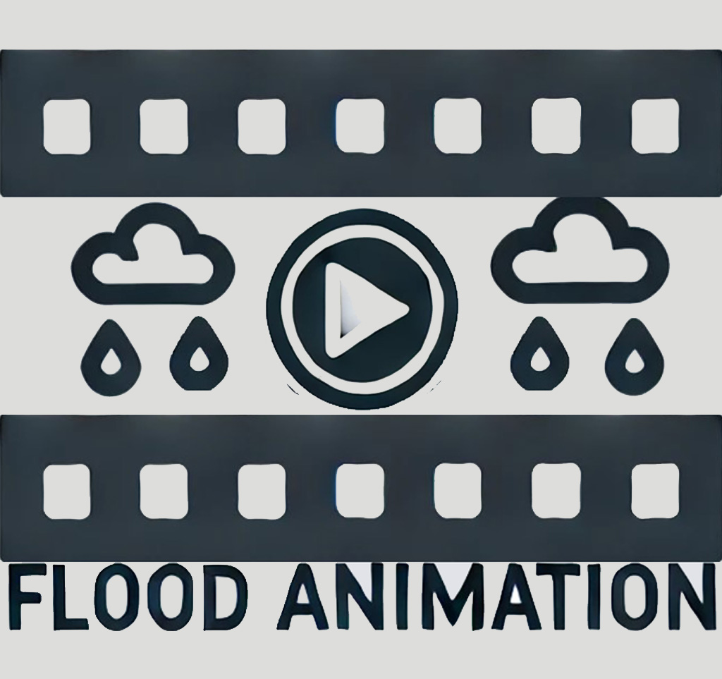


DEVELOPING FLOOD SCENARIOS by WV GISTC
3D FLOOD MODELING
A Flood Animation is made in ArcGIS Pro to show a 100-year or 500-year Flood in a Community. It highlights flood depths and Inundated Buildings, Roads, and Critical Infrastructures.
Accessible Through WV Hazard Library & WV Risk Explorer.
3D modeling and animation are powerful tools for visualizing flood hazards. They allow local communities to see the real-world impact of a flood, providing clarity that technical 2D maps
often fail to convey.
IMPORTANT

Slide 14
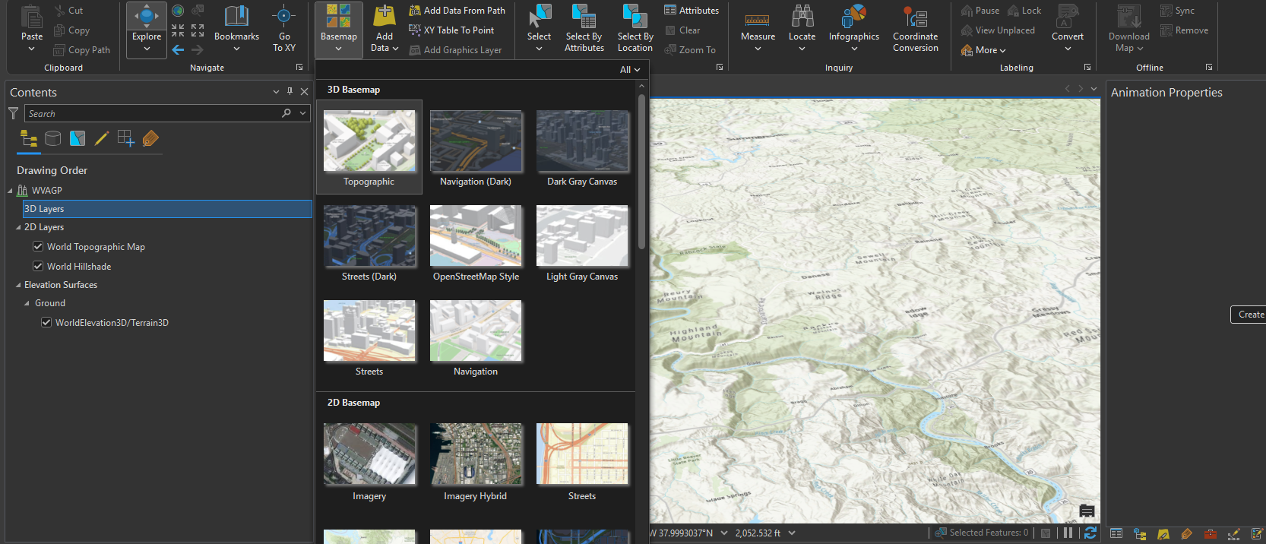
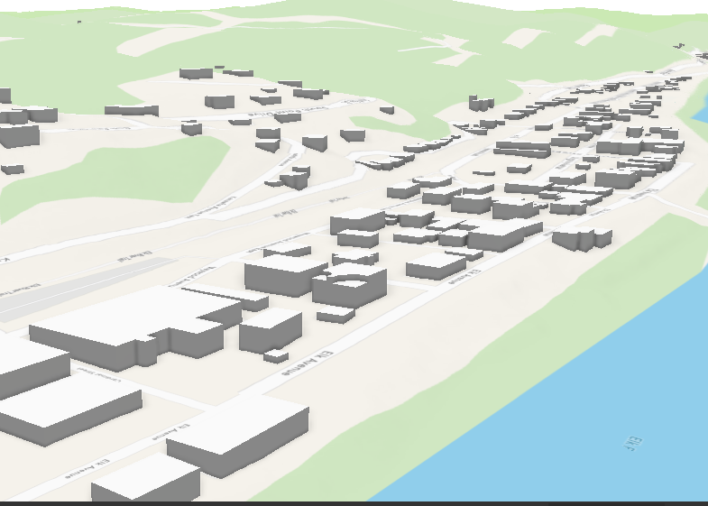
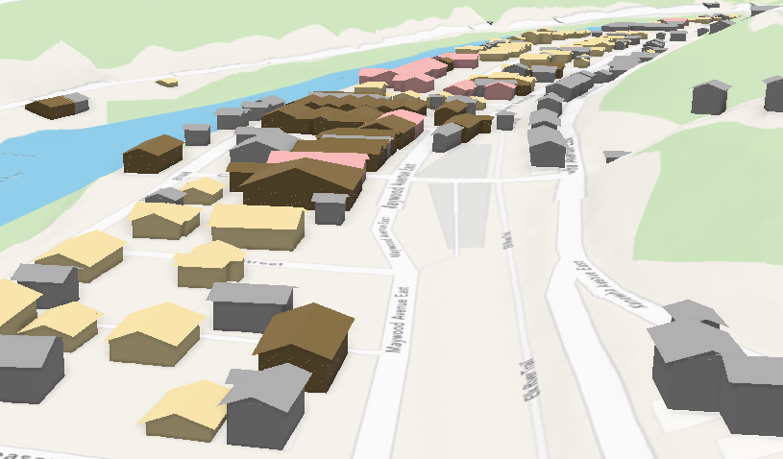
WHAT COMES FIRST in 3D MODELING
Opening a New Local Scene and Selecting a Basemap
Using 3D Basemap OR Footprints?
3D Basemaps
Footprints
Useful for a quick, 3D accurate scene
Not a very quick method for large scale areas
Precise location and height of the Buildings
Precise location and height of the Buildings
Non-real topography (not imagery)
Can be Placed on 2D Imagery
Cubic and simple buildings, all in the same color
Variety in colors, shapes, and textures of the building

Slide 15
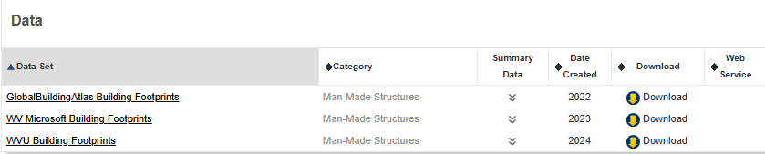
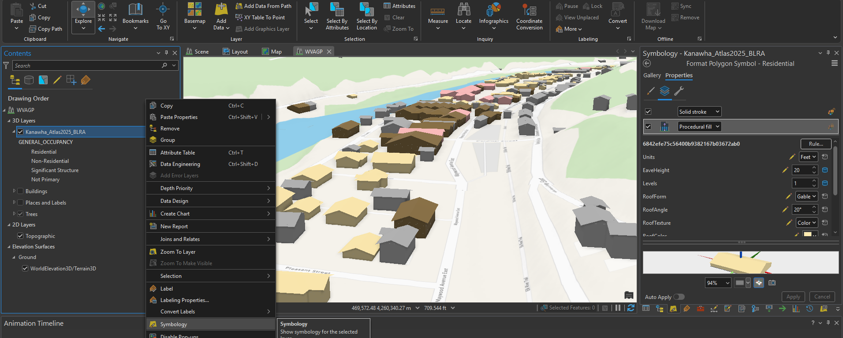
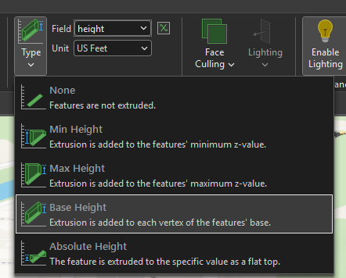
STARTING THE PROCESS…
Footprints Sources
Global Building Atlas is used in the WV GIS TC.
Extruding them to have 3D Buildings.
Using Rule Packages to add texture.
Where can we get Rule Packages?
Found in ArcGIS Online

Slide 16
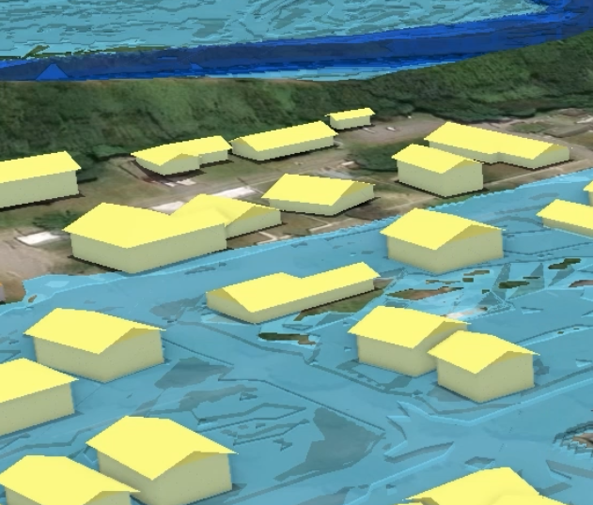
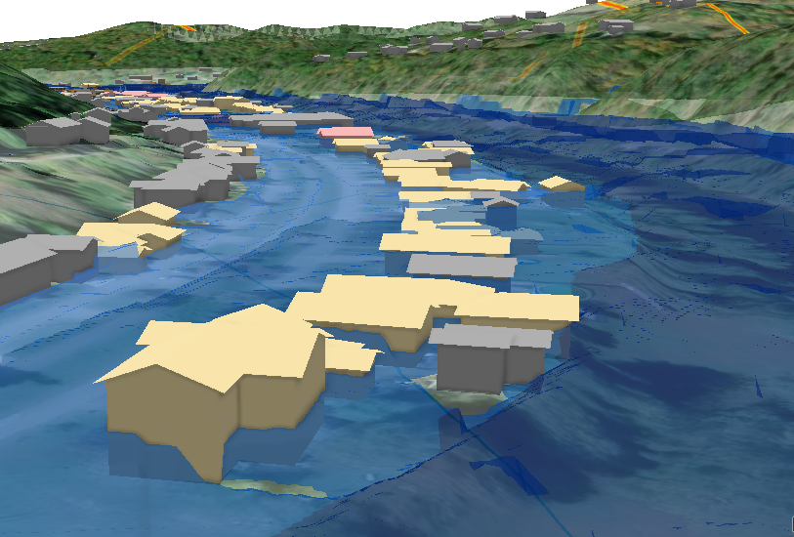
CONTINUING THE PROCESS…
Making a Water Depth Layer
Vector
Easy conversion of the depth layer from raster to vector
Thousands of polygons are created
Each polygon can be extruded based on its depth value (height)
Produces a large and heavy file
Takes longer to load
The animation may NOT be very smooth
Raster
No conversion is required
Should be placed on a new ground surface generated from the DEM
All the structures should be placed on the new surface
Produces a smoother and more realistic appearance
Creating a new surface can sometimes be challenging
The units of the surface and raster layer must match
Structures should be checked to ensure correct inundation depth

Slide 17
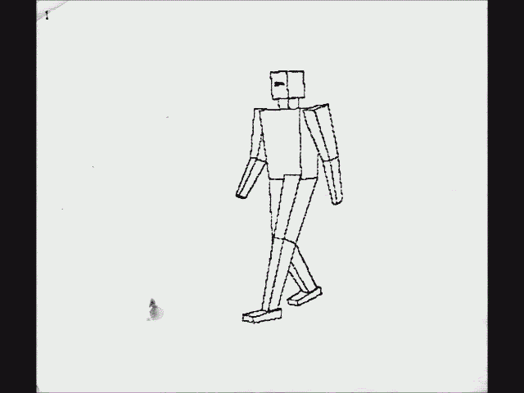
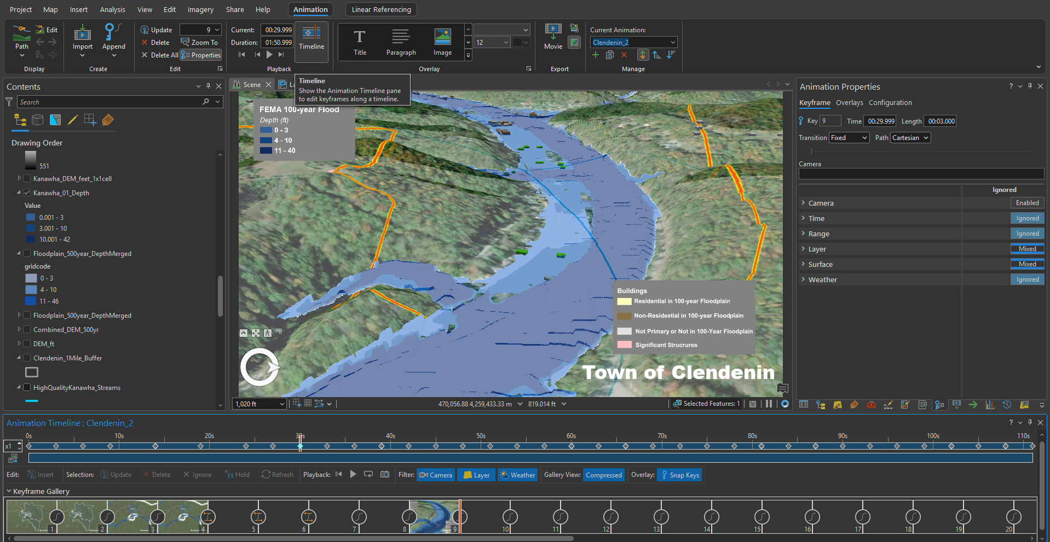
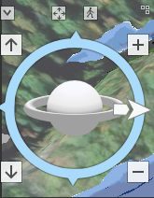
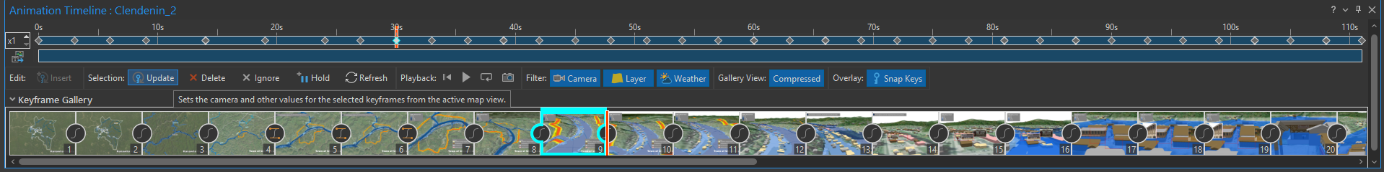
MAKING an ANIMATION
1- Import the timeline to display the sequence of frames.
2- Use the orbit tool to rotate the camera and set different viewing angles to capture the best scene.
3- Once the desired camera angle is selected, click “Update”.
Gif Courtesy: https://commons.wikimedia.org/wiki/File:Flip_Book_Movie_v2.gif

Slide 18
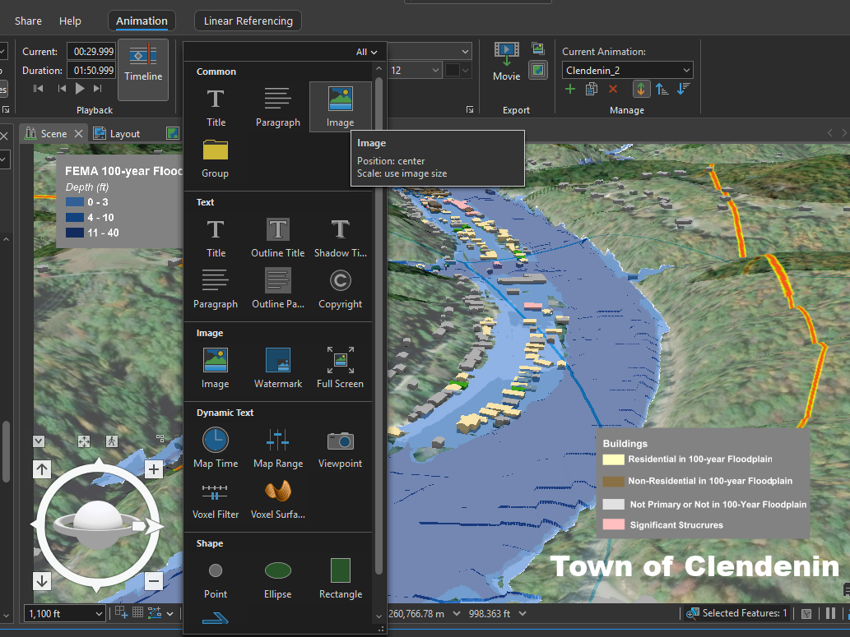
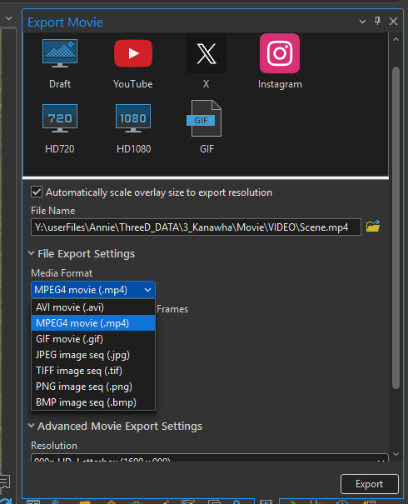
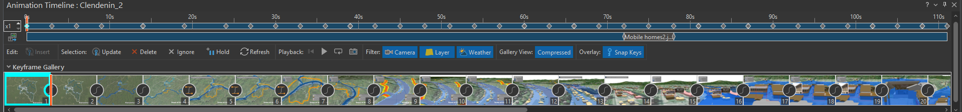
4- Images, shapes and texts can be easily added.
5- Multiple export formats are supported.
6- Animations can be easily shared across different platforms.
7- The animation can be previewed before. export.

Slide 19
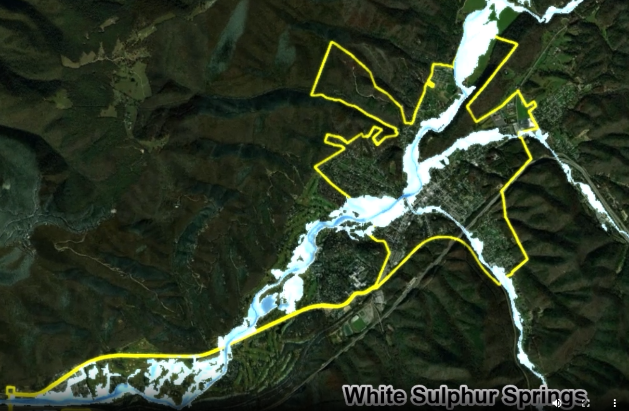
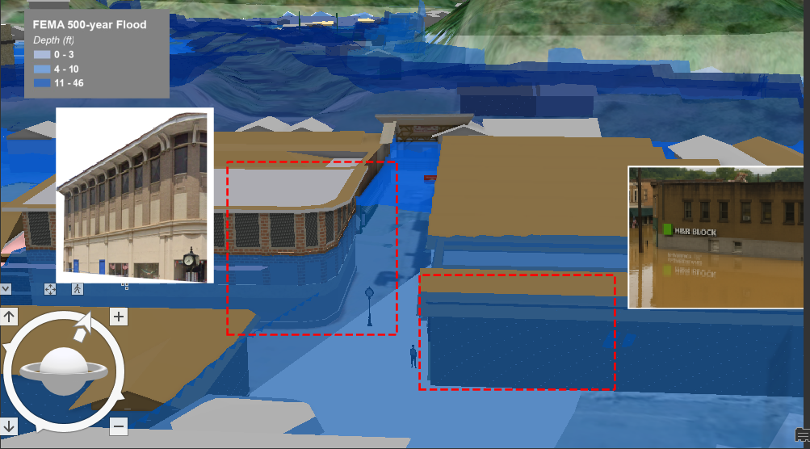
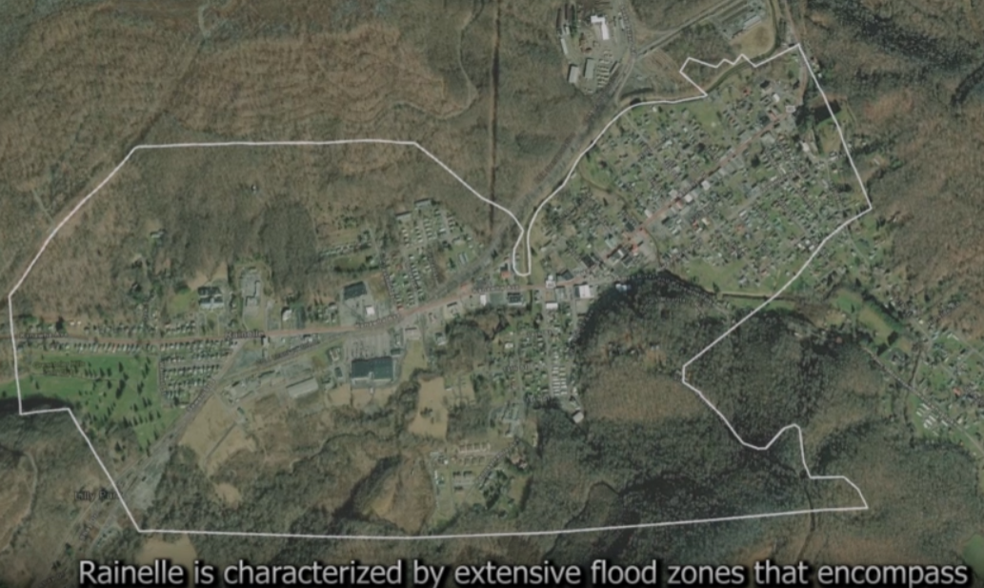
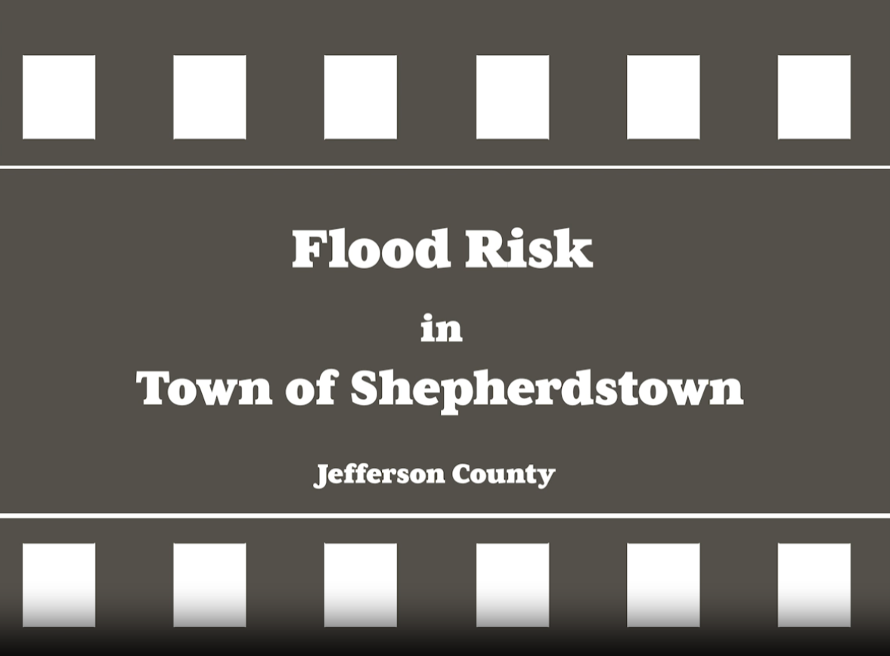
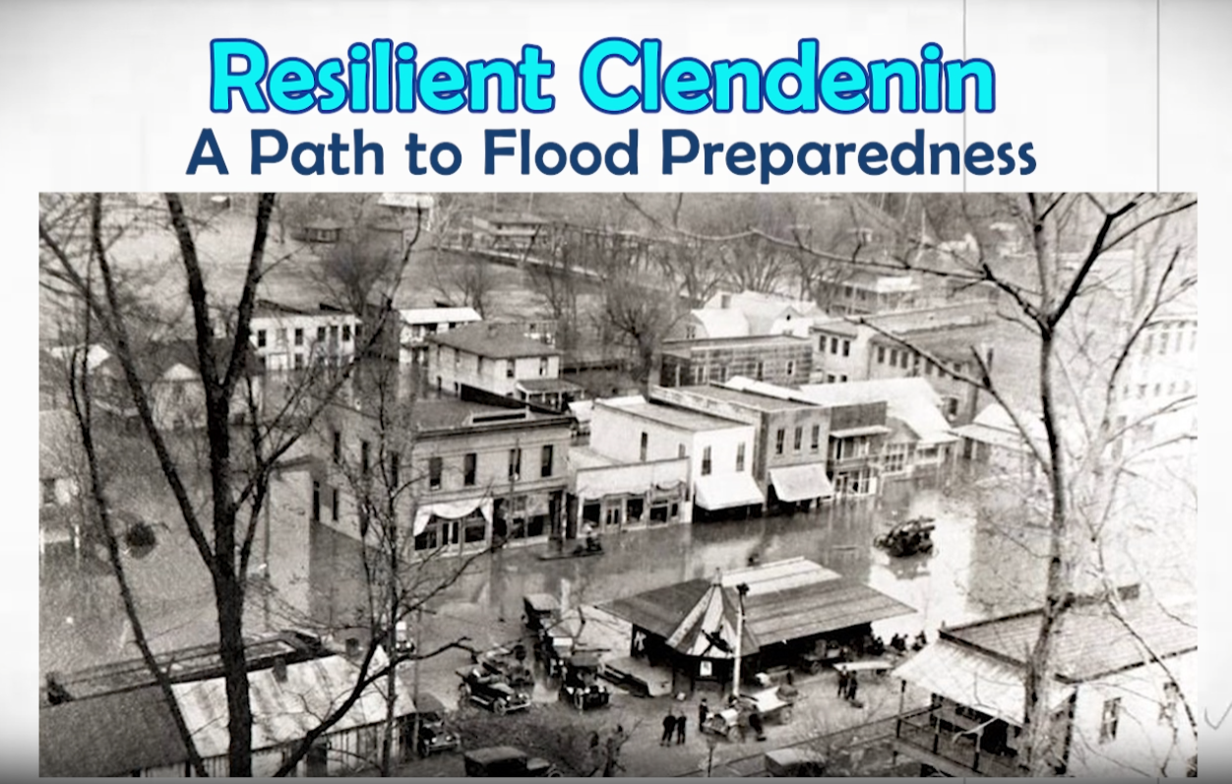
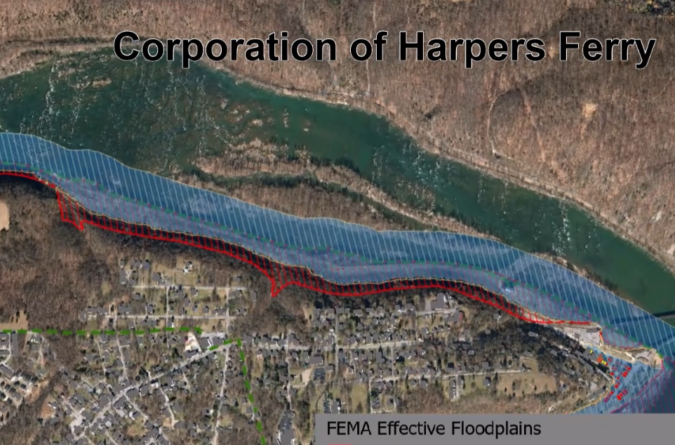
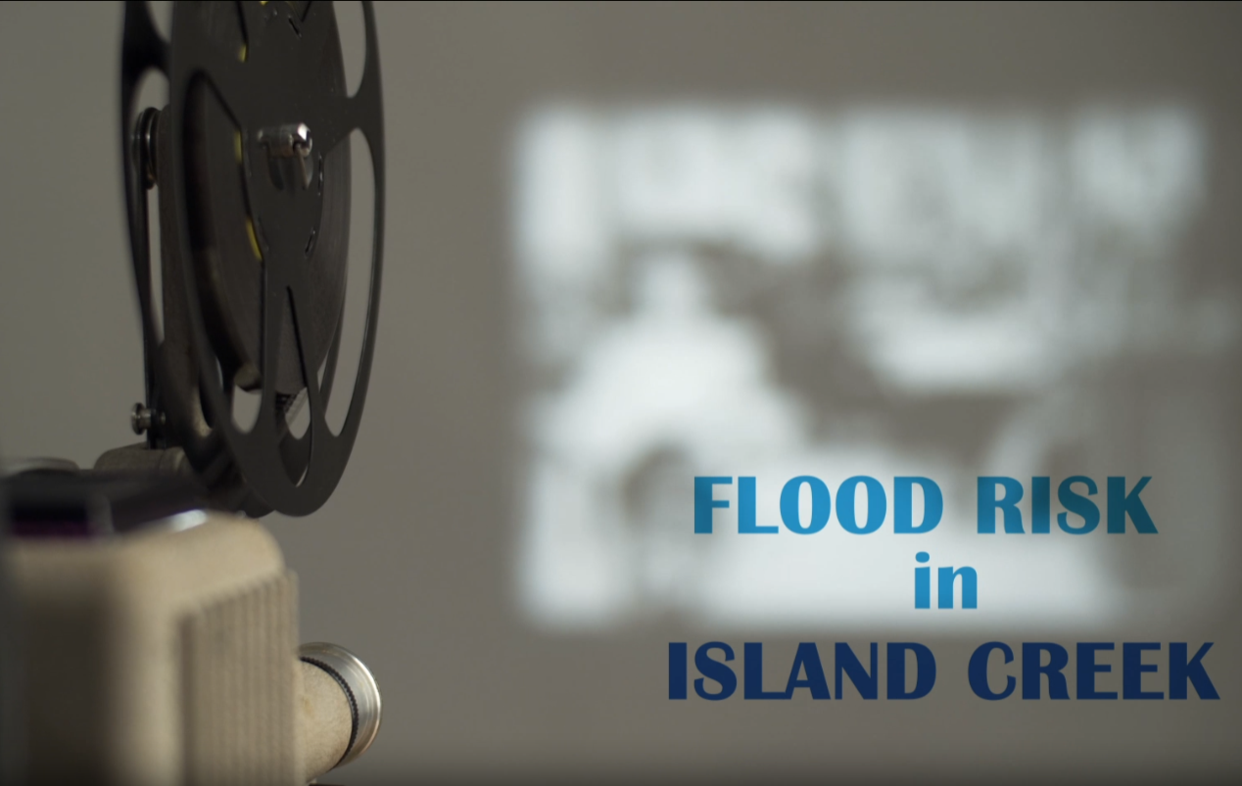
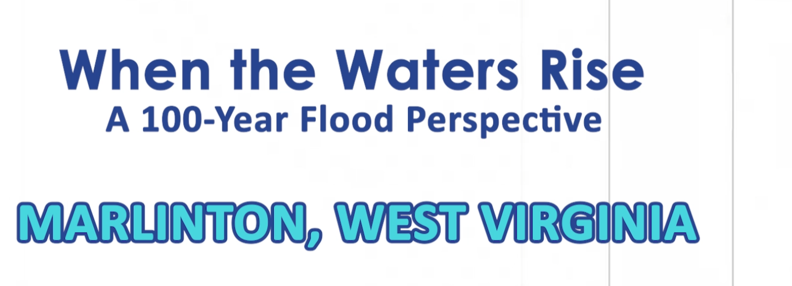
3D Flood Visualizations
White Sulphur Springs, Greenbrier County
Rainelle, Greenbrier County
Shepherdstown, Jefferson County
Clendenin, Kanawha County, (500-year, Under Process)
Clendenin, Kanawha County
Harpers Ferry, Kanawha County
Island Creek, Logan County
Marlinton, Pocahontas County

