Slide 1
Open Space Mitigation Mapping
Tracking Open Space for Flood Resilience in West Virginia
WV GeoCon 2026
West Virginia GIS Technical Center

Slide 2
Table of contents
01
02
03
04
05
Background
Data
Mapping
Discussion
Conclusions

Slide 3
Background

Slide 4


What is open space mitigation?
Voluntary property-level acquisition buyouts from federal grants are the most common flood adaptive measure implemented in WV -> these properties are converted to open space
Open space is defined as “space permanently dedicated to uses compatible with natural floodplain functions, hazard risk reduction, or environmental conservation” (FEMA).
Open space parcels can be classified as deed-restricted (deed prohibits building affixed to the land) or open space preservation (community-maintained open space, not required by deed)
In partnership with West Virginia Emergency Management Division, the goals of the WVGISTC’s open space mitigation mapping are to:
  Create a statewide open space inventory,
  Improve community access to mitigation data, and
  Standardize parcel tracking.

Slide 5
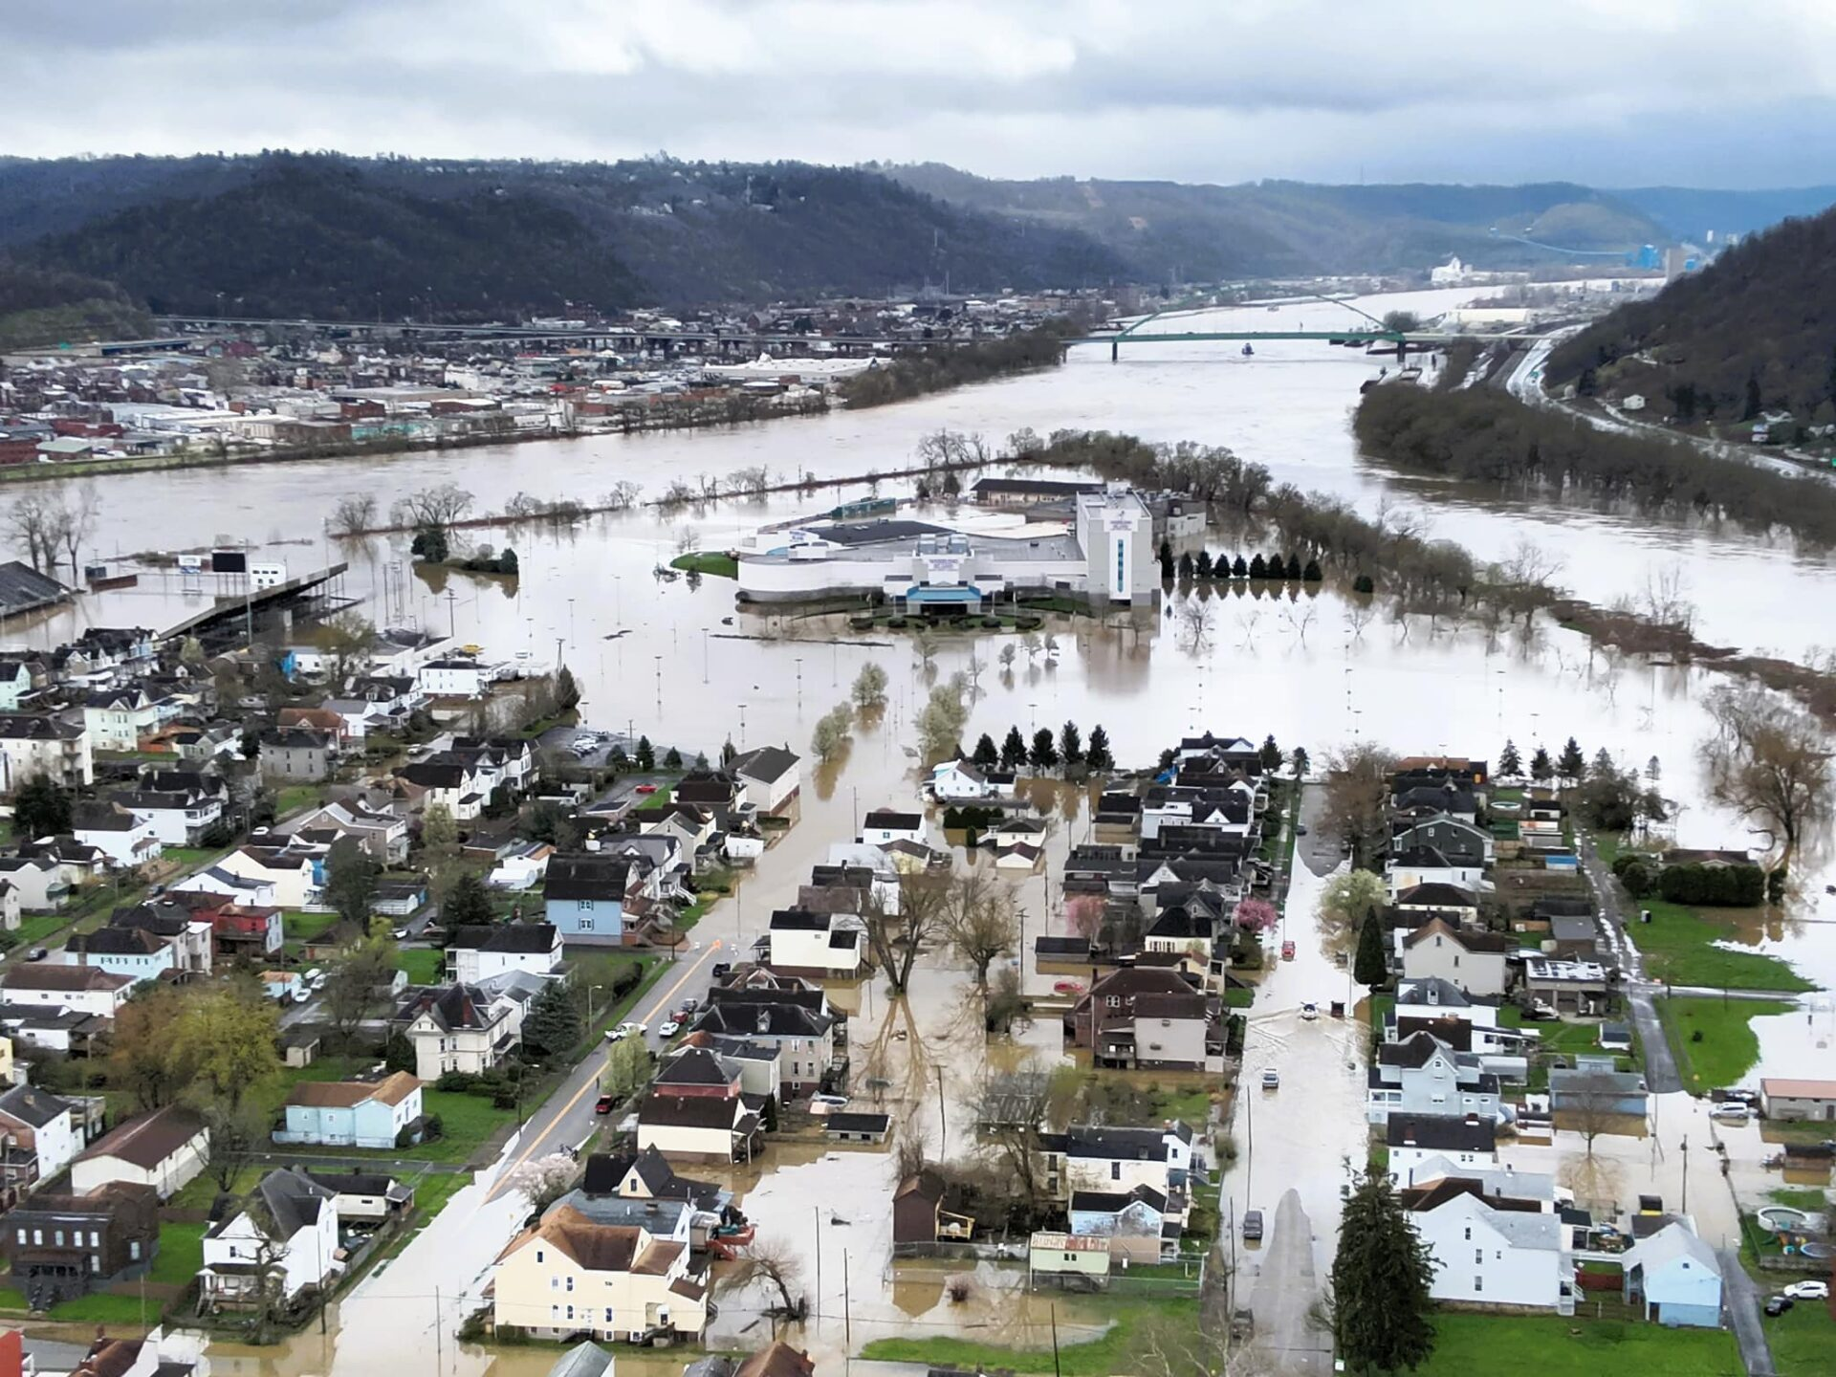
Why does it matter?
Open space parcels reduce future structural flood exposure
Flood-prone communities need accurate mitigation inventories
Tracking flood mitigation outcomes is essential for communities:
  Measuring loss avoidance
  Sustaining a community’s flood protection level
  Long-term hazard planning
  Future implementation of flood reduction measures

Slide 6
Data

Slide 7
Necessary Data
Parcels
Deeds
Flood Zones
Statewide tax parcel layer
Searchability in IDX system to determine presence of deed restrictions
Parcel must be within a flood zone to qualify for our flood mitigation inventory
Acquisition Information
Assessment Records
Attributes provided by sponsoring agencies such as FEMA, NRCS, USACE
Ownership, assessment value
Notes:
*****DEEDS – explain DR vs OSP

Slide 8
Mapping
Notes:
I will take you through the process of searching for buyouts to add to our inventory

Slide 9
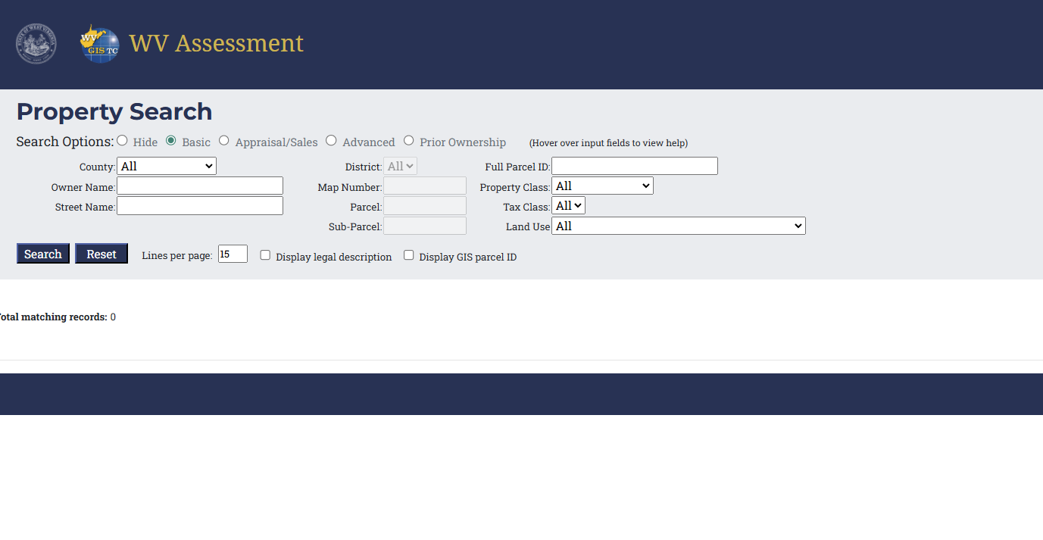
WV Property Search
County audits are performed by searching for community-related owner names and filtering out any parcel with property worth over $10,000

Slide 10
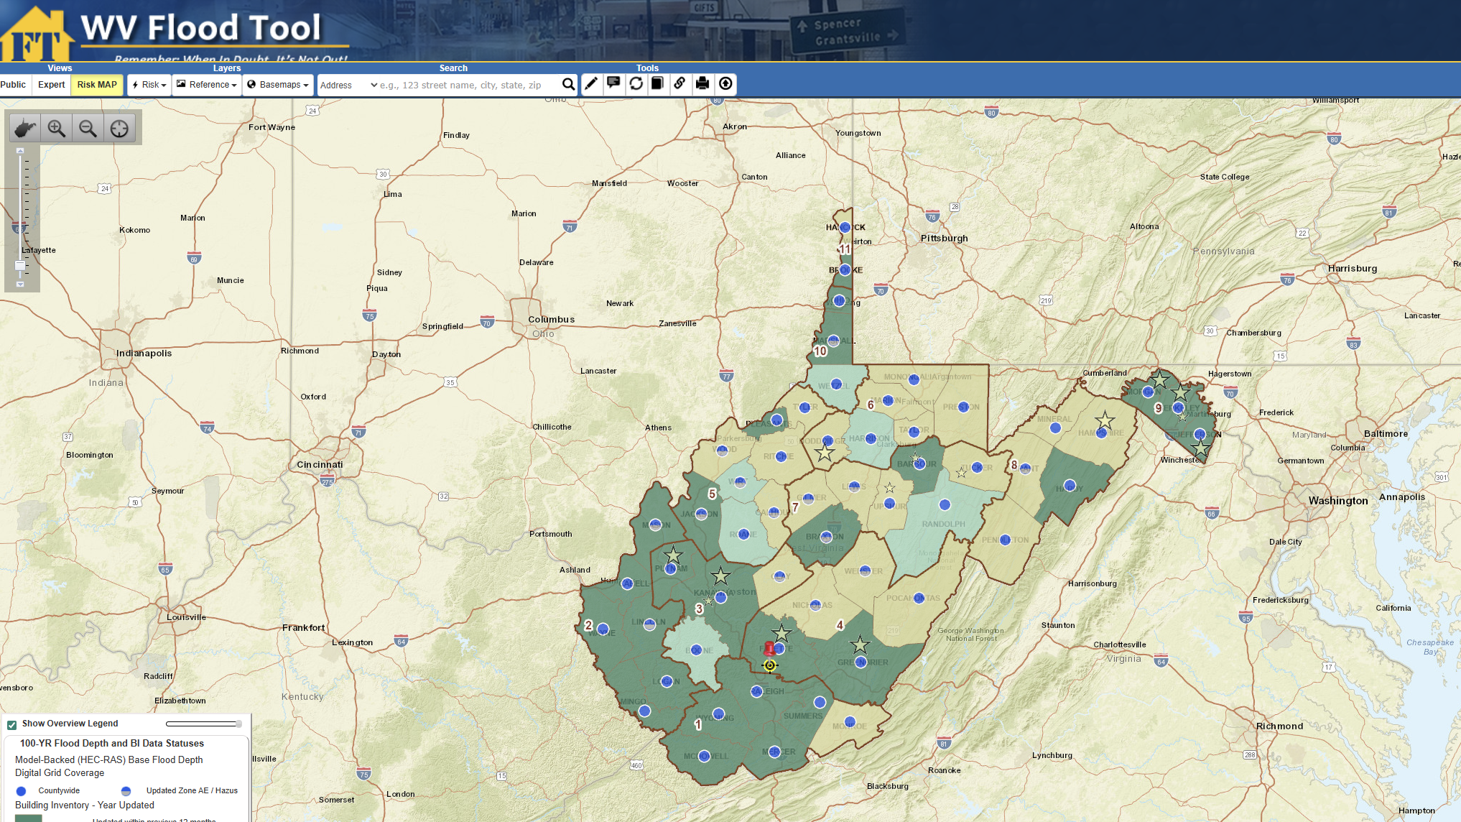
WV Flood Tool
Search results are validated on the WV Flood Tool. All inventoried open space properties (buyouts) are visible here as well.
Notes:
Open IDX search to show what DR vs OSP looks like

Slide 11
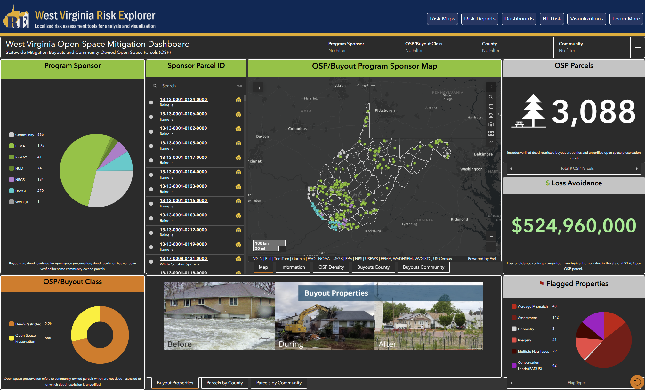
Open Space Mitigation Dashboard
View statewide open space parcels based on sponsor or location, as well as statistics such as Deed-Restricted vs. Open Space

Slide 12
Discussion

Slide 13

Key Findings
3,008 mapped open space parcels statewide
71% are Deed-Restricted, while 29% are maintained as open space by their community
Almost a third of open space parcels being locally maintained may suggest increasing community interest in preserving open space

Slide 14
Community Benefits
Flood mitigation accountability
Improved grant reporting and planning
Enhanced decision-making for
Supports long-term resilience strategies
Land use
Hazard mitigation plans
Future acquisitions

Slide 15
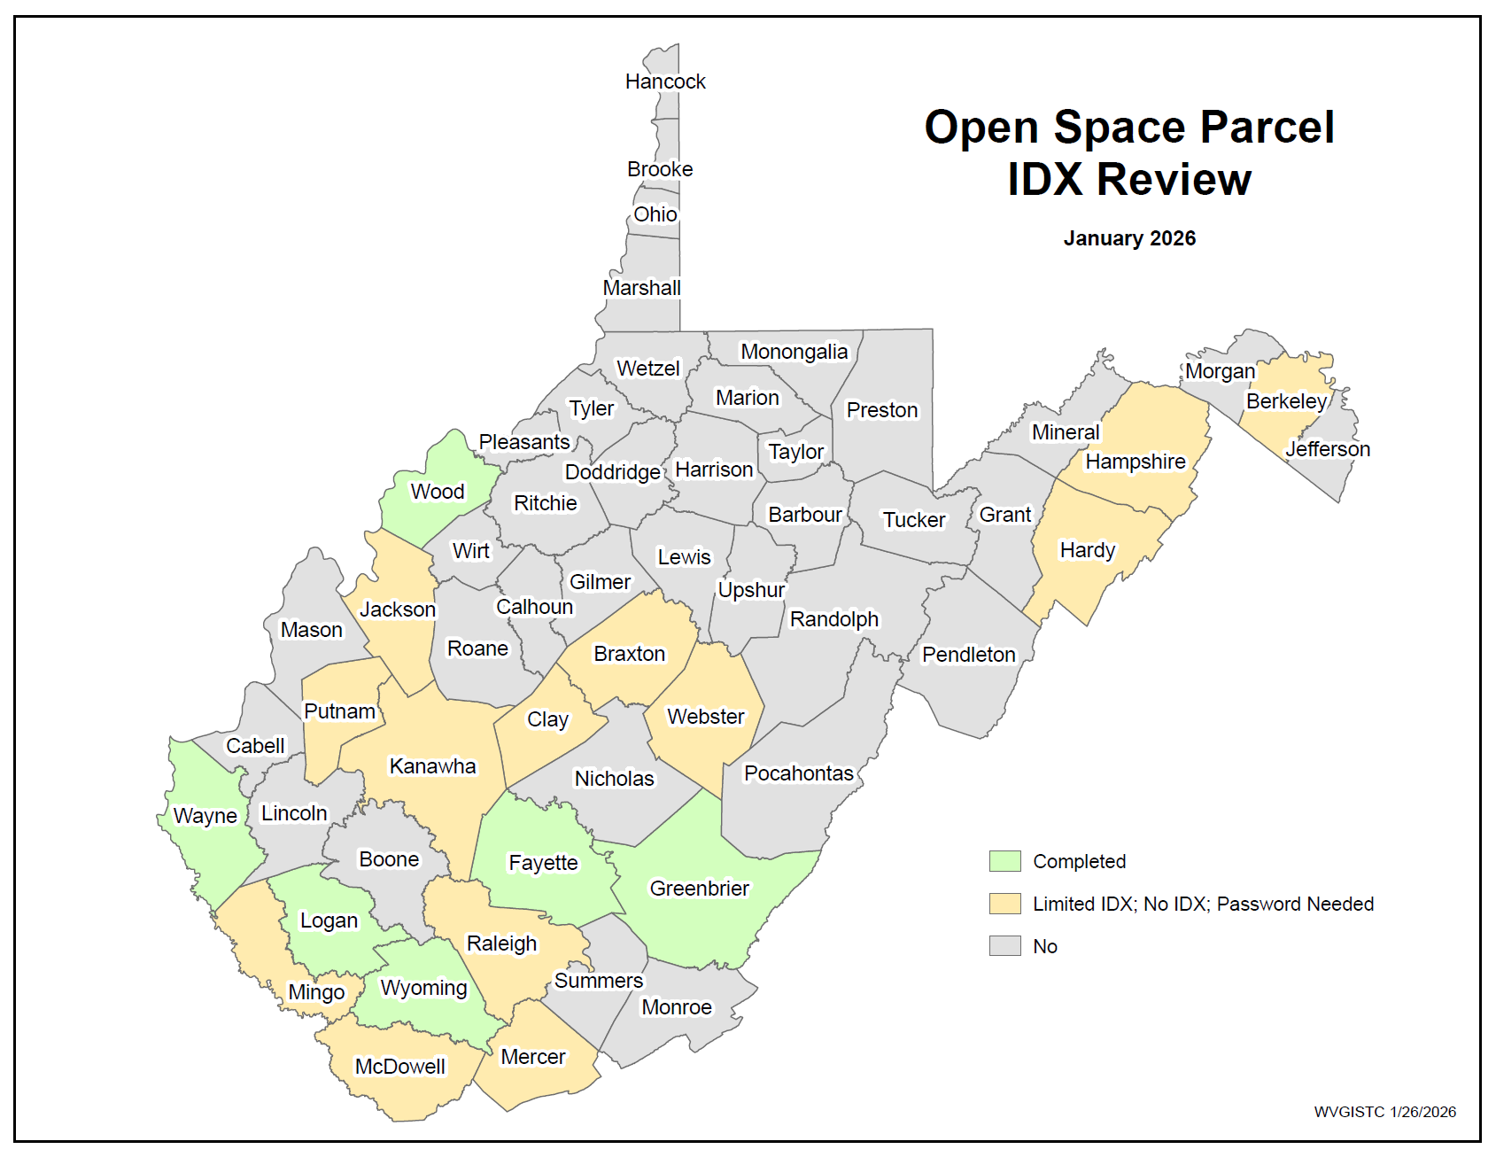
Future Directions
Expand and maintain statewide inventory
Increase access to county records
Support statewide resilience initiatives
Notes:
SECOND POINT: potentially by visiting courthouses, or requesting deeds from the county directly

Slide 16
Conclusions

Slide 17
Open Space Mitigation Mapping…
…empowers communities to track and visualize open space.
…facilitates the identification of mitigated properties and provides a centralized inventory.
…improves transparency, tracking, and planning of community flood resilience.
Notes:
Through the partnership of the West Virginia GIS Technical Center and WV Emergency Management Division, open space mitigation mapping…

Slide 18

Thank you!
Do you have any questions?
Sara Lusher – sara.lusher@mail.wvu.edu
wvgis.wvu.edu

