Slide 1

Unit 4: Floodplain Management Regulations Overview

Slide 2
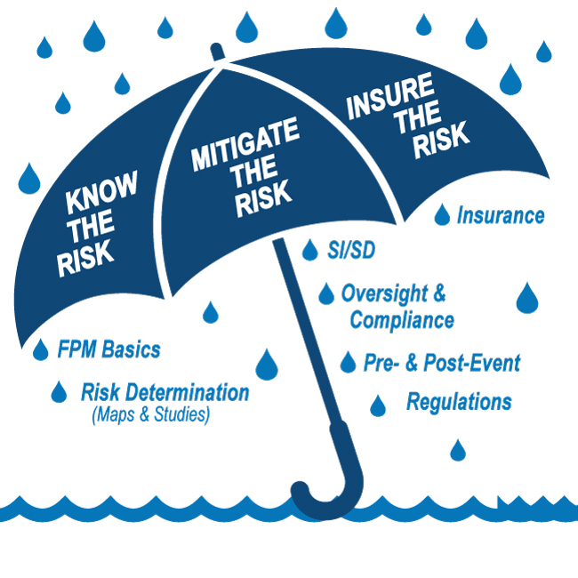
E0273 Course Map

Slide 3

Unit 4 Objectives
After completing this unit, you should be able to:
Describe the components of an effective floodplain management program to reduce loss of life and property
Describe floodplain management regulations that meet minimum NFIP requirements
Interpret development requirements for specific situations

Slide 4

Discussion: Determining Minimum Regulations
What is the connection between flood hazard information depicted on the map and the minimum NFIP floodplain management regulations?

Slide 5
Legal Authorities Governing Floodplain Management Regulations
Authority rests with the local community
Granted by state statutes
Can be found in land use authority regulations, building codes or as a stand-alone ordinance
Designed to address public health, safety, and welfare of citizens
When properly administered, floodplain management has been found not to be a "taking"

Slide 6
NFIP Regulation Overview
Special Flood Hazard Area (SFHA): Darkly shaded areas, Zone A and/or Zone V, on the flood map subject to NFIP legislation
Base Flood Elevation (BFE): The water surface elevation with a 1-percent chance of being equaled or exceeded in a given year
Lowest Floor: The lowest floor of the lowest enclosed area, including basement

Slide 7

Discussion: Connecting Mapping with Regulations
What is the relationship between the Special Flood Hazard Area and BFE?

Slide 8
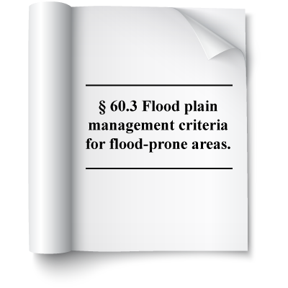
Code of Federal Regulations--Section 60.3
Regulations build cumulatively in increments according to mapping and flood zone designations.
Each step adds more stringent requirements as risk increases.

Slide 9
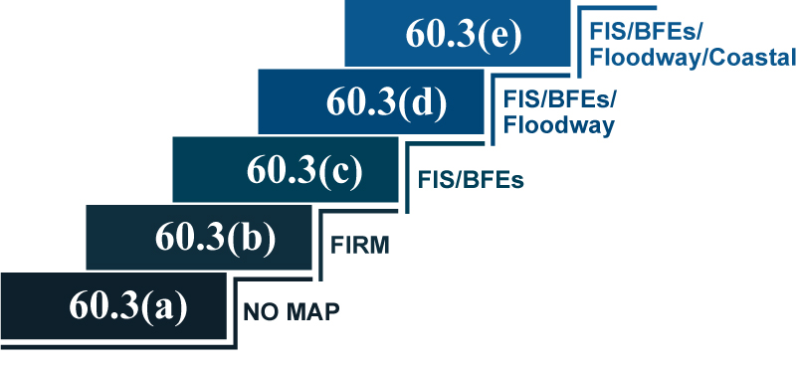
Regulation "Staircase" Elements

Slide 10
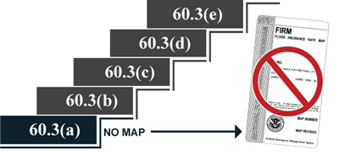
44 Code of Federal Regulations (CFR) CFR 60.3(a): No Flood Map
Applies to communities for which FEMA:
Identified no SFHAs
Prepared no flood maps

Slide 11
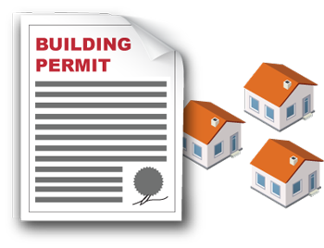
60.3(a) Requirements (1) and (2)--Floodplain Management Criteria
The community shall:
(1) Require permits for all proposed development to determine if they are in a floodprone area
(2) Ensure all necessary permits are received

Slide 12
60.3(a) Requirement (3)--New Development Criteria
3. Review permit applications for building sites to be reasonably safe from flooding. All new construction and substantial improvements must:
i. Be designed (or modified) and adequately anchored to prevent flotation, collapse, and lateral movement
ii. Be constructed with flood-resistant materials
iii. Use methods and practices to minimize flood damage
iv. Design or locate utilities and other service facilities to prevent damage from floodwaters

Slide 13
Discussion: Reasonably Safe
What do you think "reasonably safe from flooding" means?

Slide 14
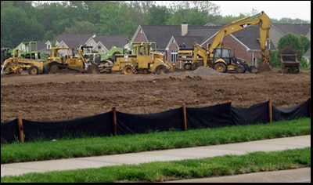
Development Oversight
Development: Any manmade change to improved or unimproved real estate, including, but not limited to:
Buildings or other structures
Mining, dredging, filling, grading, paving, excavation, or drilling operations
Storage of equipment or materials

Slide 15
Development Examples
New Construction: Structures for which the start of construction began on or after the effective date of a floodplain management regulation adopted by the community and includes any subsequent improvements to such structures, including sheds and other small projects.
Substantial Improvement: Any reconstruction rehabilitation, addition, or other improvement of a structure, the cost of which equals or exceeds 50 percent of the market value of the structure before the start of construction.

Slide 16
Discussion: Substantial Improvement vs. New Construction
How is substantial improvement different from new construction?

Slide 17
60.3(a) Requirement (3)(iv) - Protecting Utilities
(3)(iv) All new construction and substantial improvements shall be constructed with electrical, heating, ventilation, plumbing, and air conditioning equipment and other service facilities that are designed and/or located to prevent water from entering or accumulating within the components during conditions of flooding.

Slide 18
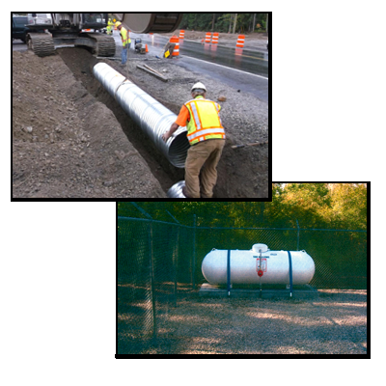
60.3(a) Requirement (3)(iii)--Fuel Tanks
(3)(iii) All new construction and substantial improvements shall be constructed by methods and practices that minimize flood damages.
Fuel tanks are considered “structures”
Like other structures, they must be anchored
Elevated platforms are recommended

Slide 19
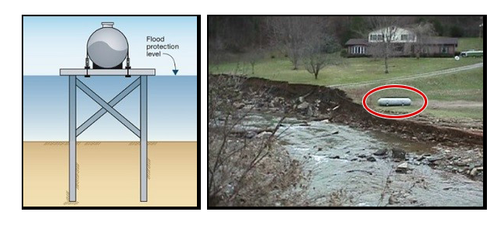
60.3(a) Requirement (3)(iv)--Anchoring Tanks

Slide 20
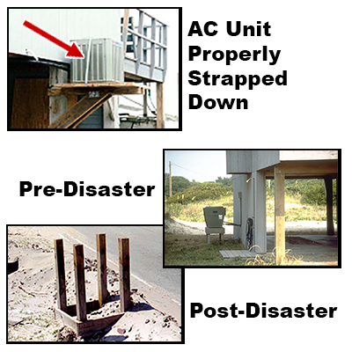
60.3(a) Requirement (3)(iv)--Anchoring Air Conditioners

Slide 21
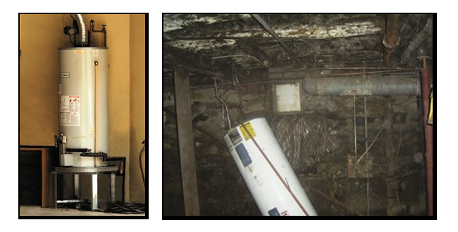
60.3(a) Requirement (3)(iv)--Elevating Water Heaters

Slide 22
60.3(a) Requirements (4) and (5)--New Development
(4) Review subdivision and other new development proposals including manufactured home parks and subdivisions to:
Locate, construct public utilities/facilities to minimize, eliminate flood damage
Provide adequate drainage
(5) Require design of new and replacement sewage and water supply systems to minimize, eliminate infiltration of flood waters.

Slide 23
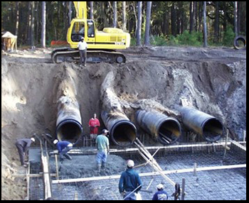
60.3(a) Requirement (6)--Sewage/Waste Disposal Systems
Within floodprone areas, require:
New/replacement sewage systems that minimize or eliminate infiltration of floodwaters
Location of onsite waste disposal systems to avoid impairment to them or contamination from them

Slide 24
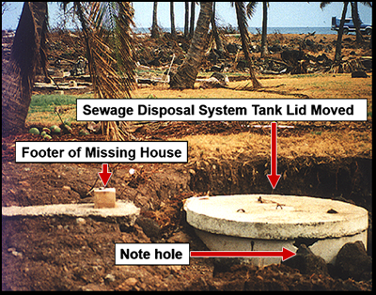
Septic Systems
Erosion allowed the septic system cap to be moved
The system is now exposed

Slide 25
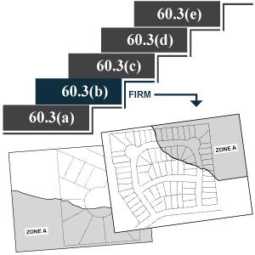
Regulations Discussion--60.3(b): Zone A No BFEs Determined
No FIS
FIRM identifies:
SFHAs (Approximate Zone A)
FIRM does not identify:
BFEs
Regulatory floodways
Coastal High Hazard Areas

Slide 26
Discussion: Approximate Zone A
Why is there an Approximate Zone A?

Slide 27
Discussion: Special Flood Hazard Areas
How are Special Flood Hazard Areas shown on flood maps?

Slide 28
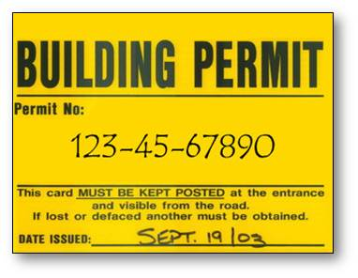
60.3(b) Requirements (1) and (2)--Permits and 60.3(a) Standards
Require permits for all development in mapped SFHAs
Apply 60.3(a)(2)--(6) standards to development

Slide 29
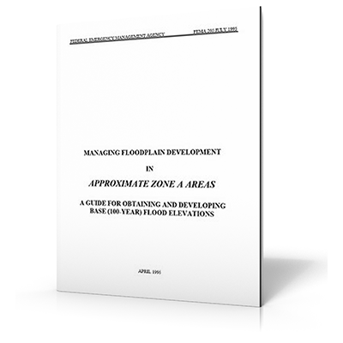
FEMA 265--The Zone A Manual
FEMA publication 265, the "Zone A Manual," contains helpful guidance on the following Approximate Zone A issues:
60.3(b)(3): Subdivisions requirements
60.3(b)(4): Obtaining BFE and elevation data
60.3(b)(4): Simplified methods for developing BFE data

Slide 30
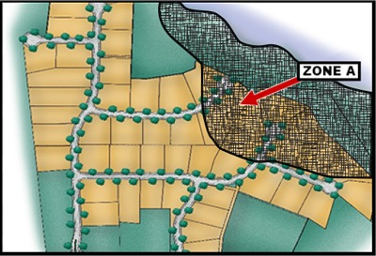
60.3(b) Requirement (3)--50 Lots/5 Acres
All new subdivision proposals and other proposed developments (including manufactured home parks) greater than 50 lots or 5 acres must include BFE data.

Slide 31
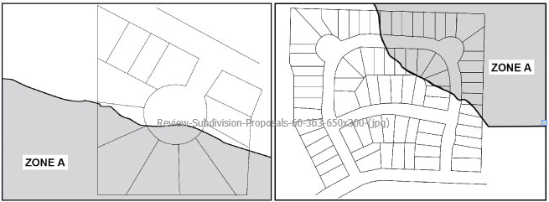
Review Subdivision Proposals: 50 lots or 5 Acres
6.7 Acre Subdivision 76 Lot Subdivision
Is BFE data required for these two subdivision proposals?

Slide 32
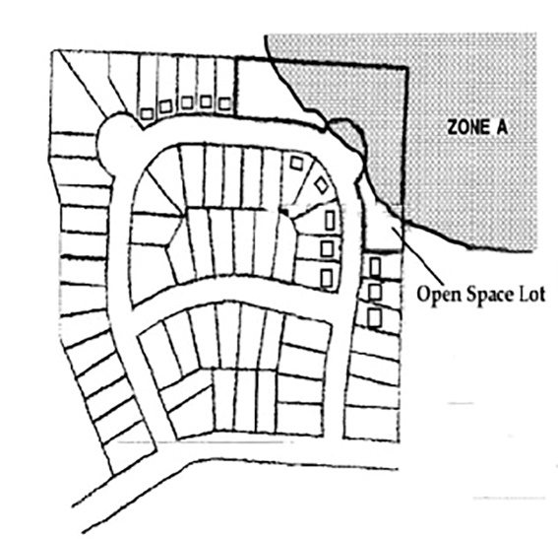
Review Subdivision Proposal: 76-Lot Subdivision
Is BFE data required for this subdivision proposal for 76 lots?

Slide 33
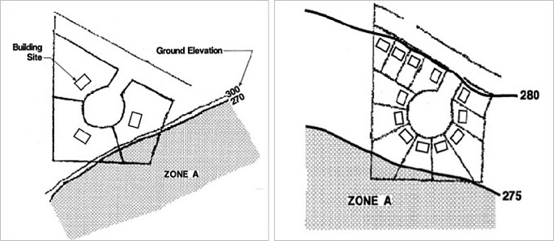
Review Subdivision Proposals: 5.6-Acre and 6.7-Acre Proposals
Is BFE data required for the proposed 5.6-acre subdivision on the left or the proposed 6.7-acre subdivision on the right?

Slide 34
Discussion: Subdivision Proposals
What regulations apply if a subdivision proposal is less than 50 lots or 5 acres?

Slide 35
Zone A Considerations
"Reasonably safe from flooding” applies to all Zone A development
Some states and communities require BFE data for all Zone A areas
Some jurisdictions may require an elevation above grade if there is no BFE
Subdivisions may require BFE information
Methods exist to estimate BFE if data are not available
To safeguard citizens in your community, always be conservative when determining acceptable elevations

Slide 36

60.3(b)(4) Requirement--Obtain BFE and Floodway Data
(4) Obtain, review and use any BFE and floodway data available from a federal, state, or other source.

Slide 37
Developing BFEs: Model-Backed Zone A
Model-backed Zone A areas are created using:
Hydrology
Discharge-Drainage Area Relationships
Hydraulics
Normal Depth
Critical Depth
Step-Backwater Analysis
Technical Support Data Notebook

Slide 38
Discussion: Reasonably Safe Scenario
Whole group discussion
Someone wants to develop in your community. The development does not have a BFE.
What do you think the steps to assuring reasonably safe from flooding would be?

Slide 39
Simplified Methods for Developing BFE Data
Data extrapolation
Contour interpolation
High-water marks
Point on boundary
Height above Highest Adjacent Grade

Slide 40
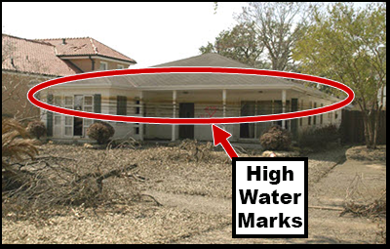
Developing BFE--High-Water Marks
A possible source of BFE in Zone A areas is high-water marks from previous floods.

Slide 41
Discussion: High-Water Marks
Can you think of a weakness of just using high-water marks for generating a BFE?

Slide 42
Developing BFE--Other Simplified Methods
Point on Boundary: Same concept as contour interpolation but uses surveyor-collected elevations of Zone A boundary instead of contour elevations.
Height above Highest Adjacent Grade (i.e., HAG): Only used for shallow flooding

Slide 43
60.3(b) Requirement (5)--Lowest Floor
(5) Document lowest floor or floodproofing elevation.
When BFE data is utilized:
Obtain the lowest floor elevation for all new and substantially improved structures
Obtain the floodproofing elevation (non-residential)
Maintain a record (Floodproofing Certificate)

Slide 44
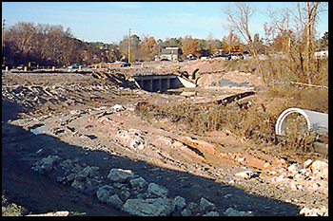
60.3(b) Requirements (6) and (7)--Watercourse Alterations
(6) Prior to altering or relocating a watercourse, notify:
Adjacent communities
State NFIP Coordinating Office
FEMA Administrator via a Letter of Map Revision (LOMR)
(7) Maintain flood-carrying capacity of altered or relocated watercourse portion

Slide 45
Discussion: Watercourse Alteration Notifications
What is the purpose of notifying adjacent communities?

Slide 46
Discussion: Watercourse Alteration Terminology
What does "flood carrying capacity" mean?

Slide 47
60.3(b) Requirement (8)--Manufactured Homes
(8) All manufactured homes within Zone A must be installed using methods and practices which minimize flood damage:
Elevate and anchor to resist flotation, collapse, and lateral movement
Use over-the-top or frame ties to ground anchors
Comply with wind resistance requirement

Slide 48
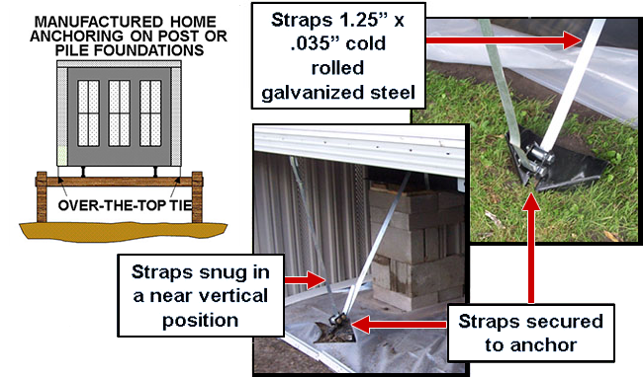
Anchoring a Manufactured Home

Slide 49

60.3(b) Requirements: Summary Part 1
Require permits for all development within Zone A.
Apply 60.3(a) requirements [except 60.3(a)(1)]
BFE data required for proposals greater than 50 lots or 5 acres.
Obtain and use detailed BFE and floodway data.
Where BFE exists, obtain lowest floor, floodproofing information.

Slide 50
60.3(b) Requirements: Summary Part 2
Maintain lowest floor, floodproofing records.
Notify adjacent communities before altering, relocating a watercourse.
Assure flood-carrying capacity is maintained.
Require manufactured homes be elevated and anchored.

Slide 51
Activity 4.1: Regulations Crosswalk Review
As a table group:
Find the section of the Sample Flood Damage Reduction Ordinance that relates to your assigned regulations.
Use the 44 CFR 60.3 Crosswalk in your Student Manual to note appropriate section of the ordinance.

Slide 52
Activity 4.1: Regulations Crosswalk Review (cont.)
Code of Federal Regulations: Title 44. Emergency Management and Assistance
Sections:
60.3(a)(3)(iii)
60.3(a)(4)(i)
60.3(b)(1)
60.3(b)(3)
60.3(b)(4)
60.3(b)(5)(iii)

Slide 53
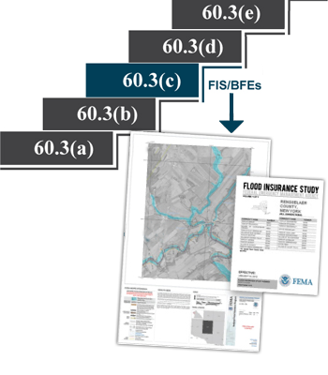
Regulations Discussion--44 CFR 60.3(c): Zone A with BFEs
FIS and FIRM identify:
SFHAs
BFEs
FIS and FIRM do not identify:
Regulatory floodways
Coastal High Hazard Areas

Slide 54
60.3(c): A Zones with BFEs and Depths and A99
Areas identified with 1-percent chance annual flood:
Zone AE, Zone A1-A30: BFEs determined
Zone AO: Shallow sheet flooding
Depths 1-3 feet
Average depths shown on FIRM
Zone AH: Shallow ponding
Depths 1-3 feet
BFE shown on FIRM
Zone A99: Protected by flood protection system under construction

Slide 55
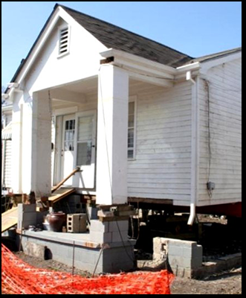
60.3(c) Requirements (2) and (3)--Elevate Lowest Floor
(2) Residential structures within Zones A1-30, Zone AE, and Zone AH must have the lowest floor (including basement) elevated to or above the base flood level.

Slide 56
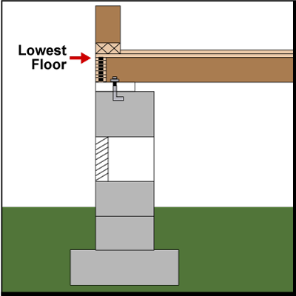
Lowest Floor Elevation
Top of lowest floor of the lowest enclosed area
Includes basement
Doesn't include:
Unfinished, flood-resistant enclosures used for parking, access, storage with proper flood openings

Slide 57
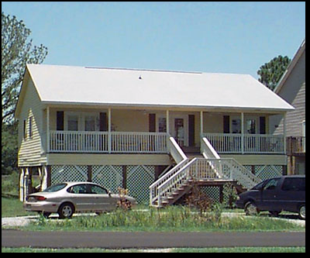
Elevated Building
Elevated Building: A non-basement building which has its lowest elevated floor raised above ground level by foundation walls, shear walls, posts, piers, pilings, or columns

Slide 58
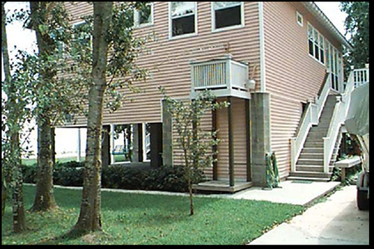
Lowest Floor, Residential
Can you identify the lowest floor from this photo?

Slide 59
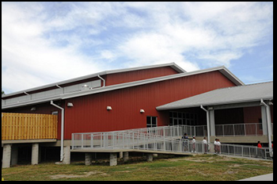
60.3(c) Requirement (3)--Lowest Floor, Non-Residential
(3) Non-residential structures within Zones A1-30, Zone AE, and Zone AH must have the lowest floor (including basement)
Elevated to or above the base flood level, or
Be designed so that below the base flood level the structure is watertight and resistant to hydrostatic and hydrodynamic loads and effects of buoyancy

Slide 60
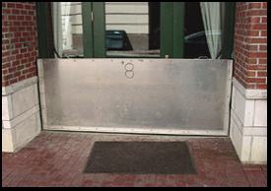
60.3(c) Requirement (4)--Floodproofing
(4) For non-residential structures intended to be floodproofed:
An engineer or architect shall certify that the design and construction meet accepted standards
Floodproofing and elevation certifications shall be maintained

Slide 61
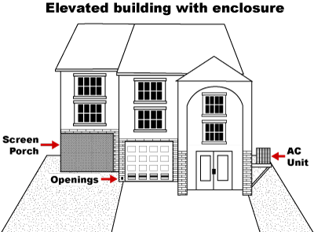
60.3(c) Requirement (5)--Enclosures
(5) Fully enclosed areas below the lowest floor shall be designed to allow for the entry and exit of floodwaters.

Slide 62
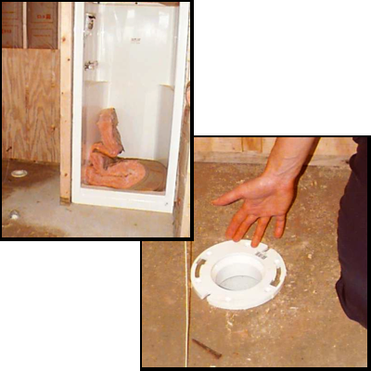
Enclosure Violation

Slide 63
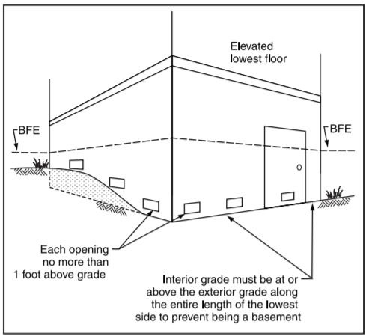
60.3(c) Requirement (5)--Flood Openings
Openings automatically equalize hydrostatic forces on exterior walls
Must be at least 2 openings
Net area of openings and enclosure should be in a proportion of 1 square inch for every 1 square foot of enclosed space
Bottom of opening shall be no higher than 1 foot above grade
Operation should be automatic

Slide 64
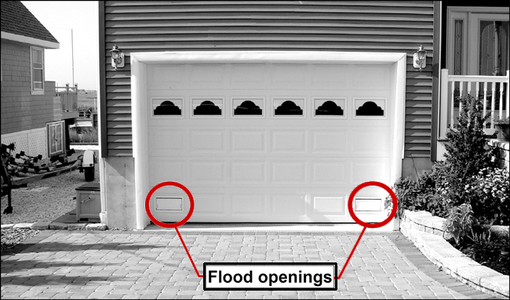
Garage Flood Openings

Slide 65
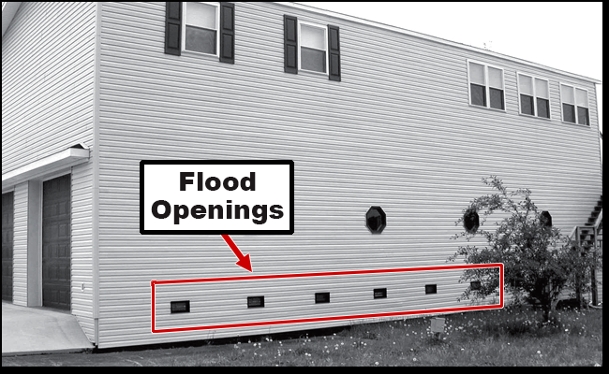
Garage Flood Openings (cont.)

Slide 66
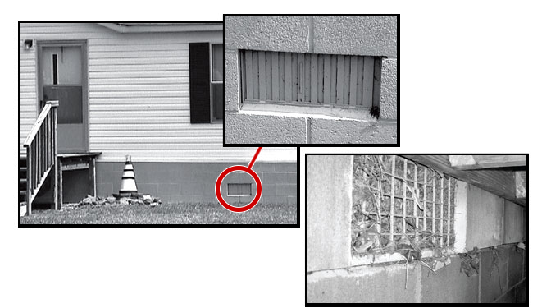
Flood Openings: Interior and Exterior Views

Slide 67
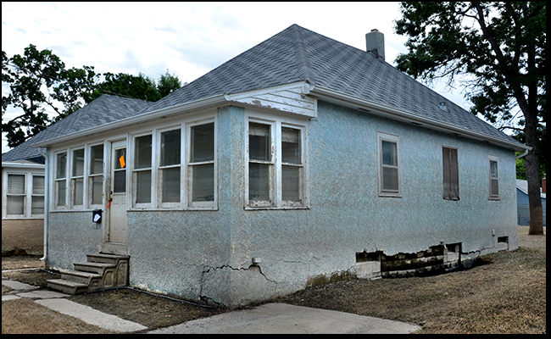
60.3(c) Requirement (5)--Collapsed Foundation

Slide 68
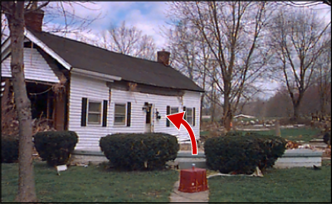
Displaced House
This house has rotated off its foundation
Flood openings and anchoring should counteract flotation, collapse, and lateral movement

Slide 69
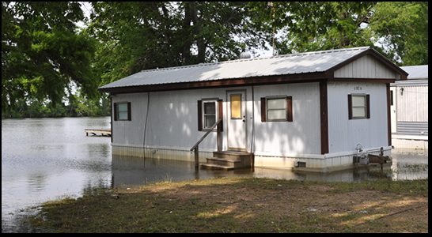
60.3(c) Requirement (6)--Elevated Manufactured Homes
(6) Manufactured homes must be:
Elevated on a permanent foundation to or above the BFE and
Securely anchored to a foundation system

Slide 70
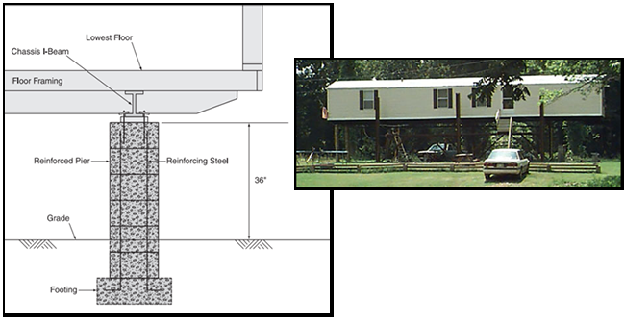
60.3(c) Requirement (12)--Manufactured Home Chassis Piers
(12) When not covered by 60.3(c)(6), manufactured home chassis must:
Have the lowest floor above the BFE
Be supported by reinforced piers 36 inches or more in height
Be securely anchored to an anchored foundation system

Slide 71
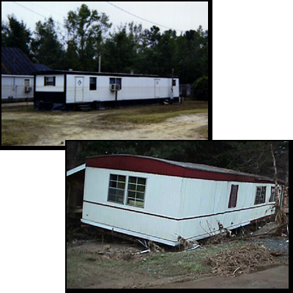
Manufactured Home Park Damage

Slide 72
Discussion: Manufactured Homes
What concerns or issues do you have with manufactured homes in your community?
Are your local floodplain regulations for manufactured homes clear and easy to enforce?
Do you have any best practices?

Slide 73
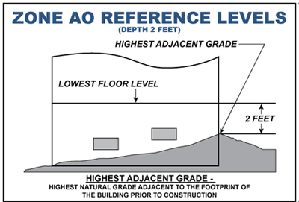
60.3(c) Requirement (7)--Zone AO Residential Reference Levels
(7) Residential structures have the lowest floor (including basement) elevated above the highest adjacent grade:
To the depth specified on the FIRM
At least 2 feet, if no depth specified

Slide 74
60.3(c) Requirement (8)--Zone AO Non-Residential Reference Levels
(8) Non-residential structures:
Have the lowest floor (including basement) elevated above the highest adjacent grade:
To the depth specified on the FIRM
At least 2 feet, if no depth specified, OR
Be completely floodproofed to that level, together with utility and sanitary facilities

Slide 75
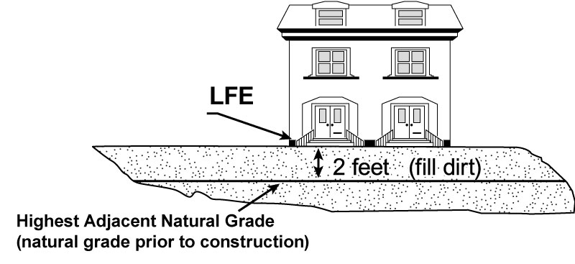
Zone AO - Lowest Floor Elevation with Fill

Slide 76
Discussion: Measuring from Natural Grade
How can you ensure the surveyor/owner/developer is measuring height from natural grade?

Slide 77
Discussion: Non-Residential AO Zone
If the previous diagram was a non-residential building, how would the requirements be different?

Slide 78
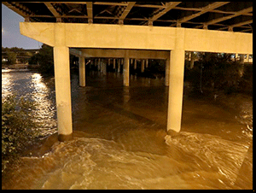
60.3(c) Requirements (10) and (13)--Cumulative Rise
(10) No new development (including fill) is permitted if it will increase the cumulative rise more than 1 foot
(13) A community may approve development which increases the base flood elevation if it receives a Conditional Letter of Map Revision (CLOMR)

Slide 79
Tracking Cumulative Rise
How do you track cumulative rise in AE zones in your community?

Slide 80
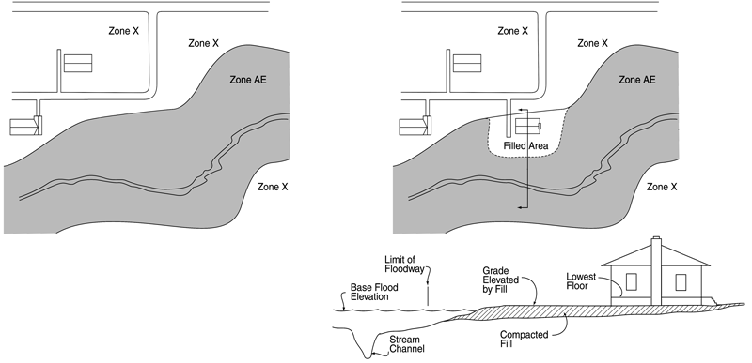
Cumulative Rise (cont.)

Slide 81
Discussion: Impact of Fill in a SFHA
What are some of the impacts of placing fill in a SFHA?

Slide 82
Discussion: Cumulative Rise Concerns
As a FPA, what are your questions and concerns about this regulatory requirement?

Slide 83
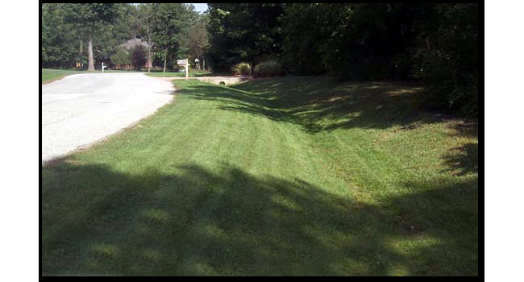
60.3(c) Requirement (11)--Grading for Drainage
(11) Within Zones AH and AO, require adequate drainage paths around structures on slopes to guide floodwaters around and away from proposed structures.

Slide 84
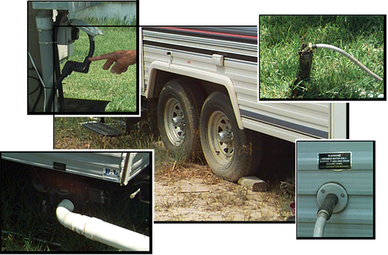
60.3(c) Requirement (14)--Recreational Vehicle Hookups
(14) Recreational vehicles:
Are on the site for fewer than 180 consecutive days, or
Are fully licensed and ready for highway use, or
Meet permit, elevation, and anchoring requirements for manufactured homes

Slide 85
Discussion: Highway-Ready Recreational Vehicles
How can you tell if a recreational vehicle is ready for highway use?

Slide 86
Activity 4.2: Structural and Non-Structural Regulations
Table group activity
Refer to your Student Manual for Scenario #1 and Scenario #2. For each scenario, identify the regulations that would apply.

Slide 87
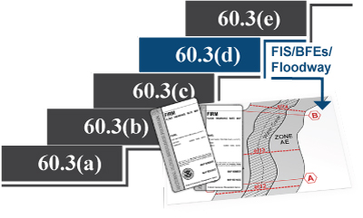
Regulations Discussion - 44 CFR 60.3(d): Zone AE with Floodway
FIS and FIRMs identify:
SFHAs
BFEs
Floodways

Slide 88
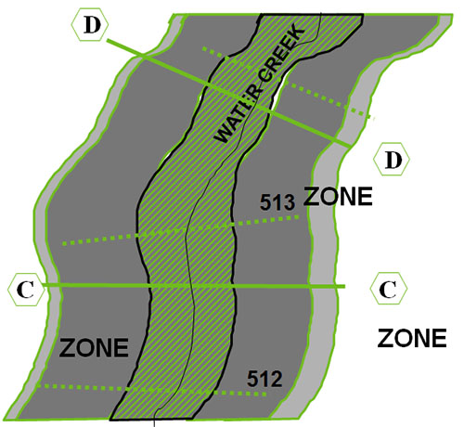
60.3(d) Requirement (3)--FIRM with Floodway

Slide 89
Regulatory Floodway Terminology
Floodway:
Watercourse channel and adjacent land, must be reserved
Portion of an SFHA that experiences high-velocity flows
Floodway Fringe: Portion of the SFHA that can be encroached
Floodway Boundary: Line on FIRM where encroachment will create 1+ foot surcharge

Slide 90
60.3(d) Requirements (1-4)
The community shall designate its regulatory floodway and shall:
(3) Prohibit encroachments, unless the proposed encroachment would not result in any increase in flood levels
(4) Encroachments my be permitted within the regulatory floodway that would result in an increase in base flood elevations, provided the community first applies for a conditional FIRM and floodway revision, and receives the approval of FEMA.

Slide 91
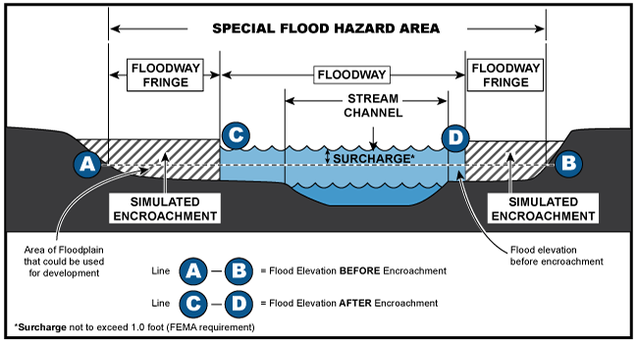
Floodway Surcharge Limit
Minimum NFIP standards require surcharge not to exceed 1.0 feet. Note that the surcharge from encroachment in the floodway fringe does not result in a higher BFE or wider SFHA

Slide 92
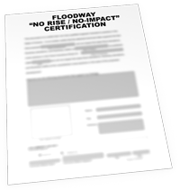
No-Rise Certification
All projects in floodway must be reviewed to determine if they will cause an increase in flood height and must:
Have a no-rise certification in the permit file
Be supported by technical data
Be signed by a registered professional engineer

Slide 93

Floodway Encroachment and No-Rise Certification
Encroachment in a floodway that increases the BFE is non-compliant with NFIP regulations
No-rise certification demonstrates that the floodway encroachment is compliant

Slide 94
Activity 4.3: Applying Regulations to Floodway Development
Whole class discussion
Review the questions
We will discuss the answers together

Slide 95

Regulations Discussion: 44 CFR 60.3(e)--Zones VE and V1–30
FIS and FIRM identify:
SFHAs
BFEs
Floodways
Coastal High Hazard Areas

Slide 96

60.3(e)--Zones VE and V1-30
Areas identified with 1-percent annual chance of flood:
Zones VE and V1-30
Coastal flooding with velocity hazards
Wave action of 3-foot waves or greater
BFE determined

Slide 97

FIRM with V Zones
What do the white lines on this FIRM represent?

Slide 98

60.3(e) Requirement (2)--Lowest Horizontal Structural Member
(2) Obtain the elevation of the bottom of the lowest horizontal structural member of the lowest floor (excluding pilings and columns).

Slide 99
Discussion: Lowest Floor Elevation
What is the difference between the lowest floor in an A Zone and the lowest floor in a V Zone?

Slide 100

60.3(e) Requirement (3)--Landward of Mean High Tide: 60.3(e)(3)
(3) Provide that all new construction within Zones V1-30, VE, and V is located landward of the reach of mean high tide.

Slide 101

60.3(e) Requirement (4) (i and ii)
(4) All new construction and substantial improvements, are elevated on pilings and columns so that:
(i) The bottom of the lowest horizontal structural member of the lowest floor (excluding pilings or columns) is elevated to or above the base flood level, and
(ii) The foundation and structure resist flotation, collapse, and lateral movement due to wind and water loads

Slide 102

Continuous Load Path

Slide 103

Supporting Foundation System

Slide 104

Supporting Foundation System (Cont.)

Slide 105

Failed Foundation System

Slide 106
Discussion: Failed Supporting Foundation System
What 60.3(e) requirement did the structure on the previous slide fail to meet?

Slide 107

60.3(e) Requirements (5)--Free of Obstruction and Breakaway Walls
(5) All new construction and substantial improvements within Zones V1-30, VE, and V have the space below the lowest floor either free of obstruction or constructed with non-supporting breakaway walls, open wood lattice-work, or insect screening intended to collapse under wind and water loads.
(5)(i) Breakaway walls should collapse from a water load less than that which would occur during the base flood.
(5)(ii) Such enclosed space shall solely be used for parking of vehicles, building access, or storage.

Slide 108

Failure of Breakaway Wall

Slide 109

Utility Connections

Slide 110

Open Wood Lattice-Work

Slide 111

Cross Bracing

Slide 112

60.3(e) Requirement (5)--V Zone Certificate
For all structures built or substantially improved in a Zone V, a registered professional engineer or architect must certify that the design and planned methods of construction meet NFIP requirements. The community must maintain a copy of this certification in the permit file.

Slide 113

60.3(e) Requirement (6)--Failure Due to Fill
Prohibit the use of fill for structural support of buildings.

Slide 114

60.3(e) Requirement (7)--Sand Dunes and Mangroves
(7) Prohibit man-made alteration of sand dunes and mangrove stands within Zones V1-30, VE, and V on the community's FIRM which would increase potential flood damage.

Slide 115
60.3(e) Requirement (8)--Manufactured Homes in V Zones
(8) Require that manufactured homes placed or substantially improved within Zones V1-30, V, and VE on the community's FIRM on sites
(i) Outside of a manufactured home park or subdivision,
(ii) In a new manufactured home park or subdivision,
(iii) In an expansion to an existing manufactured home park or subdivision, or
(iv) In an existing manufactured home park or subdivision on which a manufactured home has incurred “substantial damage” as the result of a flood,
Meet the standards of paragraphs (e)(2) through (7) of this section and that
Manufactured homes placed or substantially improved on other sites in an existing manufactured home park or subdivision within Zones VI-30, V, and VE on the community's FIRM meet the requirements of paragraph (c)(12) of this section.

Slide 116
60.3(e) Requirement (9)--Recreational Vehicles in V Zones
(9) Require that recreational vehicles placed on sites within Zones V1-30, V, and VE on the community's FIRM either
(i) Be on the site for fewer than 180 consecutive days,or
(ii) Be fully licensed and ready for highway use, or
(iii) Meet the requirements in paragraphs (b)(1) and (e) (2) through (7) of this section.
A recreational vehicle is ready for highway use if it is on its wheels or jacking system, is attached to the site only by quick disconnect type utilities and security devices, and has no permanently attached additions.

Slide 117
Discussion: Zone VE Construction
A property owner wishes to construct a vacation home on a beachfront lot located in a Zone VE. What are the applicable regulations?

Slide 118
Regulations Discussion: 44 CFR 60.1(d)--Higher Standards
(d) Any community may exceed the minimum criteria by adopting more comprehensive flood plain management regulations.
Higher Standards:
Reduces or eliminates flood damage
Makes floodplain development safer
Improves community resilience
Allows flexibility for state or local priorities
Encourages comprehensive floodplain management
Reduces the cost of flood insurance premiums

Slide 119
International Codes
I-Codes—Family of codes developed by the International Code Council
Codes have higher standards than NFIP
Communities that participate in the NFIP use I-Codes to develop building codes
Building Code Approach—Use codes based on International Building Code (IBC) Appendix G to enforce floodplain management
Comprehensive Approach—Use enforcement of planning, zoning, and building code regulations for floodplain management
Standalone Approach—Floodplain management regulations separate from building code regulations

Slide 120
Activity 4.4: Higher Standards
Table group activity
Refer to the list of Common Higher Standards in your Student Manual. Create a list of the higher standards that you believe would be most appropriate to implement in your community given your specific flood hazards and site conditions. With a check mark, indicate which higher standards are already being implemented in your community.

Slide 121

Activity 4.5: Unit 4 Communication Corner
Work with your table group
Answer the questions and statements from property owners listed on the next slide.
5 minutes

Slide 122
Activity 4.5: Unit 4 Communication Corner (cont.)
I can't afford the extra cost of raising my home to meet the requirements.
If I get damaged by a disaster, I agree to not ask for disaster assistance.
Why do I have to do this?
Why do we have a regulation?
Why do I have to build higher than it says in the federal regulations?
If I'm not getting insurance, why do I have to comply?

Slide 123
Activity 4.6: Knowledge Check
Individual work
Compare the Sample Flood Damage Reduction Ordinance to the Regulations Crosswalk.
Look for language that relates to:
Reasonably safe from flooding
Flood openings
Obstruction/breakaway walls
Obtaining lowest floor elevation
Use of flood-resistant materials
RVs onsite less than 180 days
Write the section of the Sample Ordinance in the appropriate column.

