Slide 1

Unit 5: Substantial Improvement/Substantial Damage

Slide 2
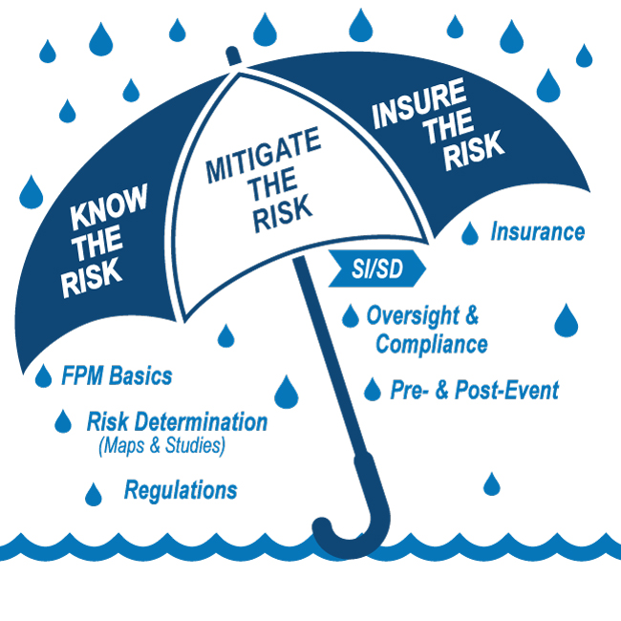
E0273 Course Map Unit 5

Slide 3

Unit 5 Objective
After completing this unit, you should be able to:
Identify the NFIP requirements related to Substantial Improvement/Substantial Damage (SI/SD)

Slide 4
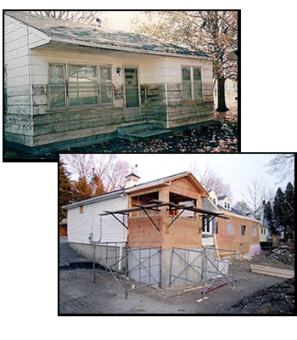
Why is Determining SI/SD Important?
Reduce number of buildings exposed to flood damage
Lower flood insurance
Protect people and property
More compliant structures
Making SI/SD determinations is a challenge, particularly after major flooding events

Slide 5
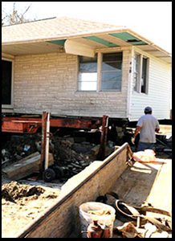
Substantial Improvement (Part 1 of 2)
Substantial improvement means any reconstruction, rehabilitation, addition, or other improvement of a structure, the cost of which equals or exceeds 50 percent of the market value of the structure before the “start of construction” of the improvement.
Includes structures which have incurred "substantial damage,'' regardless of the actual repair work performed.
Community must make the "substantially improved" determination

Slide 6
What is included in cost of Substantial Improvement?
Reconstruction cost
Rehabilitation cost
Cost of addition
Cost of any other improvements
Substantial improvement of any structure in the floodplain is considered new construction under the local floodplain ordinance.

Slide 7
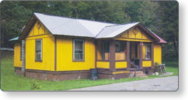
Substantial Improvement: Special Cases
Alteration of a “historic structure”
Correcting previously cited violations:
Health codes
Sanitary codes
Safety codes

Slide 8
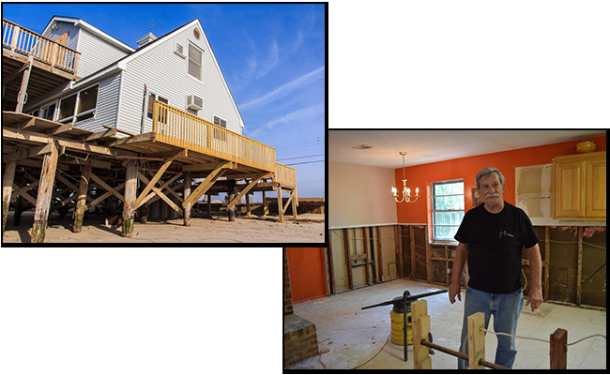
Examples: Exterior and Interior Improvements

Slide 9
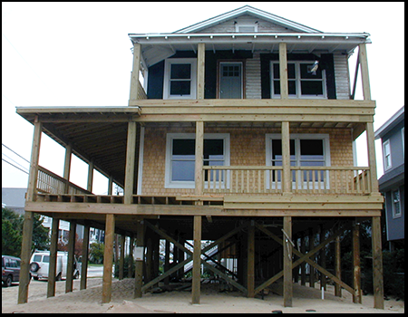
What Makes it Substantial?
Improvement costs must be equal or greater than 50% of the market value of the structure

Slide 10

Discussion: Improvement Costs
How do you determine the total costs of improvement? How do you know it is approaching 50%?

Slide 11
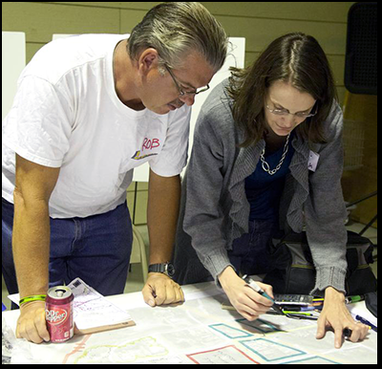
Estimating Improvement Costs
Itemized estimates from licensed contractors or design professionals
Professional estimating guidelines
Independent professional estimators

Slide 12
Market Value
Market value can be determined by:
Recent independent appraisals by a professional appraiser
Replacement cost, only if depreciated
Tax assessor data (structure only)
However you do it, be consistent

Slide 13
Substantial Improvement (Part 2 of 2)
(Cost of Improvement) / (Market Value) 100 = X%
Check the Substantial Improvement/Substantial Damage Desk Reference and the Items to be Included and Excluded tables
Ratios between 40% - 60% merit a second look
Community should require precise cost determination methods for close calls

Slide 14

Activity 5.1: Substantial Improvement Case Study
Whole group discussion
Case Study #1--Addition to a Restaurant
Read the scenario and information provided in your Student Manual
Answer the questions

Slide 15
Activity 5.1: Substantial Improvement Case Study
Total cost of constructing the proposed addition: $325,000
Appraised value of property: $645,000
Appraised value of the structure: $600,000
Appraised value of the land: $45,000
Considering only the information provided, is this a Substantial Improvement?
As the local Floodplain Administrator, is there more you should ask yourself as you determine whether this is a Substantial Improvement?

Slide 16
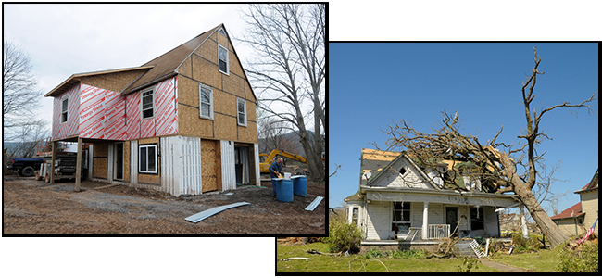
Substantial Improvement/Substantial Damage
Substantial improvement: Cost to rebuild/improve a structure in the Special Flood Hazard Area (SFHA), whether damaged or not, is equal to or more than 50 percent of market value prior to work
Substantial damage: Cost to restore a structure in the SFHA to pre-damage condition equals or exceeds 50 percent of the market value of the structure before damage occurred

Slide 17
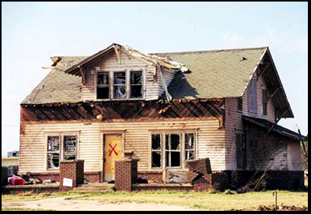
What is Damage?
Any source (fire, tornado, car or tree impacts the building)
Structures in the SFHA

Slide 18
Substantial Damage
A Substantially Damaged structure must meet the following conditions:
Located in the Special Flood Hazard Area(SFHA)
Non-compliant with current floodplain standards
Formally declared substantially damaged by community authority
Cost of post-damage repair ≥ 50 percent of pre-damage market value
Pre-Flood Insurance Rate Map (FIRM) and Post-FIRM

Slide 19
Why is Determining Substantial Damage Important?
Structures in the SFHA damaged by fire, tornado, or any other cause are subject to Substantial Damage ordinance provisions.
Repair/rebuilding:
Automatically becomes a Substantial Improvement
Must meet current design requirements of local regulations
Must meet other identified health, sanitary, or safety code requirements

Slide 20
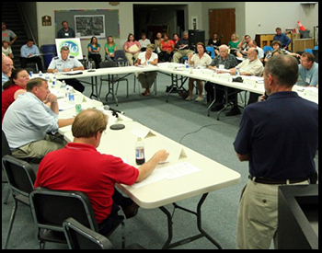
Community Responsibility
The community is the only entity that can make a substantial improvement/substantial damage determination.
Must assure accuracy and consistency of:
Full cost of improvements or repairs.
Market value of structure.
Only local community can make a Substantial Damage determination
Must issue a determination letter
Must have an appeal process
Must assure:
Accuracy of improvement cost and actual repair/damage value
Consistent market value estimates

Slide 21
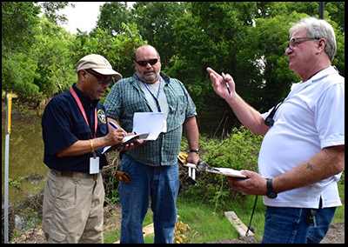
Making Substantial Damage Determinations
FPAs administer SI/SD requirements by:
Requiring permits for improvements and repairs
Determining improvement and repair costs
Determining market value of structures
Making the Substantial Improvement/Substantial Damage determinations
FPAs administer Substantial Damage (SD) requirements by:
Determining repair costs
Determining market values
Making SD determinations
Requiring appropriate permits

Slide 22
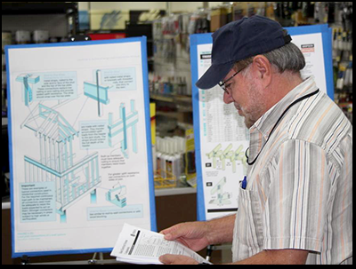
Market Value vs. Replacement Cost
Market value is the actual cash value of the structure
Market value does not equal replacement cost
Replacement cost may be used to estimate market value only if depreciated

Slide 23
Recommendations
Adopt a conservative method for determining market value
Seek accuracy, use precise methods for close calls
Apply structure value and improvement cost methods consistently
If applicant objects to the estimate, allow option to provide a certified appraisal
Develop an appeals process for disagreements on appraisals

Slide 24
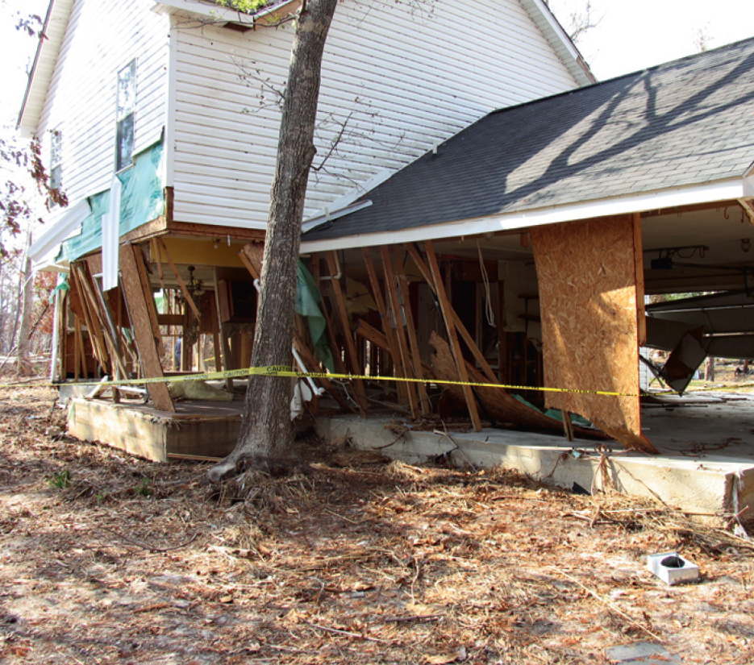
Activity 5.2: Substantial Damage Case Study
Whole group discussion
Case Study #2--Substantially Damaged?
Discuss the image on the slide
Answer the questions:
How likely is this residence to be found Substantially Damaged?
What do you see in this photograph that leads you to form this opinion?

Slide 25
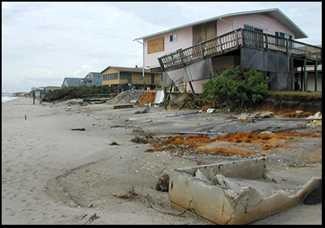
Higher Standards for SI/SD
Cumulative Substantial Improvements
Repetitive loss property
Lower SI/SD threshold
Historic structures

Slide 26

Activity 5.3: Unit 5 Communication Corner
How would you answer these questions from property owners?
Why do I have to have a permit for repairs?
Can I do half of it now and half later?
Why do I have to mitigate if my house wasn’t flooded?

Slide 27

Activity 5.4: Unit 5 Knowledge Check
Table group activity
The instructor will assign each group a topic discussed in this unit.
Table groups will summarize the key points for their topic(s).

