Slide 1

Unit 6: Oversight and Compliance

Slide 2

E0273 Course Map Unit 6

Slide 3

Unit 6 Objectives
After completing this unit, you should be able to do the following:
  Describe the responsibilities of the floodplain administrator for oversight and compliance
  Explain the basic information related to appeals and variances
  Describe the process and responsibilities for remedying violations and deficiencies

Slide 4

Discussion: FPA Responsibilities for Oversight and Compliance
What do the terms "oversight" and "compliance" mean to you?

Slide 5
Discussion: Legal Authority
Where does the local community receive its authority to regulate land use?
For what purpose?

Slide 6
Authority to Regulate Floodplains
  States grant communities the right to enact regulations to reduce flood losses
  The right includes the duty and authority to administer and enforce
  Communities enforce their own jurisdictional regulations--not FEMA
  Communities can adopt higher floodplain management standards

Slide 7
Discussion: FPA's Permitting Responsibilities
What are some specific tasks the FPA must perform during the permitting process?

Slide 8

Floodplain Administrator Responsibilities (Part 1 of 4)
  Review permit applications
  Approve or deny permit applications
  Take enforcement actions
  Interact in the appeals and variance process
  Maintain records
  Collect fees
  Investigate complaints

Slide 9

Floodplain Administrator Responsibilities (Part 2 of 4)
  Maintain and update administrative forms
  Coordinate map appeals and revisions
  Maintain floodplain maps and flood data
  Disseminate floodplain management information

Slide 10
Permitting Rules and Standards
  If no FIRM exists for a community, require permits for all development projects in floodprone areas
  Permits required for all development in the SFHA
  Permits required for all development, not just “building” projects
  Ensure Federal, state permits obtained, local regulations followed
  Development must not increase flood hazard on other properties

Slide 11
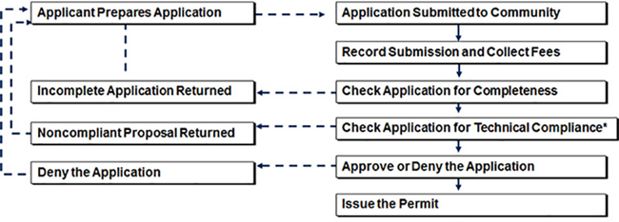
Permitting Process

Slide 12
Floodplain Administrator Responsibilities (Part 3 of 4)
  Provide educational and outreach materials
  Establish an interoffice review process
  Develop an adequate permit application form
  Offer “over-the-counter” consultation
  Check Application for Completeness

Slide 13
Floodplain Administrator Responsibilities (Part 4 of 4)
  Check Applications for Technical Compliance
  Get Necessary Interoffice Reviews/Signoffs
  Approve or Deny the Applications
  Perform Field Inspections
  Issue Certificates of Compliance/Certificates of Occupancy

Slide 14
Discussion: Determining Compliance
What is the basic information you need to know to determine compliance?

Slide 15
Discussion: Gathering Information
How does the applicant tell us the information we need to know?

Slide 16
Development Permit Application Resources and Procedures
  FEMA Map Service Center
  NFIP Technical Bulletins
  FEMA Technical Documents
  Flood Insurance Resources
  Publication - Reducing Flood Losses Through the International Codes

Slide 17
Initiating a Permit Application
Prospective applicants often contact the FPA to:
  Obtain a copy of the community's floodplain regulations
  Locate the proposed site in relation to NFIP maps
  Determine flood elevations
  Gather procedural and technical information on the permit process

Slide 18

Permit Application--Review for Compliance
  Administrative forms
  Plans
  Technical documents
  Federal and state permits
  Other local department reviews
  Certification

Slide 19

Activity 6.1: Reviewing a Permit Application
Table group activity
Read the simple scenario in your Student Manual.
  What are three things you would need to evaluate in this development proposal?
  Where can you find the information?
  Who else needs to be involved in the review?

Slide 20
Discussion: Permit Review in Your Community
How does the review of a development project flow in your community?

Slide 21

Review for Completeness: Administrative Forms
  All forms provided
  All required information provided
  Signatures provided

Slide 22
Review for Completeness: Plans
  Topography (existing/proposed)
  Floodplain and floodway boundaries
  BFEs
  Plans/elevations of existing/proposed structures
  Existing/proposed infrastructure
  Utilities

Slide 23
Review for Completeness: Technical Documents
  Floodway encroachment--No-Rise Certificate
  Floodproofing
  Enclosures below lowest floor
  Zone V construction/breakaway walls
  Engineered flood openings
  Certifications

Slide 24
Review for Completeness: Federal and State Permits
Federal permits may be required from:
  U.S. Fish and Wildlife Service
  U.S. Army Corps of Engineers
  Environmental Protection Agency
  U.S. Coast Guard
State permits may be required from:
  Department of Natural Resources
  Department of Environmental Protection
  Department of Public Health
  Department of Transportation
Regional planning commissions may require permits.

Slide 25
Review for Completeness: Other Local Department Review/Coordination
Submit copies of appropriate part to other agencies/departments for review.
  Building department
  Zoning department
  Engineers office
  FEMA Regional Office
  Health department
  State NFIP coordinating agency

Slide 26
Review for Completeness: Other Local Department Review/Coordination (cont.)
Submit copies of appropriate part to other agencies/departments for review
  U.S. Army Corps of Engineers
  Environmental Protection Agency
  U.S. Fish and Wildlife Service
  State public health agency
  Natural Resources Conservation Service
  Adjacent communities

Slide 27
Review for Completeness: Certification Requirements
Ensure that:
  The Elevation Certificate provides BFE and structure data
  The Floodproofing Certificate provides a record of floodproofing elevation
  An operational plan for installation and maintenance of floodproofing measures is provided
  Floodway No Rise, V Zone, and/or Manufactured Home Installer Anchoring certificates are signed by licensed professionals

Slide 28
Discussion: Application Errors and Omissions
What are the most common problems you find when reviewing applications for completeness?

Slide 29
How the Elevation Certificate is Used in Floodplain Management
  Form not required, but strongly recommended
  Provide consistency and uniformity
  Document compliance with regulations
  Part of maintaining records
  Provide flood and building elevation data

Slide 30
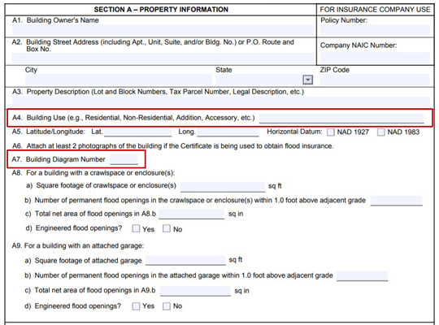
EC -- Section A: Property Information

Slide 31
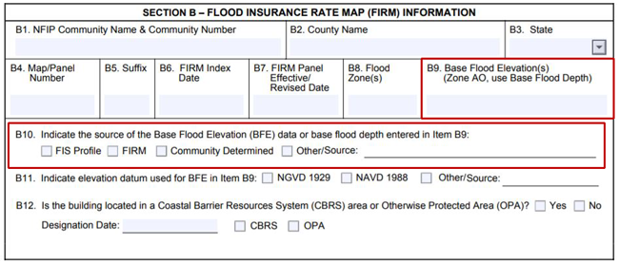
EC -- Section B: Flood Insurance Rate Map Information

Slide 32
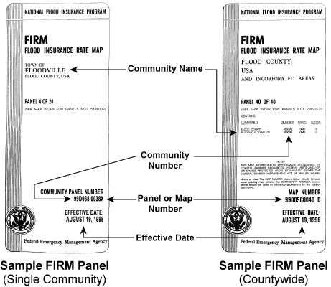
Information from a FIRM

Slide 33
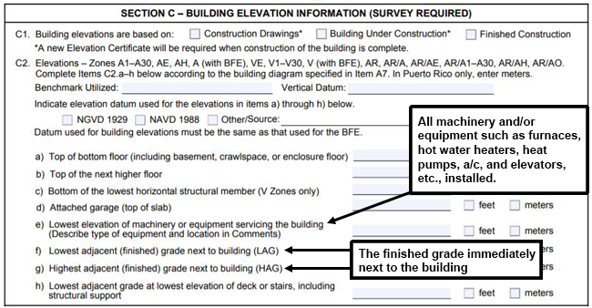
EC -- Section C: Building Elevation Information

Slide 34
Highest/Lowest Adjacent Grade
Highest Adjacent Grade (HAG): | Lowest Adjacent Grade (LAG):
Prior to construction: Highest grade next to the proposed walls of a structure If no BFE, use highest adjacent natural grade Law/ordinance elevation requirements met? | After completion of construction: Lowest (finished) grade next to building walls Is a Letter of Map Change needed?

Slide 35
When to Use Section C
  All new or substantially improved structures located in flood zones where flood elevations are provided
  Not required for Zone AO
  Not required for Zone A (without BFE)
  Must be completed if the Elevation Certificate is used to support a LOMA or LOMR-F

Slide 36
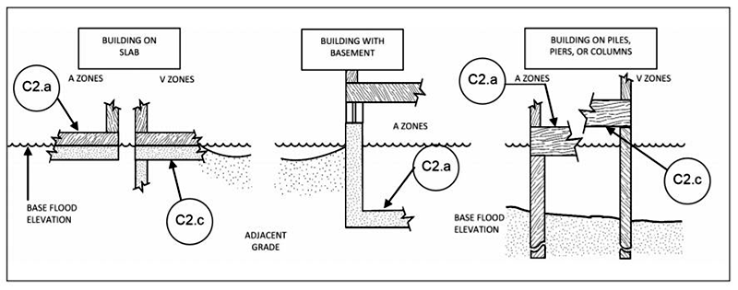
Elevation by Building Type

Slide 37
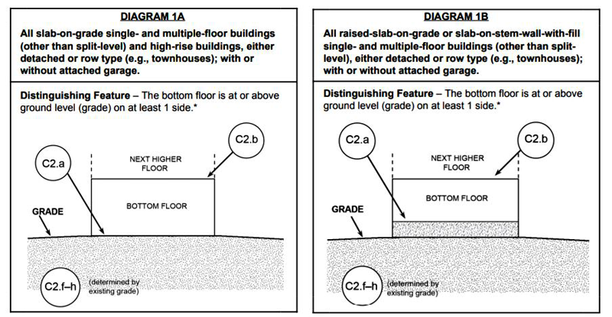
Building Diagrams -- 1A and 1B

Slide 38
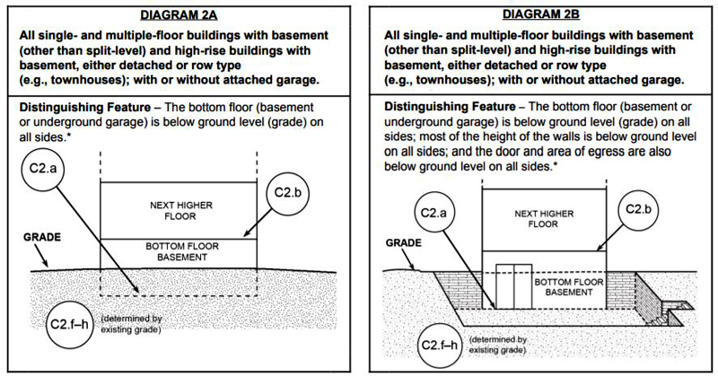
Building Diagrams -- 2A and 2B

Slide 39
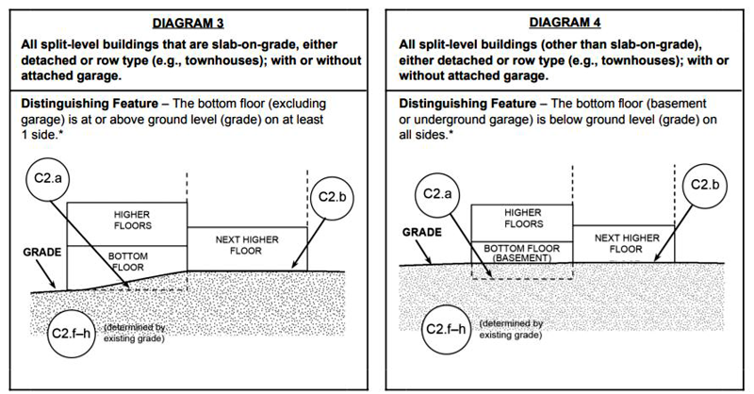
Building Diagrams -- 3 and 4

Slide 40
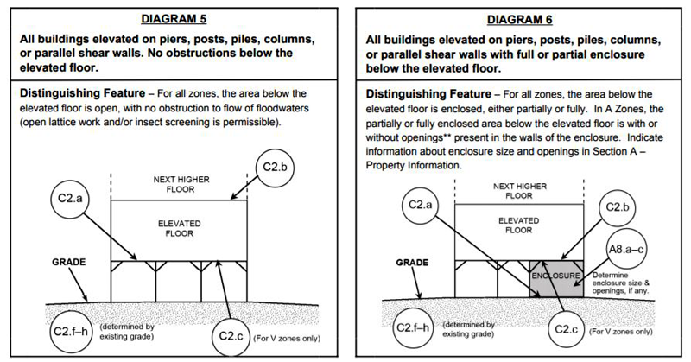
Building Diagrams -- 5 and 6

Slide 41
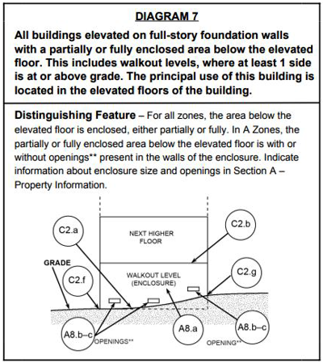
Building Diagrams -- 7

Slide 42
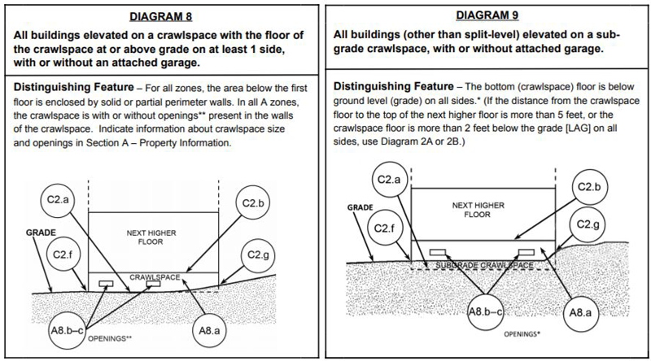
Building Diagrams -- 8 and 9

Slide 43
Activity 6.2: Which Building Diagram?
Whole group activity
The following photos show different types of building structures.
  Refer to the Building Diagrams on pages 7-9 of the Elevation Certificate Instructions.
  Choose the diagram that matches the building in the photo.

Slide 44
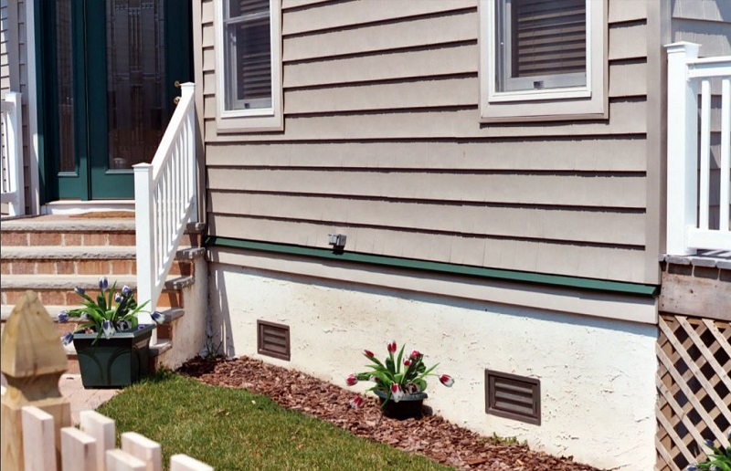
Which Diagram Do You Use? House 1

Slide 45
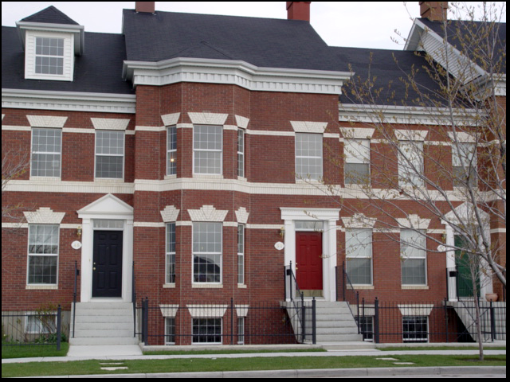
Which Diagram Do You Use? House 2

Slide 46
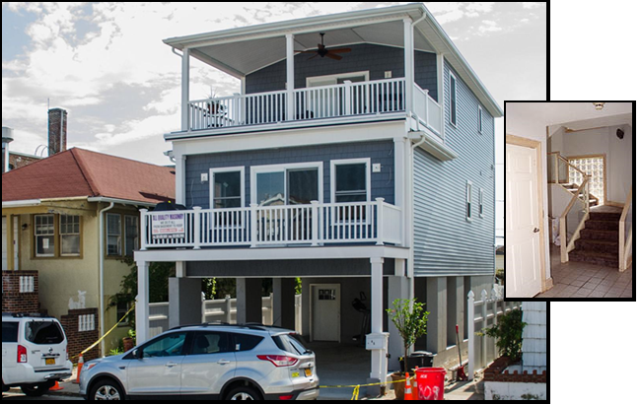
Which Diagram Do You Use? House 3

Slide 47
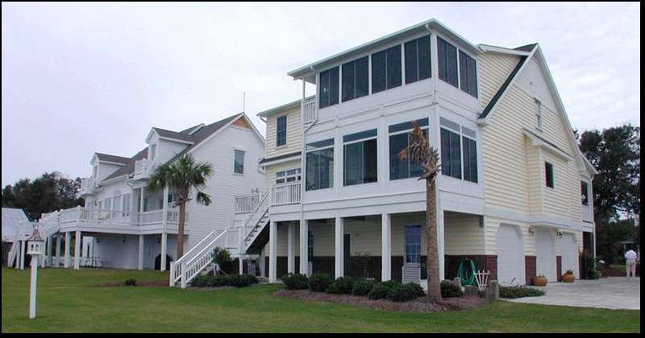
Which Diagram Do You Use? House 4

Slide 48
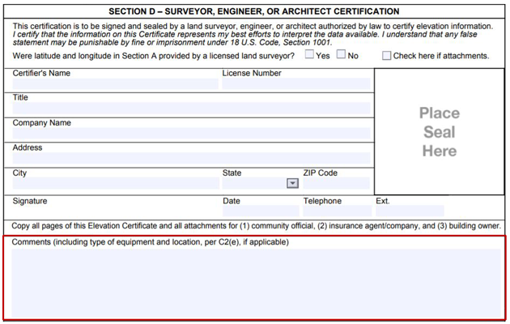
EC -- Section D: Certification and Seal

Slide 49
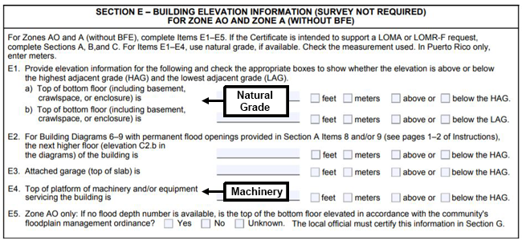
EC -- Section E: AO and Un-numbered A Zones

Slide 50
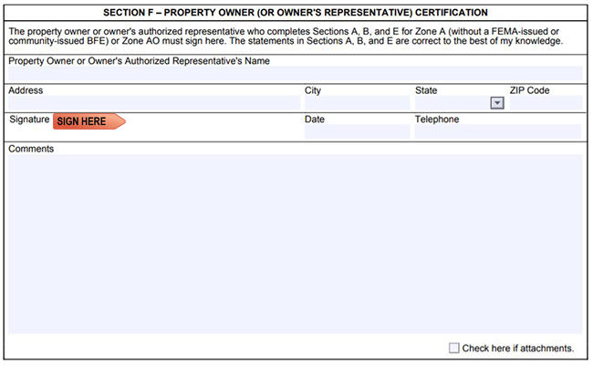
EC -- Section F: Property Owner Certification

Slide 51
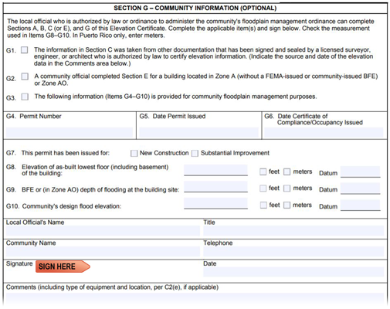
EC -- Section G: Community Information

Slide 52
Reviewing Elevation Certificates
  Verify all data in the field
  Data must match the finished structure
  Non-applicable data fields are marked N/A.
  Section D--Certifier’s seal, signature, and date
  Building photographs required for flood insurance purposes, recommended for all uses

Slide 53
Reviewing Elevation Certificates (Cont.)
  Need original--copies or faxes not acceptable
  Insist on double-sided EC
  Signature ink must a be color other than black
  No alterations or corrections, even for minor changes
  If completing Section G:
    Use a separate EC
    Attach it to the certified EC

Slide 54
Discussion: Common Elevation Certificate Errors
What are some of the most common errors on an Elevation Certificate?

Slide 55
Permit Application--Review for Technical Compliance
  Site information
  Elevation data
  Building design plans
  Structure profile
  Foundation plan
  Local engineering review

Slide 56
Review for Technical Compliance: Site Information
  Plan: Clear and understandable?
  Plotted floodplain, floodway, and Zone V boundaries: Consistent with FIRM and FIS data?
  Applicable regulations: Not violated?
  All proposed development: Shown?

Slide 57
Review for Technical Compliance: Elevation Data
  FIRM data (NGVD, NAVD, etc.): Which was used as basis?
  Existing topography/proposed grading plan included?
  Elevation data: Correct?
  Design: Complies with flood zone and BFE standards (including freeboard)?
  Conditional Letter of Map Revision (CLOMR): Needed?
  All essential data: Included?

Slide 58
Review for Technical Compliance: Building Design Plans
Review:
  Grading and drainage
  Structure and foundation type
  Existing/proposed structures/infrastructure
  Flood zone(s), BFE(s), and Lowest Floor
  Floodplain and floodway boundaries

Slide 59
Review for Technical Compliance: Building Design Plans (cont.)
Also review:
  Lower level enclosures and their uses
  Elevations of various floors and utilities
  Materials below the Flood Protection Elevation
  CBRS areas and OPA boundaries/designation date

Slide 60
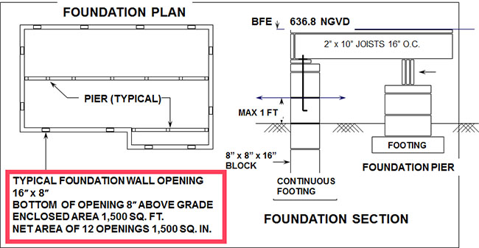
Calculating Area of Flood Openings from a Foundation Plan

Slide 61
Review for Technical Compliance: Local Engineering Review
Engineering certifications may include:
  Lowest floor (Elevation Certificate)
  Floodproofing
  Foundation design and anchoring
  Engineered flood openings
  Placement of non-structural fill in V Zones
  Floodway “no impact”
  Breakaway walls

Slide 62
Review for Technical Compliance: Local Engineering Review (Cont.)
Possibly needed, depending on circumstances:
  Floodway data
  Loading calculations, construction methods for floodproofing designs
  Zone V construction--wind and water

Slide 63
Compliance Monitoring--Inspections
  Inspections ensure applicant follows permit requirements
  Inspect periodically to ensure no noncompliant modifications
  Enclosed areas below the lowest floor present a problem
  Periodic follow up to inspect for non-compliant conversions

Slide 64
Discussion: Compliance Monitoring
How many inspections do you perform each year?
What inspection methods or approaches work for you?

Slide 65
Inspection #1 - Architectural Drawings
  Verify plan is consistent with actual ground conditions
  Check setbacks
  Verify location of floodplain and floodway boundaries
  Verify presence of CBRS areas/OPAs
  Verify locations of existing and proposed infrastructure elements

Slide 66
Inspection #2 - Foundation
Prior to the placement of the foundation, ensure that:
  Determine if placement of fill meets necessary standards
  The lowest floor will be at the elevation stipulated in the permit
  The foundation is the type specified in the plans
  Flood openings are provided
  There is no floodway encroachment

Slide 67
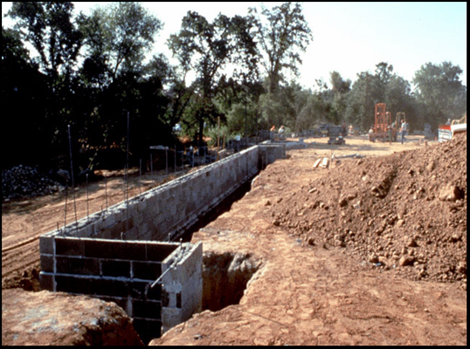
Examining a Foundation Site

Slide 68
Inspection #3 - Final
At the completion of the development, conduct the final inspection.
  Confirm lowest floor elevation to BFE
  Inspect enclosures to ensure flood openings are of adequate size
  Check equipment and machinery
  Check anchoring system on manufactured homes
  In coastal zones, check:
    Breakaway walls
    Utility connections

Slide 69
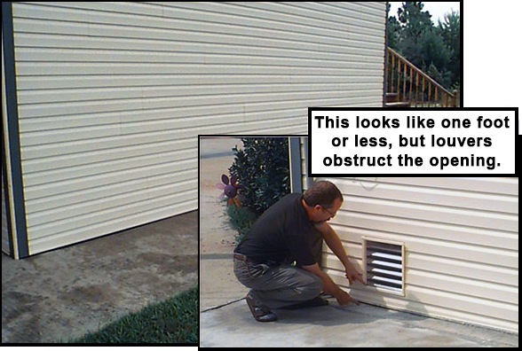
Example: Inspect Openings

Slide 70
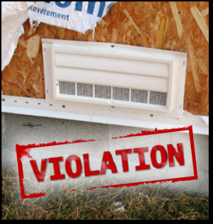
Violations
To correct violations, you must:
  Evaluate complaints
  Conduct investigations
  Use legal recourse, when necessary

Slide 71
Enforcement Options--Community
Measures that local jurisdictions can use:
  Administrative methods (stop work orders)
  Fines
  Imprisonment
  Injunctions
  Section 1316

Slide 72
Enforcement Options--FEMA Program Oversight
  Community Assistance Visits
  CRS rating downgrade
  NFIP sanctions
    Probation
    Suspension

Slide 73
Application Review Outcome--Approve
Once application is reviewed for completeness, a decision is due:
  Proposed development is in compliance--issue a permit
  Issue date becomes "start of construction" date
  Monitor to ensure that construction starts within 180 days
  Permit can expire, but deadline can be extended

Slide 74
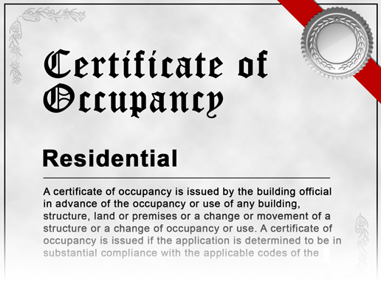
Certificate of Occupancy/Completion
  Coordinate with other building code requirements
  Consider establishing a policy concerning “renewable” (1-year) occupancy permits
  File with all records related to the project

Slide 75
Application Review Outcome--Deny
If proposed development is not in compliance--permit denied
If permit denied, the applicant can:
  Withdraw the application
  Redesign the project to bring it into compliance
  Appeal to the Board of Appeals
  Request a variance to the regulations

Slide 76
Variances
  The grant of relief by a community from the terms of a floodplain management regulation
  Minimum NFIP standards can't be met because of special circumstances
  Can create increased risk to life and property
  Should be rare

Slide 77
44 CFR 60.6: Variance Criteria
  Used as a whole, not by individual paragraphs
  For floodplain management purposes only
  May significantly increase the cost of flood insurance
  Pattern of inconsistent variances can result in sanctions against community
  Designated historic structures and functionally dependent facilities receive special consideration

Slide 78
Insufficient Reasons for a Variance
  Significant depreciation of property value
  Convenience of property owner, including people with disabilities
  Circumstances of owner, not land
  Financial hardship
  To obtain a better financial return
  Property similar to others in the neighborhood
  Hardship created by the owner’s own actions

Slide 79
If a Variance is Issued
  Notify applicant in writing:
    Higher insurance premiums (up to $25 for each $100 of coverage)
    Greater risk to life and property
  Maintain records
    Variance request
    Variance filed with the deed
    Notification to applicant
    All variance actions/procedures, including denials, and justifications

Slide 80
A Word of Advice
  Do not grant variances!
    People and property are placed at risk
    Flood insurance costs skyrocket
  FPA should only be the advisor, not the decision maker
  If you do grant a variance, be sure to document it!
Documentation is your community’s only protection after a damaging flood.

Slide 81
Discussion: Compliance Recordkeeping
What documentation do you need to retain to demonstrate compliance with your community's regulations?

Slide 82
FPA Recordkeeping--Best Practices
  An ideal permit file would include: Property address-based information
  Permit application
  SI/SD cost estimations and determinations
  Non-conversion agreements
  Inspection records
  Certifications (Elevation, No Rise, V Zone, etc.)

Slide 83
FPA Recordkeeping--Best Practices (cont.)
  An ideal permit file would also include: Current and historic flood studies and maps
  Appeal and variance findings
  NFIP correspondence
  Letters of Map Amendment and Letters of Map Revision

Slide 84

Activity 6.3: Unit 6 Communication Corner
Table group activity
  What is the essential information an FPA can provide to the applicant regarding the permitting and development process?

Slide 85

Activity 6.4: Unit 6 Knowledge Check
Table group activity
  Summarize assigned topic from unit
  Share summary with class

