Slide 1

Unit 9: Course Summary and Capstone

Slide 2
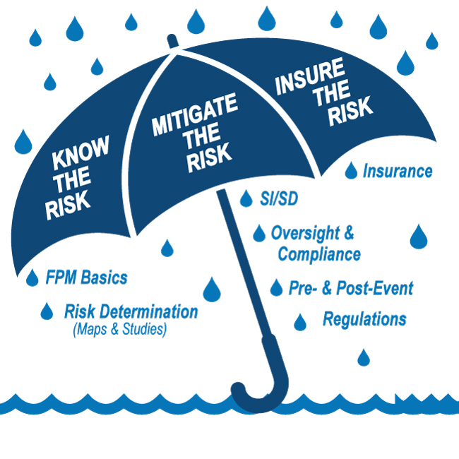
E0273 Course Map Unit 9

Slide 3

Unit 9 Objectives
At the end of this unit, you should be able to:
Summarize key points from this training course
Use a FIS, FIRMs, and a Sample Flood Damage Reduction ordinance to review development proposals for compliance with floodplain management regulations
Complete the post-course test

Slide 4
Course Objectives
At the end of this course you should be able to:
Use a Flood Insurance Rate Map (FIRM) and a Flood Insurance Study (FIS) to determine the flood zone and the Base Flood Elevation (BFE).
Describe and facilitate local jurisdictional compliance with the minimum requirements to participate in the National Flood Insurance Program (NFIP).
Describe the components of an effective Floodplain Management program to reduce loss of life and property as well as identify and remedy violations and deficiencies.

Slide 5
Course Objectives (cont.)
At the end of this course you also should be able to:
Prepare for post-event activities, including implementing an effective Substantial Improvement/Substantial Damage (SI/SD) process.
Explain basic concepts of flood insurance rating and how Floodplain Management decisions affect the cost of flood insurance.

Slide 6
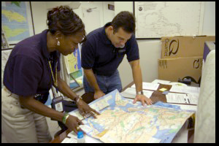
Floodplain Administrator’s Responsibilities
Keep officials and the public informed and educated about floodplain management
Upon receiving a permit application:
Make floodplain and risk determinations
Apply NFIP and community regulations
Follow the permitting process

Slide 7
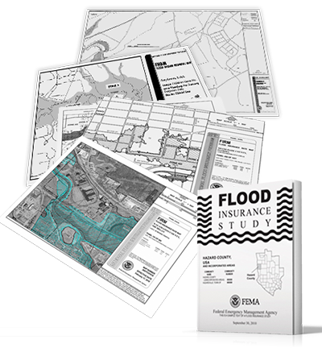
Making Floodplain and Risk Determinations
Find the correct map panel
Locate the property on the map
Identify the flood zone
Determine the BFE at the property using:
FIRM and FIS

Slide 8
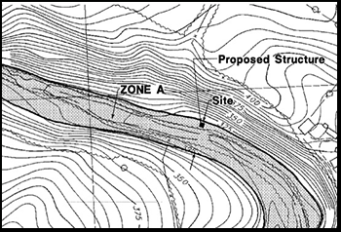
Estimating or Determining BFE
Apply regulations in Approximate Zone A
Use contour interpolation or data extrapolation to determine BFE
Determine the need for and coordinate the map change process

Slide 9
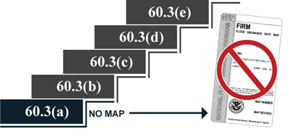
Applying Community Regulations
60.3(a) No Flood Map (minimum)
60.3(b) Approximate Zone A: SFHAs identified
60.3(c) Zone A with BFEs
60.3(d) Zone A with BFEs and Floodway Data
60.3(e) Zone V: Coastal high-hazard areas (most restrictive)

Slide 10

Following the Permitting Process
Relate State/community building codes to floodplain management
Review application package for:
Completeness
Compliance with technical requirements
Approve or deny the application
Inspect the site/work

Slide 11
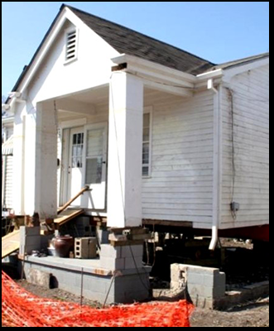
Relating Floodplain Management to Flood Insurance
Describe flood insurance terms and conditions
Explain:
How building elevation options affect insurance costs
How insurance ratings relate to floodplain data
How to use a 1316 Declaration as an enforcement tool

Slide 12
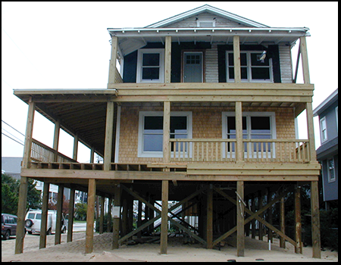
Addressing Floodplain Management Concerns
Enforce substantial improvement and substantial damage requirements
Use the Elevation Certificate

Slide 13

Activity 9.1: Capstone Activity
Developmental Project Groups*:
Table 1: Auto Dealership - 20 minutes
Table 2: Rocky River Estates - 35 minutes
Table 3: Subdivision Development - 20 minutes
Table 4: Coastal Barrier Resources Area Construction - 10 minutes and Dune Construction - 10 minutes
*NOTE: These activities are assigned to four groups. Maximum time is 35 minutes. Then each group reports their finds.

Slide 14

Course Post-Test
Complete the post-test:
This test will help assess your learning.
Write your name in the upper right-hand corner of the first page.
Select the best response by circling one of the letters for each question.
You have 20 minutes to complete the post-test.
This is an individual activity.

Slide 15

Tell Us How We Did...
Please complete the course evaluation form.
Include specific comments:
What went well
Make suggestions for improvement
Remember to Complete Line Item #19
Email address to submit EMI Course Evaluation Form (FEMA-MIT-EVALS@fema.dhs.gov).

Slide 16

Course Graduation

