Slide 1

Unit 2: Introduction to Floodplain Management

Slide 2
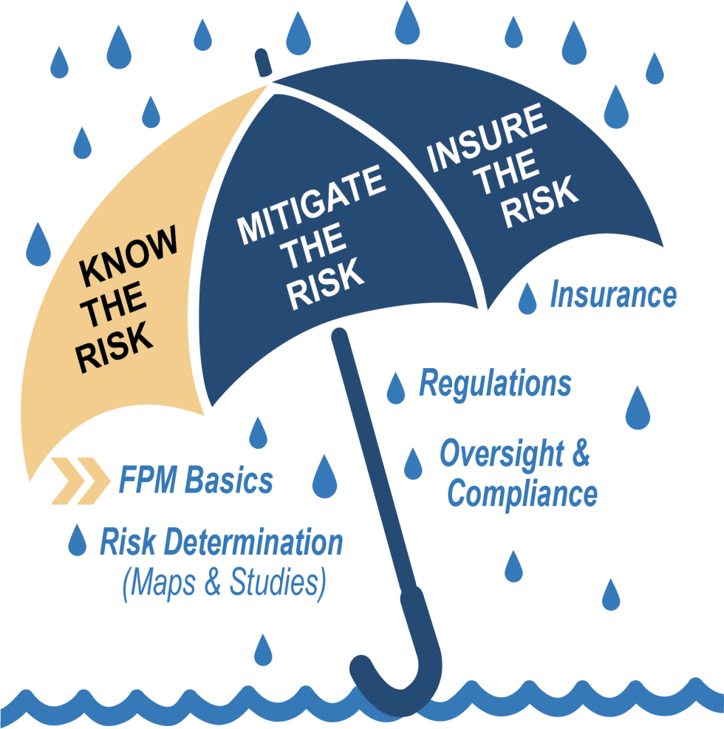

Course Map Umbrella

Slide 3

Unit 2 Objectives
After completing this unit, you should be able
to:
Describe the functions of floodplains.
Describe the general framework of the NFIP.
Explain the roles and responsibilities of Federal, State, and local governments in the NFIP.

Slide 4

Unit 2 Topics
Floodplains and the Community
Introduction to the National Flood Insurance Program (NFIP)
NFIP Framework
Federal, State, and Local NFIP Roles and
Responsibilities
Activity 2.1: Matching NFIP Responsibilities
Unit Summary
Federal Emergency Management Agency
4

Slide 5
Floodplains and the Community

Slide 6
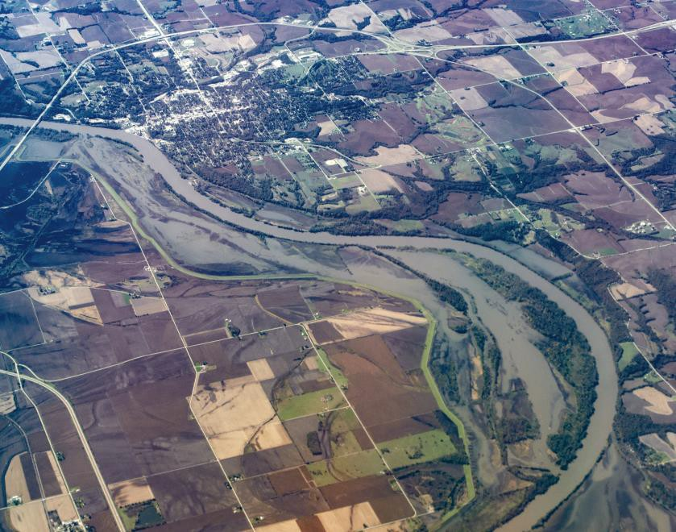

What do Floodplains Look Like?
Areas of low-lying ground (typically adjacent to a river or coast) which are subject to flooding
Provide natural and beneficial functions

Slide 7

Natural and Beneficial Functions of Floodplains
Store and convey floodwaters
Maintain water quality
Recharge groundwater aquifers
Regulate flows into rivers and lakes
Support population of plants and animals

Slide 8
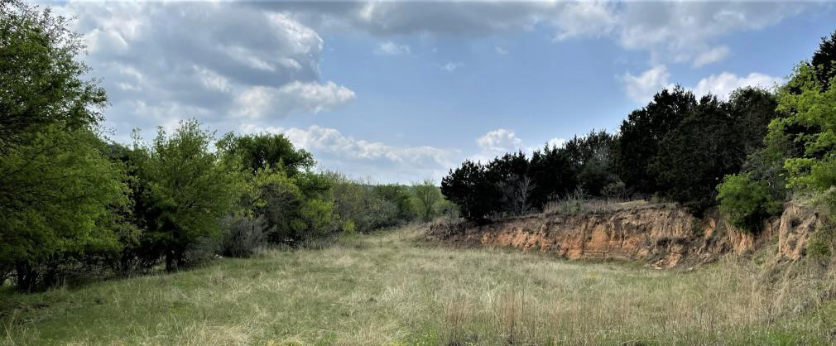

Floodplains and the Community Overview
Floods continuously alter the landscape by either eroding or building up sediment.
Floodplains provide access to:
Transportation
Water supply
Power supply
People are drawn to bodies of water to live, work,
and enjoy.
Human development can negatively impact the
floodplain.

Slide 9
Benefits of Floodplain Management
Reduces flood damage risk
Increases resiliency
Comprehensive planning can help:
Maintain natural and beneficial functions.
Direct development away from floodplains.
Avoid new infrastructure such as roads that promote further development.
Regulatory development requirements are important, but are not the only approaches.

Slide 10

Knowledge Checks 1 and 2
What are three beneficial functions of
floodplains?
Why is a strong floodplain management program important?

Slide 11
National Flood Insurance Program Framework

Slide 12

NFIP Overview

Slide 13

History of the National Flood Insurance Program (NFIP)
National Flood Insurance Act | Flood Disaster Protection Act | National Flood Insurance Reform Act | Flood Insurance Reform Act | Biggert-Waters ^{Homeowners} _{Flood Insurance} Flood Insurance _{Reform Act} Affordability Act
1968 | 1973 | 1994 | 2004 | 2012 2014
NFIP Established

Slide 14

NFIP Framework
Voluntary program
Federal Government maps the hazard
Local community agrees to adopt and enforce minimum NFIP standards
Federal Government provides flood insurance and disaster assistance
Federal Emergency Management Agency
14

Slide 15

NFIP Participation
Participation is voluntary.
Benefits:
NFIP flood insurance
Safer, stronger development in floodprone areas
Increased resilience in your community
Eligibility for grants and loans

Slide 16
Knowledge Checks 3 and 4
Who is responsible for enforcing NFIP
regulations?
What are the benefits of NFIP participation

Slide 17
Disadvantages of Non-participation in the NFIP
Inability to get federally-backed flood insurance:
Difficulty obtaining mortgages in high flood risk areas
Flood insurance may be available at a higher cost from private companies.
Increased physical and financial exposure to damages and devastating flood losses
Ineligibility for most forms of disaster assistance
For insurable structures in identified flood hazard areas

Slide 18
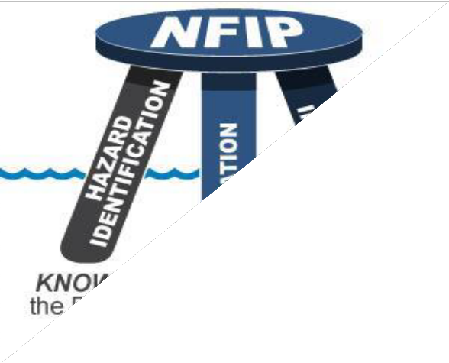
The Three-Legged Stool
The NFIP balances three related program areas:
Flood Hazard Identification (mapping)
Flood Mitigation (regulations such as building codes and zoning)
Flood Insurance (provision of federally- backed insurance for property owners in participating communities)

Slide 19
Federal, State, and Local NFIP Roles and Responsibilities

Slide 20

NFIP Roles and Responsibilities
Federal
State
Local
Federal Emergency Management Agency
20

Slide 21
Federal Roles (1 of 2)
Federal Government provides:
National program oversight
Flood hazard maps and products
Minimum development standards
Federally-backed flood insurance
Mitigation planning and technical assistance
Federal grant funding

Slide 22
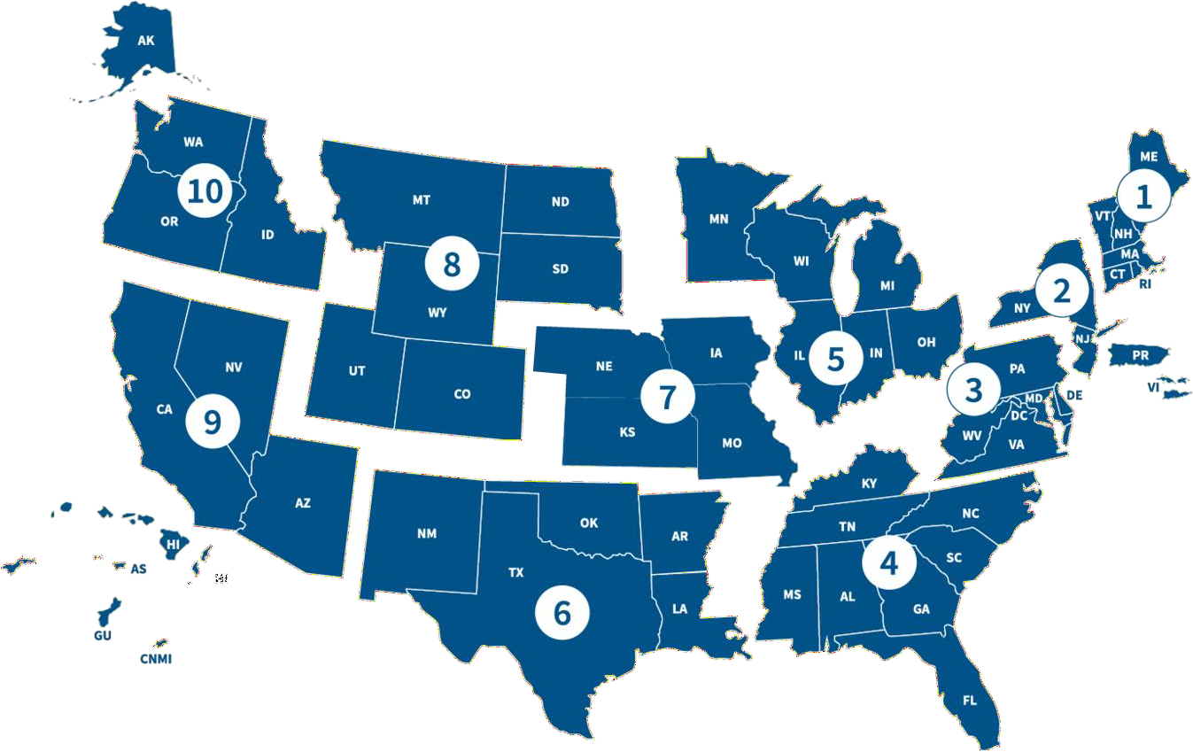
Federal Roles (2 of 2)
FEMA Regional Offices:
Work with State NFIP coordinating agencies
Advise local officials for administering their ordinance
Answer questions from design professionals and the public
Evaluate local floodplain management compliance

Slide 23
Knowledge Check 5
How FEMA helps support the NFIP in local
communities? Provide at least three examples.

Slide 24

State Roles
Provide program oversight
Establish standards, laws, and regulations
State Roles
Coordinate with FEMA on studies and maps
Provide support and technical assistance
Evaluate local floodplain management compliance

Slide 25

Community Assistance Program ─ State Support Services Element
(CAP-SSSE)
Provides funding support to States through agreement
CAP-SSSE goals:
Grow local capacity and capability to improve resiliency through floodplain management
Build state floodplain management capability and promote strong state inter-agency coordination and collaboration
Promote the benefits and drive demand for strong floodplain
management development standards and insurance

Slide 26

NFIP Legal Authority
Rests with the local community
Granted by State statutes
Designed to address public health, safety, and welfare of citizens
Varies for Tribal authority
May be in land use authority regulations, building codes, or as stand-alone ordinances

Slide 27
Knowledge Checks 6 and 7
Is it the State or Federal Government that is responsible for adopting higher standards that local communities may be required to adopt?
What is a coordinated activity a State and Federal agency conduct to manage flood risk?

Slide 28

Local Roles
Adopt a local floodplain management ordinance that meets Federal NFIP minimums (and State higher standards)
Designate a Floodplain Administrator (FPA)
Promote good floodplain management
Tribal governments have unique roles in the NFIP

Slide 29

Floodplain Administrator Permitting Responsibilities
Issue or deny permits for buildings and all floodplain development
Inspect development to assure compliance with local regulations
Pursue code enforcement action on non- compliant development
Make Substantial Improvement (SI) and Substantial Damage (SD) determinations
Maintain records in perpetuity
Provide technical assistance to citizens

Slide 30
Floodplain Administrator Responsibilities
Be familiar with enabling statutes
Protect human life and the community
Assist FEMA with flood map preparation and revision
Provide information to residents on flood hazards, map data, flood insurance, and proper development
Communicate clearly:
Explaining the benefits of floodplain management is an important part of the job.
You will need to communicate with a wide range of people.
Floodplain management concepts can be difficult to explain to some audiences.

Slide 31
Knowledge Check 8
What are the floodplain management
responsibilities of Floodplain Administrators?

Slide 32

Activity 2.1: Matching NFIP Responsibilities
Review the activity instructions.
Match the answer to the level of
government.
Prepare to share your responses.

Slide 33

Unit 2 Summary
After completing this unit, you are now able to:
Describe the functions of floodplains.
Describe the general framework of the NFIP.
Explain the roles and responsibilities of Federal, State, and local governments in the NFIP.

