Slide 1

Unit 8: Flood Insurance

Slide 2
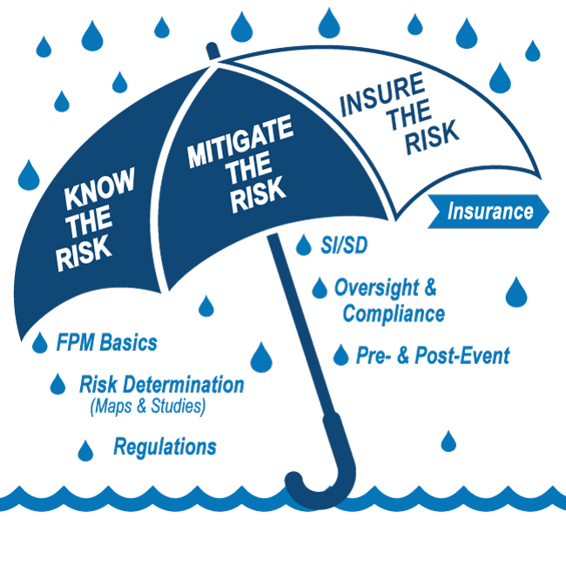
E0273 Course Map Unit 8

Slide 3

Unit 8 Objectives
At the end of this unit, you should be able to:
Describe the NFIP flood insurance basics
Explain how FPA decisions, flood map changes, and mitigation efforts affect the cost of flood insurance

Slide 4
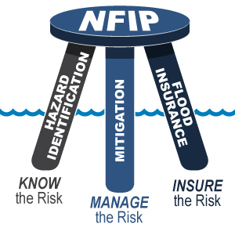
The "Three-Legged Stool”
Three related program areas support the NFIP:
Hazard Identification
Mitigation
Flood Insurance

Slide 5
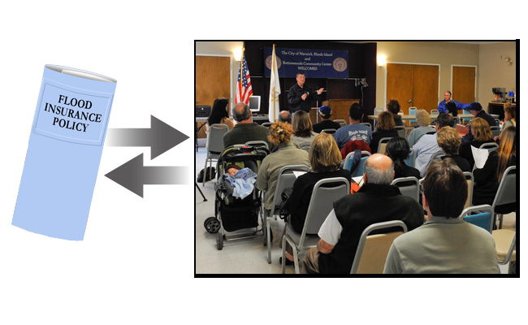
NFIP: A Quid Pro Quo Program
FEMA agrees to make flood insurance available within a community when that community agrees to adopt and enforce floodplain management regulations.

Slide 6
Flood Insurance vs. Disaster Assistance
Flood Insurance
Claims paid for all flooding events in all flood zones
No payback required
Policies are not cancelled for repeated losses
Building and contents coverages are available
Disaster Assistance
Requires Presidential declaration
Presidential Disaster declarations not made for all events
Most assistance is a loan to be repaid (with interest)

Slide 7
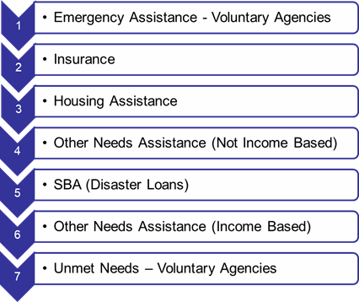
Sequence of Delivery
Assistance is available to disaster survivors
Sequence of Delivery must be followed
Ensures they receive all assistance to which they are legally entitled

Slide 8

Overview of NFIP Flood Insurance
NFIP Definitions
Eligibility and Mandatory Purchase
Rating Variables
Discounts

Slide 9
Flood Insurance Definitions – Flood
Flood: A general and temporary condition of partial or complete inundation of two or more acres of normally dry land area or of two or more properties…
Floodwater sources include:
Overflow of inland or tidal waters
Unusual, rapid surface water accumulation/runoff from any source
Mudflow
Collapse of land due to waves or currents above anticipated levels

Slide 10
Flood Insurance Definitions – Structure
Structure (for floodplain management purposes):
A walled and roofed building, including a gas or liquid storage tank, that is principally above ground, as well as a manufactured home.
Structure (for insurance purposes):
Two or more outside rigid walls
Fully secured roof
Affixed to a permanent site
Includes manufactured homes and travel trailers built on a permanent chassis affixed to a permanent foundation
Does not include RVs or storage tanks

Slide 11
Flood Insurance Definitions – RCV & ACV
Replacement Cost Value (RCV):
The cost to replace property with the same kind of material and construction, without deduction for depreciation
Actual Cash Value (ACV): Replacement cost value at the time of loss, less the value of its physical depreciation.

Slide 12
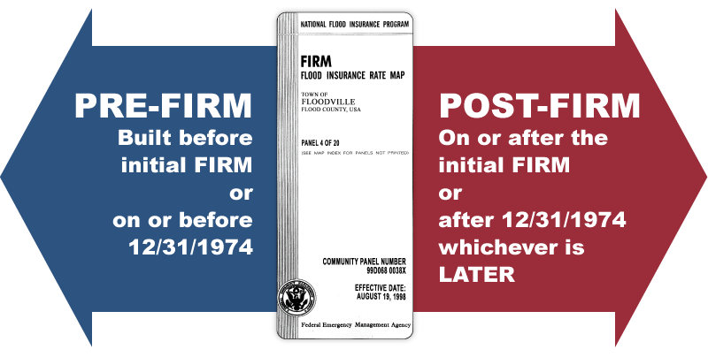
Definitions – Pre-FIRM vs Post-FIRM

Slide 13
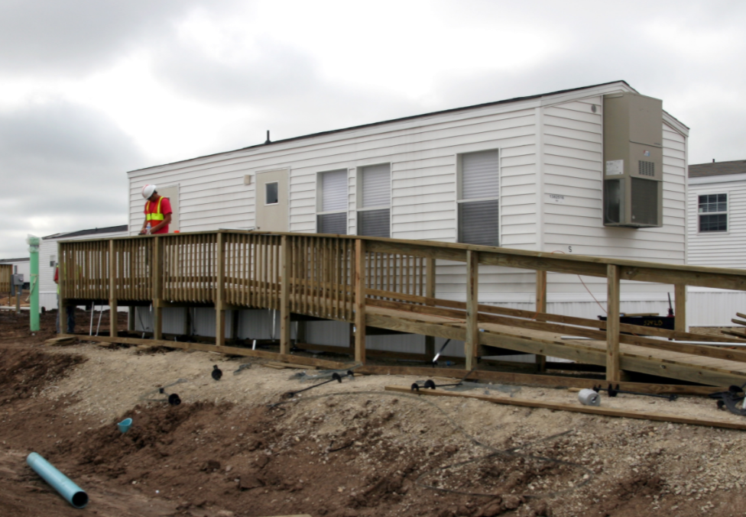
What is Insurable by the NFIP?
Walled, roofed structures principally above ground
Manufactured homes or travel trailers, if anchored to a permanent foundation
Buildings under construction
Contents of structure (available to owners and renters)

Slide 14

Not Insurable by the NFIP
Buildings completely over water
Buildings principally below ground
Unanchored manufactured homes
Motorized vehicles
Gas and liquid storage tanks outside buildings
Machinery and equipment in the open
Swimming pools, hot tubs, etc.

Slide 15
When is NFIP Flood Insurance Available?
In NFIP participating communities:
Inside and outside the Special Flood Hazard Area (SFHA)
Homeowners
Business Owners
Renters or Lessees

Slide 16
When is NFIP Flood Insurance NOT Available?
In a community that does not participate in the NFIP
In a community that has been suspended from the NFIP
For structures in Coastal Barrier Resources System (CBRS) areas or Otherwise Protected Areas (OPAs), if built after the area was designated

Slide 17
When is Flood Insurance Mandatory?
Flood Insurance is mandatory for property owners:
In the Special Flood Hazard Area (SFHA) (High-risk flood zones, beginning with Zone A or Zone V)
Government-backed mortgages (e.g., FHA, VA loans)
Mortgages from federally-regulated lenders
Certain federal grants and disaster assistance

Slide 18
When is Flood Insurance Mandatory? (Cont. 1)
Property owners who receive disaster assistance for acquisition, construction, or repair of a structure
Must purchase flood insurance if within SFHA
May not be eligible for some disaster assistance if flood insurance policy lapses

Slide 19
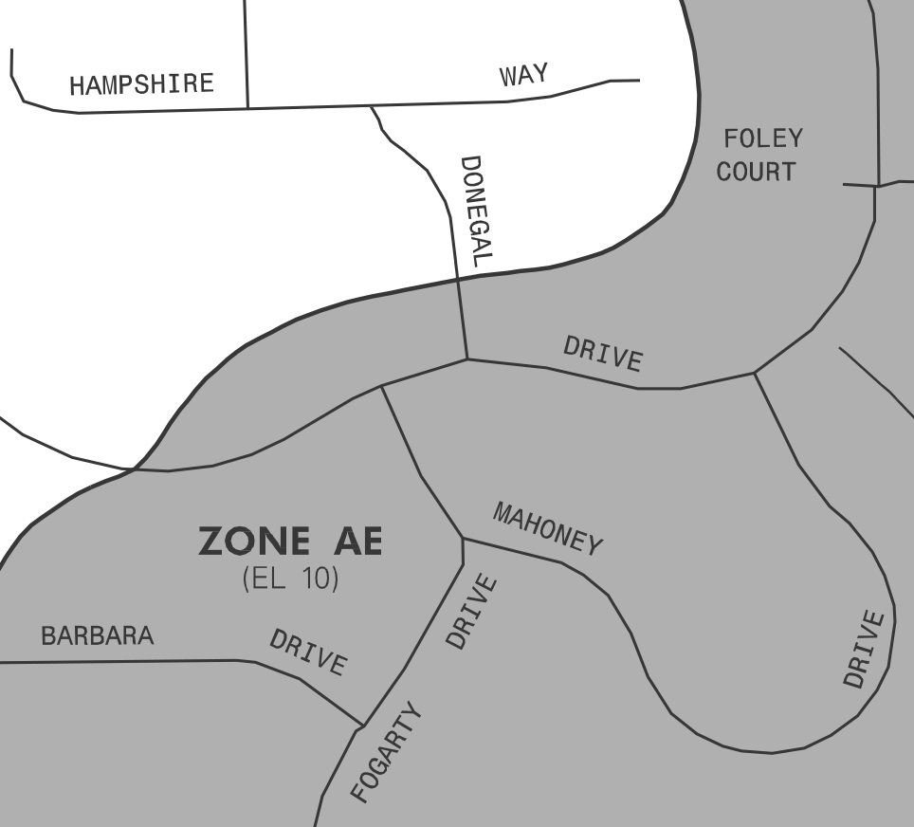
When is Flood Insurance Mandatory? (Cont. 2)

Slide 20
Mandatory Purchase Exemptions
Only FEMA can change the flood zone designation.
Property owner can apply for a LOMC
Lowest adjacent grade (LAG) or lowest ground elevation must be equal to or above base flood elevation (BFE)
If approved, the borrower can send a copy to the lender for an updated flood zone determination.
Removal from the SFHA via this process only impacts Mandatory Purchase requirements. It may not directly change the policy premium.

Slide 21

Activity 8.1: Matching Structure Location and Insurance Requirements
Table group activity
Review the mandatory insurance requirements
Assume each house has a mortgage from a federally-regulated lender
Match the mandatory insurance requirements to the appropriate structure on the map shown on the next slide
Write the number of the property in the box to the left of the matching insurance requirement

Slide 22
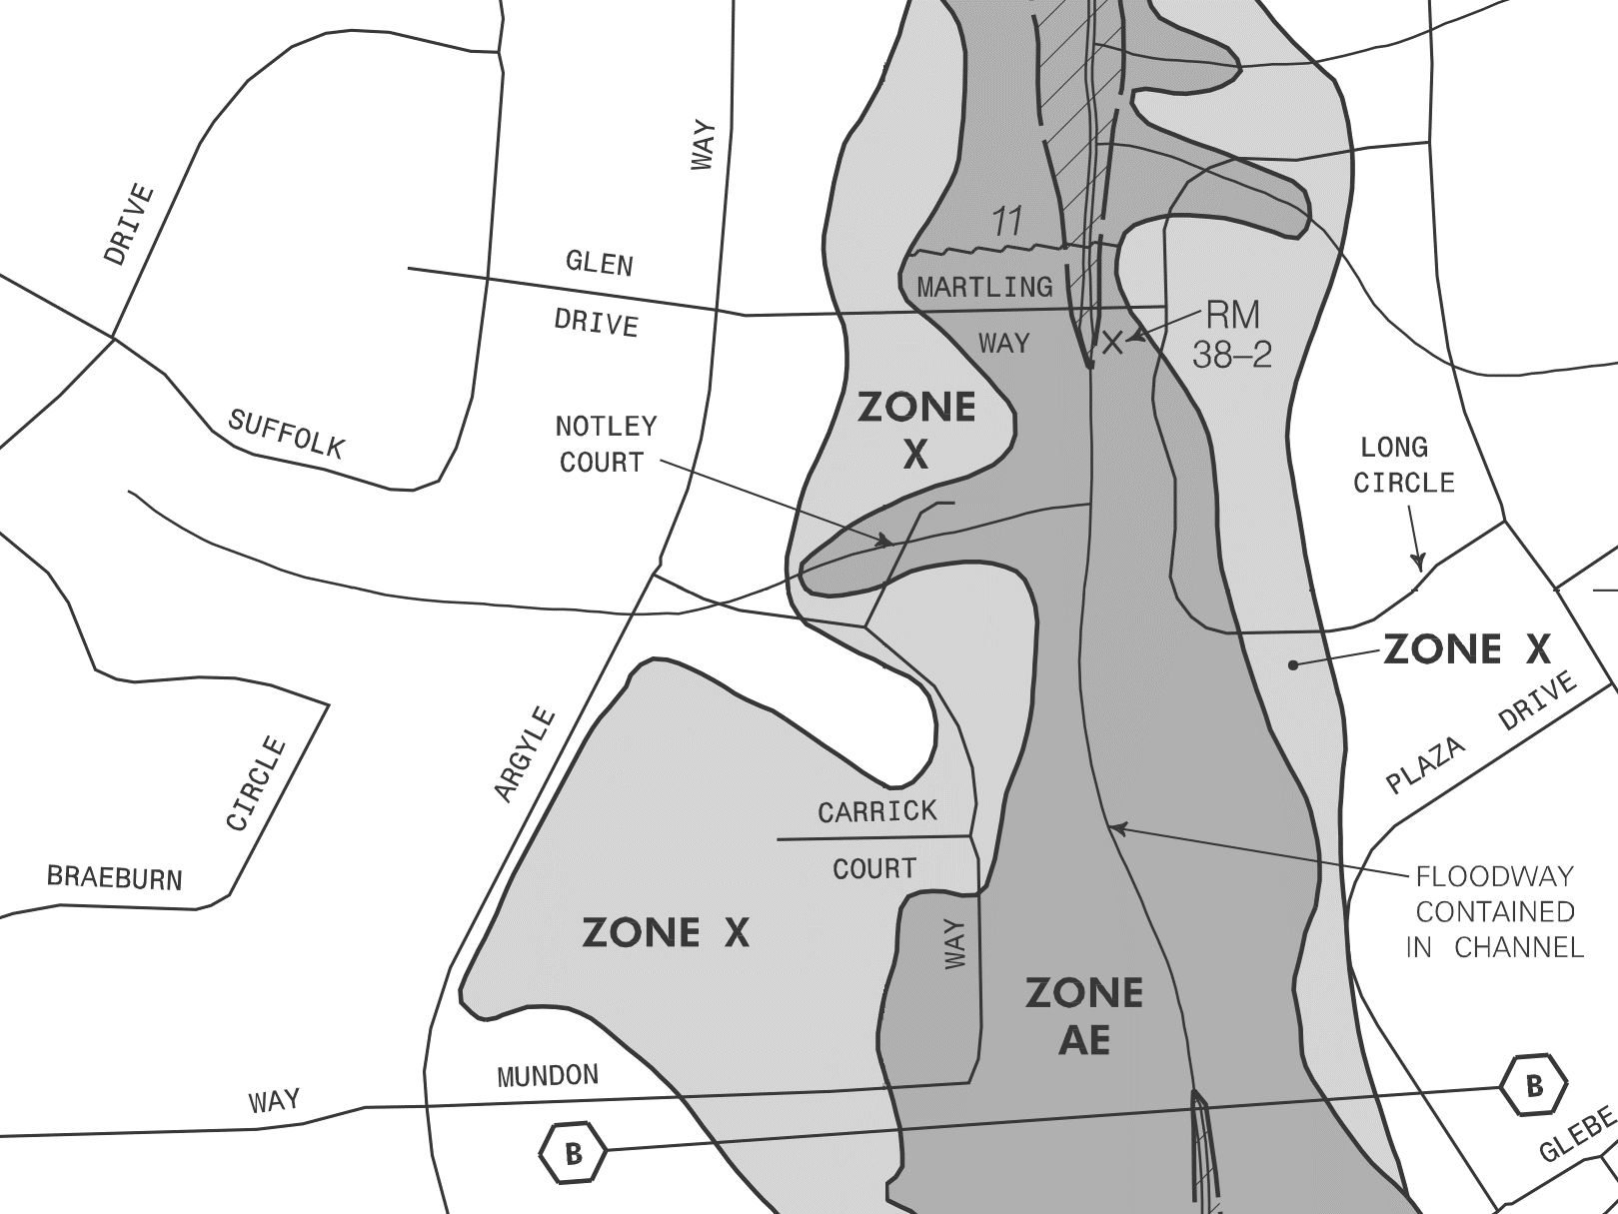
Activity 8.1: Matching Structure Location and Insurance Requirements
1
2
3
5
4

Slide 23
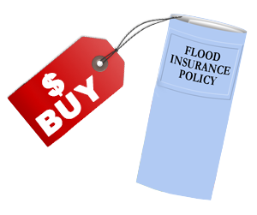
Where Do I Buy Flood Insurance?
Purchase policy through a participating NFIP insurer or agent
Find an agent at FloodSmart.gov or call 877-336-2627

Slide 24
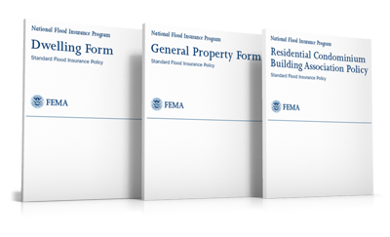
Available Coverage
Flood Insurance Policies:
Dwellings
General Property
Residential Condominium Building Association Policy (RCBAP)

Slide 25
Flood Insurance Facts
Coverage limits
Limited coverage: basements and enclosures
Flood insurance pays Actual Cash Value (ACV) for contents
Flood insurance pays Replacement Cost Value (RCV) for single-family primary residences (if insured at least 80% of RCV)
All other buildings – Insurance pays ACV
Minimum deductibles

Slide 26
Waiting Period
At loan closing – None (Policy effective immediately)
Within 12 months of a flood map change – 1 day
All others – 30 days (incl. cash purchases)
Waiver for some areas affected by wildfire
Policy Obtained | Waiting Period
At loan closing | None (policy effective immediately)
Policy Transfer | None (policy effective immediately)
Flood map change | One day
Post-wildfire | One day (conditions apply)
All others | 30 days

Slide 27

Discussion: Waiting Period
Why is there a waiting period of 30 days before policies become effective?
Why are waiting periods shortened after new maps or wildfires?

Slide 28
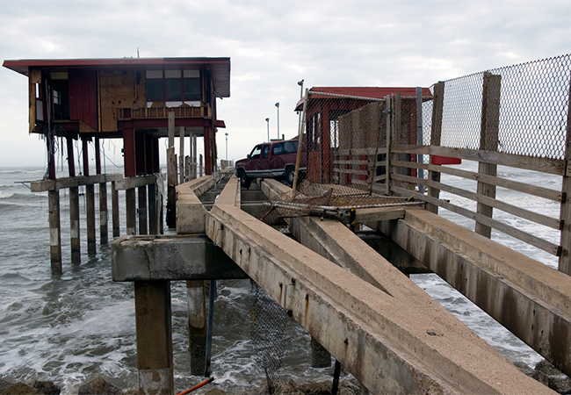
Flood Insurance Rating

Slide 29
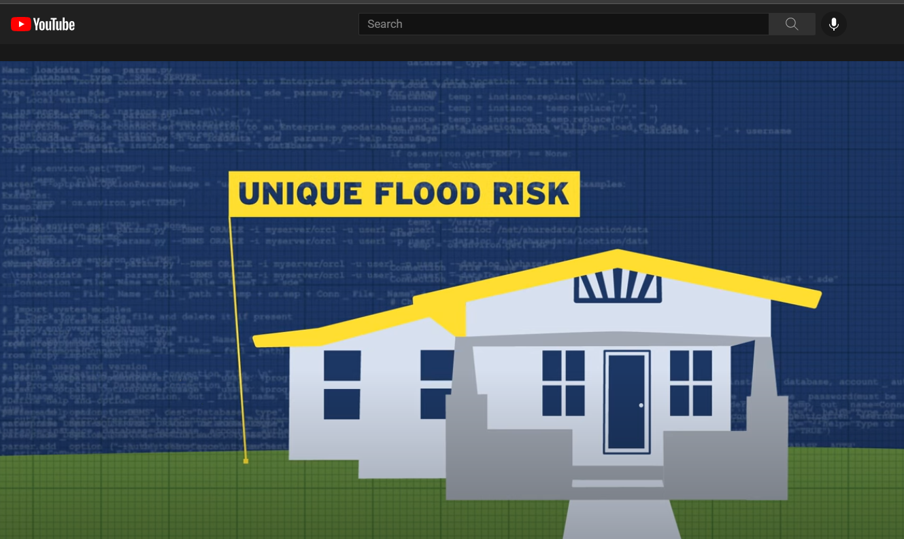
Defining a Property’s Unique Flood Risk
https://youtu.be/oi2g-0GfgMk
FEMA.gov video (1:15)

Slide 30

Overview of Flood Insurance Rating Factors
Geographic Location
Structural Variables
Claims History
Discounts
Mitigation
Statutory
CRS

Slide 31
Geographic Location
Distance to Flooding Source(s)
River, Coast, Ocean, Great Lakes
Local Relative Elevation
Elevation Relative to Flooding Source(s)
Territory (MSA)
HUC-12 Watershed
Drainage Area
River Class

Slide 32
Structural Variables – Building Characteristics
Building Occupancy
Construction Type
Frame, Masonry, Other
Foundation Type
First Floor Height
Building Replacement Cost Value
May consider square footage (some occupancy types)
Date of Construction
Number of Floors in building
Above ground, not counting basements/enclosures

Slide 33
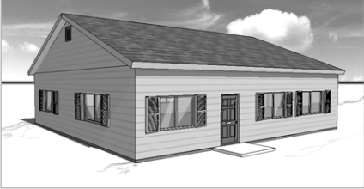
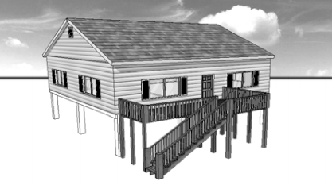
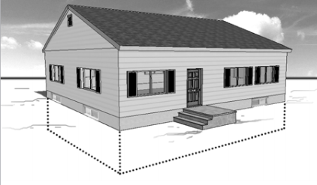
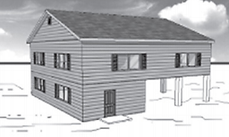
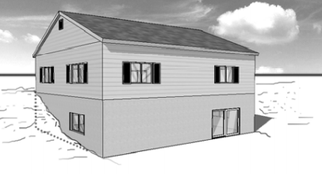
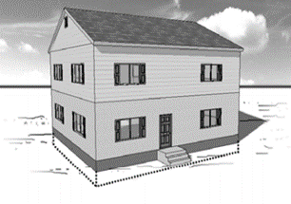
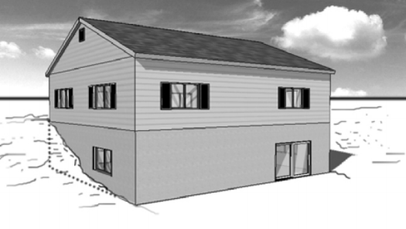
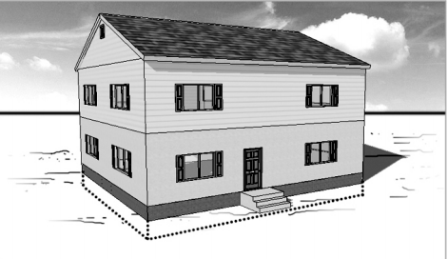

Structural Variable – Foundation Types
Slab on Grade
(Non-Elevated)
Elevated without Enclosure on Post, Pile, or Pier
Corresponds to EC Diagram 1A, 1B and 3
Corresponds to EC Diagram 5
Basement
(Non-Elevated)
Elevated with Enclosure on Post, Pile, or Pier
Corresponds to EC Diagram 2A ,2B and 4
Corresponds to EC Diagram 6
Crawlspace (Elevated, including Non-Elevated Sub-Grade Crawlspace)
Elevated with Enclosure Not on Post, Pile, or Pier (Solid Foundation Walls)
Corresponds to EC Diagram 7
Corresponds to EC Diagram 8 and 9

Slide 34
Other Structural Variables
Floor of Unit
Total Number of Units in Building
Primary Residence
Floodproofing

Slide 35
Prior NFIP Claims
Number of paid claims in a 20-year rolling window
First claim forgiven – a policy with 1 prior claim is treated the same as a policy with 0 claims
Claims where no payment was made do not count
If structure is mitigated, claims history can be reset
January 1, 2015 – Claim #1
December 2021 – Claim X (Closed without payment, so does not count)
August 2027 – Claim #2 (Prior Claims Factor: 2-1=1)
January 1, 2035 – End of 20-year window.

Slide 36
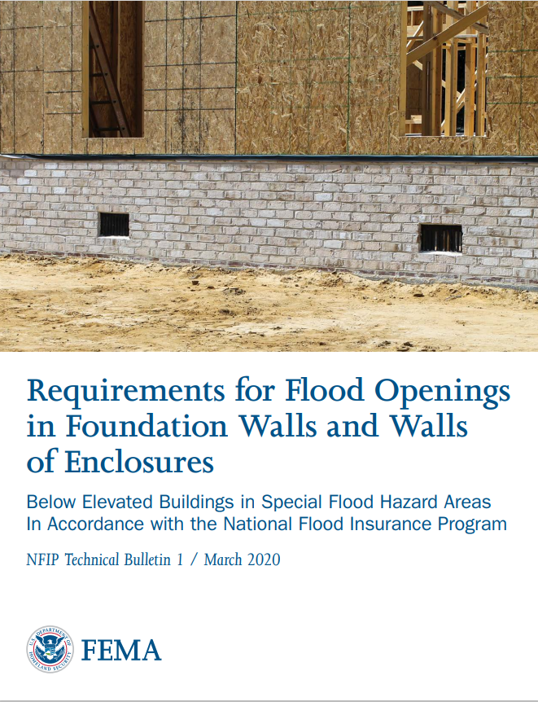
Mitigation Discounts
Flood Openings (in enclosures/crawlspaces)
Elevation of Machinery & Equipment (M&E)

Slide 37
M&E Location for Discount Eligibility
Slab on Grade
(Non-Elevated)
Elevated without Enclosure on Post, Pile, or Pier
Corresponds to EC Diagram 1A, 1B and 3
Corresponds to EC Diagram 5
Basement
(Non-Elevated)
Elevated with Enclosure on Post, Pile, or Pier
Corresponds to EC Diagram 2A ,2B and 4
Corresponds to EC Diagram 6
Crawlspace (Elevated, including Non-Elevated Sub-Grade Crawlspace)
Elevated with Enclosure Not on Post, Pile, or Pier (Solid Foundation Walls)
Corresponds to EC Diagram 7
Corresponds to EC Diagram 8 and 9

Slide 38
Mitigation for Prior Claims Reset
A building in the SFHA must have the Lowest Floor Elevation (LFE) at least 2 feet above the Base Flood Elevation (BFE).
For Unnumbered Zones A or V, the LFE must be:
BFE plus 2 feet or higher, based on best available data, or
Highest Adjacent Grade (HAG) plus 2 feet or more.
For Zone AO or outside the SFHA, the LFE must be:
HAG plus 3 feet or more for AO zones, or
HAG plus 2 feet or more in Zone X.
Applies to all foundation types

Slide 39
Statutory Discounts
Newly Mapped
First year being mapped into SFHA from a non-SFHA
Pre-FIRM
Primary Residence
Not designated an SRL property
Other Statutory Discounts
Zone A99 and AR
Emergency Program communities
Statutory discounts will phase out
Premiums increase each year until policy reaches full actuarial rate
Lapse in coverage may impact eligibility for the statutory discounts

Slide 40
Continuous Coverage and Transferring Policies
Maintaining continuous coverage will make it easier for an owner to sell their house and overall insurance costs for the buyer may be lower.
If selling, transfer flood policy instead of cancelling
Transferring policies keeps the “glidepath” for statutory discounts, if applicable

Slide 41
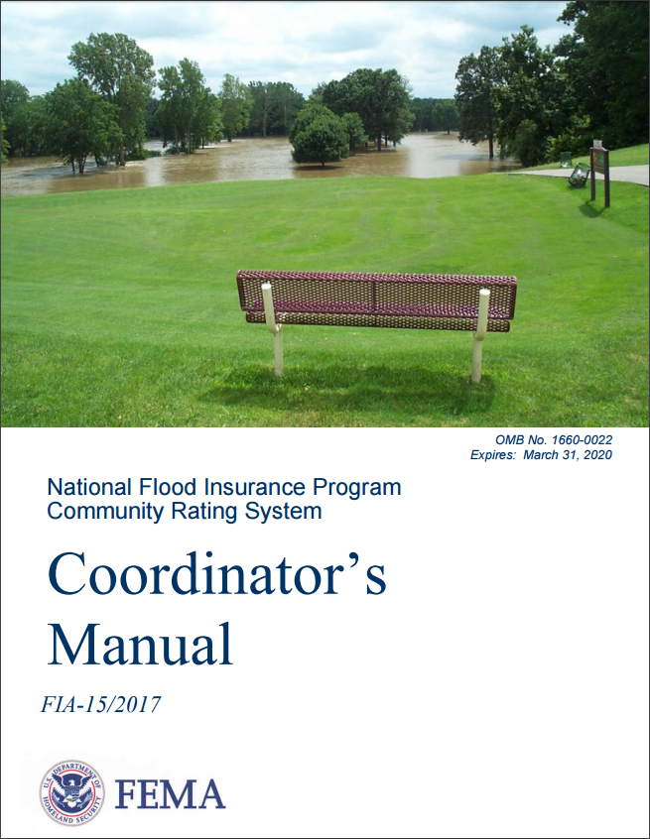
Community Rating System (CRS)
Voluntary program provides insurance premium discounts for community activities
Above and beyond the minimum requirements of the NFIP
Reduce and avoid flood damage to insurable property
Strengthen and support the insurance aspects of the NFIP
Foster comprehensive floodplain management
Creditable Activities
Public information, mapping and regulations, flood damage reduction, and flood warning and response

Slide 42
CRS Discounts on Insurance
Total creditable activities (points) determines CRS Class
Discounts of 5% to 45% depending on class
Discounts apply uniformly to all policyholders (in all zones) in CRS communities
Discounts may not apply to buildings with floodplain management violations
CRS Class | Credit Points | Premium Reduction
1 | 4500+ | 45%
2 | 4000-4499 | 40%
3 | 3500-3999 | 35%
4 | 3000-3499 | 30%
5 | 2500-2999 | 25%
6 | 2000-2499 | 20%
7 | 1500-1999 | 15%
8 | 1000-1499 | 10%
9 | 500-999 | 5%
10 | 0-499 | 0%

Slide 43
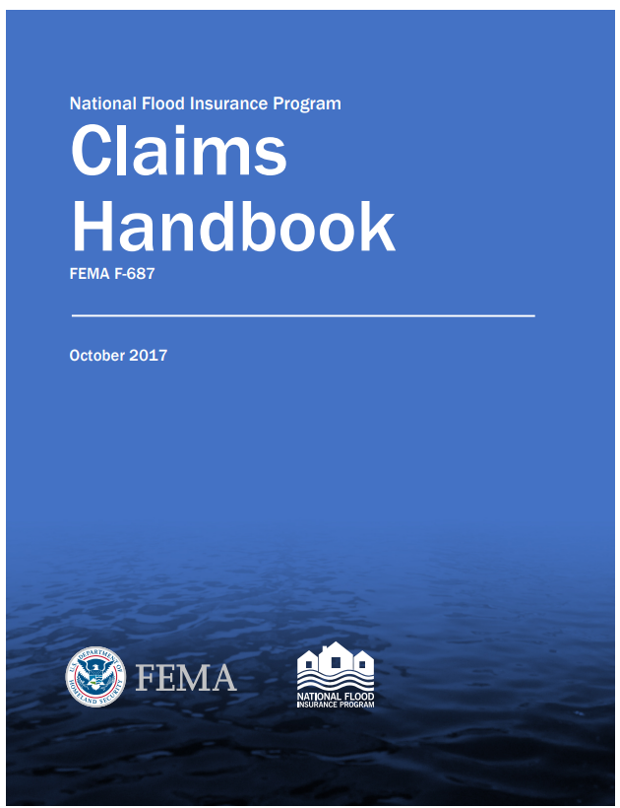
Post-Event: Filing a Flood Claim
If event meets the NFIP definition of “flood” (does not have to be a Disaster)
Document loss (file Notice of Loss)
Begin cleanup
Meet with Claims Adjuster
Submit information & meet deadlines

Slide 44
Repetitive Loss
A Repetitive Loss structure:
NFIP-insured
2 or more flood losses of $1,000 each
In any 10-year period since 1978
Flood insurance premiums will increase

Slide 45
Severe Repetitive Loss
Severe Repetitive Loss (SRL) building has had historical flood losses of:
Four or more losses of $5,000 each (building and/or contents), or
Two separate losses (building only) exceeding current market value of the structure.
Two of the claim payments must be within 10 years of each other.
SRL program:
Separate insurance program
Premium rates are higher, reflecting higher risk
Offers mitigation option

Slide 46
Mitigating Repetitive Loss Properties
Community is notified by FEMA for RL and SRL
FPA can assist owners with mitigation options
Eligible for mitigation grants
Acquisition or relocation of at-risk structures to create open space
Elevation of existing structures
Demolition and rebuilding to meet floodplain requirements
Dry floodproofing of non-residential and historic properties

Slide 47
Repetitive Loss and Substantial Damage
A repetitive loss structure:
NFIP-insured
2 or more flood losses of $1,000 each
In any 10-year period since 1978
A structure substantially damaged by flood:
Flood-damaged by a single event
Would cost 50% or more of the pre-flood market value to restore
FPA must treat as new construction when permitting repairs

Slide 48
Increased Cost of Compliance (ICC) Coverage
Policy benefit that is part of Standard Flood Insurance Policies
Provides up to $30,000 to help cover the cost of mitigation measures
Owners of buildings declared substantially damaged or a repetitive loss by flood may file if they qualify
If eligible, policy holders file a separate ICC claim

Slide 49

ICC Mitigation Solutions (FRED)
Floodproofing (non-residential properties only)
Relocating to a new site
Elevating above the flood level in the community
Demolishing the building

Slide 50
Eligibility for ICC Coverage
Eligible:
Buildings insured under an NFIP Standard Flood Insurance Policy (SFIP)
Not eligible:
Condominium units, townhouses, or rowhouse condominiums
Emergency Program policies
Contents-only policies
Group Flood Insurance Policies (GFIP)
Detached garages, unless insured by a separate policy

Slide 51
Eligibility for ICC Repetitive Loss Payment
To receive payment:
Community must have adopted/enforced a repetitive loss provision in their floodplain management ordinance
Structure must be covered by a contract for flood insurance
Must meet the definition of “Repetitive Loss Structure”:
At least two paid NFIP flood losses of more than $1,000 each in any 10-year period since 1978
The cost of repairing the flood damage, on average, must equal or exceed 25 percent of the market value of the building at the time of each flood.

Slide 52
ICC Coverage Post-Disaster
Owner may be eligible for ICC benefits after substantial damage
Structure must be brought up to code
Mitigated structures have reduced flood risk
Mitigated structures have lower premiums
Mitigated structures have higher resale value
After Presidentially-declared major disasters:
HMGP funding available through state or local government
Owners can combine ICC payments for cost share

Slide 53
Local Role in ICC
Make substantial damage determinations; send official letter to owner
Enforce repetitive loss provision in the floodplain ordinance
Provide mitigation options to policyholders
Help package ICC benefits with other funding sources
Coordinate to issue building permits for mitigation measures
Issue Certificate of Occupancy/Completion

Slide 54
Group Flood Insurance Policy (GFIP)
Offered to individuals who do not have flood insurance and have received assistance from FEMA after a Presidentially-declared disaster
Disaster assistance funding through Individuals and Households Program (IHP), triggers a requirement to obtain and maintain flood insurance on the property

Slide 55
GFIP Post-Disaster
GFIP policies provide up to 3 years of flood insurance coverage.
Before GFIP expires, individuals will need to purchase a Standard Flood Insurance Policy through a local insurance agent.
If coverage not obtained and maintained, may not be eligible for future disaster assistance

Slide 56

Floodplain Management and Flood Insurance
Floodplain management actions may affect insurance rates.
Maintaining and updating flood maps
Maintaining Elevation Certificates
Understanding how floodplain management relates to flood insurance

Slide 57
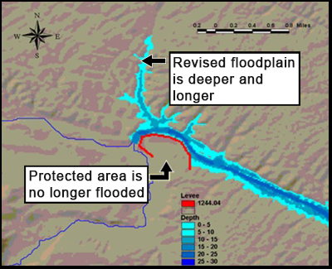
Flood Maps and Flood Insurance
FIRMs that accurately reflect current flood risk help communities make good decisions.
Floodplain administrators must keep track of map changes, revision, and updates.
SFHA boundary changes can impact mandatory purchase requirements.

Slide 58

Budgeting for Map Change
Project budgets should include costs for reviewing, applying, and obtaining:
Conditional Letters of Map Revision (CLOMRs)
Letters of Map Revision (LOMRs)
Staff budgets should include time for coordinating with FEMA, other agencies, applicants, and the general public.

Slide 59
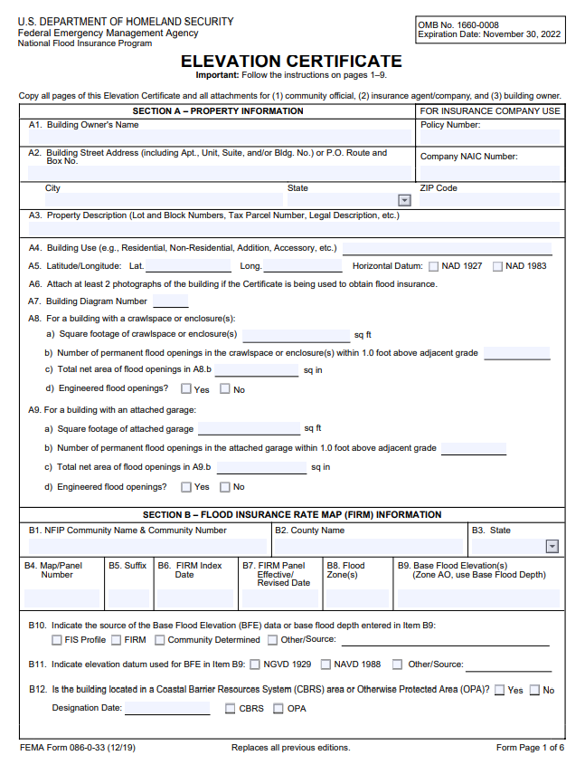
Elevation Certificates and Floodplain Management
Used to document as-built elevations of the lowest floor for compliance
EC required in CRS Communities
EC may be used to support a Letter of Map Change

Slide 60

Elevation Certificates and Insurance
An EC is not required to rate a flood insurance policy.
Property owner may submit EC to provide more detail about the structure to receive a better flood policy premium.
First Floor Height
Lowest Adjacent Grade
Flood openings

Slide 61
Floodplain Management Decisions and Flood Insurance
Floodplain Management Regulations | Flood Insurance
Communities must ensure all floodplain development is compliant | Floodplain management decisions can impact flood insurance rates
Regulations usually apply only in the SFHA | Mandatory purchase applies inside the SFHA
Higher standards can apply to all flood zones | Insurance is available in all flood zones
Higher standards are optional | Higher standards may lower premiums
Violations must have legal penalties | Violations lead to higher premiums, lost discounts

Slide 62
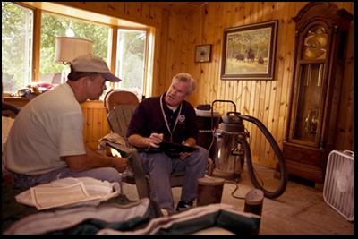
Compliance Enforcement – Section 1316
Community requests after exhausting all compliance enforcement options
FEMA declares Section 1316 on the property

Slide 63
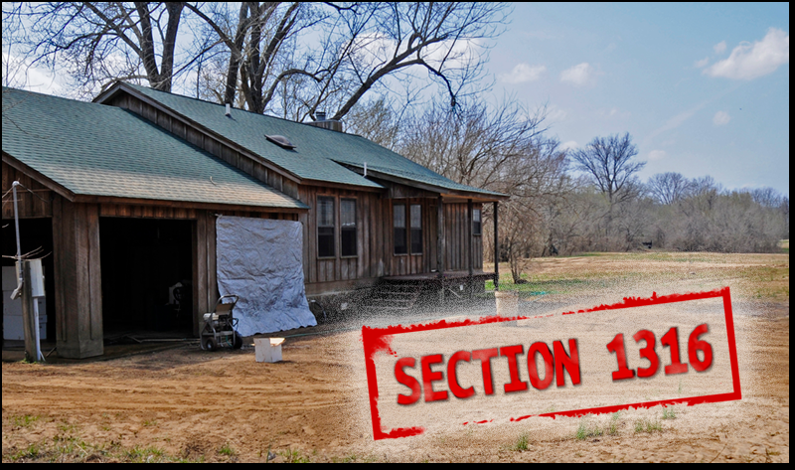
Effects of Section 1316
Property becomes ineligible for NFIP flood insurance
Risk of damage with no insurance compensation
Possible mortgage foreclosure
Denial of most types of disaster assistance
Possible reduced market value

Slide 64

Flood Insurance Outreach
Educate the public about floodplain management’s impact on insurance premiums:
Building design and location
Higher standards, freeboard
CRS activities
Map changes
Encourage owners and renters to buy flood insurance!

Slide 65
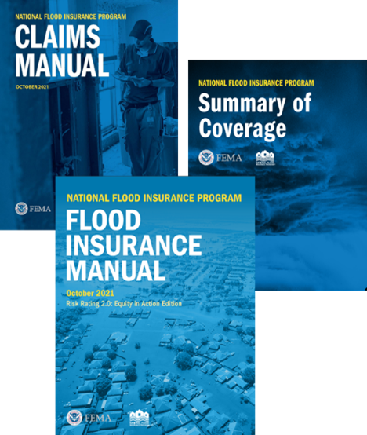
Flood Insurance Resources
NFIP Flood Insurance Manual
NFIP Claims Manual
NFIP Summary of Coverage
NFIP Flood Claims Process Fact Sheet
NFIP Prior Claims Reset Fact Sheet
Insurance agent
State NFIP Coordinator
www.floodsmart.gov
https://www.fema.gov/flood-insurance/risk-rating

Slide 66
FEMA Mapping and Insurance eXchange (FMIX)
Specialists at the FMIX Customer Care Center can:
Help with questions about flood mapping and insurance
Provide the full range of information needed to make informed decisions about insurance and risk
Connect customers with technical experts
https://floodmaps.fema.gov/fhm/fmx_main.html

Slide 67
Office of the Flood Insurance Advocate (OFIA)
OFIA advocates for the fair treatment of policyholders and property owners by:
Providing education and guidance on all aspects of the NFIP
Identifying trends affecting the public
Making recommendations for NFIP improvements to FEMA leadership
https://www.fema.gov/flood-insurance/advocate

Slide 68

Activity 8.2: Unit 8 Communication Corner
Table group activity
Role-play answering questions from the public about flood insurance rates
Refer to your Student Manual for example questions

Slide 69

Activity 8.3: Unit 8 Knowledge Check
Class discussion
Review questions about what was covered in this unit.
Discuss answers and ask questions if something isn’t clear.

