Slide 1
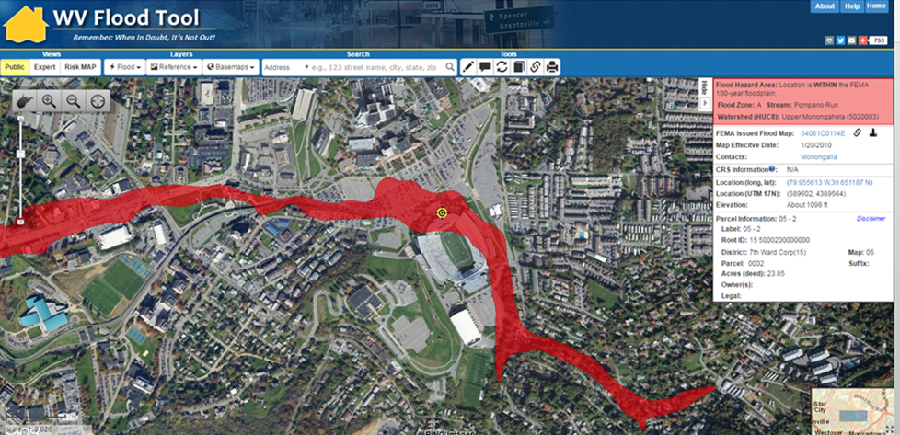
Floodplain Management: Legal & Planning
Tools

Slide 2
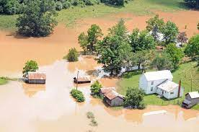
Roadmap
Overview of Legal & Planning Tools
Hypotheticals
  Common Questions
  New Legislation
Questions
Post Conference Q & A

Slide 3
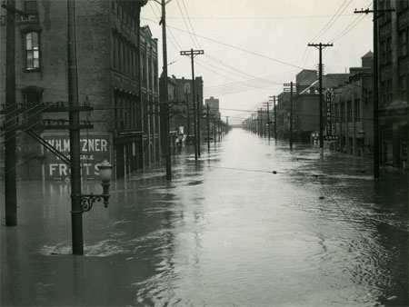
Legal & Planning Tools
Floodplain Ordinance
Comprehensive Planning
Zoning Ordinance
Subdivision Ordinance
Stormwater Regulation
Floodplain Buyout Programs
Deed Restrictions

Slide 4
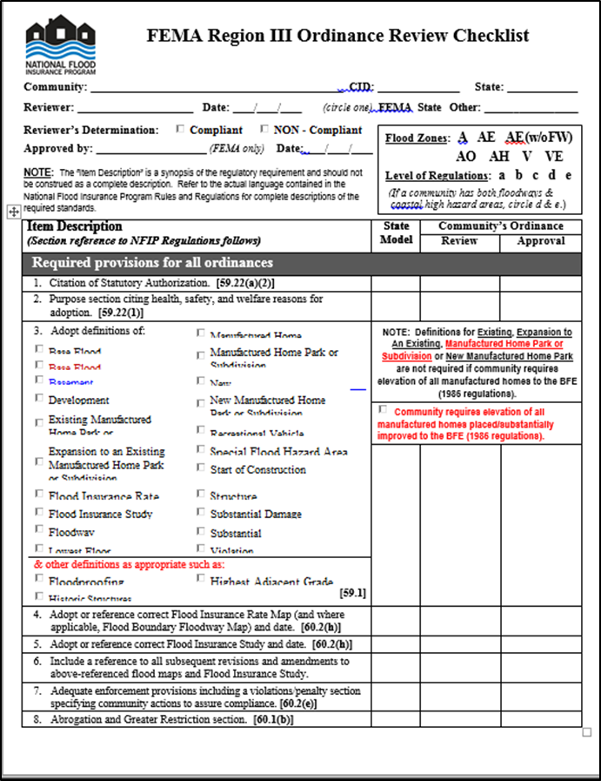
The Floodplain Ordinance...
A “sample” ordinance is available
Must be updated & current
Easily accessible
Must explain the criteria for building/development and plan approval
Variances highly disfavored
Primary regulatory tool to participate in NFIP

Slide 5
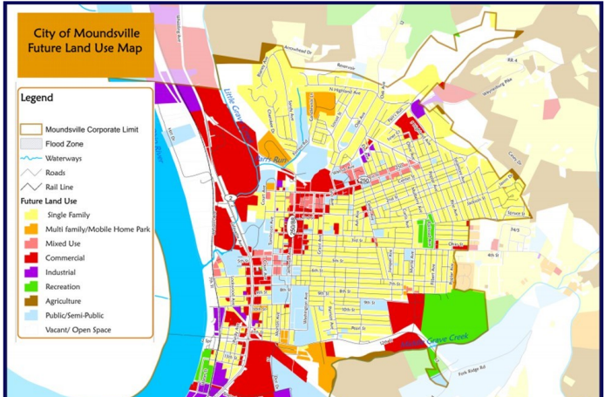
Comprehensive Plans
Good land use planning = good floodplain management
What does land use look like in the future in your community?
Policy Guide
Public Participation
Can include flood-related goals/objectives

Slide 6
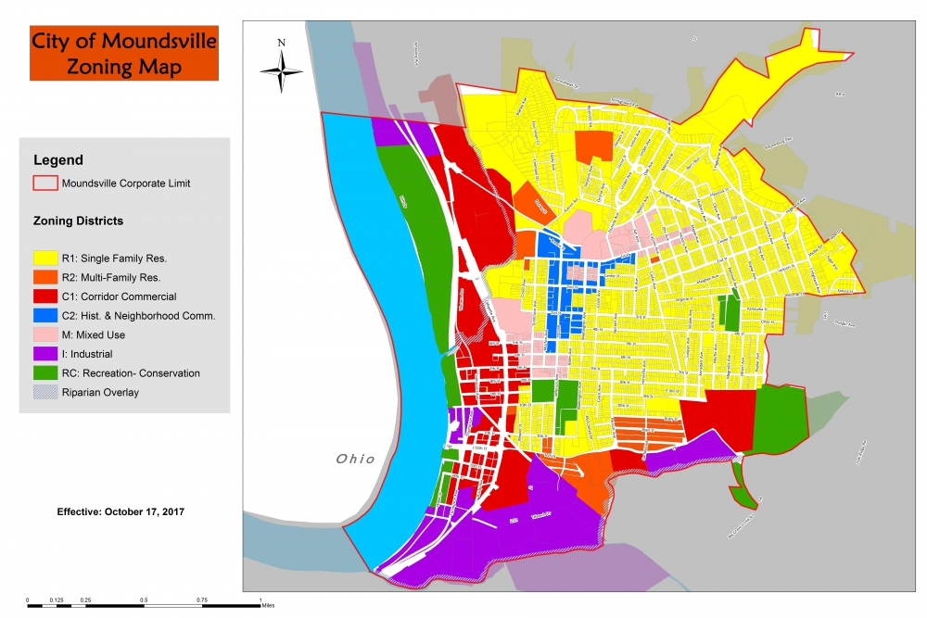
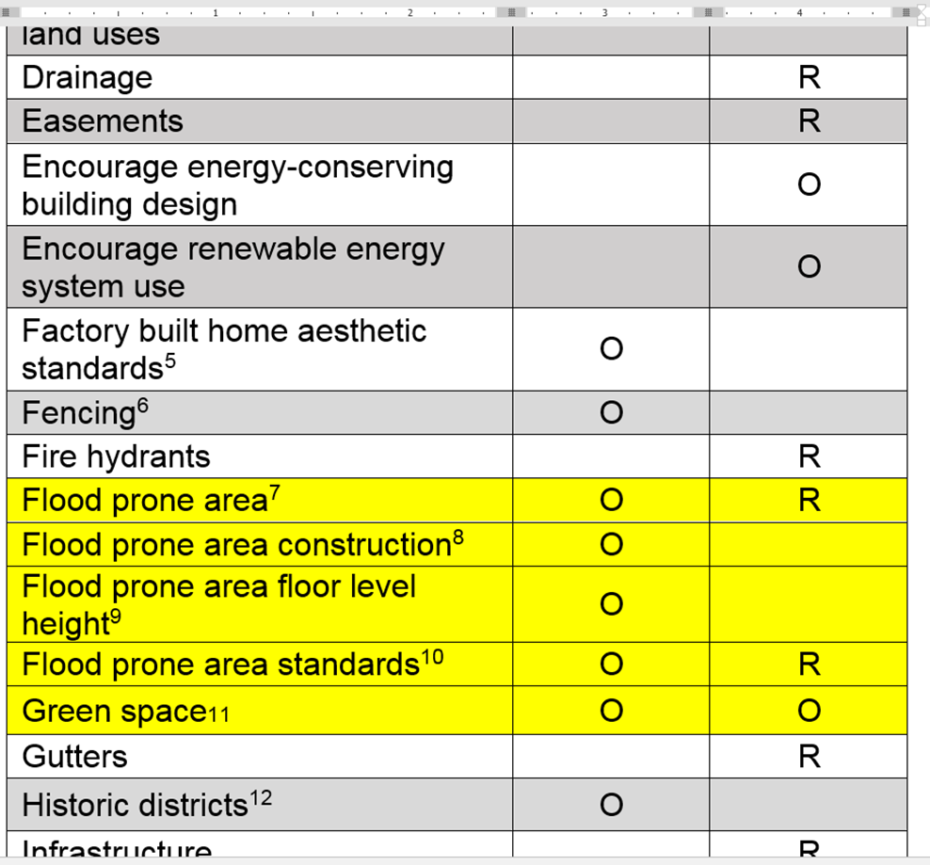
Zoning & Subdivision Ordinances

Slide 7
Zoning & Subdivision Ordinances
Zoning Ordinance
  Floodplain Overlay Districts
  Conservation/Open Space Districts, particularly in Riparian Areas
Subdivision Regulations
  Cluster Subdivisions
  Subdivisions with adequate stormwater infrastructure
  Chance to "get it right" before developer starts moving earth.

Slide 8
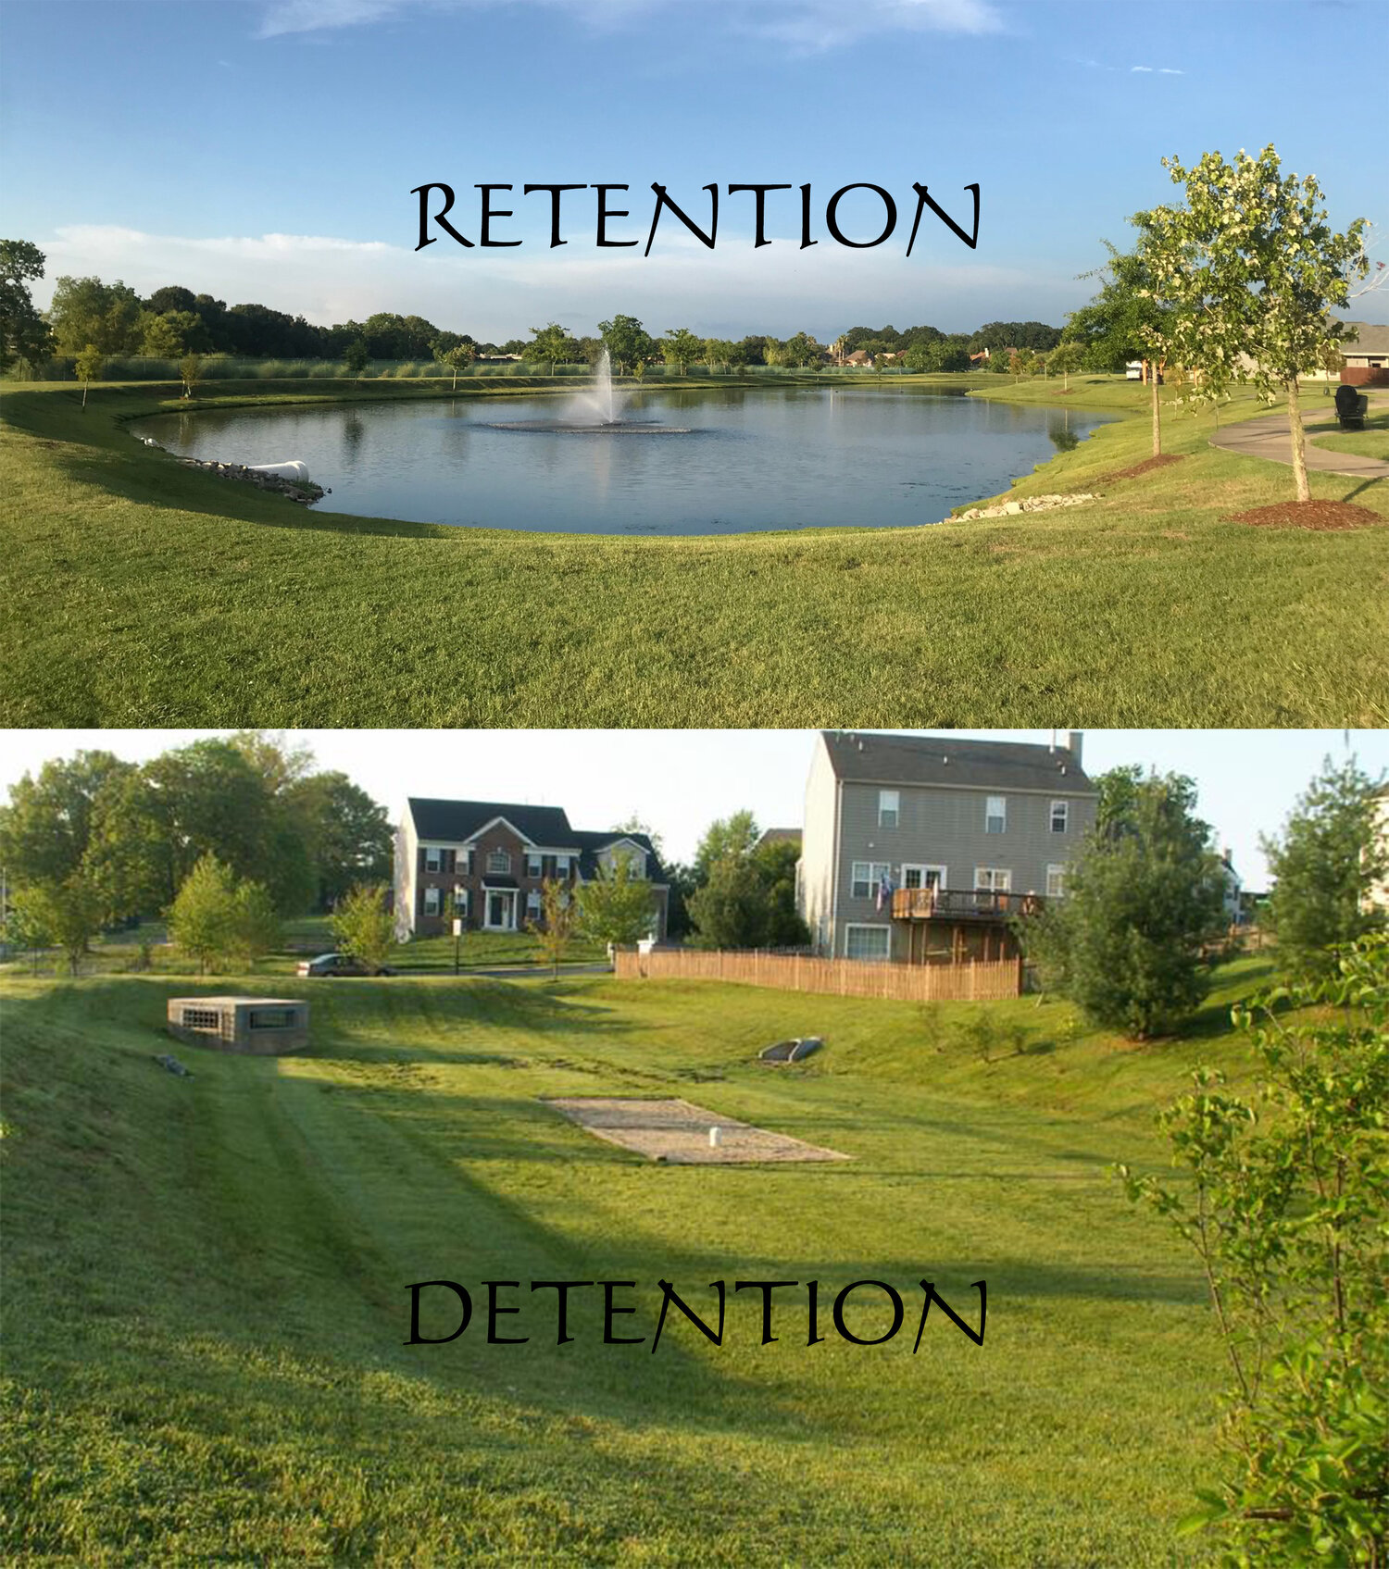
Stormwater Regulation
Lack of widespread stormwater regulations are a significant problem that exacerbates flooding, particularly in developed areas.
  Nowhere for the water to go.
Not only a water quantity issue, but also a water quality issue.

Slide 9
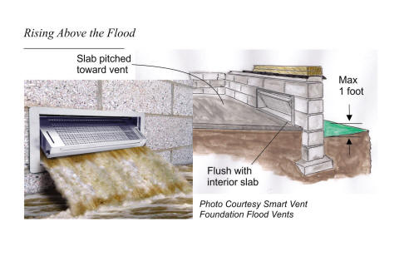
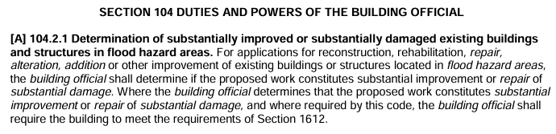
Building Code(s)
WV State Building Code Requirements (if adopted)
Define certain construction materials or methods to minimize future flood damage.
Engineered Foundation Design Requirements
Flood Resistant Construction – Electrical, Plumbing, Heating/Ventilation, Mechanical and Equipment Location

Slide 10
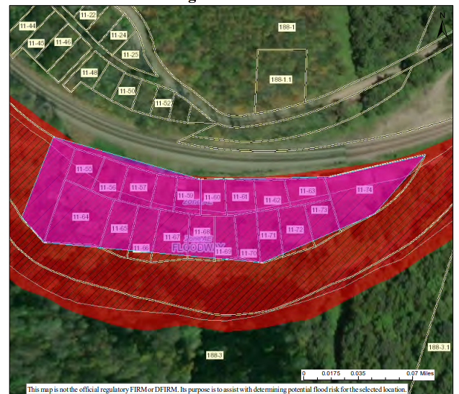
Floodplain Buyouts
Structures. No new structures or improvements shall be constructed on the Property other than:
a. A public facility that is open on all sides and functionally related to a designated open space or recreational use;
b. A public rest room; or
c. A structure that is compatible with open space and conserves the natural function of the floodplain, including the uses described in Paragraph 2, above, and approved by the [Agency]in writing before construction of the structure begins.
Any improvements on the Property shall be in accordance with proper floodplain management policies and practices.

Slide 11
Planning Tools: Preparedness & Recovery
Flood Preparedness
Post Disaster
  Code Enforcement for Funding Eligibility
  Emergency Code Enforcement
Long-Term Recovery
  Preferred Development Areas

Slide 12
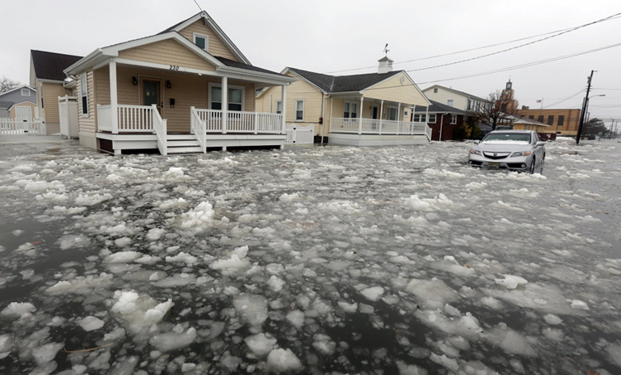
Hypothetical #1
Will Bill 171 impact flood regulation?

Slide 13
Hypothetical #1
(b) County commissions may not adopt or enact an ordinance, rule, license requirement, or other authorization that contravenes or is stricter than any state law, rule, or regulation relating to agricultural operations, as defined in §19-19-2 of this code. Any ordinance, rule, regulation, license requirement, or other authorization previously adopted by a county commission that contravenes or is stricter than any state law, rule, or regulation regarding agricultural operations is revoked.

Slide 14
Hypothetical #1
§19-19-2. Definitions.
For the purposes of this article:
(a) "Agriculture" shall mean the production of food, fiber and woodland products, by means of cultivation, tillage of the soil and by the conduct of animal, livestock, dairy, apiary, equine or poultry husbandry, and the practice of forestry, silviculture, horticulture, harvesting of silviculture products, packing, shipping, milling, and marketing of agricultural products conducted by the proprietor of the agricultural operation, or any other legal plant or animal production and all farm practices.
(b) "Agricultural land" shall mean any amount of land and the improvements thereupon, used or usable in the production of food, fiber or woodland products of an annual value of $1,000 or more, by the conduct of the business of agriculture, as defined in subsection (a) of this section.

Slide 15
Hypothetical #1
Will Bill 171 impact flood regulation?
Yes, floodplain ordinances adopted by counties could fall under this revocation.
Could cause non-compliance with FEMA’s requirement to regulate all development (including agriculture) in the flood hazard area.
Example: Vermont received a notice of non-compliance from FEMA because Vermont did not allow municipalities to regulate farming.

Slide 16
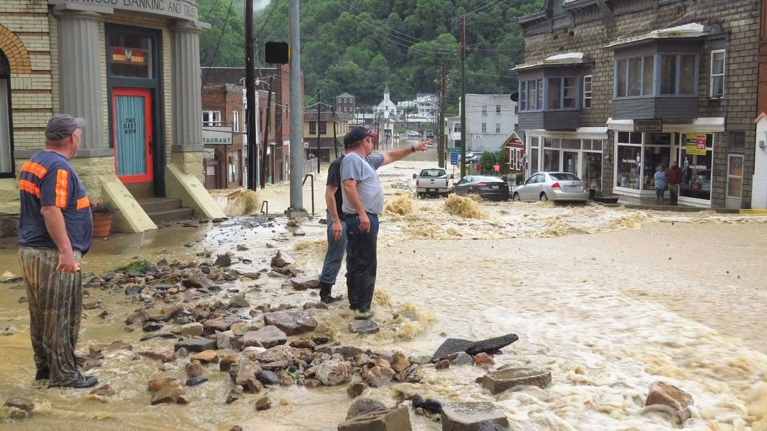
Hypothetical #2
Can local governments be found liable for improper floodplain management?

Slide 17
Hypothetical #2
Can local governments be found liable for improper floodplain management?
Yes, courts have held that governments can be liable for increasing flood hazards on adjacent land by grading OR filling land.
  Sometimes structural measures (dikes, dams, levees) can increase flooding
  Increased liability if improperly designed, operated, or maintained.
Yes, for negligence or nuisance when they issue permits for development which cause increased flood hazards on other property.

Slide 18
Hypothetical #2
Brooks v. City of Huntington (W. Va., 2014)
  Homeowners brought an action against city asserting the city had negligently maintained a stormwater culvert causing flooding.
    Culvert was constructed to help with the flooding of Krouts Creek. It was found that the city did not clean the “track rack” which collected debris from entering the culvert.
  Supreme Court of Appeals held that homeowners were entitled to recover damages for repair costs, and residual diminution of value of homes.

Slide 19
Hypothetical #3
What if there are deed restrictions?

Slide 20
Hypothetical #3
What if there are deed restrictions?
Compatible Uses. Property shall be dedicated and maintained for purposes compatible with:
open space
recreational
wetlands management
In general, such uses may include:
parks for outdoor recreational activities;
wetlands management;
water quality improvement;
environmental education;
nature reserves;
unimproved, unpaved parking lots;
buffer zones;
and other uses consistent with restoring the hydraulic capacity to the natural environment.

Slide 21
Hypothetical #3
What if there are deed restrictions?
Structures. No new structures or improvements shall be constructed on the Property other than:
A public facility that is open on all sides and functionally related to a designated open space or recreational use;
A public rest room; or
A structure that is compatible with open space and conserves the natural function of the floodplain, including compatible uses, and approved by the [AGENCY] in writing before construction of the structure begins.
Any improvements on the Property shall be in accordance with proper floodplain management policies and practices. Structures built on the Property according to Paragraph 3 of this section shall be floodproofed or elevated to at least the base flood level plus 1 foot of freeboard.

Slide 22
Hypothetical #3
What if there are deed restrictions?
A permit is required for all development in the SFHA.
Development can include:
  Construction of new structures
  Modifications or improvements to existing structures
  Excavation
  Filling
  Paving
  Drilling
  Land Clearing
  Grading
Can exempt some activities such as gardening, putting up a mailbox, etc. [Check with local floodplain coordinator].

Slide 23
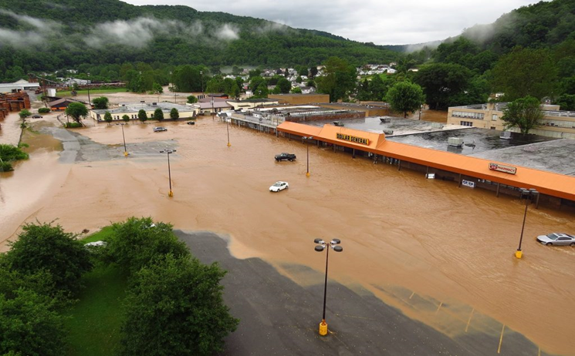
Hypothetical #4
What happens if a community is not enforcing the floodplain regulations?

Slide 24
Hypothetical #4
What happens if a community is not enforcing the floodplain regulations?
  NFIP Probation
  NFIP Suspension

Slide 25
Upcoming Q&A
Likely mid-April
Review Ordinances, bring questions
Zoom
E-mail Katherine.Garvey@mail.wvu.edu to register

Slide 26
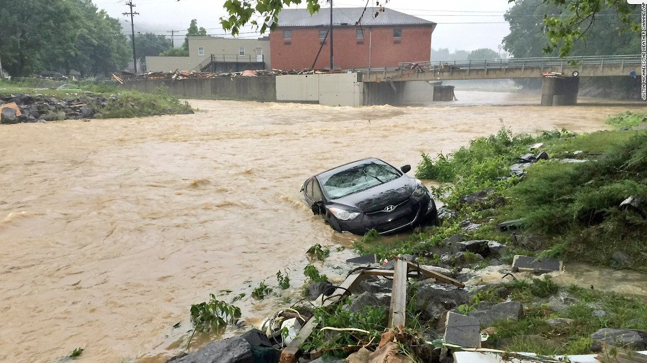
Questions???
White Sulphur Springs- June 2016

