Slide 1


The Ins and Outs of FEMA’s Group Flood Insurance Policy (GFIP)
West Virginia Emergency Management Division

Slide 2

“Preparation Through Education Is Less Costly Than Learning Through Tragedy.”
– Max Mayfield, Former National Hurricane Center Director

Slide 3
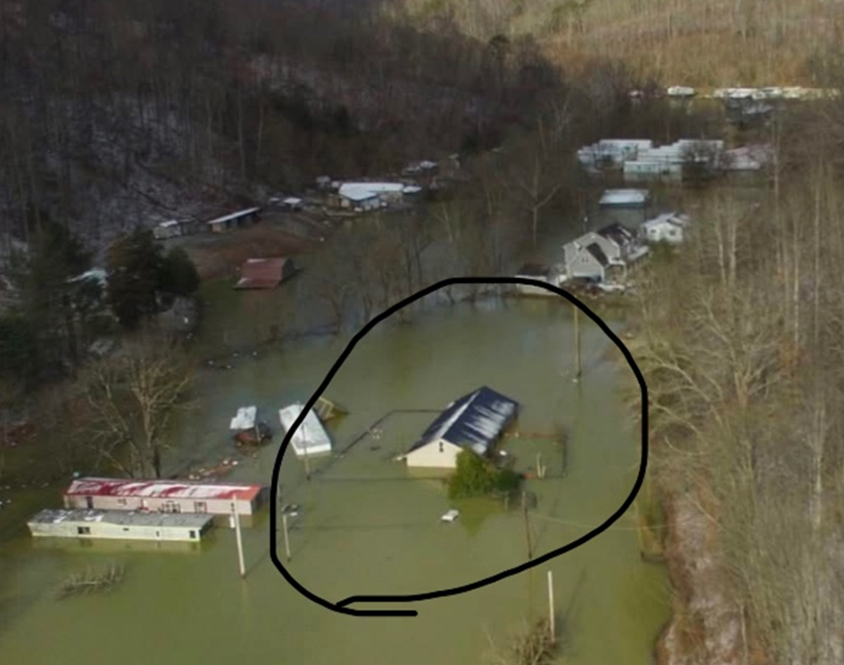
Introduction
Individual Assistance and NFIP intersect post disaster.
NFIP looks at the affected areas after flooding and decides if it will be beneficial to administer the GFIP.
This is only applicable to those who did not have flood insurance during the event.

Slide 4
What is GFIP?
GFIP is short for Group Flood Insurance Policy
After a location is declared to be a federal disaster, FEMA’s insurance personnel look at the hardest hit areas.
Only pertains to survivors who currently do not have flood insurance
FEMA may put survivors in a GFIP, which they must participate in unless they decline the FEMA financial award for their damages.
This is usually only communicated in small print with the announcement that they received money
FEMA will cover the flood insurance for 3 years, but at 3 years and 1 day the homeowner must pick up their own flood insurance to potentially be covered by FEMA again if there is another federally declared disaster

Slide 5

Pros Of A GFIP
If ANY flooding event happens within 3 years, whether it is federally declared or not, the GFIP will cover damages up to $89,600
FEMA pays the premiums for 3 years
The day the survivor accepts the check from FEMA is the day the GFIP flood protection starts.
A reminder is sent 45 days before the GFIP expires

Slide 6

Cons Of A GFIP
A high number of properties that are required to be put into a GFIP can not afford flood insurance.
GFIP caps out at $89,600 whereas a Standard Flood Insurance Policy (SFIP) caps out at $250,000 for residential homes
Disaster day: most West Virginian’s can not afford flood insurance. 3 years later and most West Virginian’s are in the same boat of not being able to afford insurance.
After 3 years if you do not get your own flood insurance policy FEMA IA will never help cover insurable losses again.

Slide 7
gfip
Only applicable after a Federally Declared Disaster
Who gets put in one?
Must not have flood insurance at the time of the disaster
How to get out of a GFIP
Q&A

Slide 8
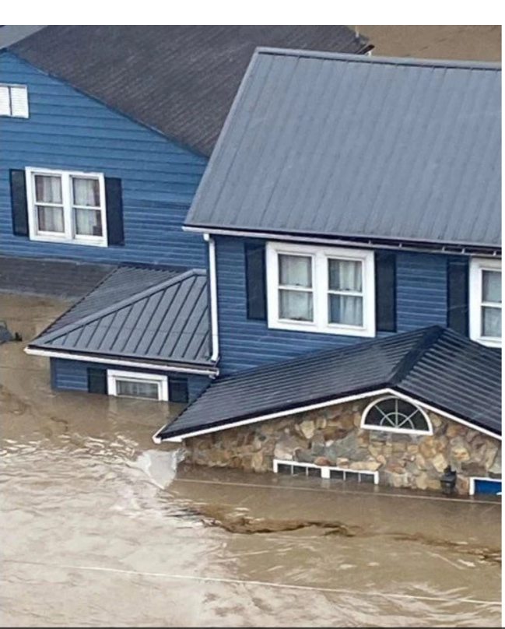
What Is Covered By FEMA If You Have No Flood Insurance:
Temporary Housing and Lodging
Personal Property
Medical, Dental, and Funeral
Childcare
Septic Tanks

Slide 9
SBA
(Small Business Administration)
Only applicable after a Federally Declared Disaster
Low-interest disaster loan, with a term agreement of up to 30 years
Homeowners, renters, and businesses are applicable
Sometimes SBA will require you to get a flood insurance policy as a condition of the loan
Q&A

Slide 10

Contact
Ehrin Starcher
Individual Assistance Coordinator
ehrin.k.starcher@wv.gov
304-414-7688

