Slide 1
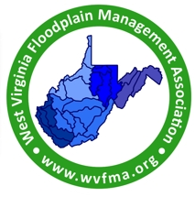

Floodplain Management for West Virginia Highway Projects:
How to work with the WVDOT to protect floodplains
West Virginia Floodplain Management Association
2026 Annual Conference
Pipestem State Park
Doug Kirk, P.E., C.F.M.

Slide 2
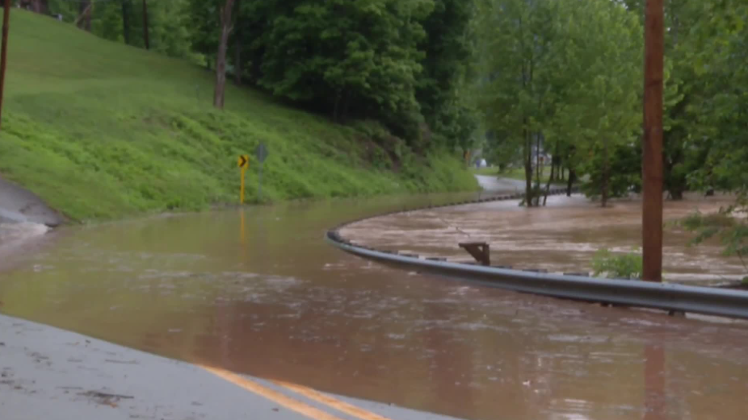
Work of the WVDOH and why it can be difficult to manage in floodplains
Mission Statement: We provide a safe, efficient, and reliable multimodal transportation system to keep West Virginia moving.
Safe, efficient and reliable may be competing rather than complementary.

Slide 3
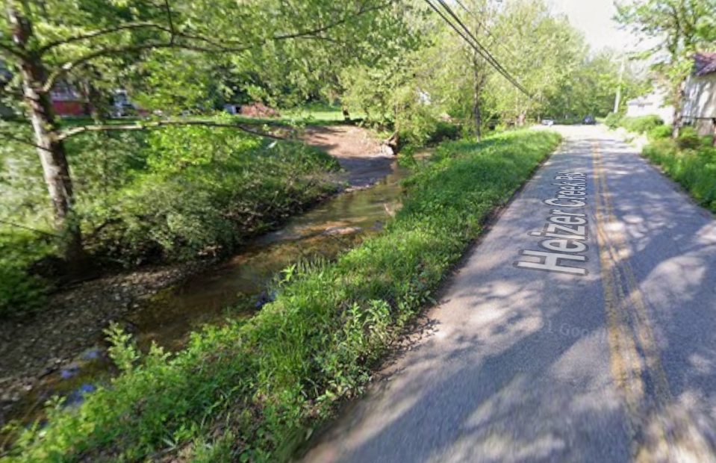
So why is that a problem for floodplains?
Most of our roads and bridges cross or follow streams.

Slide 4
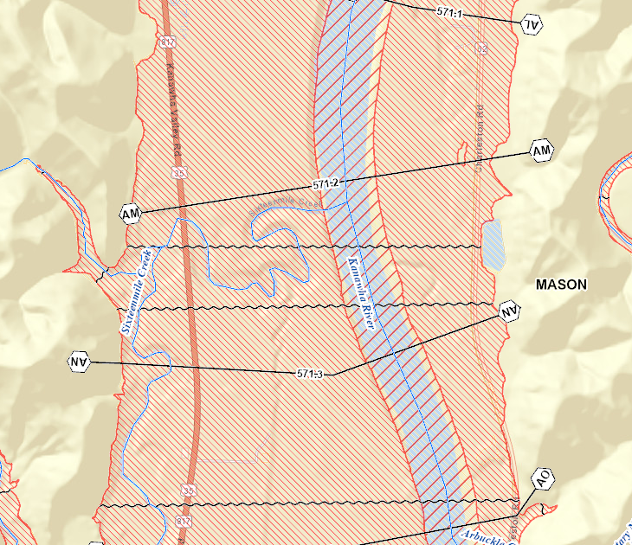
Many of our roads and bridges are in the floodplain.

Slide 5
Efforts and resources of the WVDOH to be better stewards of floodplains
Rebuilding the Hydraulic & Drainage Unit
  Darrin, James and David, plus collaboration with Initial Design
New design standards to require larger culverts on perennial streams
Upcoming training for District Staff
Utilizing progressive technology

Slide 6
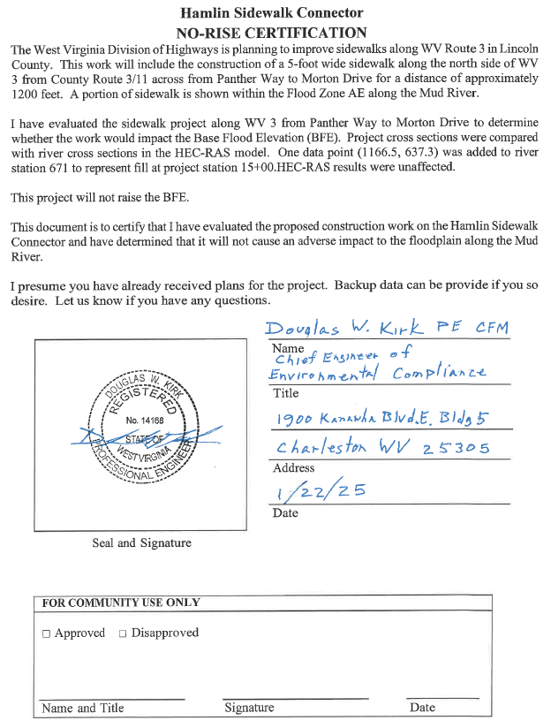
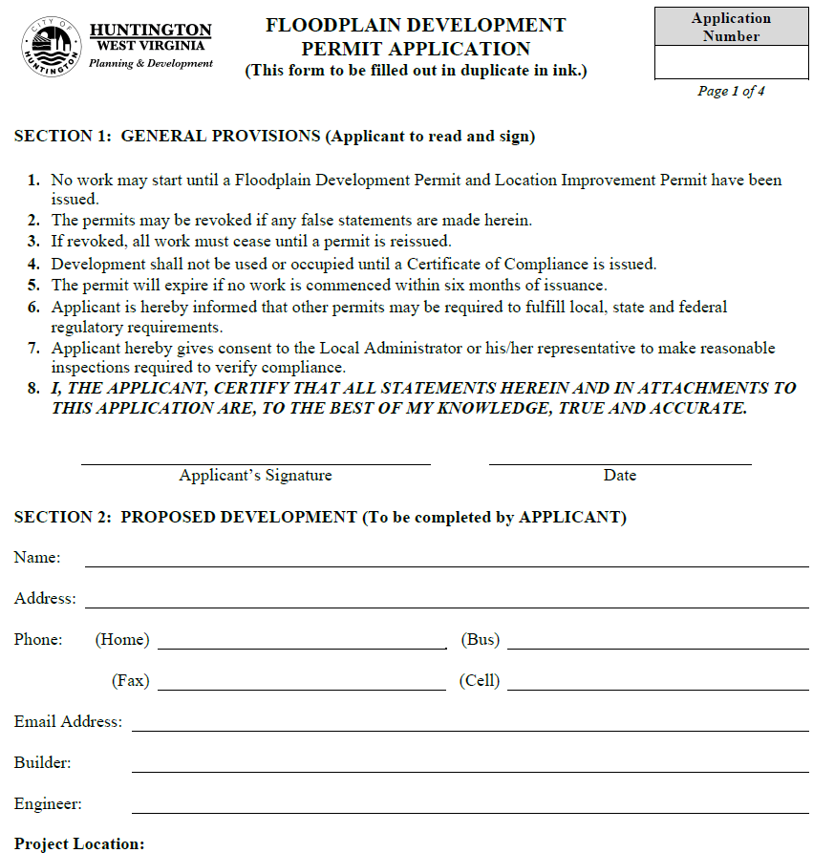
Local Floodplain Manager interaction with the WVDOH
Letter, No-Rise Certificate, of Local Floodplain Development permit

Slide 7
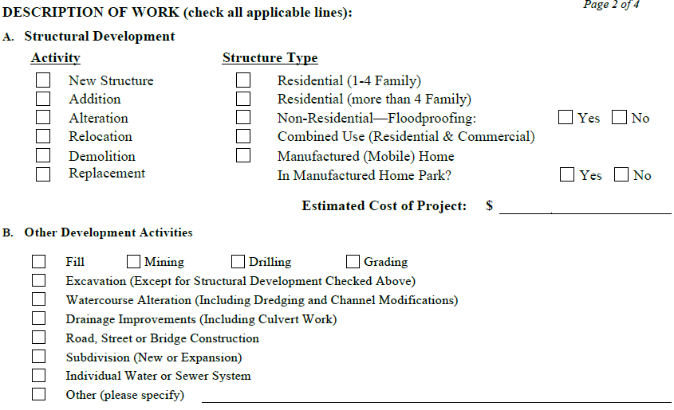
Floodplain development Permit Application

Slide 8
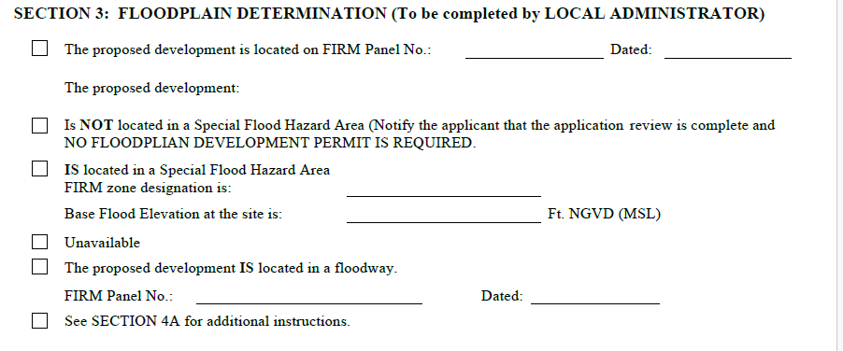
Floodplain development Permit Application

Slide 9
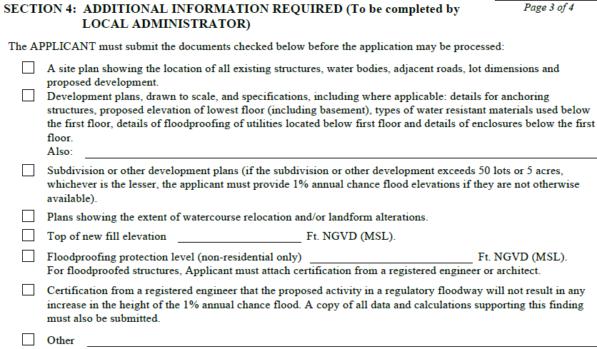
Floodplain development Permit Application

Slide 10
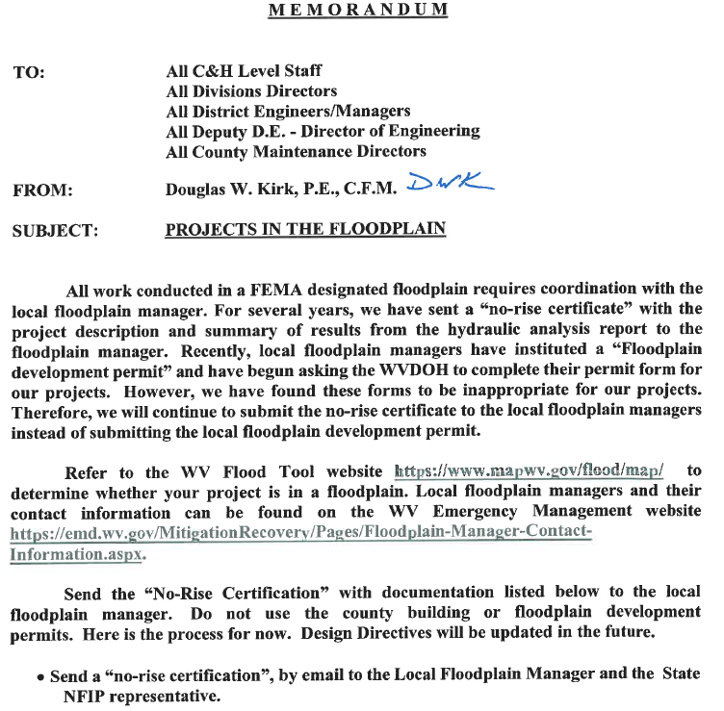
No-Rise Certificate
Always the goal
More complete instructions for our project managers
Complete and concise explanation of project and analysis

Slide 11
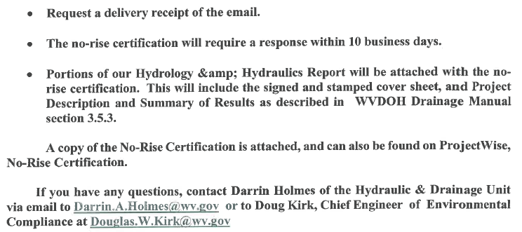
No-Rise Certificate
More complete instructions for our project managers

Slide 12
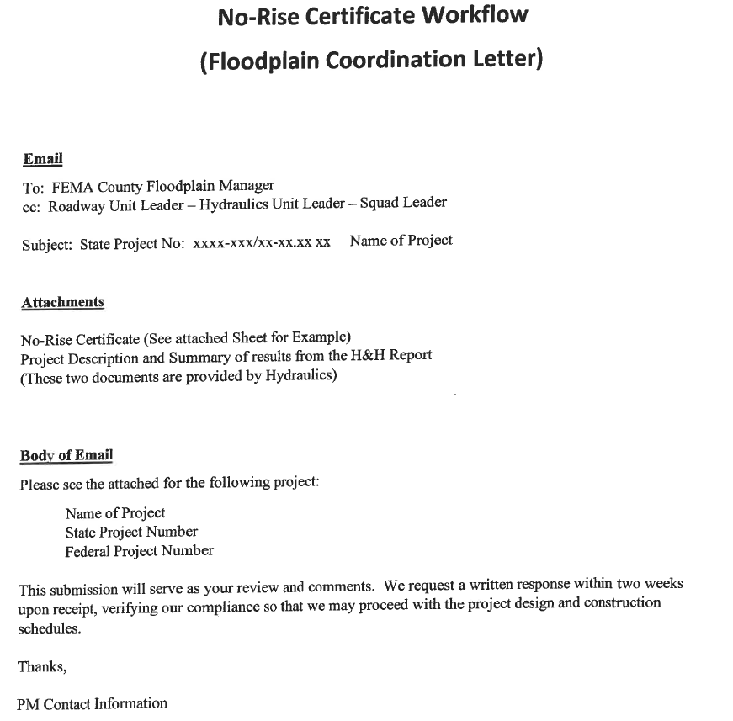
Instructions
Provide a complete and concise explanation of project and analysis for Floodplain Managers

Slide 13
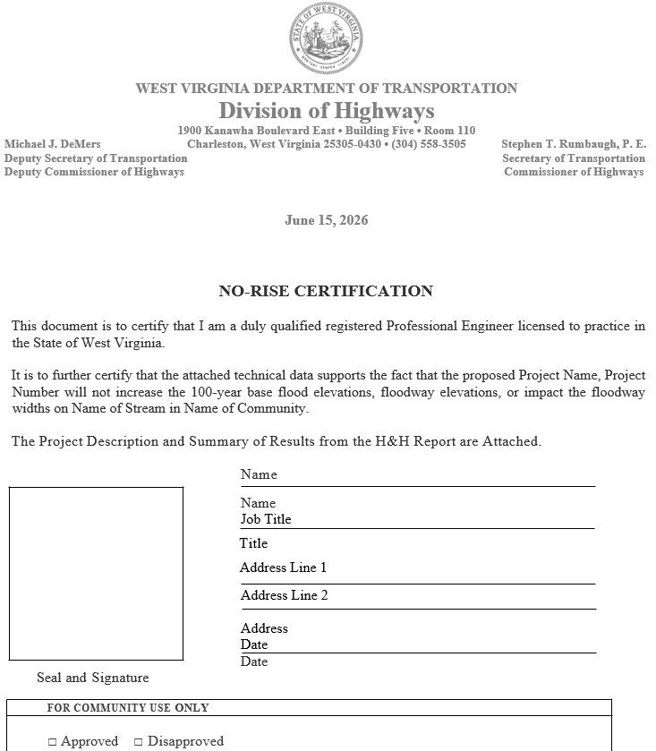
No-Rise Certificate

Slide 14
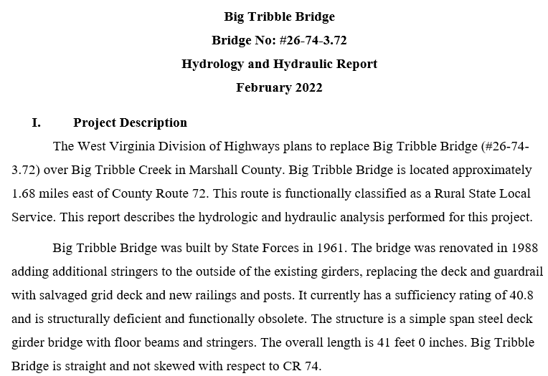
Project Description

Slide 15
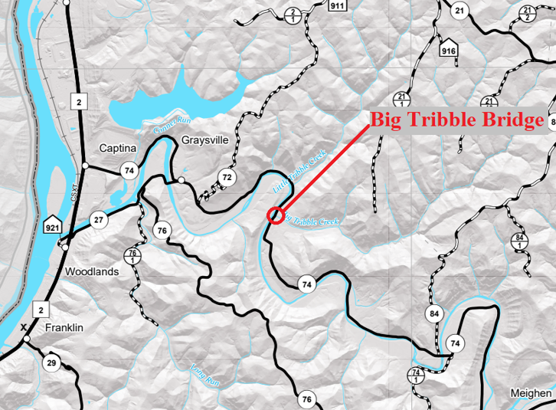
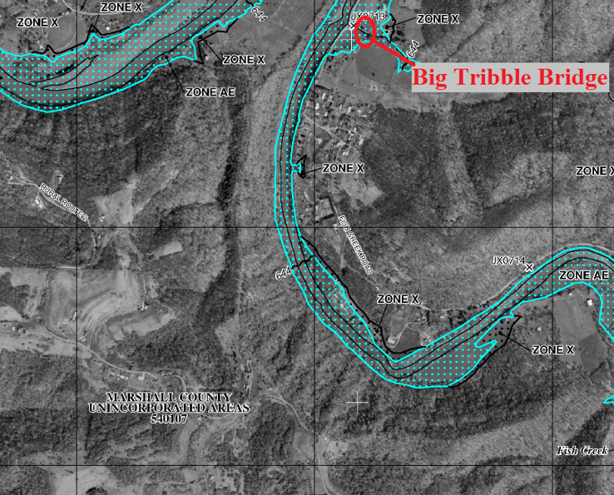
Maps

Slide 16
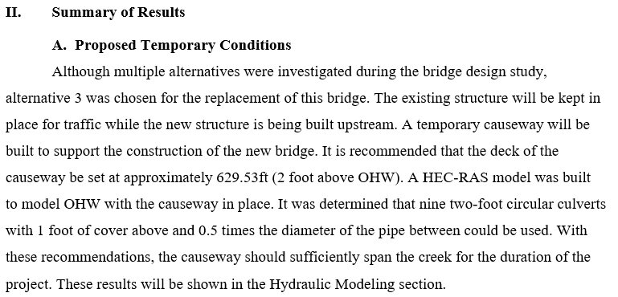
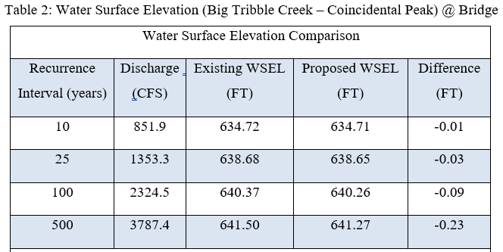
Summary of Results

Slide 17
Future contacts at WVDOH
Darrin.A.Holmes@wv.gov
James.D.Miller@wv.gov

Slide 18
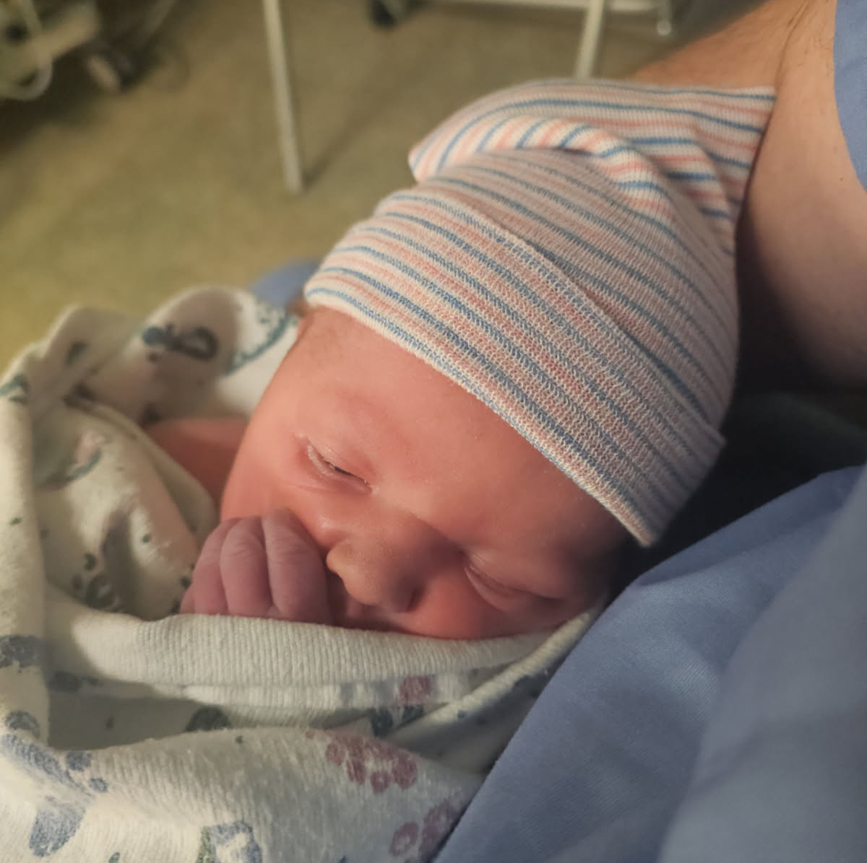
The reason I am retiring and moving to Ohio!
Samuel Charles Czyzewski
Born 2 days ago.

