Slide 1


Challenges and Changes in the Future of Flood
Del Schwalls, P.E.*, CFM
*P.E. in FL, AL, GA & SC
2026 Annual Conference
June 16, 2026 Pipestem State Park, WV

Slide 2
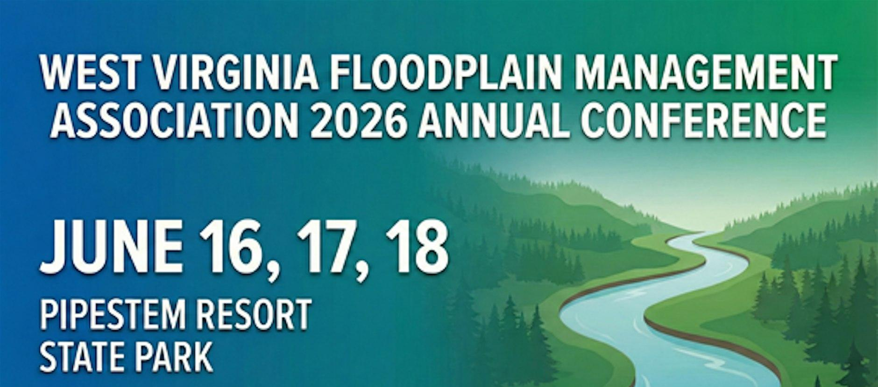

Slide 3


























Slide 4
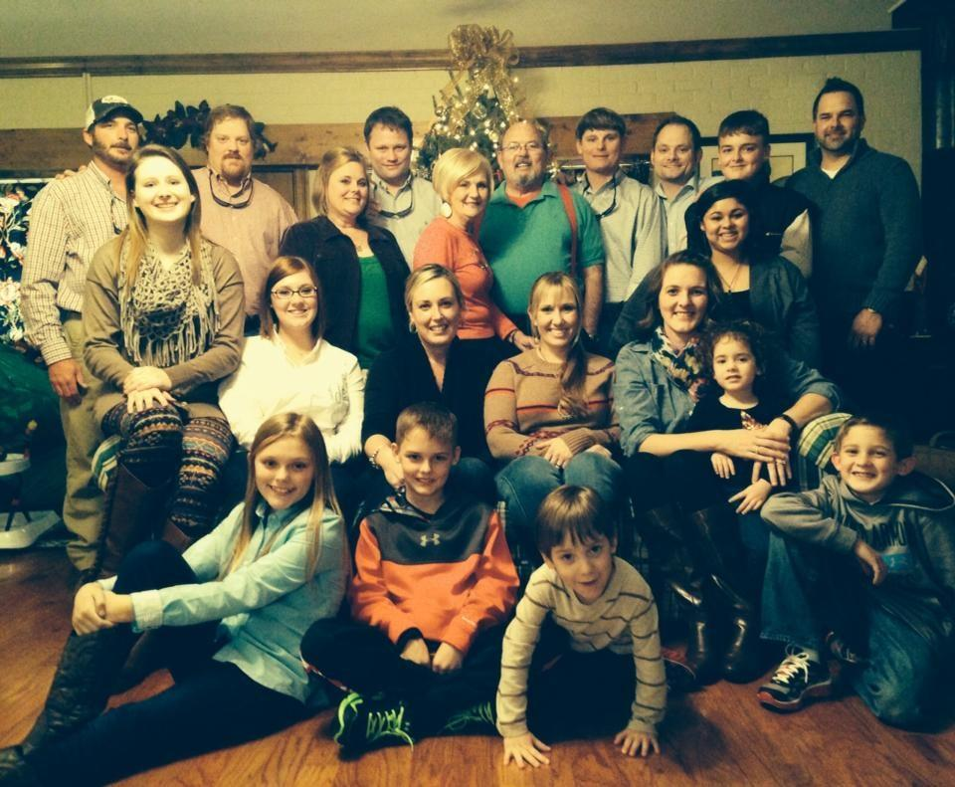
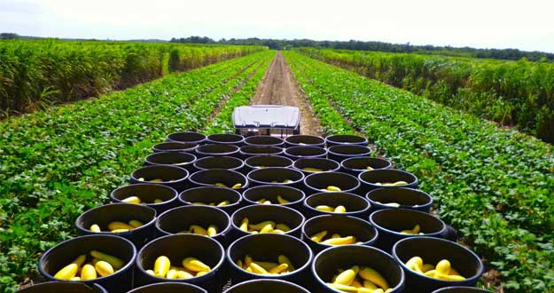
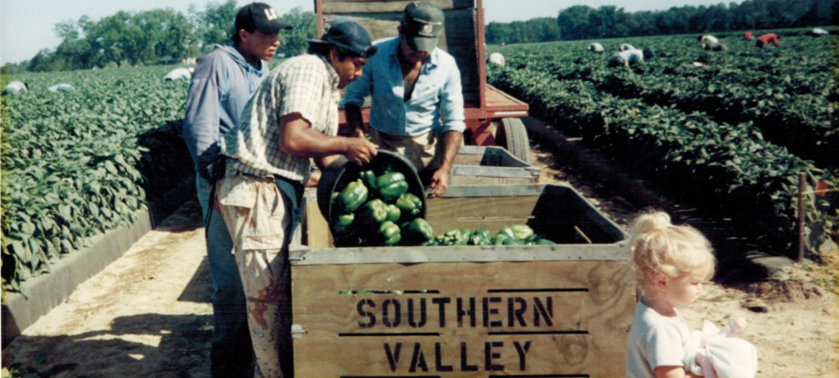

Slide 5
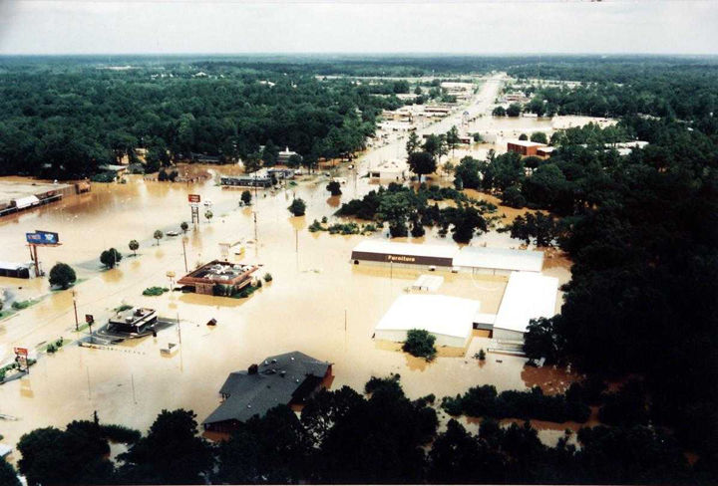

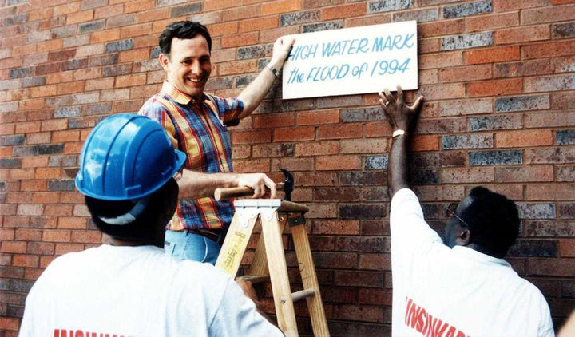


Slide 6
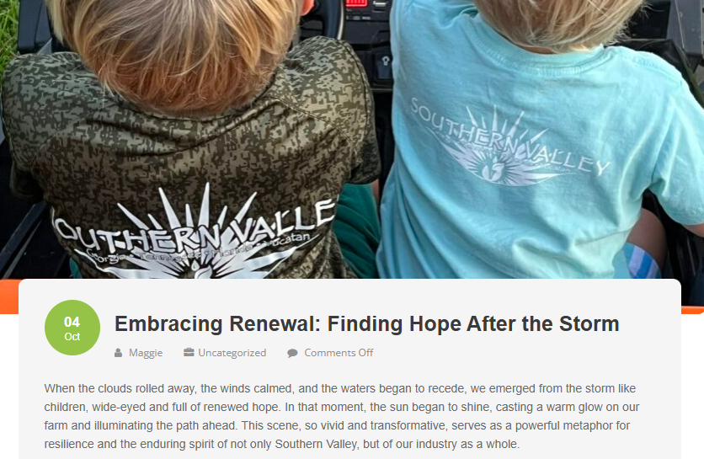

Slide 7
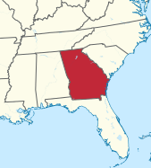
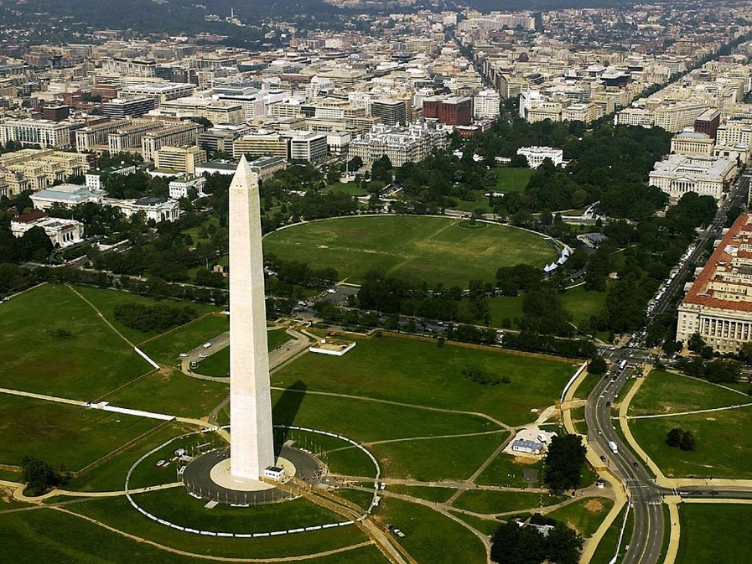
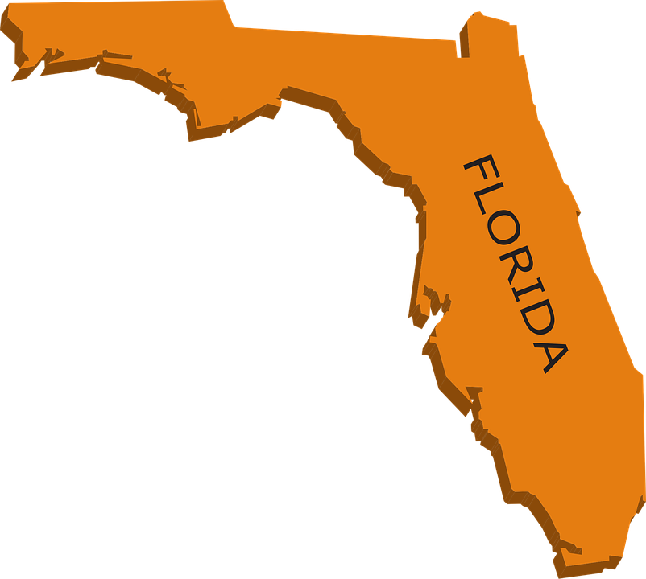

Slide 8

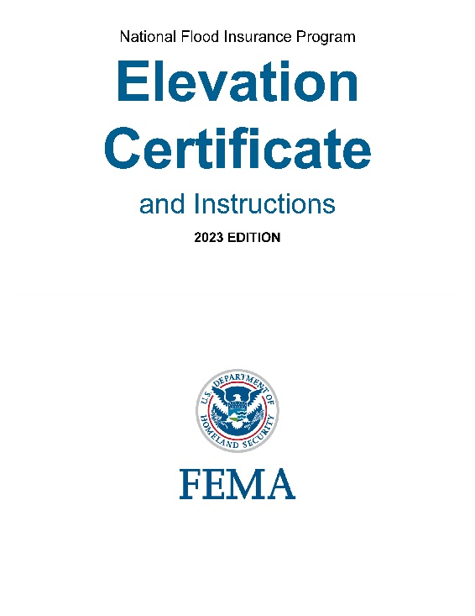
??

Slide 9
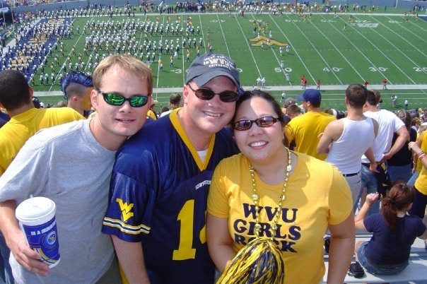

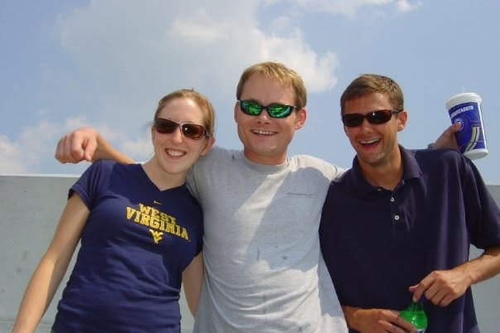

Slide 10
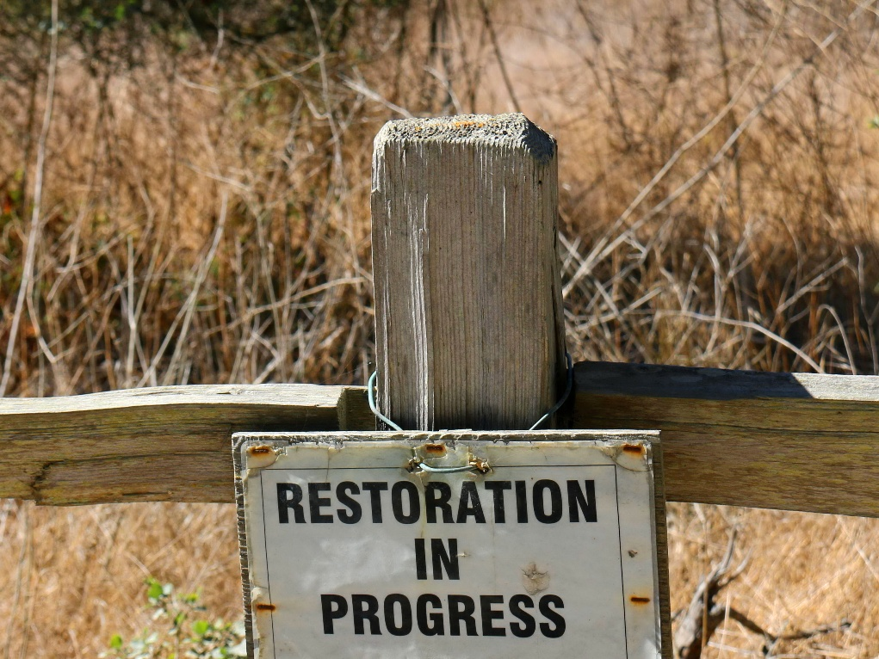



Slide 11




Slide 12
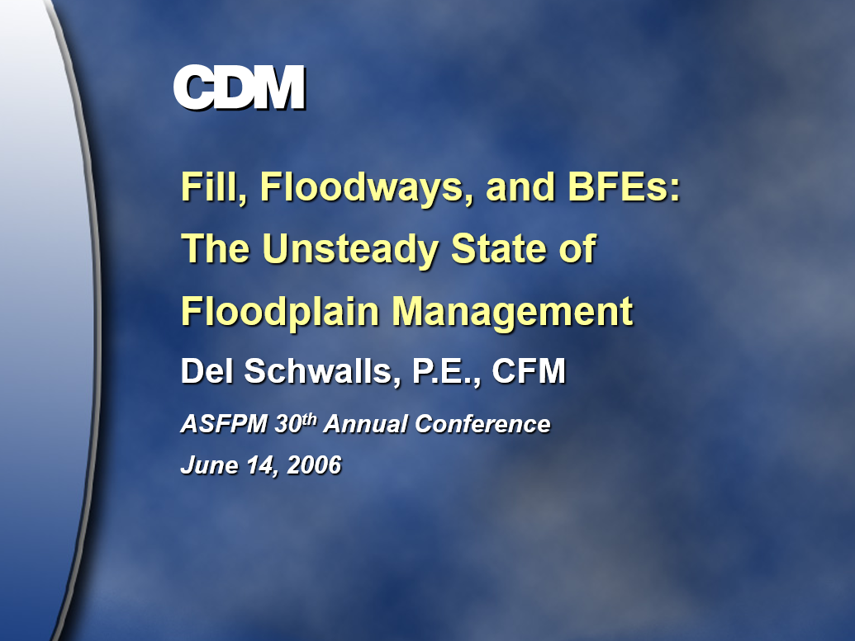

Slide 13
Limit of Detailed Study
Town
Floodway
100-Year Floodplain
Limit of Detailed Study

Slide 14
Limit of Detailed Study
Town
Floodway
100-Year Floodplain
Limit of Detailed Study

Slide 15
Limit of Detailed Study
Town
Floodway
100-Year Floodplain
Limit of Detailed Study

Slide 16
Limit of Detailed Study
Town
Floodway
Post-development 100-Year Floodplain
Limit of Detailed Study

Slide 17
Limit of Detailed Study
Town
Floodway
Post-development 100-Year Floodplain
Pre-development 100-Year Floodplain
Limit of Detailed Study

Slide 18
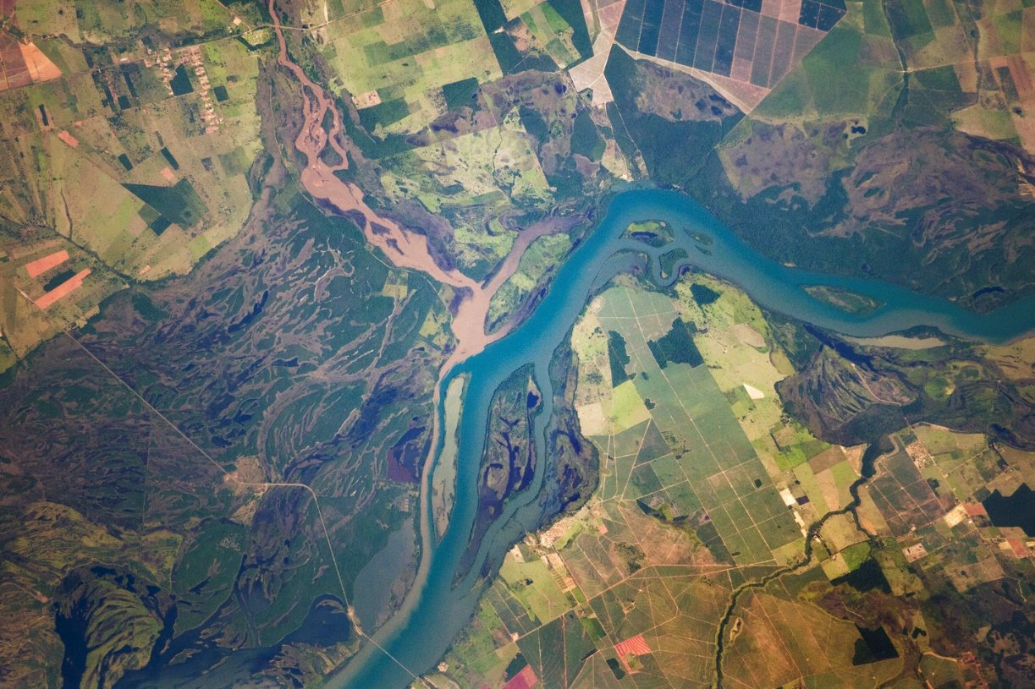

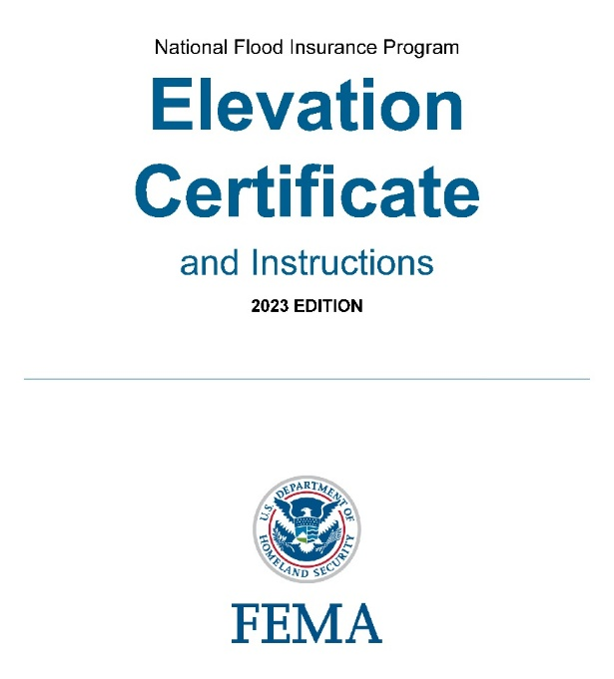

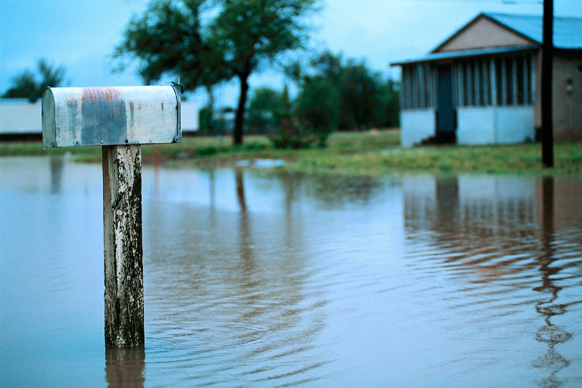
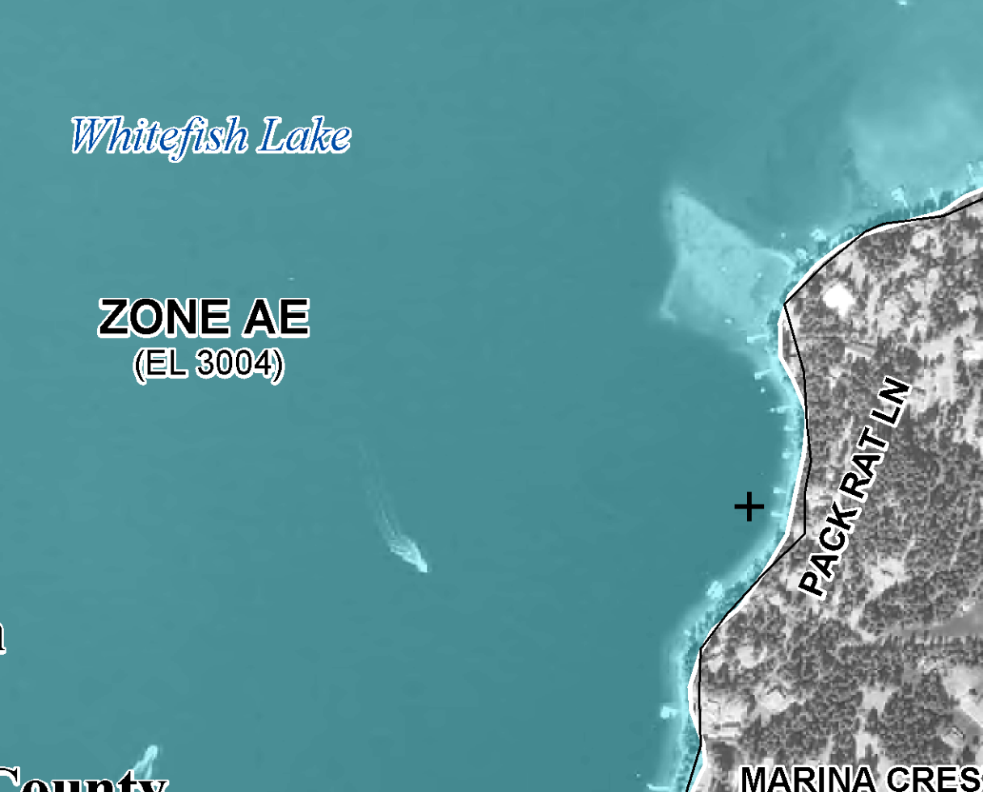
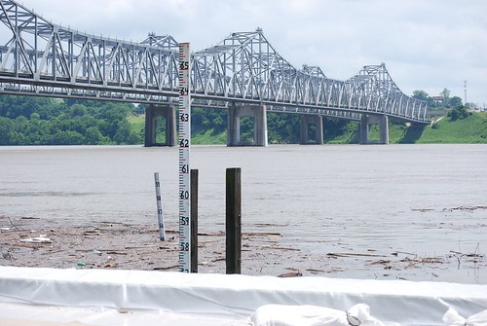

Slide 19



Slide 20
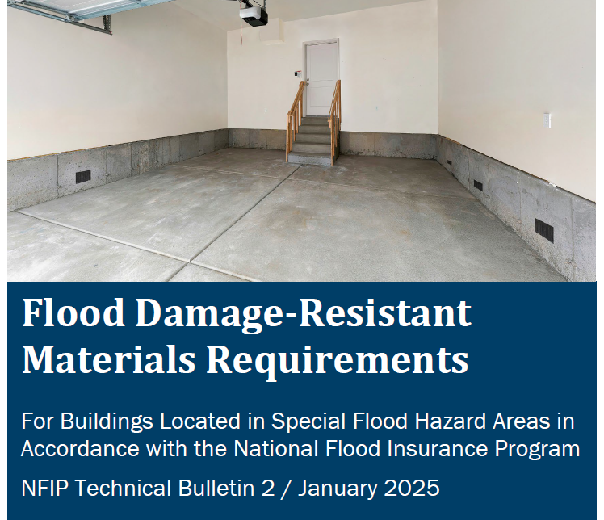


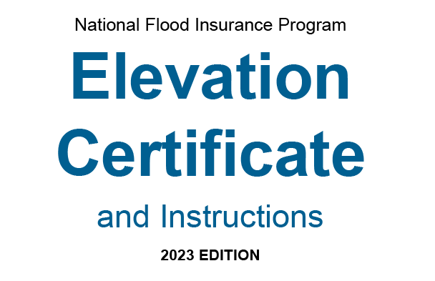


Slide 21
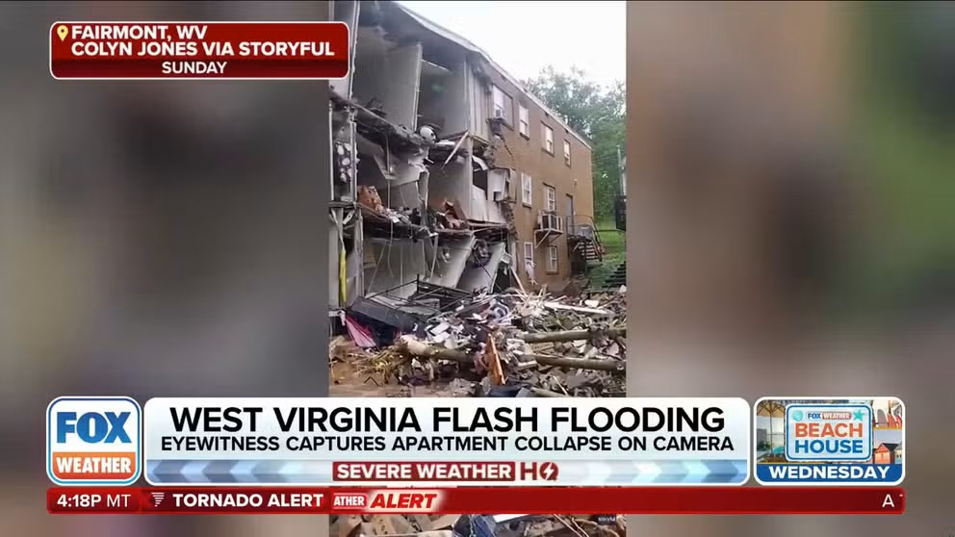
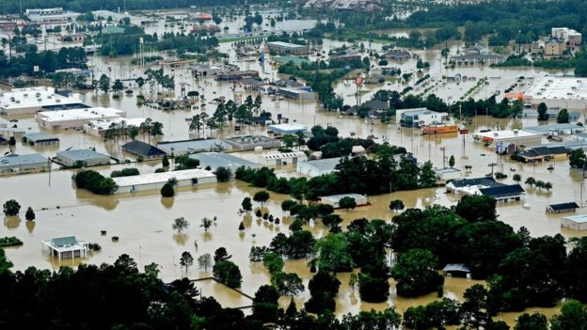
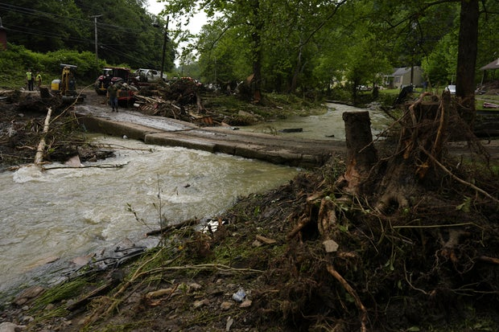
June 2025

Slide 22

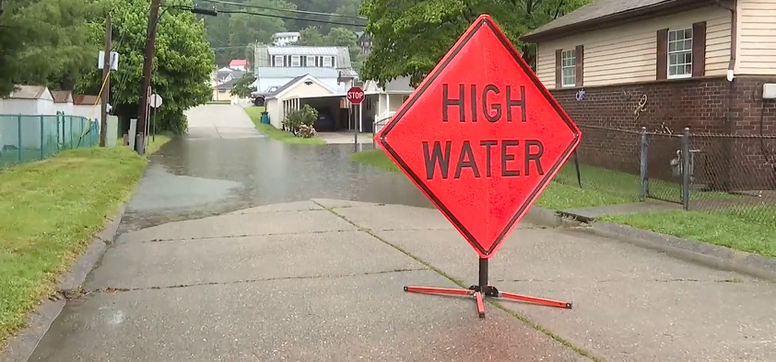
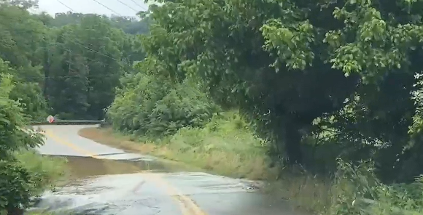
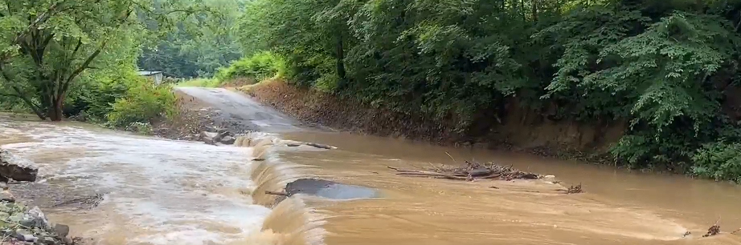

Slide 23

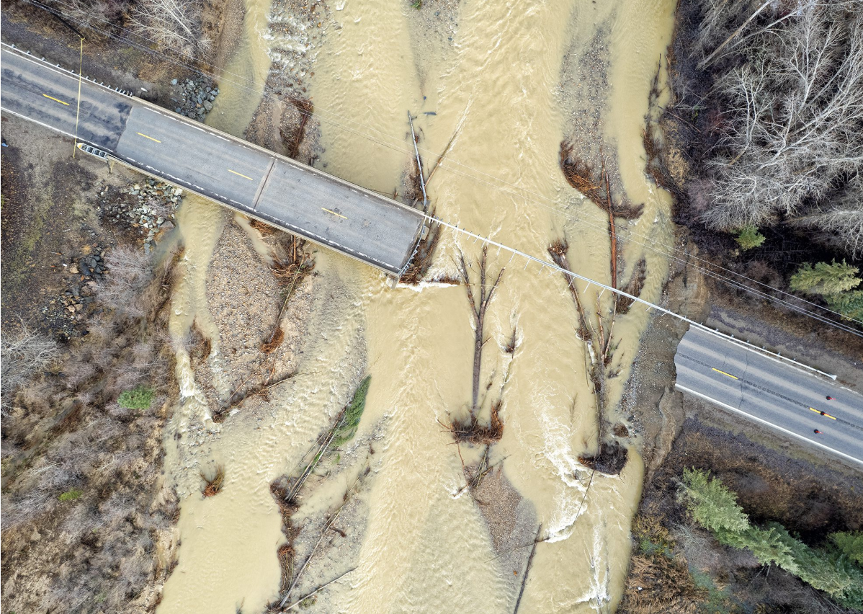
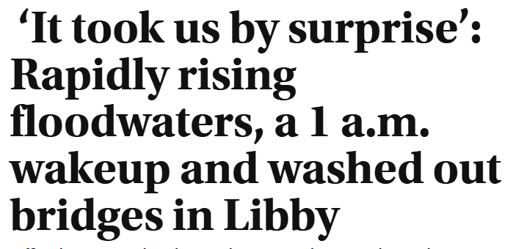
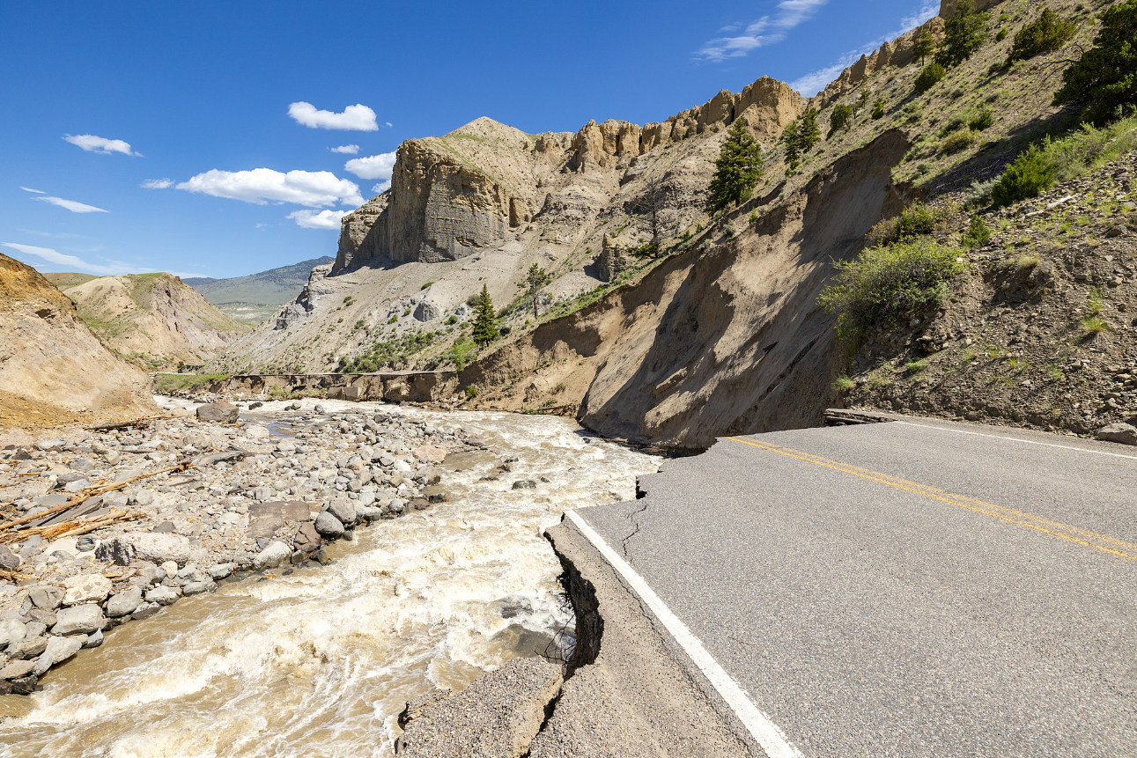
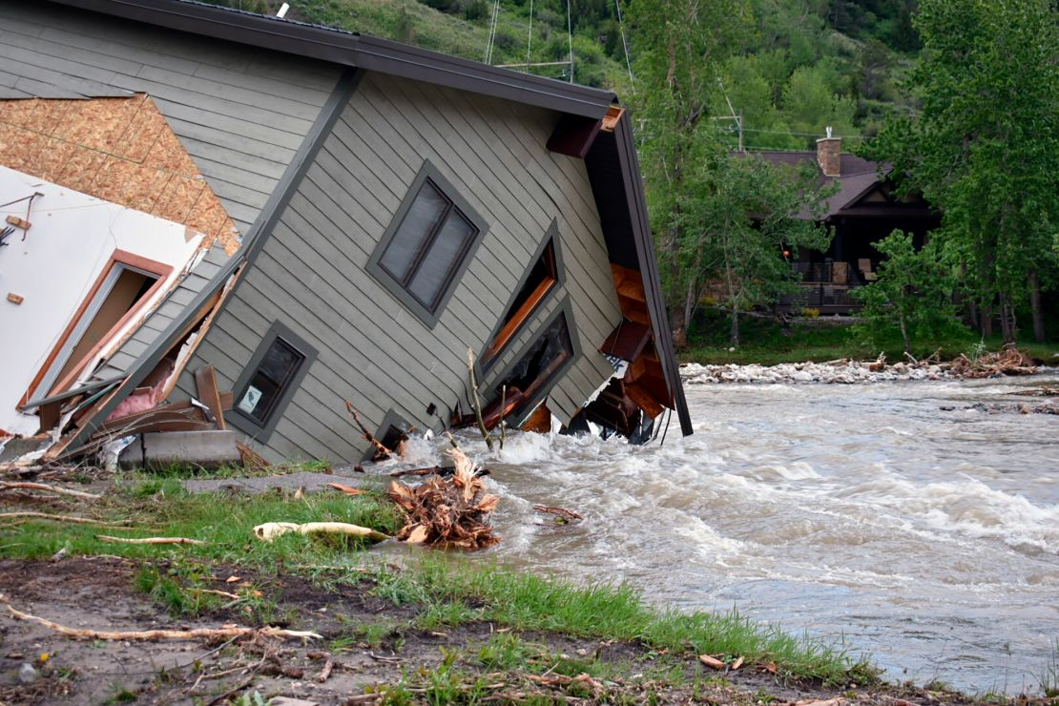


Slide 24
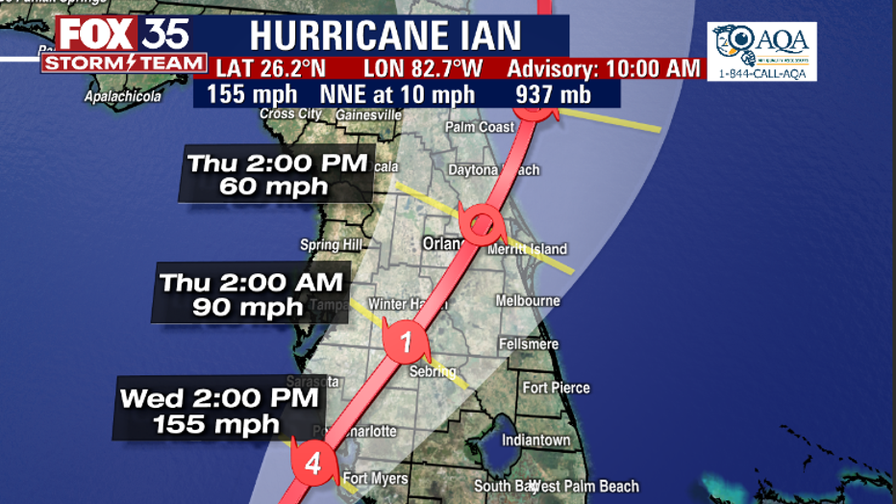
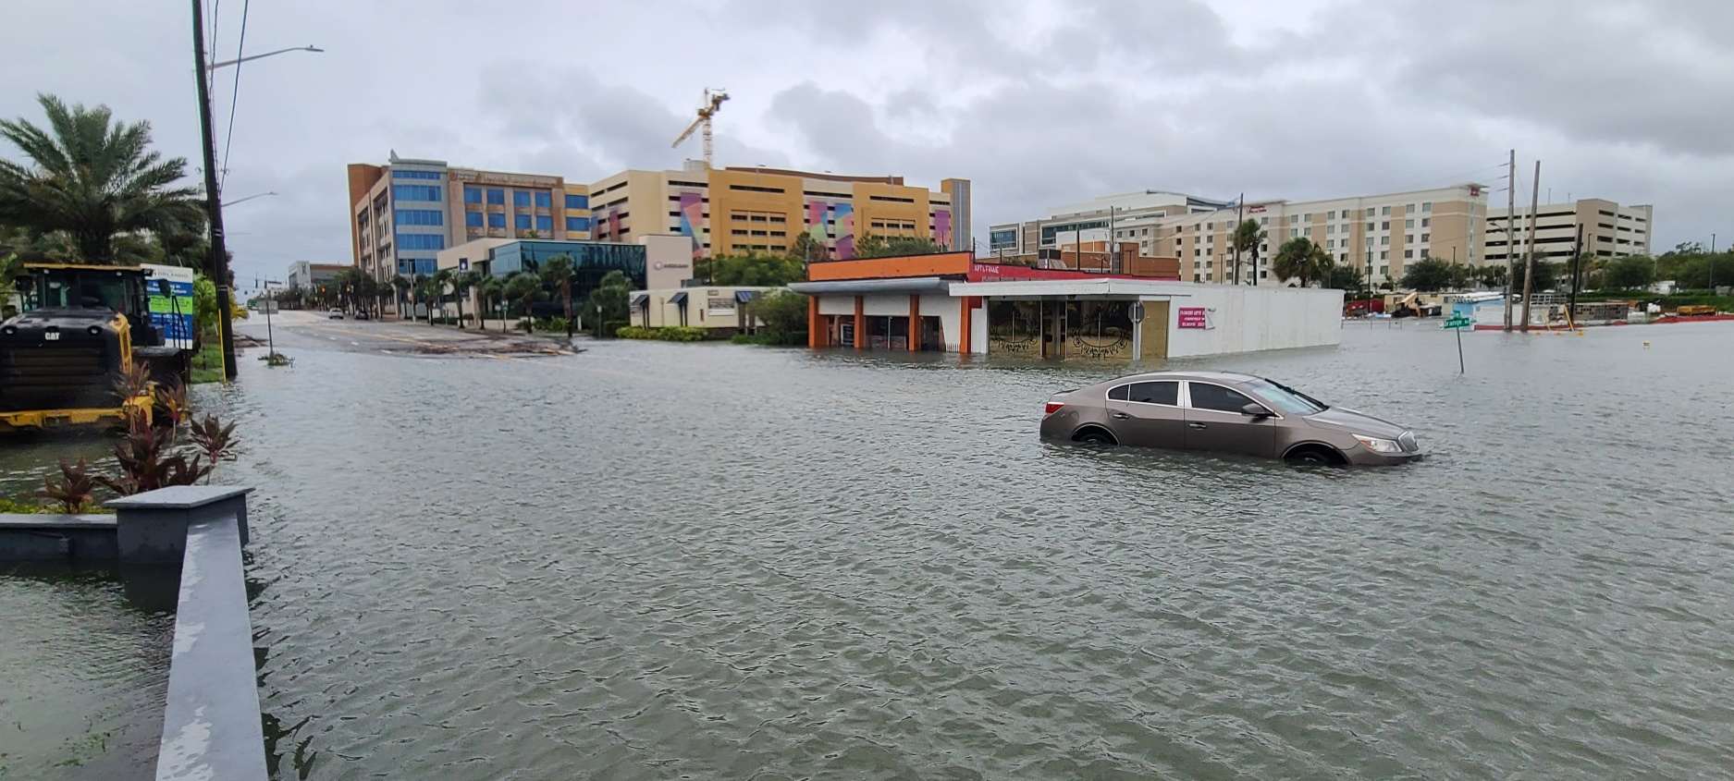
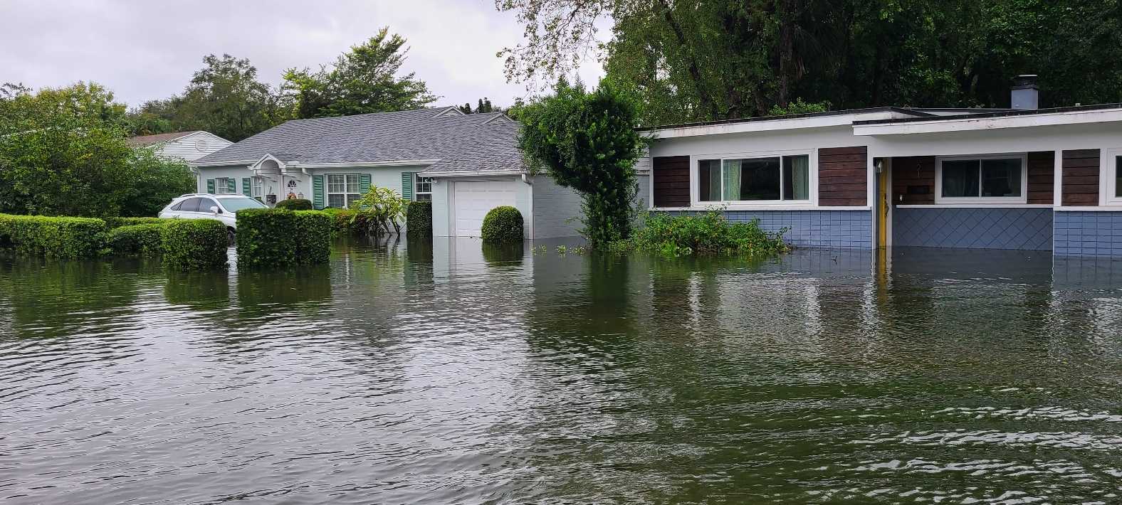
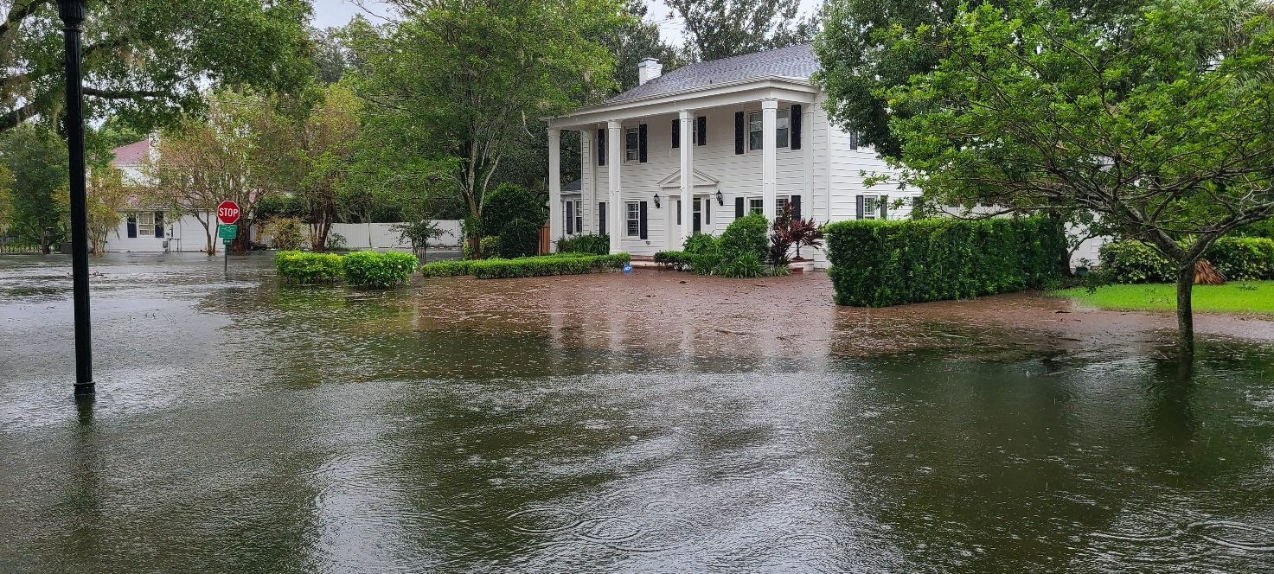

Slide 25

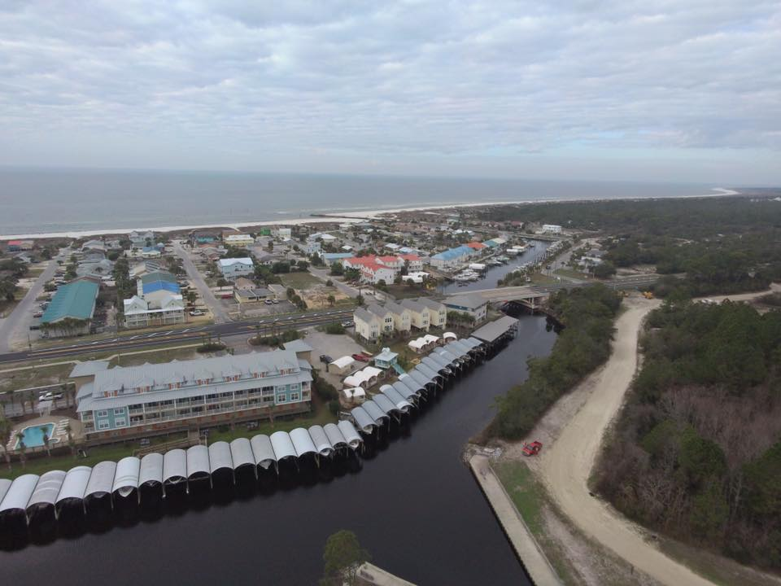
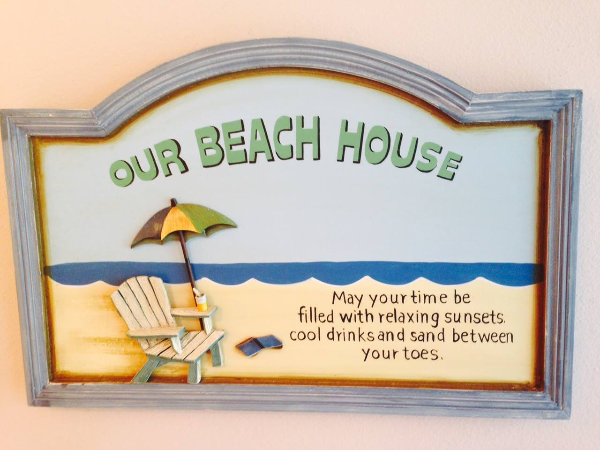

Slide 26
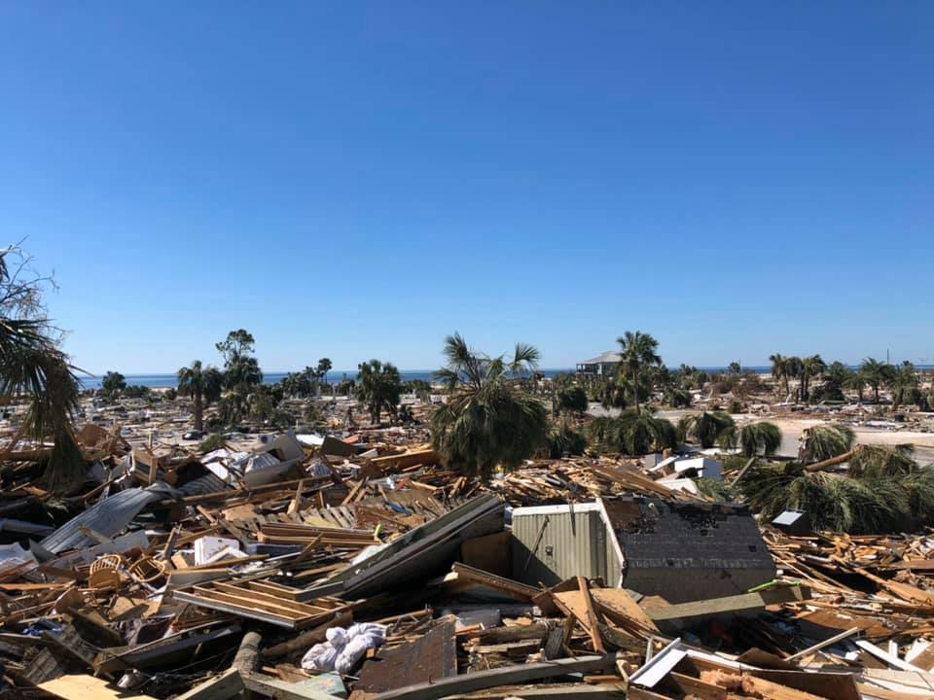
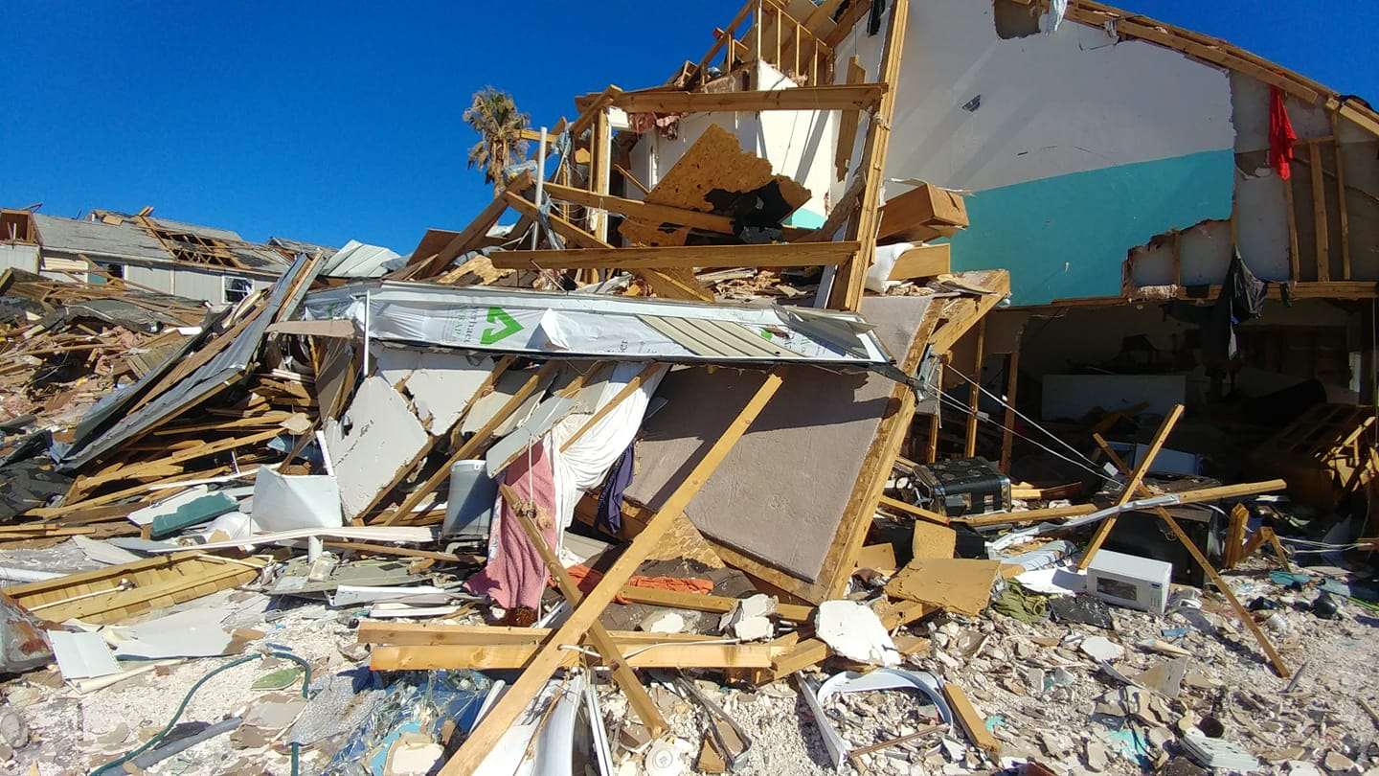
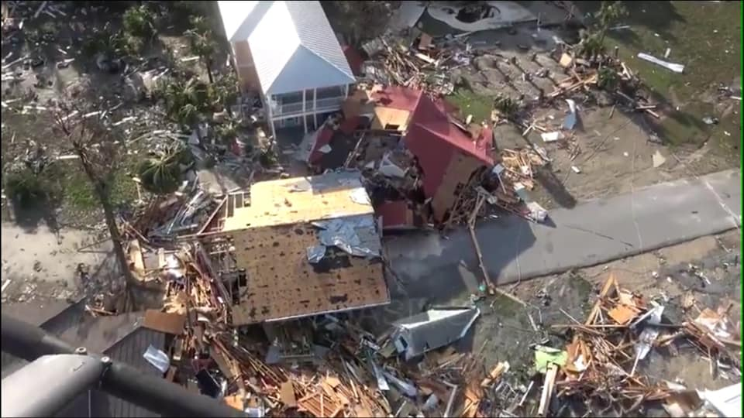
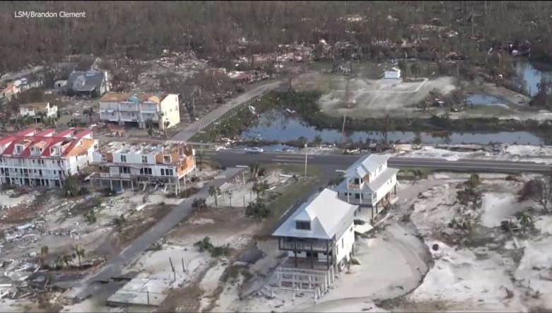

Slide 27
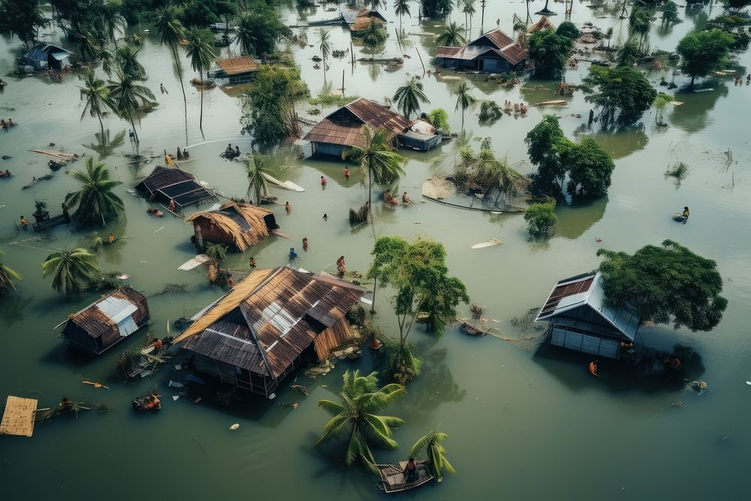

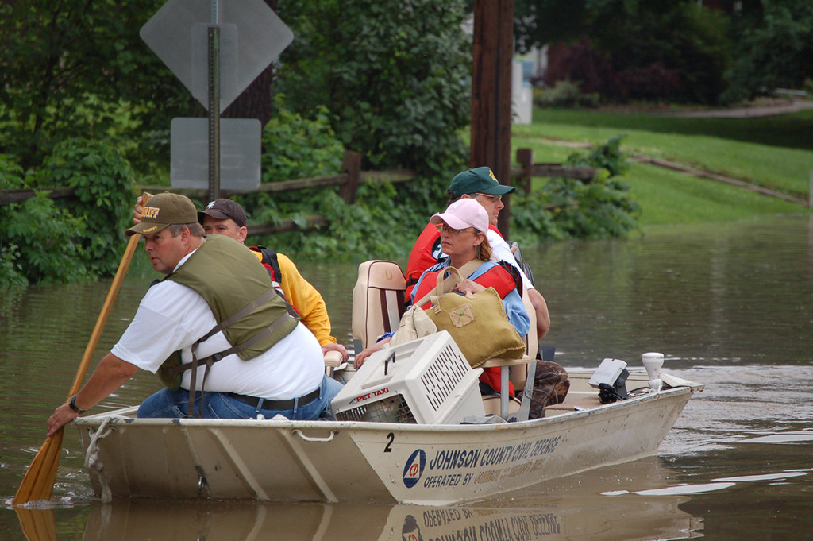


Slide 28
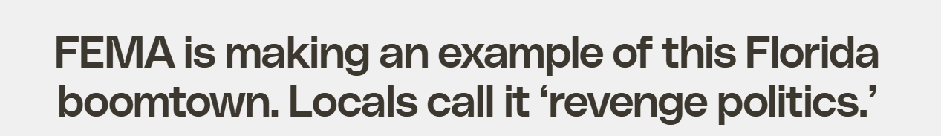
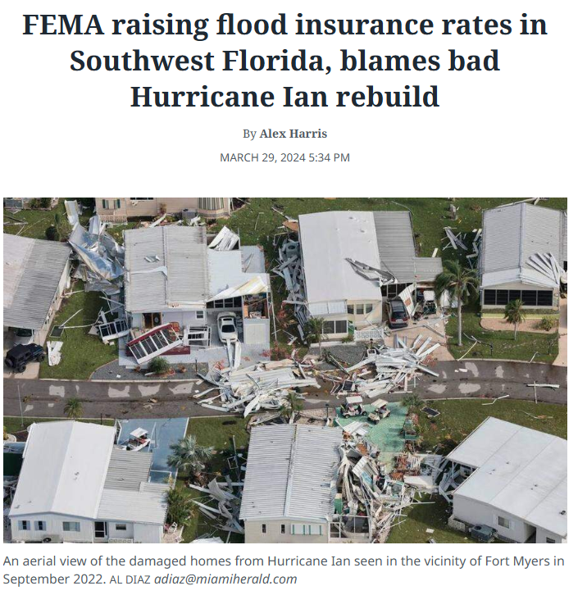





Slide 29
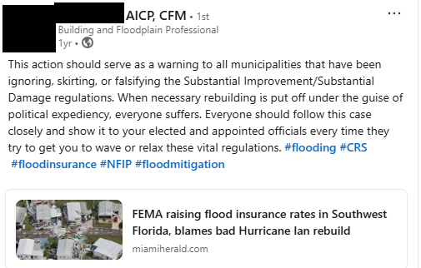
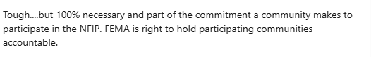

Slide 30

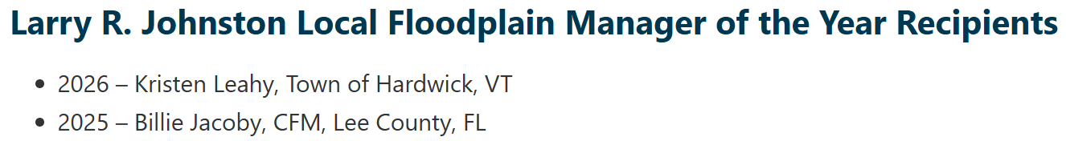
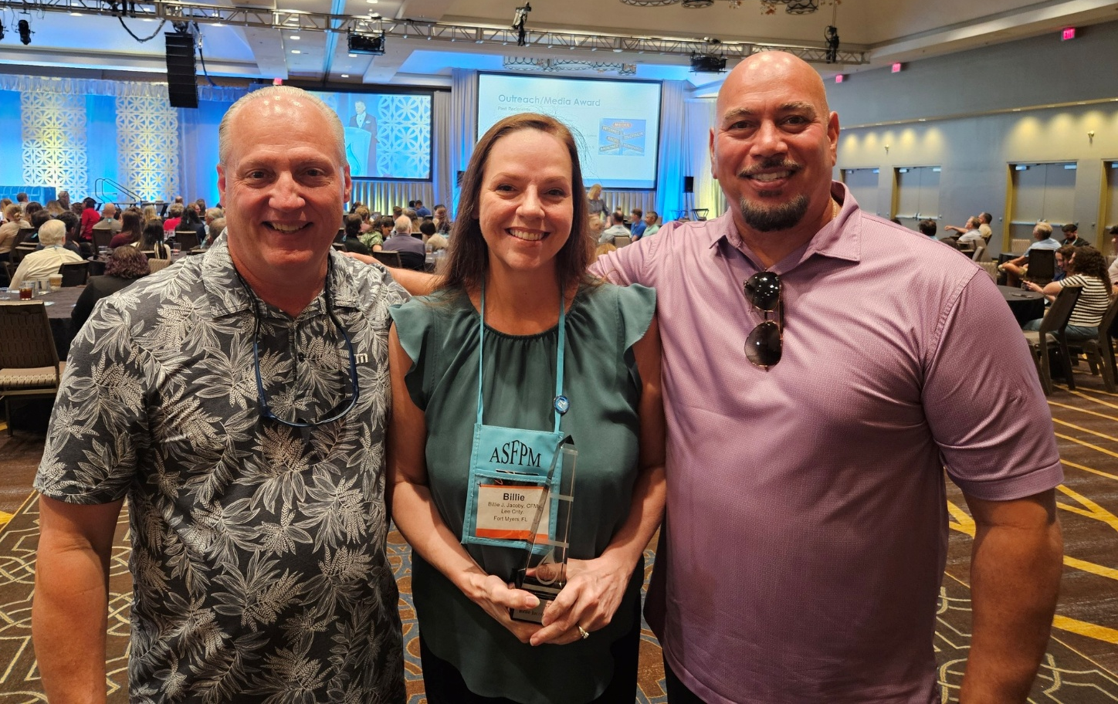


Slide 31






Slide 32


June 2024

Slide 33


June 2024

Slide 34

What Are We Doing and Why?
Del Schwalls, P.E.*, CFM
* P.E. in FL, AL, GA & SC
President, Schwalls Consulting LLC
Board of Directors, Florida Floodplain Managers Association
Associate, ASFPM Foundation
ds@schwallsconsulting.com
www.schwallsconsulting.com

Slide 35

Del Schwalls, P.E.*, CFM
* P.E. in FL, AL, GA & SC
President, Schwalls Consulting LLC
Board of Directors, Florida Floodplain Managers Association
Associate, ASFPM Foundation
ds@schwallsconsulting.com
www.schwallsconsulting.com

Slide 36

WVFMA Annual Conference
Tuesday, June 16, 2026
Del Schwalls, PE, CFM
President, Schwalls Consulting

Slide 37


Slide 38


Slide 39






HISTORY
X
ASFPM 2020 ➔ Virtual
ASFPM Foundation Grant
EC Update (2019 ➔ 2023)

Slide 40


Slide 41


Slide 42


Slide 43


Slide 44


Slide 45


Slide 46


Slide 47


Slide 48


Slide 49


Slide 51



Slide 52


Slide 53


Slide 54



Slide 55


Slide 56


Slide 57


Slide 59


Slide 60


Slide 61


Slide 62


Slide 63


Slide 64



Slide 65



Slide 66


Slide 67


Slide 68





Next Steps
Feedback from
GAFM & ASFPM Foundation
ASFPM 2026 Beta Launch
Public Launch – Fall 2026

Slide 70
Since the NFIP was established almost 60 years ago, the approach to floodplain management has been largely stagnant. While the available tools for assessing flood risk have improved exponentially, our approach to identifying the risk and protecting our citizens is largely based on an assumption that once mapped, the risk will not change. We discuss increasing the flood resiliency of our communities but continue to permit development without the future in mind. Instead of building back better after a disaster, we build back and hope it will not happen again. At the same time, our regulatory framework and administrative requirements often do more to hinder effective floodplain management and resiliency, rather than enabling staff to better protect those we serve. This presentation will discuss problems from around the country that floodplain managers face constantly, including five Florida communities who were almost suspended from the NFIP due to miscommunication and administrative mistakes, all the while recovering from the third costliest disaster in US history.
TOPIC
THEME
SUBTHEMES

Slide 71
TOPIC
THEME: Great Falls, Greater Resilience: Navigating the Floodplain Future
SUBTHEMES: Challenges and Changes in the Future of Flood
Keynote: Inspires, captivates, motivates, educates, and entertains.
Main event, Delivered by someone prominent or an expert who adds value to the event.
Careful preparation, effective delivery, genuine connection to the audience
1. Establish purpose of your message.
- Define Audience – what do I want them to take away.
Based on topic, Outline key points - Impactful, relevant, resonate with audience, tie in with overall theme
2. Connect to the audience, understand
Demographics, age, knowledge - Use stories that resonate with them
– engage with them on a personal level so they feel more connected to me and my topic.
3. Captivating Opening – most important to grab their attention; set tone for speach
Audience will be judging me, and this will set the tone for the rest of presentation
Start with compelling story, fun fact, thought provoking question to pique their interest
4. Organize and Structure – very clear outline
- Engage (with strong opening), inform (why they should listen), educate (with knowledge), inspire (take action in conclusion)
Plan some interaction with the audience - Tell stories to make my content “sticky”
Structure will help me remember what’s next and adapt if there are time constraints
5 – Visuals are aids, they should not take over from me or message. Focus should never be my slides, but should be me, my deliver, and my message, and my voice
6 – Finish effectively
- Powerful finish - even if my speech is great, the finish must be crucial - inspiring call to action, what value do I want them to take away
7 – practice! Over and over
- no ums, fillers - enjoy the experience

Slide 72
Who is delivery my introduction? Traci, Ben? Speak Up Don’t sell myself
Avoid the podium, walk around (not too much), take steps, then stop Maintain energy during whole time
Look at audience
What do you think of when I ask…
How much experience do you have if you’re an expert?
You are experts in Montana floodplain management
I want to challenge you
IDEAS
My logo, who knows what it means?
  Conversation starter – how do we start conversations
I attended 7th and 8th
Presentation topic on flawed FEMA LOMR policy – policy is still the same
Panama City Beach LOMR meeting
  Lady next to canal who thought flooding only came from ocean
What are the other presentations through the week – reference those topics or speakers to connect to my message
Reference Montana disasters/floods
  Low snow pack, low moisture later

