Slide 1

West Virginia Department of Environmental Protection
Dilapidated Properties Program (DLAP)
RECLAIMING THE MOUNTAIN STATE
Data driven, Locally led
June 11, 2026

Slide 2
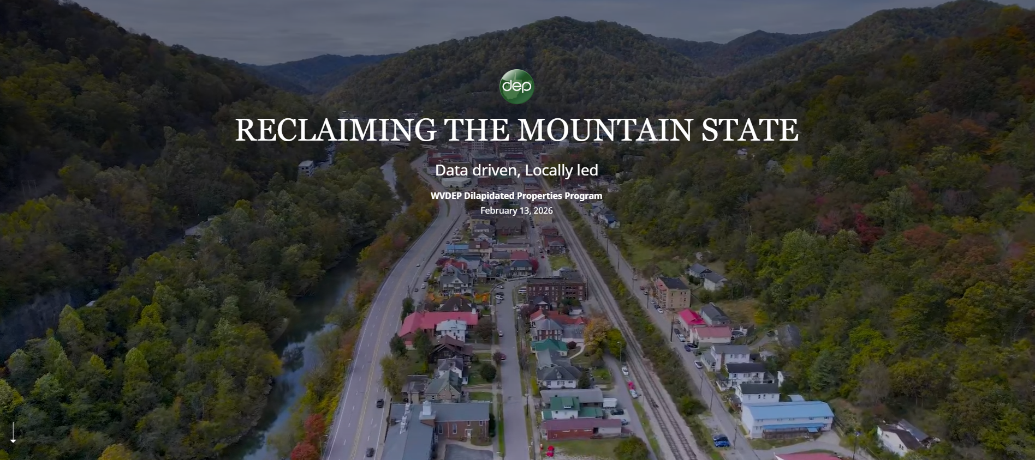

Slide 3
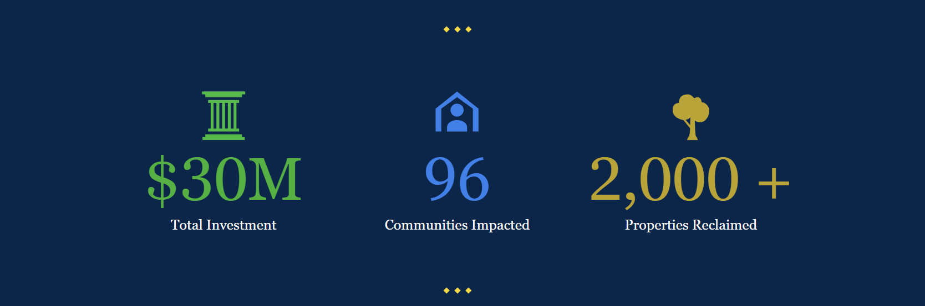

Slide 4
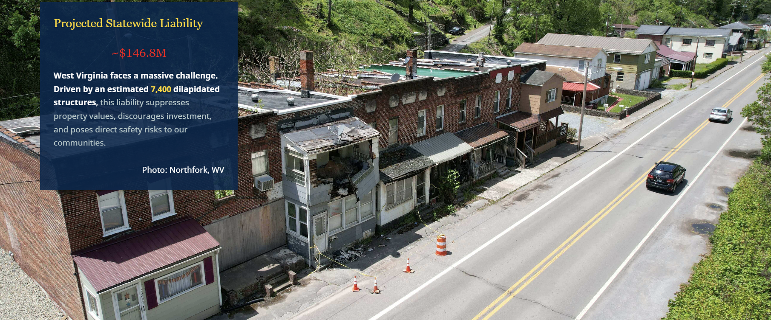

Slide 5
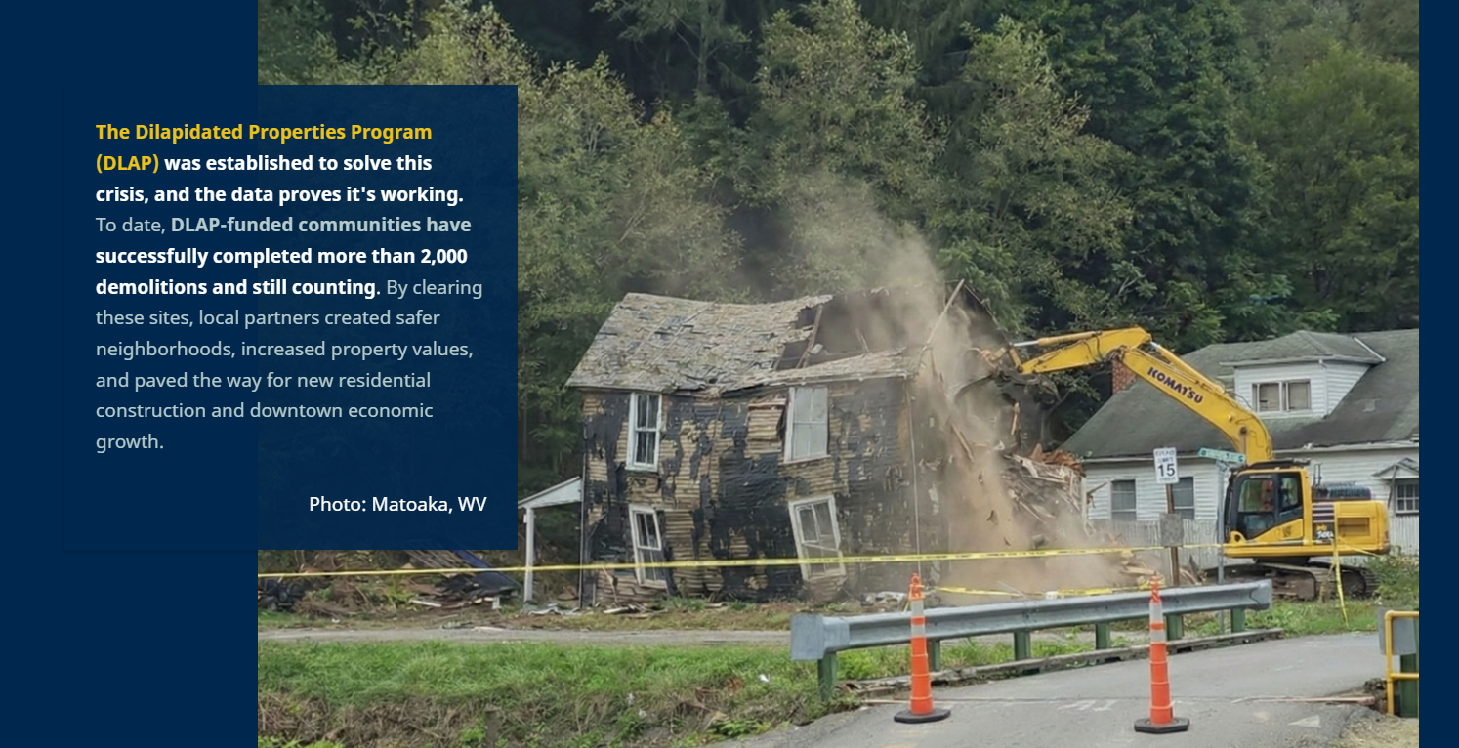

Slide 6
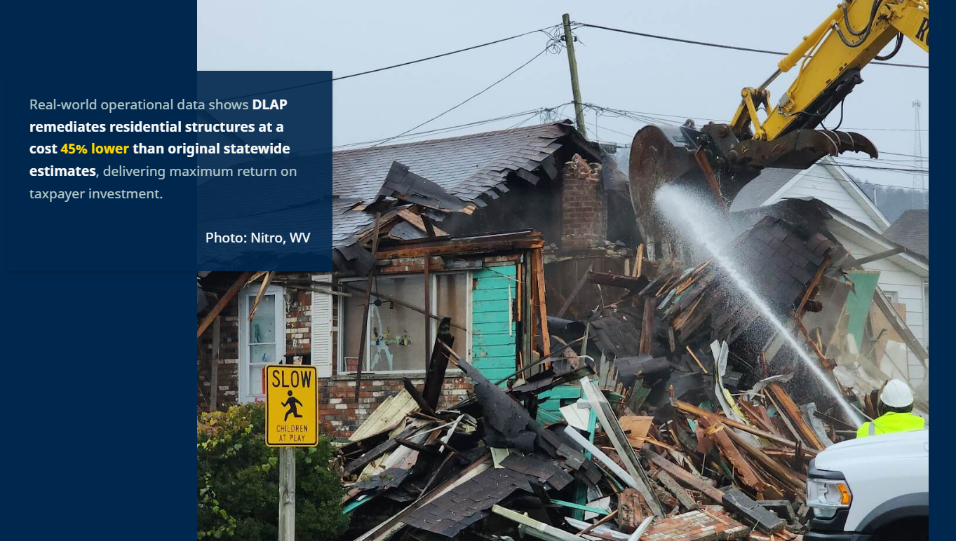

Slide 7
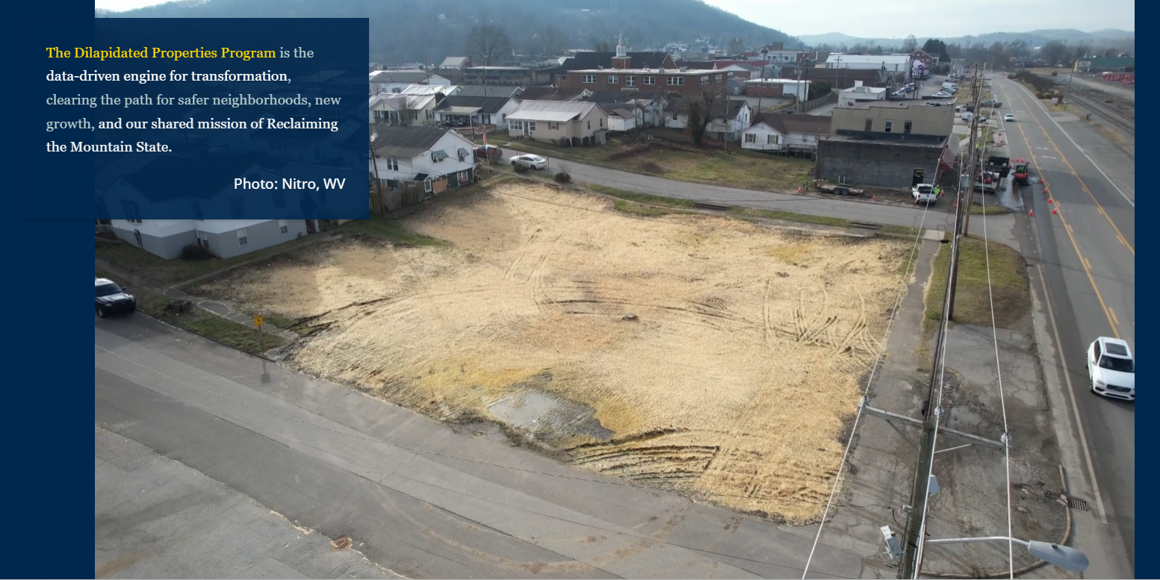

Slide 8
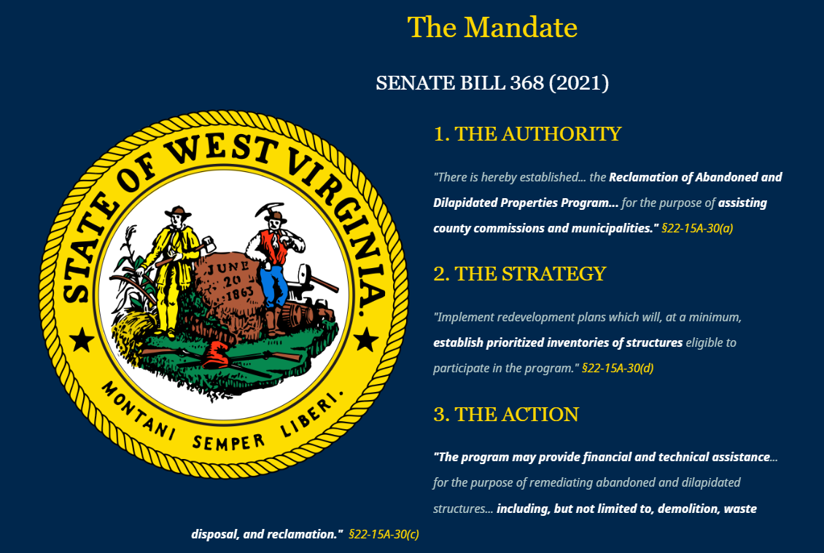

Slide 9
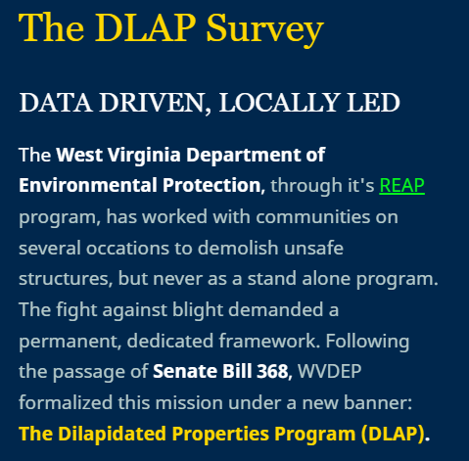
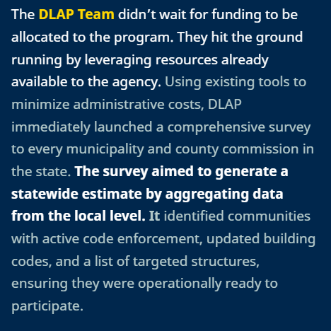

Slide 10
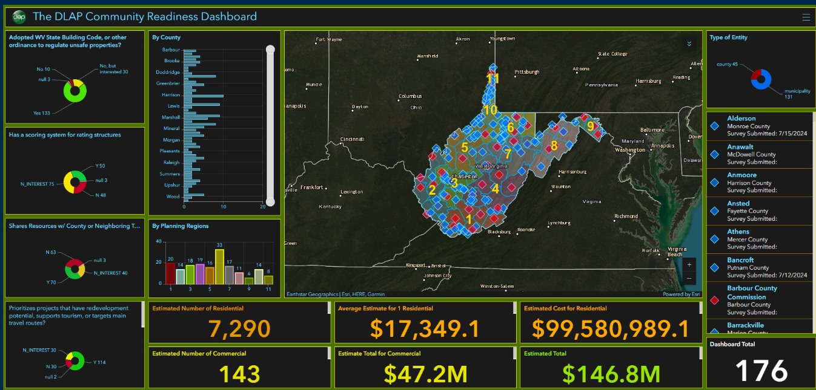

Slide 11
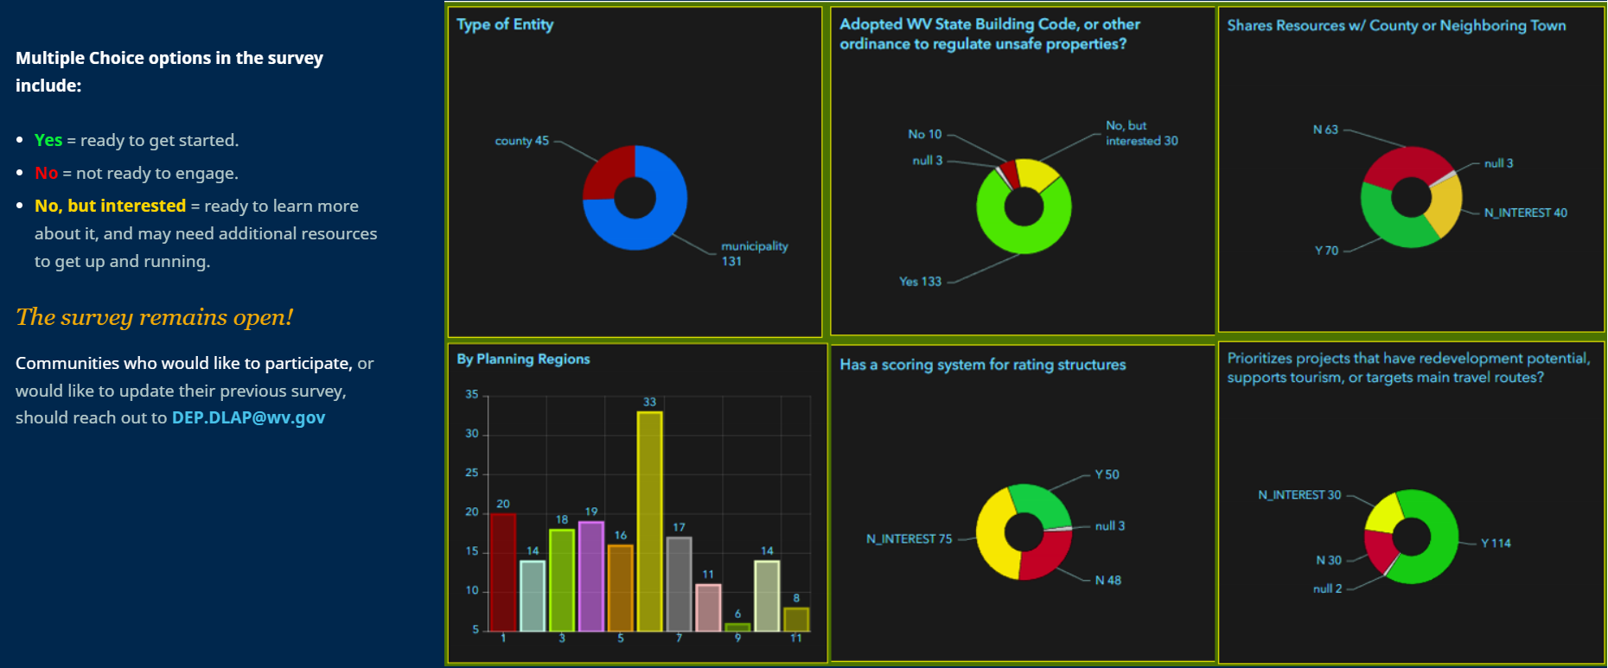

Slide 12
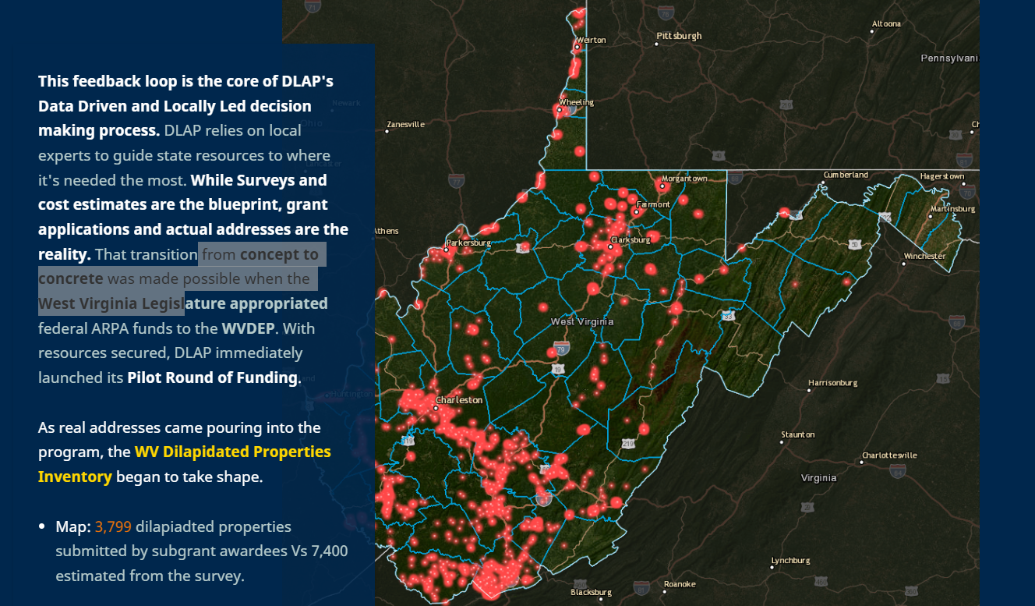

Slide 13
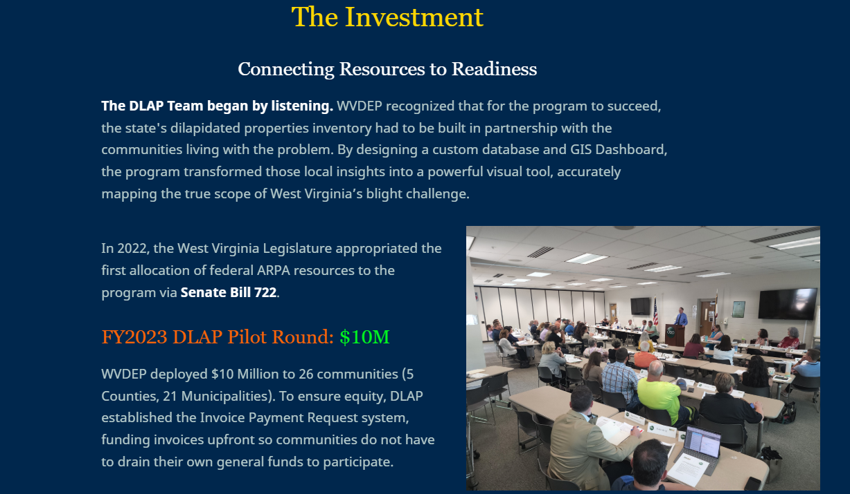

Slide 14
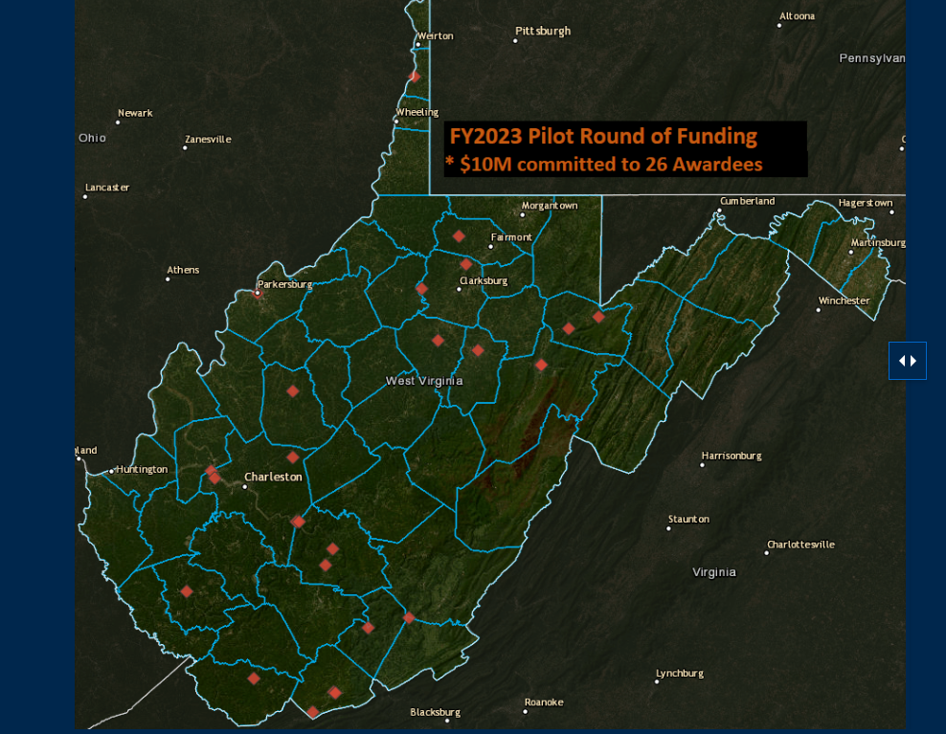

Slide 15
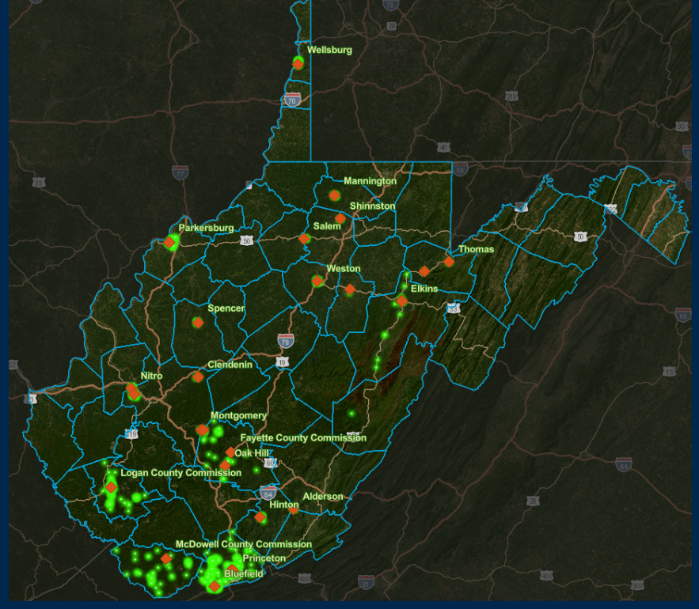
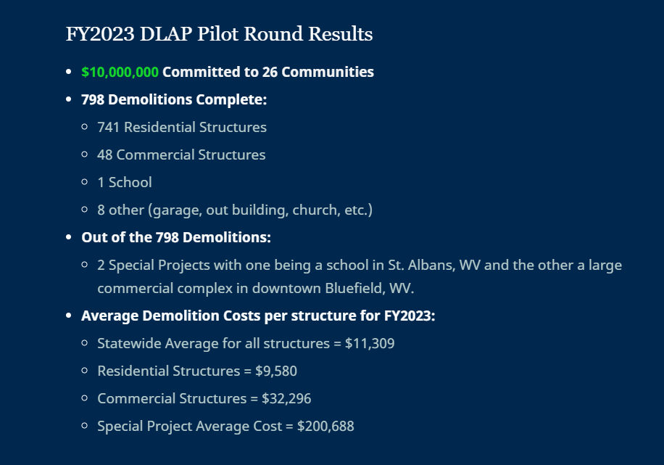

Slide 16
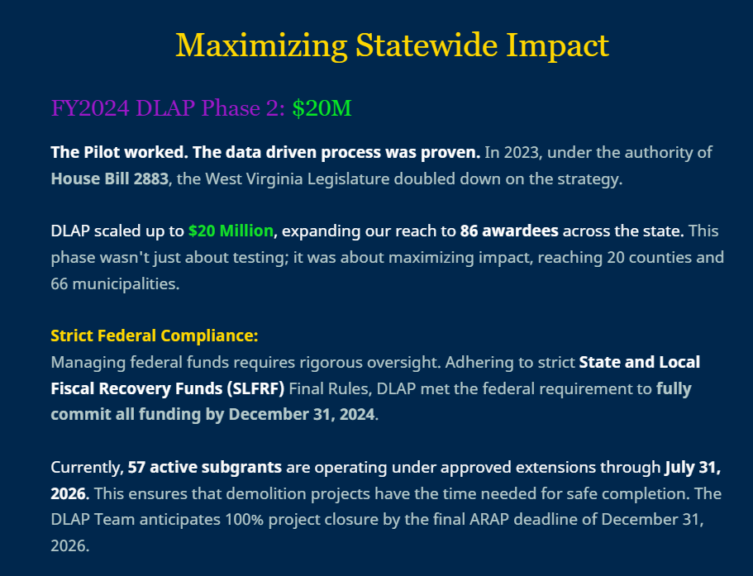

Slide 17
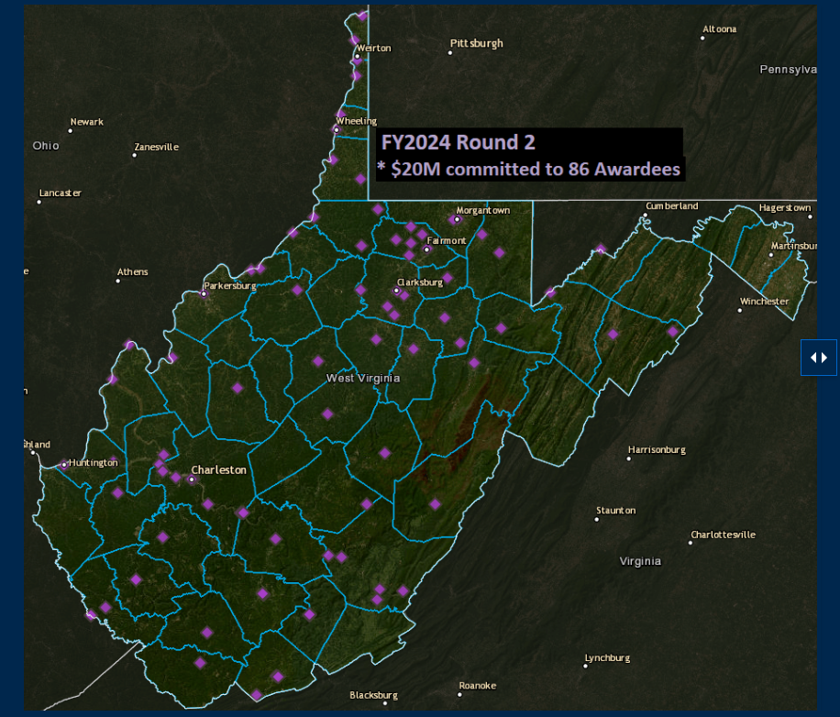

Slide 18
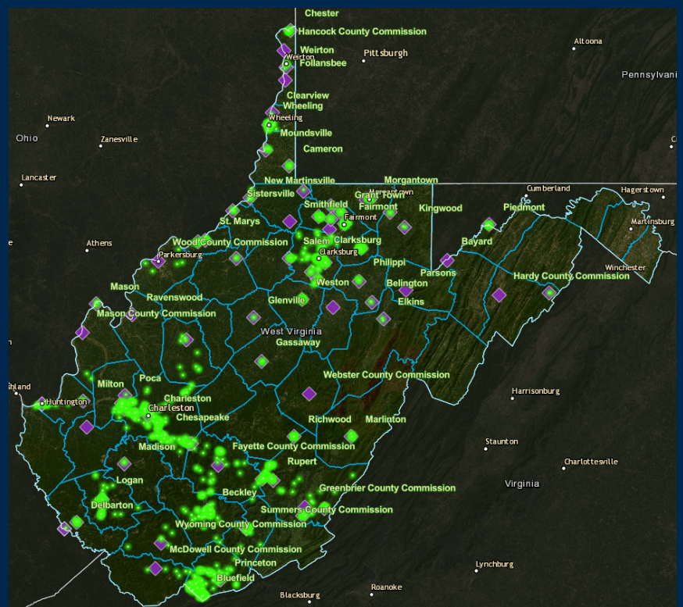
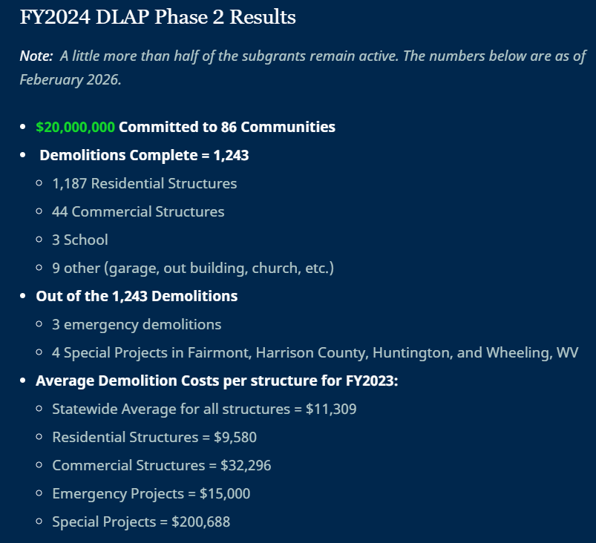

Slide 19
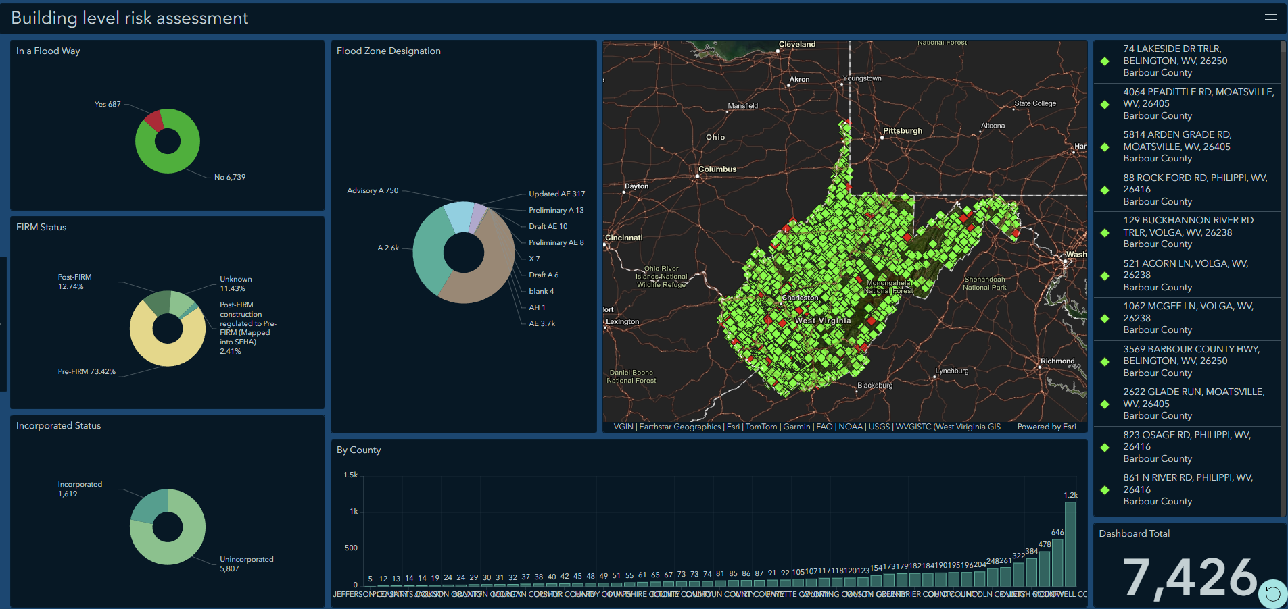
Targeted Structures in a Flood Hazard Area

Slide 20
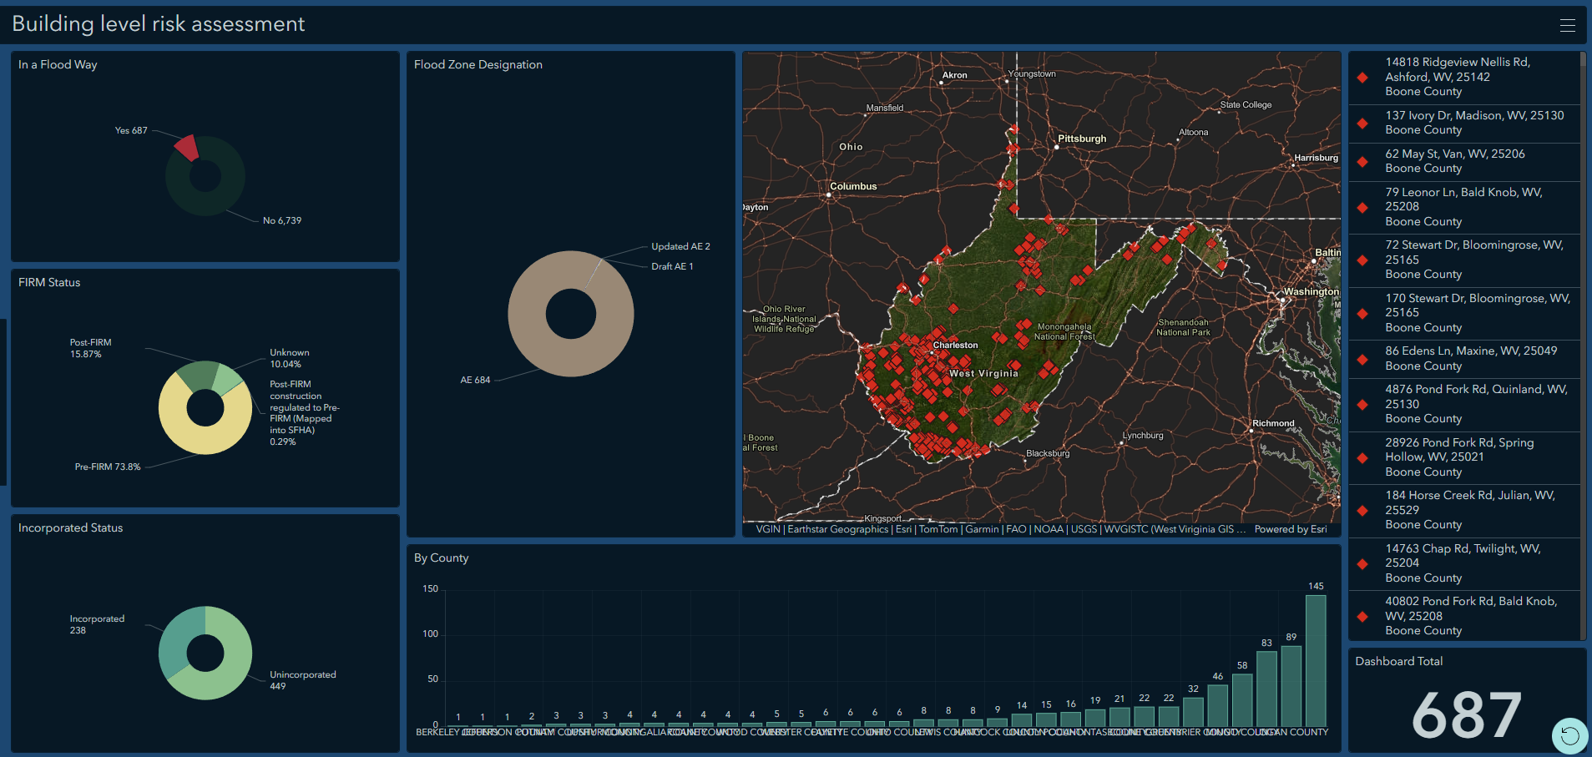
Targeted Structures in a Flood Hazard Area

Slide 21
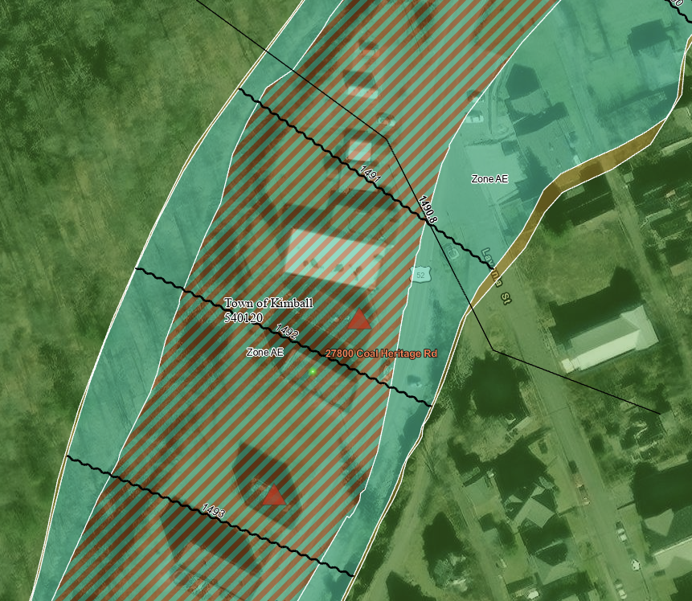
Targeted Structures in a Flood Hazard Area

Slide 22
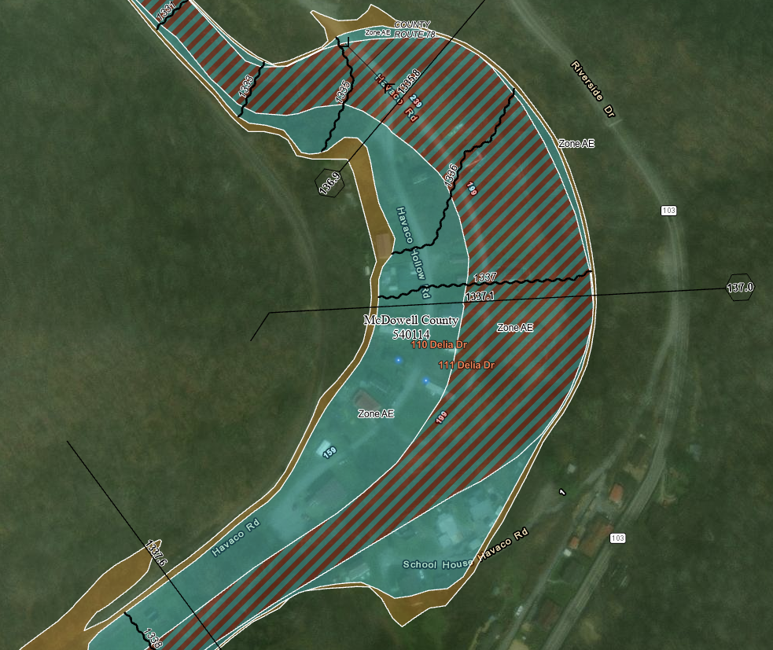
Targeted Structures in a Flood Hazard Area

Slide 23


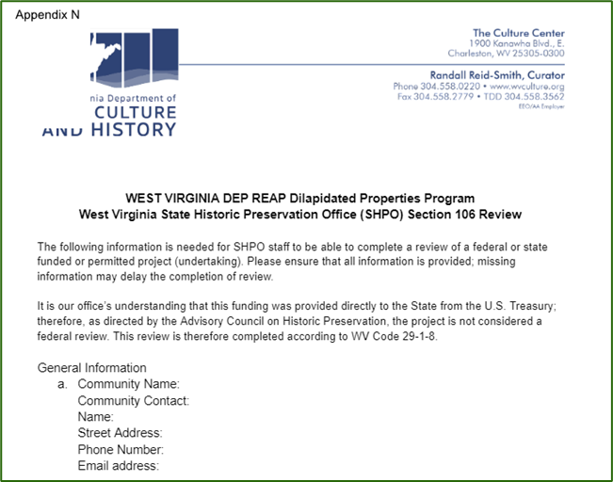
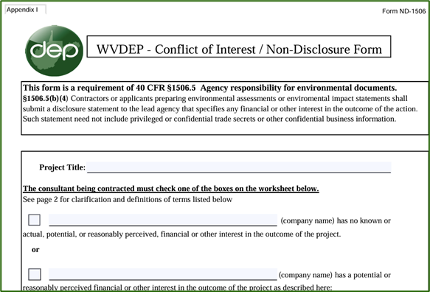
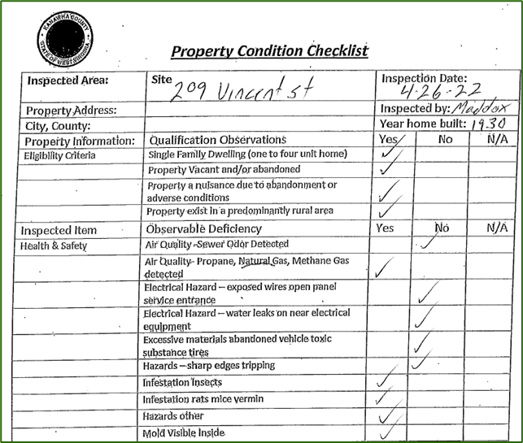
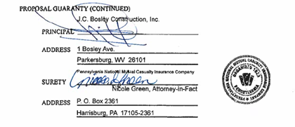
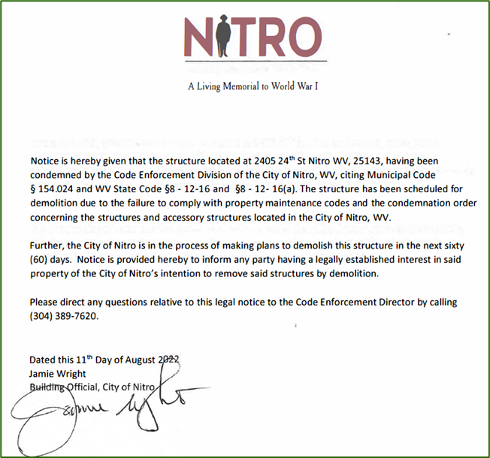
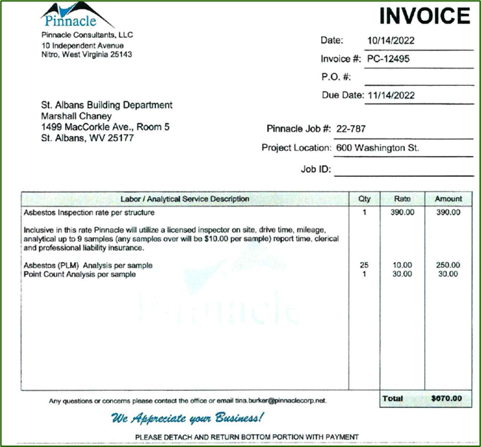
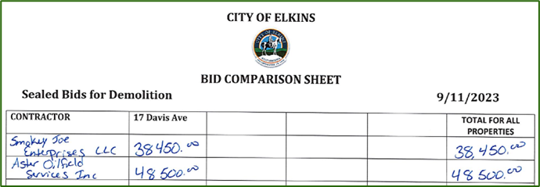
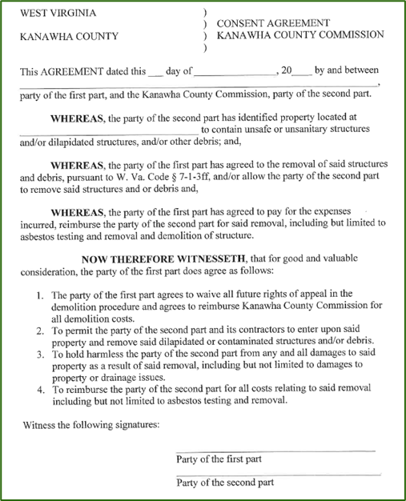
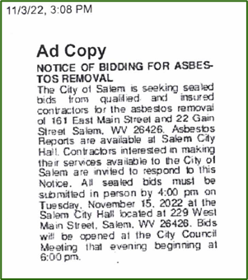

Ready to Demo Checklist
Email Request to Proceed to: DEP.DLAP@wv.gov
File Name: 128 Main Street Somewhere, WV
File Name: Somewhere, WV Batch 1 bid package and sign Contract

Slide 24
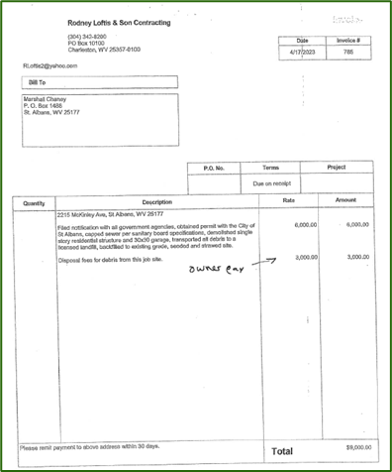
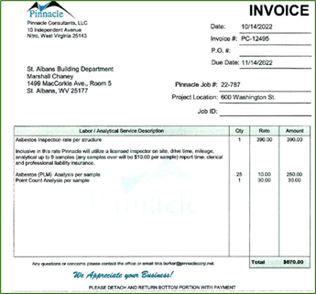
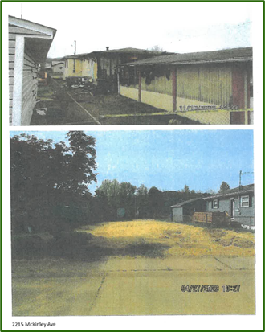
Invoice Payment Request Checklist
Attach Invoices and Before and After Photos as a separate file
Verify that all demolition, abatement, and testing invoices are meticulously linked to a specific project location.
Each expense necessitates an accompanying invoice or receipt that matches the expenditure precisely.
Label photos properly
Payments to the City or County might undergo a processing period of several weeks.
Subsequently, it is the responsibility of the respective city or county to manage payments to contractors and other professional service providers.

Slide 25
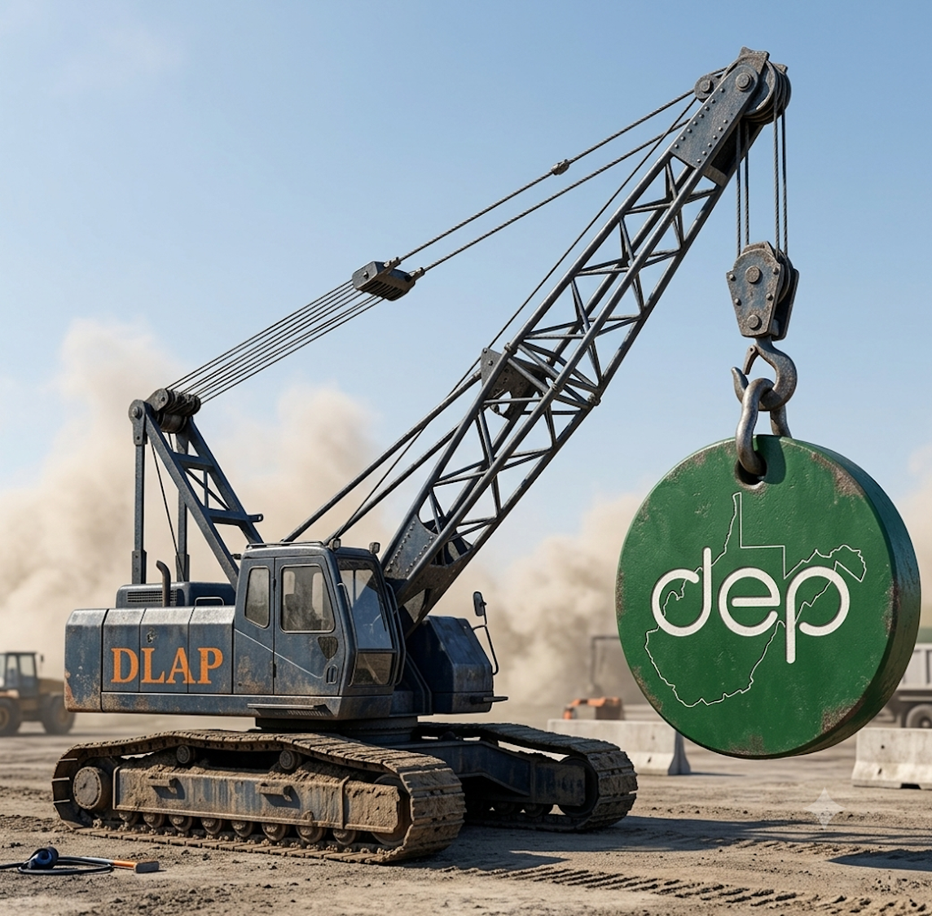
Contact Us
John M.S. King
Office of Environmental Remediation
Dilapidated Properties Program
601 57th St. SE, Charleston, WV 25304
Direct Office No.: 304-414-9760
John.M.S.King@wv.gov
DEP.DLAP@wv.gov

