Slide 1
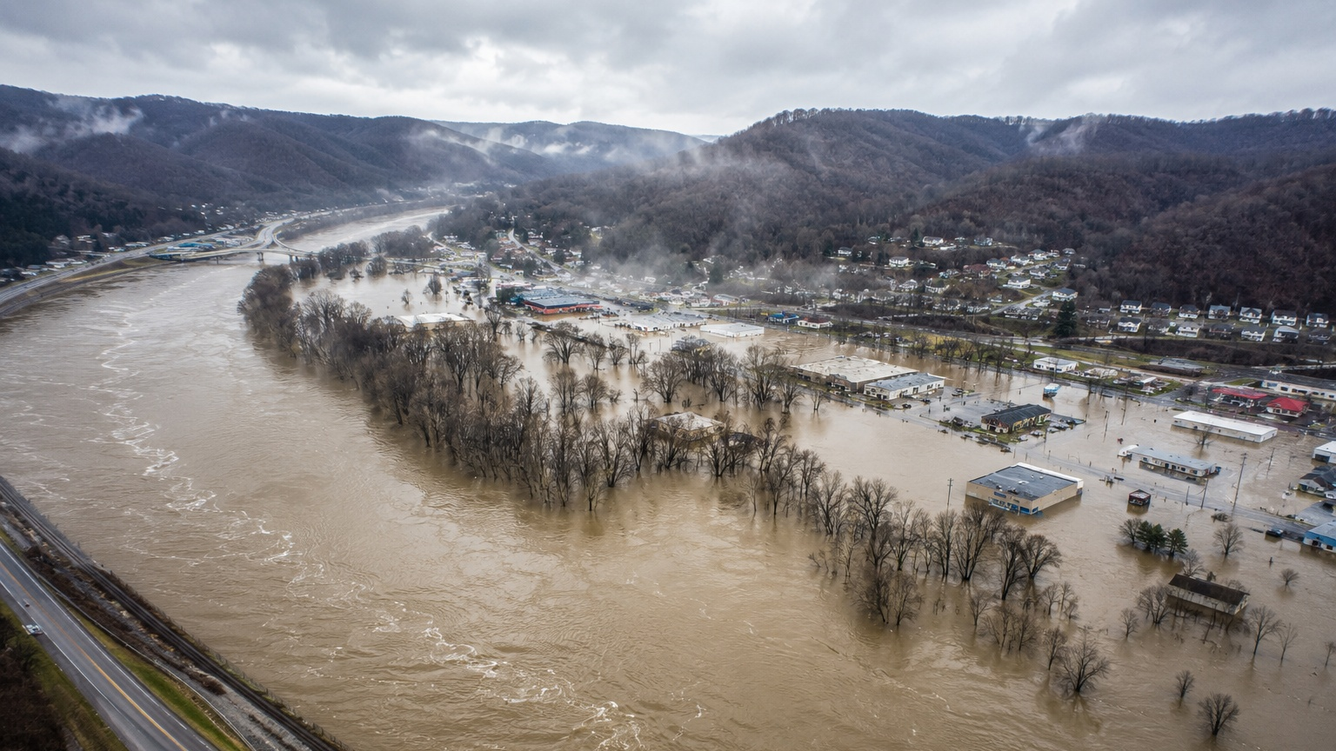


Behrang Bidadian
Kurt Donaldson
Flood Risk Tools and Resources:
Review and Update
June 17, 2026

Slide 2
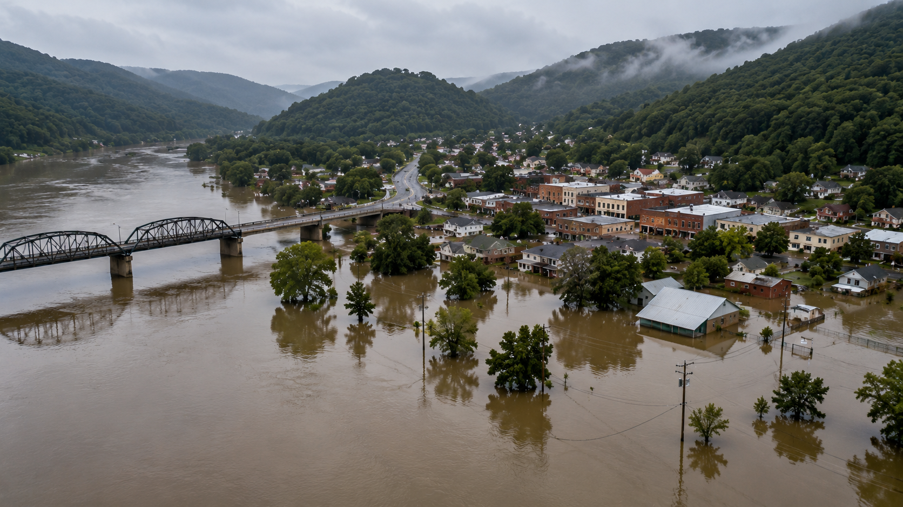
West Virginia Hazard Library (HL)
Backwater Flooding
Letter of Map Amendment (LOMA)
Map Updates

Slide 3

West Virginia Hazard Library (HL)
Image courtesy of Rorozoa on Freepik

Slide 4



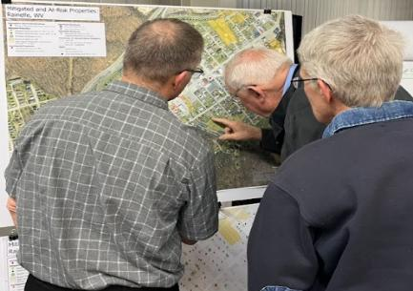

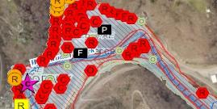
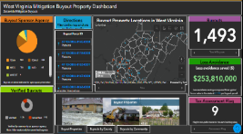
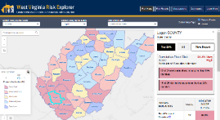
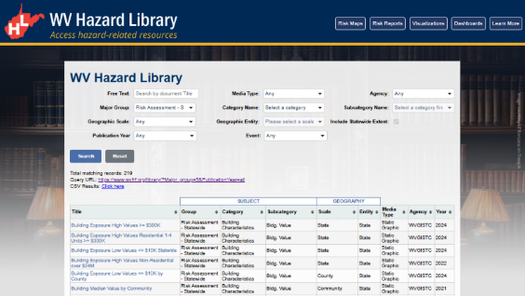
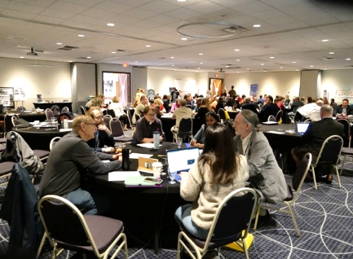
WV Hazard Library
A comprehensive source of data, documents, and media related to flood risk that we collect or generate.
Flood Visualizations
WV Flood Tool
WV Flood Resiliency Framework (WVFRF)
COMMUNITY
ENGAGEMENT
• Focused Outreach Meetings
• Flood Symposium
• Resiliency Tools & Products
• Learning Resources & Reports
RISK TOOLS
• WV Risk Explorer
• WV Flood Tool
• Visualizations
• Dashboards
9 Geographic Scales
Flood Dashboards
WV Risk Explorer
Community Engagement Meeting
Example Tools
HAZARD LIBRARY
Search online hazard resources by title, subject, media, event, geography, data, etc.
STAKEHOLDERS
• Risk Reduction Associates
• Emergency Responders
• Floodplain Managers
• Local Officials
• Volunteers
• Public
Hazard Library
Flood Symposium Stakeholders
Notes:
Resources are organized into three major topics: risk assessment/planning, mitigation, and flood disaster. Users can search online hazard resources by title, subject, media, event, geography, data, stakeholder type, etc.

Slide 5
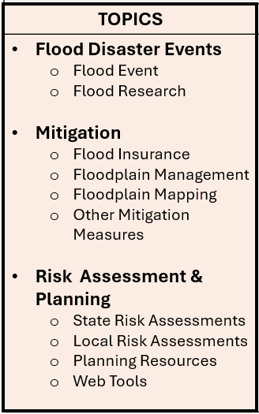
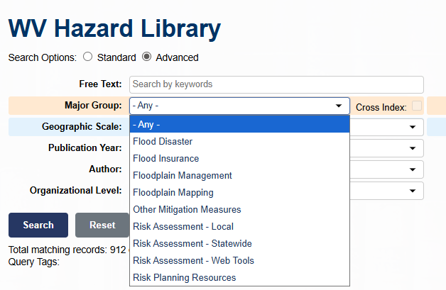
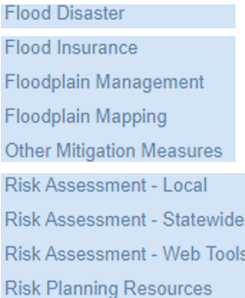
WV Hazard Library…
Content of Hazard Library
TOPICS | MEDIA TYPES |  | SEARCH TYPES
Flood Disaster Events Flood Event Flood Research Mitigation Flood Insurance Floodplain Management Floodplain Mapping Other Mitigation Measures Risk Assessment & Planning State Risk Assessments Local Risk Assessments Planning Resources Web Tools | 3D Movie Bldg. Profile Dashboard Data-GIS Data-Metadata Data-Table Flyer Graphic Guide Journal Article Letter News Article Picture | Plan Poster Report Slides Social Media Static Map Story Map Video Viewshed Web Info Web Tool | Agency Downloadable Data Event Disaster Event Meeting Geographic Scale Entity Media Type Publication Date Subject Major Group Category Subcategory cross-indexing Stakeholder Type Title (free text search) Predefined Searches Visualizations Floodplain Management Key Materials
Disaster Events
Mitigation
Risk Assessment

Slide 6
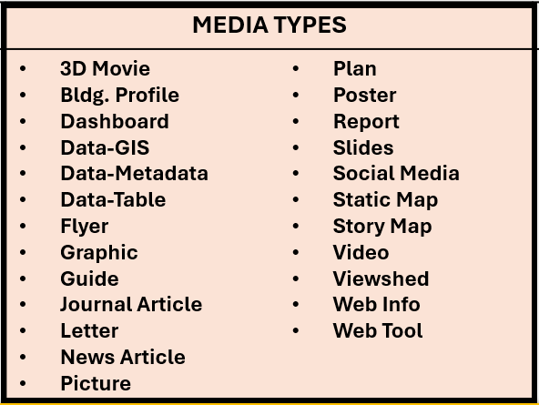
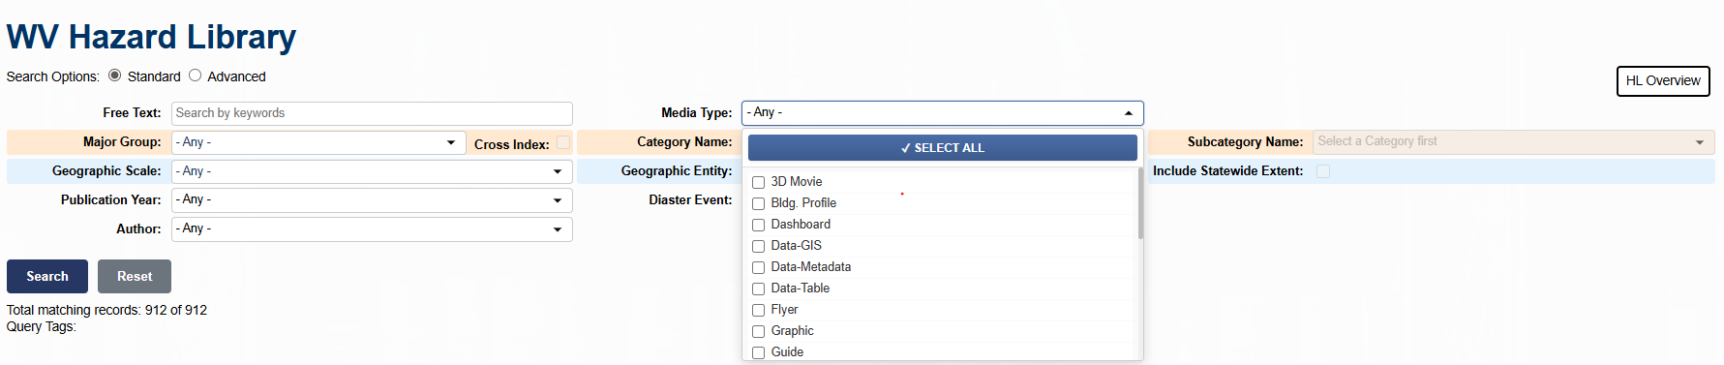
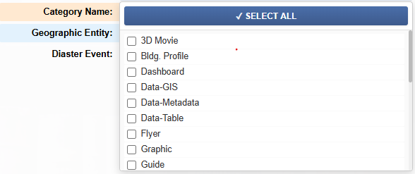
WV Hazard Library…
Content of Hazard Library
TOPICS | MEDIA TYPES |  | SEARCH TYPES
Flood Disaster Events Flood Event Flood Research Mitigation Flood Insurance Floodplain Management Floodplain Mapping Other Mitigation Measures Risk Assessment & Planning State Risk Assessments Local Risk Assessments Planning Resources Web Tools | 3D Movie Bldg. Profile Dashboard Data-GIS Data-Metadata Data-Table Flyer Graphic Guide Journal Article Letter News Article Picture | Plan Poster Report Slides Social Media Static Map Story Map Video Viewshed Web Info Web Tool | Agency Downloadable Data Event Disaster Event Meeting Geographic Scale Entity Media Type Publication Date Subject Major Group Category Subcategory cross-indexing Stakeholder Type Title (free text search) Predefined Searches Visualizations Floodplain Management Key Materials
Notes:
The WV Hazard Library contains more than 24 media resource types relevant to West Virginia.

Slide 7
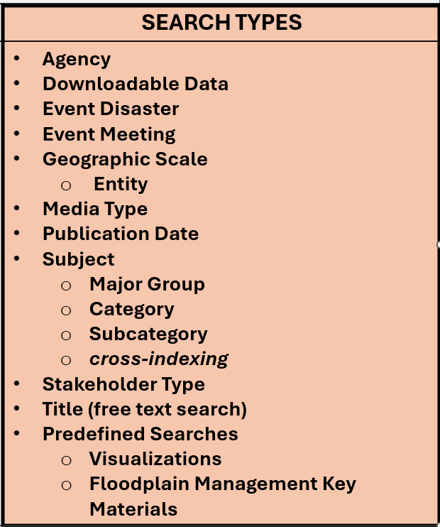

WV Hazard Library…
Content of Hazard Library
TOPICS | MEDIA TYPES |  | SEARCH TYPES
Flood Disaster Events Flood Event Flood Research Mitigation Flood Insurance Floodplain Management Floodplain Mapping Other Mitigation Measures Risk Assessment & Planning State Risk Assessments Local Risk Assessments Planning Resources Web Tools | 3D Movie Bldg. Profile Dashboard Data-GIS Data-Metadata Data-Table Flyer Graphic Guide Journal Article Letter News Article Picture | Plan Poster Report Slides Social Media Static Map Story Map Video Viewshed Web Info Web Tool | Agency Downloadable Data Event Disaster Event Meeting Geographic Scale Entity Media Type Publication Date Subject Major Group Category Subcategory cross-indexing Stakeholder Type Title (free text search) Predefined Searches Visualizations Floodplain Management Key Materials

Slide 8
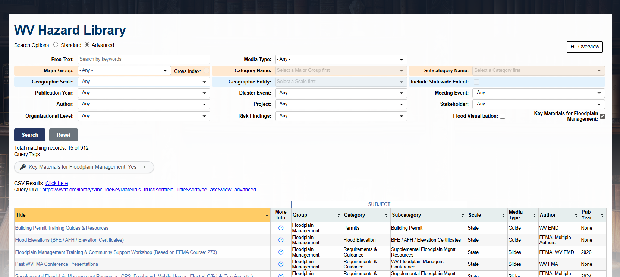
WV Hazard Library…
Key Materials for Floodplain Management

Slide 9
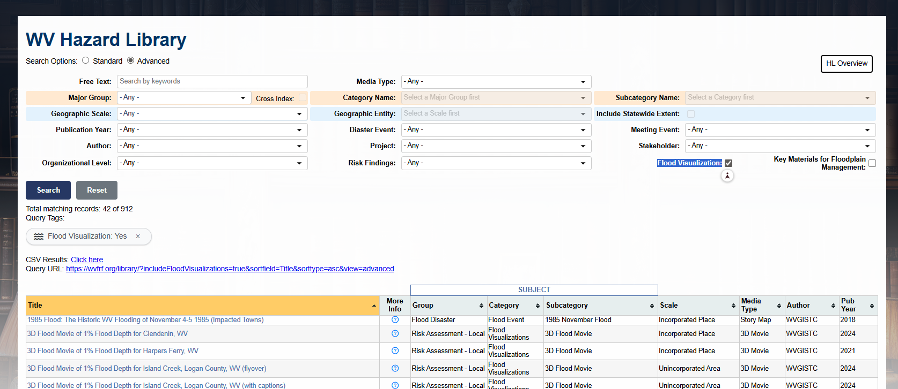
WV Hazard Library…
Flood Visualization
Notes:
Flood Visualization

Slide 10
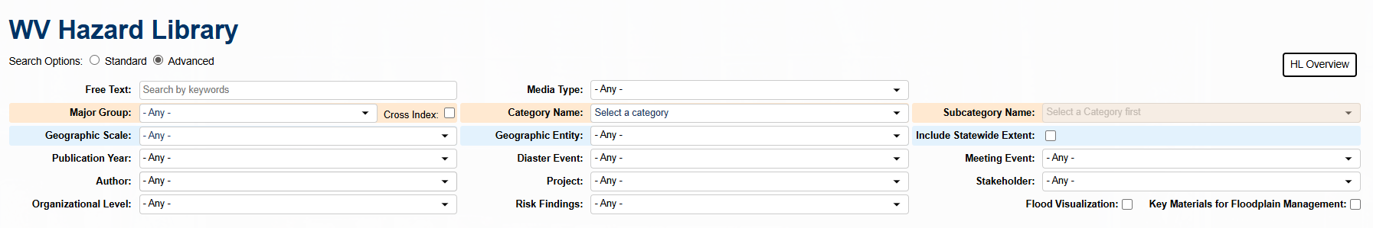
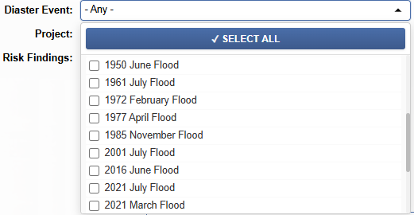
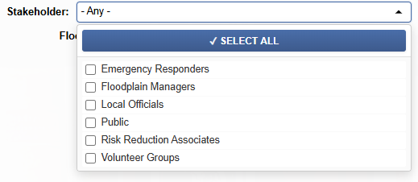
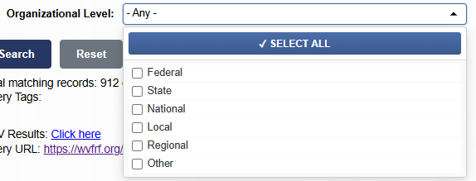
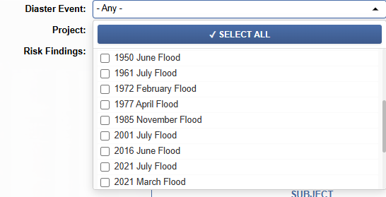
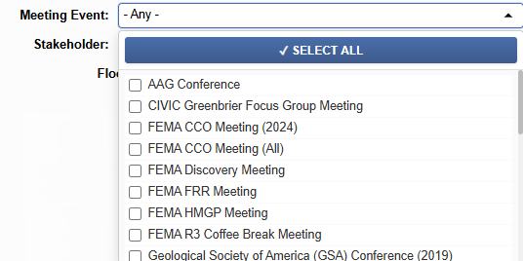
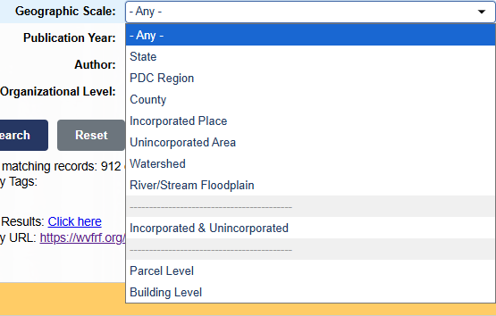
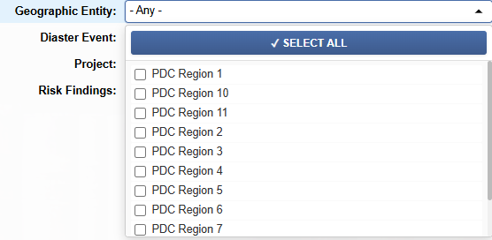
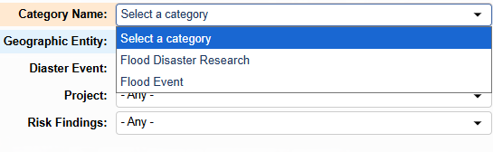
WV Hazard Library…

Slide 11
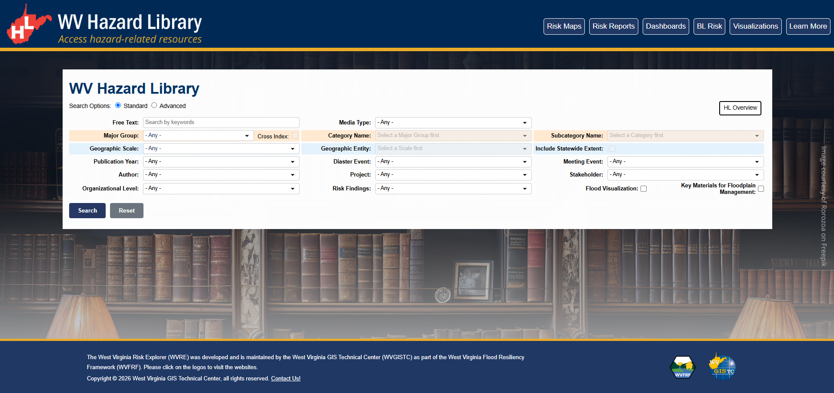
WV Hazard Library…
https://wvfrf.org/library
https://wvfrf.org/wvre
https://wvfrf.org
Notes:
Direct link or from other pages
Open the tool and show examples

Slide 12
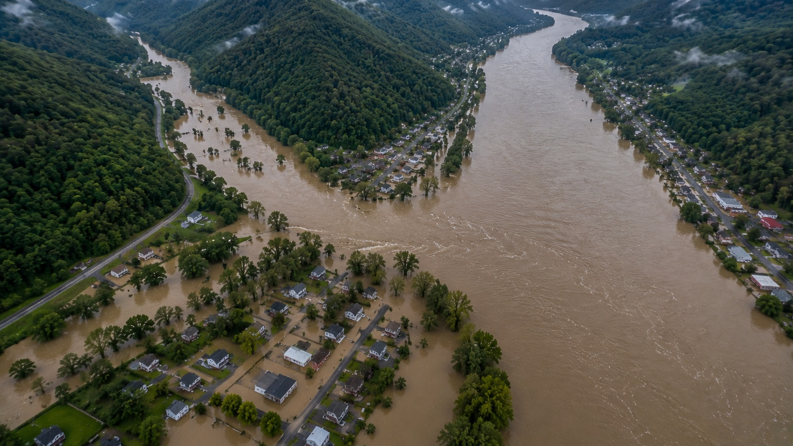
Backwater Flooding

Slide 13
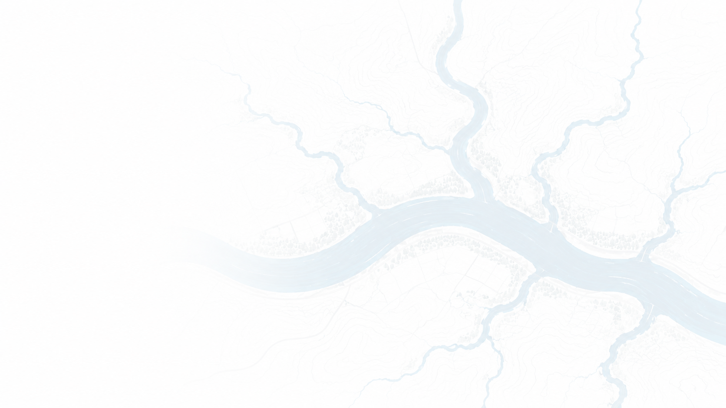



Backwater Flooding Effect
River Confluences
High flows in a main river prevent tributaries from discharging efficiently.
Common in large river systems
Bridges and Culverts
Undersized openings and bridge structural elements create hydraulic constrictions.
Water surface elevations increase upstream.
Sediments and Debris Accumulation
Temporary obstructions can create sudden backwater flooding effect.

Slide 14

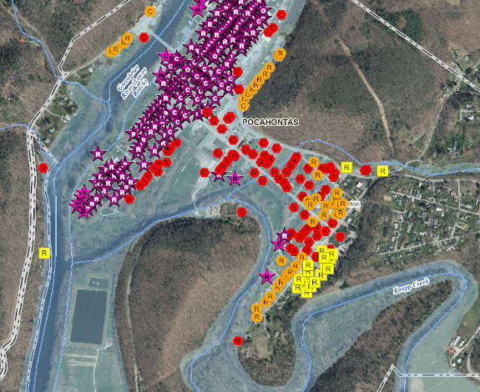
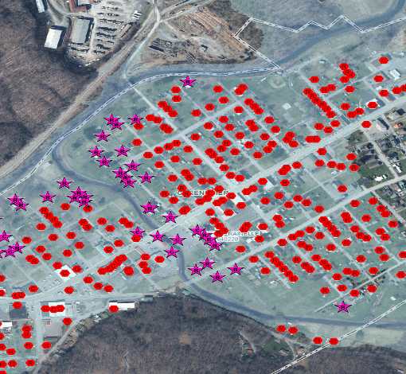
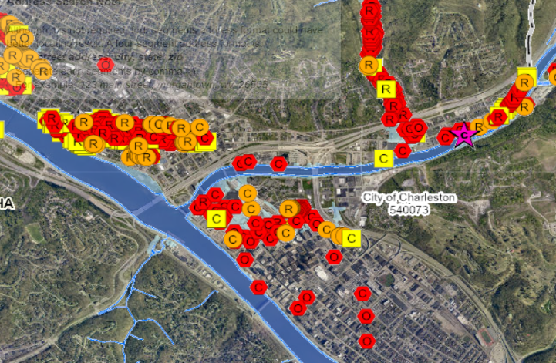
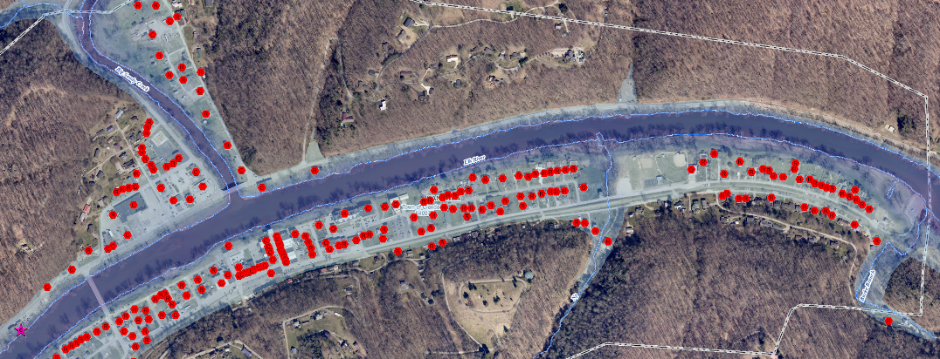
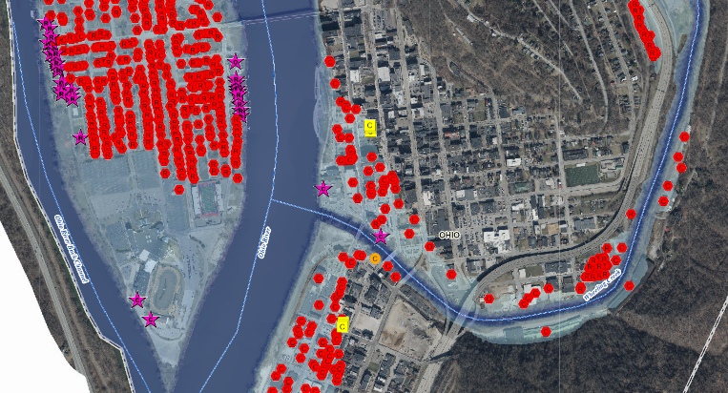
River Confluences
Most major cities in West Virginia were established at river confluences.
Marlinton
Rainelle
Charleston
Greenbrier River
Sewell Creek
Elk River
Knapp Creek
Kanawha River
Little Sewell Creek
Clendenin
Wheeling
Big Sandy Creek
Elk River
Ohio River
Wheeling Creek

Slide 15
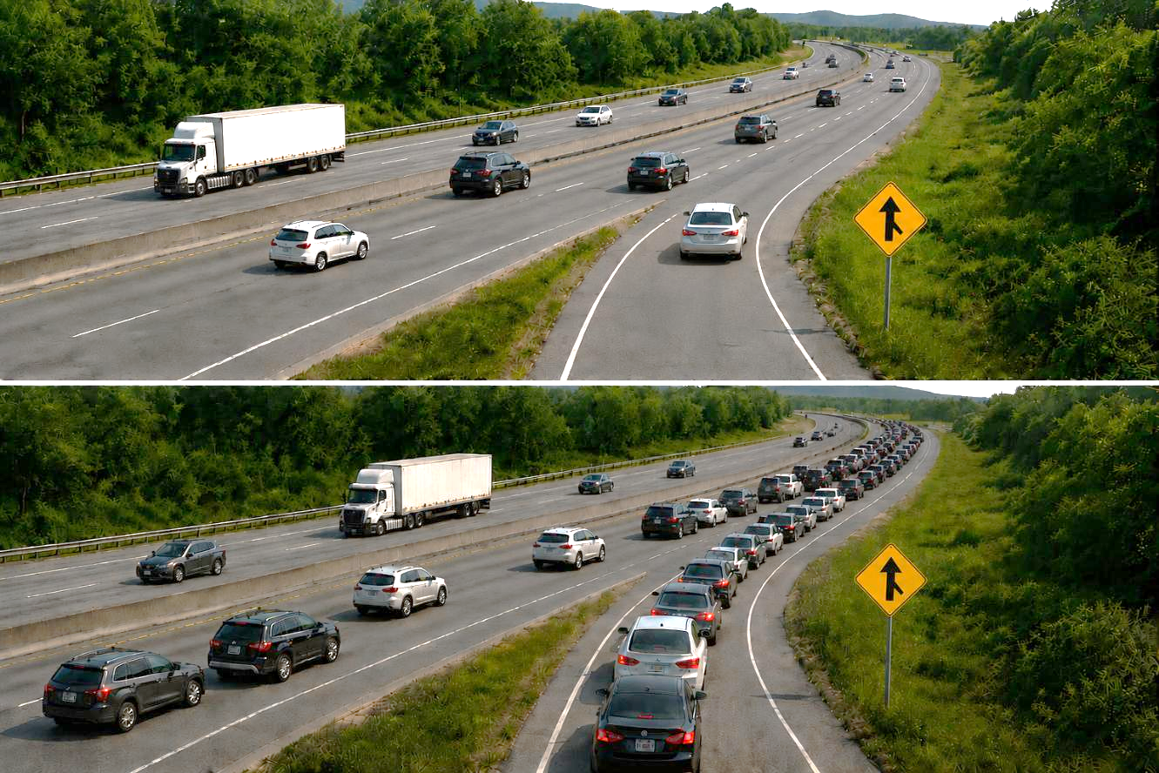

River Confluences…
Why Does a Backup Occur?
A Traffic Analogy
Traffic on the highway is moving freely. Vehicles from the side road merge easily and continue their journey.
When conditions worsen ahead, the backup propagates backward through the system.
MAIN HIGHWAY
SIDE ROAD
NORMAL CONDITIONS
Traffic on the highway becomes congested. Vehicles from the side road have difficulty merging and begin to queue farther back.
MAIN HIGHWAY
SIDE ROAD
CONGESTED CONDITIONS

Slide 16
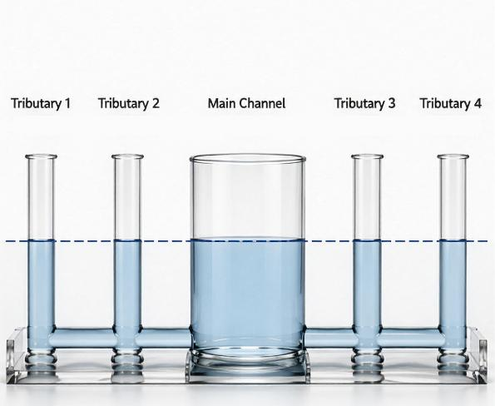
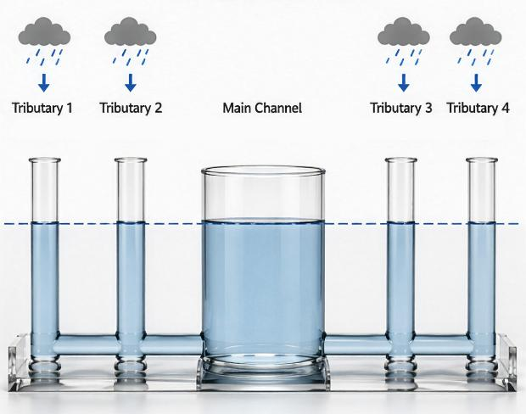
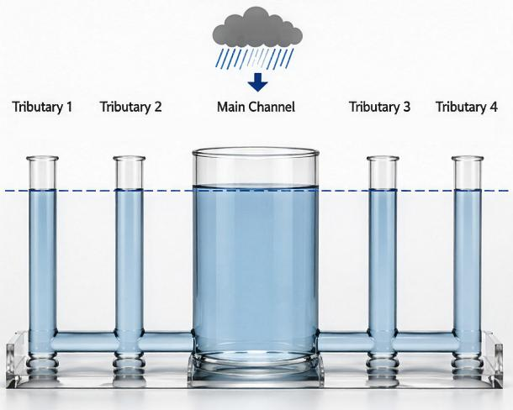

River Confluences…
Conceptual Analogy Simplified conceptual representation; actual river systems involve flowing water and changing hydraulic conditions.
INITIAL CONDITION
TRIBUTARY FLOW INCREASE
MAIN CHANNEL FLOW INCREASE
Water added to the tributaries.
Water levels rise throughout the system and stabilize at a higher elevation.
Much more water added to the main channel.
Water levels rise throughout the system and stabilize at a much higher elevation.
Water levels are in balance.
A large increase in the main channel raises water levels throughout the connected system. Tributaries experience higher water-surface elevations because the elevated downstream stage reduces their ability to drain efficiently.

Slide 17
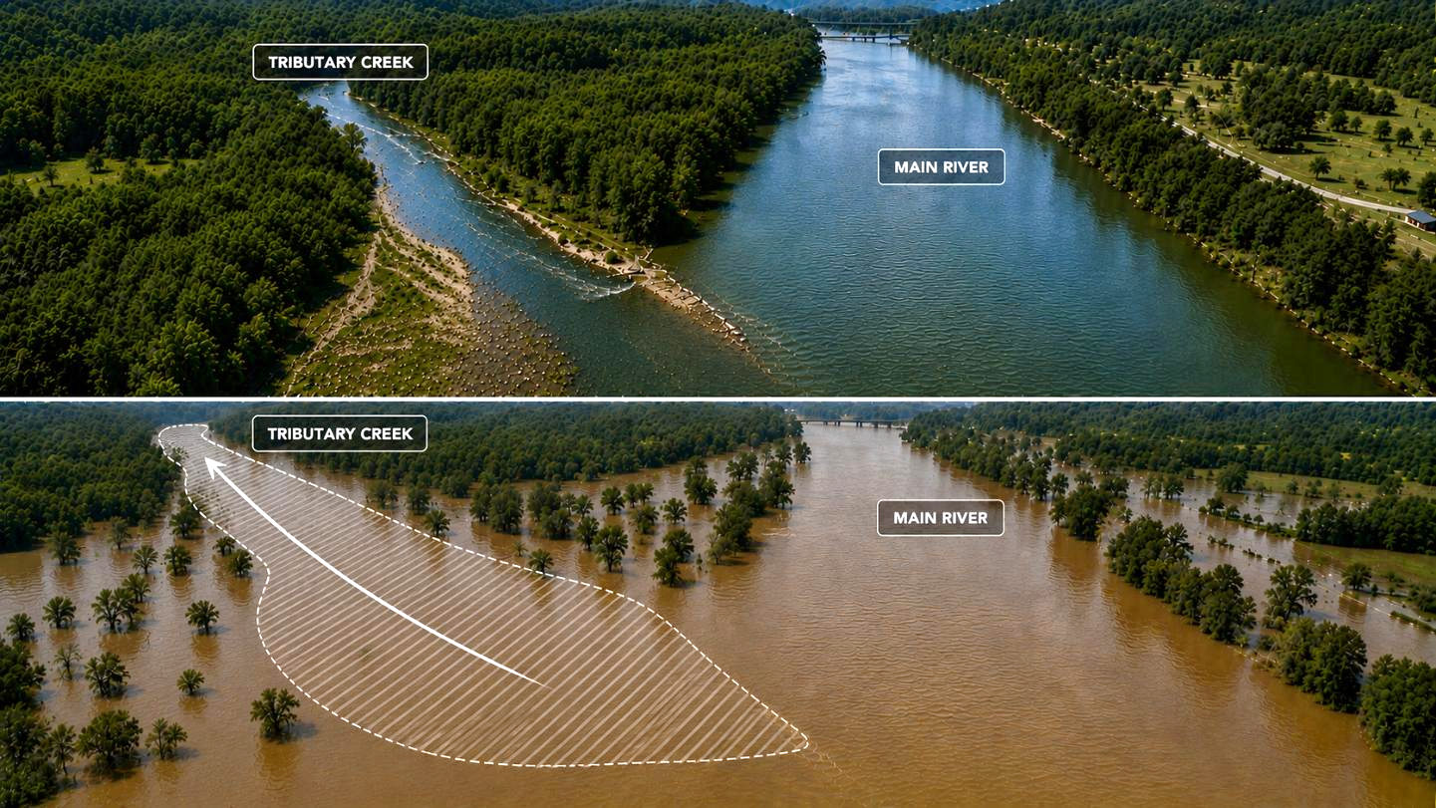
River Confluences…
Backwater effect
NORMAL CONDITIONS
Elevated water levels extend upstream.
FLOOD CONDITIONS
When flood levels rise in the main river, the tributary cannot drain efficiently. Water levels increase upstream in the tributary, creating a backwater effect.

Slide 18
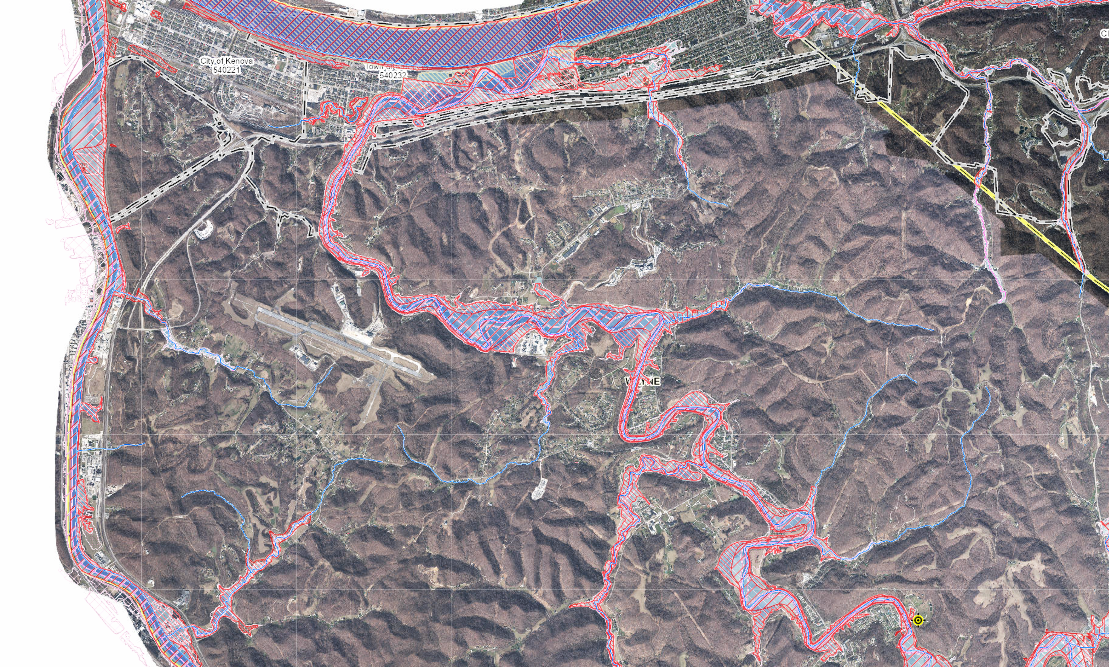
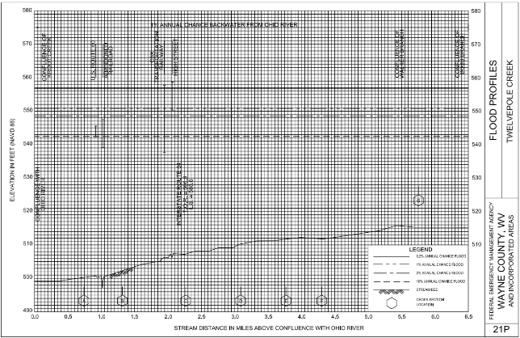
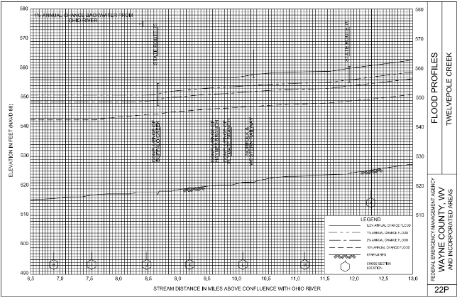
River Confluences…
Example
550.8 ft
Ohio River
Backwater effect of the Ohio River into the Twelvepole Creek and
Buffalo Creek,
Wayne County
Twelvepole Creek
About 13 Miles
Creek
Buffalo
Twelvepole Creek
550.8 ft
550.8 ft
Notes:
https://www.mapwv.gov/flood/map/?wkid=102100&x=-9186068&y=4633125&l=7&v=1
Past effective cross section of N

Slide 19
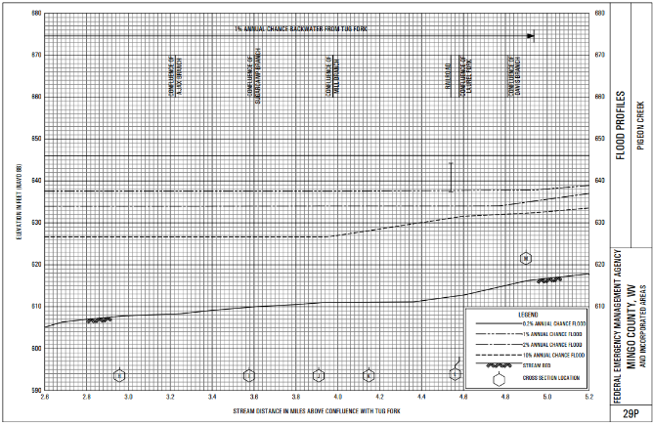
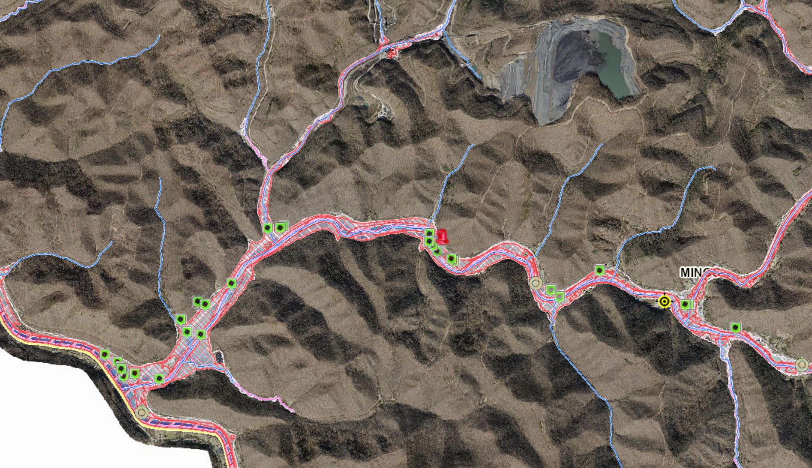
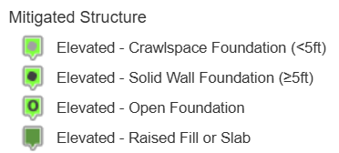
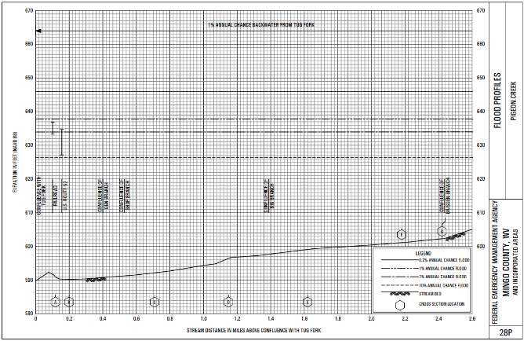
River Confluences…
Example
637.6 ft
Branch
Big
Pigeon
Creek
Pigeon Creek
637.6 ft
About 5 Miles
637.6 ft
Backwater effect of
the Tug Fork into
the Pigeon Creek and Big Branch,
Mingo County
Tug Fork
Notes:
https://www.mapwv.gov/flood/map/?wkid=102100&x=-9161619&y=4549987&l=8&v=1
Past effective cross section of K

Slide 20
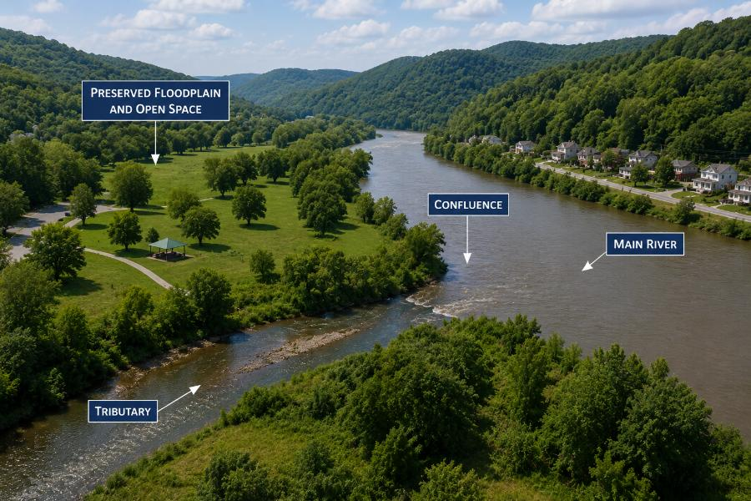
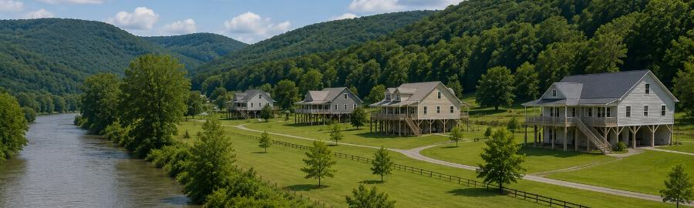
River Confluences…
Mitigation Approach
Use floodplain mapping that accounts for confluence backwater effects.
Elevate or relocate structures.
Limit development in backwater-prone areas.
Restore natural floodplain storage by open space preservation near the confluences.
Protect tributary floodways from encroachment.

Slide 21

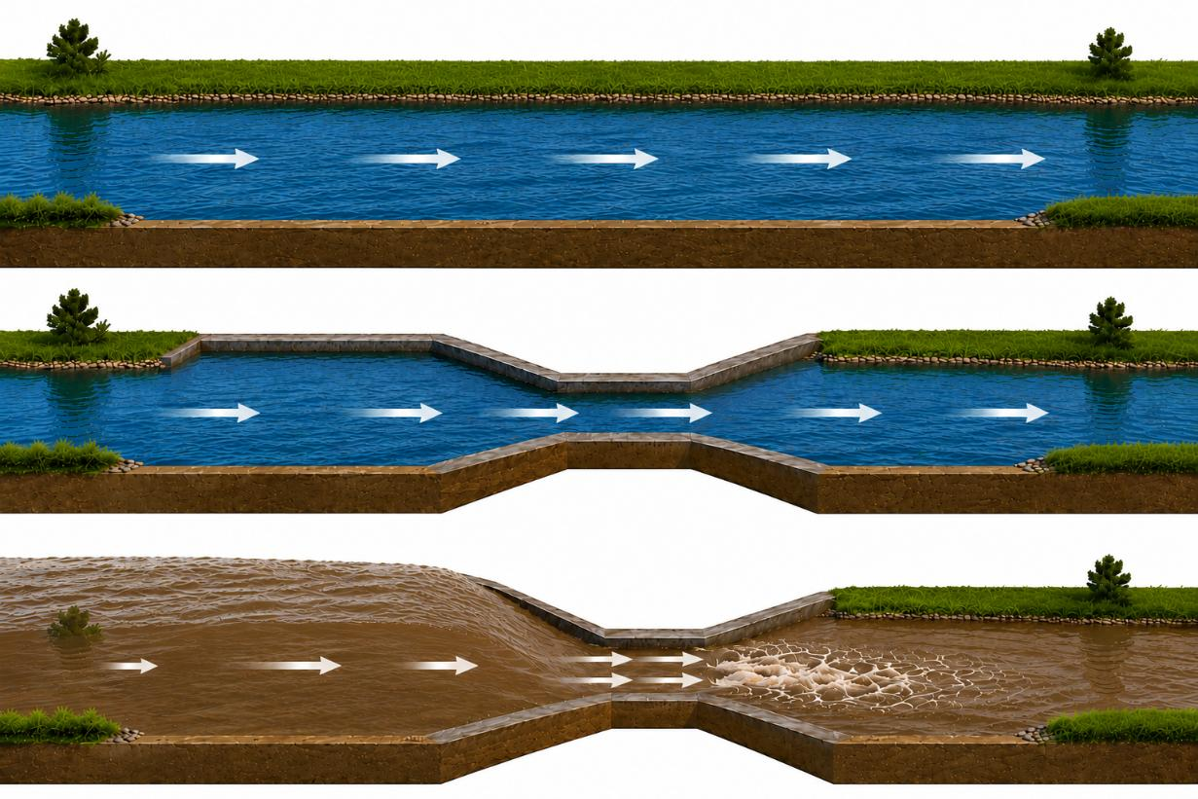
Bridges and Culverts
Hydraulic Constrictions
UNRESTRICTED CHANNEL
Flow passes through the channel without significant upstream ponding.
CONSTRICTED CHANNEL
The available flow area is reduced, but the opening may remain sufficient under normal conditions.
FLOOD CONDITIONS
During high flows, the constriction limits conveyance capacity, causing water levels to rise upstream and creating a backwater effect.
A hydraulic constriction reduces the available flow area. During flood conditions, water cannot pass through the opening as efficiently, causing water levels to rise upstream.

Slide 22
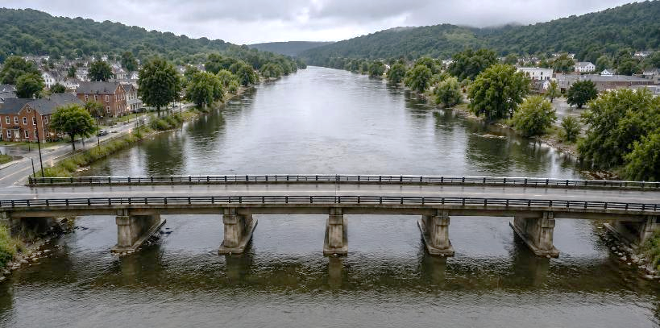



Bridges and Culverts…
Backwater effect
NORMAL CONDITIONS
NORMAL CONDITIONS
FLOOD CONDITIONS
FLOOD CONDITIONS

Slide 23


Bridges and Culverts…
Mitigation Approach
Identify crossings that contribute to flooding.
Incorporate crossing constraints into flood risk assessments.
Limit new development in areas affected by crossing-related backwater flooding.
Coordinate with transportation agencies on problem crossings.
Preserve floodplain storage upstream of constricted crossings.
Avoid new development in areas affected by backwater flooding.
Preserve floodplain storage upstream of the hydraulic constrictions.

Slide 24



Sediments and Debris Accumulation
Flow Obstructions
NORMAL CONDITIONS
PARTIAL OBSTRUCTION
FLOOD CONDITIONS
Unobstructed flow.
Water surface is nearly uniform.
Sediments / debris accumulate in the channel, reducing the effective flow area.
Water backs up upstream, causing higher water levels. Flow accelerates through the remaining opening.

Slide 25

Sediments and Debris Accumulation…
Backwater effect / Higher Flood Heights
NORMAL CONDITIONS
FLOOD CONDITIONS
Sediment deposits and debris accumulations reduce the effective flow area of a channel. During flood conditions, water backs up upstream of the obstruction, increasing water levels and flood risk.

Slide 26



Sediments and Debris Accumulation…
Example
Accumulated sediments and woody debris in Island Creek, Logan County
Channel obstructions may increase flood elevations.
WV Flood Tool
Notes:
https://www.mapwv.gov/flood/map/?wkid=102100&x=-9128240&y=4557977&l=11&v=2

Slide 27

Sediments and Debris Accumulation…
Mitigation Approach
Inspect channels and stream crossings regularly.
Identify locations prone to frequent sediment and debris accumulation.
Limit new development in areas vulnerable to sediment accumulation.
Remove excessive sediment and debris where appropriate.
Stabilize streambanks and reduce upstream erosion sources.

Slide 28

Letter of Map Amendment (LOMA)

Slide 29

Types of LOMCs
Letter of Map Amendment (LOMA)
Letter of Map Revision (LOMR)
Letter of Map Revision Based on Fill (LOMR-F)
Conditional Letter of Map Revision (CLOMR)
Conditional Letter of Map Revision Based on Fill (CLOMR-F)

Slide 30

Letter of Map Amendment (LOMA)
Official determination of a property’s location and elevation, relative to the boundary of SFHA and the Base Flood Elevation (BFE)
For an individual structure or property
Letter amends the Flood Insurance Rate Map (FIRM) for the specific property; no new map is published
LAG
LAG > BFE
LAG: Lowest Adjacent Grade
(LLE: Lowest Lot Elevation)
BFE: Base Flood Elevation
BFE

Slide 31


Verified LOMAs on WV Flood Tool
Original LOMAs from FEMA (LOMA) and their copies with the locations verified (LOMA Verified)
Notes:
https://www.mapwv.gov/flood/map/?wkid=102100&x=-8889082&y=4711805&l=7&v=1

Slide 32




Verified LOMAs on WV Flood Tool…
Positional accuracy verified with E-911 Address or Parcel Assessment Information (Legal Description; Deed Book & Page Number)
07-03-0413A
15 Miles!
07-03-0413A
Only to three decimal digits!
Notes:
https://www.mapwv.gov/flood/map/?wkid=102100&x=-9161513&y=4577577&l=6&v=1

Slide 33









Verified LOMAs on WV Flood Tool…
Total FEMA LOMAs (1997 to 2025) | 4,432 | 100%
Project Category
LOMA | 4,115 | 92.8%
Fill (LOMR-F) | 245 | 5.5%
Floodway (LOMR-FW) | 72 | 1.6%
Outcome
Mapped Out (Removal) * | 3,305 | 74.6%
Mapped In (Non-Removal) ** | 531 | 12.0%
Outside SFHA (Out as Shown) *** | 438 | 9.9%
Other **** | 158 | 3.6%
Reval Status
Superseded | 59
LOMR-FW
Building ID:
21-02-007G-0095-0000_42
* Mapped Out includes: 'Portion of property removed’, 'Property removed’, 'Structure removed-Property partially inundated’
** Mapped In includes: 'Denied',’ Portion of property denied’, 'Portion of property denied and in floodway’, 'Property denied’, 'Structure denied’, 'Structure denied and in floodway’
*** Outside SFHA includes: 'Portion of property out as shown’, 'Property out as shown’, 'Structure out as shown-Property partially inundated’
**** Other includes: Null values, 'Multiple’, 'No outcome (Other response or violation)’, UNKNOWN
LAG > BFE
Superseded
Removal
Non-Removal
LAG < BFE
Out as Shown
Notes:
LOMAs by year by case number: 2018: 278 2019: 177 2020: 162 2021: 158 2022: 133 2023: 114 2024: 97 2025: 67
https://www.mapwv.gov/flood/map/?wkid=102100&x=-8795639&y=4778865&l=13&v=1
https://www.mapwv.gov/flood/map/?wkid=102100&x=-8939918&y=4550476&l=13&v=1
https://www.mapwv.gov/flood/map/?wkid=102100&x=-8778044&y=4781378&l=13&v=1
https://www.mapwv.gov/flood/map/?wkid=102100&x=-8939893&y=4550560&l=13&v=1
https://www.mapwv.gov/flood/map/?wkid=102100&x=-8958568&y=4726561&l=13&v=2

Slide 34




SFHA Buildings Changes: LOMAs for Mapped Out
LiDAR LOMA Map Layout
More than 15,000 floodplain structures (yellow symbol) may be eligible for LiDAR LOMAs

Slide 35



SFHA Buildings Changes: LOMAs for Mapped Out…
Jefferson County
279 Mapped-out
Mapped-out structures of the SFHA may qualify for LOMAs
Floodway
WV Flood Tool LiDAR LOMA:
Instructions | Guide
All building symbols in the floodplain fringe will become “red color” once flood maps are effective
No need to wait until the maps become effective
May reduce flood insurance costs
Can be presented for selling properties
Notes:
https://data.wvgis.wvu.edu/pub/RA/_resources/LOMA/WV_Flood_Tool-LIDAR_for_LOMA_instructions.pdf
https://data.wvgis.wvu.edu/pub/RA/_resources/LOMA/WV_Flood_Tool_LiDAR_for_LOMA_Guide.pdf

Slide 36



Mapped-out List from WV Risk Explorer (BL Tool)
https://wvfrf.org/wvre/buildings
Notes:
https://wvfrf.org/wvre/buildings/

Slide 37

LiDAR for Map Amendments
LiDAR data can replace the requirement to submit elevation information certified by a licensed land surveyor or professional engineer, which can create a cost savings for property owners.
The WV Flood Tool (www.mapwv.gov/flood) can be used for the map requirement of LOMAs for properties located in A or AE Flood Zones.
High-Risk advisory flood zones identify potential structures that could be removed from the SFHA.
Source: How to Request a Map Amendment (2021)
LAG: Closest lower contour value minus
half of the contour interval or 1 ft,
whichever is greater
Notes:
https://www.fema.gov/sites/default/files/documents/fema_mt-1-process-graphic-english_2021.pdf

Slide 38
When LiDAR Cannot Be Used for LOMA
There are situations when LiDAR cannot be used in a LOMA request. These include applications involving the following:
Buildings or lots elevated using fill
Buildings or lots in the regulatory floodway or Zone AO
Buildings under construction
Conditional determinations
Requests to supersede previously issued LOMAs based on certified elevation data
If the entire lot is to be reviewed, an Elevation Form is required to complete the case with the Lowest Lot Elevation certified by a licensed land surveyor or registered professional engineer.
Notes:
https://wvfrf.org/wvre/buildings/

Slide 39

Example of LOMA Qualification
LAG 579 ft. > 576 ft. BFE
(Should qualify for LiDAR LOMA - Removal)
Applicable LAG is 579 ft.
(closest lower contour of 580’ – 1’)
Notes:
https://www.mapwv.gov/flood/map/?wkid=102100&x=-8764784&y=4802135&l=13&v=2
29-04-015J-0008-0000

Slide 40

LiDAR LOMA Submission – 4 Steps
Determine LiDAR coverage. West Virginia has statewide Quality Level 2 (QL2) LiDAR coverage and derivative elevation products (statewide 1-meter DEM and 1- or 2-foot contours) published to the WV Flood Tool.
2) Print LOMA Map using WV Flood Tool
Identify published building-level risk assessments
for potential Mapped Out structures
Determine LOMA Type: Existing Structure or Lot
Determine BFE
Determine LAG/LLE
Add Annotation
Print and Download LOMA Map
Save to PDF File
3) Further Edit/Annotate Print LOMA (optional)
4) Submit LiDAR LOMA Map Exhibit using FEMA’s Online LOMC Portal (no fee charged)
Click here for more detailed instructions
Notes:
https://data.wvgis.wvu.edu/pub/RA/_resources/LOMA/WV_Flood_Tool-LIDAR_for_LOMA_instructions.pdf
https://hazards.fema.gov/femaportal/onlinelomc/signin

Slide 41

What needs to be submitted?
# | Map Elements Required
1 | Name, organization, and contact information for the map creator
2 | E-911 Address of property
3 | Road or street intersection reference
4 | Assessor’s full Parcel ID Number (APN) for the building/lot
5 | Clearly identified building and/or lot boundaries
6 | Aerial imagery that shows building footprint
7 | Date, Source, and Accuracy of the LiDAR collected
8 | Vertical Datum of elevation data (e.g., NAVD 88, NGVD 29)
9 | Scale Bar
10 | North Arrow
11 | WV Flood Tool Location web link
More than one map can be made to present all elements.

Slide 42

LOMA Map – Identify LAG

Slide 43

Map Updates

Slide 44

WV RiskMAP
https://data.wvgis.wvu.edu/pub/RA/HL/MIT/MAPPING/Status/WV_FloodStudies.pdf

Slide 45

Advisory Flood Heights
2026 AFH mapping under contract
https://data.wvgis.wvu.edu/pub/RA/HL/MIT/FPM/4-Flood-Elev/AFH/Advisory_A_and_AFH_Status.pdf

Slide 46










Local Floodplain Information requested for WV Flood Tool
Significant Facilities in floodplain verified on
Risk MAP View
Elevation Certificates
(finished construction only)
Pictures
Accurate Latitude/Longitude
Pictures of Elevated Buildings in SFHA
where FFH > 5 feet
Pictures of High-Water Marks
of past major floods
https://wvfrf.org/wvre/buildings
Notes:
Mention 100- and 500-yr for EFs
https://www.mapwv.gov/flood/map/?wkid=102100&x=-9087009&y=4629075&l=8&v=2
https://www.wvfrf.org/wvre/buildings/
https://www.wvfrf.org/wvre/blra/?type=sigstruct&sortfield=Depth_Grid&sorttype=desc&hiddenFields=default
https://www.mapwv.gov/flood/map/?wkid=102100&x=-9069956&y=4777030&l=11&v=2
https://wvfrf.org/wvre/dashboard/?link=https://wvu.maps.arcgis.com/apps/dashboards/0a2182528f4e49ca827da8b9dcb65897
https://mapwv.gov/flood/map/?wkid=102100&x=-8987736&y=4579719&l=12&v=2
https://www.mapwv.gov/flood/map/?wkid=102100&x=-8915816&y=4610645&l=14&v=2

Slide 47


County Reference Layers
Verify accurate and current on WV Flood Tool:
Municipal Legal Boundaries
(www.mapwv.gov/BAS)
Leaf-Off Aerial Imagery
(county imagery status)
E-911 Site Addresses
(www.mapwv.gov/address)
Tax Parcels
(www.mapwv.gov/Parcel)
Notes:
https://www.mapwv.gov/flood/map/?wkid=102100&x=-9056447&y=4648304&l=8&v=1
https://data.wvgis.wvu.edu/pub/RA/_resources/Status/countyImageryYearAcquired.pdf

Slide 48












Links to Tools / Data
WV Floodplain Managers Directory:
https://www.mapwv.gov/flood/content/wvCountyFloodplainManagersList.htm
→ WV Flood Tool: https://www.mapwv.gov/flood/
→ West Virginia Flood Resiliency Framework (WVFRF): https://wvfrf.org/
→ West Virginia Risk Explorer (WVRE) (Landing Page): https://www.wvfrf.org/wvre/
→ WV Risk Explorer Maps: https://wvfrf.org/wvre/map/?scaleid=3&gslid=&index=CUM_INDEX&type=pct
→ WV Risk Explorer Reports: https://wvfrf.org/wvre/report/?entityid=68&scaleid=1&type=all
→ WV Flood Dashboards: https://wvfrf.org/wvre/dashboard/home/
→ WV Building-Level (BL) Risk: https://wvfrf.org/wvre/buildings/
→ WV Flood Visualizations: https://wvfrf.org/wvre/visualization/home/
→ Access Data: https://wvfrf.org/wvre/data/home/
WV Hazard Library: https://wvfrf.org/library/
Landslide Tools: https://wvfrf.org/wvre/landslides/
Legal Boundaries: https://www.mapwv.gov/BAS

Slide 49


Future Direction
Maintenance and Data Updates
Training and Technical Support
Sustainable Funding for Ongoing Operations of the Tools
Notes:
Begging slide ☺

Slide 50
Thank you!
Questions?
Email:
kurt.donaldson@mail.wvu.edu
behrang.bidadian@mail.wvu.edu

Slide 51
Supplemental

Slide 52
WV Hazard Library
Content of Hazard Library
TOPICS | MEDIA TYPES |  | SEARCH TYPES
Flood Disaster Events Flood Event Flood Research Mitigation Flood Insurance Floodplain Management Floodplain Mapping Other Mitigation Measures Risk Assessment & Planning State Risk Assessments Local Risk Assessments Planning Resources Web Tools | 3D Movie Bldg. Profile Dashboard Data-GIS Data-Metadata Data-Table Flyer Graphic Guide Journal Article Letter News Article Picture | Plan Poster Report Slides Social Media Static Map Story Map Video Viewshed Web Info Web Tool | Agency Downloadable Data Event Disaster Event Meeting Geographic Scale Entity Media Type Publication Date Subject Major Group Category Subcategory cross-indexing Stakeholder Type Title (free text search) Predefined Searches Visualizations Floodplain Management Key Materials
Notes:
The WV Hazard Library contains more than 24 media resource types relevant to West Virginia. Resources are organized into three major topics: risk assessment/planning, mitigation, and flood disaster. Users can search online hazard resources by title, subject, media, event, geography, data, stakeholder type, etc.

Slide 53








Critical Infrastructure: Essential Facilities
Essential Facilities provide emergency services during a flood.
Communities need to establish emergency protocols to maintain critical services amidst a flood.
Schools with children in vulnerable age groups often also serve as shelters during floods.
Nursing homes and hospitals with immobile patients are particularly more susceptible to flooding.
Nicholas County Nursing &
Rehabilitation Center
Richwood
Inundated, June. 2016 (Not active anymore)
Building ID: 34-06-0010-0072-0000_18
Clendenin Elementary School
Kanawha County
Inundated, Jun. 2016
(Demolished)
Clendenin Volunteer Fire Department
Kanawha County
Inundated, Jun. 2016
Building ID: 20-02-0007-0040-0000_109
Marlinton Volunteer Fire Department
Pocahontas County
Inundated, Nov. 1985
Building ID: 38-08-0001-0095-0000_709B
Spanishburg Elementary School
Mercer County
Inundated, Feb. 2025
Building ID: 28-11-0026-0075-0000_8544
Bridge Elementary School
Kanawha County
Inundated, Jun. 2016
Building ID: 20-15-0023-0077-0000_5120

Slide 54






Community Assets: Non-Historical
Non-Historical community assets such as churches often serve as emergency shelters during floods.
Flooding can disrupt critical community lifelines including safety, health, shelter, water, and energy.
Borderland Baptist Church
Mingo County
Inundated, Feb. 2025
Building ID: 30-10-362K-0010-0000_46
Jan-Care of Guardian Angel (EMS)
Welch, McDowell County
Inundated, Feb. 2025
Building ID: 27-15-0002-0247-0000_58
Williamson Water Plant (Veolia Water)
Williamson, Mingo County
Inundated, Feb. 2025
Building ID: 30-11-0007-0233-0000_317
Valley Grove Assembly of God
Valley Grove, Ohio County
Inundated, Jun. 2025
Building ID: 35-08-0VG9-0083-0000_8580
Cornerstone Church
Matewan, Mingo County
Inundated, Feb. 2025
Building ID: 30-08-0009-0071-0000_1028

