Slide 1

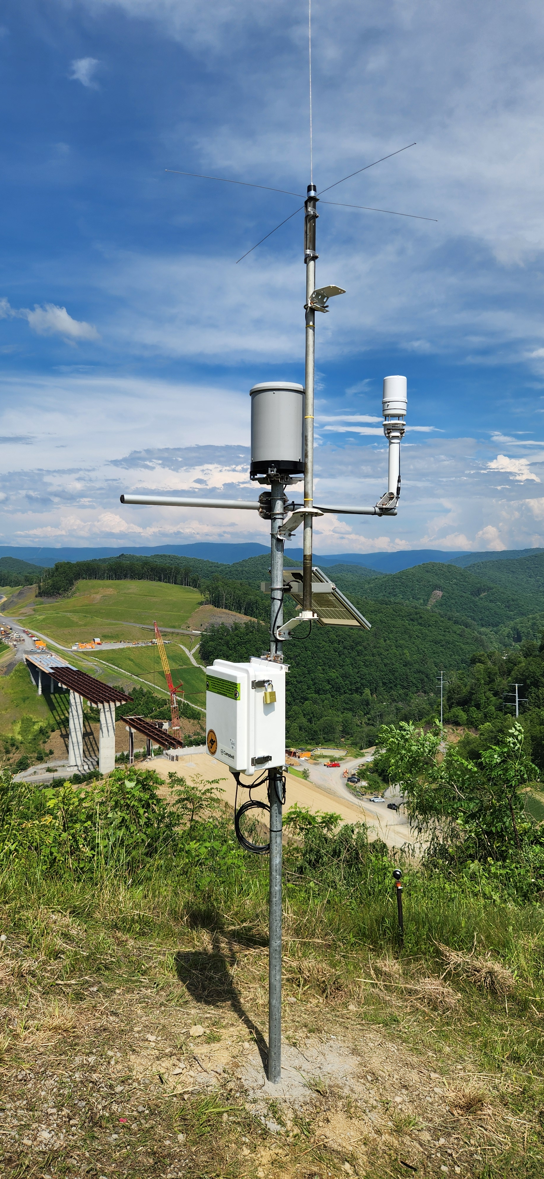
WVEMD IFLOWS
Integrated Flood Observation and Warning System
Andy Teter- IFLOWS Supervisor

Slide 2
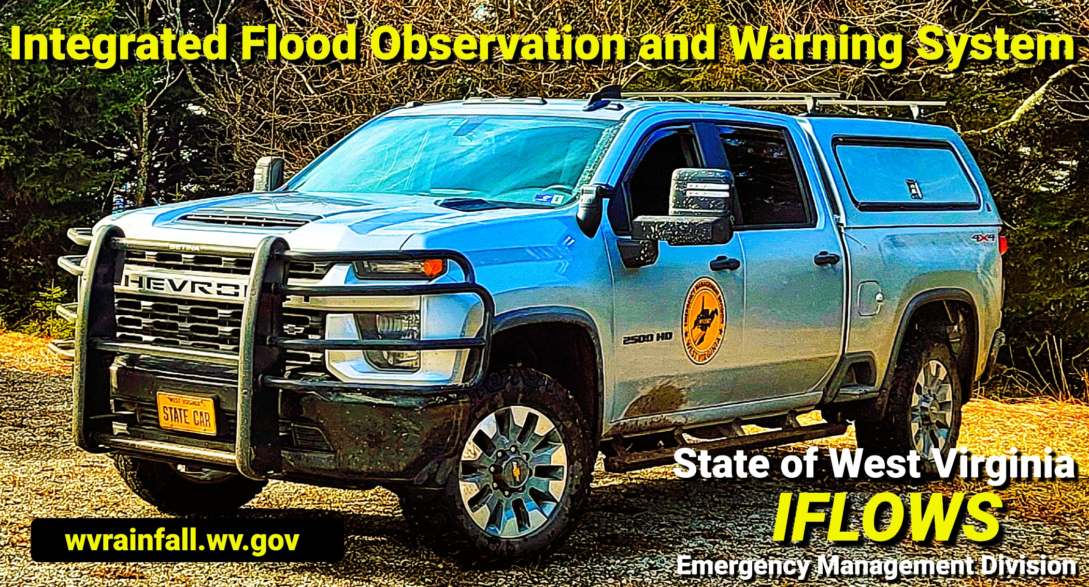
GOOD AFTERNOON !!
Introduction to IFLOWS
Flood Warning
(WVEMD IFLOWS Rapid Flood Detection- RFD)
Conclusion
QUESTIONS / COMMENTS

Slide 3


IFLOWS OVERVIEW
---------------

Slide 4

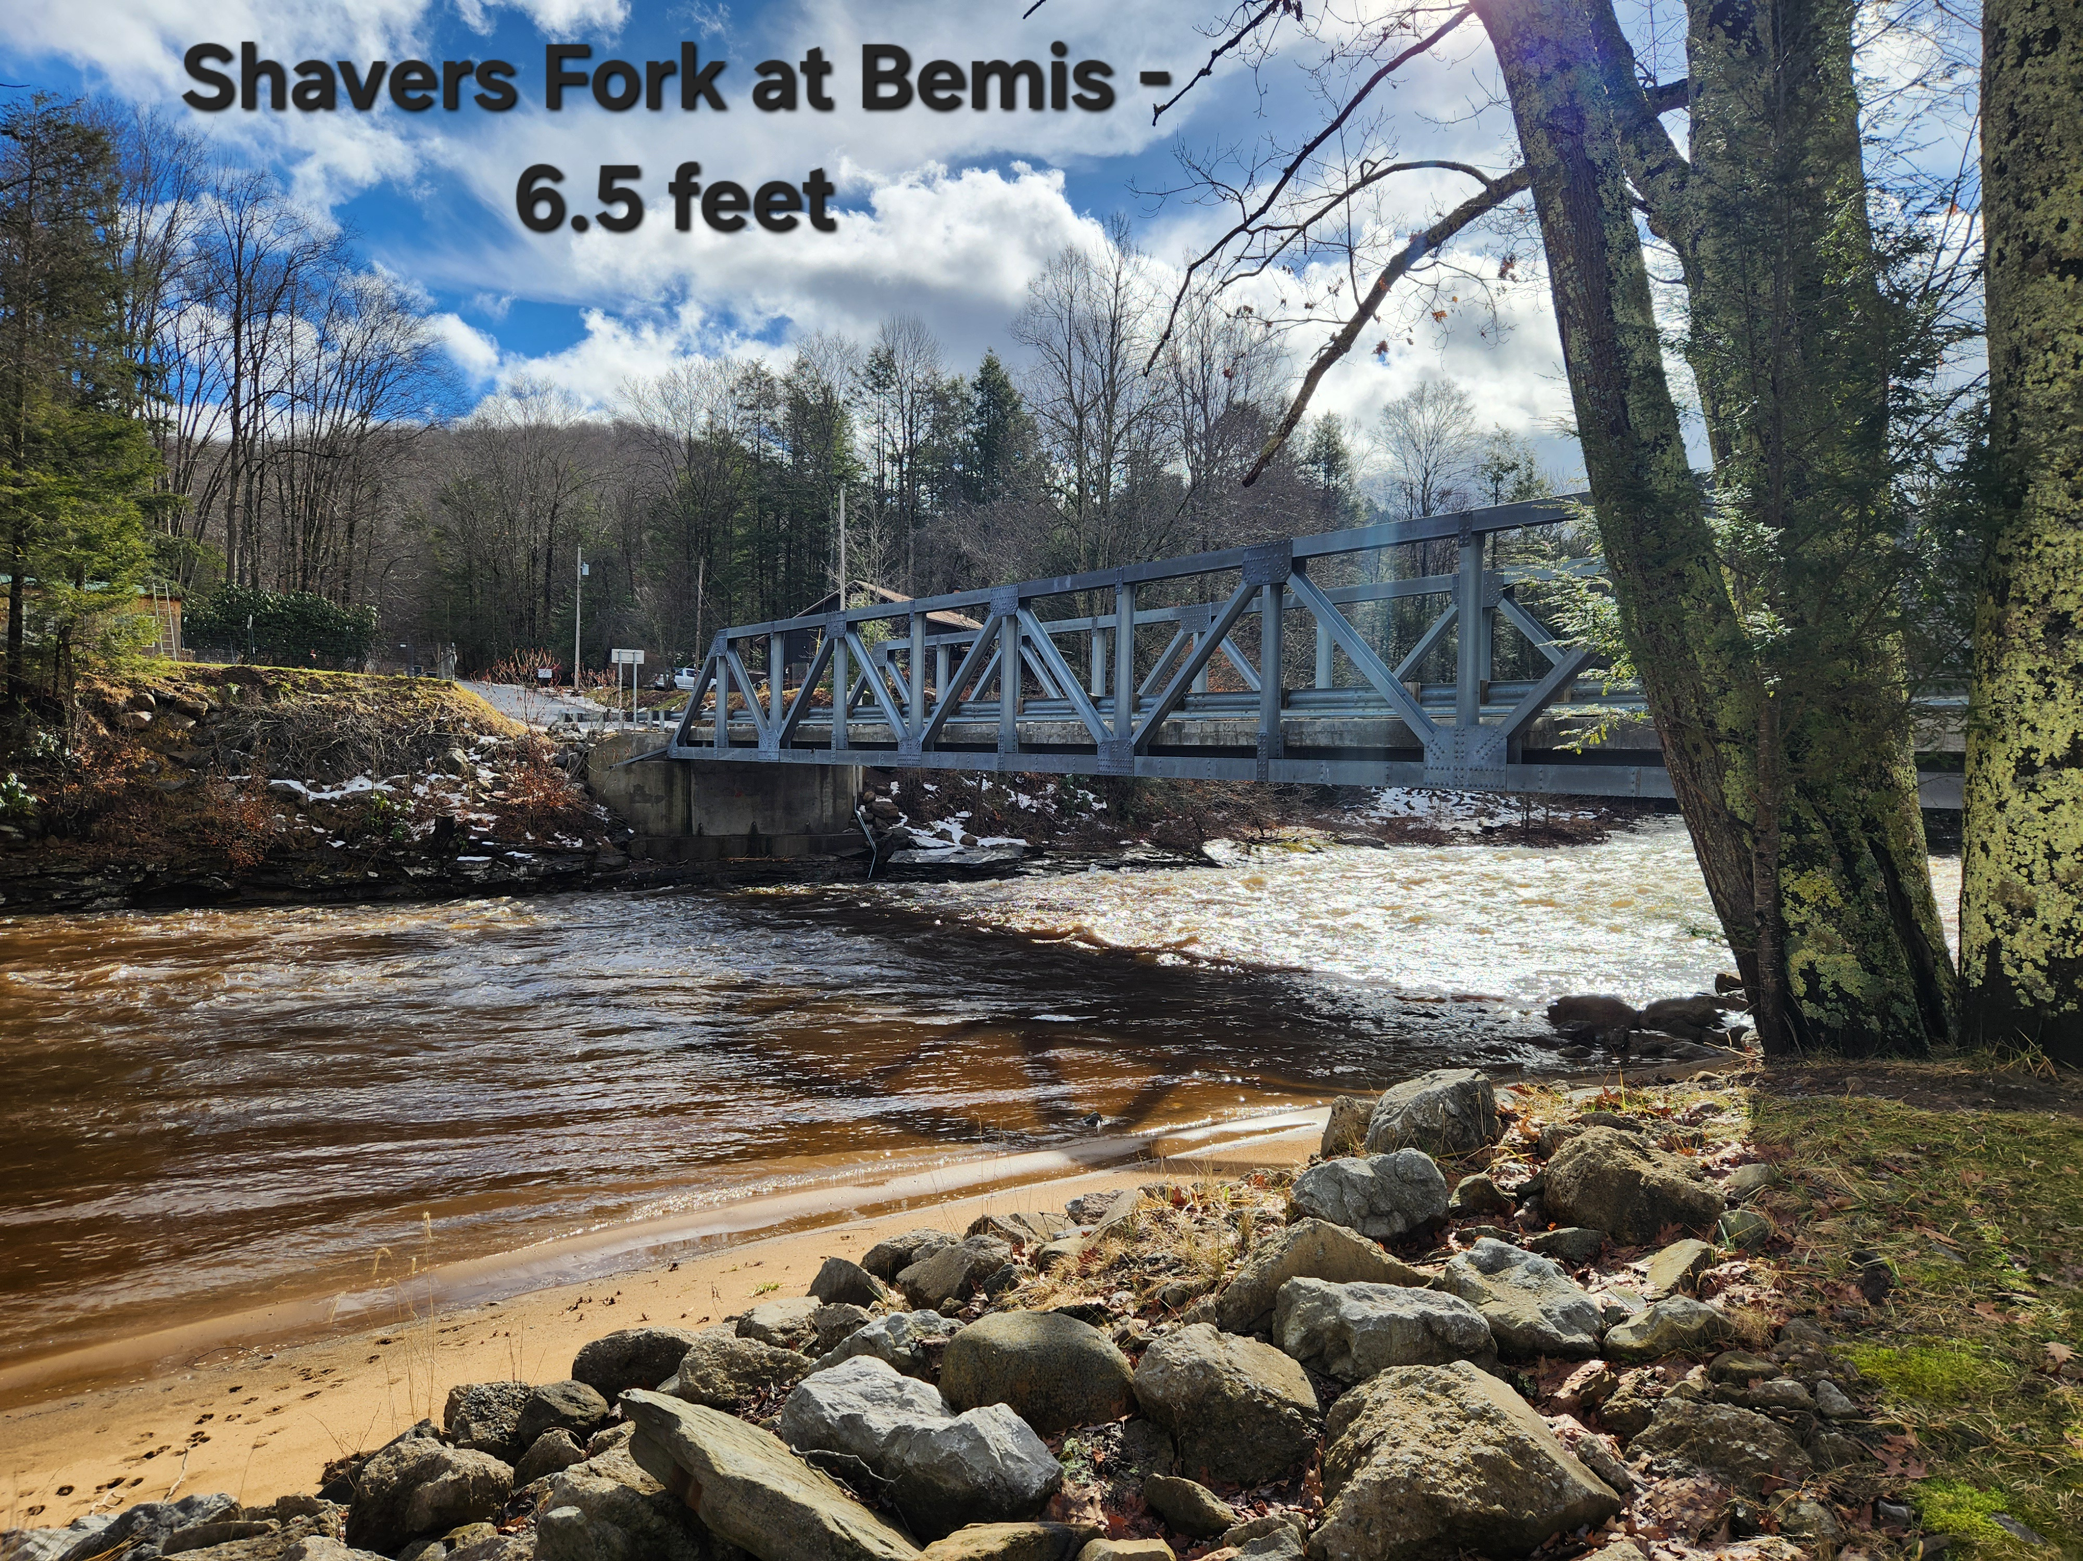
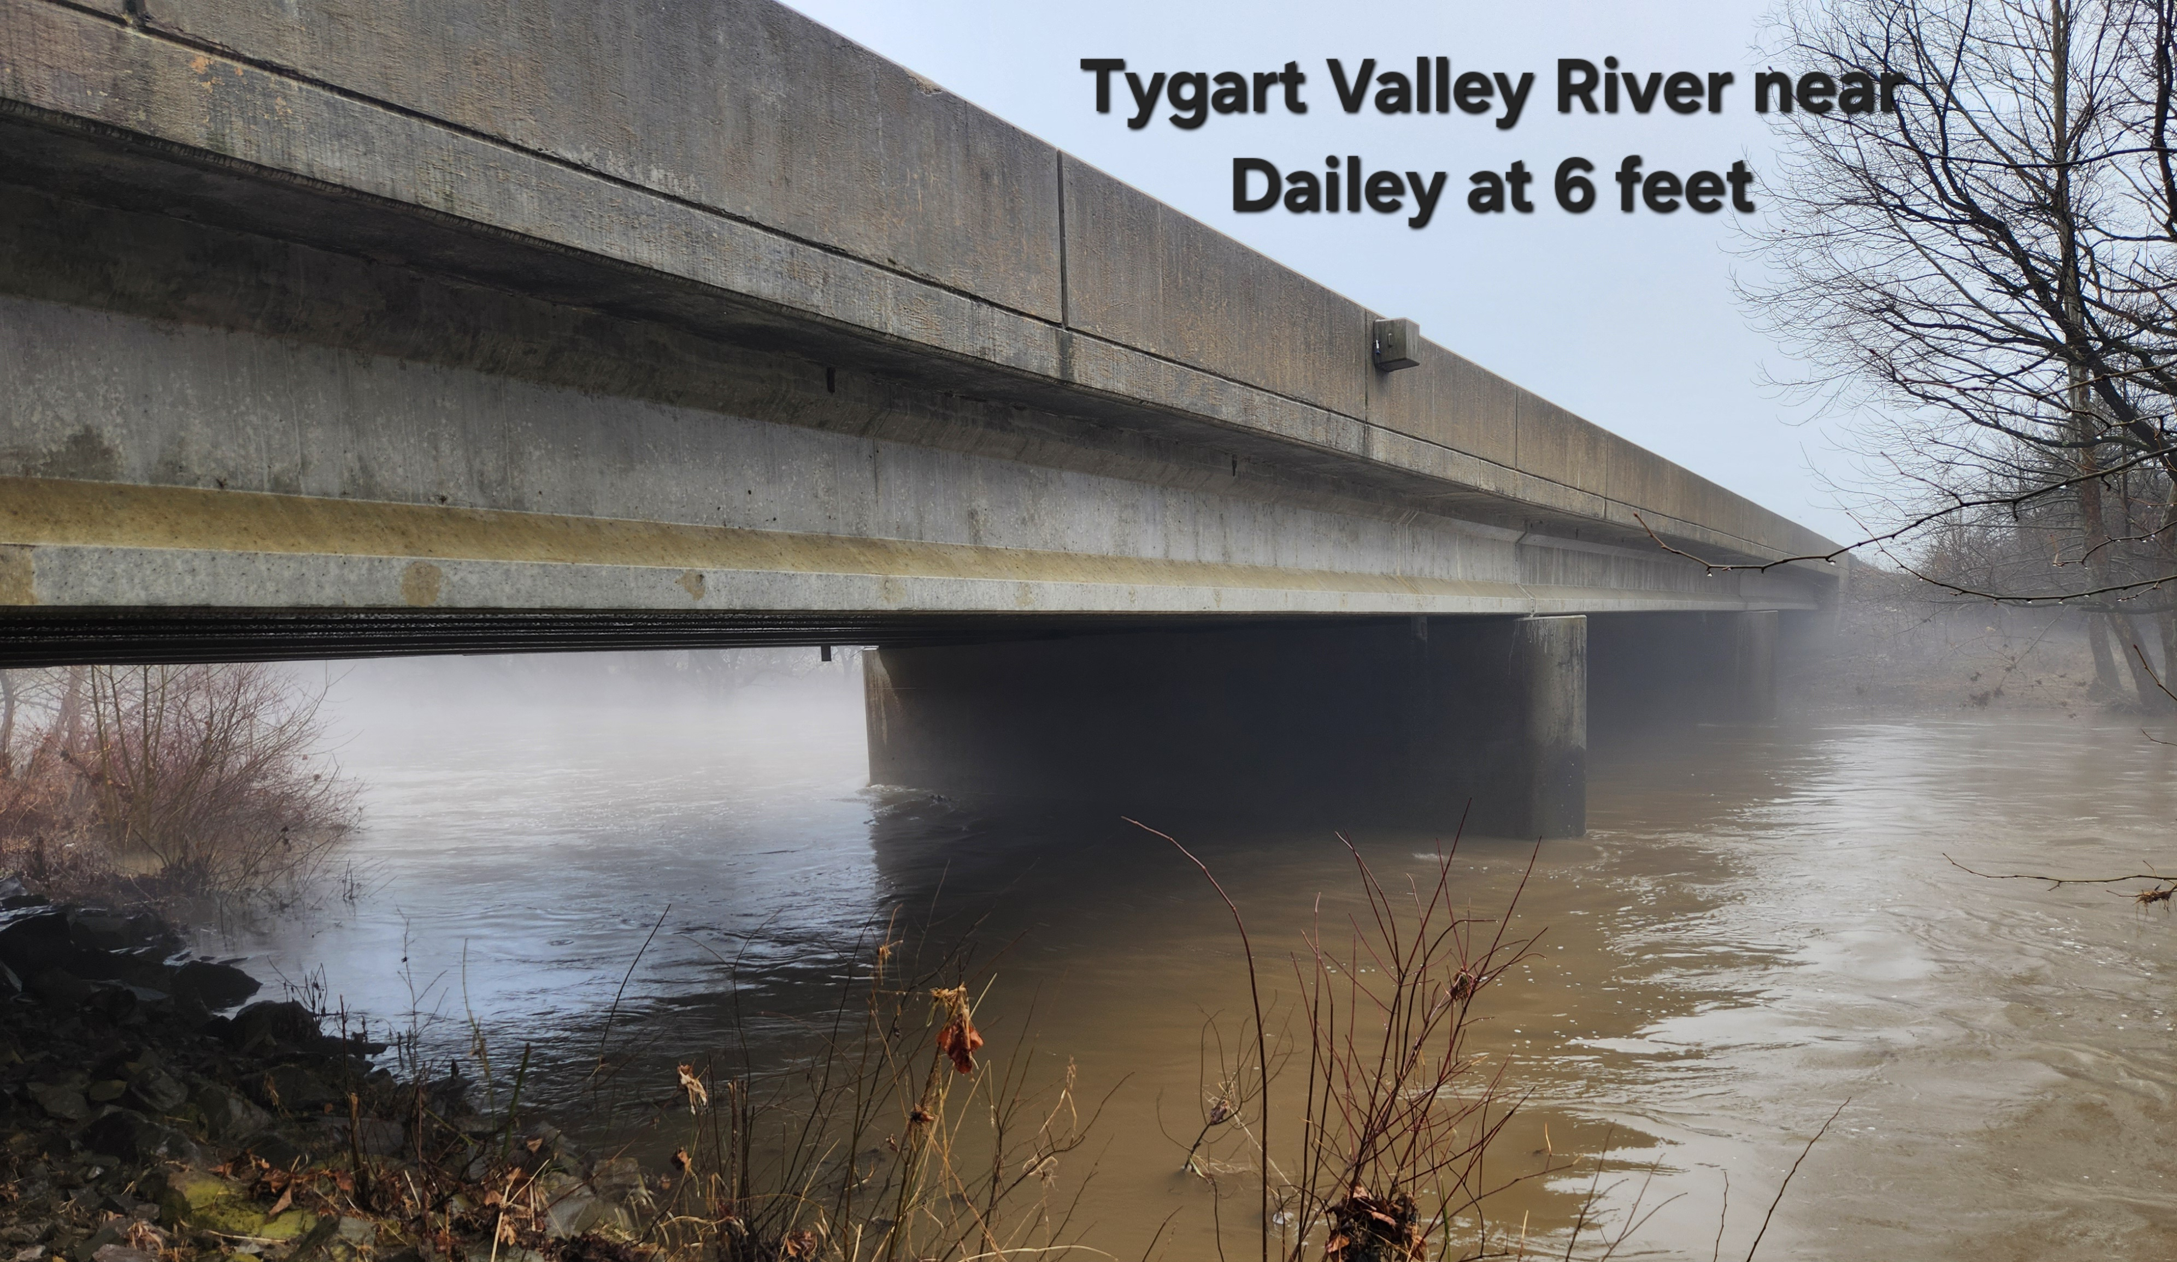
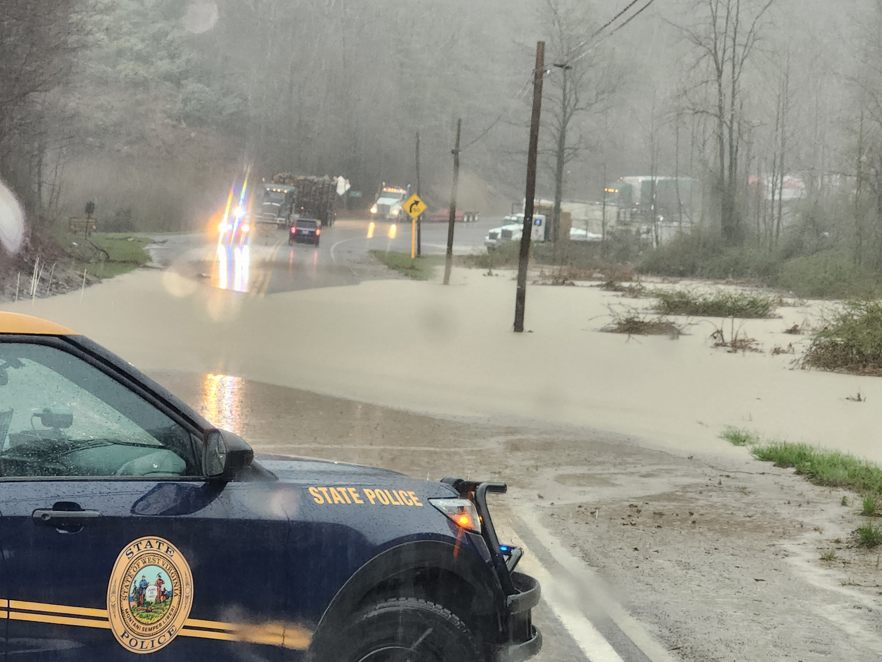
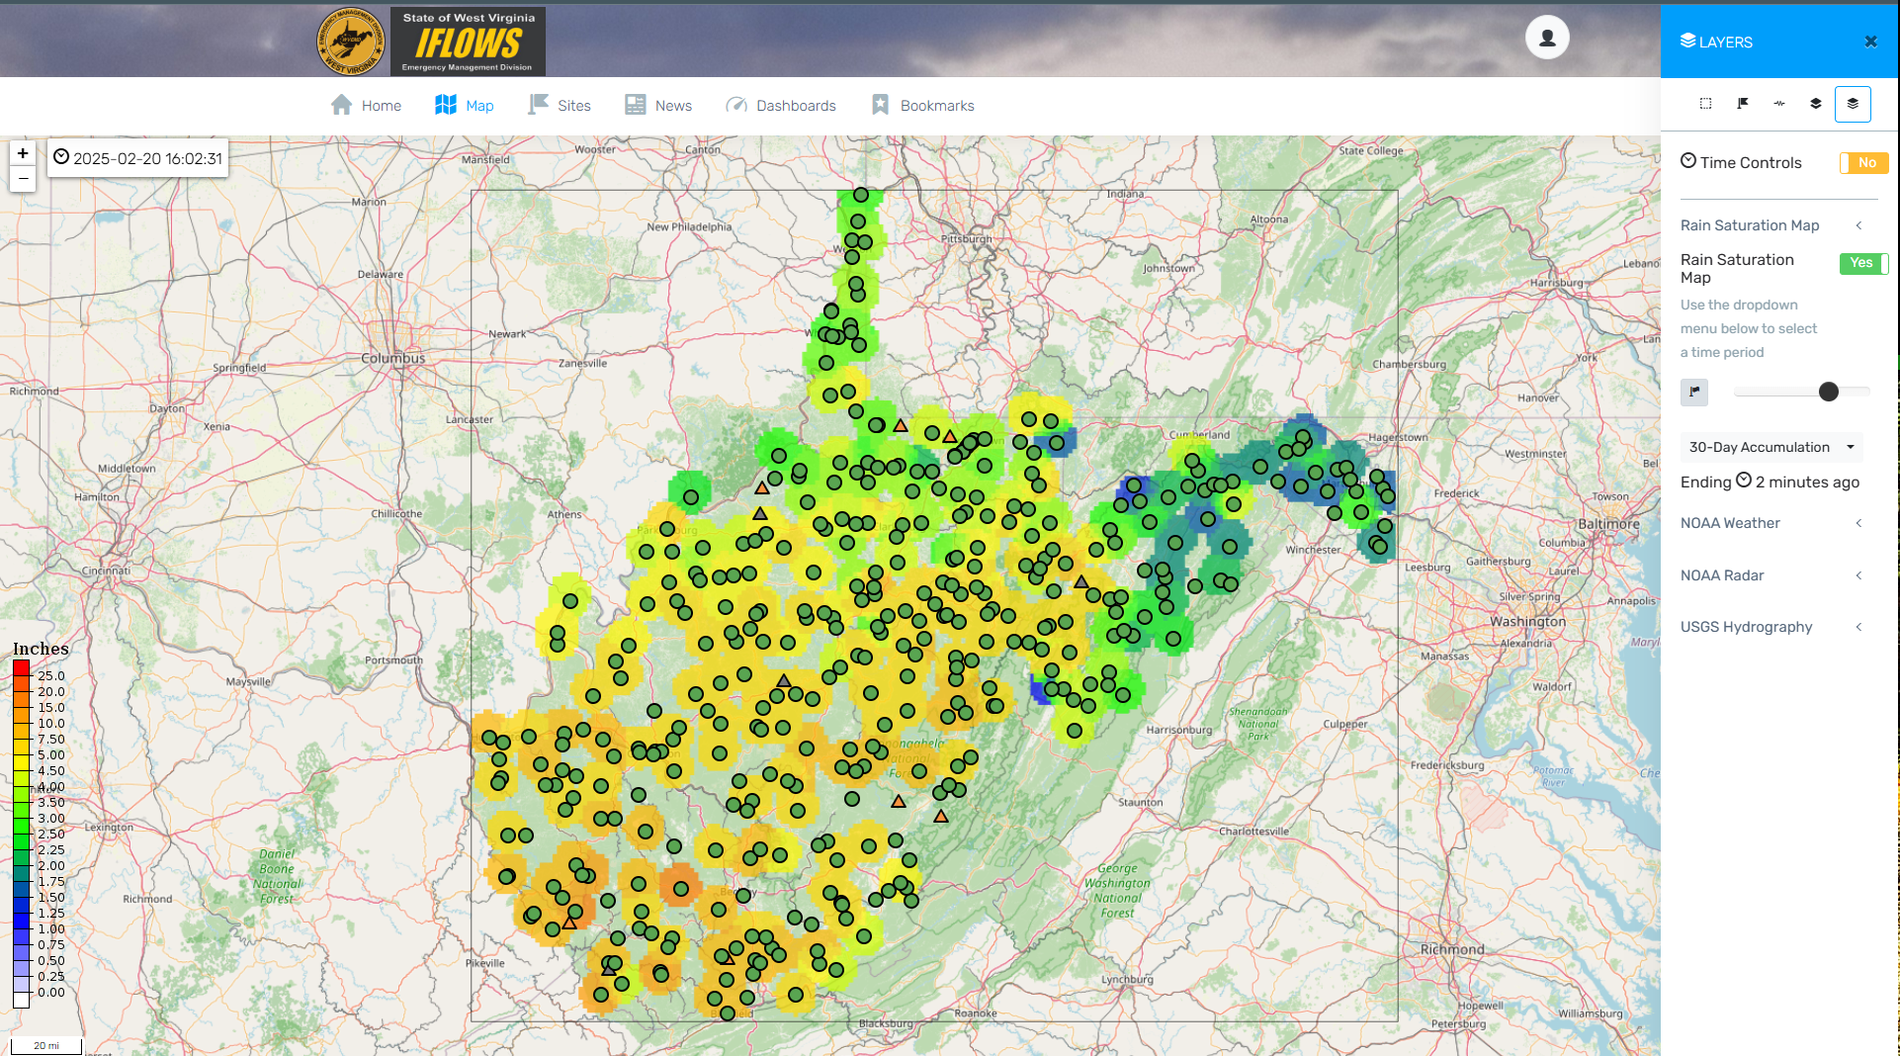
Introduction to WVEMD IFLOWS integrated flood observation and warning system
  System consists of 12 Collection Points (Towers) with approximately 7 more to be added
  258 Active Rain/Weather stations- VHF Radio telemetry- System Upgrade Ongoing…
  ONLY State Flood Warning System in the Country that is Fully Installed/Maintained by State Employees- One of the Largest in the Country
  Website – wvrainfall.wv.gov
  Local benefits of the website?
  Post Event data acquisition for FEMA / Insurance claims (recent Flooding in West Virginia)

Slide 5
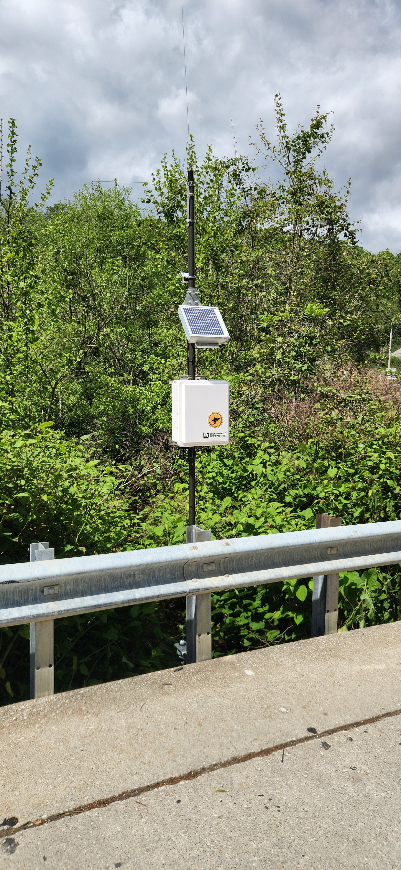
WVEMD IFLOWS
RFD - (rapid Flood Detection)
Build Out----
Site Coordination / Equipment Choice
Receiving Requests from County OEM, Summer Camps, Cities, Businesses
Locate streams of need
Prepare Site Specific Quotes
Where do you want it
How much data do you want
How do you want the data to reach IFLOWS network

Slide 6
WVEMD IFLOWS- Plan and Cost Estimate
Equipment | Estimated Cost | Yearly Cost to Partner | Customized to Partner Needs
Simple Stream gauge/Cellular | $3200-$4900 *** | $180-$600 | 100%
Simple Stream VHF-WVEMD | $5300 *** | $0 | 100%
Simple Stream Iridium Sat. | $5000-$6400 *** | $850+ | 100%
Stream and FULL Weather Station- VHF- WVEMD | $8000-$9000 *** | $0 | 100%
ONE Time cost to Partner for Equipment Purchase***
WVEMD IFLOWS Technicians Install/Maintain/Repair/Replace Equipment throughout the equipment lifespan
Custom Thresholds, Alarms and Warnings
Data displayed 24/7 at wvrainfall.wv.gov

Slide 7
Closing statement
WVEMD IFLOWS- Rapid Flood Detection- RFD
Enhanced Warning- Proactive vs Reactive….
Local Customization
Partner picks the sites of need
Partner Reimburses WVEMD for Equipment Cost
Cellular/Iridium Sat. Data- $$$ Partner responsibility, but still working to eliminate or reduce cost of this option
Existing robust -VHF NO COST to Partner

Slide 8
Questions / Comments ???
THANK YOU For Your Time !!
Andy Teter
West Virginia Emergency Management
IFLOWS Supervisor
681-205-4337
andrew.d.teter@wv.gov
wvrainfall.wv.gov

