Slide 1

Philanthropy’s Response to 2025 Flooding
A presentation to the West Virginia Floodplain Management Conference
June 16, 2026
Notes:
Reimagine Appalachia recently released their report on the dismantling of FEMA and the risks associated with these changes. They are hosting a webinar June 26 on the 10-year anniversary of the 2016 floods. Register here.
Flooding resilience is also important throughout our region. Here's a report from the American Planning Association on that topic.

Slide 2
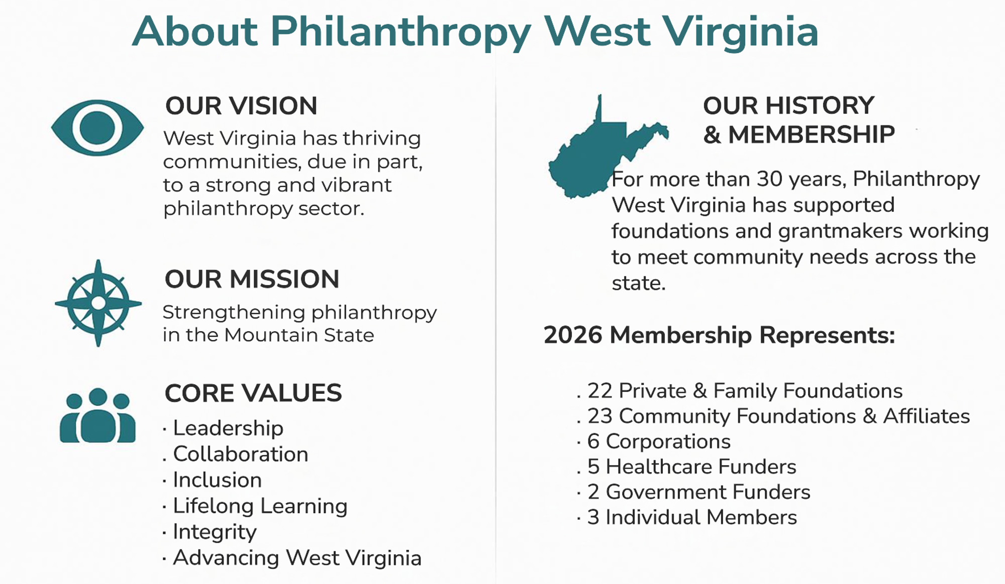

Slide 3
Philanthropy West Virginia’s Impact
Four Regional Convenings on Food Insecurity
143 participants registered
23 Counties Represented
12 Sponsors
Food Insecurity Report to 2025 Conference participants
Philanthropy and Nonprofit Day at the Legislature February 18, 2026
Foundations on the Hill Washington DC visits in March 2026
Regional Roundtables connecting members, sharing information

Slide 4
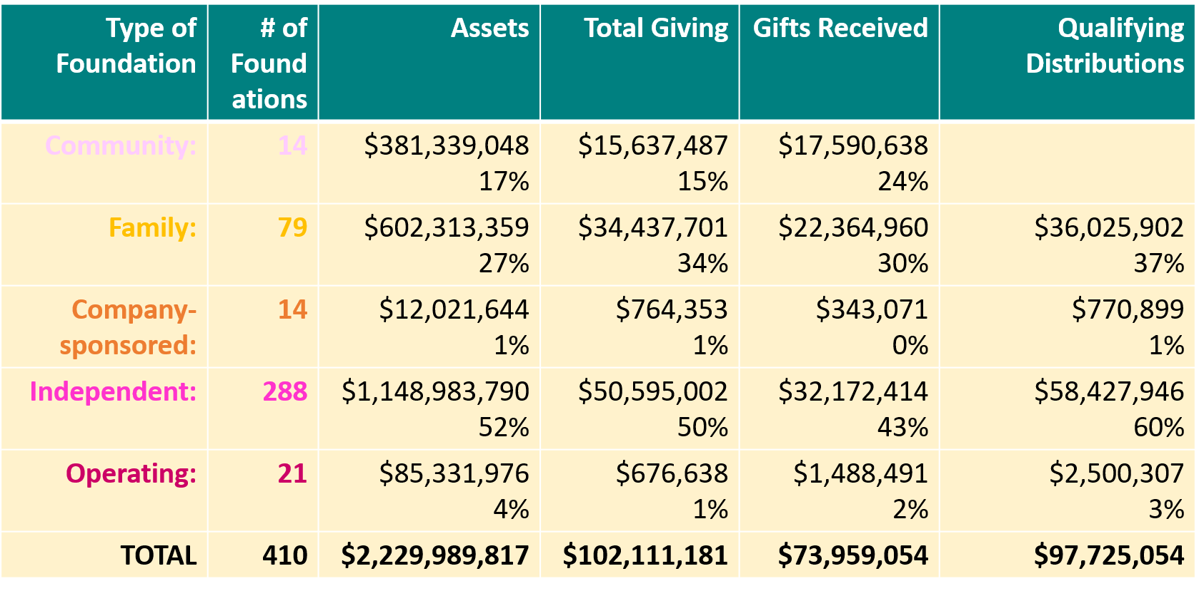
Philanthropy’s Impact in West Virginia
Notes:
2023 Dollars

Slide 5
‘Philanthropy exists because of two truths about the human condition: things often go wrong, and things could always be better.’
2008 Robert L. Payton and Michael P. Moody
Understanding Philanthropy: Its Meaning and Mission
Notes:
The Johnson Center for Philanthropy created the “11 Trends in Philanthropy for 2023” report. In it, they stated: “As Payton & Moody (2008) observed, ‘Philanthropy exists because of two truths about the human condition: things often go wrong, and things could always be better.’ The orientation of philanthropic institutions could be divided into those that respond to disasters when things go terribly wrong, and those focused on long-term development, aiming to make things better over time.”
Disaster Philanthropy is Transitioning for the Long Haul
In response to Hurricane Helene, donors contributed $33 million to the North Carolina Community Foundation for emergency response.

Slide 6
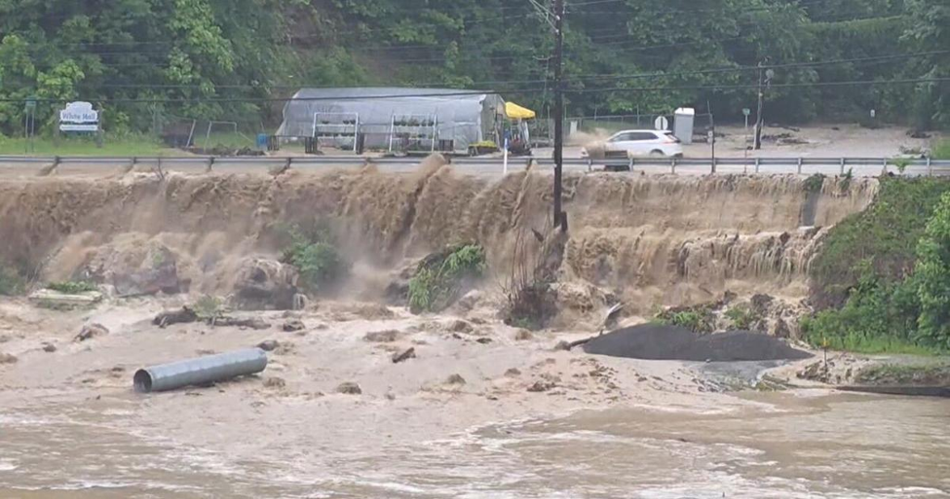
Notes:
The June 14–15, 2025 flash flood event in north central West Virginia was one of the most severe in recent years, causing widespread damage and loss of life.
Cause and Timing
Heavy rainfall from scattered showers and thunderstorms, moving slowly along a stalled frontal boundary, produced 1–3 inches of rain in some areas over just hours National Weather Service. In Ohio County, one gauge recorded 3.29 inches in 62 minutes, while Marion County saw totals near 2 inches National Weather Service. The combination of intense rain and saturated ground led to major flash flooding.
Impacts
Fatalities: Multiple confirmed deaths in Ohio County National Weather Service.
Damage: Numerous homes and structures damaged or destroyed in Ohio and Marion counties. In Marion County, the main impacts occurred on Sunday, June 15 near Fairmont National Weather Service.
Flooding Levels: The Tygart Valley River at Mill Creek saw a crest of 14.10 feet on Feb 6, 2025, but during the June 2025 event, the river reached 21 feet in some areas of Randolph County, with moderate to major flooding reported Office of Water Prediction+1.
Displacement: Many residents were evacuated, with emergency shelters set up in schools and community buildings The Intermountain.

Slide 7

Tygart Valley United Way Response
Established a Flood Fund to help meet emergent shelter and supply needs and provide an outlet for support
Coordinated with partners to set up donation and distribution sites for cleaning supplies, clothing, and hygiene items
Created and maintained a central website for information and resource sharing
$116,707 raised for response
426 nights of shelter provided
1,577 individuals received supplies
56 homeowners received financial assistance for repair
Notes:
In the wake of the devastating Father’s Day Flood, Tygart Valley United Way stepped forward to help coordinate community response efforts and support our neighbors during a time of urgent need. Working alongside nonprofit partners, local government, volunteers, and donors, we helped mobilize resources and organize assistance for individuals and families affected by the disaster. The outpouring of generosity from our community demonstrated the power of people coming together to help one another during difficult moments.
Thanks to that support, $116,707 was raised to assist with flood response and recovery efforts. These resources helped provide immediate relief and stabilization for families who lost homes, belongings, and basic necessities. Through coordinated efforts with partner organizations, 426 nights of shelter were provided to displaced residents, ensuring families had a safe place to stay while beginning the long process of recovery.
Beyond shelter, the response focused on meeting urgent everyday needs and helping families begin rebuilding their lives. 1,577 individuals received essential supplies, including food, hygiene items, and household necessities. In addition, 56 homeowners received direct financial assistance to help with recovery costs and repairs. While the road to full recovery takes time, the coordinated response demonstrated the strength and compassion of our community and reinforced United Way’s role as a trusted community leader in times of crisis.
Immediately, we:
Established a Flood Fund to help meet emergent shelter and supply needs and provide an outlet for support
Coordinated with partners to set up donation and distribution sites for cleaning supplies, clothing, and hygiene items
Created and maintained a central website for information and resource sharing
Served as the main point of contact for local, state, and federal response agencies
By the Numbers
$116,707 raised for response
426 nights of shelter provided
1,577 individuals receiving supplies
56 homeowners provided financial assistance for repair

Slide 8
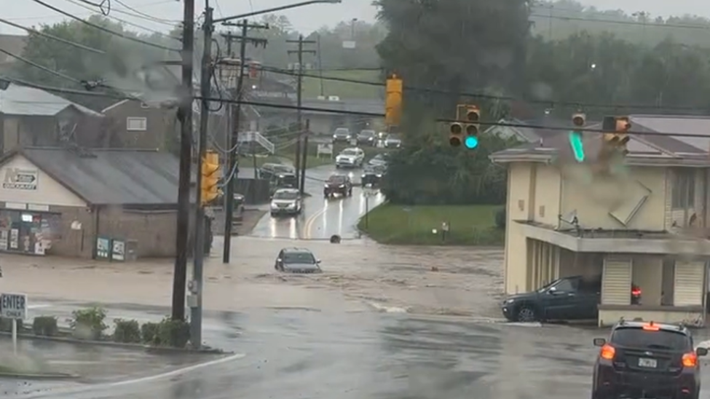

Slide 9
Long-Term Recovery Team Ohio Valley
Headed by the United Way of the Upper Ohio Valley, it includes over 30 local agencies and focuses on:
Housing assistance: Organizing short-term, long-term, and permanent housing lists for those displaced.
Case management: Assessing individual needs for housing, appliances, furniture, and rebuilding .
Volunteer and donation needs: Seeking retired tradespeople (electricians, carpenters, construction) and monetary contributions.

Slide 10


Upper Ohio Valley
Long-Term Disaster Recovery Group led by the United Way of the Upper Ohio Valley
  As of June 1, 2026 161 cases successfully closed.
  23 cases are in progress.
  16 were unable to contact.
  Assisted in building a bridge for six families that lost theirs in the flood.
  Philanthropy’s support $761,000 raised from June-August.
  Non-cash support: food, clothing, shoes, hygiene items, car rentals, a dump truck donated to small business, building materials, dehumidifiers, air conditioners, drywall, cabinets, furniture, etc.
Notes:
The

Slide 11
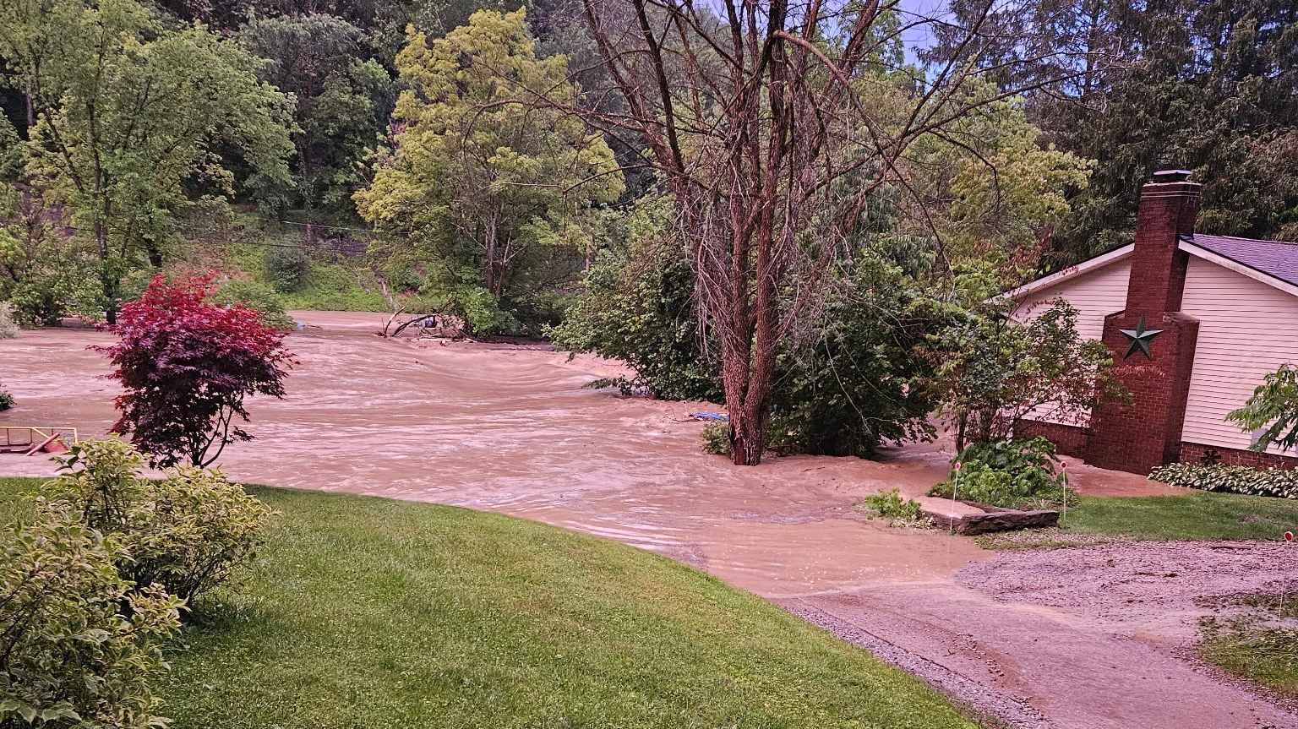

Slide 12
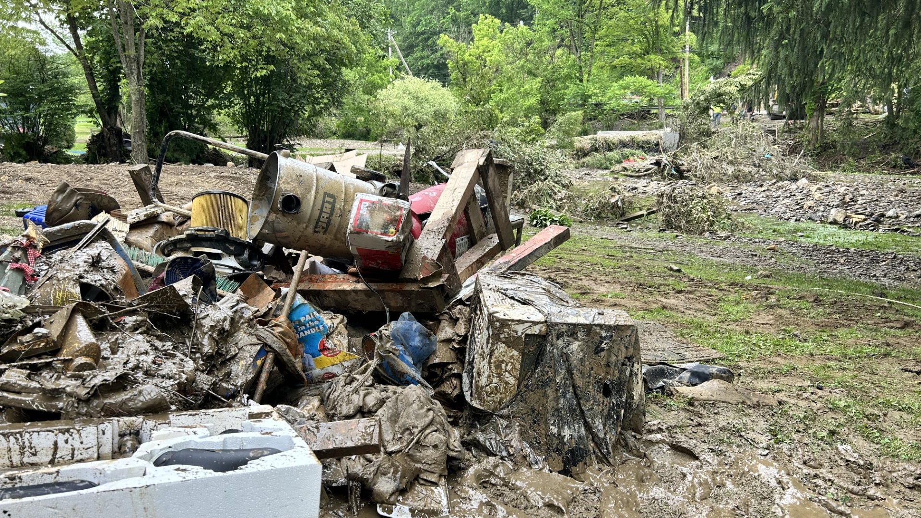

Slide 13
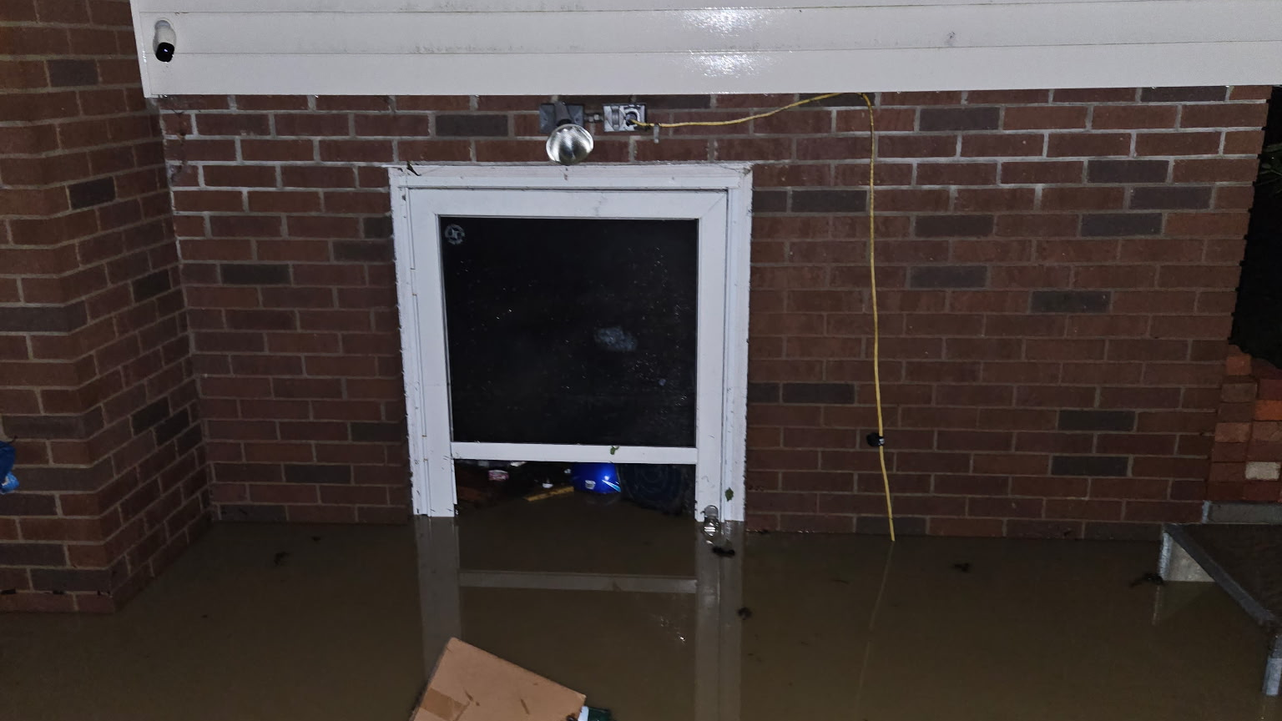

Slide 14
Other Partners in Philanthropy Responding
Catholic Charities of West Virginia
WV Chamber Foundation
Wesbanco
Brad Paisley Foundation
Notes:
All of these organizations jumped in to support people in their communities. Wesbanco and Paisley each contributed $25,000 for recovery in the Upper Ohio Valley.
Civic organizations aren’t captured in this presentation, nor are the many nonprofits which responded in person to help neighbors.

Slide 15
Disaster Response Philanthropy Playbook
Case Management,
Recovery Coordination,
Crisis Communications Toolkit,
Mental Health, Grief & Bereavement Toolkit,
Responding to a Community Crisis,
Setting up a Disaster Fund,
Vetting NGOs for Disaster Recovery
Notes:
Disaster Philanthropy Playbook - Center for Disaster Philanthropy

Slide 16


United We Prepare
Two Resiliency Centers in Fairmont and Charleston to connect nonprofits, community organizations, local governments, and emergency response agencies for better preparedness and response to disasters.
Brian Aluise, Director Candi Travis, Director
Southern Resiliency Center Northern Resiliency Center
United Way Central WV Tygart Valley United Way
Baluise@UnitedWayCWV.org Candi@TVUnitedWay.org
(304) 340-3544 (304) 366-4550
Notes:
Tygart Valley United Way and United Way of Central West Virginia have launched a statewide initiative called "United We Prepare" to enhance disaster preparedness and nonprofit coordination in West Virginia.
The initiative, funded by a national grant from Verizon and United Way Worldwide, establishes two Resiliency Centers in Fairmont and Charleston to connect nonprofits, community organizations, local governments, and emergency response agencies for better preparedness and response to disasters.
United We Prepare aims to address challenges faced by nonprofits, particularly in rural areas, by providing resources, training, communication systems, and collaborative planning opportunities to strengthen community resilience across the state.

Slide 17
Contact Us!
Jennifer Goddard
President & CEO
(304) 205-3838
Jennifer@philanthropywv.org
www.PhilanthropyWV.org

