Slide 1
Transformative Mitigation
Connecting Planning, Modeling & Outcomes
WV FMA 2026 Conference

Slide 2


Introductions
Casey Garnett
IEM Project Manager
Casey.Garnett@iem.com

Slide 3
Largest Disaster Management Firm in the United States
$280+ Billion
Federal Funds Management
Fastest CBDG-DR Disbursement in History
$1.8B to Survivors of the 2016 Louisiana Great Floods
Customers
HUD, FEMA, SBA, HHS, DOD, DHS, DOI, DOC, DOE, USTR 50 States, 3 Territories, D.C., Tribal Nations, the Private Sector & International
41+ Years in Operation
800+ Full-Time Employees
200+
Nationally Qualified Reservists & Readiness Corps
2-24 Hour
Rapid Response Deployment
Providing Integrated Community Solutions and Managing All Phases of Emergency Management and Disaster Assistance: IEM delivers integrated solutions from readiness and immediate response to long-term resiliency.
Comprehensive Expertise
Delivering specialized expertise and capabilities across all emergency management phases
Subcontractors
Vast partner network ensures we meet our clients’ full scope of mission needs

Slide 4
Objectives
By the end, you’ll be able to:
  Describe best practices for hazard mitigation plan development tied directly to project success.
  Replicate an engagement structure that produces usable plan inputs.
  Understand how to apply a clear path from risk to community priorities to actions.

Slide 5
A Changing Landscape…
Federal Mitigation Plan & Project Development Updates

Slide 6
The Outlook
BRIC funding has been released – new priorities by the current administration point to more developed plan items and ready-to-go projects.
Calls for change – increased emphasis on state and local-led programs.
Mitigation Action items have in the past been very broad statements similar to “address drainage issues”, “elevate homes”, or “restore the stream to its natural habitat.”
Traditional HM plan action items have left many communities adopting overly broad strategy sections and addressing items only after a disaster.
Notes:
Breaking down silos
Using local data
Balancing new administration priorities
Focusing on outcomes rather than specific verbiage
Identifying effective actions

Slide 7
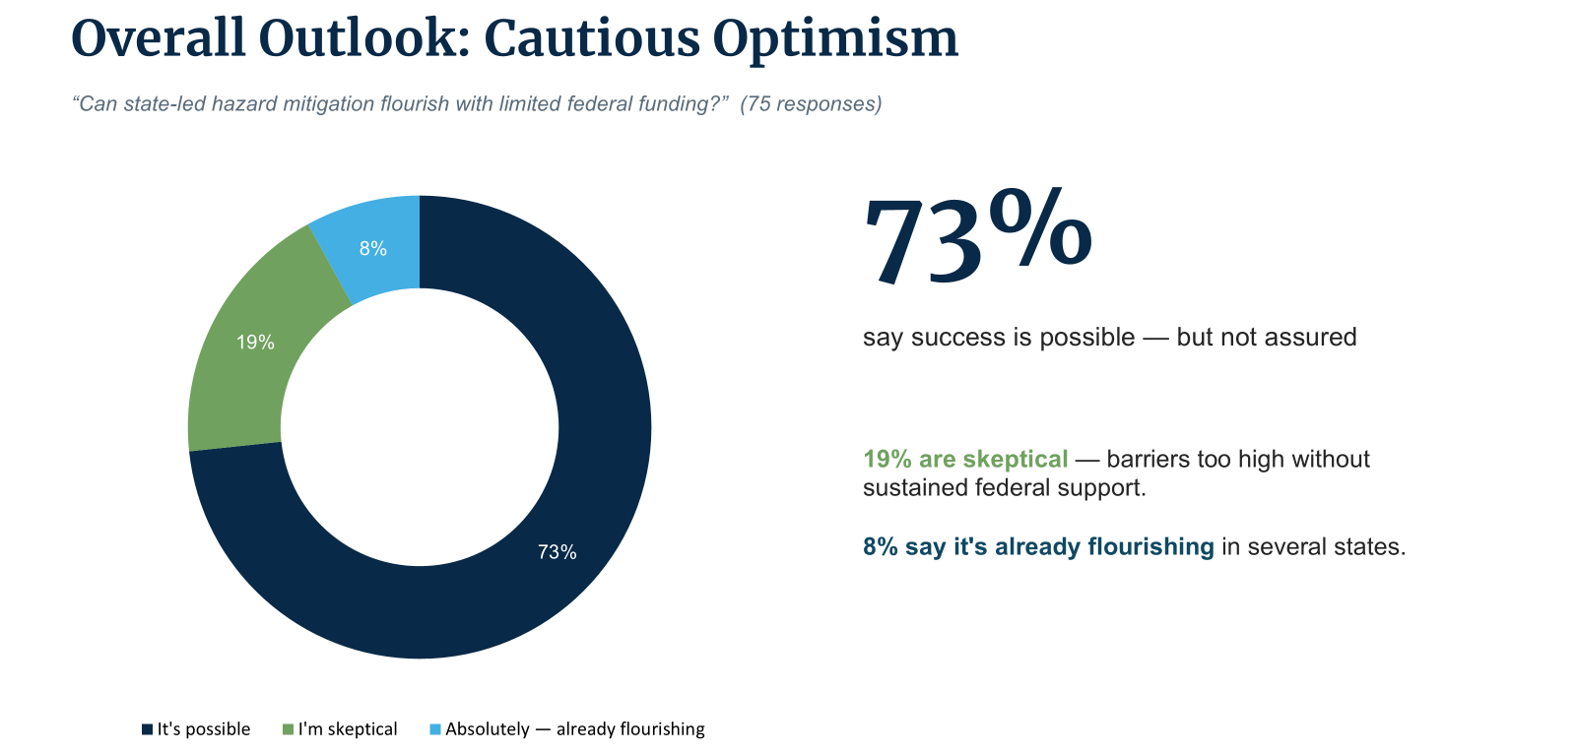

Slide 8
Flexibility vs. Capacity: Bypassing federal bureaucracy offers faster, tailored, and more innovative local solutions, but state and local staffing shortages pose a major threat.
The Socioeconomic Divide: Without federal safety nets, there is severe risk of creating a "class system of states" where affluent areas thrive and low-income communities fall behind.
Funding Stability is Paramount: Securing consistent funding for long-term plans and projects was voted as the most critical need.
Diverse Financial Horizons are Key: Successful models rely on blending state legislative appropriations with non FEMA resources, including HUD, NOAA, local taxes, and climate philanthropies.
2026 ASFPM Conference
State-Led Hazard Mitigation Survey Results

Slide 9
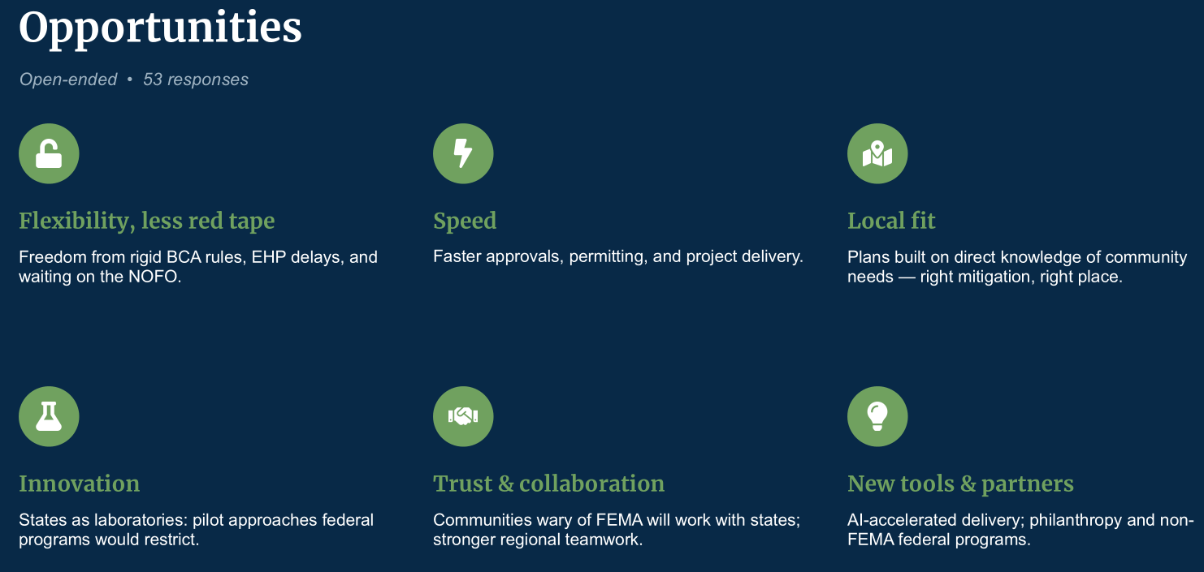

Slide 10
A Plan to Project Pipeline
Federal Mitigation Plan & Project Development Updates

Slide 11
Why Update the Plan?
Hazard mitigation plans are prepared and adopted to identify, assess, and reduce the long-term risk to life and property based on natural and human-caused hazards.
Adopting a FEMA-approved plan enables communities to be eligible for certain FEMA mitigation grants
  Hazard Mitigation Grant Program (HMGP)
  Building Resilient Infrastructure and Communities (BRIC)

Slide 12
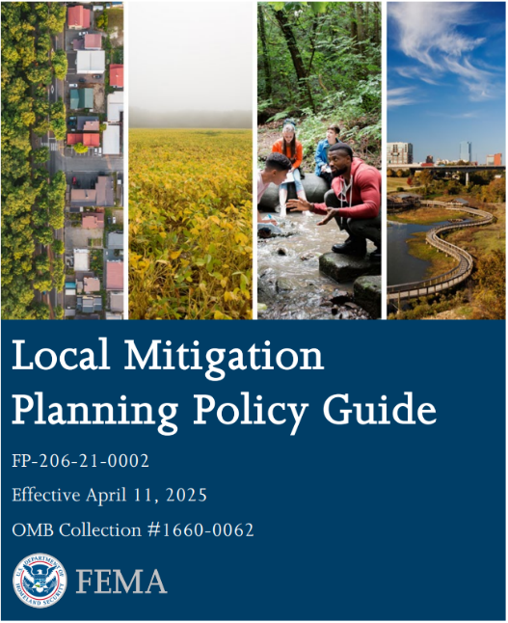
New Guidance (2023-2025)
Three sets of guidance in five years
2023 guidance changes
  Emphasis on partnerships and “whole community”
  Future conditions & climate integrated
  Stronger NFIP & building code integration
  High Hazard Potential Dam (HHPD) element
2025 guidance
  Made climate change, equity inclusion optional
  Most other 2023 guidance still in effect

Slide 13
The Hazard Mitigation Plan
Planning Process
Risk Assessment
Capability Assessment
Plan Maintenance
Mitigation Strategy
Planning Process
Risk Assessment
Capability Assessment
Plan Maintenance
Mitigation Strategy

Slide 14

Planning Process – Floodplain Management’s Role
Encourage stakeholder engagement
  Floodplain managers
  Dam owners
  Wetland preservation groups
Include special districts
  Levee
  Water
Engage the public
  Targeted focus of populations in SFHA
Consider establishing a Flooding Working Group
Best Practice: Invite anyone who can contribute to understanding flood risk, vulnerabilities, or mitigation projects

Slide 15
Interactive Formats
Workshop-style formats
  Review hazards of concern
  Identify four types of capabilities and opportunities for improvement
  Facilitate a hazard analysis poster session
  Review mitigation actions ideas
”Most people interested in mitigation I’ve ever seen together.”

Slide 16
Expert Engagement
Academic institutions
  SMEs on each hazard
Meetings with each High Hazard Potential Dam (HHPD) owner
  Risks to and from the dams
  Populations at risk
  Breach inundation data

Slide 17
Risk Assessment - Local Data is KEY
Federal data not equivalent to locally validated data
Locally maintained hazard studies make a difference
Stakeholder engagement served as a critical mechanism for identifying locally maintained data sources and community-specific vulnerabilities
HAZUS used for incorporating local critical infrastructure
Best Practice: Provide expert advice on flood-specific concerns
  Inundation impacts on community lifelines
  Post-flood secondary/cascading disasters
  Substantial damage process

Slide 18
Mitigation Strategy
Suggest ways to support reducing flood risk with all project types
  Local plans and regulations
  Structure and infrastructure projects
  Natural systems protection
  Education and awareness
Incorporate existing projects from stormwater management, capital improvement, comprehensive plans, etc.
Develop project worksheets
Best Practice: The mitigation plan should be the foundation of your grant application.

Slide 19
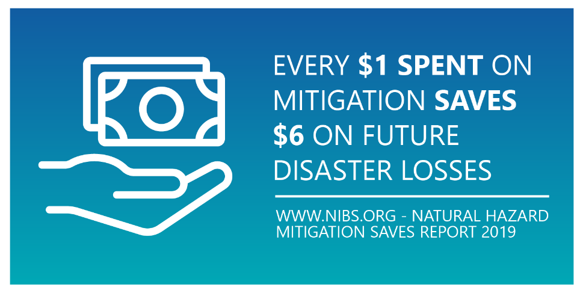
Mitigation Action Ideas
Identify list of mitigation actions, including reviewing:
  Stakeholder meeting notes
  Vulnerability assessments
  Local mitigation plans
  Common grant application types
  Mitigation expert advice
  Critical infrastructure at-risk in high, moderate flood zones

Slide 20
Plan Solutions for Action Items
Make your action items specific in nature and consider using project worksheets or doing preliminary design work as part of your plan update.
Clarify action intent
  “Reduce flooding” vs. “Perform H&H study/Perform Feasibility Study/Upsize Culvert”
Expand project descriptions through project worksheets
  Consider developing scope and budget goals for potential applications - have that pre-application basically drafted
Consider project scope
  What is the root cause of risk?
Review plans to include for both big and small projects.
  Nature-based solutions – no longer an emerging field

Slide 21
Plan Solutions for Action Items
Remember, mitigation action items can be funded both pre- and post-storm events.
Consider co-benefits and alternative funding sources.
  Stormwater fees, floodplain development permit fees.
  Look for smaller planning grants to help develop plans and 30-50% construction ready drawings.
Remember 406 Mitigation funding during recovery.
Think of mitigation funds as supplemental Capital Improvement Program (CIP) funds for your locality.
Projects can include:
  Upgrading street drainage system
  Address neighborhood nuisance flooding
  Creating new park space

Slide 22

Data, Data, Data
Local staff should work with residents to establish a historical database (e.g., oral histories, insurance claims, high water marks).
Use historic data (e.g., NFIP, IA claims) or work with partners like universities to run baseline models for Phase I projects.
Remember for FEMA projects, including the BCA, it is data, data, data, and the source validation of that information.
Pass BCA = Data (including BEST available data) go back to stakeholders; keep historical event data in one place and ready to pull for the application.
FEMA wants to see solutions to your action items.

Slide 23
Plan Maintenance: Looking Ahead
Keeps the plan relevant to current risks and priorities
Enables ongoing implementation
Keeps alignment with stakeholders and FEMA requirements
Supports continuous monitoring and updates

Slide 24
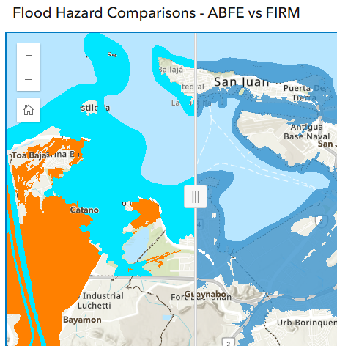
Best Practices for Your 5-year Plan Cycle
Participating in annual meetings
Providing updates to actions/projects
Communicating the need of a plan amendment prior to grant application (if needed)
Consider digital solutions
  Real-time visualization of hazards and risks
  Continuous updates instead of
  5-year revisions

Slide 25
Plan Implementation: Lessons Learned
Strong problem identification, but insufficient documentation of project benefits.
Applicants often describe the hazard but do not clearly identify the specific assets being protected (e.g., homes, roads, utilities, critical facilities, emergency access routes).
It may not be your first solution that you think of – remain open to creative ideas.
Historical damages are often anecdotal and lack supporting records, invoices, photographs, maintenance logs, or repair costs.
Many projects have only analyzed a single storm event and need multiple recurrence interval evaluations (e.g., 10-, 50-, 100-year events) to support BCA development.

Slide 26
Plan Implementation: Lessons Learned
Floodplain, floodway, permitting, and environmental considerations are not always being addressed early enough in project development.
If you have been impacted by another hazard – wildfire, landslide – considering cascading impacts
H&H and flood studies
  Ensuring engineering analysis is aligned with current grant requirements
  Consider impacts both up and downstream
  Show pre and post mitigation water surface elevations at protected assets

Slide 27
Thank You
Let’s build resilience together – visit iem.com.

