Slide 1

US Geological Survey- Flooding and Data Resources
Jeremy White
Charleston Field Office Chief
VA-WV Water Science Center
US Geological Survey-Water Mission Area
WVFMA Annual Conference
June 16, 2026

Slide 2

USGS Water Mission Area
Water information is fundamental to national and local economic well-being, protection of life and property, and effective management of the Nation’s water resources. The USGS works with partners to monitor, assess, conduct targeted research, and deliver information on a wide range of water resources and conditions including streamflow, groundwater, water quality, and water use and availability.
In WV, this mission is primarily focused on the USGS Streamgaging Network, response to flooding events, and data analysis through partnerships with the State of WV, including WV EMD, WV DEP, WV DOH, WV DNR, USACE,, and other federal, state, and local partners.

Slide 3
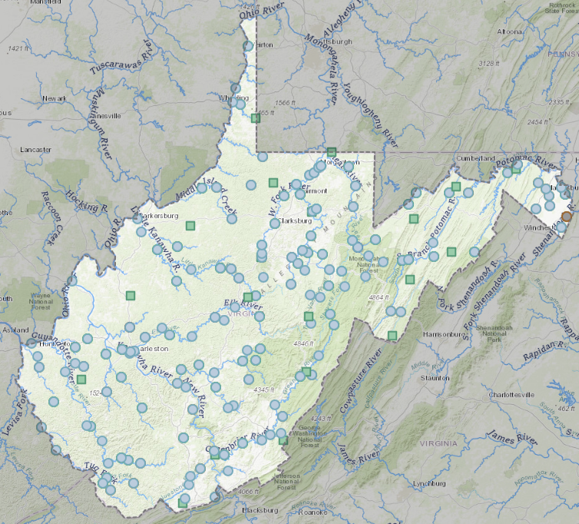
WV Streamgage Network
184 Total Streamgages
  -110 State funded (full or partial)
  -74 funded by other partners
All operated by USGS
Streamgages in WV are operated as a “statewide network” distributed across multiple funding partners and coordinated by the WV Water Gaging Council
~$2.4M per year for streamgaging across all partners in WV
**THIS IS AN IMPORTANT DISTINCTION***
Notes:
So, to get straight into it, the USGS is currently operating 183 streamgages in WV. Of that 183 gages, 111 of those sites have at least some level of funding through an agreement with the state of WV. Some of those sites are fully funded through the state agreement while many gages have costs shared by other funding partners, which could be USGS, Army COE, or other partners. We’ve taken a “network” approach to streamgages here in WV in an effort to share the limited funding resources to maximize the coverage and uses of streamgages to the variety of agencies and other users in the state. Decisions regarding streamgaging needs, be it new gaging or funding, are coordinated through the WV Water Gaging Council. This Council is made up of federal, state, and private entities with a vested interest in streamgaging. This council has played an active role in the state’s network since it was stood up in 2005.

Slide 4
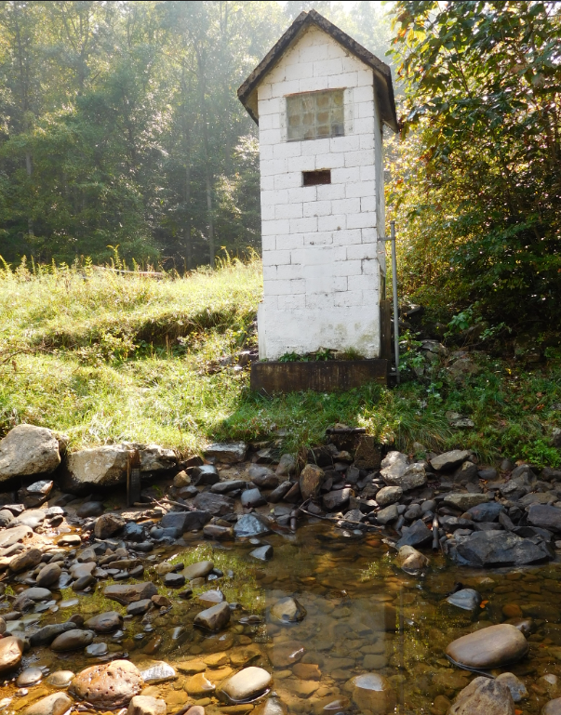
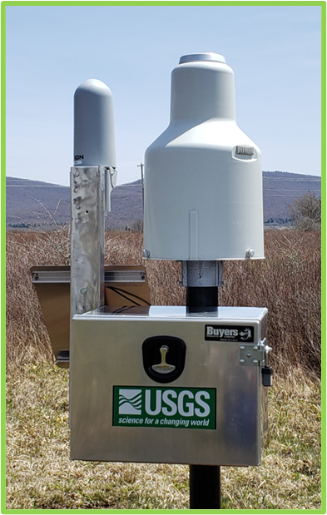
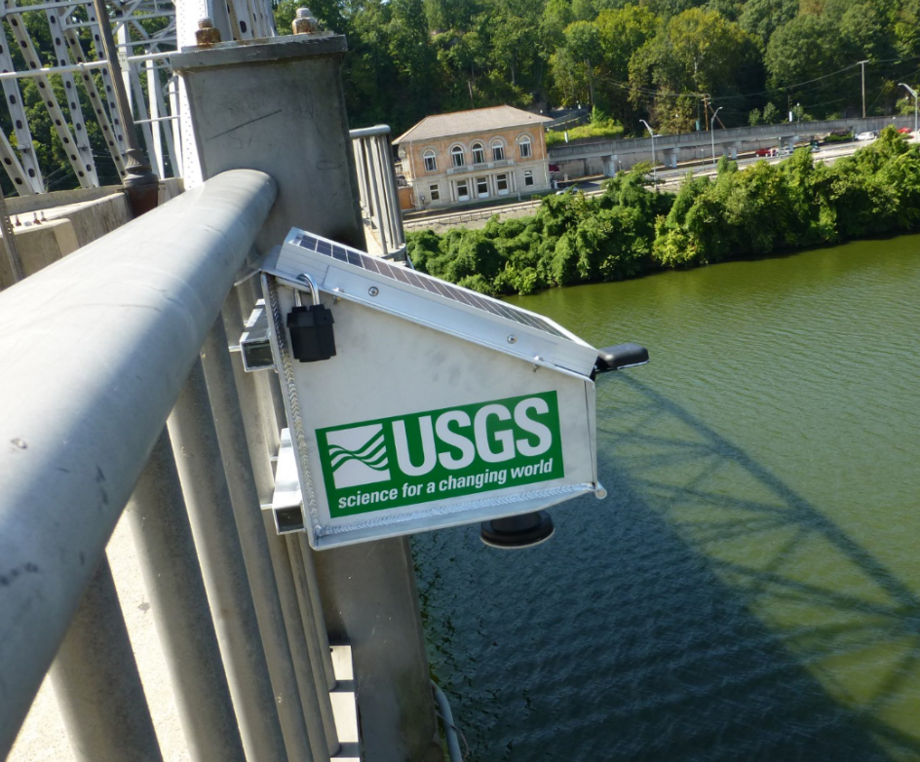
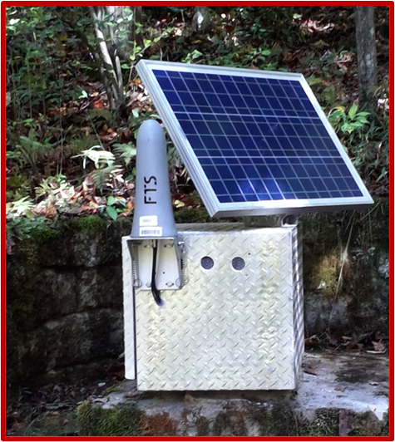
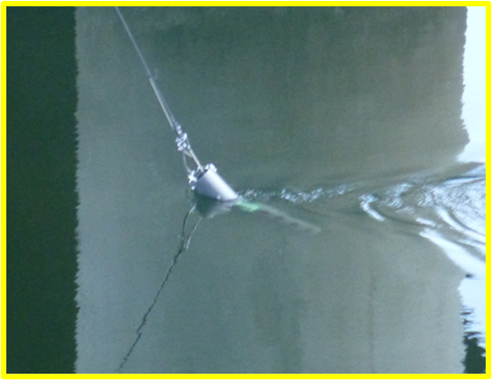

What USGS Gage Data is Available in WV?
98 Discharge gages (flow)
63 Stage-only gages (water-level)
21 Reservoir gages
63 Rain gages
19 Groundwater monitoring wells
30 Water-quality monitors
13 Crest-stage gages (annual peak only, non-telemetry)

Slide 5
Water Data Delivery in near Real-time
Most USGS gages in WV transmit to GOES Satellites
  Hourly Transmissions of 15-minute data
    RANDOM transmissions could be utilized to deliver data every 15 minutes based on thresholds
Many small-basin sites deliver 5-minute data every 15 minutes
    RANDOM transmissions could be utilized to deliver data every 5 minutes based on thresholds
40 sites, established in 2019, transmit every 5 minutes via Iridium satellite network
From transmission, to the USGS database, to the public web takes less than 5 minutes

Slide 6
Streamgage Data Delivery-Databases
Data are publicly available through the Water Data for the Nation in near real-time and on a provisional basis
Streamflow data, stage, water-quality data, groundwater data, rainfall data
Statistical data-annual peaks, daily, instantaneous highs and lows, . . .
Current, and historical data are all publicly available
  22 Centennial streamgages in WV (1039 across the US) with >100 years of continuous data
USGS API services allow for automatic retrieval into other databases
Data are also pulled directly from the downlinks by NWS and Army Corps of Engineers
    USACE operations at Locks and Dams
    NWS flood forecasts

Slide 7
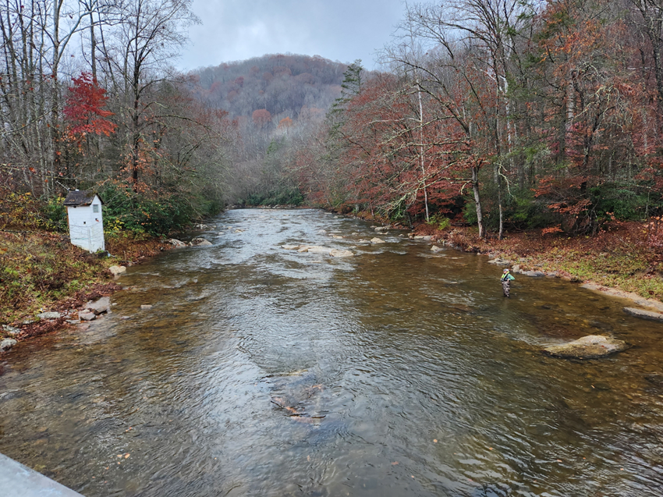
Why is Gaging Data Important for Floodplain
Preparedness and Awareness?
Streamgages tell us….
  How High, How Much, How Often, When, and What are the Trends
Specific uses of streamgage data
  Flood hazard planning and forecasting
  Development of Flood Inundation Maps
  Understanding long-term changes in streamflow
  Resource appraisal and allocation
  Design of water infrastructure (bridges, culverts)
  Reservoir operations
  Water-quality management
  In-stream flows for habitat assessment
  Recreational safety

Slide 8
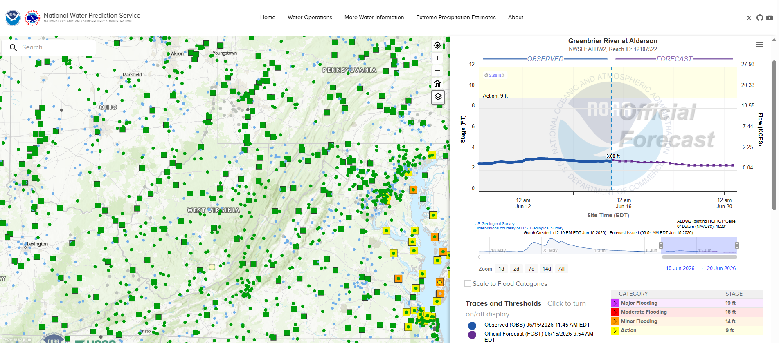
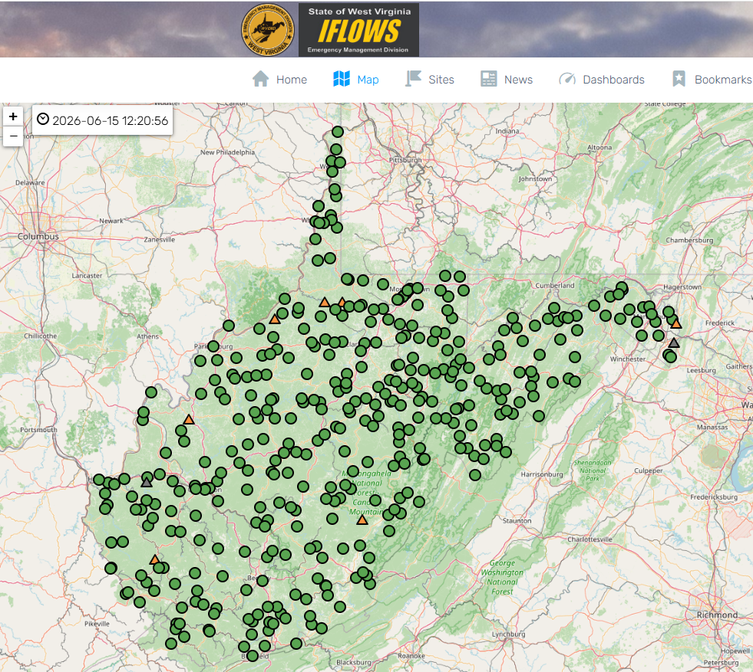
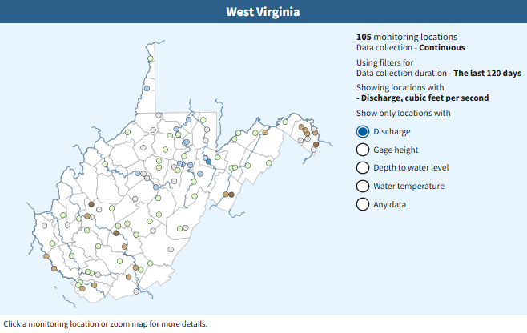
Starting to understand the data available…
There are a variety of sources of gaging data
  USGS, WVEMD (IFLOWS), NWS (NWPS),…
Get to know what’s available
What does a flow or gage height mean to your community?
How long it takes a flood wave to reach you?
Look at historic peaks
Maximize use of WaterAlert
Reach out for assistance

Slide 9
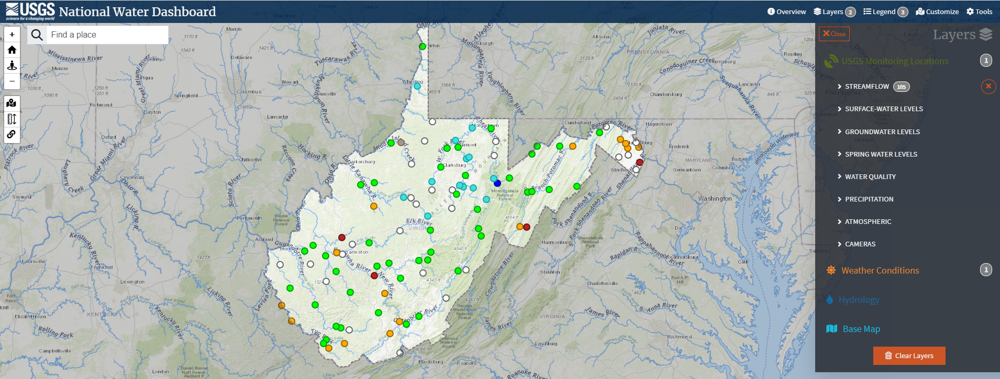
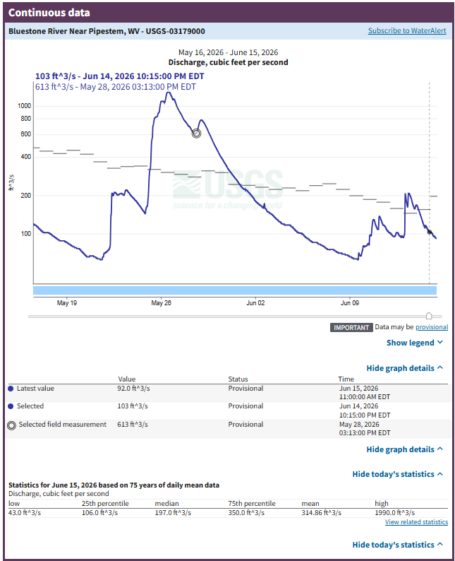
USGS Data Tools—
The National Water Dashboard
https://dashboard.waterdata.usgs.gov/app/nwd/en/?region=lower48&aoi=default
View USGS data for any continuous type collected from your desktop or mobile device
Views based on basic statistics
  High Flow, Low Flow, Increasing, Decreasing, NWS Flood Status,…
Add NWS Weather Layers
  Radar loop, Recent rainfall, Predicted rainfall, Air temperature…
View Drought Map
Maybe more than for data retrieval, this serves as a tool for field operations?

Slide 10
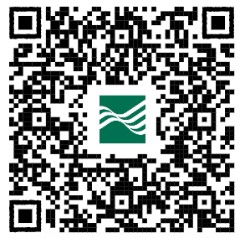
The National Water Dashboard https://dashboard.waterdata.usgs.gov/app/nwd/en/?region=lower48&aoi=default
Search: USGS National Water Dashboard or USGS NWD
Some Questions that can be answered through the NWD
How can I display all the streamgages in my area?
  What are the different ways to view/screen those sites?
Are there any rain gages in the area?
Is there any other gage data that might be useful to me?
What was the highest gage height in the past 30 days?
What was the first year that an annual peak was collected?
What is the peak of record for this site?
What was the peak discharge during the 2016 flood for XX site?
How could I automatically retrieve data for this site?

Slide 11
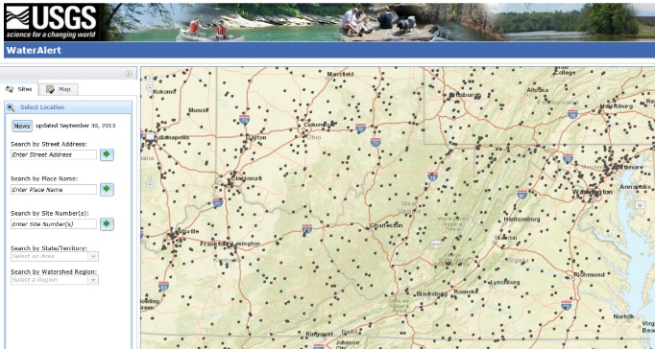
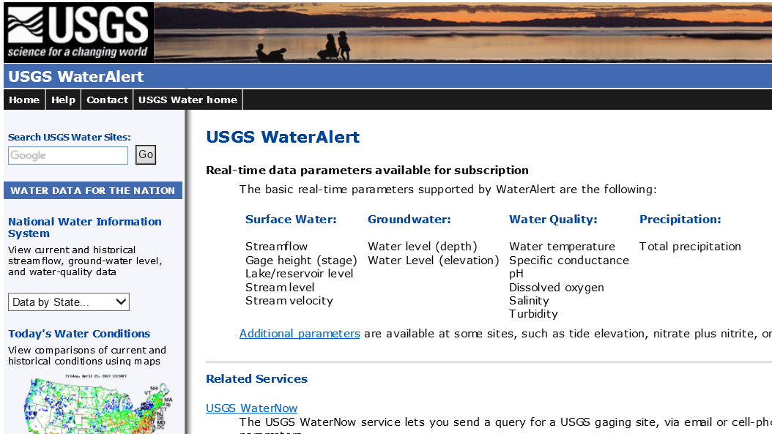
USGS WaterAlert Tool
https://maps.waterdata.usgs.gov/mapper/wateralert/
Free subscription service designed to provide alerts via email or text message based on user defined thresholds
  Users select parameters (ex. gage height, flow, rain) and the trigger threshold
    Daily or hourly alerts
June 21-27, 2016--15,769 notifications were sent

Slide 12
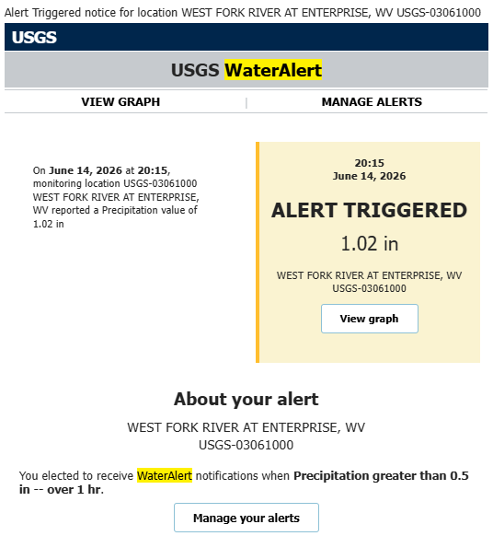
What Scenarios might you use WaterAlert??
Leading up to a potential flooding event?
General personal safety?
Are you an emergency manager?
Are you responsible for road closures?
Recreation?

Slide 13

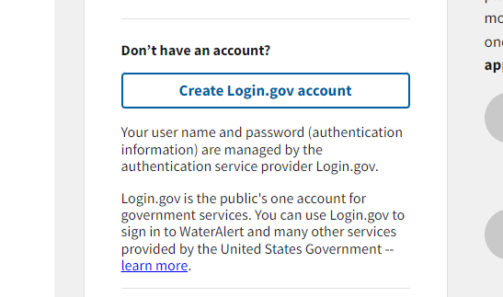
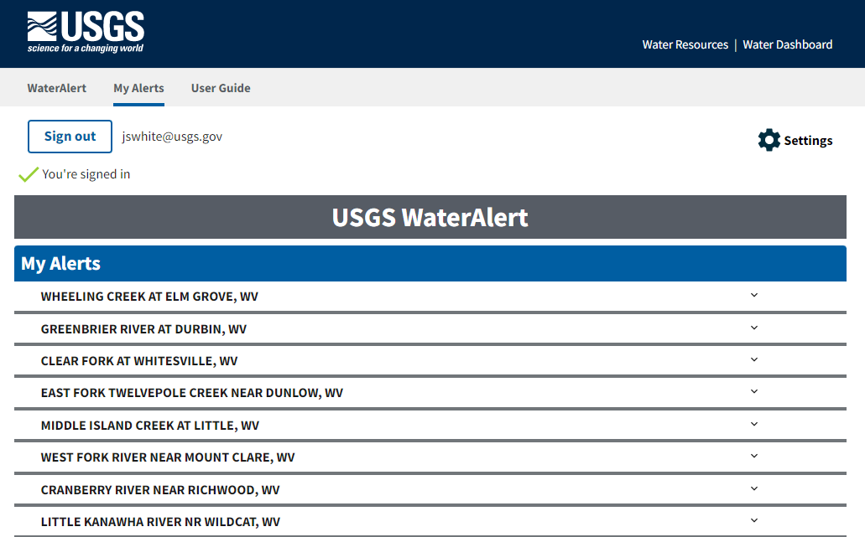
WaterAlert Logon Page
https://accounts.waterdata.usgs.gov/wateralert/

Slide 14
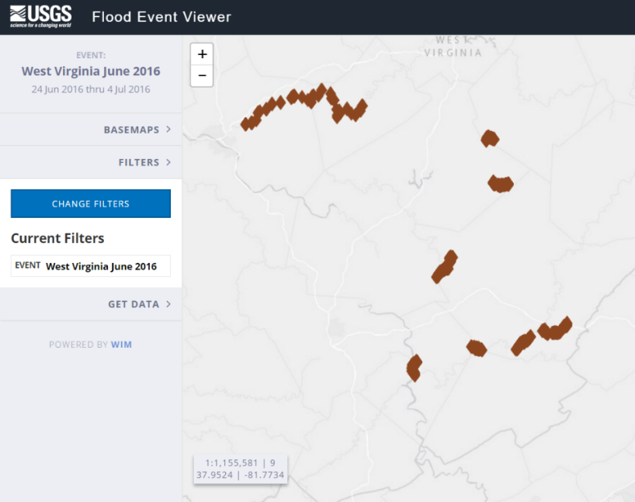
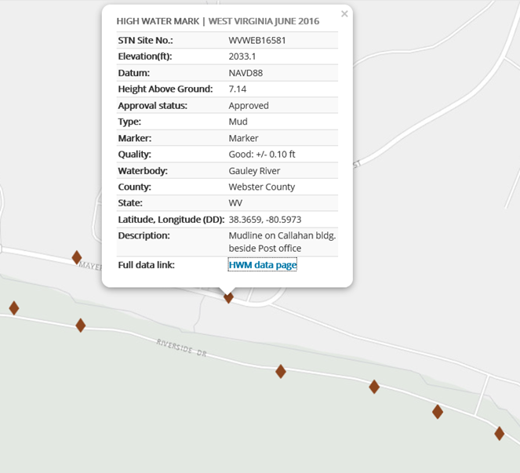
USGS Flood Event Viewer
https://water.usgs.gov/floods/FEV/
Short Term Network of Flood Events
  Event based (ex. WV June 2016 Flood)
  Publicly available database of High Water Marks (HWMs)
    ~400 HWMs entered for June 2016 Event
Document Flood Elevations and Profiles
Coordination with State and/or FEMA to establish “Event”
February 2025 Tug Fork Flooding event was documented by USACE and will be uploaded to the USGS FEV

Slide 15
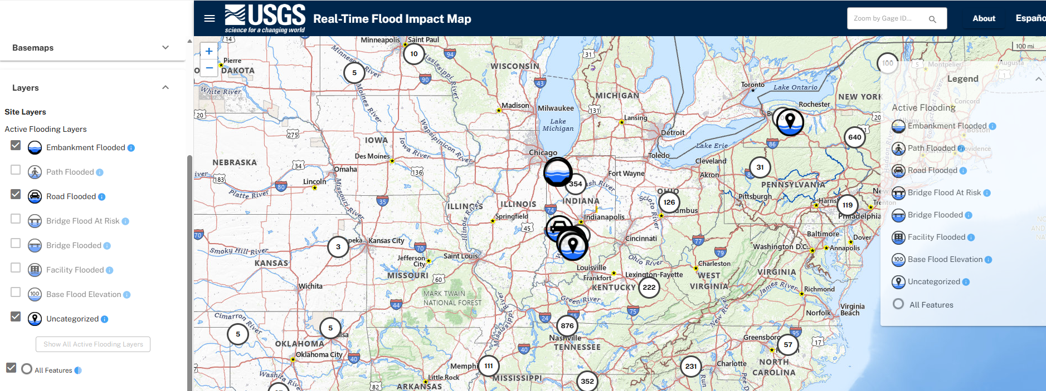
Real-Time Flood Impact Map
rtfi-map
USGS tool that displays conditions at defined locations during high flow events, typically for roadways, paths, bridges.
  There are currently no sites in WV with these defined locations/elevations, but there could be……..

Slide 16
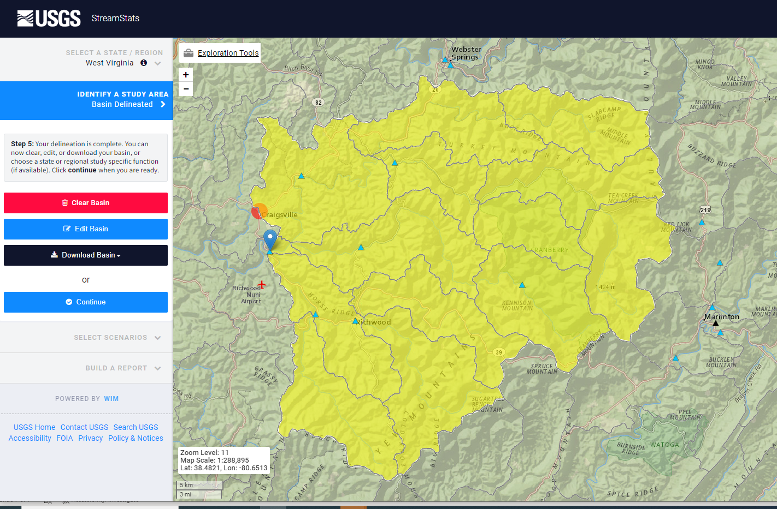
USGS Streamstats https://streamstats.usgs.gov/ss/
USGS utility that delineates basins, computes flow statistics, and other features
Computes 10-year, 20-year, 50-year, 100-year events based on local and regional equations
Streamstats are developed on a state-by-state basis
VA and WV Statistics are based on USGS Scientific Data Report 2025-5110

Slide 17
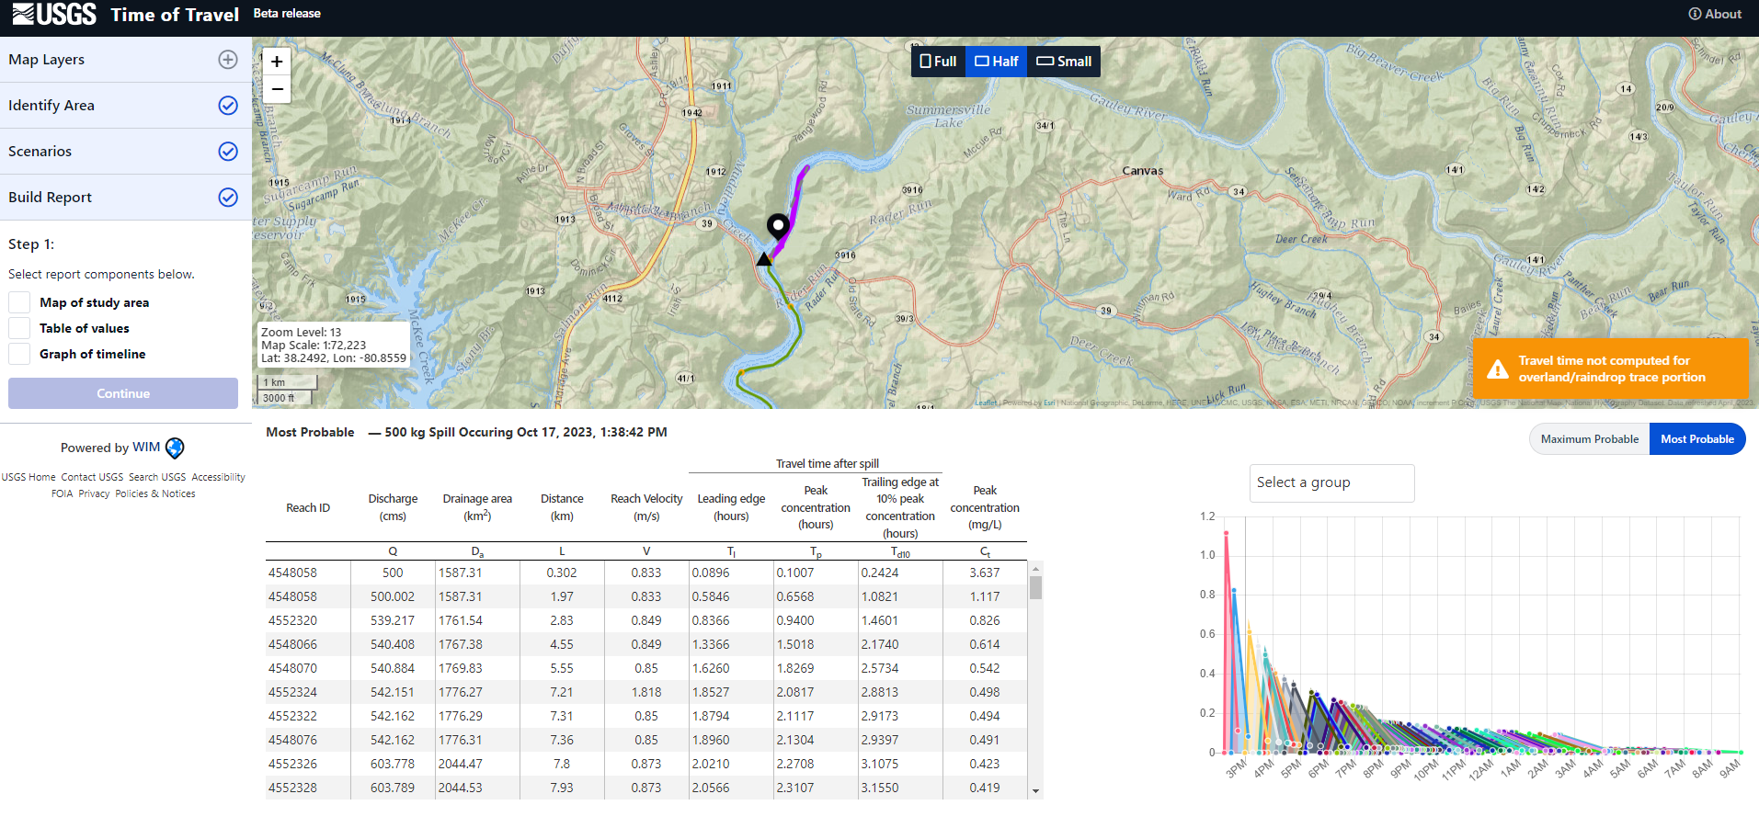
USGS Time of Travel tool https://streamstats.usgs.gov/tot-beta/
Tool based on Jobson’s equations to determine time of travel through a stream reach
Flood waves
Spill Response
Spill Planning

Slide 18
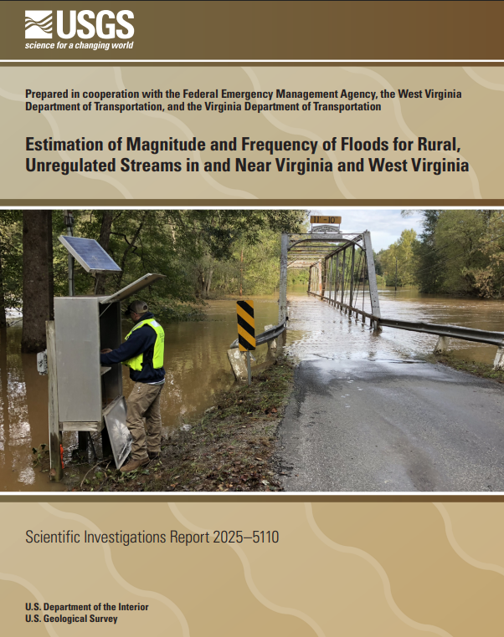
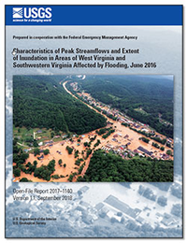
Useful USGS Reports
Estimation of Magnitude and Frequency of Floods for Rural, Unregulated Streams in and Near Virginia and West Virginia
USGS Scientific Investigations Report 2025-5110 (report)
  This report updates the “flood frequency”, or Annual Exceedance Probabilities (AEPs), across VA and WV
    Significant work to develop statistics in regulated basins that includes a “regulation index”
Characteristics of Peak Streamflows and Extent of Inundation in Areas of West Virginia and Southwestern Virginia Affected by Flooding, June 2016
  USGS Scientific Investigations Report-SIR 2017-1140

Slide 19
USGS Water Data APIs
API stands for Application Programming Interface and provides a developer with programmatic access to a proprietary software application. An API is software that makes it possible for application programs to interact with each other and share data.
  Typically, Python or R-scripts to define the retrievals
USGS tools such as WaterWatch and Groundwater Watch have been discontinued
  All USGS is still accessible, but many of the summary and visualization tools no longer exist. That’s a huge bummer!
  IF you have retrievals or visualizations that you need, please reach out to wdfn@usgs.gov or to the VA-WV WSC for assistance.

Slide 20
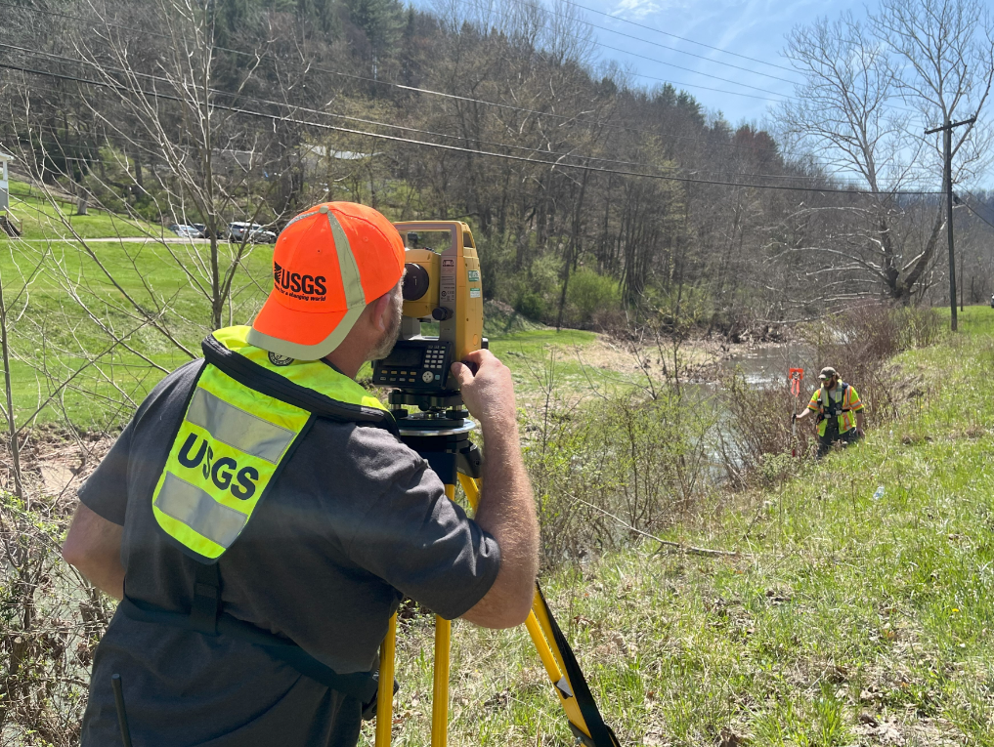
Questions???
Jeremy White
Charleston Field Office Chief
VA-WV Water Science Center
US Geological Survey
jswhite@usgs.gov
304-347-5130 x246

