Slide 1

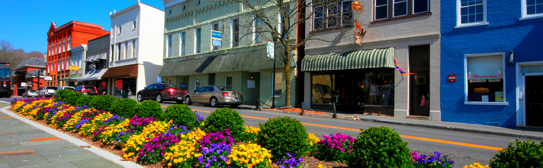




West Virginia Grant Resource Centers
Powered by: Marshall University and West Virginia University

Slide 2

Our Mission
To help small communities and other eligible applicants maximize federal and private dollars from grant applications to support economic development initiatives across the state.
This is a free resource.
WV Economic Development Council
WV Association of Counties
Appalachian Regional Commission
Notes:
Emphasize that we serve all grant eligible entities, including non-profits, city/county gov’t, small businesses, CTCs, etc.

Slide 3






Economic Development Drives Us
Workforce Development & Training
Economic Development
Community
Development &
Outdoor Recreation
Job Creation & Retention
Infrastructure
& Site Development
Notes:
Examples for each one: Workforce Development & Training: A training program to certify your existing staff; Economic Development: Purchasing equipment to expand your services; Community Development & Outdoor Recreation: Trails; Job Creation & Retention: Creating or retaining any job, full-time, part-time; Infrastructure & Site Development: Expanding utilities in an area

Slide 4




Pre-Award Process
Plan Development
  Partners
  Challenge Statement
  Goals
Funding Source Identified
  Agency/Foundation
  State-led connection
  Match required
Grant Prep
  Requirements Identified
  Metrics Identified
  Letters of Support
Grant Submission
  Requirements Met
  Timeline
  Partners Updated
Assistance Every Step of the Way

Slide 5
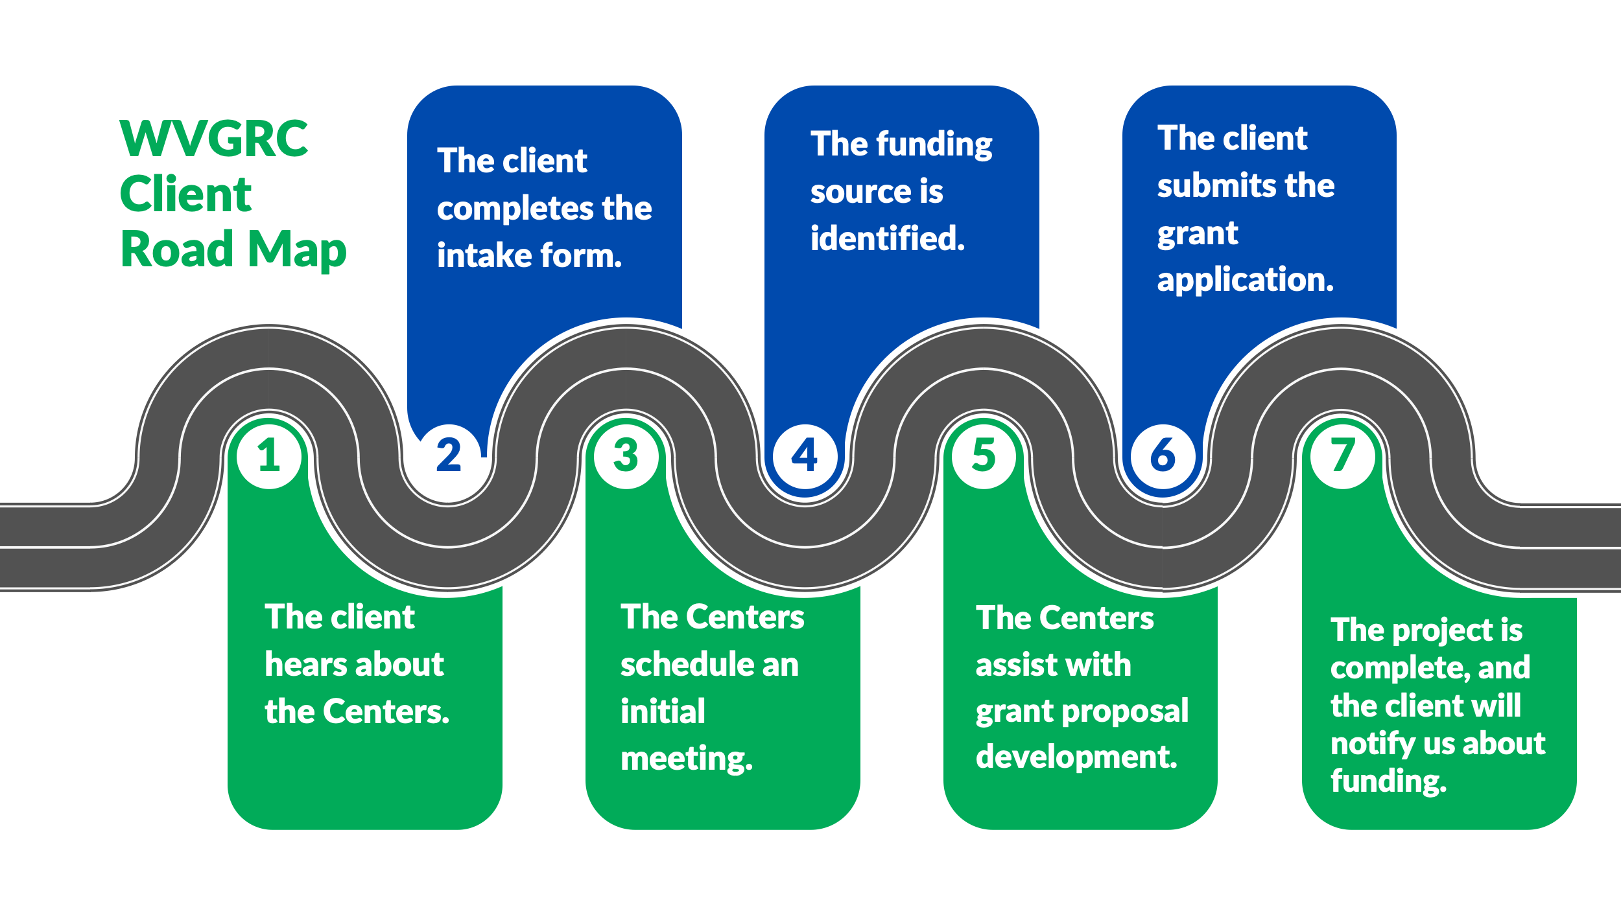
Working With Clients, Not For Clients

Slide 6
Growing Our Own: Upskilling Through Training
32
Grants 101 Workshops hosted
63
Live Grant Assistance Sessions hosted
5
Microcredential Courses led
Data Collected: January 1, 2023 – November 10, 2025
Notes:
Microcredential courses: 2 per year. Essentials of Grant Writing is offered in the Fall through WVU, mock grant app based on ARC; Intermediate Grant Writing is offered in the Spring or Summer through Marshall, real grant app writing; $250 per class; you don’t need to be a WVU or Marshall student to take either.

Slide 7
Deliverables for the
West Virginia Grant Resource Centers
Grant Writing & Grant Training
Research & Pull Stats
Facilitate Connections
Leverage University Assets
Build Grant Writing Capacity
Host Workshops & Convenings
Develop State Fact Sheets
Offer Grant Writing Certification
Provide Annual Report

Slide 8
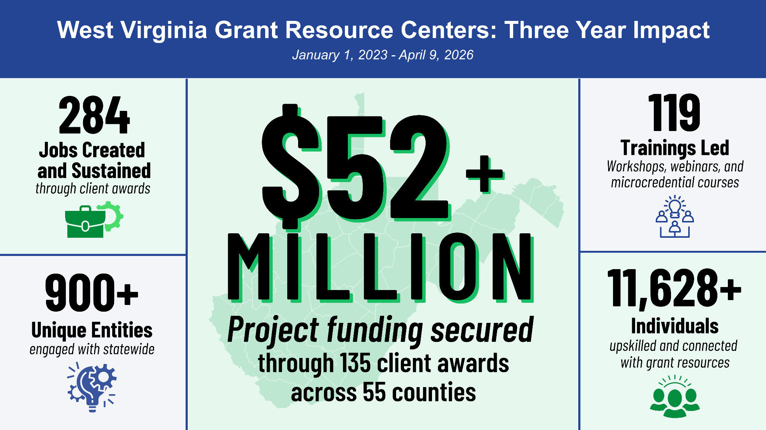

Slide 9











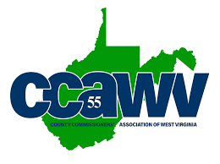



Thank You to Our Partners!
Notes:
Funded by ARC and WV State Legislature with support from the Steeley Foundation

Slide 10
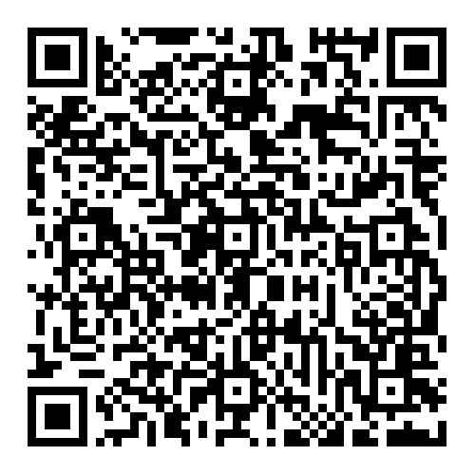
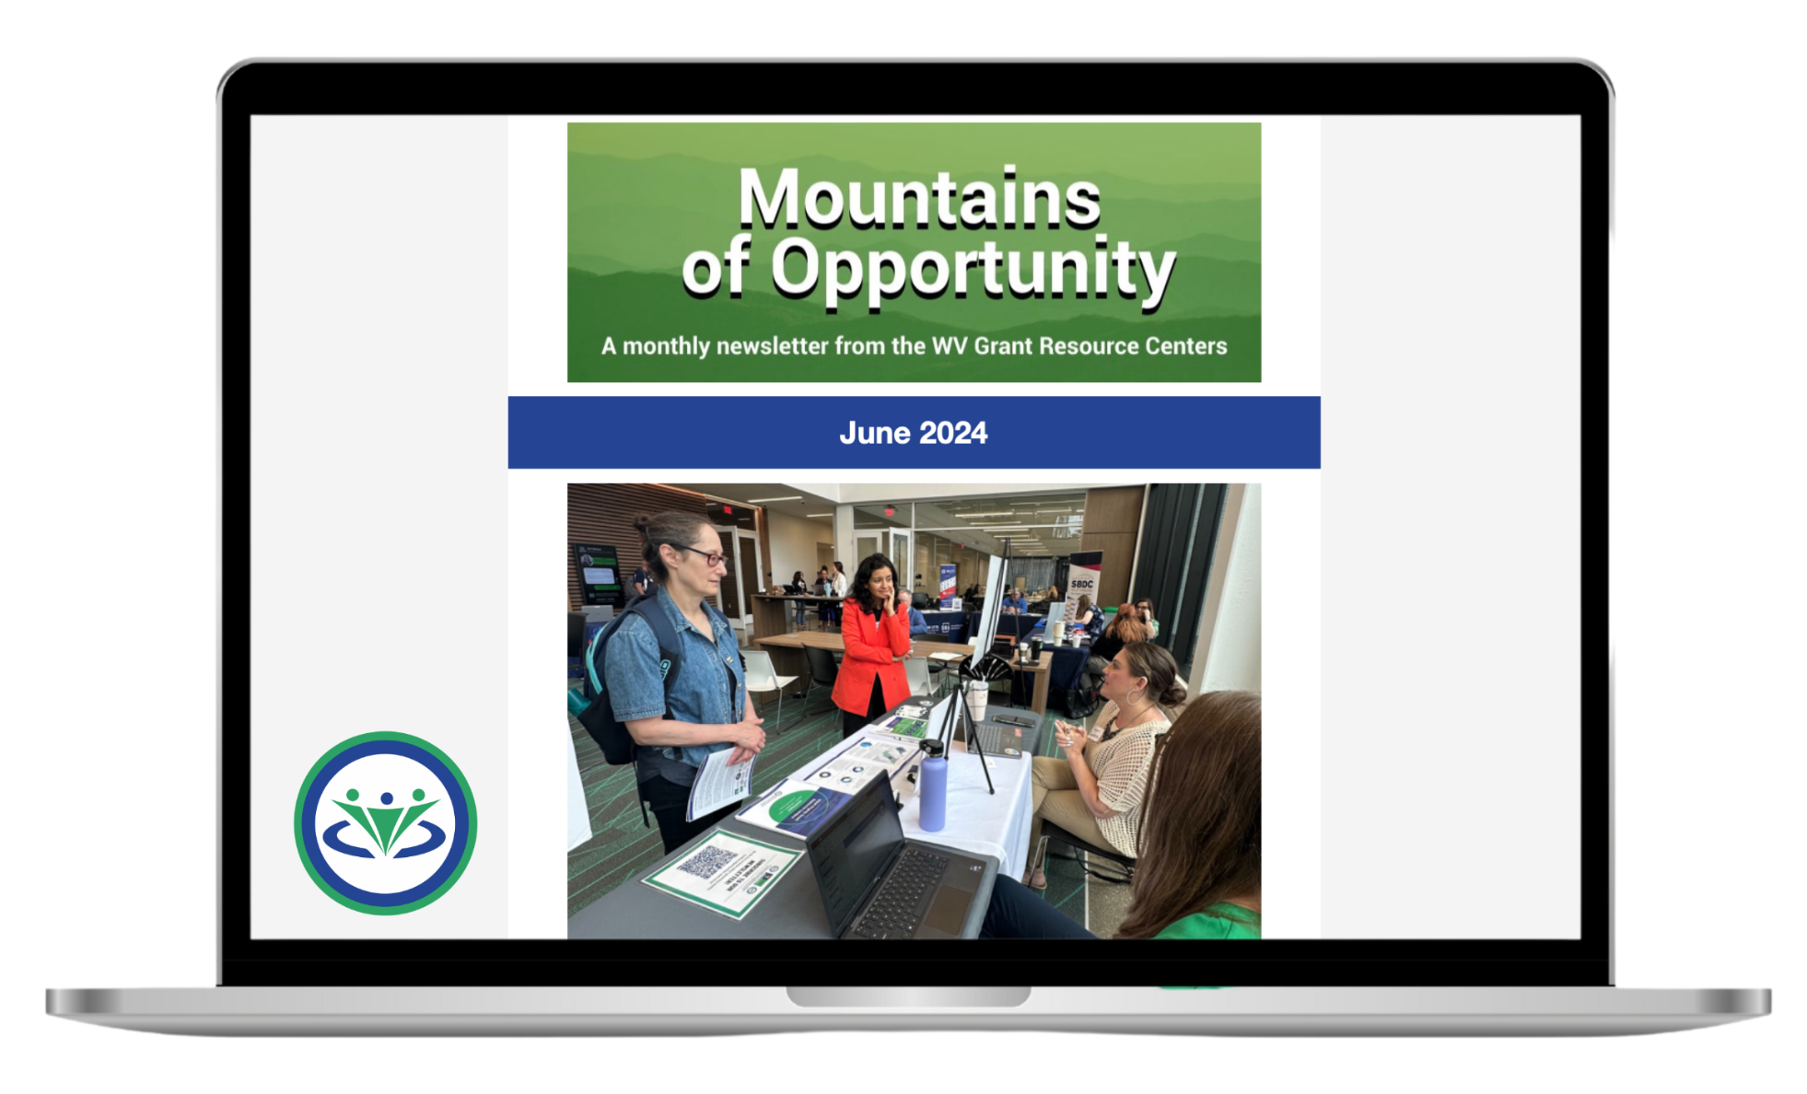
Sign up for our Newsletter!
Be the first to know about:
Subscribe here:
Funding Opportunities
Training and Event Updates
Client Spotlights, and more!
Notes:
Highlight the funding opportunities announcements

Slide 11

Universities United Project
A true 50/50 Partnership:
Clients, Funding, Trainings, & Projects
Sara Payne Scarbro
Associate Vice President for
Government Relations & External Affairs
Elizabeth Vitullo
Assistant Vice President for
Economic Innovation
sara.payne@marshall.edu
o: 304-696-2889
c: 304-417-0938
elizabeth.vitullo@mail.wvu.edu
o: 304-239-7811
c: 304-276-1745
Notes:
For big picture questions

Slide 12
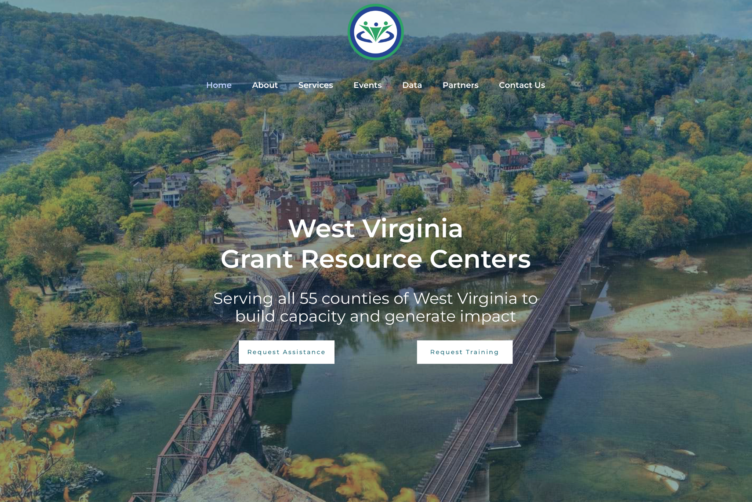
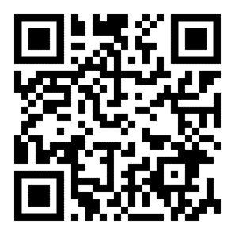
Visit Us Online!
Need grant writing training
or assistance elevating
your proposal?
Apply today and subscribe to our newsletter to receive updates from the West Virginia Grant Resource Centers.
SCAN HERE
www.wvgrantcenters.com

Slide 13


Grant Readiness
Powered by: Marshall University and West Virginia University

Slide 14
Getting Grant Ready
Questions?
Become Official
Learn
Plan Your Project
Gather Everything
Keep Learning

Slide 15
Get Registered
Questions?
As a 501(c)3, LLC, etc.
Become official with the IRS
SAM .gov
We can help!
Grants .gov
For most federal grants
Depending on your organization and who you request funding from…

Slide 16
Getting Grant Ready
Questions?
Become Official
Learn
Plan Your Project
Gather Everything
Keep Learning

Slide 17
Stay Informed
Questions?
Subscribe to Relevant Newsletters
WV Grant Resource Centers
WV Nonprofit Association
From funders (ex. ARC, TGKVF)
From your field
Local and state news

Slide 18
Do Your Research
Questions?
Relevant Needs
Economic Status
Project Effectiveness
Current Trends

Slide 19
Get to Know Funders
Questions?
Research funders to get to know their:
    Purpose (why do they exist?)
    Goals (what causes do they care about?)
    Priorities (what do they want to fund?)
    Funding Opportunities
    Typical Requirements
    Resources (successful grant examples, contacts, newsletters)

Slide 20
Getting Grant Ready
Questions?
Become Official
Learn
Plan Your Project
Gather Everything
Keep Learning

Slide 21
Build and Maintain Partnerships
Questions?
Be aware of organizations doing similar or complementary work in your area
Identify types of organizations you would like to partner with
Check in with existing partners
Brainstorm with stakeholders

Slide 22
Develop a SMART Project
Questions?
Think through your project design carefully
Choose a project that will contribute to the “greater good” and appeal to funders’ priorities
Visualize your project and list all activities
Create a rough timeline (ex: 1 year, 18 months, summer start date)
Decide your overarching goals
Draft SMART objectives
Consider potential short-term and long-term benefits
Narrow down who you will serve and how you will recruit

Slide 23
Complete Planning Activities
Questions?
Logic models
Construction projects will almost always require a Preliminary Engineer Report (PER) or equivalent
Feasibility studies and other assessments can help you prove the need for your project
Some projects require energy, environmental, and other types of assessments
There are resources to help during this stage—from planning grants to technical assistance!

Slide 24
Getting Grant Ready
Questions?
Become Official
Learn
Plan Your Project
Gather Everything
Keep Learning

Slide 25
Gather Your Documents
Questions?
Many funders will request…
IRS tax-exempt letter
List of board members
Resumes of key staff
Service area map
Planning documents
Budget quotes
Recent financial documents
Organizational chart

Slide 26
Other Info to Have Ready
Questions?
Mission statement and a brief history of your organization
List of other grant-funded projects your organization has undertaken and their results
Sustainability plan for the proposed project
A summary of your organizational capacity
A detailed budget
Data about community needs and your project’s effectiveness

Slide 27
Getting Grant Ready
Questions?
Become Official
Learn
Plan Your Project
Gather Everything
Keep Learning

Slide 28
Keep Learning
Questions?
Stay alert of funding opportunities and relevant legislation
Learn from other organizations doing similar work
Sharpen your grant writing skills
  WVGRC offer bi-monthly Live Grant Assistance Sessions, Grants 101 Workshops, and Grant Writing Certifications
  Grant writing resources:
    Instrumentl
    Grants.gov Grant Writing Basics

Slide 29
Visit Us Online!
Need grant writing training
or assistance elevating
your proposal?
Apply today and subscribe to our newsletter to receive updates from the West Virginia Grant Resource Centers.
SCAN HERE
www.wvgrantcenters.com

Slide 30
Questions?
Questions?
Katie Chaffins
katie.chaffins@marshall.edu

