Slide 1



2023 Elevation Certificate Update
Overview of Changes to the Elevation Certificate Form

Slide 2
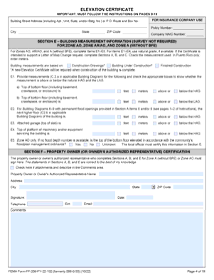
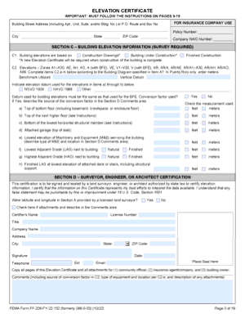
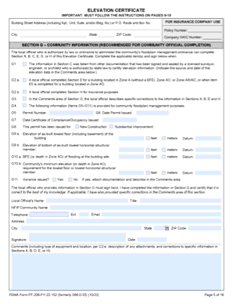
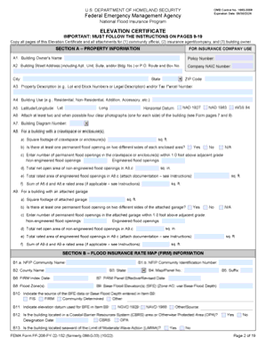
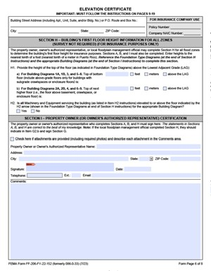
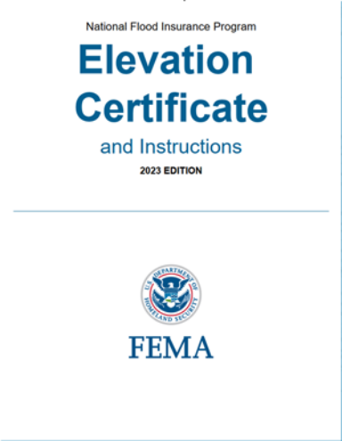
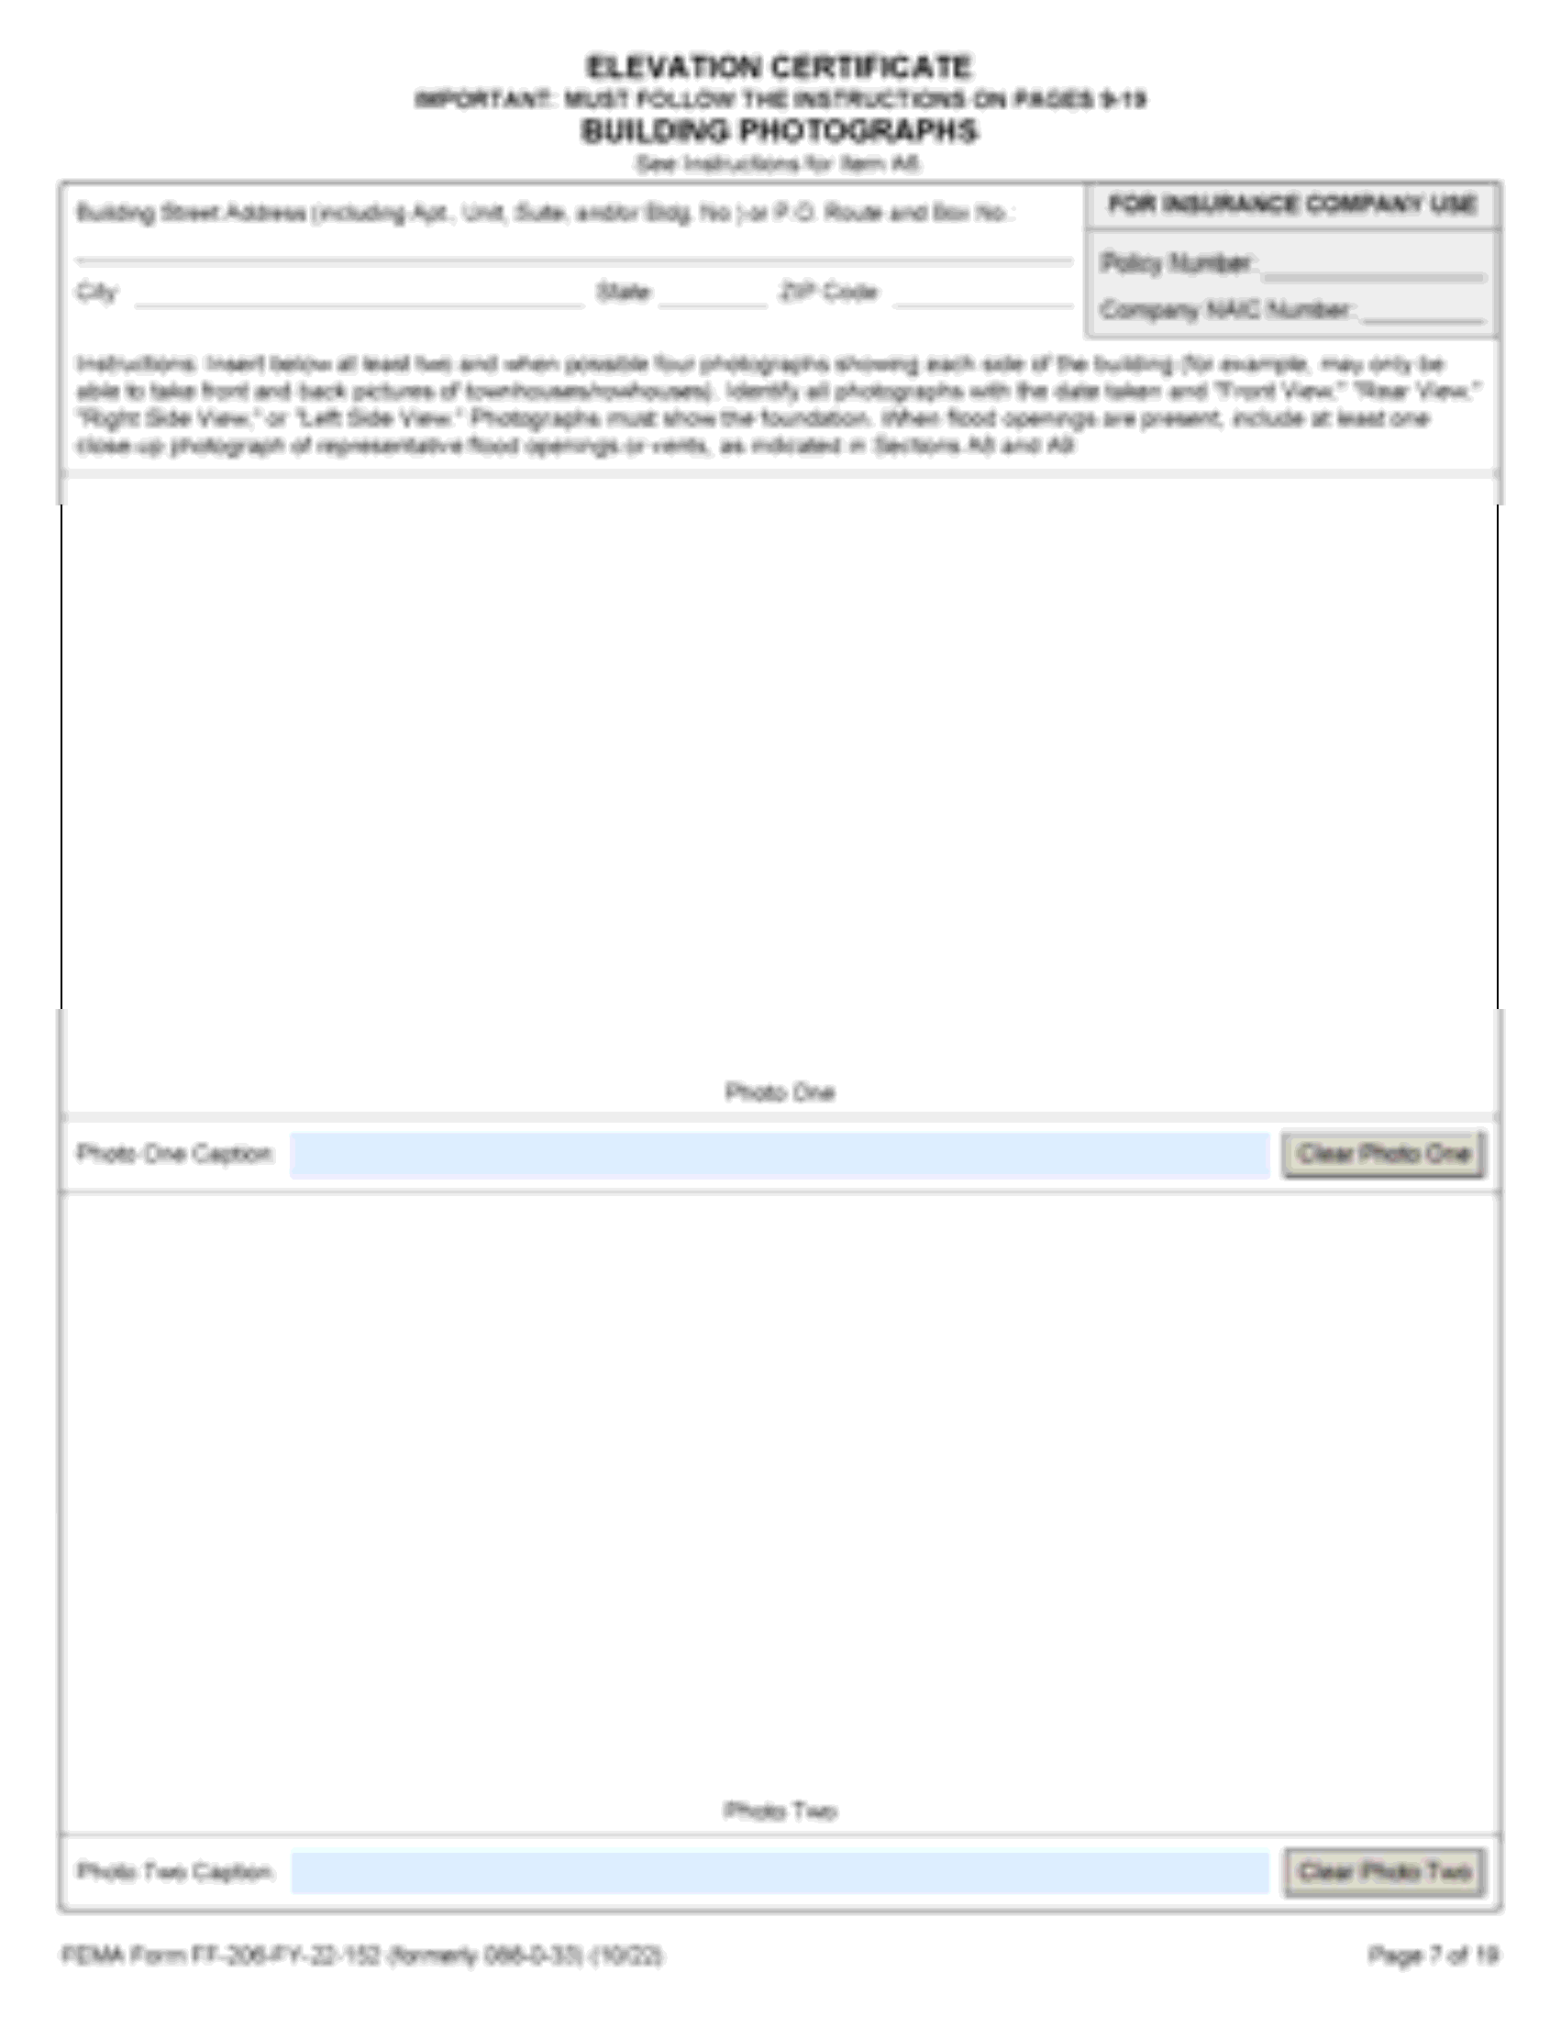



FEMA Elevation Certificate Form
Notes:
Let’s begin

Slide 3
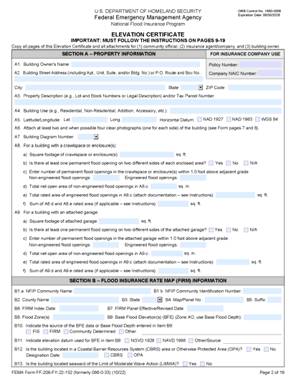

Purpose of the Elevation Certificate
Records information used to determine compliance with building codes/local floodplain ordinances
Tool for supporting Letters of Map Change (LOMC)
Prerequisite for Community Rating System (CRS) participation. Required for new construction.
No longer required to rate flood insurance for Post-FIRM buildings
May be used for flood insurance rating in any flood zone.
Download the 2023 Edition:
www.fema.gov/flood-insurance/find-form/underwriting
**Legend: dark green font and boxes indicate new or changed information

Slide 4
Many uses (and users) of the Elevation Certificate
Community Assistance Visit
Building Inspector
Insurance
Elevation Certificate
Letter of Map Change
Floodplain Manager
Community Rating System
Developer or
Builder
Floodplain Management
Flood Insurance
Flood Map Change
The EC is an important administrative tool of the NFIP for floodplain management, insurance, and map changes
Notes:
The Elevation Certificate is an important administrative tool of the NFIP.
It can be used to provide elevation information necessary to ensure compliance with community floodplain management ordinances, to inform the proper insurance premium, and to support a request for a Letter of Map Change (LOMA, CLOMA, LOMR-F, or CLOMR-F).

Slide 5
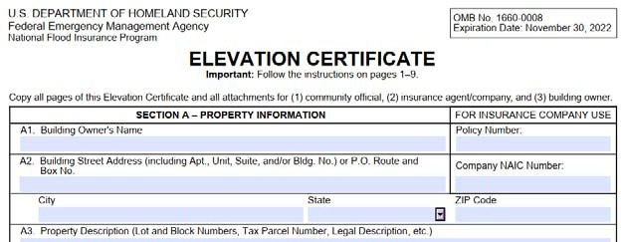
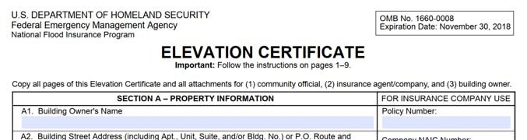
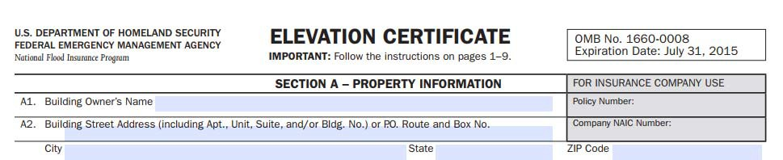




Updating the Elevation Certificate (EC)
Updates are part of a routine cycle:
  New editions of the EC are released every few years.
  Updates address emerging issues, provide clarification, and add more detail.
  The amount of change varies version to version (minor or major).
A completed Elevation Certificate form does not expire, unless there is a physical change to the building that invalidates information in the completed EC (Sections A, C, E or H).
Federal Emergency Management Agency
Notes:
Elevation Certificates can be used for floodplain management and for insurance decisions indefinitely, as long the building and its adjacent grade have not been altered in any way that it would modify any information that have been certified, specifically measurements and elevations in Sections A, C, E, or H.
If modifications have been made to the building or its adjacent grade, a new elevation certificate should be generated using the latest version of the form. A new form would be required, for example, if a building has been Substantially Damaged or Substantially Improved, or any modification that changes the information on the certificate making it invalid.

Slide 6
Updating the Elevation Certificate (EC)
Changes to the EC form in 2023 address several key issues.
  Improves alignment with the NFIP flood insurance rating methodology
    Reduces the burden on property owners to obtain elevation information for insurance
  Provides more clarity and detail to floodplain managers when regulating development
  Provides more specificity for buildings with a combination of both engineered and non- engineered flood openings
  Updates outdated phone numbers and web addresses
All new ECs on or after November 1, 2023, are required to use the new form.
Federal Emergency Management Agency
Always download and use the latest version of the EC form!

Slide 7
National Flood Insurance Program (NFIP) Key Terms
FIRM = Flood Insurance Rate Map
Flood Insurance Study
BFE = Base Flood Elevation
SFHA = Special Flood Hazard Area (1% Annual Chance Flood)
LAG = Lowest Adjacent Grade
HAG = Highest Adjacent Grade
Bottom Floor Elevation
Lowest Floor Elevation
First Floor Height
**Legend: dark green font indicates new or changed information
Depicts Community’s Flood Zones and Risk
Details history of community’s flooding and more detailed info than on FIRM
Surface Water Elevation of a 1% chance flood occurring in any given year
Area expected during 100-yr Event
Measured immediately next to the building where the foundation or building support touches the ground
Lowest enclosed area (basement, crawlspace, slab, garage enclosure).
Recorded elevations by Surveyor in Section C of Elevation Certificate.
Before Construction: Minimum building flood elevation level (BFE + Freeboard) for permit.
As-Built: Elevation of the lowest floor (including basement) of the finished construction in accordance with the permit. Interpreted by Floodplain Administrator in Section G.
First living floor of the building at or above grade. Used for rating flood insurance in Section H.

Slide 8
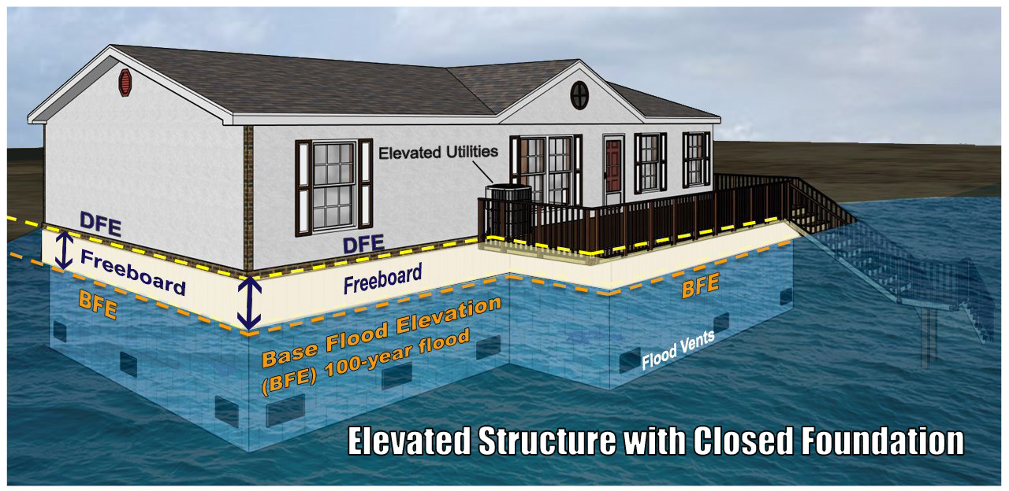

Slide 9
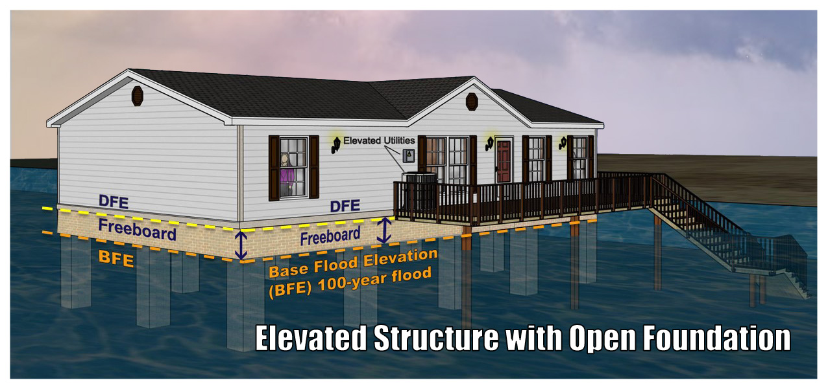

Slide 10
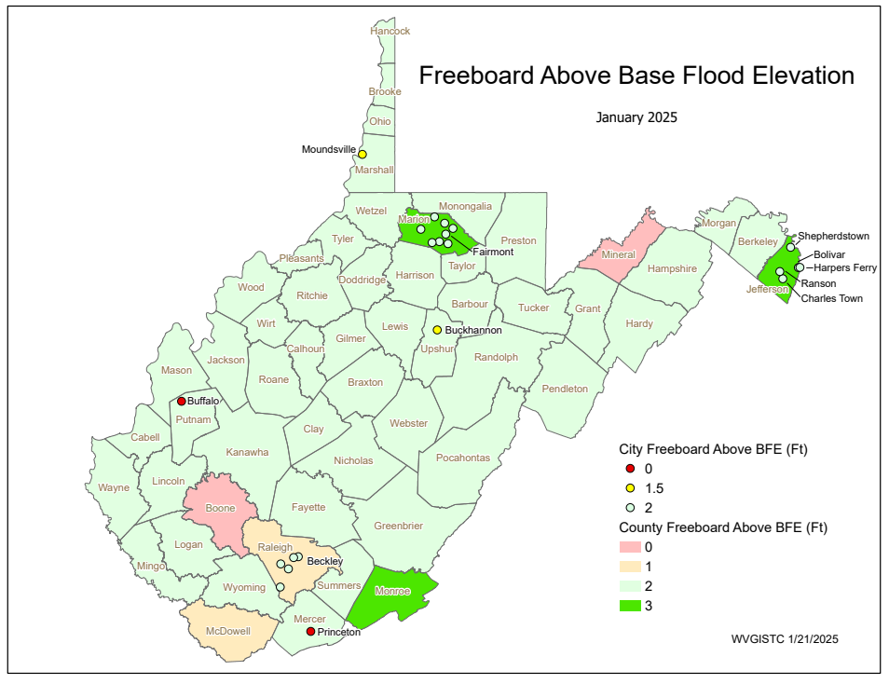

Slide 11


NFIP Flood Insurance Rating Methodology
Notes:
FEMA has updated the NFIP’s Insurance Rating System to better reflect a property’s risk. The Elevation Certificate document has several characteristics that can be used to support more favorable flood insurance premiums.

Slide 12
NFIP Flood Insurance Rating Methodology
Defining a Property’s Unique Flood Risk
The flood zone and Base Flood Elevation (BFE) are no longer used as direct rating variables.
Elevations are considered for all properties, regardless of flood zone.
Rating Variables
Geographic Location
Structural Variables
Prior Claims
Discounts
  Mitigation
  Statutory
  CRS
FEMA now includes more flood risk variables for rating flood insurance: Geographic Variables like flood frequency, type of flooding, distance to the flooding source, and Structure Variables such as the cost to rebuild the structure. Other rating variables are Prior Claims and Discounts.
Notes:
Flood Zone and BFE are no longer used as direct rating variables.
FEMA now includes more flood risk variables for rating flood insurance: Geographic Variables like flood frequency, type of flooding, distance to the flooding source, and Structure Variables such as the cost to rebuild the structure.
Other rating variables are Prior Claims and Discounts.

Slide 13

Structural Variables: Building Characteristics
Building Occupancy
Construction Type
  For single-family homes: framed, masonry, other
Foundation Type
First Floor Height
Lowest Adjacent Grade
Building’s Replacement Cost Value
  Considers square footage (for single-family homes)
Number of Floors in building
  Above ground floors only; not counting basements/enclosures
Date of Construction
Elevation Certificate
Building Diagrams Floor Elevations
The Building Diagrams and Flood Elevations of the Elevation Certificate capture many of the building elements that are needed to determine the insurance rate, including the Foundation Type, First Floor Height, and Lowest Adjacent Grade
Notes:
Structural variables like the building’s elevation are now used for rating flood insurance in all flood zones, and not just those the Special Flood Hazard Area. This is one of the major updates that has been incorporated into the new elevation certificate.
Many of the building characteristics that affect the structural variables are recorded on the Elevation Certificate form.
To some extent, the data for geographic location variables and some of the mitigation discounts are also captured on the Elevation Certificate. As you can see from this list, the Building Diagrams and Floor Elevations of the Elevation Certificate captures many of the building elements that are needed to determine the insurance rate, including the Foundation Type, First Floor Height, and Lowest Adjacent Grade.

Slide 14

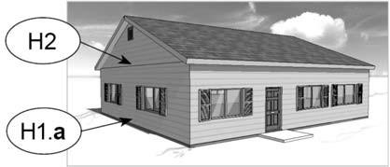
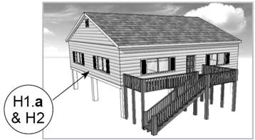
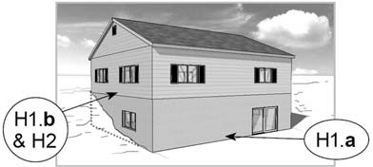



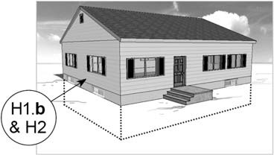
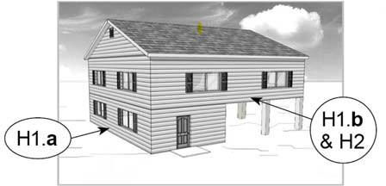
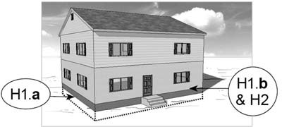



6 Foundation Types (Section H)
11 Elevation Certificate Diagrams (Section A)
Slab on Grade (Non-Elevated)
Elevated without Enclosure on Posts, Piles, or Piers
Elevated with Enclosure Not on Posts, Piles, or Piers (Solid Foundation Walls)
Diagram 1A, 1B, 3
Diagram 5
Diagram 7
Basement (Non-Elevated)
Elevated with Enclosure on Posts, Piles, or Piers
Crawlspace (Elevated, including Non-Elevated Sub-Grade Crawlspace
Diagram 2A, 2B, 4
Diagram 6
Diagram 8, 9
6 New Foundation Types for Insurance Ratings (Section H) correlate to 11 Building Diagrams (Section A)
Notes:
There are six new classifications of foundation types used as structural variables for insurance ratings. These six foundation types correlate to the 11 building diagrams used in Section A of the Elevation Certificate.
There are no major changes to the 11 building diagrams in the 2023 edition. But it is worth noting how they relate to the foundation types.

Slide 15
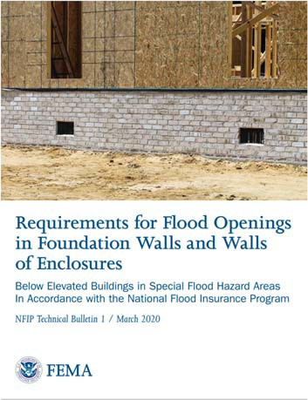
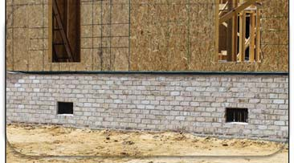

Mitigation Discounts
Flood Openings (in enclosures/crawlspaces)
  Rates are discounted for buildings
in any flood zone with proper openings in the enclosure.
  The flood insurance application will need to reflect the proper information in order to receive the discount.
Elevation of Machinery & Equipment (M&E)
  Rates are discounted for policies with
M&E elevated above the first elevated floor.
https://www.fema.gov/sites/default/files/documents/fema_discount-Explanation-Guide.pdf
(note: case sensitive link!)
Federal Emergency Management Agency
Notes:
Flood insurance discounts are available for policy holders with proper documentation of flood openings compliant with 44 CFR 60.3 and for machinery and equipment elevated above the first elevated floor.

Slide 16
Mitigation Discounts
Flood Openings (in enclosures/crawlspaces)
  Rates are discounted for buildings
in any flood zone with proper openings in the enclosure.
  The flood insurance application will need to reflect the proper information in order to receive the discount.
Elevation Certificate
Flood Openings
Elevation of Machinery & Equipment (M&E)
  Rates are discounted for policies with
M&E elevated above the first elevated floor.
Elevation Certificate
M & E
https://www.fema.gov/sites/default/files/documents/fema_discount-Explanation-Guide.pdf
(note: case sensitive link!)
Eligibility for both mitigation discounts could be documented on the Elevation Certificate. The building’s flood openings are documented in Section A, and the Machinery & Equipment Elevation is either documented in Section C or in the new Section H.
Notes:
Eligibility for both mitigation discounts could be documented on the Elevation Certificate. The building’s flood openings are documented in Section A, and the Machinery & Equipment Elevation is either documented in Section C or in the new Section H.

Slide 17
Impact on Elevation Certificate Updates
More details about flood openings in Section A help determine the mitigation discount.
Floodplain managers still need the flood zone and Base Flood Elevation (BFE) in Section B of the form for local floodplain management regulations and building codes , but they are no longer used as direct rating variables.
First Floor Height (FFH) for insurance rating
  Survey still not required—Section E didn’t capture the correct info needed to find FFH.
  More information about the location of M&E is needed to determine mitigation discount.
A new EC section was needed = Section H
  Use for insurance rating without a survey.
  Section H is recommended over Section E.
Elevation Certificate was updated to support more accurate flood insurance ratings in all flood zones while still needed for floodplain management and lender decisions
Notes:
In summary, the Elevation Certificate was updated to support more accurate flood insurance ratings in all flood zones without the need for a survey.
Surveys will still be needed for floodplain management decisions, and the new form helps floodplain managers by recording more specific and clearer details about the building and its flood openings to determine if compliant with local floodplain management regulations and building codes. This enhanced information is also used to help to determine eligibility for mitigation discounts.
Flood insurance doesn’t require a Flood Zone as a direct rating variable anymore, but floodplain managers and lenders still need to know the flood zone for regulatory and lending decisions, and Section B has been updated to better support those decisions.
In Sections C and E there are changes that relate to determination of First Floor Height, and the new Section H is used to rate buildings even outside the SFHA.

Slide 18
2023 Elevation Certificate (EC) Form

Slide 19
Overview of Changes to the Sections of the EC
Section A – Property Information
Section B – FIRM Information
Section C – Building Elevations (Survey needed)
Section D – Surveyor Certification (for Section C)
Section E – Building Measurements (Survey not needed)
Section F – Owner or Representative Certification (for Section E) *Additional information*
Section G – Community Information (Recommended)
Section H – First Floor Height (insurance only; survey not needed)
Section I – Owner or Representative Certification (for Section H)
*Expanded*
*Additional information*
*More instructions, clarity*
*Additional information*
*More instructions, clarity*
*Expanded*
*NEW SECTION*
*NEW SECTION*
Federal Emergency Management Agency
**Legend: dark green font and boxes indicate new or changed information
Notes:
Every section of the form has been modified.
Section A has been expanded to ask for additional information. Section B is also asking for additional information.
There's more detailed instructions for Section C and Section E.
Additional information in the surveyor certification and property owners in Sections D and F.
An expanded Section G that's for community officials.
And then we have the new sections Section H to document first floor height for insurance purposes only and Section I is for property owners or their representatives to certify their measurements in Section H.
So let's go section by section through the changes.

Slide 20
Section A
Property Information

Slide 21
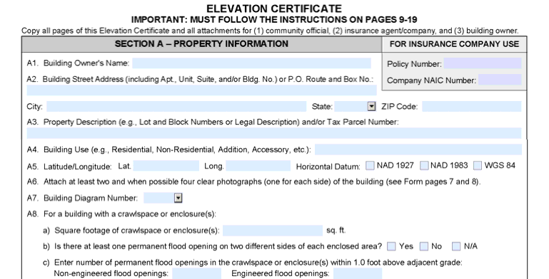
Section A – Property Information
Can be completed by the community or homeowner
Property Description & Building Use
Latitude/Longitude &
Horizontal datum (WGS 84 added)
Photographs, two required for all uses
– four, when possible
Building diagram number
Measurements of crawl spaces, enclosures, attached garages, and flood openings
**Legend: dark green font and boxes indicate new or changed information
Notes:
Section A of the elevation certificate can be completed by anyone, the community or the property owner or the surveyor, and it's where we capture information about the building’s location, the type of foundation, the latitude and longitude, and information about flood openings.
There's a new Horizontal datum option WGS 84. There's a new check box there.
Four photographs of each building, when possible, instead of only two. For row houses and other buildings where you can't photograph four sides of the building because only the front and back are visible, then two pictures. In all other cases, the form asks for four photographs showing all four sides of the exterior.
Pictures should also capture things like flood openings, machinery and equipment, and they should support the selection of the building diagram.

Slide 22
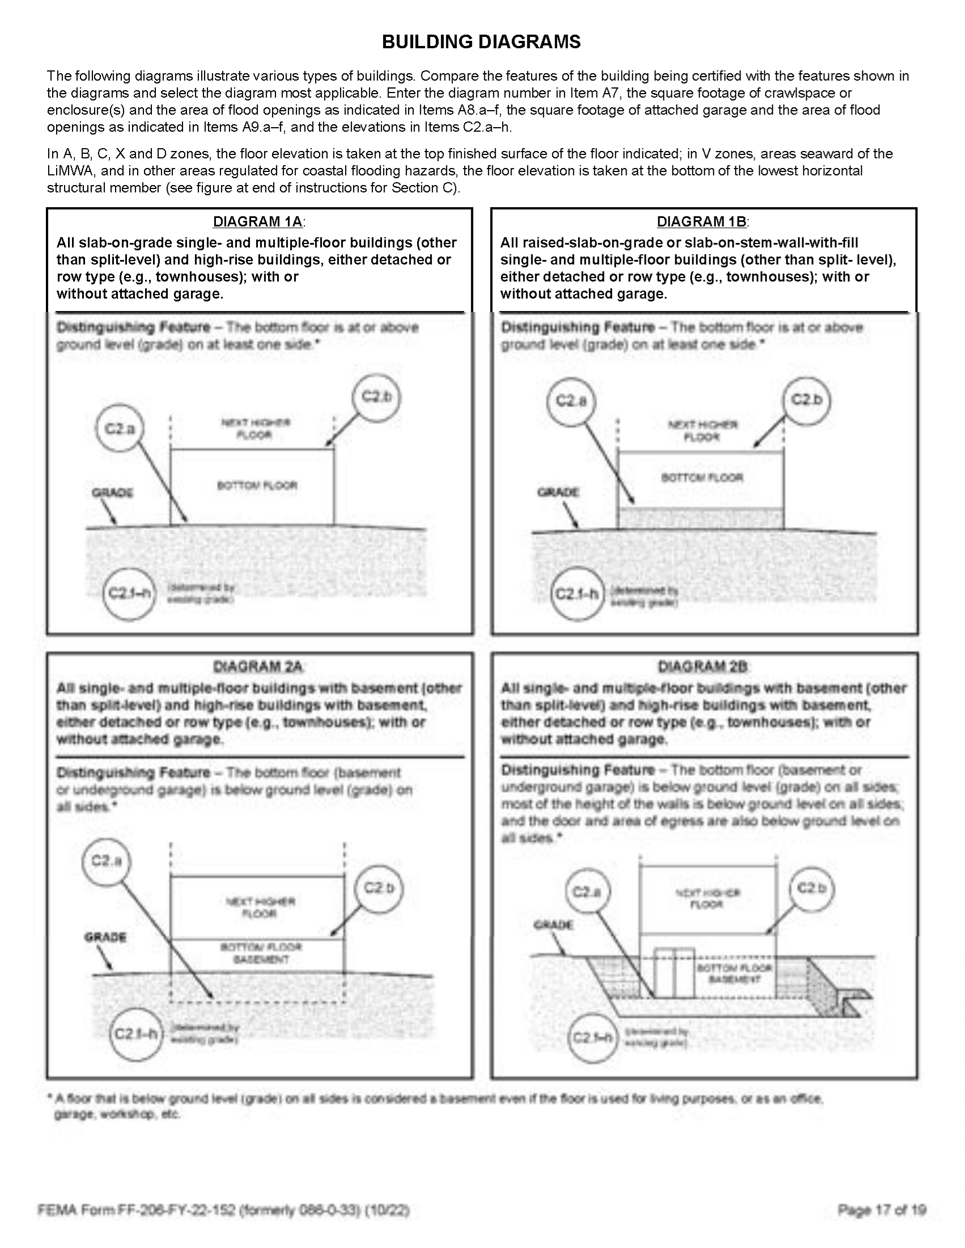
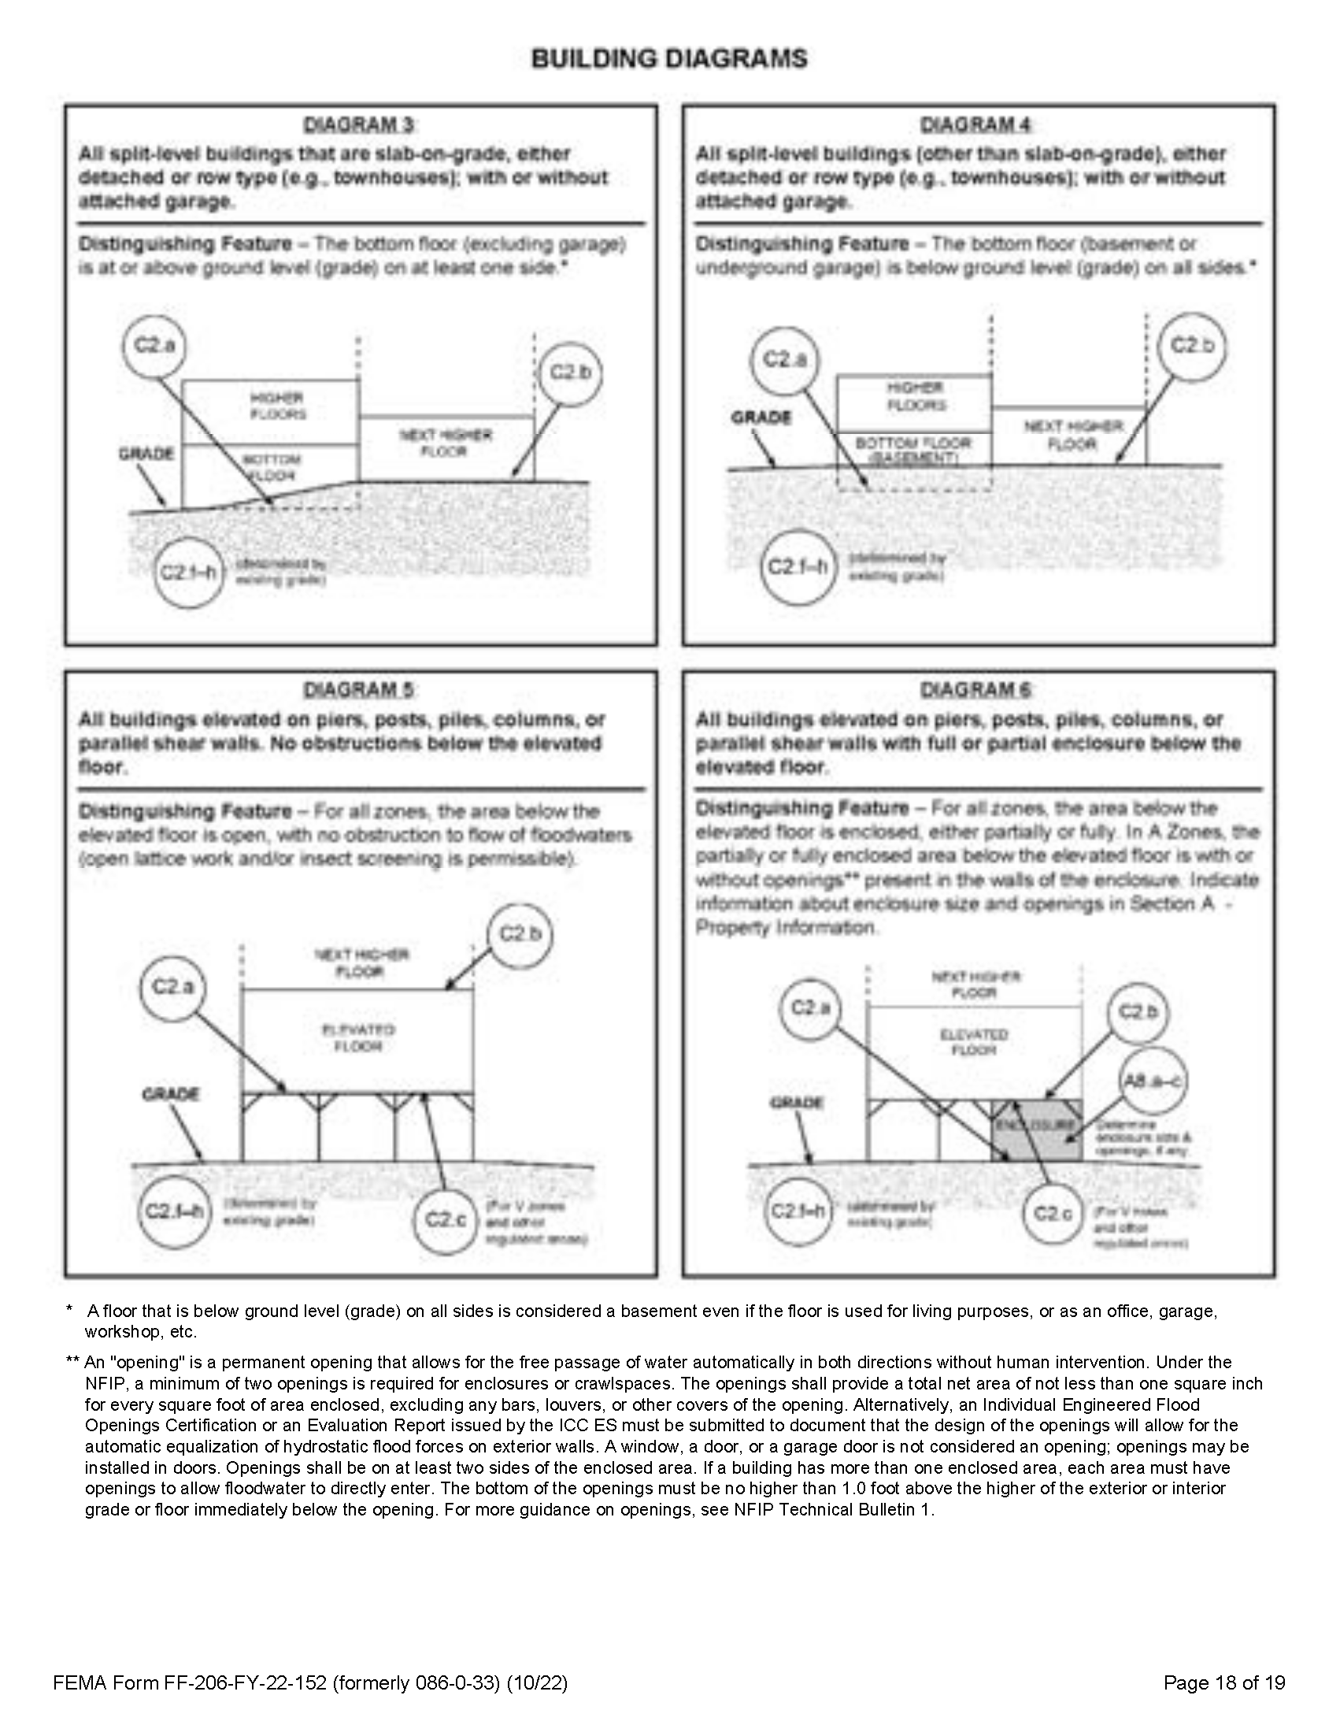
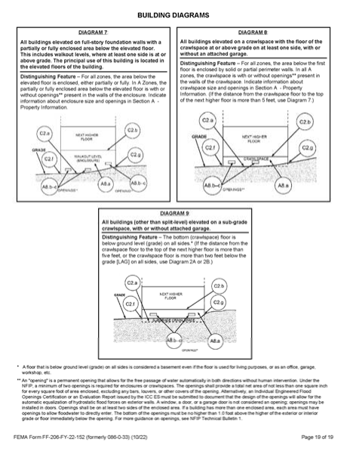
11 Building Diagrams: Clarification on Diagram 7 and 8
Notes:
There are no major changes to the 11 building diagrams, but there is a clarification in the instructions regarding the differences between Diagram 7 and Diagram 8.

Slide 23
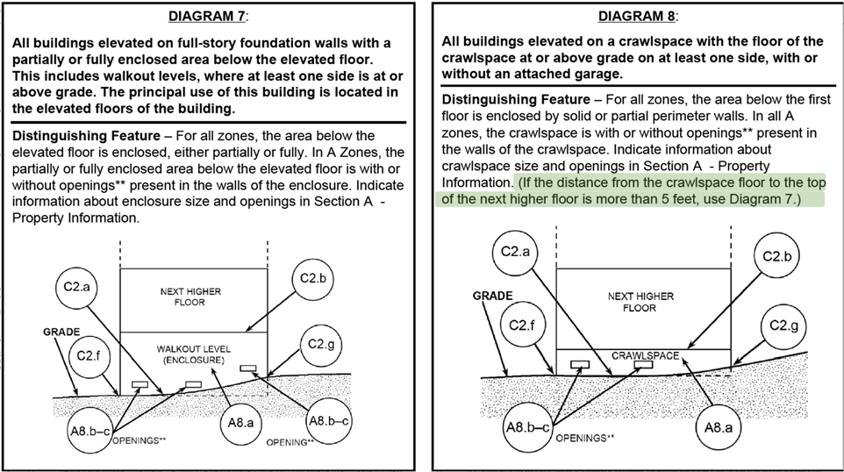
Building Diagrams: Clarification on Diagram 7 and 8
Notes:
Specifically, that when the crawl space height is more than 5 feet, generally that's 4 feet to the top of the foundation wall, assuming a 12-inch floor joist resulting in a 5-foot difference between the bottom floor and next higher floor. That's not a crawl space.
If it's more than 5 feet use Diagram 7 This is not a policy change, it's just a clarification about what the difference is between the Diagrams 7 and 8 now in print in the instructions..

Slide 24
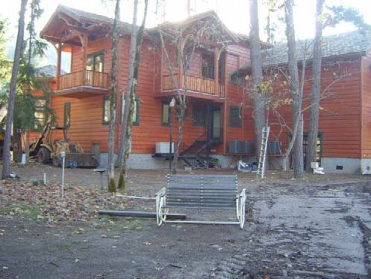
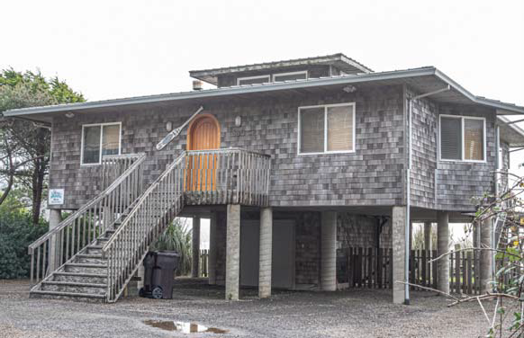
A8 – Crawlspace or Enclosure
Building Diagrams 6, 7, 8, 9
Photo: B. Kaiser
Photo: M. Paine
Notes:
The elevation certificate still collects information about the area of the crawl space or enclosure areas which still apply to building Diagrams 6 through 9. There is no change here.

Slide 25
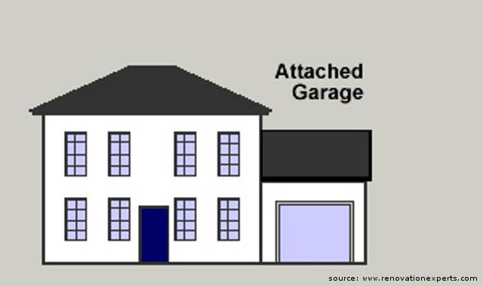
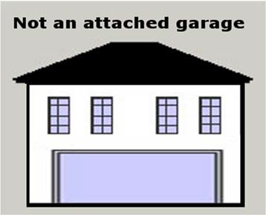
A9 – Attached Garage
Attached Garage
Common wall, Single structure
Nothing above the garage
Not an Attached Garage
Parking on the bottom floor
Enclosure underneath an elevated building
Notes:
An attached garage, A9 on the elevation certificate, is one that is attached and next to the building or beside the building, not underneath or separate from the building.
On the left here you see an illustration of an attached garage with a common wall. It's a single structure.
If you have a garage that's actually the first floor of an elevated building like the one on the right where you're parking on the bottom floor and it's actually underneath an elevated building, that's not an attached garage. That's an enclosure. And so those measurements should be included in section A8, not in A9.

Slide 26
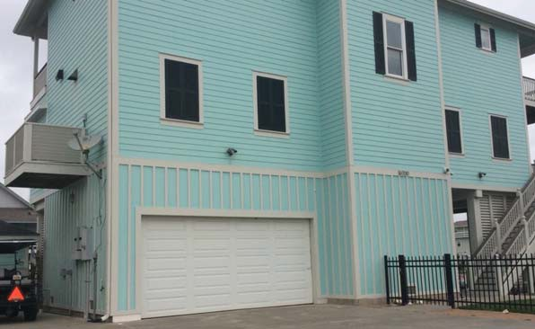
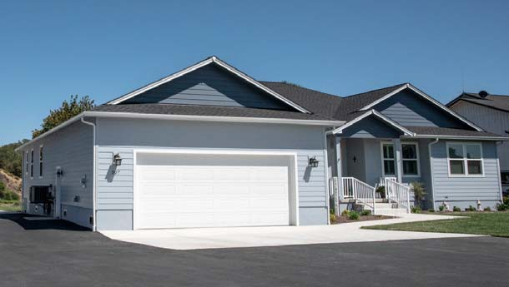
A8 / A9 and Flood Openings
A8: Enclosure (not Attached Garage)
A9: Attached Garage
A9
A8
Photo: M. Paine
Photo: M. Gilbert
Notes:
The building on the left is elevated. And they're parking on the 1st floor. That garage is an enclosure used for parking, not an attached garage. And the measurements for that area should be recorded in Section A8. That garage is an enclosure used for parking, not an attached garage. And the measurements for that area should be recorded in Section A8.
The one on the right is an attached garage and you would record its dimensions and the flood openings in Section A9.

Slide 27
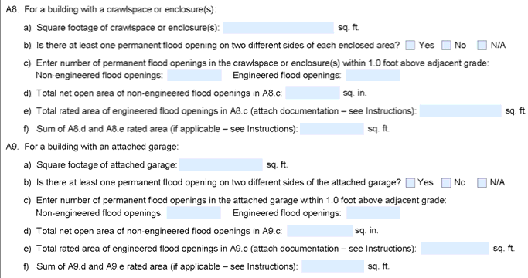
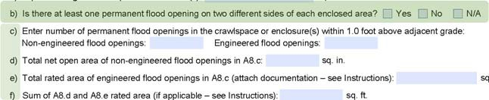
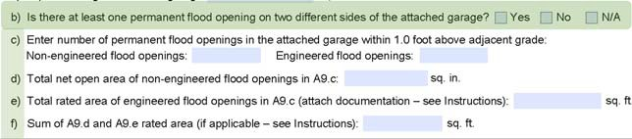
Flood Openings
A permanent flood opening allows for the free passage of water automatically in both directions without human intervention.
Sections A8 and A9 expanded to collect more information about flood openings and the NFIP requirements...
A minimum of two openings (at least one on two different sides) are required for every enclosed area or crawlspace. (A8b/A9b)
  ASCE 24 & building code consistency
Detailing number and type(s) of flood openings
Notes:
A permanent flood opening allows for the free passage of water automatically in both directions without human intervention.
The new form collects more information about these flood openings than before.
Sections A8 and a A9 have been expanded to more closely align with building codes ASCE 24 and the minimum standards of the NFIP.
For NFIP compliance enclosures subject to flooding, enclosures need 2 openings for every enclosed area and at least one square inch of opening per square foot of enclosure.
That ASCE 24 and most building codes require that there be openings on at least two different sides of the enclosure. Previously, the elevation certificate did not capture that. Now under A8b and A9b, there's a new question. Is there at least one permanent opening on two different sides of the enclosed area or the attached garage? That’s a Yes, No, or N/A response.

Slide 28
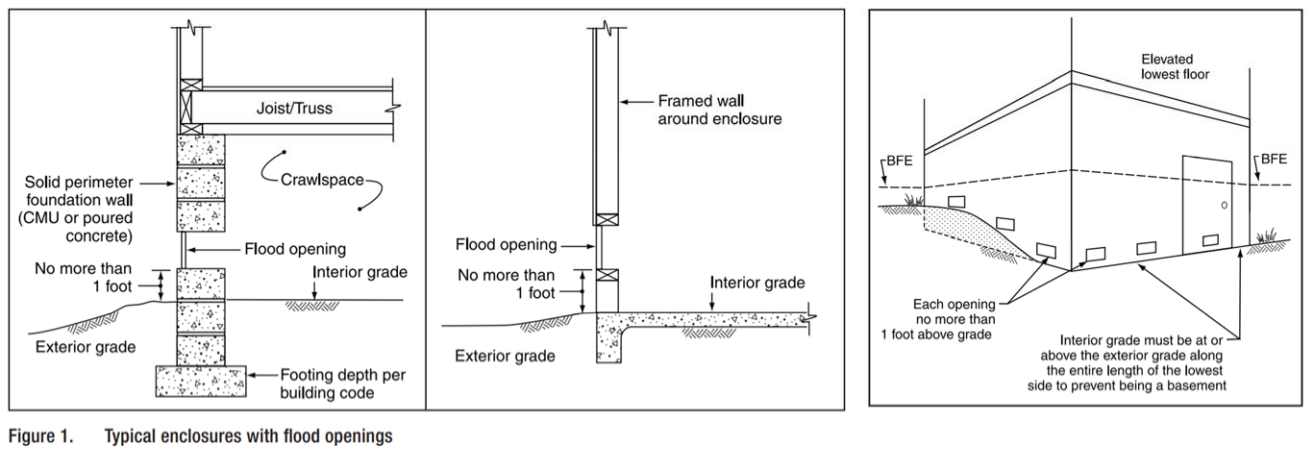
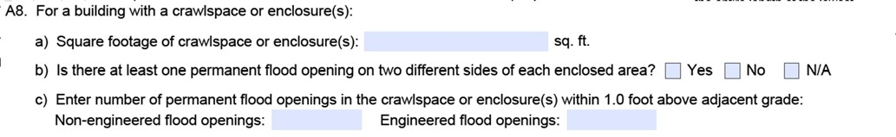
No more than one (1.0) foot above grade
Federal Emergency Management Agency
Notes:
Only count flood openings that are within one foot of the adjacent grade, either the interior grade or the exterior grade.
If the bottom of the opening is 12 inches or less from the ground, then it can be counted. But if it’s higher than one foot on both sides of the wall, then it’s just not a flood opening and should not be recorded at all in Section A.

Slide 29
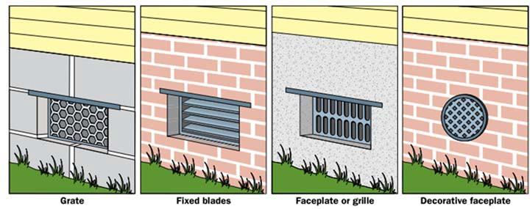
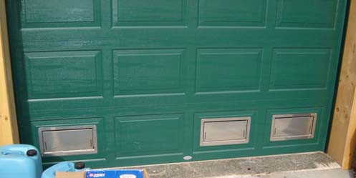
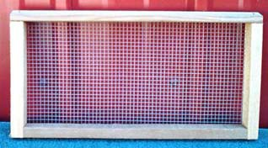
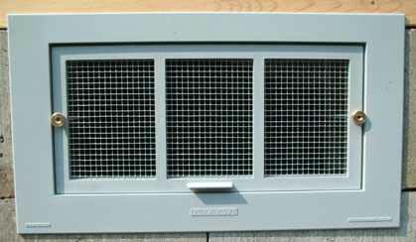
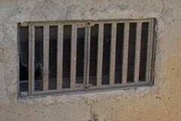

Flood Openings
Federal Emergency Management Agency
Notes:
Here are some examples of flood openings that might be counted. Many openings have louvers or some sort of grate or covering over them.
The one-to-one requirement assumes that there will be screening, so if it's 1/4 inch mesh then we don't have to deduct any inches from the overall measurement, but if you have louvers bars or any kind of decorative material then you'll have to subtract the area of that material from the overall area of the opening.
To account for that blockage, if the louvers can be closed and the flow of water therefore obstructed, then deduct 100% from the area, resulting in as little as zer square inches of opening.

Slide 30
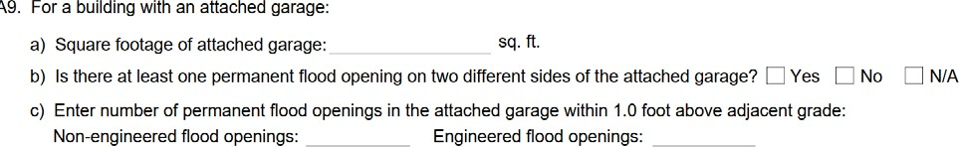
A8 or A9 (c) – What type of flood openings? How many of each?
Non-engineered Flood Openings
A permanent opening without moving parts that allows for the free passage of water automatically in both directions without human intervention.
Required ratio for compliance:
1 square inch of flood openings 1 square foot of enclosure
Engineered Flood Openings
Flood conditions trigger the movable parts to allow floodwater and debris to freely and automatically enter or exit.
Design and performance criteria in ASCE 24
Notes:
Some buildings have multiple types of flood openings. They'll have non-engineered openings and engineered openings. Non-engineered openings are permanent openings that have no moving parts. They allow the water to go in and out of the enclosure without any human intervention. The minimum requirement for non-engineered openings is one square inch of opening per square foot of enclosure.
Engineered openings are activated under flood conditions. They usually have moving parts that will allow the water to go in and out.
They must be certified to meet the design and performance criteria in ASCE 24.

Slide 31
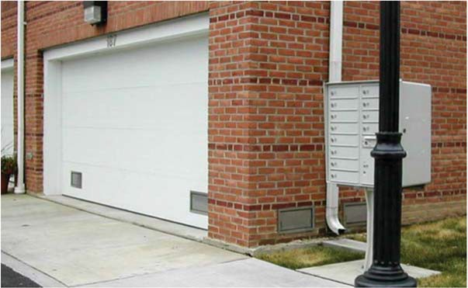
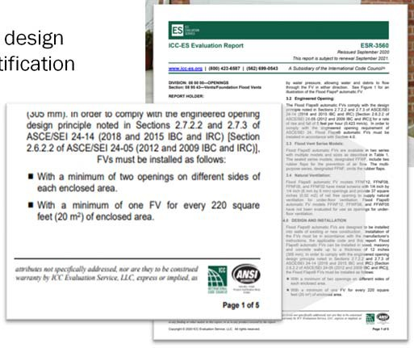
If Engineered Flood Openings are used…
…Certification needed.
  Individual Engineered Flood Openings Certification, or an Evaluation Report issued by the International Code Council Evaluation Service (ICC-ES)
  ICC-ES Evaluation Report includes requirements, rated area, and cer specifications.
Attach to Elevation Certificate
design
tification
Notes:
In order to be considered engineered flood openings, they must also have an individual certification from a professional engineer or an evaluation report from the International Code Council Evaluation Service.
That certification must be attached to the elevation certificate and detail the enclosed area of the building that each vent is rated to cover.
Without the certification, the opening cannot be considered engineered and its actual net area in its-non activated state must be used which could be as little as 0 square inches.

Slide 32
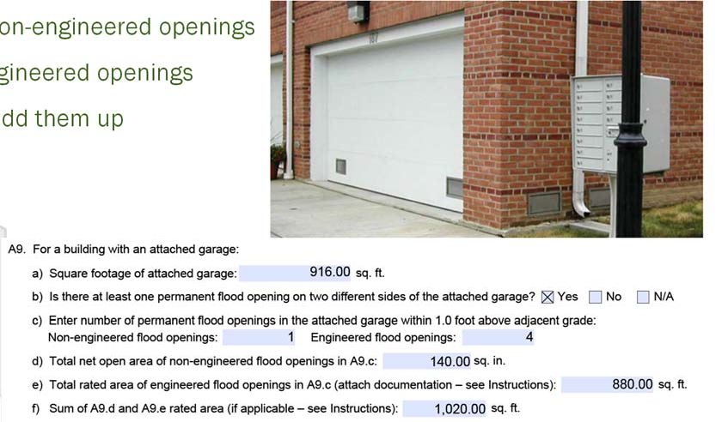
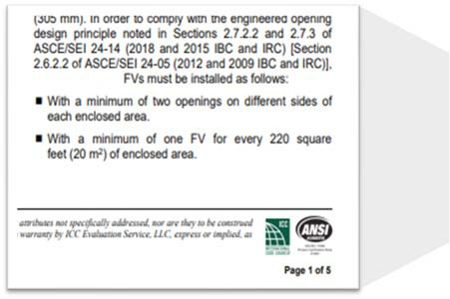
A8 or A9 (d-e-f)
A8d/A9d = Net open area for n
A8e/A9e = “Rated area” for e
A8f/A9f = If using both kinds, a
Notes:
The elevation certificate form now asks for the number of openings that are non engineered and the number of openings that are engineered.
If that ICC report for an engineered opening is not attached to the elevation certificate form, then the vent cannot be considered to be engineered.
On the ICC evaluation report, you'll see that there's usually an area of the enclosure that each opening is rated to support. For example, this ICT report shows that event of this type will cover 220 square feet of enclosed area. So if you have 4 engineered openings that are rated to cover 220 square feet each, then you have a total net rated area of 880 square feet.
The new form now accounts for the possible combination of the rated area of the engineered openings recorded in feet and the net area of non engineered openings recorded in inches. And you add those up to get the total net rated area which gets recorded in A8F or A9F.
If the building only has one type of openings, then you enter N/A in the fields that don't apply.
A8F and A9F are only for enclosures that have two different kinds of openings, both engineered and non-engineered openings.
If the form doesn't allow you to enter the N/A text in number field just leave it bland and enter a note in the comments if needed.

Slide 33
Section A – Updated Instructions
A5. Indicate latitude/longitude method or source in Comments.
A6. Provide four photographs of building (when possible)
A8/A9.b. Is there at least 2 flood openings (within 1.0 ft of adjacent grade) and are they on at least 2 exterior walls?
A8/A9.c. What is the total number of flood openings (non-engineered and/or engineered)?
A8/A9.d. What is the total measured net open area of the non-engineered flood openings?
A8/A9.e. What is the total rated area of the engineered flood openings?
A8/A9.f. Are both engineered and non- engineered flood openings present?
Notes:
The instructions for each section of the form have also been updated to align with the form changes. Section A instructions now clarify the requirement for four photographs. The new horizontal datum, and now the requirement for latitude and longitude to be to 6 decimal places and for the lat, long method and source to be indicated in the comments in Section D.
The instructions include prompts about engineered openings and clarified that ICC or other documentation should be attached.
And there are additional instructions about using Section A8 and A9 when there are both engineered openings and non engineered openings present.

Slide 34
Section B
Flood Insurance Rate Map (FIRM) Information
Notes:
The changes in section B are mostly just about clarity in the instructions, but there are some updates.

Slide 35
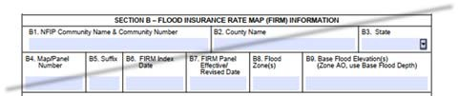
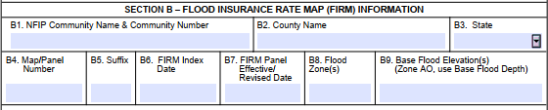

Section B – FIRM Information
No major changes in form data collected…
…but specificity and clarity added to instructions.
  Different layout for B1-B9 (lines, not a table-grid)
  B1b. Community Identification Number
  In multiple zones? B8 – List all flood zones, B9 – list all appropriate BFEs
  B13. Seaward of LIMWA?
Federal Emergency Management Agency
Notes:
The Community Name and Community Number have been split into two different boxes, B1A and B1B. This will impact CRS communities that need to have both of these correct now, rather than just one or the other.
In B10, the word “profile” has been removed from the FIS box, so any use of the flood insurance study for determining BFE can be indicated with that selection.
In B11, make sure the correct datum for the BFE is used. There are model-backed studies in the state that still use NGVD29.
There's a new field B13 for LIMWAs, since no building in West Virginia are not in a coastal area, always No. Do not leave blank.

Slide 36
Section B – Updated Instructions
Instructions:
  If using information based on best available data, such as base-level engineering or advisory flood hazard data, indicate in the Comments area of Section D.
B7. FIRM panel effective date sources:
  msc.fema.gov or local floodplain official
  If the area where the building is located was revised by a LOMR, enter the LOMR effective date & case number in the Comments area of Section D.
B8. WV Flood Tool, FIRM, or NFHL Viewer
B9. BFE:
Enter the base flood depth to the nearest 0.1 foot (in Puerto Rico, nearest 0.1 meter).
The BFE entered in Item B9 must be based on hydrologic and hydrologic analyses.
In an A Zone where BFEs are not obtained from another source, enter “N/A” in Item B9 and complete Section E.
B10. Indicate the source entered in Item B9:
  If BFE from other source (other than FIS/FIRM/community): include the study name, source (agency or company that produced it), and date completed.
Notes:
In the new section B instructions, there's clarification in B7 that LOMR case numbers and the effective dates should be recorded in the comments Section D when applicable. Enter the effective firm date in Section B and then the LOMR information in the section D comments.
Remember that for B9, that's the BFE we're going to use the appropriate source which could be the WV Flood Tool, FIS, FIRM, but whatever that source is, the BFE is rounded to the nearest 10th of a foot in West Virginia.
If the building is located in more than one flood zone, we're going to list all the applicable flood zones and BFE's.
The BFE that's recorded in section B9 must be based on hydrologic and hydraulic (H&H) analysis such as the Advisory Flood Heights for Approximate A Zones in West Virginia.; otherwise, it belongs in the Section D comments.
In B10, we indicate the source of the BFE or the base flood depth. If the BFE is from a source other than the flood insurance study or the flood insurance rate map, such as model-backed Advisory Flood Heights in the WV Flood Tool, then include the name of the study (e.g., Advisory Flood Heights), the agency or company that produced it (e.g., FEMA/WV NFIP Office), and the date when the study was completed. The WVGIS Technical Center can provide the date of the study.

Slide 37




FIRM Info: Typical FIRM Panel and Flood Zones
B8 – Flood Zone
Zone AE
Floodway
Zone AE
Zone X
Shaded
Zone X
Zone A

Slide 38

Floodplain Map Overview
B8 – Flood Zone
HIGH RISK (Special Flood Hazard Area) |  |  | Regulatory Floodway
 |  |  | 1%-Annual-Chance Flood Hazard Area with BFEs
 |  |  | 1%-Annual-Chance Flood Hazard Area without published BFEs. Refer to Advisory Flood Heights on WV Flood Tool
MODERATE RISK |  |  | 0.2%-Annual-Chance Flood Hazard Area
 |  |  | Cross Sections with 1%-Annual-Chance Water Surface Elevation Value
ZONE AE
ZONE A
Notes:
Discuss 1% floodplain and 0.2% floodplain, floodway, cross sections, and BFEs
“Cross sections now show water surface elevations.”
“Transparent fills over aerial photography”
“new maps will look different”

Slide 39
Floodplain Map Overview
B8 – Flood Zone
HIGH RISK (Special Flood Hazard Area)
MODERATE RISK
 |  |  | Cross Sections with 1%-Annual-Chance Water Surface Elevation Value
Development is not allowed unless “no rise” in flood levels is certified
ZONE AE
Flood insurance is mandatory for structures with federally backed mortgages
ZONE A
Flood insurance is not mandatory
Notes:
It is highly recommended that owners get flood insurance in areas of moderate risk even though it is not required

Slide 40


WV Flood Tool
FIRM Information on WV Flood Tool
B8 – Flood Zone

Slide 41

High Risk Flood Zone Types: Zone AE & Zone A
B10 – Flood Zone

Slide 42

Floodplain Map Overview
B9 – BFE & AFH
A) ZONE AE (Base Flood Elevation) or ZONE A (Advisory Flood Height)
B) ZONE SHADED X
C) ZONE X

Slide 43

Floodplain Map Overview
B9 – Advisory Flood Heights

Slide 44

Floodplain Map Overview
Future Maps

Slide 45
Section B – Updated Instructions
B11. Make sure to select the correct elevation datum of the BFE or Advisory Flood Heights. There are still model-backed flood studies in WV that reference the NGVD 1929 datum.
B12. Is the building in a Coastal Barrier Resources System (CBRS) area or Otherwise Protected Area (OPA)?
  CBRS areas and OPAs are no longer shown on the FIRMs, though they may be visible on the National Flood Hazard Layer Viewer (msc.fema.gov/nfhl)
  Use the official maps of these areas, available at www.fws.gov/cbra/ to complete item B12.
B13. Is the building located seaward of the Limit of Moderate Wave Action (LiMWA)?
  If LiMWA is not shown on FIRM, check “No”
  Visit www.fema.gov/flood- maps/coastal/insurance-rate-maps for information about the LiMWA and other coastal zones.
Notes:
For B11 make sure to select the correct vertical datum of the BFE or Advisory Flood Heights. There are still model-backed flood studies that reference the NGVD 1929 datum.
B12 and B13 have no coastal areas so check NO for both.

Slide 46

Floodplain Map Overview
B11 - Datum

Slide 47
Section C
Building Elevation Information (Survey Required)

Slide 48

Section C – Building Elevation Information (Survey Required)
For Zones with BFE
Survey required by licensed professional
New: Datum Conversion factor checkbox
  If yes, prompt to describe in Section D.
Section C may be completed for insurance purposes to determine First Floor Height for insurance purposes for any zone, including B (Zone X Shaded; 500-YR; Behind Levee), and C (Zone X Unshaded; Minimal Flood Hazard), and D (Undetermined)
Notes:
In West Virginia, Section C is for flood zones with a base flood elevation. The are minimal or no AO Zones in West Virginia that require a base flood depth.
This section has to be completed by a licensed survey professional!
There's a new date and conversion factor check box asking the surveyor to check the box that indicates whether they used one. And if so, to describe the source of their conversion factor in the comments.
Section C may be used to document first floor height for insurance purposes in any flood zone, including B, C, X, and D).

Slide 49




C2(a) – Top of Bottom Floor
Additional detail now in EC instructions…
Enter the elevation measured at the top of the bottom floor (excluding the attached garage) indicated by the selected Building Diagram.
For buildings elevated on a crawlspace, enter the lowest elevation on the top of the crawlspace floor in Item C2.a.
  Regardless of whether the crawlspace has permanent flood openings.
C2a – Bottom Floor
Photo: M. Paine
C2a – Bottom Floor
Photo: B Croft
Notes:
Section C2.a records the same bottom floor just as before but now has additional instructions for clarity.
In section C2.a, enter the elevation measured at the top of the bottom floor, excluding the attached garage enclosures used for parking are recorded in C2.a.

Slide 50

C2(b) – Next Higher Floor
Additional detail now in EC instructions…
For Building Diagrams 2A through 9 in any flood zone, including Zones B, C, X, and D, enter the elevation measured at the top of the next higher floor (excluding the attached garage)
For buildings requiring more than two floors or levels to be surveyed, such as those with multiple floors or multi-level enclosures, enter the additional surveyed elevations and floor descriptions in the Section D Comments; clarify which floors are entered as Item C2.a and C2.b.
C2b - Next Higher Floor
C2a – Bottom Floor
Photo: M. Paine
Notes:
For C2.b, there's no change in the form, but additional instructions indicate the proper way to measure that floor.
Section C2.b is only for building diagrams 2A through 9 and any flood zone. Buildings on slap foundations (Diagram 1) typically don’t have two floors, as slab foundations are not designed to support the weight of a second story.
For buildings that have more than two floors or levels to be surveyed, record additional elevations in the Section D comments and then specify which of those fours were entered as C2.a or C2.b.

Slide 51


C2(c) – Bottom of Lowest Horizontal Structural Member
2023 Elevation Certificate Update
August 2023
Required in V zones
  EC form says “See Instructions” ( was removed}
“Only V Zones”
C2b - Next Higher Floor
Why? Coastal A Zones
For Building Diagrams 5 and 6 and in regulated areas subject to coastal flooding
C2c - LHSM
C2a – Bottom Floor
Photo: M. Paine
Notes:
In C2.c, there has been a change on the form but just enter “N/A” since there are no coastal zones in West Virginia.

Slide 52
A floor by any other name…
2023 Elevation Certificate Update
August 2023
Bottom Floor Elevation
Lowest Floor Elevation
First Floor Height
Measured by the surveyor
The floor with the lowest elevation
  May be at, above, or below grade
C2.a or E1 on the EC
Not determined by the surveyor
Interpreted by the community floodplain administrator in G9a
Based on multiple factors
Not used for rating insurance
Determines whether structure is compliant with local floodplain ordinance:
“Is Lowest Floor above BFE (plus freeboard)?”
Used for rating insurance
At or above-grade only
Varies by foundation type and building diagram
Recorded in Section H, or interpreted from Section C or E
Notes:
Earlier we reviewed the definitions for three different floors, so while we're talking about floor elevations in Section C, let's breakdown the differences so you'll understand which of these are recorded here.
Bottom Floor is an objective elevation recorded by the professional surveyor. It could be at grade, above grade, or even below grade. Bottom floor could be a slab floor, a raise slab, a crawl space, an enclosure, a basement, and it can even be elevated on posts or piers. Bottom floor is recorded on the elevation certificate as either C2.a. or E1.
The Lowest Floor Elevation is something that's interpreted by the community official based on multiple measurements, elevations, and characteristics of the building. Lowest floor is not used for rating flood insurance, but communities still use it to determine compliance with local floodplain management regulations. Lowest floor is recorded in section G9a.
First Floor Height is used for rating flood insurance. The First Floor Height will always be at or above grade. It does vary by foundation type and it's recorded in section H. It can be interpreted from information provided in Section C, but it's specifically called out in section H.

Slide 53


C2(d) – Attached Garage, measure top of slab
N/A; not an attached garage.
Attached Garage – C2(d)
Photo: M. Gilbert
Photo: M. Paine
Notes:
For C2.d, there's no change to the form it records the lowest point of the slab floor in an attached garage. A garage that's the first floor of an elevated building with other floors above it is not an attached garage. It's just an enclosure.
The example on the left is an enclosure floor used for parking and it's actually C2.a, not C2.d.
The one on the right is an attached garage, so C2.d would be the garage floor slab at its lowest point.

Slide 54

C2(e) – Machinery and Equipment (M&E)
Prompt to describe in Section D Comments
Additional notes in Instructions:
  Requirements for M&E and elevation for floodplain management compliance are different than the NFIP insurance M&E discount eligibility considerations.
  Refer to FEMA P-348, Protecting Building Utility Systems from Flood Damage
https://www.fema.gov/sites/default/files/documents/fema_discount-Explanation-Guide.pdf
Notes:
In C2.e a prompt has been added to describe in the comments the machinery or equipment that was measured.
Machinery and equipment elevation requirements are different for floodplain management compliance than they are for the requirements to get the M&E flood insurance discount.
In previous versions of the elevation certificate there was some confusion about which machinery should be recorded here, so the elevation certificate form instructions now provide an example non exhaustive list of machinery that could be measured.
For C2.e, this is intended to prompt surveyors to measure the lowest of all machinery, not just the lowest of those listed in the instructions.
If you'd like to read more about how to protect machinery from flood damage, check out FEMA Publication 348. Information about the mitigation discounts can be found at FEMA.gov.

Slide 55

Adjacent Grades C2(f) – C2(g); Attached Decks/Stairs C2(h)
C2(f) – Lowest Adjacent Grade
C2(g) – Highest Adjacent Grade
C2(f) and C2(g) have new checkboxes:
  Is the adjacent grade Natural or Finished?
C2(h) clarifies Finished LAG at attached deck or stairs
Notes:
There's a new box in C2.f and C2.g for indicating whether the adjacent grade measured is finished ground level or natural ground level.
Checking one of these boxes is required. Historically, we only used finished grade here, but now we're asking the surveyors to indicate whether the ground is finished or natural grade.
Natural grade is the undisturbed natural surface of the ground prior to any excavation or fill. If in doubt, select finished.
For C2.h., where we measure the ground elevation of the deck, support or stairs only finished grade should be indicated. That's now clear on the form.

Slide 56
Section C – Updated Instructions
Supporting a request for a LOMA, CLOMA, LOMR-F, or CLOMR-F? Complete Section C!
Note: Section C may also be completed for insurance purposes, to determine the building's First Floor Height in any flood zone (including Zones B, C, X and D).
Additional instructions on procedures to follow if access to the crawlspace is limited or cannot be gained.
Note: If any item does not apply to the building, enter “N/A” for not applicable.
Use the Comments area of Section D
Notes:
Instructions for section C have been updated, providing additional detail and clarity. For example, there are clarifications on the new natural versus finished grade options and instructions on procedures to follow if access to the crawl space is limited.

Slide 57
Section D
Surveyor, Engineer, or Architect Certification
Notes:
Section D only has minor changes

Slide 58


Section D
Certifies the surveyed information in Section C.
Must be signed by a Registered Professional Land Surveyor, Engineer, or Architect (state dependent)
Email address field added
The certification box must include the certifier’s seal if Section C was completed by a surveyor or engineer
Additional instructions now provide clarity/examples for using Comments area of Section D to provide relevant and clarifying information not specified elsewhere on the EC,
PLS
####
Notes:
Section D is used by the surveyor or other licensed professional who completed section C. Here they sign and seal to certify that their surveyed elevations are correct. The change here is the addition of a field for their e-mail address.
All fields are required in this section. There are a lot more prompts for the comments in the Section D instructions.

Slide 59
Which section(s) to complete?
Notes:
With all these new uses and two new sections, let's review who can complete which section of the elevation certificate form and which sections should be completed for the various EC uses.

Slide 60
Sections of the Elevation Certificate – Who can complete?
Anyone
Anyone
Licensed Pro Licensed Pro
Anyone
Anyone
Local Official
Anyone Anyone
Section A – Property Information
Section B – FIRM Information
Section C – Building Elevations (Survey needed)
Section D – Surveyor Certification (for Section C)
Section E – Building Measurements (Survey not needed)
Section F – Owner or Representative Certification (for Section E)
Section G – Community Information (Recommended)
Section H – First Floor Height (insurance; survey not required)
Section I – Owner or Representative Certification (for Section H)
Federal Emergency Management Agency
Notes:
Sections A & B are property information and for FIRM information. Anyone can complete these two sections, and they're always needed in every case.
Sections C & D require a licensed professional to complete those surveyed elevations.
Anyone can complete Section E, including the property owner, and they'll certify in Section F.
Section G is reserved only for the community official to use, and finally Section H and I can be filled out by anyone, and it's only used for insurance purposes.

Slide 61




For Compliance with Floodplain Management Regulations…
Anyone
Anyone
Licensed Pro Licensed Pro
Anyone Anyone
Section A – Property Information
Section B – FIRM Information
Section C – Building Elevations (Survey neede
Section D – Surveyor Certification (for Section C
Section E – Building Measurements (Survey not needed)
Section F – Owner or Representative Certification (for Section E
Section G – Community Information (Recommended)
Section H – First Floor Height (insurance; survey not required)
Section I – Owner or Representative Certification (for Section H)
d)
)
In All Flood Zones
Only AO, A Zones
)
Local Official
Federal Emergency Management Agency
Notes:
Which sections should be completed? If you're using the elevation certificate to document compliance with floodplain management regulations. That is Sections A & B and either Sections C & D, or E and F.
Notice that Sections H and I are not on that list. Sections C & D are good for all flood zones.
Sections E & F are only for zones that don't have a baseline elevation or where the flood is measured in terms of depth.
Completion of Section G by the community official is always recommended in all cases and required for CRS communities.

Slide 62


For Flood Insurance Reasons Only…
Anyone
Anyone
Licensed Pro Licensed Pro
Section A – Property Information
Section B – FIRM Information
Section C – Building Elevations (Survey needed)
Section D – Surveyor Certification (for Section C)
Section E – Building Measurements (Survey not needed)
Section F – Owner or Representative Certification (for Section E)
Section G – Community Information (Recommended)
Section H – First Floor Height (insurance; survey not required)
Section I – Owner or Representative Certification (for Section H)
Section C supersedes Section H for insurance if both are filled out
F P A
Local Official
Anyone
Anyone
Federal Emergency Management Agency
Notes:
For flood insurance only, use Sections A & B and Section H with certification in either section I, if completed by the property owner, or Section G If completed by the Community official.
If there are surveyed elevations and section C is completed, it will supersede Section H. Surveyed elevations will always supersede measured elevations.
In flood zones where surveys are not needed, that’s AO and A zones. FEMA recommends that you use Section H instead of section E for insurance purposes.

Slide 63
For Letter of Map Change…
Anyone
Anyone
Licensed Pro Licensed Pro
Local Official
Section A – Property Information
Section B – FIRM Information
Section C – Building Elevations (Survey needed)
Section D – Surveyor Certification (for Section C)
Section E – Building Measurements (Survey not needed)
Section F – Owner or Representative Certification (for Section E)
Section G – Community Information (Recommended)
Section H – First Floor Height (insurance; survey not required)
Section I – Owner or Representative Certification (for Section H)
Federal Emergency Management Agency
Notes:
To use the elevation certificate to support a letter of map change decision for removing the property from this Special Flood Hazard Area, surveyed elevations are required.
Sections A & B and then Sections C & D are needed for a letter of map change to termination.
Completion of Section G by the community official is recommended.

Slide 64
Summary
Two new form sections (H and I) can be used for NFIP insurance policy rating.
Expanded sections capture additional detail and clarity.
Section G (for community officials) connects the form to local permit and variance decisions, and documents compliance with higher standards.
More photographs capture additional building details and are now required regardless of the intended use of the EC form.
More detailed instructions pages provide better clarity on how to properly complete the EC form.
Email your questions about the new form to nfipunderwritingmailbox@fema.dhs.gov.
Federal Emergency Management Agency
Notes:
In summary, there are two new form sections that can be used for flood insurance policy rating without the need for a professional survey. But surveyed elevations are still required for other uses like floodplain management and letters of map change.
There are expanded sections throughout the EC to capture additional detail and clarity.
Section G has been expanded and enhanced.
Community officials can now use it to connect the permit process or the variance decisions and the compliance determinations with higher standards. It's now required for CRS communities.
Additional photographs are required to capture building details, regardless of the intended use of the form, and finally updated and detailed instruction pages help clarify how to properly complete the form.

Slide 65
Which form sections can I use for…?
Minimum Requirement | O Optional Use | R Recommended Use | R* Required for CRS | ✗ Do Not Use
Purpose | Flood Zone | EC Form Section
 |  | A | B | C | D | E | F | G | H | I
Insurance | A with BFE | ✓ | ✓ | O | O | Use H or C instead ↔ |  | R | ✓ | ✓
 | A without BFE | ✓ | ✓ | O | O | Use H or C instead ↔ |  | R | ✓ | ✓
 | Outside SFHA | ✓ | ✓ | O | O | Use H or C instead ↔ |  | R | ✓ | ✓
Letter of Map Change (LOMC) | A with BFE | ✓ | ✓ | ✓ | ✓ | ✗ | ✗ | R | ✗ | ✗
 | A without BFE | ✓ | ✓ | ✓ | ✓ | ✗ | ✗ | R | ✗ | ✗
 | Outside SFHA | - | - | - | - | - | - | - | - | -
Floodplain Management | A with BFE | ✓ | ✓ | ✓ | ✓ | ✗ | ✗ | _{R}* | ✗ | ✗
 | A without BFE | ✓ | ✓ | O | O | ✓ | ✓ | _{R}* | ✗ | ✗
 | Outside SFHA (if regulated) | ✓ | ✓ | O | O | ✓ | ✓ | R | ✗ | ✗
Federal Emergency Management Agency
Notes:
Here's a handy guide created to help users of the elevation certificate to identify the appropriate sections of the form to complete based on the flood zone of the structure and the intended use of the completed form.

