Slide 1
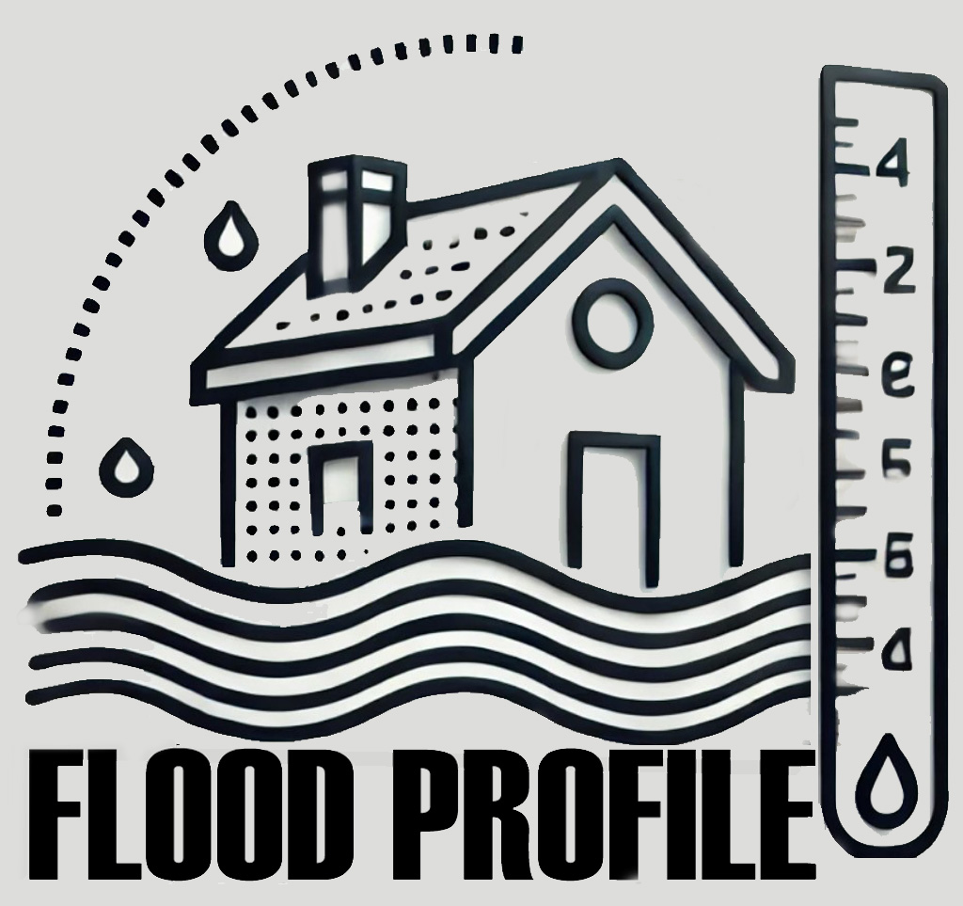
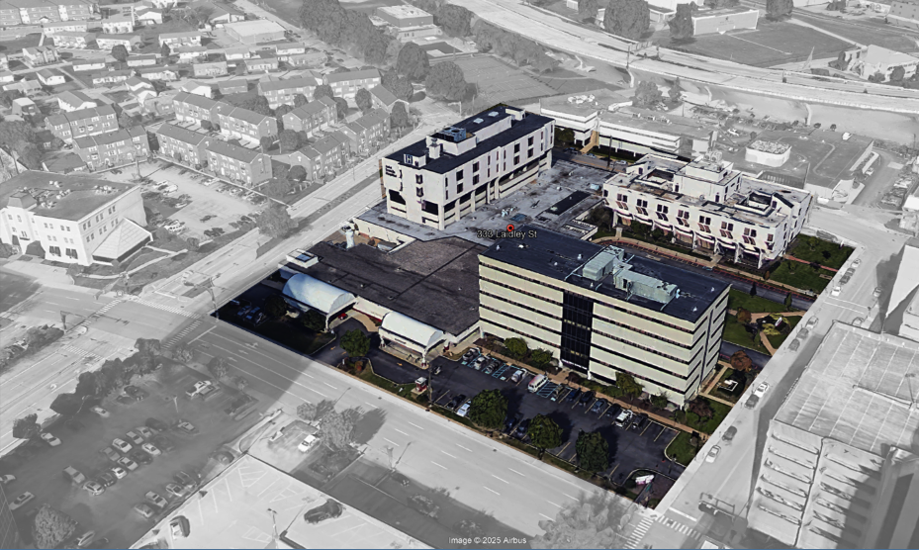
Building Flood Profile
Saint Francis Hospital

Slide 2
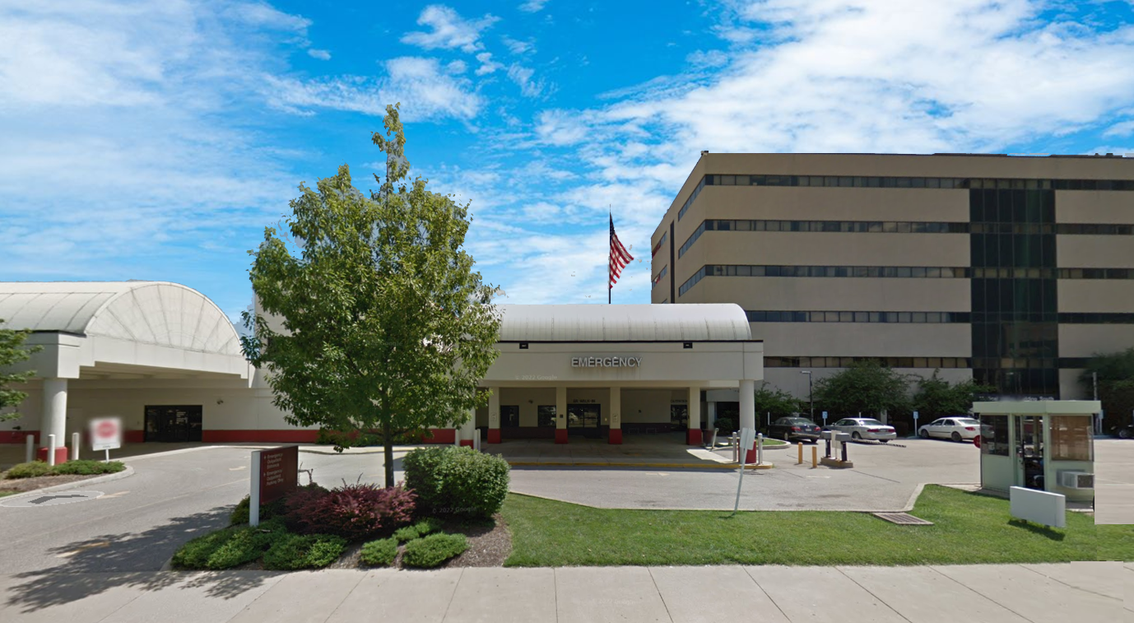
333 LAIDLEY ST, Charleston, WV, 25301
20-11-0009-0017-0000_333
Building Flood Profile

Slide 3
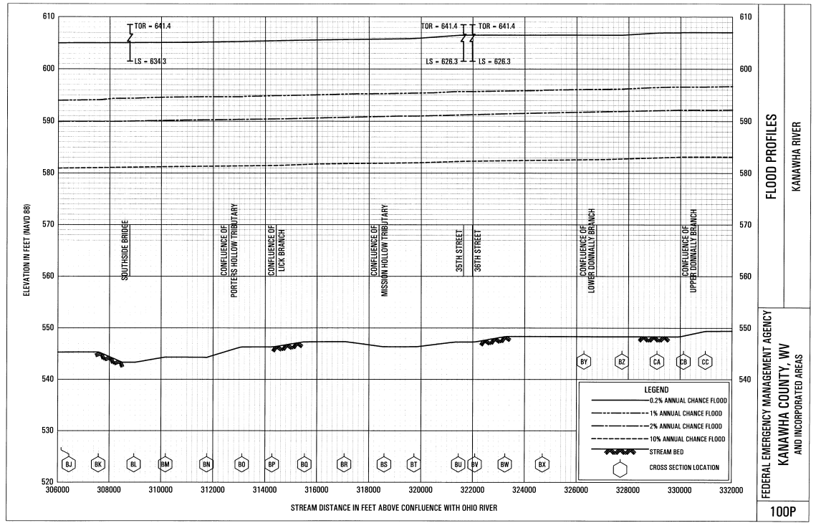
Probability and Height of Flood in a year
FEMA (2008) 500-year Flood Elevation: 604 ft
1861 Flood High Water Mark: 605.5 ft
Building’s Elevation: 595.4 ft
FEMA (2008)100-year Flood Elevation: 594 ft

Slide 4
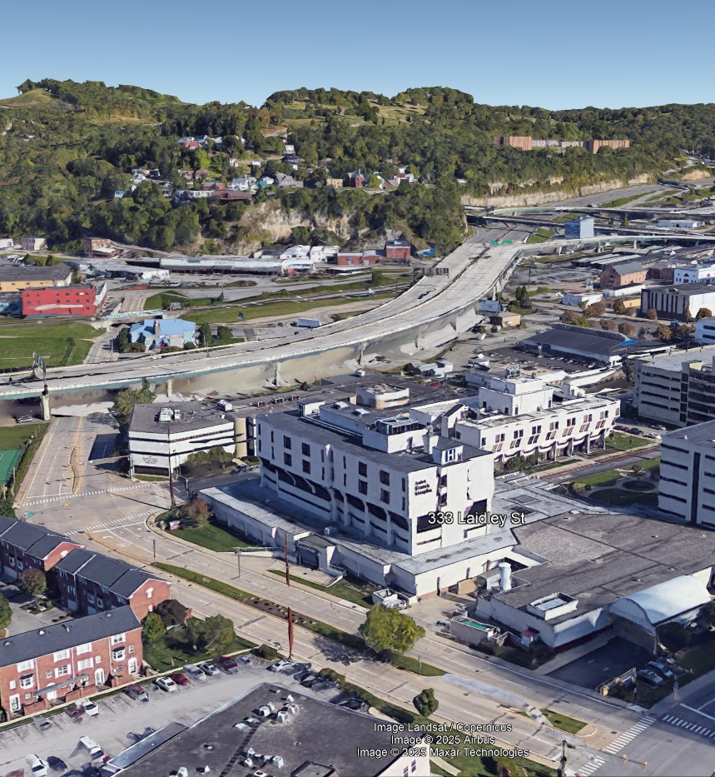
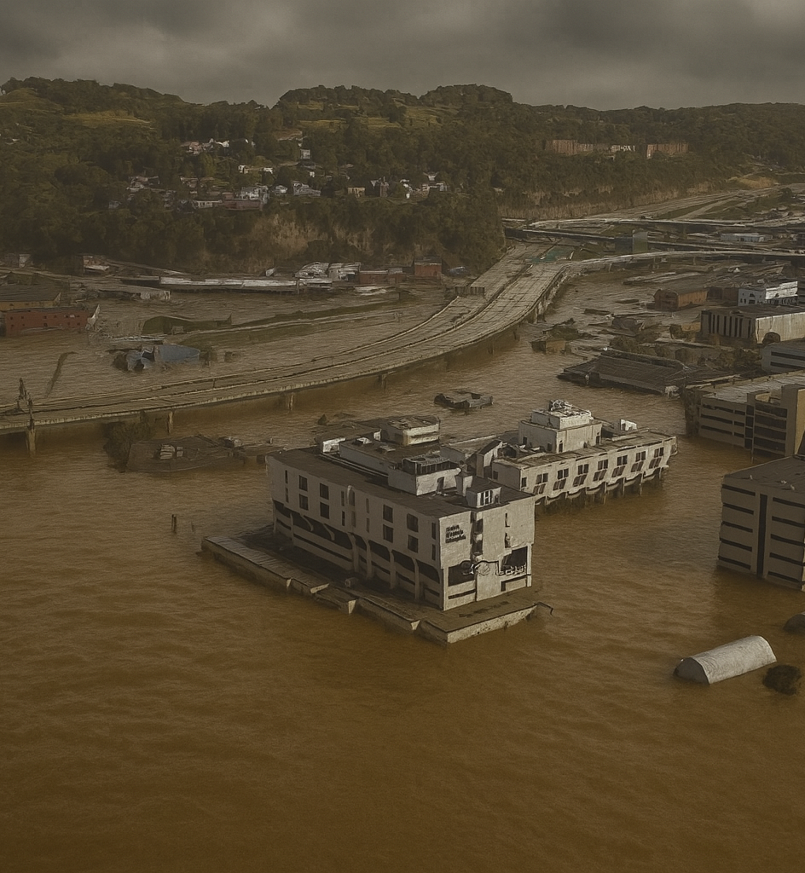
Saint Francis Hospital, Charleston, WV
FEMA 0.2% Annual Chance (500-year) Flood

Slide 5
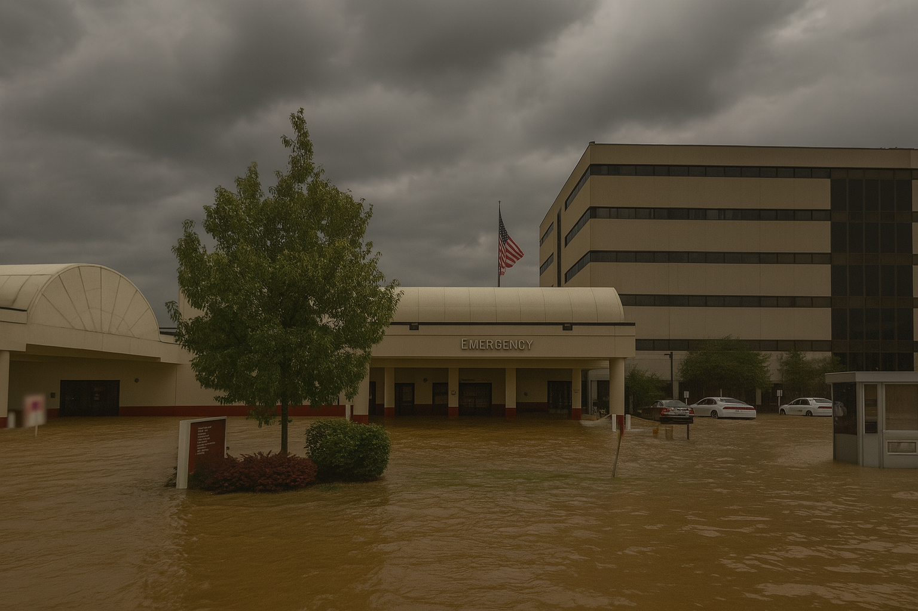
Flood Level
0’ft (FEMA 1% / 100-Yr)
FEMA, Effective 2008
First Street Foundation (FSF, 2022)
1861 Flood High Water Mark
Dam Failure

Slide 6
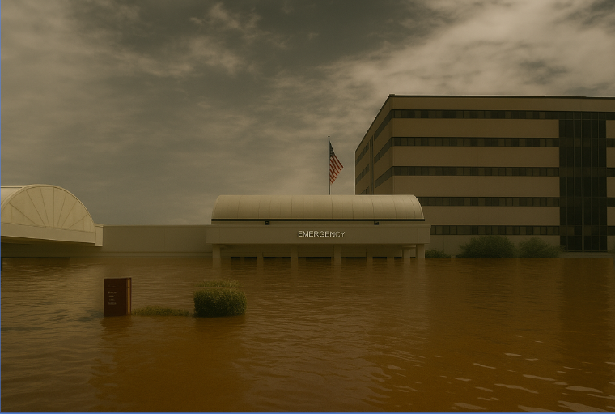
10’ ft (FEMA 0.2% / 500-Yr)
0’ft (FEMA 1% / 100-Yr)
FEMA, Effective 2008
First Street Foundation (FSF, 2022)
1861 Flood High Water Mark
Dam Failure

Slide 7
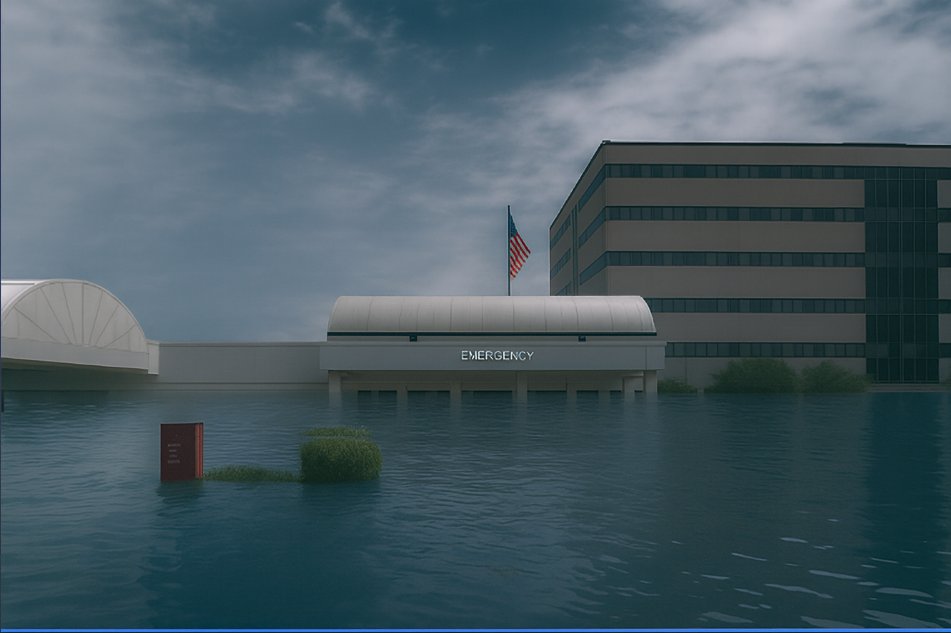
11.5’ ft (1861 High Water Mark)
Flood Level
10’ ft (FEMA 0.2% / 500-Yr)
11.1 ft. Water Depth (Sutton Dam Failure)
0’ft (FEMA 1% / 100-Yr)
FEMA, Effective 2008
First Street Foundation (FSF, 2022)
1861 Flood High Water Mark
Dam Failure

Slide 8
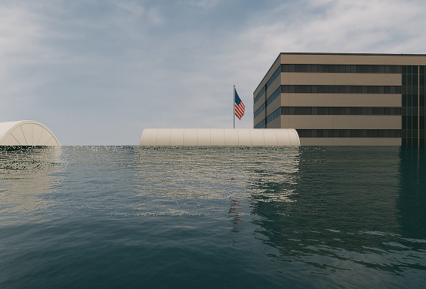
Flood Level
15.5’ ft (FSF 1% / 100-Yr)
11.5’ ft (1861 High Water Mark)
10’ ft (FEMA 0.2% / 500-Yr)
11.1 ft. Water Depth (Sutton Dam Failure)
0’ft (FEMA 1% / 100-Yr)
FEMA, Effective 2008
First Street Foundation (FSF, 2022)
1861 Flood High Water Mark
Dam Failure

Slide 9
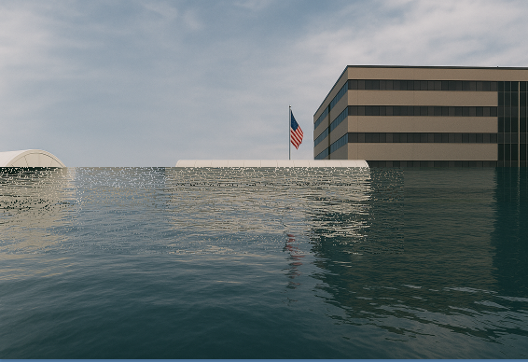
Flood Level
21.1’ ft (FSF 0.2% / 500-Yr)
15.5’ ft (FSF 1% / 100-Yr)
11.5’ ft (1861 High Water Mark)
10’ ft (FEMA 0.2% / 500-Yr)
11.1 ft. Water Depth (Sutton Dam Failure)
0’ft (FEMA 1% / 100-Yr)
FEMA, Effective 2008
First Street Foundation (FSF, 2022)
1861 Flood High Water Mark
Dam Failure

Slide 10
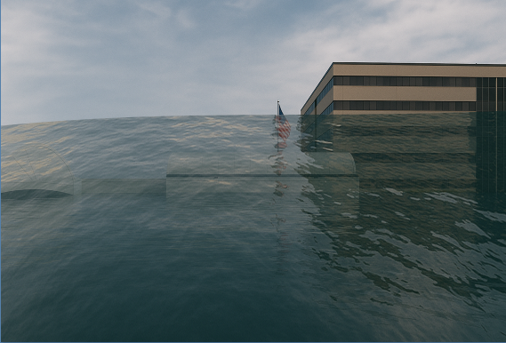
Flood Level
21.1’ ft (FSF 0.2% / 500-Yr)
36.5 ft. Water Depth (Summersville Dam Failure)
15.5’ ft (FSF 1% / 100-Yr)
11.5’ ft (1861 High Water Mark)
10’ ft (FEMA 0.2% / 500-Yr)
11.1 ft. Water Depth (Sutton Dam Failure)
0’ft (FEMA 1% / 100-Yr)
FEMA, Effective 2008
First Street Foundation (FSF, 2022)
1861 Flood High Water Mark
Dam Failure

Slide 11
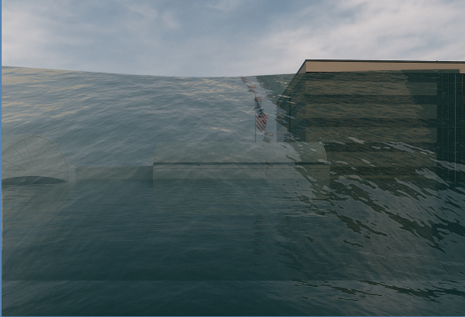
Flood Level
43.8 ft. Water Depth (Bluestone Dam Failure)
21.1’ ft (FSF 0.2% / 500-Yr)
36.5 ft. Water Depth (Summersville Dam Failure)
15.5’ ft (FSF 1% / 100-Yr)
11.5’ ft (1861 High Water Mark)
10’ ft (FEMA 0.2% / 500-Yr)
11.1 ft. Water Depth (Sutton Dam Failure)
0’ft (FEMA 1% / 100-Yr)
FEMA, Effective 2008
First Street Foundation (FSF, 2022)
1861 Flood High Water Mark
Dam Failure

Slide 12
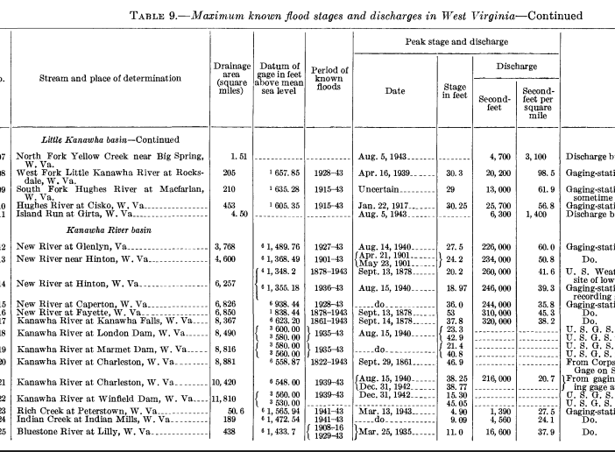
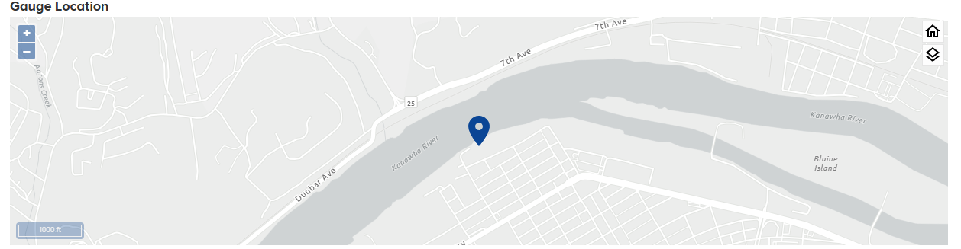
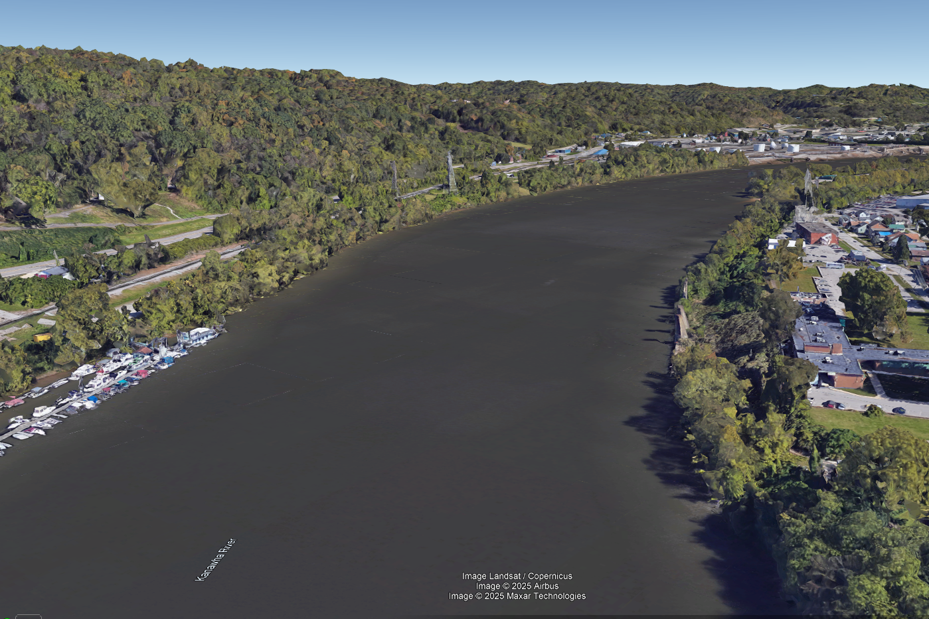
September 1861 Flood
According to USGS, 1952
Gauge Location
The U.S. Weather Bureau gage at river mile 58.5 on the Kanawha River reached an elevation of 605.5 feet, 5.3 feet higher than the second-highest flood of record at Charleston, which occurred in September 1878 (USACE 1958).
Sources: FEMA Kanawha County Flood Insurance Study Report (Effective 2008; Revised 2023)

Slide 13
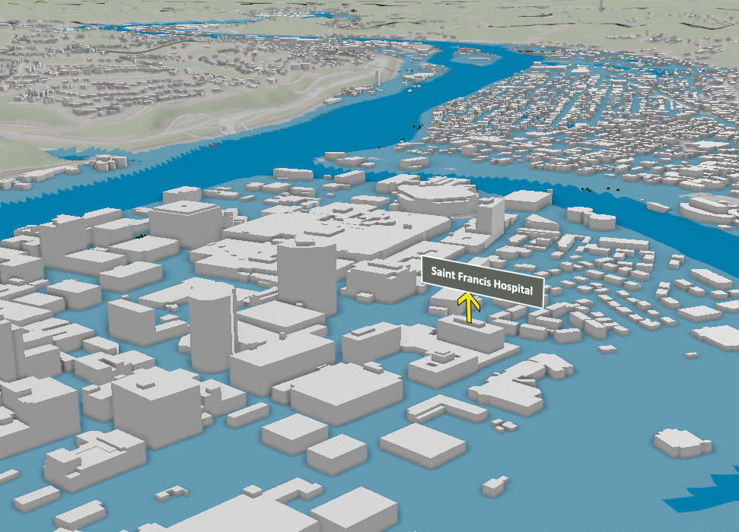
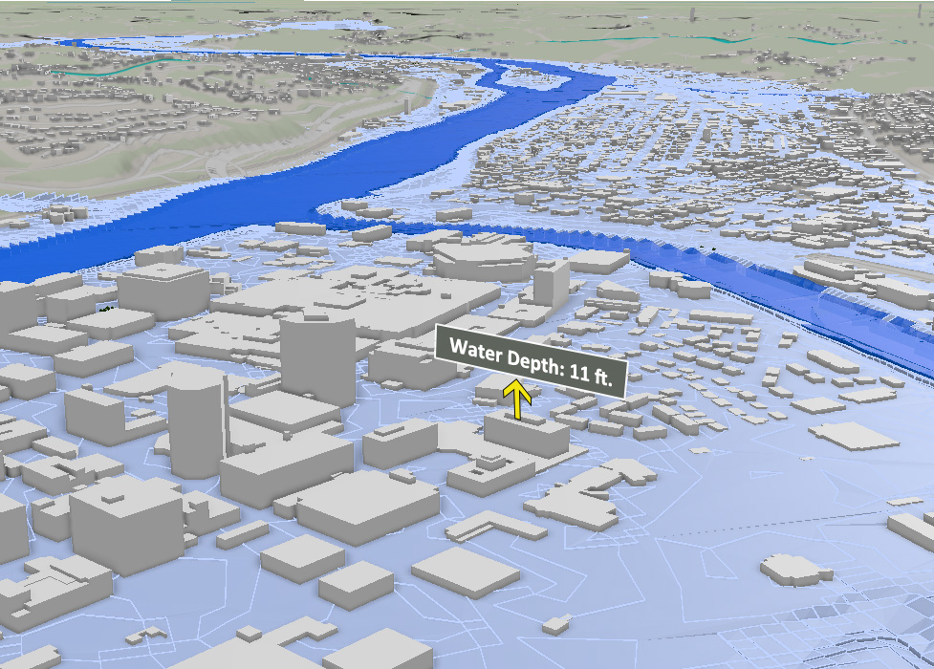
Sutton Dam Maximum Height
Kanawha River
Elk River
The extent of the inundated area
Water Height
Maximum High (MH) is the pool level near the top of dam resulting from water flowing into the reservoir from heavy rainfall, snowmelt, or other significant high-water events.

Slide 14
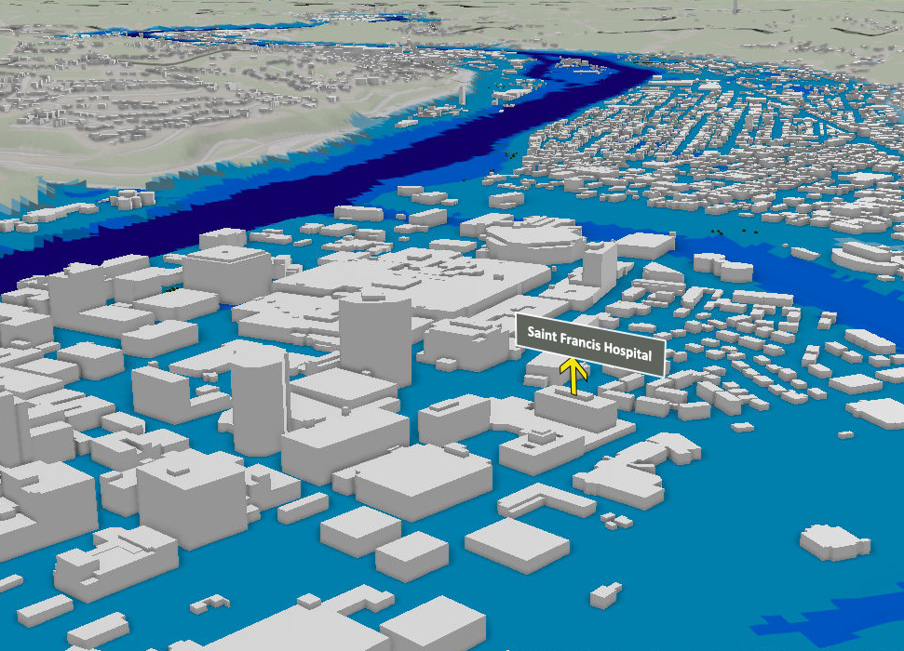
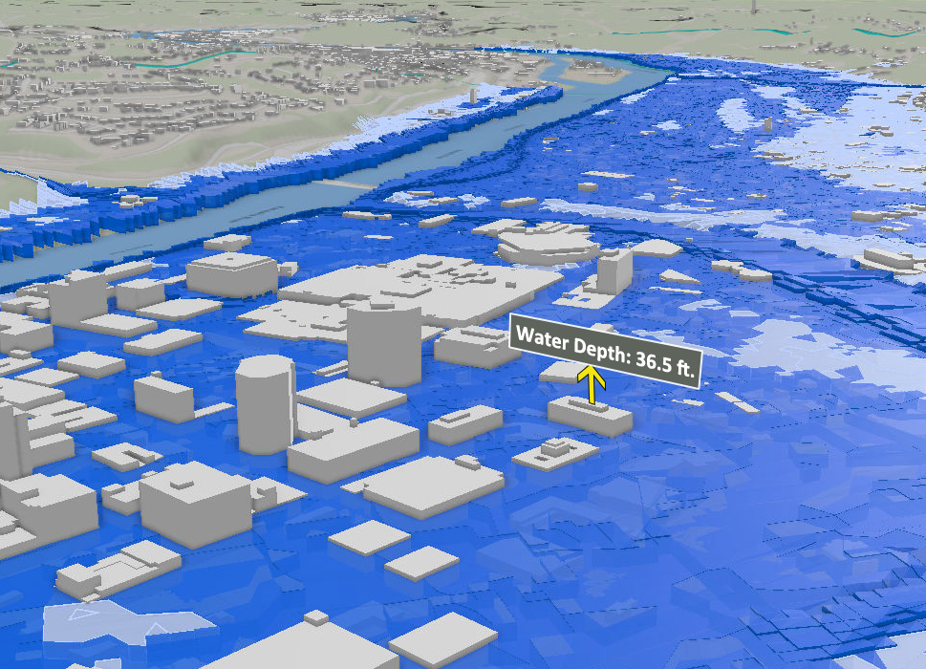
Summersville Dam Maximum Height
Kanawha River
Elk River
The extent of the inundated area
Water Height
Maximum High (MH) is the pool level near the top of dam resulting from water flowing into the reservoir from heavy rainfall, snowmelt, or other significant high-water events.

Slide 15
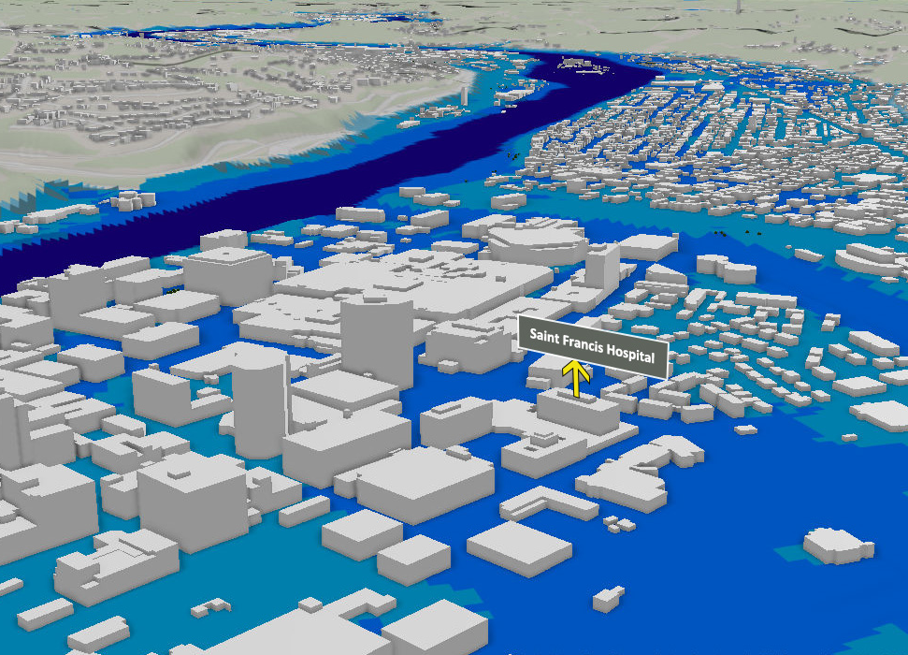
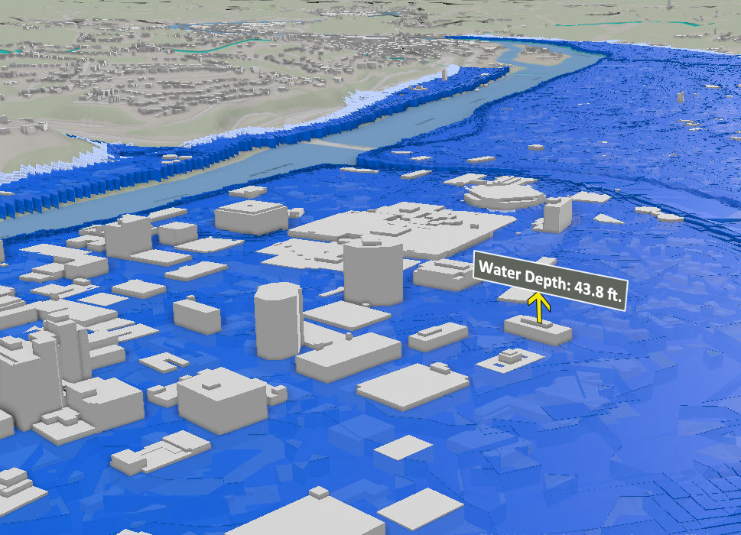
Bluestone Dam Maximum Height
Kanawha River
Elk River
The extent of the inundated area
Water Height
Maximum High (MH) is the pool level near the top of dam resulting from water flowing into the reservoir from heavy rainfall, snowmelt, or other significant high-water events.

