Slide 1
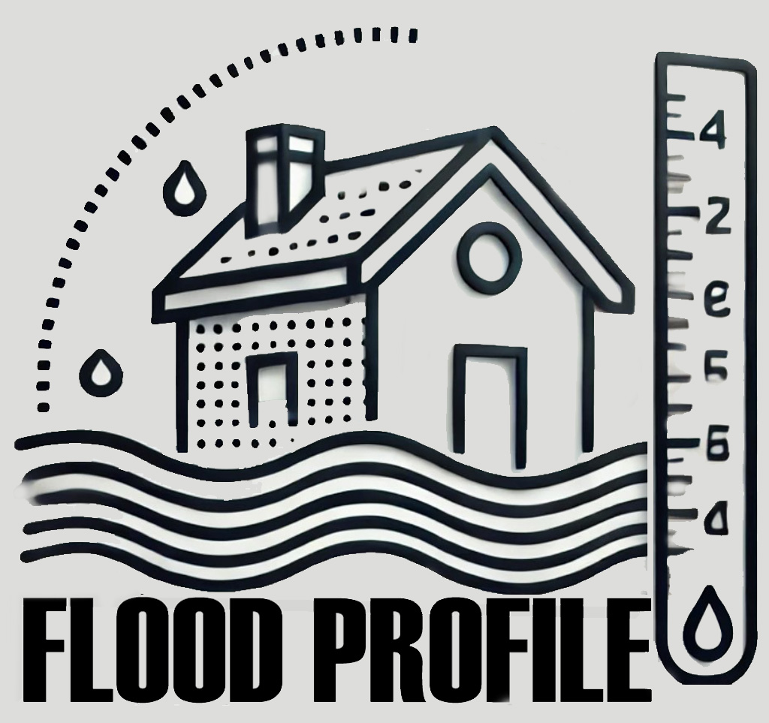
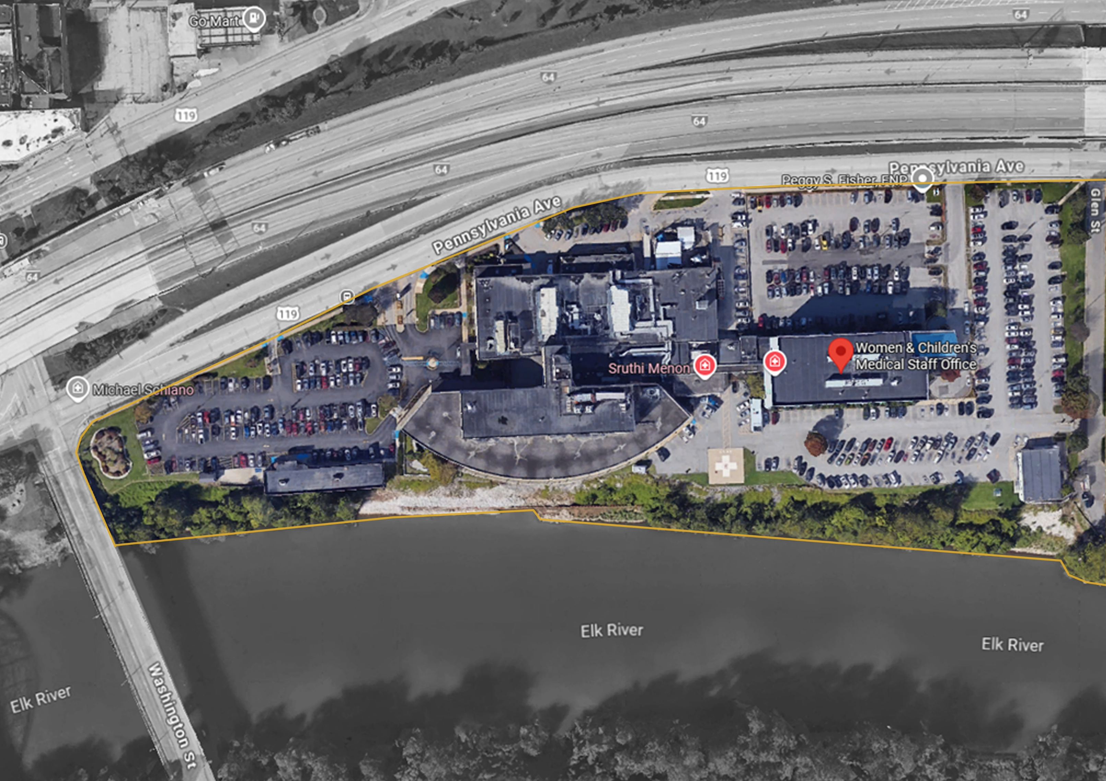
Building Flood Profile
Women and Children’s Hospital

Slide 2
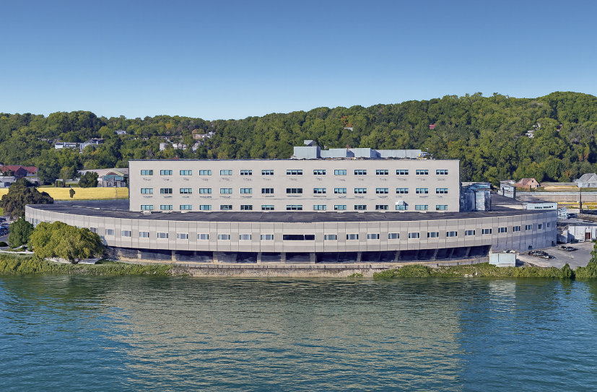
800 Pennsylvania Avenue, Charleston, Kanawha, WV, 25302
20-12-0027-0400-0000_800
Building Flood Profile

Slide 3
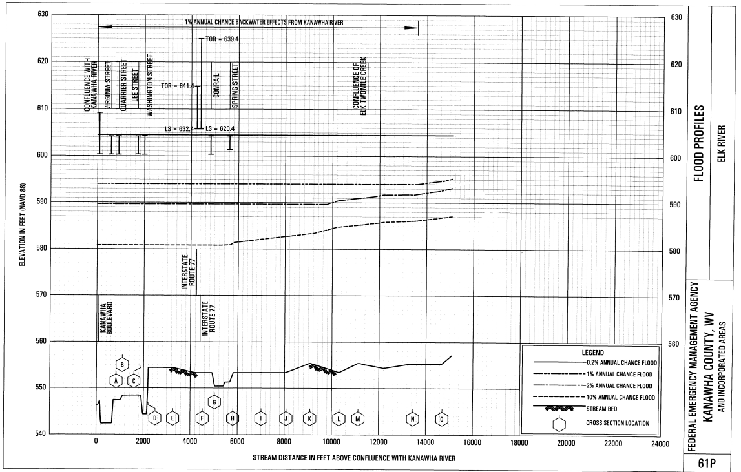
Probability and Height of Flood in a year
1861 Flood High Water Mark: 605.5 ft
FEMA (2008) 500-year Flood Elevation: 604.5 ft
Building’s Elevation: 596.7 ft
FEMA (2008)100-year Flood Elevation: 594 ft

Slide 4
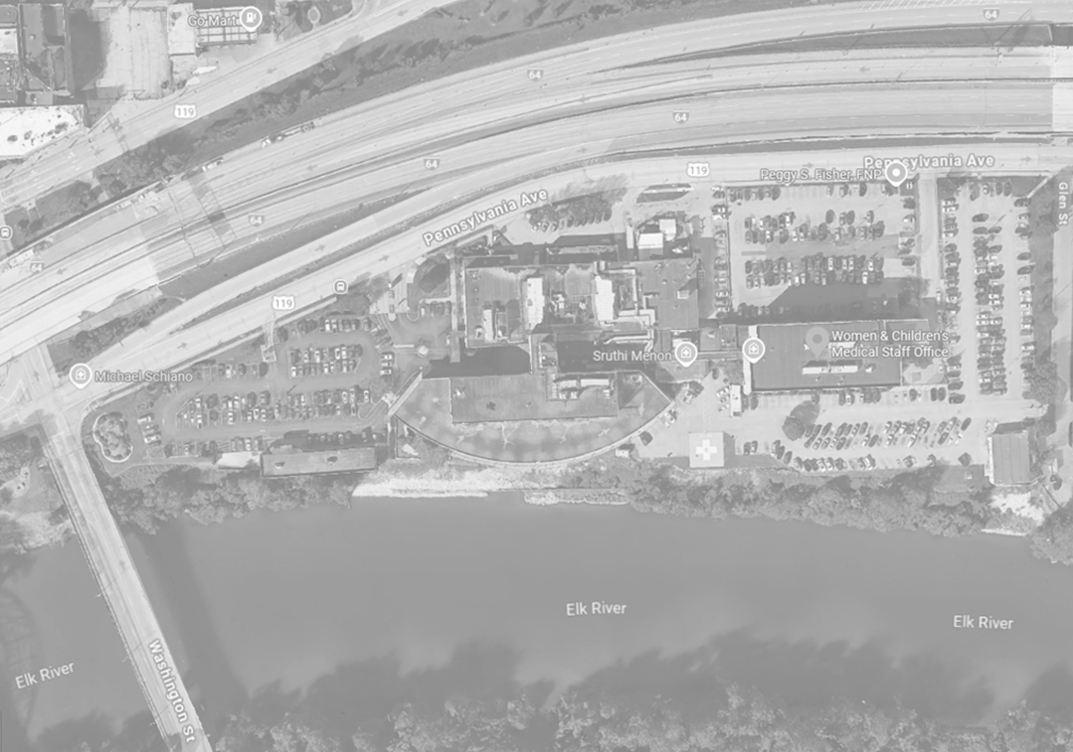
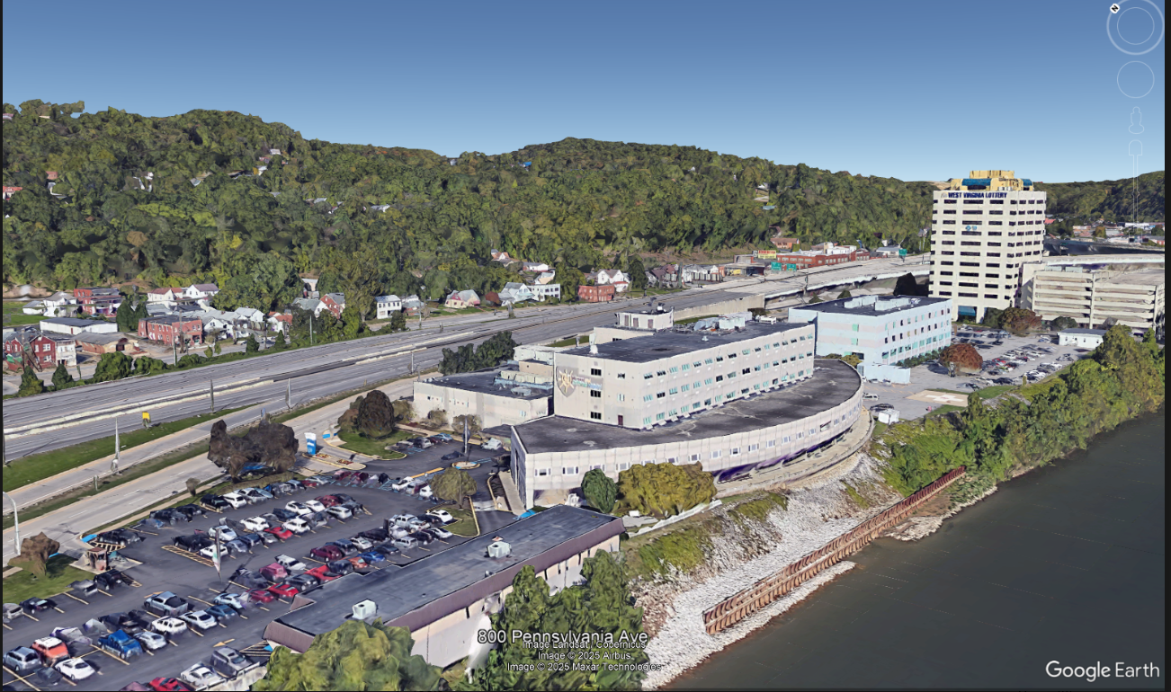
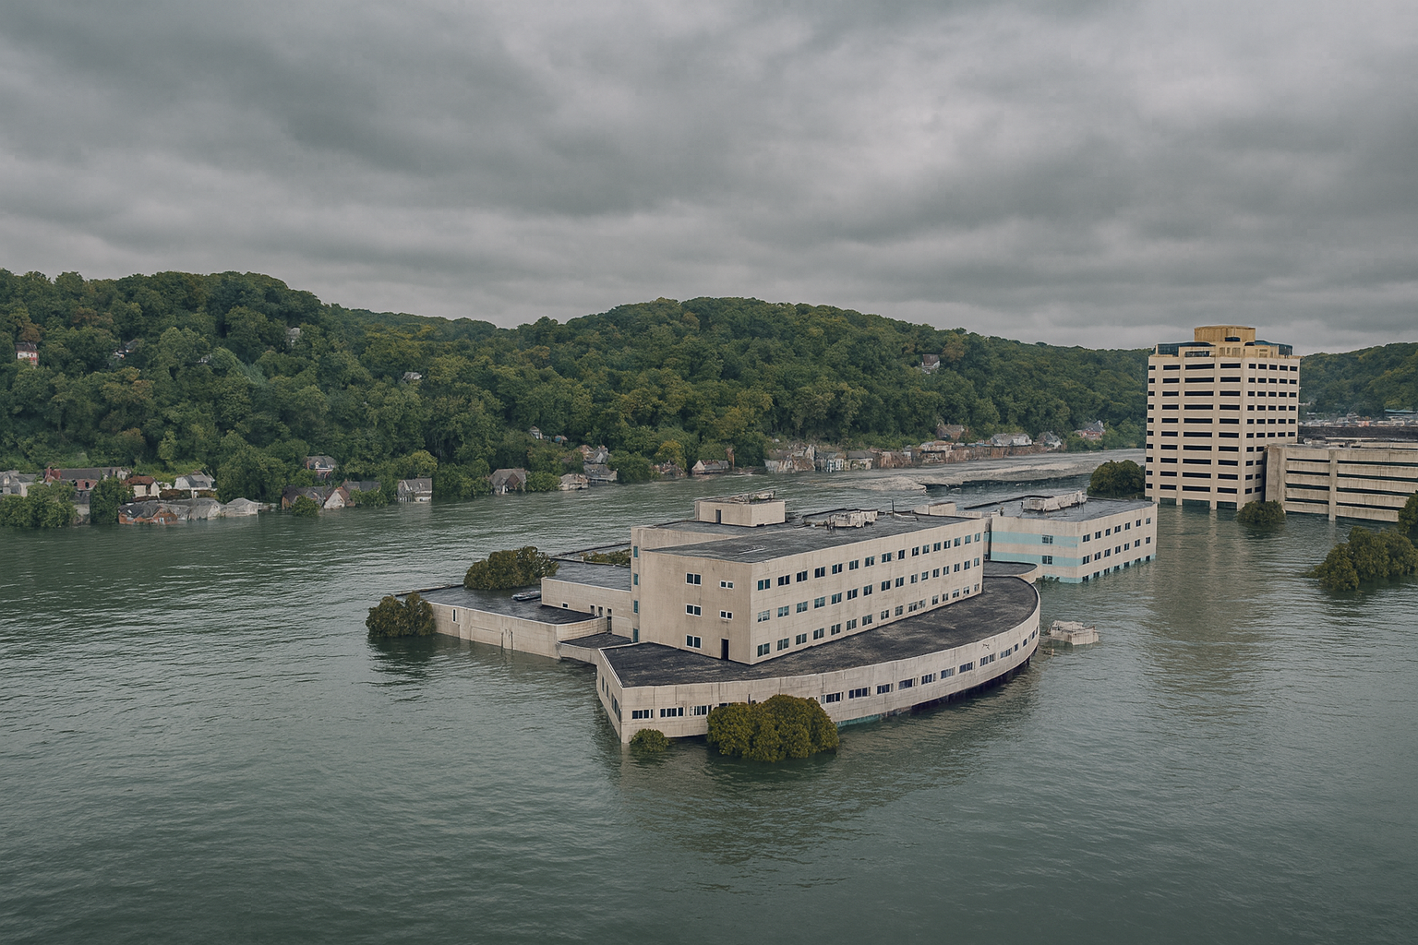
Women and Children’s Hospital
FEMA 0.2% Annual Chance (500-year) Flood

Slide 6
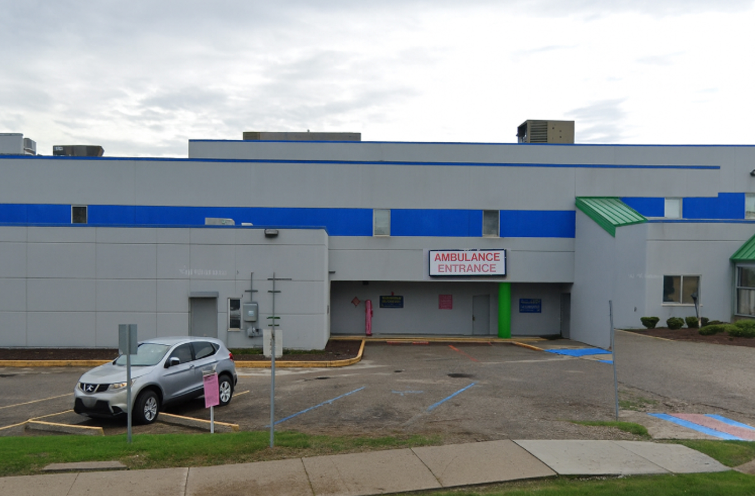

Slide 7
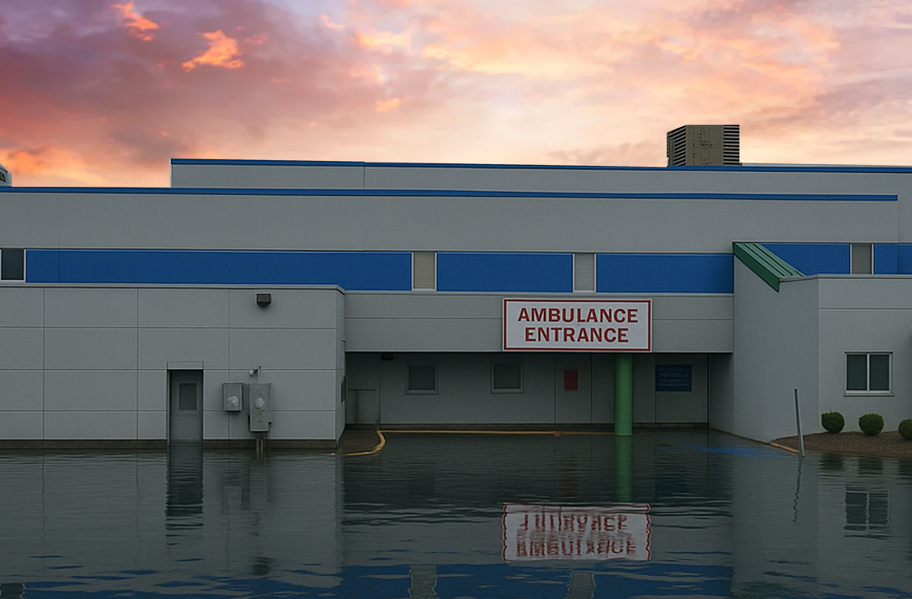
Flood Level
0’ft (FEMA 1% / 100-Yr)
FEMA, Effective 2008
First Street Foundation (FSF, 2022)
1861 Flood High Water Mark
Dam Failure

Slide 8
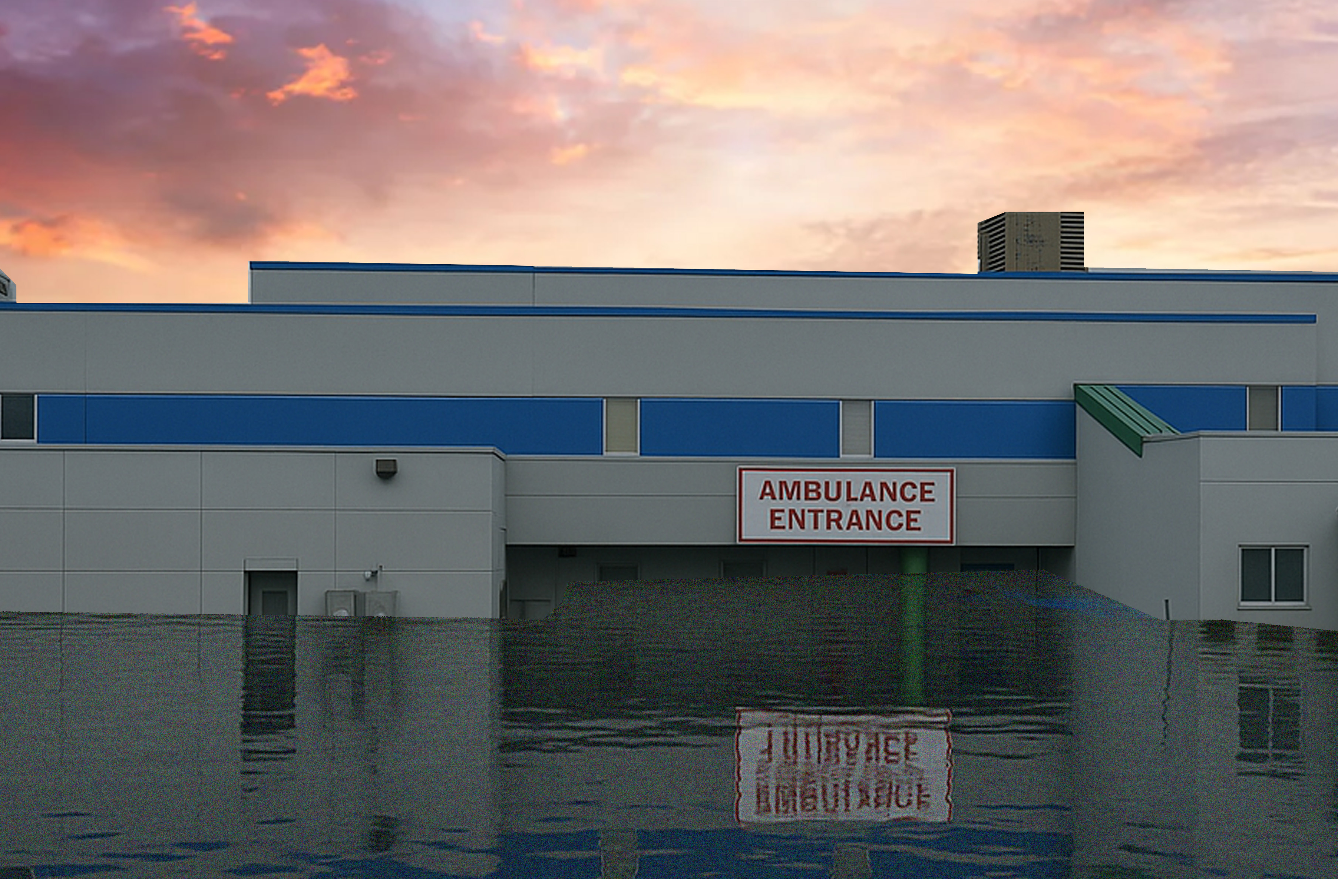
8.8’ ft (1861 High Water Mark)
Flood Level
7.8’ ft (FEMA 0.2% / 500-Yr)
0’ft (FEMA 1% / 100-Yr)
FEMA, Effective 2008
First Street Foundation (FSF, 2022)
1861 Flood High Water Mark
Dam Failure

Slide 9
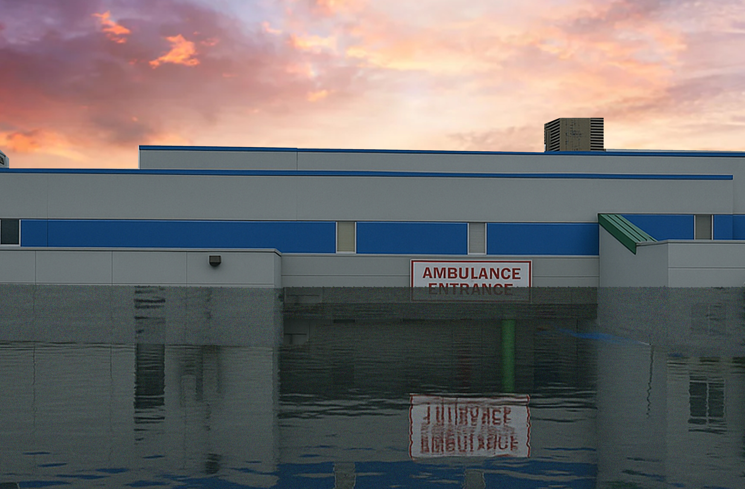
Flood Level
8.8’ ft (1861 High Water Mark)
7.8’ ft (FEMA 0.2% / 500-Yr)
11.1 ft. Water Depth (Sutton Dam Failure)
0’ft (FEMA 1% / 100-Yr)
FEMA, Effective 2008
First Street Foundation (FSF, 2022)
1861 Flood High Water Mark
Dam Failure

Slide 10
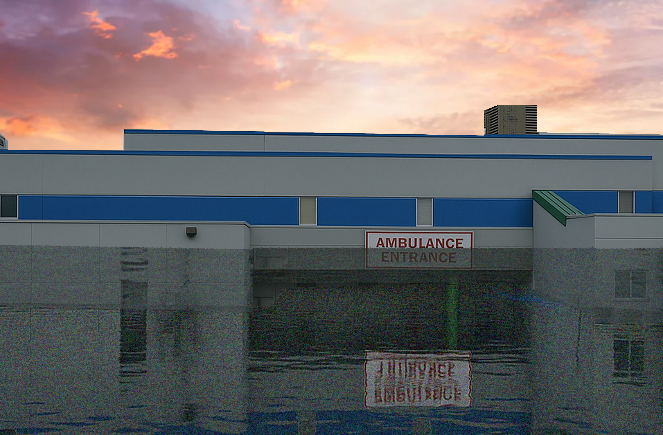
12.7’ ft (FSF 0.2% / 500-Yr)
8.8’ ft (1861 High Water Mark)
Flood Level
7.8’ ft (FEMA 0.2% / 500-Yr)
6.5’ ft (FSF 1% / 100-Yr)
11.1 ft. Water Depth (Sutton Dam Failure)
0’ft (FEMA 1% / 100-Yr)
FEMA, Effective 2008
First Street Foundation (FSF, 2022)
1861 Flood High Water Mark
Dam Failure

Slide 11
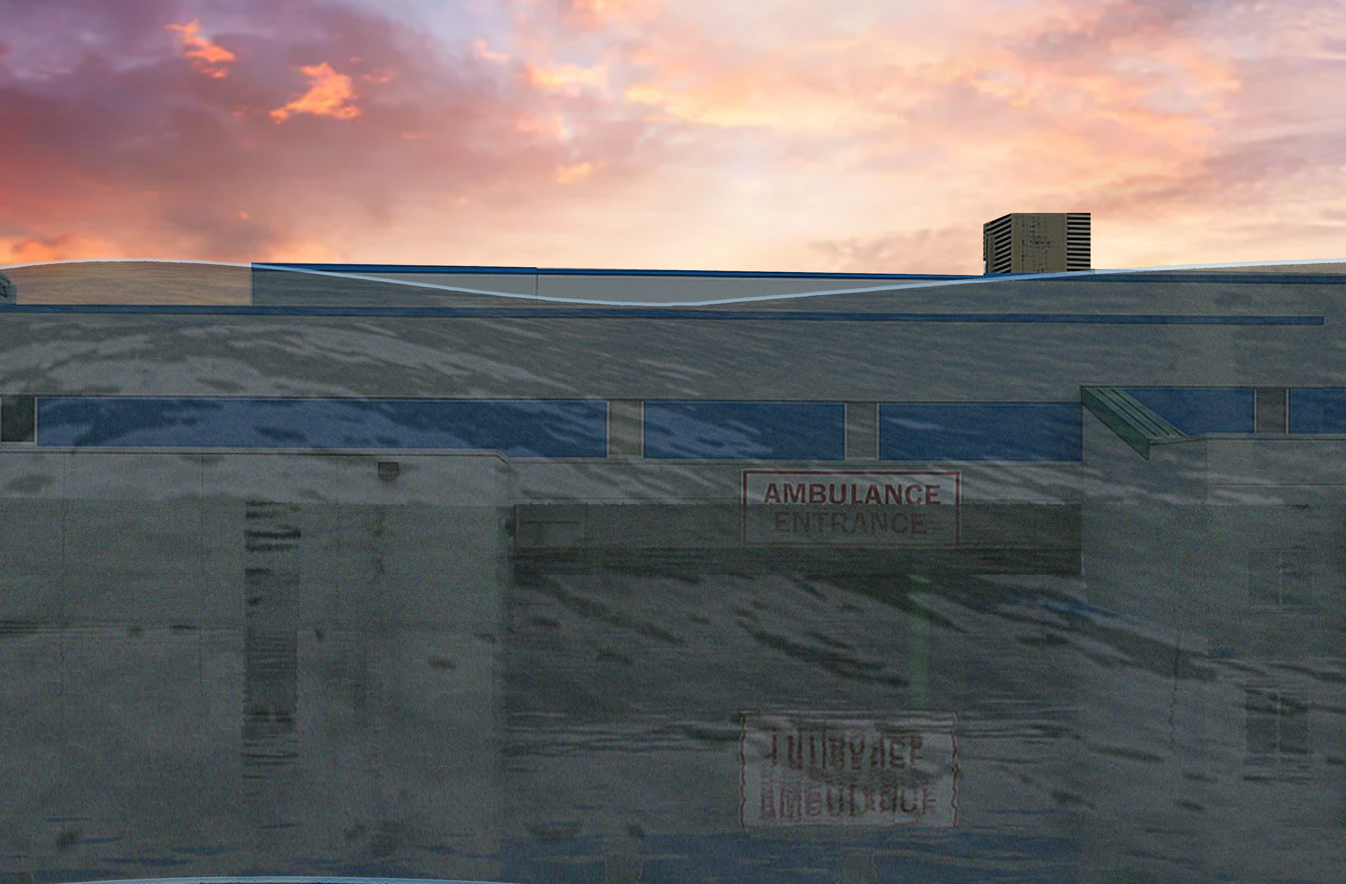
12.7’ ft (FSF 0.2% / 500-Yr)
Flood Level
26 ft. Water Depth (Summersville Dam Failure)
8.8’ ft (1861 High Water Mark)
7.8’ ft (FEMA 0.2% / 500-Yr)
6.5’ ft (FSF 1% / 100-Yr)
11.1 ft. Water Depth (Sutton Dam Failure)
0’ft (FEMA 1% / 100-Yr)
FEMA, Effective 2008
First Street Foundation (FSF, 2022)
1861 Flood High Water Mark
Dam Failure

Slide 12
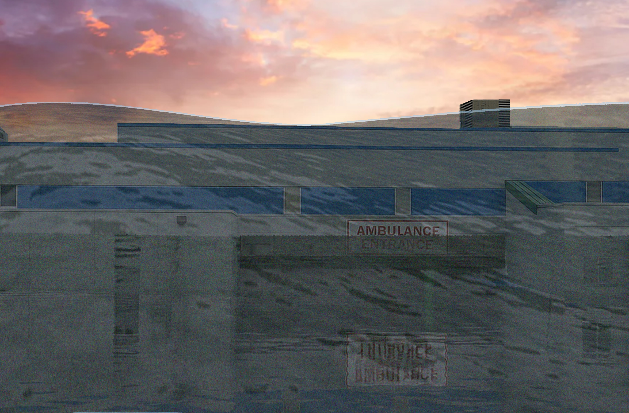
34 ft. Water Depth (Bluestone Dam Failure)
12.7’ ft (FSF 0.2% / 500-Yr)
Flood Level
26 ft. Water Depth (Summersville Dam Failure)
8.8’ ft (1861 High Water Mark)
7.8’ ft (FEMA 0.2% / 500-Yr)
6.5’ ft (FSF 1% / 100-Yr)
11.1 ft. Water Depth (Sutton Dam Failure)
0’ft (FEMA 1% / 100-Yr)
FEMA, Effective 2008
First Street Foundation (FSF, 2022)
1861 Flood High Water Mark
Dam Failure

Slide 13
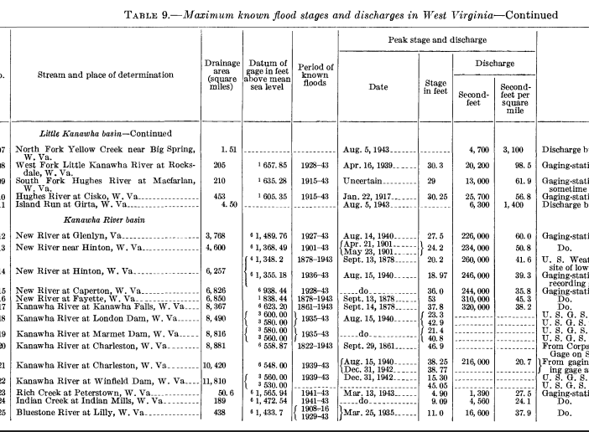
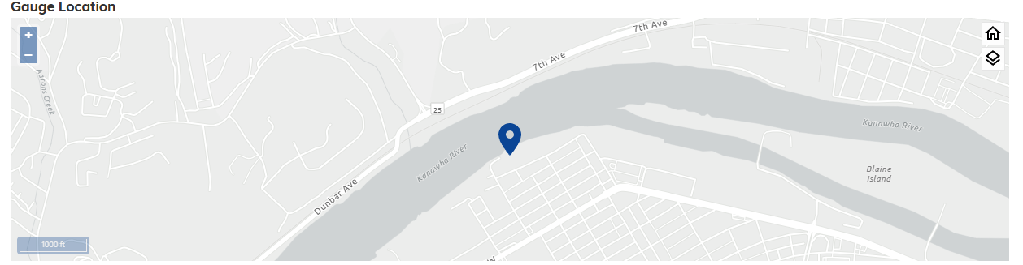
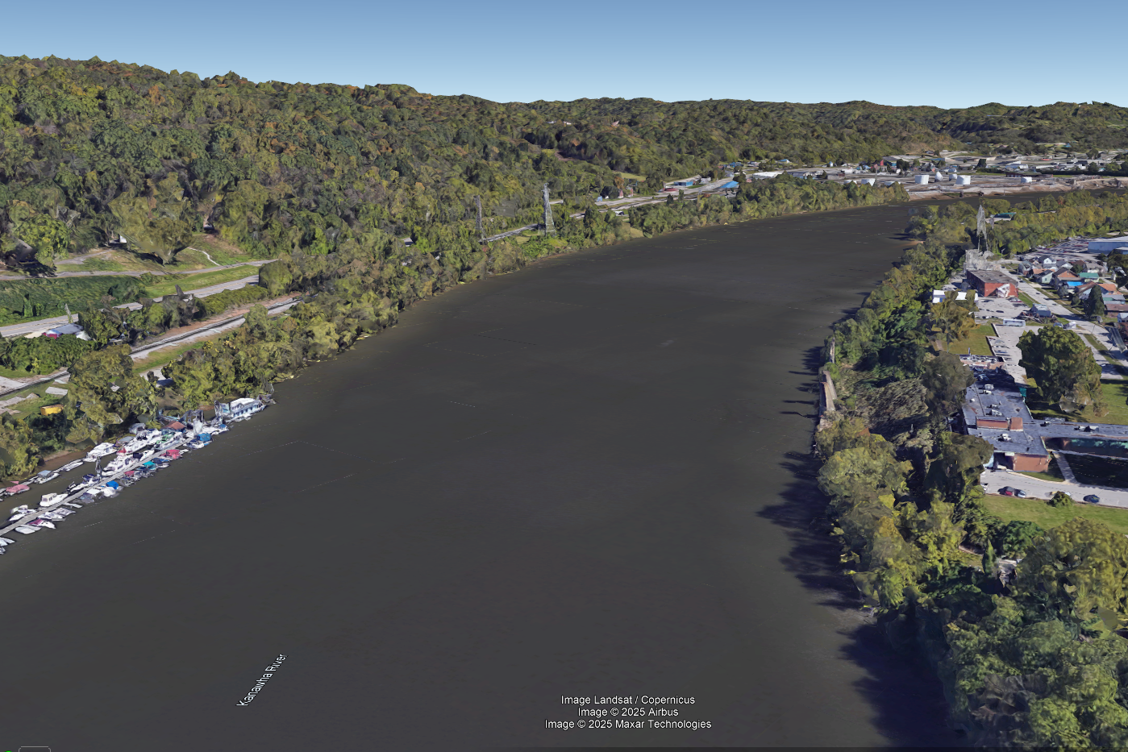
September 1861 Flood
According to USGS, 1952
Gauge Location
The U.S. Weather Bureau gage at river mile 58.5 on the Kanawha River reached an elevation of 605.5 feet, 5.3 feet higher than the second-highest flood of record at Charleston, which occurred in September 1878 (USACE 1958).
Sources: FEMA Kanawha County Flood Insurance Study Report (Effective 2008; Revised 2023)

Slide 14
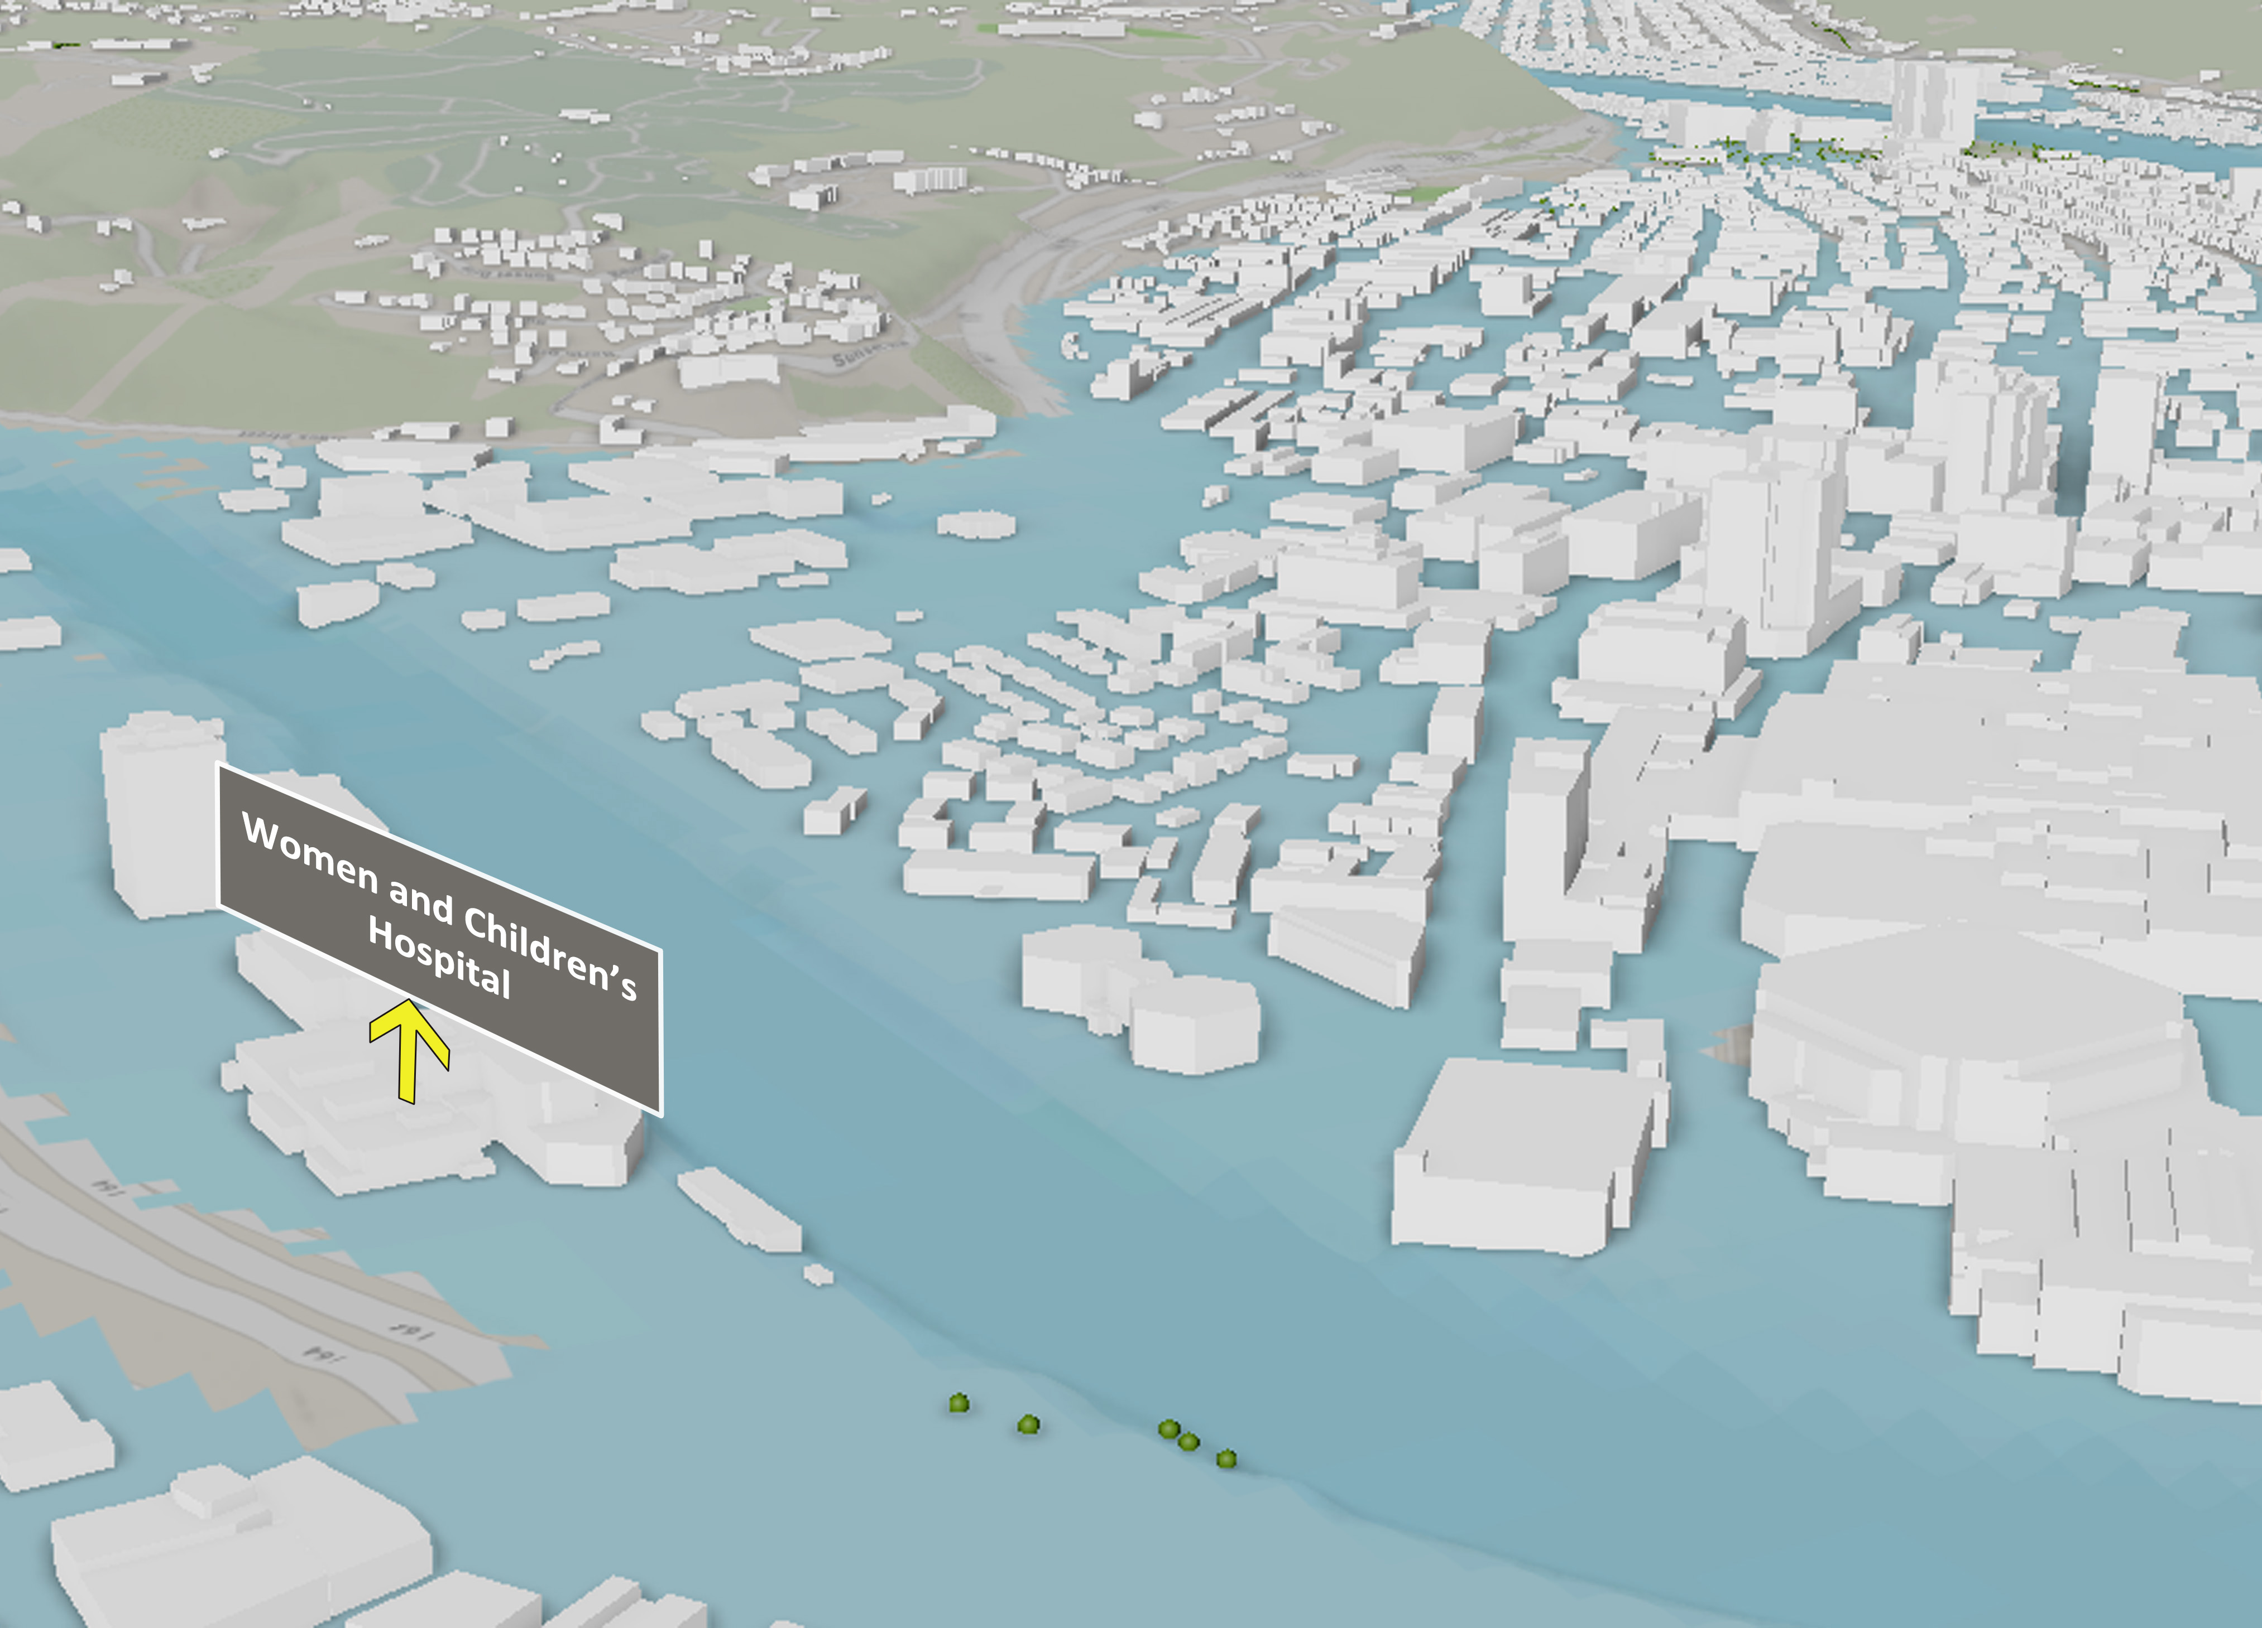
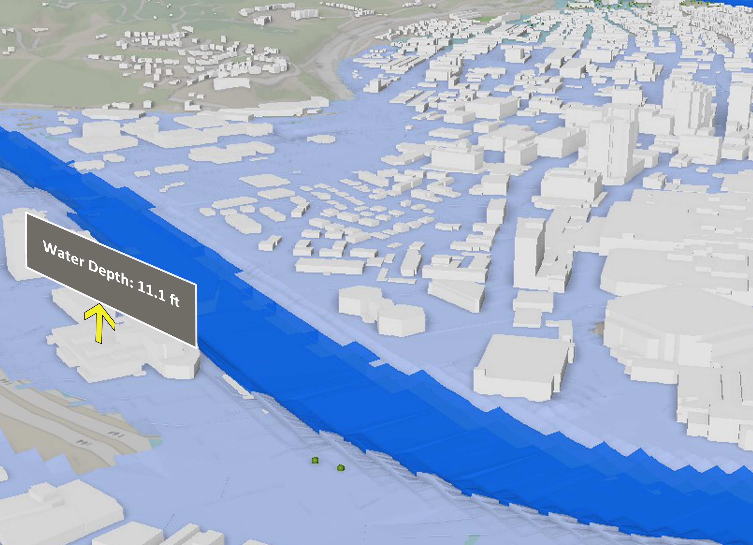
Sutton Dam Maximum Height
Kanawha River
Elk River
Elk River
Elk River
The extent of the inundated area
Water Height
Maximum High (MH) is the pool level near the top of dam resulting from water flowing into the reservoir from heavy rainfall, snowmelt, or other significant high-water events.

Slide 15
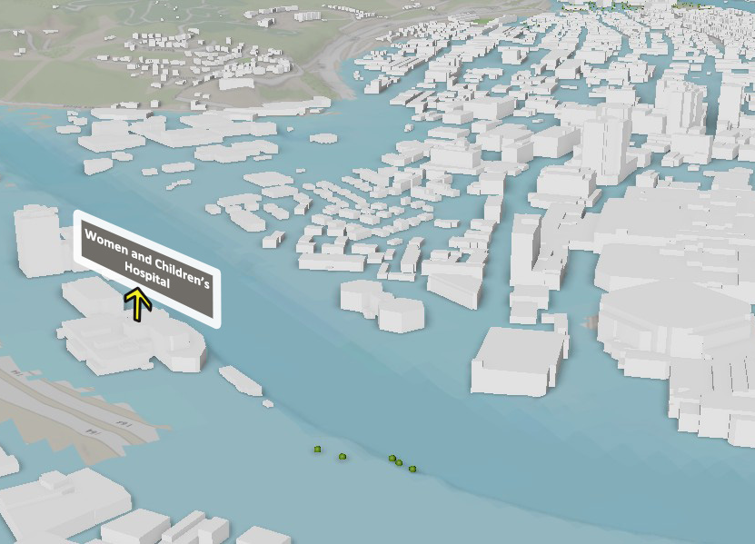
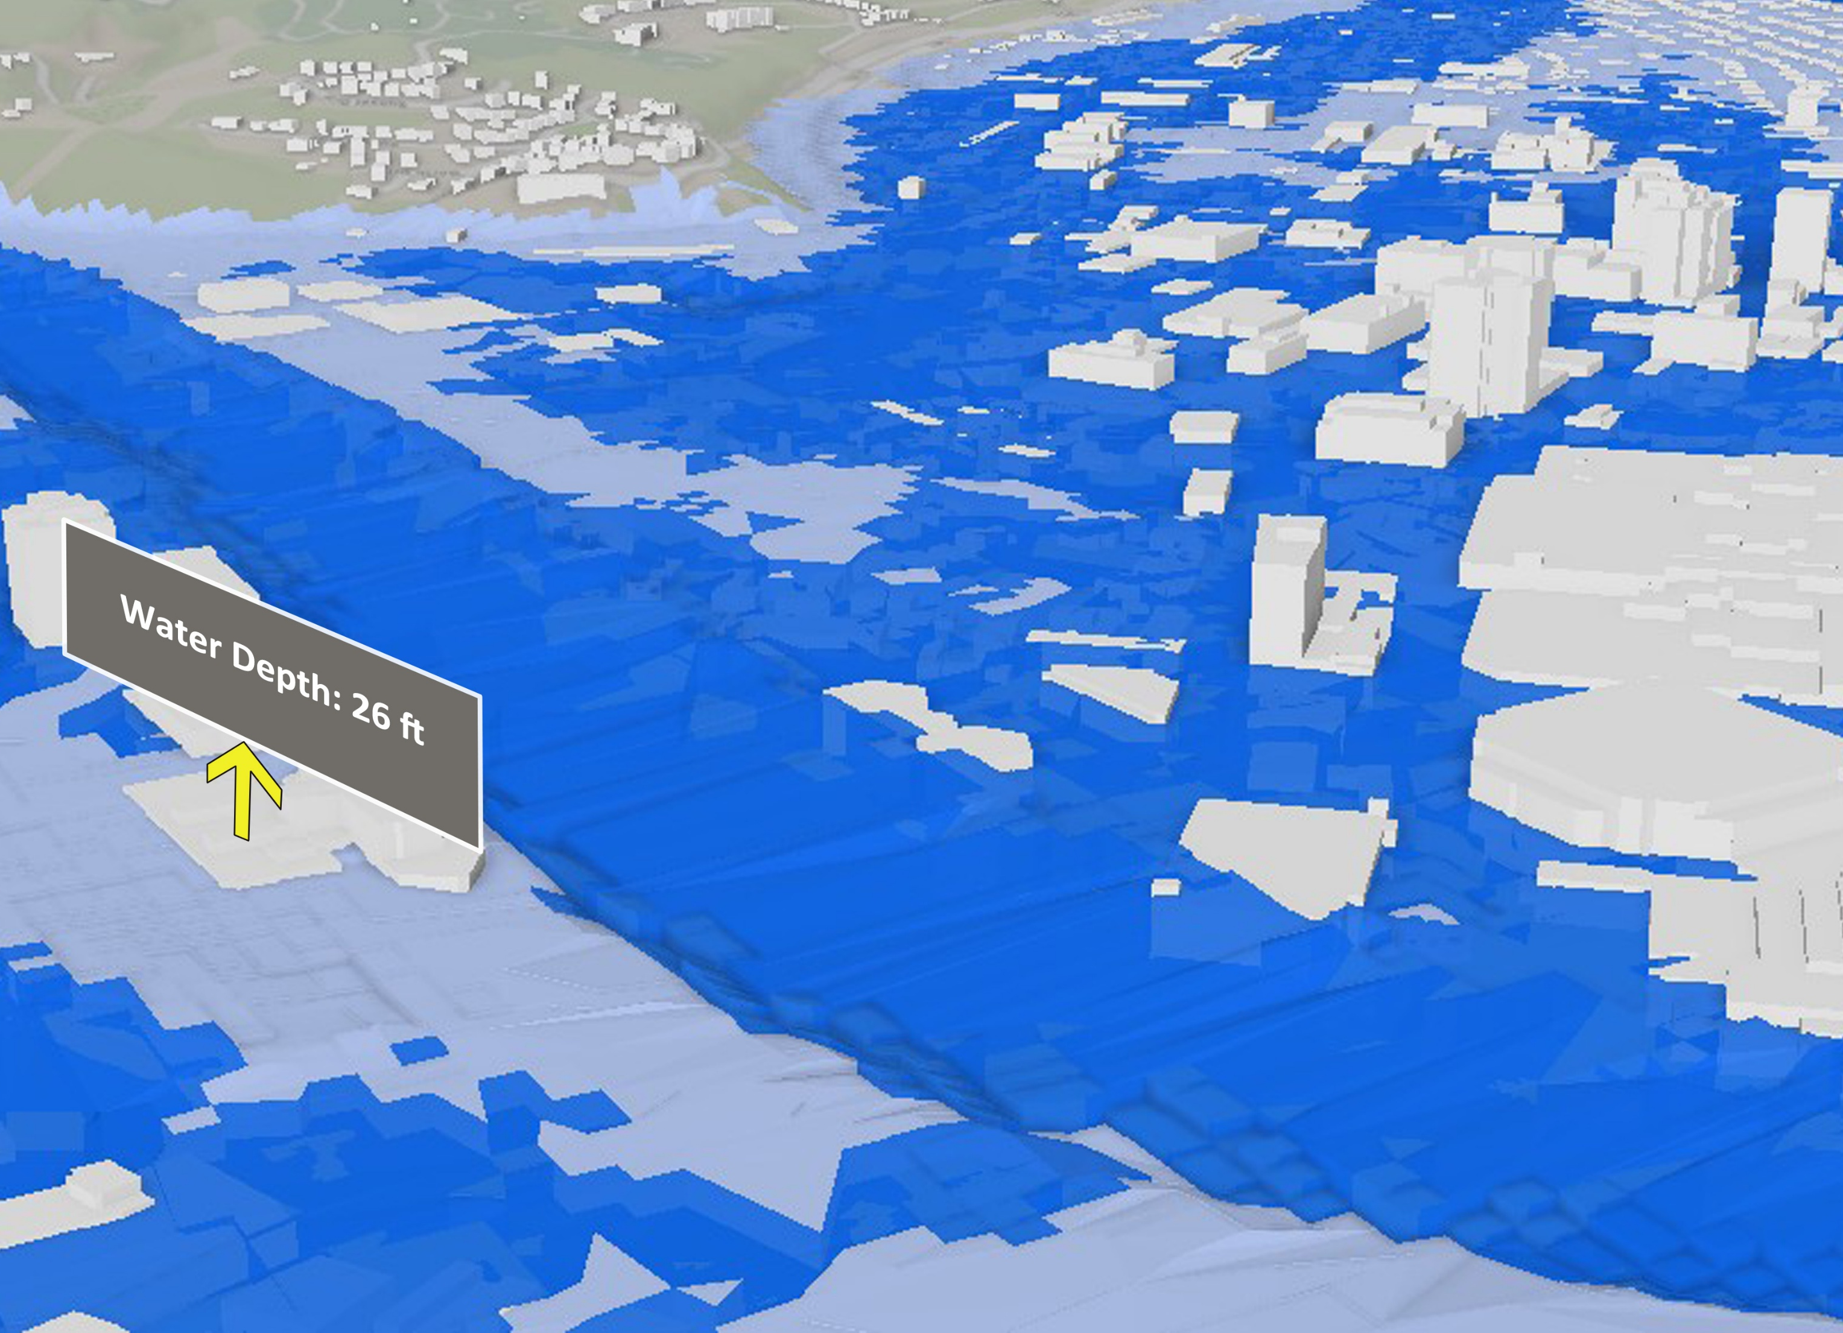
Summersville Dam Maximum Height
Elk River
Elk River
Elk River
The extent of the inundated area
Water Height
Maximum High (MH) is the pool level near the top of dam resulting from water flowing into the reservoir from heavy rainfall, snowmelt, or other significant high-water events.

Slide 16
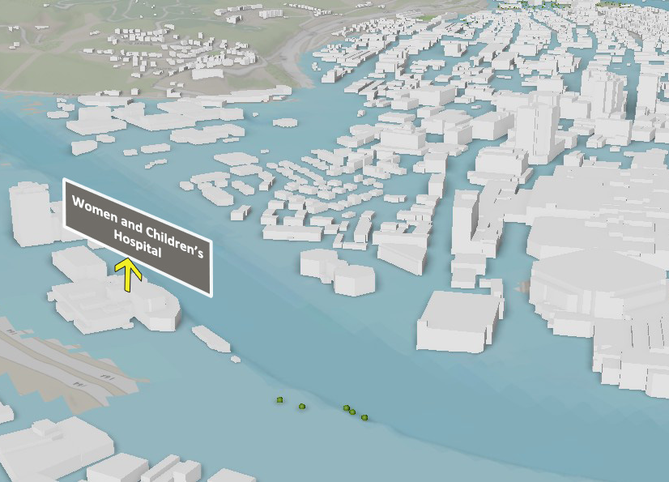
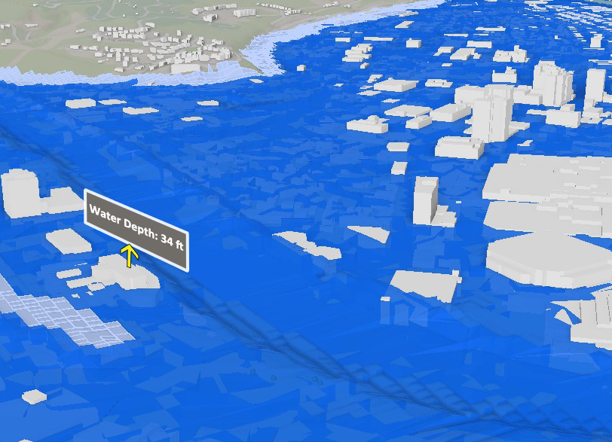
Bluestone Dam Maximum Height
Kanawha River
Elk River
Elk River
Elk River
The extent of the inundated area
Water Height
Maximum High (MH) is the pool level near the top of dam resulting from water flowing into the reservoir from heavy rainfall, snowmelt, or other significant high-water events.

