Slide 1

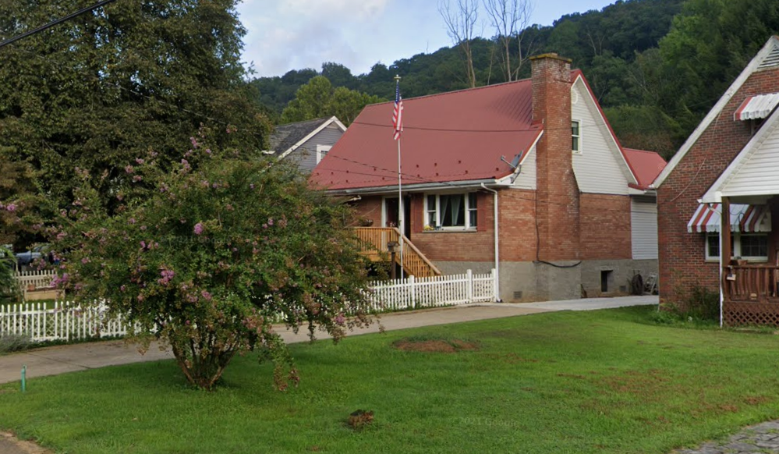
Clendenin
Building Flood Profile
405 Koontz Ave, Clendenin, WV, 25045
20-02-0007-0026-0000_405
Building-scale flood visualizations of different flood frequencies and magnitudes

Slide 2
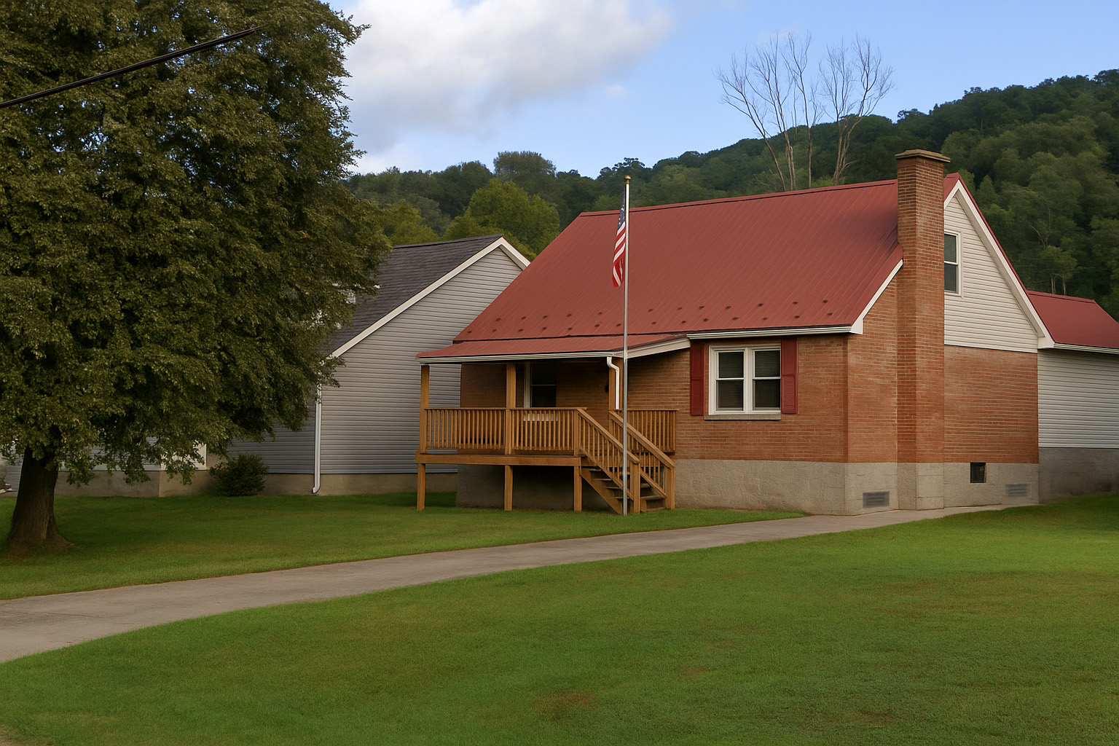
Clendenin
Building Flood Profile
405 Koontz Ave, Clendenin, WV, 25045
20-02-0007-0026-0000_405
Building-scale flood visualizations of different flood frequencies and magnitudes

Slide 3
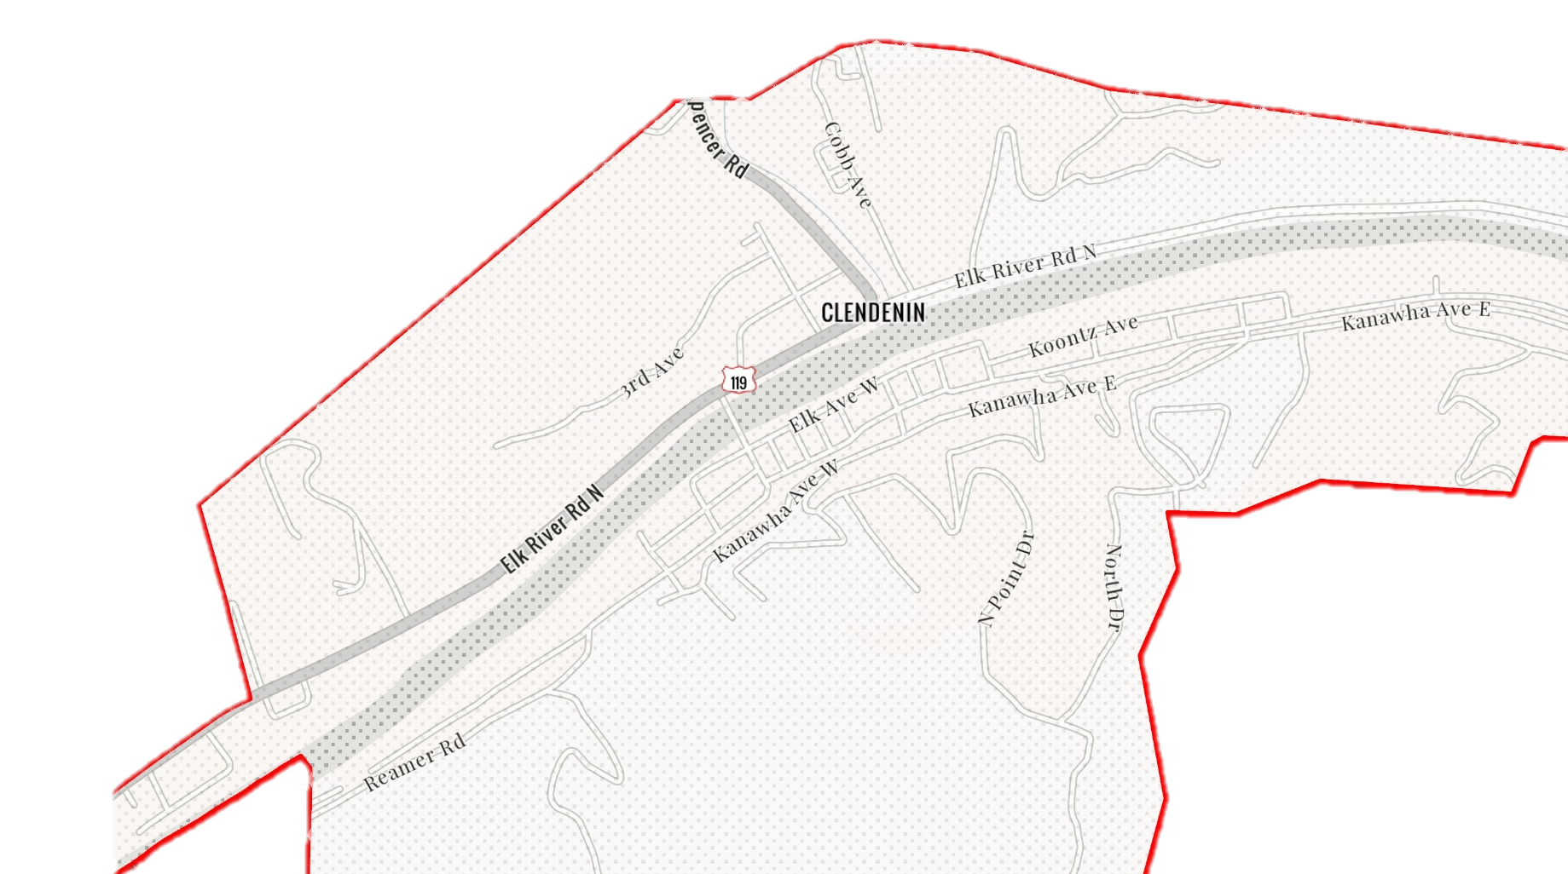
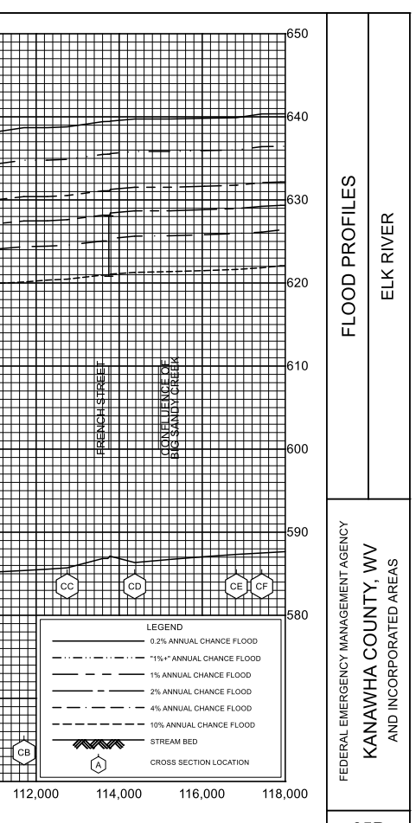
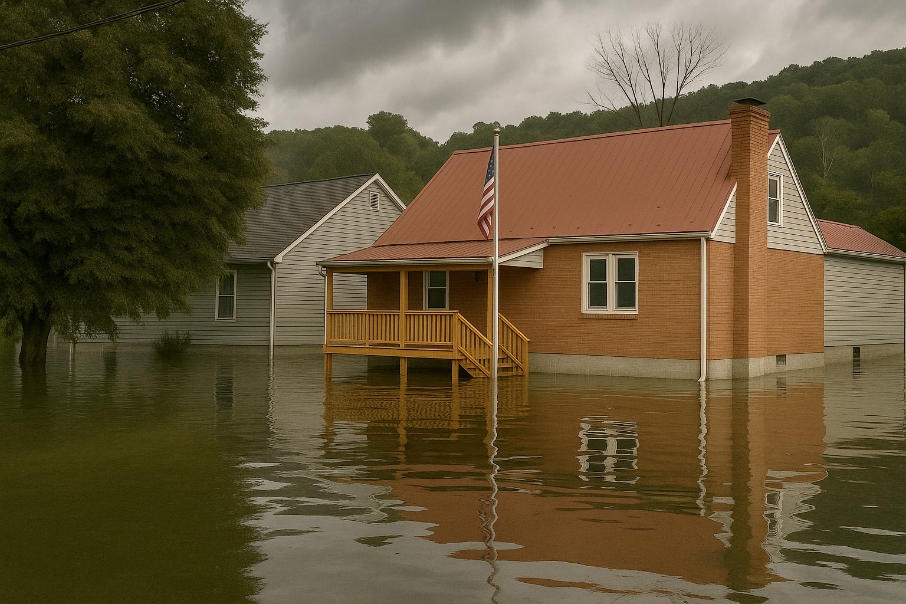
2% Probability of Flood in a year (50-year flood)
2.4’ (FEMA 2% / 50-Yr)
Building’s Ground Elevation

Slide 4
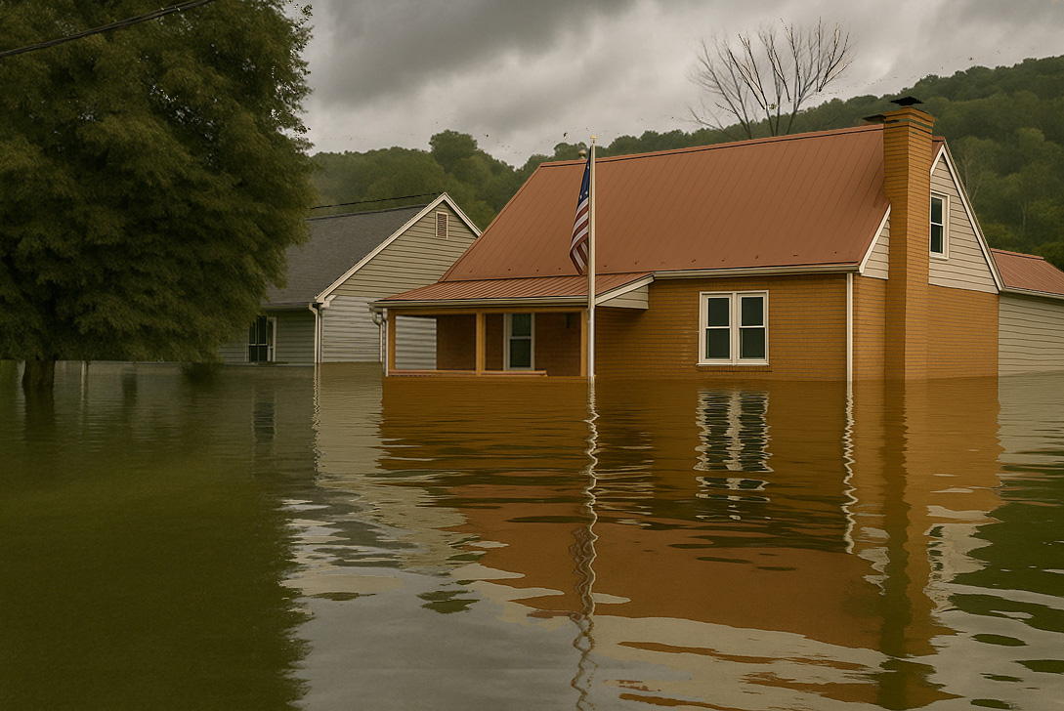
1% Probability of Flood in a year (100-year flood)
5.3’ (FEMA 1% / 100-Yr)

Slide 5

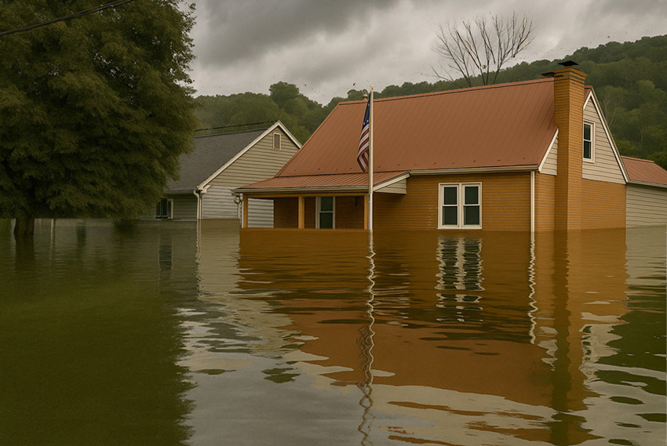
2016 High Watermark
High Watermark
6.2’ (2016 High Water)
9.5’ (FEMA 2% / 50-Yr)

Slide 6
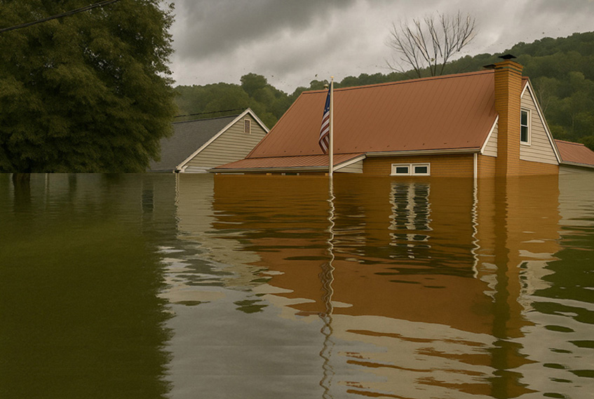
1%+ Probability of Flood in a year
(100-year Plus flood)
9.4’ (FEMA 1+% / 100-Yr)

Slide 7
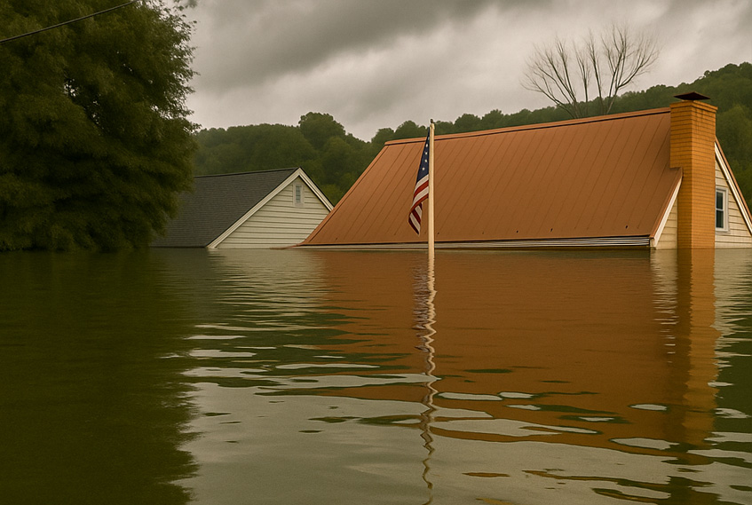
0.2% Probability of Flood in a year (500-year flood)
12’ (FEMA 0.2% / 500-Yr)

