Slide 1
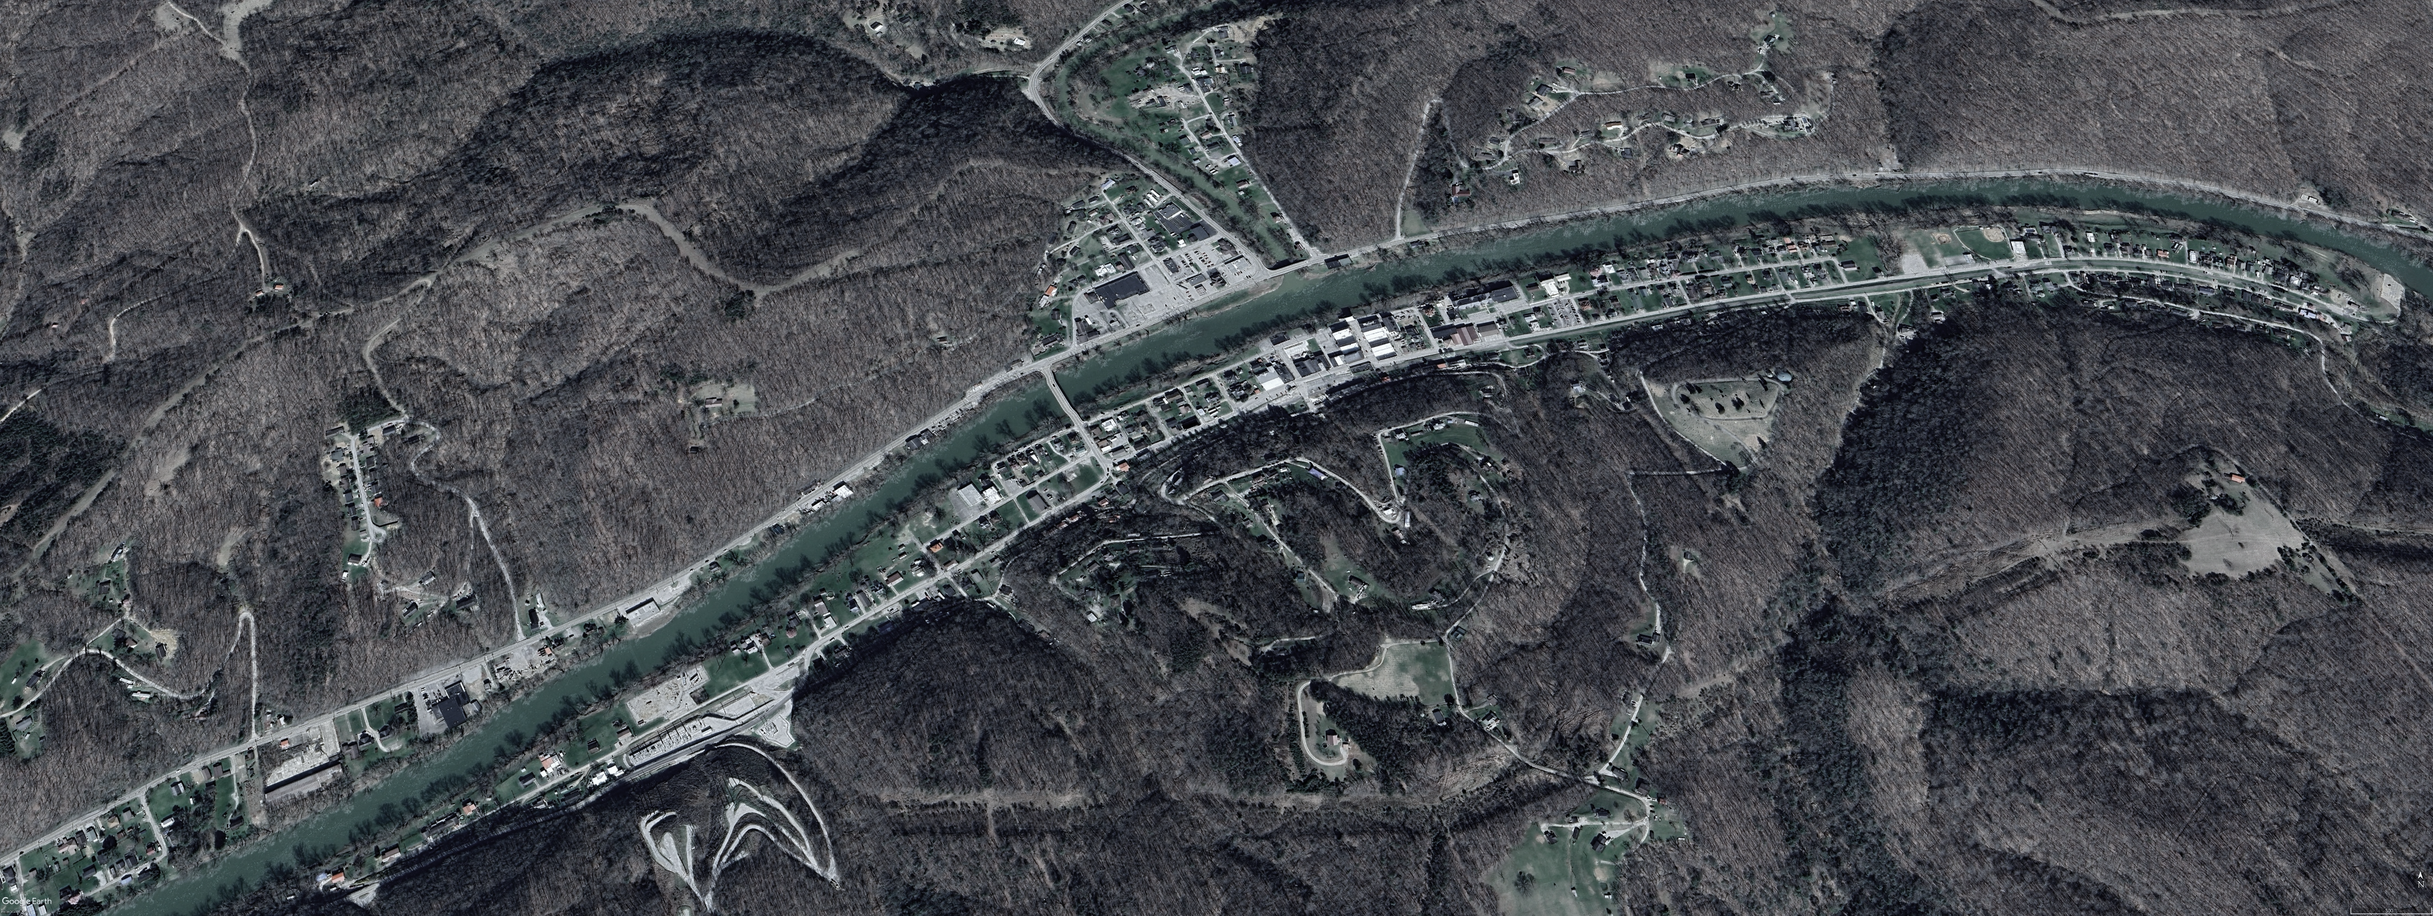
A Bird’s view over:
Clendenin, WV
North

Slide 2
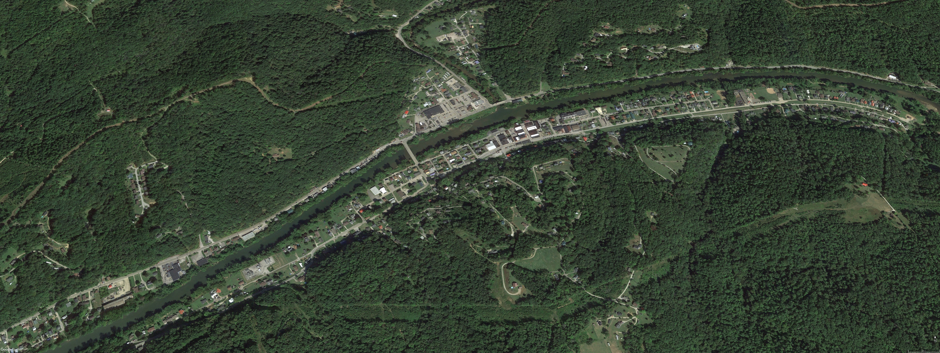

Pre-Disaster Aerial View
Imagery of September 2015
8th St.
7th St.
6th St.
5th St.
Image courtesy of Google Earth Pro

Slide 3
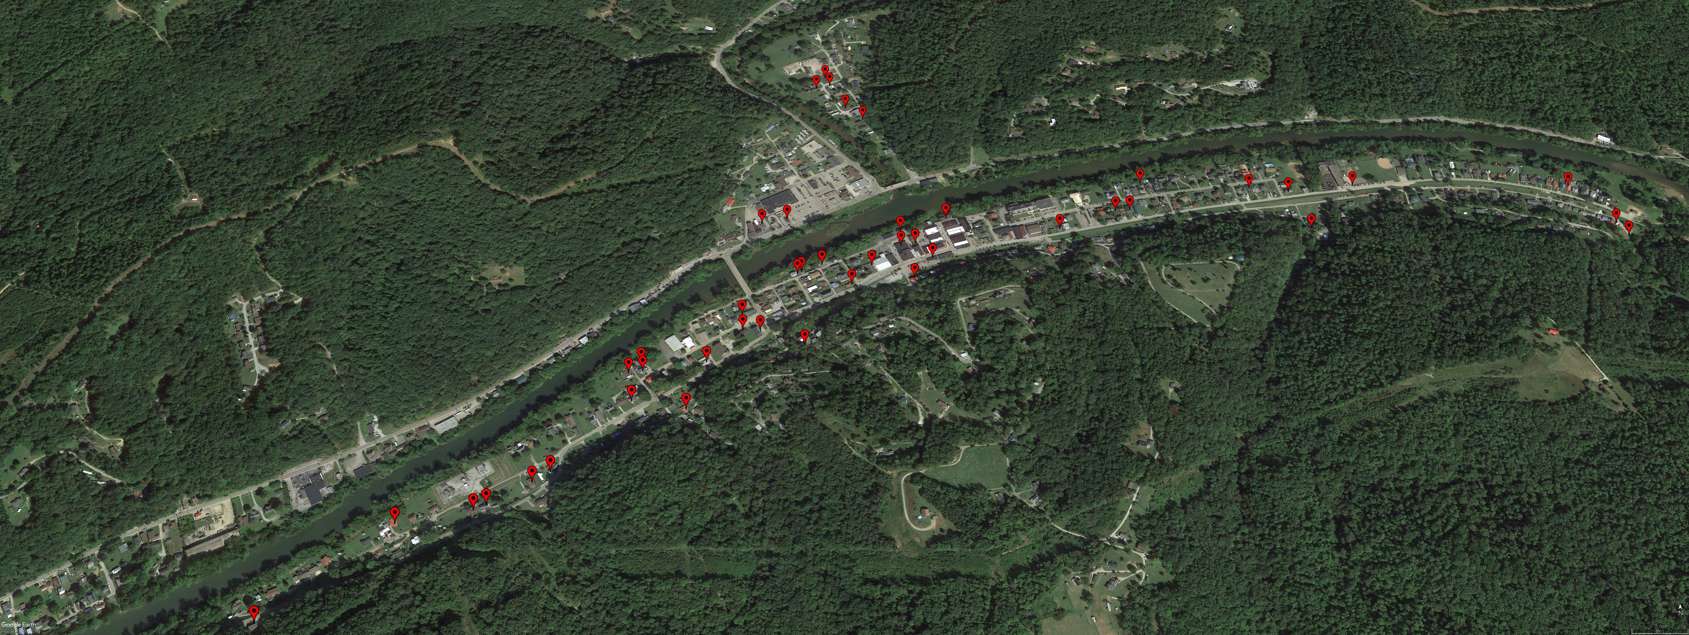
Removed Structure
Imagery of September 2015
Building REMOVED (Vacant Parcel)
Image courtesy of Google Earth Pro

Slide 4
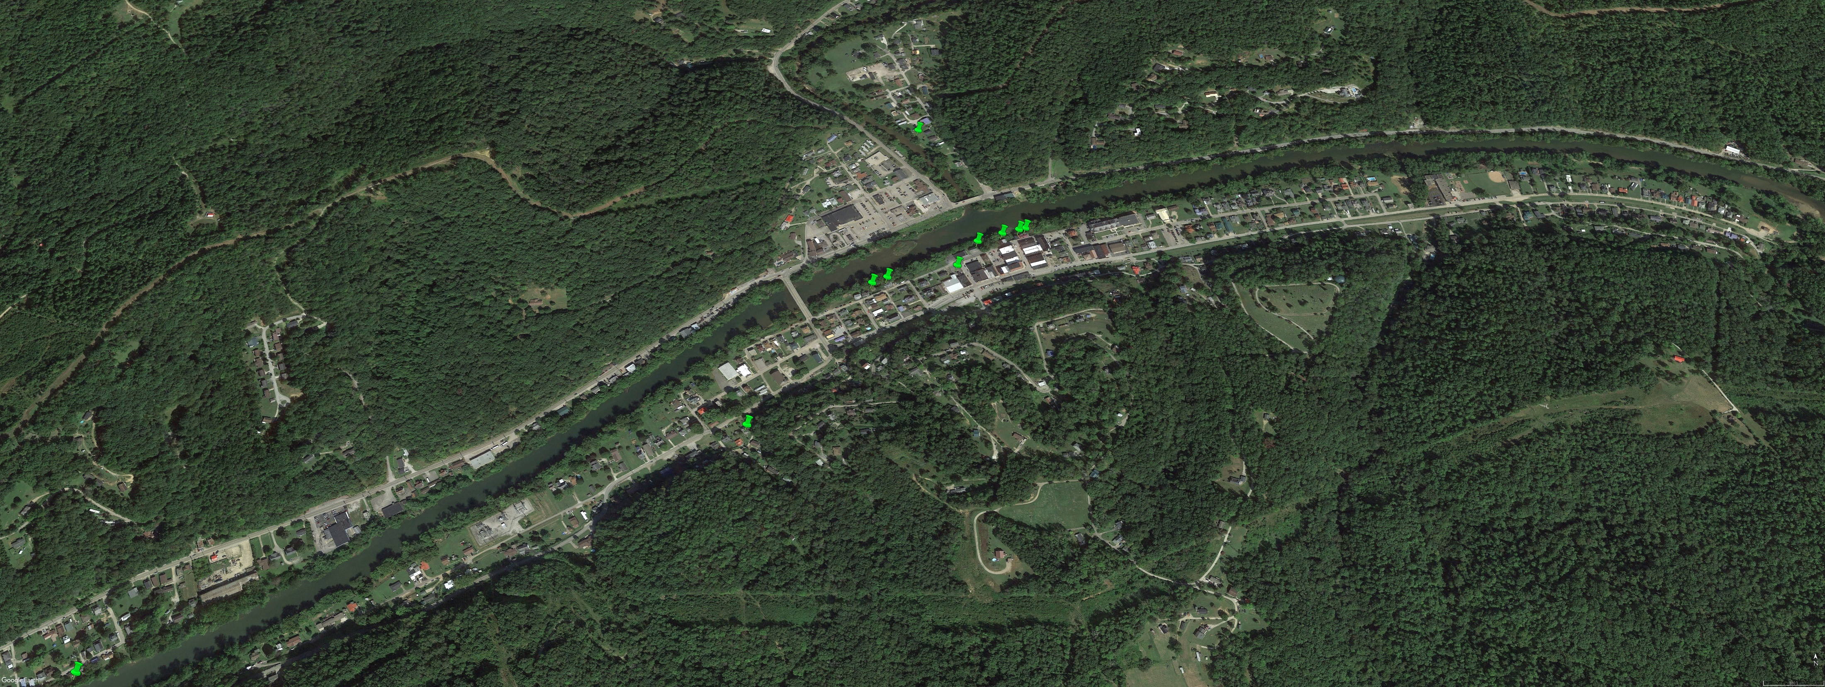
Deed-Restricted Buyout Parcels
Imagery of September 2015
ACQUISITION or Buyout Property
Image courtesy of Google Earth Pro

Slide 5

Imagery of September 2013
Mitigated Structures
by Elevating to Design Flood Elevation (DFE)
Mitigation RECONSTRUCTION
Image courtesy of Google Earth Pro

Slide 6
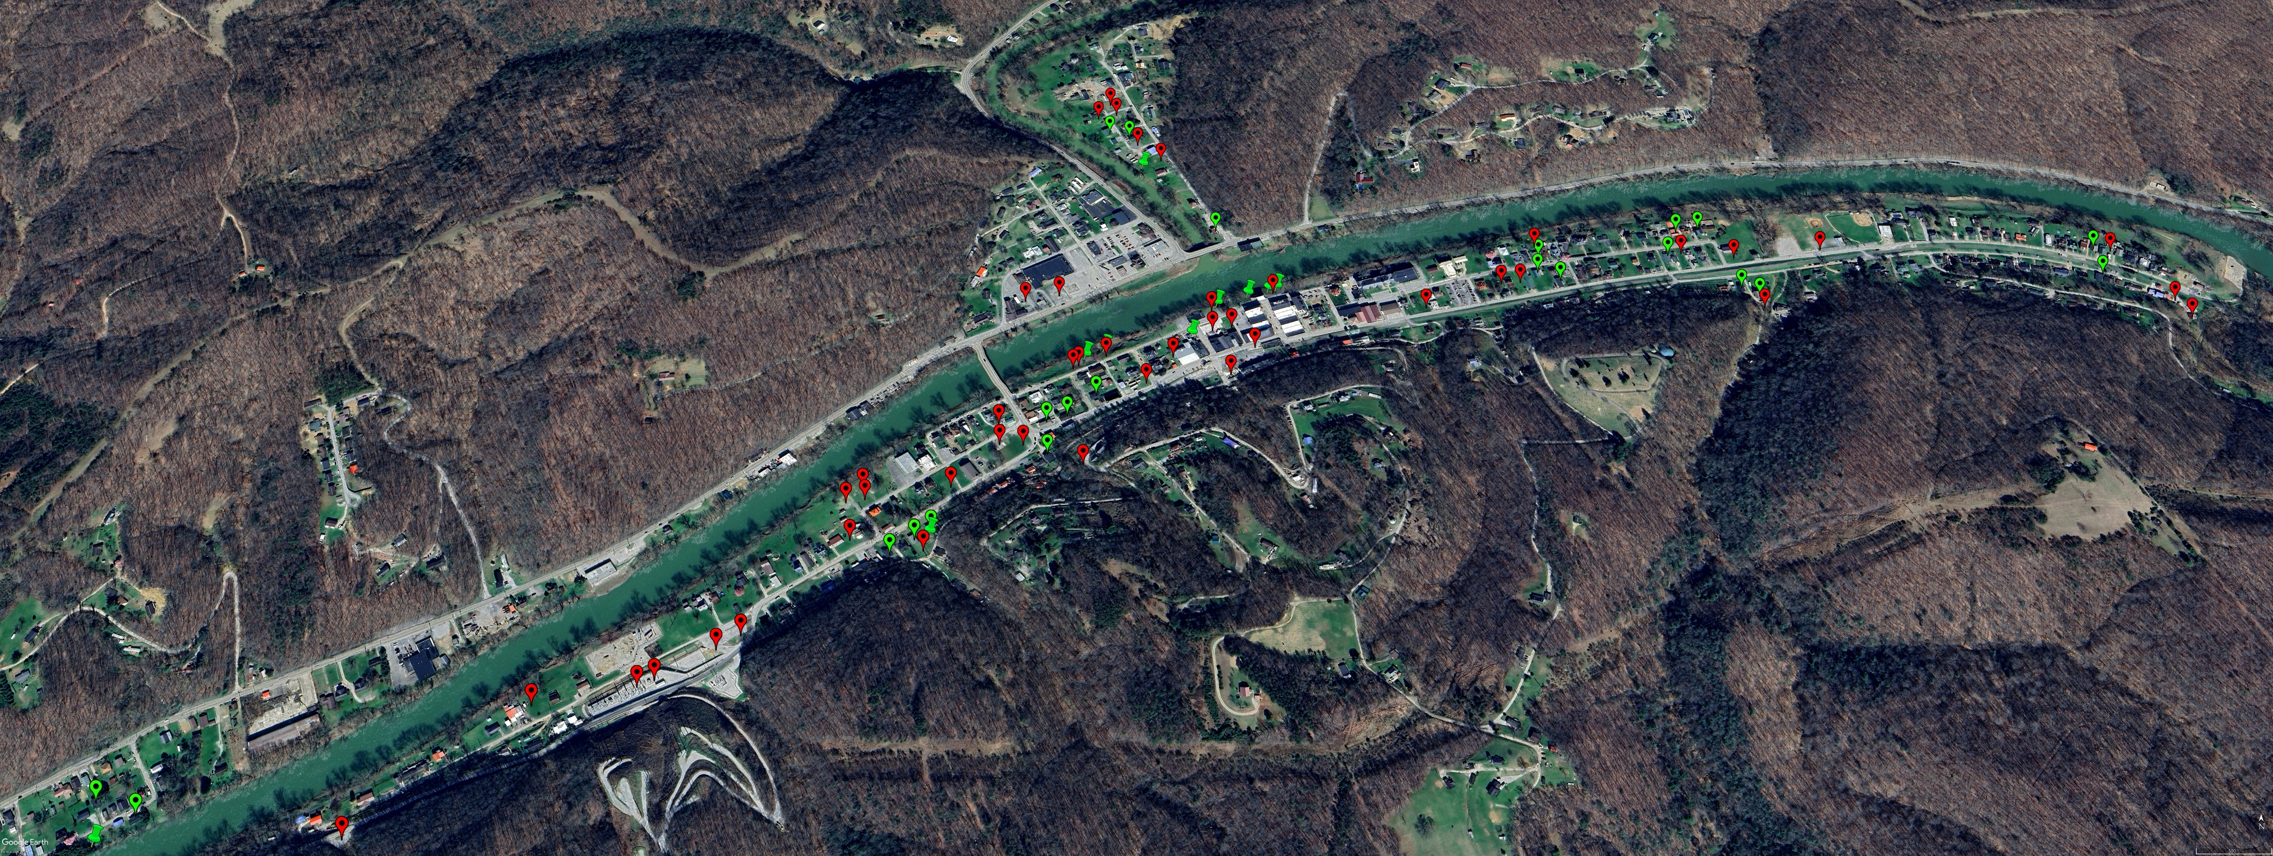



Imagery of October 2024
Building REMOVED (Vacant Parcel)
ACQUISITION or Buyout Property
Mitigation RECONSTRUCTION
Image courtesy of Google Earth Pro

