Slide 1
Flood Characteristics

Slide 2
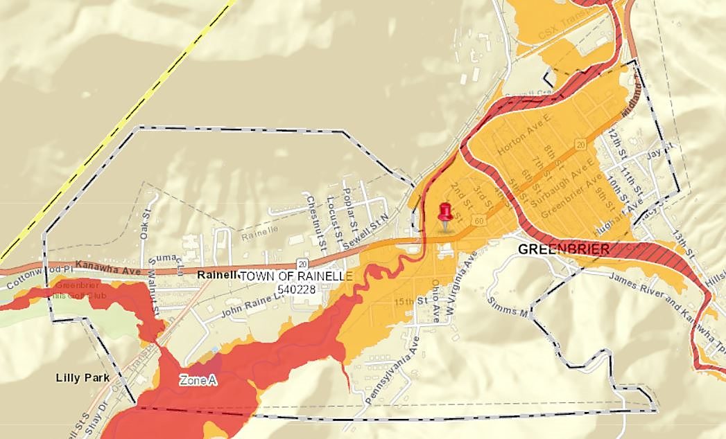
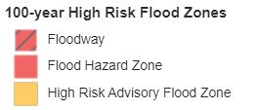
Flood Zone Measurements
1%-Annual-Chance Flood Zone or Special Flood Hazard Area (SFHA):
White Sulphur Springs: 21.9% of the community area; 266 acres
Rainelle: 31.1% of the community area; 223 acres
Median ratio for all incorporated areas in the state: 10.2%
Historical Flood Information (2016 event):
White Sulphur Springs: Similarities to a 500-year event
Rainelle: Between a 1%-annual chance (100-yr) and 0.2% chance (500-yr) flood event
2016 high-water marks: 2,396 ft; 100-year BFE: 2,393; 500-year flood depth: 2,399 ft
Large destructive event but not a 1000-year flood (0.1%) as erroneously publicized in the media
Active Flood Studies & Mapping:
Rainelle: A significant SFHA increase in the new maps
(July 2023) due to the 2012 inaccurate effective floodplain maps
currently in use
Flood Tool Link: https://www.mapwv.gov/flood/map/?wkid=102100&x=-8990877&y=4575135&l=8&v=0

Slide 3
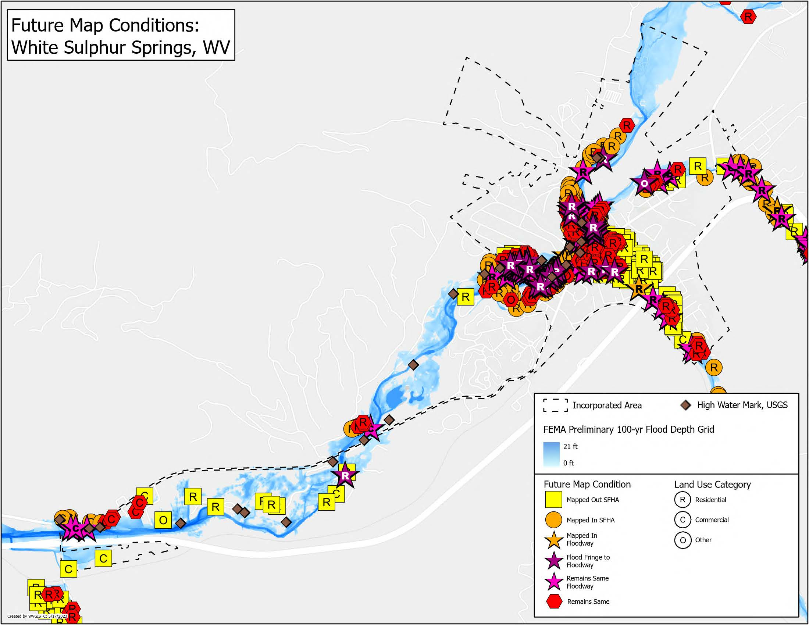
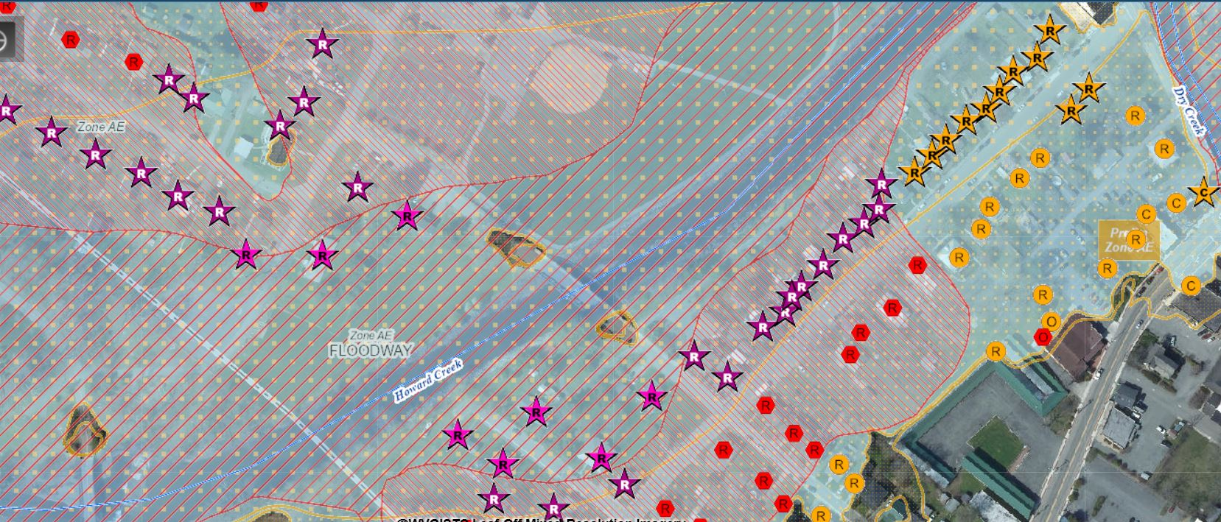
Future Map Conditions, White Sulphur Springs
Buildings “Mapped In” SFHA: 75 (Rank: 11th)
Average in all incorporated areas in the state: 19
Buildings “Mapped In” Floodway: 14
Buildings Mapped from SFHA to Floodway: 40
Flood Tool Link: https://www.mapwv.gov/flood/map/?wkid=102100&x=-8939505&y=4550361&l=11&v=2

Slide 4
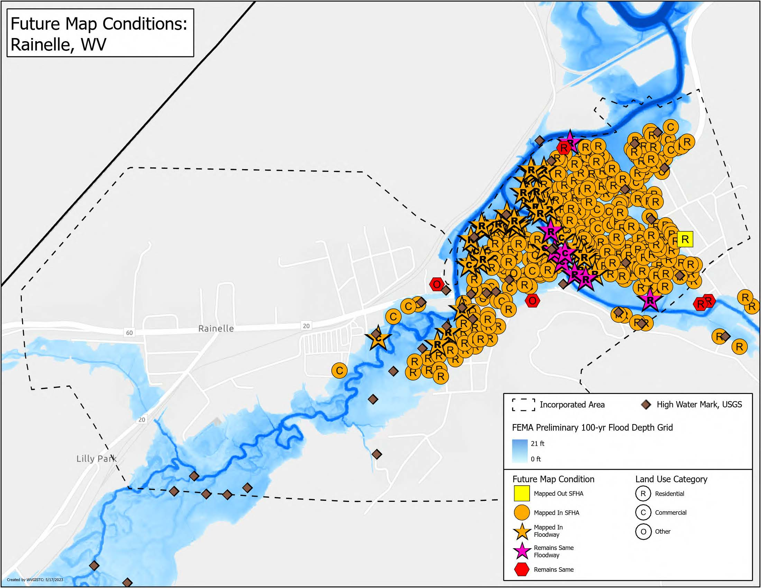
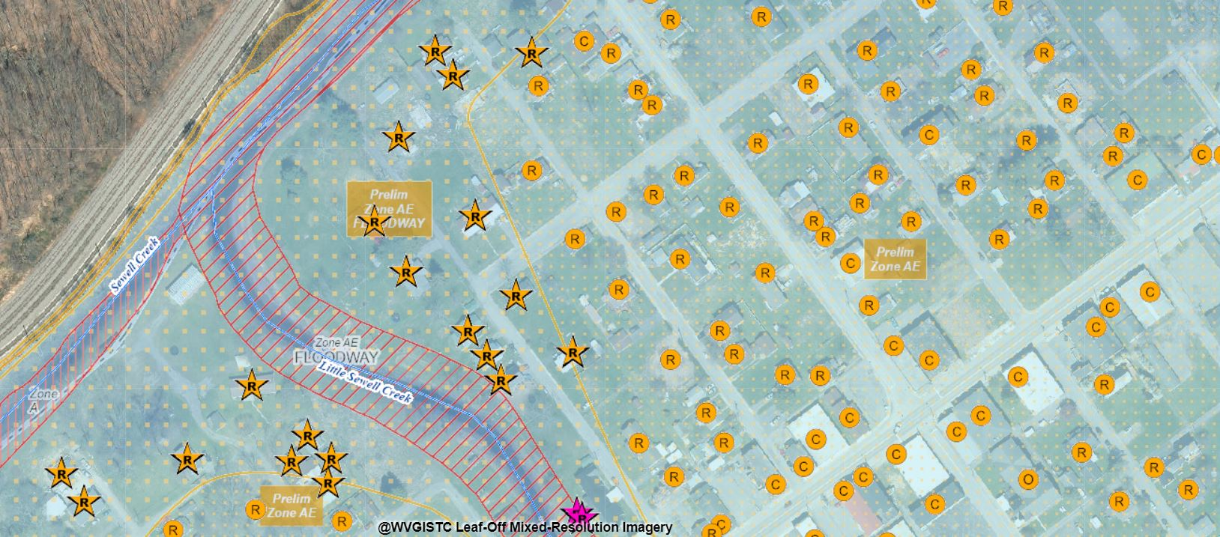
Future Map Conditions, Rainelle
Buildings “Mapped In” SFHA: 325 (Rank: 3rd)
Average in all incorporated areas in the state: 19
Buildings “Mapped In” Floodway: 38
Buildings Mapped from SFHA to Floodway: 0
Flood Tool Link: https://www.mapwv.gov/flood/map/?wkid=102100&x=-8990644&y=4575309&l=11&v=2

Slide 5
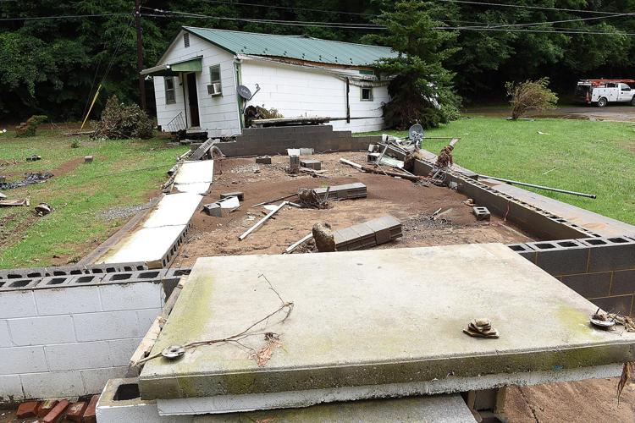
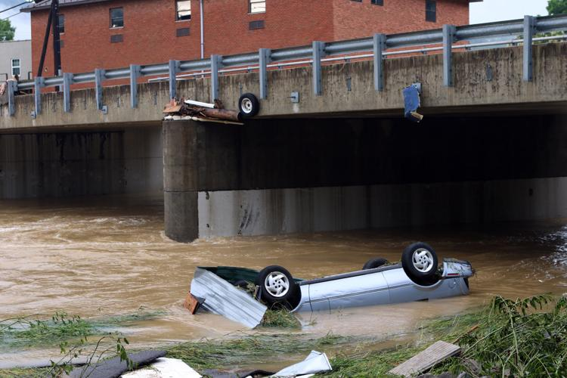
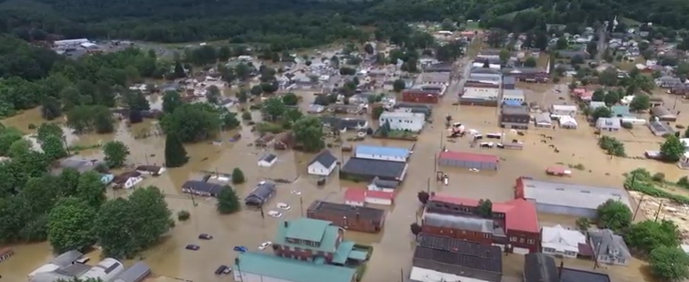
Major Concerns
White Sulphur Springs: Higher flood velocity
Rainelle: Higher flood depths; Higher frequency; Longer duration
Image courtesy of The Register Herald at
https://www.register-herald.com/flood/gallery-white-sulphur-springs-flood-of-2016/collection_cdf2d4b0-56d9-11e7-a382-7b8f9ba26dee.html
Image courtesy of Elevated Media, clipped from a video at https://www.youtube.com/watch?v=FmZBWNUwms8

Slide 6
Physical / Human Exposure

Slide 7
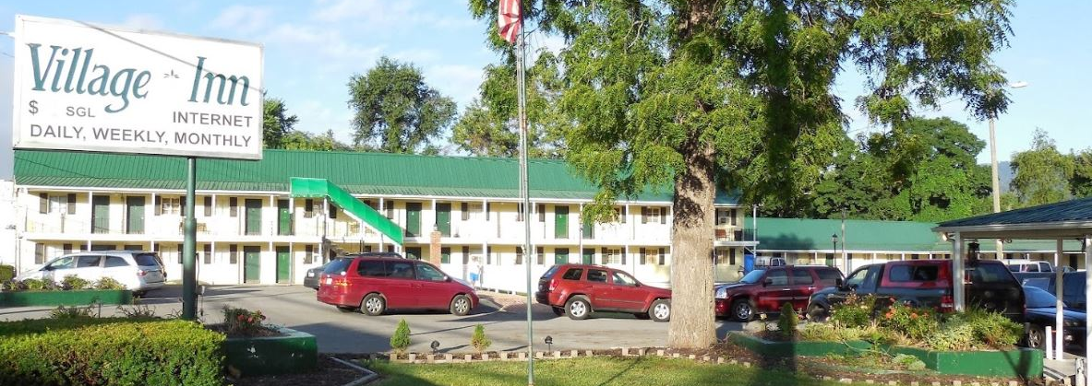
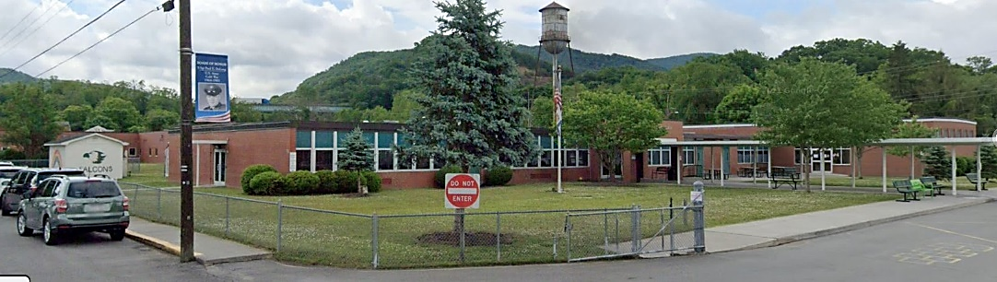
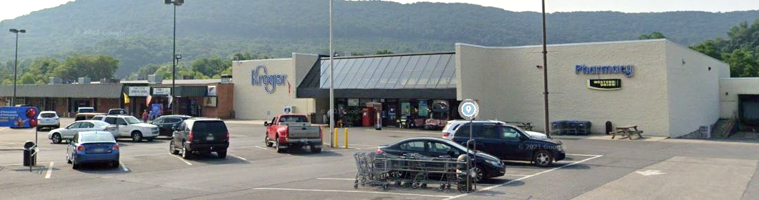
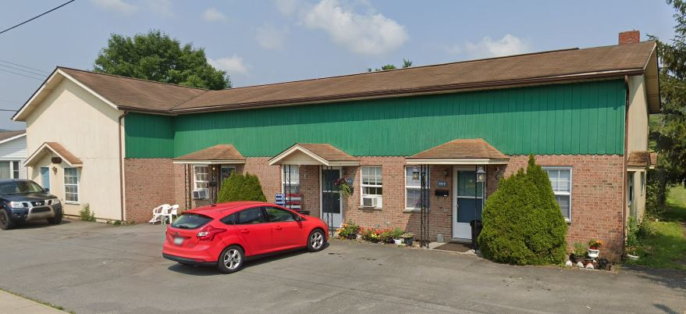
Total Primary Buildings in Floodplain
Rationale:
The number of structures located in floodplain indicates the level of physical and human exposure, as elements of flood risk, in a community.
Findings:
White Sulphur Springs: 26% of total buildings in the community (n=425, Rank: 12th)
Rainelle: 34% of total buildings in the community (n=338, Rank: 18th)
Median ratio for all incorporated areas in the state: 9%
High % Buildings in Floodplain
Building ID: 13-17-0011-0246-0000_559 Flood Tool Link
Building ID: 13-17-0009-0342-0000_150 Flood Tool Link
User Survey
75% primary residences affected by 2016 flood
Building ID: 13-13-0004-0194-0000_506 Flood Tool Link
Building ID: 13-13-0005-0341-0000_249 Flood Tool Link
Recommendations:
Community-level management: Regulations limiting development in floodplains

Slide 8
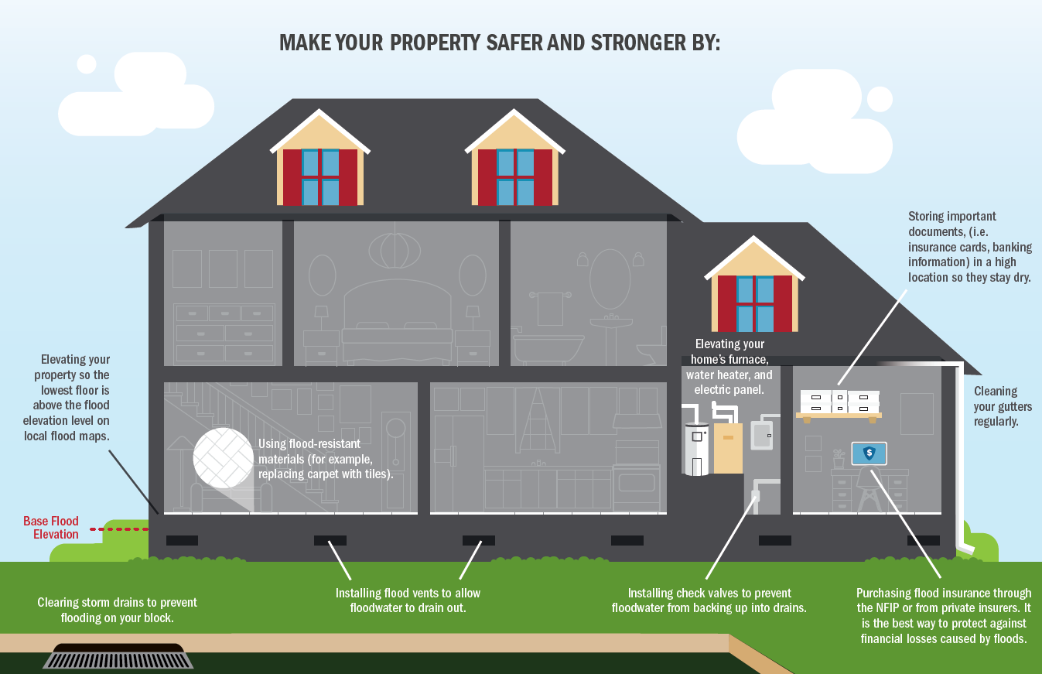
Total Primary Buildings in Floodplain…
Rationale:
The number of structures located in floodplain indicates the level of physical and human exposure, as elements of flood risk, in a community.
Recommendations:
Building-level by owners:
Purchase flood Insurance;
Elevate buildings;
Provide flood openings;
Seal foundations;
Elevate and anchor utilities;
Protect valuable possessions
https://www.floodsmart.gov
“What to do before a flood”
Retrieved from: FEMA. Understanding Flood Dangers
in Central West Virginia: LESSONS LEARNED FROM THE JUNE 2016 FLOOD

Slide 9
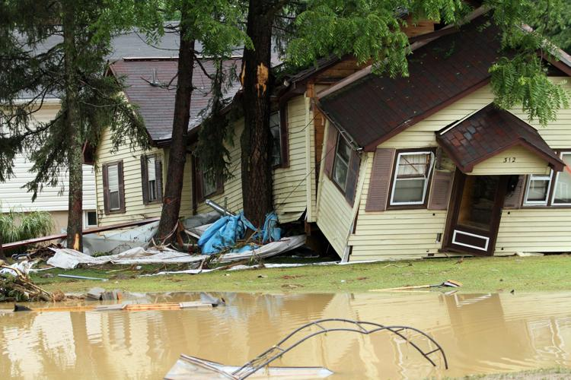
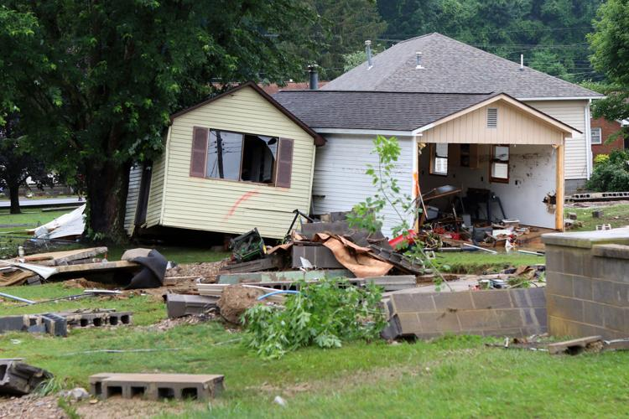
Primary Buildings in Floodway
Rationale:
Buildings in the floodway channel of a stream or close to the flood source, will be subject to the greatest flood depths, highest velocities, and greatest debris potential.
Findings:
White Sulphur Springs: 105 (Rank: 6th); 25% of SFHA buildings in floodway
Rainelle: 47 (Rank: 18th); 14% of SFHA buildings in floodway
Median ratio for all incorporated areas in the state: 8%
Structures exposed to High Velocity Flows
White Sulphur Springs, 2016
Image courtesy of The Register Herald at https://www.register-herald.com/flood/gallery-white-sulphur-springs-flood-of-2016/collection_cdf2d4b0-56d9-11e7-a382-7b8f9ba26dee.html
Recommendations:
Should be a priority for mitigation efforts
Stricter engineering development standards should be applied: No expansion on building footprint; “No-Rise/No Impact” cert.

Slide 10

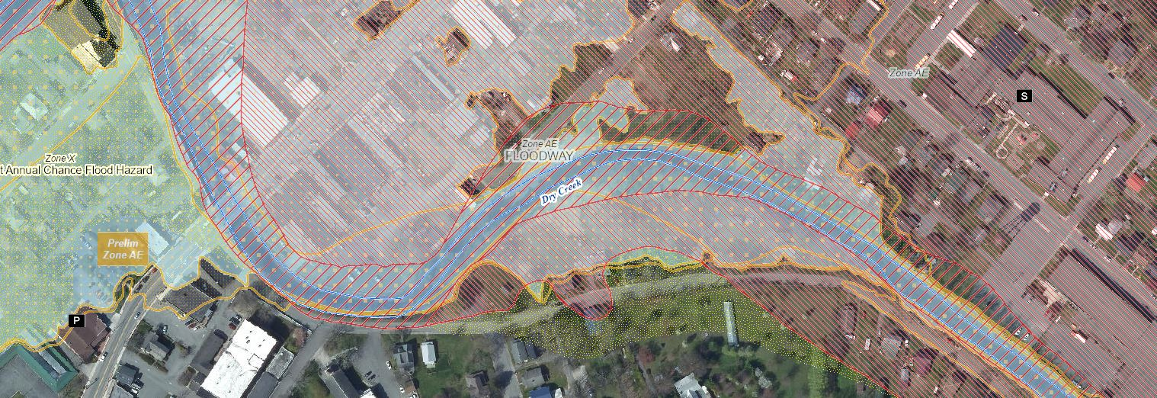
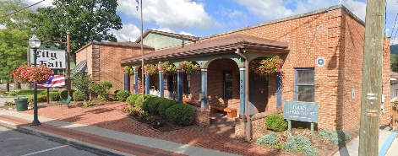
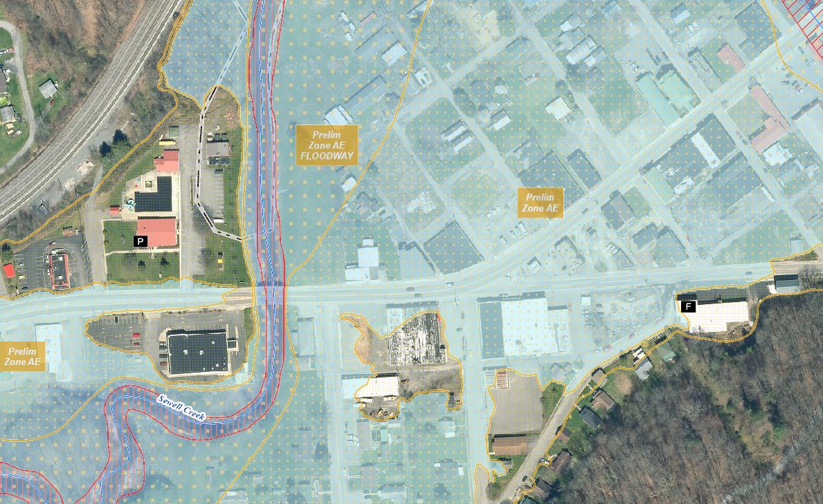
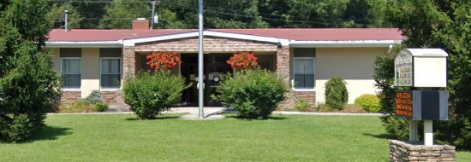
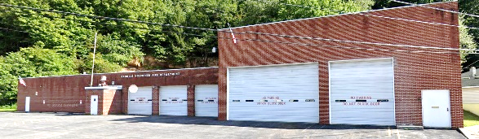
Essential Facilities in the Moderate Risk (0.2%-Annual-Chance) Floodplain
Rationale:
Providing emergency services during a flood; Used as shelters; Immobile patients or residents
Findings:
White Sulphur Springs
Significant Structures at Risk
White Sulphur Elementary School
White Sulphur Springs Police Department
Flood Tool Link: https://www.mapwv.gov/flood/map/?wkid=102100&x=-8938734&y=4550388&l=11&v=2
Rainelle
Rainelle Police Department
Rainelle Volunteer Fire Department
Flood Tool Link: https://www.mapwv.gov/flood/map/?wkid=102100&x=-8990932&y=4575020&l=11&v=2
Recommendations:
Plan to relocated out of high-risk floodplains

Slide 11
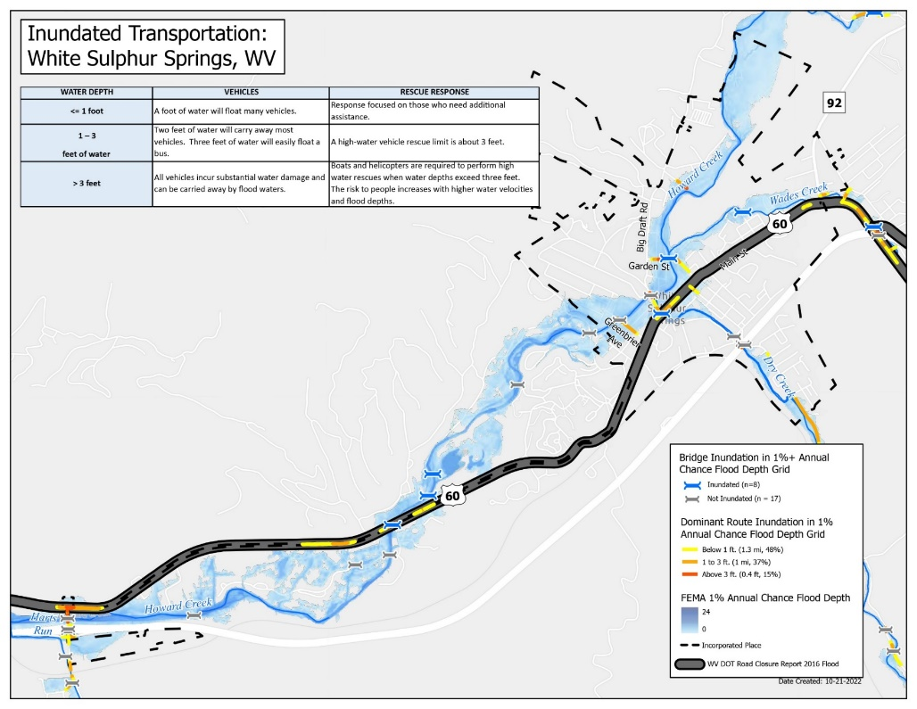
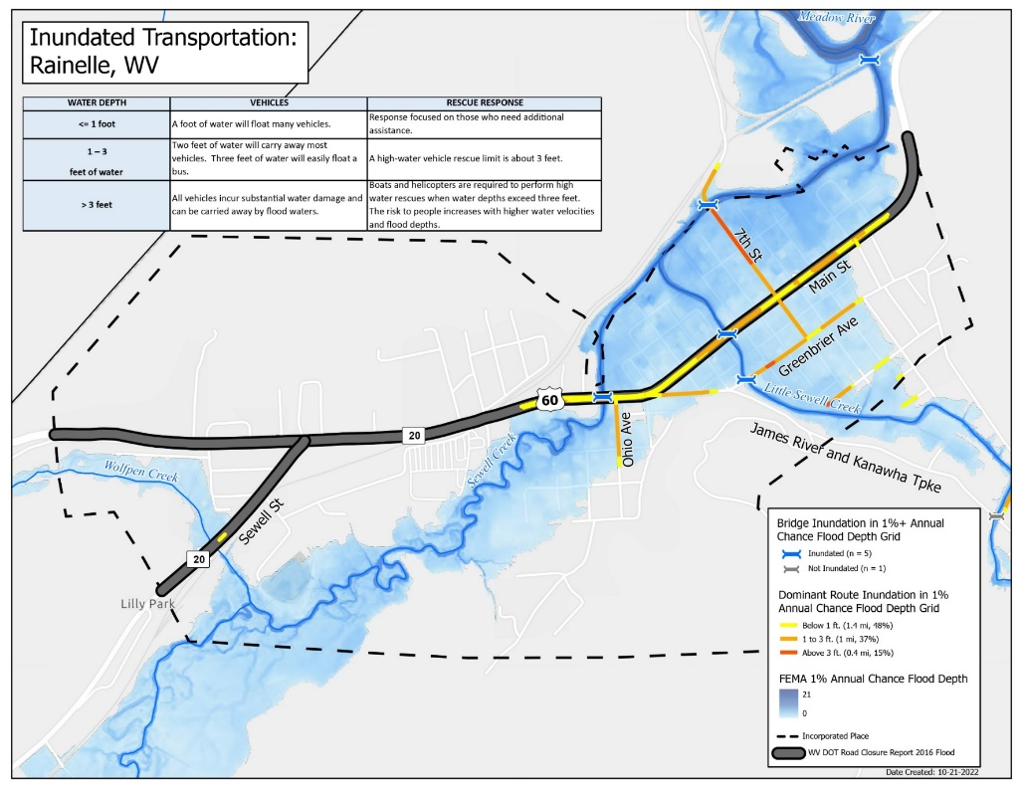
Transportation: Inundated Roads & Bridges
Rationale:
1 ft: Vehicles start floating & roads impassable; 3 ft: Need to high-profile vehicles for rescues
Findings:
White Sulphur Springs: 23% of the Total Road Network Mileage including U.S. 60 inundated to 1 ft or higher; 3 bridges
Rainelle: 36% of the Total Road Network Mileage including U.S. 60 inundated to 1 ft or higher;
2 bridges
Plan for Road Closures
Recommendations:
Pre-disaster planning should consider how road closures affect disaster response and recovery

Slide 12
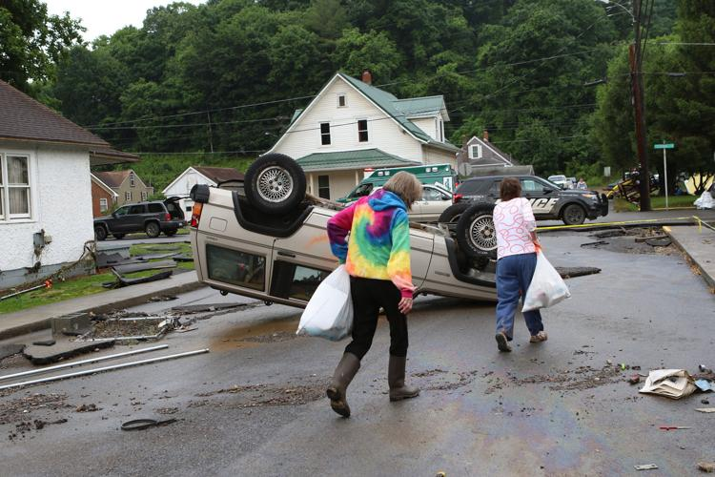
Estimated Population Residing in High-Risk Flood Zones
Rationale:
More people residing in floodplains, higher human exposure to floods and higher human loss
Findings:
White Sulphur Springs: 39% of the total population (n=1,026)
Rainelle: 43% of the total population (n= 582)
Ratio for all incorporated areas in the state: 10%
High Population at Risk
White Sulphur Springs, 2016
Image courtesy of The Register Herald at https://www.register-herald.com/flood/gallery-white-sulphur-springs-flood-of-2016/collection_cdf2d4b0-56d9-11e7-a382-7b8f9ba26dee.html
Recommendations:
Plan for more effective acquisition and relocation out of high-risk floodplains including early warning systems

Slide 13
Social / Physical Vulnerability

Slide 14







Social Vulnerability
Rationale:
Demographic and socioeconomic characteristics can make some groups of people more susceptible to hazards, affecting their ability to anticipate, respond to, and recover
Findings:
Vulnerability Indicators |  | White Sulphur Springs | Rainelle | State Ratio | National Ratio
 | Poverty Rate | 14.4% | 37.0% | 17.3% | 12.9%
 | Unemployment Rate | 21.4% | 33.6% | 23.8% | 14.7%
 | Vulnerable Ages Ratio | 41.7% | 39.8% | 30.8% | 28.3%
 | Disability Ratio | 17.8% | 26.9% | 18.7% | 13.0%
 | Population Growth Ratio | -9.1% | -20.9% | -3.2% | 7.4%
 | Renter-Occupied Ratio | 42.8% | 43.0% | 26.8% | 36.0%
 | Housing Values Less than $50K Housing Median Value | 3.9% $125,700 | 37.5% $59,400 | 16.9% $119,600 | 6.6% $229,800
High Social Vulnerability
Recommendations:
Economic development incentives

Slide 15
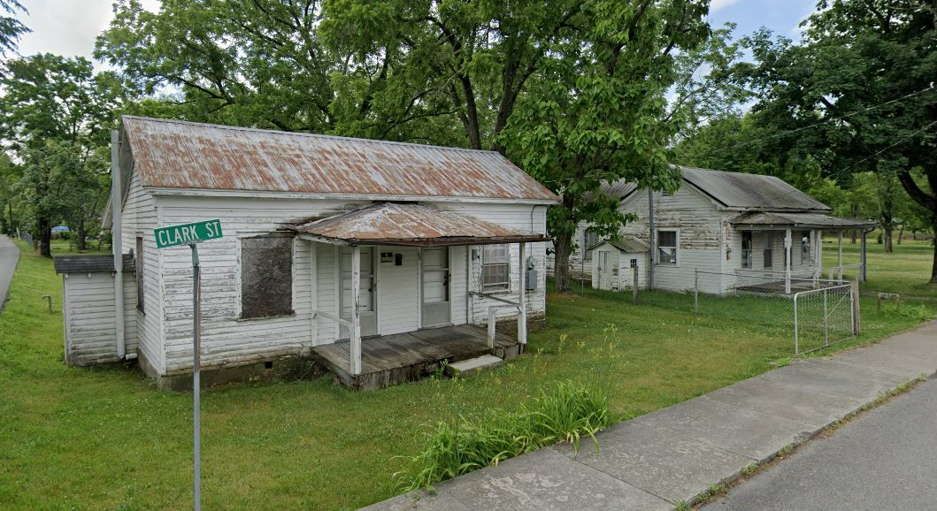
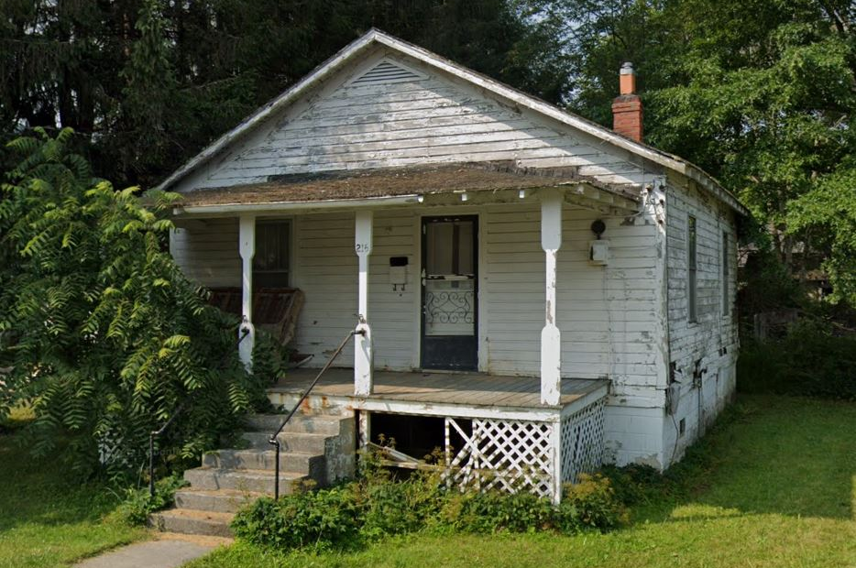
Red Tag Structures
Rationale:
Dilapidated, vacant, or low-valued structures (<=$10K) may be more vulnerable to floods in terms of building quality.
Findings:
White Sulphur Springs: 5% of the total buildings in floodplain (n=20)
Rainelle: 17% of the total buildings in floodplain (n=56)
Median ratio for all incorporated areas (with more than 50 buildings in the high-risk floodplain) statewide: 4%
Low-Value Structures
White Sulphur Springs
Rainelle
Building IDs: 13-17-0009-0270-0000_208 & 13-17-0009-0269-0000_196
Flood Tool Link
Building ID: 13-13-0001-0176-0000_214
Flood Tool Link
Recommendations:
Acquisition and demolition of red tag structures in floodplain for community recovery and resilience

Slide 16
Flood Loss Estimates

Slide 17
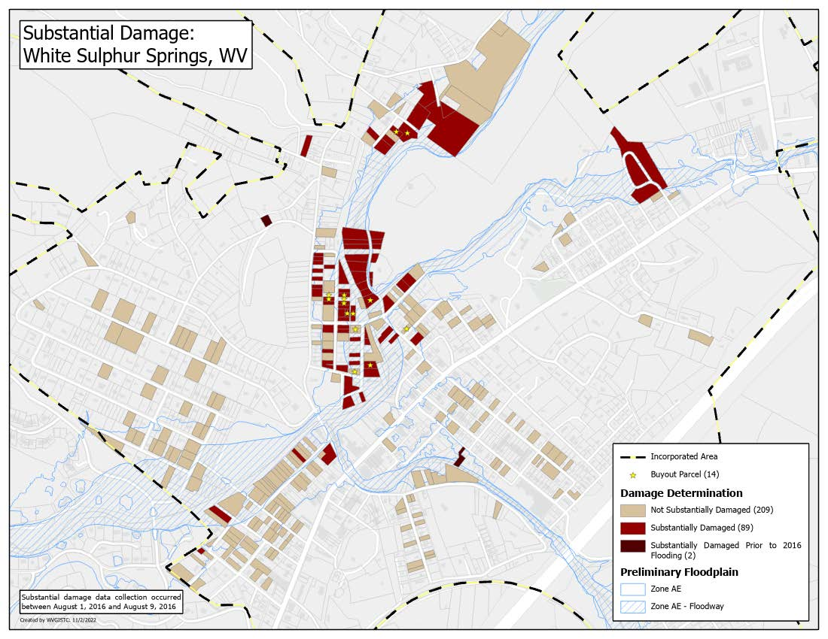
Substantial Damage (2016)
Rationale:
Substantial damage: Equal to or greater than 50% of the structure market value before flooding Moderate damage: Between 10% and 50% of the structure market value before flooding
Findings:
White Sulphur Springs
89 substantial &
98 moderate damages by the 2016 flood
2016 Substantial Damage Surveys

Slide 18
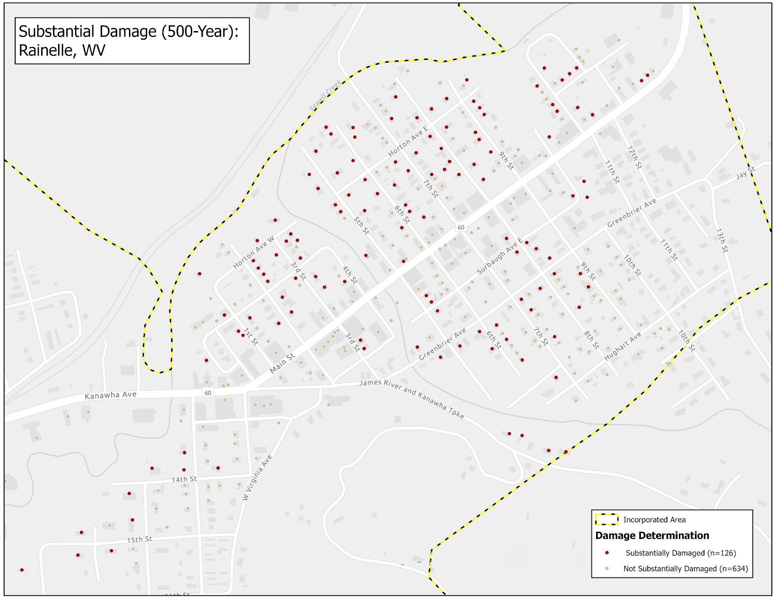
Substantial Damage (by 500-Year flood)
Rainelle
126 estimated substantial damages
Substantial
Damage Estimates (500-yr)
User Survey
44% experienced complete destruction of their residences by 2016 flood
Recommendations:
Priority for risk communications and flood reduction efforts

Slide 19
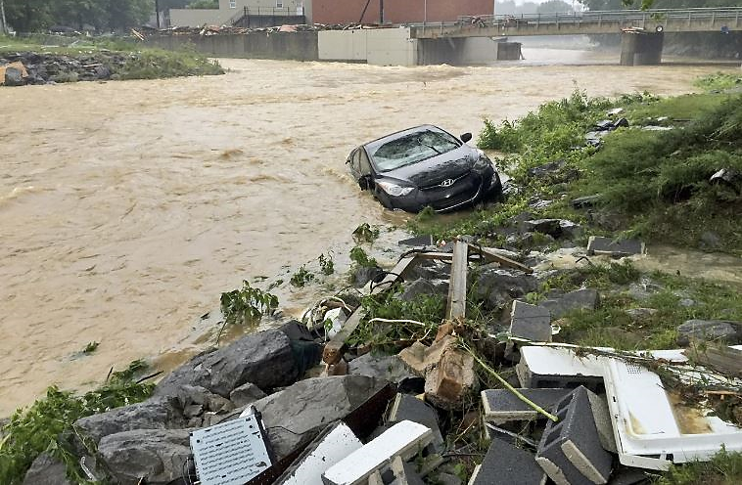
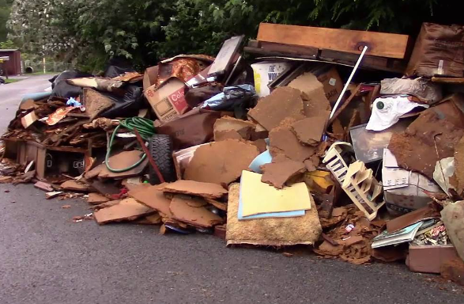
Building Debris Removal
Rationale:
A significant costly problem for recovery after floods
Findings:
White Sulphur Springs: 450 ton
Rainelle: 809 ton
Median for all incorporated areas in the state: 165 ton
Debris Removal
White Sulphur Springs, 2016
Rainelle, 2016
Image courtesy of CNN at
https://www.cnn.com/2016/06/24/us/west-virginia-flooding-deaths/index.html
Image courtesy of Keep-N-up W/Jones', clipped from a video at
https://www.youtube.com/watch?v=BCoNA2szDok
Recommendations:
Estimates should be incorporated into debris removal plans

Slide 20
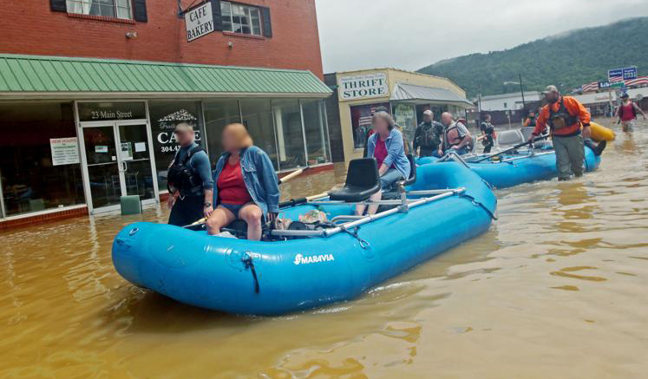
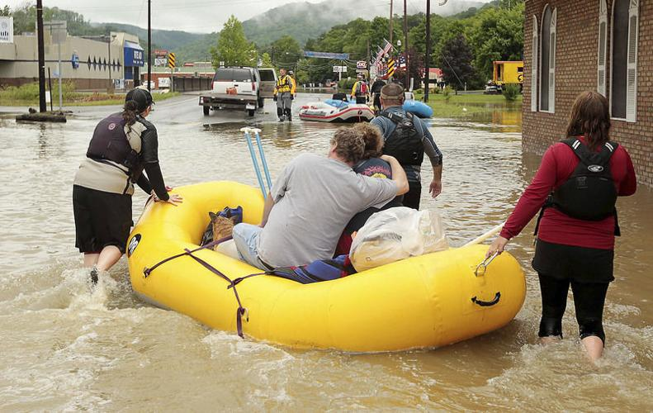
Displaced Population & Short-Term Shelter Needs
Rationale:
Short-term displacement estimates due to damage to residential units or inundation blocking access can indicate evacuation needs; A percentage of displaced people in need of shelters
Findings:
Displacement Estimates
White Sulphur Springs: 17% of the community population (n=462, Rank: 17th)
Rainelle: 36% of the community population (n= 487, Rank: 16th)
Average ratio in all incorporated areas in the state: 13%
Shelter Needs
White Sulphur Springs: 23% of the displaced population; (n=104, Rank: 18th)
Rainelle: 25% of the displaced population; (n= 123, Rank: 14th)
Average ratio in all incorporated areas in the state: 24%
Population Displacement
Rainelle, 2016
Image courtesy of The Register Herald at https://www.register-herald.com/flood/gallery-rainelle-flood-of-2016/collection_59999528-56d8-11e7-9c45-5b4aa2a44464.html
Recommendations:
Estimates should be incorporated into disaster emergency and evacuation plans.
Development of pet-friendly shelters in safe areas

Slide 21
Flood Mitigation
HAZARD IDENTIFICATION
FLOODPLAIN MANAGEMENT
NFIP
FLOOD INSURANCE

Slide 22
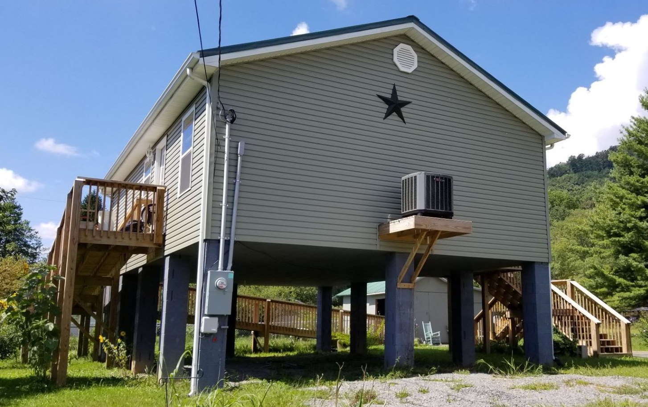
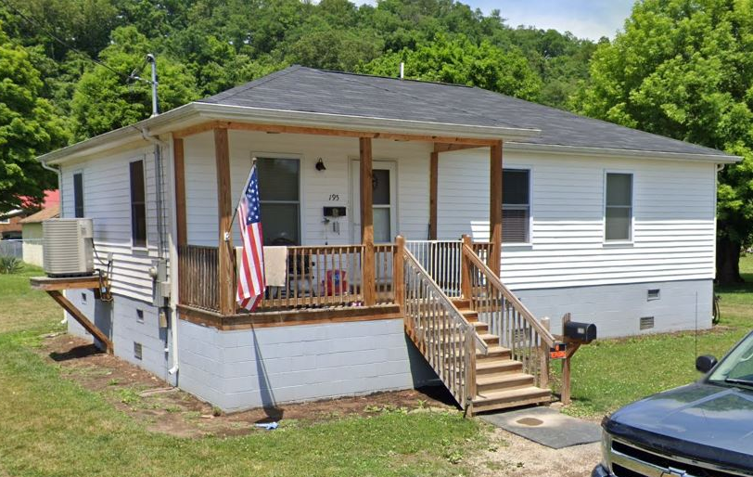
Elevated Structures to Design Flood Elevation (DFE)
Rationale:
How communities have applied flood adaptive measures in response to major flood events
DFE: 100-Year or Base Flood Elevation (BFE) + 2 feet
Findings:
White Sulphur Springs: 59% of residential structures in 100-year floodplain elevated to DFE (n=217, res./non-res.)
Rainelle: 35% of residential structures in 100-year floodplain elevated to DFE
(n=87, res./non-res.)
Mitigation Reconstruction
Rainelle
White Sulphur Springs
Building ID: 13-13-0001-0069-0000_108
Flood Tool Link
Building ID: 13-17-0008-0152-0000_195
Flood Tool Link
Examples of Mitigation Reconstruction

Slide 23
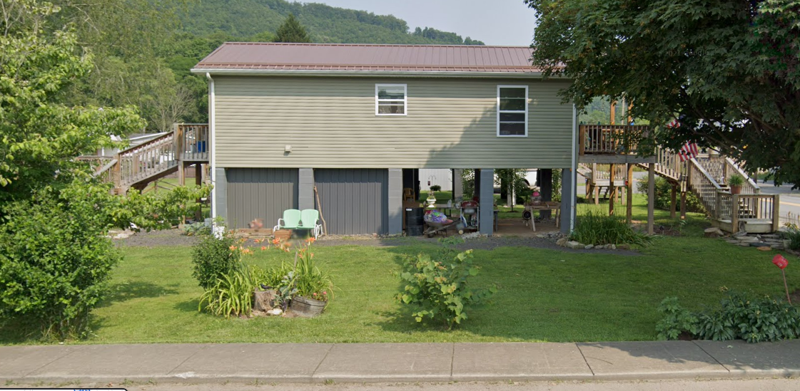
Elevated Still At Risk
First Floor Height BELOW: FEMA/FSF 0.2-percent chance (500-yr) floods
12.2’ (FSF 0.2% / 500-Yr )
9.9’ (FEMA; 0.2% / 500-Yr)
6.5’ (2016 High Water)
3.9’ (FEMA 1% / 100-Yr)

Slide 24
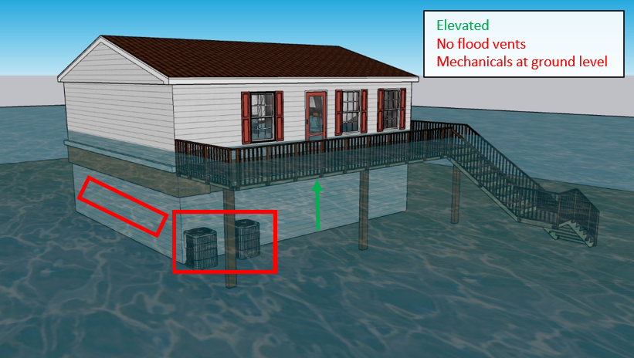
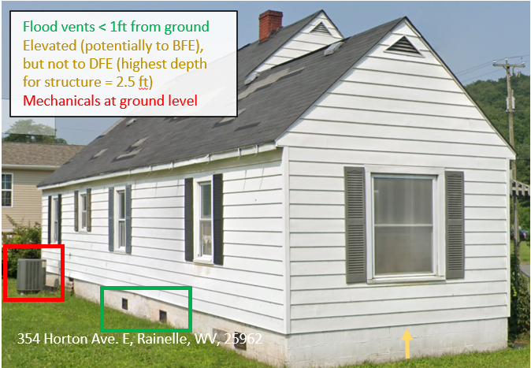
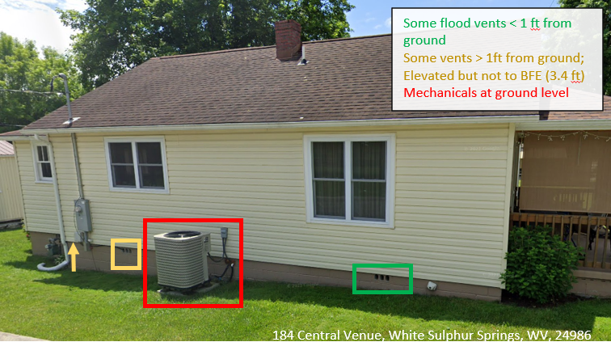
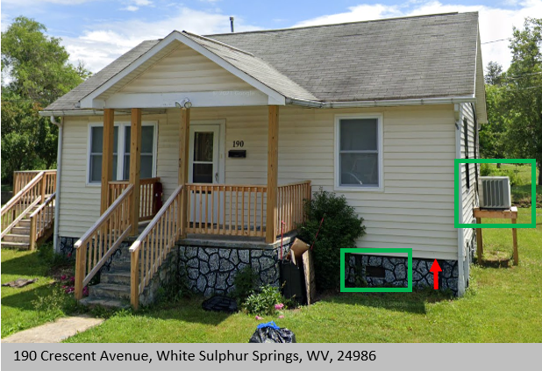
Partial Mitigation Examples
Residential Mitigation
190 Crescent Avenue, White Sulphur Springs, WV, 24986
Recommendations:
65% of the residential structures in Rainelle and 41% of the structures in White Sulphur Springs should be elevated above the base flood elevation, especially substantially damaged buildings

Slide 25
Floodplain Building Value Recovery after 2016
Rationale:
Net cumulative tax assessment of floodplain building values pre- and post-disaster indicating community’s recovery and resiliency to future floods
Findings:
White Sulphur Springs: Net Value 2016-2022 Tax Assessment Value: + $6.1M
Rainelle: Net Value 2016-2022 Tax Assessment Value: - $1.0M
Economic Recovery
COMMUNITY | 2015 | 2016 | 2017 | 2018 | 2019 | 2020 | 2021 | 2022
Rainelle (n=326) | 13.1 Million | 13.3 Million | 5.0 Million | 9.4 Million | 11.0 Million | 11.1 Million | 11.3 Million | 12.3 Million
White Sulphur Springs (n=409) | 22.6 Million | 23.0 Million | 13.4 Million | 21.5 Million | 22.4 Million | 22.9 Million | 26.2 Million | 29.2 Million

Slide 26
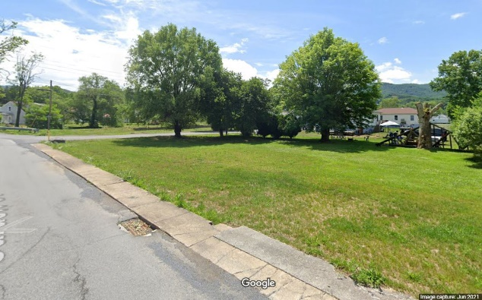
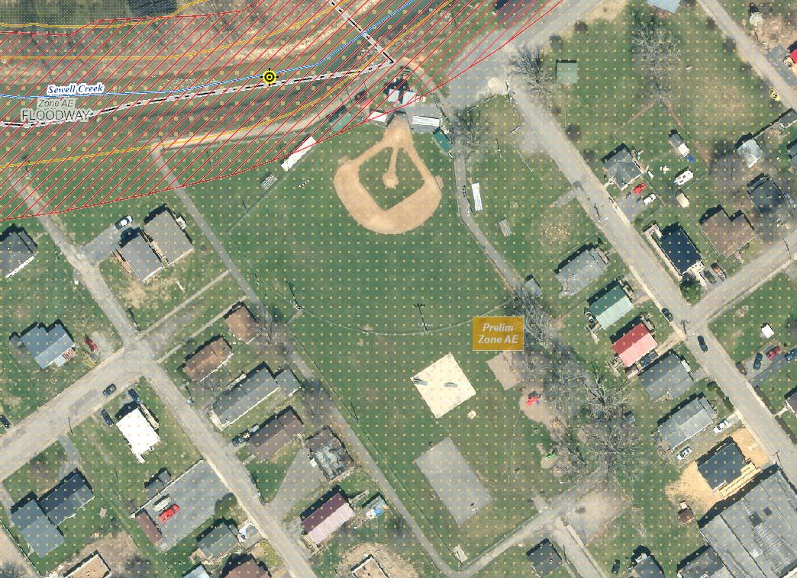
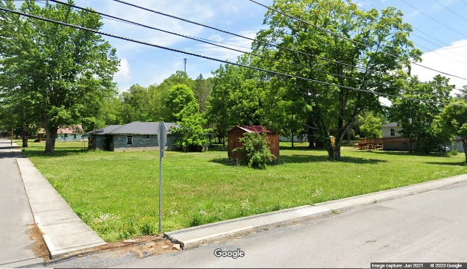
Open Space Preservation (OSP)
Rationale:
Restoring floodplains to their natural functions of slowing down runoff and storing floodwater
Findings:
White Sulphur Springs: 2.6% of the high-risk floodplain (SFHA); 5 acres
Rainelle: 4.5% of the high-risk floodplain (SFHA); 3 acres
Average ratio for all incorporated areas in the state: 5%
Open Space Mitigation
Rainelle
White Sulphur Springs
Recommendations:
Planning and Investing in development of green spaces in floodplains by consolidating deed-restricted buyout parcels to restore floodplains to their natural state

Slide 27
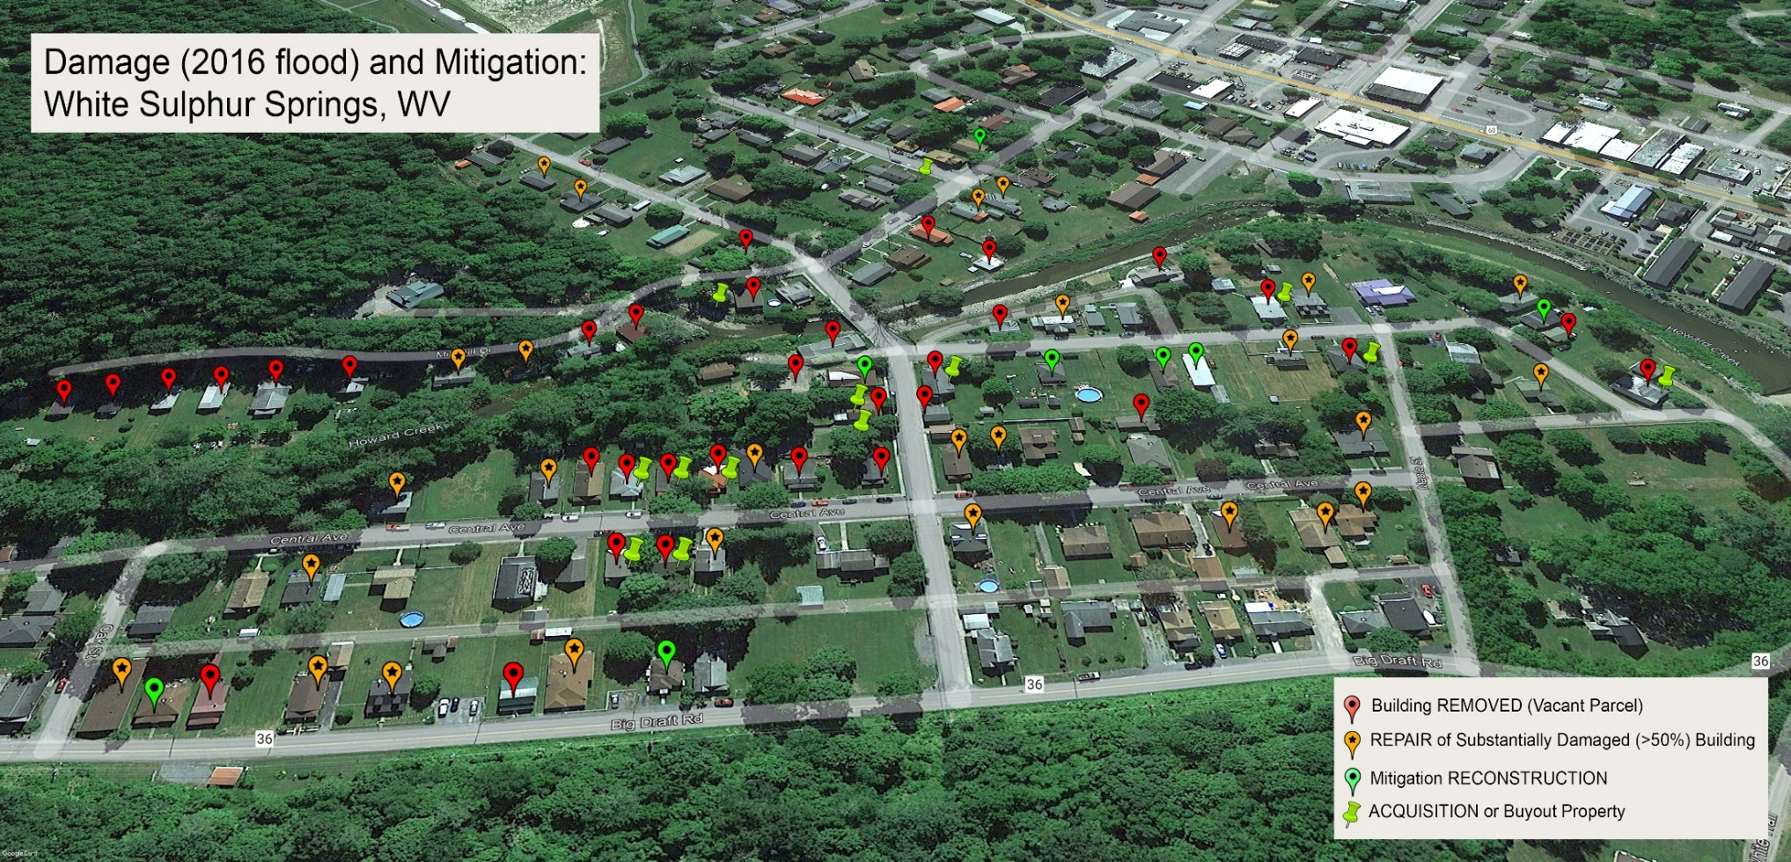
Loss Avoidance
Rationale:
Difference between loss estimates for buildings with a first-floor height of 1 ft and elevated to DFE or removed entirely;
The losses avoided by federally funded riverine flood mitigation projects far exceeds the money spent (7x return on investment)*
Findings:
White Sulphur Springs: $2.6M
Mitigation Saves
Central Ave.
*FEMA. “Natural Hazard Mitigation Saves Interim Report”

Slide 28
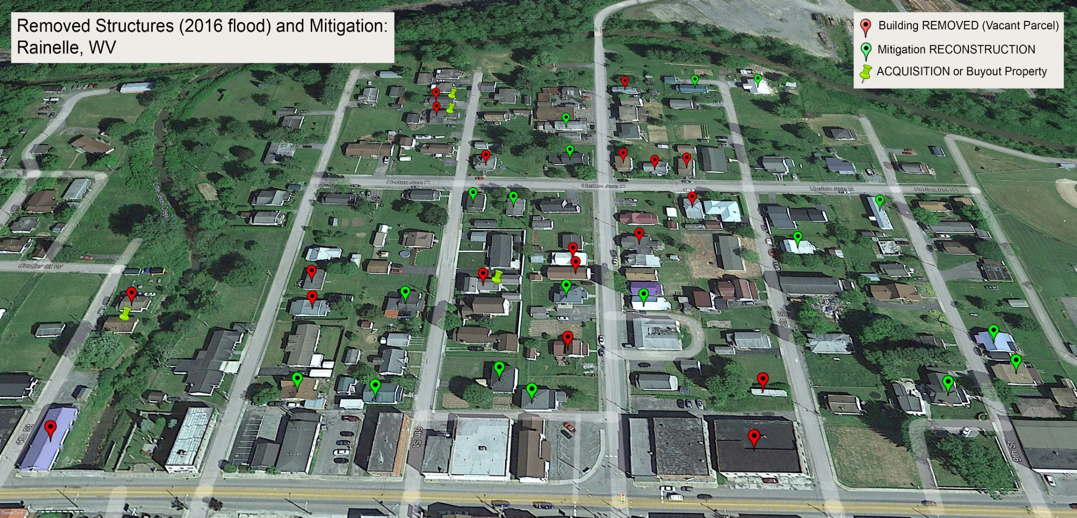
Loss Avoidance…
Rainelle: $2.3M
7th St.
Mitigation Saves
Recommendations:
Mitigation efforts of elevating buildings above the base flood and buyouts should be considered as investment not cost

Slide 29
Flood Insurance
Rationale:
Reducing financial risk and allowing homeowners and businesses to protect themselves and recover more quickly after a flood
Findings:
White Sulphur Springs: 16% of the primary structures in the high-risk floodplain; 67 policies in force (2023)
Rainelle: 11% of the primary structures in the high-risk floodplain; 36 policies in force (2023)
National average ratio: 30%
23% of the insurance claims of the 2016 event in the affected counties were outside the SFHA; Had to apply for FEMA’s Individual Assistance (IA) program providing a small amount of grant funding
Flood Insurance
User Survey
84% knew that their residences were in a flood zone before the 2016 flood
User Survey
46% of the participants didn’t purchase flood insurance, although are very concerned about the next major flood
Recommendations:
Risk communication with community residents and encouraging to buy flood insurance even not in the high-risk zones;
Consult with floodsmart.gov “Buying a Policy” https://www.floodsmart.gov/flood-insurance

Slide 30
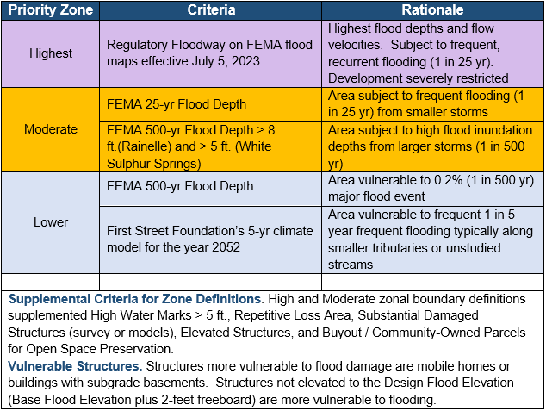
Areas of Mitigation Interest (AoMI)
Rationale:
Identifying priority zones for mitigation:
Mitigation Priorities

Slide 31
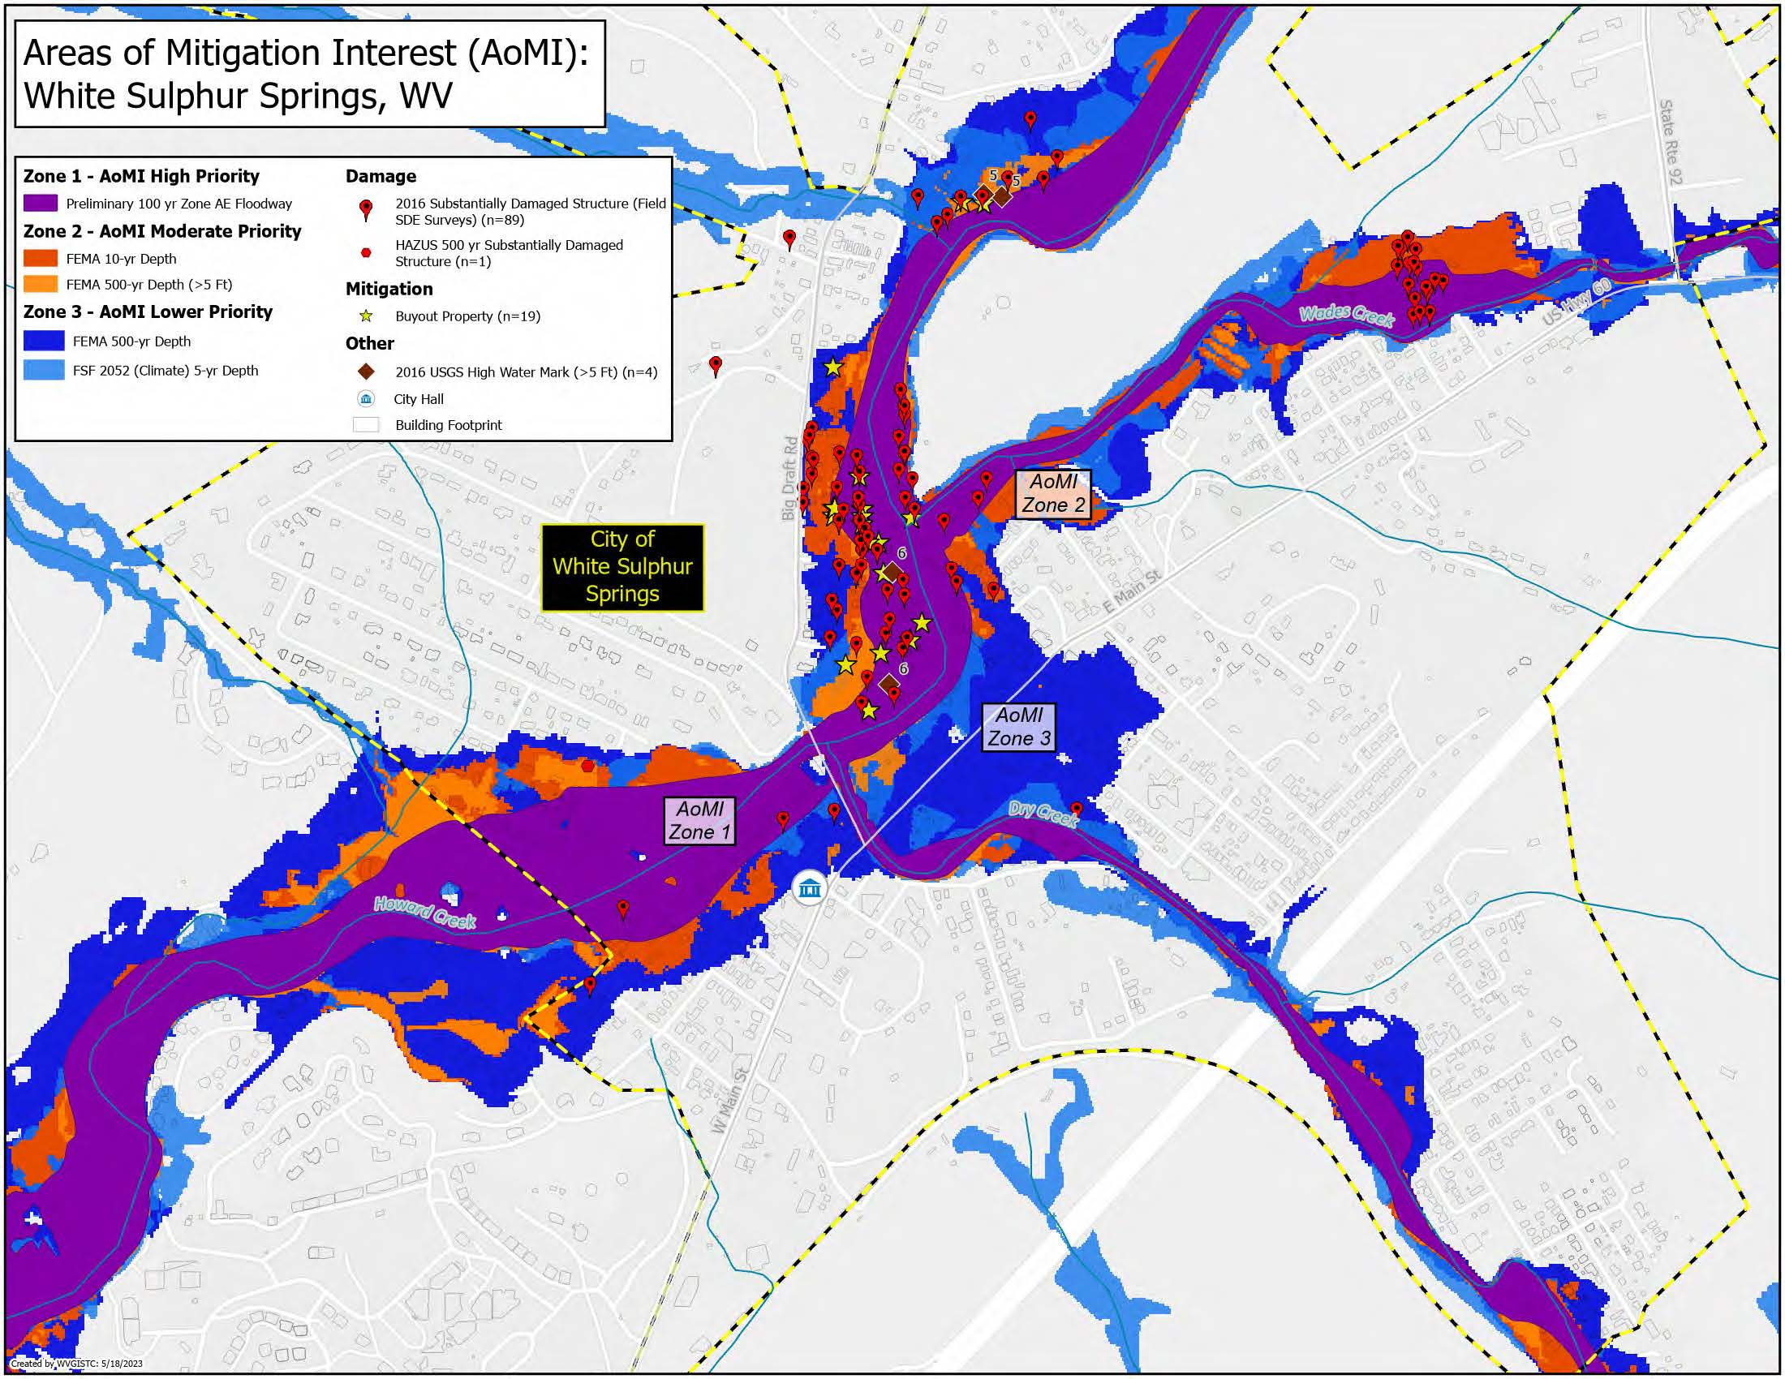
Areas of Mitigation Interest (AoMI)…
Findings:
White Sulphur Springs
Mitigation Priorities

Slide 32
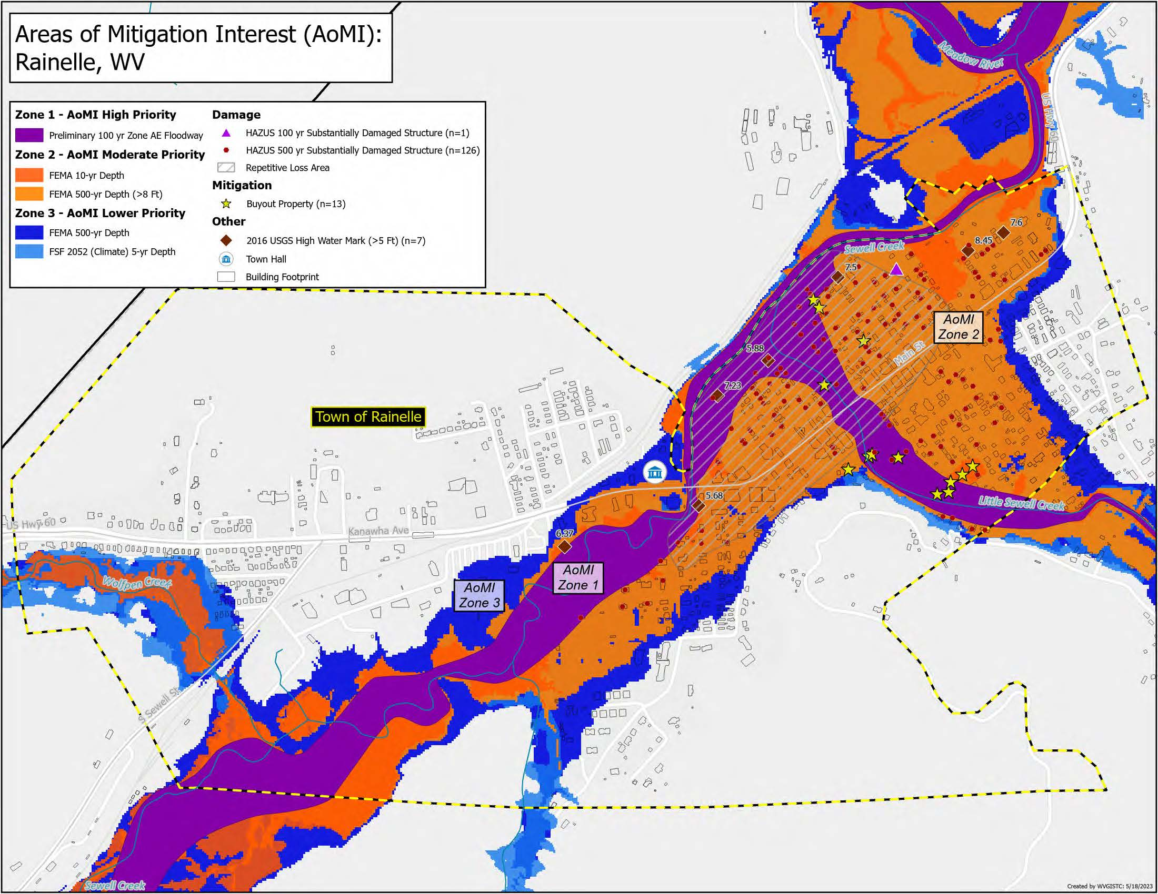
Areas of Mitigation Interest (AoMI)…
Rainelle
Mitigation Priorities
Recommendations:
Mitigation plans should correspond to the AoMI priorities

Slide 33
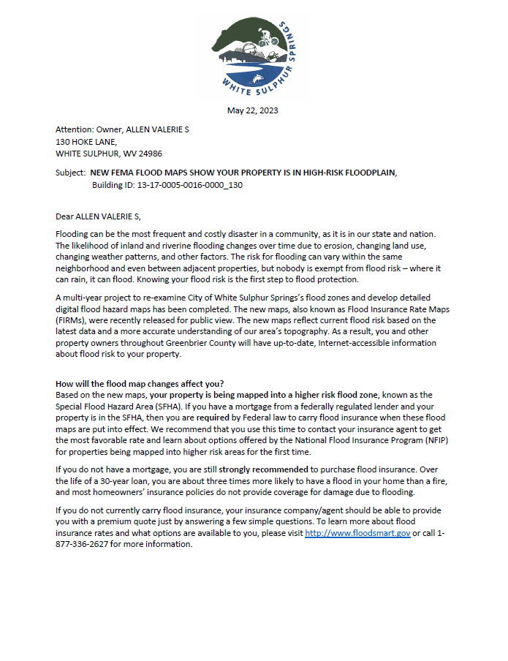
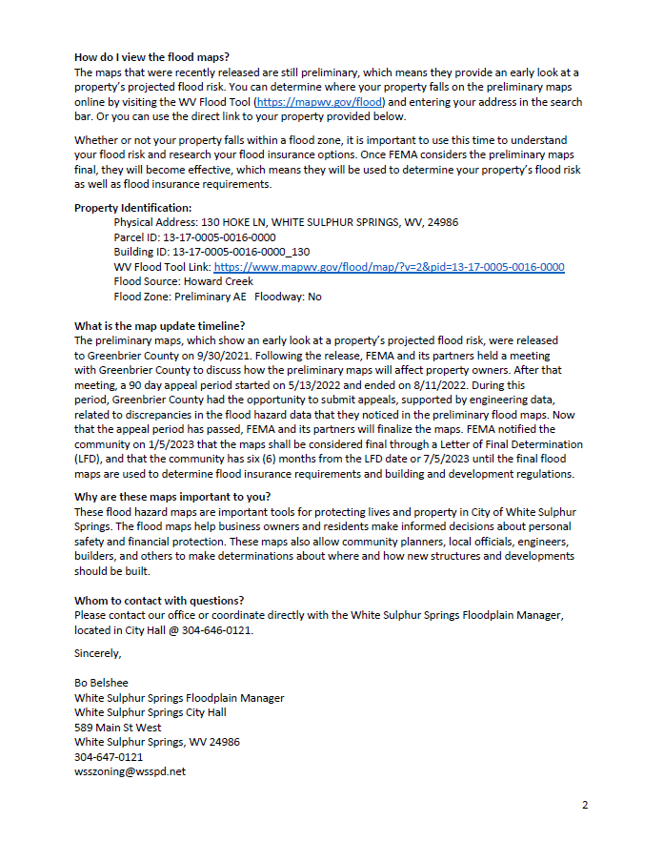
Planning for Floodplain Management
Pre-Disaster Planning
Risk Communication
Ensure the public is informed of the risk in your community
Community Rating System (CRS)
Participate in CRS, a voluntary incentive
program that recognizes and encourages
community floodplain management
practices that exceed the minimum
requirements of the National Flood
Insurance Program (NFIP).
Flood Warning Systems
Outreach / Community Engagement
- Substantial Damage Estimate (SDE)
- Letters of Future Map Conditions
Example of “Mapped In” Letters, White Sulphur Springs
Floodplain Management

Slide 34
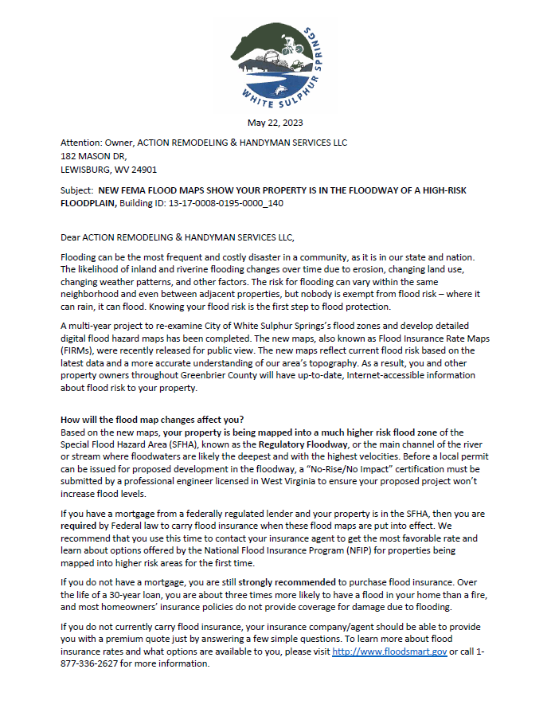

Planning for Floodplain Management…
Example of “Mapped In Floodway” Letters, White Sulphur Springs

Slide 35


Planning for Floodplain Management…
Example of “Mapped Out” Letters, White Sulphur Springs

Slide 36


Planning for Floodplain Management…
Risk & Mitigation Dashboards,
White Sulphur Springs

Slide 37


Planning for Floodplain Management…
Risk & Mitigation Dashboards,
Rainelle

Slide 38
Resources
Federal Emergency Management Agency (FEMA). Understanding flood dangers in central West Virginia: Lessons learned from the June 2016 flood. https://www.fema.gov/sites/default/files/documents/Region_III_WV_FloodReport.pdf
Federal Emergency Management Agency (FEMA). What to do before a flood. https://www.floodsmart.gov/first-prepare-flooding
Federal Emergency Management Agency (FEMA). Reducing Flood Risk to Residential Buildings That Cannot Be Elevated. https://www.fema.gov/sites/default/files/2020-07/fema_P1037_reducing_flood_risk_residential_buildings_cannot_be_elevated_2015.pdf
Federal Emergency Management Agency (FEMA). Natural Hazard Mitigation Saves Interim Report. https://www.fema.gov/sites/default/files/2020-07/fema_mitsaves-factsheet_2018.pdf
West Virginia GIS Tech Center. WV Flood Tool. http://www.mapwv.gov/flood/

