Slide 1


Risk MAP (Hampshire Co. Preliminary Flood Maps)
Risk Mapping (New Preliminary Flood Maps)
Understand Flood Map Changes (BFEs, Floodplains/Floodways)
Floodplain Building Counts
SFHA Building Changes and Outreach Letters
LOMAs (SFHA mapped out)
All Essential Facilities mapped out
New Vertical Datum (NAVD88)
Risk Analysis (Risk Identification)
Large Floodplain Area (acres) and Length (miles)
Higher Number of Community Assets
High Flood Depths
High Building Damage Losses
High Repetitive Loss Structures and Paid Claims
Higher Number of Recreational Vehicles
Risk Planning (Flood resiliency)
Swift Grant Funding for RL Structures
Preload Structures into FEMA SDE Software
Validate floodplain building inventory
Plan for Inundated Roads
Verify Buyout Properties
Apply for higher CRS status class
Plan for more stream gauges besides South Branch of Potomac
Publish Elevation Certificates on WV Flood Tool

Slide 2
Preliminary Floodplain Building Counts
COMMUNITY IDENTIFICATION
Community Name | Community Type | Estimated structures in the Community | Estimated structures in the preliminary flood high hazard area | Estimated structures newly mapped in | Estimated structures newly mapped out
Hampshire County* | Unincorporated | 14,884 | 727 | 31 | 384
Capon Bridge | Incorporated | 263 | 26 | 0 | 12
Romney | Incorporated | 1,158 | 4 | 0 | 3
 | County | 16,305 | 757 | 31 | 399
County Net Change in structures: - 368
County Net Change in floodway structures: - 74

Slide 3
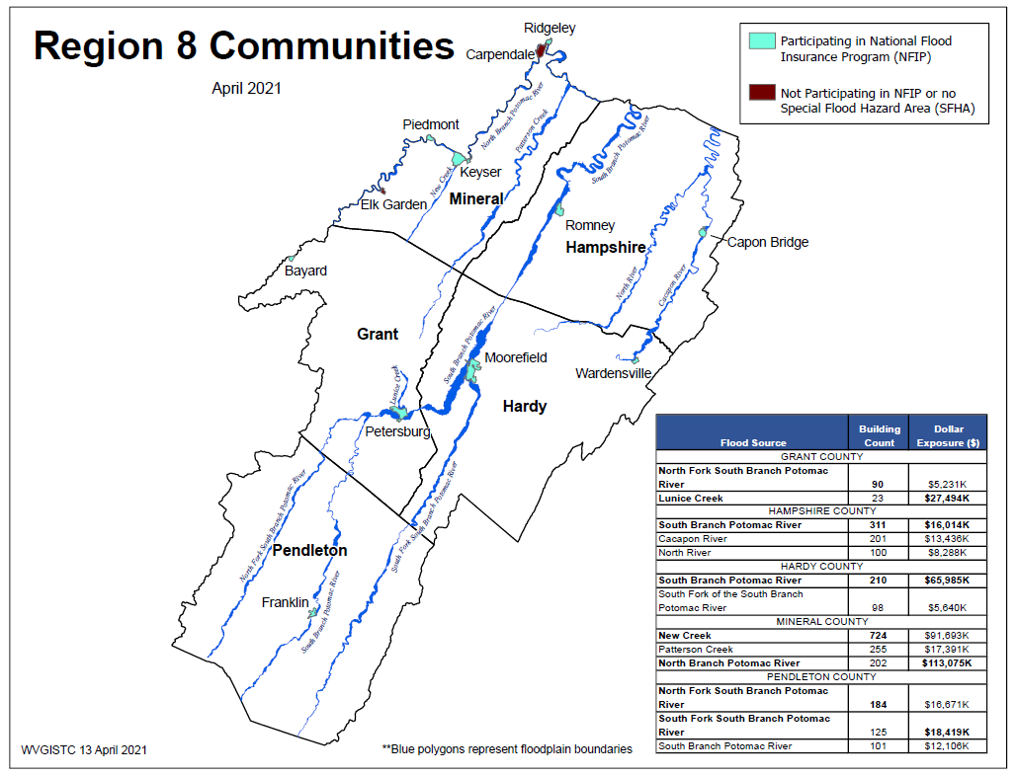
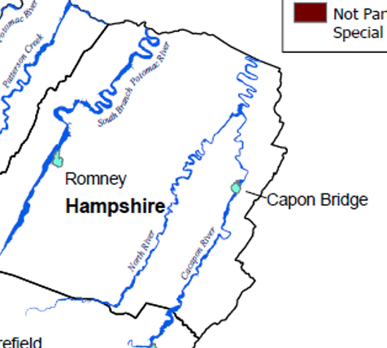
Building Counts & Values by Rivers (2021)
Top Rivers with highest building counts are South Branch of Potomac River (311), Cacapon River (201), and North River (100).

Slide 4
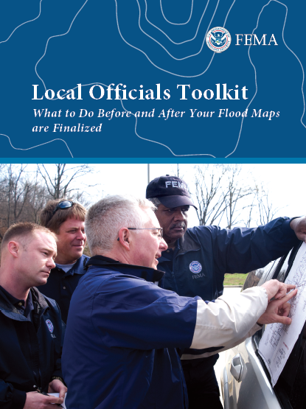
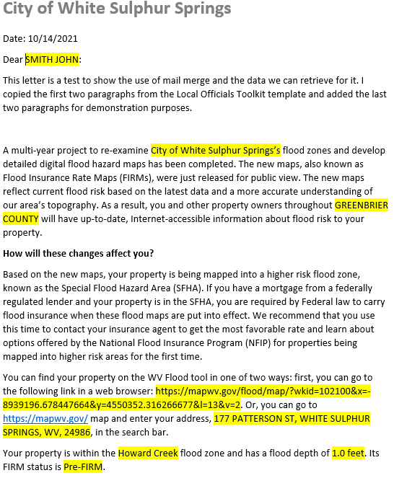
SFHA Map Change Letters
Incorporate 1% Floodplain Building Risk Assessment Inventory into Mitigation and NFIP/CRS Management Activities
White Sulphur Springs has 68 buildings being mapped into the SFHA
Counties which recently sent outreach letters to homeowners:
Hardy County
Risk MAP
Kanawha County - Elk River PMR
Greenbrier County Risk MAP
FEMA Region 3 Toolkit for New Flood Studies
Mail Merge Template for SFHA Mapped-in Structures

Slide 5
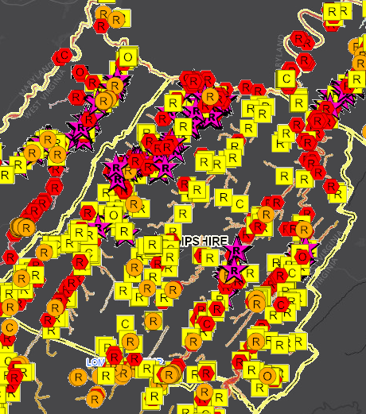
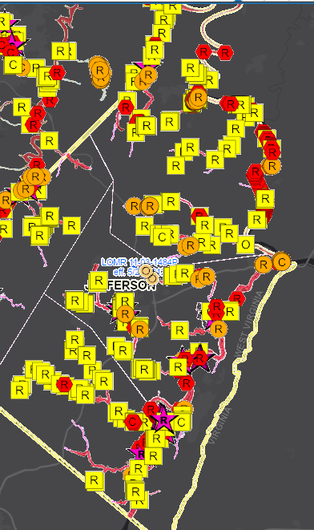
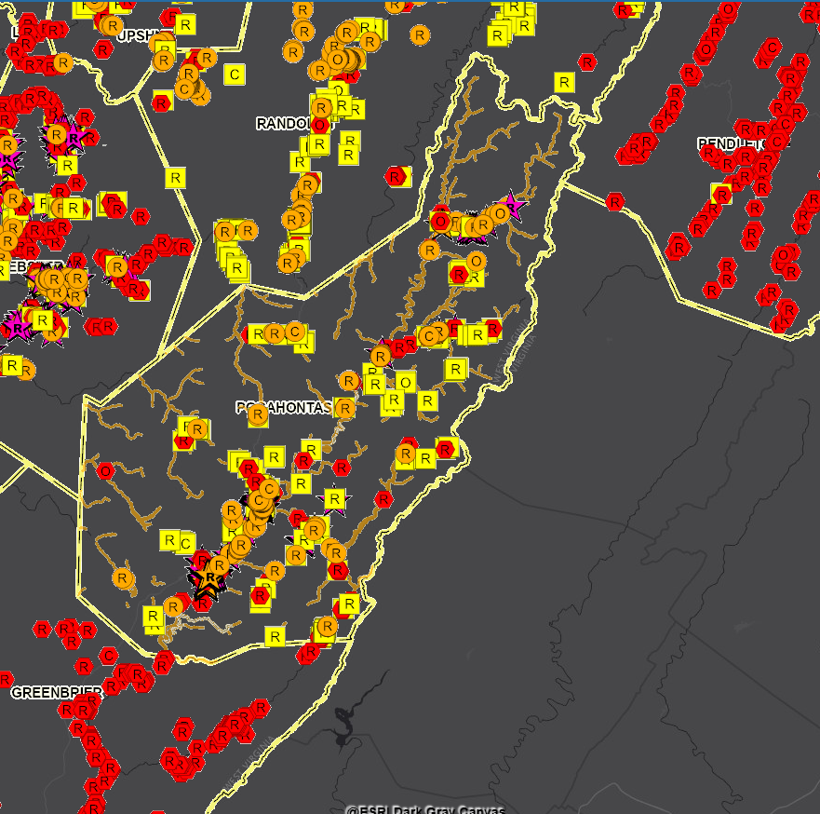
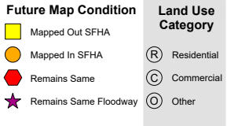
Building SFHA Change (LiDAR LOMAs)
Hampshire County
Jefferson County
Pocahontas County
399
Mapped Out
200
Mapped Out
All building symbols in the floodplain fringe will become “red color” once flood maps are effective
276
Mapped Out
Floodway

Slide 6
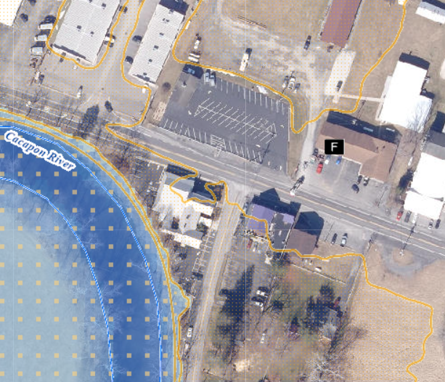
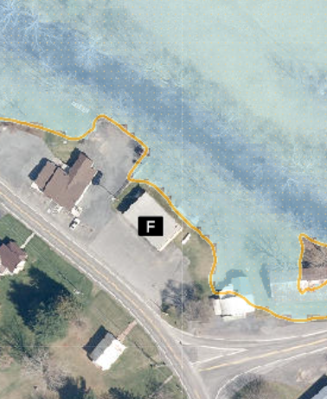
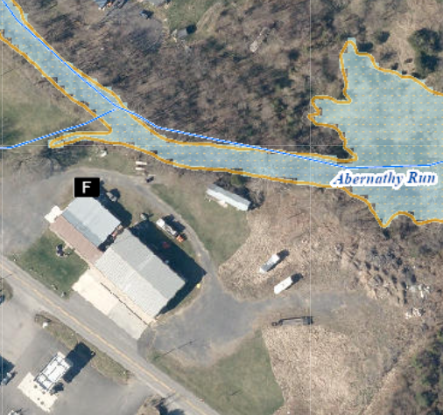
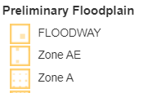
All Essential Facilities Mapped Out
All essential facilities in Hampshire County mapped out:
Capon Bridge Volunteer Fire Department mapped out
North River Valley Volunteer Fire Company in Hampshire County* mapped out
Springfield Valley Fire Co. in Hampshire County* mapped out
Building ID: 14-03-0002-0012-0000_2766
Building ID: 14-10-0018-0094-0002_221
Building ID: 14-09-0001-0034-0000_15137

Slide 7
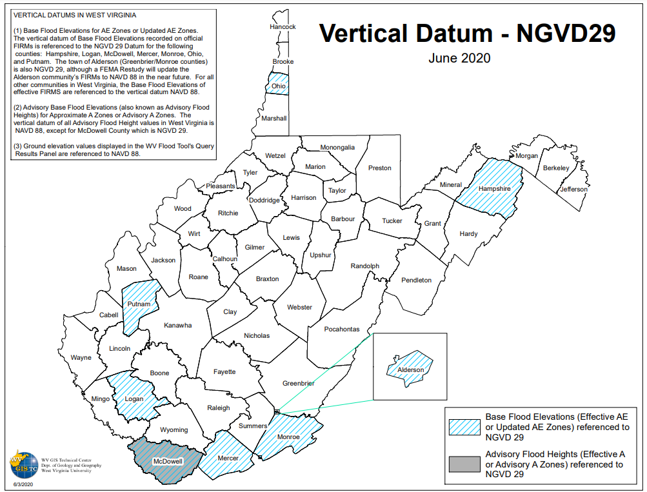
Newer Vertical Data (NAVD 88)
Old NGVD 29 Vertical Datum modernized to NAVD 88

Slide 8
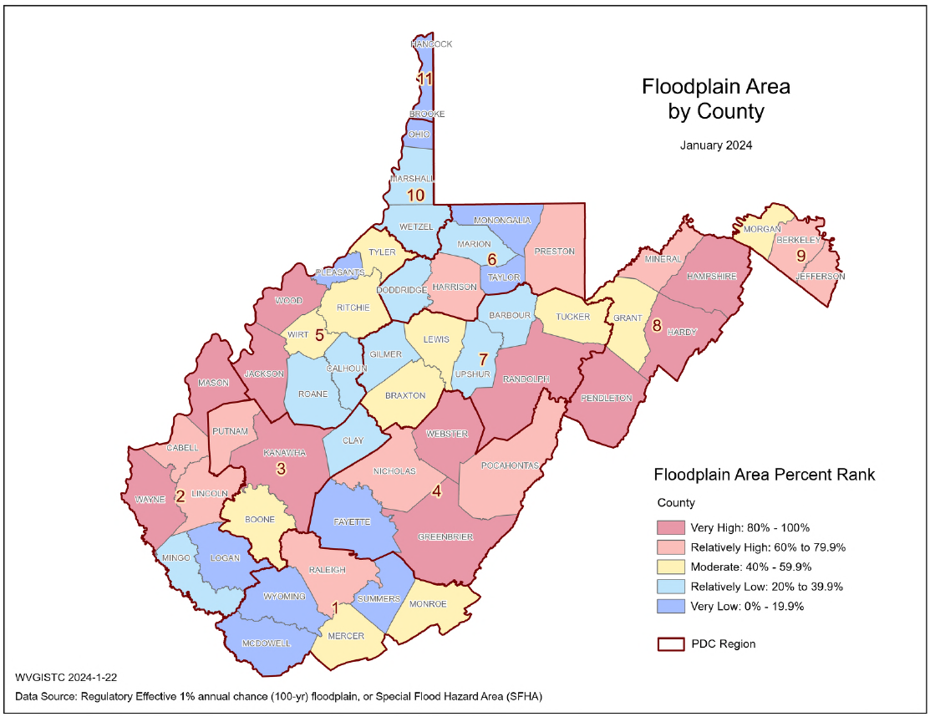

Risk Indicator: Large Floodplain Area & Length
Community | Community Area (acres) | SFHA Area | Ratio of SHFA to Community Area
Hampshire County* | 411,510 | 26,373 | 6.4%
Capon Bridge | 470 | 179 | 38.1%
Romney | 677 | 55 | 8.1
1
First Rank in State
For unincorporated areas and at the county level, it may be more challenging for communities larger in geographic size to enforce their floodplain management ordinance. Often larger jurisdictions have more acres and miles of floodplain extent than compared to smaller communities.
Consequently, larger jurisdictions must be vigilant in monitoring and permitting new development for an expansive geographic area that includes a large amount floodplain area/miles.
1

Slide 9
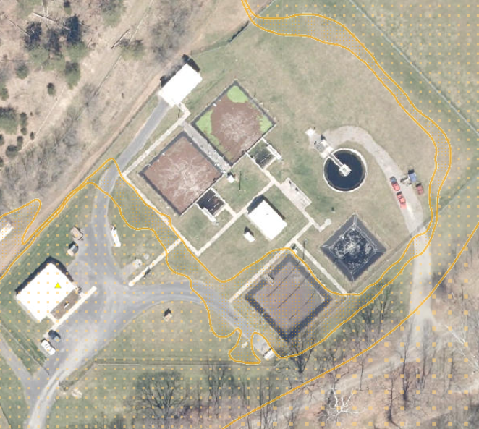

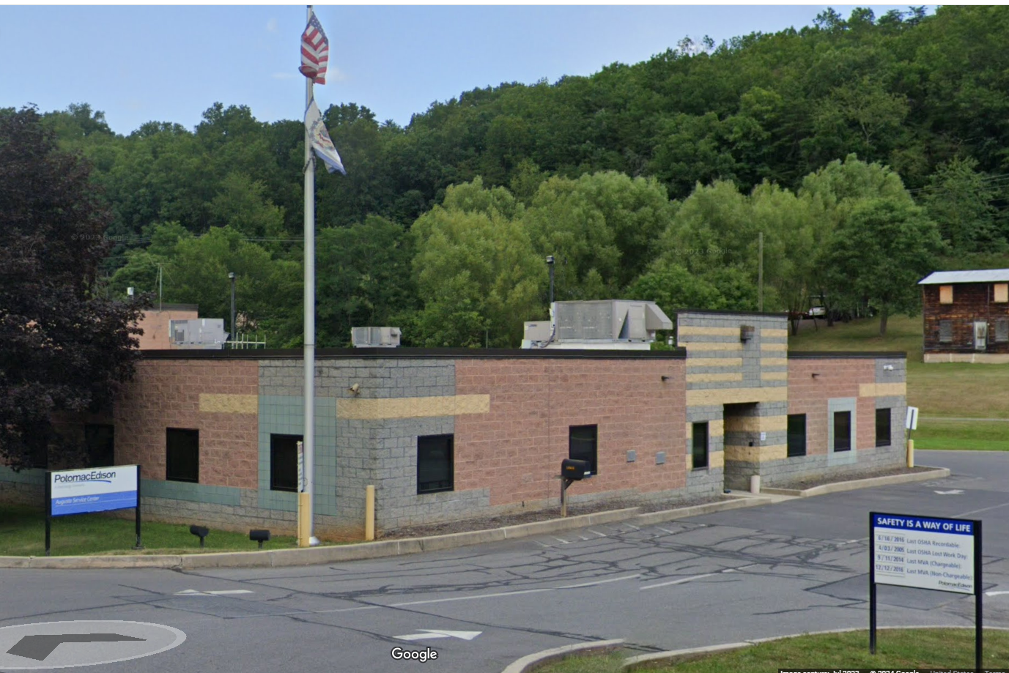
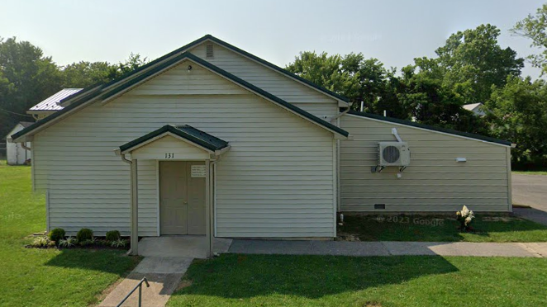
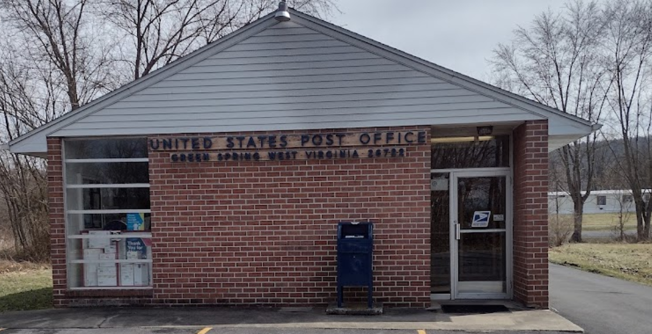
Risk Indicator: High Number of Community Assets
Community Assets (CAs)
Hampshire Communities
COMMUNITY | NON-HISTORICAL COMMUNITY ASSETS |  |  |  | Total Non-Historical Community Assets | HISTORICAL COMMUNITY ASSETS |  | Total Historical Community Assets
 | Religious | Government | EMS | Utility |  | National Register | In Historic Districts Older than 1930
Hampshire County* | 8 | 5 | 0 | 3 | 16 | 2 | 5 | 7
Capon Bridge | 1 | 1 | 1 | 0 | 3 | 0 | 0 | 0
Romney | 0 | 1 | 0 | 0 | 1 | 0 | 0 | 0
Hampshire County*
Central Hampshire Public Service District Wastewater Treatment Plant
Highest Non-Hist. CA Value ($3.0M)
(Building ID: 14-05-0018-0092-0000_251)
* Unincorporated area
Among the community assets in Hampshire Communities, four of them are more vulnerable (in Floodway or Depths >= 4 ft)
Potomac Edison Augusta Service CenterHighest 2nd Highest Non-Hist. CA Value ($1.4M)
(Building ID: 14-05-0017-0024-0000_18444)
Green Spring Assembly of God
Highest Hist. CA Depth (9.1 ft) & Value ($76K)
(Building ID: 14-10-022B-0062-0000-131)
United States Post Office
Highest Hist. CA Depth (9.1 ft) & Value ($32K)
(Building ID: 14-10-022B-0037-0000-167)

Slide 10
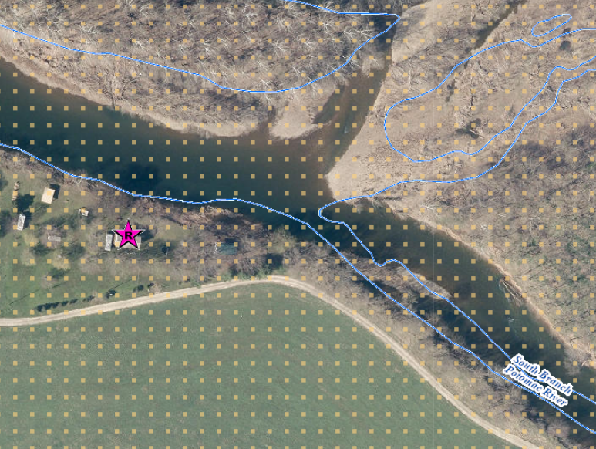
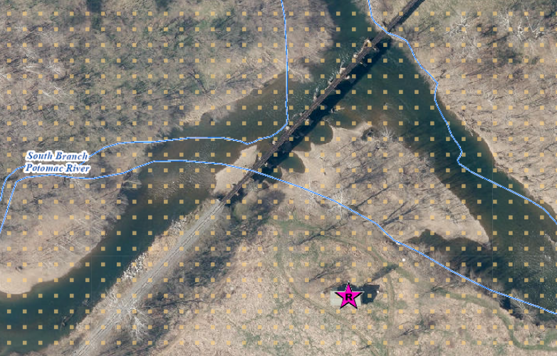
Risk Indicator: High Flood Depths
Community | Maximum Flood Depth (Feet) | Median Flood Depth (Feet)
Hampshire County* | 24.5 | 5.1
Capon Bridge | 10.2 | 3.4
Romney | 0.1 | 0.1
 | Rank among Unincorporated places: 5 | Rank among Unincorporated places: 3
Hampshire County*
* Unincorporated area
Maximum flood depth in Hampshire County (24.5 ft)
(Building ID: 14-10-0015-0068-0000_1216)
2nd Maximum flood depth in Hampshire County (22.5 ft)
(Building ID: 14-10-0016-0047-0000_160)
Question: Are these primary structures or carports on the South Branch?

Slide 11
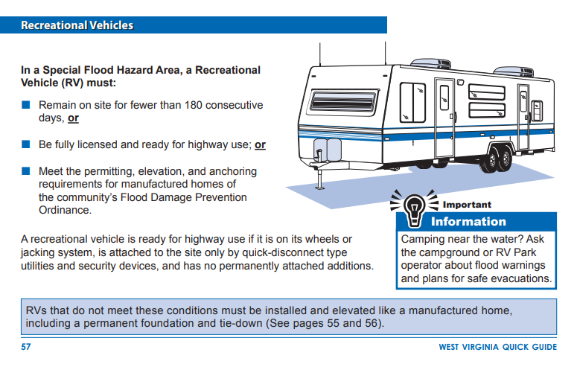
Risk Indicator: Higher Number of Recreational Vehicles
<< WV Quick Guide resource >>
https://emd.wv.gov/MitigationRecovery/Documents/Floodplain%20Management%20in%20WV%20Quick%20Guide.pdf

Slide 12
Risk Indicator: High Building Damage Losses
Among Top 10%
Estimated / Previous Damage | Hampshire County | Hampshire Unincorporated Area | Capon Bridge | Romney | State
Population Residing in Floodplain Ratio | 8.9% | 9.5% | 15.9% | 0.1% | 11.1%
Displaced Population Ratio | 7.2% | 7.7% | 15.1% | 0.1% | 6.6%
Population in Need of Short-Term Shelter | 290 | 278 | 11 | 1 | 22,930
WV SVI | 48.1% | 37.0% | 22.0% | 68.7% | N/A
Estimated / Previous Damage
Building Flood Loss Ratio | 13.3% | 14.0% | 5.3% | 0.0% | 8.6%
Substantial Damage Count | 253 | 251 | 2 | 0 | 6,493
Substantial Damage Count Ratio | 35.9% | 25.1% | 2.4% | 0.0% | 6.6%
Minus Rated (>1ft) Post-FIRM Count Ratio | 15.6% | 10.8% | 2.4% | 0.0% | 4.8%
Median Building Damage Value (>= $1K) | $13,933 | $14,135 | $9,596 | $67 | $7,657
Total Number of Claims since 1978 | 335 | 319 | 12 | 4 | 27,880
Total Paid Claims since 1978 | $5,322K | $5,017K | $220K | $85K | $368,292K
Number of Repetitive Losses | 116 | 109 | 7 | 0 | 9,716
Among Top 20%
Rankings done separately for counties, unincorporated areas, and 229 incorporated places

Slide 13
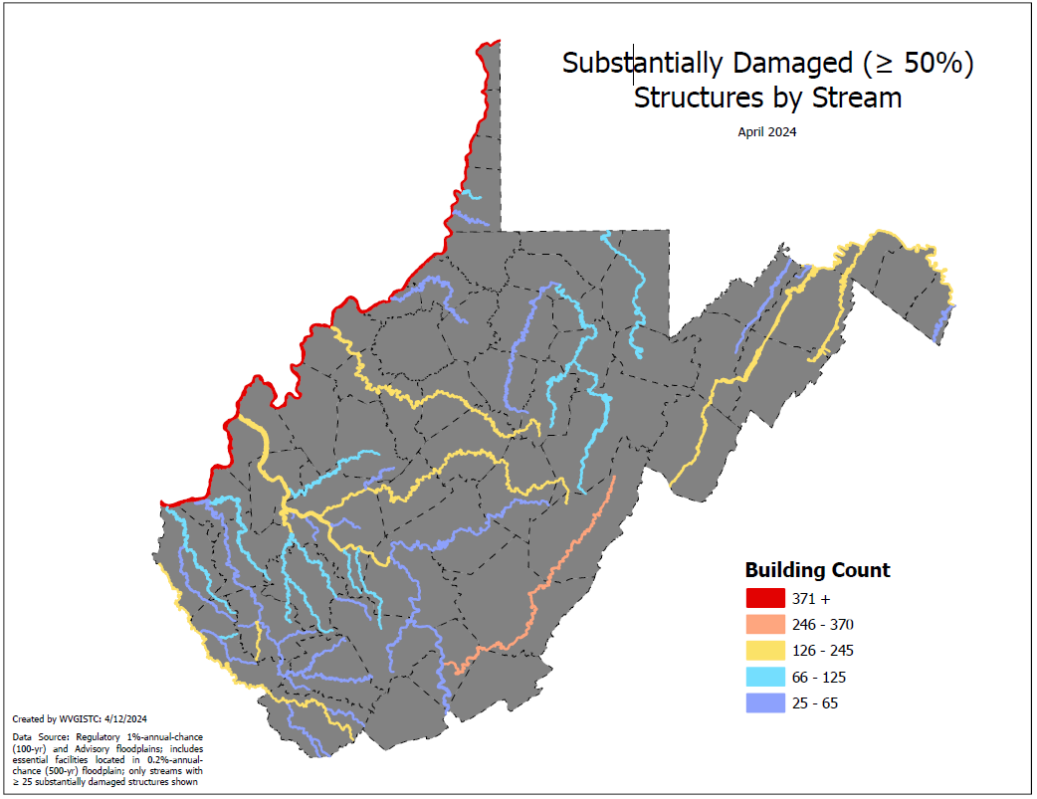
Risk Indicator: High Damage Loss Estimates
Stream Name | Substantially Damaged Building Count
Ohio River | 920
Greenbrier River | 368
Kanawha River | 243
Potomac River | 206
South Branch Potomac River | 171
Island Creek | 168
Coal River | 163
Cacapon River | 158
Elk River | 158
Tug Fork | 136
LIttle Kanawha River | 126
Pond Fork | 119
Pocatalico River | 110
Cheat River | 104
Buckhannon River | 100
Potomac River
Cacapon River
South Branch Potomac River
Flood Risk Indicator: Substantial Damage
Statewide Stream Scale

Slide 14
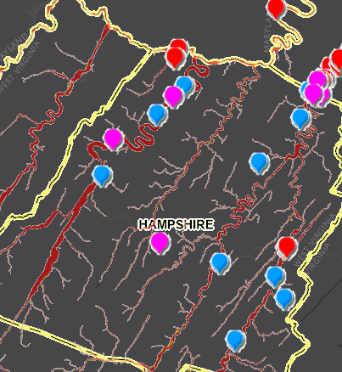
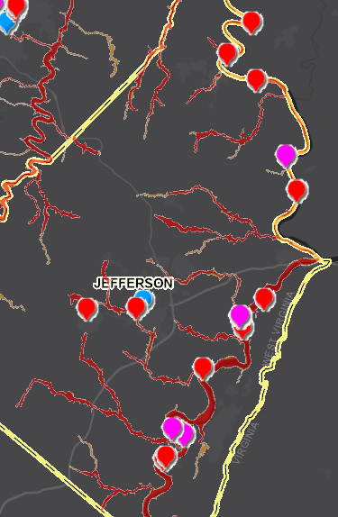
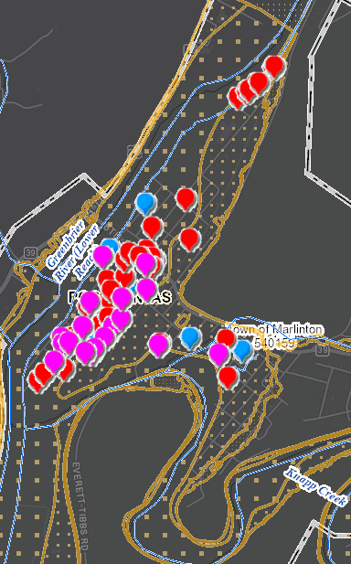



Repetitive Loss Structures (Mapped)
Hampshire County
Jefferson County
Marlinton (Pocahontas County)
Severe Repetitive Loss
(Site Address Matched)
Repetitive Loss
(Site Address Matched)
Repetitive Loss
(Street Address Matched)

Slide 15
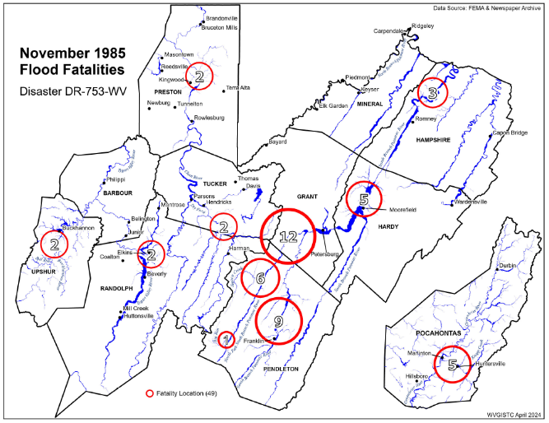
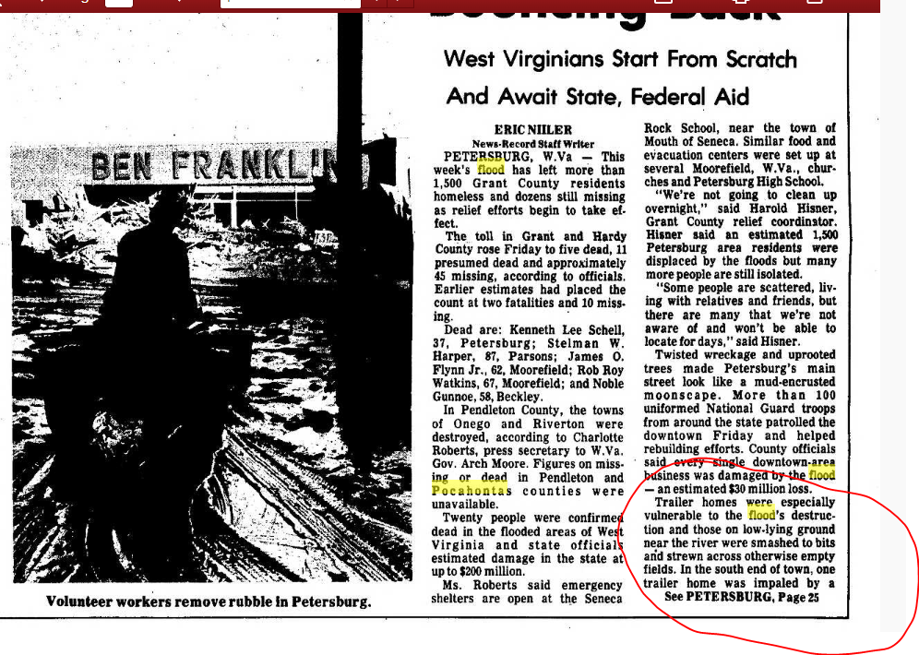
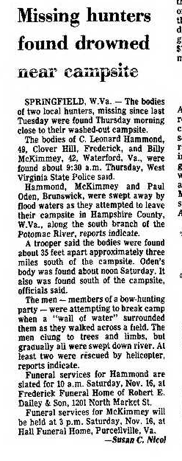
Site Hazard Study (South Branch, Springfield)
3 Hunters Drowned on South Branch
November 1985 Flood (47 fatalities – 3 in Hampshire)

Slide 16
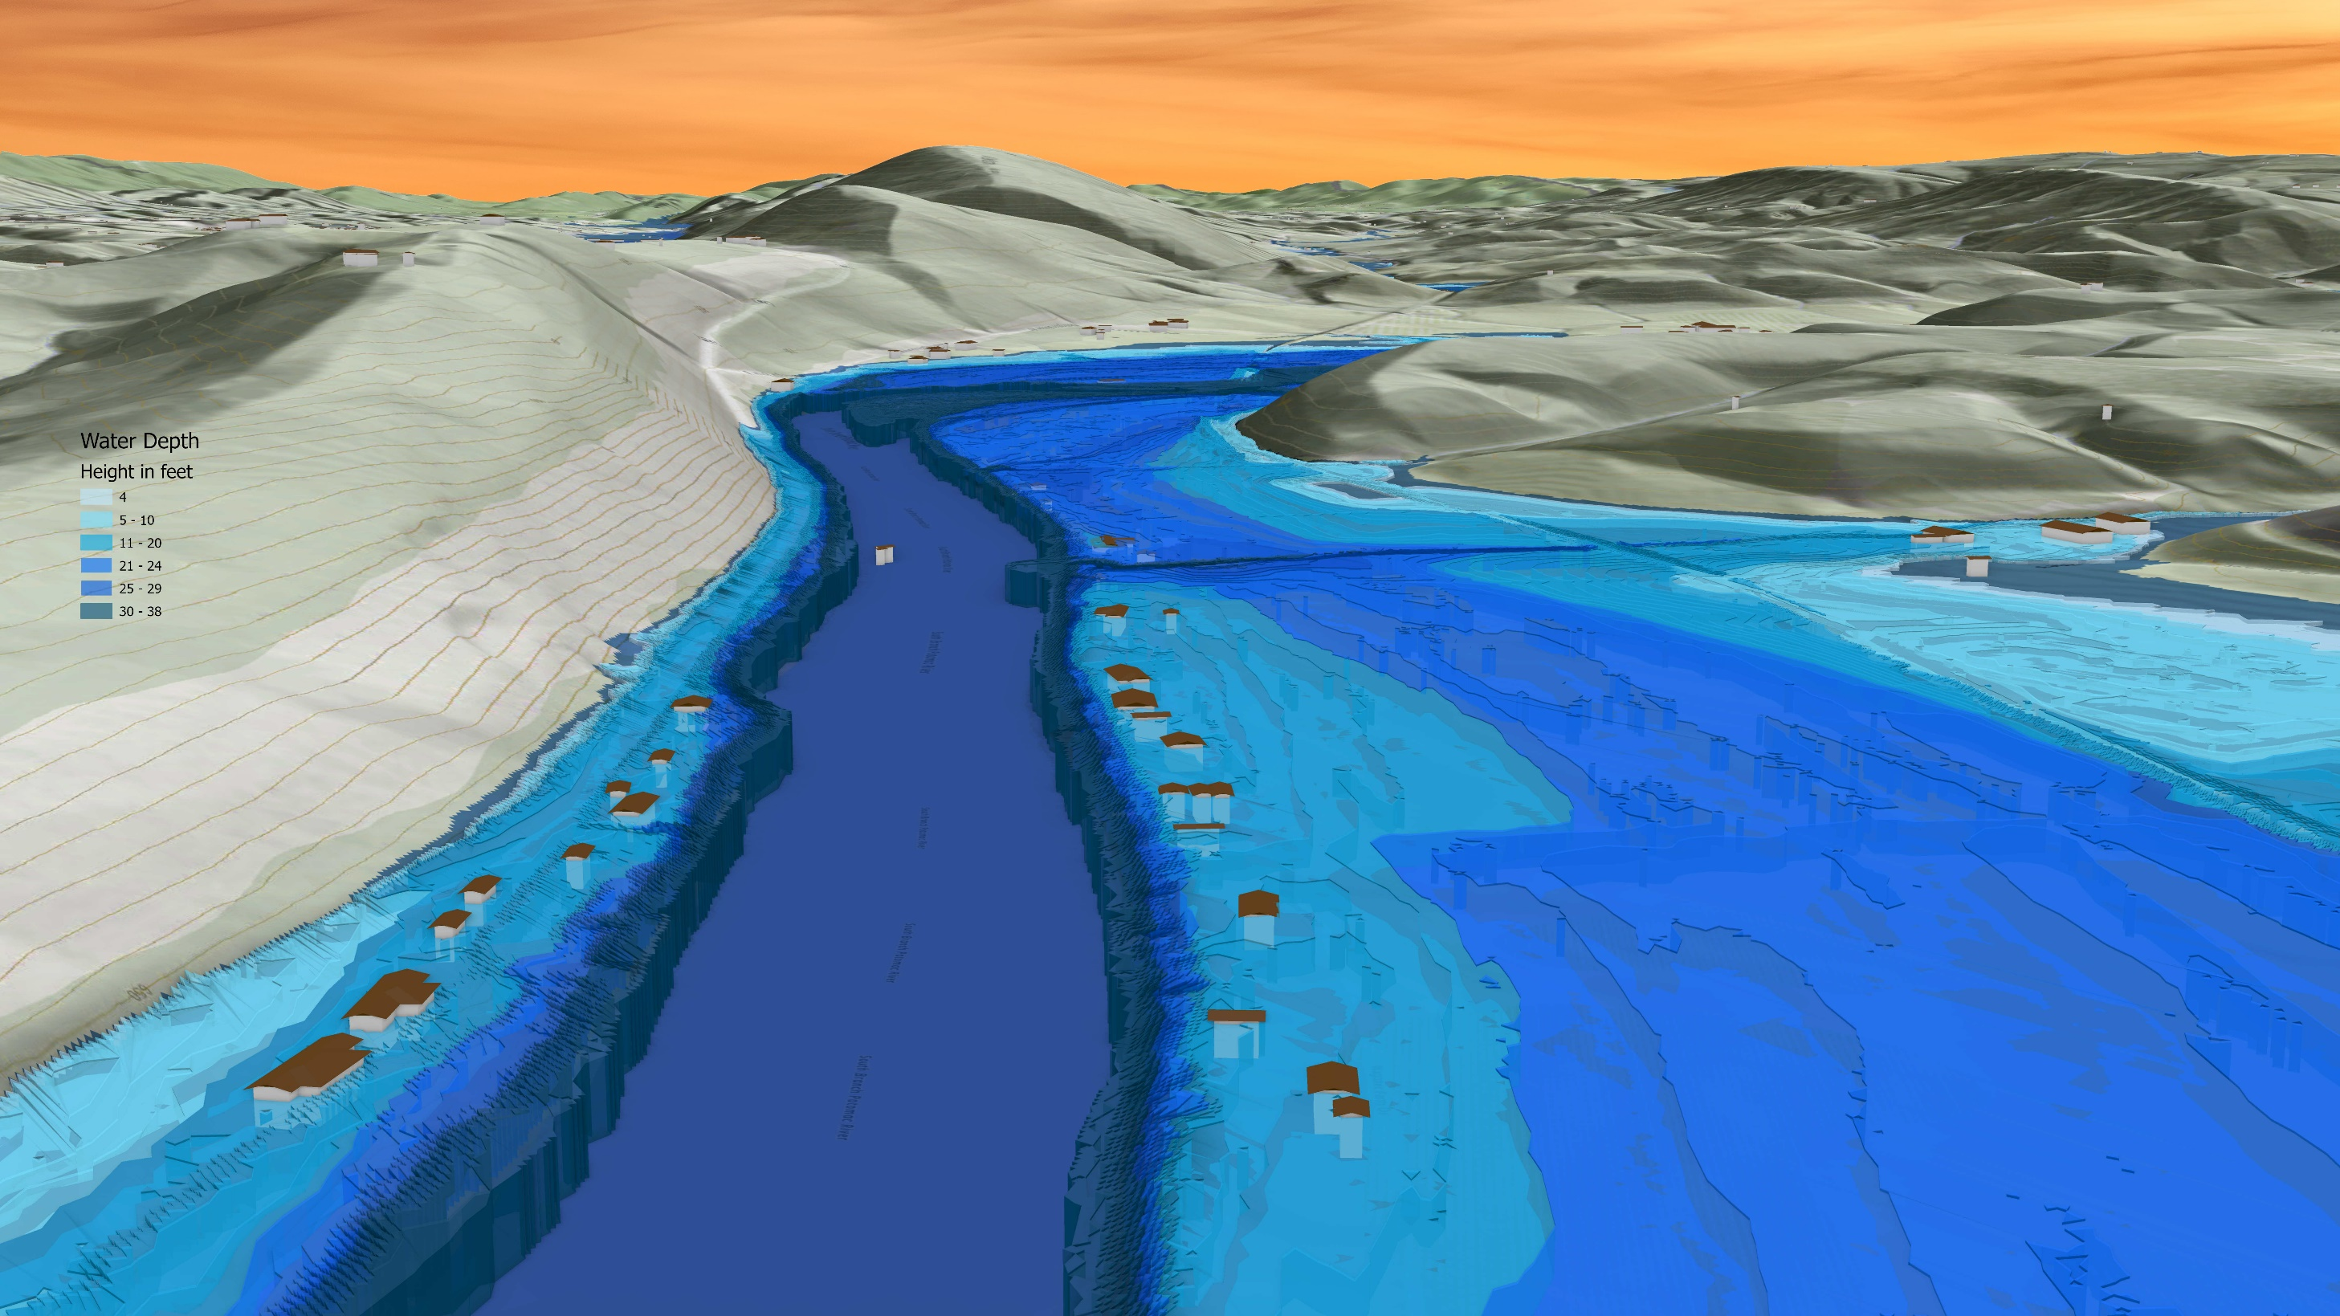
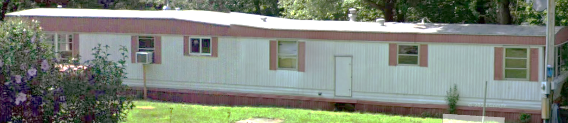
Site Hazard Study (Springfield, WV)
Cumberland Road
South Branch Potomac River
Cumberland Road
6081 CUMBERLAND RD
FEMA 1% Annual Chance (100-year)
26% probability of flooding at least once over 30 years
Community Scale Flood Visualization

Slide 17
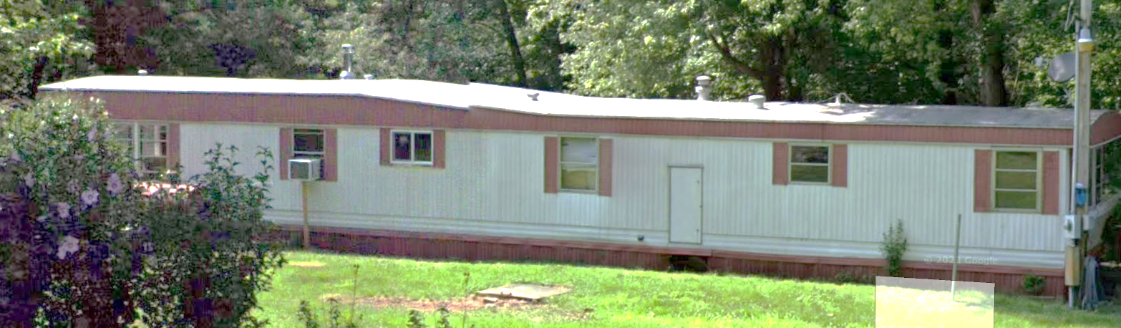
Site Study: High Flood Depths
12.2’ Preliminary 1% (New BFE)
6081 CUMBERLAND RD, Springfield, WV, 26757
10.1’ Effective 1% (Current BFE)
FLOOD DEPTH
2002 Effective 1% (current BFE) | 10.1
2024 Preliminary 1% (Preliminary BFE) | 12.2
Building: 14-10-0016-0024-0000_6081
Mitigation measures of elevation and wet floodproofing are not economically effective for very deep flood depths greater than 12 ft.
Building Scale (Flood Profile) Visualization

Slide 18
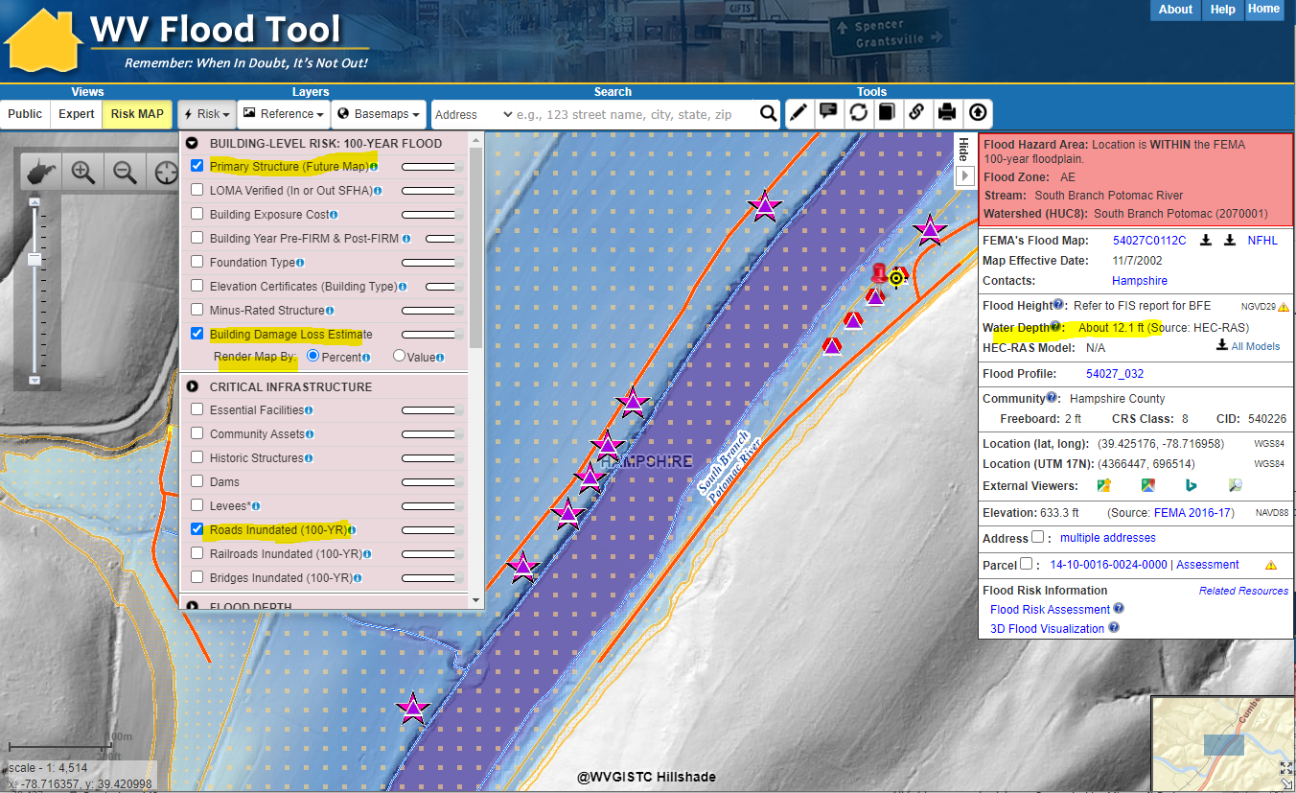

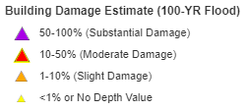
Site Study: High Flood Depth Impact
Primary Structures
(n = 757; verify status)
Substantial Damage estimate of 6081 Cumberland Rd. > 50%. Verify lowest floor elevation
Building Damage (Top 10%)
High Flood Depths correlate with major structural damage.
Road Inundation
(Top 20%)
Road Inundation of Cumberland Road against steep hillside where no escape if become trapped and potential loss of life
WV Flood Tool’s Risk MAP View (property level)

Slide 19

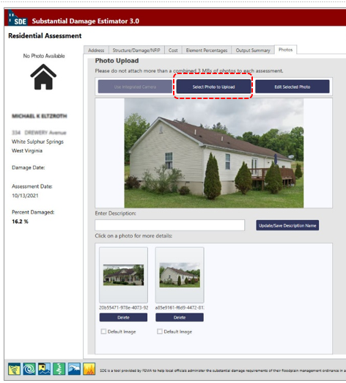
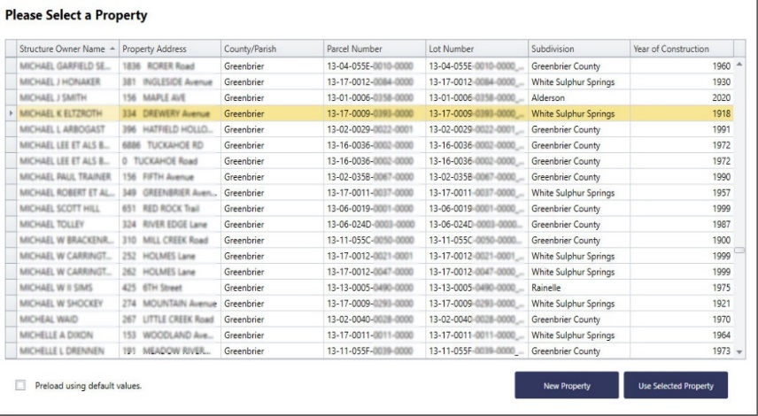
Preload Structures into SDE Software
Incorporate 1% Floodplain Building Risk Assessment Inventory into Mitigation and NFIP/CRS Management Activities
STEP 1: Community preloads Floodplain Properties into FEMA’s Substantial Damage Estimator software
STEP 2: Community performs practice Substantial Damage Assessments for Residential and Non-Residential Properties
Hampshire County has 1,111 Structures (both effective and preliminary floodplains) that can be uploaded
SDE Upload Files and Instructions

Slide 20
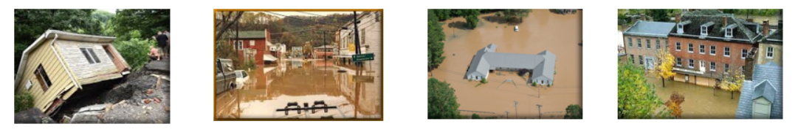
Verify Building Risk Assessments
Verify Primary Structures for High Depths
Verify Mitigation Status of Post-FIRM Structures
Use Building-Level (BL) Tables to identify Most Vulnerable Structures
Statewide BLRA (GIS)
BLRA County Tables organized by region
BLRA Data Extract Tables: High Building Value, High Damage Loss, High Minus Ratings
BLRA Statewide Top Lists: Building Value, Flood Depth, Damage Loss $, Damage Loss %, Minus Rated, Mitigated Structures
Risk Indicator Matrices: Exposure and Damage Loss Matrices of Risk Indicators
Verify Lowest Floor Elevations
Publish Elevation Certificates to WV Flood Tool
Verify Foundation & Basement Types

Slide 21
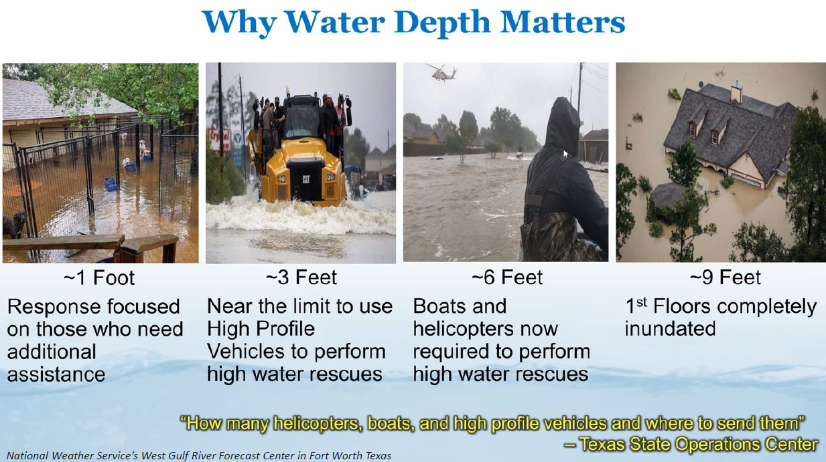
Plan for Inundated Road Impacts

Slide 22
Risk MAP (Hampshire Co. Preliminary Flood Maps)
Risk Mapping (New Preliminary Flood Maps)
Understand Flood Map Changes (BFEs, Floodplains/Floodways)
Floodplain Building Counts
SFHA Building Changes and Outreach Letters
LOMAs (SFHA mapped out)
All Essential Facilities mapped out
New Vertical Datum (NAVD88)
Risk Analysis (Risk Identification)
Large Floodplain Area (acres) and Length (miles)
Higher Number of Community Assets
High Flood Depths
High Building Damage Losses
High Repetitive Loss Structures and Paid Claims
Higher Number of Recreational Vehicles
Risk Planning (Flood resiliency)
Swift Grant Funding for RL Structures
Preload Structures into FEMA SDE Software
Validate floodplain building inventory
Plan for Inundated Roads
Verify Buyout Properties
Apply for CRS status
Plan for more stream gauges besides South Branch of Potomac
Publish Elevation Certificates on WV Flood Tool

