Slide 1

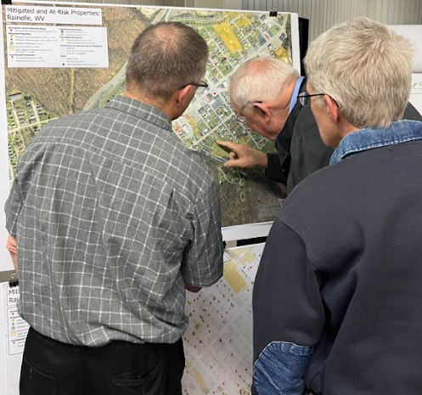
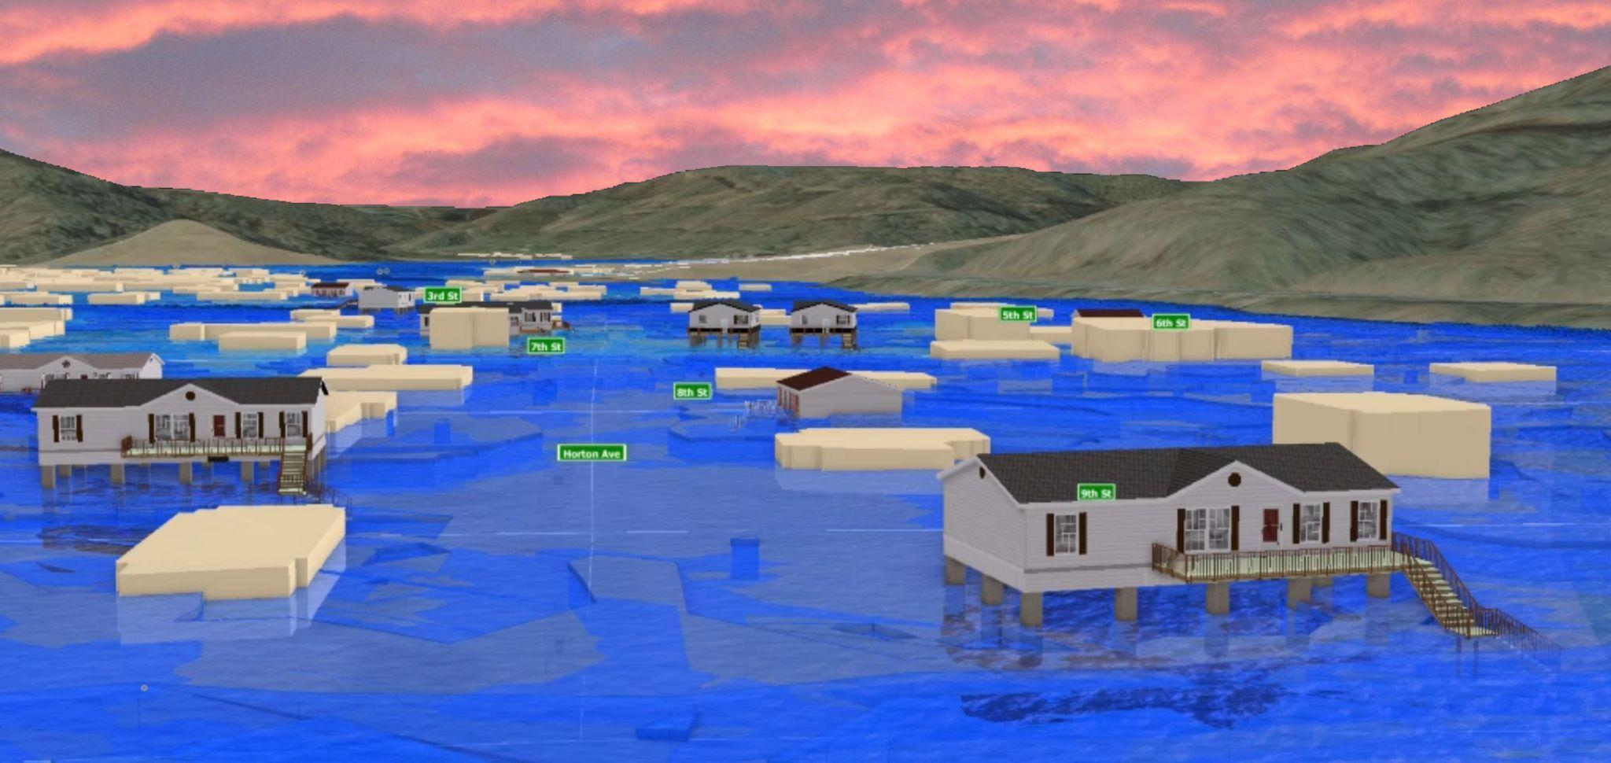
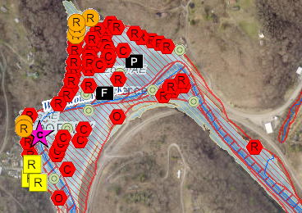
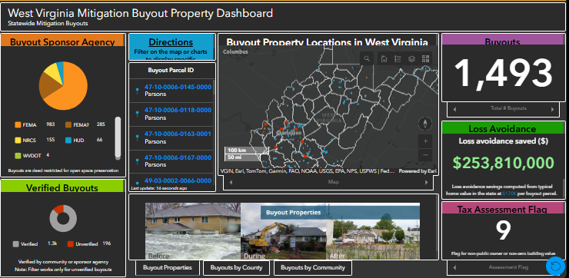
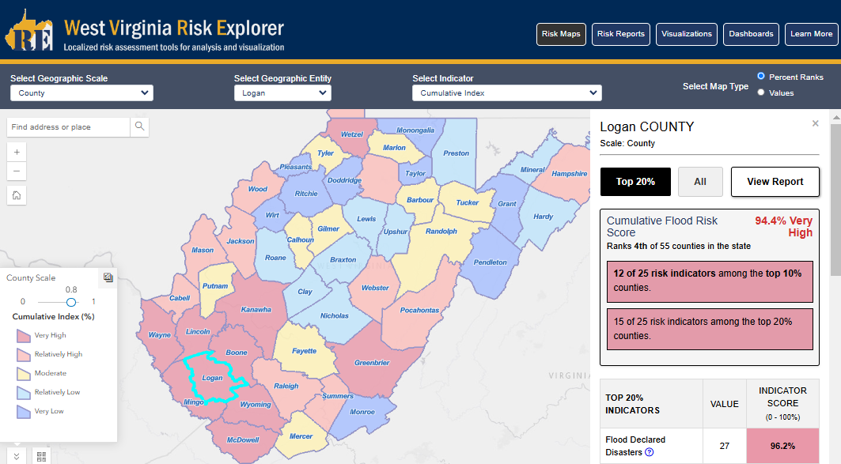
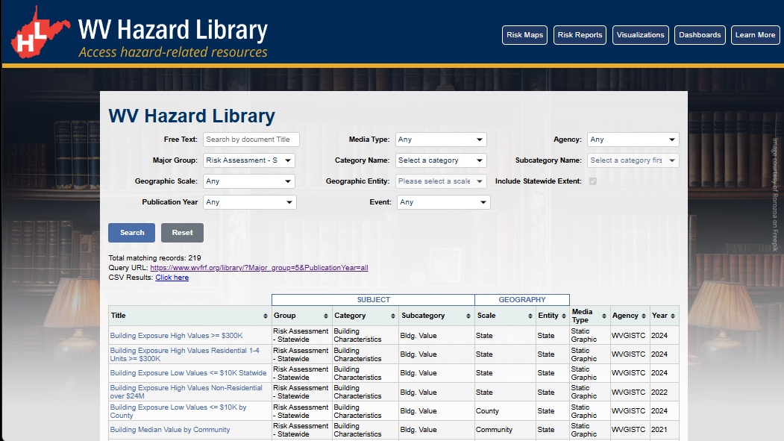
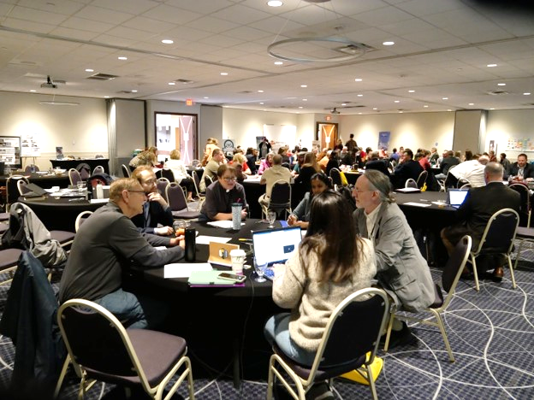
WV Flood Resiliency Framework
A virtual hub of risk assessment, visualization, planning, and training resources for building community flood resiliency in WV
Flood Visualizations
WV Flood Tool
COMMUNITY
ENGAGEMENT
• Focused Outreach Meetings
• Flood Symposium
• Resiliency Tools & Products
• Learning Resources & Reports
RISK TOOLS
• WV Risk Explorer
• WV Flood Tool
• Visualizations
• Dashboards
10 Geographic Scales
Flood Dashboards
WV Risk Explorer
Community Engagement Meeting
Example Risk Tools
HAZARD LIBRARY
Search online hazard resources by title, subject, media, event, geography, data, etc.
STAKEHOLDERS
• Risk Reduction Associates
• Emergency Responders
• Floodplain Managers
• Local Officials
• Volunteers
• Public
Hazard Library
Flood Symposium Stakeholders
Notes:
The WV Flood Resiliency Framework employs risk assessment, visualization, and resource discovery tools to engage communities and stakeholders in building flood resiliency.

Slide 2
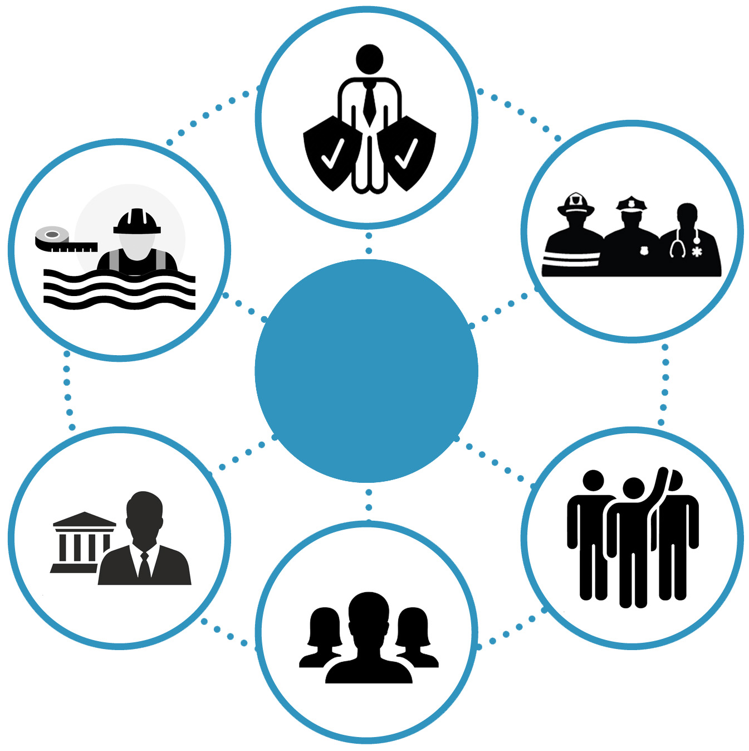
Stakeholders
Risk Reduction Associates
Floodplain Managers
Emergency Responders
Stakeholders
Local Officials
Volunteers
Public
Notes:
Six targeted stakeholder groups for WVFRF tools and hazard library resources.

Slide 3
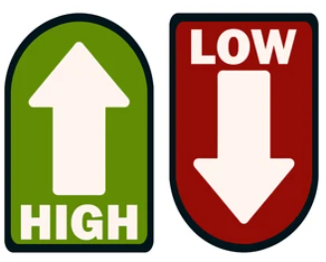
Tool Usage by Stakeholder Groups
Stakeholder Groups of anticipated usage of Risk Tools and Hazard Library
 |  | Property-Level Scale |  |  |  | All Geographic Scales
# | Stakeholders | Property Viewer | Flood Tool |  |  | Risk Explorer Tools | Hazard Library³
 |  |  | Public | Expert | RiskMAP
1 | Floodplain Managers ¹ – FM (includes surveyors and engineers) | FM |  | FM | FM | FM | FM-Learning
2 | Risk Reduction Associates - RRA (planners, researchers, mitigation specialists, etc.) | RRA |  | RRA | RRA | RRA | RRA-Studies
3 | Emergency Responders – ER | ER |  |  | ER | ER | ER-Learning
4 | Local Officials | Officials | Officials |  |  | Officials | Off-Learning
5 | Public (includes realtors and insurance officials) | Public | Public |  |  |  | Pub-Learning
6 | Volunteers – Vols. (VOAD, Charities, etc.) | Vols. | Vols. |  |  |  | Vol-Learning
Popularity of Tools ² by
Stakeholder Group
¹ Floodplain Managers may be representatives of other stakeholder groups such as E-911 Directors or Mayors.
² Floodplain Managers and Risk Reduction Associates stakeholders have the highest demand for flood resiliency tools.
³ All Stakeholders benefit by using the Hazard Library which is broadly categorized into learning, study, and reference resources. The primary stakeholder group for the WV Property Viewer is the Public, while the main stakeholder group for WV Flood Tool is the Floodplain Managers, and for the WV Risk Explorer various Risk Reduction Specialists.
Notes:
Risk Reduction Associates and Floodplain Managers are the two primary stakeholder groups of the WV Flood Tool and WV Risk Explorer.

Slide 4
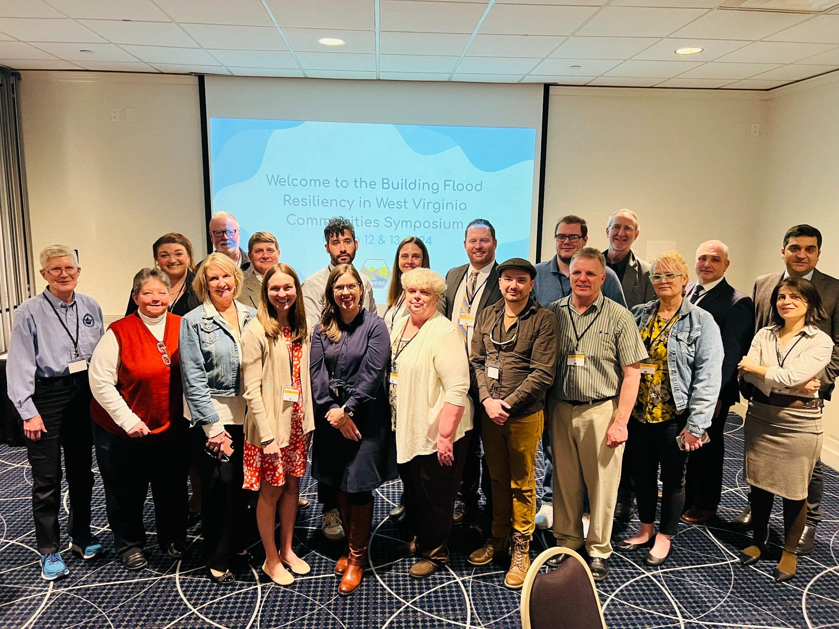
Community Engagement
Community Engagement modes to convey flood risk and build resiliency
COMMUNITY ENGAGEMENT METHODS
Focused Outreach Meetings Risk Communications Risk Reduction Meetings Resiliency Tools & Products Risk Assessments (Detailed or Summarized) Mitigation Measures (Planned or Implemented) Flood Visualizations Learning Resources & Published Reports Best Practice Guides and Training Materials Lessons Learned Planning Documents Research and Policy Papers Risk information communicated via WV Risk Tools, WV Hazard Library, and other resources.
Flood Symposium Stakeholders
Flood Symposium Project Team
Notes:
Communicating flood risk and resiliency to stakeholder groups of varying subject knowledge in an effective manner can be challenging. Community engagement methods may include focused outreach meetings, resiliency tools, learning resources, etc.

Slide 5
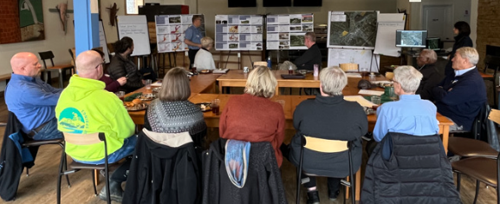
Community Engagement
White Sulphur Springs, WV (11/17/2022)
Rainelle, WV (11/18/2022)
Feedback desired from Focus Groups:
  What lessons were learned from the immediate response and longer-term recovery from the 2016 flood?
  What priorities are needed for a stronger flood response and recovery plan in the event of a future flood?
Feedback of Flood Study Products:
  Flood Characteristics and Models
  Flood Risk Assessment (vulnerability, exposure, loss)
  Mitigation Maps
  Flood Visualization Tools
Notes:
Examples of community outreach meetings for two small communities in Greenbrier County – White Sulphur Springs and Rainelle – that were devastated by the 2016 flood. The WVFRF Tools allow for the engagement of floodprone communities with tailored risk assessments and mitigation strategies.

Slide 6

WV Hazard Library
Hazard Library of online hazard resources including data, documents, and media searchable by title, subject, event, geography, and more.
WV HAZARD LIBRARY
TOPICS | MEDIA TYPES |  | SEARCH TYPES
Risk Assessment & Planning State Risk Assessments Local Risk Assessments Planning Resources Web Tools Mitigation Flood Insurance Floodplain Management Floodplain Mapping Other Mitigation Measures Flood Disaster Events Flood Event Flood Research | 3D Movie Bldg. Profile Dashboard Data-GIS Data-Metadata Data-Table Flyer Graphic Guide Journal Article Letter News Article Picture | Plan Poster Report Slides Social Media Static Map Story Map Video Viewshed Web Info Web Tool | Agency Downloadable Data Event Disaster Event Meeting Geographic Scale Entity Media Type Publication Date Subject Major Group Category Subcategory cross-indexing Stakeholder Type Title (free text search) Predefined Searches Visualizations Floodplain Management Key Materials
Notes:
The WV Hazard Library contains more than 24 media resource types relevant to West Virginia. Resources are organized into three major topics: risk assessment/planning, mitigation, and flood disaster. Users can search online hazard resources by title, subject, media, event, geography, data, stakeholder type, etc.

Slide 7

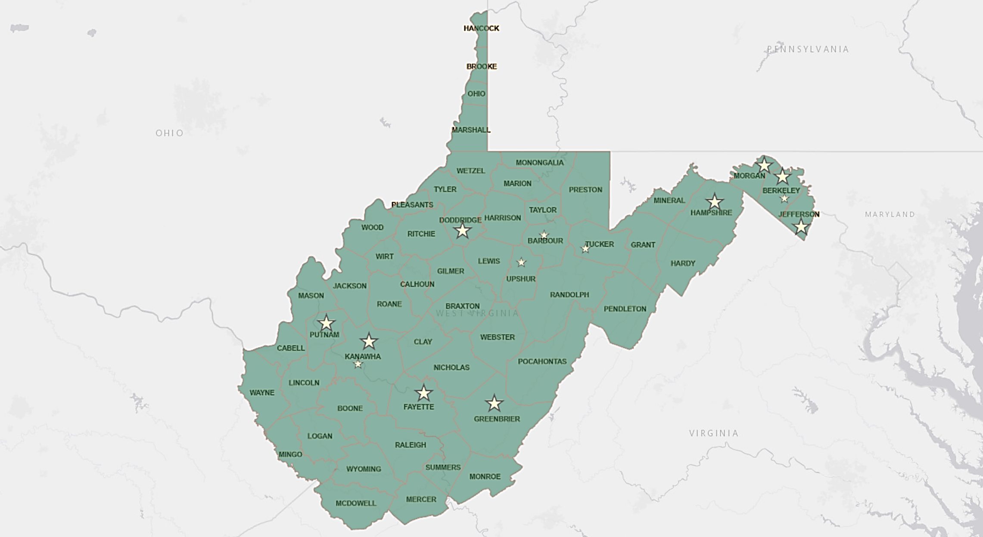
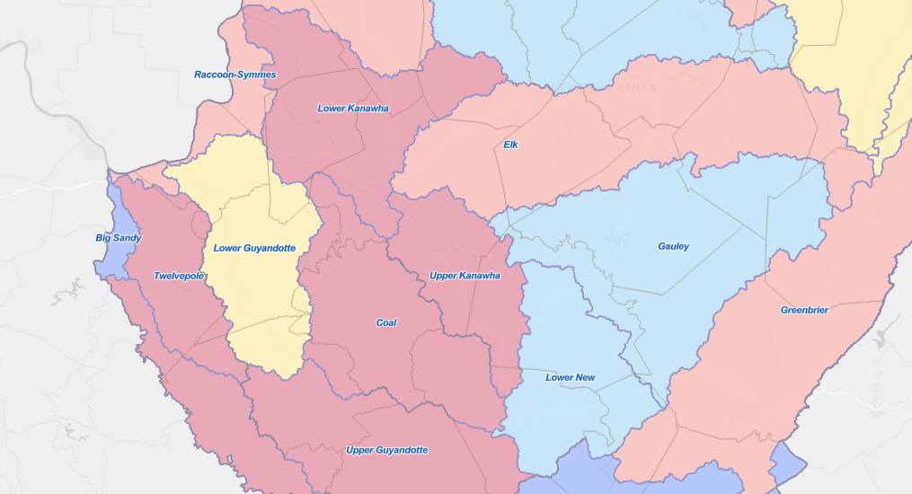
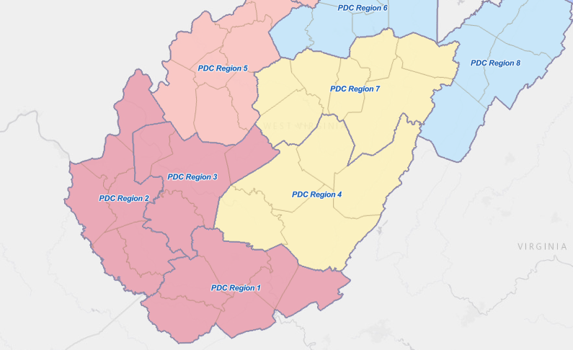
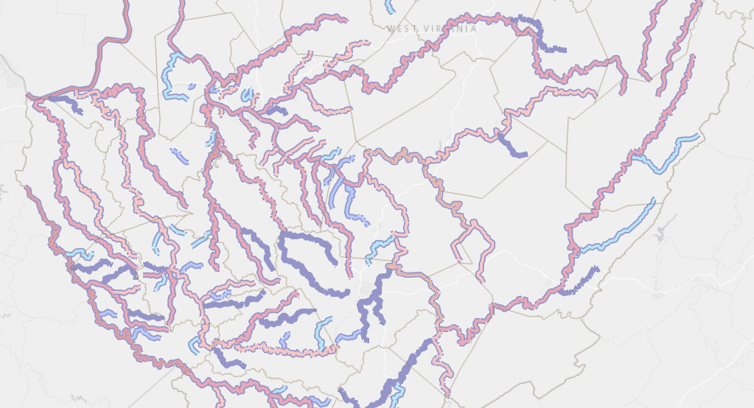
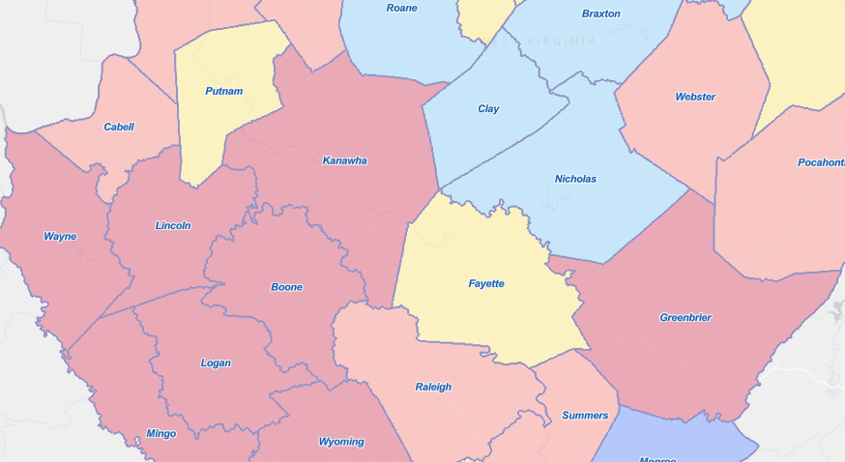
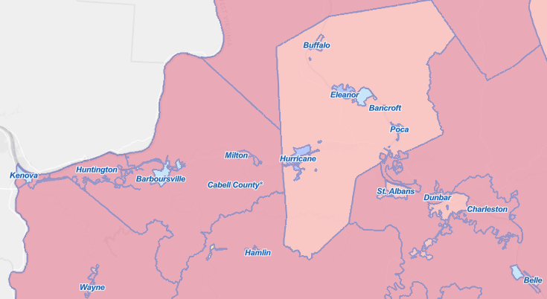
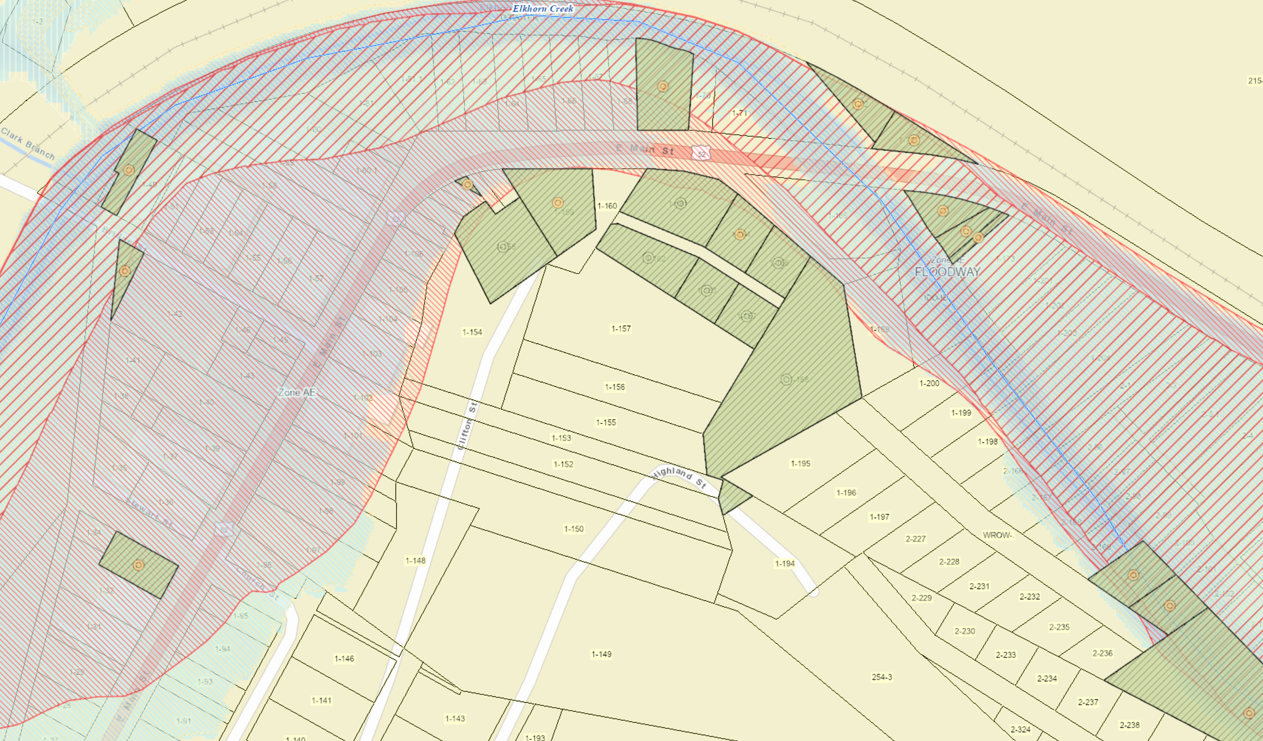
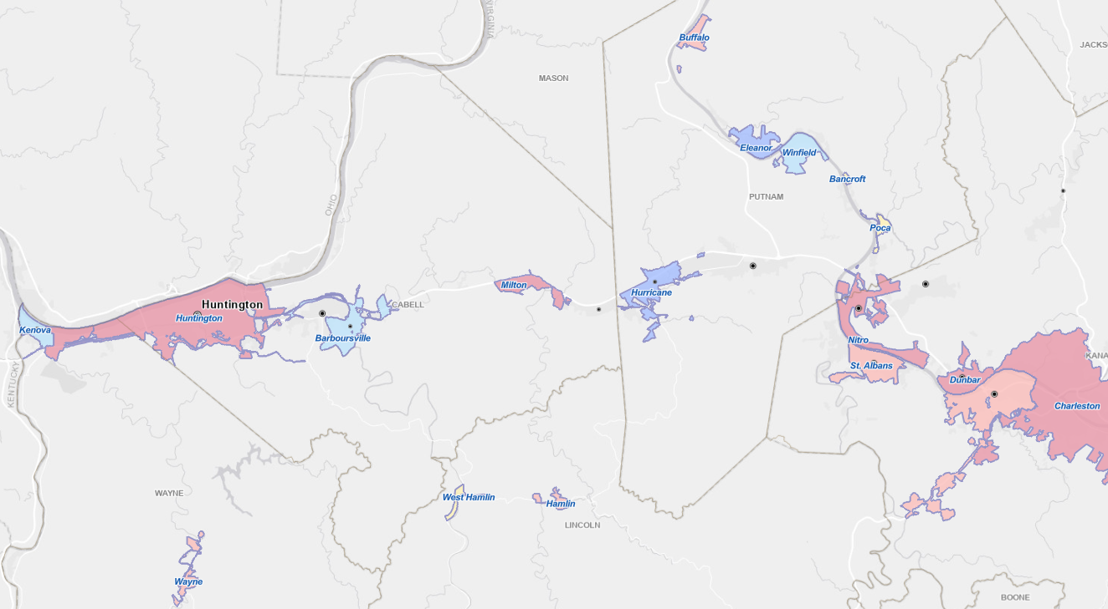
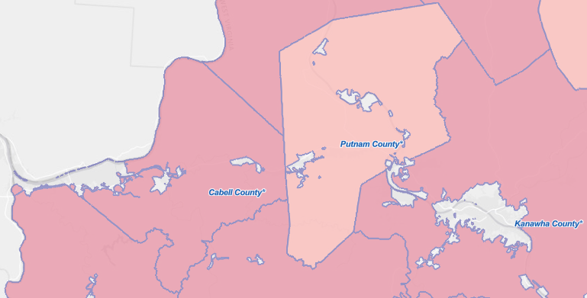
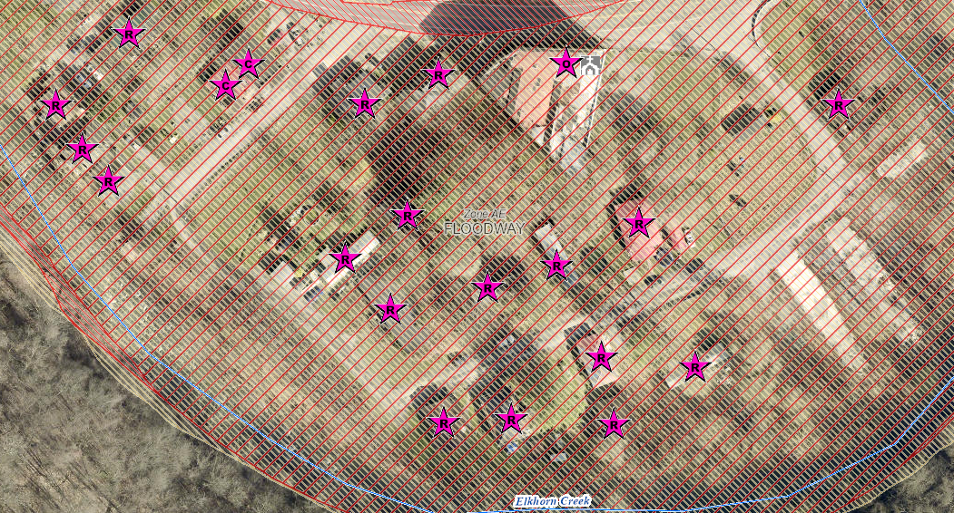
Geographic Scales of Analytical & Visualization Tools
Political Boundaries
Drainage Areas / Streams
State
Watersheds
(33)
PDC Regions (11)
Streams/Rivers
(156)
Counties (55)
Property Levels
Communities (284)
Parcels
Incorporated Places
(229)
Unincorporated Areas
(55)
Buildings
Notes:
The WV Flood Tool and WV Risk Explorer applications quantify riverine flood risk at the building and summary geographic levels, respectively. Cumulative risk rankings at different geographic scales and entities are computed from various risk indicators, including building, people, and social-economic factors.

Slide 8
Risk Tools at Multiple Scales
GEOGRAPHIC SCALES |  | APPLICATIONS |  |  |  | WVFRF TOOLS
Geographic Unit | # Units | Floodplain Management & Mitigation | FEMA Mapping | Risk Planning | Disaster Management | WV Risk Tools (WV Flood Tool & WV Explorer) | Flood Visualization Tools | Hazard Library (Document Center Tool)
PROPERTY LEVEL
Structures¹ | 98,000 | X | X | X | X | Yes | Yes | Yes
Parcels | 275,000 | X | X | X | X | Yes |  | Yes
Other Features² |  | X | X | X | X | Yes |  | Yes
COMMUNITY LEVEL
Incorporated Places | 211 | X | X | X | X | Yes | Yes | Yes
Unincorporated Areas | 55 | X | X | X | X | Yes | Yes | Yes
Communities (NFIP)³ | 266 | X | X | X | X | Yes | Yes | Yes
COUNTY-REGION-STATE LEVEL
Counties | 55 | X | X | X | X | Yes | Yes | Yes
Regions (RPDCs) | 11 | X | X | X | X | Yes |  | Yes
State | 1 | X | X | X | X | Yes |  | Yes
DRAINAGE LEVEL
Watersheds | 32 | X | X | X | X | Yes |  | Yes
Streams (named) | 6,748 | X | X | X | X | Yes | Yes | Yes
NOTES:
¹ Primary structures located in high-risk effective and advisory floodplains (1%-annual-chance flood)
² Other Features include roads, bridges, National Register Areas, flood mitigation structures (dams, levees, floodwalls)
³ Total 284 communities in state: 266 NFIP; 18 incorporated places not in NFIP
Notes:
The WV Flood Resiliency Framework Tools support flood visualization and analytical tools for hazard risk planning, floodplain management, flood zone mapping, and disaster management at nine geographic scales, ranging from the building level to community to region to state scales as well as stream and watershed scales. Additionally, the WVFRF Tools are integrated together in that the WV Risk Explorer, for example, links with the WV Flood Tool and Hazard Library.

Slide 9

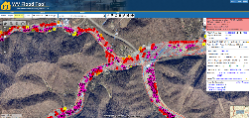
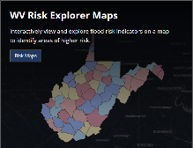
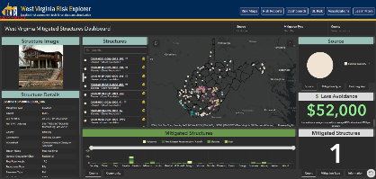
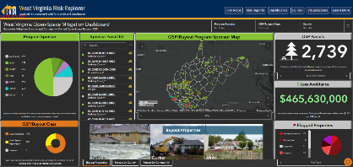
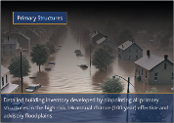
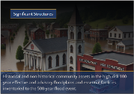


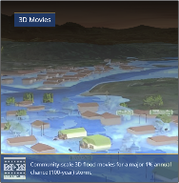
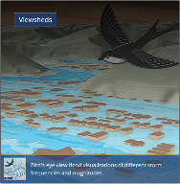


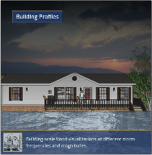
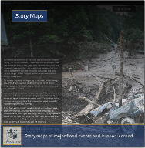

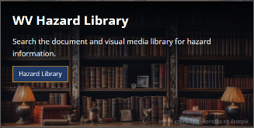
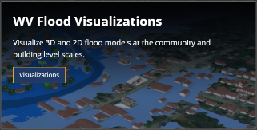
Risk Tool Types
Risk Assessment Tools
Localized riverine flood risk assessment by quantifying and aggregating detailed building-level data at multiple scales
Help identify the communities most at risk of riverine flooding for efficient allocation of limited mitigation resources
Mitigation Assessment Tools
Quantifies mitigation efforts such as elevation, relocation, and buyouts and calculation of loss estimates
Enable planners and decision-makers to evaluate past and ongoing efforts, identify gaps, and prioritize future investments
Building/Property-Level
Aggregated
Mitigated Structures Dashboard
Open-Space Mitigation Dashboard
Risk Communication Tools
Scenario-based 2D and 3D visualizations for effective risk communication
Facilitate risk comprehension for various stakeholders to support informed decision-making and encourage public engagement
Hazard Library and Data Access Tools
Access to online hazard resources including data, documents, and media searchable by title, subject, event, geography, and more.
Allow users to access comprehensive datasets for use in analyses, maps, or applications to support planning, research, and decision-making related to hazard mitigation and response
Notes:
Click on the images to open the links
Link (WVRE landing page): https://www.wvfrf.org/wvre/

Slide 10
WV Flood Risk Index & Factors
Overall Flood Risk
(1) FLOODPLAIN CHARACTERISTICS
(2) BUILDING EXPOSURE
(3) BUILDING CHARACTERISTICS
(4) CRITICAL INFRASTRUCTURE
(5) COMMUNITY ASSETS
(6) BUILDING DAMAGE LOSS
(7) PEOPLE / SOCIAL VULNERABILITIES
(8) OTHER HAZARDS
Floodplain Area
Building Floodplain Count¹ ²
Building Value¹ ²
Essential Facilities
Historical Assets
Substantial Damage Estimates*¹ ²
Population in Floodplain
Landslides
Floodplain Length¹ ²
Building Floodway Count¹ ²
Mobile Homes
Roads Inundated
Non-Historical Assets
Previous Claims
Population Displaced
Karst**
Floodplain Depth¹ ²
Building Floodplain Ratio²
Basement
Repetitive Losses
WV Social Vulnerability Index
Dam/Levee Failure**
Flood Disaster Frequency
Building Density¹ ²
One Story
Building Year*
Used for the Index
* Multiple Indicators
** In Progress
1
River/Stream Indicator
2
Watershed Indicator
Notes:
Categories 1 to 7 used to develop the risk index

Slide 11
WV Risk Tools & Risk Factors
Analytical & Visualization Tools at multiple scales
Risk Factors for riverine hazard assessments
WV RISK TOOLS
2 KEY FLOOD RISK TOOLS | 10 GEOGRAPHIC SCALES
<< Aggregate & Property Levels >> WV Risk Explorer Risk Maps Risk Reports Bldg. Risk Tools Dashboards Visualizations Data Access ----------------------------------- << Property Level >> WV Flood Tool WV Property Viewer | << Political Boundaries >> 1) State 2) Region 3) County 4) Community 5) Incorporated Place 6) Unincorporated Area ----------------------------------- << Drainage Areas / Streams >> 7) Watershed 8) Stream/River ----------------------------------- << Property Levels >> 9) Parcel 10) Building
WV RISK FACTORS
RISK INDICATORS | ENVIRONMENTS
Floodplain Characteristics Building Exposure Building Characteristics Critical Infrastructure Community Assets People/Social Vulnerabilities Other Hazards | Physical (Flood Factors, Topography, Hydrology, Hydraulics) Human (People) Social Economic Institutional Manmade (Buildings, Roads)
Notes:
The WV Flood Tool and WV Risk Explorer applications quantify riverine flood risk at the building and summary geographic levels, respectively. Cumulative risk rankings at different geographic scales and entities are computed from various risk indicators, including building, people, and social-economic factors

Slide 12


Risk Tools Comparison
WV Flood Tool | WV Risk Explorer
Determine the degree of flood risk for a specific area or property using the Public and Expert Views. View building risk assessments and mitigation measures using the Risk Map View. | View and analyze riverine flood risk at the aggregate level for community, county, region, watershed, and stream scales. Compare risk among different geographic entities, complete with risk scores and rankings, from the building level to state scales.
Primary Components: Public View Expert View (Floodplain Management) RiskMap View (Risk Reduction) Reference Layers & Basemaps Property Search Tools Links to External Viewers & Resources | Primary Components: Risk Maps Tool Risk Reports Tool Risk & Mitigation Dashboard Tools Building Level Risk Tools Flood Visualization Tools Data linkages to WV Flood Tool & Hazard Library
Applications: Flood Risk Determinations at Property Level Floodplain Management Mitigation Measures Damage Assessments Property Identification Flood Visualizations & Risk Communications CRS Map Credits Other Hazards | Applications: Plans (Resiliency, Emergency Operations, Hazard Mitigation) Risk Studies (Risk MAP, Risk Reduction, Community Focused) Mitigation Measures, Tracking & Monitoring Flood Visualizations & Risk Communications CRS Programming Variables Other Hazards
Notes:
The WV Flood Tool and WV Risk Explorer applications allow for risk assessment at the building and summary geographic levels, respectively.

