Slide 1

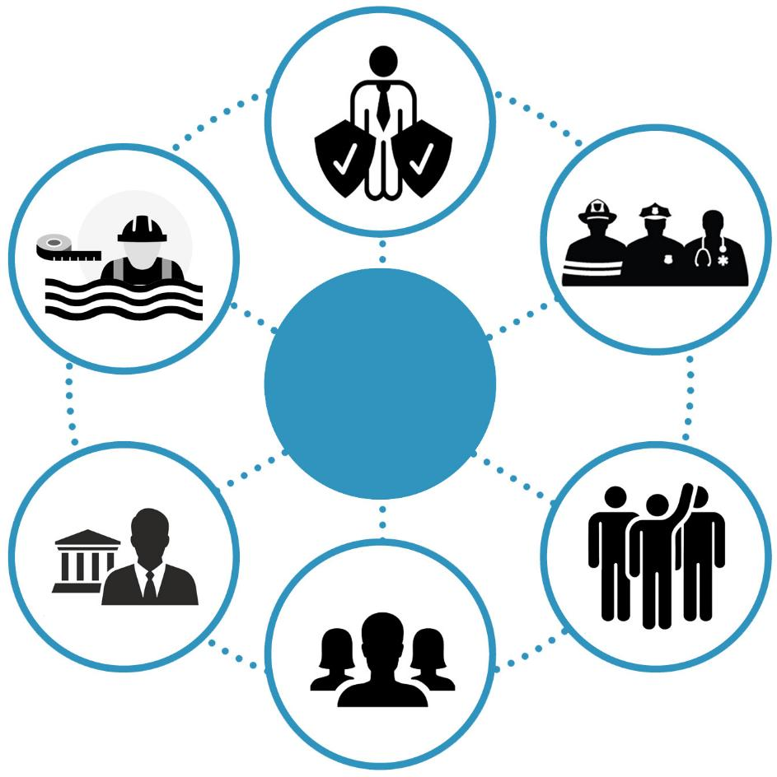
Stakeholders
Risk Reduction Associates
Floodplain
Managers
Emergency Responders
Stakeholders
Local/State Officials
Volunteers
Public
Notes:
Six targeted stakeholder groups for WVFRF tools and hazard library resources.

