Slide 1


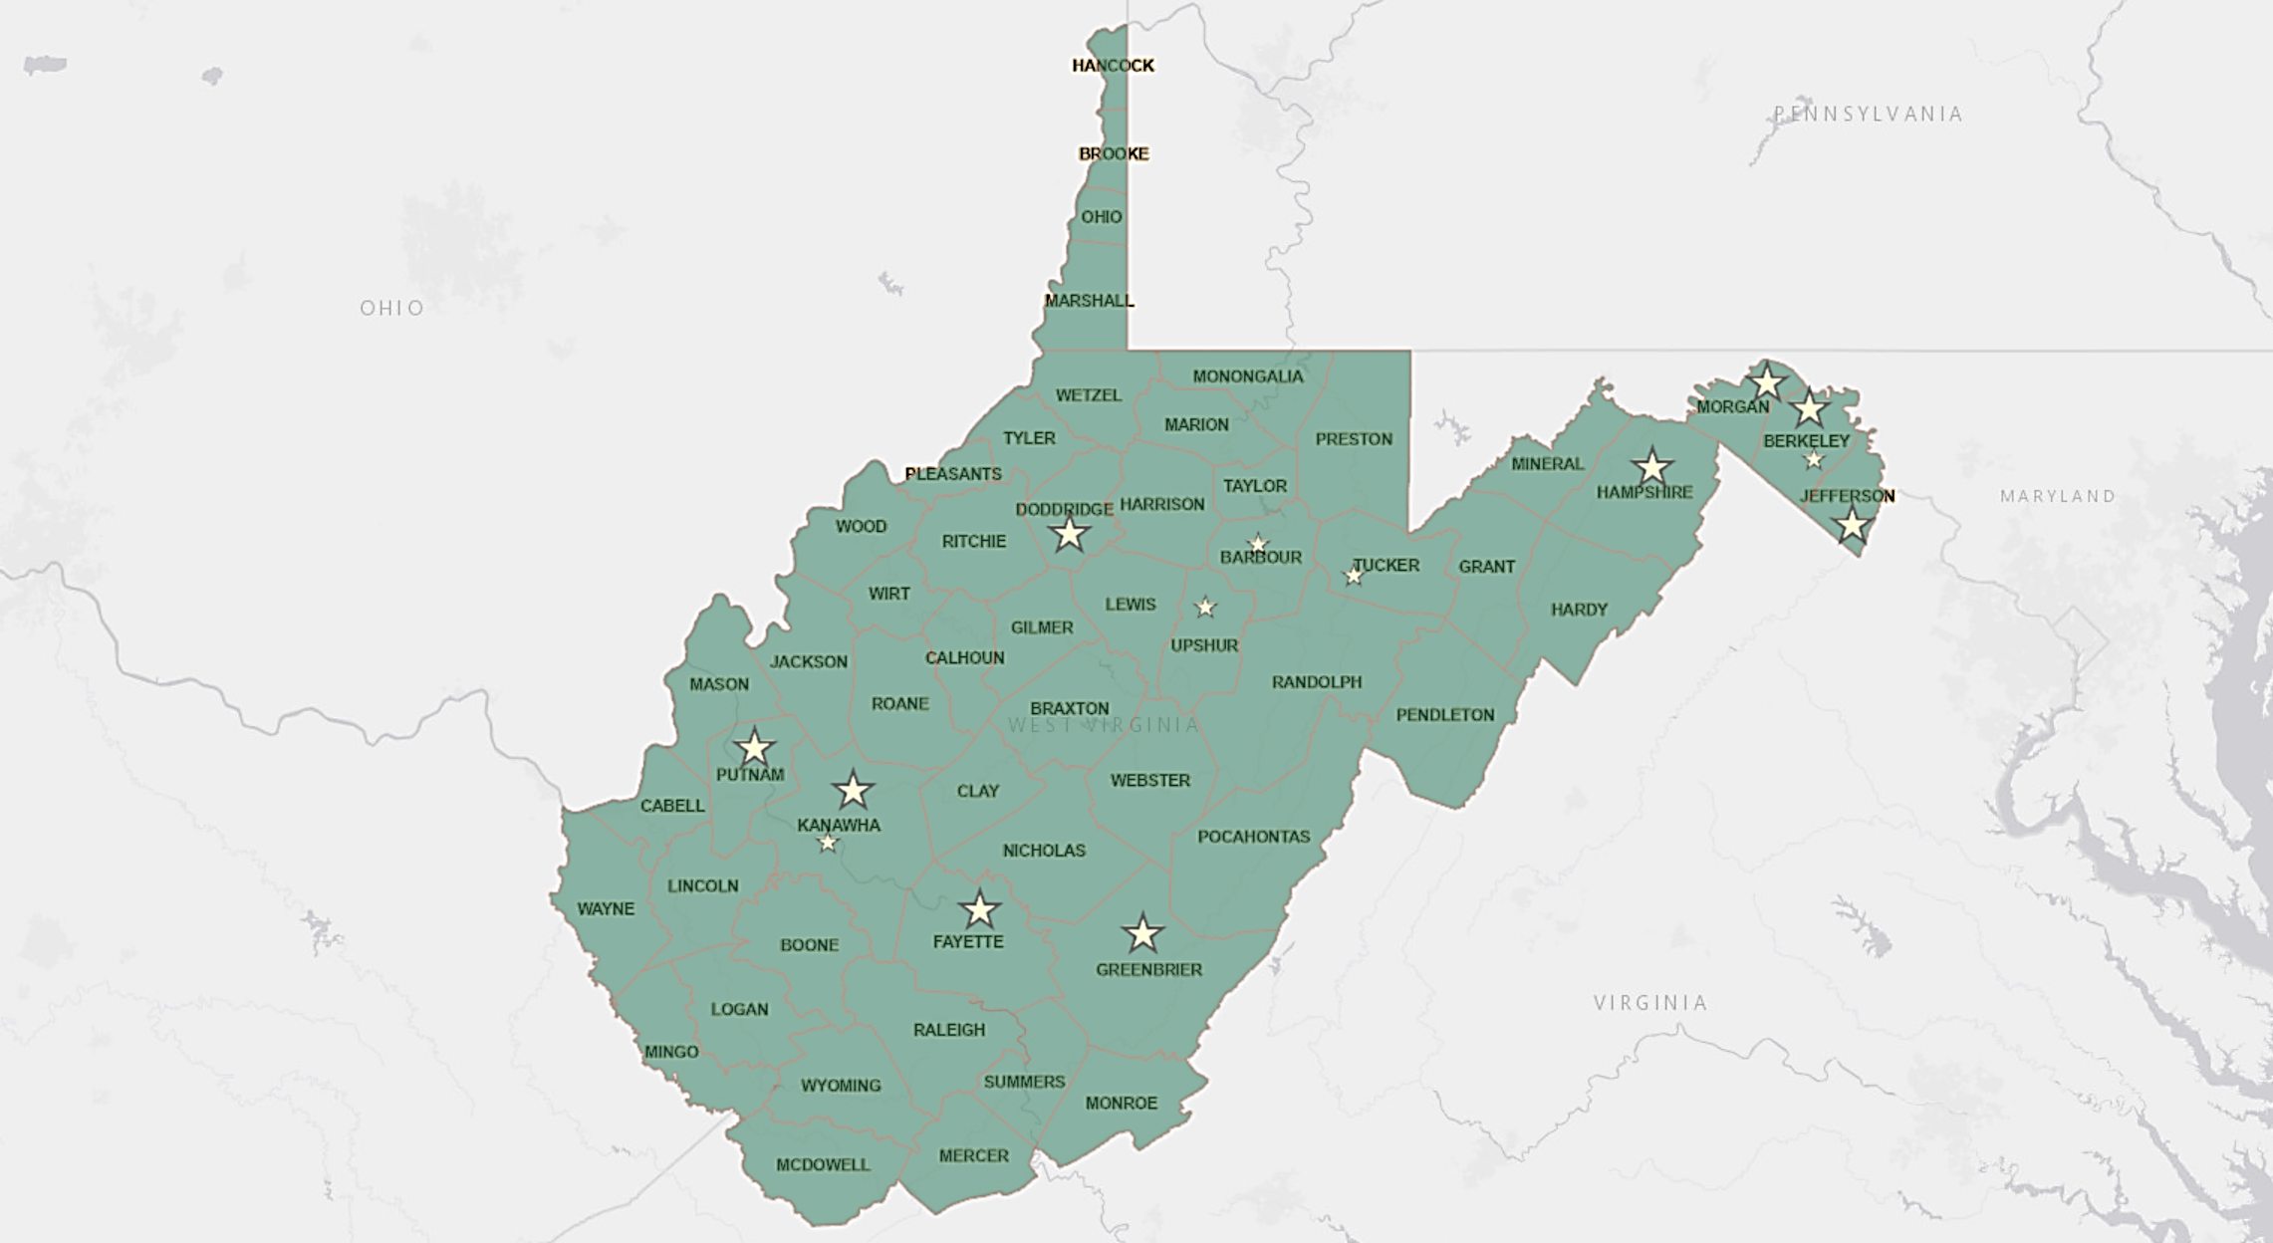
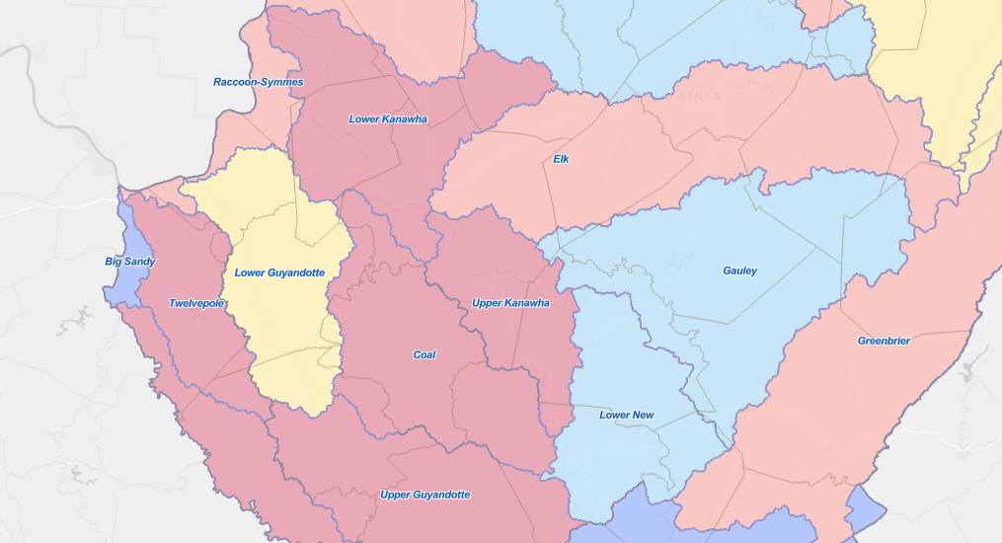
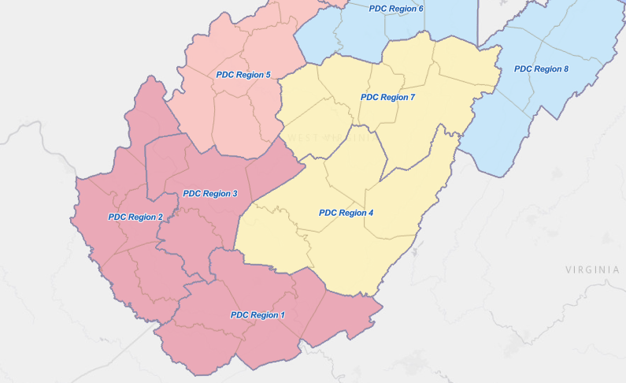
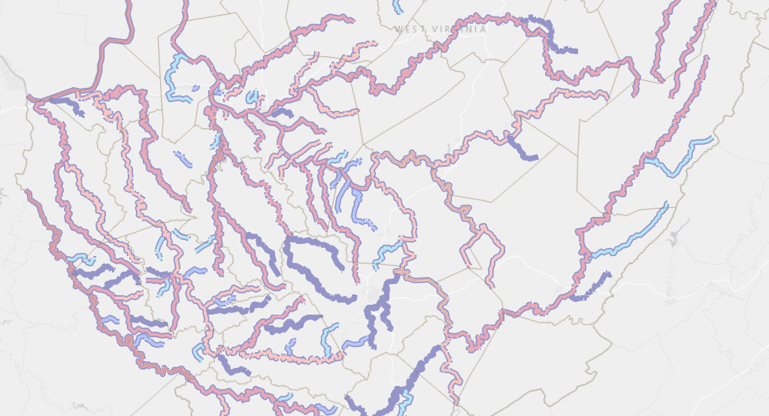
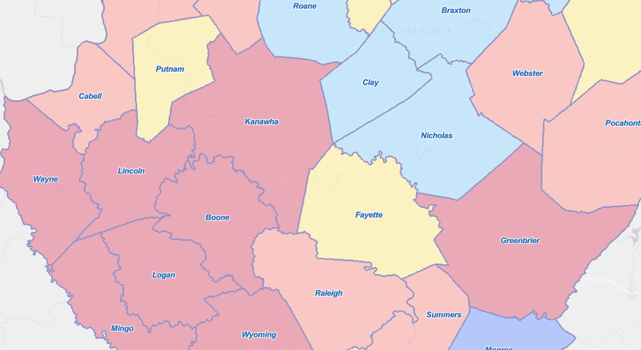
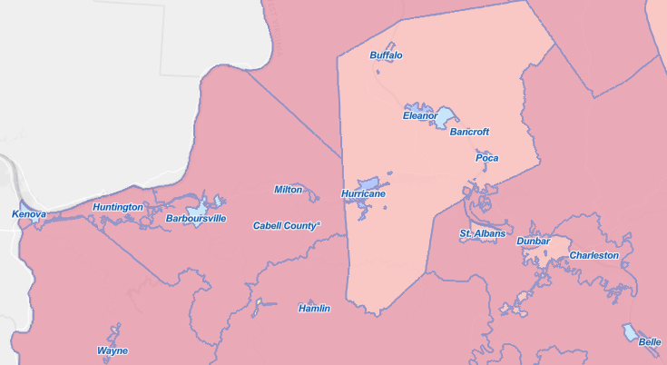
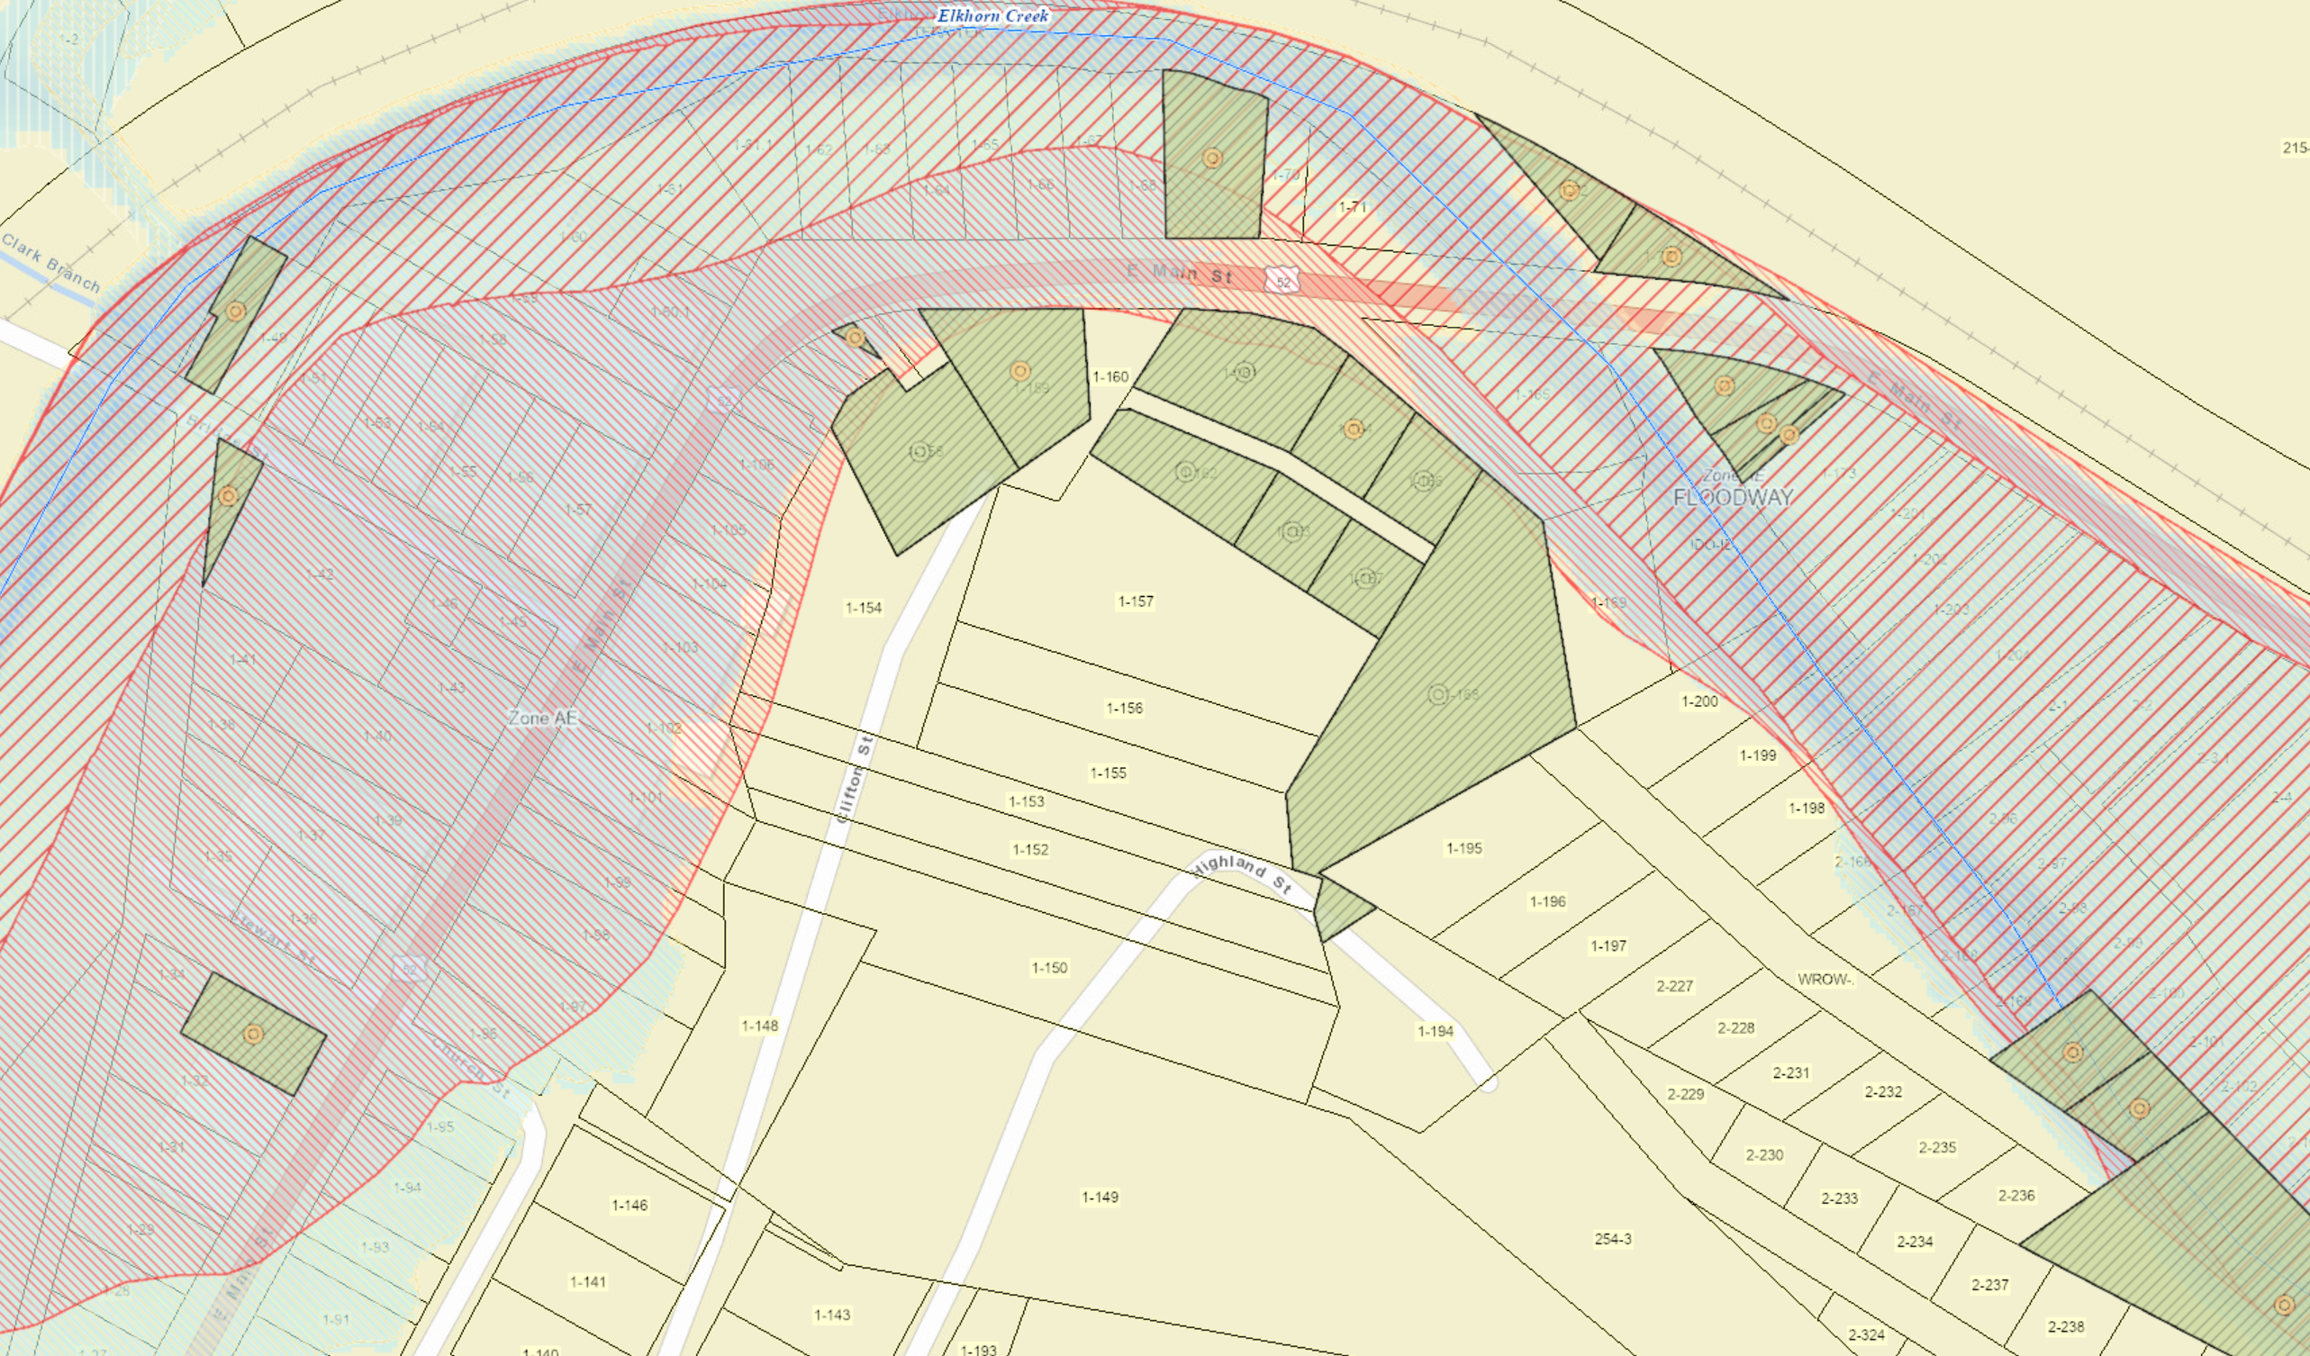
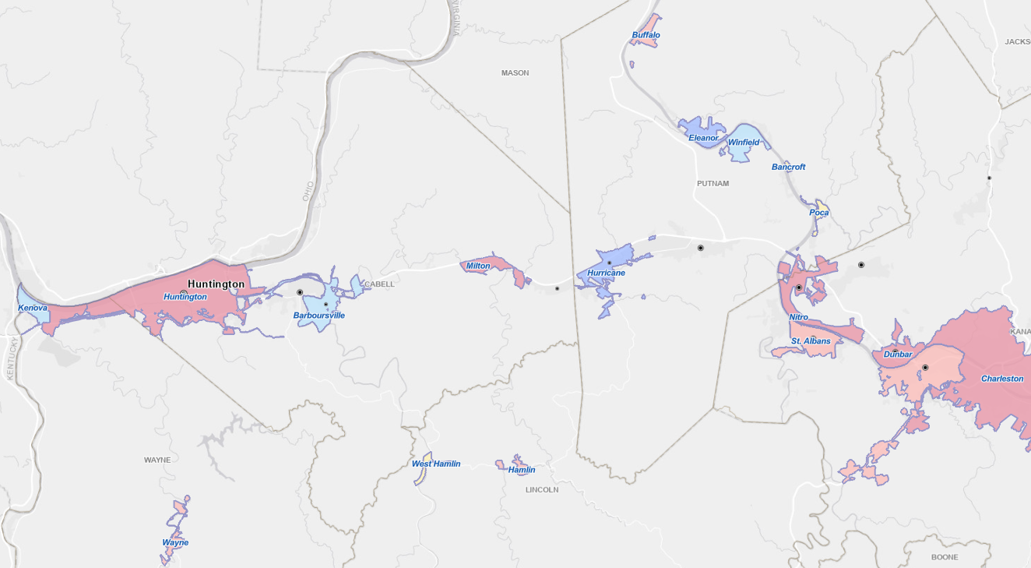
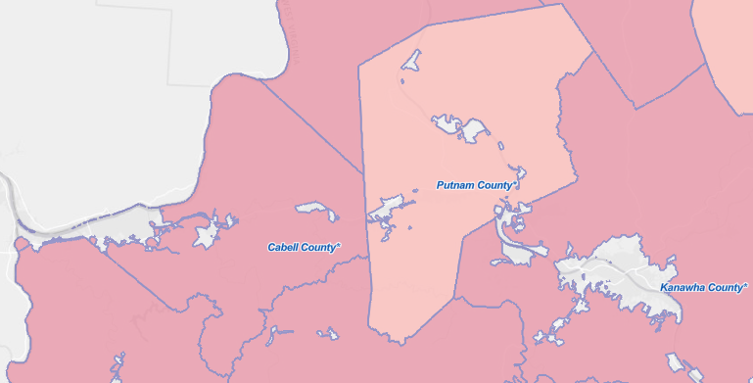
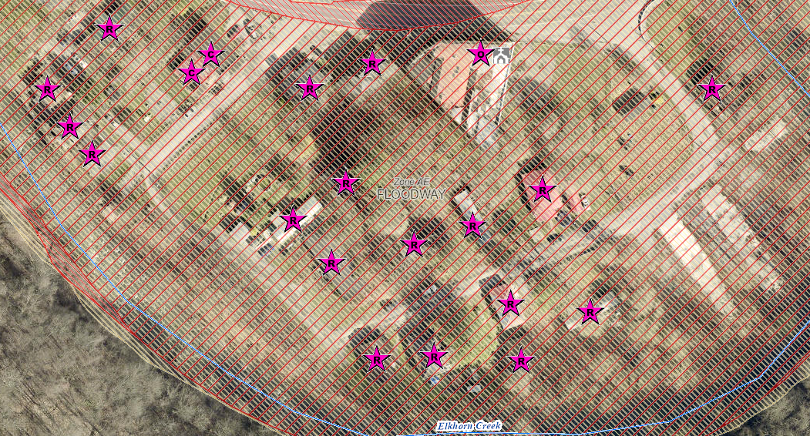
Geographic Scales of Analytical & Visualization Tools
Political Boundaries
Drainage Areas / Streams
State
Watersheds
(33)
PDC Regions (11)
Streams/Rivers
(156)
Counties (55)
Property Levels
Communities (284)
Parcels
Incorporated Places
(229)
Unincorporated Areas
(55)
Buildings
Notes:
The WV Flood Tool and WV Risk Explorer applications quantify riverine flood risk at the building and summary geographic levels, respectively. Cumulative risk rankings at different geographic scales and entities are computed from various risk indicators, including building, people, and social-economic factors.

